Slide 1
Technical Indicator: Moving Average 技術指標：均線
J.-S. Roger Jang (張智星)
jang@mirlab.org
http://mirlab.org/jang
MIR Lab, CSIE Dept.
National Taiwan University

Slide 2
均線( Moving Average, MA )
均線( MA )定義
一段時間內的平均價格，代表此時間內買入股票的平均成本
是一項最基礎且最普及的技術指標
範例
5日均線（5MA、週線）
最近 5 個交易日的平均收盤價
20日均線（20MA、月線）
最近 20 個交易日的平均收盤價
計算方式
將前n天（含今天）的收盤價加總後除以n，得到今天的nMA

Slide 3
均線：計算範例
Quiz!
股價：6, 3, 7, 8, 5, 1, 2, 4, 9, 6
算法一
3MA = 6.00, 4.50, 5.33, 6.00, 6.67, 4.67, 2.67, 2.33, 5.00, 6.33
4MA = 6.00, 4.50, 5.33, 6.00, 5.75, 5.25, 4.00, 3.00, 4.00, 5.25
算法二
3MA = nan, nan, 5.33, 6.00, 6.67, 4.67, 2.67, 2.33, 5.00, 6.33
4MA = nan, nan, nan, 6.00, 5.75, 5.25, 4.00, 3.00, 4.00, 5.25
nan = not a number

Slide 4
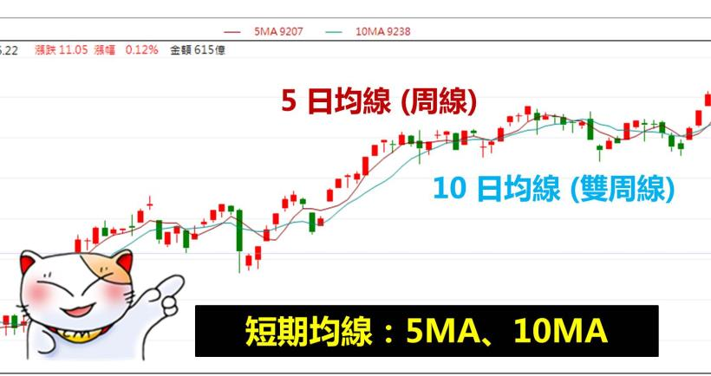
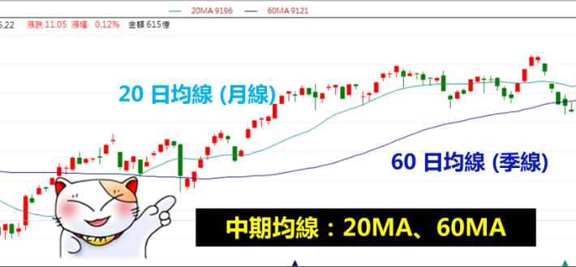
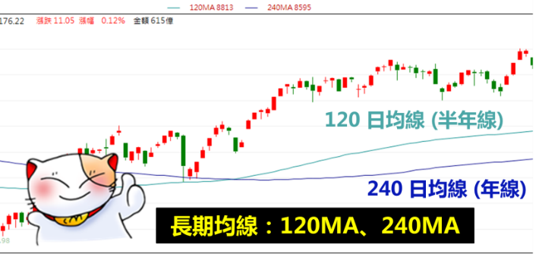
短期、中期、長期均線
短期均線（簡稱「短線」）
5 日均線(週線)、10 日均線(雙週線)
適用於短線操作的投資人
中期均線（簡稱「中線」）
20 日均線(月線)、60 日均線(季線)
適用於中線操作的投資人
長期均線（簡稱「長線」）
120 日均線(半年線)、240 日均線(年線)
適用於長線操作的投資人

Slide 5
Example of MA: 10-year View of SPY500
2007/01/03 ~ 2017/10/25
Notes:
Code; jang/courses/fintech/example/maPlot01.m

Slide 6
Example of MA: 1-year View of SPY500
2011/01/19 ~ 2011/12/28
季線
Momentum of the price wrt MA!
Notes:
Code; jang/courses/fintech/example/maPlot01.m

Slide 7
Example of MA – 1-quarter View of SPY500
2011/01/19 ~ 2011/04/12
季線
Notes:
Code; jang/courses/fintech/example/maPlot01.m

Slide 8
Trading Strategy based on MA
Basic (and poor) trading strategy based on MA
Buy if the price is larger than MA
Sell if the price is lower than MA
Backtest (回測)
Verify how the strategy performs
Optimize the parameters of strategy
Find the best value of n (window size)
Assume
Buy and sell at the price of “adj close”.
Buy with all your money, sell with all your holdings. (All-in and all-out.)
Require no transaction fee
Emergence of ML!

Slide 9
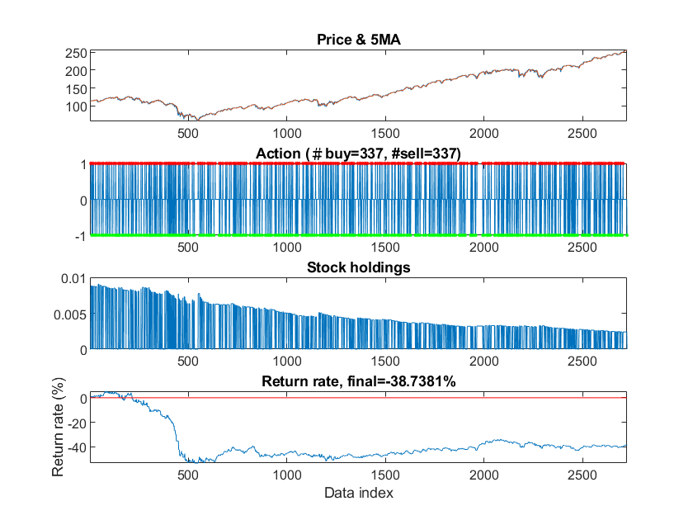
Profit Estimate via 5MA (週線)
Notes:
Code; jang/courses/fintech/example/maProfitEstimate01.m

Slide 10
Profit Estimate via 20MA (月線)
Notes:
Code; jang/courses/fintech/example/maProfitEstimate01.m

Slide 11
Profit Estimate via 60MA (季線)
Notes:
Code; jang/courses/fintech/example/maProfitEstimate01.m

Slide 12
Profit Estimate via 120MA (半年線)
Notes:
Code; jang/courses/fintech/example/maProfitEstimate01.m

Slide 13
Profit Estimate via 240MA (年線)
Notes:
Code; jang/courses/fintech/example/maProfitEstimate01.m

Slide 14
MA Profit vs. Windows
Notes:
Code; jang/courses/fintech/example/maProfitVsWindow01.m

Slide 15
Extension of MA-based strategy
Adopt variants of MA
SMA (simple MA)、WMA (weighted MA)、EMA (exponential MA) (wiki)
買點與賣點
黃金交叉：短期均線大於長期均線 ⎝ 買進
For example, 5MA > 20MA
死亡交叉：短期均線小於長期均線 ⎝ 賣出
For example, 5MA < 20MA
Another possibility
Buy when the current price is higher than MA by a margin α
Sell when the current price is lower than MA by a margin β

Slide 16



More about Moving Average (1/3)
General formula of MA
SMA (simple MA)
General formula
Example when n=5

Slide 17


More about Moving Average (2/3)
WMA (weighted MA)
General formula:
Example when n=5:

Slide 18



More about Moving Average (3/3)
EMA
General formula:
Since i>>1 and 0<r<1, we have
Or equivalent iterative formula:
Usually r = (n-1)/(n+1), where n is equivalent to a window size.
Source: https://hackmd.io/@rogerjang/SJF2MrKIK

Slide 19
MA References
均線
什麼是均線？
股票投資人，你知道什麼是均線嗎?
突破均線糾結 強勢股
阿斯匹靈判斷盤勢多空理財寶(很多用到均線觀念)
什麼是「均線糾結」?
移動平均 (Wiki)
回測
回測容易犯的幾種錯誤

