Slide 1
缺漏資料的補值方法 Imputation Methods for Missing Data
J.-S. Roger Jang (張智星)
MIR Lab, CSIE Dept.
National Taiwan University
jang@mirlab.org, http://mirlab.org/jang

Slide 2
Outline
Introduction
Imputation methods
Simple method
MICE method
Summary

Slide 3
Format of Structured Dataset for Classification
Format of structured dataset
Feature matrix: dxn
d: feature dimension
n: data count
Class label: 1xn
c: no. of classes
I/O pair
Column-major!
n I/O pairs
Features
Feature matrix (dxn)
Class label (1xn)
with values in 1~c
3
3
2
1
1
2
2
2
1
2
d = 6, n = 10, c=3
Class size ratio = 3:5:2

Slide 4
Anomaly in a Dataset
Outlier detection
Via domain knowhow
Body temperature 364 degrees
Via box plot
Via multiple ML models for leave-one-out CV
Other types of anomaly
Two different-class I/O pairs with the same feature vectors
A feature with the same value…
Across a dataset ➔ We can delete the feature since it has not discriminant power.
Across a class ➔ It will causes a error in naïve Bayes classifiers.
Why?

Slide 5
Simple Imputation for Missing Data
Simple imputation
Categorical feature: Use “mode” of the feature.
Numerical feature: Use “mean” or “median” of the feature.
Mean: Easily affected by extreme values (“income” for example)
Pros and cons of simple imputation
Pros: Quick and easy
Cons: Do not consider the correlation between features
Example: “income” of a 20-years-old man
Extended simple imputation
Impute features based on “similar group”
Impute “income” based on “similar-age group”
Impute “height” based on “same-gender
and similar-age group”
Quiz!
3
3
2
1
1
2
2

Slide 6
MICE Imputation for Missing Data
MICE: Multiple imputation by chained equations
Use simple imputation at the beginning
For each of the missing value, perform imputation one by one
Categorical feature: Use “classification”
Numerical feature: Use “regression”
Repeat the above process until convergence.
Characteristics
Iterative in nature ➔ Slow!
Wide selection of classifiers/regressors
For training set only, since we need to
Use the whole dataset
Use the labels as a feature
3
3
2
1
1
2
2
2
1
2

Slide 7
Missing Data Handling on Test/Validation Sets
Imputation for test/validation sets
Duplicate the test input by adding each class labels ➔ c test inputs
Perform regular classification based on the imputed training set and the imputed c test inputs
Assign the class based on max. likelihood of these c inputs.
Duplicate
Impute
Classify
Class = arg max {P_{i} }
?
1
2
3
1
2
3
1
2
3
P₁
P₂
P₃

Slide 8
Visualization on Test Input Imputing
Y
X

Slide 9
Caveat in Handling Missing Data during Cross Validation
Approximate method: Quick
Impute missing data
Perform cross validation
Exact method: Slow
Hide a fold as the test set
Impute the training set
Use the hidden fold for evaluation (with imputation, if needed)
Go back to step 1 until done.
3
3
2
1
1
2
2
2
1
2

Slide 10
Delete Features or I/O Pairs
If the missing data ratio is high and the dataset is large, we can simply delete features (rows) or data pairs (columns).
Try to plot missing data ratio vs. features or I/O pairs
For a given n, delete n features (or I/O pairs) to minimize overall missing data ratio ➔ Max coverage problem!
3
3
2
1
1
2
2
2
1
2
3
3
2
1
1
2
2
2
1
2
Missing data ratio = 21/60
Missing data ratio = 14/60

Slide 11
Summary
Missing data imputation is an important first task in handling real-world data.
We can use machine learning (classification or regression) for imputing missing data for the final machine learning task.
Evaluation of test input with missing data is not very straightforward.

Slide 12
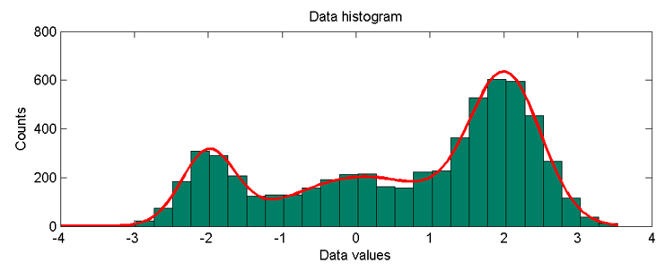
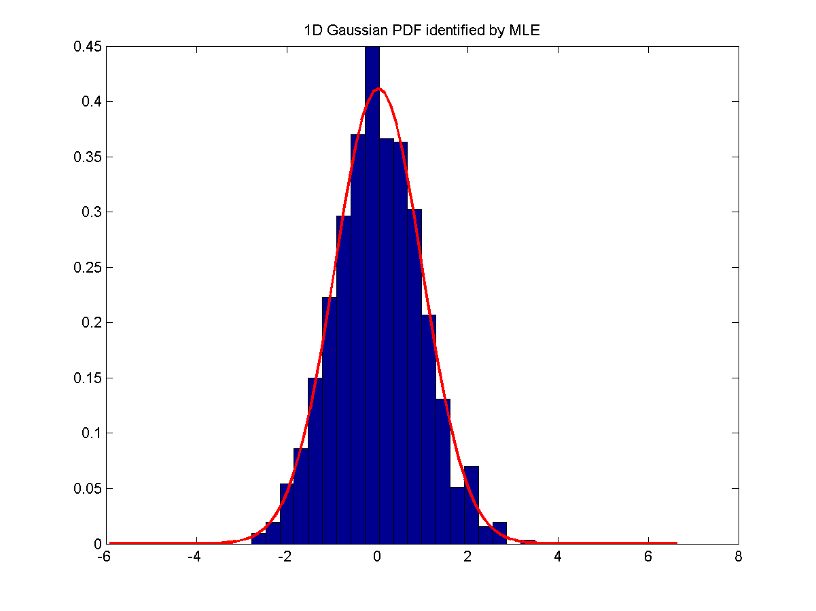
From Histogram to PDF
To create PDF
Data ➔ Histogram ➔ PDF

Slide 13
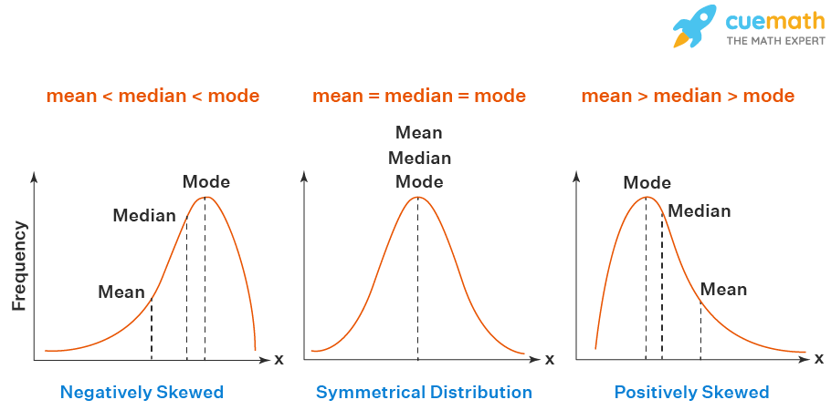
About Mean, Median, Mode
Representative numbers of distributions
Mean: Average of samples
Median: Middle number of sample after sorting
Median: Most-appearing number of samples
Quiz!
(Left Skewed)
(Right Skewed)
https://www.cuemath.com/data/relation-between-mean-median-and-mode

Slide 14
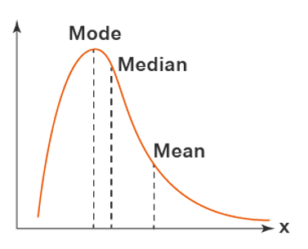


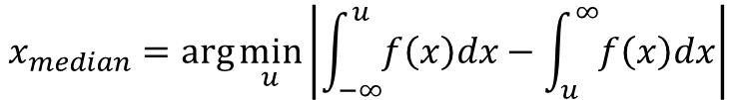
Definitions of Mean, Median, and Mode
Definitions
Mode
Median
Mean
$$x_{mode}=\arg{\max_{x}{f(x)}}$$
$$x_{median}=\arg{\min_{u}\left|\int_{−∞}^{u}{f\left(x\right)dx}−\int_{u}^{∞}{f\left(x\right)dx}\right|}$$
$$x_{mean}=\frac{\int_{−∞}^{∞}{xf\left(x\right)dx}}{\int_{−∞}^{∞}{f\left(x\right)dx}}$$

Slide 15
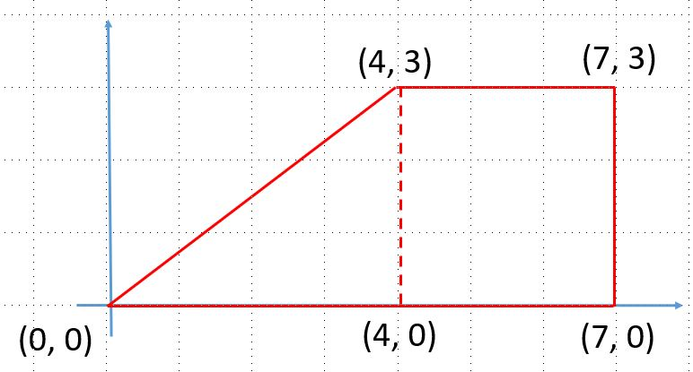
Exercise
Compute the mean, median, and mode of the following PDF-like histogram.

Slide 16
Missing Value Imputation
Steps
Determine neighborhood
Derive the value
Neighborhood identification
1D input
2D input
K-nearest neighbor
All
Value determination
Nearest
Interpolation
Model-based

Slide 17
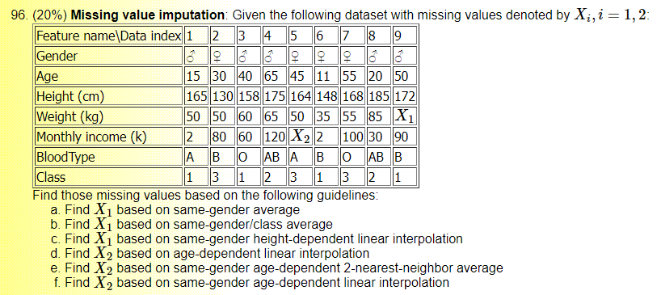
Missing Value Imputation: Example

