Slide 1
Performance Indices for Classification
J.-S. Roger Jang (張智星)
MIR Lab, CSIE Dept.
National Taiwan University
jang@mirlab.org, http://mirlab.org/jang

Slide 2
Outline
Confusion matrices
Performance indices based on confusion matrix
ROC, DET and AUROC
Cost-sensitive classification
PRC and AUPRC
Lift charts
Exercises

Slide 3
Intro. to Performance Indices (PIs)
Performance index
AKA performance metrics, figure of merit, etc.
To evaluate the performance of a ML model
Different situations require different PIs
Purposes
Classification
Sequence decoding
Regression
Ranking
Situations
Imbalanced dataset for classification
Binary or multi-class classification problems

Slide 4
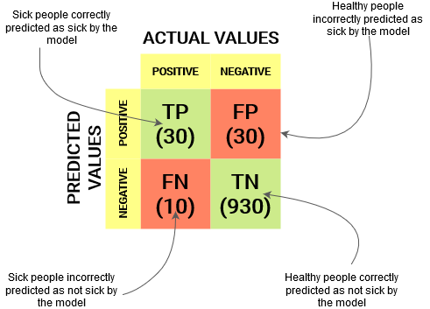
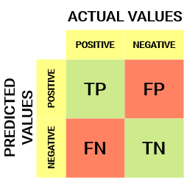
Confusion Matrix for Binary Classification
Confusion matrix for binary classification
Can be extended to multi-class classification
Example: covid-19 detection
of 1000 cases
https://www.analyticsvidhya.com/blog/2020/04/confusion-matrix-machine-learning

Slide 5
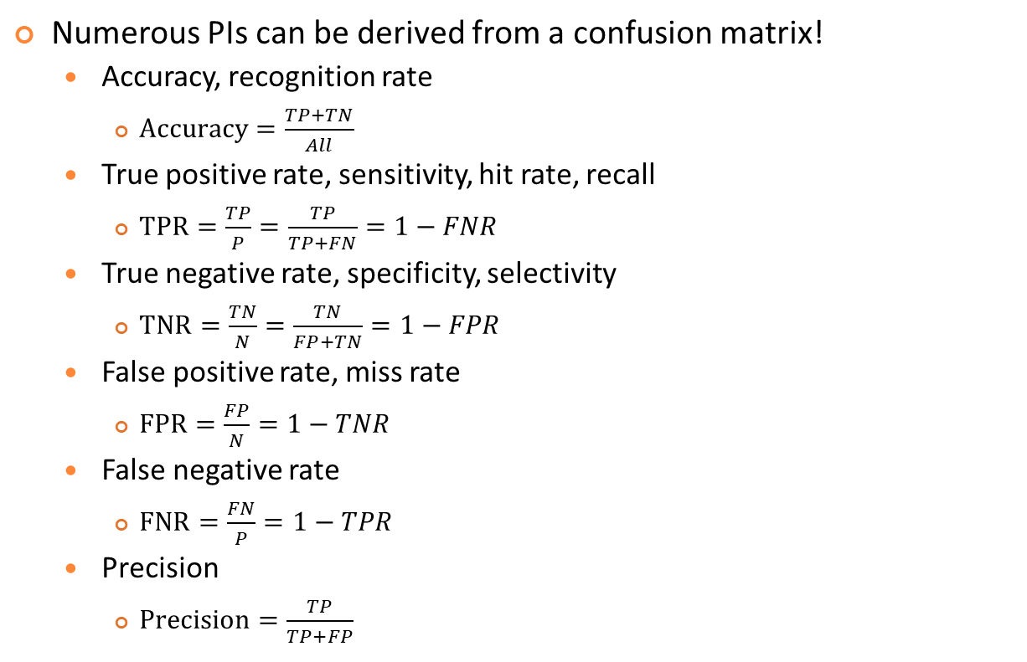
PIs Derived from Confusion Matrices
Quiz!
Numerous PIs can be derived from a confusion matrix!
Accuracy, recognition rate
$Accuracy=\frac{TP+TN}{All}$
True positive rate, sensitivity, hit rate, recall
$TPR=\frac{TP}{P}=\frac{TP}{TP+FN}=1−FNR$
True negative rate, specificity, selectivity
$TNR=\frac{TN}{N}=\frac{TN}{FP+TN}=1−FPR$
False positive rate, miss rate
$FPR=\frac{FP}{N}=1−TNR$
False negative rate
$FNR=\frac{FN}{P}=1−TPR$
Precision
$Precision=\frac{TP}{TP+FP}$
https://en.wikipedia.org/wiki/Confusion_matrix

Slide 6
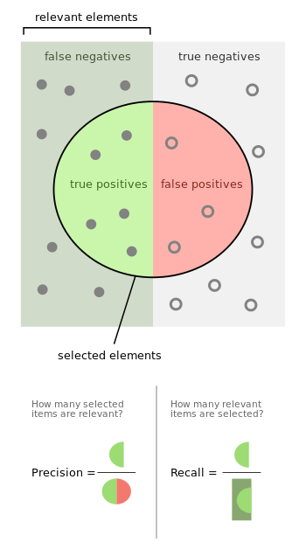

Precision and Recall
Quiz!
From the viewpoint of information retrieval
Precision: $p=\frac{TP}{TP+FP}$
Recall: $r=\frac{TP}{TP+FN}$
F-measure: $f=\frac{2pr}{p+r}=$ $\frac{TP}{(2TP+FP+FN)/2}$
Usually
p ↗ ➔ r ↘
P ↘ ➔ r ↗
Harmonic mean
of p and r
Aka F1-score
https://en.wikipedia.org/wiki/Precision_and_recall

Slide 7
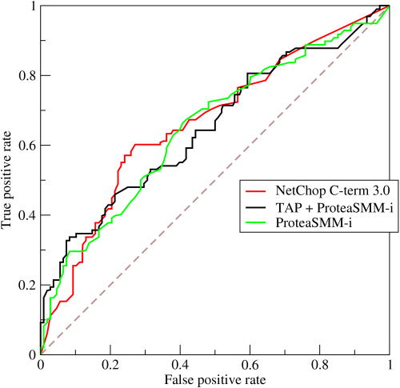
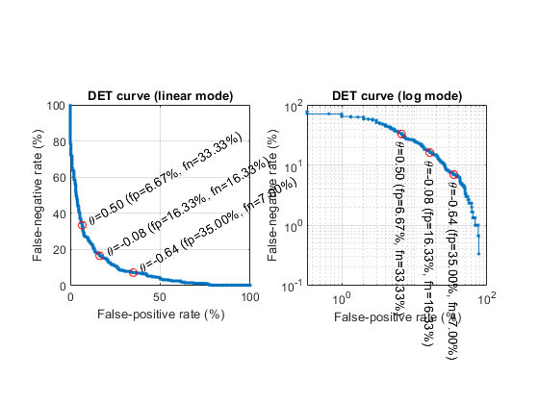
ROC and DET
Quiz!
ROC (Receiver Operating Characteristics) curve
TPR vs. FPR when threshold is varying
Endpoints at (0, 0) & (1, 1)
DET (Detection Error Tradeoff) curve
FNR vs. FPR when threshold is varying
Endpoints at (0, 1) & (1, 0)
ROC
Similarity, likelihood, etc
DET
https://en.wikipedia.org/wiki/Receiver_operating_characteristic

Slide 8
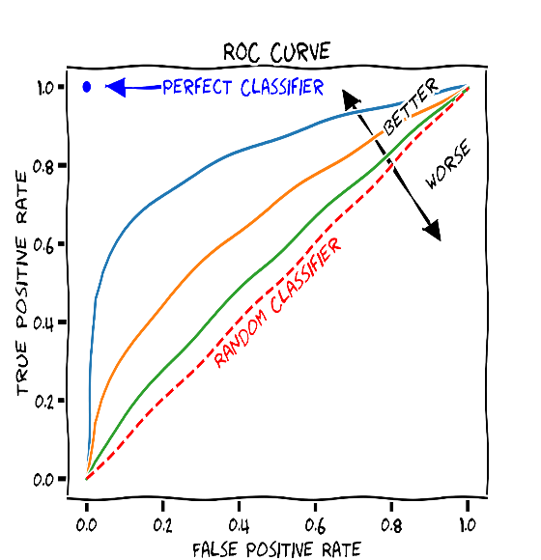
AUROC
Quiz!
AUROC: Area under ROC
0.5 ≦ AUROC ≦ 1.0
0.5 ➔ Random guess
1.0 ➔ Perfect classification
Suitable PI for imbalance datasets
Determine the operating point based on cost
For covid-19 detection, which classifier is better, A or B? At what operating points?
FNR
DET curves
A
B
FPR
https://en.wikipedia.org/wiki/Receiver_operating_characteristic

Slide 9
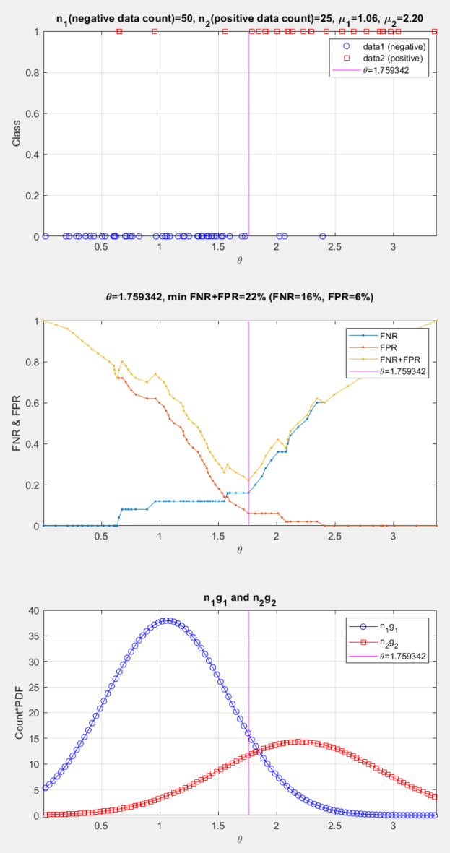
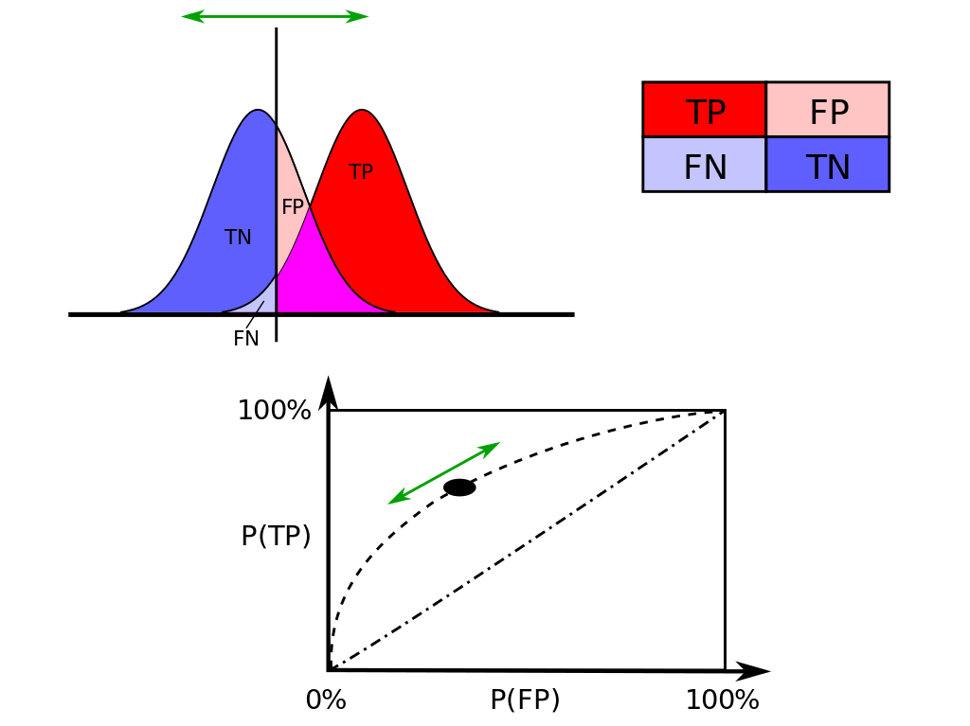
Two Ways to Plot ROC
Sample-point based
Less smooth
More realistic
Distribution based
More smooth
If the threshold is at the intersection
FNR+FPR is minimized
TPR+TNR is maximized

Slide 10




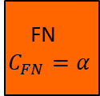
Cost-sensitive Classification
Quiz!
Cost matrix
Objective function
$f\left(θ\right)={C_{TP}∗TP\left(θ\right)+C}_{FN}∗FN\left(θ\right)+C_{FP}∗FP\left(θ\right)+C_{TN}∗TN\left(θ\right)$
$=α∗FN\left(θ\right)+FP\left(θ\right)$
$\hat{θ}=\arg{\min_{θ}{f\left(θ\right)}}$
Prediction
Positive Negative
TP
$C_{TP}$=0
FN
$$C_{FN}=α$$
Usually a big number
Negative Positive
Groundtruth
FP
$$C_{FP}=1$$
TN
$C_{TN}$=0

Slide 11
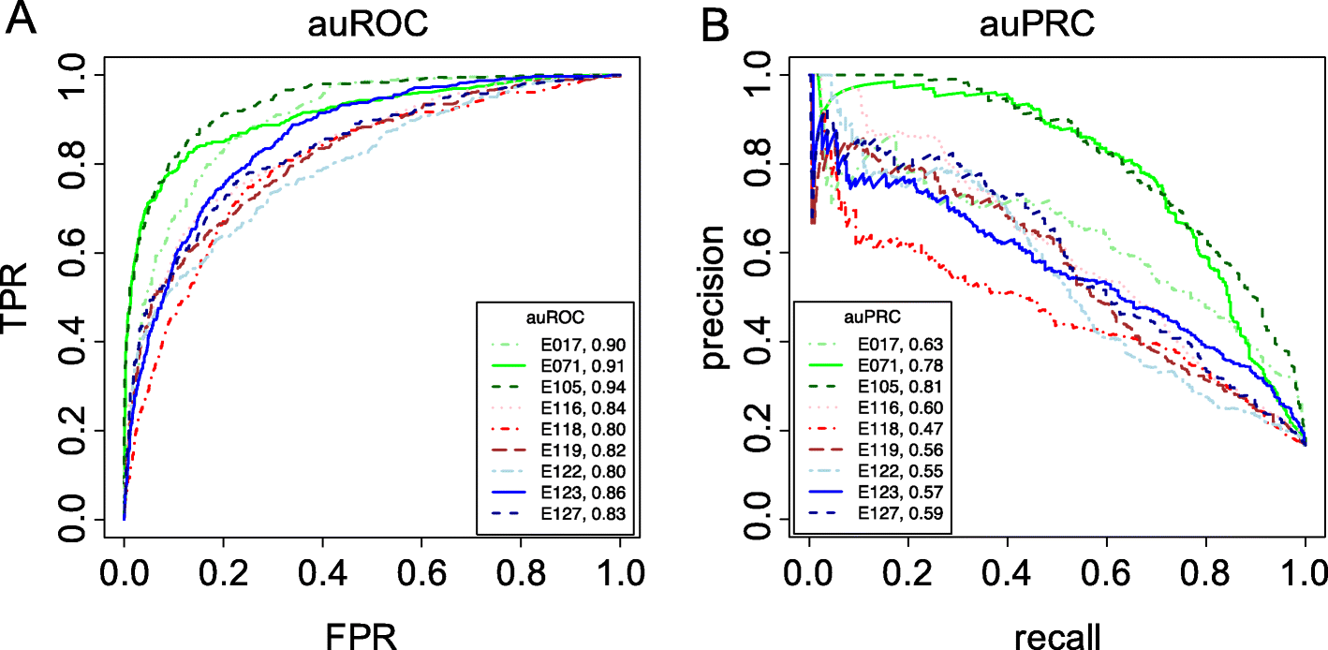
Precision-Recall Curve (PRC)
PRC
Plot of precision vs. recall
AUPRC (area under PRC)
Usually not smooth
Where are the endpoints?
Quiz!

Slide 12
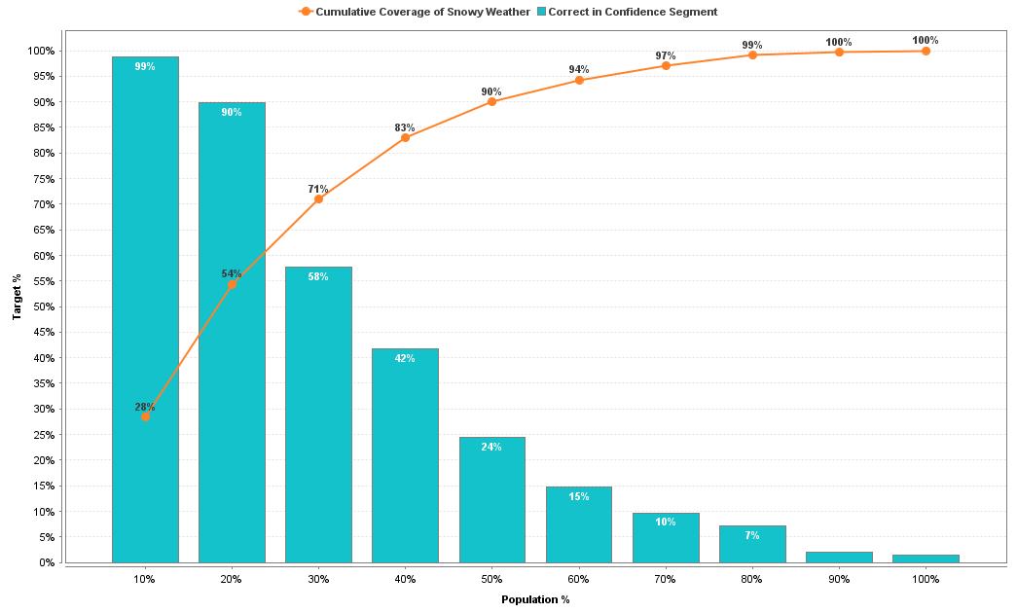
Lift Charts
Good for convincing people to appreciate power of ML
Example:
Cumulated Recall
Bin precision
⬅ 對40%人發送廣告，就可以抓到83%想出國的人！

Slide 13
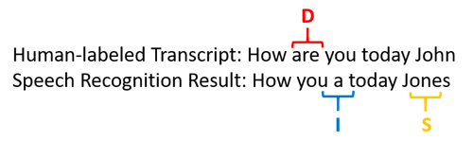


Accuracy of Sequence Decoding
Accuracy of ASR (automatic speech recognition) for English
WER: word error rate
Example:
Facts
Accuracy could be negative! ➔ Counter intuitive!
You need to use edit distance (based on DP) to find D, I, and S. ➔ Computation intensive!
$$WER=\frac{D+I+S}{N}⇒Accuracy=1−WER$$
Length of groundtruth
Could be negative!
$$WER=\frac{1+1+1}{5}=60\%⇒Accuracy=40\%$$

Slide 14
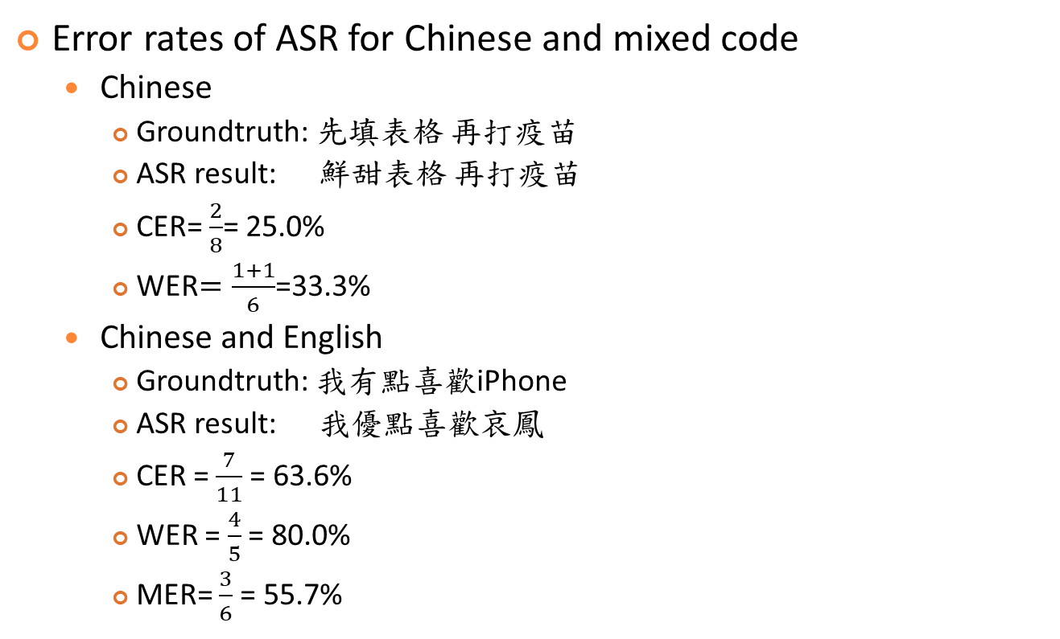
Error Rate of Sequence Decoding
Quiz!
Error rates of ASR for Chinese and mixed code
Chinese
Groundtruth: 先填表格 再打疫苗
ASR result: 鮮甜表格 再打疫苗
CER= $\frac{2}{8}$= 25.0%
WER$=\frac{1+1}{6}$=33.3%
Chinese and English
Groundtruth: 我有點喜歡iPhone
ASR result: 我優點喜歡哀鳳
CER = $\frac{7}{11}$ = 63.6%
WER = $\frac{4}{5}$ = 80.0%
MER= $\frac{3}{6}$ = 55.7%
WER: Word error rate
(Chinese & English: word)
CER: Character error rate
(Chinese & English: character)
MER: mixed error rate
(Chinese: character, English: word)

Slide 15
Exercise: PIs Based on a Confusion Matrix
Derive various PIs based on the confusion matrix obtained from a detection method for covid-19:
Prediction
Positive Negative
TP
= 30
FN
= 10
Negative Positive
Groundtruth
FP
= 20
TN
= 940

Slide 16


Exercise: ROC/DET/PRC
A plot of sample data vs. thresholds is shown next.
Plot FNR/FPR vs. thresholds, ROC, DET, PRC.
Plot $f\left(θ\right)=α∗FN\left(θ\right)+FP\left(θ\right)$ when $α$=1 and 3, respectively. What is the corresponding $\arg{\min_{θ}{f\left(θ\right)}}$?
Class
1: positive
o
o
o
0: negative
x
x
x
x
x
3
4
5
6
Threshold $θ$
7
8
9

Slide 17
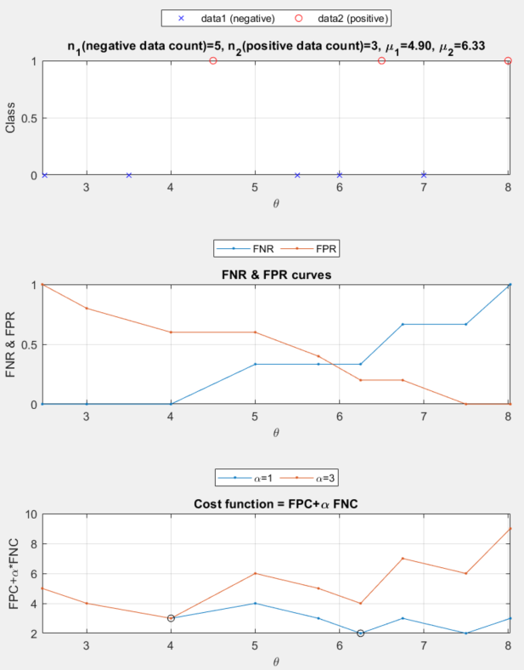
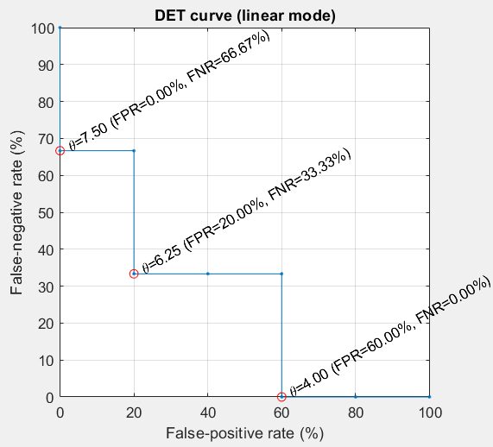
Exercise: DET/ROC
Another example
FNR & FPR curves
DET plots
Cost function

Slide 18
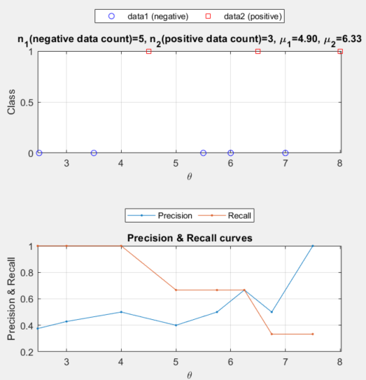
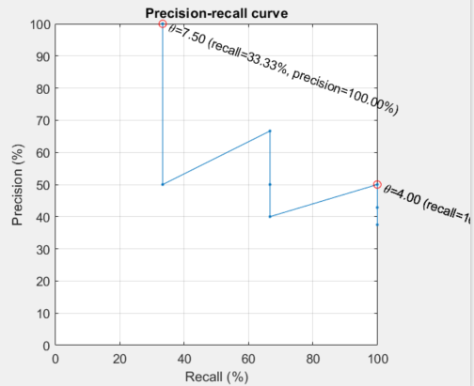
Exercise: PRC
Another example
Precision & recall curves
PRC plots

Slide 19
Exercise: DET/PRC
Increasing? Decreasing? Or none of the above?
FNR vs. threshold
FPR vs. threshold
DET (FNT vs. FPR)
Precision vs. threshold
Recall vs. threshold
PRC (precision vs. recall)
Endpoints?
DET
PRC

Slide 20
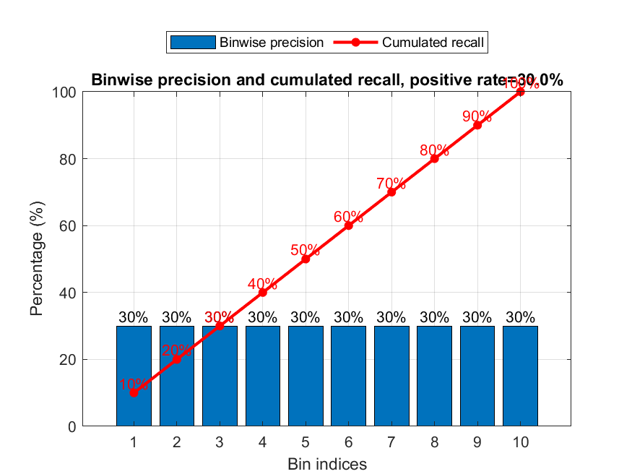
Exercise: Lift Chart
Plot the ideal lift chart of a random-guess classifier, with no. of bins equal to 10, and N:P=7:3 where N and P are numbers of negative and positive cases, respectively.

Slide 21
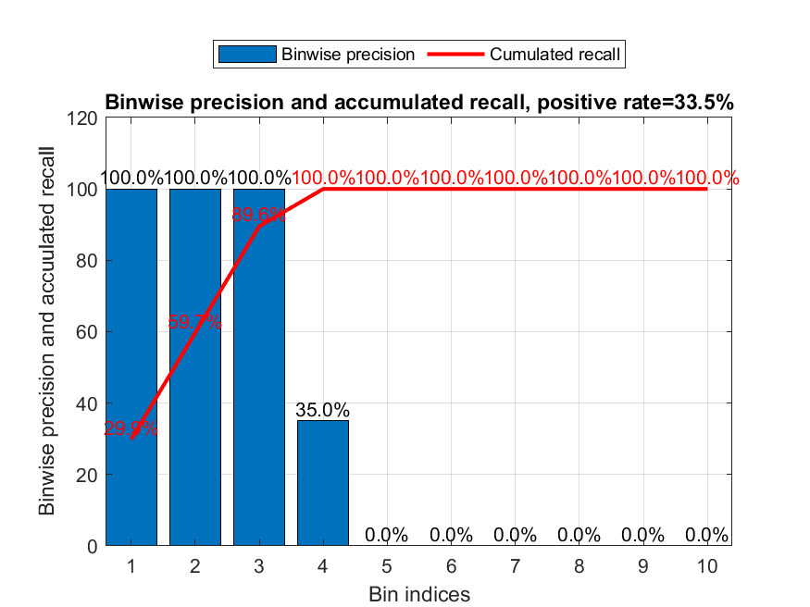
Exercise: Yet Another Lift Chart
Plot the lift chart of a perfect classifier when P=335 and N=665, with no. of bins equal to 10.

