Slide 1
金融科技導論 Intro to FinTech
Roger Jang (張智星)
Sean Han (韓傳祥)
Jimmy Chen (陳君明)
CSIE/Math Dept, National Taiwan University

Slide 2
Course Syllabus
Course description
金融科技(Financial Technology, FinTech)是目前全球金融業與科技業的焦點，它所引發的破壞式創新，正挑戰既有金融服務的供給方式和消費行為。本課程由資工、財金、數學三方教授共同開設，將嘗試將數學方法與電腦計算應用於財金領域，期望同學在跨領域的訓練下，能夠一窺金融科技殿堂之美。
Course objectives
瞭解與 FinTech 相關的概念與理論
財務基礎、密碼學、機器學習、最佳化等
實做與 FinTech 相關的專題與系統
學界/業界出題、學生解題

Slide 3
Instructors
For Evaluation…
韓傳祥 (Sean Han)
金融科技簡介、機器人理財 (Robo Advisor)、金融工程、金融數據分析、保險科技與風險管理
陳君明 (Jimmy Chen)
區塊鏈 (Block Chain) 原理及應用、比特幣 (Bitcoin) 與其他密碼貨幣 (Cryptocurrency)、密碼學背景知識
張智星 (Roger Jang)
數學分析工具、機器學習、技術指標、資產配置最佳化、演算法、金融科技應用

Slide 4
助教群
TAs
鄭世朋、許智翔
Mailing alias: ta4fintech@mirlab.org
TAs and instructors will receive emails sent to this account.
私訊不回應！
Office hours
One hour per week for each TA
Please refer to the course webpage
http://mirlab.org/jang/courses/fintech
請特別注意！

Slide 5
Course Participation
Slido for raising questions
URL ➔ http://slido.com
Event code: fintech101
Auditing welcome
Contact TAs for auditing (ta4fintech@mirlab.org)
No enrollment limits
We’ll have polls here!

Slide 6
Time & Place, Prerequisites
Time & place
Time: Wed 9:10pm – 12:10pm
Place:
實體教學：綜合大講堂
線上教學：https://ntucc.webex.com/meet/rogerjang
Prerequisites
Calculus, Linear Algebra, Probability
Machine Learning
如果你沒修過ML，但又想修這門課，請務必先完成每週的 Optional 教材。
Computer programming
本課程以方法論為主，不會實際教授程式語言，但會提供相關教材（Python）讓同學自行學習。

Slide 7
Important Links
Course website: http://mirlab.org/jang/courses/finTech
Schedule, video links, homework, etc.
NTU COOL: https://cool.ntu.edu.tw/courses/31046
Announcement, discussion, scores, mailing list, etc.
Online interaction: http://slido.com (Event code: fintech101)
Live streaming: https://ntucc.webex.com/meet/rogerjang (若線上上課)

Slide 8
Class Activities
Lectures
Online course material (with pre-class recordings)
Flipped learning, with supplementary material and exercise discussion in class
Exams
In-class online quizzes and midterm exam
Homework
Handwritten & programming (graded by our judge system)
Term projects
Machine learning：人工智慧公開挑戰賽 by 玉山銀行
Ideas & Innovation：金融科技創新創意大賽 by AI金融科技協會
Invited talks
Any dishonest behavior
➔ Fail the class!

Slide 9
Grading Policy
Percentages
Quizzes: ~25%
Homework: ~25%
Midterm exam: ~25%
Term project: ~25% (with min. of 15%)
Final grades are based on scores and ranking.
The instructors reserve the rights to
Adjust percentage of each categories if necessary
Determine the way to combine scores and ranking

Slide 10
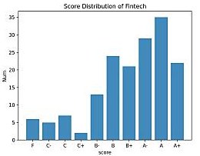
More about Grading
Grade computation
Raw score computation in double ➔ rounding to nearest integers ➔ final letter grades
No-change policy
We will not change the final grades once they are sent to the academic affairs office, unless it is due to mistakes on our part.
Grade statistics
Usually we have 25% of A+ and A
Respect the results by computers!
Previous distribution

Slide 11
Penalty for Late HW Submissions
Overdue penalty for homework, up to a delay of 7 days
80% weighting for overdue of 0-24 hours
(80%)^2 weighting for overdue of 24-48 hours
(80%)^3 weighting for overdue of 48-72 hours
…
We will not change deadline for personal cases, unless it is due to force majeure (不可抗力) events.

Slide 12
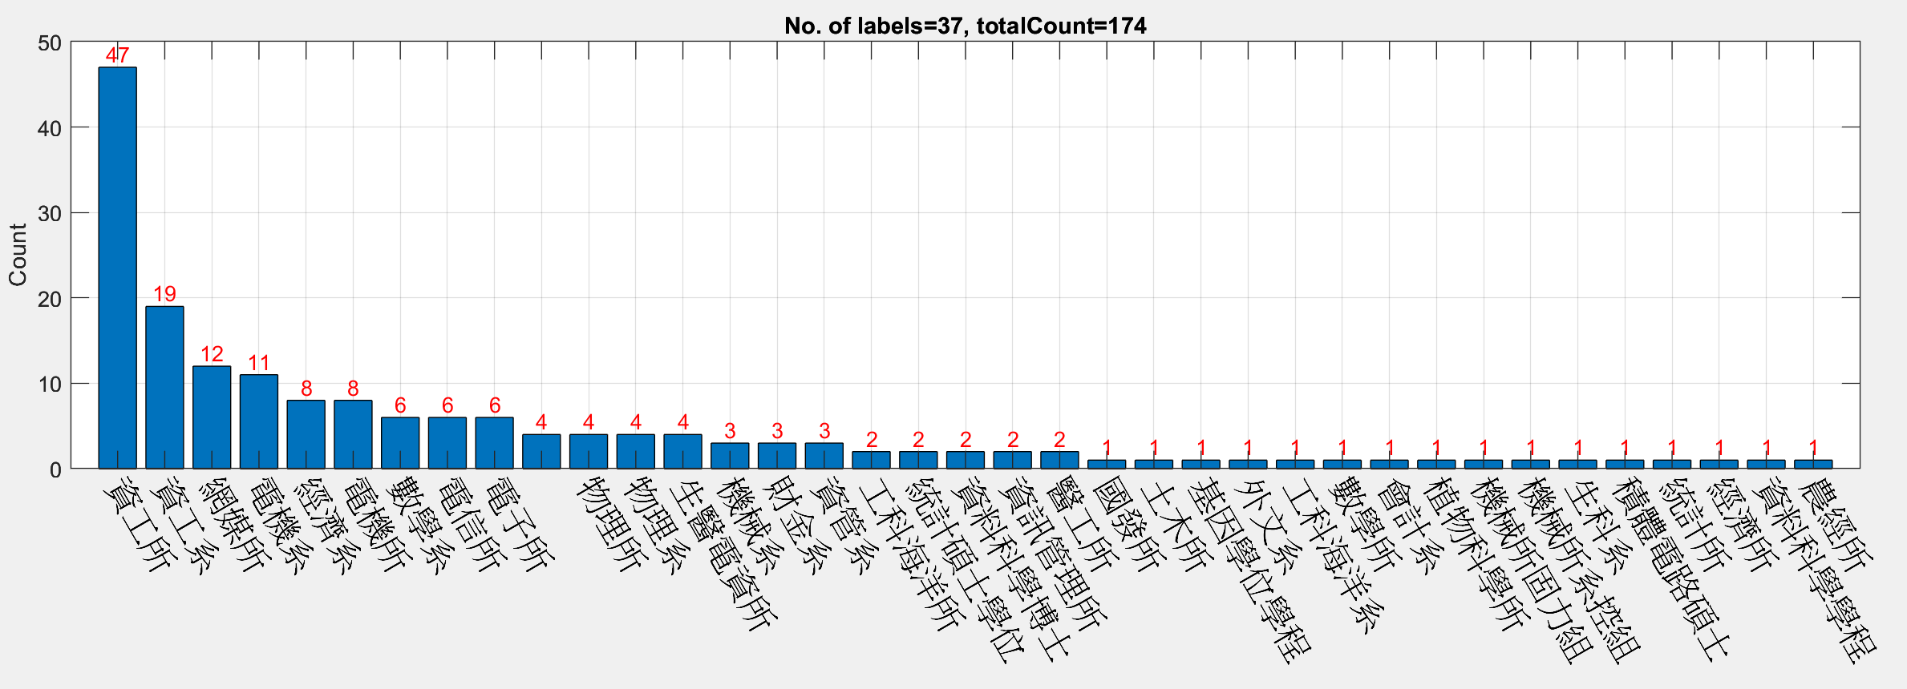
Student Counts Based on Departments

Slide 13
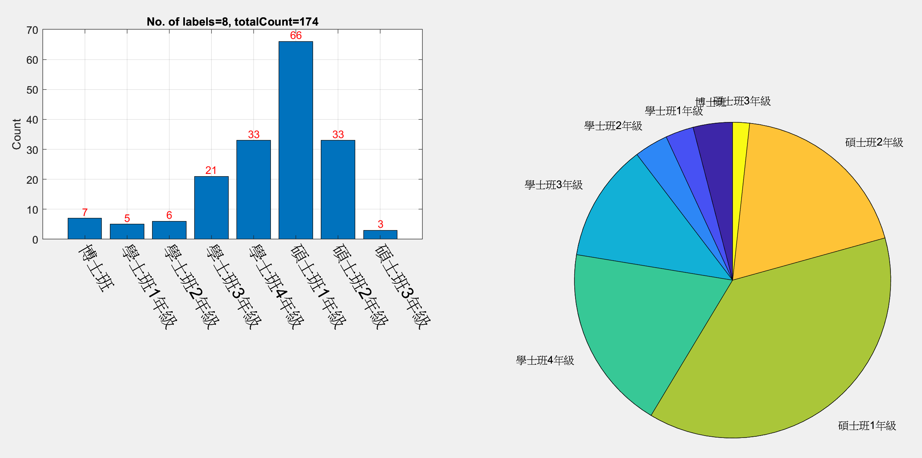
Student Counts Based on Programs & Years

Slide 14
How To Pass the Class?
How to pass the class?
小考、作業、期中考、期末計畫等，都要交！
在上課前務必先讀取教材
Todo list for week 1
Understand the policy thoroughly
Check out the course schedule page
Welcome aboard!
Any questions?

