Slide 1
Introduction
ECON 300
Intermediate Price Theory

Slide 2
What is Intermediate Price Theory?
Directly from the Monmouth College course catalog...
“A rigorous analysis of the modern micro-economic theory of the behavior of the firm and the individual.”
Prerequisites:
  ECON 200 Principles of Economics
  BUSI 201 Business Data Analysis
  BUSI 205 Business Math and Statistics

Slide 3

PollEverywhere
https://pollev.com/brianpark046

Slide 4
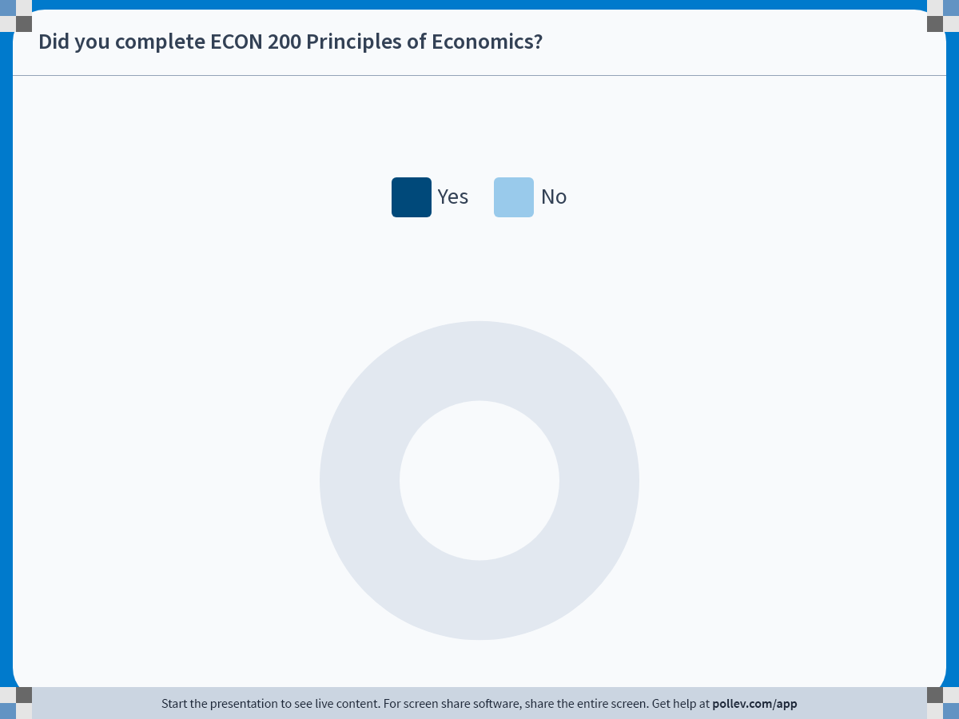
Notes:
Poll Title: Do not modify the notes in this section to avoid tampering with the Poll Everywhere activity.
More info at polleverywhere.com/support
Did you complete ECON 200 Principles of Economics?
https://www.polleverywhere.com/multiple_choice_polls/ZhVSCRdd00fosPei4xZIj?state=opened&flow=Default&onscreen=persist

Slide 5
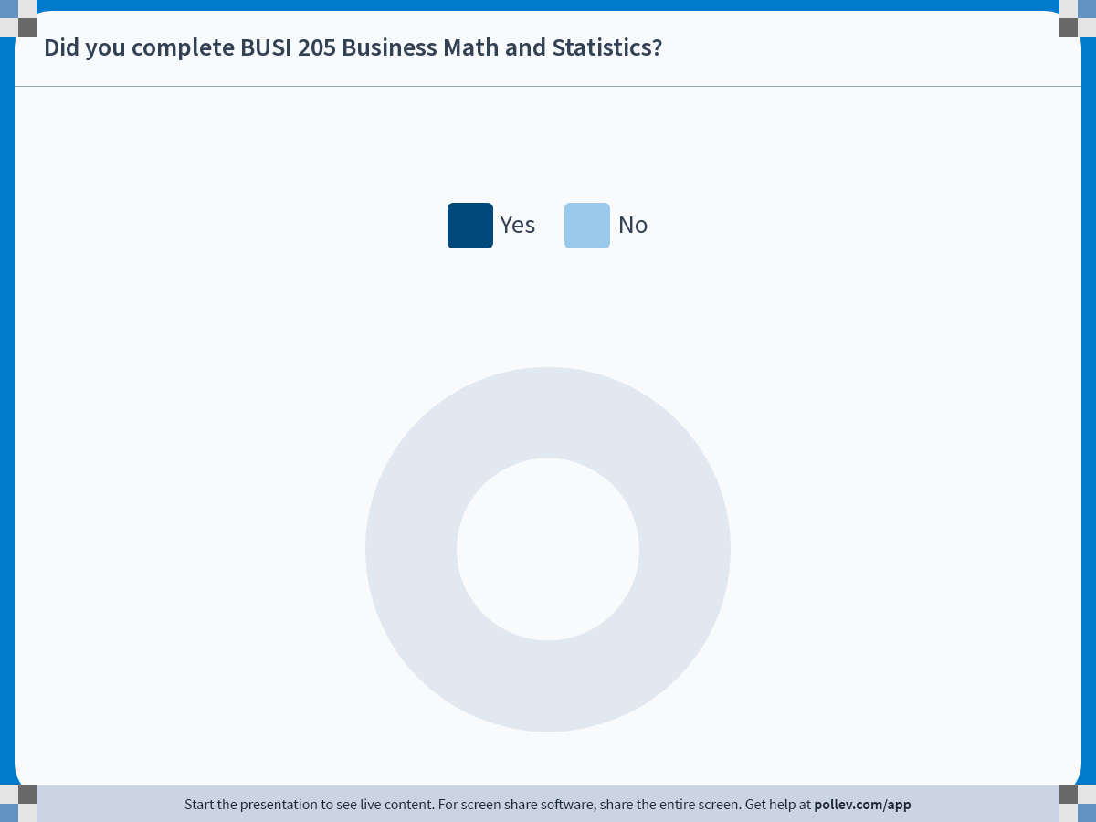
Notes:
Poll Title: Do not modify the notes in this section to avoid tampering with the Poll Everywhere activity.
More info at polleverywhere.com/support
Did you complete BUSI 205 Business Math and Statistics?
https://www.polleverywhere.com/multiple_choice_polls/auTy1OHlPrXjwvOnl8VWE?state=opened&flow=Default&onscreen=persist

Slide 6
What is Intermediate Price Theory?
Typically called “Intermediate Microeconomic Theory”
JEL Classification under “Microeconomics”
  Household Behavior and Family Economics
  Production and Organizations
  Distribution
  Market Structure, Pricing, and Design
  General Equilibrium and Disequilibrium
  Welfare Economics
  Analysis of Collective Decision-Making
  Information, Knowledge, and Uncertainty
  Micro-Based Behavioral Economics

Slide 7
What is Intermediate Price Theory?
In this course we cover the following topics:
How individuals make decisions
  How would an agent make consumption choices?
  How would agents make production decisions?
How these individual decisions interact
  What is a market equilibrium?
  Who wins, and who loses?
  How would the government fit in this framework?
What happens when assumptions fail

Slide 8
About Me
Ph.D. Cornell University
B.A. Korea University
Research Interests
  Environmental: Climate Change, Air Pollution
  Demographic: Migration, Fertility
  Labor: Employment Stability
1st Year at Monmouth College

Slide 9
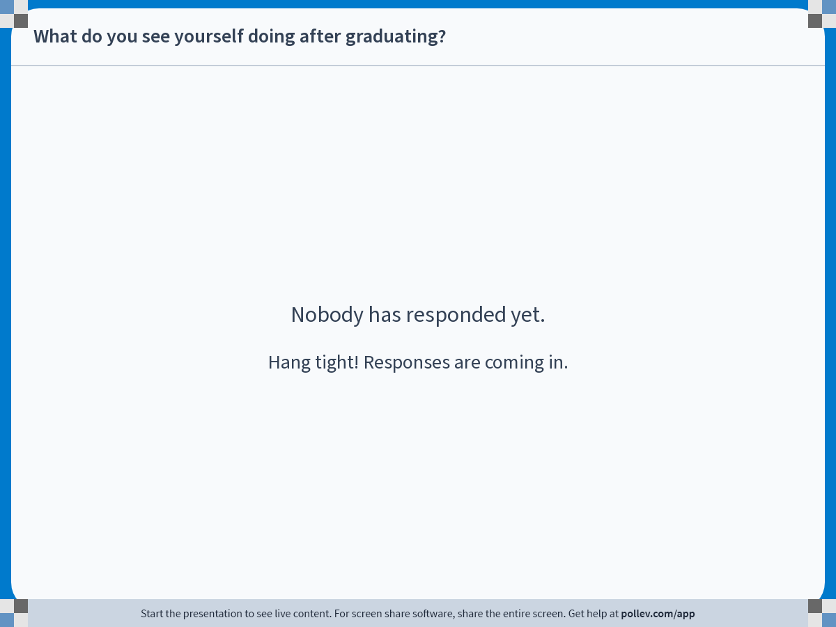
Notes:
Poll Title: Do not modify the notes in this section to avoid tampering with the Poll Everywhere activity.
More info at polleverywhere.com/support
What do you see yourself doing after graduating?
https://www.polleverywhere.com/free_text_polls/9i0swkUqm8pA0pnPL97FK

Slide 10
Contact Information
Email: BPARK@monmouthcollege.edu
  Please include “ECON300” in the subject line.
  Target response within 1 business day.
Office: CSB 248
Regular Office Hours: Tue/Thu 12:30 PM ~ 2:00 PM
Individual (or Group) Appointments via Calendly.
  https://calendly.com/brianhwpark
  Book on-demand office hours in 30-minute increments
  Calendar opens 15 days in advance
Send me an email if you need anything else

Slide 11

Office Hours

Slide 12
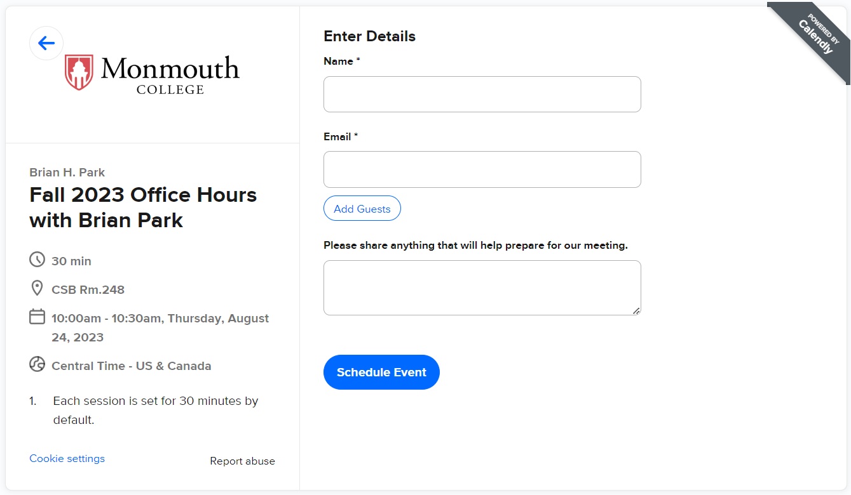
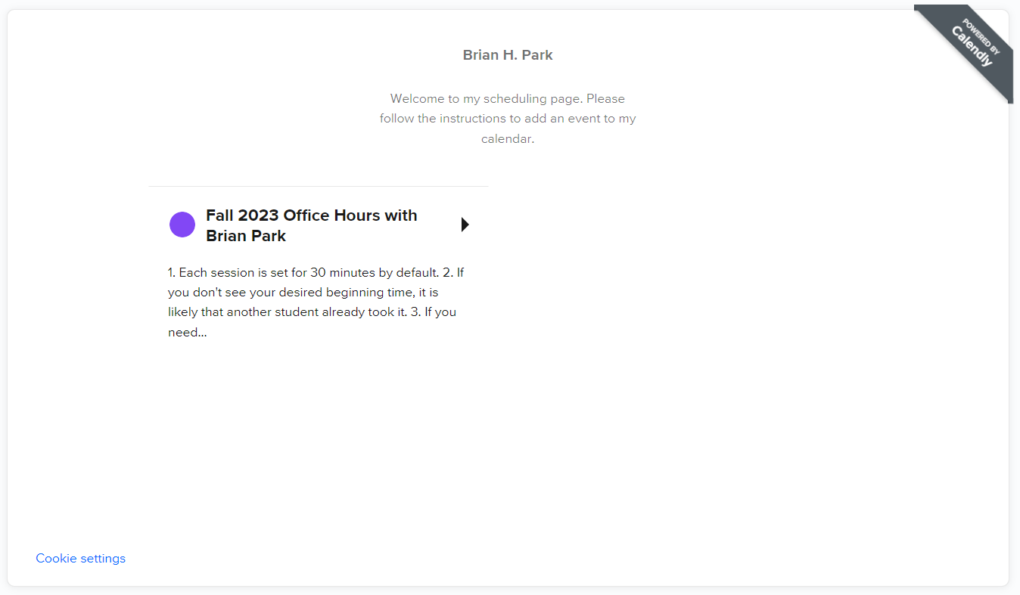
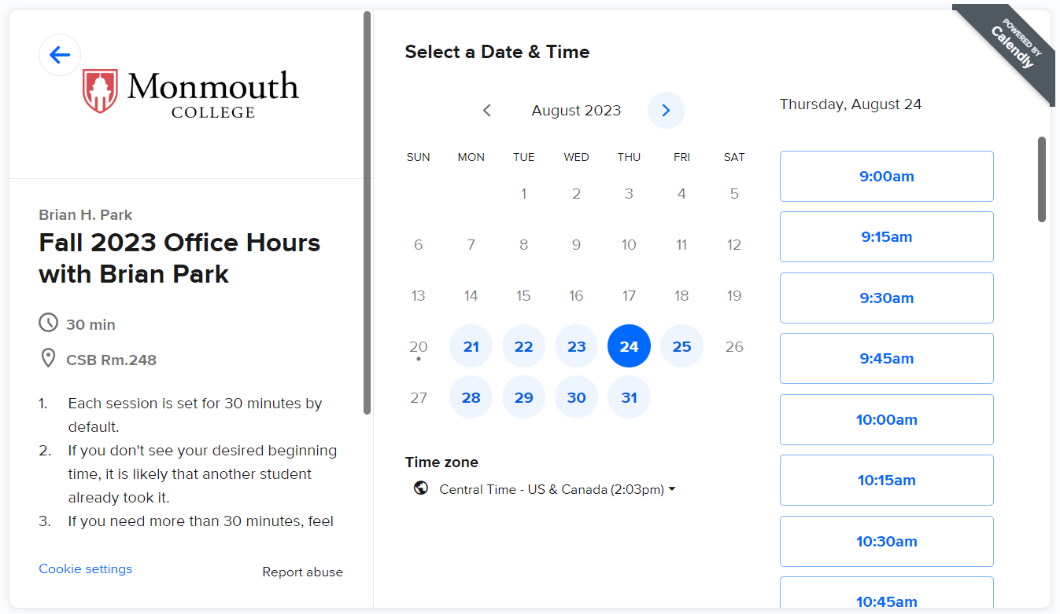
Office Hours

Slide 13
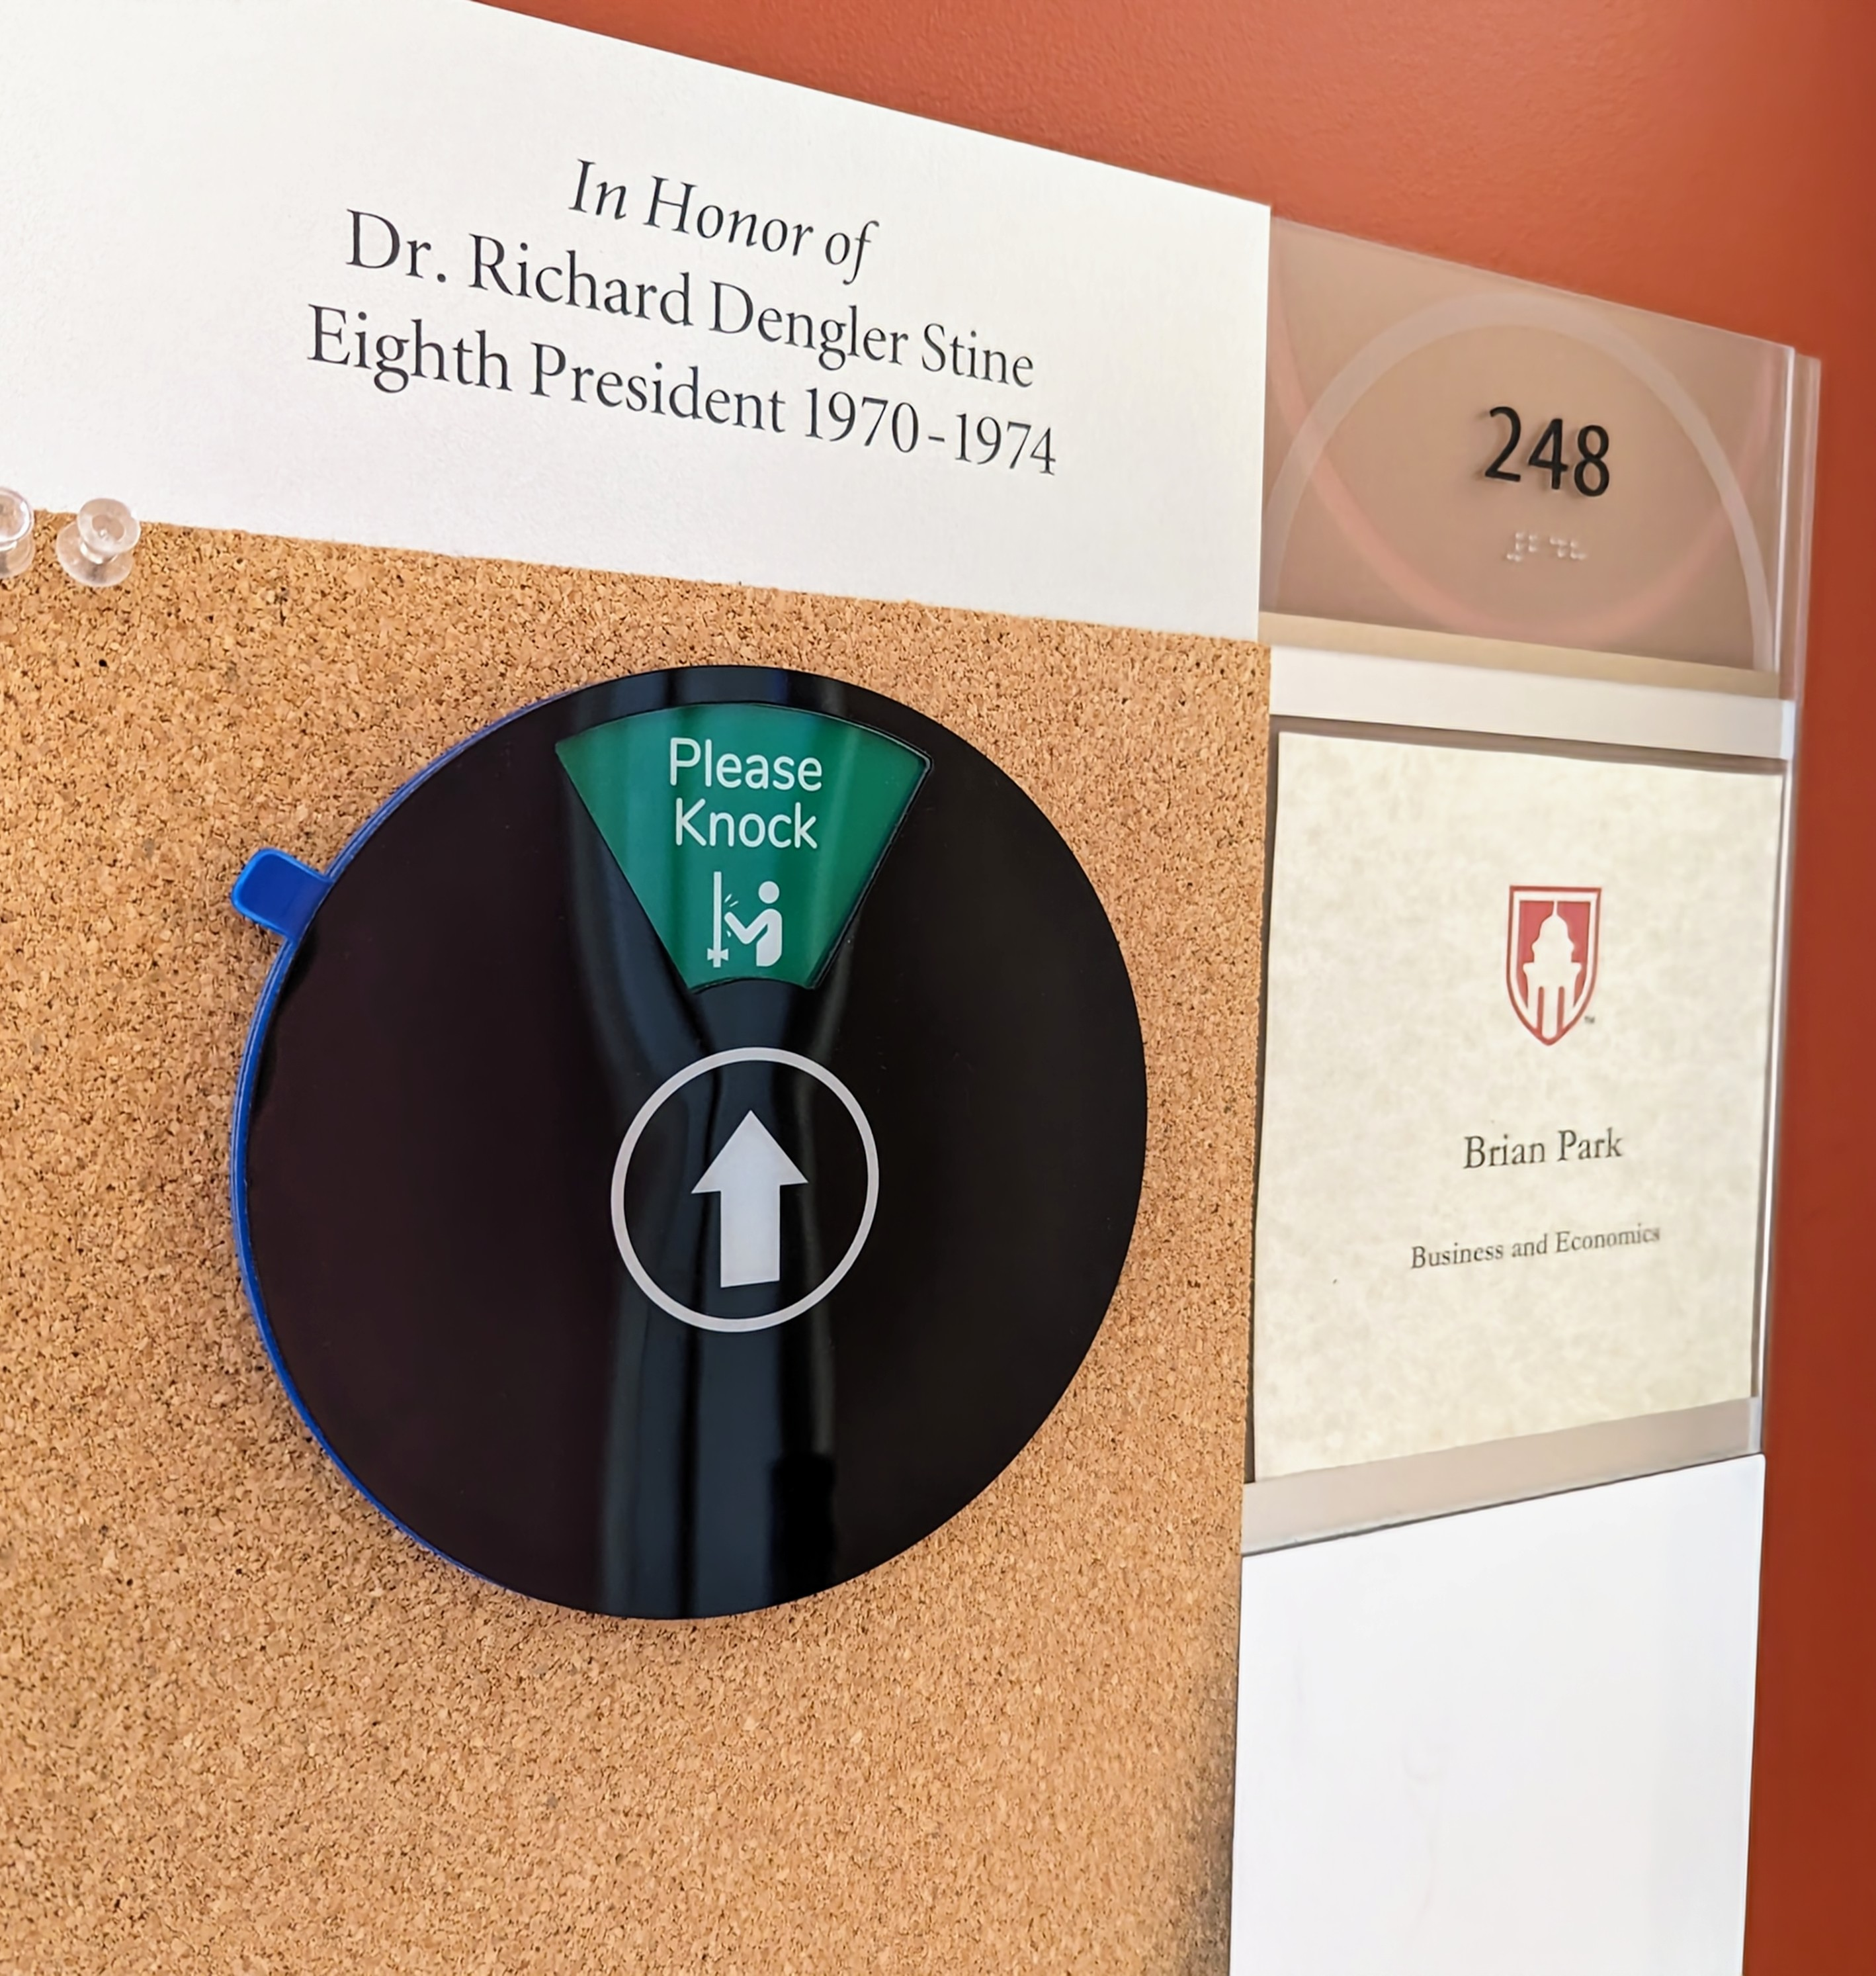
Office Hours
Whenever it displays “Please Knock”, that means that I am available.
When it is at “Back Soon”, it means that I have briefly left the office, but will be back soon.
If you see anything else, and need to talk, send me an email!

Slide 14
Grades
Final letter grades based on four factors:
  Attendance: 10%
  Quizzes / Assignments: 30%
  Midterm Exam: 25%
  Final Exam: 35%
There are no predetermined “cutoff” points for letter grades.
The cutoffs will be updated as the semester progresses.

Slide 15
Attendance
Attendance may be called every time we meet.
One “no-points-deducted” absence for each month.
Extra “no-points-deducted” absences may be granted on a case-by-case basis.
Attendance scores will be calculated as:
$$Attendance= \frac{\# Attendance Checks−\# Absences+\# Excused Absences}{\# Attendance Checks}×10$$

Slide 16
Quizzes / Homework
Quizzes will act as a low-stakes status check.
Students can recover extra credit by attending office hours and “correcting” any mistakes made.
The lowest 1 or 2 quizzes will be dropped at the end of the semester.
Quizzes may be substituted to homework assignments at the instructor’s discretion.

Slide 17
Exams
Two exams; one midterm and a comprehensive final.
No “review sessions” for partial credit for exams.
Students may submit a request for regrading within the first 5 days the scores are made available.
If you miss an exam due to valid cause, the option would be either a written make-up exam, or an oral exam.

Slide 18
Textbook / Reading Material
The main textbook for this course:
  H. Varian’s Intermediate Microeconomics.
  Optional, but recommended
Slides / Notes will be distributed online.
  LMS: Moodle?
  Cloud: OneDrive , Google Drive, Dropbox?
  Personal Webpage?
News articles, short stories, or videos may occasionally be assigned as supplementary material.

Slide 19
PollEverywhere
https://pollev.com/brianpark046

Slide 20
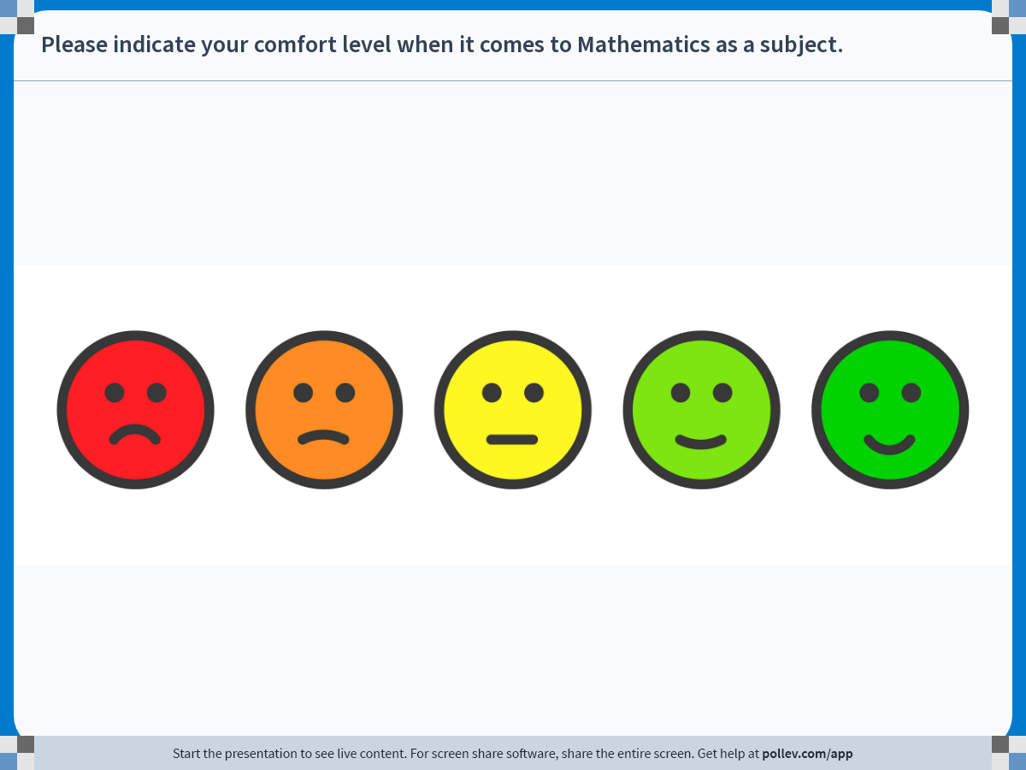
Notes:
Poll Title: Do not modify the notes in this section to avoid tampering with the Poll Everywhere activity.
More info at polleverywhere.com/support
Please indicate your comfort level when it comes to Mathematics as a subject.
https://www.polleverywhere.com/clickable_images/OzEjzbfv0ix8hUpYFk34L

Slide 21
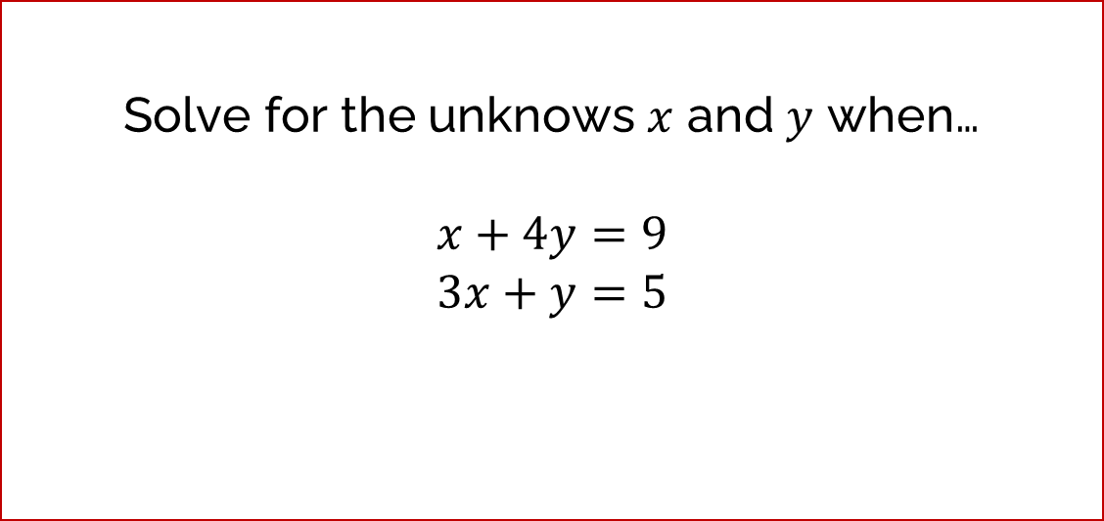
Quick Math Background Check
How comfortable are you with solving a system of two linear equations with two unknowns?
Solve for the unknows $x$ and $y$ when…
$$x+4y=9$$
$$3x+y=5$$

Slide 22

Quick Math Background Check
How comfortable are you dealing with multiplication and division with powers?
Simplify the following:
$$x^{3}×x^{5}= ?$$
$$y^{7}÷y^{2}= ?$$

Slide 23
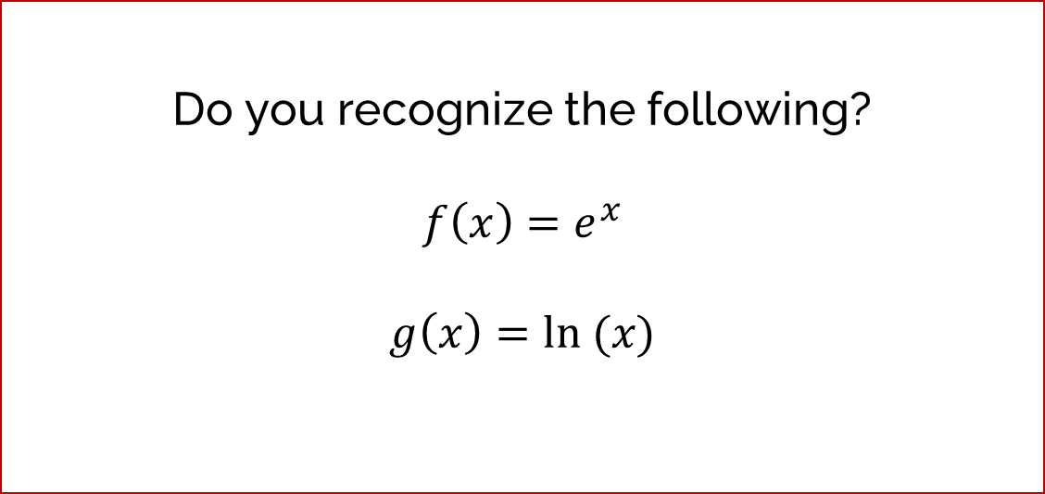
Quick Math Background Check
How comfortable are you dealing with natural logarithmic functions and exponential functions?
Do you recognize the following?
$${f\left(x\right)=e}^{x}$$
$$g\left(x\right)=ln⁡ (x)$$

Slide 24

Quick Math Background Check
How comfortable are you taking simple first derivatives of linear functions?
Solve the following:
$$\frac{d}{dx}{3x}^{2}= ?$$

Slide 25

Quick Math Background Check
How comfortable are you taking slightly more complicated first derivatives?
Solve the following:
$$\frac{d}{dx}{(x}^{2}+xy+3y+1)= ?$$

Slide 26

Quick Math Background Check
How comfortable are you taking even more complicated first derivatives?
Solve the following:
$$\frac{d}{dx}{{ (x}^{5}y^{2}+10y)}^{3}= ?$$

Slide 27
Preview
We will be reviewing material covered in Principles of Economics.
  Demand, Supply, Equilibrium, Preferences, Budgets, etc.
This review may (or may not) cover some mathematics.
A short homework assignment (max 500 words) will be assigned over the weekend.

