Slide 1
INTERMEDIATE MICROECONOMIC THEORY
Chapter 24: Industry Supply

Slide 2
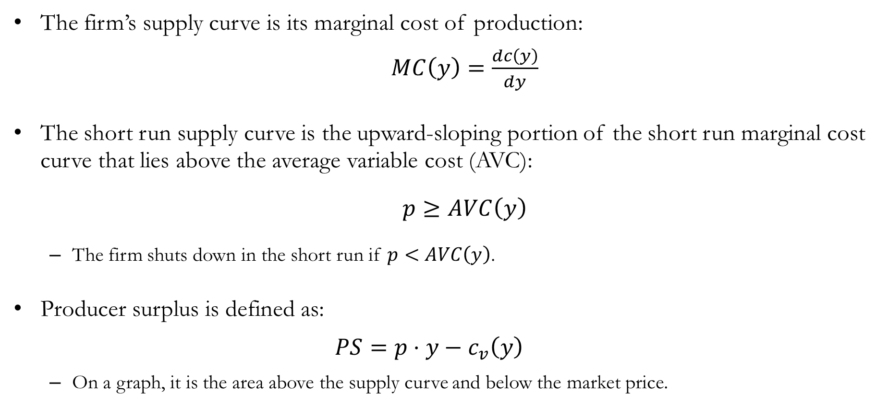
Recap: Firm Supply
The firm’s supply curve is its marginal cost of production:
$MC\left(y\right)=\frac{dc\left(y\right)}{dy}$
The short run supply curve is the upward-sloping portion of the short run marginal cost curve that lies above the average variable cost (AVC):
$p≥AVC\left(y\right)$
The firm shuts down in the short run if $p<AVC\left(y\right)$.
Producer surplus is defined as:
$$PS=p⋅y−c_{v}\left(y\right)$$
On a graph, it is the area above the supply curve and below the market price.

Slide 3

Recap: Firm Supply
The long run supply curve is the upward-sloping portion of the long run marginal cost curve that lies above the average total cost (ATC):
$p≥ATC\left(y\right)$
The firm exits the market in the long run if $p<ATC\left(y\right)$.
Compared to the short run:
Firms adjust output more in the long run.
Hence, the long run supply curve is “flatter.”

Slide 4
Short Run Industry Supply

Slide 5
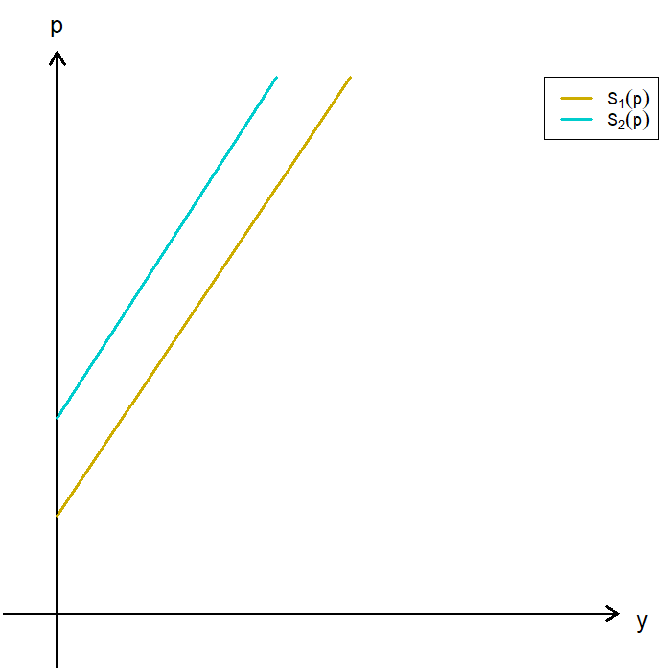
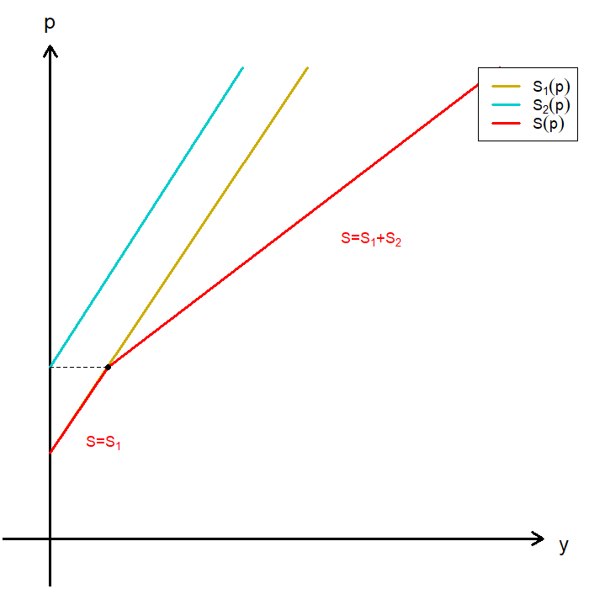
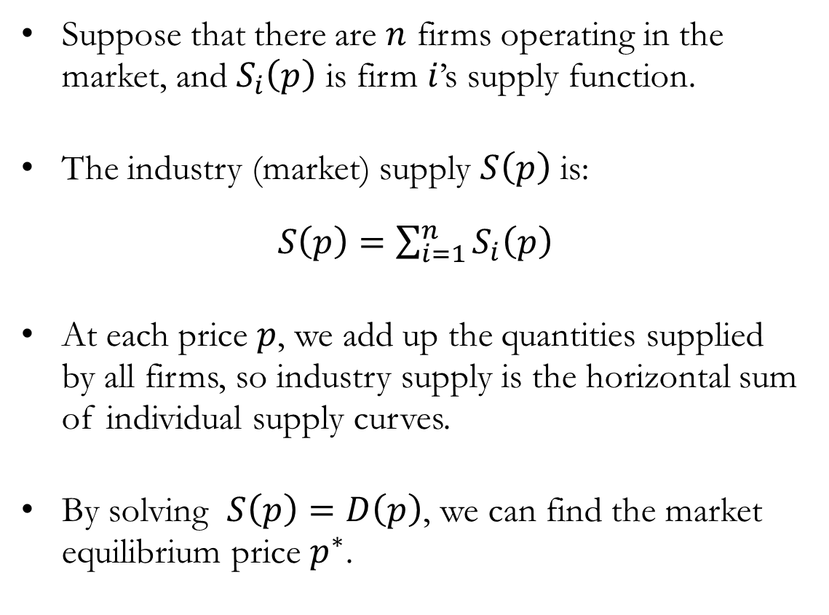
Short Run Industry Supply
Suppose that there are $n$ firms operating in the market, and $S_{i}\left(p\right)$ is firm $i$’s supply function.
The industry (market) supply $S\left(p\right)$ is:
$S\left(p\right)=\sum_{i=1}^{n}{S_{i}\left(p\right)}$
At each price $p$, we add up the quantities supplied by all firms, so industry supply is the horizontal sum of individual supply curves.
By solving $S\left(p\right)=D\left(p\right)$, we can find the market equilibrium price $p^{∗}$.

Slide 6
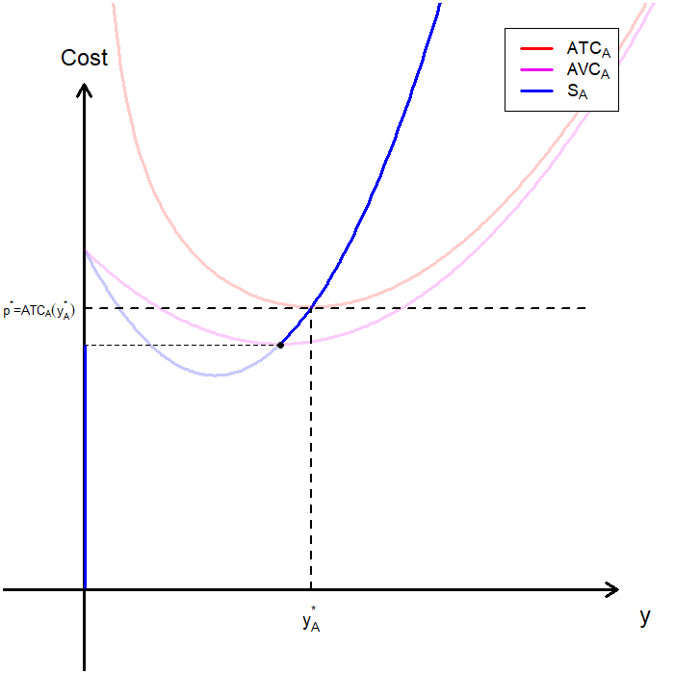
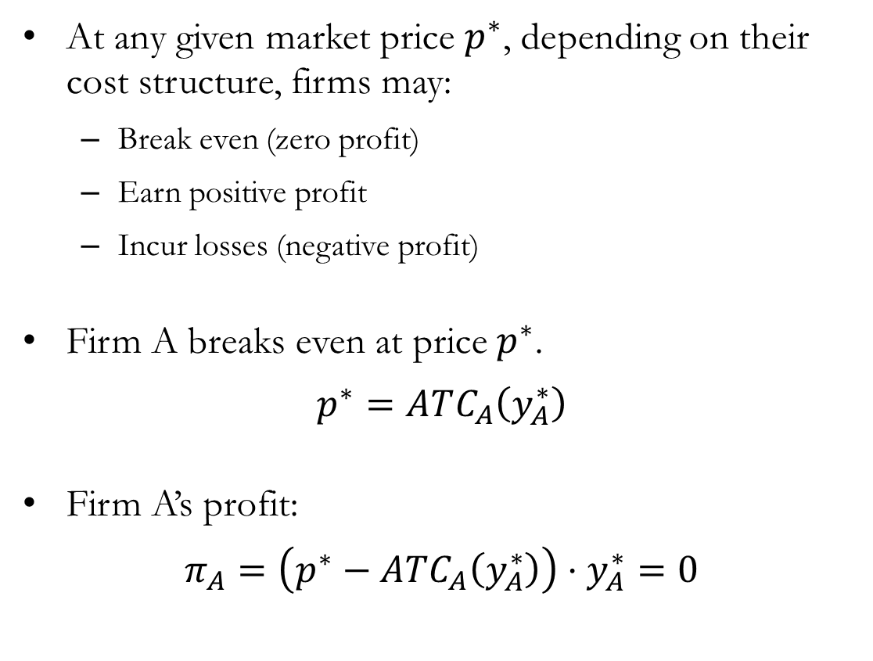
Short Run Profits Across Firms
At any given market price $p^{∗}$, depending on their cost structure, firms may:
Break even (zero profit)
Earn positive profit
Incur losses (negative profit)
Firm A breaks even at price $p^{∗}$.
$$p^{∗}=ATC_{A}\left(y_{A}^{∗}\right)$$
Firm A’s profit:
$$π_{A}=\left(p^{∗}−ATC_{A}\left(y_{A}^{∗}\right)\right)⋅y_{A}^{∗}=0$$

Slide 7
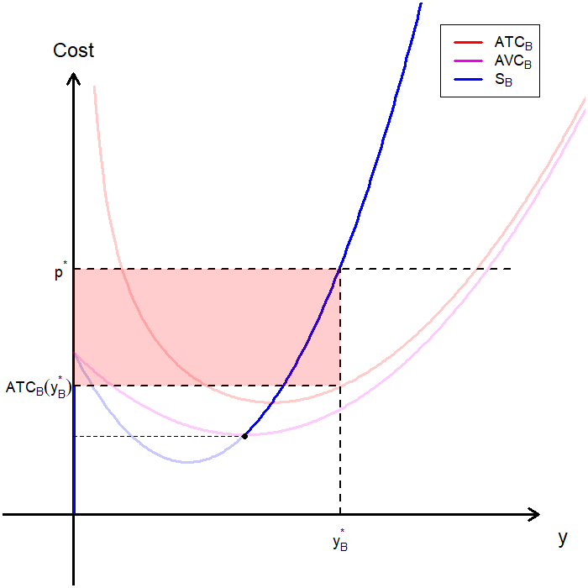
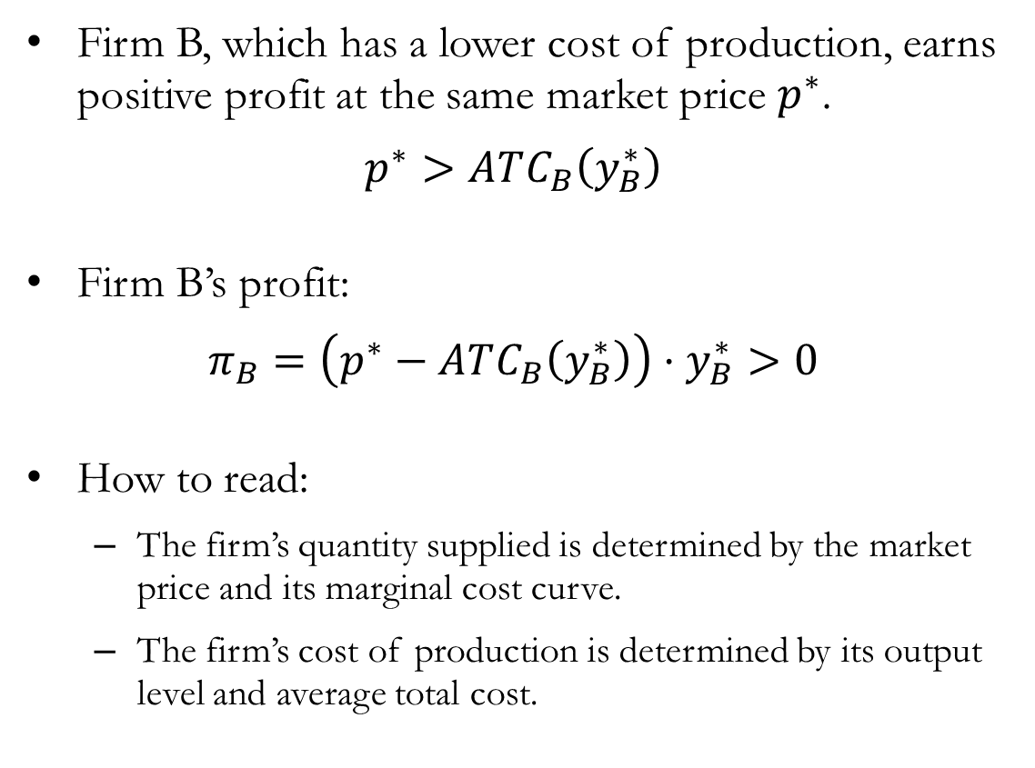
Short Run Profits Across Firms
Firm B, which has a lower cost of production, earns positive profit at the same market price $p^{∗}$.
$$p^{∗}>ATC_{B}\left(y_{B}^{∗}\right)$$
Firm B’s profit:
$$π_{B}=\left(p^{∗}−ATC_{B}\left(y_{B}^{∗}\right)\right)⋅y_{B}^{∗}>0$$
How to read:
The firm’s quantity supplied is determined by the market price and its marginal cost curve.
The firm’s cost of production is determined by its output level and average total cost.

Slide 8
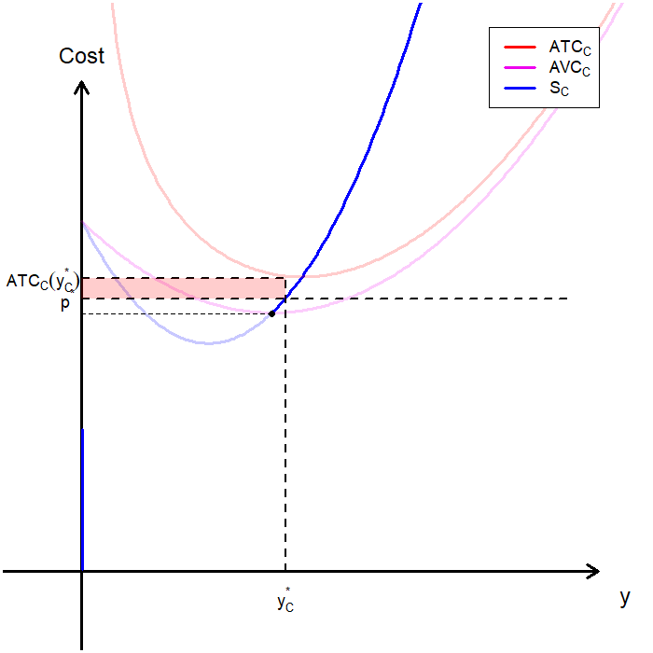
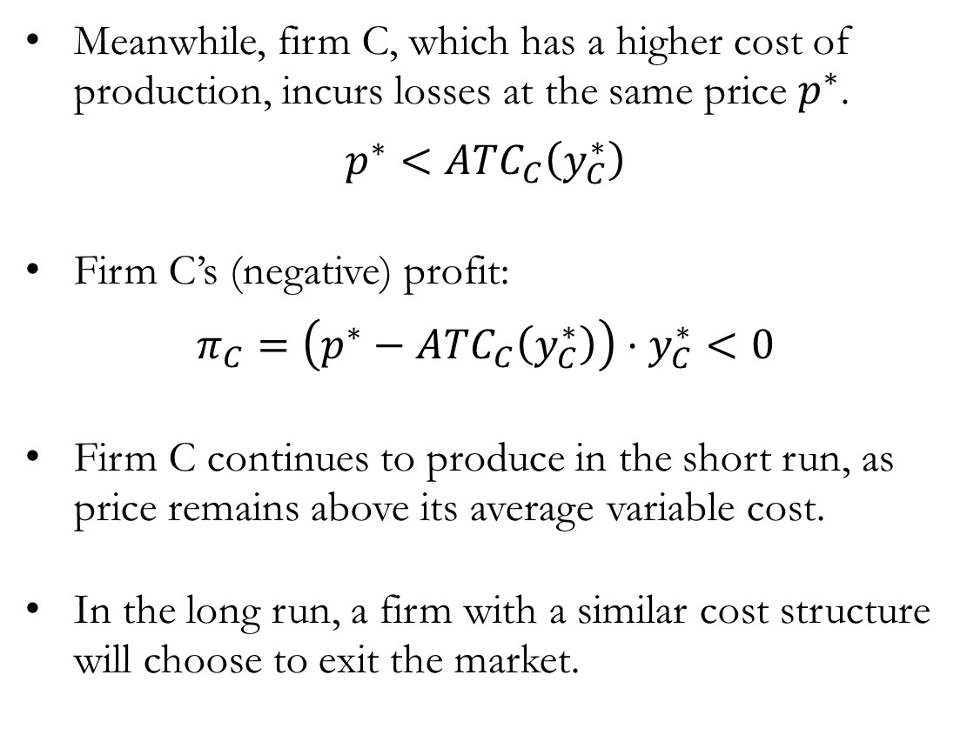
Short Run Profits Across Firms
Meanwhile, firm C, which has a higher cost of production, incurs losses at the same price $p^{∗}$.
$$p^{∗}<ATC_{C}\left(y_{C}^{∗}\right)$$
Firm C’s (negative) profit:
$$π_{C}=\left(p^{∗}−ATC_{C}\left(y_{C}^{∗}\right)\right)⋅y_{C}^{∗}<0$$
Firm C continues to produce in the short run, as price remains above its average variable cost.
In the long run, a firm with a similar cost structure will choose to exit the market.

Slide 9
Long Run Industry Supply

Slide 10
Long Run Industry Supply
In the long run, firms adjust all inputs and operate along their LMC curves.
Firms may also choose to exit the market if conditions are no longer favorable.
By exiting the industry in the long run, firms can reduce their losses to zero.
This means that the relevant portion of the LMC curve is the portion above the LAC curve.
If market conditions are favorable, firms may enter the market.
If firms are making positive profits in a market, entrants with similar technologies would enter.
This is conditional on the competitive market assumption with no barriers to entry.
The entry and exit of firms in the industry will influence market prices, which in turn influence future entry and exits.

Slide 11
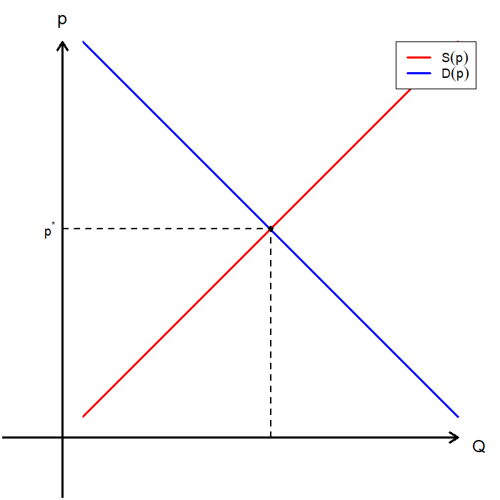
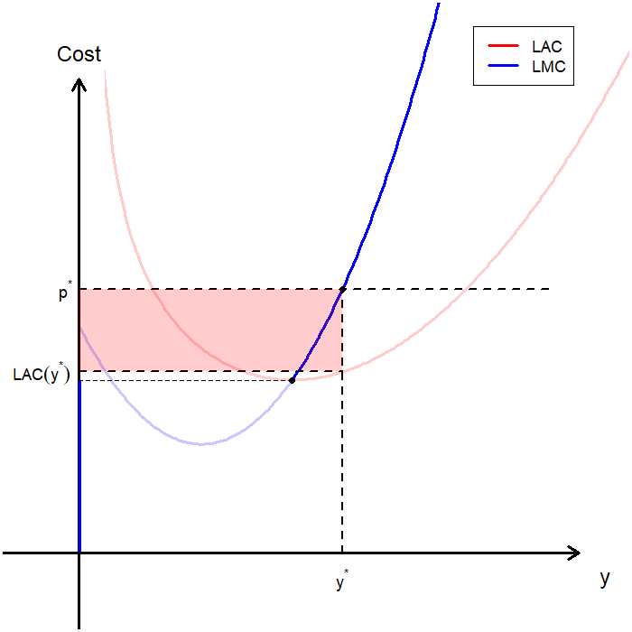

Firm Entry: Positive Profits Attract Entrants
Suppose the market price is $p^{∗}$, and firms in the industry are earning positive profits, as shown below.

Slide 12
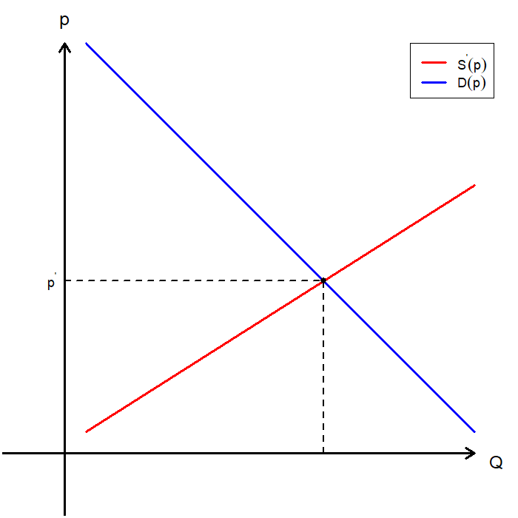
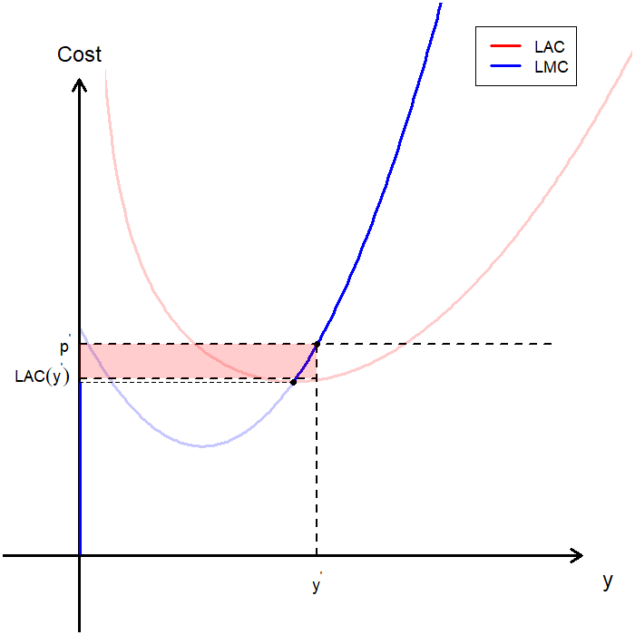

Firm Entry: Profits Margins Shrink
More firms with similar cost structures enter the market, shifting the market supply curve outward and driving the price down to $p^{′}$. Each firm’s profit falls accordingly.

Slide 13
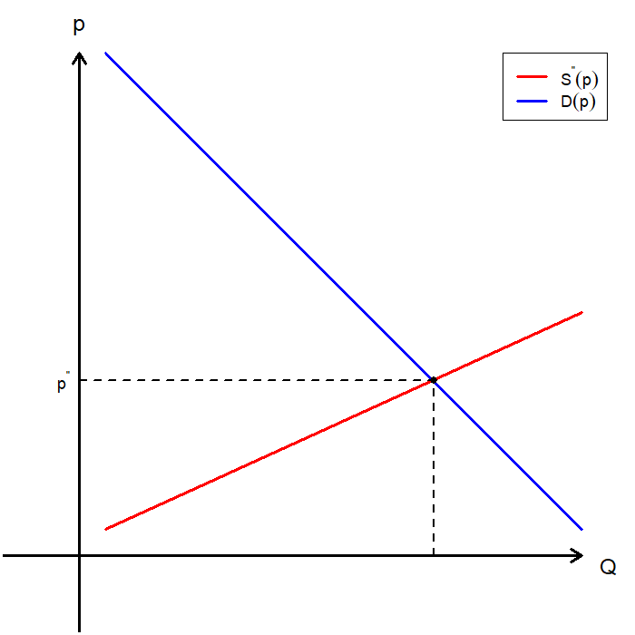
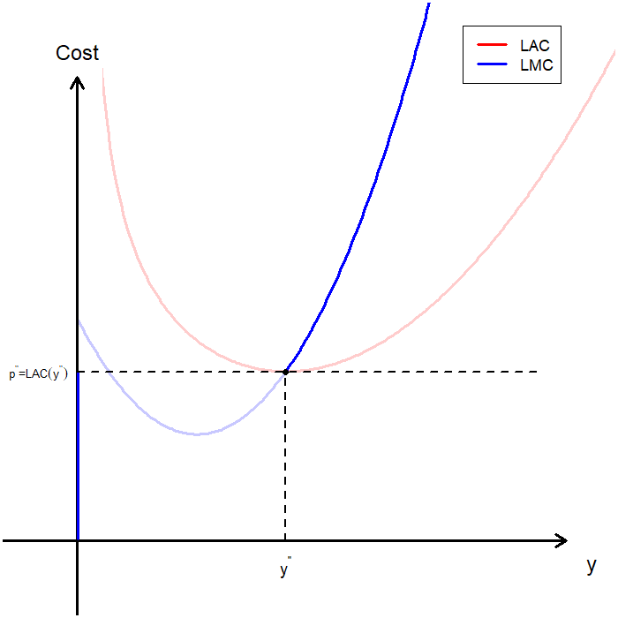

Firm Entry: Entry Ceases at Zero Profit
Entry continues until the market price reaches $p^{′′}$, a level at which all firms in the industry earn zero profit.

Slide 14
Firm Entry and Exit
If potential entrants observe positive profit:
Firms enter the market, increasing supply.
The increase in supply lowers the market price.
The lower price reduces profit.
If firms in the industry incur negative profit:
Firms exit the market, reducing supply.
The decrease in supply raises the market price.
The higher price increases profit.
In the long run, the number of firms adjusts according to profit opportunities so that economic profits are zero.

Slide 15
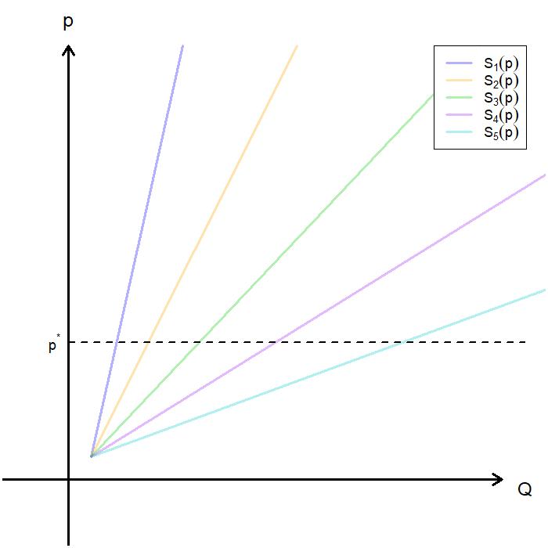
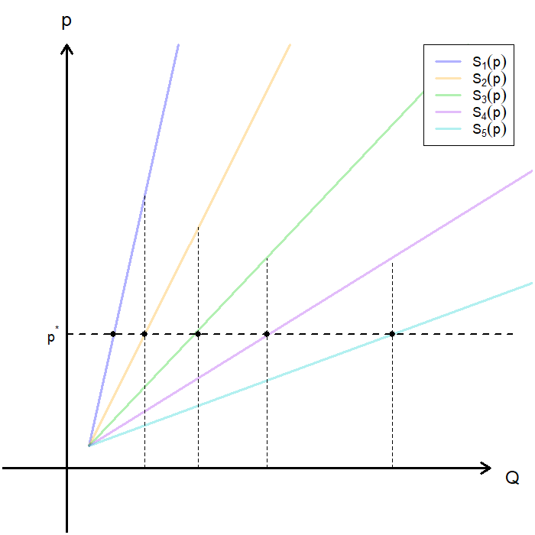
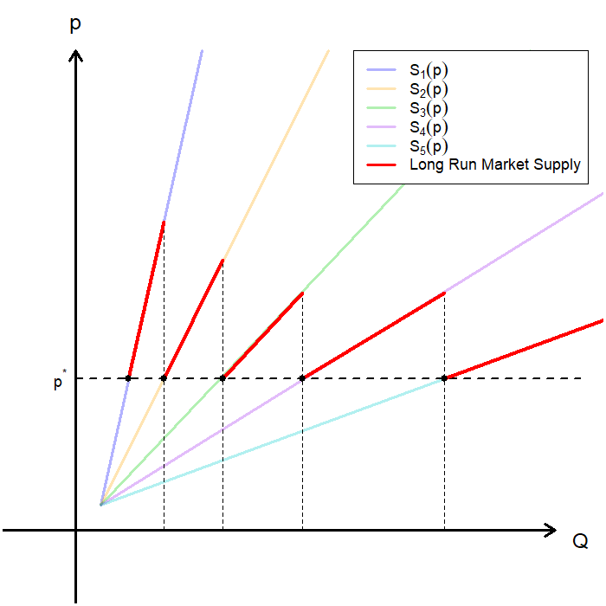
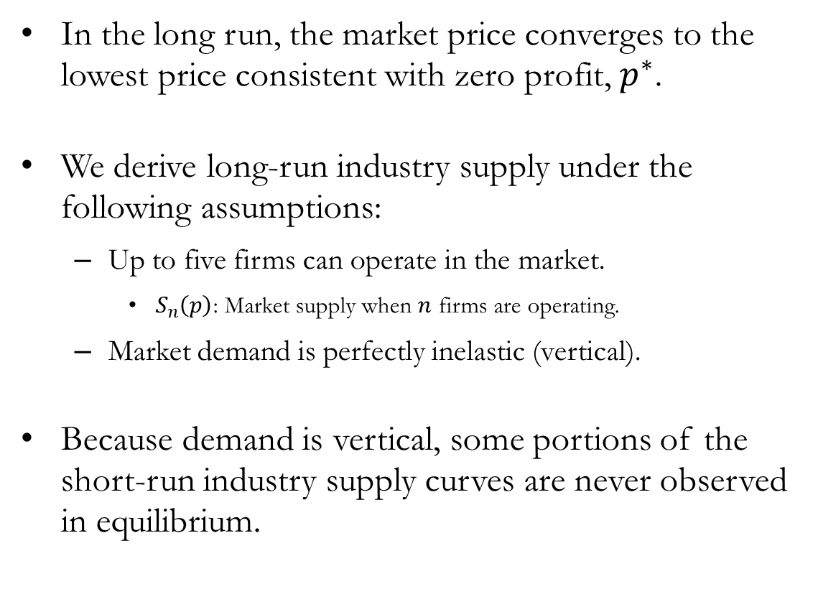
The Long Run Industry Supply Curve
In the long run, the market price converges to the lowest price consistent with zero profit, $p^{∗}$.
We derive long-run industry supply under the following assumptions:
Up to five firms can operate in the market.
$S_{n}\left(p\right)$: Market supply when $n$ firms are operating.
Market demand is perfectly inelastic (vertical).
Because demand is vertical, some portions of the short-run industry supply curves are never observed in equilibrium.

Slide 16
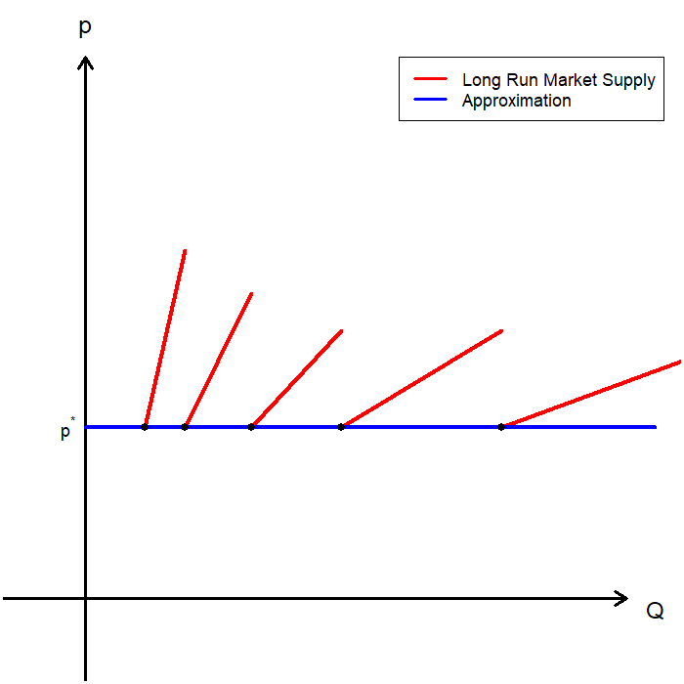
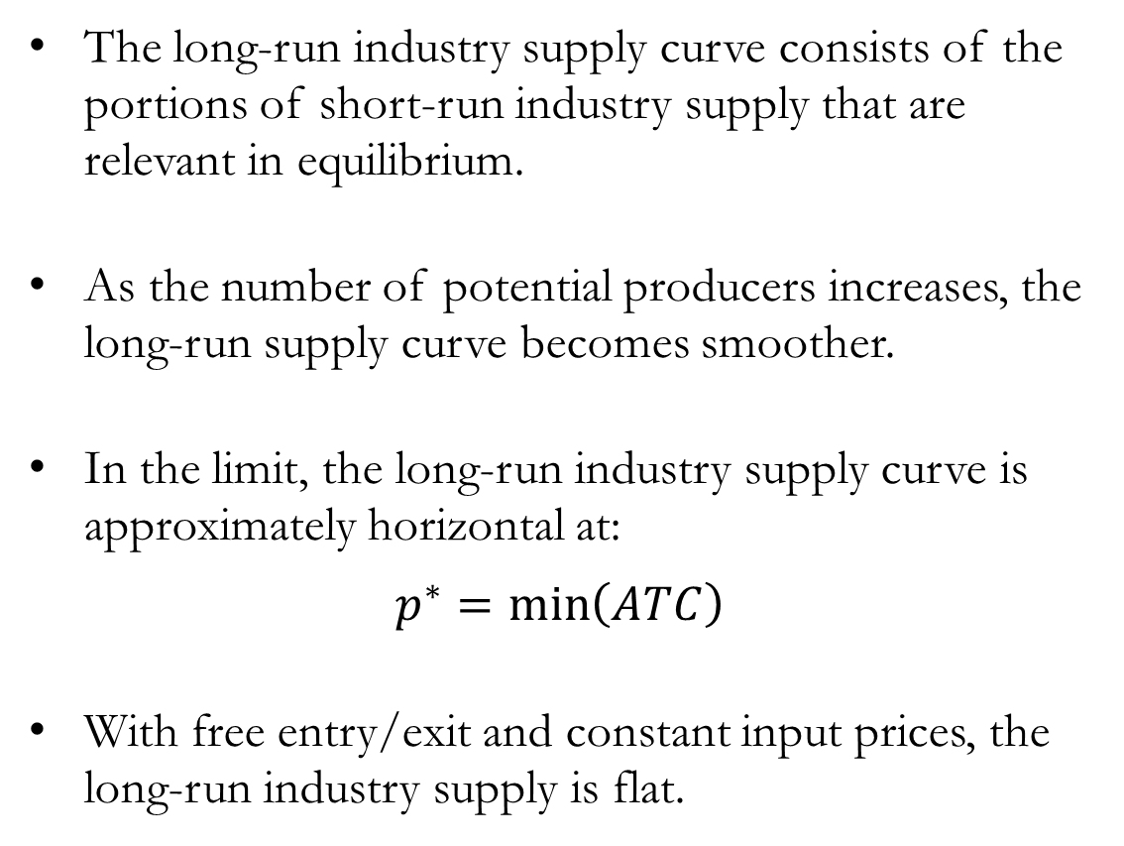
The Long Run Industry Supply Curve
The long-run industry supply curve consists of the portions of short-run industry supply that are relevant in equilibrium.
As the number of potential producers increases, the long-run supply curve becomes smoother.
In the limit, the long-run industry supply curve is approximately horizontal at:
$$p^{∗}=\min\left(ATC\right)$$
With free entry/exit and constant input prices, the long-run industry supply is flat.

Slide 17
Caveat: Cost Structures and Long Run Supply
A flat (horizontal) long-run supply curve relies on the assumption that input prices do not change as the industry expands.
When this assumption does not hold, long-run supply may not be flat:
Constant-cost: Input prices remain unchanged → Long-run supply is horizontal.
Increasing-cost: Input prices rise as the industry expands → Long-run supply is upward sloping.
Decreasing-cost: Input prices fall as the industry expands → Long-run supply is downward sloping.
Industry expansion can affect input markets and production costs.
Therefore, the shape of long-run supply depends on how costs change with industry output.

Slide 18
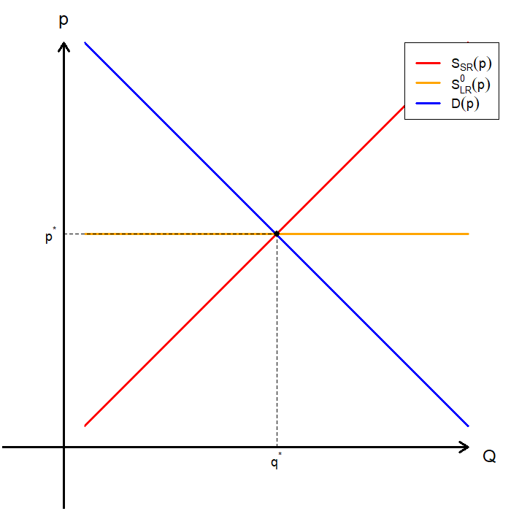
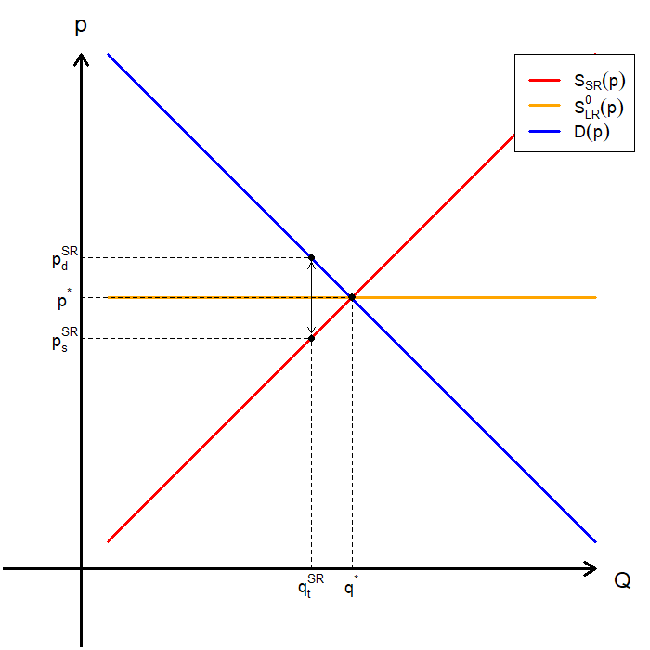
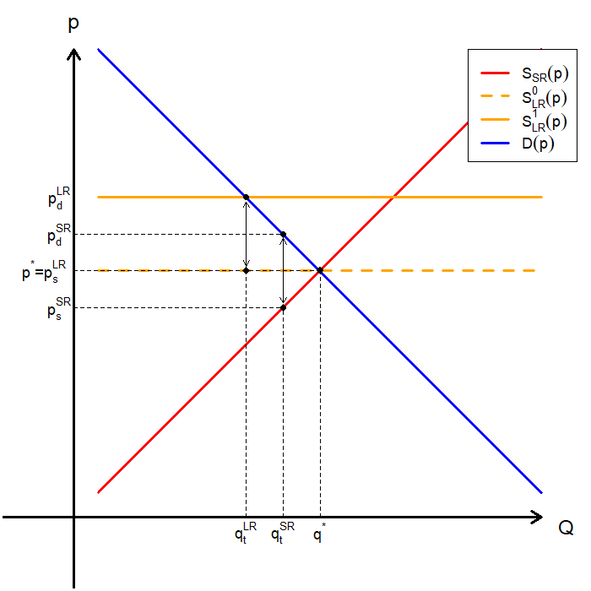
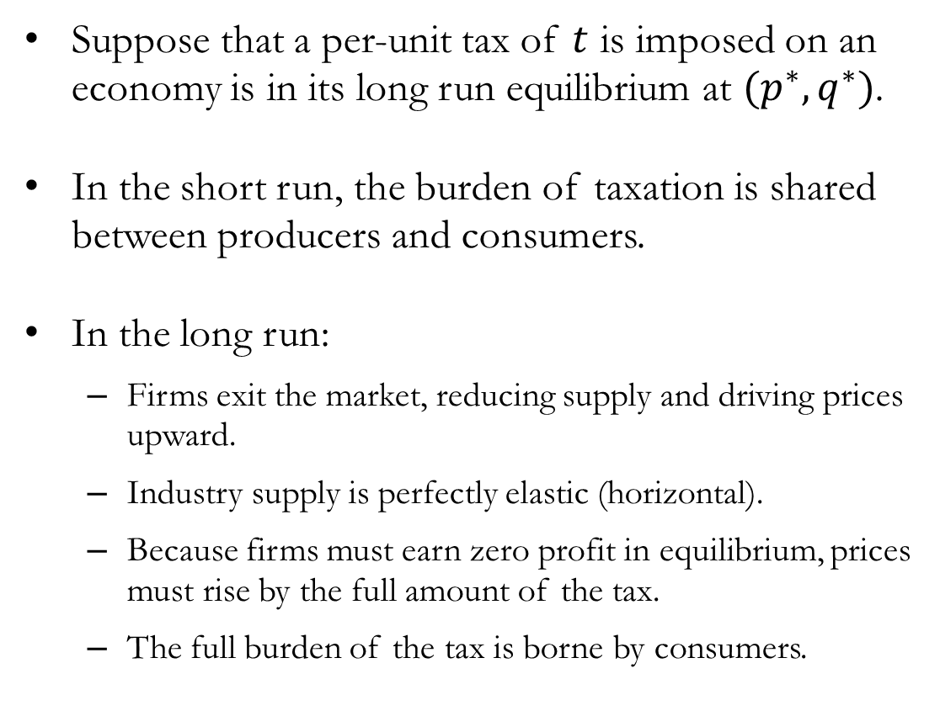
Application: Impact of Taxation in the Long Run
Suppose that a per-unit tax of $t$ is imposed on an economy is in its long run equilibrium at $(p^{∗},q^{∗})$.
In the short run, the burden of taxation is shared between producers and consumers.
In the long run:
Firms exit the market, reducing supply and driving prices upward.
Industry supply is perfectly elastic (horizontal).
Because firms must earn zero profit in equilibrium, prices must rise by the full amount of the tax.
The full burden of the tax is borne by consumers.

Slide 19
Zero Profits and Economic Rent

Slide 20
Zero Profits
Zero (economic) profit does not mean the firm is doing poorly, because economic profit includes all opportunity costs:
Explicit costs (wages, rent, materials), and
Implicit costs (owner’s time, capital, foregone alternatives)
Free entry and exit drives profits to zero:
Positive Profit: New firms enter → Industry supply increases → Prices fall → Economics profit falls.
Negative Profit: Firms exit → Industry supply decreases → Prices rise → Economics profit rises.
Firms stay in the market not because they earn extra profit, but because they earn exactly their opportunity cost.

Slide 21
Economic Rent
In markets without free entry and exit, positive profits may persist in the long run due to opportunities for economic rent.
Economic rent is defined as the payment to factors of production that exceeds the minimum payment necessary for those factors to be supplied.
Common causes may include:
Limited natural resources: precious metals, oil, arable land, etc.
Individuals with unique talent
Legal or institutional barriers: patents, regulations, etc.
Strategic barriers: prohibitively high fixed costs, network effects, etc
Economic rent arises whenever competition is limited or supply cannot fully adjust.

Slide 22
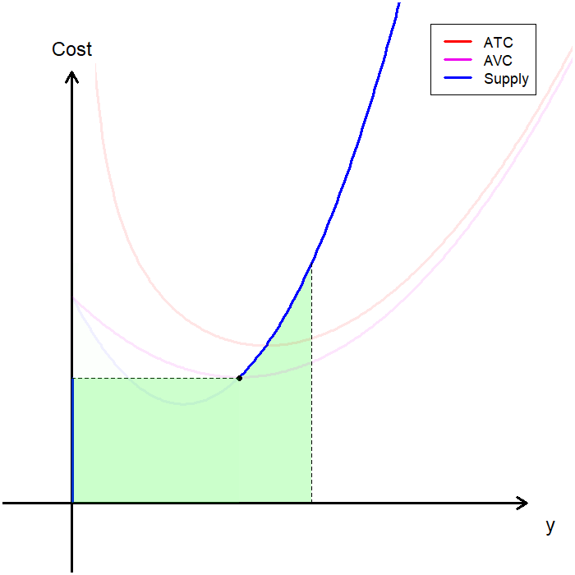
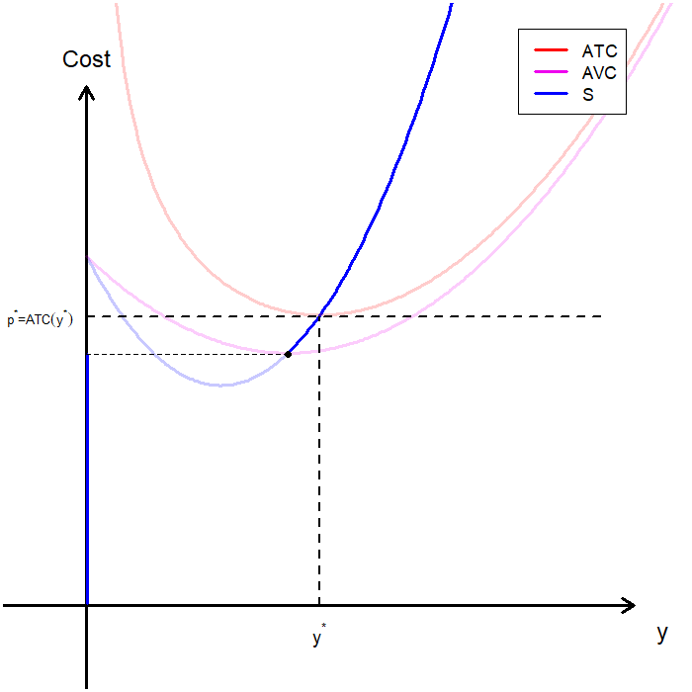
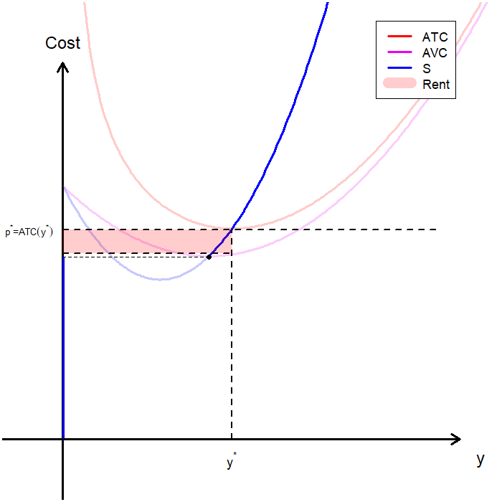
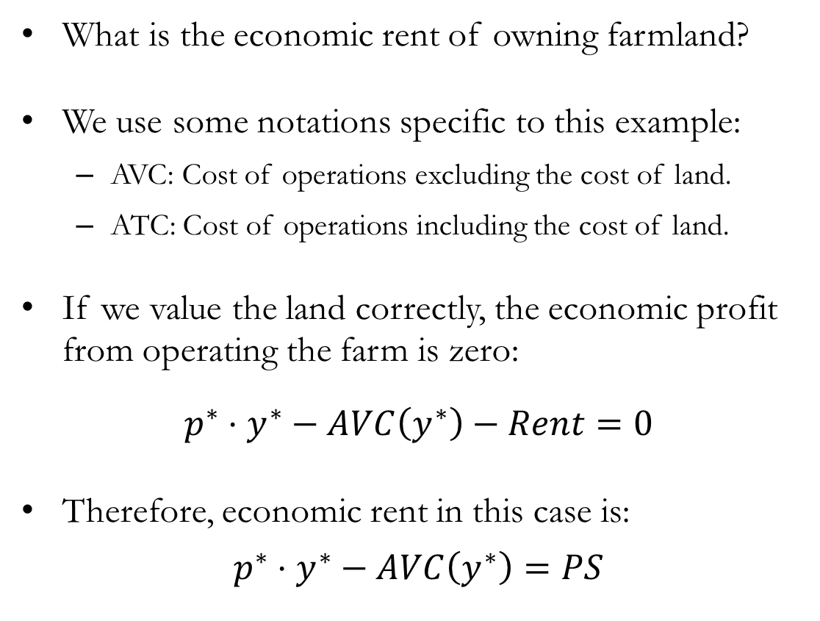
Economic Rent: Visualized
What is the economic rent of owning farmland?
We use some notations specific to this example:
AVC: Cost of operations excluding the cost of land.
ATC: Cost of operations including the cost of land.
If we value the land correctly, the economic profit from operating the farm is zero:
$p^{∗}⋅y^{∗}−AVC\left(y^{∗}\right)−Rent=0$
Therefore, economic rent in this case is:
$p^{∗}⋅y^{∗}−AVC\left(y^{∗}\right)=PS$

Slide 23
Recap & Preview

Slide 24
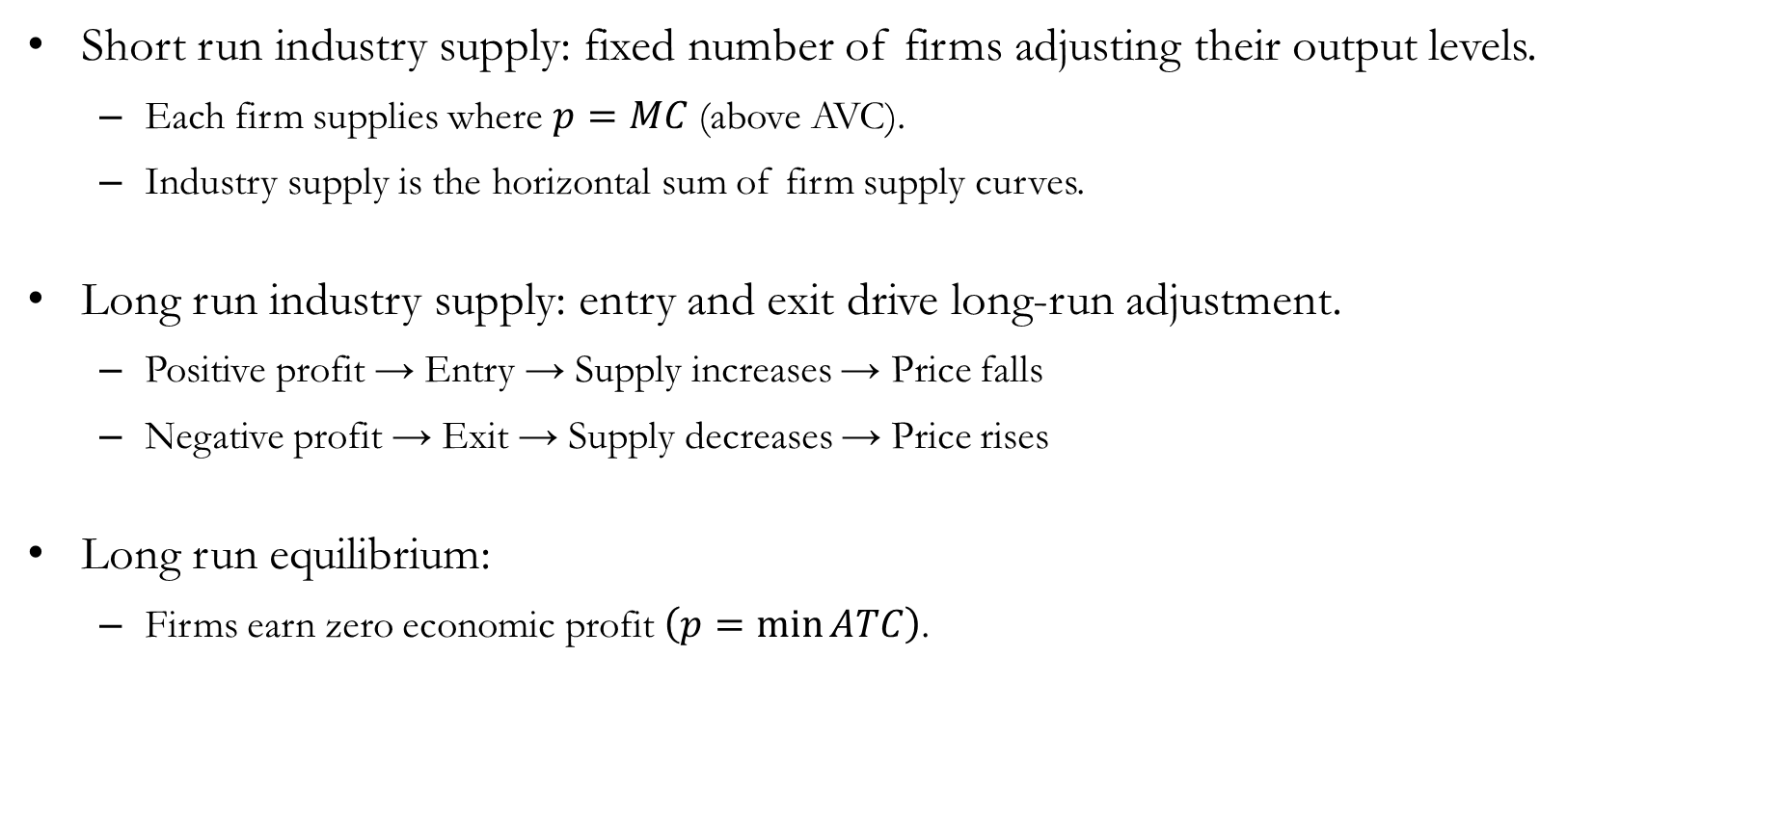
Recap: Industry Supply
Short run industry supply: fixed number of firms adjusting their output levels.
Each firm supplies where $p=MC$ (above AVC).
Industry supply is the horizontal sum of firm supply curves.
Long run industry supply: entry and exit drive long-run adjustment.
Positive profit → Entry → Supply increases → Price falls
Negative profit → Exit → Supply decreases → Price rises
Long run equilibrium:
Firms earn zero economic profit $\left(p=\min{ATC}\right)$.

Slide 25
Preview: Exchange
So far, we have studied how markets determine prices and allocations.
Now we ask:
Do these outcomes lead to efficient outcomes?
Can we make someone better off without making someone else worse off?
Consider a simple setting:
Two individuals.
Two goods.
No production, only exchange.
What outcomes are possible, and which are desirable?

