Slide 1
Quiz #1 Review
ECON 300

Slide 2
Quiz #1 “Recovery” Office Hours
https://calendly.com/brianhwpark
Venue: Rm. 248 Center for Science and Business
Dates: Sep. 9th ~ Sep. 13th, 2024
Length: 30 Minutes per Session
Use the Whiteboard / Paper to correct your answers.
Recovery Rate: 50%

Slide 3
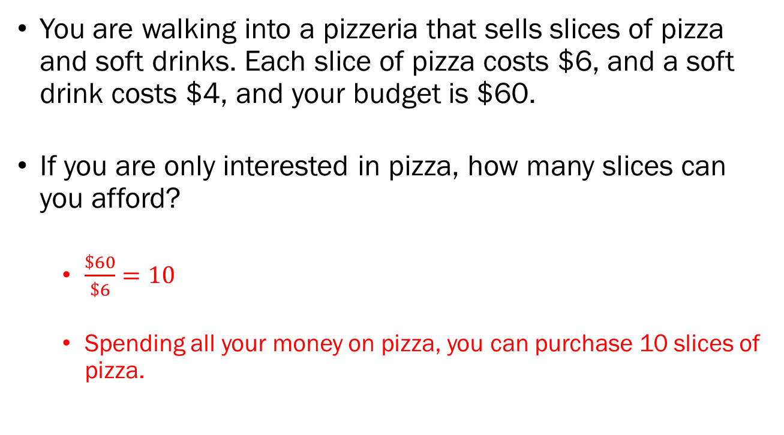
Problem 1.A.
You are walking into a pizzeria that sells slices of pizza and soft drinks. Each slice of pizza costs $6, and a soft drink costs $4, and your budget is $60.
If you are only interested in pizza, how many slices can you afford?
  $\frac{\$60}{\$6}=10$
  Spending all your money on pizza, you can purchase 10 slices of pizza.

Slide 4
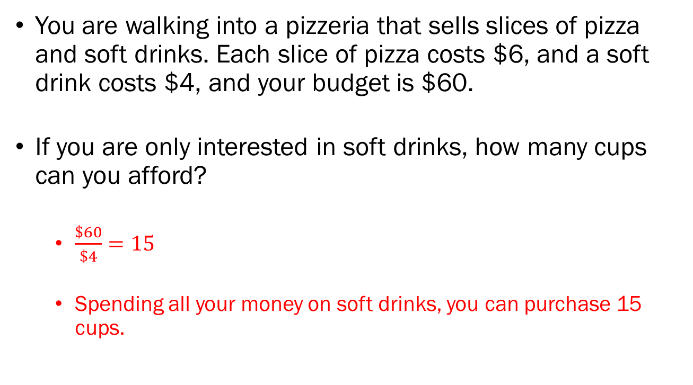
Problem 1.B.
You are walking into a pizzeria that sells slices of pizza and soft drinks. Each slice of pizza costs $6, and a soft drink costs $4, and your budget is $60.
If you are only interested in soft drinks, how many cups can you afford?
  $\frac{\$60}{\$4}=15$
  Spending all your money on soft drinks, you can purchase 15 cups.

Slide 5
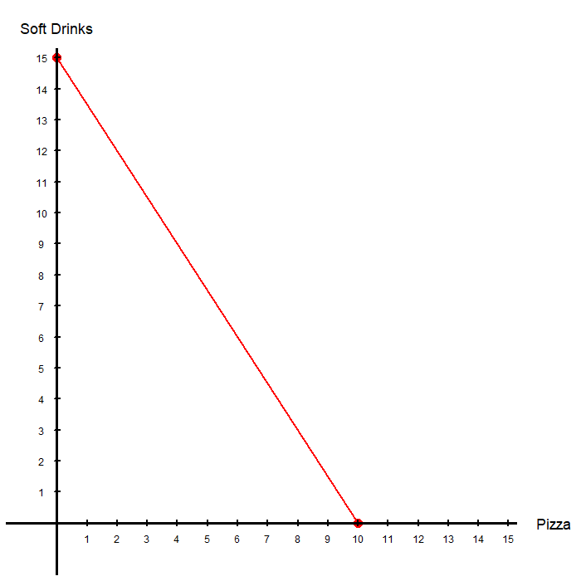
Problem 1.C.
Using your answers from 1.A. and 1.B., plot your budget constraint below:

Slide 6
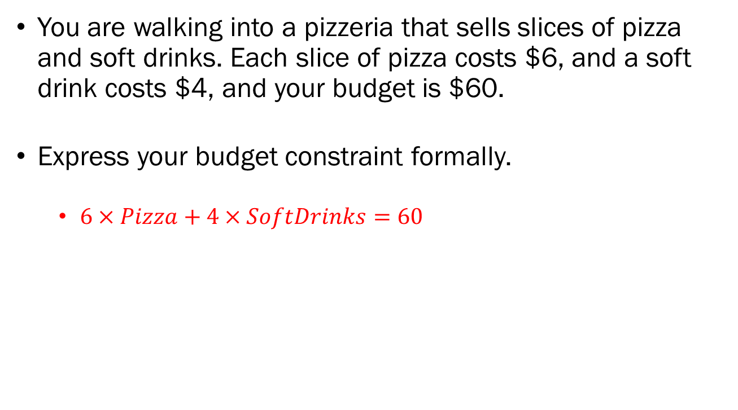
Problem 1.D.
You are walking into a pizzeria that sells slices of pizza and soft drinks. Each slice of pizza costs $6, and a soft drink costs $4, and your budget is $60.
Express your budget constraint formally.
  $6×Pizza+4×SoftDrinks=60$

Slide 7
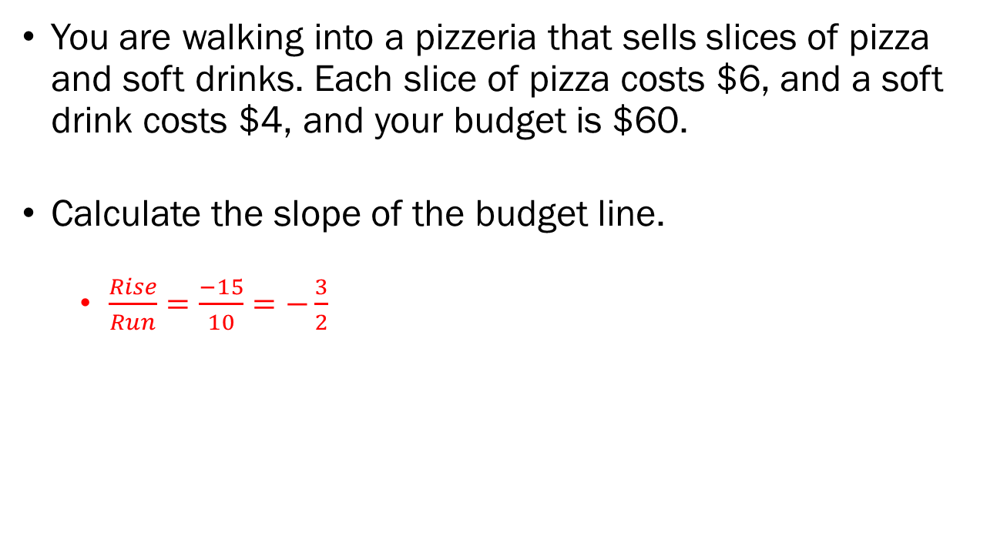
Problem 1.E.
You are walking into a pizzeria that sells slices of pizza and soft drinks. Each slice of pizza costs $6, and a soft drink costs $4, and your budget is $60.
Calculate the slope of the budget line.
  $\frac{Rise}{Run}=\frac{−15}{10}=−\frac{3}{2}$

Slide 8
Problem 1.F.
You are walking into a pizzeria that sells slices of pizza and soft drinks. Each slice of pizza costs $6, and a soft drink costs $4, and your budget is $60.
In your own words, explain how you would interpret the slope of the budget line.
  The slope of the budget line represents the cups of soft drinks that you must give up to purchase one slice of pizza.
  “Market Rate of Exchange,” or the “Objective Rate of Exchange.”

Slide 9
Problem 2.A.
You return to the pizzeria that sells slices of pizza and soft drinks. Now, each slice of pizza costs $6, and a soft drink costs $6, and your budget is still $60.
Did your budget set shrink or expand? Why?
  The budget set, which are the bundles that you can afford, will shrink since the price of goods has increased.

Slide 10
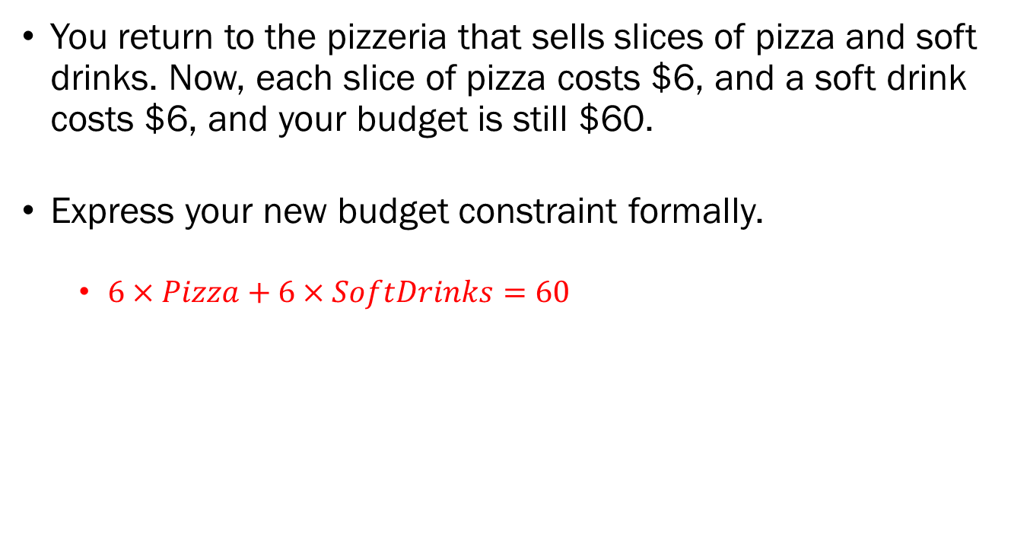
Problem 2.B.
You return to the pizzeria that sells slices of pizza and soft drinks. Now, each slice of pizza costs $6, and a soft drink costs $6, and your budget is still $60.
Express your new budget constraint formally.
  $6×Pizza+6×SoftDrinks=60$

Slide 11
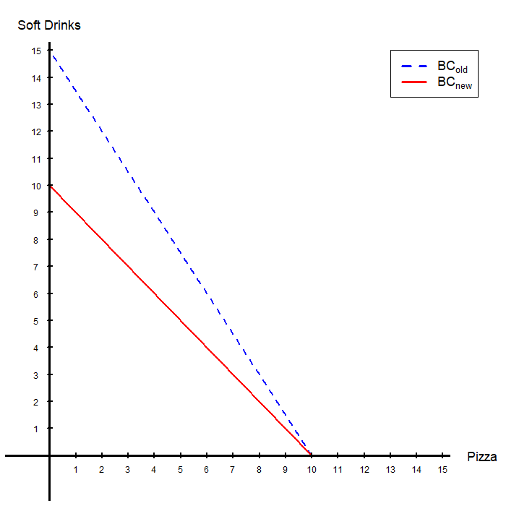
Problem 2.C.
Plot and label your old and new budget constraints below.

Slide 12
Problem 2.D.
You return to the pizzeria that sells slices of pizza and soft drinks. Now, each slice of pizza costs $6, and a soft drink costs $6, and your budget is still $60.
Would you have been happy with this change if you were the customer? Why?
  In general, you would not be happy with this change, as your budget set is now smaller: you can afford less stuff.
  Exception being if you absolutely hate soft drinks, to the point that consuming them would cause discomfort. That is, if soft drinks are “bads” not “goods.”

Slide 13
Problem 2.E.
You return to the pizzeria that sells slices of pizza and soft drinks. Now, each slice of pizza costs $6, and a soft drink costs $6, and your budget is still $60.
If you had no information about someone’s preferences, would you be able to tell if they were more or less happy due to this change in prices? How? Why?
  Effectively the same question as problem 2.D.
  The only difference is that you can’t determine if soft drinks are goods or bads for the consumer.

