Slide 1
Consumer Theory:
The Budget Constraint
ECON 300

Slide 2

PollEv.com/brianpark046

Slide 3
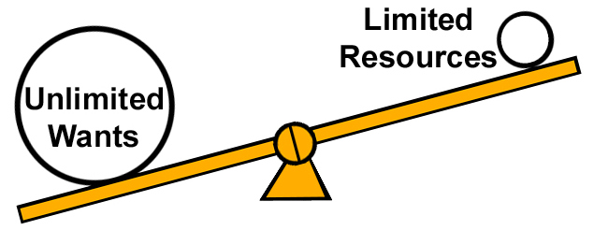
Economics
Economics is the study of choice under scarcity.

Slide 4
Scarcity
Scarcity comes in many forms:
  Land to farm crops, or
  Labor to produce cars, or
  Money to purchase a new phone, or
  Natural Resources to produce energy, and most of all…
  Time is limited.
Most “problems” will cease to be “problems” if scarcity was eliminated from the picture.

Slide 5
Scarcity
Consumers face scarcity:
  Should we purchase a new car or fix the one we have?
  If we had infinite money, not a problem at all.
Firms face scarcity:
  Should we be hiring more people or buying more machines?
  If we had infinite inputs, not a problem at all.
Governments face scarcity:
  Should we update our SOC or invest in the military?
  If we had infinite tax revenue, not a problem at all.

Slide 6
Budget Constraint in Words
“You can consume all the goods and services you want… IF your bank account can cash the checks.”
How do we formalize this idea?
  How do we express this in a graph?
  How do we translate these words into math?
Start with…
  Two goods, and
  Prices for each of the goods, and
  An amount of money you can spend.

Slide 7
The Budget Constraint as a Graph
Suppose you are in an economy where the only two goods are coffee and sandwiches.
Each cup of coffee costs $2, and each sandwich costs $3.
You have $12 as your income.
How would you draw your budget constraint as a graph?

Slide 8
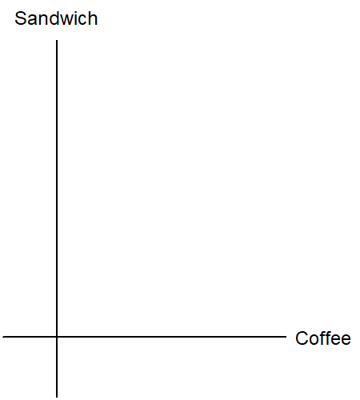
“Commodity Plane”
We imagine a grid of sandwiches and cups of coffee.
Each point in this Coffee-Sandwich plane represent a “commodity bundle.”
The collection of all possible commodity bundles consist the “commodity plane”.

Slide 9
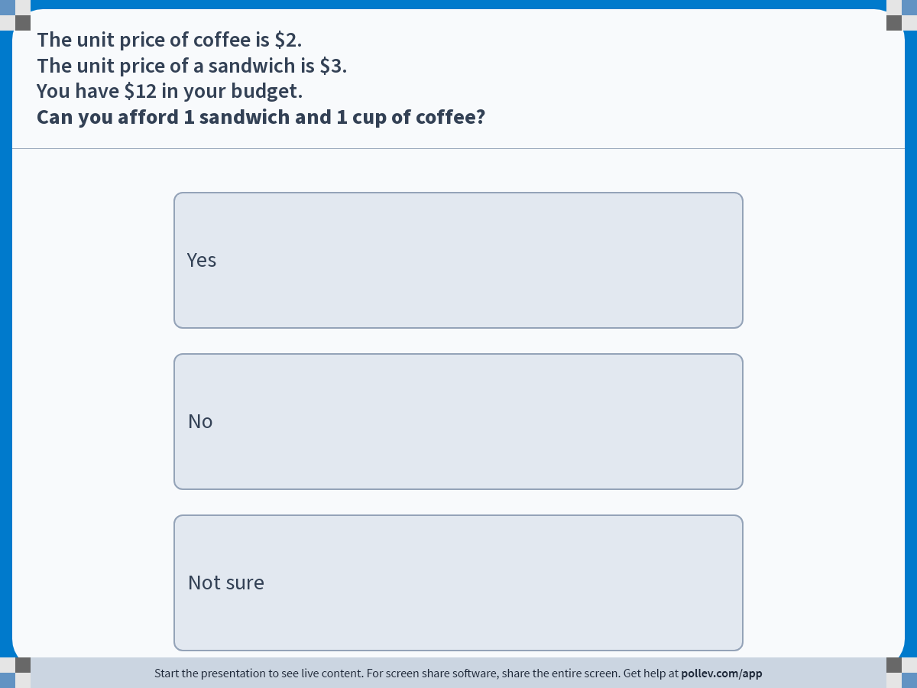
Notes:
Poll Title: Do not modify the notes in this section to avoid tampering with the Poll Everywhere activity.
More info at polleverywhere.com/support
The unit price of coffee is $2.The unit price of a sandwich is $3. You have $12 in your budget. Can you afford 1 sandwich and 1 cup of coffee?
https://www.polleverywhere.com/multiple_choice_polls/sacWZhX4Y7YnGjJQarN2D?display_state=instructions&activity_state=opened&state=opened&flow=Engagement&onscreen=persist

Slide 10
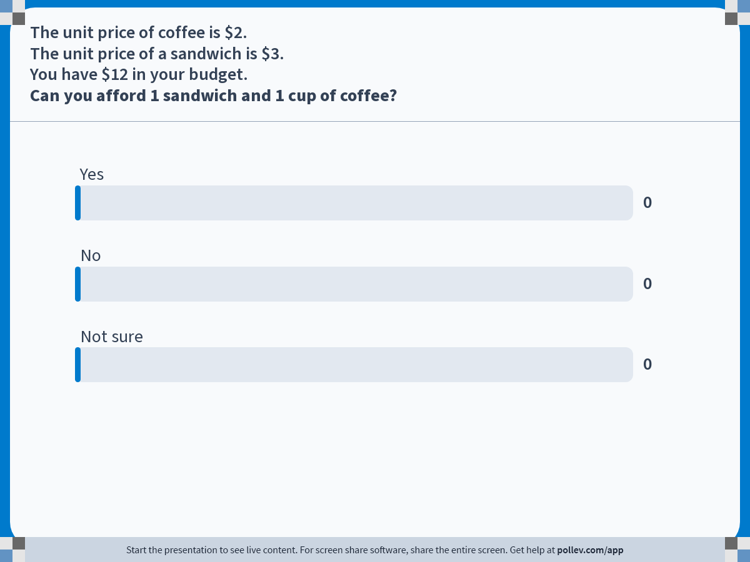
Notes:
Poll Title: Do not modify the notes in this section to avoid tampering with the Poll Everywhere activity.
More info at polleverywhere.com/support
The unit price of coffee is $2.The unit price of a sandwich is $3. You have $12 in your budget. Can you afford 1 sandwich and 1 cup of coffee?
https://www.polleverywhere.com/multiple_choice_polls/sacWZhX4Y7YnGjJQarN2D?display_state=chart&activity_state=closed&state=closed&flow=Engagement&onscreen=persist

Slide 11
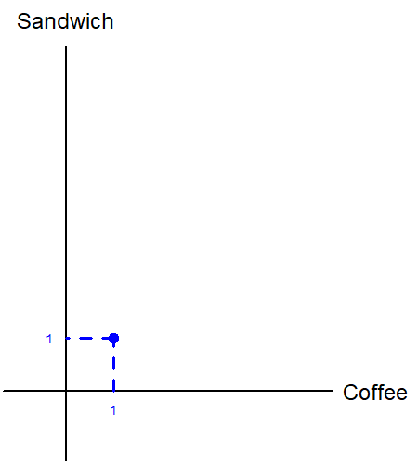
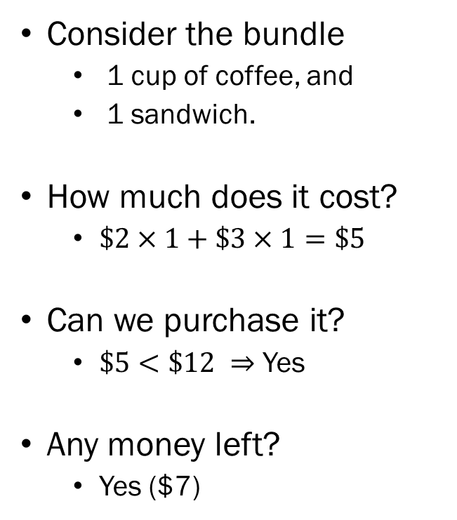
Checking Affordability (1)
Consider the bundle
  1 cup of coffee, and
  1 sandwich.
How much does it cost?
  $\$2×1+\$3×1=\$5$
Can we purchase it?
  $\$5<\$12 ⇒$ Yes
Any money left?
  Yes ($7)

Slide 12
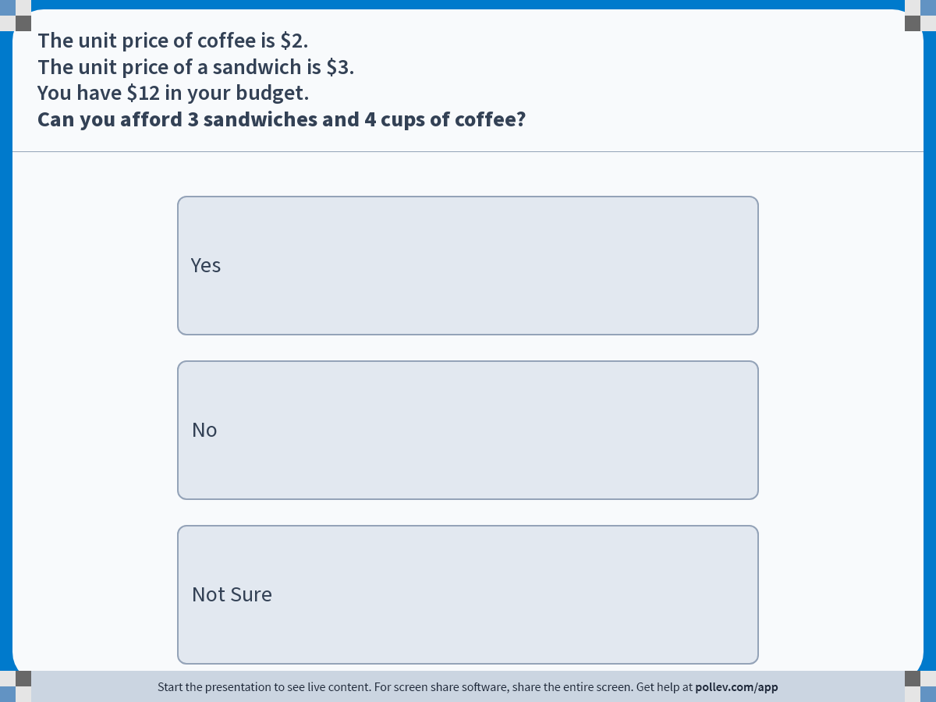
Notes:
Poll Title: Do not modify the notes in this section to avoid tampering with the Poll Everywhere activity.
More info at polleverywhere.com/support
The unit price of coffee is $2.The unit price of a sandwich is $3. You have $12 in your budget. Can you afford 3 sandwiches and 4 cups of coffee?
https://www.polleverywhere.com/multiple_choice_polls/9gb2VtVZvCm8wSP4lIl2t?display_state=instructions&activity_state=opened&state=opened&flow=Engagement&onscreen=persist

Slide 13

Notes:
Poll Title: Do not modify the notes in this section to avoid tampering with the Poll Everywhere activity.
More info at polleverywhere.com/support
The unit price of coffee is $2.The unit price of a sandwich is $3. You have $12 in your budget. Can you afford 3 sandwiches and 4 cups of coffee?
https://www.polleverywhere.com/multiple_choice_polls/9gb2VtVZvCm8wSP4lIl2t?display_state=chart&activity_state=closed&state=closed&flow=Engagement&onscreen=persist

Slide 14
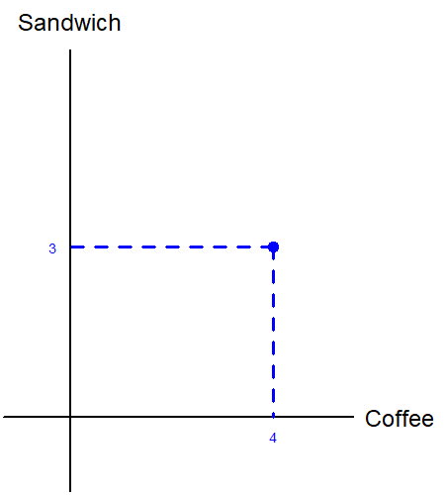
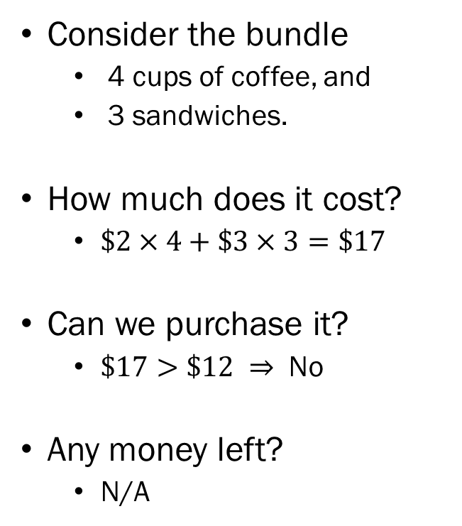
Checking Affordability (2)
Consider the bundle
  4 cups of coffee, and
  3 sandwiches.
How much does it cost?
  $\$2×4+\$3×3=\$17$
Can we purchase it?
  $\$17>\$12 ⇒$ No
Any money left?
  N/A

Slide 15

Notes:
Poll Title: Do not modify the notes in this section to avoid tampering with the Poll Everywhere activity.
More info at polleverywhere.com/support
The unit price of coffee is $2.The unit price of a sandwich is $3. You have $12 in your budget. Can you afford 2 sandwiches and 3 cups of coffee?
https://www.polleverywhere.com/multiple_choice_polls/I6dKwYblIOneluKfefzbs?display_state=instructions&activity_state=opened&state=opened&flow=Engagement&onscreen=persist

Slide 16

Notes:
Poll Title: Do not modify the notes in this section to avoid tampering with the Poll Everywhere activity.
More info at polleverywhere.com/support
The unit price of coffee is $2.The unit price of a sandwich is $3. You have $12 in your budget. Can you afford 2 sandwiches and 3 cups of coffee?
https://www.polleverywhere.com/multiple_choice_polls/I6dKwYblIOneluKfefzbs?display_state=chart&activity_state=closed&state=closed&flow=Engagement&onscreen=persist

Slide 17
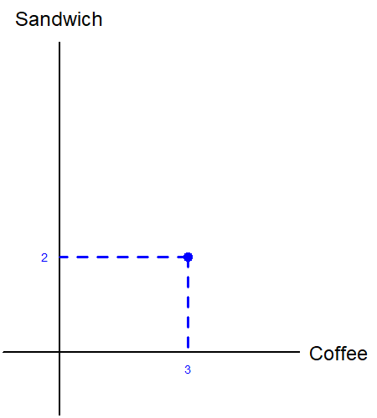
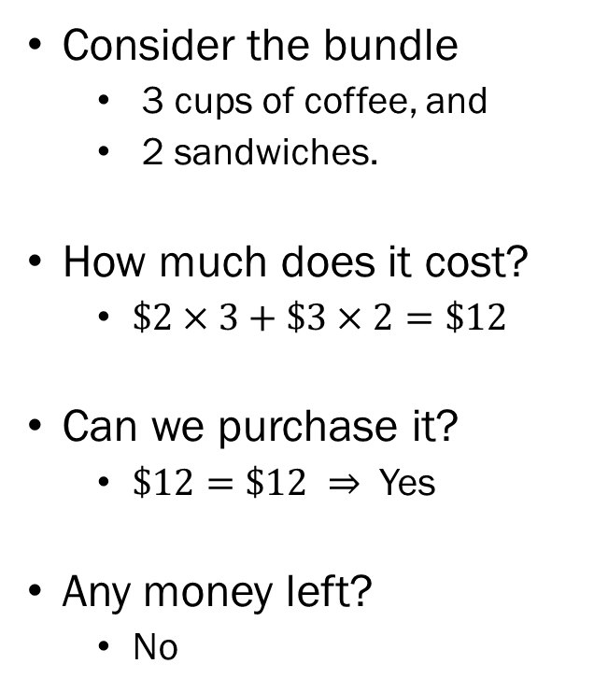
Checking Affordability (3)
Consider the bundle
  3 cups of coffee, and
  2 sandwiches.
How much does it cost?
  $\$2×3+\$3×2=\$12$
Can we purchase it?
  $\$12=\$12 ⇒$ Yes
Any money left?
  No

Slide 18
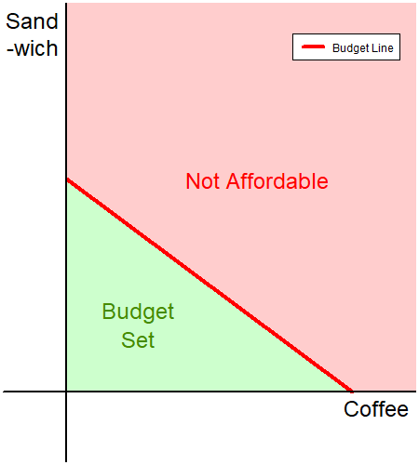
“Budget Set”
Doing this for all possible combinations of coffee and sandwiches…
The bundles that are affordable make up the “budget set.”
The bundles that are affordable, and leave no money left over make up the “budget line.”

Slide 19
The Budget Constraint with “Math”
We will now formalize the concept of the budget constraint using general terms.
The setting remains identical:
  Two goods, and
  Prices for each of the goods, and
  An amount of money you can spend.
Derive of one of the two equations governing the rule that determines the optimal amount of goods that a consumer can purchase.

Slide 20
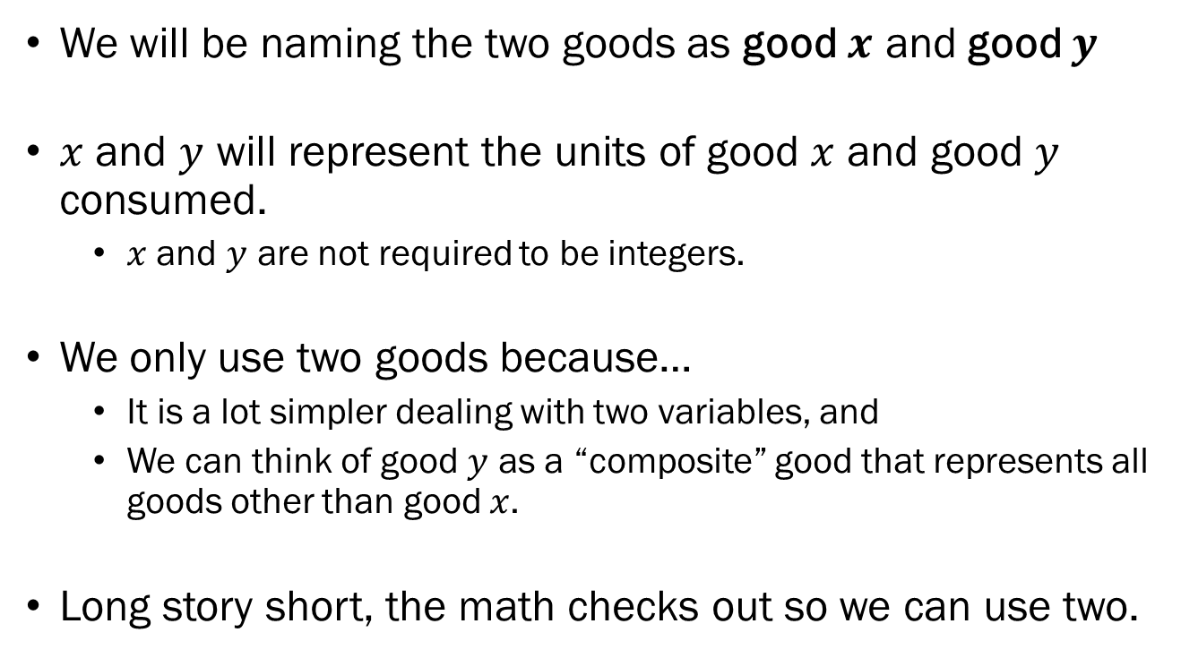
The Two Goods
We will be naming the two goods as good $x$ and good $y$
$x$ and $y$ will represent the units of good $x$ and good $y$ consumed.
  $x$ and $y$ are not required to be integers.
We only use two goods because…
  It is a lot simpler dealing with two variables, and
  We can think of good $y$ as a “composite” good that represents all goods other than good $x$.
Long story short, the math checks out so we can use two.

Slide 21
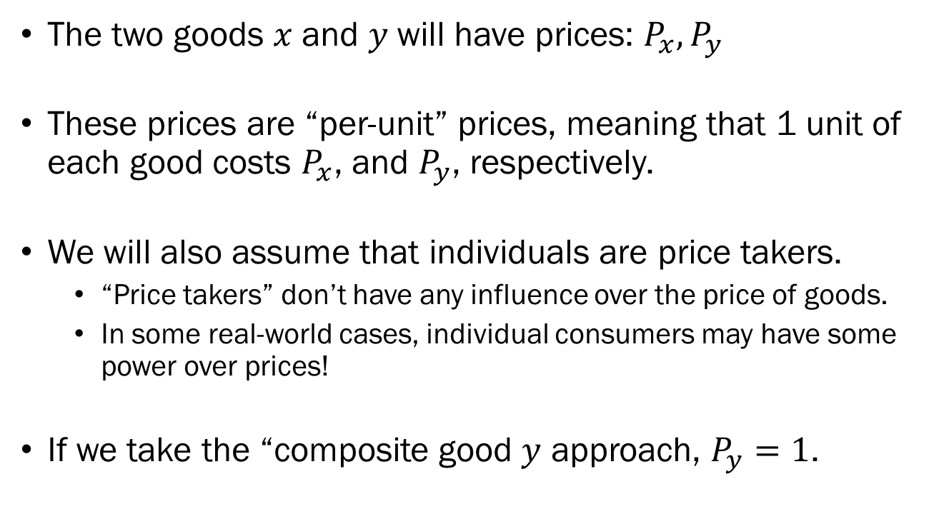
The Market Prices
The two goods $x$ and $y$will have prices: $P_{x},P_{y}$
These prices are “per-unit” prices, meaning that 1 unit of each good costs $P_{x}$, and $P_{y}$, respectively.
We will also assume that individuals are price takers.
  “Price takers” don’t have any influence over the price of goods.
  In some real-world cases, individual consumers may have some power over prices!
If we take the “composite good $y$ approach, $P_{y}=1$.

Slide 22
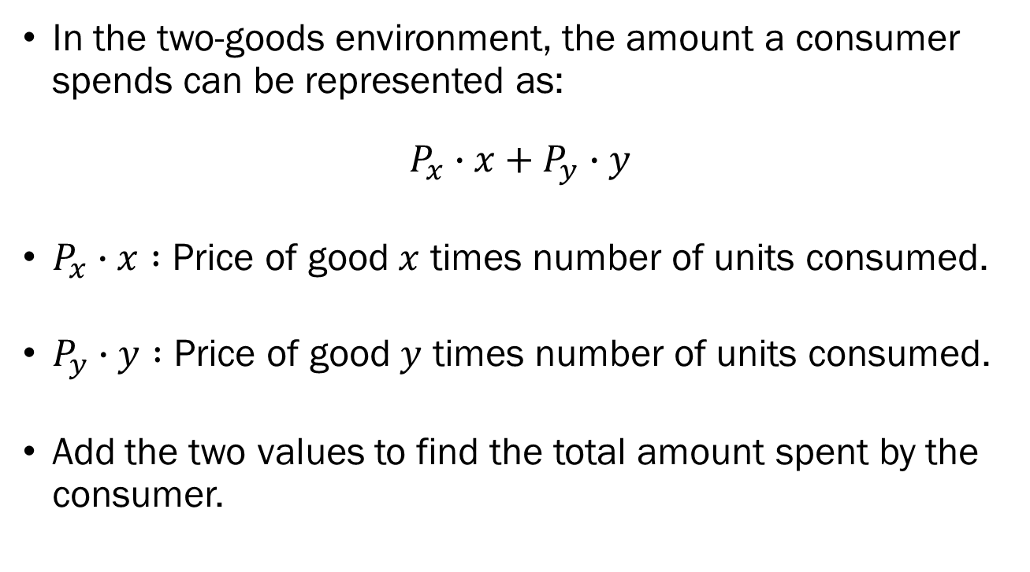
The Expenditure
In the two-goods environment, the amount a consumer spends can be represented as:
$$P_{x}∙x+P_{y}∙y$$
$P_{x}∙x :$ Price of good $x$ times number of units consumed.
$P_{y}∙y :$ Price of good $y$ times number of units consumed.
Add the two values to find the total amount spent by the consumer.

Slide 23
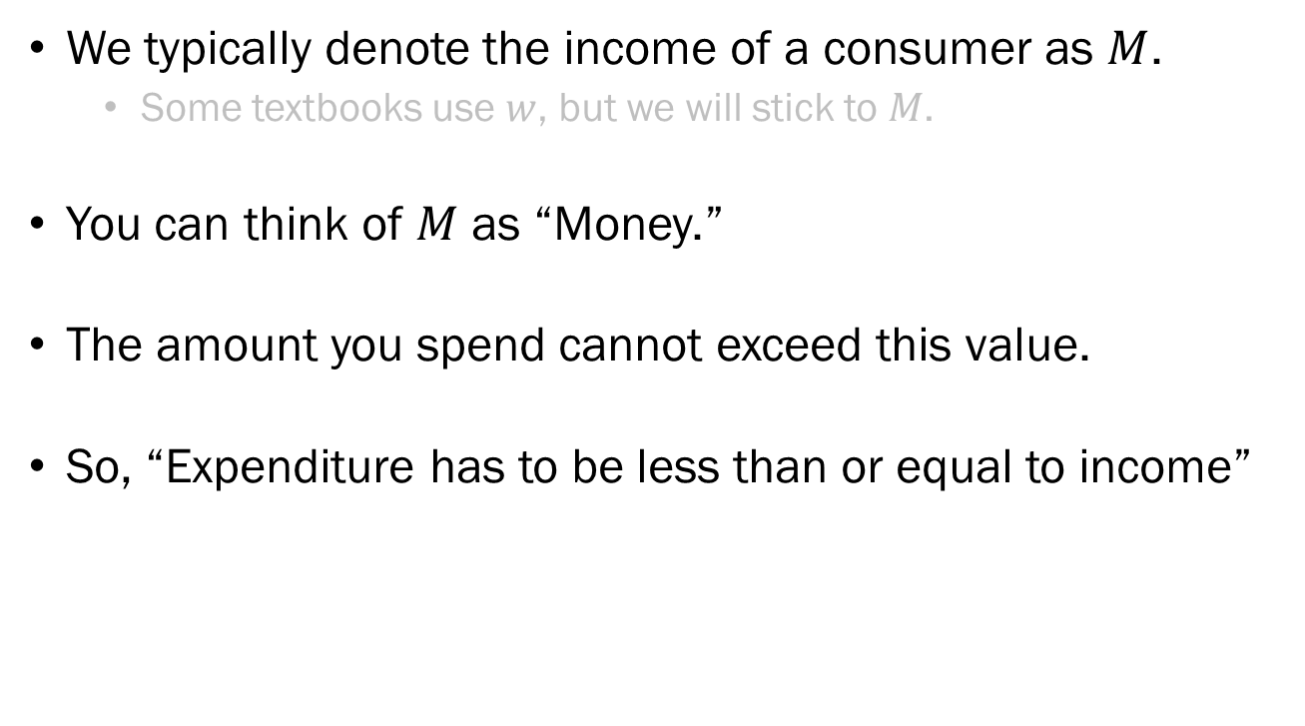
The Income
We typically denote the income of a consumer as $M$.
  Some textbooks use $w$, but we will stick to $M$.
You can think of $M$ as “Money.”
The amount you spend cannot exceed this value.
So, “Expenditure has to be less than or equal to income”

Slide 24
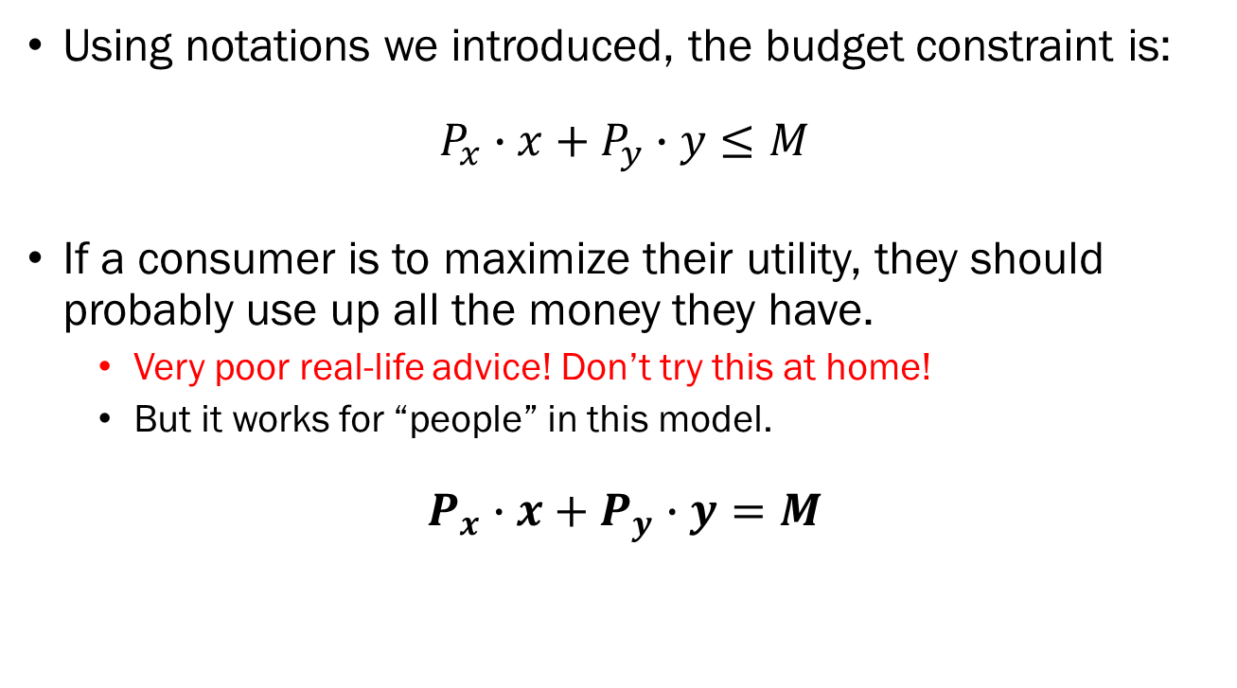
The Budget Constraint / Line
Using notations we introduced, the budget constraint is:
$$P_{x}∙x+P_{y}∙y≤M$$
If a consumer is to maximize their utility, they should probably use up all the money they have.
  Very poor real-life advice! Don’t try this at home!
  But it works for “people” in this model.
$$P_{x}∙x+P_{y}∙y=M$$

Slide 25
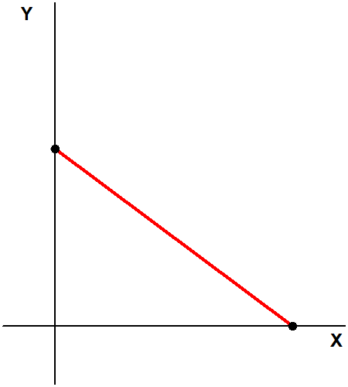
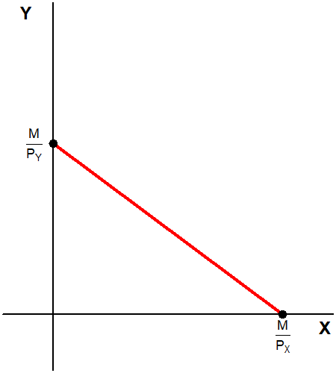
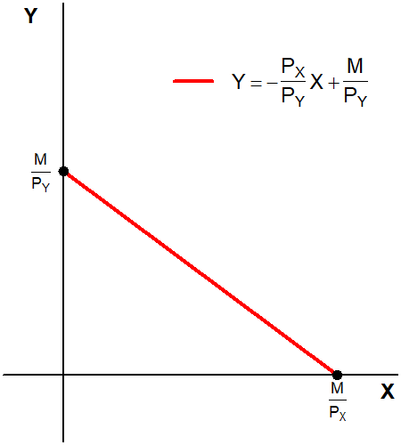
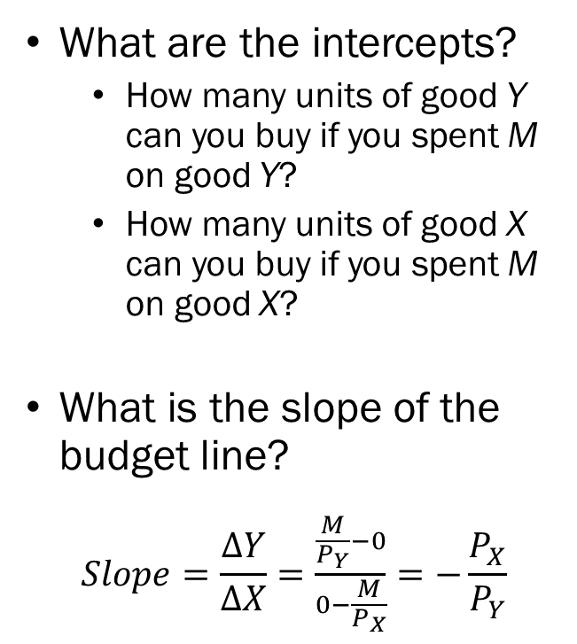
Examining the Budget Constraint
What are the intercepts?
  How many units of good Y can you buy if you spent M on good Y?
  How many units of good X can you buy if you spent M on good X?
What is the slope of the budget line?
$$Slope=\frac{∆Y}{∆X}=\frac{\frac{M}{P_{Y}}−0}{0−\frac{M}{P_{X}}}=−\frac{P_{X}}{P_{Y}}$$

Slide 26
The Slope of the Budget Constraint
How to interpret the slope of the budget constraint?
“How many units of good Y do you need to give up
to be able to afford an additional unit of good X.”
What does the slope of the budget constraint represent?
  Objective Rate of Exchange: What the market dictates.
  Opportunity Cost: Giving up purchasing one good for the other.

Slide 27
Comparative Statics: An Overview
Comparative statics is “the examination of a change in outcome in response to a change in underlying economic parameters.”
We are going to change some values and see how our model reacts.
  Consumer’s income, and
  Market Price(s)
Ceteris Paribus: “With other conditions remaining the same.”

Slide 28
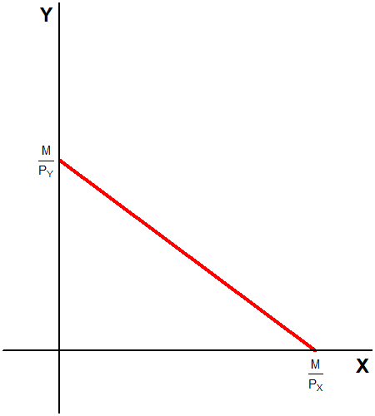
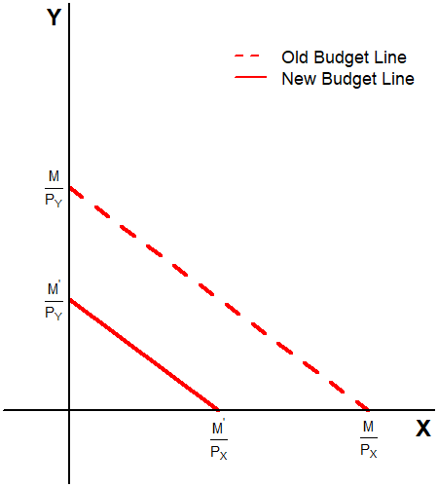
Comparative Statics: Income ↓
What happens when the amount of money the consumer has decreases?
What happens to the once “not affordable” commodity bundles?
Budget line “shifts down”
Slope does not change.

Slide 29
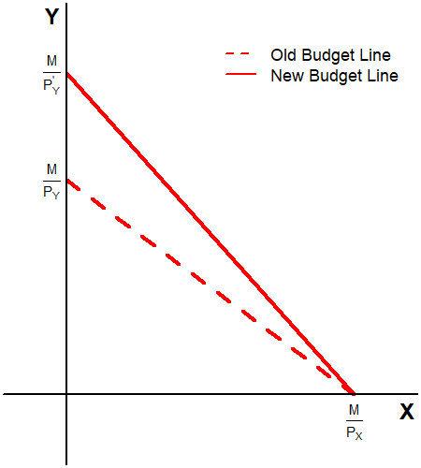
Comparative Statics: Price ↓
What happens when the price of good Y decreases?
  What happens when you spend M on the now cheaper good Y?
  What happens when you spend M on good X which had no price change?
The budget line “pivots.”
Slope is now steeper.

Slide 30
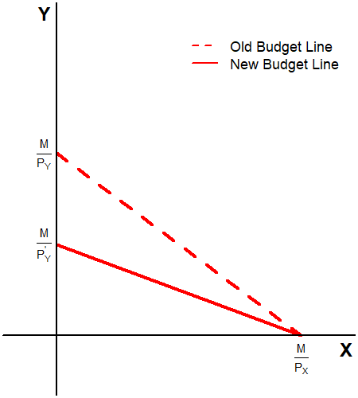
Comparative Statics: Price ↑
What happens when the price of good Y increases?
  What happens when you spend M on the now more expensive good Y?
  What happens when you spend M on good X which had no price change?
The budget line “pivots.”
Slope is now less steep.

Slide 31
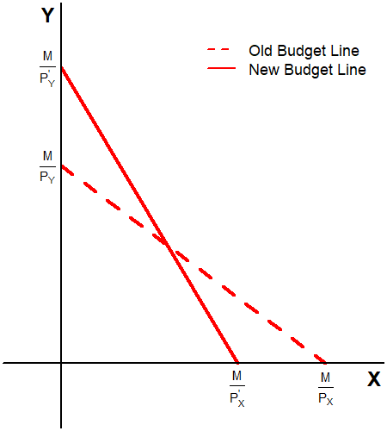
Comparative Statics: Prices
What happens when prices of both good X and Y change?
  Suppose that the price of good X increases, and
  Suppose that the price of good Y decreases.
The budget line will… “change” in some way.
The slope may or may not change.

Slide 32
Comparative Statics: Recap
When the consumer’s income…
  Increases, the budget line “shifts up” or “expands outward.”
  Decreases, the budget line “shifts down” or “contracts inward.”
When the market price of one good changes…
  The budget line “pivots” either clockwise or anti-clockwise depending on the circumstances.
  The fixed pivot point will be the intercept of the good whose price did not change.
When the market price of two goods change…
  It is not clear what will happen until we plot the result.

Slide 33
Real-World Examples
There are some cases in the real world where producers or governments create situations where the budget constraint is not a neat line.
Sometimes, these constraints come from the consumers themselves.
Three examples:
  Governments: Supplemental Nutrition Assistance Program
  Producers: Bulk Purchase Discounts
  Consumers: Time Constraints

Slide 34

Supplemental Nutrition
Assistance Program
Formerly called the “Food Stamp Program”
Provides a subsidy to qualifying American households.
Limited to food for the household.
  Alcohol, Tobacco, Health Supplements, Nonfood Necessities excluded.

Slide 35
SNAP
The market consists of Apples and Books.
The market price of an apple is $4, and the market price of books is $5.
The consumer’s budget is $300.
The government will be providing this consumer with SNAP benefits of $100, which can be used to purchase apples, but not books.

Slide 36
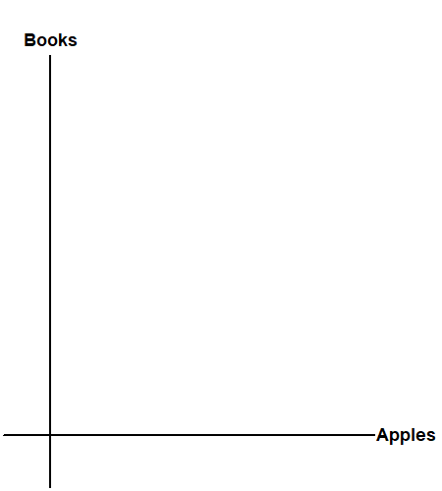
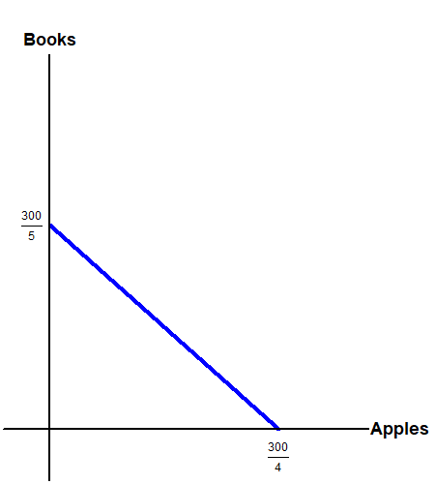
Budget Constraint: Pre - SNAP
It is often helpful to think about the budget constraint before SNAP.
What is the maximum number of apples this consumer can afford before SNAP?
What is the maximum number of books this consumer can afford before SNAP?

Slide 37
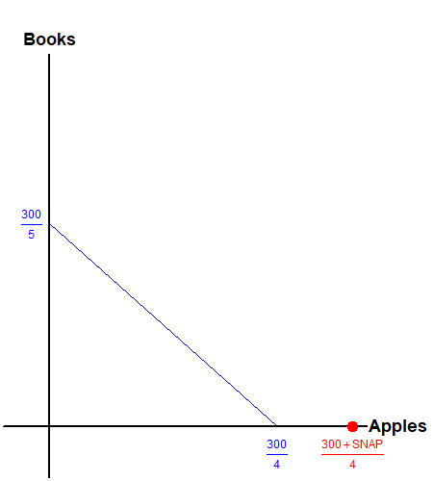
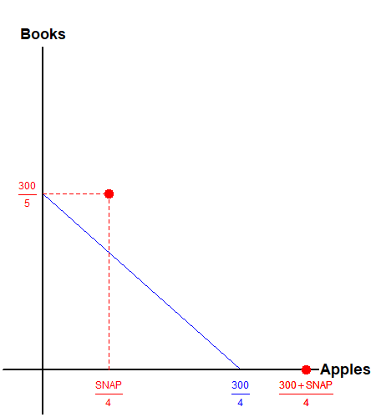
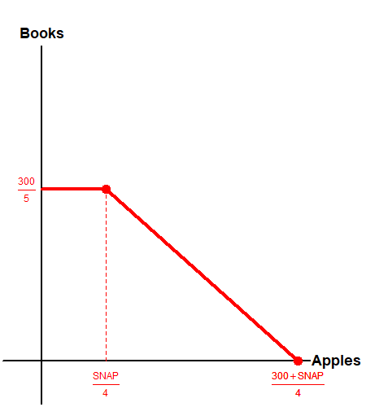
Budget Constraint: Post - SNAP
With SNAP, what is the maximum number of apples the consumer can purchase?
With SNAP, how many apples can the consumer purchase when they already consumed 60 books?

Slide 38
Bulk Order Discount
The market consists of Apples and Books.
The market price of an apple is $4, and the market price of books is $5.
The consumer’s budget is $300.
The publisher offers to provide a discounted price of $2.5 per book for any book following their 40th unit purchased.
  Up to 40 books, the price is $5 per book.
  Above 40 books, the price is $2.5 per book.

Slide 39
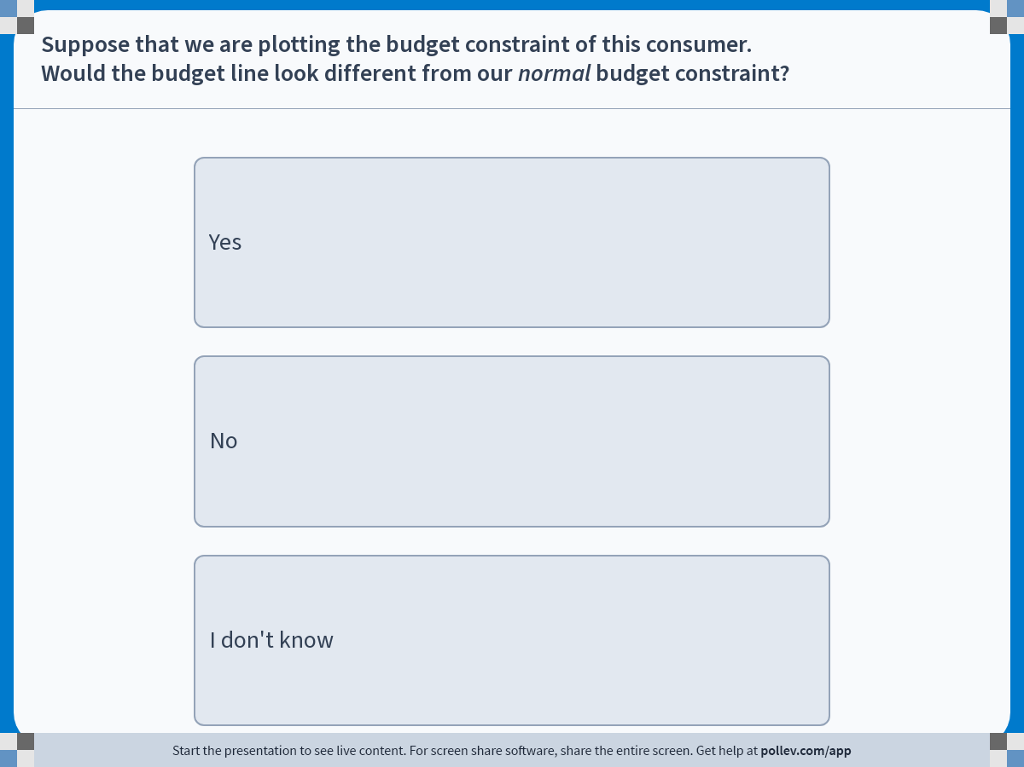
Notes:
Poll Title: Do not modify the notes in this section to avoid tampering with the Poll Everywhere activity.
More info at polleverywhere.com/support
Suppose that we are plotting the budget constraint of this consumer.Would the budget line look different from our normal budget constraint?
https://www.polleverywhere.com/multiple_choice_polls/TIms9Lg413pIHOgVZRgky?display_state=instructions&activity_state=opened&state=opened&flow=Engagement&onscreen=persist

Slide 40
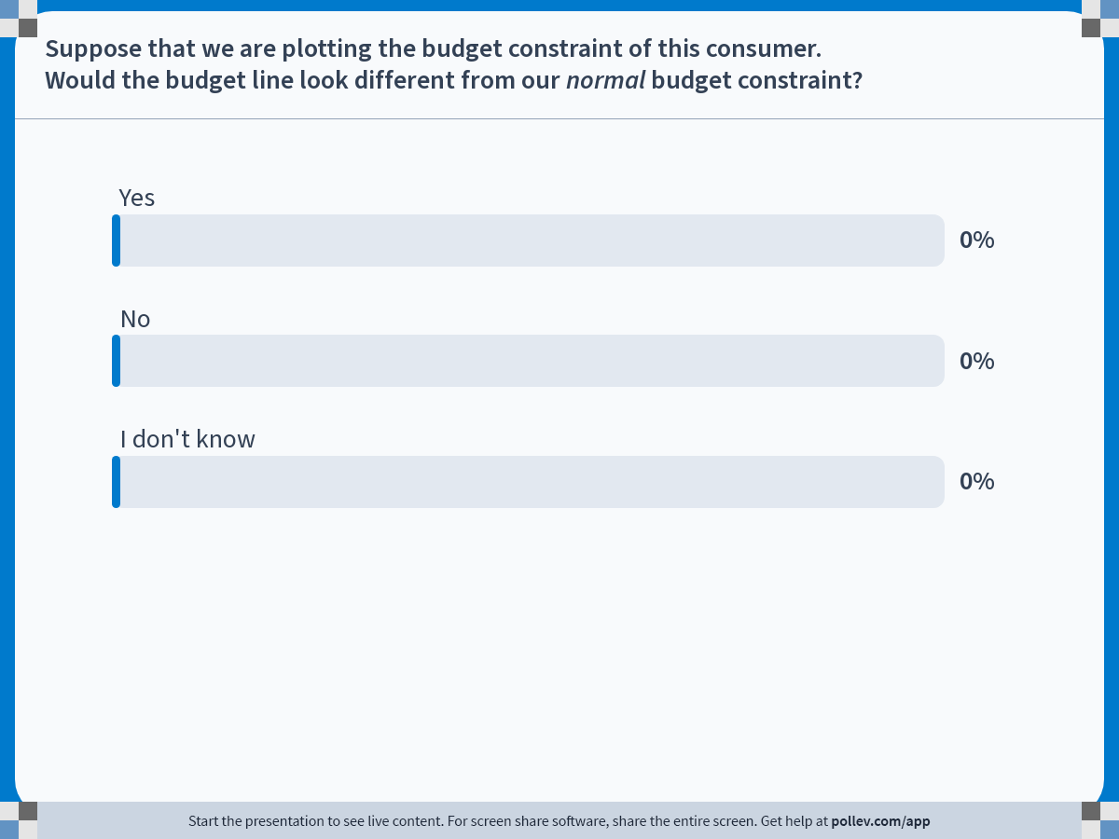
Notes:
Poll Title: Do not modify the notes in this section to avoid tampering with the Poll Everywhere activity.
More info at polleverywhere.com/support
Suppose that we are plotting the budget constraint of this consumer.Would the budget line look different from our normal budget constraint?
https://www.polleverywhere.com/multiple_choice_polls/TIms9Lg413pIHOgVZRgky?display_state=chart&activity_state=closed&state=closed&flow=Engagement&onscreen=persist

Slide 41
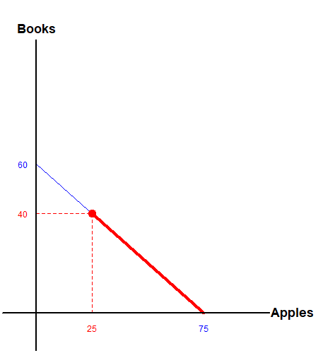
Budget Constraint: Bulk Discount
Up to the point where the consumer purchases 40 books, the situation remains unchanged.
Upon purchase of the 40th book, the consumer faces new market prices.
What is the maximum quantity of books that the consumer can purchase?

Slide 42
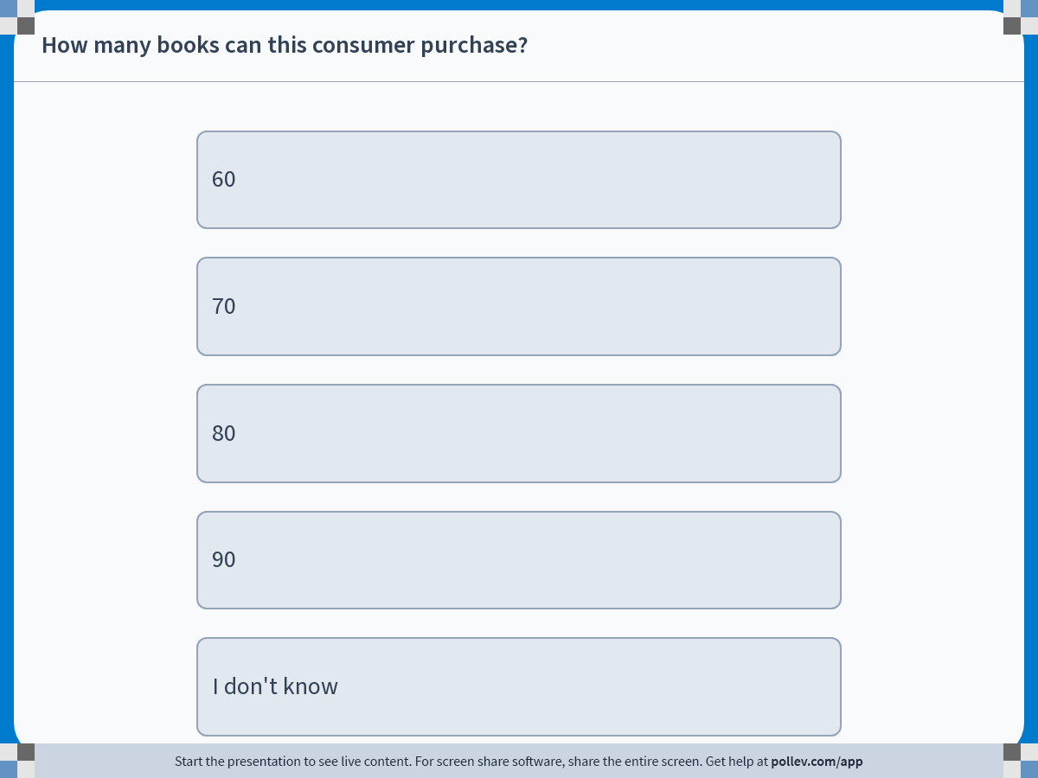
Notes:
Poll Title: Do not modify the notes in this section to avoid tampering with the Poll Everywhere activity.
More info at polleverywhere.com/support
How many books can this consumer purchase?
https://www.polleverywhere.com/multiple_choice_polls/m5r2Q0wJyyurpLrHWxpz1?display_state=instructions&activity_state=opened&state=opened&flow=Engagement&onscreen=persist

Slide 43
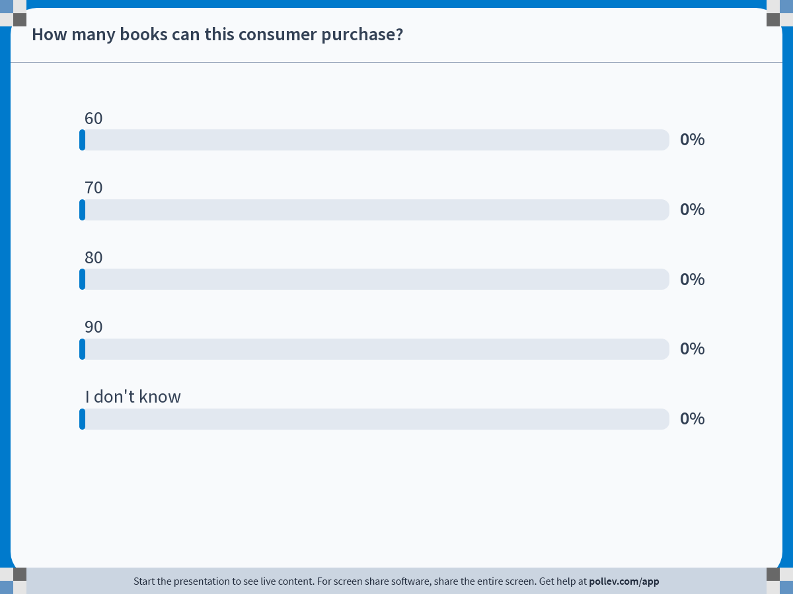
Notes:
Poll Title: Do not modify the notes in this section to avoid tampering with the Poll Everywhere activity.
More info at polleverywhere.com/support
How many books can this consumer purchase?
https://www.polleverywhere.com/multiple_choice_polls/m5r2Q0wJyyurpLrHWxpz1?display_state=chart&activity_state=closed&state=closed&flow=Engagement&onscreen=persist

Slide 44
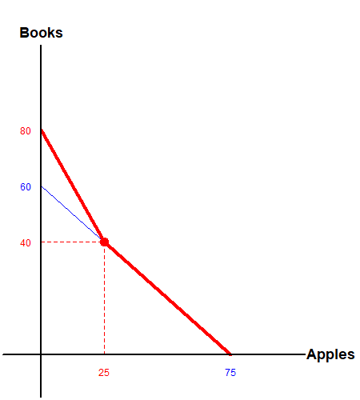
Budget Constraint: Bulk Discount
Up to the point where the consumer purchases 40 books, the situation remains unchanged.
Upon purchase of the 40th book, the consumer faces new market prices.

Slide 45
Time Constraints
The market consists of Apples and Books.
The market price of an apple is $4, and the market price of books is $5.
The consumer’s budget is $300.
For simplicity, suppose that the consumer has 100 hours in a term, and can consume one apple every 1 hour, and read one book every 2 hours.

Slide 46
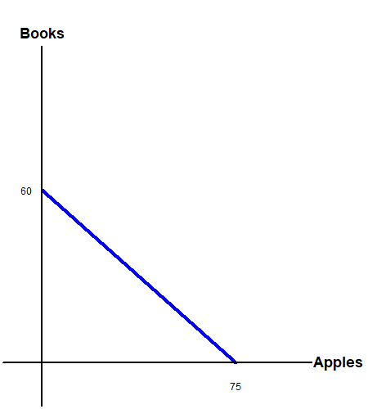
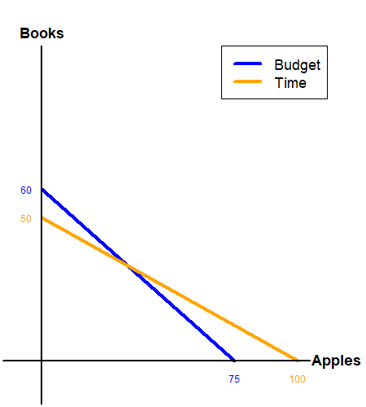
Budget Constraint with Time: Lines
We start off with the original budget constraint.
We then overlay the time constraint.
  How many books can this consumer read in 100 hours?
  How many apples can this consumer eat in 100 hours?

Slide 47
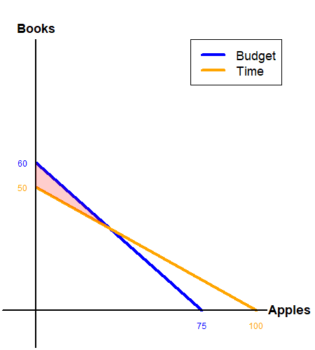
Budget Constraint with Time: Region 1
Consider each of the 4 “regions” created by the two lines…
Can the you consume and bundle in this region?
Can purchase 60 books?
Can read 60 books?

Slide 48
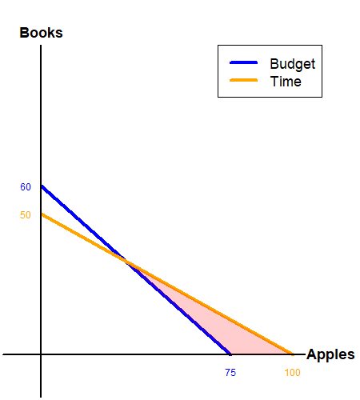
Budget Constraint with Time: Region 2
Consider each of the 4 “regions” created by the two lines…
Can the you consume and bundle in this region?
Can eat 100 apples?
Can buy 100 apples?

Slide 49
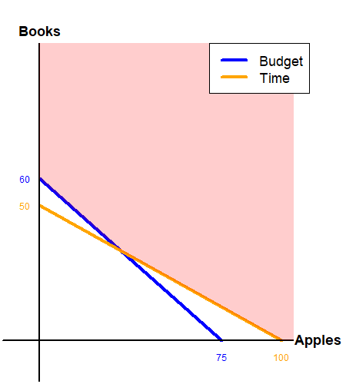
Budget Constraint with Time: Region 3
Consider each of the 4 “regions” created by the two lines…
Can the you consume and bundle in this region?
Can eat 100 apples and read 60 books?
Can buy 100 apples and buy 60 books?

Slide 50
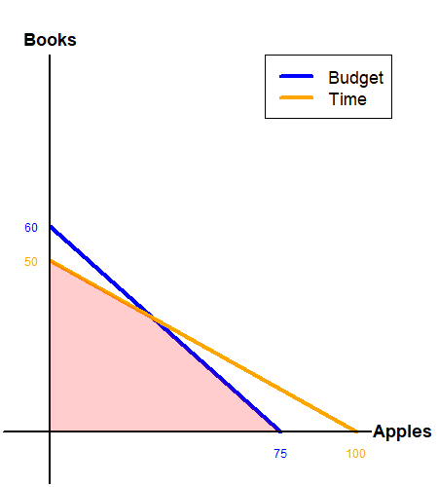
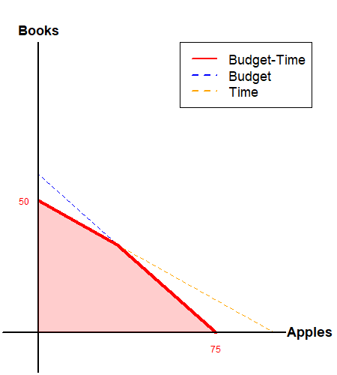
Budget Constraint with Time: Region 4
Can the you consume and bundle in this region?
Can eat 30 apples and read 30 books?
Can buy 30 apples and buy 30 books?
We have found the joint budget-time constraint!

Slide 51
Endowment in Goods
The market consists of Apples and Books.
The market price of an apple is $4, and the market price of books is $5.
The consumer is given 50 apples and 20 books as an endowment.
The consumer is free to sell their endowment and purchase desired goods in the market at the market price.

Slide 52
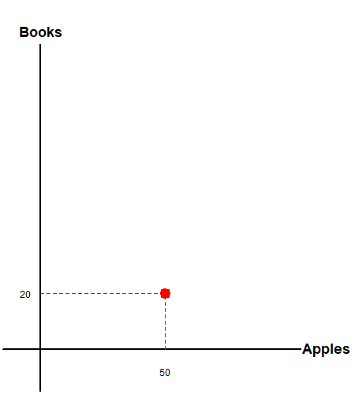
Budget Constraint with Endowments
We start off by plotting the consumer’s endowment.
Then we calculate the max units of apples and books the consumer can purchase.

Slide 53
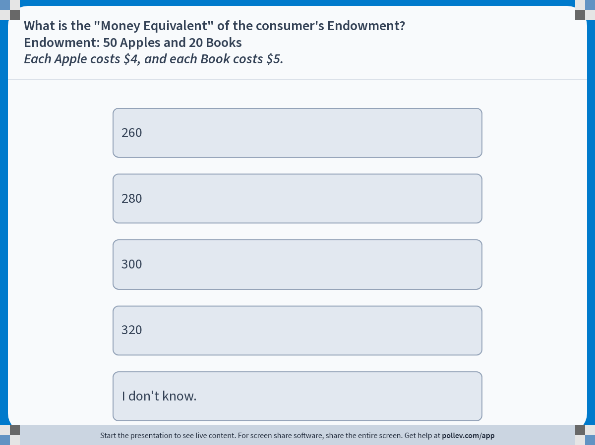
Notes:
Poll Title: Do not modify the notes in this section to avoid tampering with the Poll Everywhere activity.
More info at polleverywhere.com/support
What is the "Money Equivalent" of the consumer's Endowment?Endowment: 50 Apples and 20 BooksEach Apple costs $4, and each Book costs $5.
https://www.polleverywhere.com/multiple_choice_polls/OeqSKor2RiabG8HHZAKQL?display_state=instructions&activity_state=opened&state=opened&flow=Engagement&onscreen=persist

Slide 54
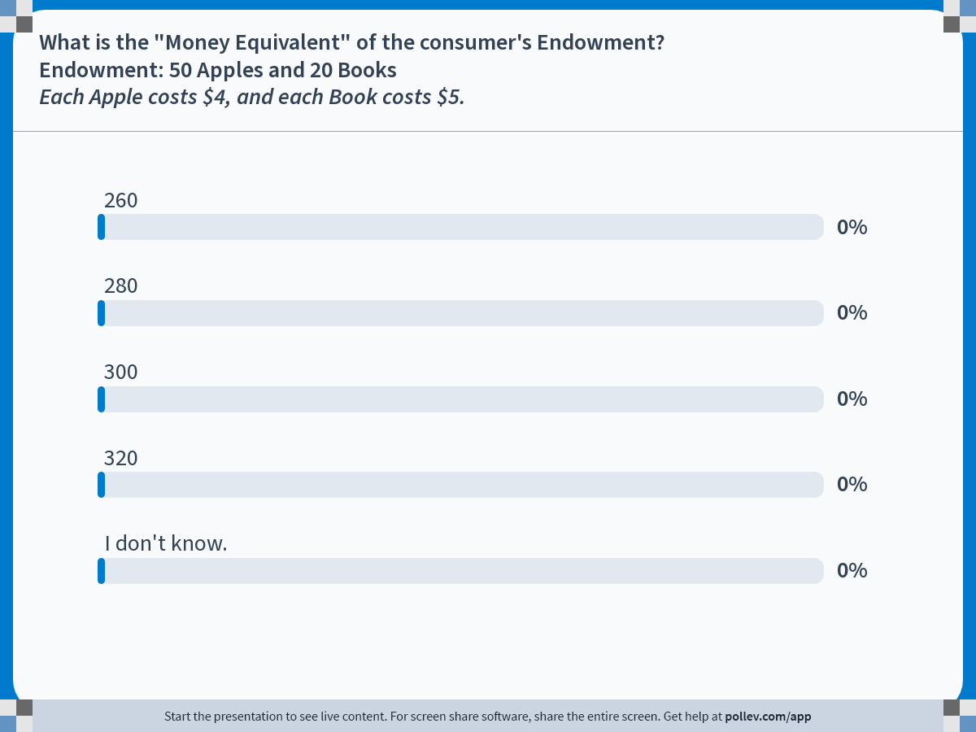
Notes:
Poll Title: Do not modify the notes in this section to avoid tampering with the Poll Everywhere activity.
More info at polleverywhere.com/support
What is the "Money Equivalent" of the consumer's Endowment?Endowment: 50 Apples and 20 BooksEach Apple costs $4, and each Book costs $5.
https://www.polleverywhere.com/multiple_choice_polls/OeqSKor2RiabG8HHZAKQL?display_state=chart&activity_state=closed&state=closed&flow=Engagement&onscreen=persist

Slide 55
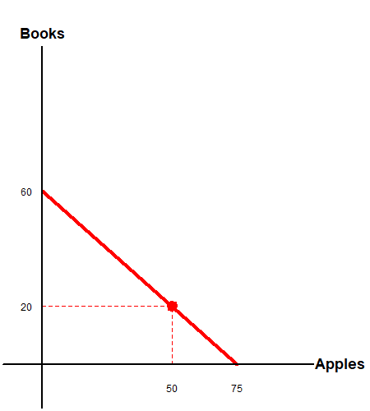
Budget Constraint with Endowments
We start off by plotting the consumer’s endowment.
Then we calculate the max units of apples and books the consumer can purchase.
  75 Apples
  60 Books
Identical to prior cases.

Slide 56
Budget Constraint with Endowments
What would happen when prices change?
Suppose that the price of books fall to $4 per unit.
What is the “money equivalent” of the consumer’s endowment?

Slide 57
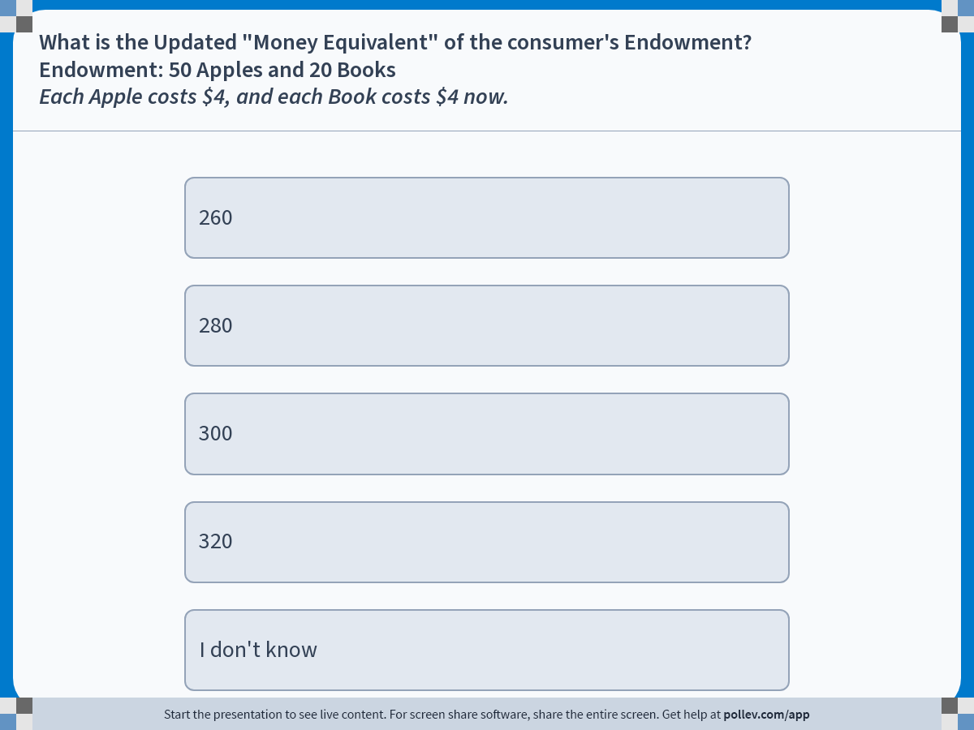
Notes:
Poll Title: Do not modify the notes in this section to avoid tampering with the Poll Everywhere activity.
More info at polleverywhere.com/support
What is the Updated "Money Equivalent" of the consumer's Endowment?Endowment: 50 Apples and 20 BooksEach Apple costs $4, and each Book costs $4 now.
https://www.polleverywhere.com/multiple_choice_polls/xknVH1MoWiO4ZS6C2tdCN?display_state=instructions&activity_state=opened&state=opened&flow=Engagement&onscreen=persist

Slide 58
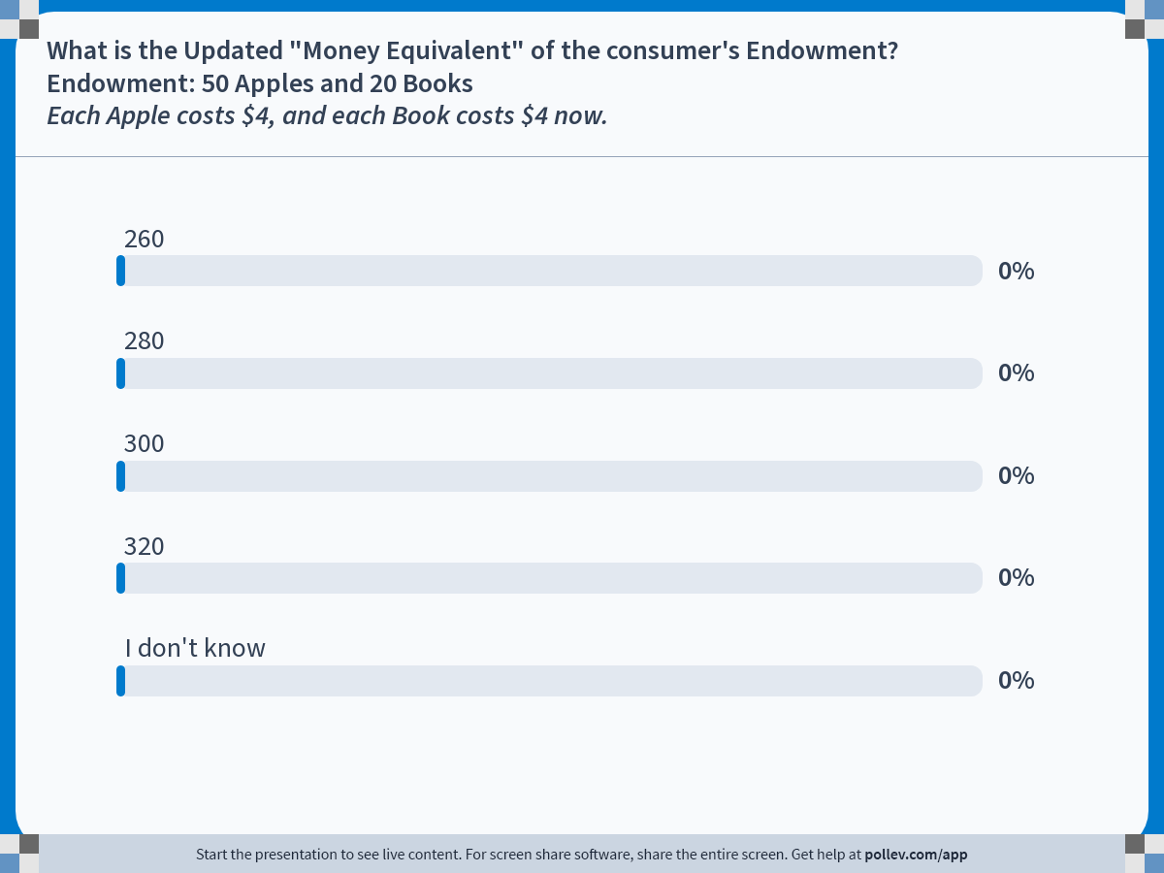
Notes:
Poll Title: Do not modify the notes in this section to avoid tampering with the Poll Everywhere activity.
More info at polleverywhere.com/support
What is the Updated "Money Equivalent" of the consumer's Endowment?Endowment: 50 Apples and 20 BooksEach Apple costs $4, and each Book costs $4 now.
https://www.polleverywhere.com/multiple_choice_polls/xknVH1MoWiO4ZS6C2tdCN?display_state=chart&activity_state=closed&state=closed&flow=Engagement&onscreen=persist

Slide 59
Budget Constraint with Endowments
What would happen when prices change?
Suppose that the price of books fall to $4 per unit.
What is the “money equivalent” of the consumer’s endowment?
  Now the consumer “has” $280 instead of $300.

Slide 60

Budget Constraint with Endowments
The “normal” budget line shifts when income changes.
Can that happen to this budget line with goods as endowments?
No. The original endowment will always be available!
Budget line “pivots” around the endowment point.

Slide 61

Budget Constraint with Endowments
What would happen when the endowment changes?
Suppose that the endowment is now 20 books and 40 apples.
What is the “money equivalent” of the consumer’s endowment when apples are $4 and books $5?

Slide 62

Notes:
Poll Title: Do not modify the notes in this section to avoid tampering with the Poll Everywhere activity.
More info at polleverywhere.com/support
What is the "Money Equivalent" of the consumer's Endowment?Endowment: 40 Apples and 20 BooksEach Apple costs $4, and each Book costs $5.
https://www.polleverywhere.com/multiple_choice_polls/UC7wa2wz3dCpVdYcZ5LjR?display_state=instructions&activity_state=opened&state=opened&flow=Engagement&onscreen=persist

Slide 63

Notes:
Poll Title: Do not modify the notes in this section to avoid tampering with the Poll Everywhere activity.
More info at polleverywhere.com/support
What is the "Money Equivalent" of the consumer's Endowment?Endowment: 40 Apples and 20 BooksEach Apple costs $4, and each Book costs $5.
https://www.polleverywhere.com/multiple_choice_polls/UC7wa2wz3dCpVdYcZ5LjR?display_state=chart&activity_state=closed&state=closed&flow=Engagement&onscreen=persist

Slide 64

Budget Constraint with Endowments
The consumer now “has” $260 as their endowment.
Plotting the new budget constraint…

Slide 65
Recap: Budget Constraint
The budget constraint tells us which commodity bundles are feasible, and which are not feasible.
The slope of the budget constraint represents the objective rate of exchange determined by the market.
When income changes, the budget line (usually) shifts.
When prices change, the budget line (usually) pivots.
The budget line is not always one straight line.

