Slide 1
Quiz #2 Review
ECON 301

Slide 2
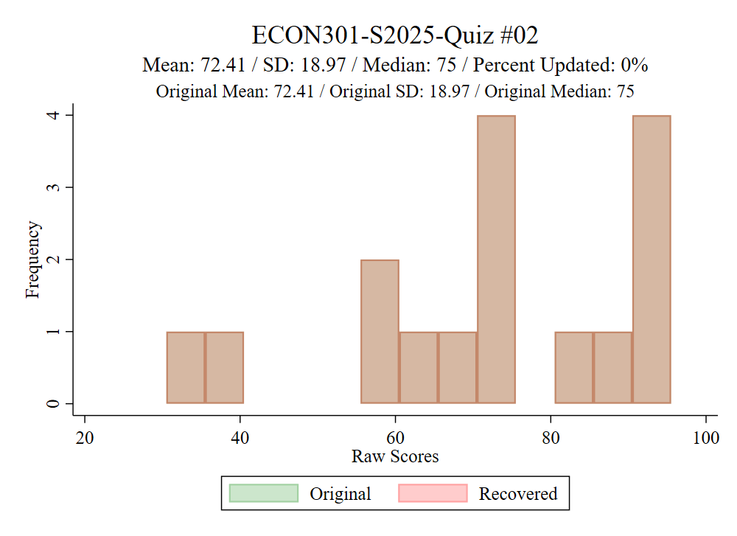
Grade Distribution

Slide 3
How to Read Marks
Correct
Partially Correct
Incorrect

Slide 4
Quiz #2 “Recovery” Office Hours
https://calendly.com/brianhwpark
Venue: Rm. 248 Center for Science and Business
Dates: Feb. 26th ~ Mar. 7th , 2025 (Wednesday ~ Friday)
Length: 30 Minutes per Session
Use the Whiteboard / Paper to correct your answers.

Slide 5
Problem 1. Definitions
Federal Funds Rate
  The interest rate that private banks charge each other in the federal funds market.
Nominal Interest Rate
  The interest rate in terms of dollars.
LM Curve
  A graph that shows the relationship between interest rates and output when the money market is in equilibrium

Slide 6
Problem 1. Definitions
Fiat Money
  Assets that are used as money that have no intrinsic value.
Open Market Operations
  One of the Federal Reserve’s tools of conducting monetary policy. Involves the purchase and sale of securities.
Double Coincidence of Wants
  A situation where two individuals each possess a good or service that the other desires.

Slide 7
Problem 2.A.
A higher risk premium means that an asset is considered safer by investors.
  FALSE
  The risk premium (x) increases when the asset is considered to be riskier.

Slide 8
Problem 2.B.
A decrease in the federal funds rate typically leads to an increase in borrowing and investment.
  TRUE

Slide 9
Problem 2.C.
The IS curve represents equilibrium in the money market, while the LM curve represents equilibrium in the goods market.
  FALSE
  The IS curve represents the equilibria in the goods market.
  The LM curve represents the equilibria in the financial market.

Slide 10
Problem 2.D.
An asset that satisfy the following three functions is defined as money: a medium of exchange, a store of value, and a source of economic growth.
  FALSE
  The three functions of money are as follows:
    Medium of Exchange
    Store of Value
    Unit of Account

Slide 11











Problem 3.A.
Illustrate and explain how an increase in risk-taking behavior by financial institutions affects the extended IS-LM framework.
The economy starts off at the short run equilibrium $A$.
The increase in risk-taking lowers the risk premium, which lowers the borrowing rate.
Investment increases given the same interest rate.
The IS curve shifts to the right, and the economy reaches a new equilibrium at $A^{′}$.
$$r$$
$$\overline{r}$$
$$A^{′}$$
$$A$$
$$LM$$
$$Y^{∗^{′}}$$
$$Y$$
$$Y^{∗}$$
$$IS$$
$$IS^{′}$$

Slide 12
Problem 3.B.
What policy actions could the Federal Reserve take to manage potential risks and maintain economic stability?
  The economy is overshooting its short run equilibrium, and the Fed will want to lower output to its short run equilibrium.
  The Fed can conduct contractionary monetary policy to increase the interest rates, which shifts the LM curve upward.
  The increased interest rate counteracts the lowered risk premium and restores the original borrowing rate.
  The economy will return to its original short run equilibrium, with a higher interest rate.

Slide 13
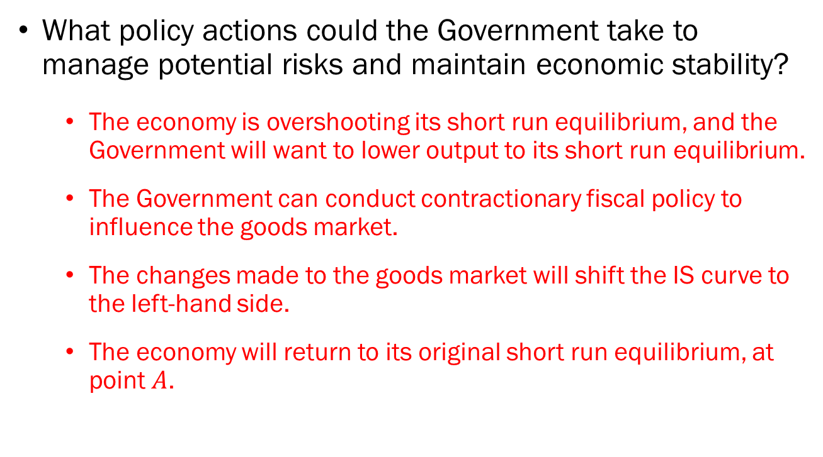
Problem 3.C.
What policy actions could the Government take to manage potential risks and maintain economic stability?
  The economy is overshooting its short run equilibrium, and the Government will want to lower output to its short run equilibrium.
  The Government can conduct contractionary fiscal policy to influence the goods market.
  The changes made to the goods market will shift the IS curve to the left-hand side.
  The economy will return to its original short run equilibrium, at point $A$.

Slide 14
Problem 3.D.
Would you prioritize monetary or fiscal policy to address the risks associated with increased financial risk-taking?
  This problem is open-ended.
  If you choose monetary policy, you should mention that the interest rate will permanently be increased.
  If you choose fiscal policy, you should mention the impact of government spending cuts on the economy, impact of increased taxation, and the potential of lowering the budget deficit.
  You could also choose a mix of monetary and fiscal policy, which will result in a moderately higher interest rate with budget cuts and new taxes being less intense.

