Slide 1
Consumer Theory:
Special Cases in the UMP
ECON 300

Slide 2
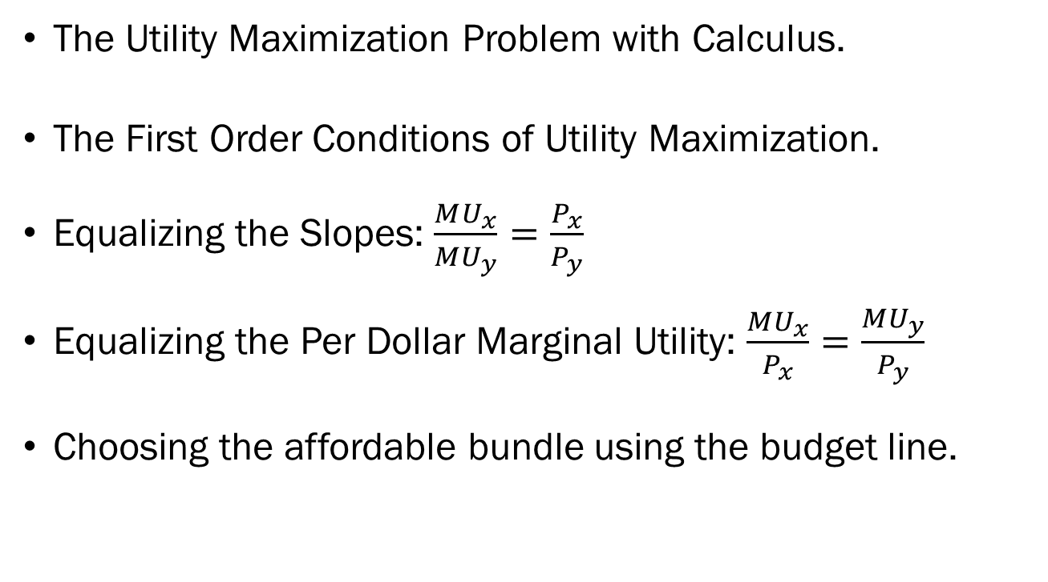
Review of Previous Lecture
The Utility Maximization Problem with Calculus.
The First Order Conditions of Utility Maximization.
Equalizing the Slopes: $\frac{MU_{x}}{MU_{y}}=\frac{P_{x}}{P_{y}}$
Equalizing the Per Dollar Marginal Utility: $\frac{MU_{x}}{P_{x}}=\frac{MU_{y}}{P_{y}}$
Choosing the affordable bundle using the budget line.

Slide 3
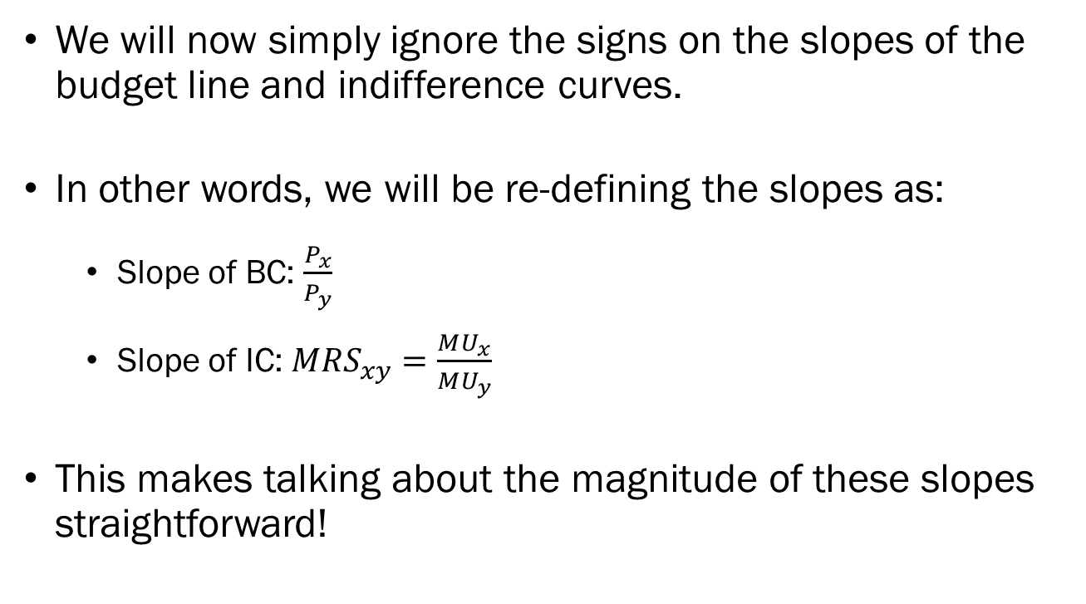
Simplifying Assumptions
We will now simply ignore the signs on the slopes of the budget line and indifference curves.
In other words, we will be re-defining the slopes as:
  Slope of BC: $\frac{P_{x}}{P_{y}}$
  Slope of IC: ${MRS}_{xy}=\frac{MU_{x}}{MU_{y}}$
This makes talking about the magnitude of these slopes straightforward!

Slide 4

Recap: Partial Derivatives
$$\frac{∂}{∂(variable)}\left(constant⋅variable^{power}\right)$$
$$=constant⋅power⋅variable^{power−1}$$
Try out the following:
  $\frac{∂}{∂x}7x^{3}y$
  $\frac{∂}{∂y}7x^{3}y$

Slide 5
Special Cases
There are some cases where our approach must be slightly modified.
The Linear Utility Function has constant marginal rate of substitution, which causes some issues.
The Leontief Utility Function is not differentiable, which causes some issues.
If one good is a “bad,” then our previous approach may or may not work.

Slide 6
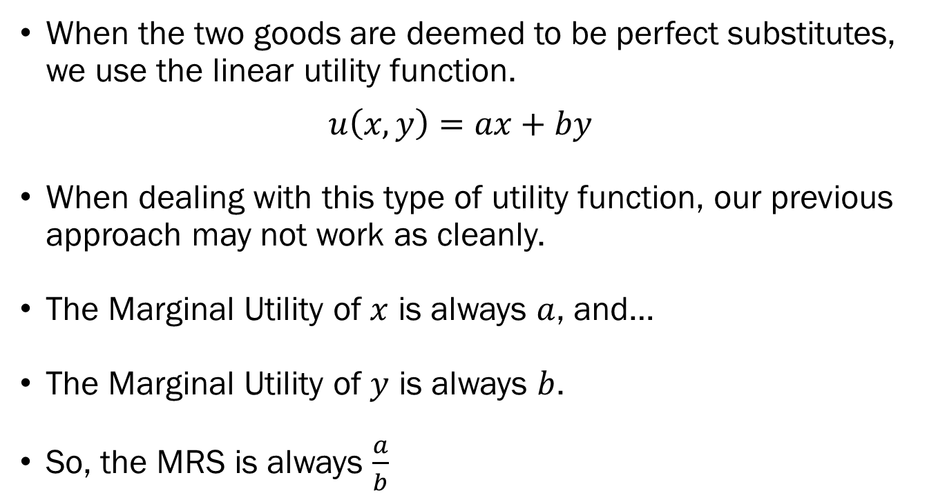
Special Case: Linear Utility Functions
When the two goods are deemed to be perfect substitutes, we use the linear utility function.
$$u\left(x,y\right)=ax+by$$
When dealing with this type of utility function, our previous approach may not work as cleanly.
The Marginal Utility of $x$ is always $a$, and…
The Marginal Utility of $y$ is always $b$.
So, the MRS is always $\frac{a}{b}$

Slide 7
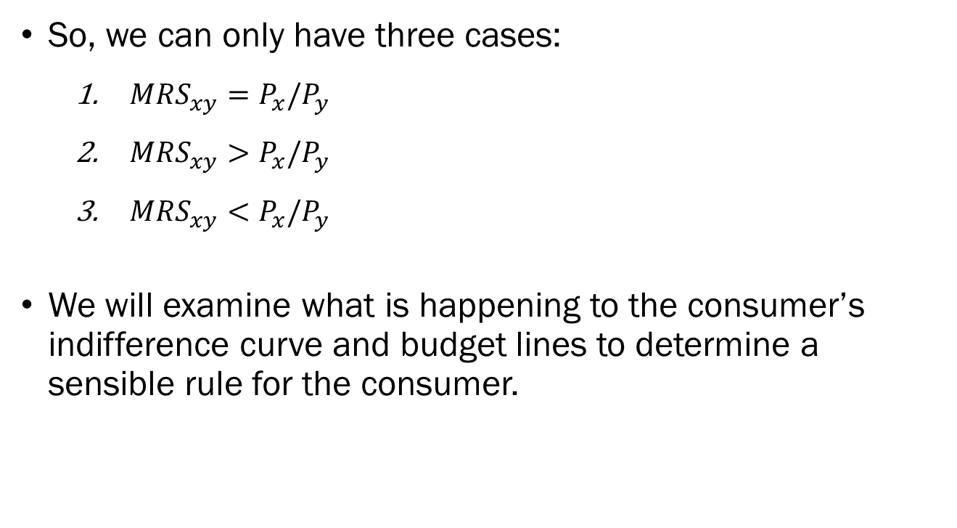
Special Case: Linear Utility Functions
So, we can only have three cases:
  $MRS_{xy}=P_{x}/P_{y}$
  $MRS_{xy}>P_{x}/P_{y}$
  $MRS_{xy}<P_{x}/P_{y}$
We will examine what is happening to the consumer’s indifference curve and budget lines to determine a sensible rule for the consumer.

Slide 8
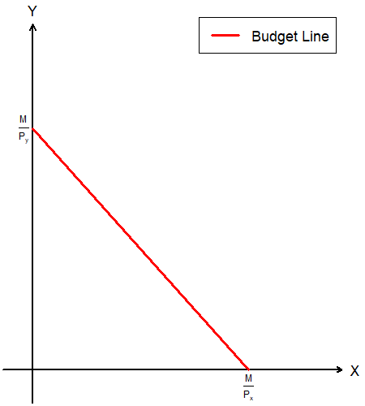
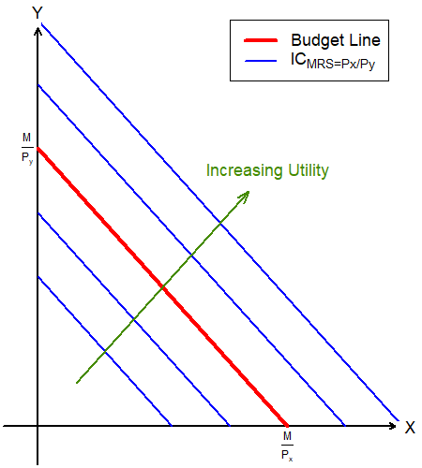
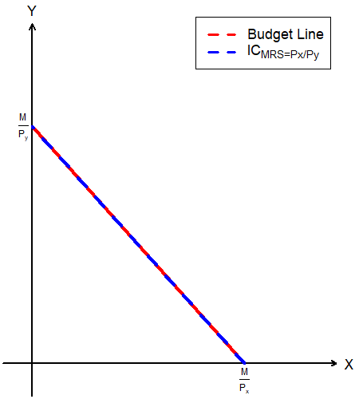

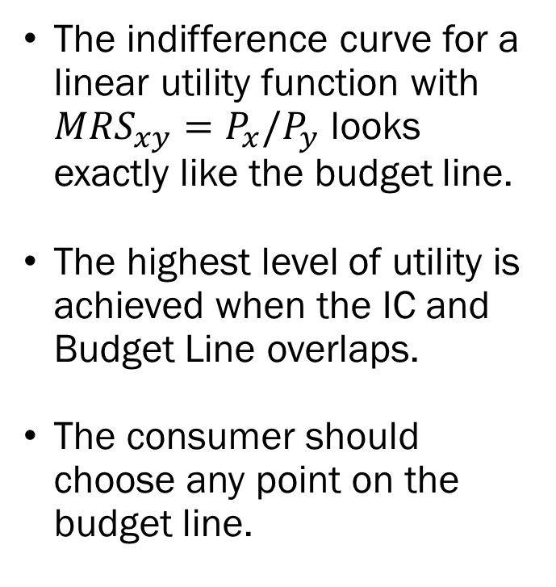
Linear Utility Functions when
$$MRS_{xy}=P_{x}/P_{y}$$
The indifference curve for a linear utility function with $MRS_{xy}=P_{x}/P_{y}$ looks exactly like the budget line.
The highest level of utility is achieved when the IC and Budget Line overlaps.
The consumer should choose any point on the budget line.

Slide 9

PollEv.com/brianpark046

Slide 10
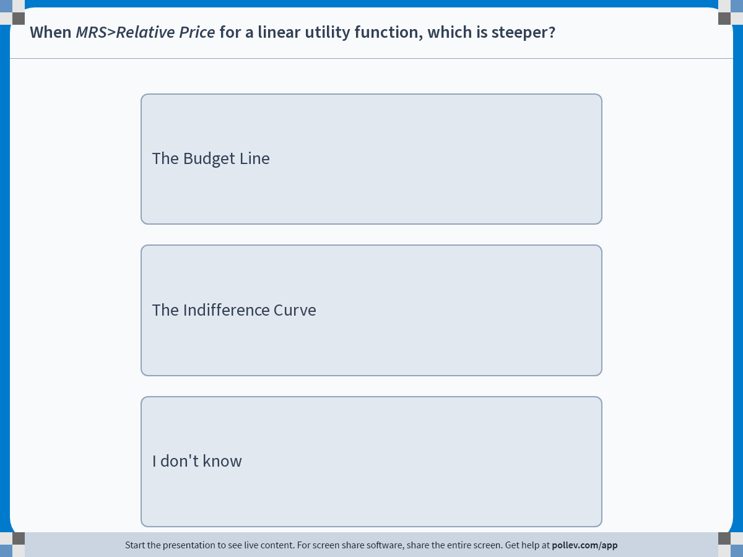
Notes:
Poll Title: Do not modify the notes in this section to avoid tampering with the Poll Everywhere activity.
More info at polleverywhere.com/support
When MRS&gt;Relative Price for a linear utility function, which is steeper?
https://www.polleverywhere.com/multiple_choice_polls/TIhgf8S0c8rZsi0gHknFT?display_state=instructions&activity_state=opened&state=opened&flow=Engagement&onscreen=persist

Slide 11
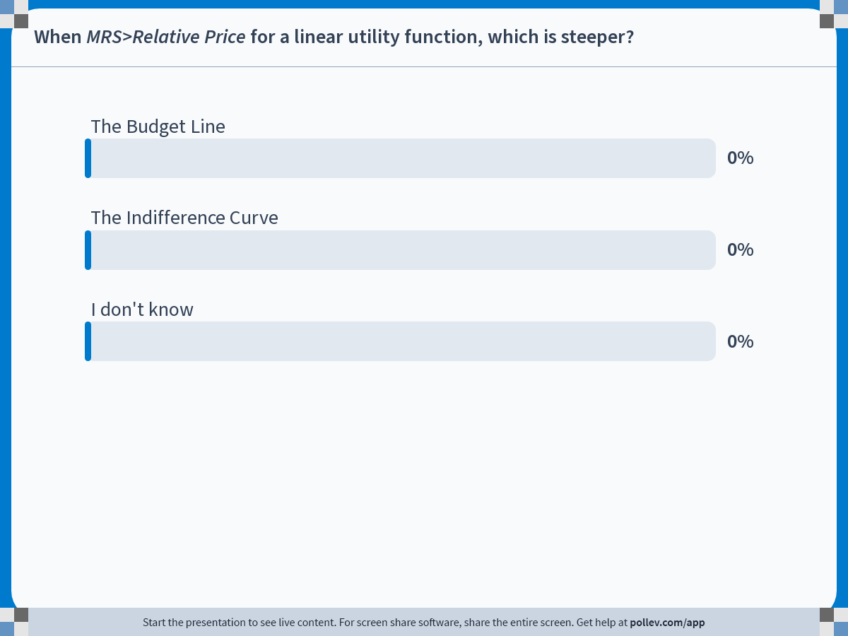
Notes:
Poll Title: Do not modify the notes in this section to avoid tampering with the Poll Everywhere activity.
More info at polleverywhere.com/support
When MRS&gt;Relative Price for a linear utility function, which is steeper?
https://www.polleverywhere.com/multiple_choice_polls/TIhgf8S0c8rZsi0gHknFT?display_state=chart&activity_state=closed&state=closed&flow=Engagement&onscreen=persist

Slide 12
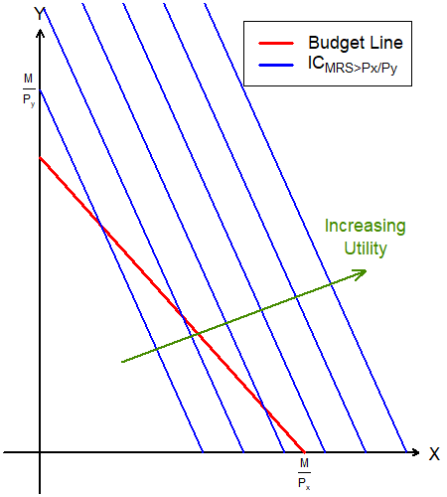
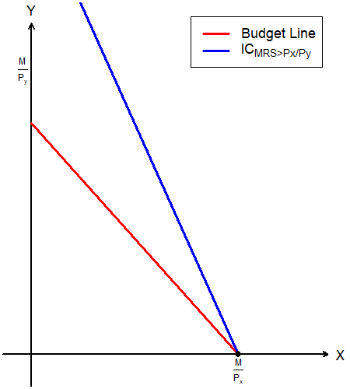

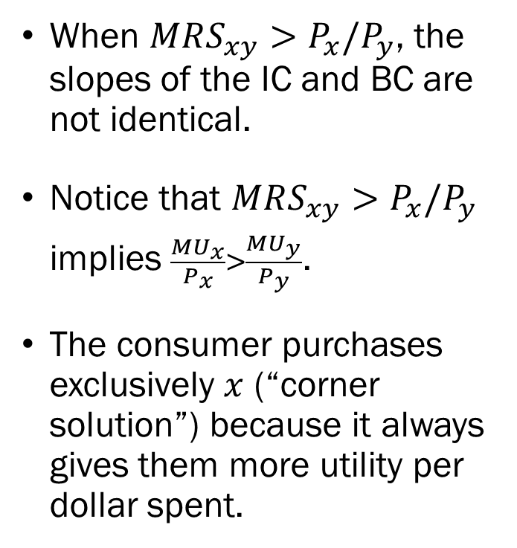
Linear Utility Functions when
$$MRS_{xy}>P_{x}/P_{y}$$
When $MRS_{xy}>P_{x}/P_{y}$, the slopes of the IC and BC are not identical.
Notice that $MRS_{xy}>P_{x}/P_{y}$ implies $\frac{MU_{x}}{P_{x}}>\frac{MU_{y}}{P_{y}}$.
The consumer purchases exclusively $x$ (“corner solution”) because it always gives them more utility per dollar spent.

Slide 13
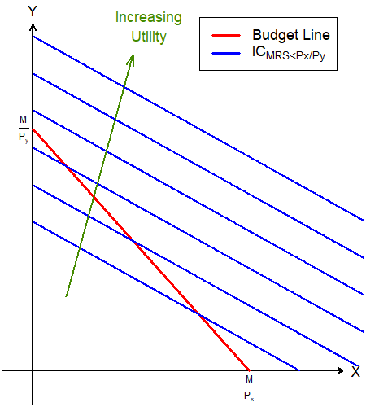
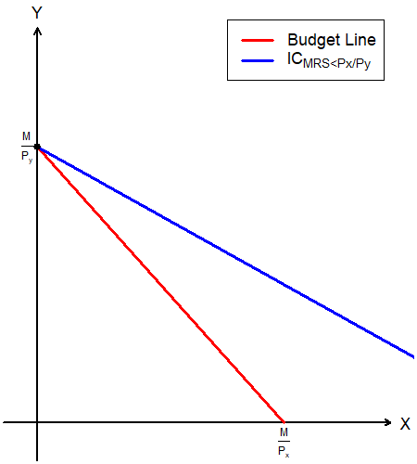

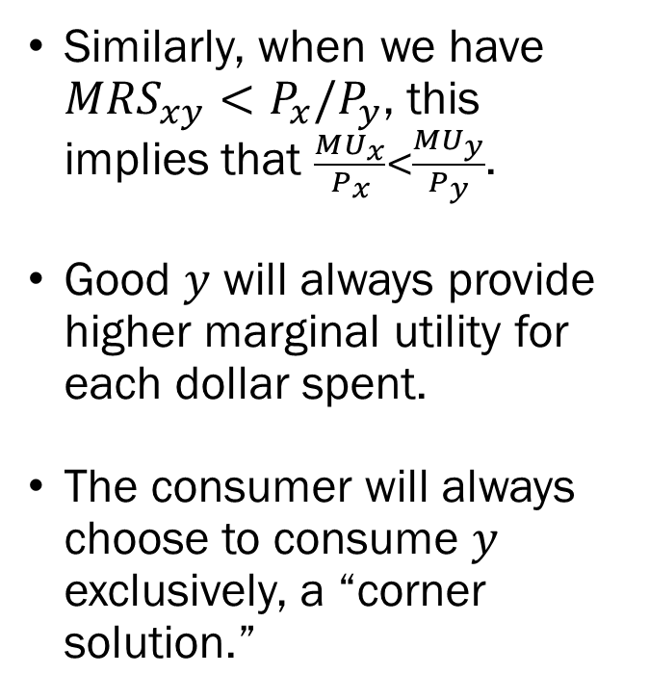
Linear Utility Functions when
$$MRS_{xy}<P_{x}/P_{y}$$
Similarly, when we have $MRS_{xy}<P_{x}/P_{y}$, this implies that $\frac{MU_{x}}{P_{x}}<\frac{MU_{y}}{P_{y}}$.
Good $y$ will always provide higher marginal utility for each dollar spent.
The consumer will always choose to consume $y$ exclusively, a “corner solution.”

Slide 14
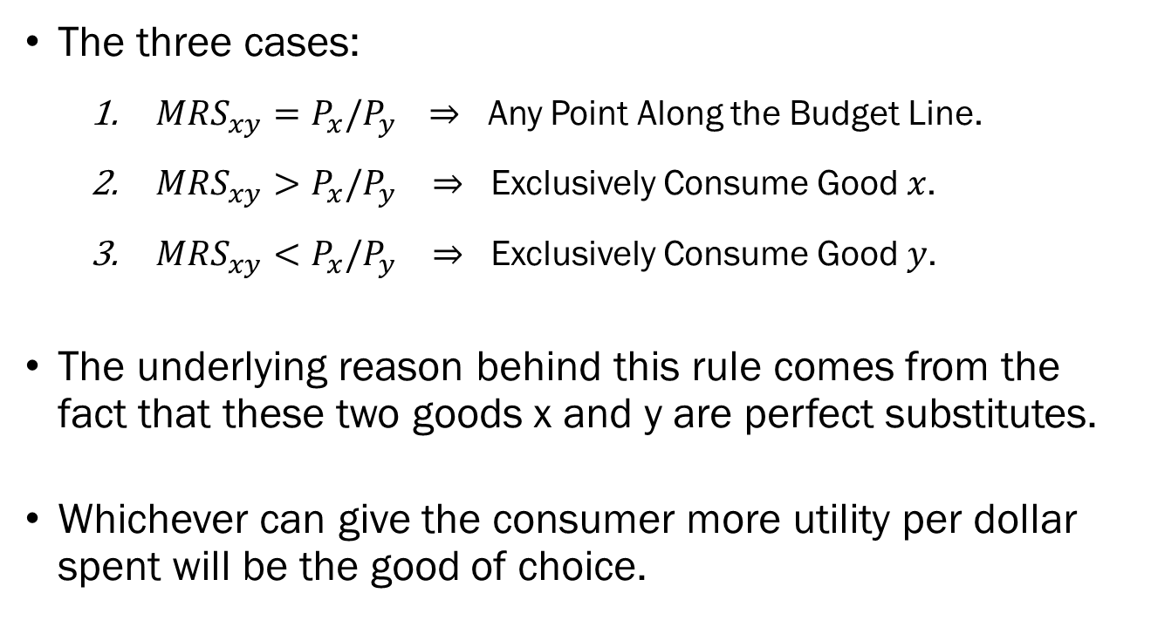
Special Case: Linear Utility Functions
The three cases:
  $MRS_{xy}=P_{x}/P_{y }$ $⇒$ Any Point Along the Budget Line.
  $MRS_{xy}>P_{x}/P_{y}$ $⇒$ Exclusively Consume Good $x$.
  $MRS_{xy}<P_{x}/P_{y}$ $⇒$ Exclusively Consume Good $y$.
The underlying reason behind this rule comes from the fact that these two goods x and y are perfect substitutes.
Whichever can give the consumer more utility per dollar spent will be the good of choice.

Slide 15
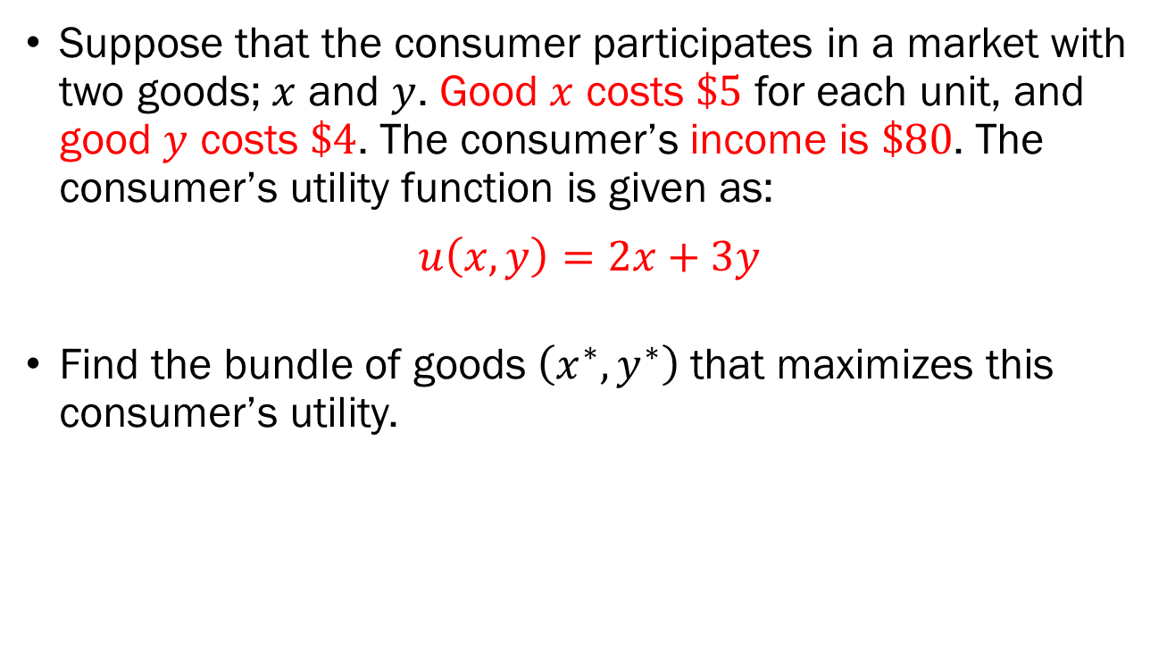
In-Class Exercise
Suppose that the consumer participates in a market with two goods; $x$ and $y$. Good $x$ costs $\$5$ for each unit, and good $y$ costs $\$4$. The consumer’s income is $\$80$. The consumer’s utility function is given as:
$$u\left(x,y\right)=2x+3y$$
Find the bundle of goods $\left(x^{∗},y^{∗}\right)$ that maximizes this consumer’s utility.

Slide 16
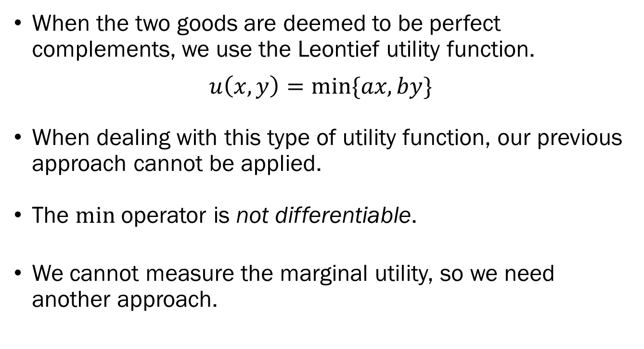
Special Case: Leontief Utility Functions
When the two goods are deemed to be perfect complements, we use the Leontief utility function.
$$u\left(x,y\right)=min⁡\{ax,by\}$$
When dealing with this type of utility function, our previous approach cannot be applied.
The $min$ operator is not differentiable.
We cannot measure the marginal utility, so we need another approach.

Slide 17
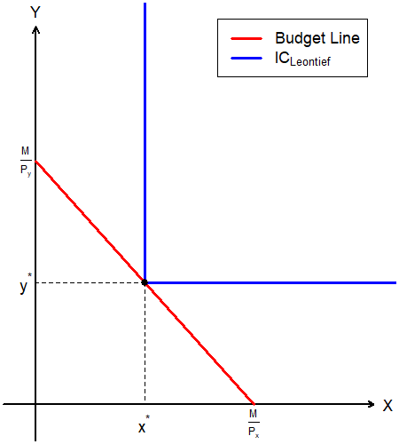
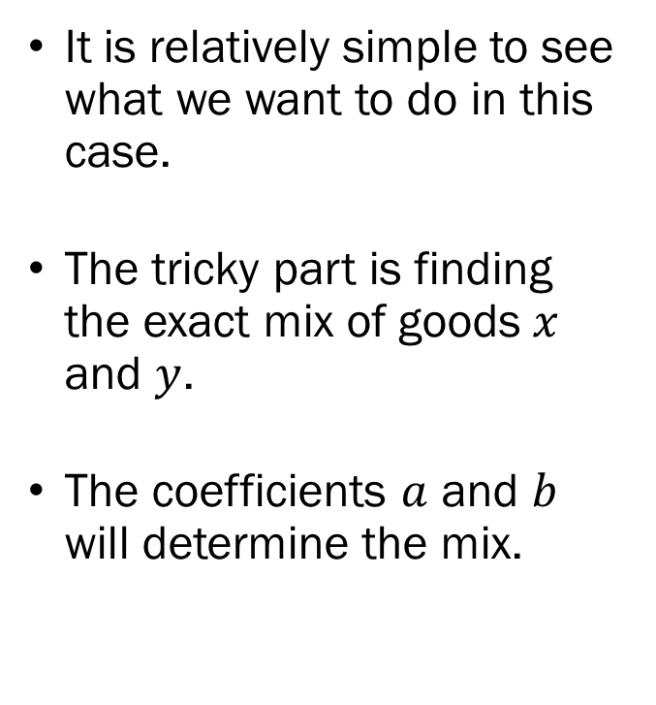
Special Case: Leontief Utility Functions
It is relatively simple to see what we want to do in this case.
The tricky part is finding the exact mix of goods $x$ and $y$.
The coefficients $a$ and $b$ will determine the mix.

Slide 18
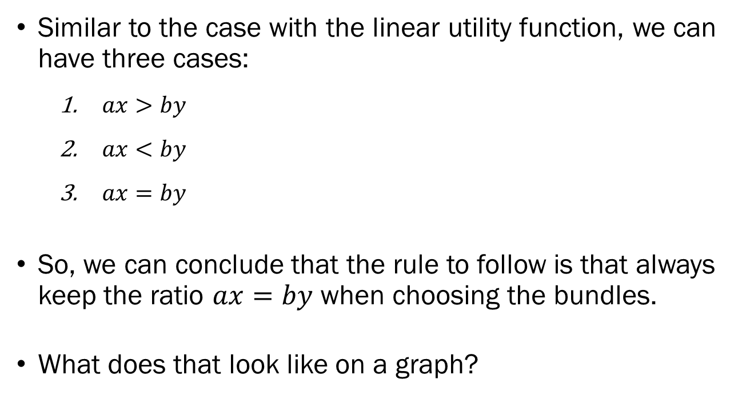
Special Case: Leontief Utility Functions
Similar to the case with the linear utility function, we can have three cases:
  $ax>by$
  $ax<by$
  $ax=by$
So, we can conclude that the rule to follow is that always keep the ratio $ax=by$ when choosing the bundles.
What does that look like on a graph?
$:u(x,y)=by ⟹$ Some amount of $x$ goes to waste.
$:u(x,y)=ax ⟹$ Some amount of $y$ goes to waste.
$:u\left(x,y\right)=ax=by ⟹$ Neither $x$ nor $y$ are wasted.

Slide 19
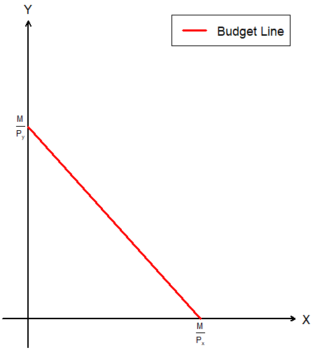
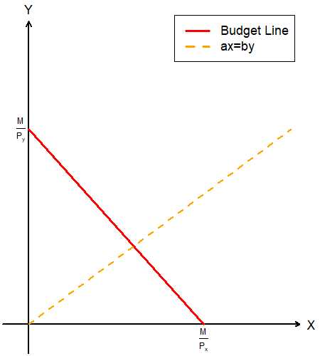
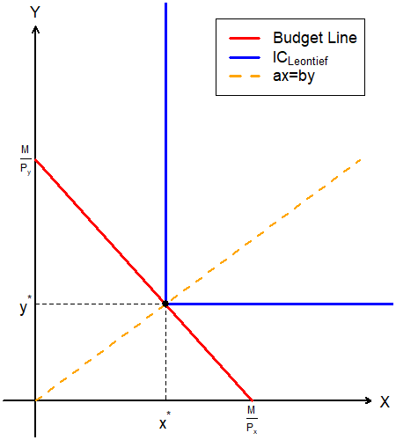
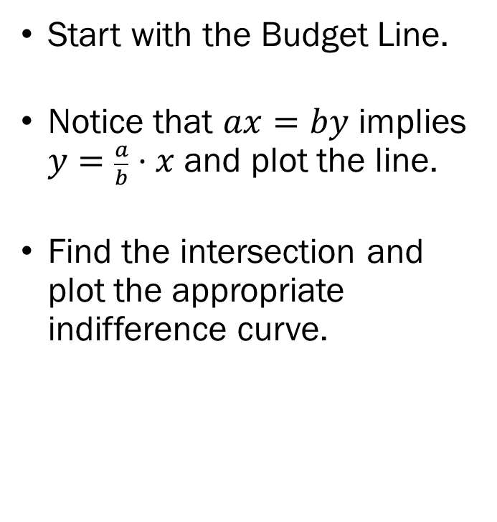
Special Case: Leontief Utility Functions
Start with the Budget Line.
Notice that $ax=by$ implies $y=\frac{a}{b}⋅x$ and plot the line.
Find the intersection and plot the appropriate indifference curve.

Slide 20
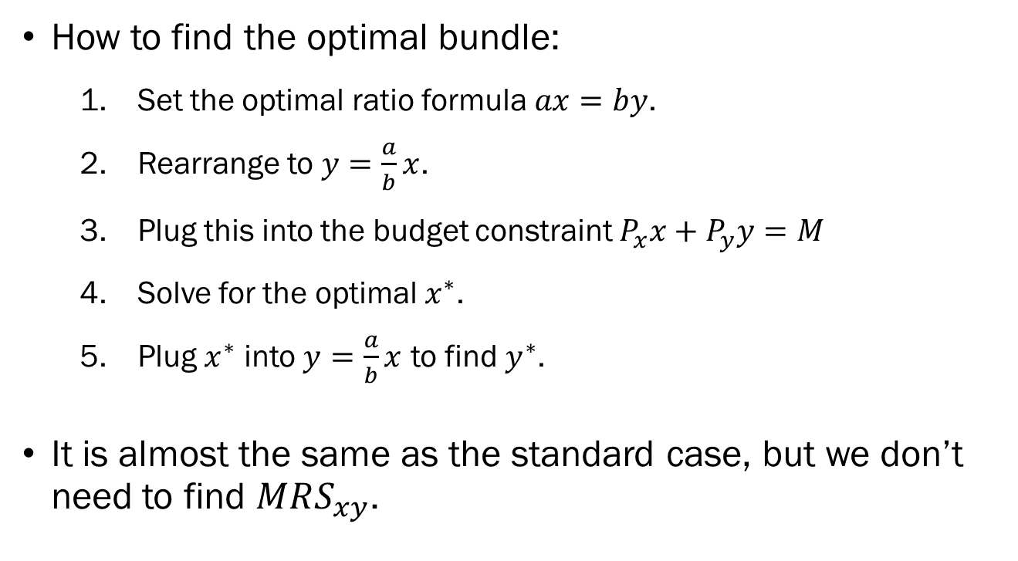
Special Case: Leontief Utility Functions
How to find the optimal bundle:
  Set the optimal ratio formula $ax=by$.
  Rearrange to $y=\frac{a}{b}x$.
  Plug this into the budget constraint $P_{x}x+P_{y}y=M$
  Solve for the optimal $x^{∗}$.
  Plug $x^{∗}$ into $y=\frac{a}{b}x$ to find $y^{∗}$.
It is almost the same as the standard case, but we don’t need to find $MRS_{xy}$.

Slide 21
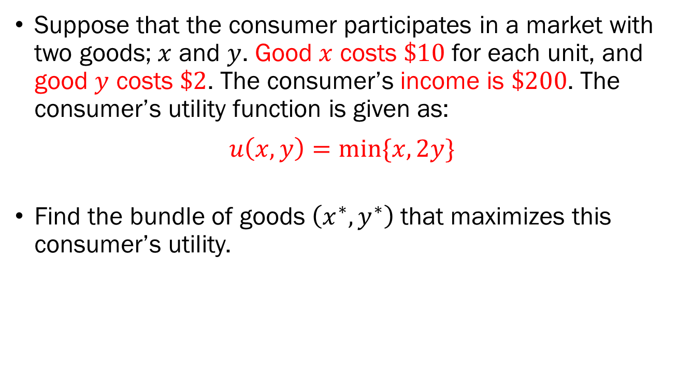
In-Class Exercise
Suppose that the consumer participates in a market with two goods; $x$ and $y$. Good $x$ costs $\$10$ for each unit, and good $y$ costs $\$2$. The consumer’s income is $\$200$. The consumer’s utility function is given as:
$$u\left(x,y\right)=\min{\{x, 2y\}}$$
Find the bundle of goods $\left(x^{∗},y^{∗}\right)$ that maximizes this consumer’s utility.

Slide 22
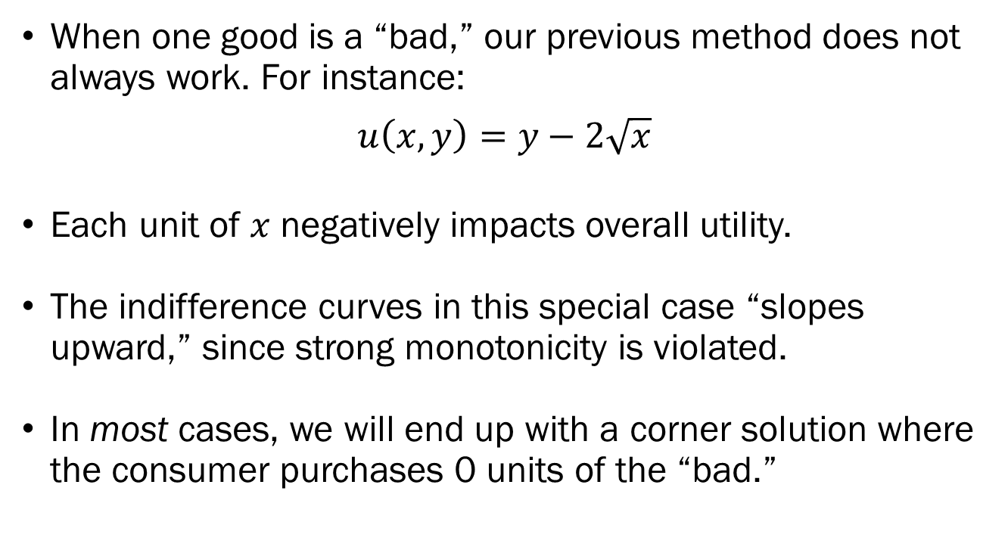

Special Case: When $x$ is a “Bad”
When one good is a “bad,” our previous method does not always work. For instance:
$$u\left(x,y\right)=y−2\sqrt{x}$$
Each unit of $x$ negatively impacts overall utility.
The indifference curves in this special case “slopes upward,” since strong monotonicity is violated.
In most cases, we will end up with a corner solution where the consumer purchases 0 units of the “bad.”

Slide 23
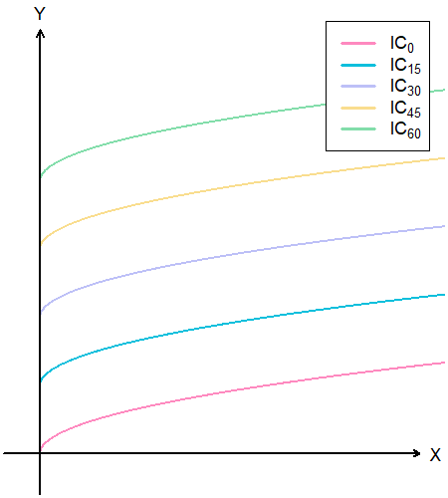
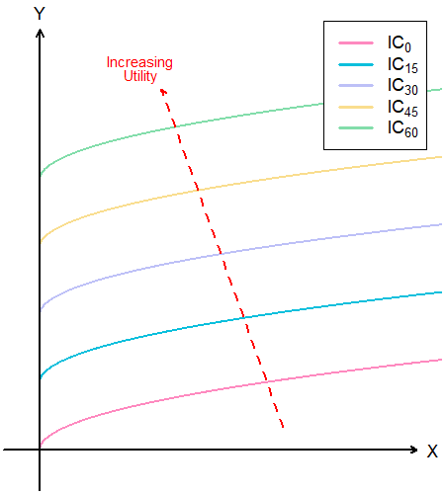
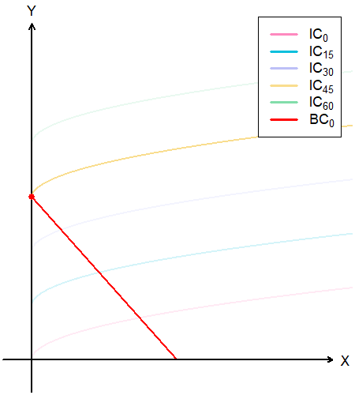
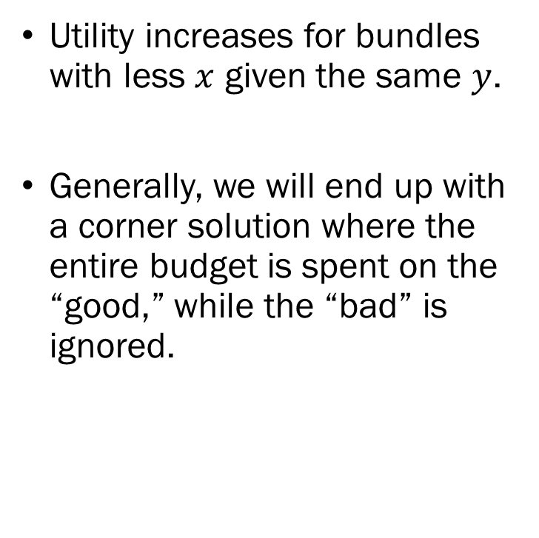
Special Case: When $x$ is a “Bad”
Utility increases for bundles with less $x$ given the same $y$.
Generally, we will end up with a corner solution where the entire budget is spent on the “good,” while the “bad” is ignored.

Slide 24
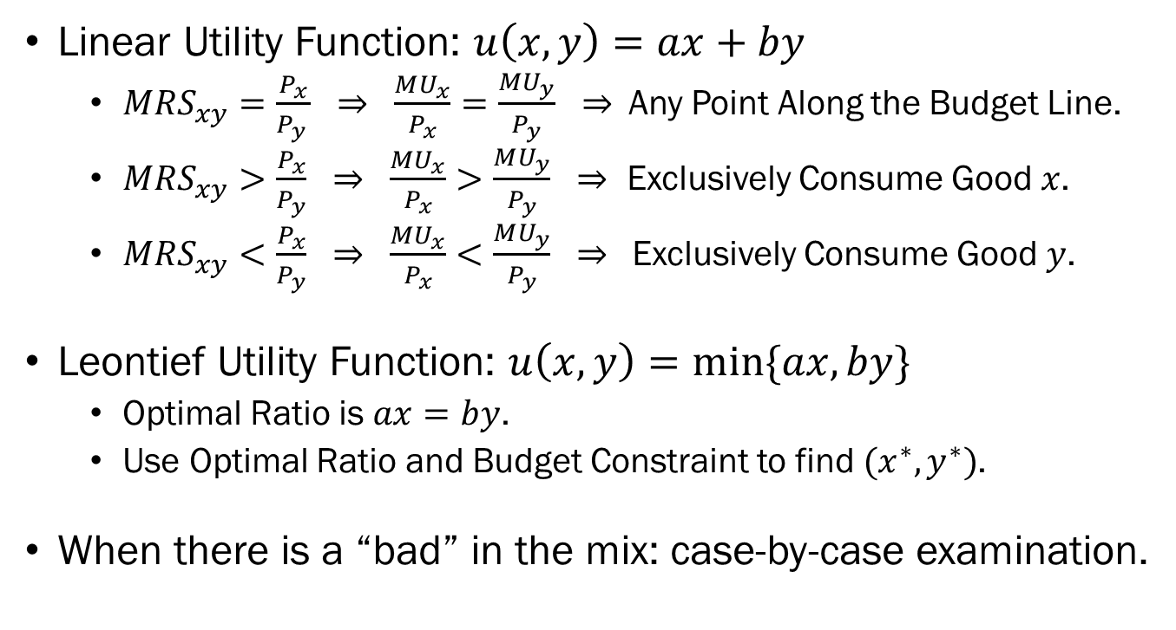
Recap of Special Cases
Linear Utility Function: $u\left(x,y\right)=ax+by$
  $MRS_{xy}=\frac{P_{x}}{P_{y }} ⇒ \frac{MU_{x}}{P_{x}}=\frac{MU_{y}}{P_{y}}$ $⇒$Any Point Along the Budget Line.
  $MRS_{xy}>\frac{P_{x}}{P_{y}} ⇒ \frac{MU_{x}}{P_{x}}>\frac{MU_{y}}{P_{y}} ⇒$ Exclusively Consume Good $x$.
  $MRS_{xy}<\frac{P_{x}}{P_{y}} ⇒ \frac{MU_{x}}{P_{x}}<\frac{MU_{y}}{P_{y}} ⇒$Exclusively Consume Good $y$.
Leontief Utility Function: $u\left(x,y\right)=min⁡\{ax,by\}$
  Optimal Ratio is $ax=by$.
  Use Optimal Ratio and Budget Constraint to find $(x^{∗},y^{∗})$.
When there is a “bad” in the mix: case-by-case examination.

