Slide 1
Consumer Theory:
Comparative Statics of UMP Part 1
ECON 300

Slide 2
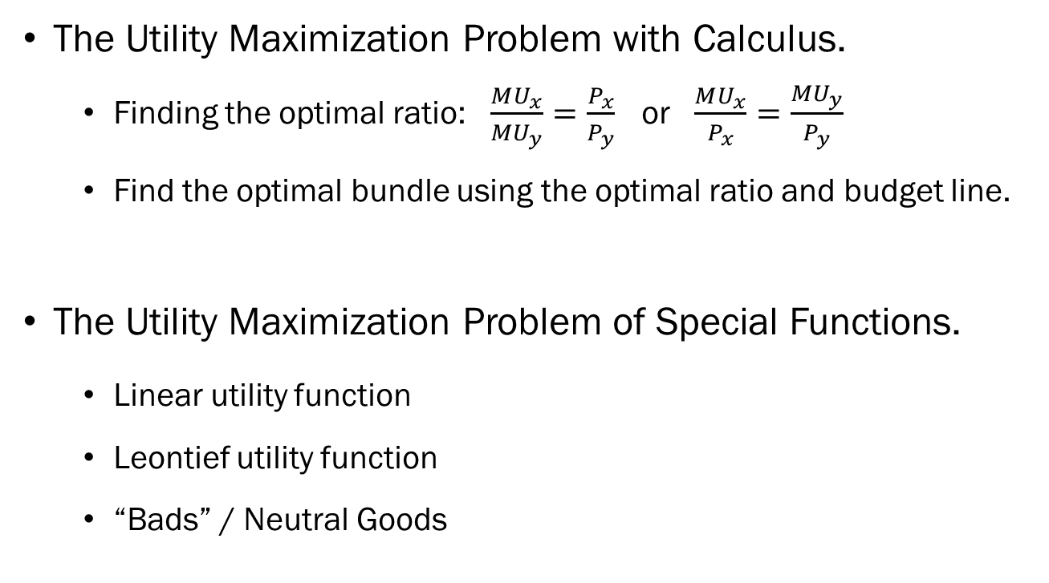
Review of Previous Lecture(s)
The Utility Maximization Problem with Calculus.
  Finding the optimal ratio: $\frac{MU_{x}}{MU_{y}}=\frac{P_{x}}{P_{y}}$ or $\frac{MU_{x}}{P_{x}}=\frac{MU_{y}}{P_{y}}$
  Find the optimal bundle using the optimal ratio and budget line.
The Utility Maximization Problem of Special Functions.
  Linear utility function
  Leontief utility function
  “Bads” / Neutral Goods

Slide 3
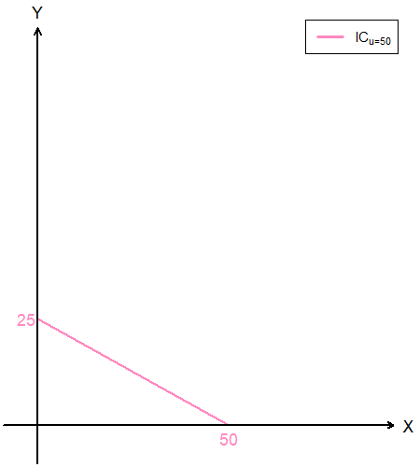
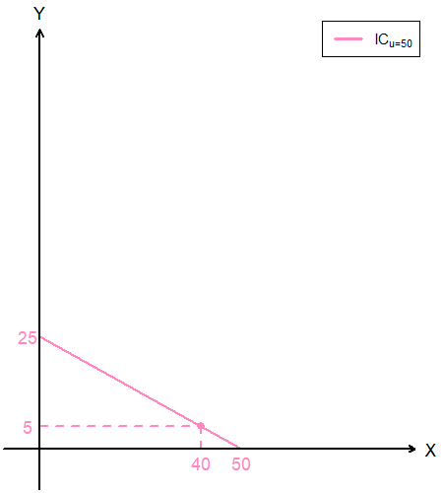
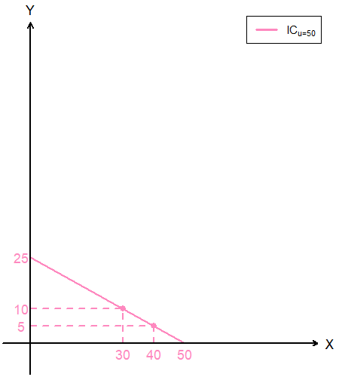
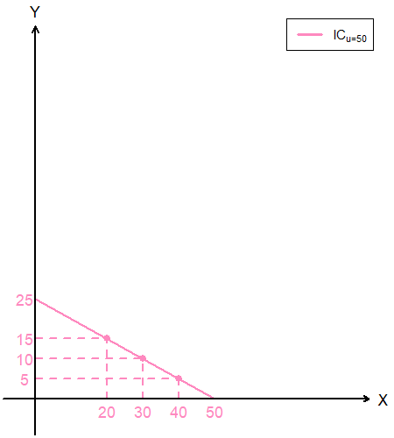
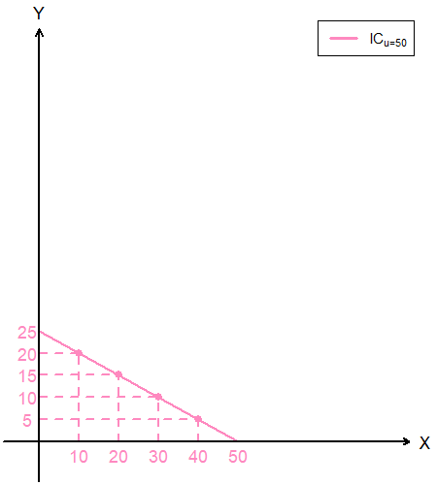
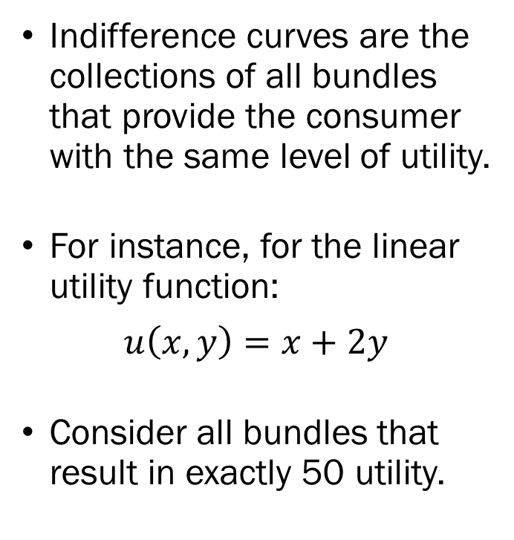
Recap: Indifference Curve
Indifference curves are the collections of all bundles that provide the consumer with the same level of utility.
For instance, for the linear utility function:
$$u\left(x,y\right)=x+2y$$
Consider all bundles that result in exactly 50 utility.

Slide 4
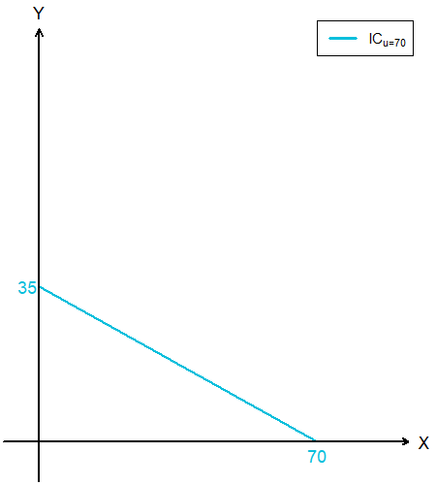
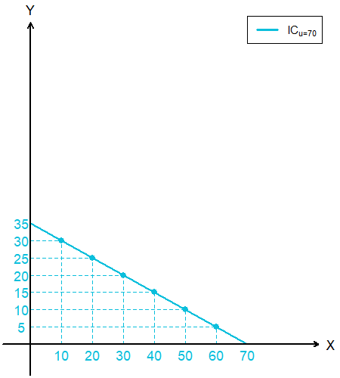
Recap: Indifference Curve
Now consider an indifference curve that represents a higher level of utility.
Observe that any point along this indifference curve will provide the consumer with exactly 70 utility.

Slide 5
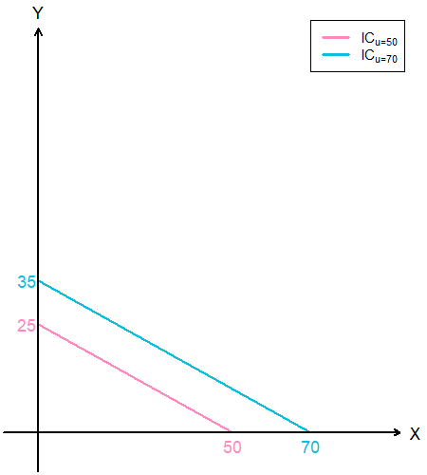
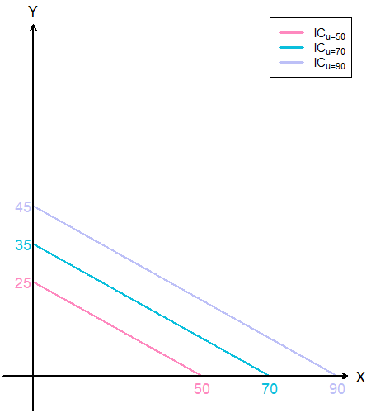
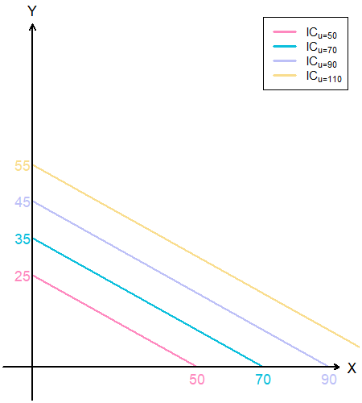
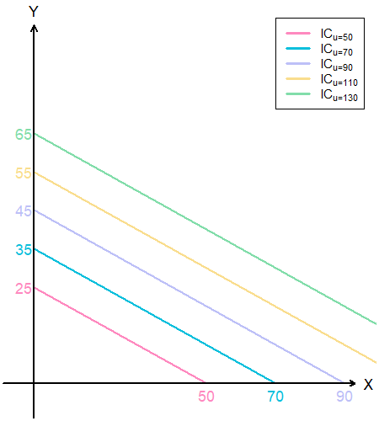
Recap: Indifference Curve
We can repeat this exercise for any level of utility we want, and we will find that the indifference curve representing higher utility values will always be “above” ones representing lower utility values.

Slide 6
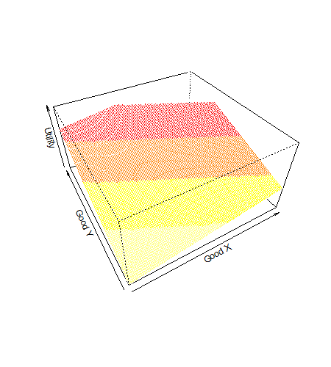
Recap: Indifference Curve
If we plot the utility function, we have a 3D model where the level of utility is plotted on the third axis.
This illustrates what it means to say that the indifference curves are “contour lines” on a map. They represent the “height” of utility for each bundle.

Slide 7
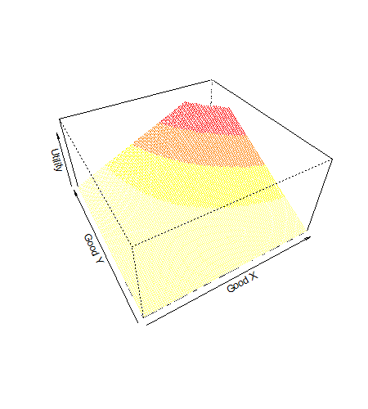
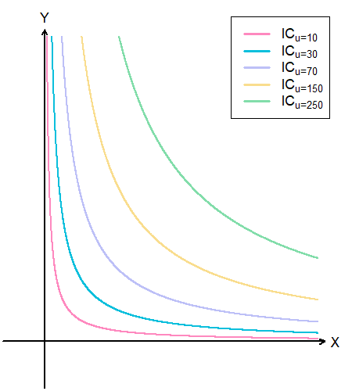
Recap: Indifference Curve
3D Plot of a Cobb-Douglas Utility Function
ICs of the Cobb-Douglas Utility Function

Slide 8
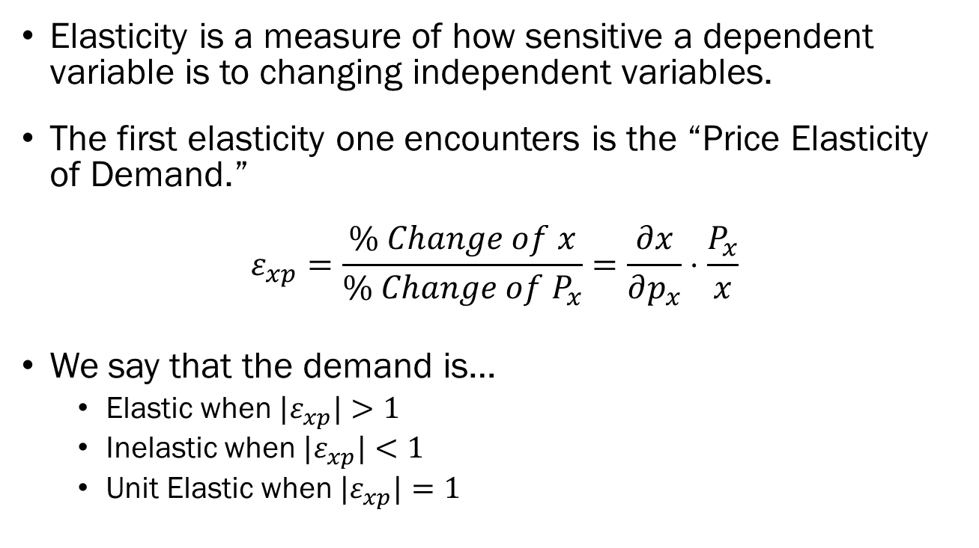
Recap: Elasticity
Elasticity is a measure of how sensitive a dependent variable is to changing independent variables.
The first elasticity one encounters is the “Price Elasticity of Demand.”
$$ε_{xp}=\frac{\% Change of x}{\% Change of P_{x}}=\frac{∂x}{∂p_{x}}⋅\frac{P_{x}}{x}$$
We say that the demand is…
  Elastic when ${|ε}_{xp}|>1$
  Inelastic when ${|ε}_{xp}|<1$
  Unit Elastic when ${|ε}_{xp}|=1$

Slide 9
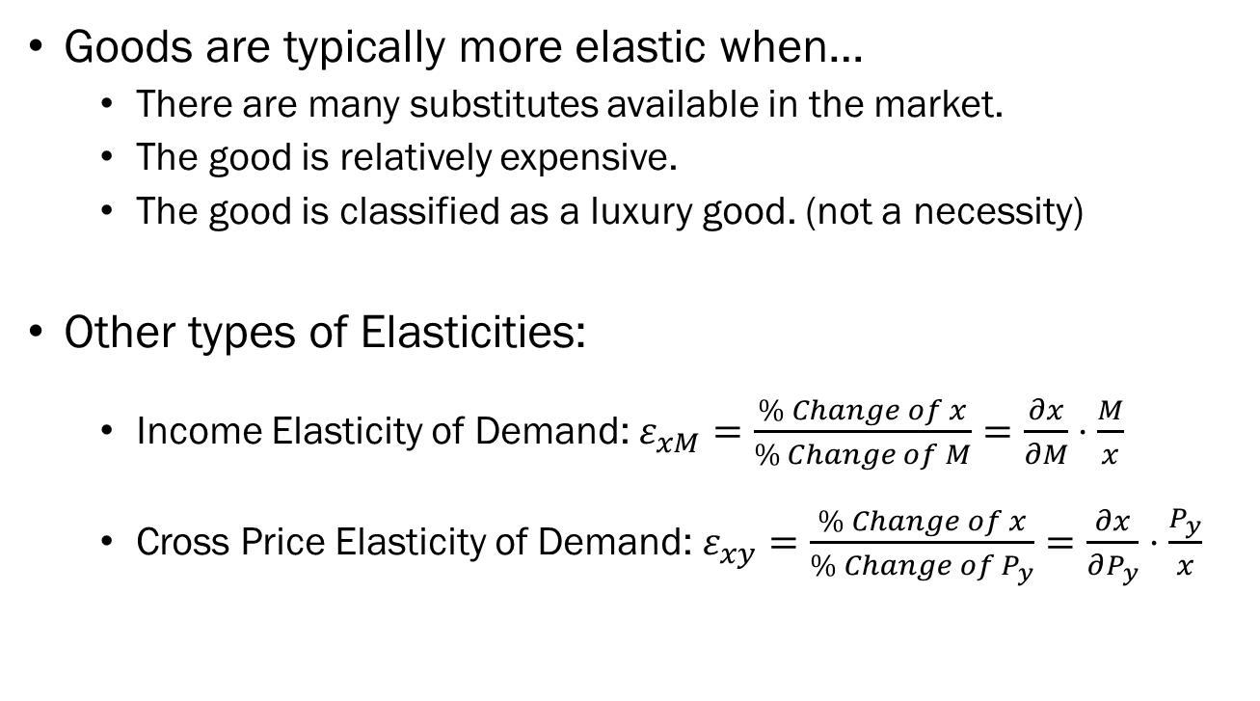
Recap: Elasticity
Goods are typically more elastic when…
  There are many substitutes available in the market.
  The good is relatively expensive.
  The good is classified as a luxury good. (not a necessity)
Other types of Elasticities:
  Income Elasticity of Demand: $ε_{xM}=\frac{\% Change of x}{\% Change of M}=\frac{∂x}{∂M}⋅\frac{M}{x}$
  Cross Price Elasticity of Demand: $ε_{xy}=\frac{\% Change of x}{\% Change of P_{y}}=\frac{∂x}{∂P_{y}}⋅\frac{P_{y}}{x}$

Slide 10
Comparative Statics of the UMP Part 1
Changes to the consumer’s income.
  Normal Goods and Inferior Goods
  Luxury Goods and Necessary Goods
  The Income Consumption Curve
  The Engel Curve

Slide 11
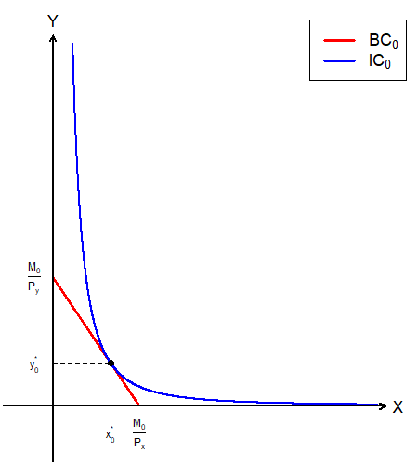
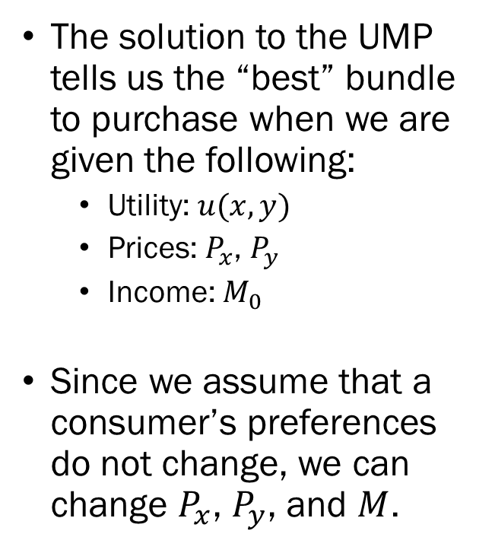
The Utility Maximization Problem
The solution to the UMP tells us the “best” bundle to purchase when we are given the following:
  Utility: $u(x,y)$
  Prices: $P_{x}$, $P_{y}$
  Income: $M_{0}$
Since we assume that a consumer’s preferences do not change, we can change $P_{x}$, $P_{y}$, and $M$.

Slide 12
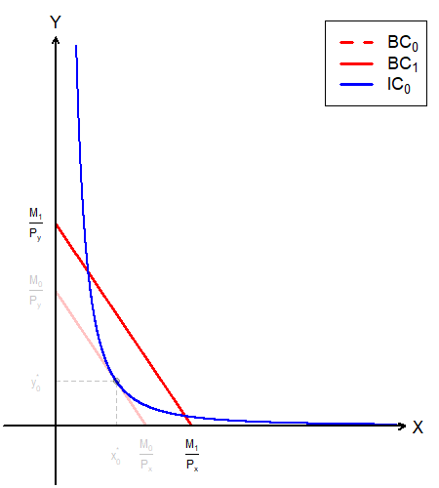
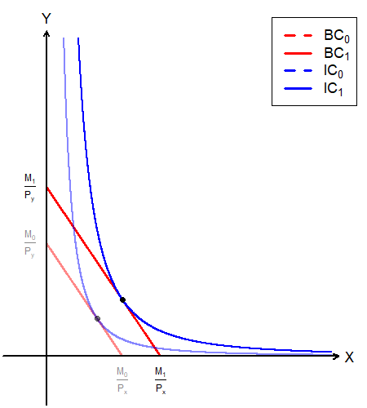

UMP: Changes in $M$
When the consumer’s income increases…
The budget set expands, and the budget line shifts outward.
The consumer can now reach a higher level of utility.

Slide 13
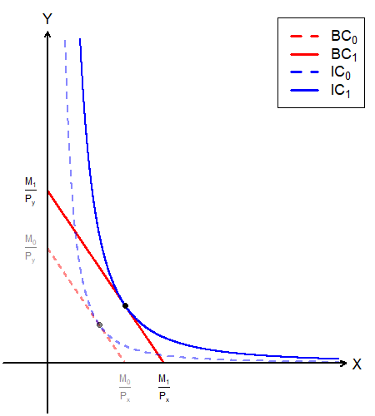
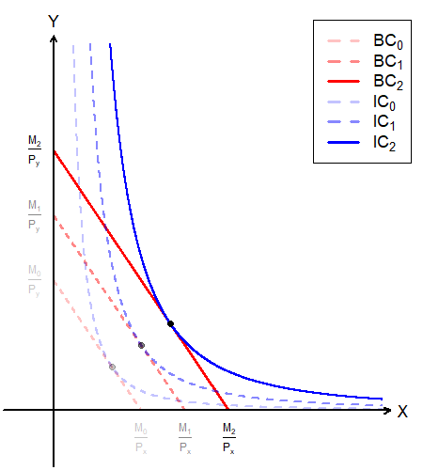
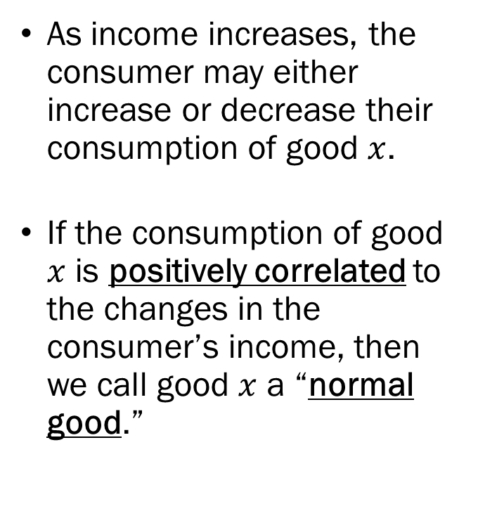
Normal Goods
As income increases, the consumer may either increase or decrease their consumption of good $x$.
If the consumption of good $x$ is positively correlated to the changes in the consumer’s income, then we call good $x$ a “normal good.”

Slide 14
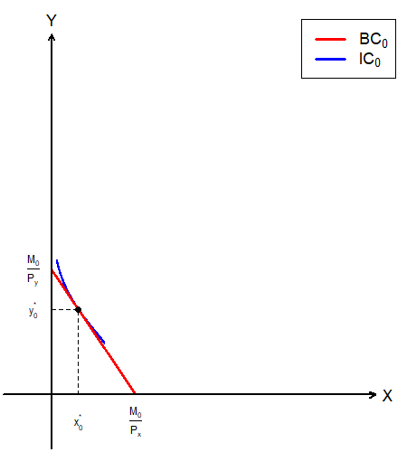
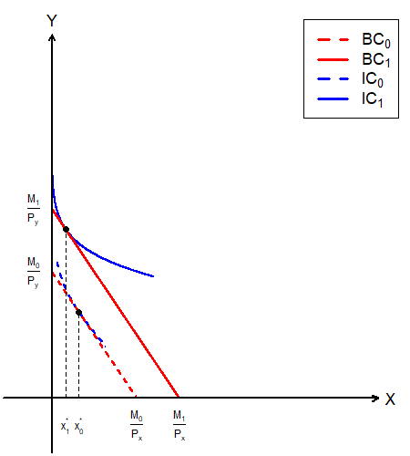
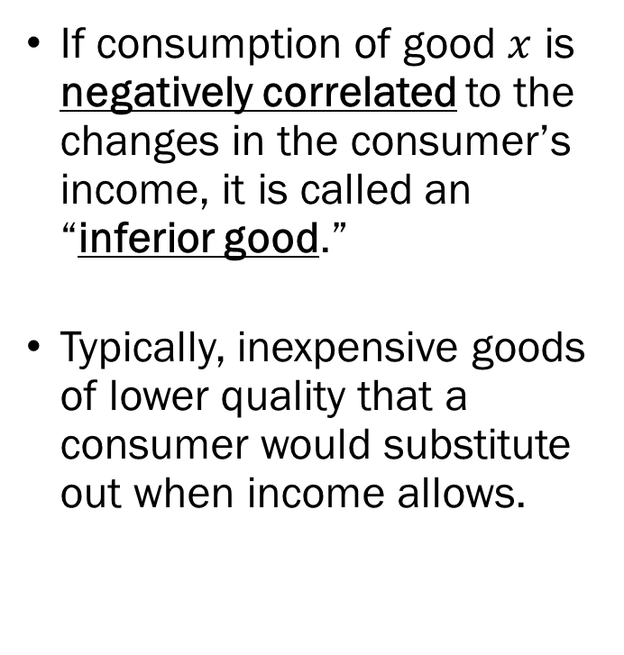
Inferior Goods
If consumption of good $x$ is negatively correlated to the changes in the consumer’s income, it is called an “inferior good.”
Typically, inexpensive goods of lower quality that a consumer would substitute out when income allows.

Slide 15
Normal Goods vs. Inferior Goods
Normal Goods:
  Income Elasticity of Demand is greater than 0.
  Consumption increases as income increases.
  Consumption decreases as income decreases.
  Classified into luxury goods and necessary goods.
Inferior Goods:
  Income Elasticity of Demand is less than 0.
  Consumption decreases as income increases.
  Consumption increases as income decreases.

Slide 16
Luxury Goods vs. Necessary Goods
Both Luxury Goods and Necessary Goods are Normal Goods.
Luxury Goods:
  Income Elasticity of Demand is greater than 1.
  Consumption increases more than what is proportional as the increase in income.
Necessary Goods:
  Income Elasticity of Demand is between 0 and 1.
  Consumption increases less than what is proportional as the increase in income.

Slide 17
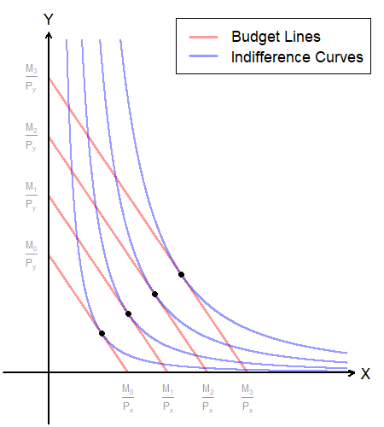
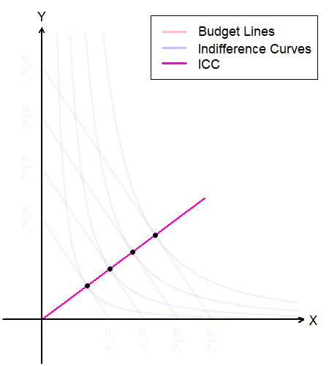
The Income Consumption Curve
At each new level of income, the optimal bundle is subject to change.
The collection of these optimal bundles for each possible level of income is the “Income Consumption Curve (ICC).”

Slide 18
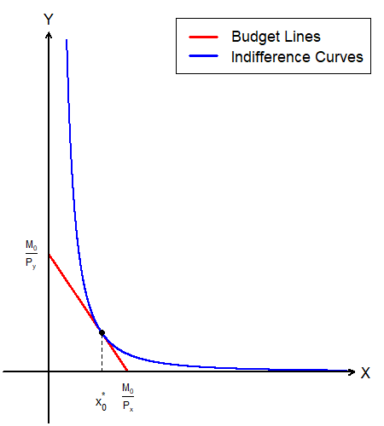
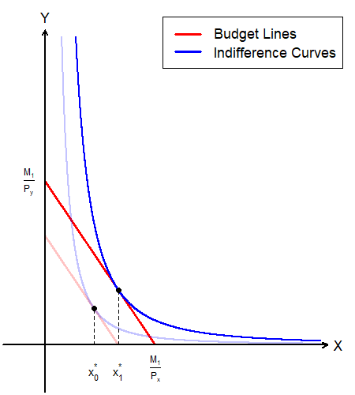
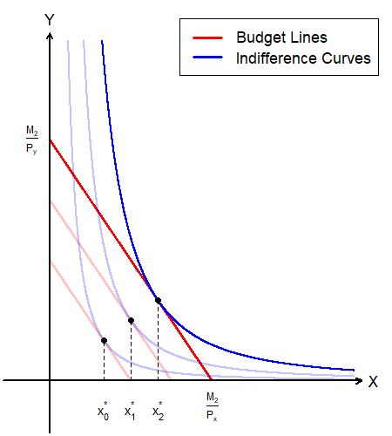
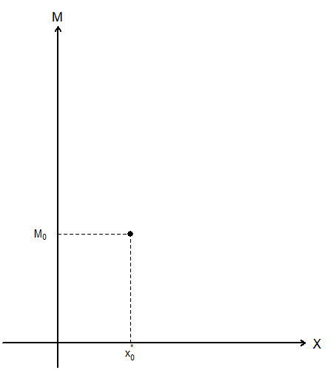
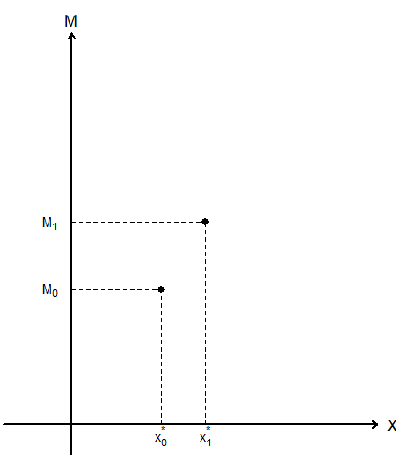
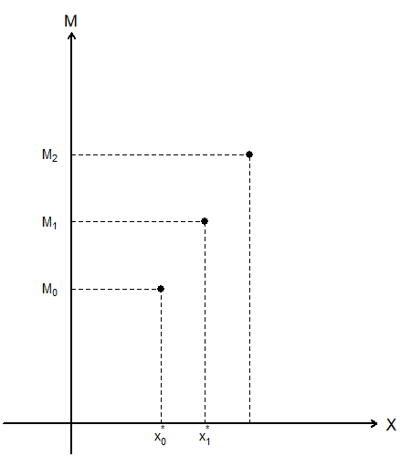
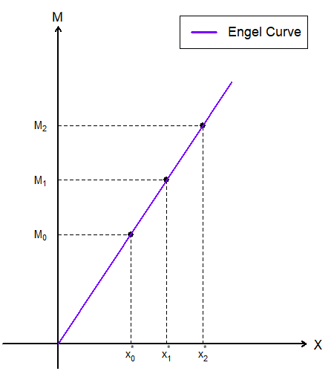
The ICC and the Engel Curve

Slide 19
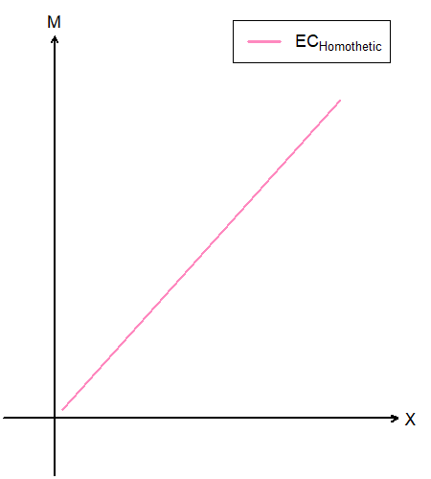
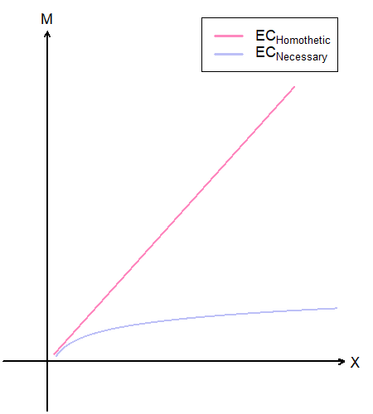
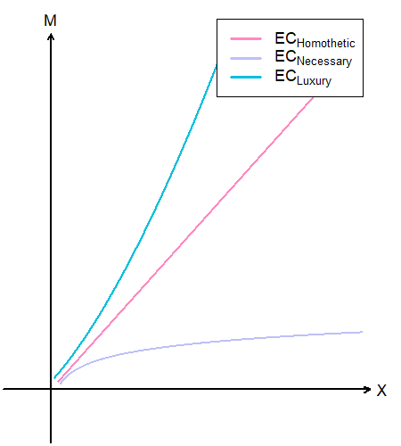
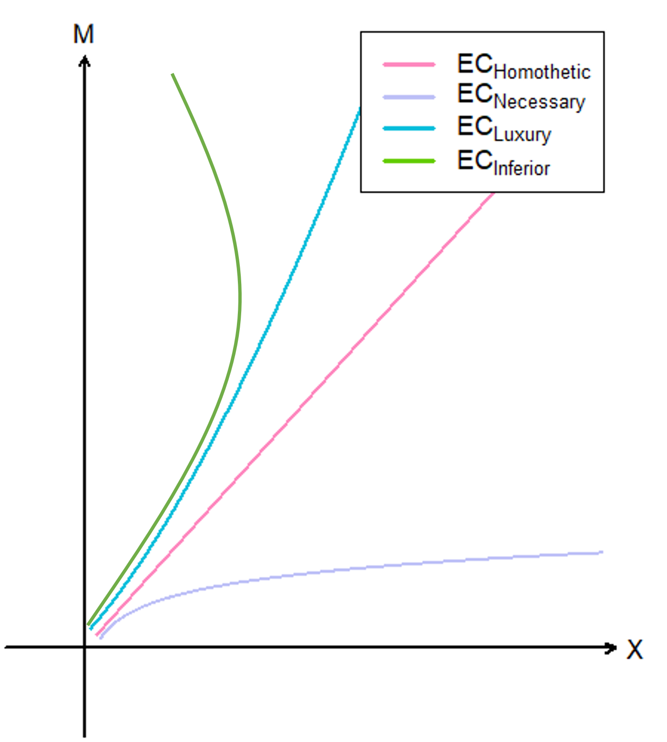
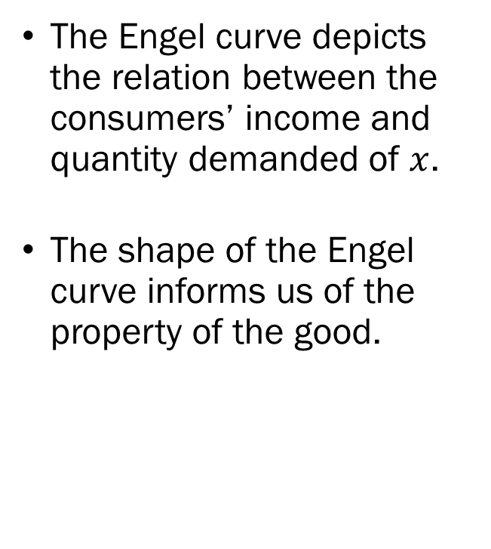
The Engel Curve
The Engel curve depicts the relation between the consumers’ income and quantity demanded of $x$.
The shape of the Engel curve informs us of the property of the good.

Slide 20
Today’s Lecture
Recap of Indifference Curves
Recap of Elasticities
Comparative Statics of the UMP Part 1
  Normal vs. Inferior Goods
  Necessary vs. Luxury Goods
  Income Consumption Curve
  Engel Curve

Slide 21
Future Topics
Comparative Statics of the UMP Part 2
  Ordinary vs. Giffen Goods
  Price Consumption Curve
  (Walrasian) Demand Curve
  Deriving the Demand Function
Comparative Statics of the UMP Part 3
  Income Effects and Substitution Effects
  (Hicksian) Compensated Demand Curve
(Tentative) Revealed Preferences

