Slide 1
Consumer Theory:
Comparative Statics of UMP Part 2
ECON 300

Slide 2
Review of Previous Lecture
Comparative Statics of the UMP: Part 1
  Changes in the consumer’s income.
  Normal vs. Inferior Goods
  Luxury vs. Necessary Goods
  The Income Consumption Curve
  The Engel Curve

Slide 3
Today’s Topics
Comparative Statics of the UMP: Part 2
  Changes in the market price(s).
  Ordinary vs. Giffen Goods
  The Price Consumption Curve
  The Demand Curve
  Deriving the Demand Function

Slide 4
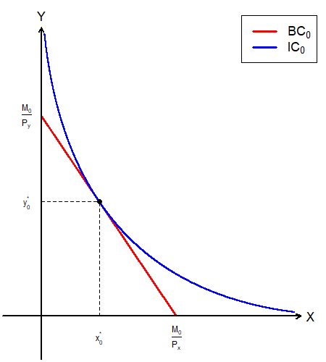
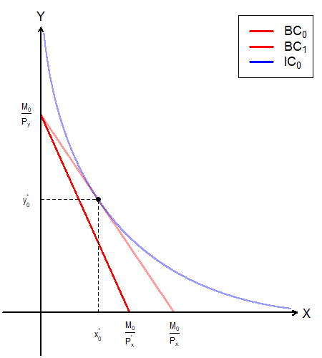
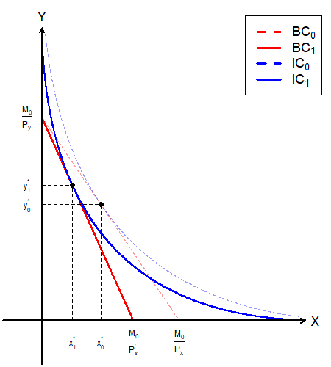
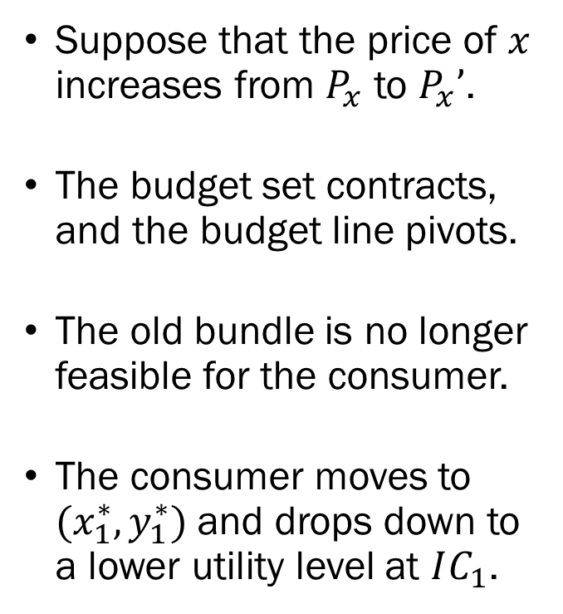

UMP: Changes in $P_{x}$
Suppose that the price of $x$ increases from $P_{x}$ to $P_{x}’$.
The budget set contracts, and the budget line pivots.
The old bundle is no longer feasible for the consumer.
The consumer moves to $(x_{1}^{∗},y_{1}^{∗})$ and drops down to a lower utility level at $IC_{1}$.

Slide 5
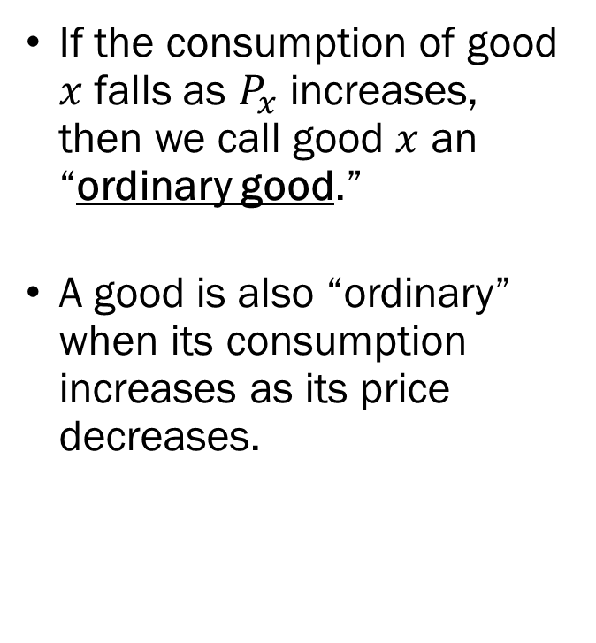
Ordinary Goods
If the consumption of good $x$ falls as $P_{x}$ increases, then we call good $x$ an “ordinary good.”
A good is also “ordinary” when its consumption increases as its price decreases.

Slide 6
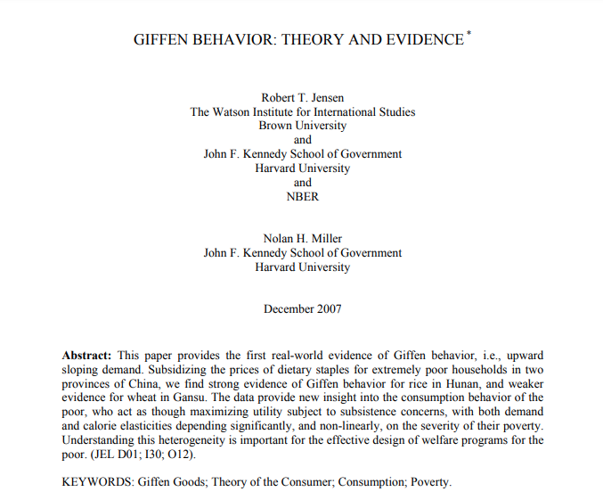
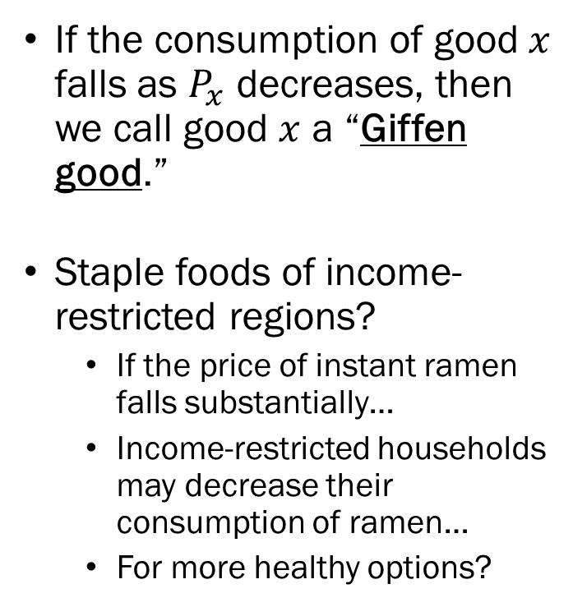
Giffen Goods
If the consumption of good $x$ falls as $P_{x}$ decreases, then we call good $x$ a “Giffen good.”
Staple foods of income-restricted regions?
  If the price of instant ramen falls substantially…
  Income-restricted households may decrease their consumption of ramen…
  For more healthy options?

Slide 7
Ordinary Goods vs. Giffen Goods
Ordinary Goods:
  Price Elasticity of Demand is less than 0.
  Consumption increases as Price decreases.
  Consumption decreases as Price increases.
Giffen Goods:
  Price Elasticity of Demand is greater than 0.
  Consumption increases as Price increases.
  Consumption decreases as Price decreases.

Slide 8
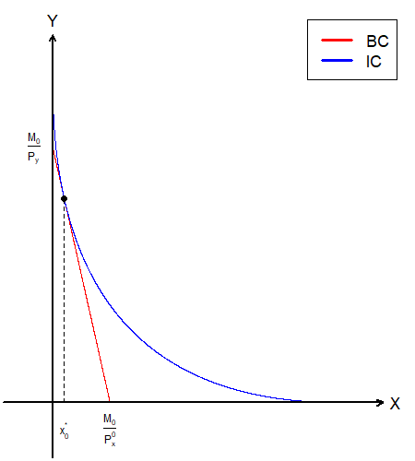
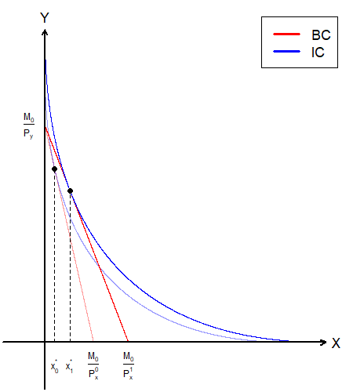
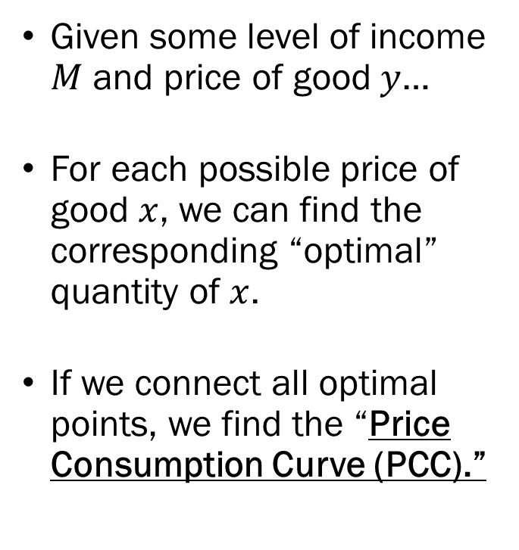
The Price Consumption Curve
Given some level of income $M$ and price of good $y$…
For each possible price of good $x$, we can find the corresponding “optimal” quantity of $x$.
If we connect all optimal points, we find the “Price Consumption Curve (PCC).”

Slide 9
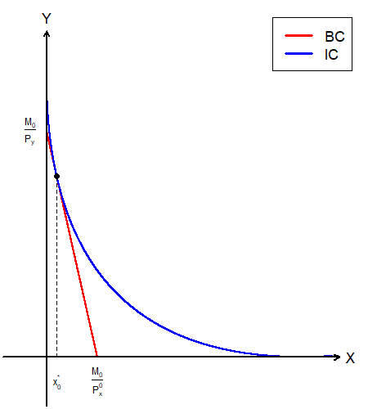
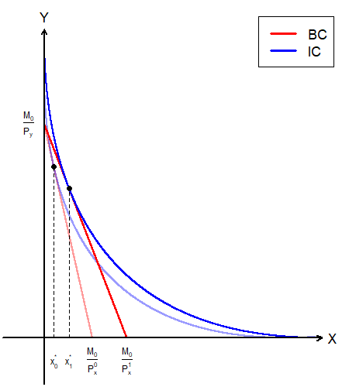
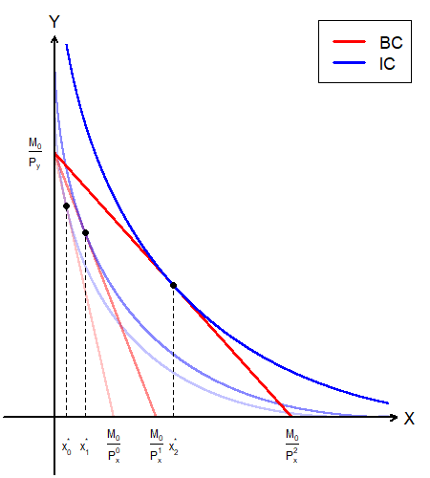
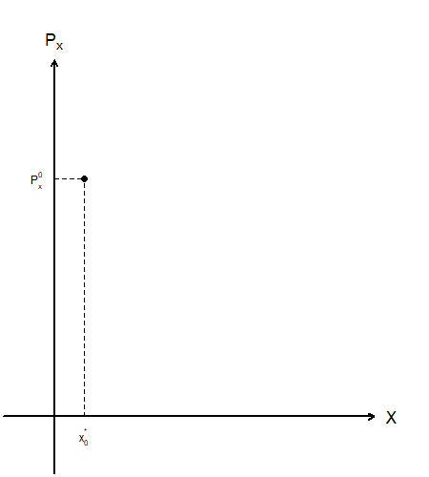
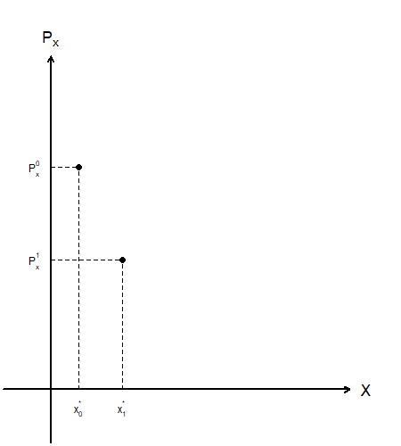
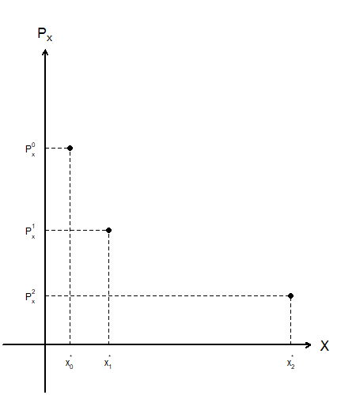
The PCC and the Demand Curve

Slide 10
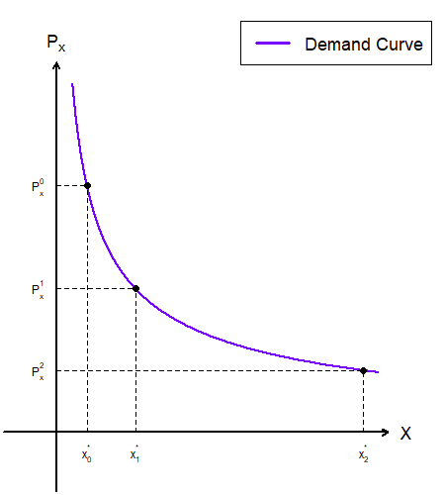
From the UMP to the Demand Function
We find the classical “downward sloping” demand curve.
Explains the relationship between the good’s price and quantity demanded.
This is called the (Walrasian) Demand curve.

Slide 11
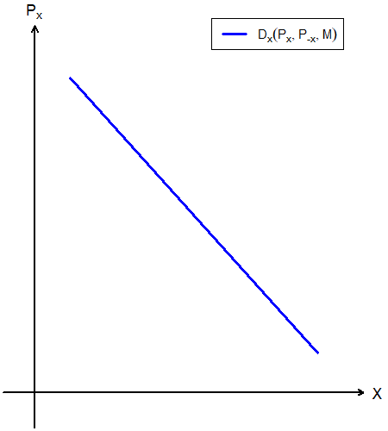
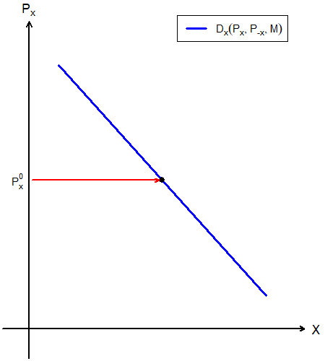
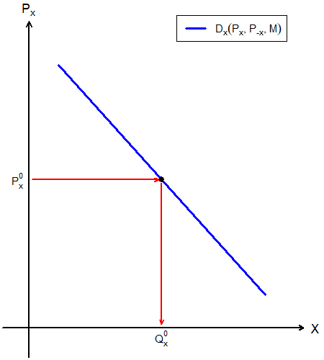
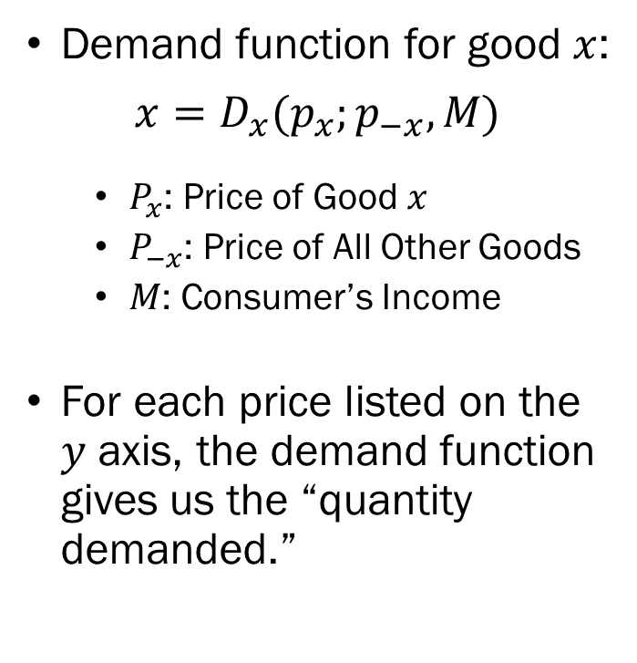
Demand Curve Basics
Demand function for good $x$:
$$x=D_{x}(p_{x};p_{−x},M)$$
  $P_{x}$: Price of Good $x$
  $P_{−x}$: Price of All Other Goods
  $M$: Consumer’s Income
For each price listed on the $y$ axis, the demand function gives us the “quantity demanded.”

Slide 12
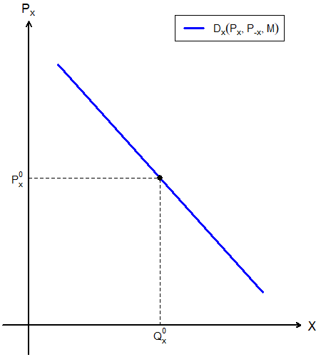
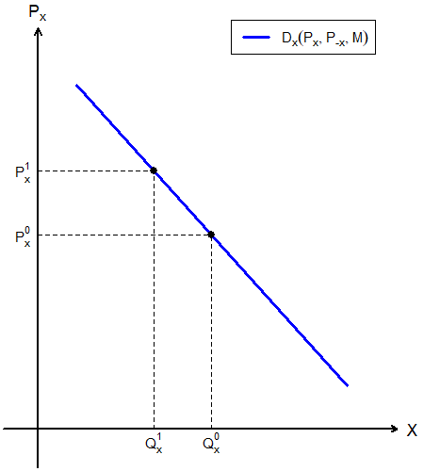
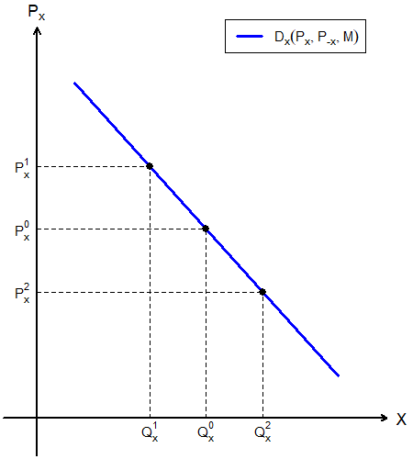
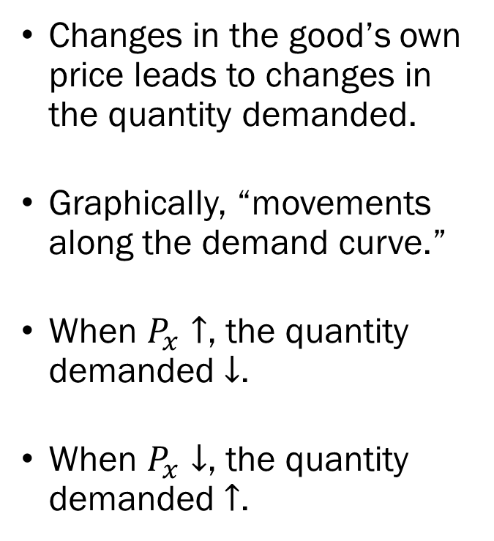
Recap: The Demand Curve
Changes in the good’s own price leads to changes in the quantity demanded.
Graphically, “movements along the demand curve.”
When $P_{x}↑$, the quantity demanded $↓$.
When $P_{x}↓$, the quantity demanded $↑$.

Slide 13
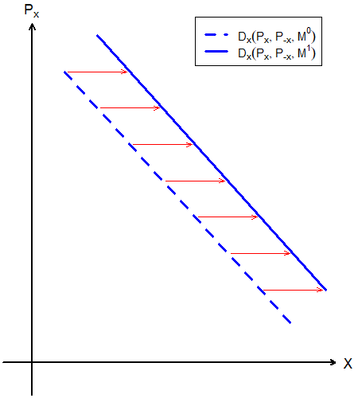
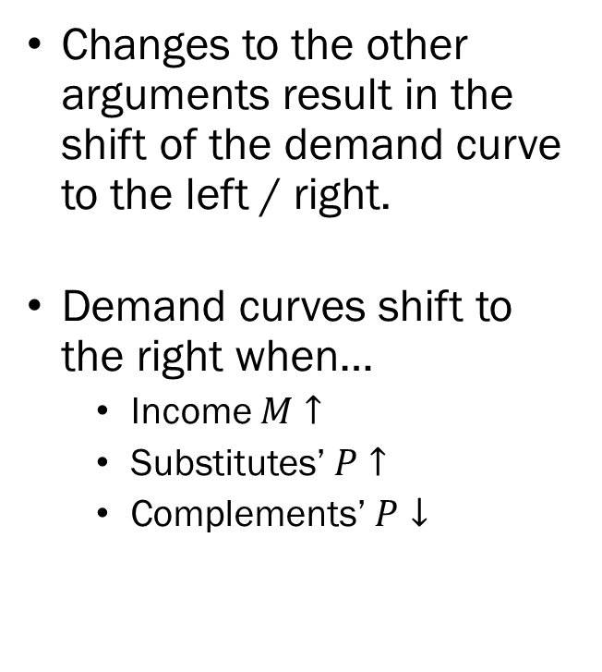
Recap: The Demand Curve
Changes to the other arguments result in the shift of the demand curve to the left / right.
Demand curves shift to the right when…
  Income $M↑$
  Substitutes’ $P↑$
  Complements’ $P↓$

Slide 14
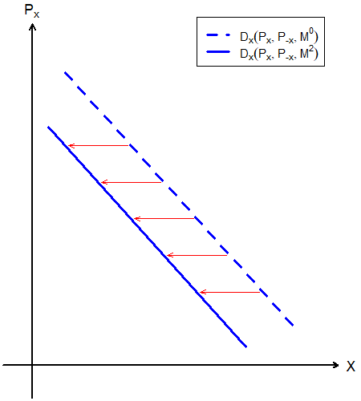
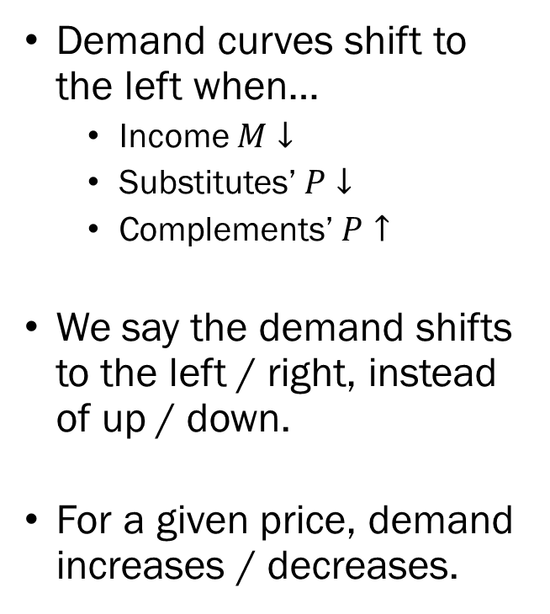
Recap: The Demand Curve
Demand curves shift to the left when…
  Income $M↓$
  Substitutes’ $P↓$
  Complements’ $P↑$
We say the demand shifts to the left / right, instead of up / down.
For a given price, demand increases / decreases.

Slide 15
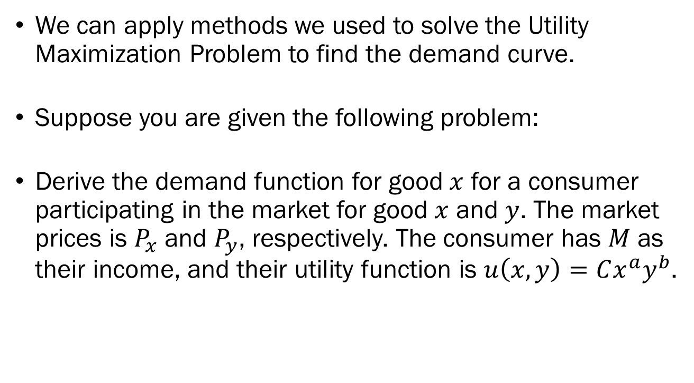
Deriving the Demand Curve
We can apply methods we used to solve the Utility Maximization Problem to find the demand curve.
Suppose you are given the following problem:
Derive the demand function for good $x$ for a consumer participating in the market for good $x$ and $y$. The market prices is $P_{x}$ and $P_{y}$, respectively. The consumer has $M$ as their income, and their utility function is $u\left(x,y\right)=Cx^{a}y^{b}$.

Slide 16
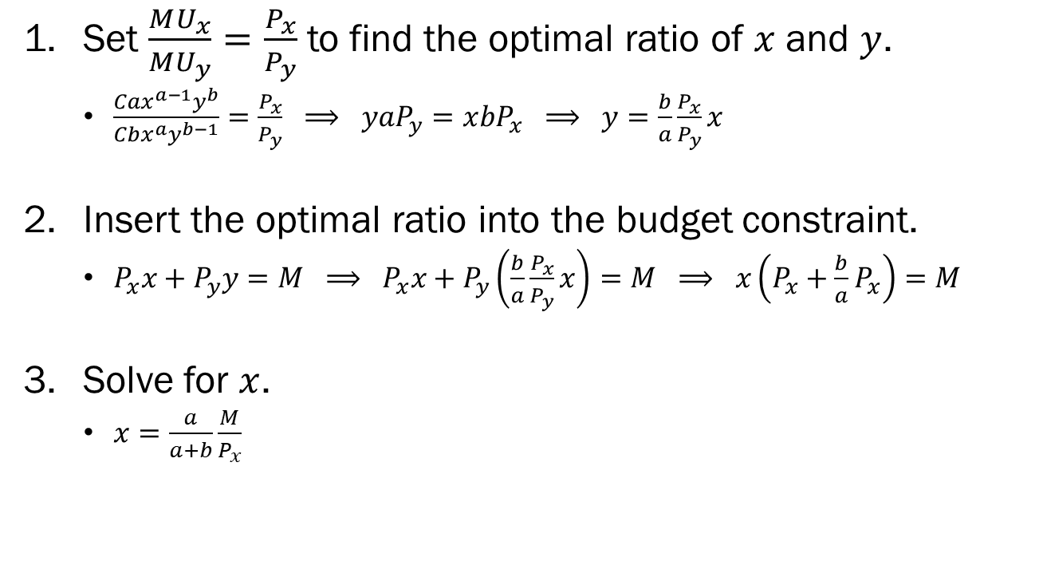
Deriving the Demand Curve
Set $\frac{MU_{x}}{MU_{y}}=\frac{P_{x}}{P_{y}}$ to find the optimal ratio of $x$ and $y$.
  $\frac{Cax^{a−1}y^{b}}{Cbx^{a}y^{b−1}}=\frac{P_{x}}{P_{y}} ⟹ y{aP}_{y}=x{bP}_{x} ⟹ y=\frac{b}{a}\frac{P_{x}}{P_{y}}x$
Insert the optimal ratio into the budget constraint.
  $P_{x}x+P_{y}y=M ⟹ P_{x}x+P_{y}\left(\frac{b}{a}\frac{P_{x}}{P_{y}}x\right)=M ⟹ x\left(P_{x}+\frac{b}{a}P_{x}\right)=M$
Solve for $x$.
  $x=\frac{a}{a+b}\frac{M}{P_{x}}$

Slide 17
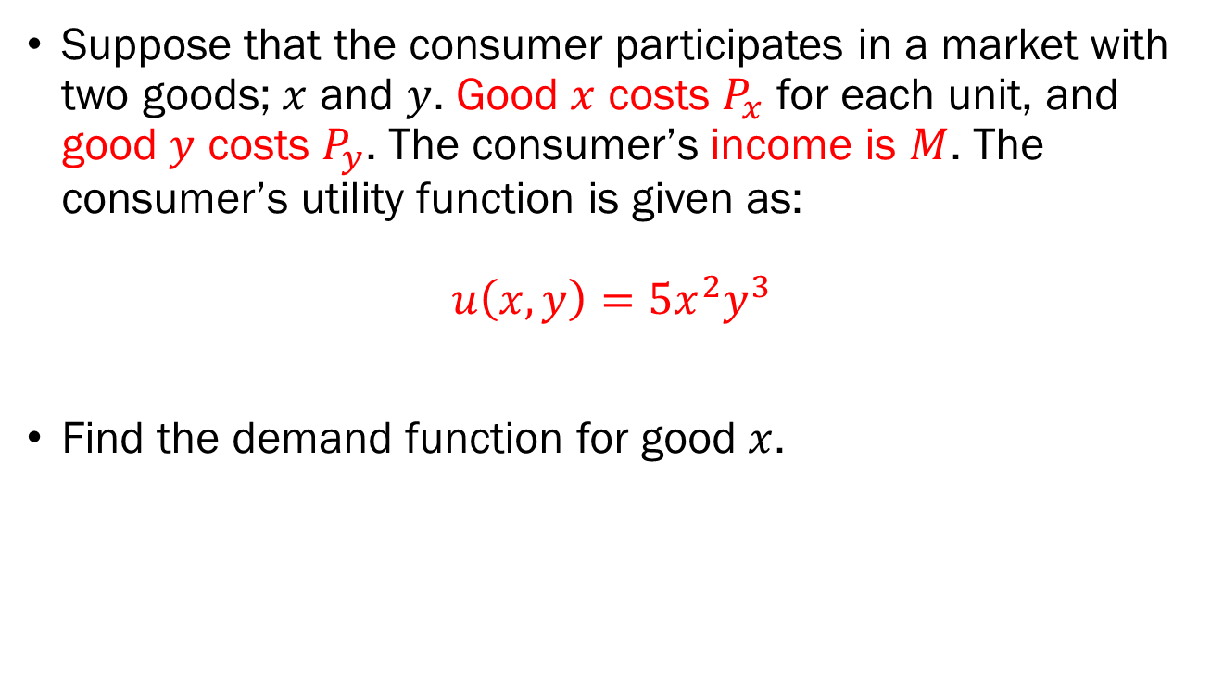
In-Class Exercise
Suppose that the consumer participates in a market with two goods; $x$ and $y$. Good $x$ costs $P_{x}$ for each unit, and good $y$ costs $P_{y}$. The consumer’s income is $M$. The consumer’s utility function is given as:
$$u\left(x,y\right)=5x^{2}y^{3}$$
Find the demand function for good $x$.

Slide 18
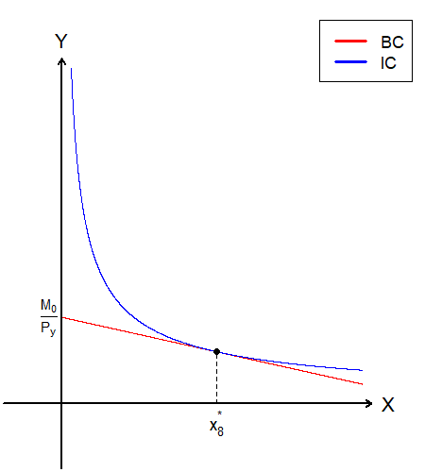
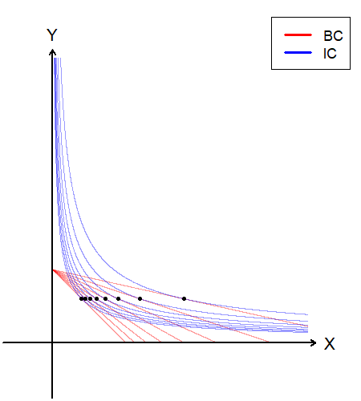
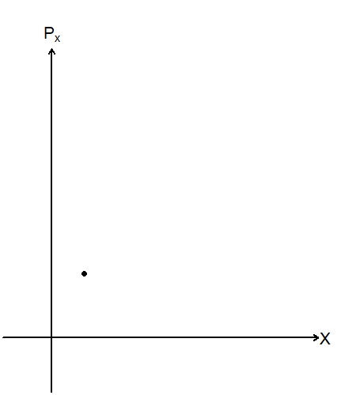
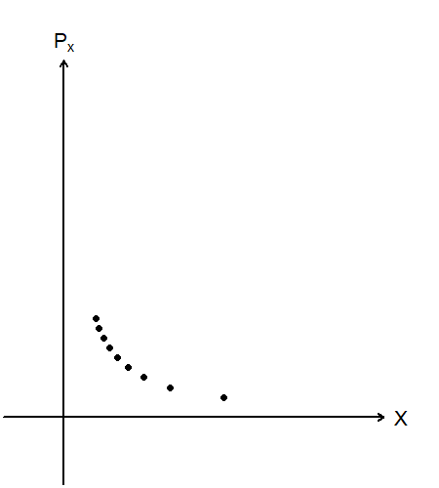
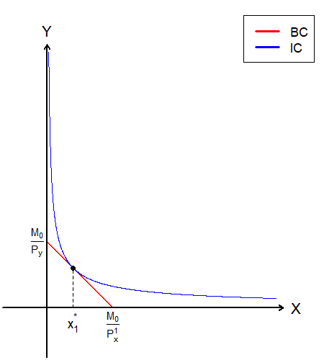
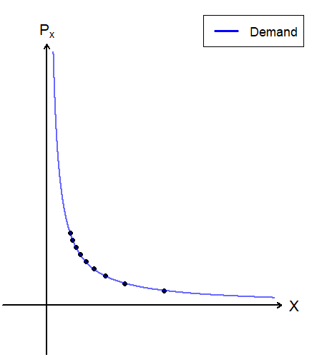
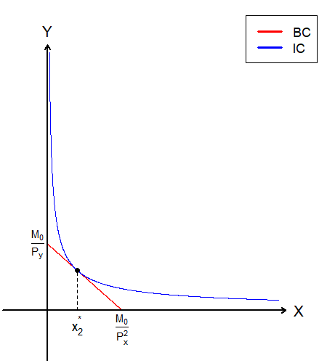
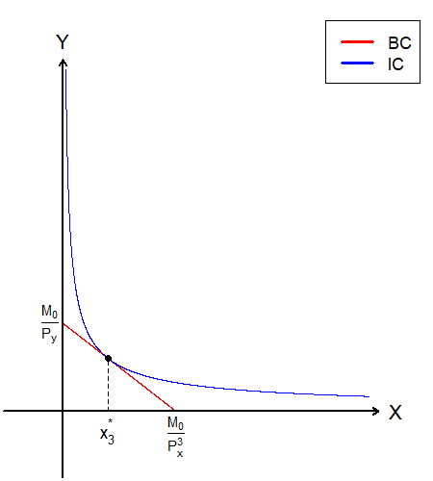
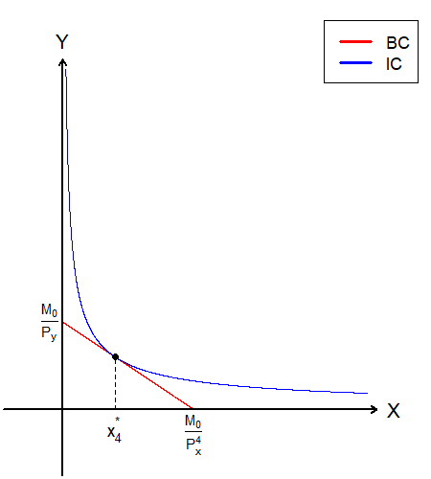
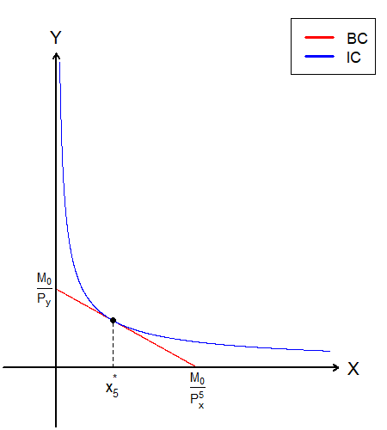
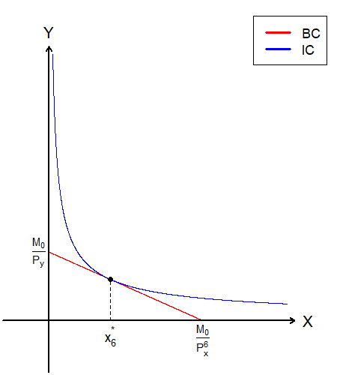
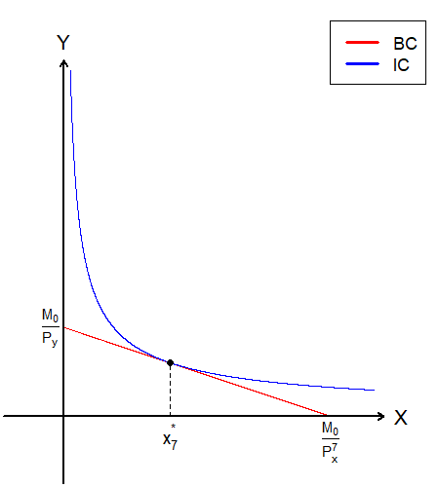
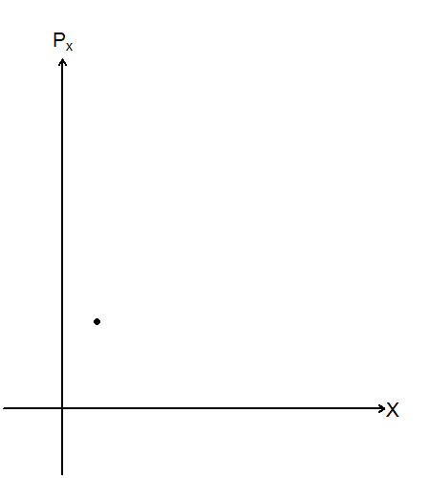
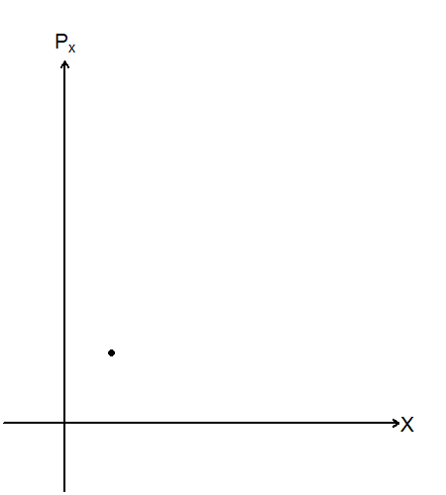
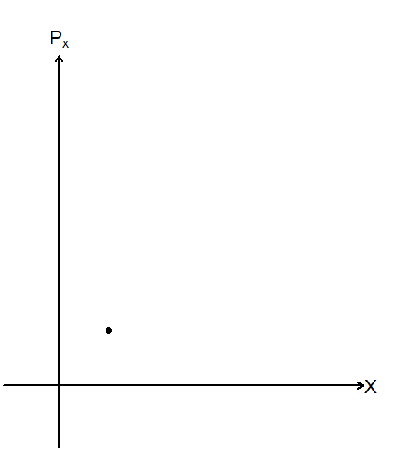
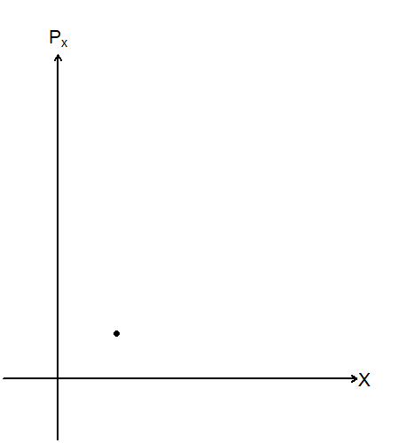
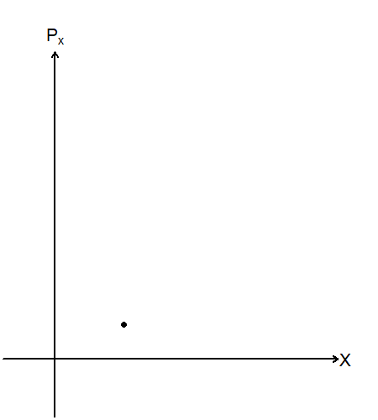
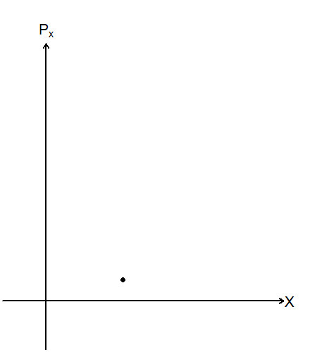

In-Class Exercise Visualized

Slide 19
Demand Curves of
Special Utility Functions
The demand function for the two special utility functions we introduced earlier would look quite different from the Cobb-Douglas function’s results.
We will derive the demand function for consumers with the Linear and Leontief utility functions to observe the differences.

Slide 20

The Linear Utility Function and the Demand Curve
Suppose that the consumer participates in a market with two goods; $x$ and $y$. Good $x$ costs $P_{x}$ for each unit, and good $y$ costs $P_{y}$. The consumer’s income is $M$. The consumer’s utility function is given as:
$$u\left(x,y\right)=ax+by$$
Recall that we examined three possible relations between the MRS and Relative prices.
The demand function will be “divided” into three distinct parts.

Slide 21







The Linear Utility Function and the Demand Curve
When $MRS_{xy}>{P_{x}}/{P_{y}}$, the consumer will spend their entire budget on $x$.
When $MRS_{xy}={P_{x}}/{P_{y}}$, the consumer can purchase any combination of $x$ and $y$ that exhaust their budget.
When $MRS_{xy}>{P_{x}}/{P_{y}}$, the consumer will spend their entire budget on $y$.

Slide 22








The Linear Utility Function and the Demand Curve

Slide 23

The Linear Utility Function and the Demand Curve
The Demand Function when the underlying utility function is the Linear Utility Function can be expressed as:
$$x\left(P_{x},P_{−x},M\right)=\left\{\begin{aligned}0, when P_{x}>\frac{a}{b}P_{y} \\ \left[0, \frac{M}{P_{x}}\right], when P_{x}=\frac{a}{b}P_{y} \\ \frac{M}{P_{x}}, when P_{x}<\frac{a}{b}P_{y}\end{aligned}\right.$$

Slide 24

The Leontief Utility Function and the Demand Curve
Suppose that the consumer participates in a market with two goods; $x$ and $y$. Good $x$ costs $P_{x}$ for each unit, and good $y$ costs $P_{y}$. The consumer’s income is $M$. The consumer’s utility function is given as:
$$u\left(x,y\right)=min⁡\{ax,by\}$$
Recall that the rules for finding the optimal bundles for the Leontief Utility Function is to set $ax=by$.

Slide 25

Deriving the Demand Curve
Set $ax=by$ to find the optimal ratio of $x$ and $y$.
  $ax=by ⟹ y=\frac{a}{b}x$
Insert the optimal ratio into the budget constraint.
  $P_{x}x+P_{y}y=M ⟹ P_{x}x+P_{y}\left(\frac{a}{b}x\right)=M ⟹ x\left(\frac{bP_{x}}{b}+\frac{aP_{y}}{b}\right)=M$
Solve for $x$.
  $x=\left(\frac{b}{bP_{x}+aP_{y}}\right)M$

Slide 26













The Leontief Utility Function and the Demand Curve

Slide 27
Recap of Today’s Topics
Comparative Statics of the UMP: Part 2
  Ordinary vs. Giffen Goods
  The Price Consumption Curve
  The Demand Curve
  Deriving the Demand Function
    Cobb Douglas
    Linear
    Leontief

Slide 28
Preview of Next Lecture
Comparative Statics of the UMP: Part 3
  Breaking down the Price Effect
  The Substitution Effect
  The Income Effect
  Compensated Demand

