Slide 1
Market Analysis:
Monopolistic Competition and Oligopolies
ECON 300

Slide 2
Monopolistic Competition
Today we examine some more departures from the five assumptions of a perfectly competitive market.
  Infinite number of producers and consumers, and
  Homogeneous products, and
  Perfect information, and
  Free entry and exit, and
  Zero transaction costs.
First, we will examine the market when rule 2 is broken.
  Breaking Rule #2: Differentiated Products.
We call this “Monopolistic Competition.”

Slide 3
Monopolistic Competition
The market power of individual firms exist to the extent that the consumers differentiate between the products.
If consumers believe that a firm’s product is different from its competitors, that firm will face a downward sloping demand curve.
When consumers believe that one firm’s product is more “differentiated,” the demand will be less elastic, and the firm will wield greater market power.
If you are running a firm with a differentiated product…

Slide 4
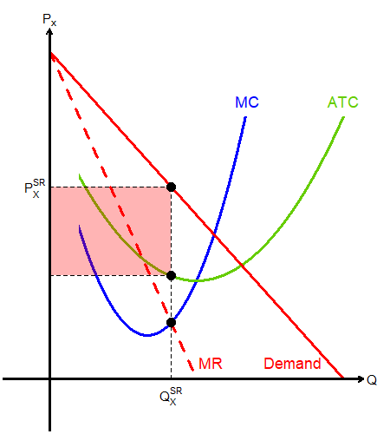
Short Run Monopolistic Competition
In the short run, you are the only firm offering this product, and you face a rather inelastic demand.
You can act as a monopoly supplier and reap positive profit in the short run.
The red rectangle visualizes this short run profit, which invites competition.

Slide 5
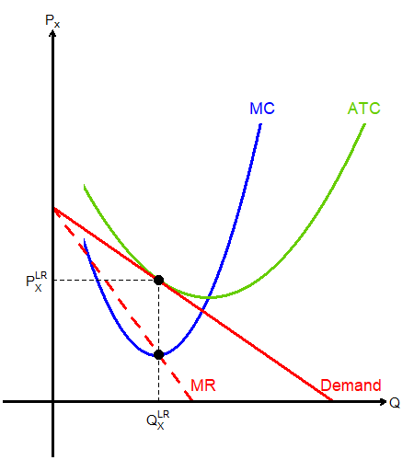
Long Run Monopolistic Competition
In the long run, competitors will enter the market with similar products.
This results in your demand curve shifting, and possibly displaying more elasticity.
Your market share will fall, and price will fall so that the market reaches zero profit.

Slide 6
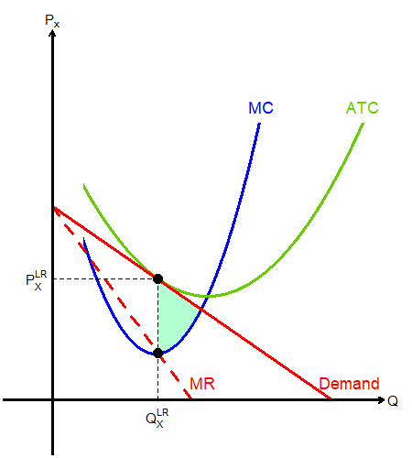
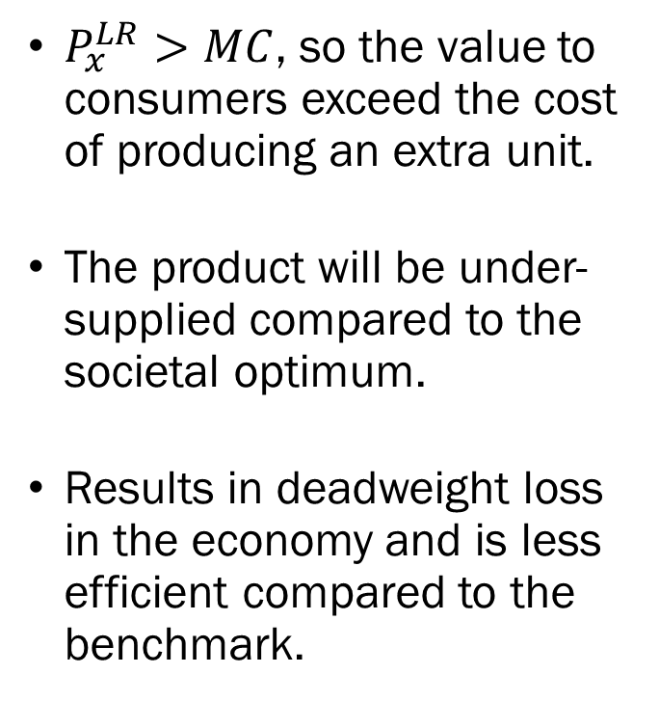
Societal Welfare under
Monopolistic Competition
$P_{x}^{LR}>MC$, so the value to consumers exceed the cost of producing an extra unit.
The product will be under-supplied compared to the societal optimum.
Results in deadweight loss in the economy and is less efficient compared to the benchmark.

Slide 7
Is Monopolistic Competition “Bad”?
Deadweight loss exists in monopolistic competition, so we are losing out on some potential.
However, the extent to which individual firms hold market power is relatively small compared to monopolies.
Moreover, the existence of differentiated products offer the consumers product diversity, which is not easily measured in our framework.
The gains from product diversity may outweigh the loss due to individual firms’ market power.

Slide 8
Marketing Efforts in
Monopolistic Competition
Excess profit does not last in the long run due to…
  Competitors producing similar products, and
  Consumers finding more suitable substitutes to the product.
How can a producer combat this long run effect?
Advertisements?
  In a perfectly competitive market, spending money on marketing efforts is a waste of money.
  In monopolistic competition, if advertisements can maintain the perception of a differentiated product, it is optimal behavior.

Slide 9
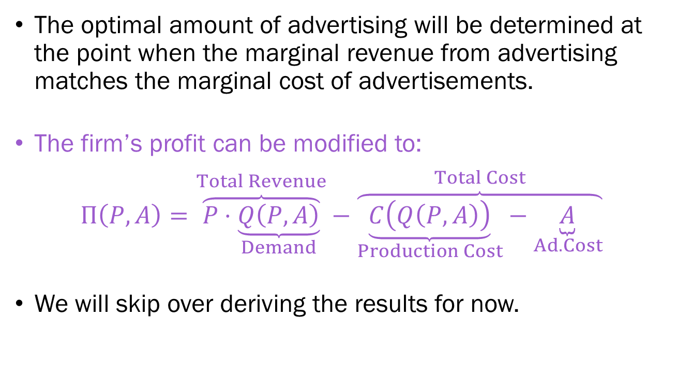
Marketing Efforts in
Monopolistic Competition
The optimal amount of advertising will be determined at the point when the marginal revenue from advertising matches the marginal cost of advertisements.
The firm’s profit can be modified to:
$$Π\left(P,A\right)=\overset{Total Revenue}{\overbrace{P⋅\underset{Demand}{\underbrace{Q\left(P,A\right)}}}}−\overset{Total Cost}{\overbrace{\underset{Production Cost}{\underbrace{C\left(Q\left(P,A\right)\right)}}−\underset{Ad. Cost}{\underbrace{A}}}}$$
We will skip over deriving the results for now.

Slide 10
Marketing Efforts in
Monopolistic Competition
The implications from the model tell us that the optimal amount of advertising will be greater when…
  The price elasticity of demand is lower.
  The advertising elasticity of demand is higher
This simple model does not account for the quality of an ad campaign, when and where the ads are placed, etc.
Aside from advertisements, a firm may keep its product differentiated by adopting a closed platform approach.
  Gaming consoles having “platform exclusive” products, or
  Exclusion based “ecosystem” approach of iOS/Android products.

Slide 11
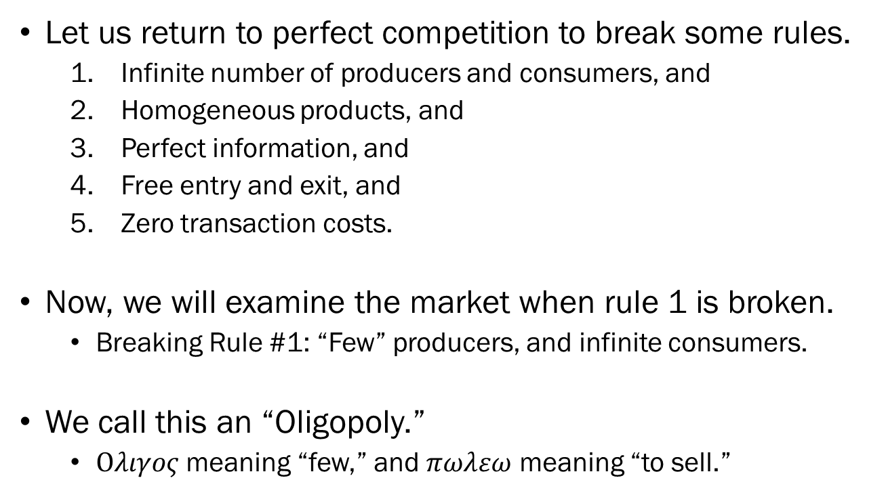
Oligopoly
Let us return to perfect competition to break some rules.
  Infinite number of producers and consumers, and
  Homogeneous products, and
  Perfect information, and
  Free entry and exit, and
  Zero transaction costs.
Now, we will examine the market when rule 1 is broken.
  Breaking Rule #1: “Few” producers, and infinite consumers.
We call this an “Oligopoly.”
  $Ολιγος$ meaning “few,” and $πωλεω$ meaning “to sell.”

Slide 12
Oligopoly
The main difference between an oligopoly and a perfectly competitive market is the aspect of strategic behavior.
In an oligopoly, one firm’s actions will affect the market.
For instance, in a two-firm oligopoly, if one firm suddenly increases their output, the demand curve that other firm faces shifts to the left.
This requires a slight modification to the definition of how we view a market equilibrium.

Slide 13
Nash Equilibrium
Previously, we determined the equilibrium as a point where “firms are doing the best they can, and have no reason to change their price or output.”
In an oligopoly, we adopt the concept of a Nash equilibrium.
Named after the mathematician John F. Nash.
In a Nash equilibrium, “each firm is doing the best it can, given what its competitors are doing.”

Slide 14

A Beautiful Mind (2001)

Slide 15
Dimensions of Competition
Firms may compete in the Quantity dimension, or they may compete in the Price dimension.
  Quantity, Simultaneous Decisions: Cournot Duopoly
  Price, Simultaneous Decisions: Bertrand Duopoly
Sometimes, certain firms may have an advantage of being the first mover in the competition.
  Quantity, Sequential Movers: Stackelberg
  Price, Sequential Movers: N/A
Sometimes, firms may cooperate on setting quantity or prices, and form “cartels.”

Slide 16
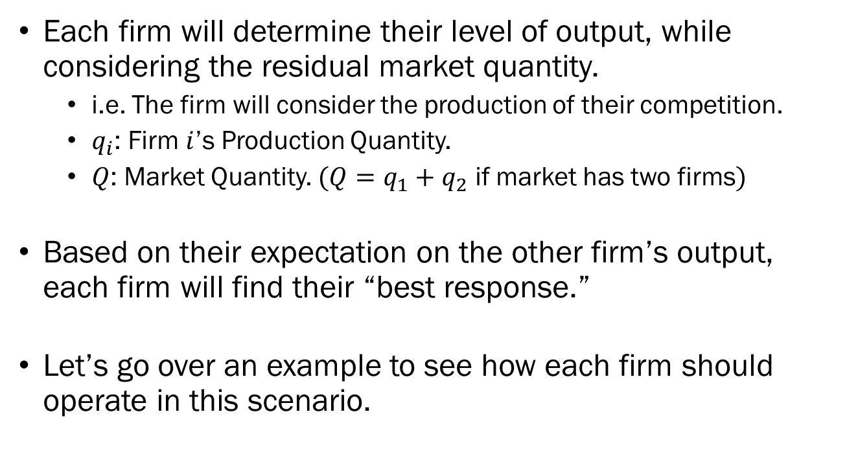
The Cournot Duopoly
Each firm will determine their level of output, while considering the residual market quantity.
  i.e. The firm will consider the production of their competition.
  $q_{i}$: Firm $i$’s Production Quantity.
  $Q$: Market Quantity. $(Q=q_{1}+q_{2}$ if market has two firms$)$
Based on their expectation on the other firm’s output, each firm will find their “best response.”
Let’s go over an example to see how each firm should operate in this scenario.

Slide 17
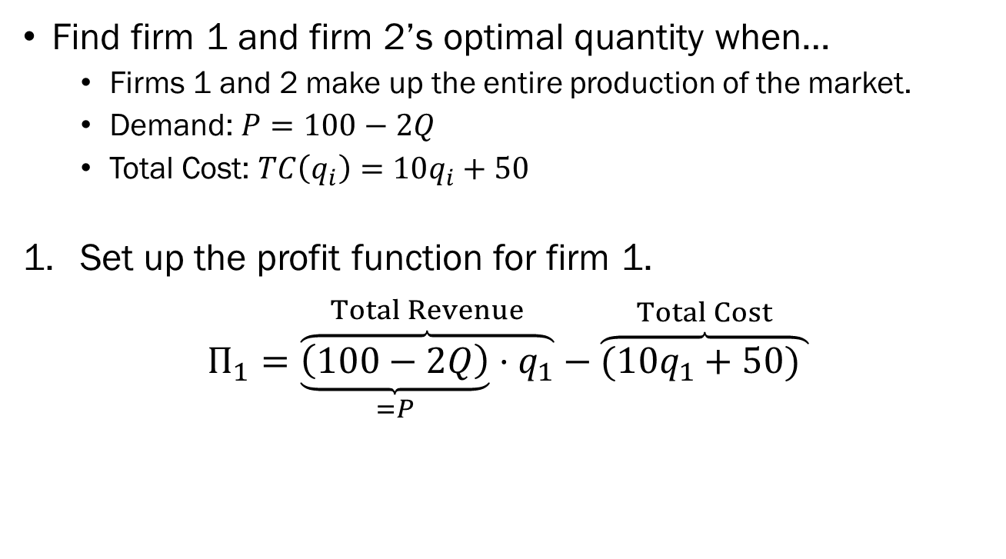
Example: Cournot Duopoly
Find firm 1 and firm 2’s optimal quantity when…
  Firms 1 and 2 make up the entire production of the market.
  Demand: $P=100−2Q$
  Total Cost: $TC\left(q_{i}\right)=10q_{i}+50$
Set up the profit function for firm 1.
$$Π_{1}=\overset{Total Revenue}{\overbrace{\underset{=P}{\underbrace{\left(100−2Q\right)}}⋅q_{1}}}−\overset{Total Cost}{\overbrace{(10q_{1}+50) }}$$

Slide 18
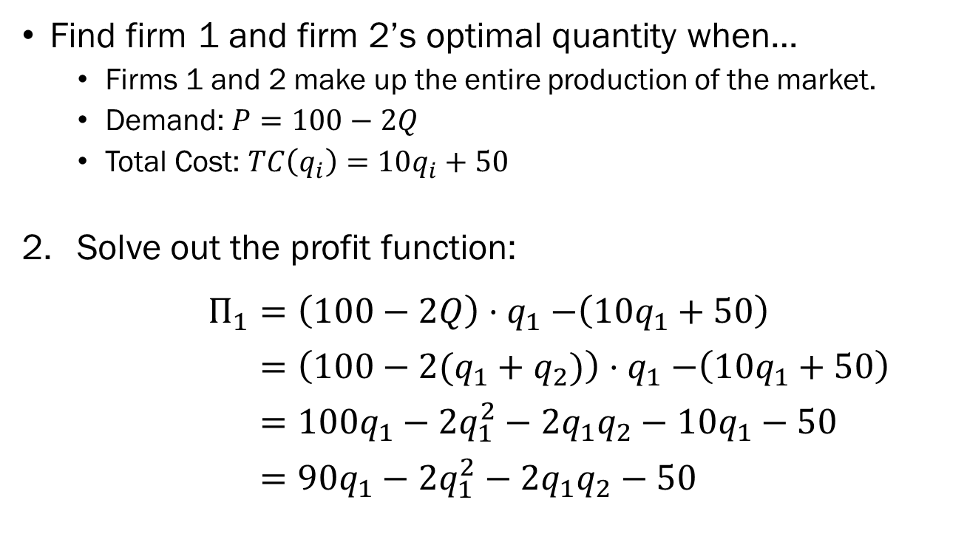
Example: Cournot Duopoly
Find firm 1 and firm 2’s optimal quantity when…
  Firms 1 and 2 make up the entire production of the market.
  Demand: $P=100−2Q$
  Total Cost: $TC\left(q_{i}\right)=10q_{i}+50$
Solve out the profit function:
$$Π_{1}=\left(100−2Q\right){⋅q}_{1}−\left(10q_{1}+50\right)$$
$=\left(100−2(q_{1}+q_{2})\right){⋅q}_{1}−\left(10q_{1}+50\right)$
$=100q_{1}−2q_{1}^{2}−2q_{1}q_{2}−10q_{1}−50$
$=90q_{1}−2q_{1}^{2}−2q_{1}q_{2}−50$

Slide 19
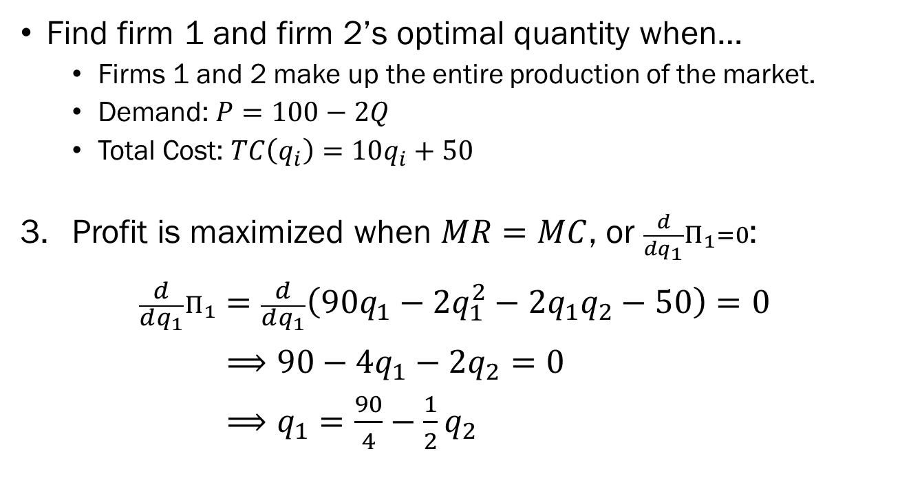
Example: Cournot Duopoly
Find firm 1 and firm 2’s optimal quantity when…
  Firms 1 and 2 make up the entire production of the market.
  Demand: $P=100−2Q$
  Total Cost: $TC\left(q_{i}\right)=10q_{i}+50$
Profit is maximized when $MR=MC$, or $\frac{d}{dq_{1}}Π_{1}=0$:
$$\frac{d}{dq_{1}}Π_{1}=\frac{d}{dq_{1}}\left(90q_{1}−2q_{1}^{2}−2q_{1}q_{2}−50\right)=0$$
$⟹90−4q_{1}−2q_{2}=0$
$⟹q_{1}=\frac{90}{4}−\frac{1}{2}q_{2}$

Slide 20
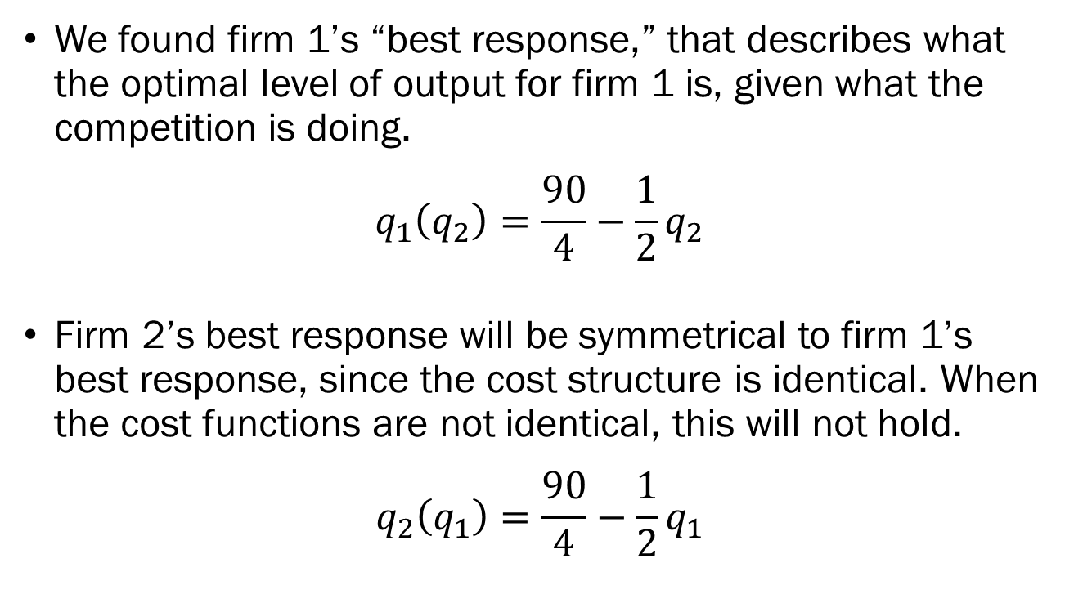
Example: Cournot Duopoly
We found firm 1’s “best response,” that describes what the optimal level of output for firm 1 is, given what the competition is doing.
$$q_{1}\left(q_{2}\right)=\frac{90}{4}−\frac{1}{2}q_{2}$$
Firm 2’s best response will be symmetrical to firm 1’s best response, since the cost structure is identical. When the cost functions are not identical, this will not hold.
$$q_{2}\left(q_{1}\right)=\frac{90}{4}−\frac{1}{2}q_{1}$$

Slide 21
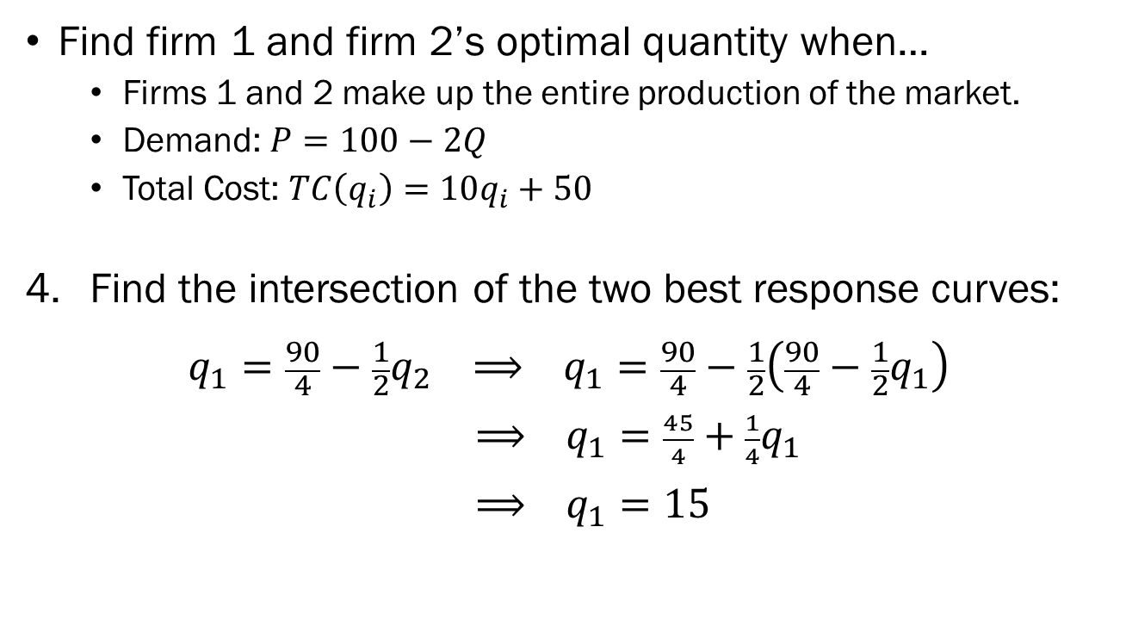
Example: Cournot Duopoly
Find firm 1 and firm 2’s optimal quantity when…
  Firms 1 and 2 make up the entire production of the market.
  Demand: $P=100−2Q$
  Total Cost: $TC\left(q_{i}\right)=10q_{i}+50$
Find the intersection of the two best response curves:
$$q_{1}=\frac{90}{4}−\frac{1}{2}q_{2} ⟹ q_{1}=\frac{90}{4}−\frac{1}{2}\left(\frac{90}{4}−\frac{1}{2}q_{1}\right)$$
$⟹ q_{1}=\frac{45}{4}+\frac{1}{4}q_{1}$
$⟹ q_{1}=15$

Slide 22
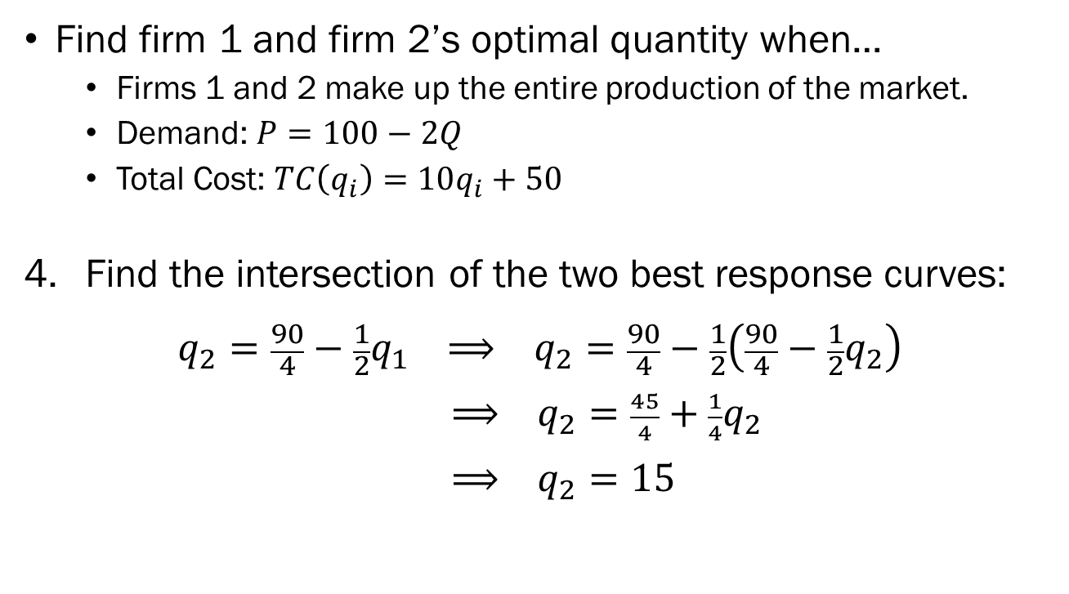
Example: Cournot Duopoly
Find firm 1 and firm 2’s optimal quantity when…
  Firms 1 and 2 make up the entire production of the market.
  Demand: $P=100−2Q$
  Total Cost: $TC\left(q_{i}\right)=10q_{i}+50$
Find the intersection of the two best response curves:
$$q_{2}=\frac{90}{4}−\frac{1}{2}q_{1} ⟹ q_{2}=\frac{90}{4}−\frac{1}{2}\left(\frac{90}{4}−\frac{1}{2}q_{2}\right)$$
$⟹ q_{2}=\frac{45}{4}+\frac{1}{4}q_{2}$
$⟹ q_{2}=15$

Slide 23
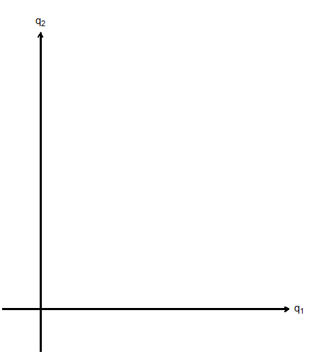
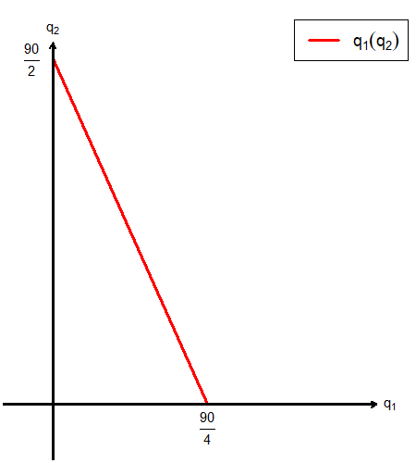
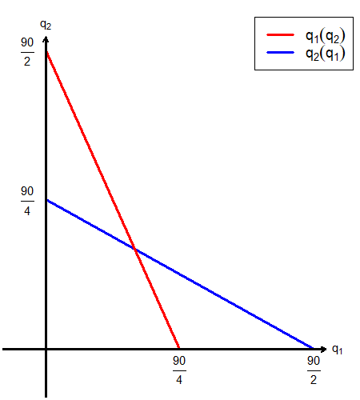
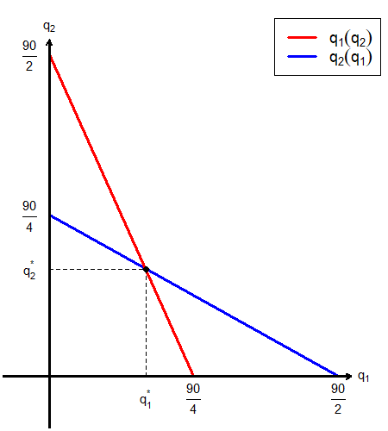
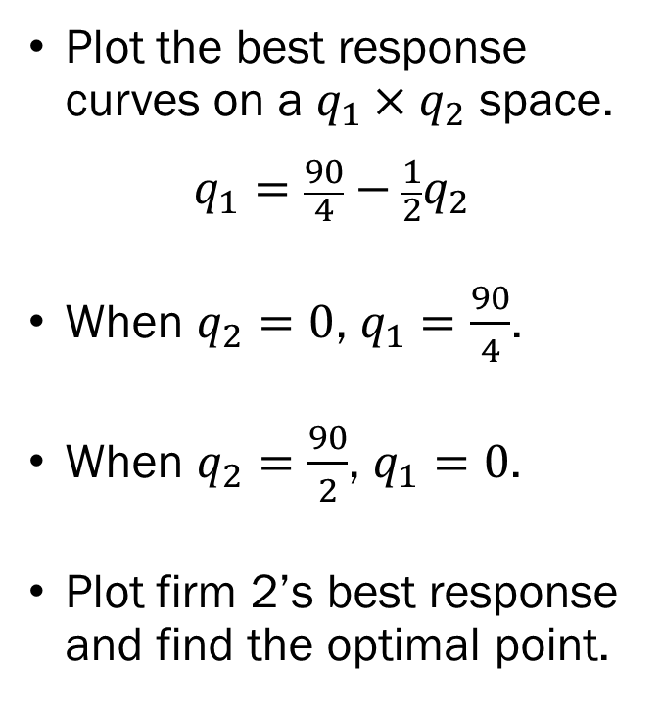
Example: Cournot Duopoly
Plot the best response curves on a $q_{1}×q_{2}$ space.
$$q_{1}=\frac{90}{4}−\frac{1}{2}q_{2}$$
When $q_{2}=0$, $q_{1}=\frac{90}{4}$.
When $q_{2}=\frac{90}{2}$, $q_{1}=0$.
Plot firm 2’s best response and find the optimal point.

Slide 24
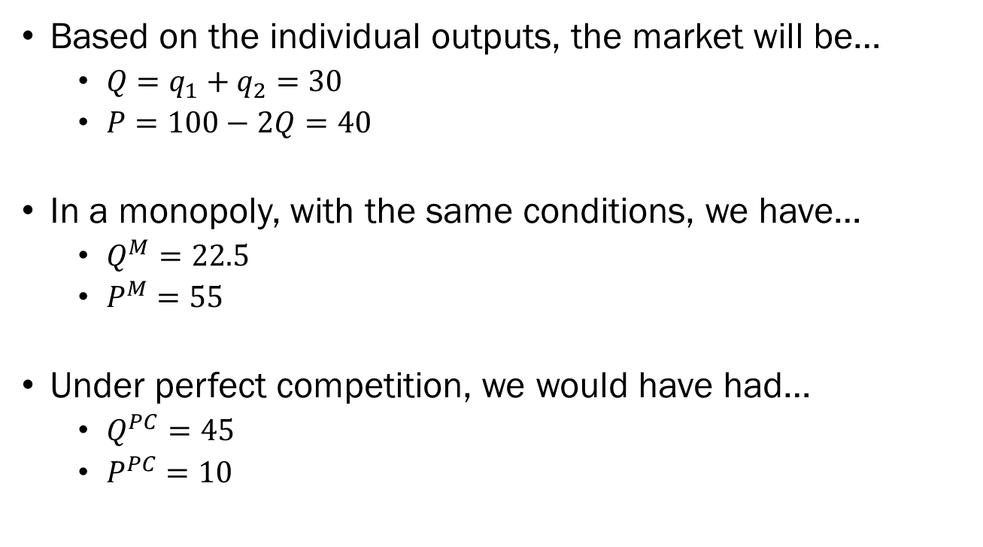
Results by Market Structures
Based on the individual outputs, the market will be…
  $Q=q_{1}+q_{2}=30$
  $P=100−2Q=40$
In a monopoly, with the same conditions, we have…
  $Q^{M}=22.5$
  $P^{M}=55$
Under perfect competition, we would have had…
  $Q^{PC}=45$
  $P^{PC}=10$

Slide 25
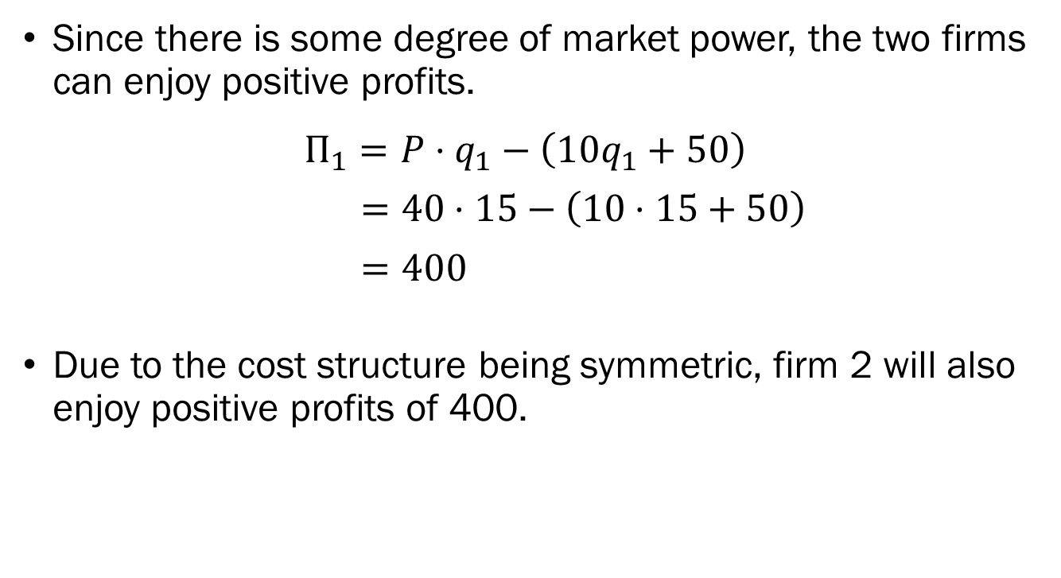
Profit in the Cournot Duopoly
Since there is some degree of market power, the two firms can enjoy positive profits.
$$Π_{1}=P⋅q_{1}−\left(10q_{1}+50\right)$$
$=40⋅15−\left(10⋅15+50\right)$
$=400$
Due to the cost structure being symmetric, firm 2 will also enjoy positive profits of 400.

Slide 26
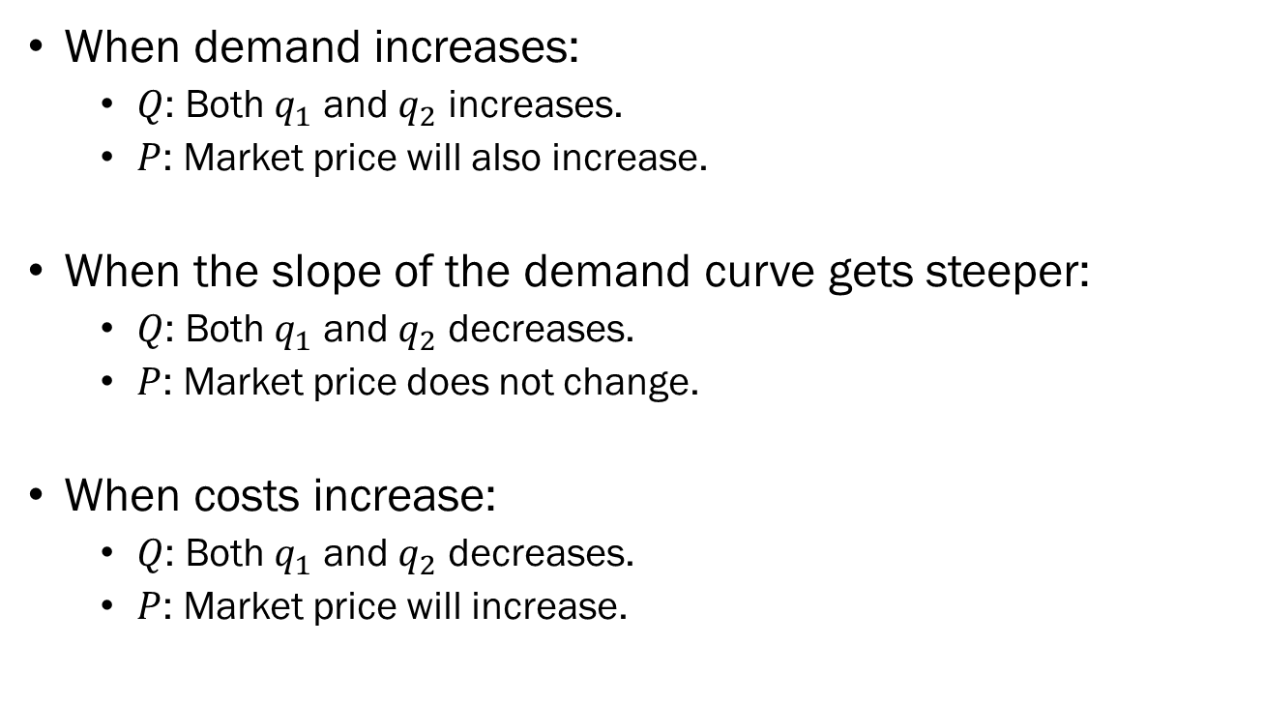
Changes in the Market Conditions and the Cournot Duopoly
When demand increases:
  $Q$: Both $q_{1}$ and $q_{2}$ increases.
  $P$: Market price will also increase.
When the slope of the demand curve gets steeper:
  $Q$: Both $q_{1}$ and $q_{2}$ decreases.
  $P$: Market price does not change.
When costs increase:
  $Q$: Both $q_{1}$ and $q_{2}$ decreases.
  $P$: Market price will increase.

Slide 27
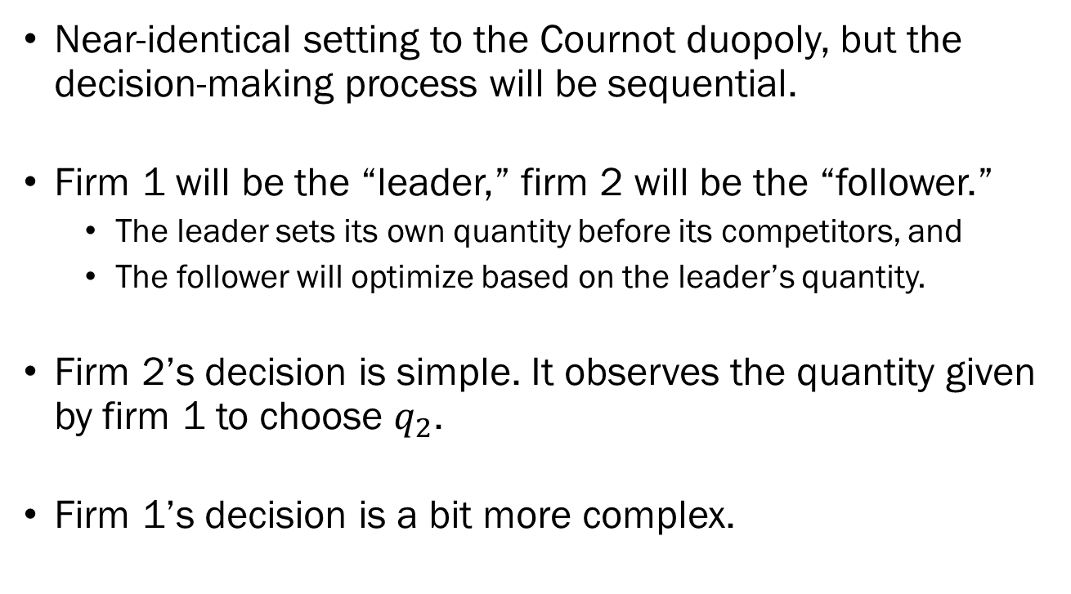
The Stackelberg Duopoly
Near-identical setting to the Cournot duopoly, but the decision-making process will be sequential.
Firm 1 will be the “leader,” firm 2 will be the “follower.”
  The leader sets its own quantity before its competitors, and
  The follower will optimize based on the leader’s quantity.
Firm 2’s decision is simple. It observes the quantity given by firm 1 to choose $q_{2}$.
Firm 1’s decision is a bit more complex.

Slide 28
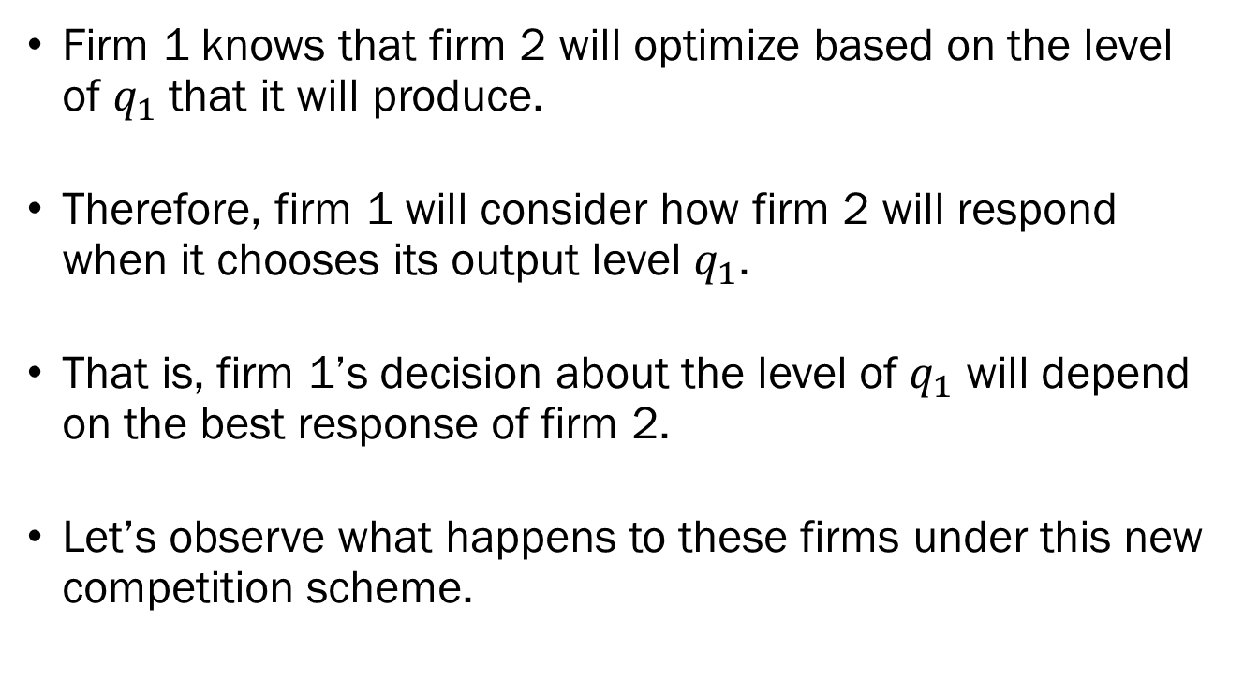
The Stackelberg Duopoly
Firm 1 knows that firm 2 will optimize based on the level of $q_{1}$ that it will produce.
Therefore, firm 1 will consider how firm 2 will respond when it chooses its output level $q_{1}$.
That is, firm 1’s decision about the level of $q_{1}$ will depend on the best response of firm 2.
Let’s observe what happens to these firms under this new competition scheme.

Slide 29
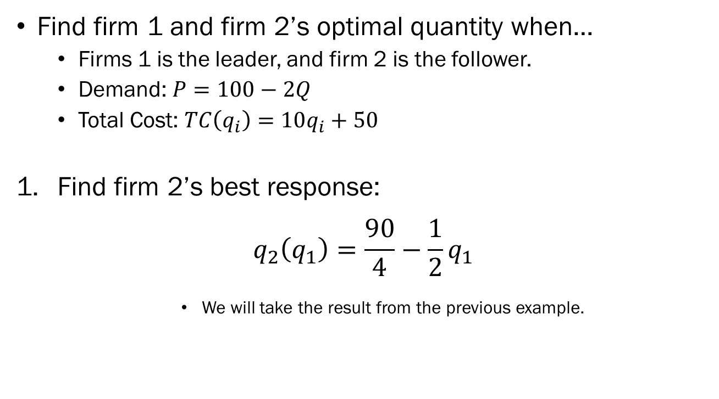
Example: Stackelberg Duopoly
Find firm 1 and firm 2’s optimal quantity when…
  Firms 1 is the leader, and firm 2 is the follower.
  Demand: $P=100−2Q$
  Total Cost: $TC\left(q_{i}\right)=10q_{i}+50$
Find firm 2’s best response:
$$q_{2}\left(q_{1}\right)=\frac{90}{4}−\frac{1}{2}q_{1}$$
        We will take the result from the previous example.

Slide 30
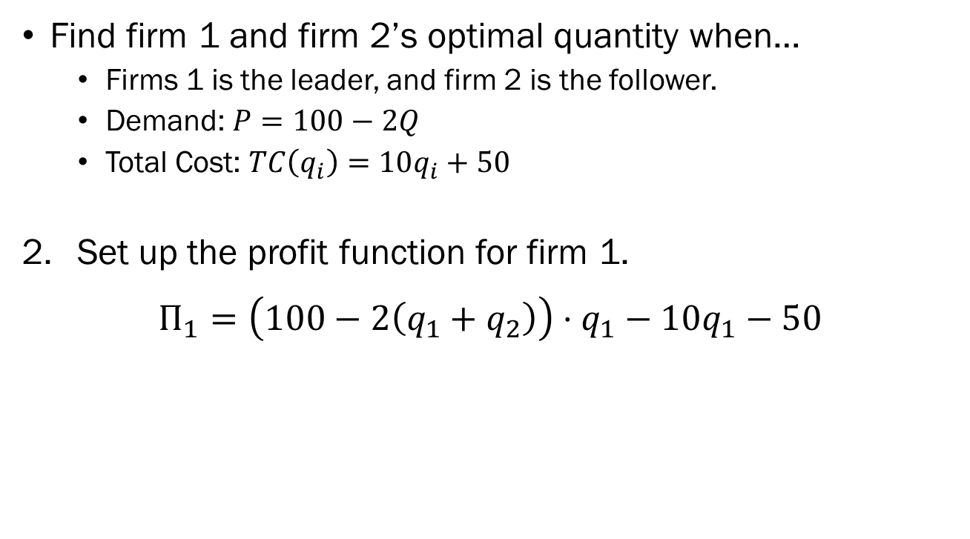
Example: Stackelberg Duopoly
Find firm 1 and firm 2’s optimal quantity when…
  Firms 1 is the leader, and firm 2 is the follower.
  Demand: $P=100−2Q$
  Total Cost: $TC\left(q_{i}\right)=10q_{i}+50$
Set up the profit function for firm 1.
$$Π_{1}=\left(100−2\left(q_{1}+q_{2}\right)\right)⋅q_{1}−10q_{1}−50$$

Slide 31
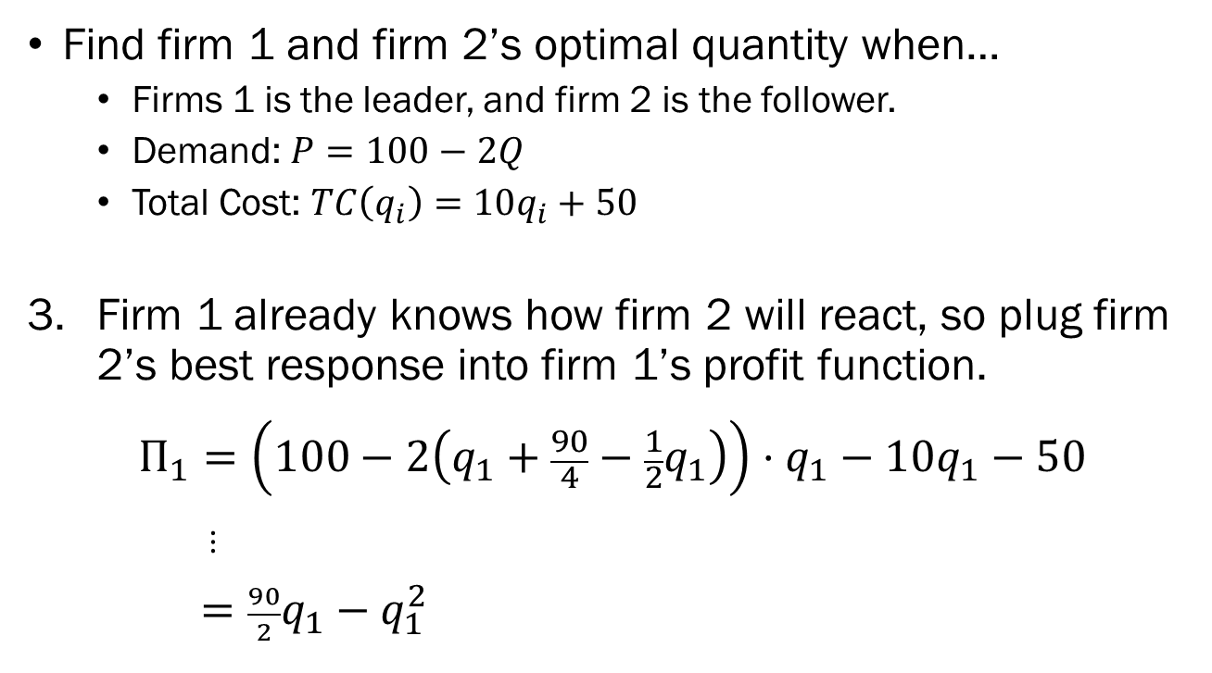
Example: Stackelberg Duopoly
Find firm 1 and firm 2’s optimal quantity when…
  Firms 1 is the leader, and firm 2 is the follower.
  Demand: $P=100−2Q$
  Total Cost: $TC\left(q_{i}\right)=10q_{i}+50$
Firm 1 already knows how firm 2 will react, so plug firm 2’s best response into firm 1’s profit function.
$$Π_{1}=\left(100−2\left(q_{1}+\frac{90}{4}−\frac{1}{2}q_{1}\right)\right)⋅q_{1}−10q_{1}−50$$
$⋮$
$=\frac{90}{2}q_{1}−q_{1}^{2}$

Slide 32
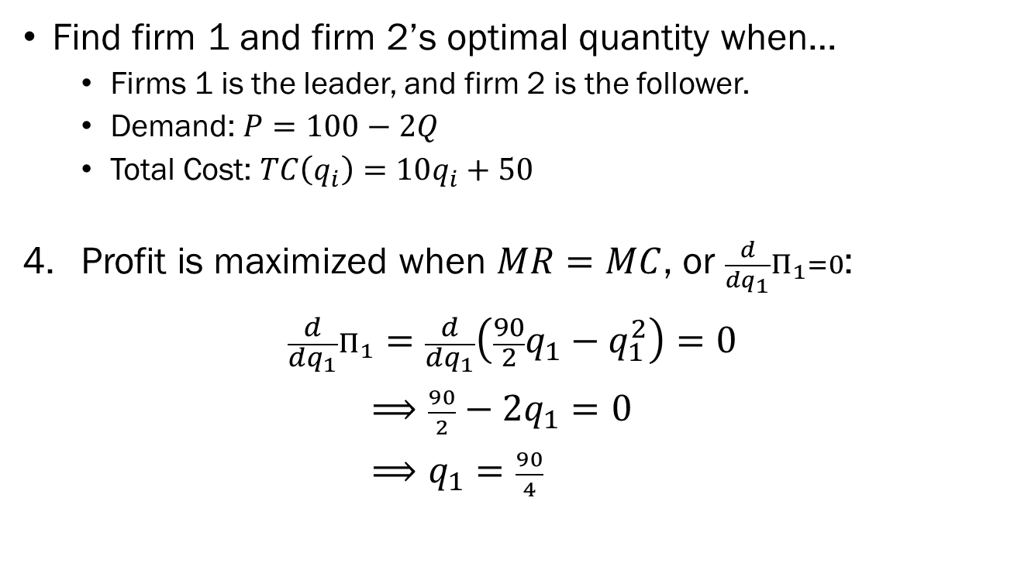
Example: Stackelberg Duopoly
Find firm 1 and firm 2’s optimal quantity when…
  Firms 1 is the leader, and firm 2 is the follower.
  Demand: $P=100−2Q$
  Total Cost: $TC\left(q_{i}\right)=10q_{i}+50$
Profit is maximized when $MR=MC$, or $\frac{d}{dq_{1}}Π_{1}=0$:
$$\frac{d}{dq_{1}}Π_{1}=\frac{d}{dq_{1}}\left(\frac{90}{2}q_{1}−q_{1}^{2}\right)=0$$
$⟹\frac{90}{2}−2q_{1}=0$
$⟹q_{1}=\frac{90}{4}$

Slide 33
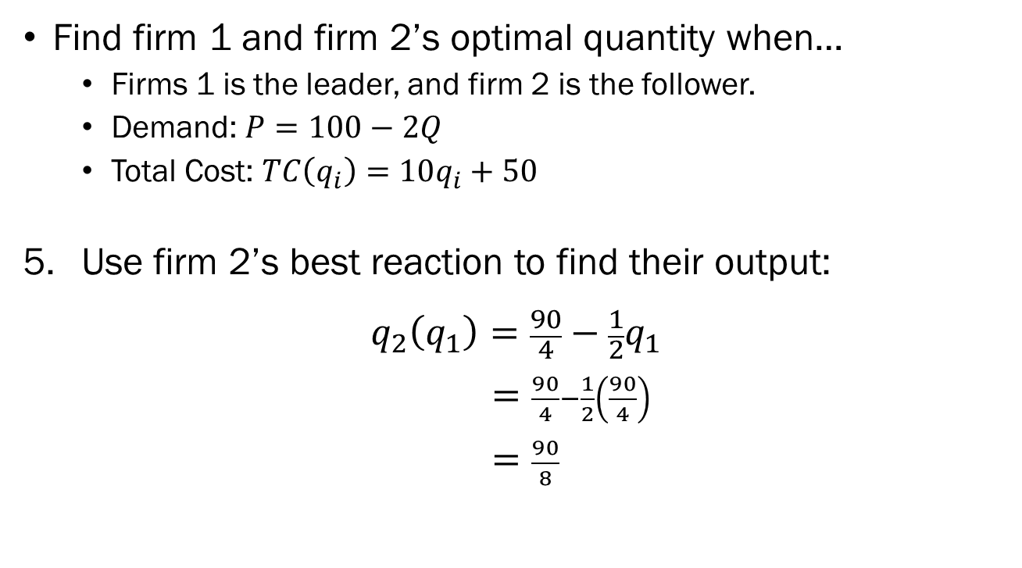
Example: Stackelberg Duopoly
Find firm 1 and firm 2’s optimal quantity when…
  Firms 1 is the leader, and firm 2 is the follower.
  Demand: $P=100−2Q$
  Total Cost: $TC\left(q_{i}\right)=10q_{i}+50$
Use firm 2’s best reaction to find their output:
$$q_{2}\left(q_{1}\right)=\frac{90}{4}−\frac{1}{2}q_{1}$$
$=\frac{90}{4}−\frac{1}{2}\left(\frac{90}{4}\right)$
$=\frac{90}{8}$

Slide 34
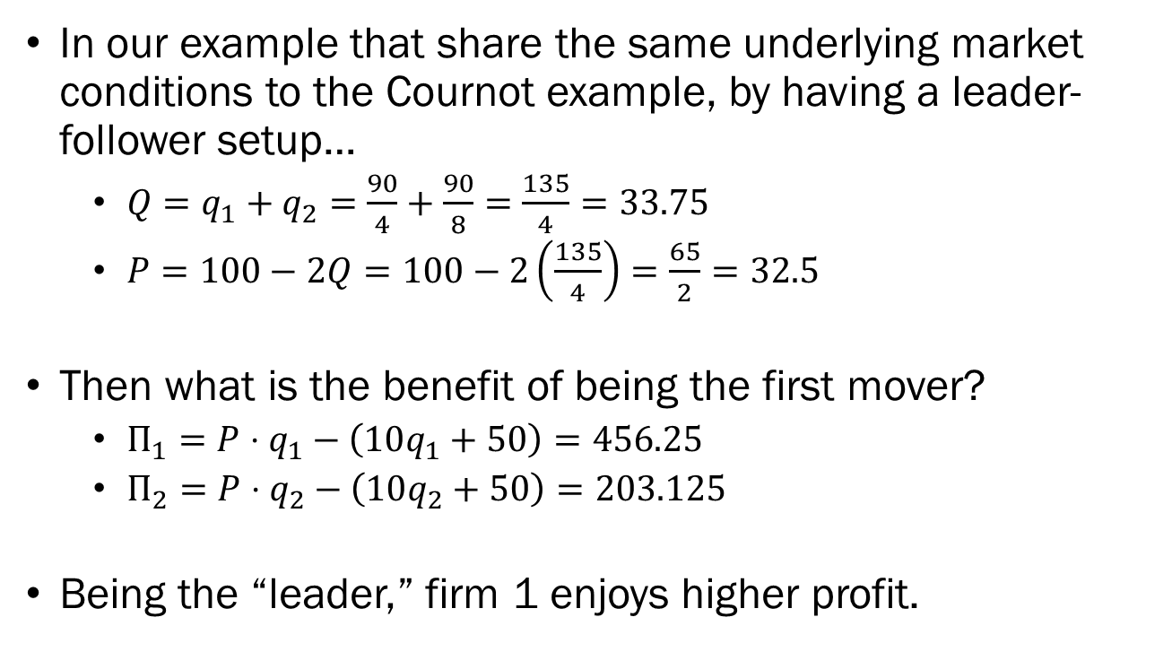
The Stackelberg Duopoly
In our example that share the same underlying market conditions to the Cournot example, by having a leader-follower setup…
  $Q=q_{1}+q_{2}=\frac{90}{4}+\frac{90}{8}=\frac{135}{4}=33.75$
  $P=100−2Q=100−2\left(\frac{135}{4}\right)=\frac{65}{2}=32.5$
Then what is the benefit of being the first mover?
  $Π_{1}=P⋅q_{1}−\left(10q_{1}+50\right)=456.25$
  $Π_{2}=P⋅q_{2}−\left(10q_{2}+50\right)=203.125$
Being the “leader,” firm 1 enjoys higher profit.

