Slide 1
Quiz #3 Review
ECON 300

Slide 2
Quiz #3 Recovery Office Hours
https://calendly.com/brianhwpark
Venue: Rm. 248 Center for Science and Business
Dates: Oct. 4th ~ Oct. 16th, 2024 (Fri ~ Wed)
ABSOLUTELY REQUIRED that you review notes, problem sets, and homework assignments prior to the visit.
Recovery Rate: 50%

Slide 3
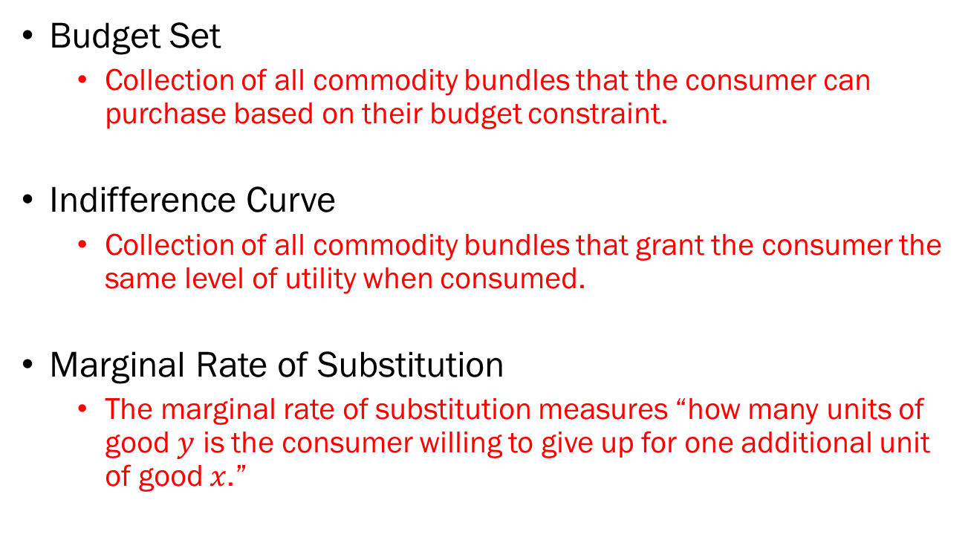
Problem 1. Definitions
Budget Set
  Collection of all commodity bundles that the consumer can purchase based on their budget constraint.
Indifference Curve
  Collection of all commodity bundles that grant the consumer the same level of utility when consumed.
Marginal Rate of Substitution
  The marginal rate of substitution measures “how many units of good $y$ is the consumer willing to give up for one additional unit of good $x$.”

Slide 4
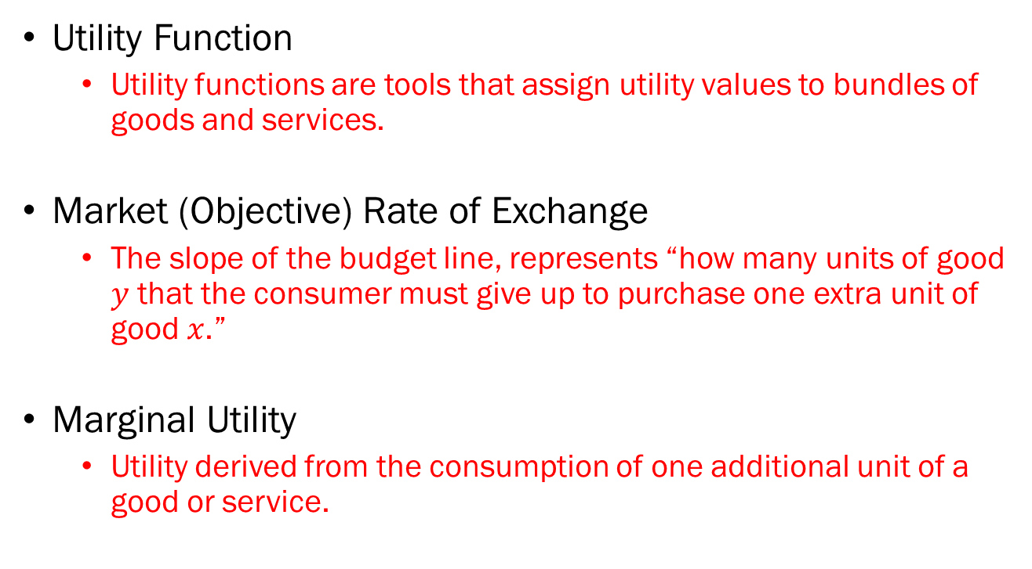
Problem 1. Definitions
Utility Function
  Utility functions are tools that assign utility values to bundles of goods and services.
Market (Objective) Rate of Exchange
  The slope of the budget line, represents “how many units of good $y$ that the consumer must give up to purchase one extra unit of good $x$.”
Marginal Utility
  Utility derived from the consumption of one additional unit of a good or service.

Slide 5
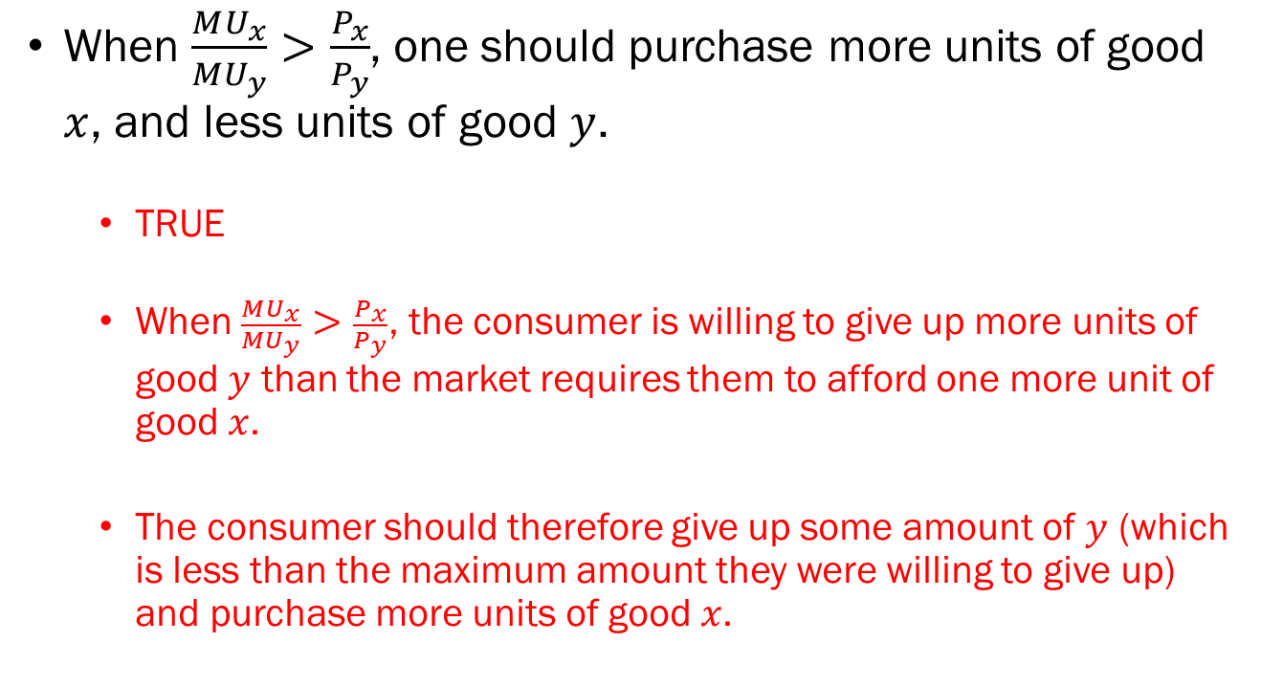
Problem 2.A.
When $\frac{MU_{x}}{MU_{y}}>\frac{P_{x}}{P_{y}}$, one should purchase more units of good $x$, and less units of good $y$.
  TRUE
  When $\frac{MU_{x}}{MU_{y}}>\frac{P_{x}}{P_{y}}$, the consumer is willing to give up more units of good $y$ than the market requires them to afford one more unit of good $x$.
  The consumer should therefore give up some amount of $y$ (which is less than the maximum amount they were willing to give up) and purchase more units of good $x$.

Slide 6
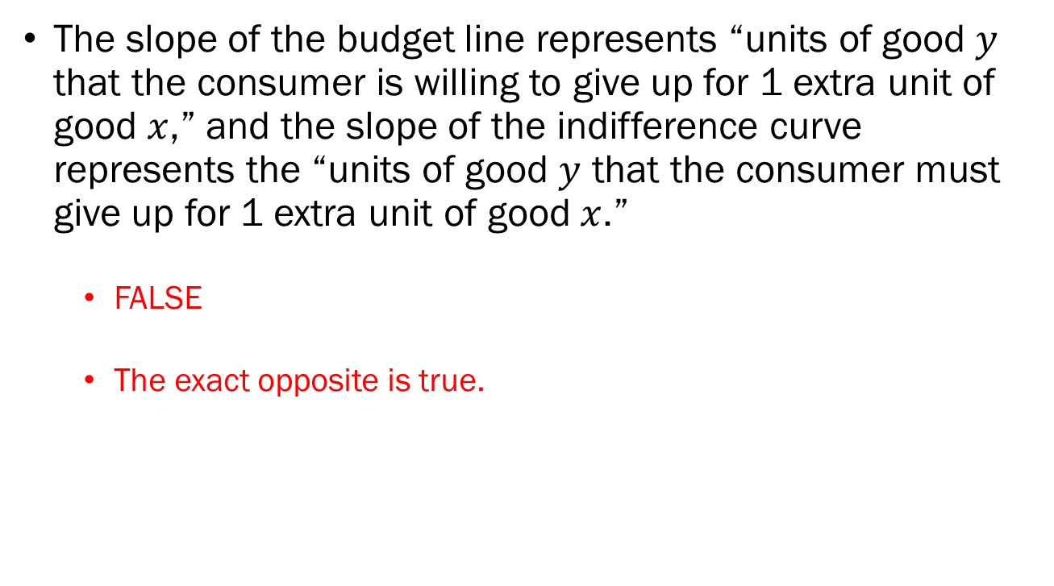
Problem 2.B.
The slope of the budget line represents “units of good $y$ that the consumer is willing to give up for 1 extra unit of good $x$,” and the slope of the indifference curve represents the “units of good $y$ that the consumer must give up for 1 extra unit of good $x$.”
  FALSE
  The exact opposite is true.

Slide 7
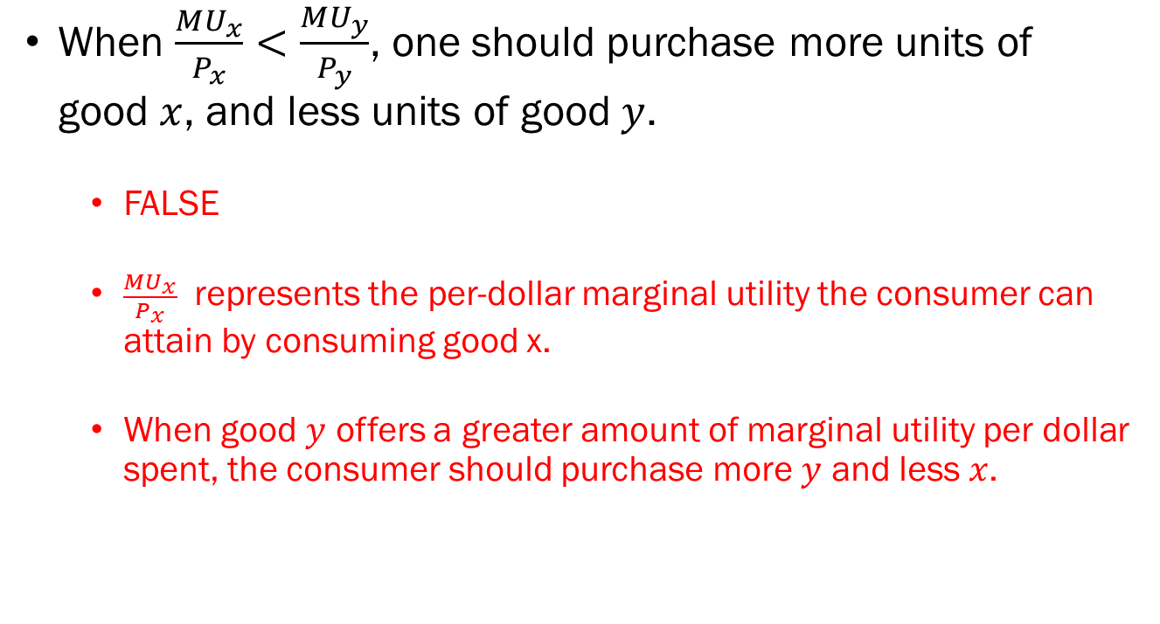
Problem 2.C.
When $\frac{MU_{x}}{P_{x}}<\frac{MU_{y}}{P_{y}}$, one should purchase more units of good $x$, and less units of good $y$.
  FALSE
  $\frac{MU_{x}}{P_{x}}$ represents the per-dollar marginal utility the consumer can attain by consuming good x.
  When good $y$ offers a greater amount of marginal utility per dollar spent, the consumer should purchase more $y$ and less $x$.

Slide 8
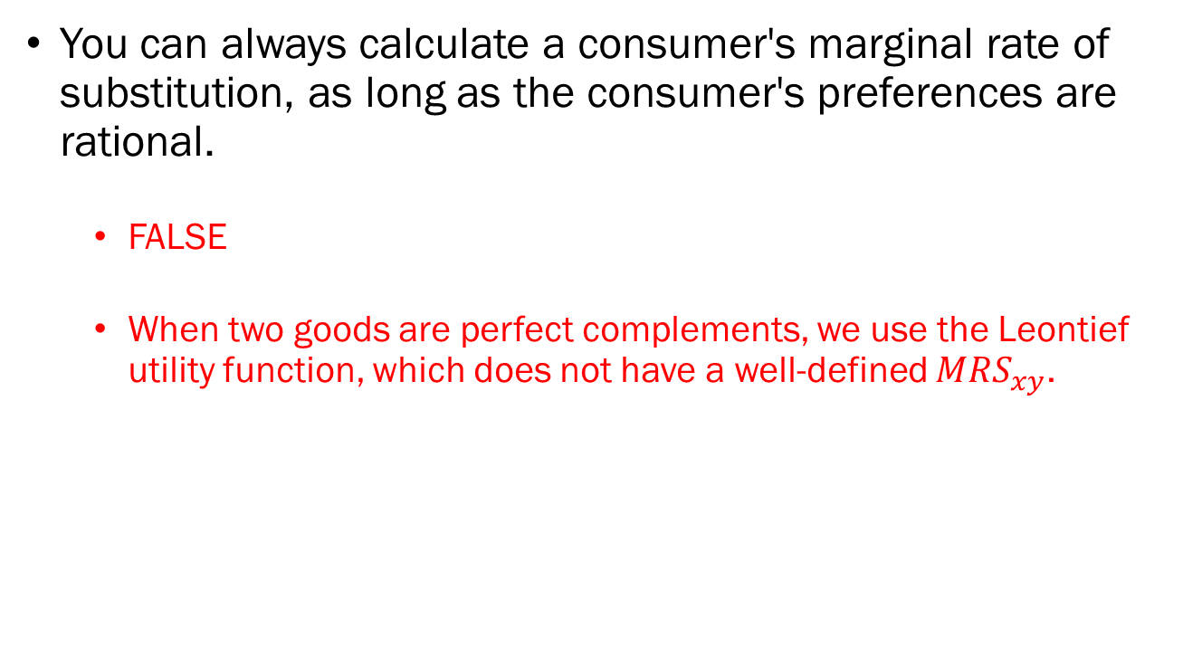
Problem 2.D.
You can always calculate a consumer's marginal rate of substitution, as long as the consumer's preferences are rational.
  FALSE
  When two goods are perfect complements, we use the Leontief utility function, which does not have a well-defined $MRS_{xy}$.

Slide 9
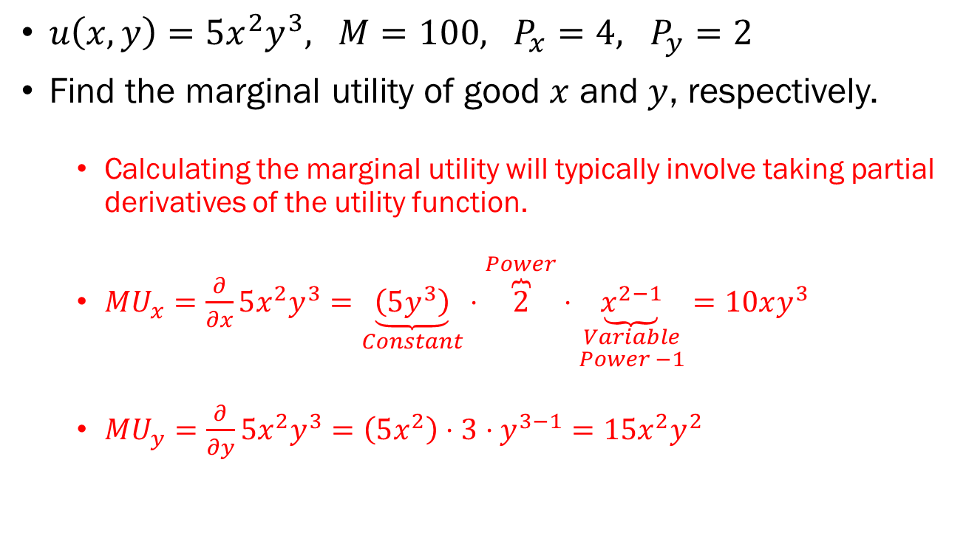
Problem 3.A.
$u\left(x,y\right)=5x^{2}y^{3}, M=100, P_{x}=4, P_{y}=2$
Find the marginal utility of good $x$ and $y$, respectively.
  Calculating the marginal utility will typically involve taking partial derivatives of the utility function.
  $MU_{x}=\frac{∂}{∂x}5x^{2}y^{3}=\underset{Constant}{\underbrace{\left(5y^{3}\right)}}⋅\overset{Power}{\overbrace{2}}⋅\underset{\begin{aligned}Variable \\ Power −1\end{aligned}}{\underbrace{x^{2−1}}}=10xy^{3}$
  $MU_{y}=\frac{∂}{∂y}5x^{2}y^{3}=\left(5x^{2}\right)⋅3⋅y^{3−1}=15x^{2}y^{2}$

Slide 10
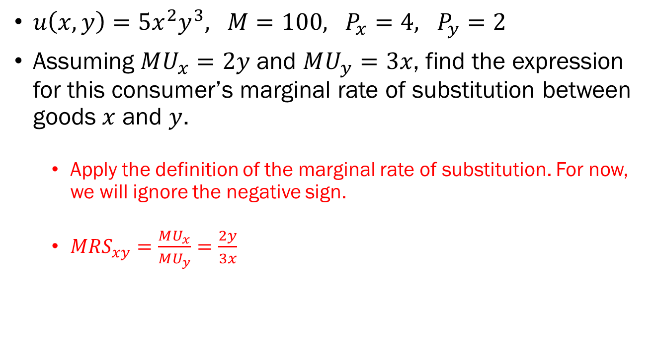
Problem 3.B.
$u\left(x,y\right)=5x^{2}y^{3}, M=100, P_{x}=4, P_{y}=2$
Assuming $MU_{x}=2y$ and $MU_{y}=3x$, find the expression for this consumer’s marginal rate of substitution between goods $x$ and $y$.
  Apply the definition of the marginal rate of substitution. For now, we will ignore the negative sign.
  $MRS_{xy}=\frac{MU_{x}}{MU_{y}}=\frac{2y}{3x}$

Slide 11
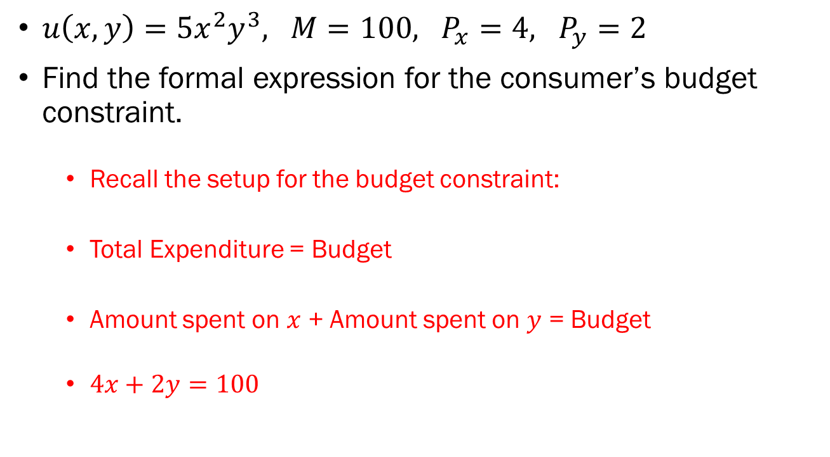
Problem 3.C.
$u\left(x,y\right)=5x^{2}y^{3}, M=100, P_{x}=4, P_{y}=2$
Find the formal expression for the consumer’s budget constraint.
  Recall the setup for the budget constraint:
  Total Expenditure = Budget
  Amount spent on $x$ + Amount spent on $y$ = Budget
  $4x+2y=100$

Slide 12
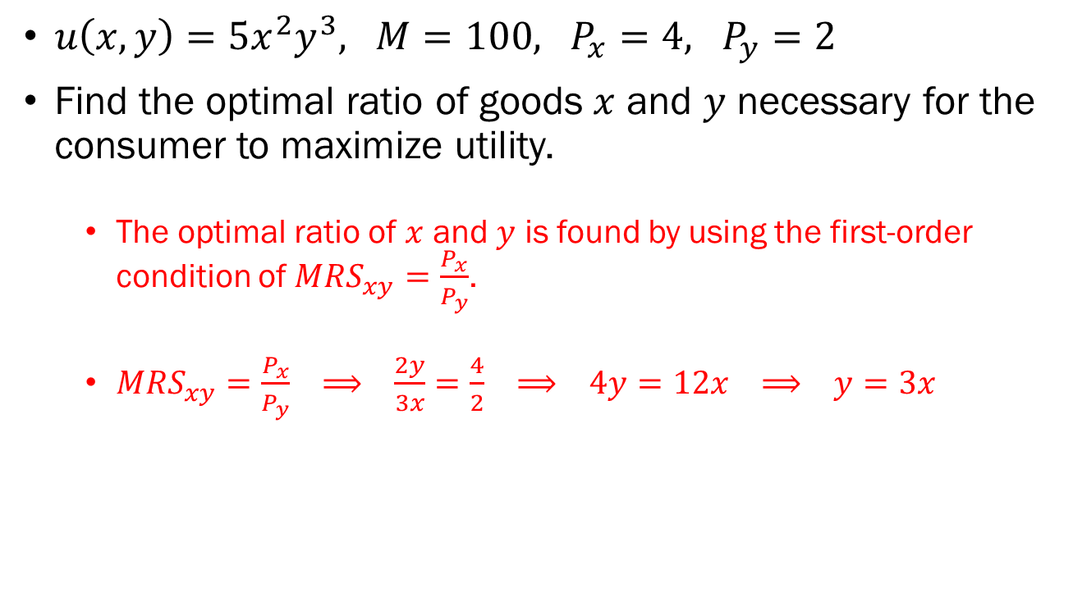
Problem 3.D.
$u\left(x,y\right)=5x^{2}y^{3}, M=100, P_{x}=4, P_{y}=2$
Find the optimal ratio of goods $x$ and $y$ necessary for the consumer to maximize utility.
  The optimal ratio of $x$ and $y$ is found by using the first-order condition of $MRS_{xy}=\frac{P_{x}}{P_{y}}$.
  $MRS_{xy}=\frac{P_{x}}{P_{y}} ⟹ \frac{2y}{3x}=\frac{4}{2} ⟹ 4y=12x ⟹ y=3x$

Slide 13
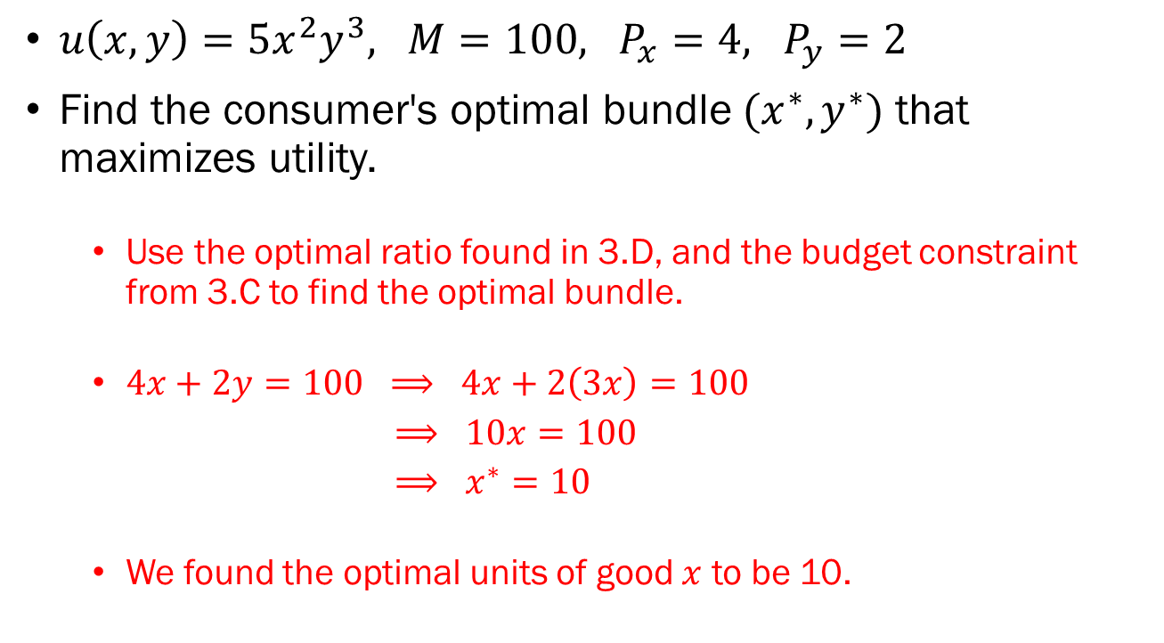
Problem 3.E.
$u\left(x,y\right)=5x^{2}y^{3}, M=100, P_{x}=4, P_{y}=2$
Find the consumer's optimal bundle $(x^{∗},y^{∗})$ that maximizes utility.
  Use the optimal ratio found in 3.D, and the budget constraint from 3.C to find the optimal bundle.
  $4x+2y=100 ⟹ 4x+2\left(3x\right)=100$
  $⟹ 10x=100$
  $⟹ x^{∗}=10$
  We found the optimal units of good $x$ to be 10.

Slide 14
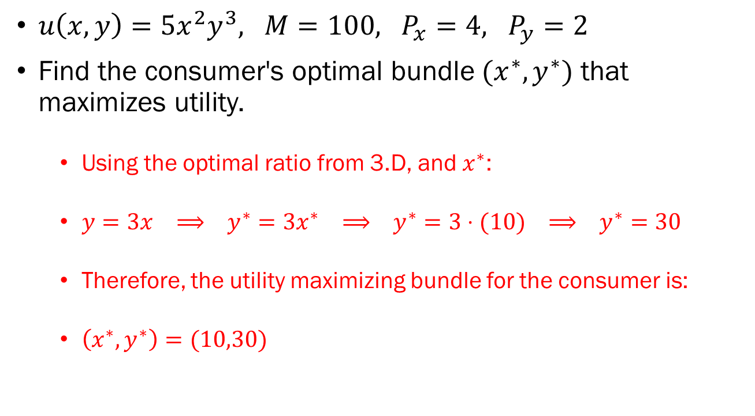
Problem 3.E. (Continued)
$u\left(x,y\right)=5x^{2}y^{3}, M=100, P_{x}=4, P_{y}=2$
Find the consumer's optimal bundle $(x^{∗},y^{∗})$ that maximizes utility.
  Using the optimal ratio from 3.D, and $x^{∗}$:
  $y=3x ⟹ y^{∗}=3x^{∗} ⟹ y^{∗}=3⋅(10) ⟹ y^{∗}=30$
  Therefore, the utility maximizing bundle for the consumer is:
  $\left(x^{∗},y^{∗}\right)=(10,30)$

Slide 15
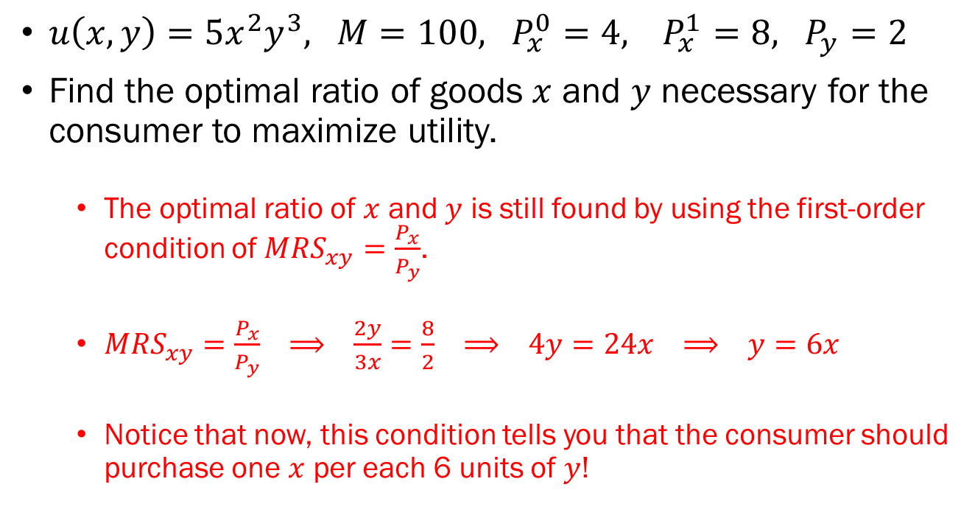
Problem 3.F.
$u\left(x,y\right)=5x^{2}y^{3}, M=100, P_{x}^{0}=4, P_{x}^{1}=8, P_{y}=2$
Find the optimal ratio of goods $x$ and $y$ necessary for the consumer to maximize utility.
  The optimal ratio of $x$ and $y$ is still found by using the first-order condition of $MRS_{xy}=\frac{P_{x}}{P_{y}}$.
  $MRS_{xy}=\frac{P_{x}}{P_{y}} ⟹ \frac{2y}{3x}=\frac{8}{2} ⟹ 4y=24x ⟹ y=6x$
  Notice that now, this condition tells you that the consumer should purchase one $x$ per each 6 units of $y$!

Slide 16
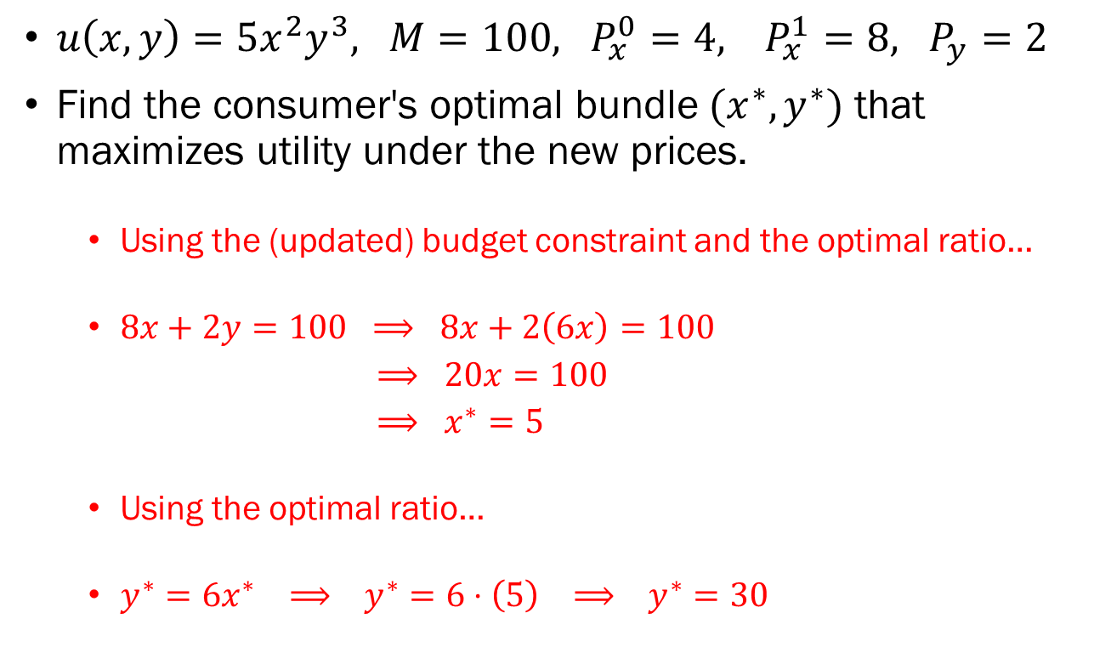
Problem 3.G.
$u\left(x,y\right)=5x^{2}y^{3}, M=100, P_{x}^{0}=4, P_{x}^{1}=8, P_{y}=2$
Find the consumer's optimal bundle $(x^{∗},y^{∗})$ that maximizes utility under the new prices.
  Using the (updated) budget constraint and the optimal ratio…
  $8x+2y=100 ⟹ 8x+2\left(6x\right)=100$
  $⟹ 20x=100$
  $⟹ x^{∗}=5$
  Using the optimal ratio…
  $y^{∗}=6x^{∗} ⟹ y^{∗}=6⋅\left(5\right) ⟹ y^{∗}=30$

Slide 17
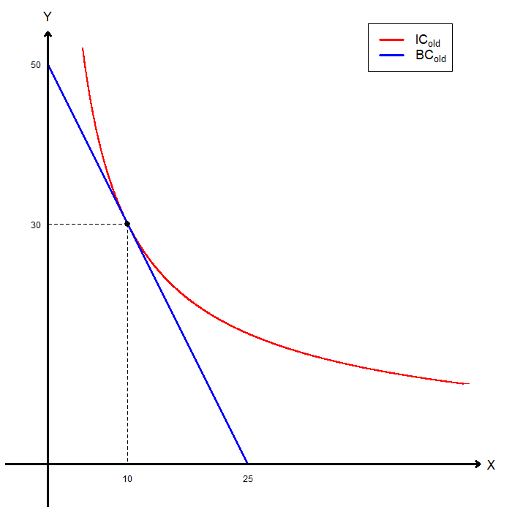

Problem 3.H.
$u\left(x,y\right)=5x^{2}y^{3}, M=100, P_{x}^{0}=4, P_{x}^{1}=8, P_{y}=2$

Slide 18
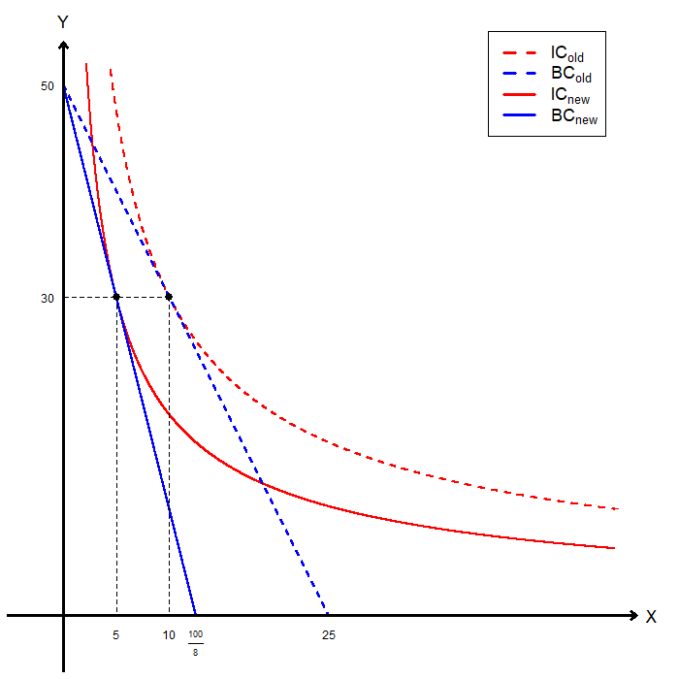
Problem 3.H. (Continued)
$u\left(x,y\right)=5x^{2}y^{3}, M=100, P_{x}^{0}=4, P_{x}^{1}=8, P_{y}=2$

Slide 19
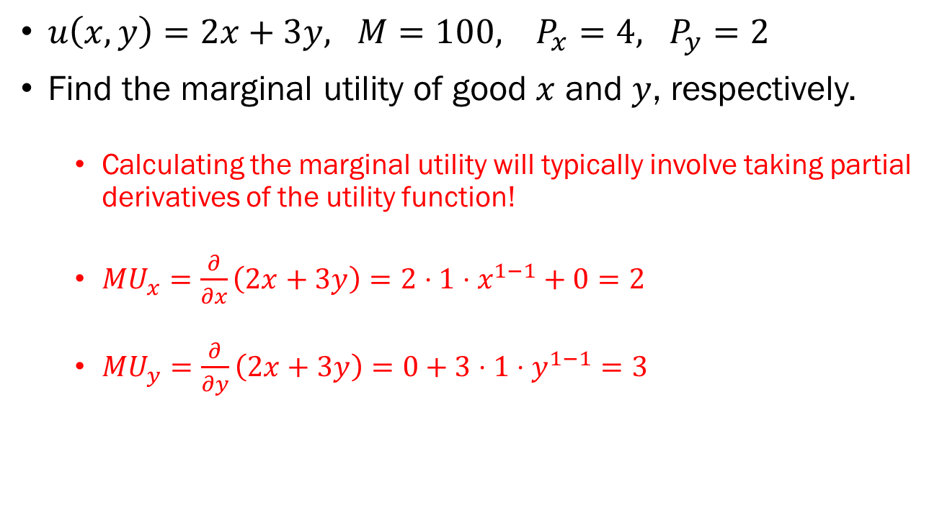
Problem 4.A.
$u\left(x,y\right)=2x+3y, M=100, P_{x}=4, P_{y}=2$
Find the marginal utility of good $x$ and $y$, respectively.
  Calculating the marginal utility will typically involve taking partial derivatives of the utility function!
  $MU_{x}=\frac{∂}{∂x}\left(2x+3y\right)=2⋅1⋅x^{1−1}+0=2$
  $MU_{y}=\frac{∂}{∂y}\left(2x+3y\right)=0+3⋅1⋅y^{1−1}=3$

Slide 20
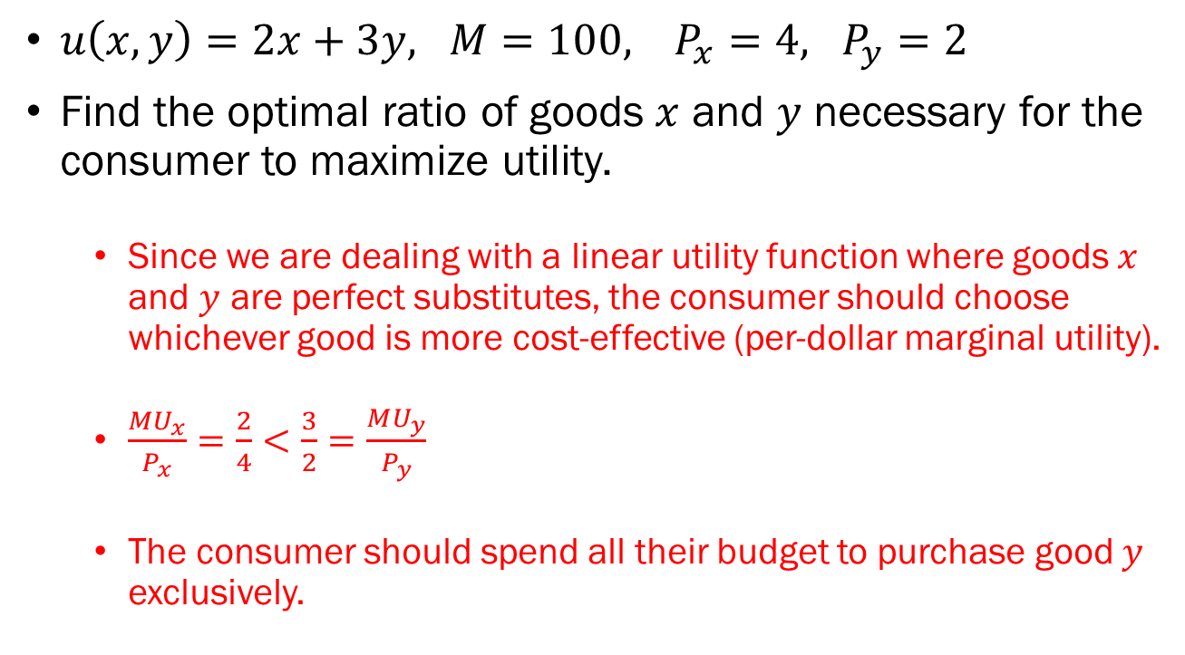
Problem 4.B.
$u\left(x,y\right)=2x+3y, M=100, P_{x}=4, P_{y}=2$
Find the optimal ratio of goods $x$ and $y$ necessary for the consumer to maximize utility.
  Since we are dealing with a linear utility function where goods $x$ and $y$ are perfect substitutes, the consumer should choose whichever good is more cost-effective (per-dollar marginal utility).
  $\frac{MU_{x}}{P_{x}}=\frac{2}{4}<\frac{3}{2}=\frac{MU_{y}}{P_{y}}$
  The consumer should spend all their budget to purchase good $y$ exclusively.

Slide 21
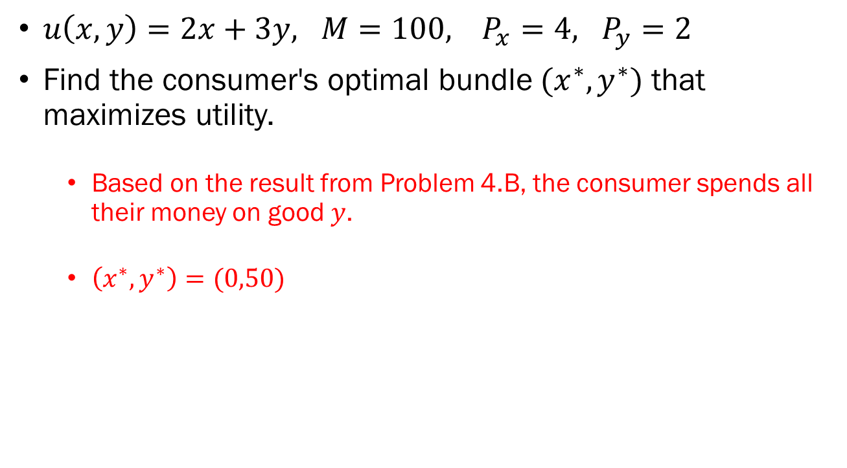
Problem 4.C.
$u\left(x,y\right)=2x+3y, M=100, P_{x}=4, P_{y}=2$
Find the consumer's optimal bundle $(x^{∗},y^{∗})$ that maximizes utility.
  Based on the result from Problem 4.B, the consumer spends all their money on good $y$.
  $\left(x^{∗},y^{∗}\right)=(0,50)$

