Slide 1
Consumer Theory:
Preferences and Utility Functions
ECON 300

Slide 2

PollEv.com/brianpark046

Slide 3
Preferences
As a contrast to the previous topic, preferences are purely subjective.
When evaluating if the consumer “prefers” one good over another, “feasibility” does not play any role.
Just as we did not care about whether the consumer “likes” one bundle over the other in the budget constraint, “prices” do not enter preferences.

Slide 4
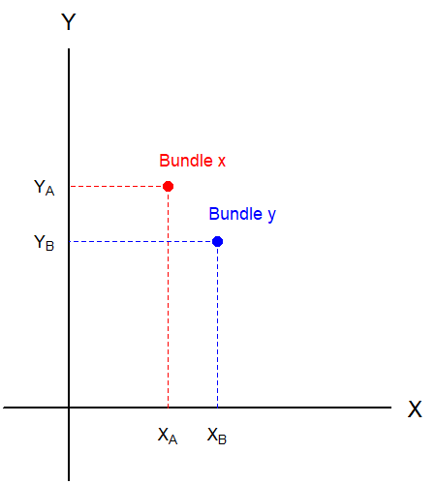
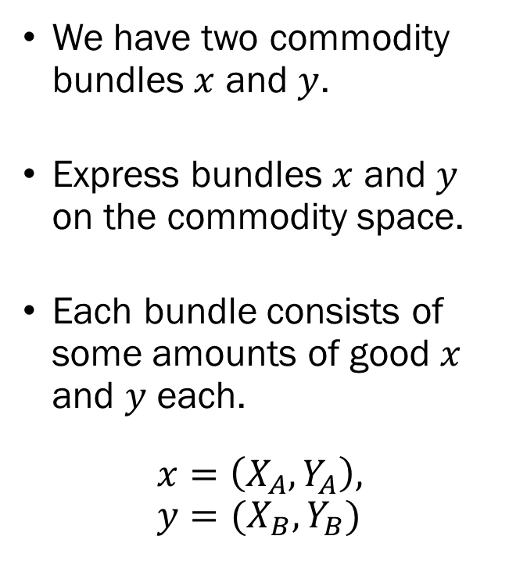
Preferences
We have two commodity bundles $x$ and $y$.
Express bundles $x$ and $y$ on the commodity space.
Each bundle consists of some amounts of good $x$ and $y$ each.
$$x=\left(X_{A}, Y_{A}\right), y=(X_{B}, Y_{B})$$

Slide 5
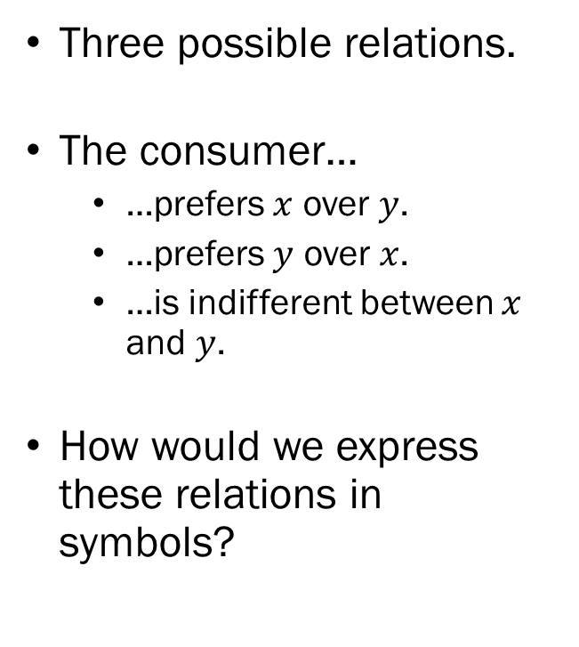
Preferences
Three possible relations.
The consumer…
  …prefers $x$ over $y$.
  …prefers $y$ over $x$.
  …is indifferent between $x$ and $y$.
How would we express these relations in symbols?

Slide 6
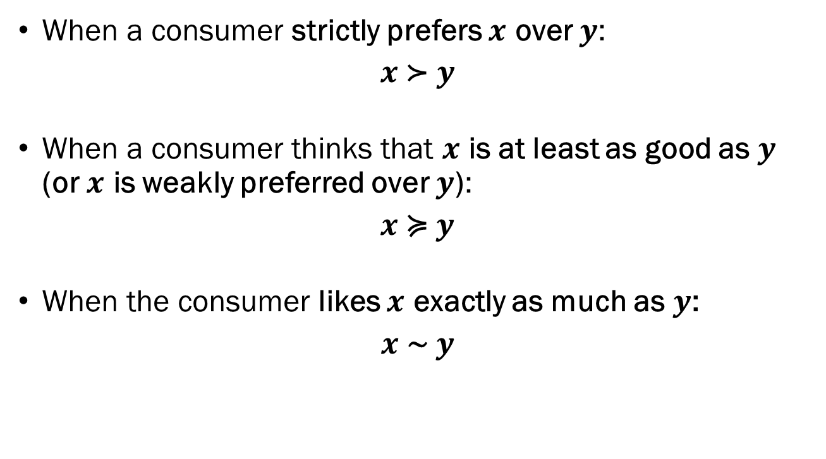
Preferences: Notations
When a consumer strictly prefers $x$ over $y$:
$$x \text{≻} y$$
When a consumer thinks that $x$ is at least as good as $y$ (or $x$ is weakly preferred over $y$):
$$x \text{≽} y$$
When the consumer likes $x$ exactly as much as $y$:
$$x \text{∼} y$$

Slide 7
Preferences: The Axioms
Completeness
Transitivity
Reflexivity
Continuity
Strong Monotonicity
Convexity

Slide 8
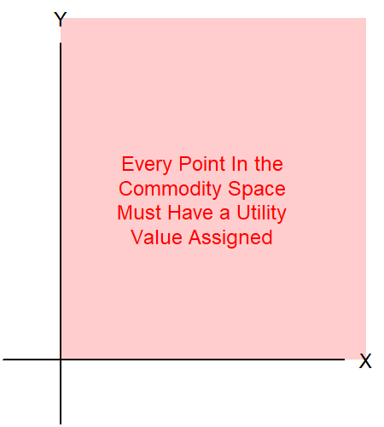
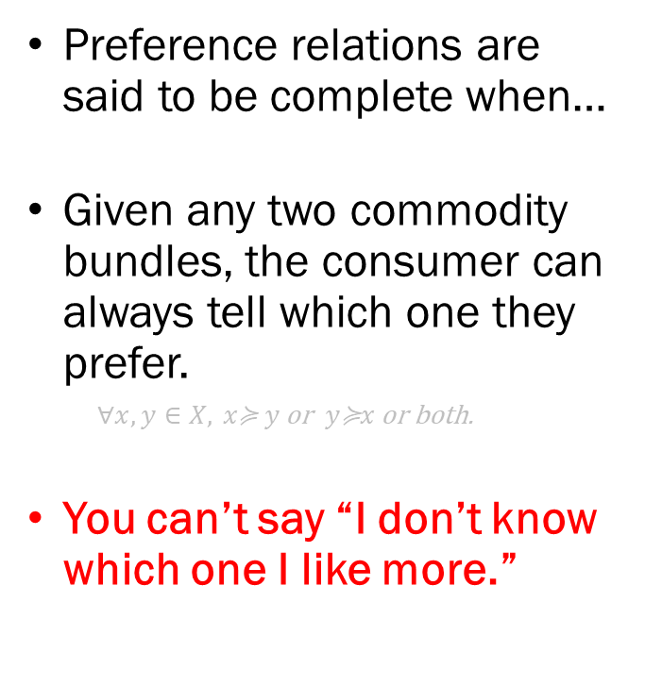
Completeness
Preference relations are said to be complete when…
Given any two commodity bundles, the consumer can always tell which one they prefer.
  $$∀x,y∈X, x\text{≽} y \text{or} y\text{≽}x \text{or} \text{both}\text{.}$$
You can’t say “I don’t know which one I like more.”

Slide 9
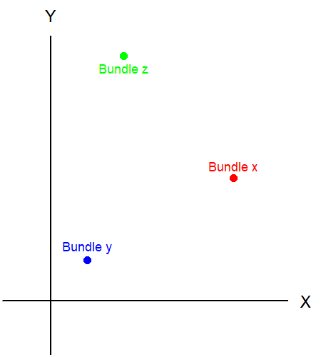
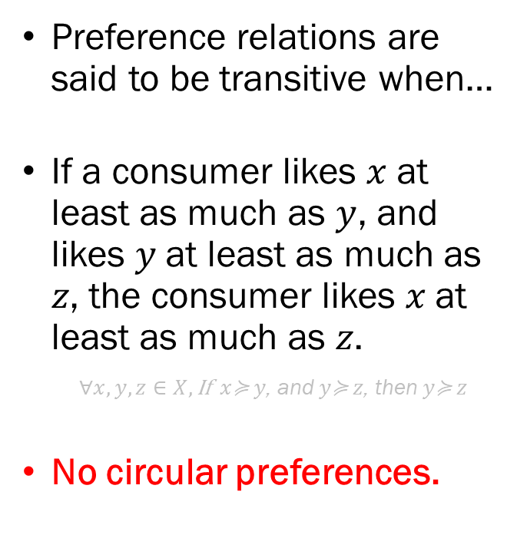
Transitivity
Preference relations are said to be transitive when…
If a consumer likes $x$ at least as much as $y$, and likes 𝑦 at least as much as 𝑧, the consumer likes 𝑥 at least as much as 𝑧.
  $$∀x,y,z∈X,\text{If} x\text{≽} y\text{, }\text{and} y\text{≽} z\text{, }\text{then} y\text{≽} z$$
No circular preferences.

Slide 10
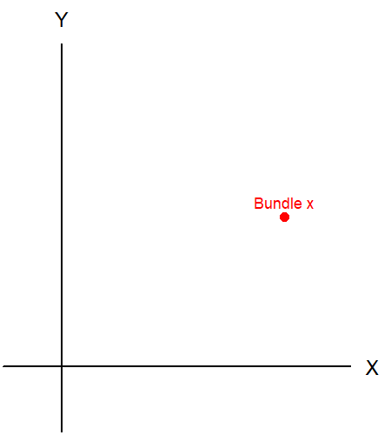
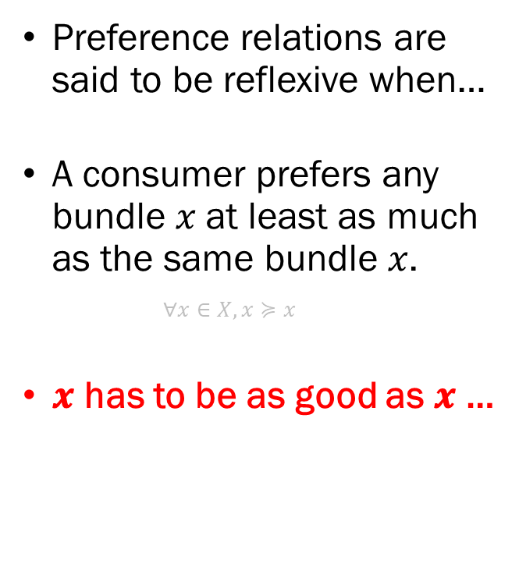
Reflexivity
Preference relations are said to be reflexive when…
A consumer prefers any bundle 𝑥 at least as much as the same bundle 𝑥.
  $$∀x∈X, x≽x$$
𝒙 has to be as good as 𝒙 …

Slide 11
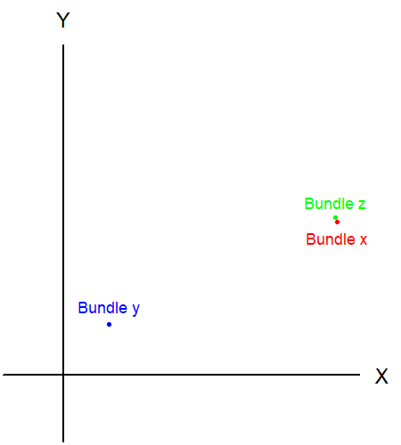
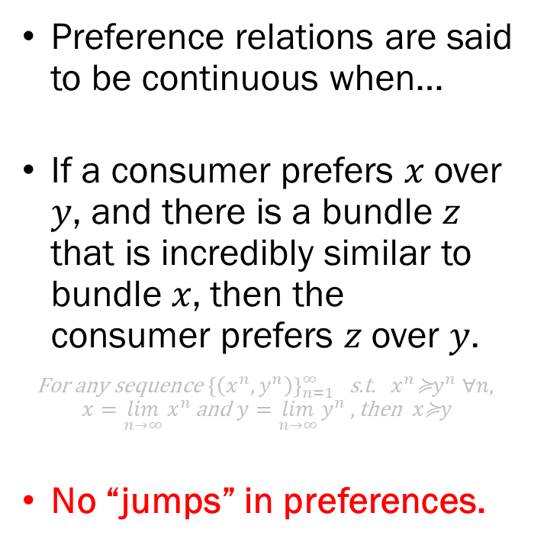
Continuity
Preference relations are said to be continuous when…
If a consumer prefers 𝑥 over 𝑦, and there is a bundle 𝑧 that is incredibly similar to bundle 𝑥, then the consumer prefers 𝑧 over 𝑦.
$$\text{For} \text{any} \text{sequence} {\left\{\left(x^{n},y^{n}\right)\right\}}_{n=1}^{∞} \text{s}\text{.}\text{t}\text{. }x^{n}\text{≽}y^{n} ∀n,$$
$$x=\lim_{n→∞}{x^{n}}\text{and} y=\lim_{n→∞}{y^{n}},\text{then} x\text{≽}y$$
No “jumps” in preferences.

Slide 12
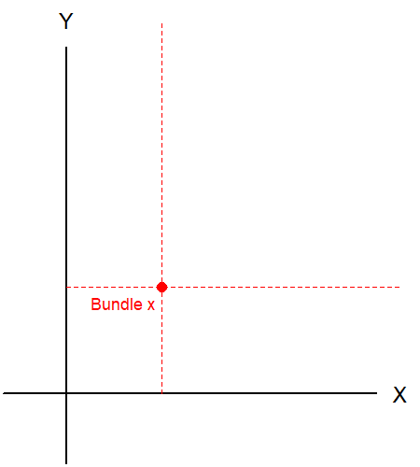
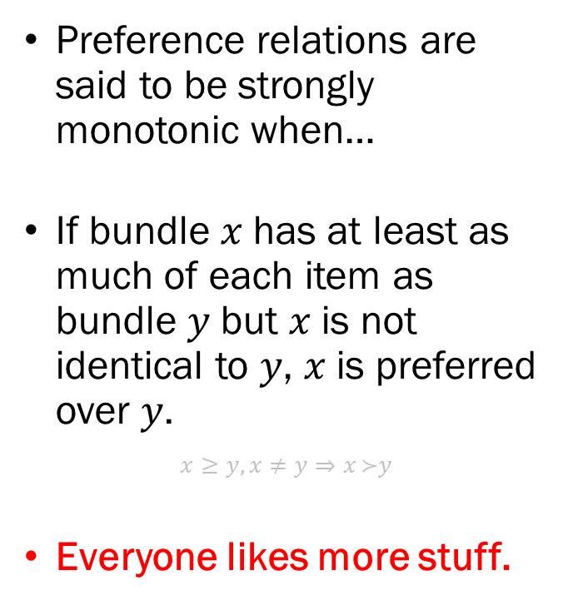
Strong Monotonicity
Preference relations are said to be strongly monotonic when…
If bundle 𝑥 has at least as much of each item as bundle 𝑦 but 𝑥 is not identical to 𝑦, 𝑥 is preferred over 𝑦.
$$x≥y, x≠y⇒x \text{≻}y$$
Everyone likes more stuff.

Slide 13
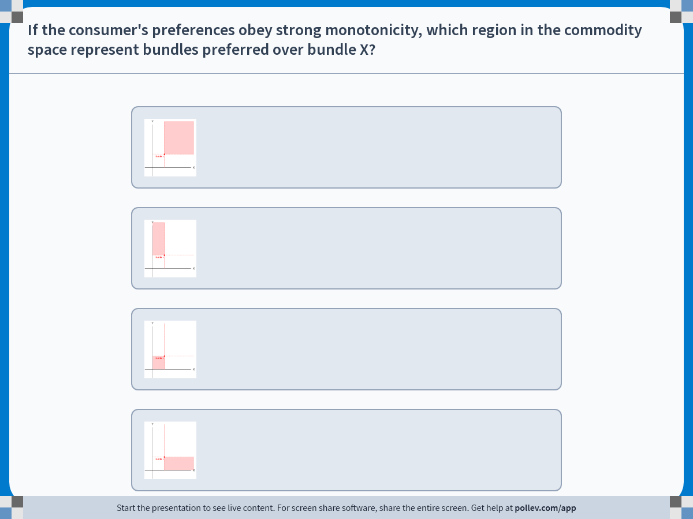
Notes:
Poll Title: Do not modify the notes in this section to avoid tampering with the Poll Everywhere activity.
More info at polleverywhere.com/support
If the consumer's preferences obey strong monotonicity, which region in the commodity space represent bundles preferred over bundle X?
https://www.polleverywhere.com/multiple_choice_polls/gMATs40TBc744cbK2SHx7?display_state=instructions&activity_state=opened&state=opened&flow=Engagement&onscreen=persist

Slide 14
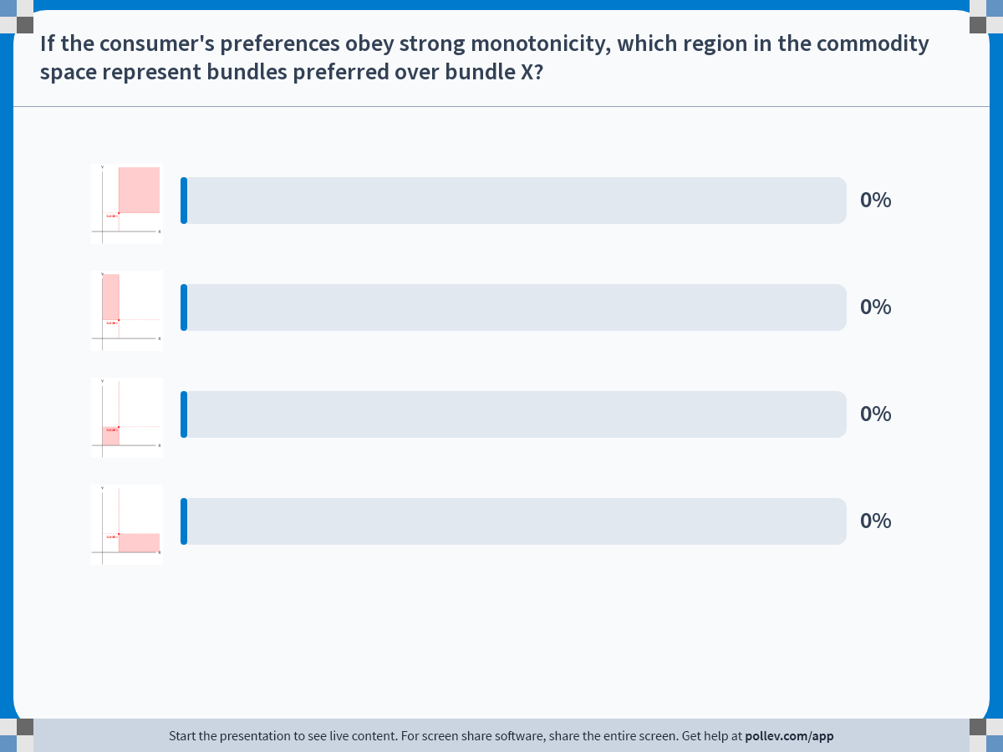
Notes:
Poll Title: Do not modify the notes in this section to avoid tampering with the Poll Everywhere activity.
More info at polleverywhere.com/support
If the consumer's preferences obey strong monotonicity, which region in the commodity space represent bundles preferred over bundle X?
https://www.polleverywhere.com/multiple_choice_polls/gMATs40TBc744cbK2SHx7?display_state=chart&activity_state=closed&state=closed&flow=Engagement&onscreen=persist

Slide 15
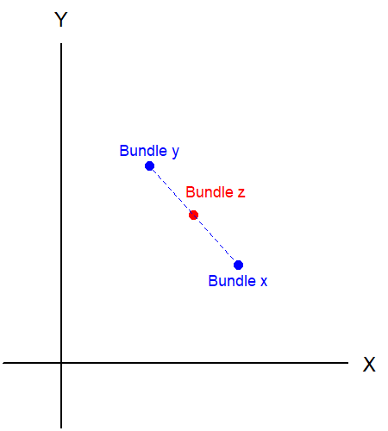
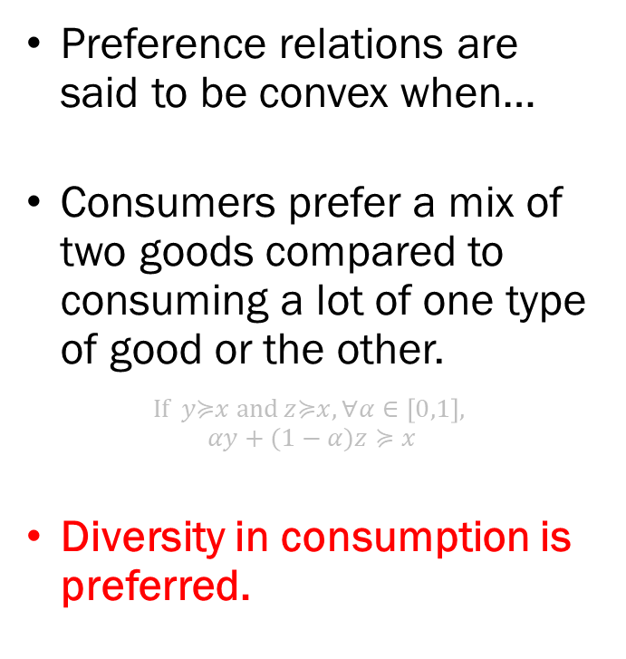
Convexity
Preference relations are said to be convex when…
Consumers prefer a mix of two goods compared to consuming a lot of one type of good or the other.
$$\text{If} y\text{≽}x \text{and} z\text{≽}x, ∀α∈\left[0,1\right],$$
$$αy+(1−α)z≽x$$
Diversity in consumption is preferred.

Slide 16
Preferences: The Axioms
Completeness: All bundles can be evaluated.
Transitivity: No circular preferences.
Reflexivity: Anything is as good as itself.
Continuity: No sudden jumps in preferences.
Strong Monotonicity: The more the better.
Convexity: Consumers like combinations of goods.

Slide 17
Utility
We represent the consumer’s preference in mathematics by constructing the Utility Function.
But first, we must understand Utility.
Utility is the “subjective satisfaction” that the consumer derives from consuming a certain commodity bundle.
If a consumer reports that the bundle A provides 100 utility, and bundle B provides 200 utility, we can say that the consumer prefers bundle B over bundle A.

Slide 18
Ordinal and Cardinal Utility
Utility is Ordinal, but NOT Cardinal.
  Ordinal: The “rank” is the only thing that matters.
  Cardinal: The “value” means something.
If bundle A gives 100 utility and bundle B gives 200 utility, it does NOT mean that bundle B is twice as good. Simply that B is preferred over A.
Since the relative rank is the only thing that matters, we cannot compare utility across different individuals.

Slide 19
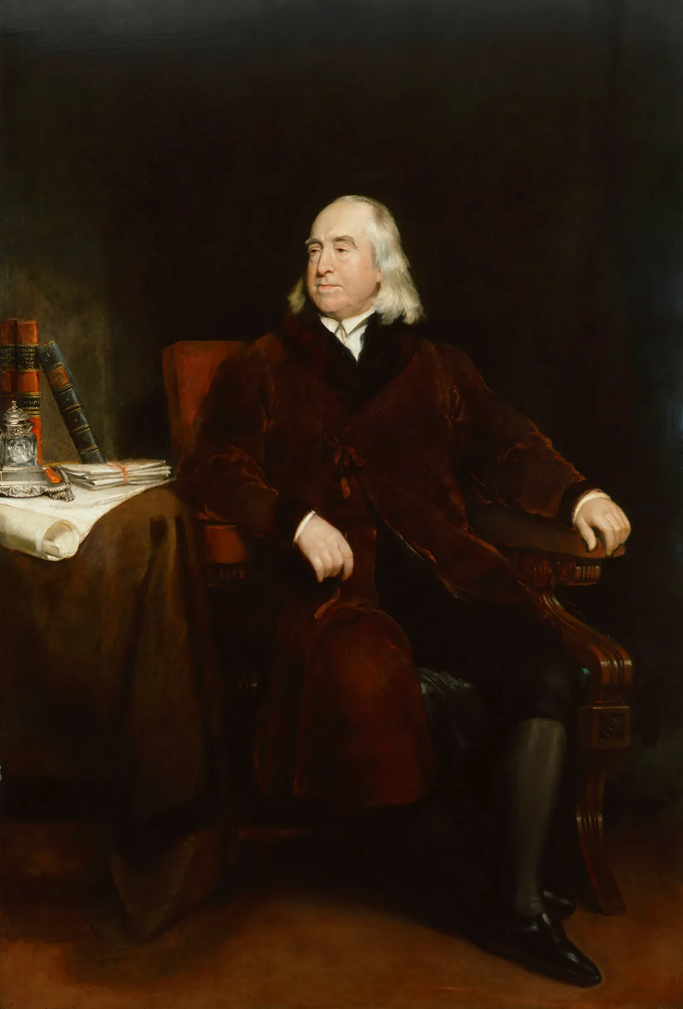
Utilitarianism and Ordinal Utility
Utilitarianism (Jeremy Bentham)
The doctrine of “the greatest happiness of the greatest number.”
Seems to suggest that to maximize social welfare, we should choose the distribution that maximizes the sum of all individuals’ utility.
Similar in name, not compatible.

Slide 20
Utilitarianism and Ordinal Utility
 | Consumer 1’s Utility | Consumer 2’s Utility
Bundle A | 1 | 100
Bundle B | 2 | 300
Bundle C | 5 | 400
Bundle D | 7 | 125
Bundle E | 2 | 50
Bundle F | 3 | 1,027
Bundle G | 10 | 740
Bundle H | 4 | 1
If utility was cardinal, and we follow utilitarianism, we give everything but bundle H to consumer 2.
The problem is that the utility values from consumer 1 and the utility values from consumer 2 are NOT comparable.

Slide 21
Pareto Improvements
We use the concept of Pareto Improvements.
“A change that leaves nobody worse off than the previous state, while improving the welfare of at least one person.”
Compatible with cardinal utility.
Not easy to pull off in the real-world.

Slide 22
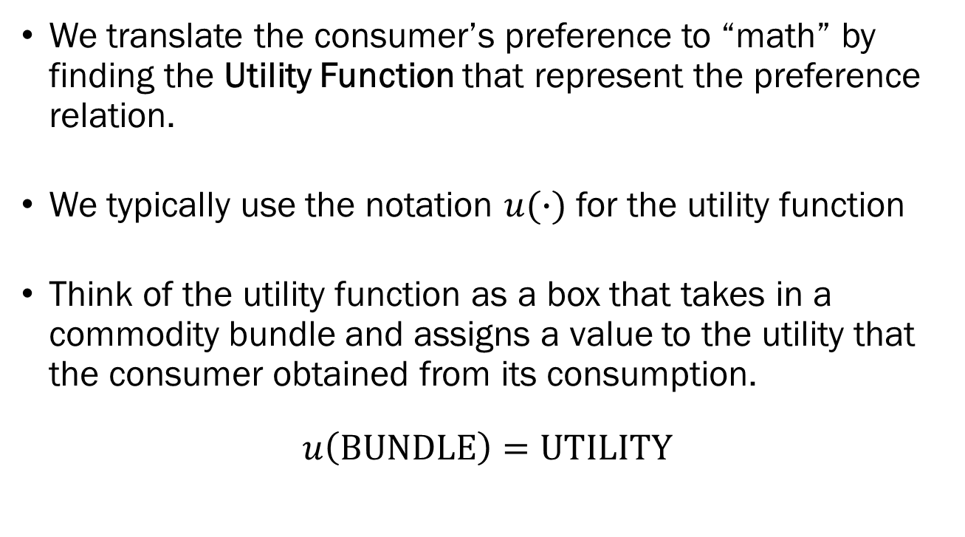
The Utility Function
We translate the consumer’s preference to “math” by finding the Utility Function that represent the preference relation.
We typically use the notation $u(∙)$ for the utility function
Think of the utility function as a box that takes in a commodity bundle and assigns a value to the utility that the consumer obtained from its consumption.
$$u\left(\text{BUNDLE}\right)=\text{UTILITY}$$

Slide 23
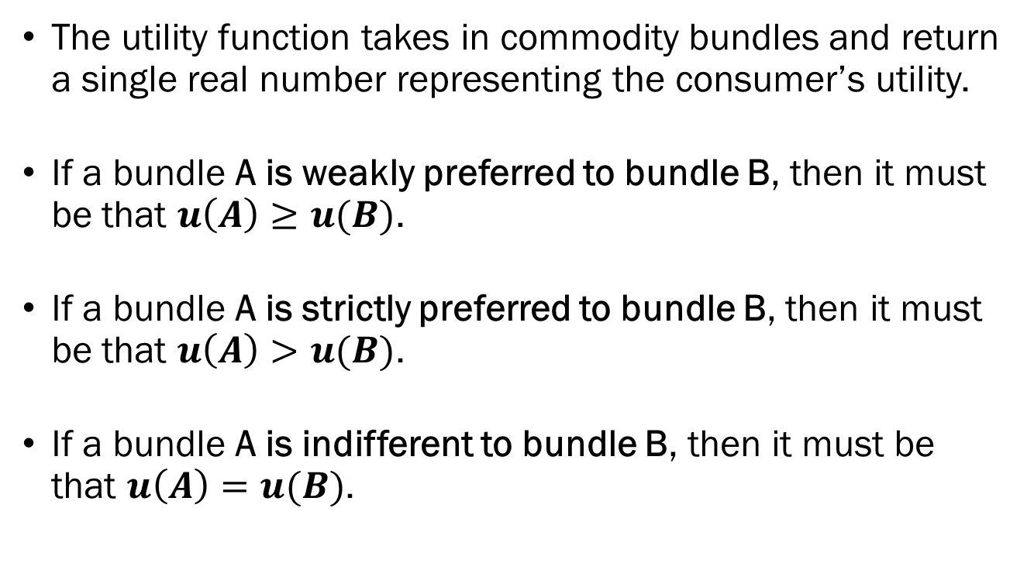
Rules of the Utility Function
The utility function takes in commodity bundles and return a single real number representing the consumer’s utility.
If a bundle A is weakly preferred to bundle B, then it must be that $u\left(A\right)≥u(B)$.
If a bundle A is strictly preferred to bundle B, then it must be that $u\left(A\right)>u(B)$.
If a bundle A is indifferent to bundle B, then it must be that $u\left(A\right)=u(B)$.

Slide 24
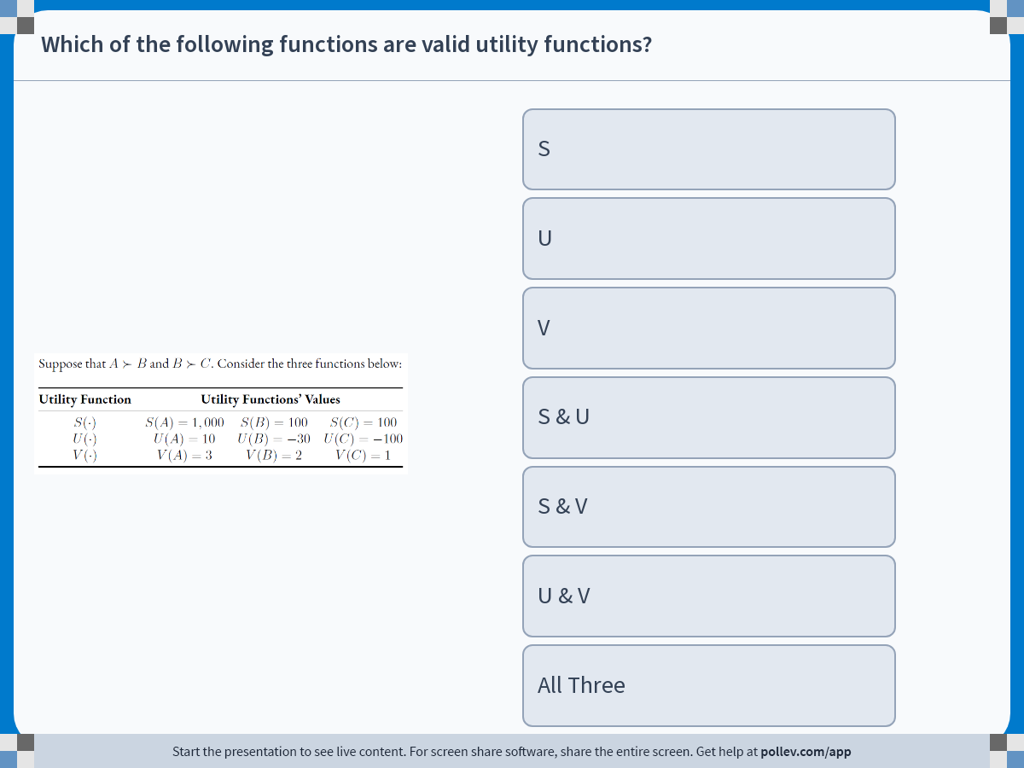
Notes:
Poll Title: Do not modify the notes in this section to avoid tampering with the Poll Everywhere activity.
More info at polleverywhere.com/support
Which of the following functions are valid utility functions?
https://www.polleverywhere.com/multiple_choice_polls/tVCup3ElyuVkjofjMD8yS?display_state=instructions&activity_state=opened&state=opened&flow=Engagement&onscreen=persist

Slide 25
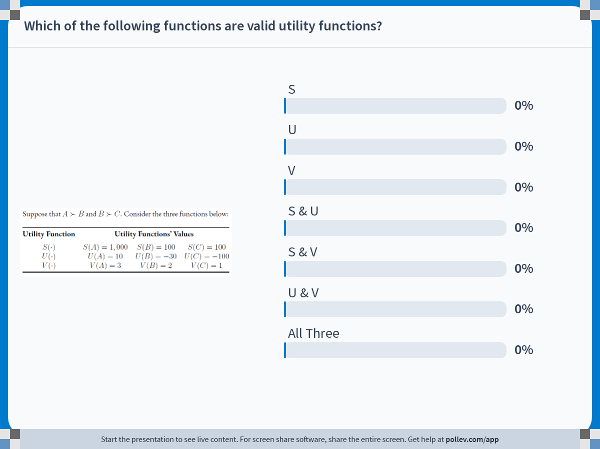
Notes:
Poll Title: Do not modify the notes in this section to avoid tampering with the Poll Everywhere activity.
More info at polleverywhere.com/support
Which of the following functions are valid utility functions?
https://www.polleverywhere.com/multiple_choice_polls/tVCup3ElyuVkjofjMD8yS?display_state=chart&activity_state=closed&state=closed&flow=Engagement&onscreen=persist

Slide 26
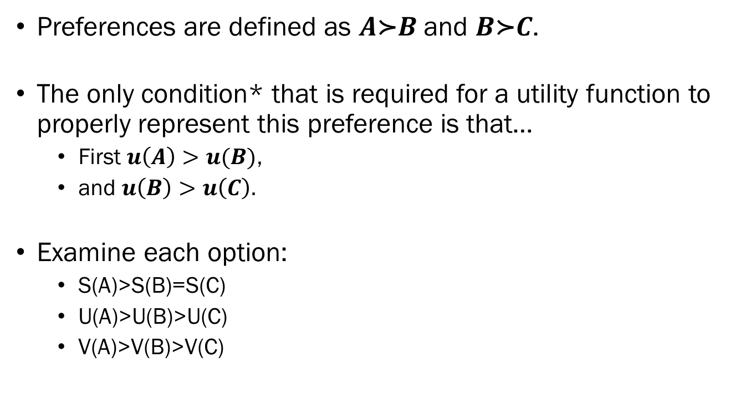
In-class Exercise
Preferences are defined as $A\text{≻}B$ and $B\text{≻}C$.
The only condition* that is required for a utility function to properly represent this preference is that…
  First $u\left(A\right)>u(B)$,
  and $u\left(B\right)>u\left(C\right).$
Examine each option:
  S(A)>S(B)=S(C)
  U(A)>U(B)>U(C)
  V(A)>V(B)>V(C)

Slide 27
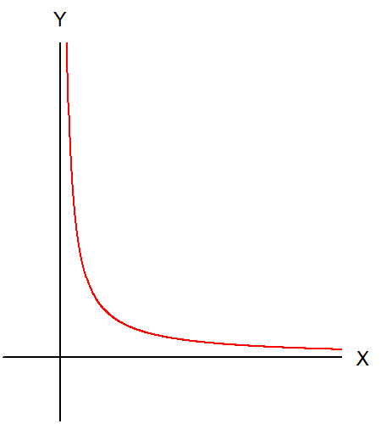
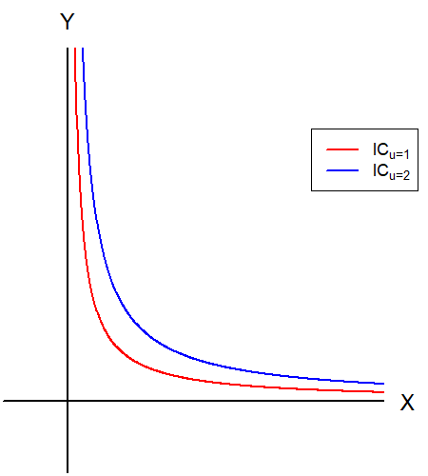
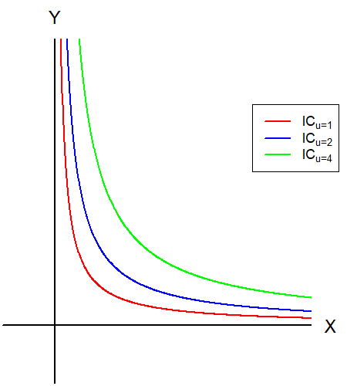
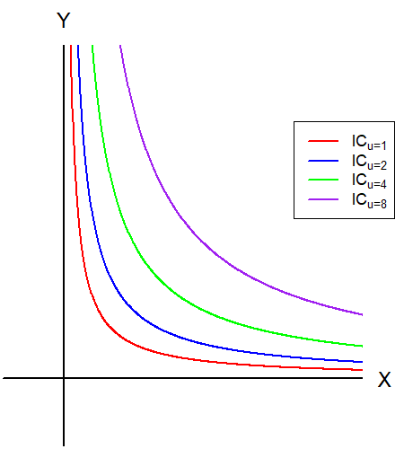
The Utility Function Visualized
We can visualize the utility function by drawing what is known as the Indifference Curve.
Indifference curves are plotted on the commodity space.
Indifference curve “links” all bundles that result in the exact same utility value.

Slide 28

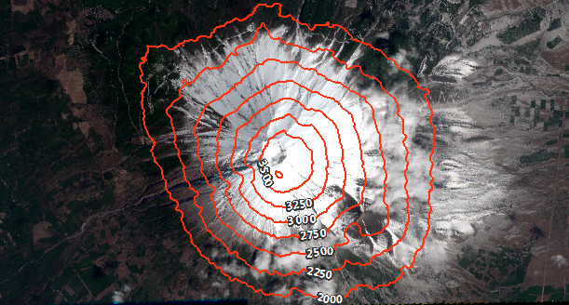
Similarity to Topographic Maps
3D Map
Topographic Map
Imagine that there is a hidden third axis, representing “Height” or “Utility.”

Slide 29
Preview
(Mon) Labor Day: No Class
(Wed) In-class Quiz #1
(Wed) More on the indifference curve:
  The interpretation,
  How preferences mold the indifference curve,
  Different “Types” of utility functions and the indifference curve,
  The slope of the indifference curve.
(Fri) The consumer’s choice:
  Combining the utility function and budget constraint.

