Slide 1
Introduction
ECON 300

Slide 2
About Me
Ph.D. Cornell University
B.A. Korea University
Research Interests
  Environmental: Climate Change, Air Pollution
  Demographic: Migration, Fertility
  Labor: Employment Stability
  Others: Misinformation, Education, Networks
2nd Year at Monmouth College

Slide 3
Contact Information
Email: BPARK@monmouthcollege.edu
  Please include “ECON300” in the subject line.
Office: CSB 248
Regular Office Hours
  Tuesdays and Thursdays 9:00 AM ~ 11:00 AM
Office Hours by Demand via Calendly.
Send me an email if you need anything!

Slide 4
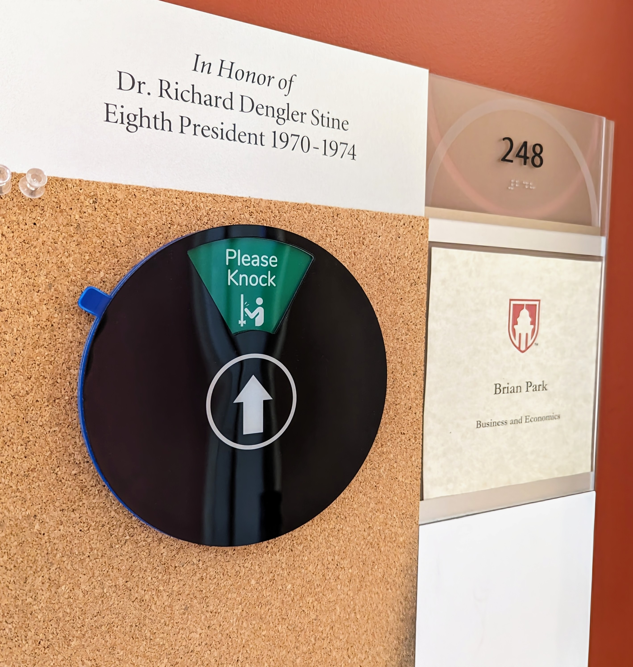
Office Hours: Irregular
Even outside of the regular office hours…
“Please Knock” means that I am available.
“Back Soon” means that I should be back in 30 minutes at the latest.

Slide 5
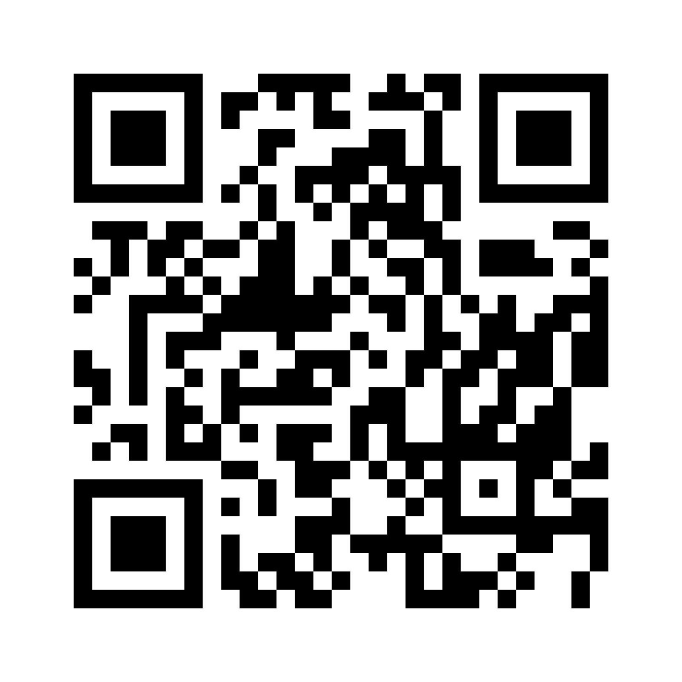
Office Hours: Calendly

Slide 6
Intermediate Price Theory
“A rigorous analysis of the
modern micro-economic theory
of the behavior of the firm
and the individual.”

Slide 7
Intermediate Price Theory
How individuals make decisions…
  How do consumers decide what to purchase?
  How do producers (firms) choose how much to produce?
How these individual decisions interact…
  How are prices determined in the market?
  When is the market efficient?
  What are the effects of government interventions?
What happens when assumptions fail…

Slide 8

PollEverywhere
https://pollev.com/brianpark046

Slide 9
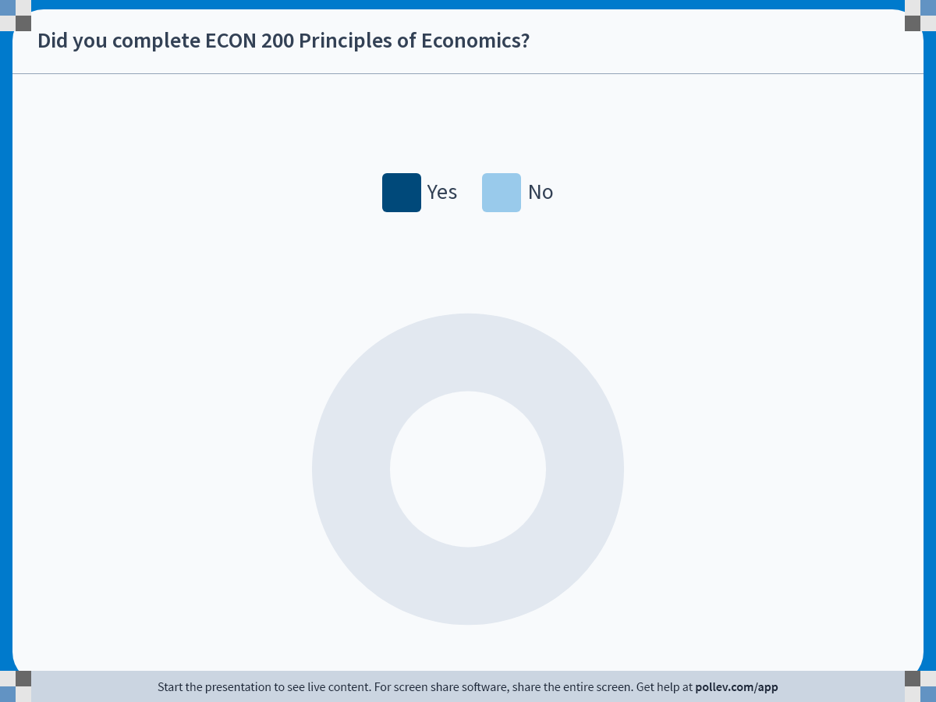
Notes:
Poll Title: Do not modify the notes in this section to avoid tampering with the Poll Everywhere activity.
More info at polleverywhere.com/support
Did you complete ECON 200 Principles of Economics?
https://www.polleverywhere.com/multiple_choice_polls/ZhVSCRdd00fosPei4xZIj?state=opened&flow=Default&onscreen=persist

Slide 10

Textbook / Reading Material
Microeconomics, 9th ed.
Pindyck & Rubinfeld
Pearson
MUST purchase with MyLab Access.
Slides will be distributed via Moodle.

Slide 11
Pearson MyLab
https://mlm.pearson.com/
Course ID: park80362
Homework will be administered on this platform.
When purchasing the textbook, make sure you purchase access to Pearson MyLab.
  The MC bookstore has the correct version!
A trial of 14 days is allowed until you acquire a textbook.

Slide 12
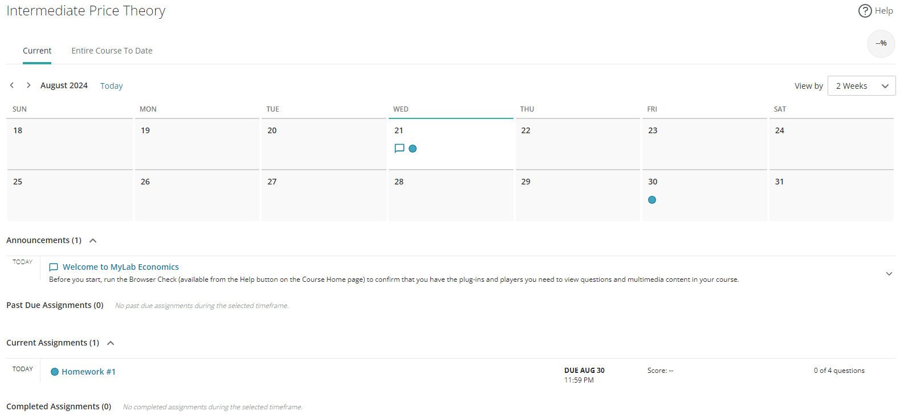
Pearson MyLab

Slide 13
Grades
Your grand total score for the semester will be calculated as follows:
  Attendance: 10%
  Homework: 10%
  Quizzes: 40%
  Final Exam: 40%

Slide 14
Grades
For instance, if you get:
  95 in attendance, and
  90 in homework, and
  80 in quizzes, and
  87 in the final.
Your grand total score will be:
  95 x 10% + 90 x 10% + 80 x 40% + 87 x 40% = 85.3

Slide 15
Grades
There are no predetermined “cutoff” for letter grades.
The cutoffs will be determined based on the performance of the class.
The cutoffs used in Fall 2023 were…
  90+: A
  87 ~ 90: A-
  83 ~ 87: B+
  80 ~ 83: B
  77 ~ 80: B-
  and so on…

Slide 16
Attendance
Attendance may be called every time we meet.
One “no-points-deducted” absence for each month.
Extra “no-points-deducted” absences may be granted on a case-by-case basis.
Attendance scores will be calculated as:
$$Attendance= \frac{\# Attendance Checks−\# Absences+\# Excused Absences}{\# Attendance Checks}×10$$

Slide 17
Homework
Homework will be assigned through the MyLab platform.
Homework will be announced in class when assigned.
One week to finish each homework assignment.
Students get a total of 5 attempts.
Max score out of all five attempts will count.

Slide 18
Quizzes
Quizzes will act as a low-stakes status check.
Students can recover extra credit by attending office hours and “correcting” any mistakes made.
The lowest quiz result will be dropped at the end of the semester.
Quizzes may be substituted to homework assignments at the instructor’s discretion.

Slide 19
Final Exam
The final exam will be a comprehensive exam on all materials covered over the semester.
By principle, no “recovery sessions” for partial credit for exams.
Students may submit a request for regrading within the first 3 days the scores are made available.
If you miss the final exam due to valid cause, the option would be either a written make-up exam, or an oral exam.

Slide 20
Other Policies / Announcements
Any students with accommodations are strongly encouraged to reach out via email or office hours.
Slides for the next lecture will be posted on Moodle at least a day ahead of the lecture.
Mid-semester, there will be a short anonymous survey to check up on any requests or comments.
Missed Class: Nov. 8th (Fri)
  Instructor will be attending a conference in St. Louis…

Slide 21
PollEverywhere
https://pollev.com/brianpark046

Slide 22
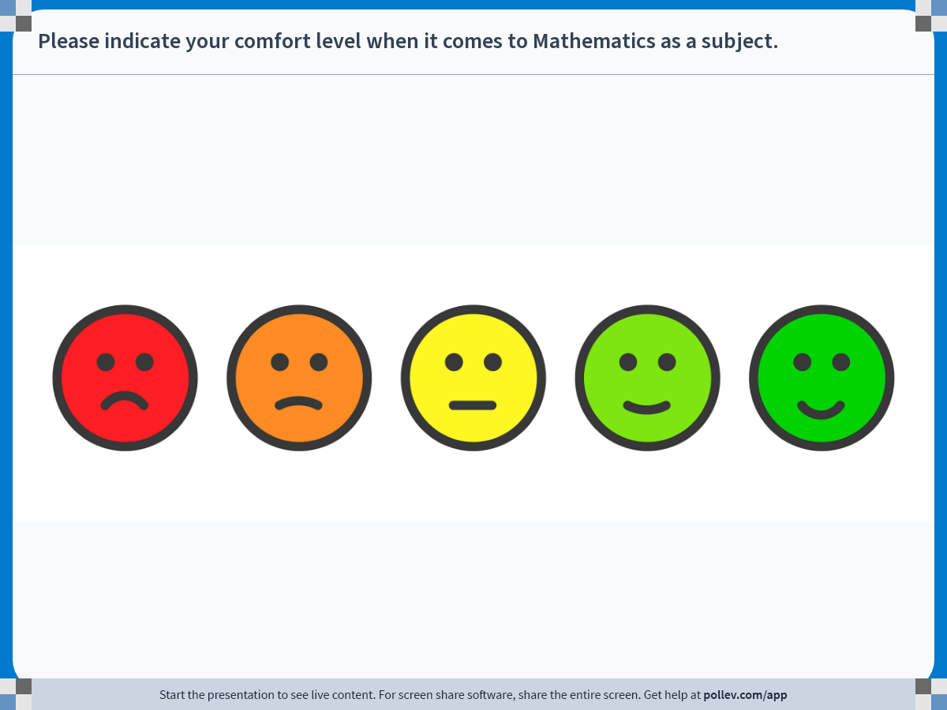
Notes:
Poll Title: Do not modify the notes in this section to avoid tampering with the Poll Everywhere activity.
More info at polleverywhere.com/support
Please indicate your comfort level when it comes to Mathematics as a subject.
https://www.polleverywhere.com/clickable_images/OzEjzbfv0ix8hUpYFk34L

Slide 23
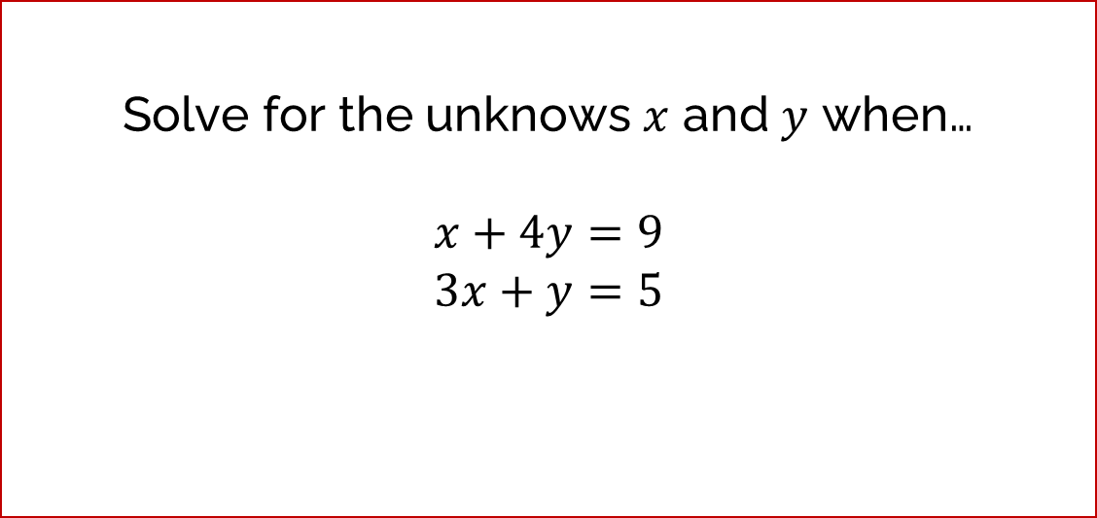
Quick Math Background Check
How comfortable are you with solving a system of two linear equations with two unknowns?
Solve for the unknows $x$ and $y$ when…
$$x+4y=9$$
$$3x+y=5$$

Slide 24

Quick Math Background Check
How comfortable are you dealing with multiplication and division with powers?
Simplify the following:
$$x^{3}×x^{5}= ?$$
$$y^{7}÷y^{2}= ?$$

Slide 25

Quick Math Background Check
How comfortable are you taking simple first derivatives of linear functions?
Solve the following:
$$\frac{d}{dx}{3x}^{2}= ?$$

