Slide 1
Math Review
ECON 300

Slide 2
Why Math?
Over the course of the semester, we will be finding ways to answer various questions:
  How do Consumers… determine their shopping list?
  How do Workers… determine their optimal labor supply?
  How do Producers… determine how much to produce?
Answering any of these questions require us to understand the incentives and constraints that drive each decision.
Economics as a field rely on models to describe such underlying mechanisms that dictate individual behavior.

Slide 3
Why Math?
Using models to describe the world comes with some advantages that are useful:
  Very clear way of communicating the elements included, elements left out, how each element interacts, etc.
  Allows researchers to derive meaningful implications from the models, and provide predictions based on the model.
To understand and communicate these models, we will have to rely on some mathematical tools.

Slide 4
Topics
Systems of Equations
Exponents
Slopes
Derivatives
Geometric Series
Partial Derivatives
Unconstrained Optimization
Constrained Optimization

Slide 5
System of Equations
Throughout the semester, we will encounter many problems that boils down to: “Find X and Y when they are related in a certain way.”
Almost all cases will have 2 unknowns and will be linked together by 2 equations.
Typically shows up as the final step when calculating the…
  Units of good X and Y to be purchased
  Units of labor and capital to be deployed
  Units to be produced
  and more…

Slide 6
Notes:
Poll Title: Do not modify the notes in this section to avoid tampering with the Poll Everywhere activity.
More info at polleverywhere.com/support
[System of Linear Equations] Find the value of X.
https://www.polleverywhere.com/free_text_polls/zC7nC5VqaOnDUC99WTS83

Slide 7
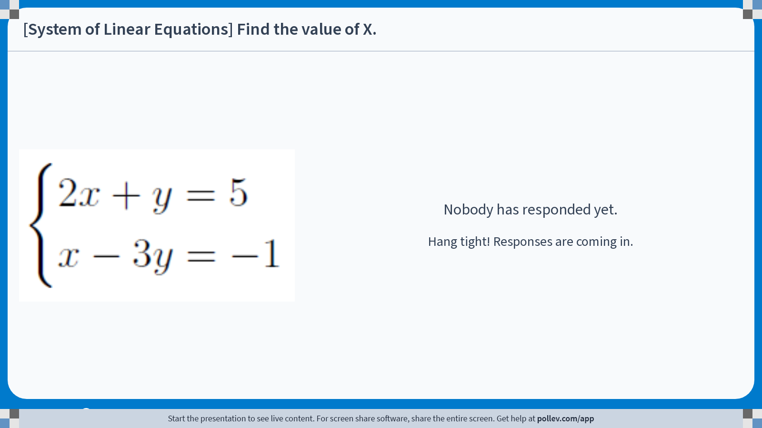
Notes:
Poll Title: Do not modify the notes in this section to avoid tampering with the Poll Everywhere activity.
More info at polleverywhere.com/support
[System of Linear Equations] Find the value of X.
https://www.polleverywhere.com/free_text_polls/zC7nC5VqaOnDUC99WTS83

Slide 8
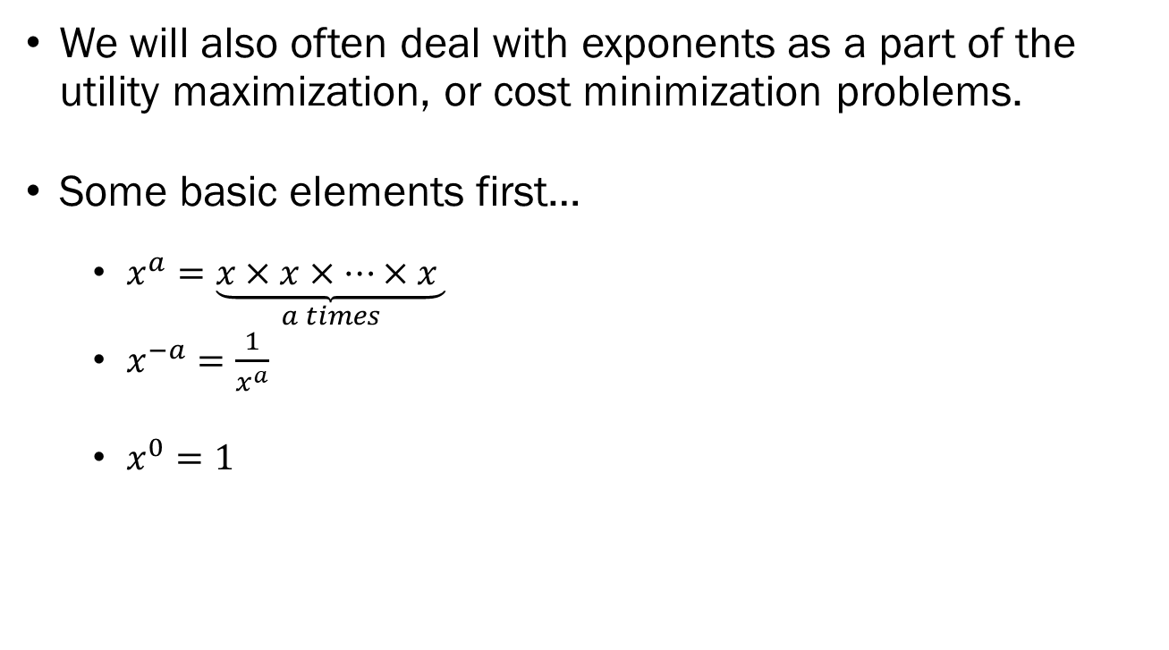
Exponents
We will also often deal with exponents as a part of the utility maximization, or cost minimization problems.
Some basic elements first…
  $x^{a}=\underset{a times}{\underbrace{x×x×⋯×x }}$
  $x^{−a}=\frac{1}{x^{a}}$
  $x^{0}=1$

Slide 9

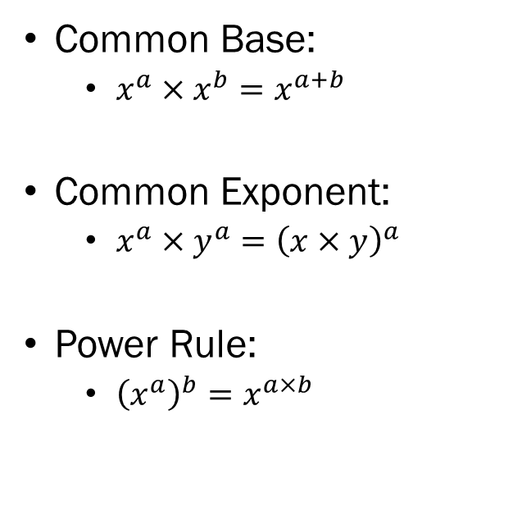
Exponent Rules
Products
Quotients
Common Base:
  $x^{a}×x^{b}=x^{a+b}$
Common Exponent:
  $x^{a}×y^{a}={\left(x×y\right)}^{a}$
Power Rule:
  ${\left(x^{a}\right)}^{b}=x^{a×b}$
Common Base:
  $\frac{x^{a}}{x^{b}}=x^{a−b}$
Common Exponent:
  $\frac{x^{a}}{y^{a}}={\left(\frac{x}{y}\right)}^{a}$

Slide 10
Notes:
Poll Title: Do not modify the notes in this section to avoid tampering with the Poll Everywhere activity.
More info at polleverywhere.com/support
[Exponents] Find the value of C when...
https://www.polleverywhere.com/free_text_polls/wfJGW5jdc5AJKQcTMnYbL

Slide 11
Notes:
Poll Title: Do not modify the notes in this section to avoid tampering with the Poll Everywhere activity.
More info at polleverywhere.com/support
[Exponents] Find the value of C when...
https://www.polleverywhere.com/free_text_polls/wfJGW5jdc5AJKQcTMnYbL

Slide 12
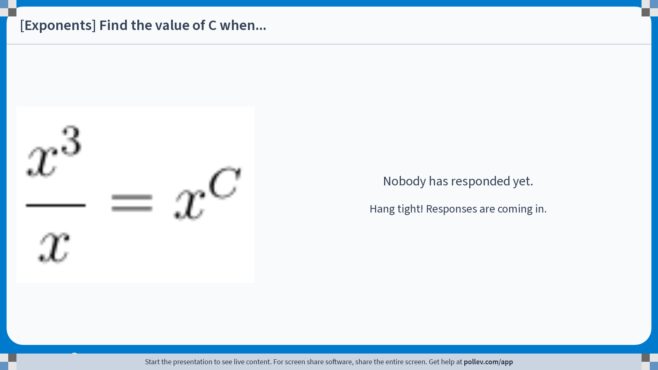
Notes:
Poll Title: Do not modify the notes in this section to avoid tampering with the Poll Everywhere activity.
More info at polleverywhere.com/support
[Exponents] Find the value of C when...
https://www.polleverywhere.com/free_text_polls/wfJGW5jdc5AJKQcTMnYbL

Slide 13
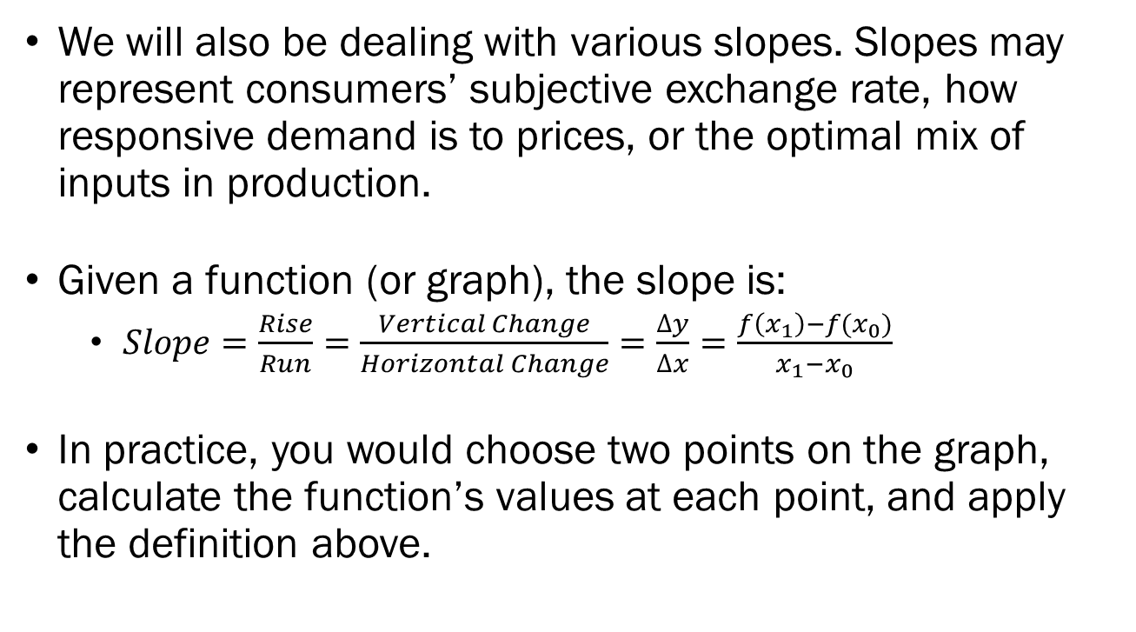
Slopes
We will also be dealing with various slopes. Slopes may represent consumers’ subjective exchange rate, how responsive demand is to prices, or the optimal mix of inputs in production.
Given a function (or graph), the slope is:
  $Slope=\frac{Rise}{Run}=\frac{Vertical Change}{Horizontal Change}=\frac{∆y}{∆x}=\frac{f\left(x_{1}\right)−f(x_{0})}{x_{1}−x_{0}}$
In practice, you would choose two points on the graph, calculate the function’s values at each point, and apply the definition above.

Slide 14
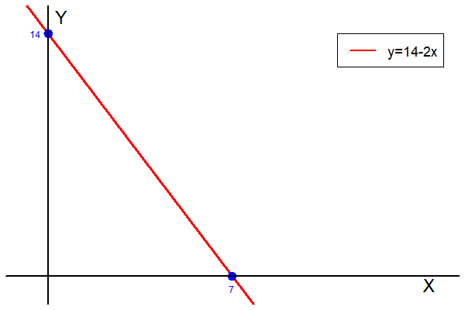
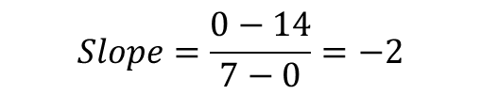
Slope of Linear Functions
When a function is “linear”, the slope is constant over the entire domain.
Take the two intercept points (7,0) and (0,14).
The slope is:
$$Slope=\frac{0−14}{7−0}=−2$$

Slide 15
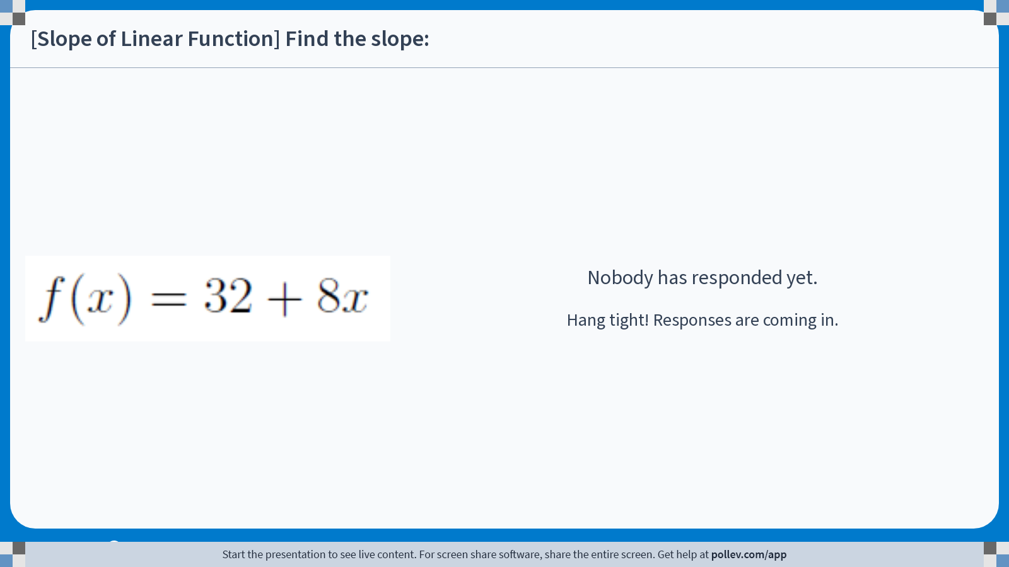
Notes:
Poll Title: Do not modify the notes in this section to avoid tampering with the Poll Everywhere activity.
More info at polleverywhere.com/support
[Slope of Linear Function] Find the slope:
https://www.polleverywhere.com/free_text_polls/5Hx3Y0pyaPD8FNOCDnpCI

Slide 16
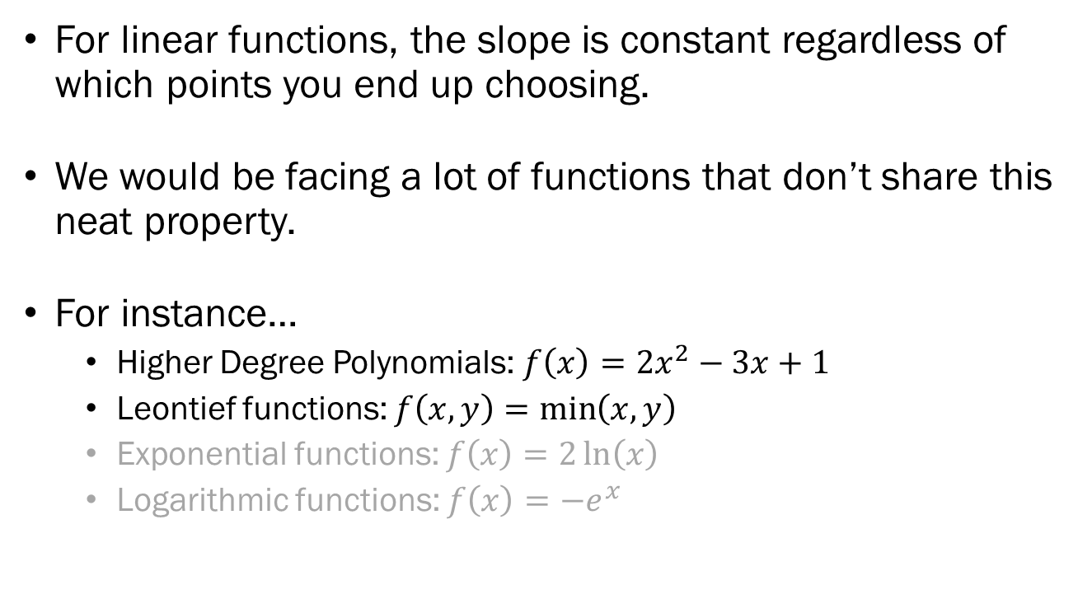
Non-Constant Slopes
For linear functions, the slope is constant regardless of which points you end up choosing.
We would be facing a lot of functions that don’t share this neat property.
For instance…
  Higher Degree Polynomials: $f\left(x\right)=2x^{2}−3x+1$
  Leontief functions: $f\left(x,y\right)=\min\left(x, y\right)$
  Exponential functions: $f\left(x\right)=2\ln\left(x\right)$
  Logarithmic functions: $f\left(x\right)={−e}^{x}$

Slide 17
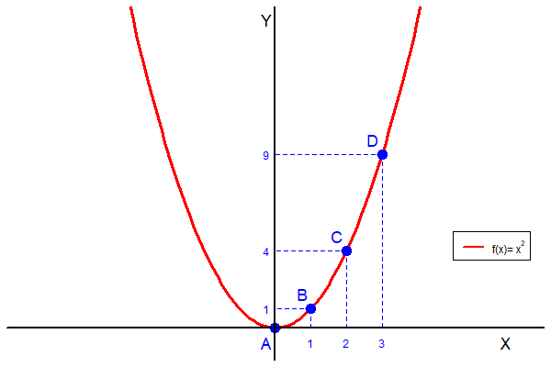
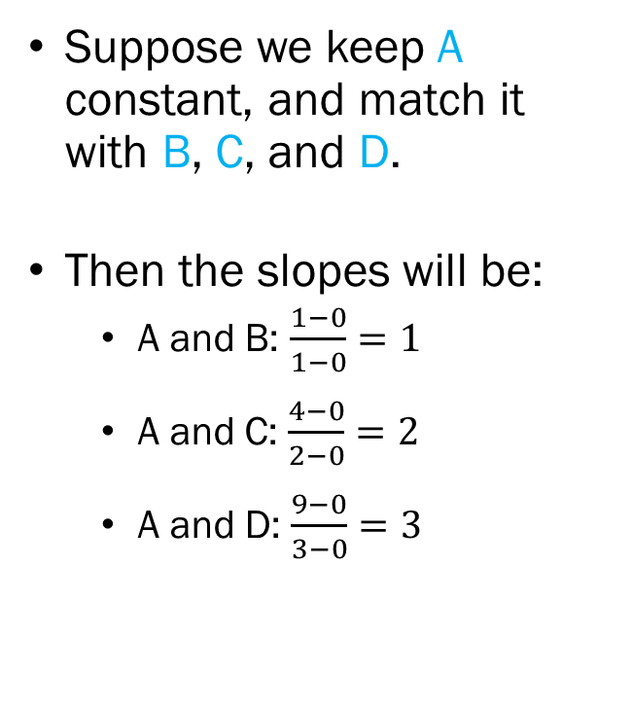
Slope of Quadratic Functions
Suppose we keep A constant, and match it with B, C, and D.
Then the slopes will be:
  A and B: $\frac{1−0}{1−0}=1$
  A and C: $\frac{4−0}{2−0}=2$
  A and D: $\frac{9−0}{3−0}=3$

Slide 18
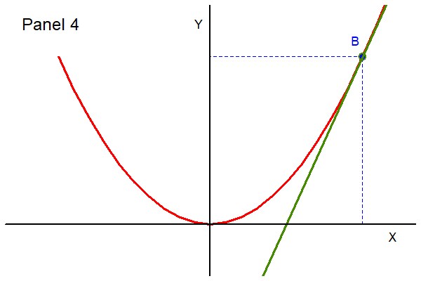
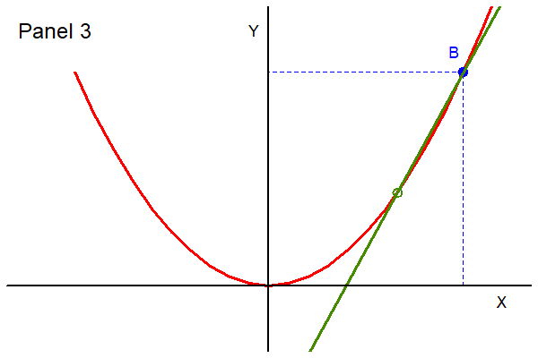
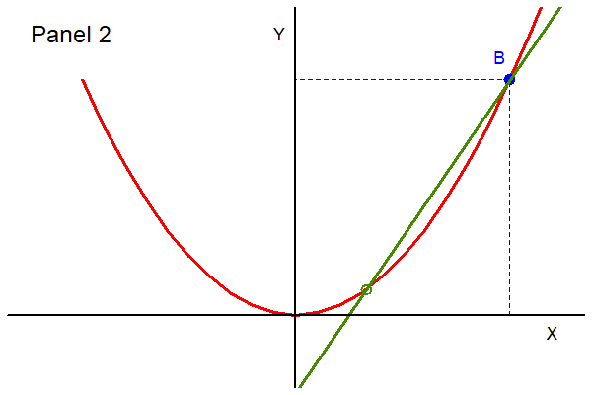
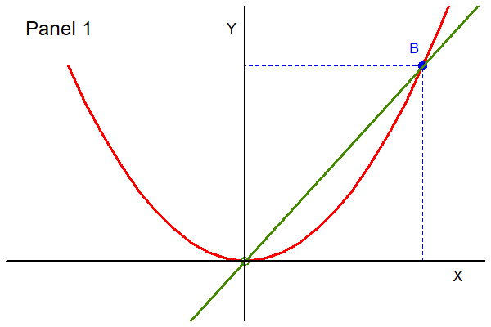
Can We Fix This?
One way we could “fix” this issue is to remove some of the messiness by finding a way to define a slope not between two points, but at a single point.

Slide 19
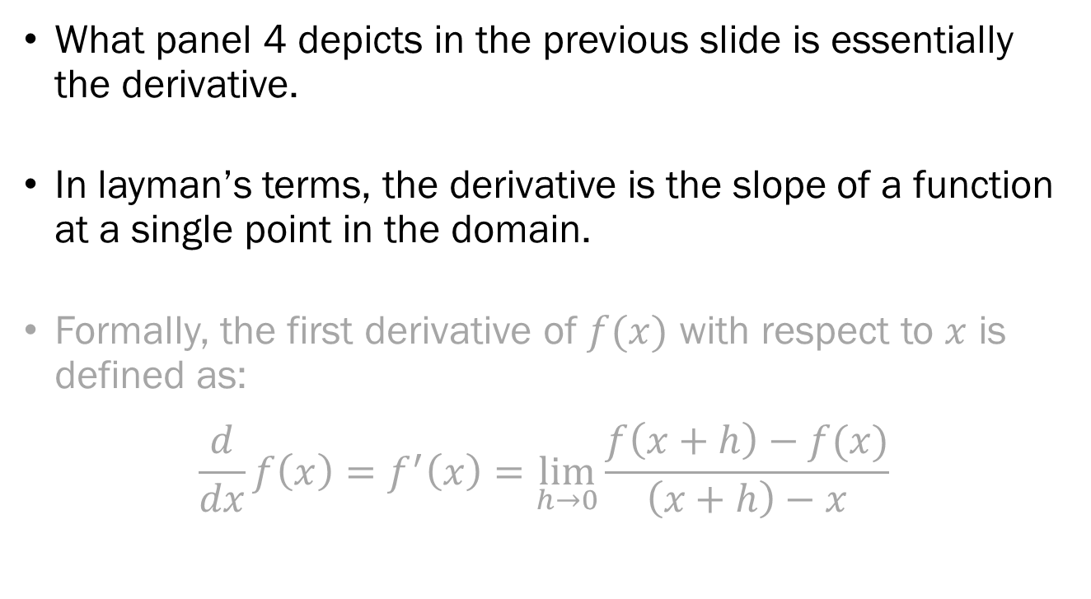
Derivatives
What panel 4 depicts in the previous slide is essentially the derivative.
In layman’s terms, the derivative is the slope of a function at a single point in the domain.
Formally, the first derivative of $f(x)$ with respect to $x$ is defined as:
$$\frac{d}{dx}f\left(x\right)=f^{′}\left(x\right)=\lim_{h→0}{\frac{f\left(x+h\right)−f(x)}{\left(x+h\right)−x}}$$

Slide 20

Power Rule
$$\frac{d}{dx}{bx}^{a}=a{bx}^{a−1}$$

Slide 21
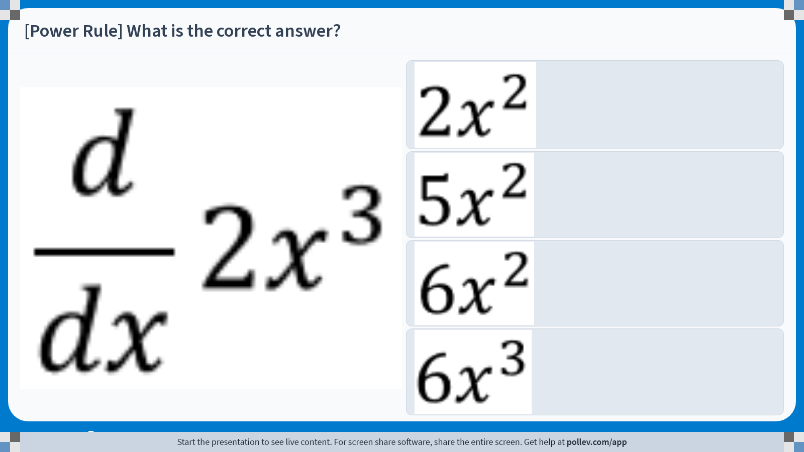
Notes:
Poll Title: Do not modify the notes in this section to avoid tampering with the Poll Everywhere activity.
More info at polleverywhere.com/support
[Power Rule] What is the correct answer?
https://www.polleverywhere.com/multiple_choice_polls/1DjlYDWLp0XDTPA1vRe2p?display_state=instructions&activity_state=opened&state=opened&flow=Engagement&onscreen=persist

Slide 22
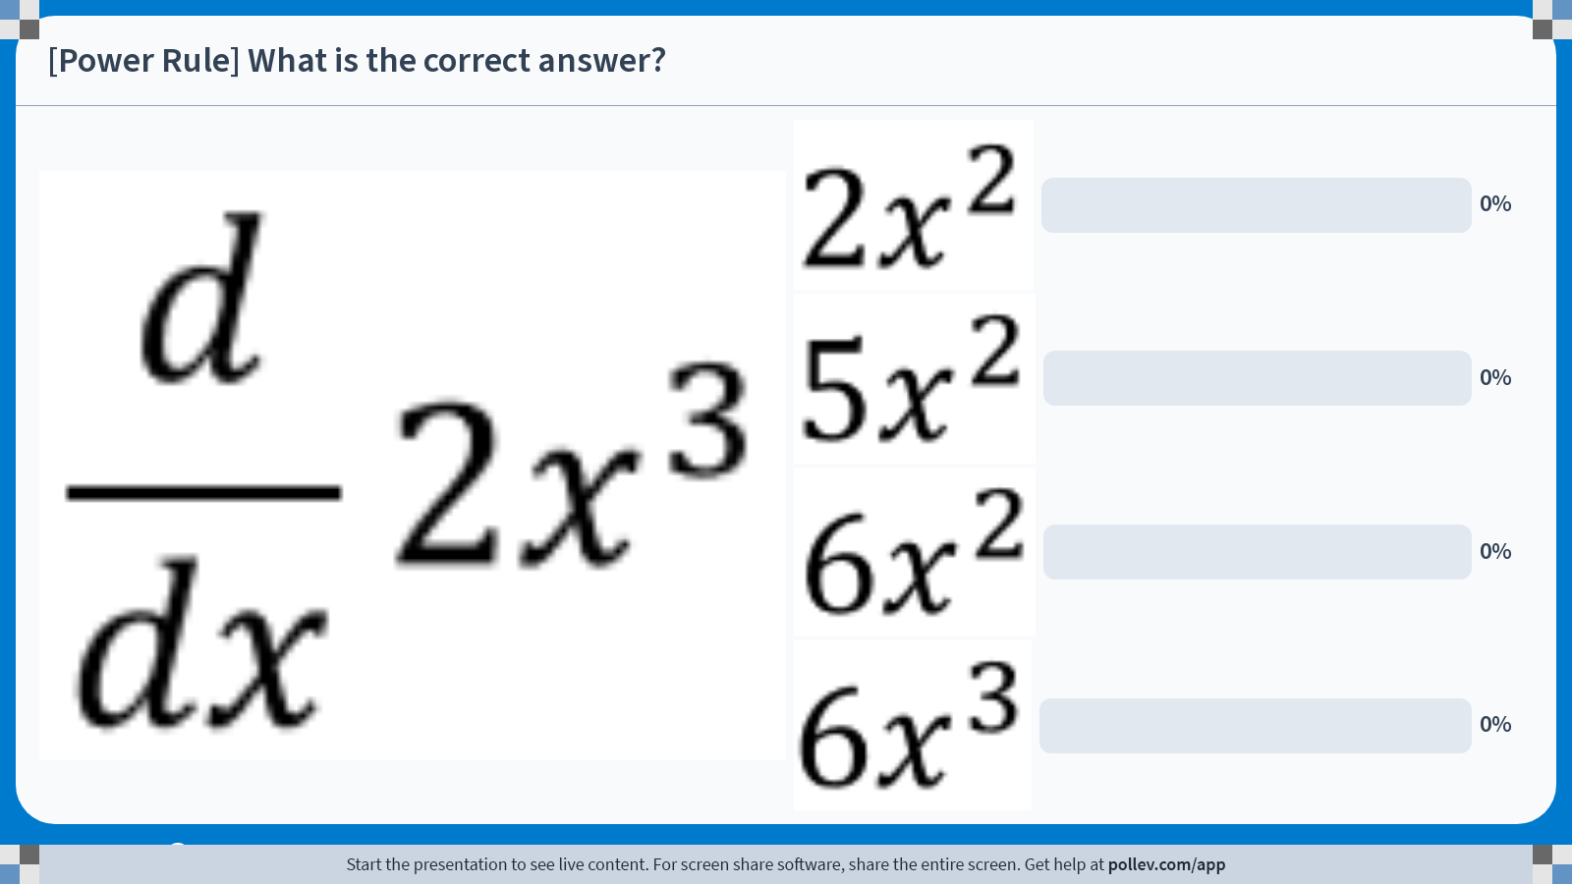
Notes:
Poll Title: Do not modify the notes in this section to avoid tampering with the Poll Everywhere activity.
More info at polleverywhere.com/support
[Power Rule] What is the correct answer?
https://www.polleverywhere.com/multiple_choice_polls/1DjlYDWLp0XDTPA1vRe2p?display_state=chart&activity_state=closed&state=closed&flow=Engagement&onscreen=persist

Slide 23

Derivative of Constants
$$\frac{d}{dx}c=0$$

Slide 24

Derivative of a Sum
$$\frac{d}{dx}\left\{f\left(x\right)+g\left(x\right)\right\}=f^{′}\left(x\right)+g′(x)$$

Slide 25
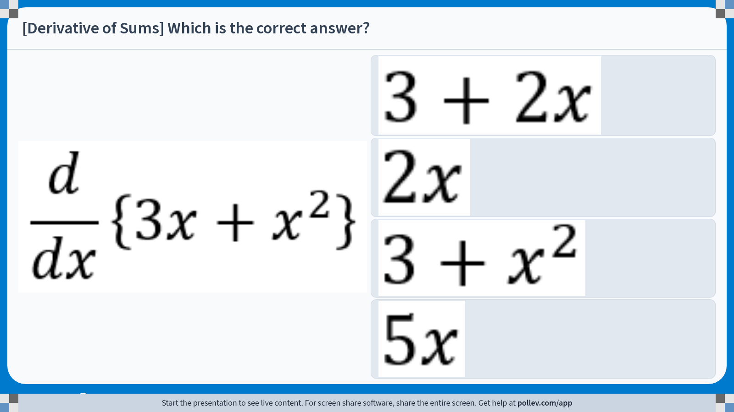
Notes:
Poll Title: Do not modify the notes in this section to avoid tampering with the Poll Everywhere activity.
More info at polleverywhere.com/support
[Derivative of Sums] Which is the correct answer?
https://www.polleverywhere.com/multiple_choice_polls/L6QvEoXRMGMeZKc06puYs?display_state=instructions&activity_state=opened&state=opened&flow=Engagement&onscreen=persist

Slide 26
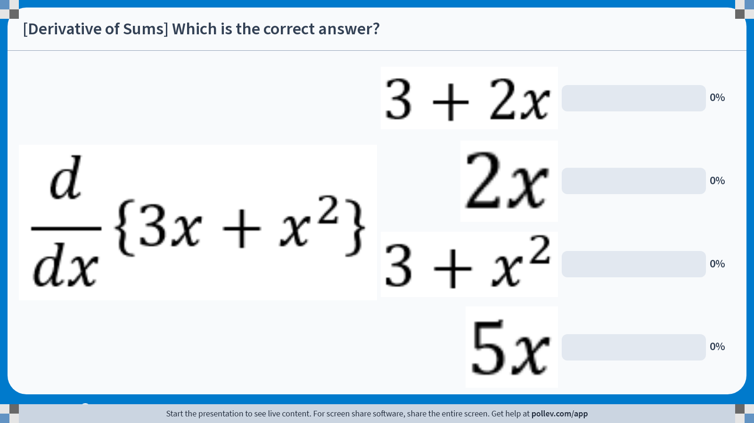
Notes:
Poll Title: Do not modify the notes in this section to avoid tampering with the Poll Everywhere activity.
More info at polleverywhere.com/support
[Derivative of Sums] Which is the correct answer?
https://www.polleverywhere.com/multiple_choice_polls/L6QvEoXRMGMeZKc06puYs?display_state=chart&activity_state=closed&state=closed&flow=Engagement&onscreen=persist

Slide 27

Quotient Rule
(Less Important)
$$\frac{d}{dx}\left(\frac{f(x)}{g(x)}\right)=\frac{f^{′}\left(x\right)g\left(x\right)−f\left(x\right)g′(x)}{g{\left(x\right)}^{2}}$$

Slide 28

Chain Rule
(Less Important)
$$\frac{d}{dx}f\left(g\left(x\right)\right)=f^{′}\left(g\left(x\right)\right)g′(x)$$

Slide 29
Why Calculus?
Modern economic theory is grounded in the concept of “marginalism.” We tend to investigate the value and cost associated with the very last unit in question.
When the marginal value of some variable transitions from being positive to negative, that is when the variable itself is maximized.

Slide 30
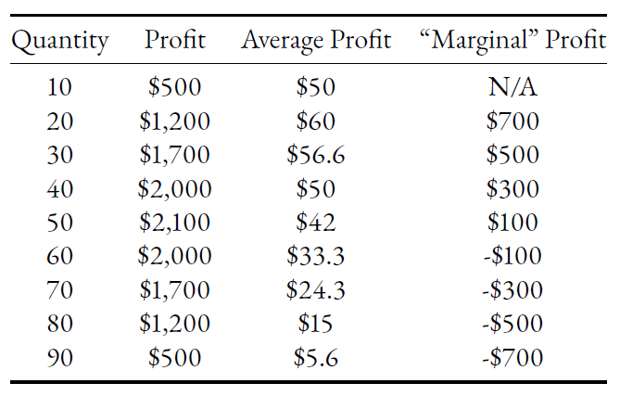
Example: Discrete Data
Take a look at this profit data:

Slide 31
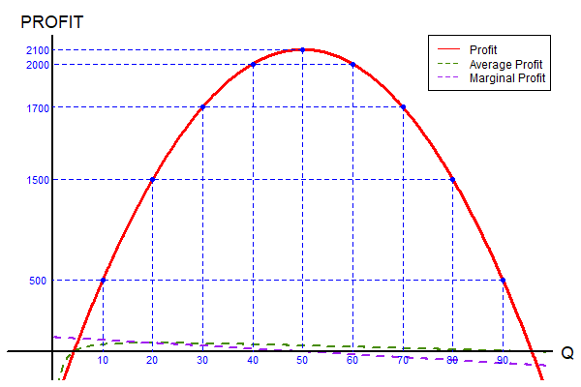
Example: Continuous Data
If we observe the actual underlying function:

Slide 32
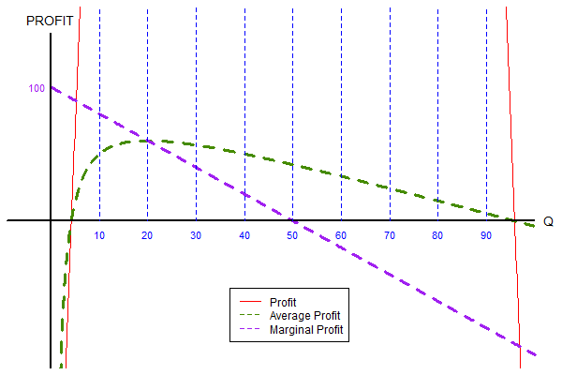
Example: Continuous Data
If we observe the actual underlying function:

Slide 33
Preview of Next Week
What is Economics?
Introduction to Microeconomics
  Overview of Consumer Theory
  What are Budget Constraints
  Plotting Budget Constraints
  Budget Constraints in Mathematical Terms
  Special Cases
  How it Relates to Preferences

