Slide 1
MANAGEMENT INFORMATION SYSTEMS
Chapter 5: IT Infrastructure and Emerging Technologies

Slide 2
Recap of Chapter 4
Describe IT/IS-related ethical, social, and political issues.
Describe principles for ethical conduct.
Discuss information rights and privacy issues.
Discuss intellectual property issues.
Discuss system quality issues.
Discuss accountability and control issues.
Discuss quality of life issues.

Slide 3
IT Infrastructure and
Emerging Technologies

Slide 4
IT Infrastructure
IT infrastructure decisions are long-term, costly, and difficult to reverse.
Global IT infrastructure spending exceeded $5 trillion in 2024
Mistakes are difficult and expensive to reverse.
Infrastructure determines what a firm can and cannot do.
IT infrastructure refers to the shared technology resources that provide the platform for all information systems within a firm.
It includes hardware, software, and firmwide services used across business units.
These shared resources form the operational backbone of the organization, supporting customers, suppliers, internal processes, and business strategy.

Slide 5
Core Infrastructure Services
Core Infrastructure Services of a firm consist of:
Computing platforms
Telecommunications services
Data management services
Physical facilities management
Application software services
IT management and standards
IT education and research
Together, these services determine how scalable, secure, and flexible a firm’s information systems can be.

Slide 6
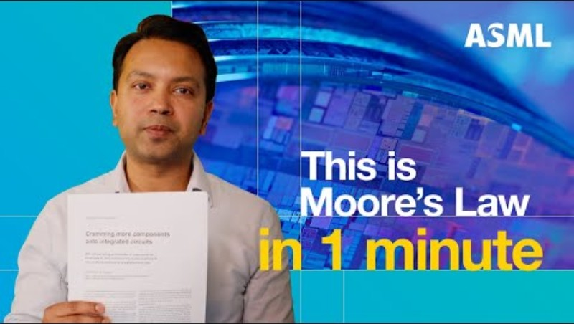
ASML (2024, December 19). What is Moore’s Law? Is it still relevant? Episode 3 | ASML Nanoland [Video]. YouTube. https://youtu.be/C7BCCrCoU3A?si=drqVDN87wMa2L7Vs

Slide 7
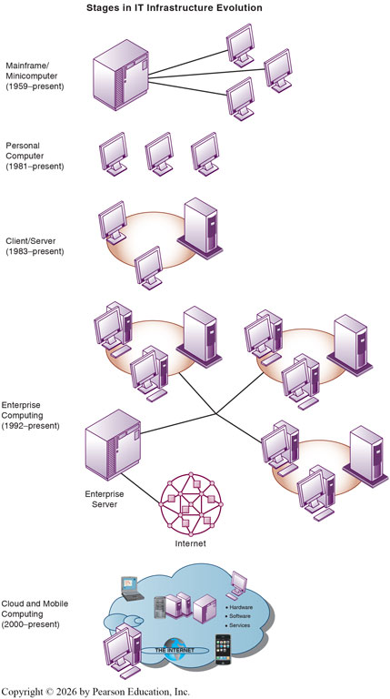
Evolution of IT Infrastructure
Today’s IT infrastructure is the result of more than 70 years of technological evolution in computing and communication.
Each stage expanded computing power and reduced costs, reshaping how organizations process and share information.
The evolution of computing can be divided into five major eras, each reflecting a distinct organizational logic:
General-Purpose Mainframe and Minicomputer Computing
Personal Computer
Client/Server Computing
Enterprise Computing
Cloud and Mobile Computing

Slide 8
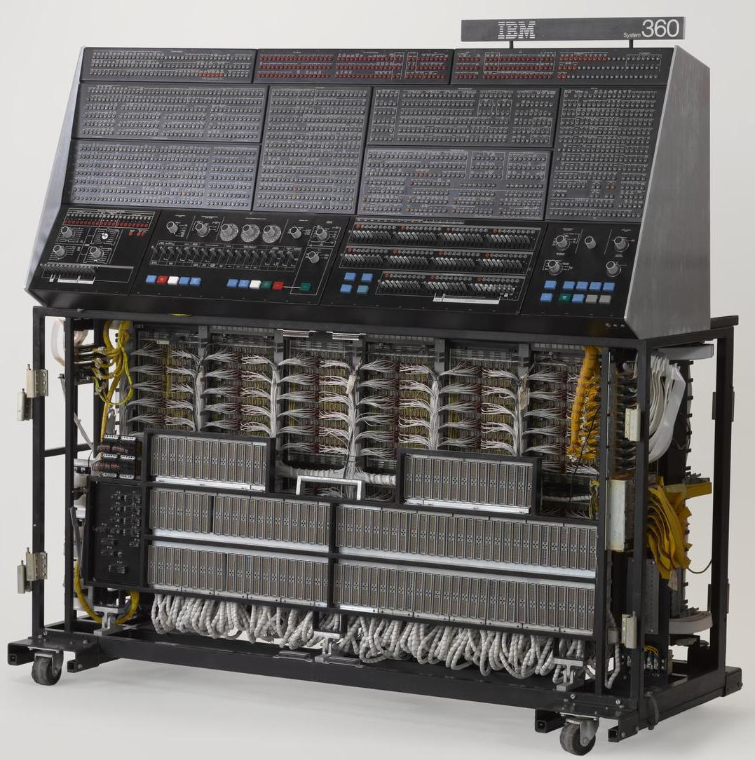
Mainframe and Minicomputer Era (1959–Present)
The mainframe era featured centralized computing managed by professional operators:
High reliability and strong control,
But limited flexibility.
Minicomputers later introduced departmental computing, increasing flexibility for smaller units within firms.
Mainframes remain essential in industries such as finance and healthcare for mission-critical, high-volume transaction processing and secure data handling.

Slide 9
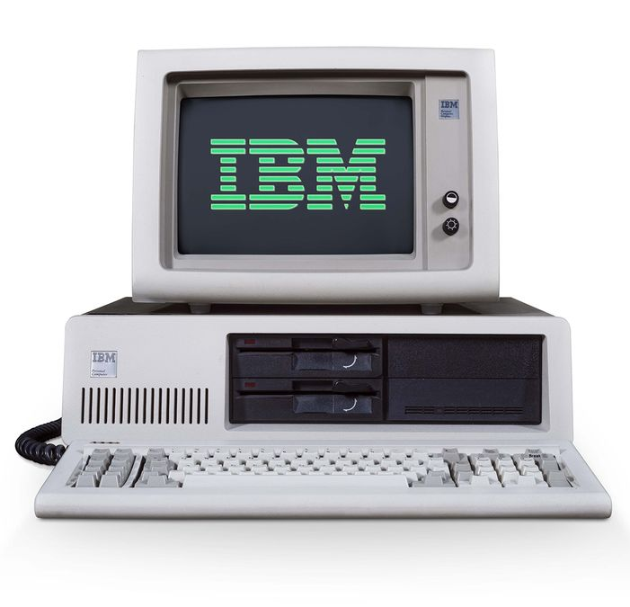
Personal Computer Era (1981–Present)
The PC era decentralized computing by providing affordable access to data processing.
PCs became standard tools for productivity applications, such as spreadsheets and word processing.
The PC era empowered employees and departments to manage data independently of central IT departments, often outside formal governance structures.

Slide 10
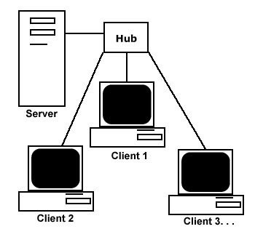
Client/Server Era (1983–Present)
The client/server model connected PCs (clients) to more powerful server computers through networks.
Client: Devices that request access to services or resources.
Server: computers dedicated to performing common functions needed by clients on the network.
Servers typically carried out tasks such as:
File storage
Software applications
Printing
Internet Access

Slide 11
Client/Server Era: Distributed Processing
Processing tasks are divided between clients and servers, allowing workloads to be distributed efficiently across multiple, relatively inexpensive machines.
This model enabled firms to expand computing capacity without relying on costly centralized systems.
Client/server computing also laid the foundation for the development of the Internet.
This architecture allowed firms to scale computing incrementally rather than through large, centralized investments.
The simplest model, a two-tier client/server architecture, consists of a single client computer and a single server computer.

Slide 12
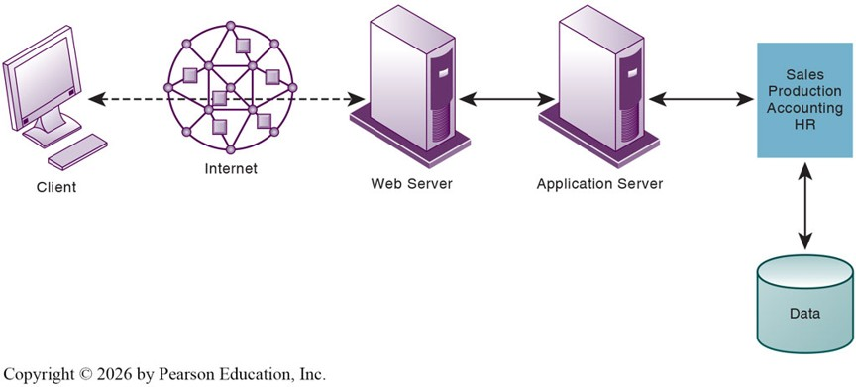
Client/Server Era: Multitier Architecture
Modern businesses employ a multitiered (N-tier) client/server architecture that distributes computing and network workloads across multiple servers.
Web servers are responsible for locating and managing stored web pages and delivering them to clients in response to service requests.
Application servers handle application operations between browser-based clients and an organization’s back-end business applications or databases.

Slide 13
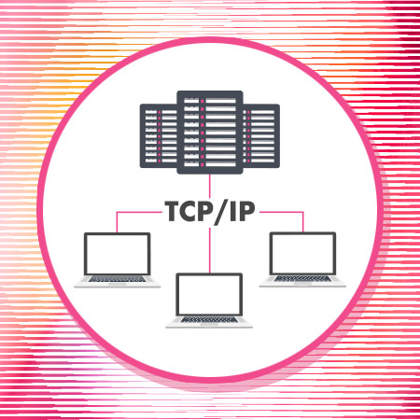
Enterprise Computing Era (1992–Present)
Introduced network standards and protocols that allowed different hardware and networks to communicate seamlessly.
Organizations began integrating previously separate systems into enterprise-wide networks, enabling information to move freely across the firm.
This connectivity extended beyond the firm, linking organizations with suppliers, partners, and customers.
Emphasized integration and scalability, enabling firms to coordinate complex operations on a global scale.

Slide 14
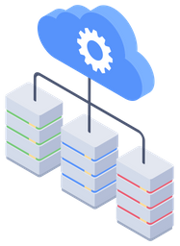
Cloud and Mobile Computing Era (2000–Present)
In the cloud and mobile computing era, data and applications are stored in remote cloud data centers accessible through the Internet.
Users access resources from a wide range of devices, including computers, smartphones, and tablets, without maintaining local infrastructure.
Computing, storage, and application development take place in the cloud, while firms subscribe to services on demand.
This model allows organizations to scale resources flexibly, reduce costs, and support a mobile workforce operating from anywhere.

Slide 15
IT Infrastructure Evolution
Each new era builds upon the previous one rather than completely replacing it.
Mainframes continue to handle mission-critical operations, while cloud systems provide agility and global connectivity.
Understanding these eras helps explain how firms adapt infrastructure to changing technological and business needs.
Together, these successive technological eras have introduced components that form the backbone of today’s digital firms.
In the next section, we examine these infrastructure components in detail.

Slide 16
Mobile Platform, Apps, and BYOD

Slide 17
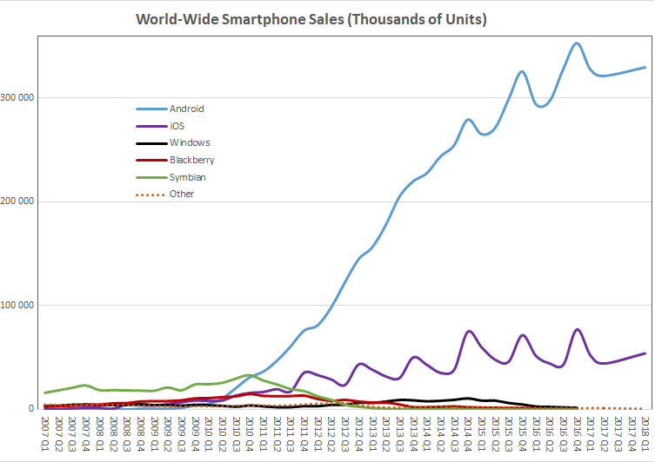
The Rise of Mobile Computing

Slide 18
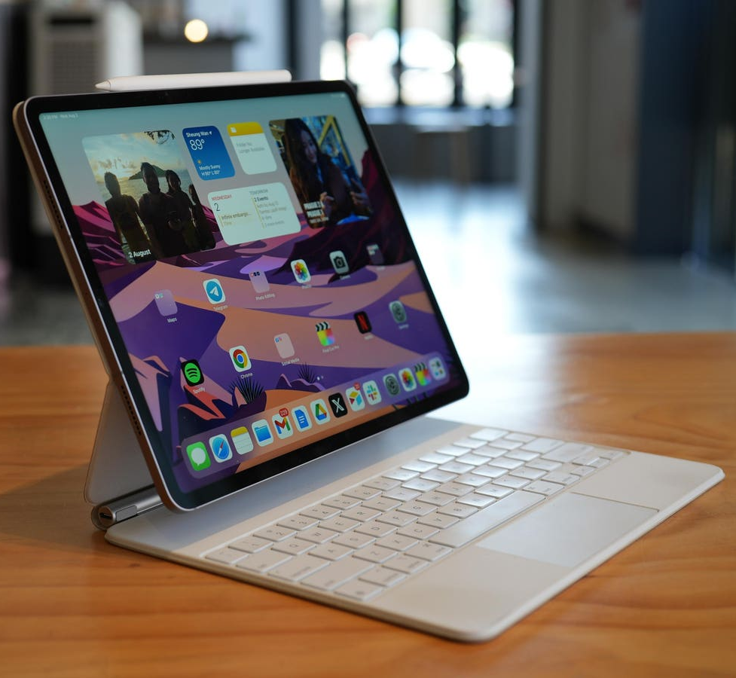
The Mobile Platform
Mobile computing has shifted computing from centralized infrastructure to distributed, user-level access.
Mobile devices now integrate directly with enterprise systems, extending corporate IT beyond physical office boundaries.
The mobile platform includes a growing ecosystem of devices, operating systems, and applications.
For many users, mobile devices are now the primary means of accessing the Internet.

Slide 19
Business Uses of Mobile Devices
Mobile devices have become operational tools embedded directly in core business processes.
Firms integrate mobile devices into enterprise workflows to enable real-time data access, coordination, and execution.
For example, sales managers use customized mobile dashboards to track performance, manage pricing, and coordinate logistics in real time.
Mobile computing enables faster decision-making, greater responsiveness, and improved field productivity.

Slide 20
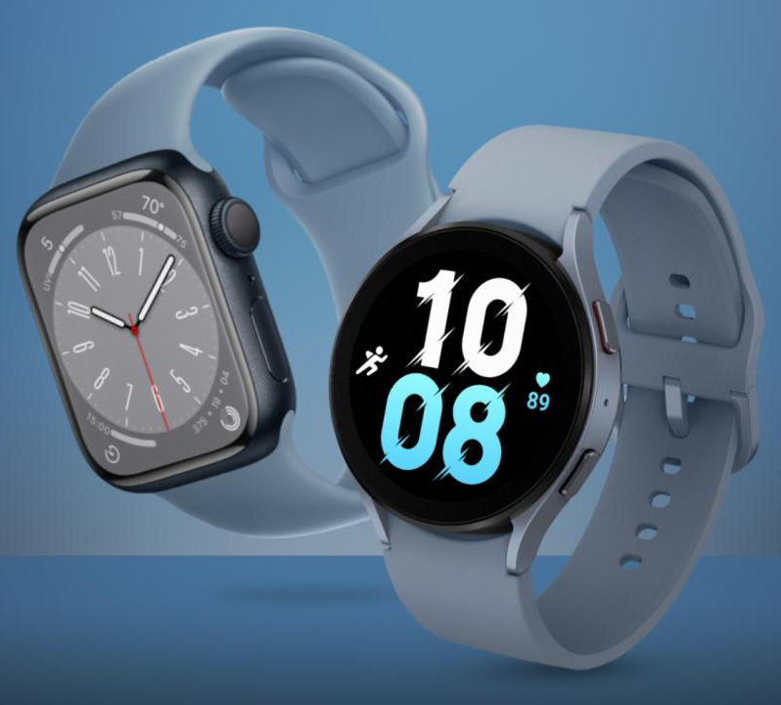
Wearable Computing Devices
Wearables extend the mobile platform from handheld interaction to continuous, embedded computing.
Devices include smartwatches, smart glasses, smart badges, and industrial sensors.
Wearables deliver real-time data and alerts at the point of activity, reducing coordination lag and decision delays.
As adoption increases, wearables are reshaping field operations, healthcare monitoring, logistics tracking, and industrial safety systems.

Slide 21
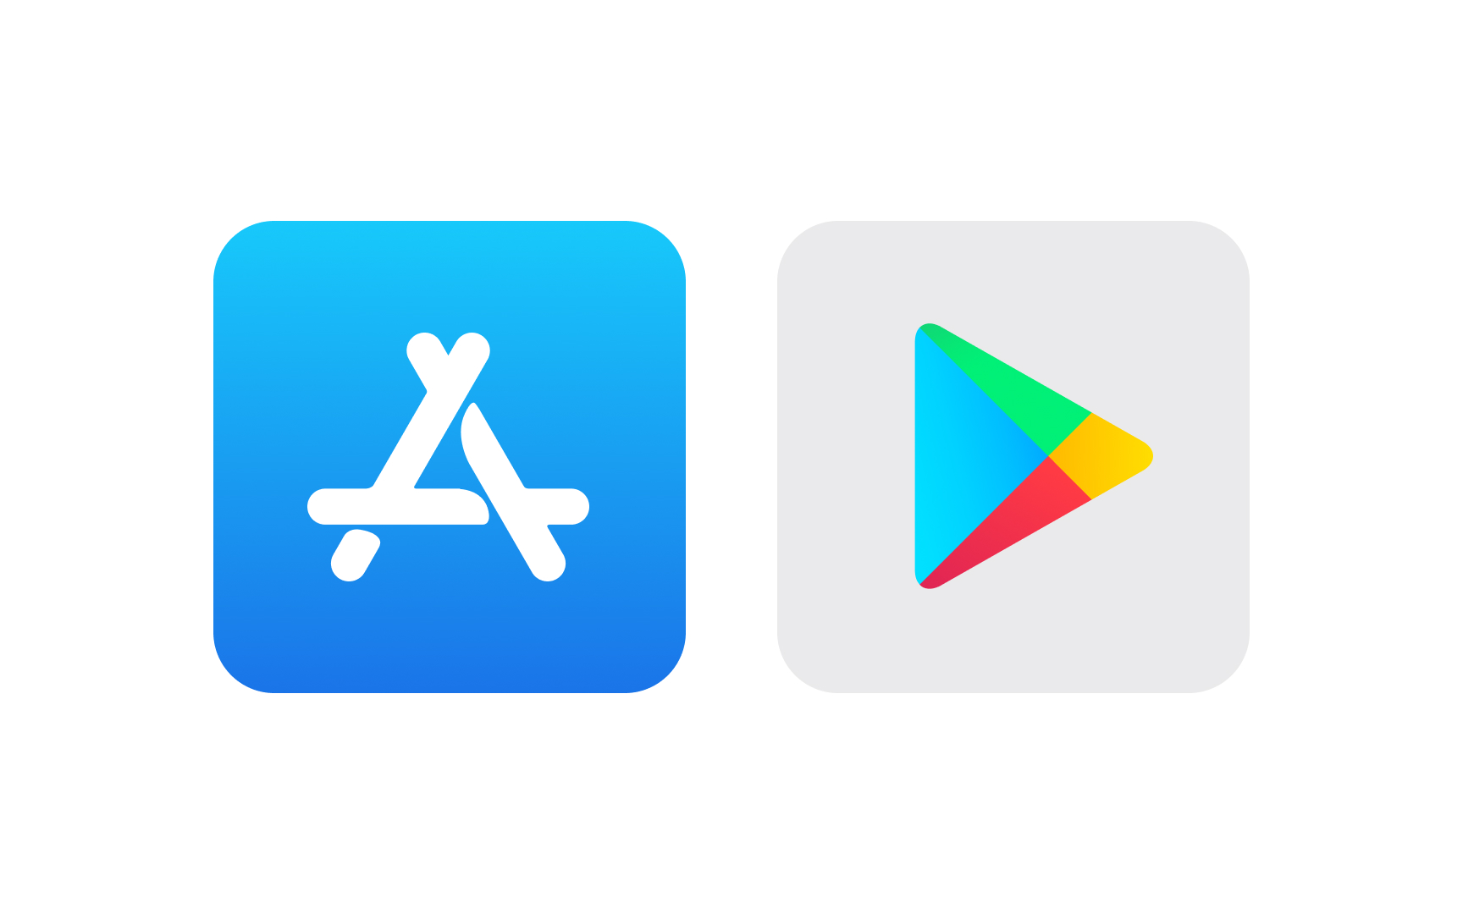
Understanding Apps
Apps are software interfaces that connect users to digital services and enterprise systems.
Apps transform mobile devices into gateways for commerce, communication, analytics, and operational control.
App ecosystems create platform-based competition, where operating systems compete on developer networks, user adoption, and integrated services.
U.S. adults now spend an average of 4.5 hours per day on mobile phones (Volz, 2024).
Companies increasingly redesign digital services to mirror the simplicity and usability of mobile apps.

Slide 22
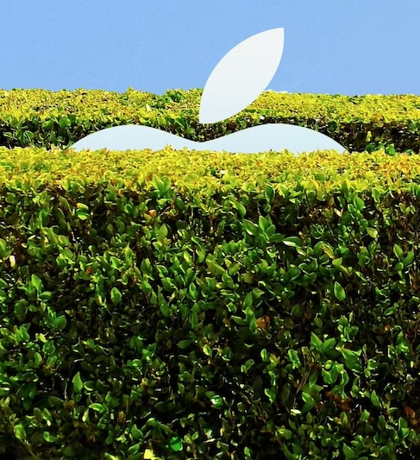
Apps and Platform Dependence
The success of a mobile platform depends on the breadth and quality of its app ecosystem.
Apps tie users to specific platforms, since iOS and Android applications are not fully cross-compatible.
As users invest in apps, data, and platform-specific services, switching costs increase, fostering long-term brand loyalty.
This interdependence between hardware and software ecosystems drives competition among mobile providers.

Slide 23
The Consumerization of IT
The Consumerization of Information Technology refers to the adoption of consumer technologies within business environments.
Employees are bringing consumer devices and applications, such as Gmail, Google Maps, Dropbox, Facebook, and TikTok, into the workplace.
This trend challenges the traditional model in which corporate IT departments selected and controlled all hardware and software.
Decision-making authority over technology is shifting from centralized IT departments to business units and individual users.

Slide 24
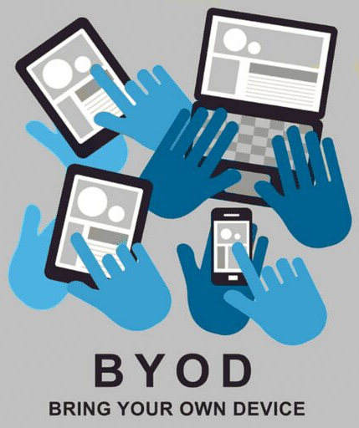
Bring Your Own Device (BYOD)
The BYOD movement encourages employees to use their own personal devices for work-related tasks and network access.
BYOD offers flexibility, convenience, and device familiarity, enabling employees to work seamlessly across personal and professional contexts.
Supporting multiple devices and operating systems increases system complexity.
Thousands of device models and OS versions create fragmentation and management challenges.

Slide 25
Risks and Management of BYOD
BYOD can create security vulnerabilities such as data loss, hacking, and unauthorized access to corporate networks.
Lost or stolen devices can expose sensitive data if not properly encrypted or remotely managed.
Companies must track employee devices, access permissions, software versions, and encryption standards to reduce breach risk.
Effective BYOD programs rely on:
Clear usage and security policies
Mobile device management (MDM) tools
Remote-wipe and encryption technologies
Employee training
The core trade-off: Employee flexibility and productivity vs. organizational control and security.

Slide 26
Quantum Computing and Green Computing

Slide 27
Emerging Trends in IT Infrastructure
Two major trends are reshaping IT infrastructure: Quantum computing and Green computing.
Quantum computing explores how data can be processed at the subatomic level, potentially enabling dramatic increases in computational speed and capacity.
Green computing emphasizes energy efficiency and environmental responsibility in the design and management of hardware, software, and data centers.
Together, these trends reflect the drive toward computing that is both more powerful and more sustainable.

Slide 28
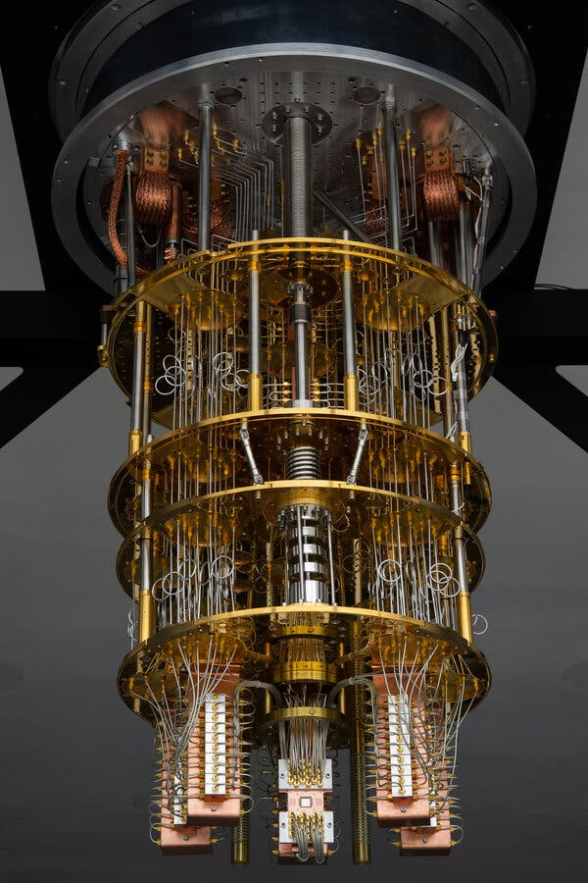
What Is Quantum Computing?
Quantum computing applies the principles of quantum mechanics, where matter and light behave differently at atomic and subatomic scales.
While classical computers use bits that represent either 0 or 1, quantum computers use qubits, which can exist in 0, 1, or a combination of both states simultaneously.
This property, known as superposition, allows quantum systems to explore many possible solutions at once.
For certain types of problems, quantum computers have the potential to outperform today’s most advanced supercomputers.

Slide 29
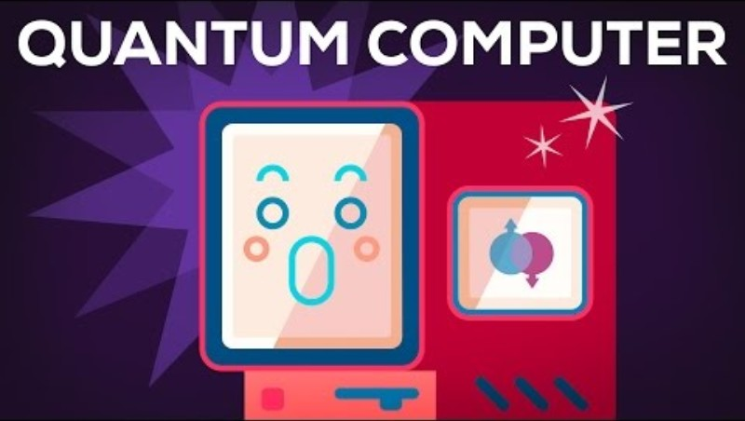
Kurzgesagt – In a Nutshell (2015, December 8). Quantum Computers Explained – Limits of Human Technology [Video]. YouTube. https://youtu.be/JhHMJCUmq28?si=c_xo7R0nTctnqW1u

Slide 30

How Quantum Computing Works
Quantum computers derive their power from:
Superposition, allowing qubits to exist in multiple states simultaneously.
Entanglement, where qubits become correlated in ways that classical bits cannot.
These properties make quantum systems especially promising for problems involving optimization, cryptography, and molecular simulation.
However, most quantum systems remain experimental as researchers work to improve stability, scalability, and error correction.

Slide 31
Benefits and Limitations of Quantum Computing
Benefits:
For certain problems, quantum algorithms may provide exponential or dramatic speedups compared to classical methods.
Particularly promising for optimization, cryptography, material science, and complex simulations.
May accelerate specific AI and machine learning tasks in the future.
Limitations:
Requires extreme cooling and specialized infrastructure, making systems expensive and energy-intensive.
Qubits are fragile and prone to noise, requiring advanced error correction.
Practical, large-scale quantum advantage has not yet been achieved for most business applications.
Could disrupt existing encryption standards, raising long-term cybersecurity concerns.

Slide 32

Introducing Green Computing
Green computing, or green IT, focuses on minimizing the environmental impact of information technology across its entire lifecycle.
It encompasses the design, operation, and disposal of hardware, software, and data centers to reduce energy consumption, carbon emissions, and electronic waste.
For organizations, sustainability initiatives often align with cost reduction, regulatory compliance, and corporate social responsibility goals.

Slide 33
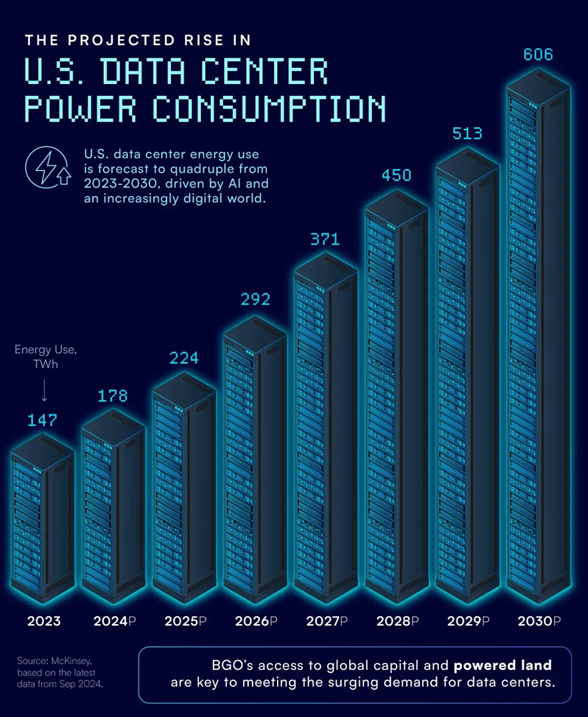
Data Centers and Energy Use
Modern data centers can consume more than 100 times the electricity of a standard office building, significantly increasing operational costs and carbon emissions.
U.S. residential electricity consumption in 2023 totaled approximately 1,450 TWh.
Rising demand for AI, cloud services, and streaming is accelerating data center power consumption.
To address these challenges, firms are investing in:
Energy-efficient cooling systems
Renewable energy sources
Low-power and specialized processors
Cloud computing

Slide 34
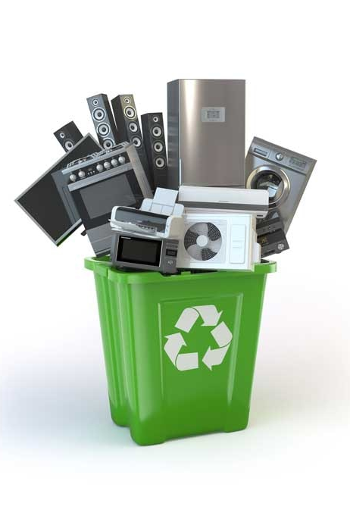
Green Computing Practices
Energy-efficient hardware:
Use devices and processors that minimize power consumption.
E-waste reduction:
Recycle and properly dispose of outdated electronics under environmental regulations.
Optimized systems:
Apply IoT sensors and AI tools to manage energy use in data centers automatically.
Renewable energy:
Use wind, hydroelectric, or geothermal power to operate computing facilities sustainably.

Slide 35
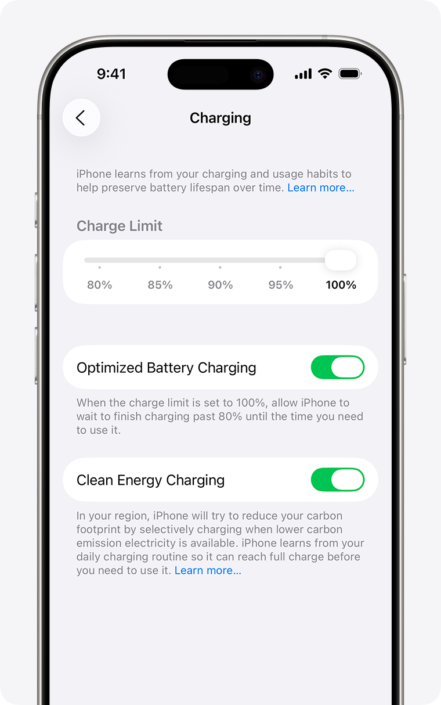
Sustainable Software and Virtualization
Sustainable software tools:
Use applications that measure digital emissions and promote energy-efficient system design.
Green coding practices:
Optimize algorithms and reduce code complexity to conserve processing power and memory usage.
Server virtualization:
Run multiple virtual machines on a single physical server to improve utilization and reduce CO₂ emissions.
Remote and digital work models:
Lower commuting and building energy consumption through cloud platforms and virtual collaboration tools..

Slide 36
The Future of Sustainable Computing
AI growth and data expansion are accelerating energy consumption and electronic waste challenges.
Firms must balance the pursuit of computing power with responsible stewardship of environmental resources.
High-performance and sustainable computing increasingly require rethinking how infrastructure is structured and delivered.
The next section examines virtualization and cloud computing, which enable scalability, flexibility, and more efficient use of energy and capital.

Slide 37
Virtualization and Cloud Computing

Slide 38
Virtualization
Virtualization uses software to create multiple logical systems from a single physical machine.
A single server can run multiple operating systems, each functioning as an independent virtual server.
To users and applications, each virtual machine appears as a separate physical computer.
Why it matters for managers:
Improves hardware utilization
Reduces energy consumption and cost
Enables flexible deployment and rapid scaling
Forms the foundation of cloud computing

Slide 39
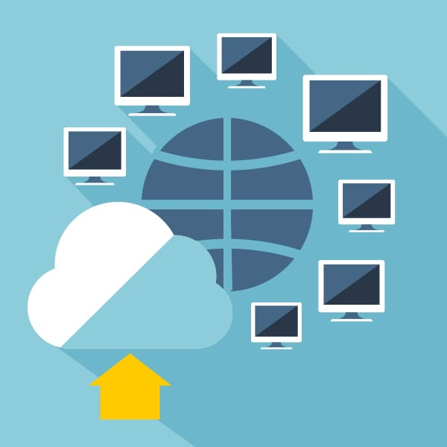
Benefits of Virtualization
Cost Reduction:
Fewer servers are needed as utilization rates rise from 15~20 percent to as high as 70 percent.
Space and Energy Savings:
Consolidating servers reduces data-center footprint and power consumption.
Simplified Administration:
Hardware resources can be centrally managed and allocated dynamically.
Scalability:
New virtual machines can be created quickly to meet changes in demand.

Slide 40
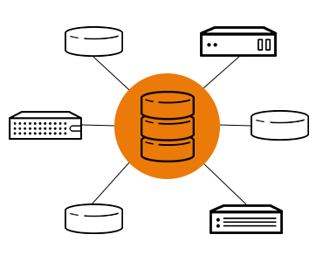
Software-Defined Storage (SDS)
Storage Virtualization:
Physical storage devices are pooled into a single logical resource managed by software.
Decoupling Hardware and Control:
SDS separates storage management software from the underlying physical hardware.
Cost and Flexibility Gains:
Firms can use lower-cost commodity hardware while dynamically allocating storage where it is needed.
Strategic Impact:
SDS extends virtualization principles to data infrastructure, increasing scalability, efficiency, and resilience.

Slide 41
Virtualization and Cloud Computing
Virtualization abstracts physical hardware into scalable, shareable logical resources.
Cloud computing builds on this abstraction to deliver computing power on demand.
Without virtualization:
Providers would dedicate entire servers to individual clients.
Hardware utilization would remain low.
Scaling would require manual physical reconfiguration.
Result: Virtualization enables the cost efficiency, elasticity, and rapid provisioning that define the cloud model.

Slide 42
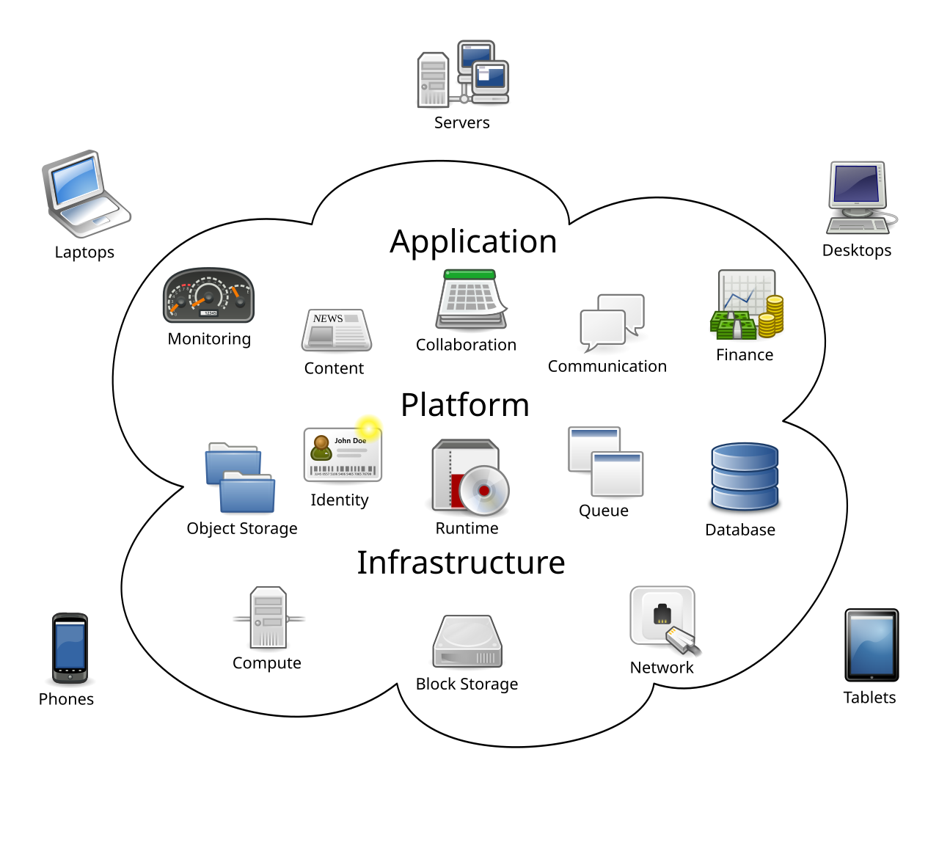
Cloud Computing
Cloud computing delivers computing power, storage, and software as on-demand virtualized services over the Internet.
Users access a shared pool of scalable resources from any device or location.
For firms, this shifts computing from owning hardware to renting capacity as needed.
Implication: Cloud computing converts fixed IT costs into flexible operating expenses and enables rapid scaling.

Slide 43

Characteristics of Cloud Computing
The U.S. National Institute of Standards and Technology identifies five essential characteristics:
On-demand Self-service: Users can provision computing resources automatically.
Ubiquitous Network Access: Services are accessible via standard Internet-connected devices.
Resource Pooling: Providers dynamically allocate shared resources across multiple users.
Rapid Elasticity: Capacity scales up or down quickly based on demand.
Measured Service: Usage is monitored and billed based on actual consumption.

Slide 44
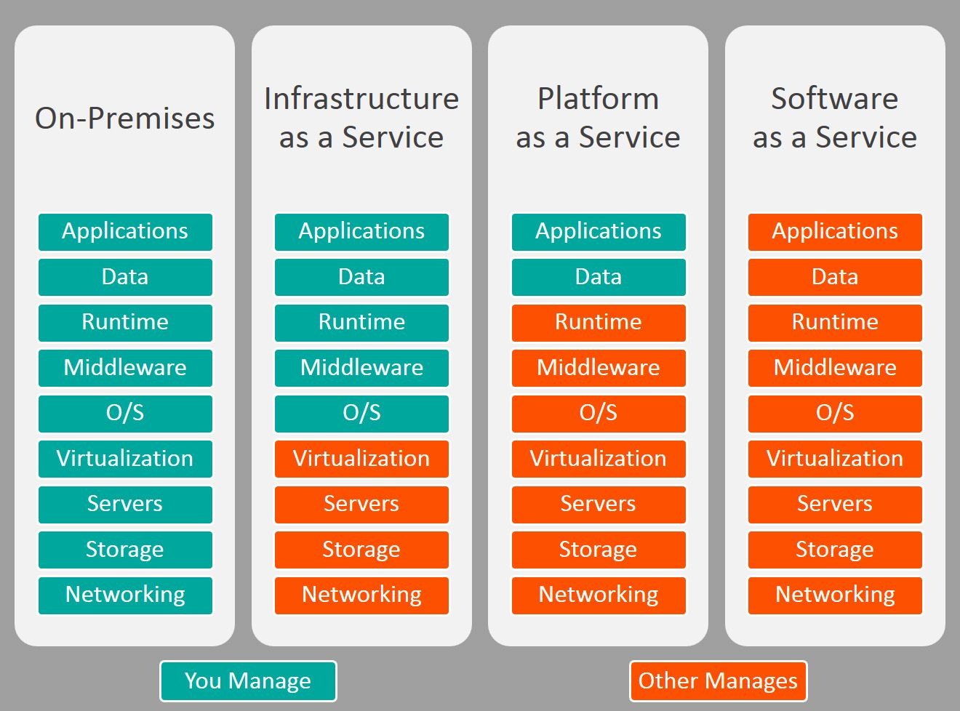
Types of Cloud Services
Infrastructure as a Service (IaaS):
Firms rent computing infrastructure (servers, storage, networking) instead of owning hardware.
e.g., Amazon Web Services (AWS).
Platform as a Service (PaaS):
Providers supply infrastructure and development tools for building and testing applications.
e.g., Microsoft Azure, Salesforce Platform.
Software as a Service (SaaS):
Users access fully managed applications over the Internet.
e.g., Google Workspace, Microsoft 365, Salesforce CRM.

Slide 45
Advantages and Challenges of Cloud Computing
Advantages:
Elastic scalability: Instantly scale computing resources up or down.
Cost efficiency: Pay-for-use pricing and economies of scale.
Operational outsourcing: Providers handle infrastructure maintenance.
Accessibility: Enterprise-grade tools available to firms of all sizes.
Challenges:
Data control: Sensitive information resides with external providers.
Security and reliability: Outages or breaches can halt operations.
Cost unpredictability: Usage spikes may create unexpected expenses.
Vendor lock-in: Switching providers can be difficult and costly.
Integration complexity: Legacy systems may require redevelopment.

Slide 46
Hybrid Cloud and On-Demand Computing
Many large firms adopt a hybrid model, keeping sensitive workloads on private servers while using public clouds for less critical tasks.
This approach balances security, performance, and cost.
On-demand computing allows firms to provision resources instantly and pay only for what they use.
Hybrid architectures are increasingly common among mid-sized and large organizations.
Major providers such as AWS, Microsoft Azure, Google Cloud Platform, and Salesforce offer integrated AI services.
These include tools for natural-language processing, image recognition, and predictive analytics delivered through the cloud.
Cloud-based AI lowers the barrier to entry for machine learning by providing scalable computing power and pretrained models.

Slide 47
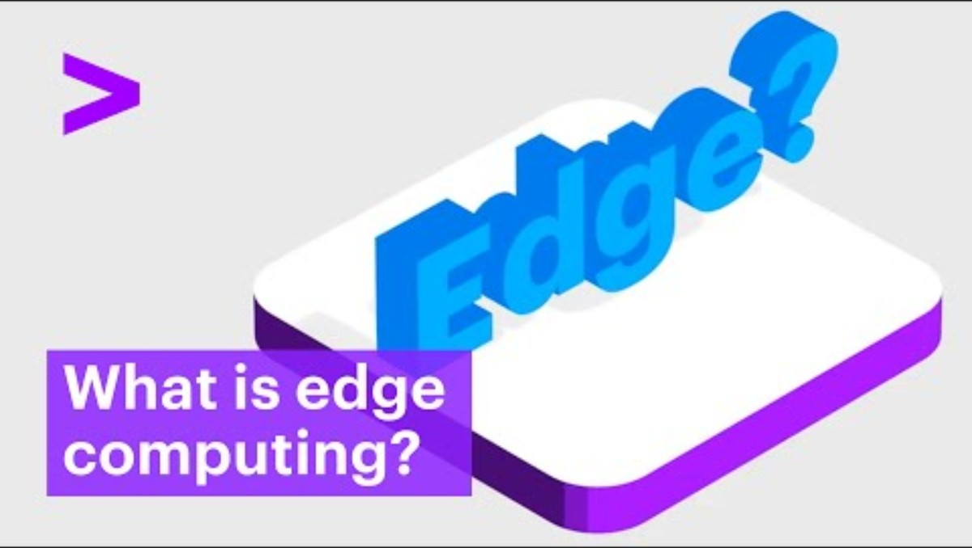
Accenture (2022, October 18). What is Edge Computing? [Video]. YouTube. https://youtu.be/WMvb9LLXzUs?si=-44kOZLrcatKb_NL

Slide 48
Edge Computing
Edge computing processes data closer to its source instead of sending everything to distant data centers.
This approach reduces network delays and bandwidth costs.
It is especially valuable for IoT applications, where sensors or devices generate large volumes of data.
Examples include oil rig sensors and autonomous vehicles that require real-time data processing.
Benefits of Edge Computing
Reduced Latency: Processing near the data source speeds response times for time-sensitive applications.
Lower Network Load: Only essential data are transmitted to the central cloud.
Improved Reliability: Local systems can continue operating even if cloud connectivity is interrupted.
After examining how infrastructure technologies evolved, we now shift to the managerial question: How should firms govern and invest in these technologies?

Slide 49
Infrastructure Management

Slide 50
Managing Modern IT Infrastructure
Building and managing a coherent IT infrastructure presents ongoing challenges for every organization.
Firms must navigate technological change, governance and management decisions, and infrastructure investment strategies.
These challenges determine how efficiently and securely a company operates in an increasingly digital environment.
As firms expand, they often outgrow their existing IT infrastructure, and when they contract, they may retain excess capacity.
Key Question: How can firms remain flexible when infrastructure investments are often fixed costs?

Slide 51
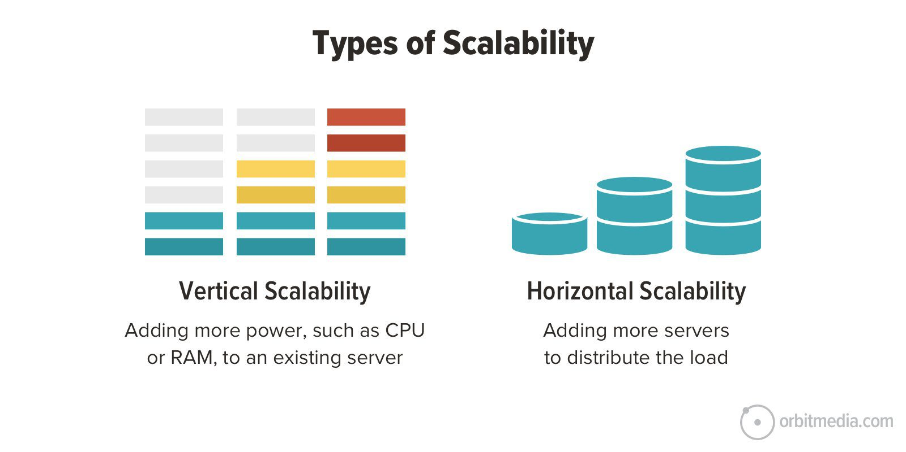
Dealing with Platform and Infrastructure Change
Scalability refers to the ability to expand systems to accommodate more users or applications.
Designing and maintaining scalable IT infrastructure helps firms manage fluctuations effectively.
It ensures systems can handle growth from new applications, mergers, and increased business volume.
Poor scalability can lead to performance failures or underutilized systems.
Infrastructure planning must anticipate future capacity needs and align them with strategic goals.
Horizontal vs. Vertical Scalability.

Slide 52
Dealing with Platform and Infrastructure Change
Firms adopting mobile and cloud computing must develop new tools and policies for security, tracking, and performance.
Mobile Device Management (MDM) software helps monitor and secure devices used across multiple operating systems and carriers.
MDM systems can update applications, back up data, and remove information from lost or stolen devices.
Firms using cloud services must establish clear contractual agreements with vendors.
Define availability standards, response times, and security requirements for critical applications.
Business management must determine acceptable performance benchmarks for outsourced infrastructure

Slide 53
IT Management and Governance
Central question in IT management: Who controls and governs the firm’s infrastructure?
IT governance defines how responsibilities are distributed between central IT management and individual business units.
Key governance issues include decision authority, cost allocation, and alignment with business objectives.
Firms must decide whether IT decisions should be centrally managed or distributed among departments.
Centralized governance ensures consistency and standardization but may limit flexibility.
Decentralized governance allows customization but can lead to redundancy and higher costs.
Most firms adopt a hybrid approach, balancing efficiency and local autonomy.

Slide 54
Making Wise Infrastructure Investments
IT infrastructure represents a major long-term investment.
Spending too much creates idle capacity and wastes resources, while spending too little leads to service gaps and competitive disadvantage.
Firms must analyze how much to invest and whether to own or rent infrastructure resources.
Firms must choose between purchasing IT assets or renting them from cloud service providers.
Renting through cloud computing can increase flexibility and scalability but requires careful cost analysis.
Over time, subscription and usage fees may exceed the cost of ownership for some systems.
Firms should balance cost, security, and workflow impacts when making this decision.

Slide 55
Understanding Total Cost of Ownership
Total Cost of Ownership (TCO) analysis helps firms identify hidden costs and evaluate investment alternatives more accurately.
Hardware and software acquisition: Purchase or license of technology.
Installation and training: Costs for setup and employee preparation.
Support and maintenance: Help desk services, upgrades, and system upkeep.
Infrastructure and utilities: Network equipment, data centers, space, and power.
Downtime: Lost productivity due to system failures.
Hardware and software purchases account for only about 20 percent of total ownership costs, and the greatest savings come from reducing administrative and support expenses.
Standardizing hardware and software can reduce TCO.
Centralizing IT management can reduce TCO.
Using cloud services for scalable storage and computing can reduce TCO.

Slide 56
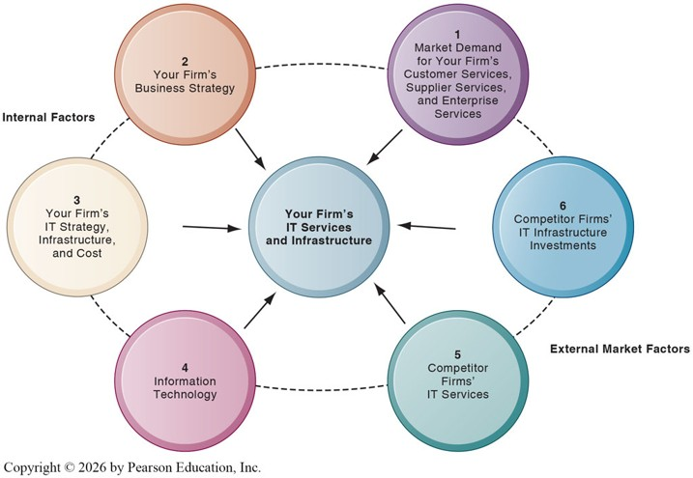
Competitive Forces Model for IT Infrastructure

Slide 57
Factors in the Model
Your business strategy: Identify future services and capabilities required to achieve strategic goals.
Your IT strategy, infrastructure, and cost: Assess alignment with business objectives and evaluate total IT costs.
Information technology assessment: Determine whether the firm is technologically outdated or investing too far ahead of standards.
Market demand: Evaluate customer, supplier, and employee needs for faster or higher-quality digital services.
Competitor firm services: Compare your technology offerings and service levels with those of competitors.
Competitor IT investments: Benchmark IT spending and innovation strategies to maintain competitive advantage.

Slide 58
Recap of Chapter 5

Slide 59
Recap of Chapter 5
Discuss IT infrastructure and its evolution
Discuss the mobile platform, apps, and BYOD
Discuss quantum computing and green computing
Discuss virtualization and cloud computing
Discuss IT infrastructure management challenges

