Slide 1
Introduction
BUSI 201
Business Data Analysis

Slide 2
What is Business Data Analysis
Directly from the Monmouth College course catalog...
“An introduction to business problem solving using critical thinking skills to analyze data and solve real-life business problems. Problems will come from accounting, finance, marketing, management, and statistics. Students will use a variety of solving problems tools including intuition, pencil and paper, spreadsheets, etc..”
Primarily Spreadsheets, with a dash of Data Visualization Software

Slide 3

PollEverywhere
https://pollev.com/brianpark046

Slide 4
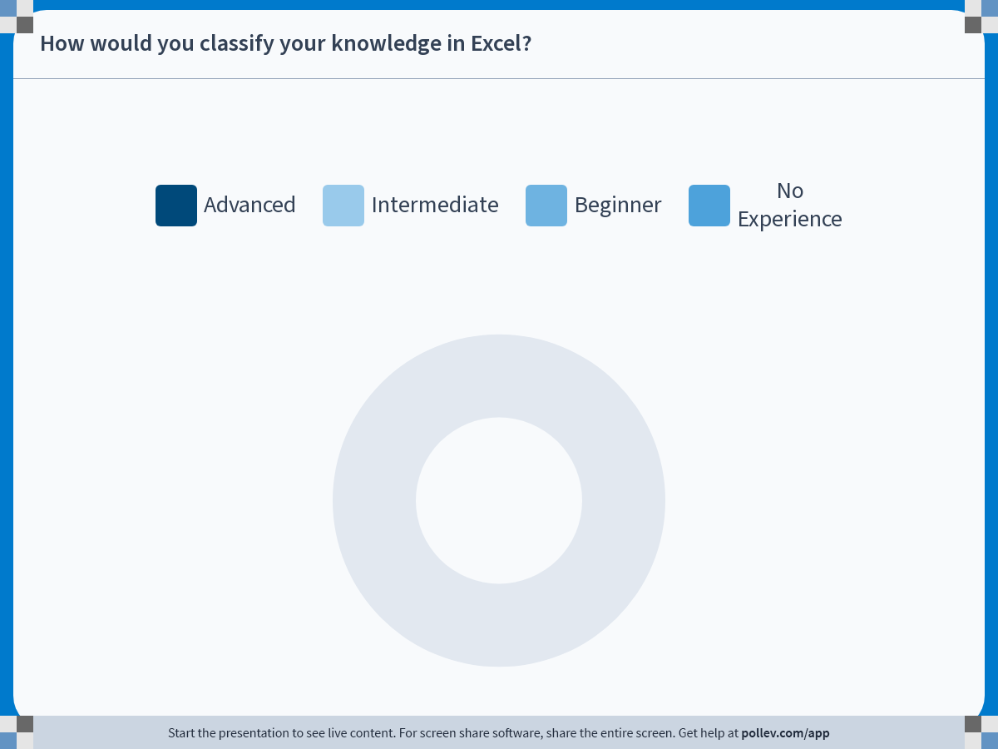
Notes:
Poll Title: Do not modify the notes in this section to avoid tampering with the Poll Everywhere activity.
More info at polleverywhere.com/support
How would you classify your knowledge in Excel?
https://www.polleverywhere.com/multiple_choice_polls/qHzWieX9Cu9FkrMVbgiCa?state=opened&flow=Default&onscreen=persist

Slide 5
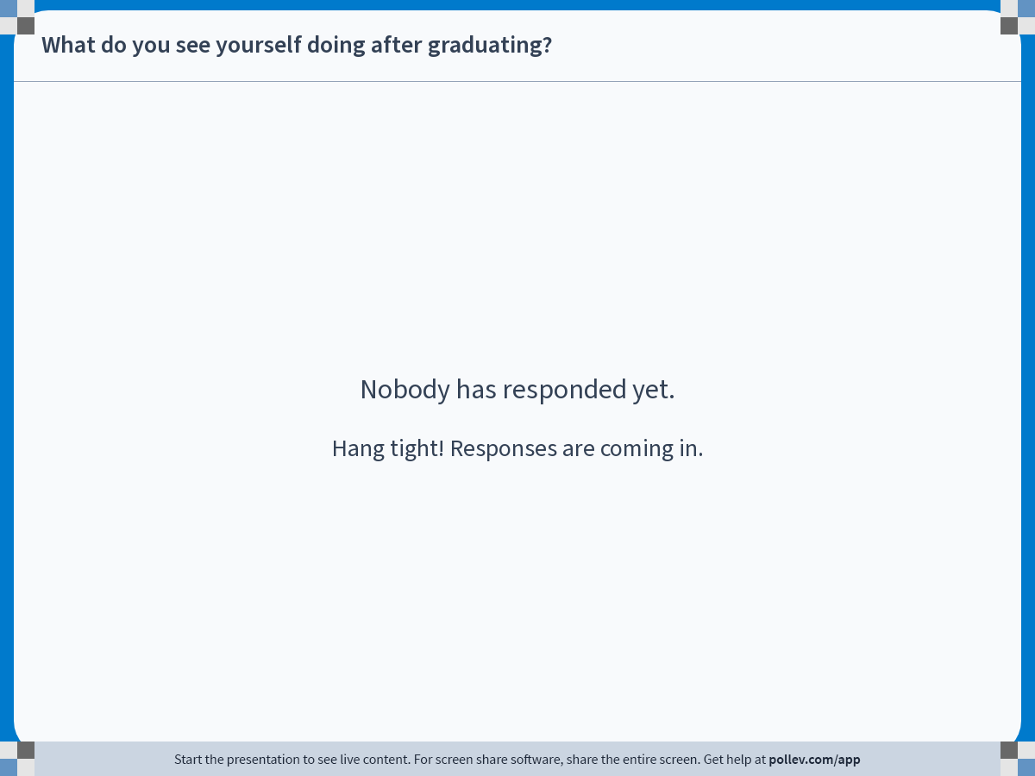
Notes:
Poll Title: Do not modify the notes in this section to avoid tampering with the Poll Everywhere activity.
More info at polleverywhere.com/support
What do you see yourself doing after graduating?
https://www.polleverywhere.com/free_text_polls/Ay6cnsPmCa3xTogYAi5RT

Slide 6
About Me
Ph.D. Cornell University
B.A. Korea University
Research Interests
  Environmental: Climate Change, Air Pollution
  Demographic: Migration, Fertility
  Labor: Employment Stability
1st Year at Monmouth College

Slide 7
Contact Information
Email: BPARK@monmouthcollege.edu
  Please include “BUSI 201” in the subject line.
  Target response within 1 business day.
Office: CSB 248
Regular Office Hours: Tue/Thu 12:30 PM ~ 2:00 PM
Individual (or Group) Appointments via Calendly.
  https://calendly.com/brianhwpark
  Book on-demand office hours in 30-minute increments
  Calendar opens 15 days in advance
Send me an email if you need anything else

Slide 8

Office Hours

Slide 9
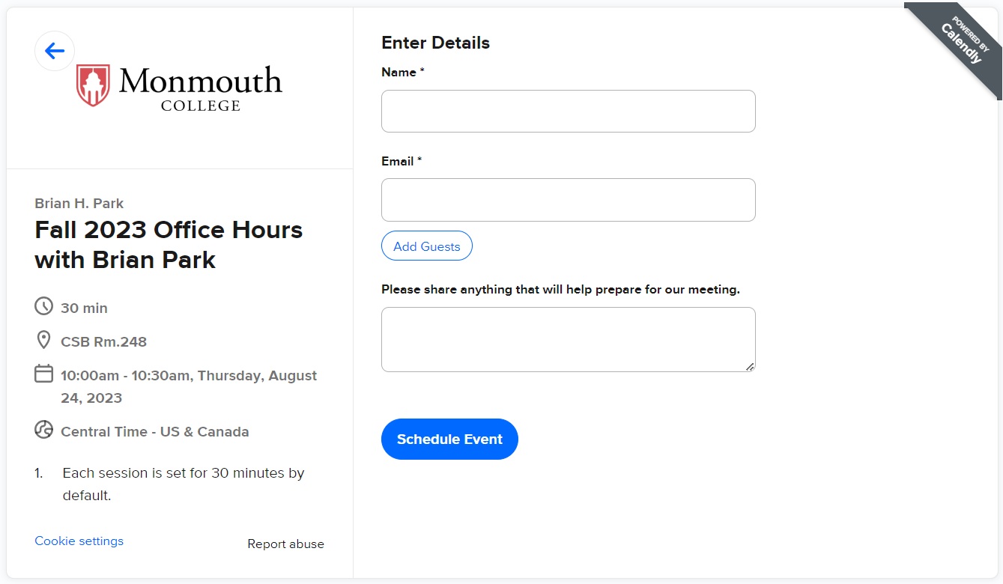
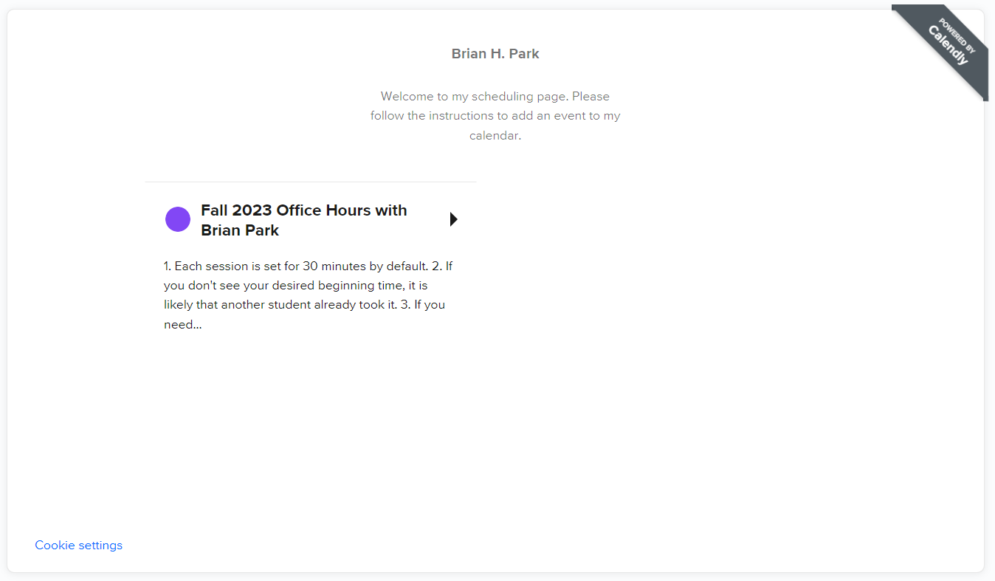
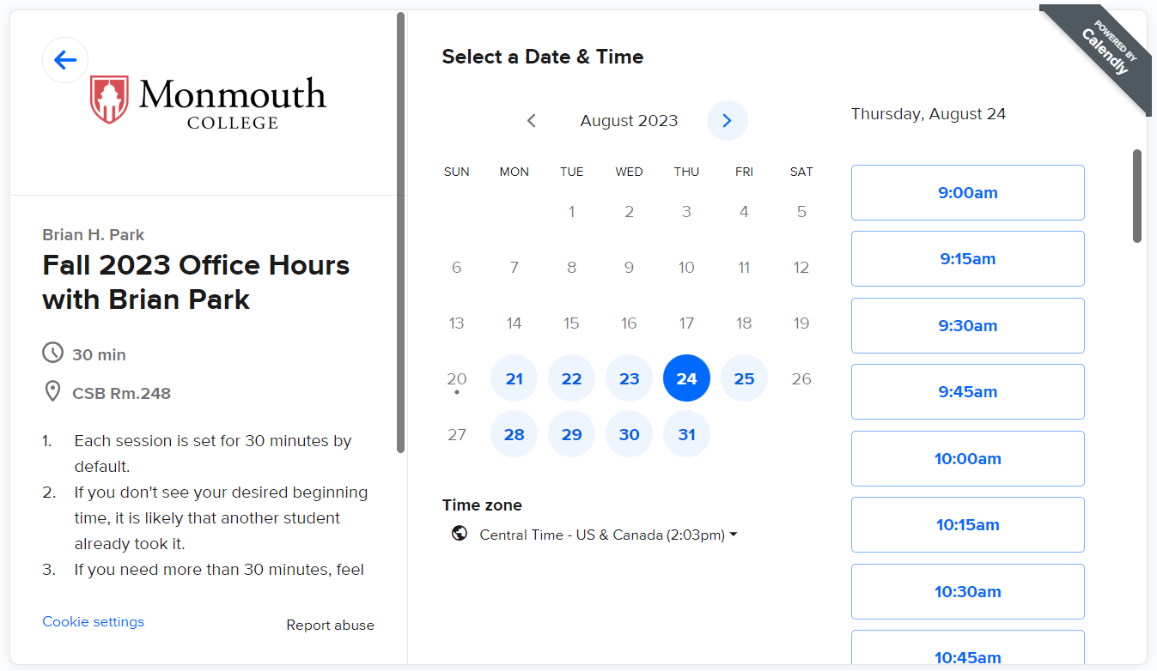
Office Hours

Slide 10
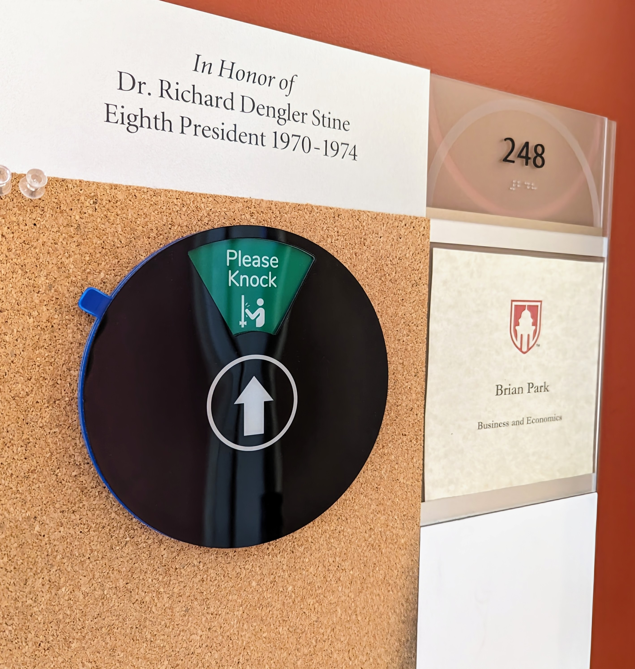
Availability
Indicator
Whenever it displays “Please Knock”, that means that I am available.
When it is at “Back Soon”, it means that I have briefly left the office, but will be back soon.
If you see anything else, and need to talk, send me an email!

Slide 11
Grades
Final letter grades based on four factors:
  Attendance: 10%
  Quizzes / Assignments: 40%
  Midterm Exam: 20%
  Final Exam: 30%
There are no predetermined “cutoff” points for letter grades.
The cutoffs will be updated as the semester progresses.

Slide 12
Attendance
Attendance may be called every time we meet.
One “no-points-deducted” absence for each month.
Extra “no-points-deducted” absences may be granted on a case-by-case basis.
Attendance scores will be calculated as:
$$Attendance= \frac{\# Attendance Checks −\# Absences}{\# Attendance Checks}×10$$

Slide 13
Quizzes / Homework
Quizzes will act as a low-stakes status check.
Students can recover extra credit by attending office hours and “correcting” any mistakes made.
The lowest 1 or 2 quizzes will be dropped at the end of the semester.
Quizzes may be substituted to homework assignments at the instructor’s discretion.

Slide 14
Exams
Two exams; one midterm and a comprehensive final.
No “review sessions” for partial credit for exams.
Students may submit a request for regrading within the first 5 days the scores are made available.
If you miss an exam due to valid cause, the option would be either a written make-up exam, or an oral exam.

Slide 15
Textbook
There is no textbook required for this course.
Will be handing out material and worksheets throughout the semester.
Most of this will be hands-on!

Slide 16
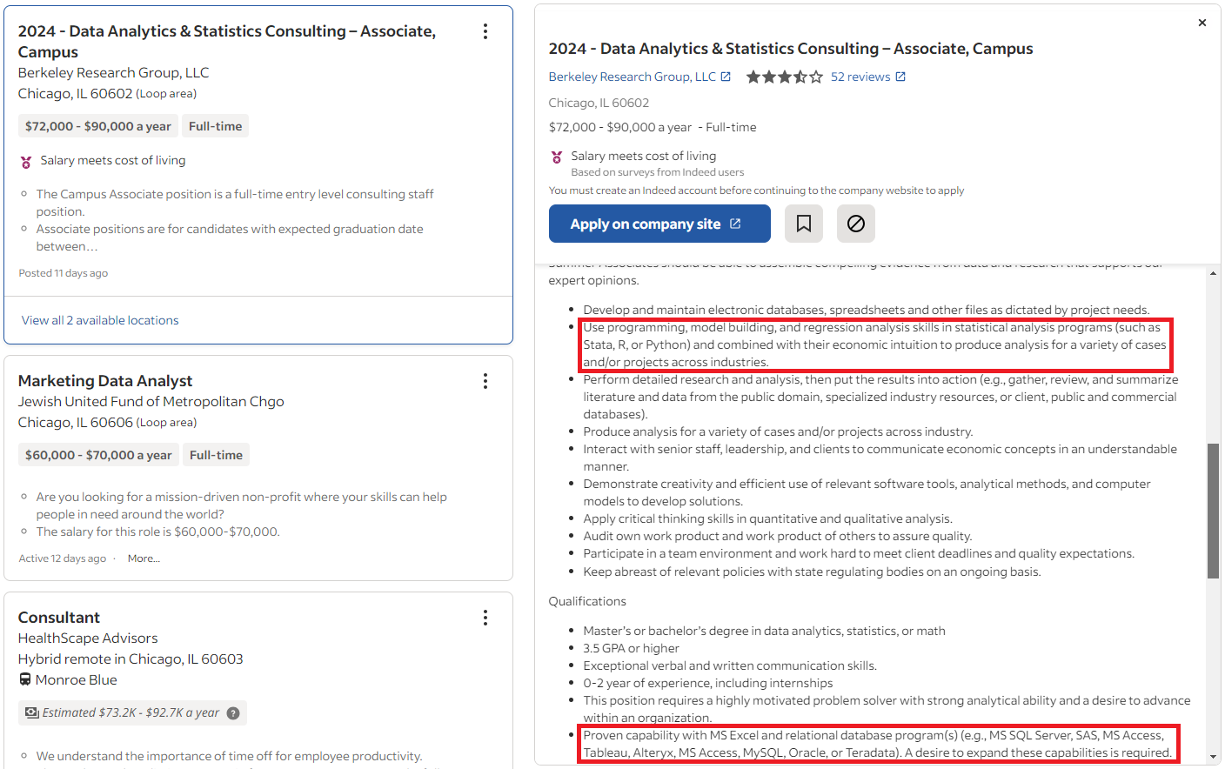
The “Beyond Spreadsheets” Portion

Slide 17
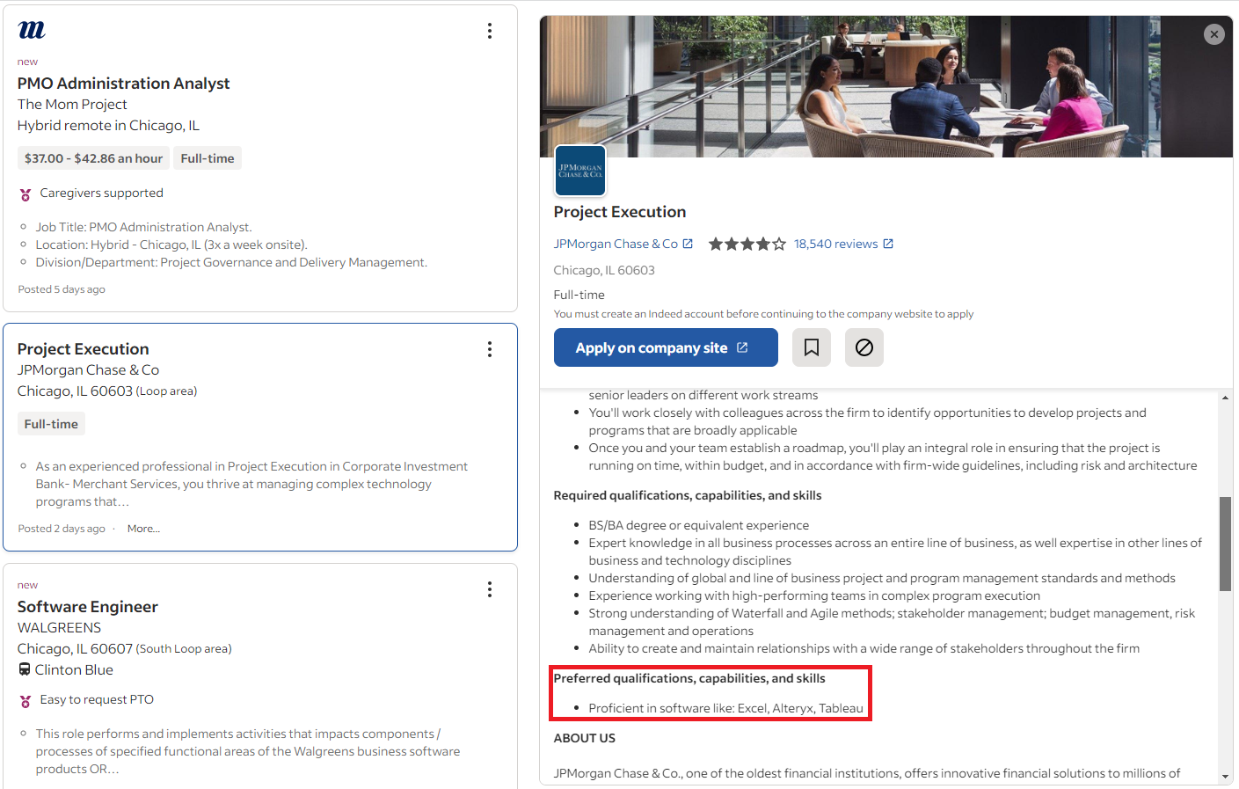
The “Beyond Spreadsheets” Portion

Slide 18
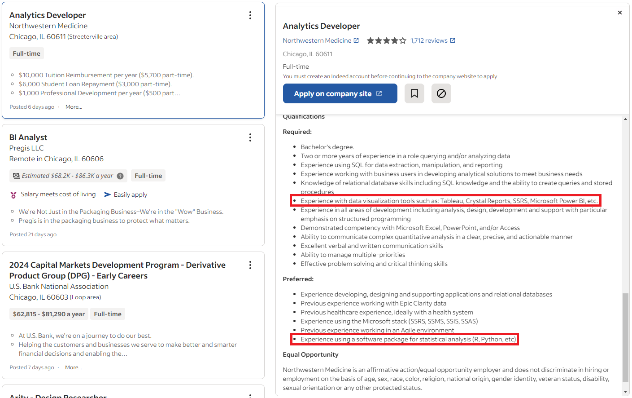
The “Beyond Spreadsheets” Portion

Slide 19
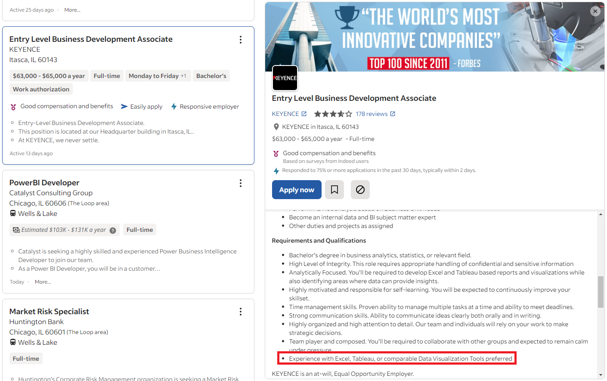
The “Beyond Spreadsheets” Portion

Slide 20
PollEverywhere
https://pollev.com/brianpark046

Slide 21
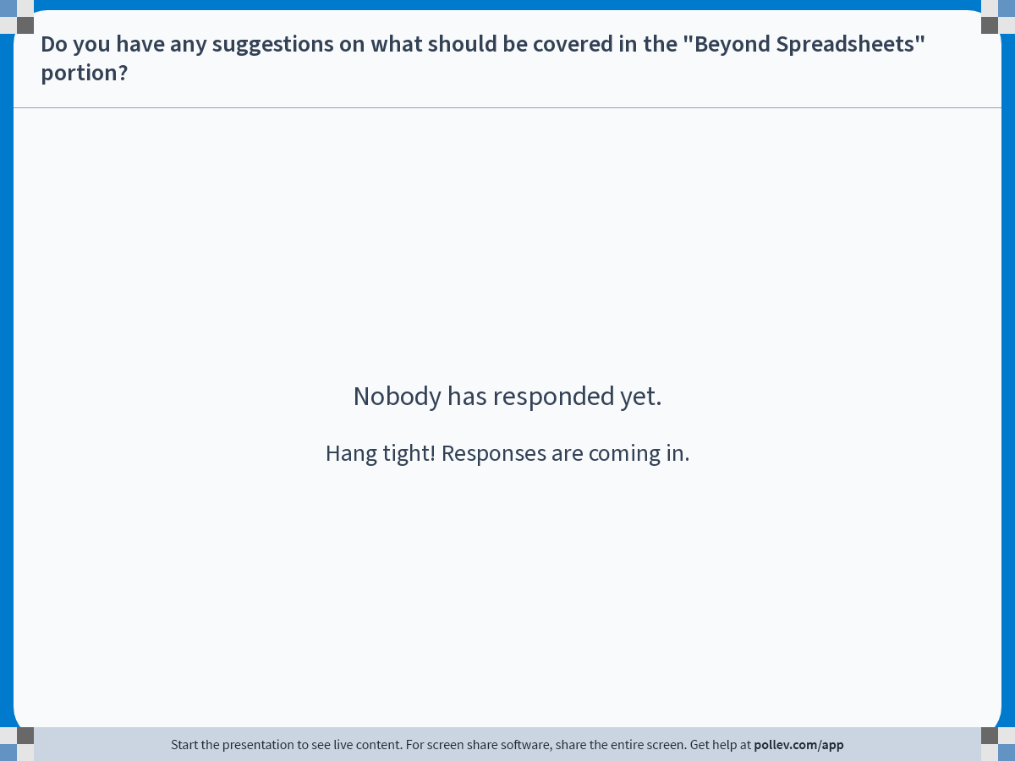
Notes:
Poll Title: Do not modify the notes in this section to avoid tampering with the Poll Everywhere activity.
More info at polleverywhere.com/support
Do you have any suggestions on what should be covered in the "Beyond Spreadsheets" portion?
https://www.polleverywhere.com/free_text_polls/aeo903UZ2Nx5h8yktxOne

Slide 22
Preview
The next few classes will be devoted to the basic functions of Excel.
Topics to be covered include…
  The concept of Columns, Rows, and Cells
  Inserting Data in Cells
  Selecting Multiple Cells at once
  Adding New Sheets in a Workbook
  Fonts and Sizes
  Formats

