Slide 1
Quiz #2 Review
ECON 300

Slide 2
Quiz #2 Recovery Office Hours
https://calendly.com/brianhwpark
Venue: Rm. 248 Center for Science and Business
Dates: Sep. 9th ~ Sep. 13th, 2024 (Mon ~ Fri)
Length: 30 Minutes per Session
Use the Whiteboard / Paper to correct your answers.
Recovery Rate: 50%

Slide 3
Problem 1. Definitions
Utility Functions
  Utility functions are tools that assign utility values to bundles of goods and services.
Rational Preferences
  Rational preferences are preferences that satisfy the axioms of completeness and transitivity.
Marginal Utility
  Utility derived from the consumption of one additional unit of a good or service.

Slide 4
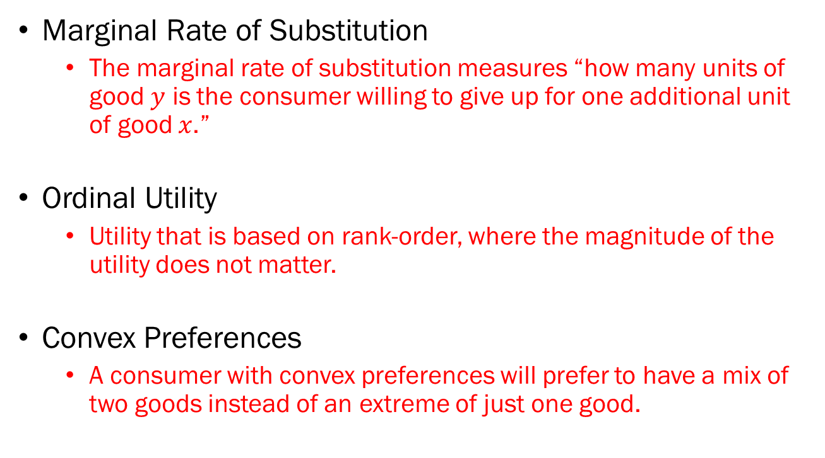
Problem 1. Definitions
Marginal Rate of Substitution
  The marginal rate of substitution measures “how many units of good $y$ is the consumer willing to give up for one additional unit of good $x$.”
Ordinal Utility
  Utility that is based on rank-order, where the magnitude of the utility does not matter.
Convex Preferences
  A consumer with convex preferences will prefer to have a mix of two goods instead of an extreme of just one good.

Slide 5
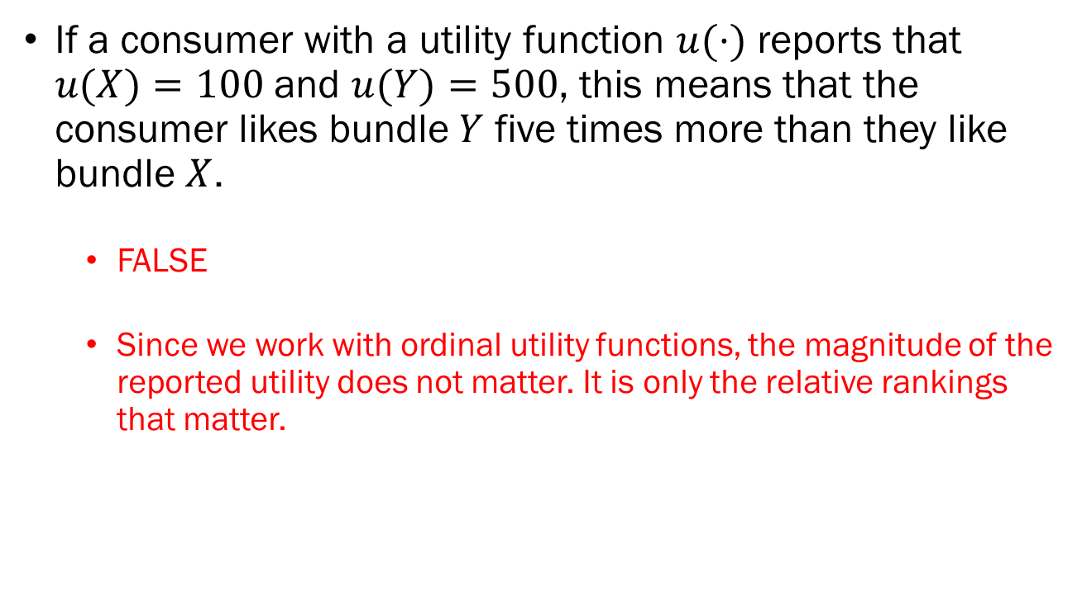
Problem 2.A.
If a consumer with a utility function $u(·)$ reports that $u(X)=100$ and $u(Y)=500$, this means that the consumer likes bundle $Y$ five times more than they like bundle $X$.
  FALSE
  Since we work with ordinal utility functions, the magnitude of the reported utility does not matter. It is only the relative rankings that matter.

Slide 6

Problem 2.B.
If a consumer reports that $X≻Y$, and $Y≻Z$, we assume that $X ≻ Z$.
  TRUE
  Since we only consider “rational” preferences, preferences must obey transitivity.

Slide 7
Problem 2.C.
According to the Law of Diminishing Marginal Utility, we assume that a consumer’s 2nd cup of coffee grants them lower marginal utility than their 3rd cup of coffee.
  FALSE
  The Law of Diminishing Marginal Utility implies the exact opposite. The third cup of coffee should give them a lower level of marginal utility.

Slide 8
Problem 2.D.
When two goods are perfect complements, the “Cobb-Douglas” family of functions should be used to model their preferences.
  FALSE
  For perfect complements, you want to use the Leontief (min) utility function.

Slide 9
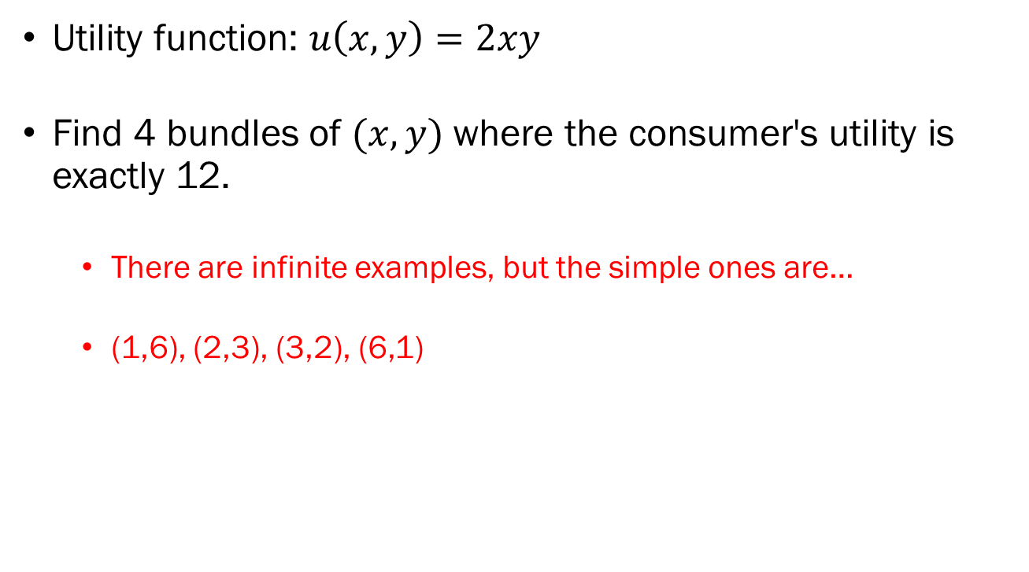
Problem 3.A.
Utility function: $u\left(x,y\right)=2xy$
Find 4 bundles of $(x,y)$ where the consumer's utility is exactly 12.
  There are infinite examples, but the simple ones are…
  (1,6), (2,3), (3,2), (6,1)

Slide 10
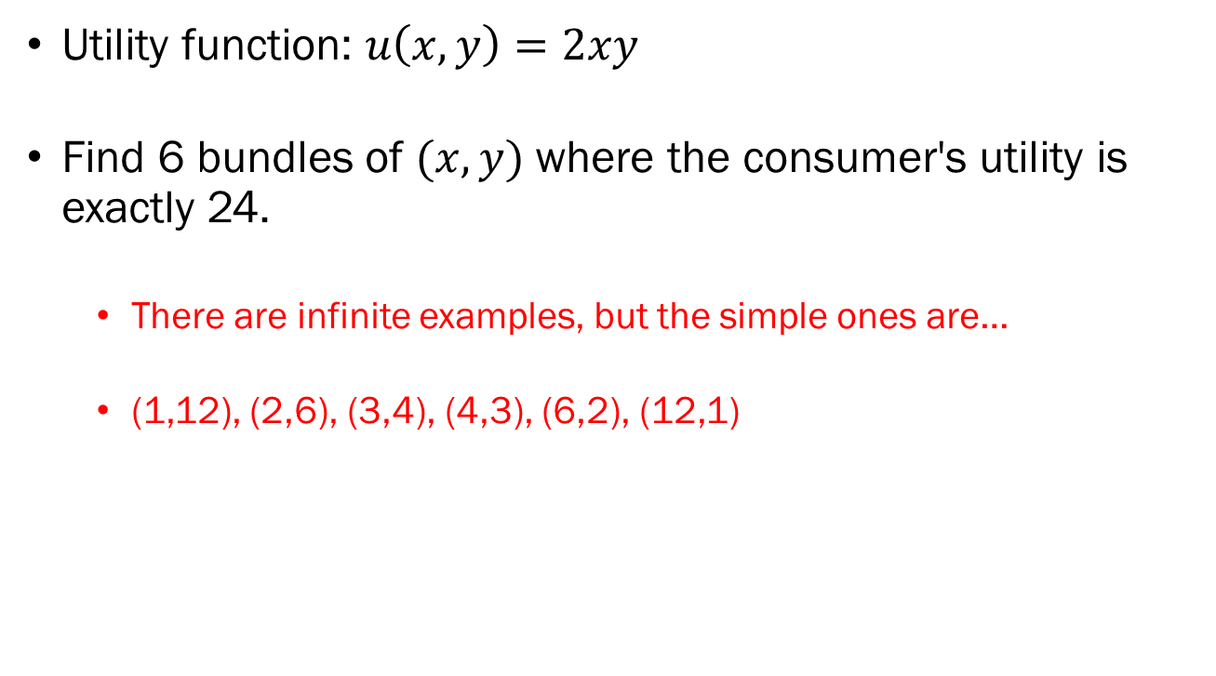
Problem 3.B.
Utility function: $u\left(x,y\right)=2xy$
Find 6 bundles of $(x,y)$ where the consumer's utility is exactly 24.
  There are infinite examples, but the simple ones are…
  (1,12), (2,6), (3,4), (4,3), (6,2), (12,1)

Slide 11
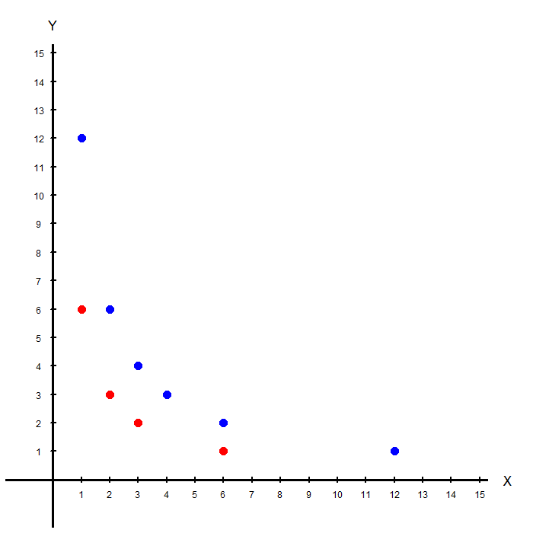
Problem 3.C.
Plot your answers of 3.A. and 3.B….

Slide 12
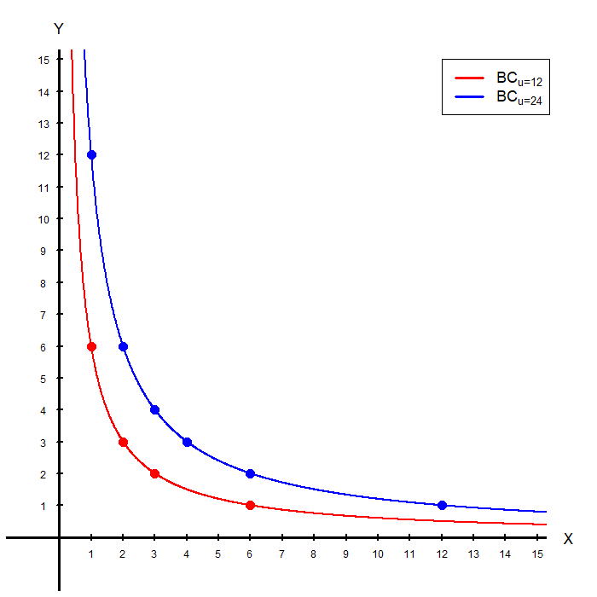
Problem 3.C.
…and roughly plot and label the indifference curves representing the utility level 12 and 24.

Slide 13
Problem 4.A.
Explain why an indifference curve further away from the origin represent a greater level of utility.
  Short Answer: The Axiom of Strong Monotonicity.
  Long Answer: To be illustrated on the board…

Slide 14
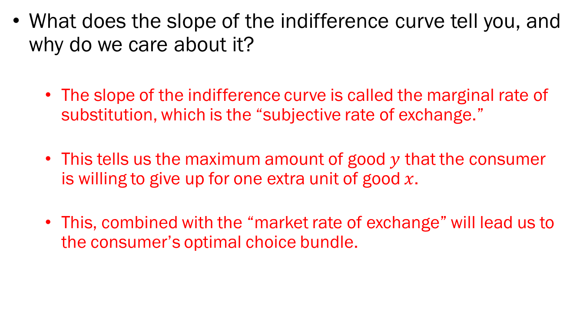
Problem 4.B.
What does the slope of the indifference curve tell you, and why do we care about it?
  The slope of the indifference curve is called the marginal rate of substitution, which is the “subjective rate of exchange.”
  This tells us the maximum amount of good $y$ that the consumer is willing to give up for one extra unit of good $x$.
  This, combined with the “market rate of exchange” will lead us to the consumer’s optimal choice bundle.

Slide 15
Problem 4.C.
Explain why typical indifference curves tend to “bulge inward” towards the origin.
  Short Answer: The Axiom of Convexity.
  Long Answer: To be illustrated on the board…

