Slide 1
INTERMEDIATE MICROECONOMIC THEORY
Chapter 5: Choice

Slide 2
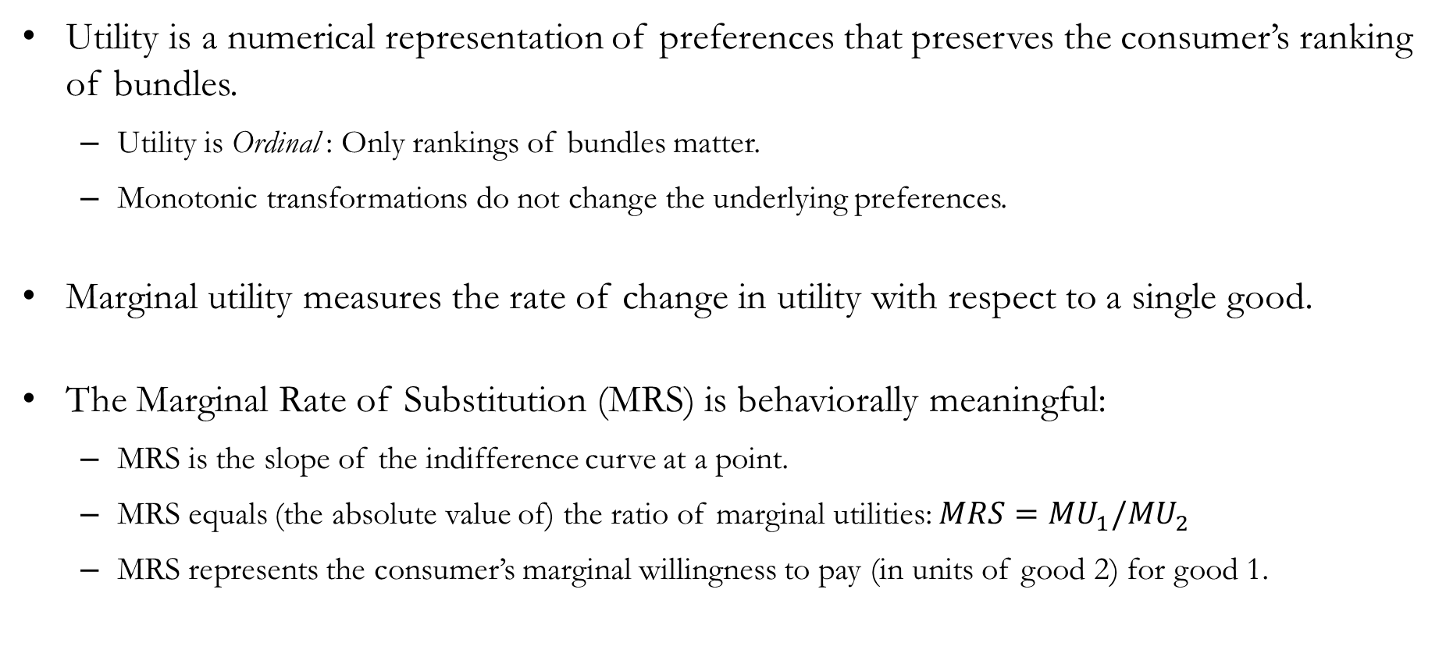
Recap: Utility
Utility is a numerical representation of preferences that preserves the consumer’s ranking of bundles.
  Utility is Ordinal : Only rankings of bundles matter.
  Monotonic transformations do not change the underlying preferences.
Marginal utility measures the rate of change in utility with respect to a single good.
The Marginal Rate of Substitution (MRS) is behaviorally meaningful:
  MRS is the slope of the indifference curve at a point.
  MRS equals (the absolute value of) the ratio of marginal utilities: $MRS=MU_{1}/MU_{2}$
  MRS represents the consumer’s marginal willingness to pay (in units of good 2) for good 1.

Slide 3
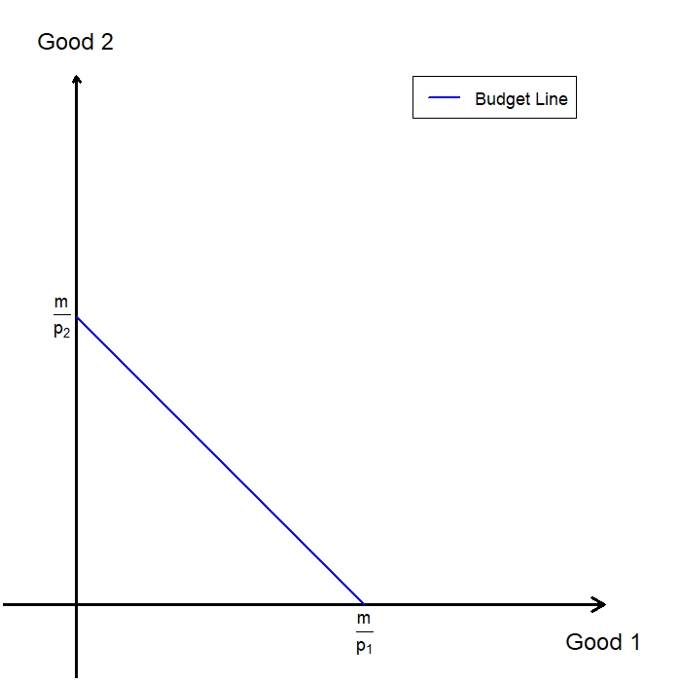
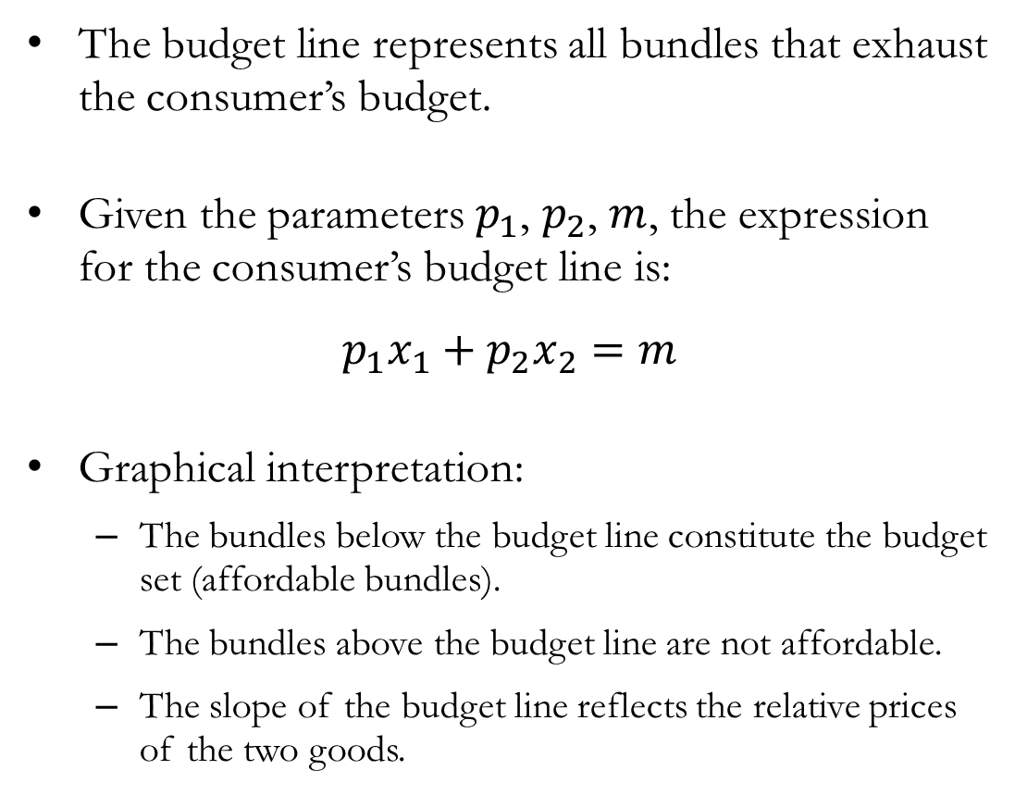
Recap: Budget Line
The budget line represents all bundles that exhaust the consumer’s budget.
Given the parameters $p_{1}$, $p_{2}$, $m$, the expression for the consumer’s budget line is:
$$p_{1}x_{1}+p_{2}x_{2}=m$$
Graphical interpretation:
  The bundles below the budget line constitute the budget set (affordable bundles).
  The bundles above the budget line are not affordable.
  The slope of the budget line reflects the relative prices of the two goods.

Slide 4
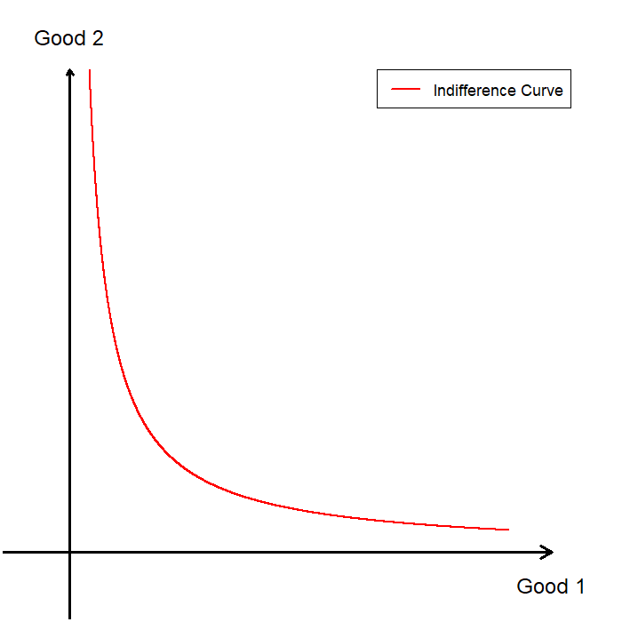
Recap: Indifference Curve
The indifference curve is a collection of all bundles that share the same utility value.
Graphical interpretation:
  Bundles above the indifference curve represent bundles associated with a higher utility level.
  Bundles below the indifference curve represent bundles associated with a lower utility level.
  The slope of the indifference curve is the marginal rate of substitution, which represents the subjective exchange ratio between the two goods.

Slide 5
The Geometry of
Optimal Choice

Slide 6
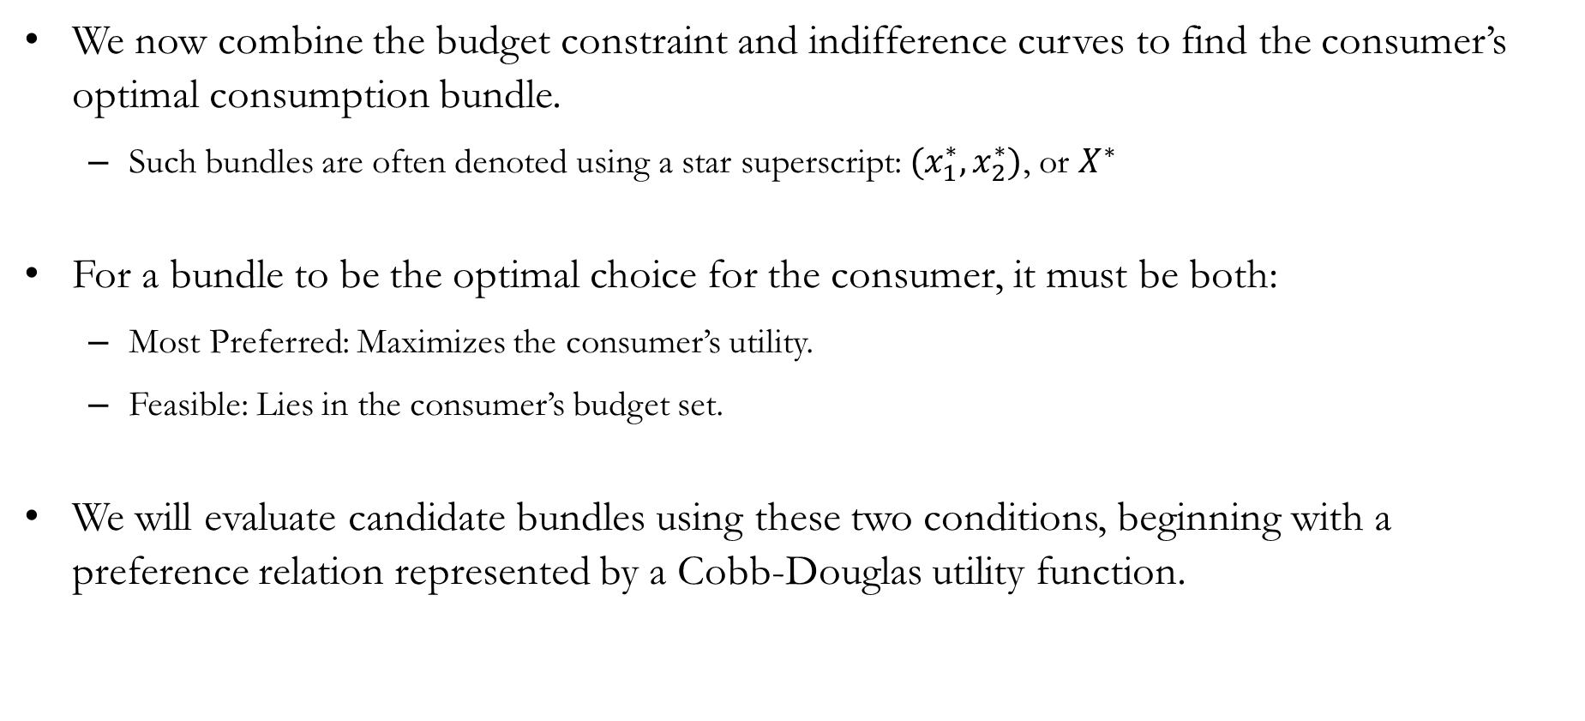
Optimal Choice
We now combine the budget constraint and indifference curves to find the consumer’s optimal consumption bundle.
  Such bundles are often denoted using a star superscript: $(x_{1}^{∗},x_{2}^{∗})$, or $X^{∗}$
For a bundle to be the optimal choice for the consumer, it must be both:
  Most Preferred: Maximizes the consumer’s utility.
  Feasible: Lies in the consumer’s budget set.
We will evaluate candidate bundles using these two conditions, beginning with a preference relation represented by a Cobb-Douglas utility function.

Slide 7
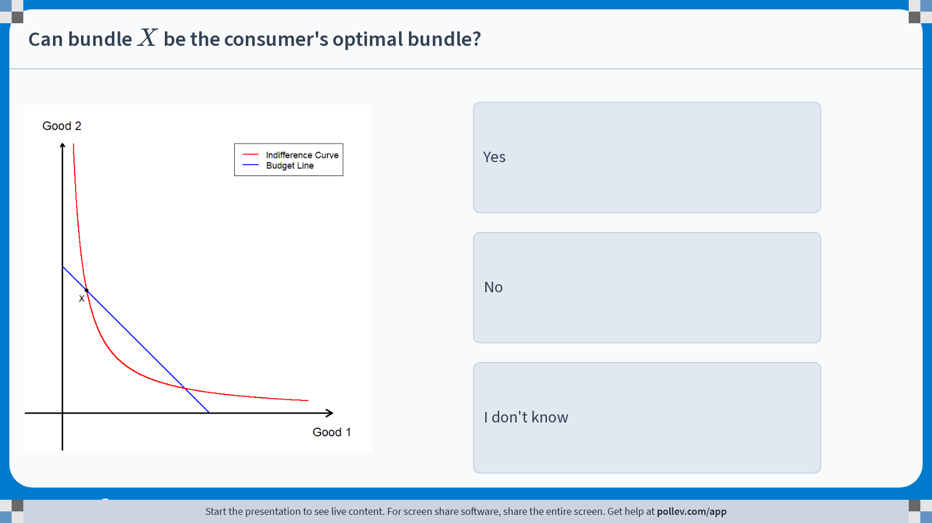
Poll Everywhere multiple choice poll instructions screen
Activity Title: Can bundle $$X$$ be the consumer's optimal bundle?
Slide 6
Notes:
Do not modify the notes in this section to avoid tampering with the Poll Everywhere activity.
More info at polleverywhere.com/support
Can bundle $$X$$ be the consumer's optimal bundle?
https://www.polleverywhere.com/multiple_choice_polls/WKiMAxWG5bnNtOcoKBkK8?display_state=instructions&activity_state=opened&state=opened&flow=Engagement&onscreen=persist

Slide 8
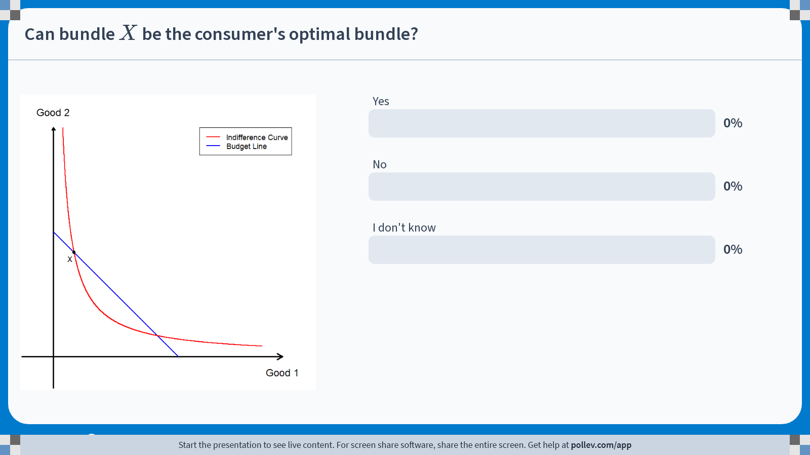
Poll Everywhere multiple choice poll chart screen
Activity Title: Can bundle $$X$$ be the consumer's optimal bundle?
Slide 8
Notes:
Do not modify the notes in this section to avoid tampering with the Poll Everywhere activity.
More info at polleverywhere.com/support
Can bundle $$X$$ be the consumer's optimal bundle?
https://www.polleverywhere.com/multiple_choice_polls/WKiMAxWG5bnNtOcoKBkK8?display_state=chart&activity_state=closed&state=closed&flow=Engagement&onscreen=persist

Slide 9
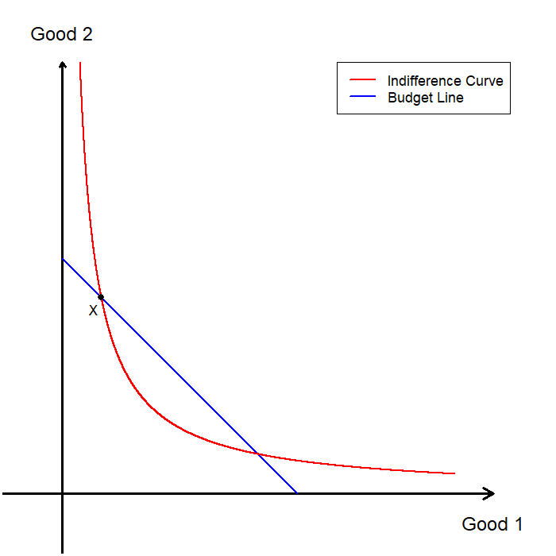
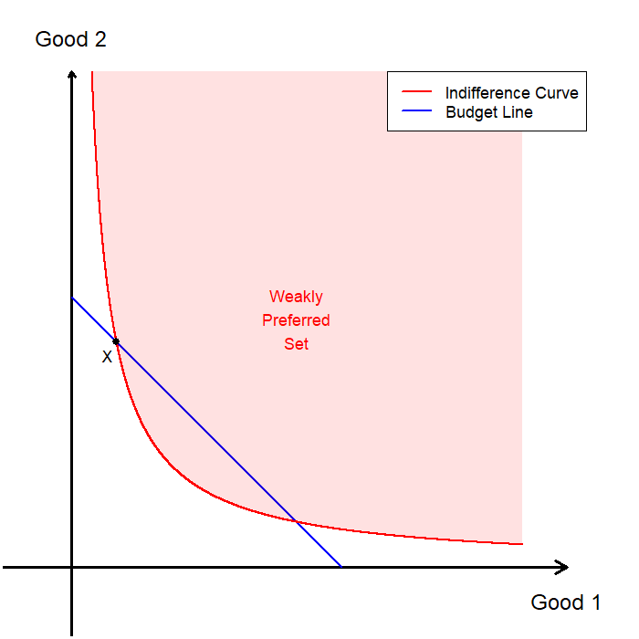
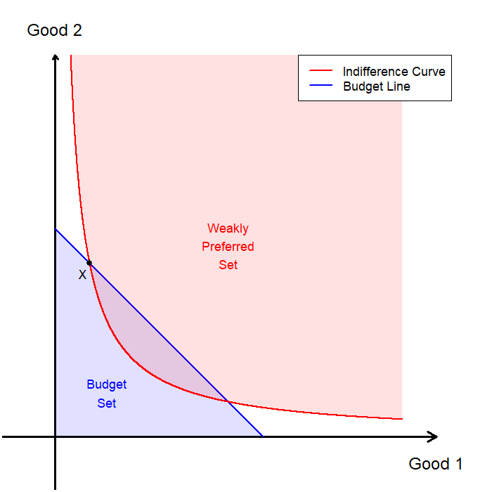
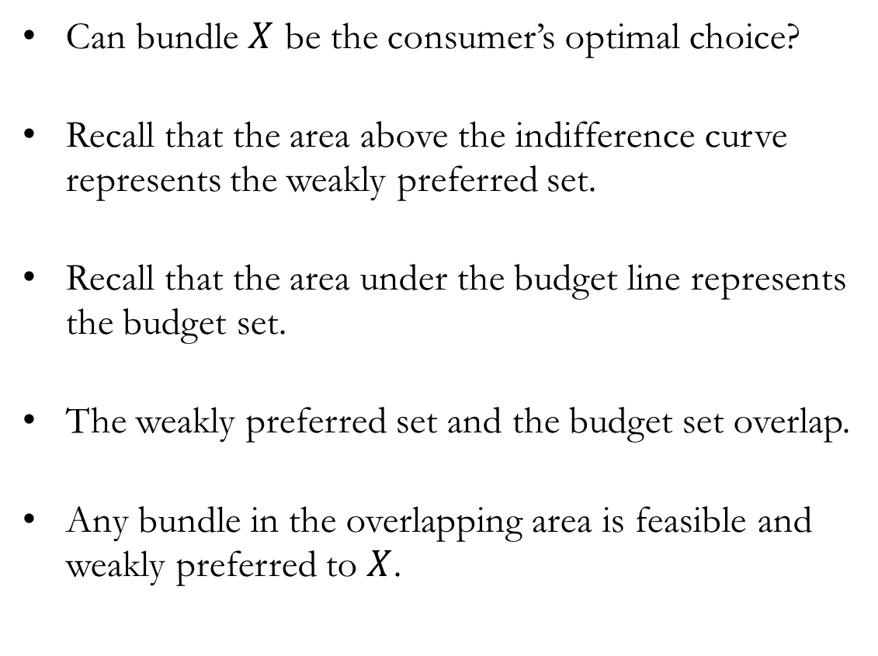
Optimal Choice: Candidate #1
Can bundle $X$ be the consumer’s optimal choice?
Recall that the area above the indifference curve represents the weakly preferred set.
Recall that the area under the budget line represents the budget set.
The weakly preferred set and the budget set overlap.
Any bundle in the overlapping area is feasible and weakly preferred to $X$.

Slide 10
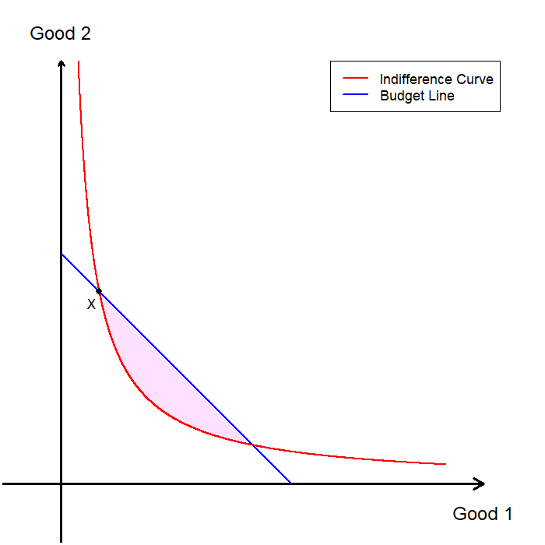

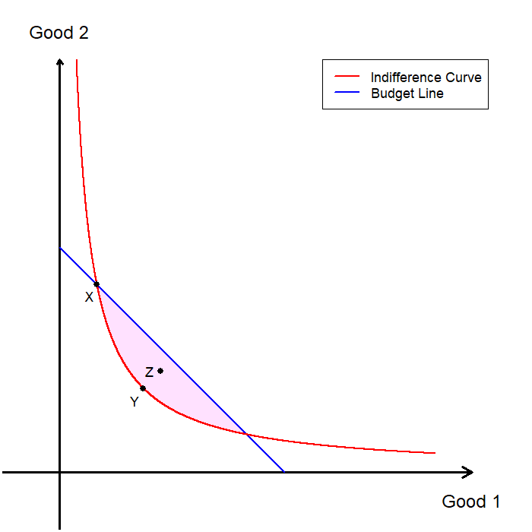
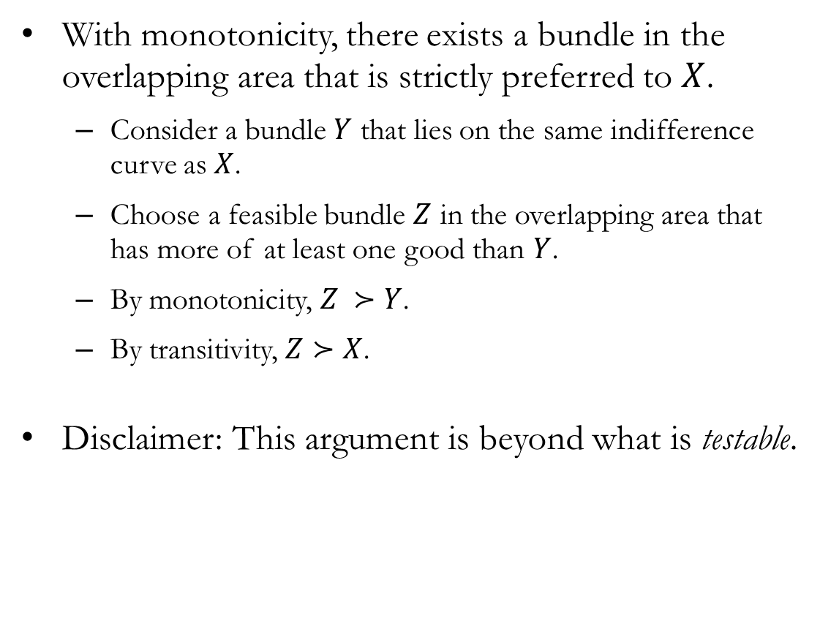
Optimal Choice: Candidate #1
With monotonicity, there exists a bundle in the overlapping area that is strictly preferred to $X$.
  Consider a bundle $Y$ that lies on the same indifference curve as $X$.
  Choose a feasible bundle $Z$ in the overlapping area that has more of at least one good than $Y$.
  By monotonicity, $Z ≻Y$.
  By transitivity, $Z≻X$.
Disclaimer: This argument is beyond what is testable.

Slide 11
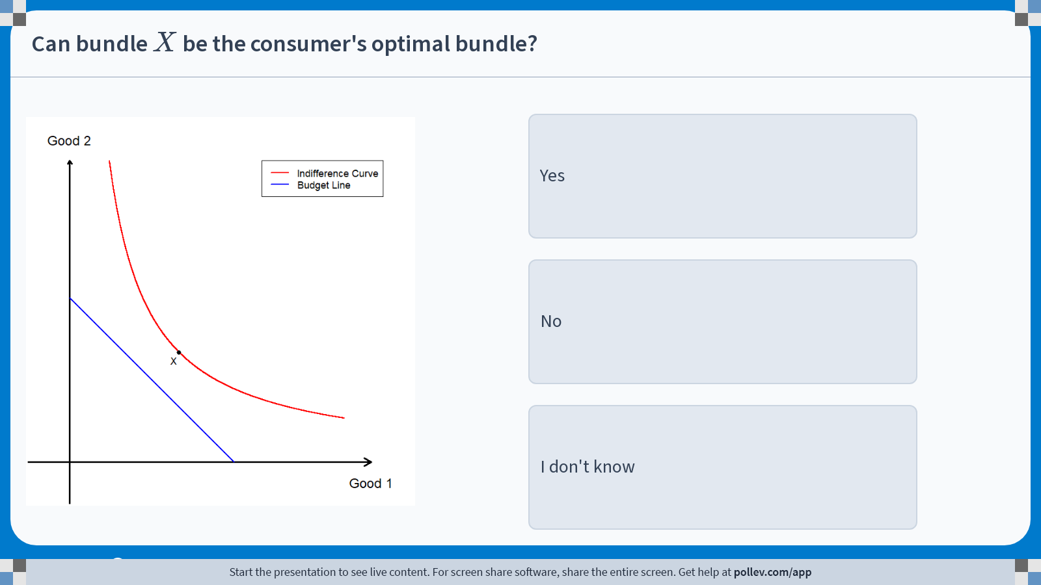
Poll Everywhere multiple choice poll instructions screen
Activity Title: Can bundle $$X$$ be the consumer's optimal bundle?
Slide 10
Notes:
Do not modify the notes in this section to avoid tampering with the Poll Everywhere activity.
More info at polleverywhere.com/support
Can bundle $$X$$ be the consumer's optimal bundle?
https://www.polleverywhere.com/multiple_choice_polls/JFAZjgleV8IeY1k1RQ09G?display_state=instructions&activity_state=opened&state=opened&flow=Engagement&onscreen=persist

Slide 12
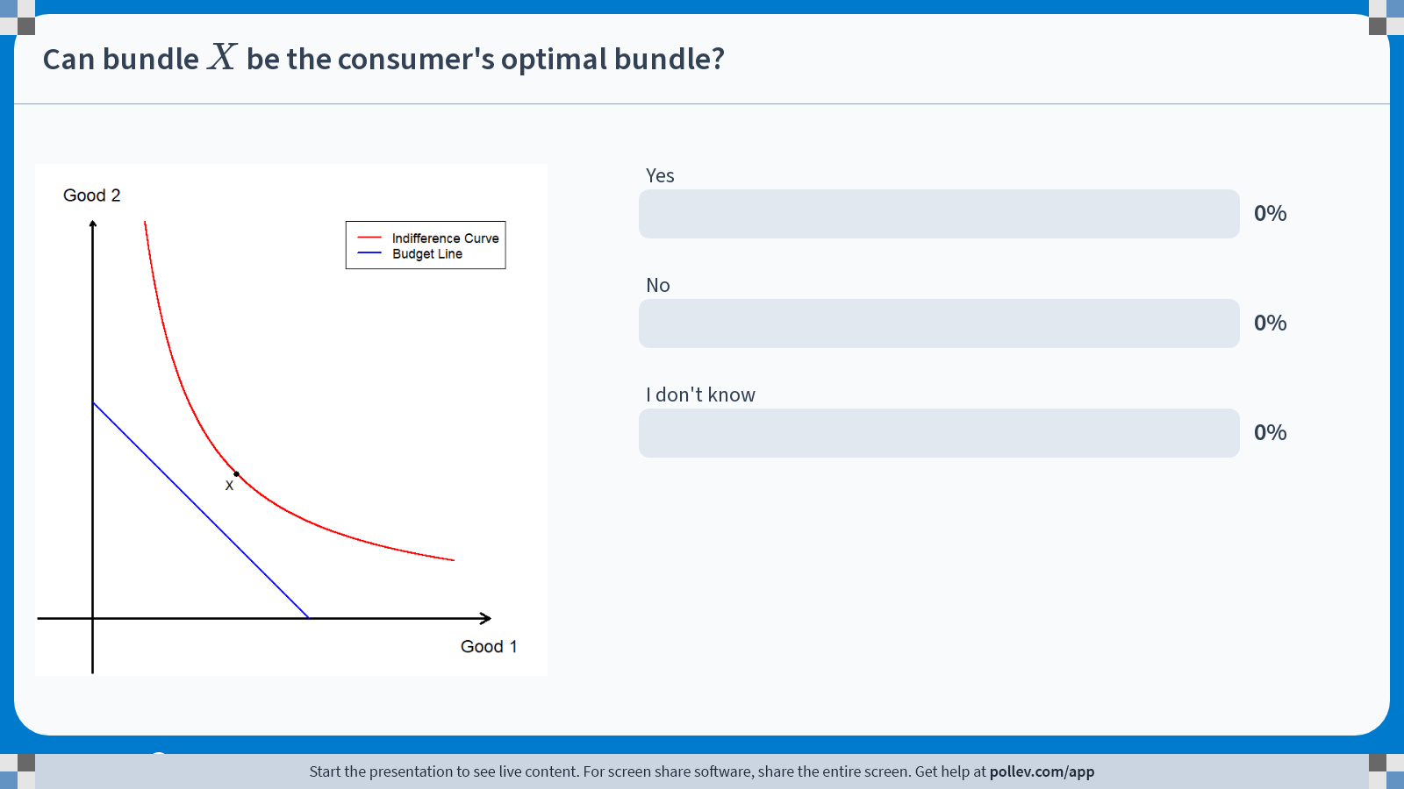
Poll Everywhere multiple choice poll chart screen
Activity Title: Can bundle $$X$$ be the consumer's optimal bundle?
Slide 12
Notes:
Do not modify the notes in this section to avoid tampering with the Poll Everywhere activity.
More info at polleverywhere.com/support
Can bundle $$X$$ be the consumer's optimal bundle?
https://www.polleverywhere.com/multiple_choice_polls/JFAZjgleV8IeY1k1RQ09G?display_state=chart&activity_state=closed&state=closed&flow=Engagement&onscreen=persist

Slide 13
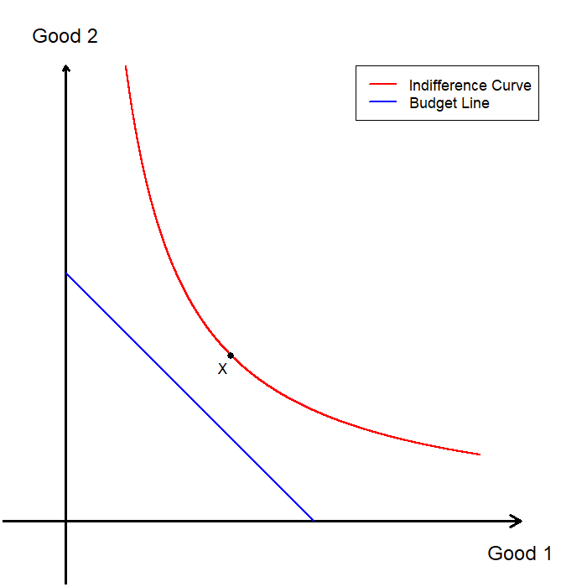
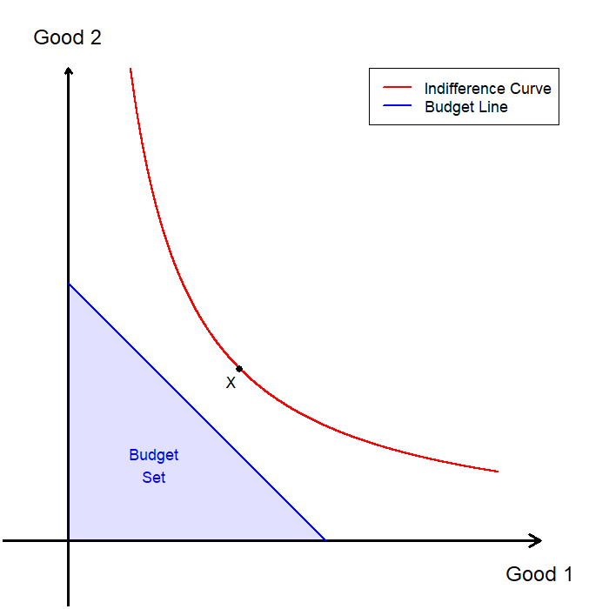
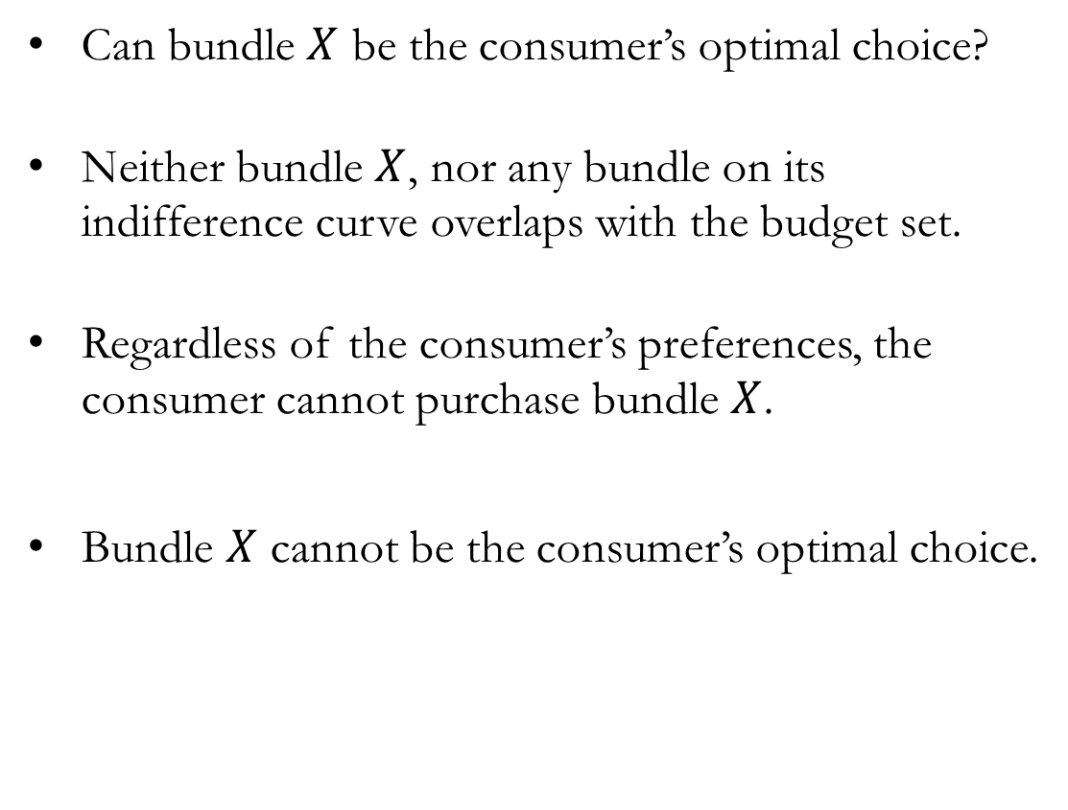
Optimal Choice: Candidate #2
Can bundle $X$ be the consumer’s optimal choice?
Neither bundle $X$, nor any bundle on its indifference curve overlaps with the budget set.
Regardless of the consumer’s preferences, the consumer cannot purchase bundle $X$.
Bundle $X$ cannot be the consumer’s optimal choice.

Slide 14
Optimal Choice
Let us briefly review the key lessons up to this point.
Candidate #1: The bundle of choice was feasible, but not most preferred.
  Any bundle whose indifference curve intersects the interior of the budget set cannot be optimal.
  The indifference curve not intersecting the interior of the budget set is a necessary condition for optimality (but not sufficient on its own).
Candidate #2: The bundle of choice was not feasible.
  Any bundle that does not lie in the consumer’s budget set cannot be optimal.
We now look for a feasible bundle that lies on the highest attainable indifference curve.

Slide 15
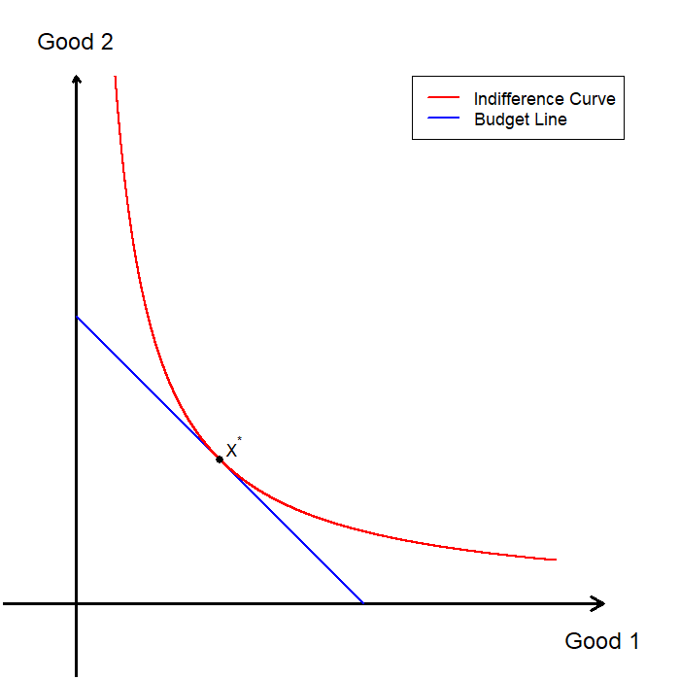
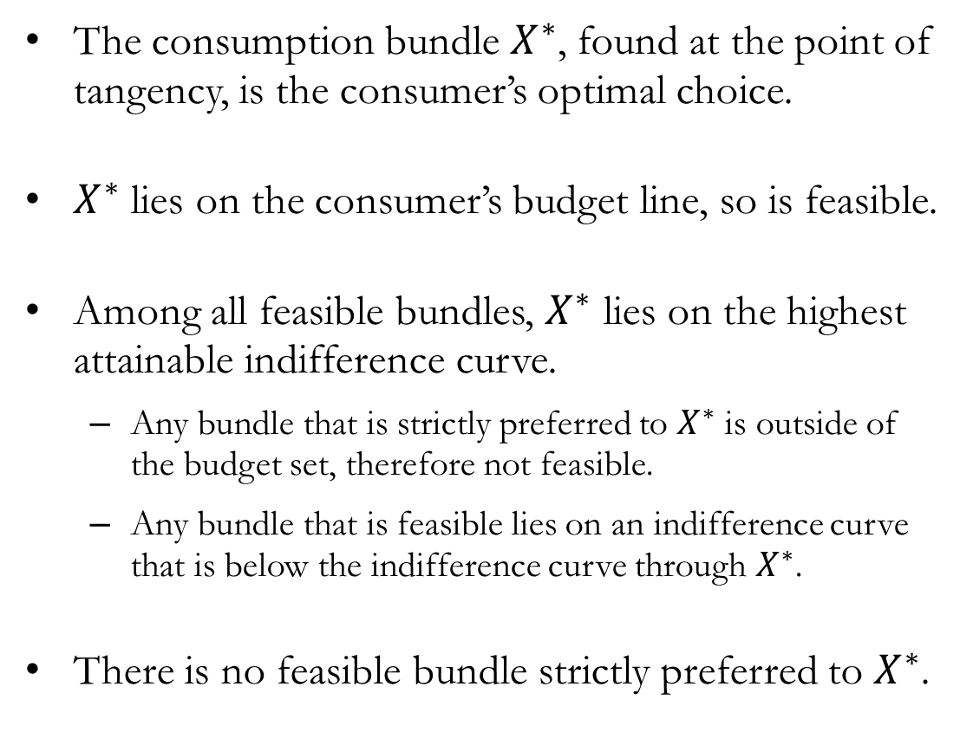
Optimal Choice
The consumption bundle $X^{∗}$, found at the point of tangency, is the consumer’s optimal choice.
$X^{∗}$ lies on the consumer’s budget line, so is feasible.
Among all feasible bundles, $X^{∗}$ lies on the highest attainable indifference curve.
  Any bundle that is strictly preferred to $X^{∗}$ is outside of the budget set, therefore not feasible.
  Any bundle that is feasible lies on an indifference curve that is below the indifference curve through $X^{∗}$.
There is no feasible bundle strictly preferred to $X^{∗}$.

Slide 16
The Marginal Rate of Substitution
and Relative Prices

Slide 17
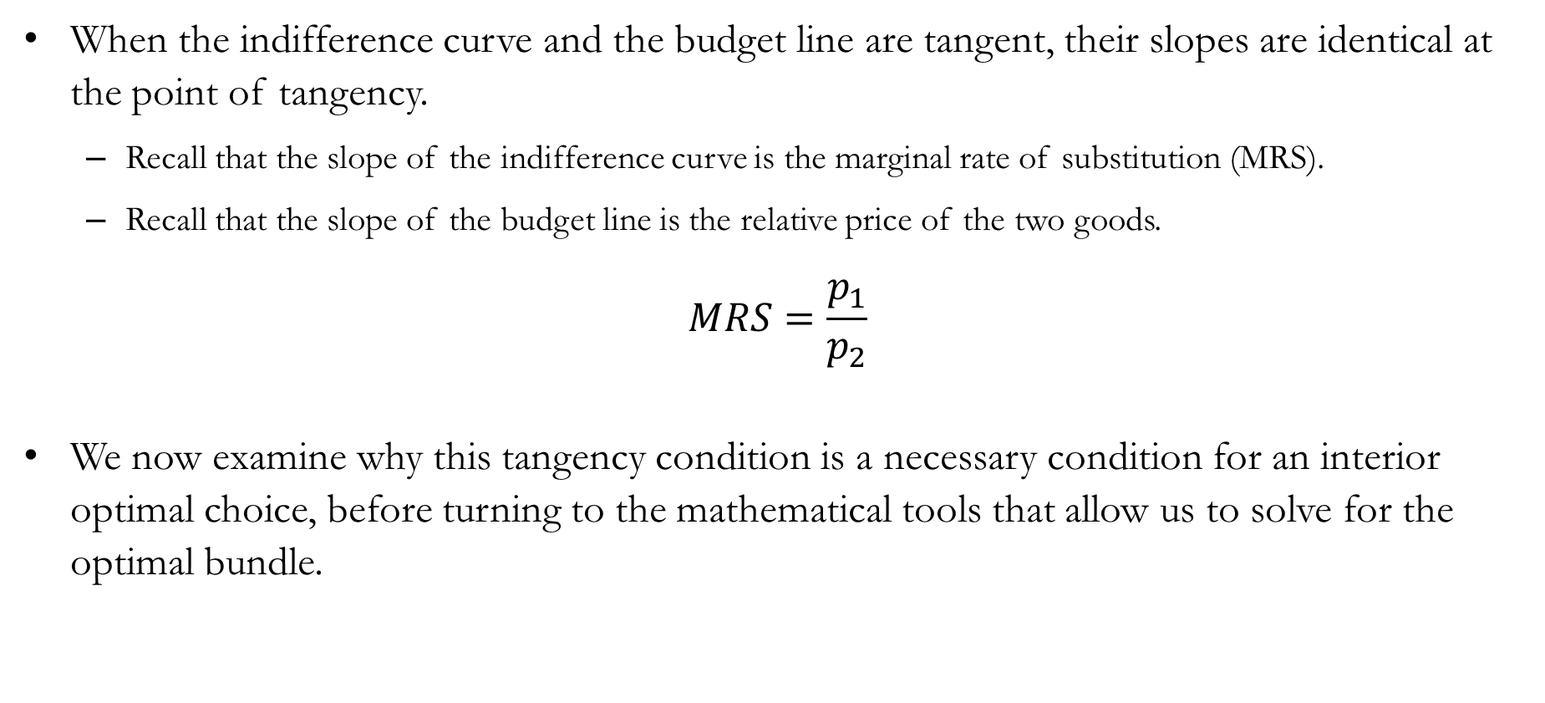
MRS and Relative Prices
When the indifference curve and the budget line are tangent, their slopes are identical at the point of tangency.
  Recall that the slope of the indifference curve is the marginal rate of substitution (MRS).
  Recall that the slope of the budget line is the relative price of the two goods.
$$MRS=\frac{p_{1}}{p_{2}}$$
We now examine why this tangency condition is a necessary condition for an interior optimal choice, before turning to the mathematical tools that allow us to solve for the optimal bundle.

Slide 18
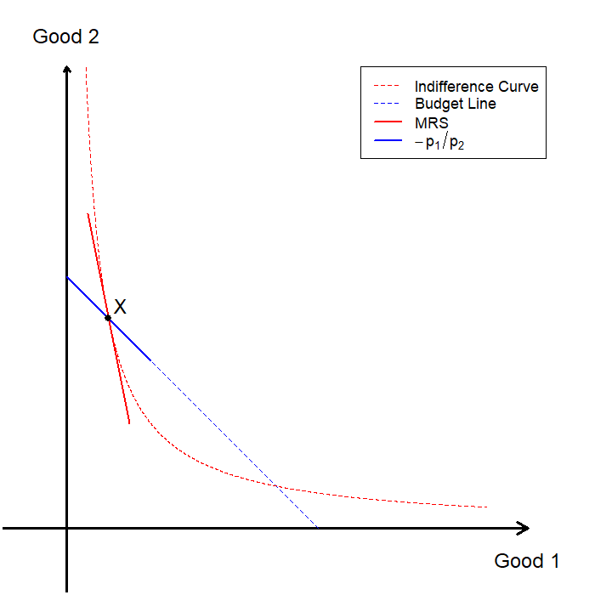
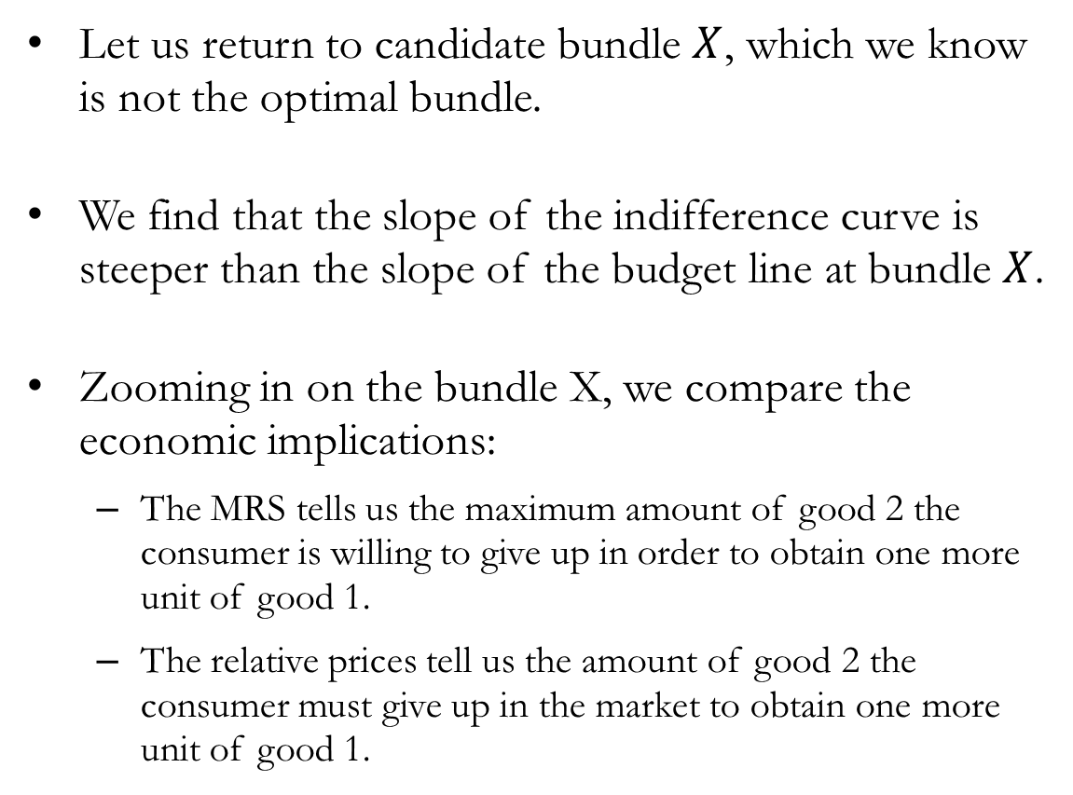
When MRS > Relative Prices
Let us return to candidate bundle $X$, which we know is not the optimal bundle.
We find that the slope of the indifference curve is steeper than the slope of the budget line at bundle $X$.
Zooming in on the bundle X, we compare the economic implications:
  The MRS tells us the maximum amount of good 2 the consumer is willing to give up in order to obtain one more unit of good 1.
  The relative prices tell us the amount of good 2 the consumer must give up in the market to obtain one more unit of good 1.

Slide 19
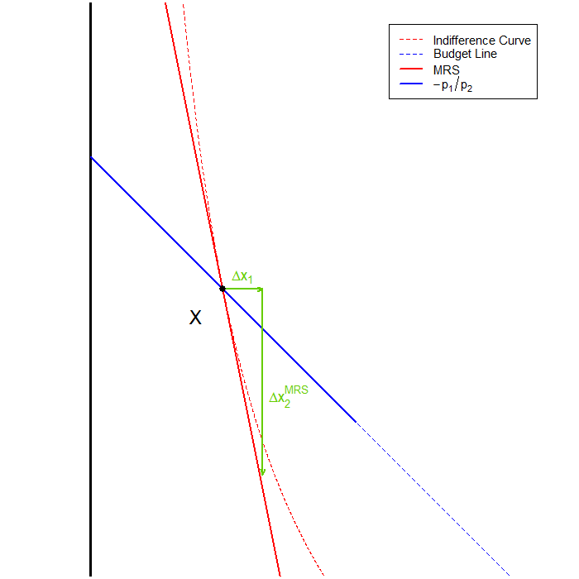
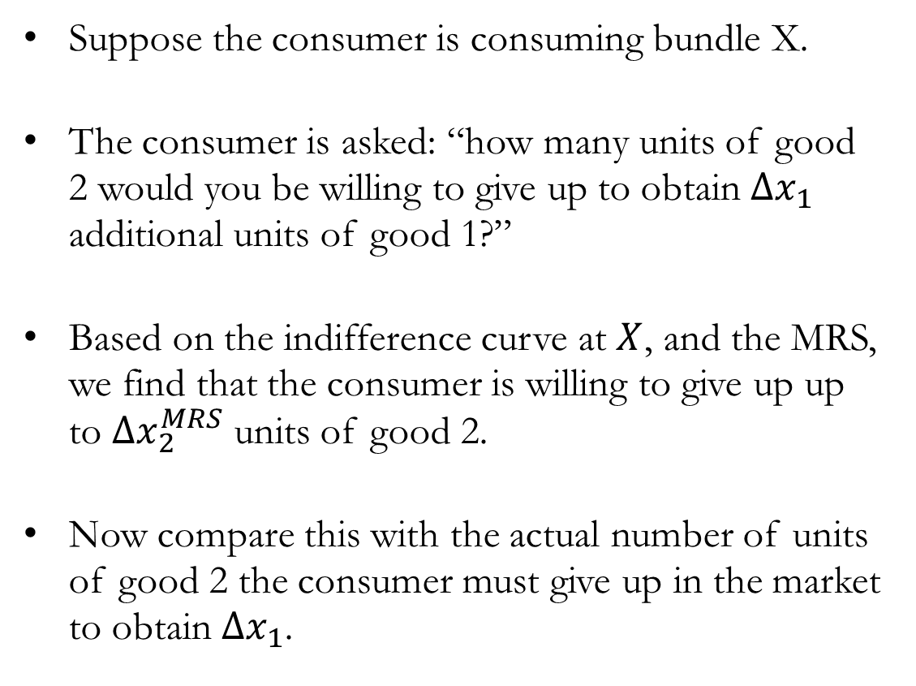
When MRS > Relative Prices
Suppose the consumer is consuming bundle X.
The consumer is asked: “how many units of good 2 would you be willing to give up to obtain $Δx_{1}$ additional units of good 1?”
Based on the indifference curve at $X$, and the MRS, we find that the consumer is willing to give up up to $Δx_{2}^{MRS}$ units of good 2.
Now compare this with the actual number of units of good 2 the consumer must give up in the market to obtain $Δx_{1}$.

Slide 20
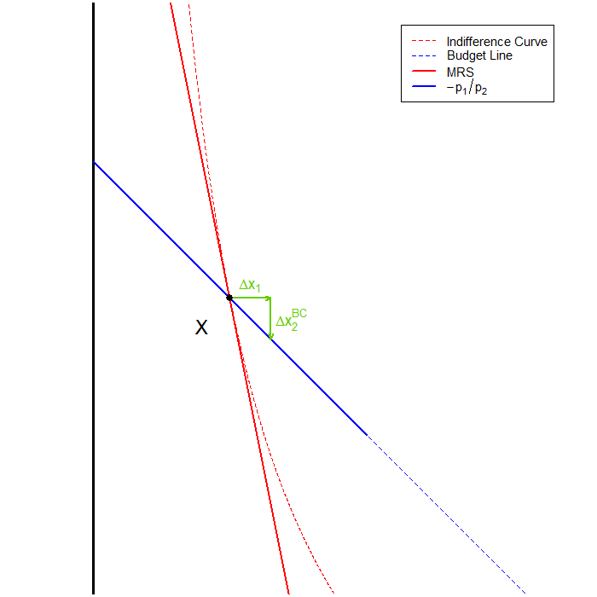
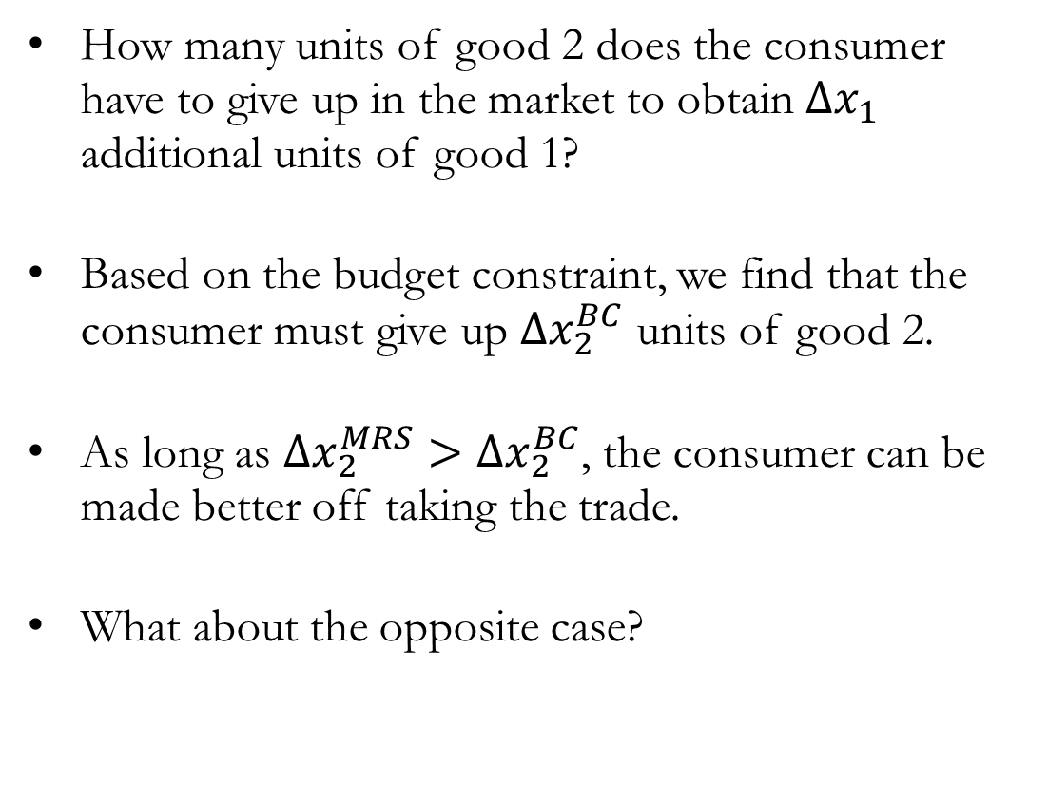
When MRS > Relative Prices
How many units of good 2 does the consumer have to give up in the market to obtain $Δx_{1}$ additional units of good 1?
Based on the budget constraint, we find that the consumer must give up $Δx_{2}^{BC}$ units of good 2.
As long as $Δx_{2}^{MRS}>Δx_{2}^{BC}$, the consumer can be made better off taking the trade.
What about the opposite case?

Slide 21
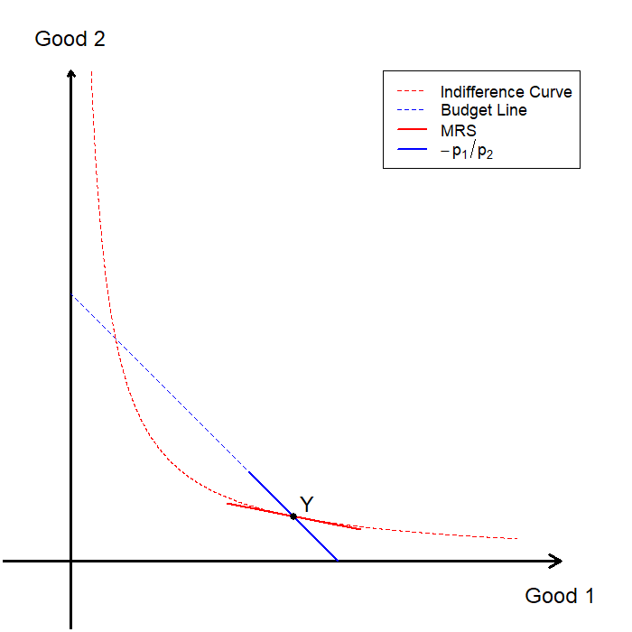
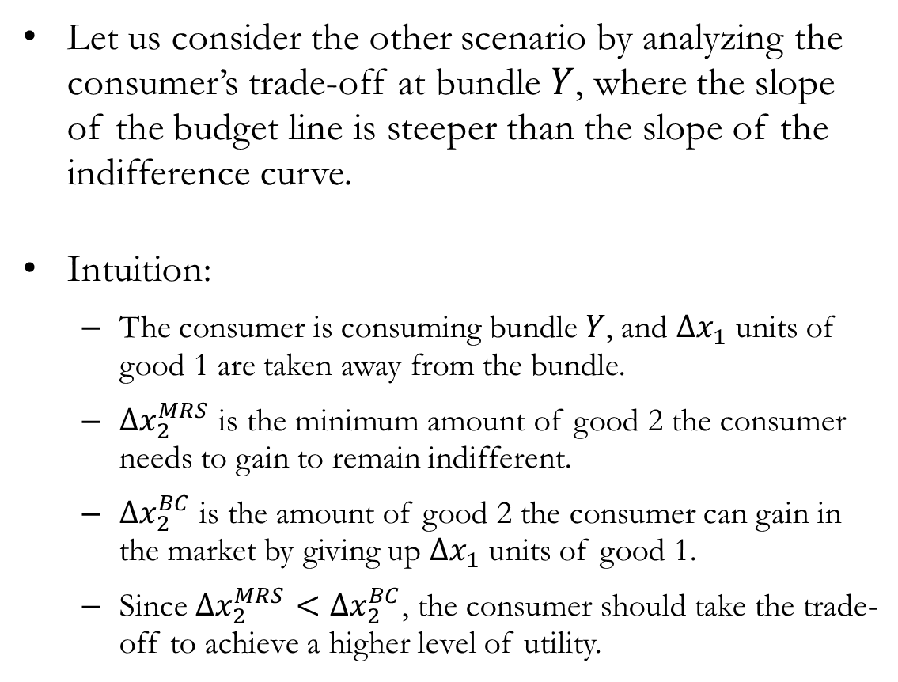
When MRS < Relative Prices
Let us consider the other scenario by analyzing the consumer’s trade-off at bundle $Y$, where the slope of the budget line is steeper than the slope of the indifference curve.
Intuition:
  The consumer is consuming bundle $Y$, and $Δx_{1}$ units of good 1 are taken away from the bundle.
  $Δx_{2}^{MRS}$ is the minimum amount of good 2 the consumer needs to gain to remain indifferent.
  $Δx_{2}^{BC}$ is the amount of good 2 the consumer can gain in the market by giving up $Δx_{1}$ units of good 1.
  Since $Δx_{2}^{MRS}<Δx_{2}^{BC}$, the consumer should take the trade-off to achieve a higher level of utility.

Slide 22
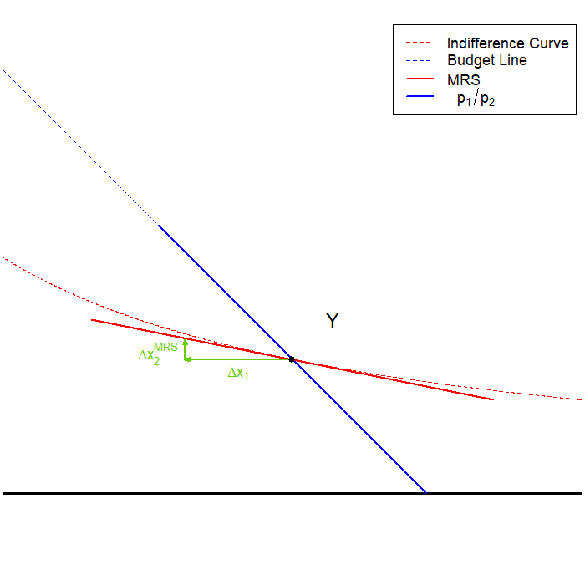
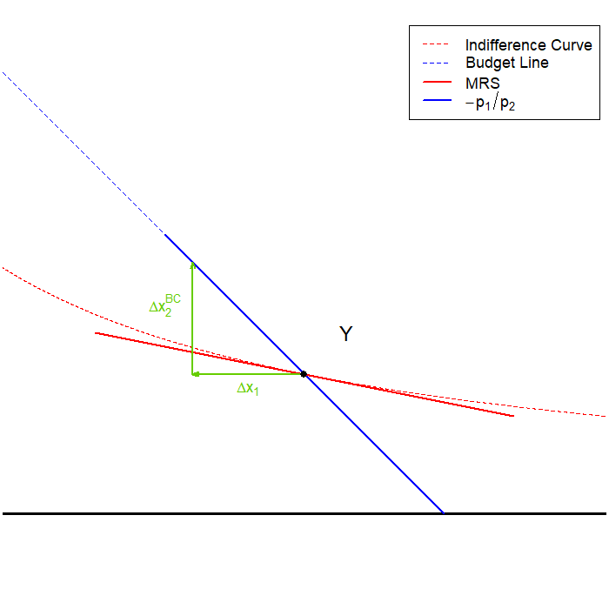
When MRS < Relative Prices
Marginal Rate of Substitution: Subjective Trade-off
Relative Prices: Market Trade-off

Slide 23
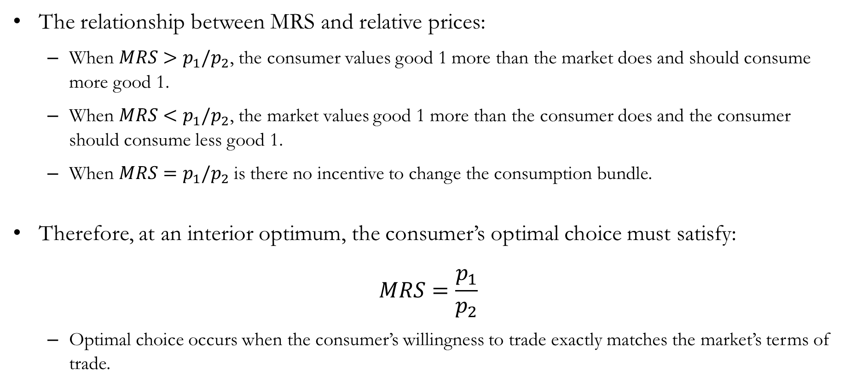
MRS and Relative Prices
The relationship between MRS and relative prices:
  When $MRS>p_{1}/p_{2}$, the consumer values good 1 more than the market does and should consume more good 1.
  When $MRS<p_{1}/p_{2}$, the market values good 1 more than the consumer does and the consumer should consume less good 1.
  When $MRS=p_{1}/p_{2}$is there no incentive to change the consumption bundle.
Therefore, at an interior optimum, the consumer’s optimal choice must satisfy:
$$MRS=\frac{p_{1}}{p_{2}}$$
  Optimal choice occurs when the consumer’s willingness to trade exactly matches the market’s terms of trade.

Slide 24
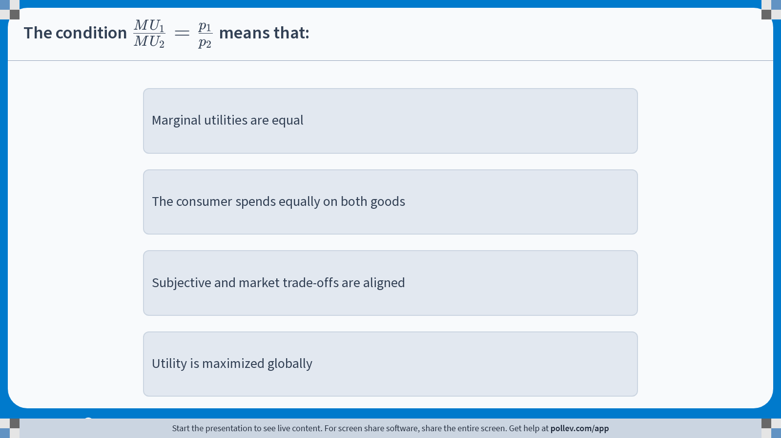
Poll Everywhere multiple choice poll instructions screen
Activity Title: The condition $$\\frac{MU_1}{MU_2}=\\frac{p_1}{p_2}$$ means that:
Slide 24
Notes:
Do not modify the notes in this section to avoid tampering with the Poll Everywhere activity.
More info at polleverywhere.com/support
The condition $$\\frac{MU_1}{MU_2}=\\frac{p_1}{p_2}$$ means that:
https://www.polleverywhere.com/multiple_choice_polls/iKhX0jSHHtFsG0YrVtXzO?display_state=instructions&activity_state=opened&state=opened&flow=Engagement&onscreen=persist

Slide 25
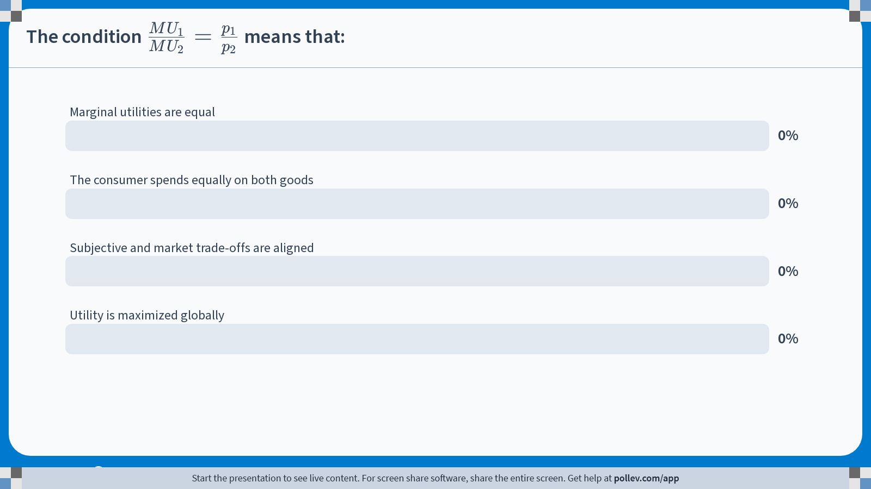
Poll Everywhere multiple choice poll chart screen
Activity Title: The condition $$\\frac{MU_1}{MU_2}=\\frac{p_1}{p_2}$$ means that:
Slide 26
Notes:
Do not modify the notes in this section to avoid tampering with the Poll Everywhere activity.
More info at polleverywhere.com/support
The condition $$\\frac{MU_1}{MU_2}=\\frac{p_1}{p_2}$$ means that:
https://www.polleverywhere.com/multiple_choice_polls/iKhX0jSHHtFsG0YrVtXzO?display_state=chart&activity_state=closed&state=closed&flow=Engagement&onscreen=persist

Slide 26
The Utility Maximization Problem

Slide 27
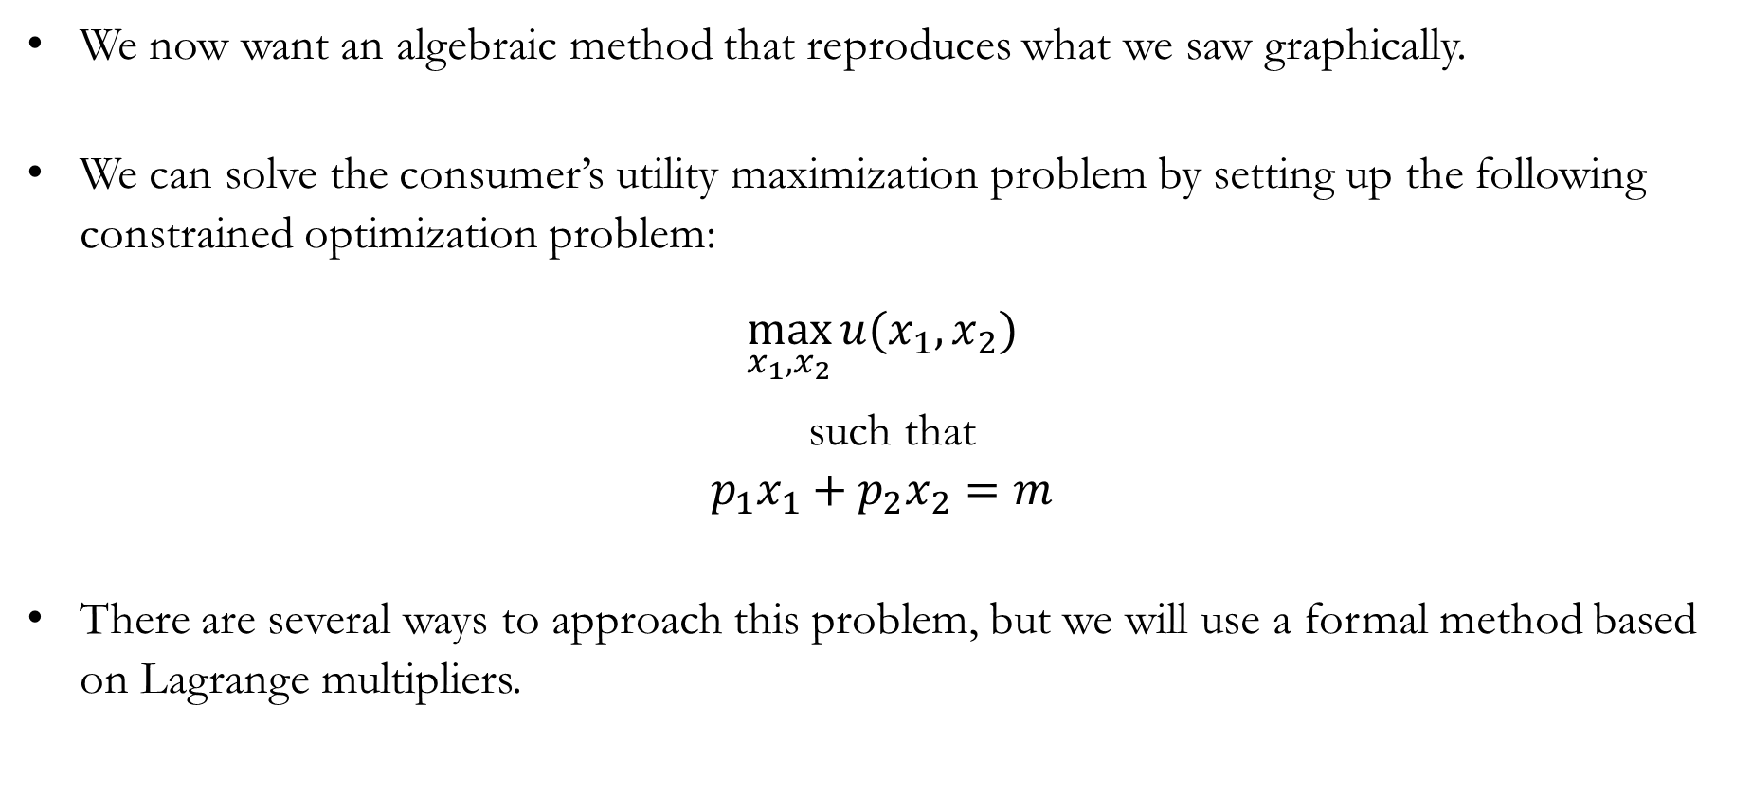
Constrained Optimization
We now want an algebraic method that reproduces what we saw graphically.
We can solve the consumer’s utility maximization problem by setting up the following constrained optimization problem:
$$\max_{x_{1},x_{2}}{u(x_{1},x_{2})}$$
such that
$$p_{1}x_{1}+p_{2}x_{2}=m$$
There are several ways to approach this problem, but we will use a formal method based on Lagrange multipliers.

Slide 28
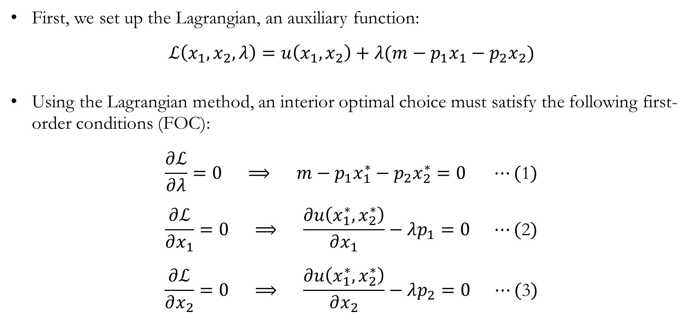
The Lagrangian: Setup & First-order Conditions
First, we set up the Lagrangian, an auxiliary function:
$$ℒ\left(x_{1},x_{2},λ\right)=u\left(x_{1},x_{2}\right)+λ(m−p_{1}x_{1}−p_{2}x_{2})$$
Using the Lagrangian method, an interior optimal choice must satisfy the following first-order conditions (FOC):
$$\frac{∂ℒ}{∂λ}=0 ⟹ m−p_{1}x_{1}^{∗}−p_{2}x_{2}^{∗}=0 ⋯(\text{1})$$
$$\frac{∂ℒ}{∂x_{1}}=0 ⟹ \frac{∂u\left(x_{1}^{∗},x_{2}^{∗}\right)}{∂x_{1}}−λp_{1}=0 ⋯(\text{2})$$
$$\frac{∂ℒ}{∂x_{2}}=0 ⟹ \frac{∂u\left(x_{1}^{∗},x_{2}^{∗}\right)}{∂x_{2}}−λp_{2}=0 ⋯(\text{3})$$

Slide 29
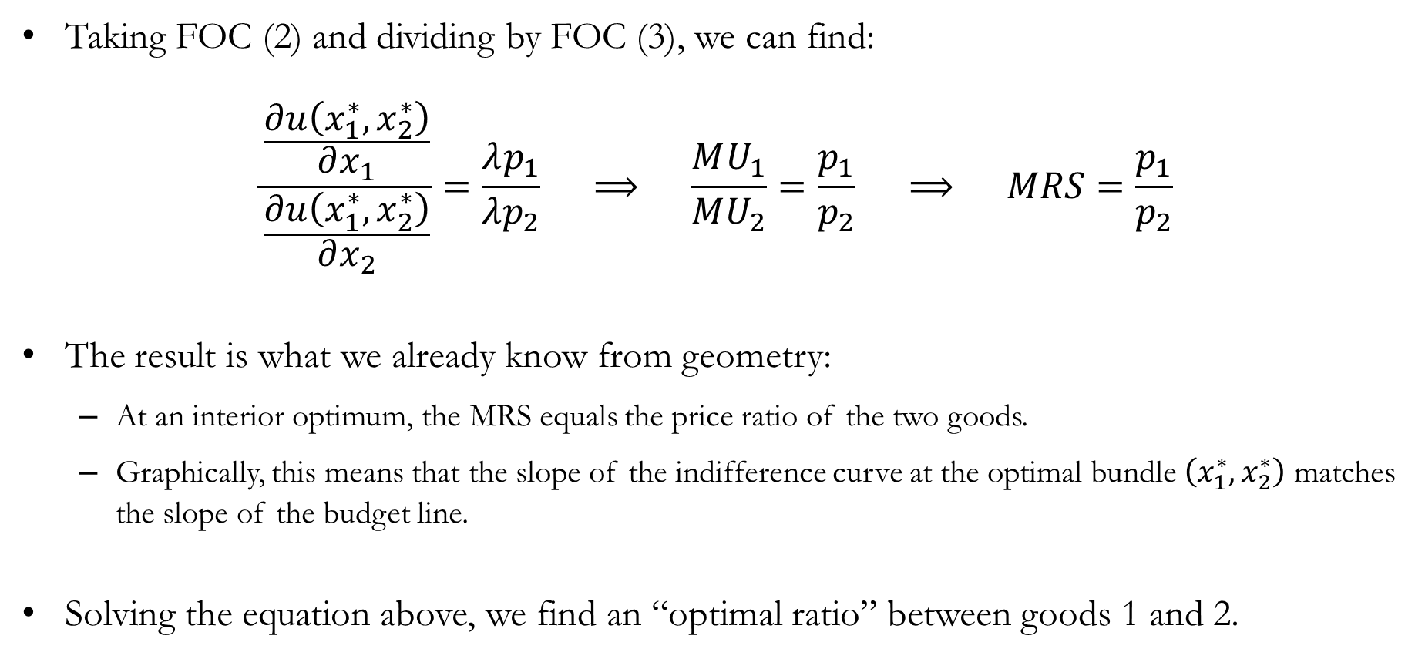
The Lagrangian: Optimal Ratio
Taking FOC (2) and dividing by FOC (3), we can find:
$$\frac{\frac{∂u\left(x_{1}^{∗},x_{2}^{∗}\right)}{∂x_{1}}}{\frac{∂u\left(x_{1}^{∗},x_{2}^{∗}\right)}{∂x_{2}}}=\frac{λp_{1}}{λp_{2}} ⟹ \frac{MU_{1}}{MU_{2}}=\frac{p_{1}}{p_{2}} ⟹ MRS=\frac{p_{1}}{p_{2}}$$
The result is what we already know from geometry:
  At an interior optimum, the MRS equals the price ratio of the two goods.
  Graphically, this means that the slope of the indifference curve at the optimal bundle $\left(x_{1}^{∗},x_{2}^{∗}\right)$ matches the slope of the budget line.
Solving the equation above, we find an “optimal ratio” between goods 1 and 2.

Slide 30
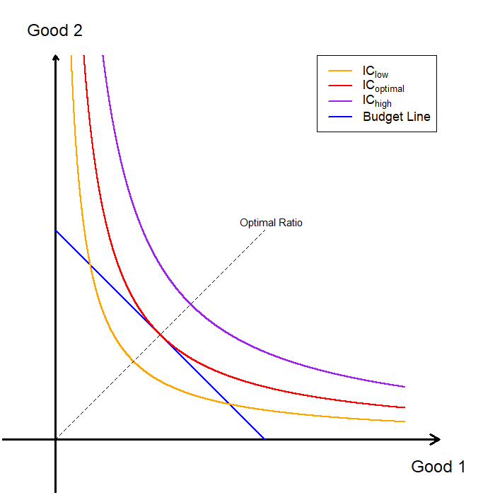

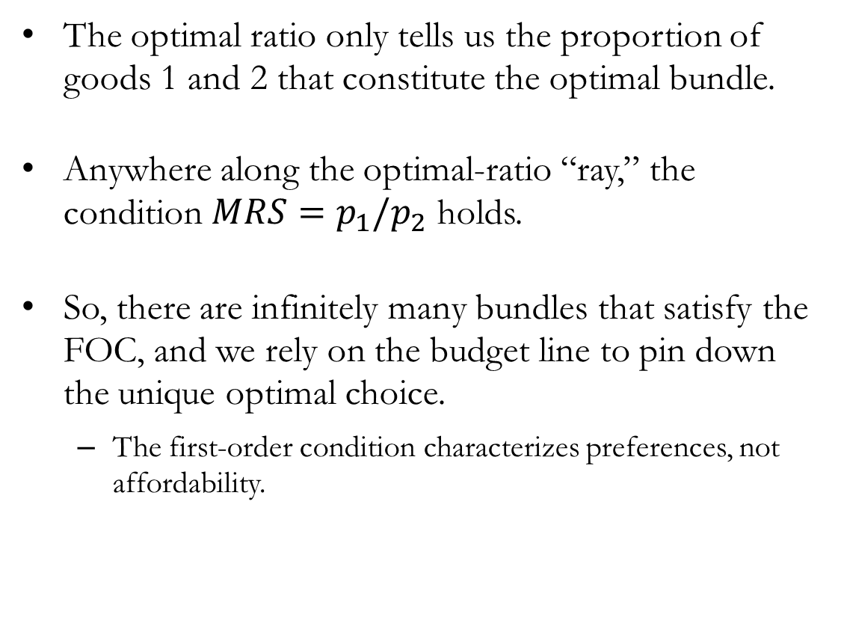
The Lagrangian: Geometry of the Optimal Ratio
The optimal ratio only tells us the proportion of goods 1 and 2 that constitute the optimal bundle.
Anywhere along the optimal-ratio “ray,” the condition $MRS=p_{1}/p_{2}$ holds.
So, there are infinitely many bundles that satisfy the FOC, and we rely on the budget line to pin down the unique optimal choice.
  The first-order condition characterizes preferences, not affordability.

Slide 31
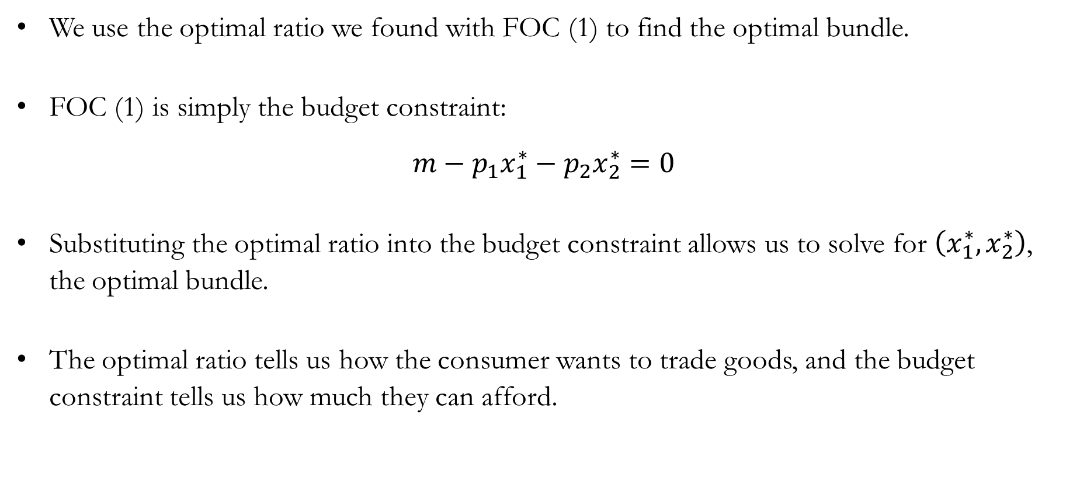
The Lagrangian: Optimal Bundle
We use the optimal ratio we found with FOC (1) to find the optimal bundle.
FOC (1) is simply the budget constraint:
$$m−p_{1}x_{1}^{∗}−p_{2}x_{2}^{∗}=0$$
Substituting the optimal ratio into the budget constraint allows us to solve for $\left(x_{1}^{∗},x_{2}^{∗}\right)$, the optimal bundle.
The optimal ratio tells us how the consumer wants to trade goods, and the budget constraint tells us how much they can afford.

Slide 32
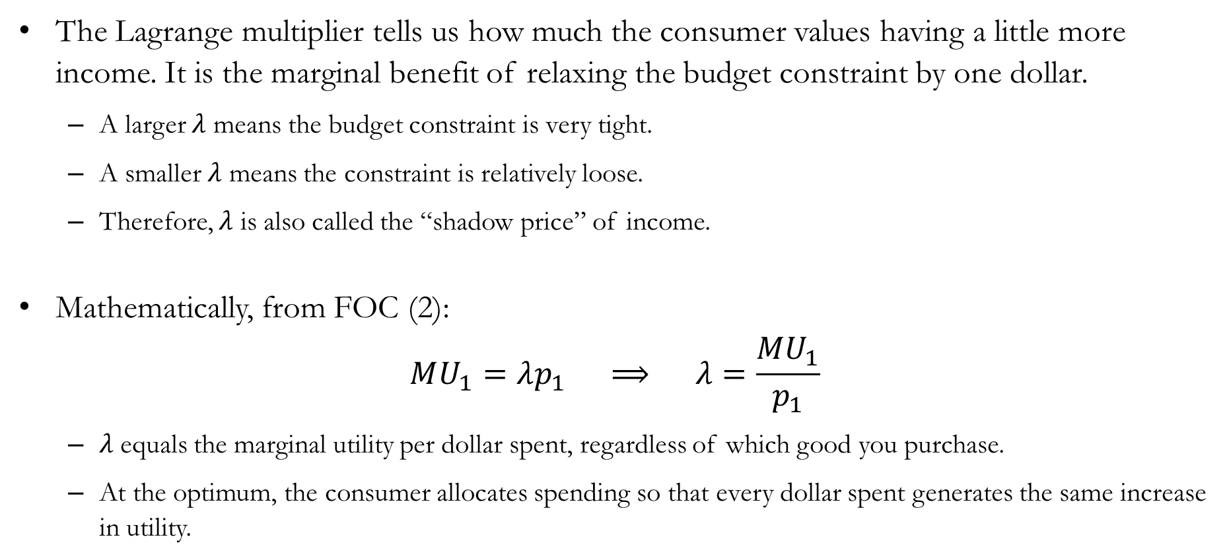
Detour: The Lagrange Multiplier
The Lagrange multiplier tells us how much the consumer values having a little more income. It is the marginal benefit of relaxing the budget constraint by one dollar.
  A larger $λ$ means the budget constraint is very tight.
  A smaller $λ$ means the constraint is relatively loose.
  Therefore, $λ$ is also called the “shadow price” of income.
Mathematically, from FOC (2):
$$MU_{1}=λp_{1} ⟹ λ=\frac{MU_{1}}{p_{1}}$$
  $λ$ equals the marginal utility per dollar spent, regardless of which good you purchase.
  At the optimum, the consumer allocates spending so that every dollar spent generates the same increase in utility.

Slide 33
Utility Maximization Problem:
An Example

Slide 34
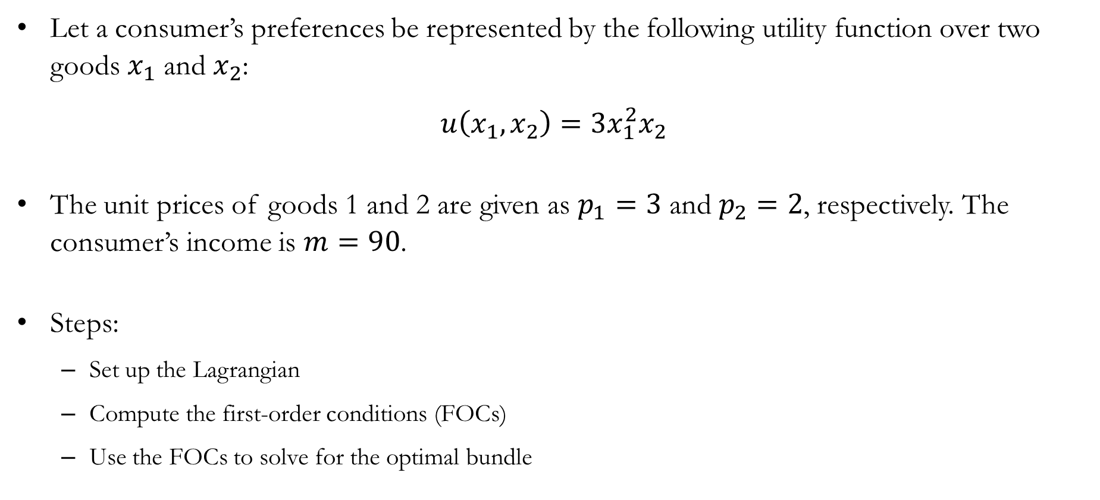
The Lagrangian: An Example
Let a consumer’s preferences be represented by the following utility function over two goods $x_{1}$ and $x_{2}$:
$$u\left(x_{1},x_{2}\right)=3x_{1}^{2}x_{2}$$
The unit prices of goods 1 and 2 are given as $p_{1}=3$ and $p_{2}=2$, respectively. The consumer’s income is $m=90$.
Steps:
  Set up the Lagrangian
  Compute the first-order conditions (FOCs)
  Use the FOCs to solve for the optimal bundle

Slide 35

The Lagrangian: An Example
The Lagrangian can be set up as:
$$ℒ\left(x_{1},x_{2},λ\right)=3x_{1}^{2}x_{2}+λ\left(90−3x_{1}−2x_{2}\right)$$
The FOCs can be found as:
$$\frac{∂ℒ}{∂λ}=0 ⟹ 90−3x_{1}^{∗}−2x_{2}^{∗}=0 ⋯(\text{1})$$
$$\frac{∂ℒ}{∂x_{1}}=0 ⟹ 6x_{1}x_{2}−3λ=0 ⋯(\text{2})$$
$$\frac{∂ℒ}{∂x_{2}}=0 ⟹ 3x_{1}^{2}−2λ=0 ⋯(\text{3})$$

Slide 36

The Lagrangian: An Example
Take the ratio between FOCs (2) and (3):
$$\frac{6x_{1}^{∗}x_{2}^{∗}}{3{\left(x_{1}^{∗}\right)}^{2}}=\frac{3}{2} ⟹ 4x_{2}^{∗}=3x_{1}^{∗} ⟹ x_{2}^{∗}=\frac{3}{4}x_{1}^{∗}$$
Combine with FOC (1) to find the optimal quantity of good 1:
$$90−3x_{1}^{∗}−2x_{2}^{∗}=0 ⟹ 90−3x_{1}^{∗}−2\left(\frac{3}{4}x_{1}^{∗}\right)=0$$
$⟹ 90−3x_{1}^{∗}−\frac{3}{2}x_{1}^{∗}=0$
$⟹ 90=\frac{9}{2}x_{1}^{∗}$
$⟹ x_{1}^{∗}=20$

Slide 37

The Lagrangian: An Example
Plug the result $x_{1}^{∗}=20$ back into the optimal ratio:
$$x_{2}^{∗}=\frac{3}{4}x_{1}^{∗} ⟹ x_{2}^{∗}=\frac{3}{4}⋅20 ⟹ x_{2}^{∗}=15$$
The optimal bundle is $\left(x_{1}^{∗},x_{2}^{∗}\right)=(20,15)$.
Notice that the consumer spends all income:
$$p_{1}x_{1}^{∗}+p_{2}x_{2}^{∗}=3⋅20+2⋅15=60+30=90=m$$

Slide 38
Optimal Choice:
Special Cases

Slide 39
Interior vs. Boundary Optimum
An interior optimum is an optimal choice where the consumer chooses positive amounts of all goods, and the solution occurs inside the feasible set rather than at its edge.
  An interior optimum is an optimal bundle found where the indifference curve is tangent to the budget constraint.
  For standard, smooth preferences (such as Cobb–Douglas preferences), the optimal solution is typically an interior solution.
A boundary optimum (or corner solution ) is an optimal choice where the consumer spends all income on one good and consumes zero of at least one other good.
  The usual tangency condition does not apply, even though the solution is still optimal.
  Boundary optima commonly arise with preferences such as perfect substitutes, where indifference curves are linear.

Slide 40
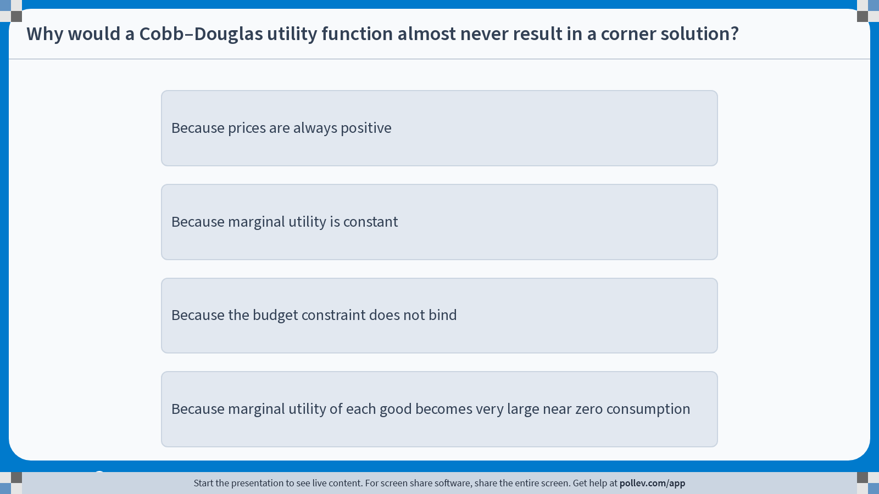
Poll Everywhere multiple choice poll instructions screen
Activity Title: Why would a Cobb–Douglas utility function almost never result in a corner solution?
Slide 38
Notes:
Do not modify the notes in this section to avoid tampering with the Poll Everywhere activity.
More info at polleverywhere.com/support
Why would a Cobb–Douglas utility function almost never result in a corner solution?
https://www.polleverywhere.com/multiple_choice_polls/VetIgNfLb2xoprEGasGeX?display_state=instructions&activity_state=opened&state=opened&flow=Engagement&onscreen=persist

Slide 41
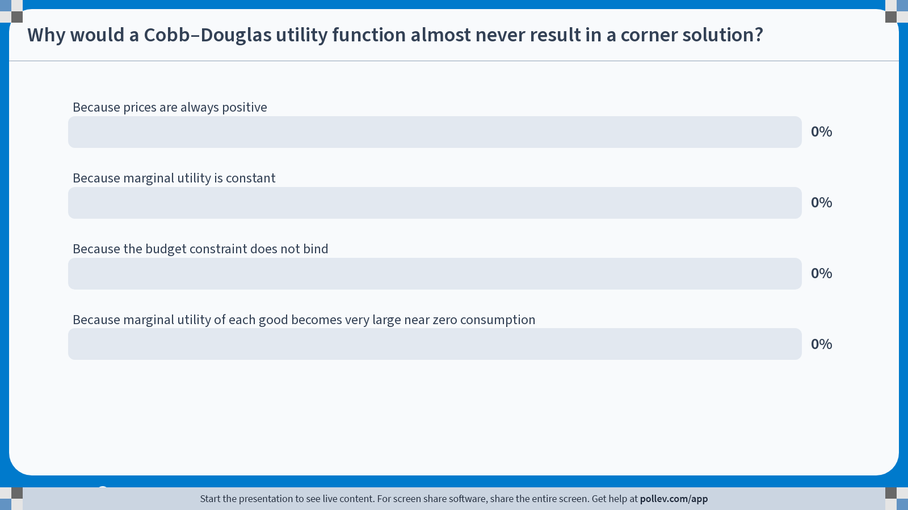
Poll Everywhere multiple choice poll chart screen
Activity Title: Why would a Cobb–Douglas utility function almost never result in a corner solution?
Slide 40
Notes:
Do not modify the notes in this section to avoid tampering with the Poll Everywhere activity.
More info at polleverywhere.com/support
Why would a Cobb–Douglas utility function almost never result in a corner solution?
https://www.polleverywhere.com/multiple_choice_polls/VetIgNfLb2xoprEGasGeX?display_state=chart&activity_state=closed&state=closed&flow=Engagement&onscreen=persist

Slide 42
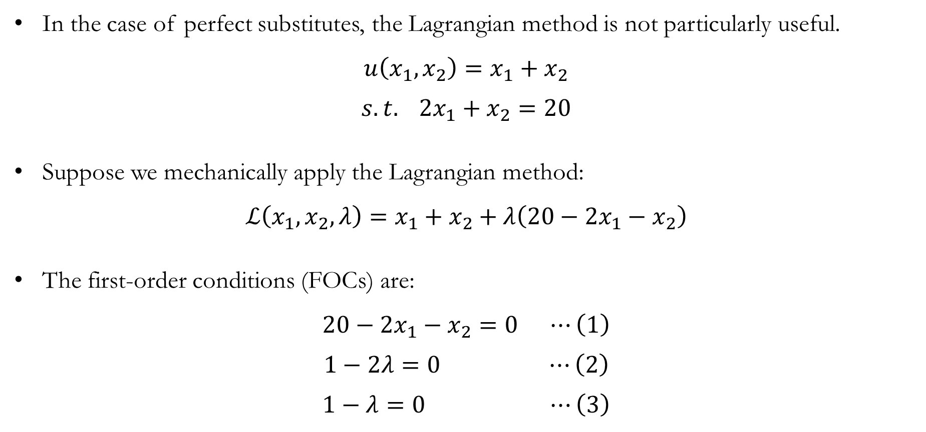
Perfect Substitutes: The Lagrangian?
In the case of perfect substitutes, the Lagrangian method is not particularly useful.
$$u\left(x_{1},x_{2}\right)=x_{1}+x_{2}$$
$$s.t. 2x_{1}+x_{2}=20$$
Suppose we mechanically apply the Lagrangian method:
$$ℒ\left(x_{1},x_{2},λ\right)=x_{1}+x_{2}+λ\left(20−2x_{1}−x_{2}\right)$$
The first-order conditions (FOCs) are:
$$20−2x_{1}−x_{2}=0 ⋯\left(1\right)$$
$$1−2λ=0 ⋯\left(2\right)$$
$$1−λ=0 ⋯\left(3\right)$$

Slide 43
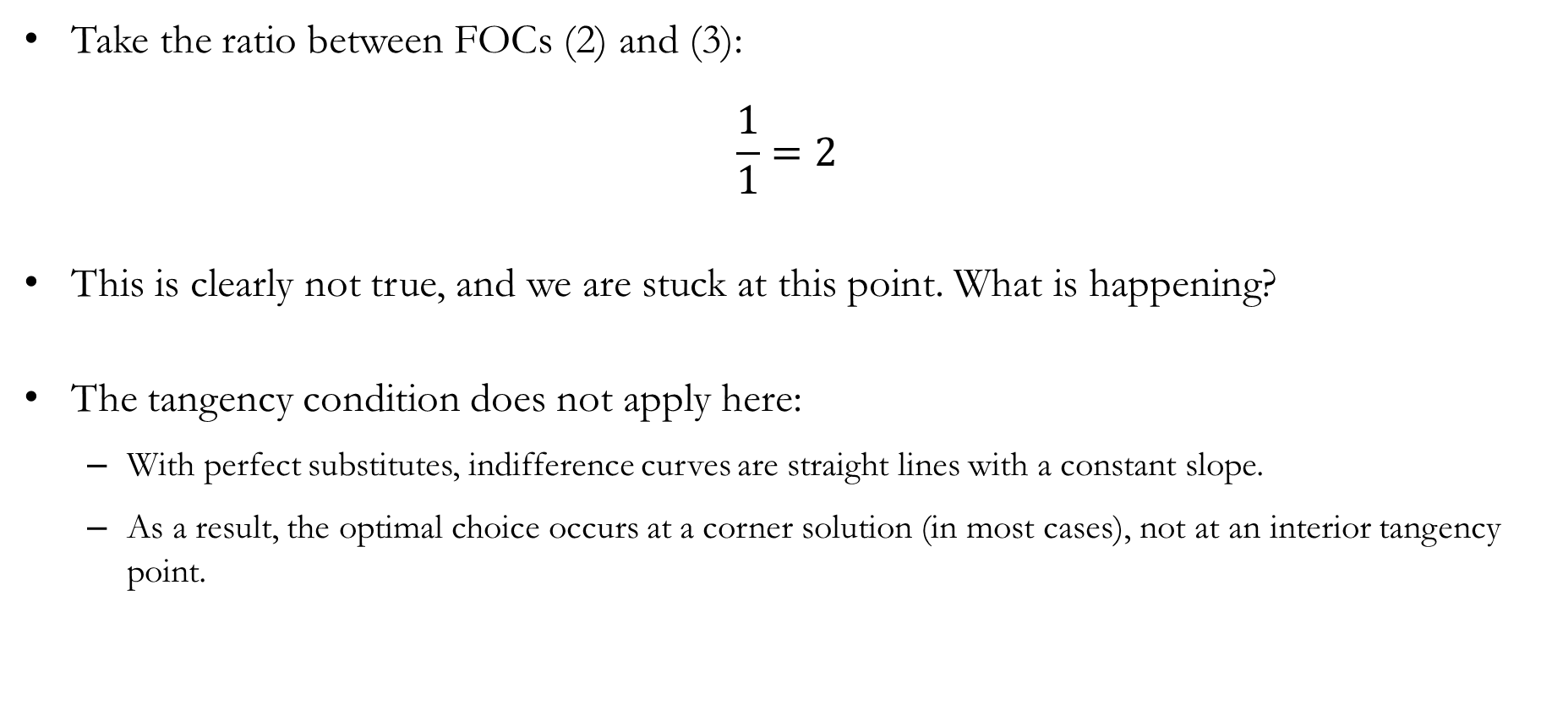
Perfect Substitutes: The Lagrangian?
Take the ratio between FOCs (2) and (3):
$$\frac{1}{1}=2$$
This is clearly not true, and we are stuck at this point. What is happening?
The tangency condition does not apply here:
  With perfect substitutes, indifference curves are straight lines with a constant slope.
  As a result, the optimal choice occurs at a corner solution (in most cases), not at an interior tangency point.

Slide 44






Perfect Substitutes: Visualized
Graphically, we can see why we rarely find an interior optimum for perfect substitutes.
  Suppose that some bundle $X$ is an interior optimum for the consumer.
  Consider the indifference curve that passes through $X$.
  We can find bundles that the consumer prefers to $X$, which are also in the budget set.
  In particular, the consumer can choose a bundle $Y$ that is both feasible and strictly preferred to $X$.
  Moving along the budget line in this way, the consumer eventually reaches a corner solution, where all income is spent on good 2.

Slide 45

Perfect Substitutes: Finding the Optimal Bundle
Although we cannot directly apply the tangency condition, we can use a closely related idea to determine the consumer’s optimal choice.
$$\frac{MU_{1}}{MU_{2}}=\frac{p_{1}}{p_{2}} ⟺ \frac{MU_{1}}{p_{1}}=\frac{MU_{2}}{p_{2}}$$
This formulation tells us that the marginal utility per dollar spent should be compared across goods.
  If $\frac{MU_{1}}{p_{1}}>\frac{MU_{2}}{p_{2}}$, the consumer can increase utility by shifting spending toward good 1.
  If $\frac{MU_{1}}{p_{1}}<\frac{MU_{2}}{p_{2}}$, the consumer can increase utility by shifting spending toward good 2.
  If $\frac{MU_{1}}{p_{1}}=\frac{MU_{2}}{p_{2}}$, the consumer is indifferent between reallocating spending across goods.

Slide 46

Perfect Substitutes: An Example
We return to the original example we started with:
$$\max_{x_{1},x_{2}}{u\left(x_{1},x_{2}\right)=x_{1}+x_{2}}$$
$$s.t. 2x_{1}+x_{2}=20$$
Finding the marginal utility per dollar spent:
$$\frac{MU_{1}}{p_{1}}=\frac{1}{2}<\frac{1}{1}=\frac{MU_{2}}{p_{2}}$$
The consumer should exclusively purchase good 2, resulting in a corner solution, since it provides a higher level of utility per dollar spent.
$$\left(x_{1}^{∗},x_{2}^{∗}\right)=\left(0,20\right)$$

Slide 47


Perfect Substitutes: When $MU_{1}/p_{1}=MU_{2}/p_{2}$
In some rare cases, perfect substitutes satisfy $MU_{1}/p_{1}=MU_{2}/p_{2}$.
Graphically, the slope of the budget line and the slope of the indifference curves are identical at every point.
In this case, any bundle that exhausts the consumer’s income can be an optimal choice, since all such bundles deliver the same level of utility.
What about perfect complements?

Slide 48

Perfect Complements: The Lagrangian?
Consider the case of perfect complements:
$$\max_{x_{1},x_{2}} u\left(x_{1},x_{2}\right)=min⁡\{x_{1},x_{2}\}$$
$$s.t. 2x_{1}+x_{2}=20$$
Why the standard Lagrangian approach breaks down:
  The utility function is not differentiable at the kink, so marginal utilities are not well defined at the kink.
  As a result, the usual first-order conditions do not characterize the optimum.
This also rules out our “marginal utility per dollar” comparison.
For perfect complements, the optimal choice is determined by the geometry of preferences and the budget constraint, not by marginal conditions.

Slide 49



Perfect Complements: The Geometry
When it comes to perfect complements, we can directly find the optimal proportion of goods 1 and 2, without relying on marginal utilities.
For a utility function over perfect complements:
$$u\left(x_{1},x_{2}\right)=min⁡\{c_{1}x_{1},c_{2}x_{2}\}$$
The optimal mix, which pins down the proportion in which the goods are consumed, is characterized by:
$$c_{1}x_{1}^{∗}=c_{2}x_{2}^{∗}$$

Slide 50

Poll Everywhere multiple choice poll instructions screen
Activity Title: For $$u(x_1,x_2)=min\\{x_1,x_2\\}$$, why must $$x_1=x_2$$ at the optimum?
Slide 50
Notes:
Do not modify the notes in this section to avoid tampering with the Poll Everywhere activity.
More info at polleverywhere.com/support
For $$u(x_1,x_2)=min\\{x_1,x_2\\}$$, why must $$x_1=x_2$$ at the optimum?
https://www.polleverywhere.com/multiple_choice_polls/Q1twEKURfZJoaGVS7JL6a?display_state=instructions&activity_state=opened&state=opened&flow=Engagement&onscreen=persist

Slide 51

Poll Everywhere multiple choice poll chart screen
Activity Title: For $$u(x_1,x_2)=min\\{x_1,x_2\\}$$, why must $$x_1=x_2$$ at the optimum?
Slide 52
Notes:
Do not modify the notes in this section to avoid tampering with the Poll Everywhere activity.
More info at polleverywhere.com/support
For $$u(x_1,x_2)=min\\{x_1,x_2\\}$$, why must $$x_1=x_2$$ at the optimum?
https://www.polleverywhere.com/multiple_choice_polls/Q1twEKURfZJoaGVS7JL6a?display_state=chart&activity_state=closed&state=closed&flow=Engagement&onscreen=persist

Slide 52

Perfect Complements: Why $c_{1}x_{1}^{∗}=c_{2}x_{2}^{∗}$?
Consider the alternate scenarios:
  If $c_{1}x_{1}>c_{2}x_{2}$, there are some units of good 1 that are not increasing the consumer’s utility.
  If $c_{1}x_{1}<c_{2}x_{2}$, there are some units of good 2 that are not increasing to the consumer’s utility.
  In either case, the consumer could reallocate spending toward the other good and increase utility.
So, we can use $c_{1}x_{1}^{∗}=c_{2}x_{2}^{∗}$ alongside the budget constraint to pin down the optimal bundle.

Slide 53

Perfect Complements: An Example
Let’s examine a numerical example:
$$\max_{x_{1},x_{2}} u\left(x_{1},x_{2}\right)=\min\left\{{3x}_{1},x_{2}\right\} s.t. 2x_{1}+x_{2}=20$$
The optimal ratio in which goods 1 and 2 should be consumed is given by:
$${3x}_{1}^{∗}=x_{2}^{∗}$$
Substitute this optimal ratio into the budget constraint to find the optimal bundle:
$$2x_{1}^{∗}+x_{2}^{∗}=20 ⟹ 2x_{1}^{∗}+\left(3x_{1}^{∗}\right)=20 ⟹ x_{1}^{∗}=4$$
Therefore, the consumer’s optimal bundle is:
$$\left(x_{1}^{∗},x_{2}^{∗}\right)=\left(4,12\right)$$

Slide 54
The Utility Maximization Problem:
Extension and Advanced Topics

Slide 55
Extension and Advanced Topics in UMP
Utility maximization with more than two goods.
  Extending the logic we have developed, we can solve utility maximization problems involving more than two goods or services.
Concavity of the utility function and second-order conditions (SOC).
  So far, we have implicitly assumed that the first-order conditions identify a local maximum.
  Strictly speaking, the first-order conditions identify all local extrema, including local minima.
  Formally, we use second-order (sufficient) conditions to verify that a solution is a local maximum.
Non-negativity constraints and the Karush-Kuhn-Tucker (KKT) conditions.
  So far, we have not explicitly imposed the requirement that consumption quantities must be non-negative.
  To incorporate non-negativity constraints, we can apply the Karush-Kuhn-Tucker (KKT) conditions.

Slide 56

Extension: UMP with Three Goods
Consider a consumer choosing among three goods, who must find the optimal bundle $\left(x_{1}^{∗},x_{2}^{∗},x_{3}^{∗}\right)$.
The logic remains that the consumer’s subjective trade-offs must balance the market’s objective trade-offs:
$$\frac{MU_{1}}{p_{1}}=\frac{MU_{2}}{p_{2}}=\frac{MU_{3}}{p_{3}}$$
Once we have the optimal ratio across goods, we can use the budget constraint to pin down the unique optimal bundle.
$$p_{1}x_{1}+p_{2}x_{2}+p_{3}x_{3}=m$$

Slide 57

Extension: UMP with Three Goods
Suppose a consumer has income $m=60$ and faces three goods with prices $p_{1}=2$, $p_{2}=3$, and $p_{3}=1$, respectively.
$$2x_{1}+3x_{2}+x_{3}=60$$
The consumer’s utility function can be expressed as:
$$u\left(x_{1},x_{2},x_{3}\right)=x_{1}x_{2}x_{3}$$
The FOCs give us:
$$\frac{MU_{1}}{p_{1}}=\frac{MU_{2}}{p_{2}}=\frac{MU_{3}}{p_{3}} ⟹ \frac{x_{2}x_{3}}{2}=\frac{x_{1}x_{3}}{3}=\frac{x_{1}x_{2}}{1}$$

Slide 58

Extension: UMP with Three Goods
From the FOCs, we find that $2x_{1}=3x_{2}=x_{3}$ characterize the optimal ratio.
  $2x_{1}x_{3}=3x_{2}x_{3} ⟹ 2x_{1}=3x_{2}$
  $3x_{1}x_{2}=x_{1}x_{3} ⟹ 3x_{2}=x_{3}$
Plugging the FOCs into the budget constraint, we have:
$$2x_{1}+3x_{2}+x_{3}=60 ⟹ 2x_{1}+\left(2x_{1}\right)+\left(2x_{1}\right)=60 ∵2x_{1}=3x_{2}=x_{3}$$
$⟹ x_{1}=10$
We then recover the remaining optimal quantities using the FOCs.
$$\left(x_{1}^{∗},x_{2}^{∗},x_{3}^{∗}\right)=\left(10,\frac{20}{3},20\right)$$

Slide 59

Advanced: Second-order (Sufficient) Conditions
To be exact, we do need to verify that the bundle we find is indeed a local maximum.
  For instance, we may instead be finding a local minimum if the indifference curves look like those shown on the left.
There are two ways we can handle this problem:
  The formal way is to derive the bordered Hessian of the utility maximization problem.
  We take the informal approach instead, and assume that preferences are strictly convex (with a convex budget set), which guarantees a unique local maximum.

Slide 60

Advanced: Non-negativity Constraints
• Technically, the consumer’s utility maximization problem can be written as:
$$\max_{x_{1},x_{2}}{u\left(x_{1},x_{2}\right)}$$
$$s.t. p_{1}x_{1}+p_{2}x_{2}≤m$$
$x_{1}≥0, x_{2}≥0$
To analyze optimization problems with inequality constraints, we must use the Karush-Kuhn-Tucker (KKT) conditions.
The details of this method are beyond the scope of this course.

Slide 61
Recap & Preview

Slide 62

Recap: Choice
A consumer’s choice problem consists of:
  A utility function: $u(x_{1},x_{2})$
  A budget constraint: $p_{1}x_{1}+p_{2}x_{2}=m$
The consumer chooses the feasible bundle that maximizes utility.
The budget constraint represents the set of bundles the consumer can afford.
  Bundles on the budget line exhaust income.
  Bundles below the budget line are affordable but not chosen at an optimum.

Slide 63

Recap: Choice
The Marginal Rate of Substitution (MRS) describes the consumer’s local trade-off.
  The MRS is the slope of the indifference curve at a bundle.
  It represents how much of good 2 the consumer is willing to give up for more of good 1.
At an interior optimum, the necessary condition for optimal choice is $MRS=\frac{p_{1}}{p_{2}}$.
When this condition does not hold:
  If $MRS=\frac{p_{1}}{p_{2}}$, the consumer wants more good 1.
  If $MRS=\frac{p_{1}}{p_{2}}$, the consumer wants less good 1.
Corner solutions arise naturally when the MRS does not cross the relative price.

Slide 64
Preview: Demand
Next chapter, we ask how choice responds to changes in the economic environment.
We focus on two central questions:
  How does a consumer’s optimal choice change when prices change?
  How does a consumer’s optimal choice change when income changes?
Using the tools from the choice problem, we will:
  Derive the consumer’s demand functions.
  Study how demand reflects preferences, prices, and income.
This allows us to connect individual optimization to observable demand behavior in markets.

