Slide 1
Overview
ECON 301

Slide 2

https://pollev.com/brianpark046

Slide 3
Brief History of Macroeconomics
Classical School of Economics
  Adam Smith, David Ricardo, Alfred Marshall
  “Supply-side” economics.
  Unwavering belief in the market mechanisms.
  Proponents of Free Trade.
  Assumes a natural, rapid market adjustment in prices, wages, and interest rates to keep the market in equilibrium.
  Advocates for a minimal role of governments.
  The Great Depression in the 1930s proved that there are situations where the market may not naturally return to an equilibrium.

Slide 4
Brief History of Macroeconomics
Keynesian School of Economics
  John M. Keynes
  The General Theory of Employment, Interest and Money (1936)
  Wages and prices are often “sticky,” and resist adjustments.
  Emphasis on the Demand-side of the economy.
  Long lasting recessions will cause lower employment, which leads to lower aggregate demand, which lengthens recessions.
  Government’s fiscal policies can stimulate the market to fill the gap in the short run and lift the economy out of the recession.
  FDR’s New Deal
  In the 1970s, “Stagflation,” a recession with high inflation, happened.

Slide 5
Brief History of Macroeconomics
Monetary School of Economics
  Milton Friedman
  Expansionary fiscal policy to stimulate demand will cause inflationary pressure, which weakens the economy.
  “Inflationary Gap”
  Instead of fiscal policy, regulators should rely on monetary policy to control inflation (not unemployment).
New Classical School of Economics
  Robert Lucas, Thomas Sargent
  “Rational Expectations”
  In aggregate, the rational expectations of individuals will offset any government interventions.

Slide 6
Three Central Themes of Macroeconomics
Macroeconomics is the study of the economy as a whole.
Three main topics that typically occupy the center of interest in the field of Macroeconomics is…
  Aggregate Output
  Unemployment
  Inflation
How do economies grow over time?
How can we keep unemployment at a reasonable level?
How can we keep prices stable?

Slide 7
Aggregate Output
How do we measure aggregate output (national product / income) of an economy?
Before WW2, we relied on limited sample surveys such as sales in some grocery stores, to estimate the aggregate output.
Owing to the work of Simon Kuznets and Richard Stone, we now have standardized measures of national income.
One of the most widely used measure of aggregate output is Gross Domestic Product (GDP).

Slide 8
Gross Domestic Product
The market value of the final goods
and services produced in the economy
during a given period.
Notes:
Underground: Pay in cash for a cheaper rate? Illegal drug sales (1% of US GDP)? Anywhere between 10% ~ 50% of GDP is estimated to be underground.
Home Production: Childcare, Homeschooling, Food Preparation, Household Maintenance.
Externalities: Coal powered electrical plant generating energy, Energy is counted, Social cost of pollution not counted.

Slide 9
Gross Domestic Product
The market value of the final goods and services produced in the economy during a given period.
Only goods traded in the market will be counted in GDP.
Value of the underground economy is excluded.
Value of home production is excluded.
Value of externalities is excluded.
Notes:
Underground: Pay in cash for a cheaper rate? Illegal drug sales (1% of US GDP)? Anywhere between 10% ~ 50% of GDP is estimated to be underground.
Home Production: Childcare, Homeschooling, Food Preparation, Household Maintenance.
Externalities: Coal powered electrical plant generating energy, Energy is counted, Social cost of pollution not counted.

Slide 10
Gross Domestic Product
The market value of the final goods and services produced in the economy during a given period.
The value of intermediate goods is not counted in GDP.
Intermediate goods are goods used as a factor when producing other goods. (e.g. Steel used to produce cars)
Coffee beans when sold to cafes are intermediate goods, but when sold directly to consumers are final goods.

Slide 11
Gross Domestic Product
The market value of the final goods and services produced in the economy during a given period.
“Produced” implies that GDP counts goods and services are newly produced.
Simple transactions where goods change hands with no new production is omitted from GDP.
Transfer payments such as subsidies and aid is omitted from GDP.

Slide 12
Gross Domestic Product
The market value of the final goods and services produced in the economy during a given period.
“In the economy” implies that GDP counts goods and services produced within the borders of a certain country.
A US citizen’s production in Canada is not counted in the GDP of USA.
A Canadian citizen’s production in the US is counted in the GDP of USA.

Slide 13
Gross Domestic Product
The market value of the final goods and services produced in the economy during a given period.
“given period” implies that GDP is a flow variable.
Flow variables are variables whose quantity can be measured over a period of time. (e.g. GDP)
Stock variables are variables whose quantity can be measured at a certain point in time. (e.g. Money)

Slide 14
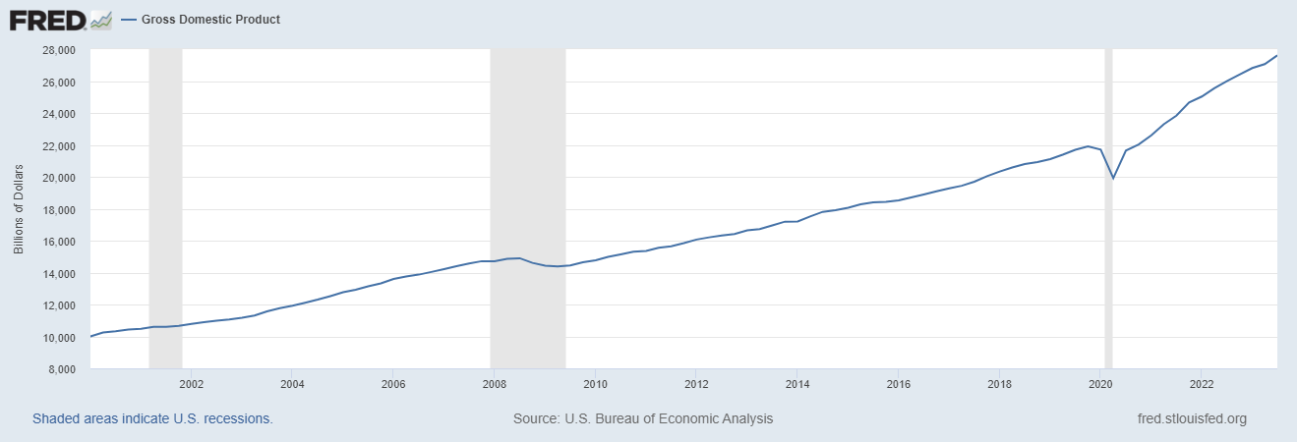
US GDP from 2000 Q1 ~ 2023 Q3
US GDP was measured to be $27 trillion.
  The entire world’s GDP was $105 trillion (IMF).
In 2000, US GDP was measured to be $10 trillion.

Slide 15
Aggregate Output
Overall, the GDP of the US increased over a long period of time, which represents economic growth.
Economic growth measures how aggregate output evolves over a long period of time.
During certain short bursts of time, aggregate output will fluctuate up and down, which represents business cycles.
When aggregate output decreases over two consecutive quarters, we say that the economy is in a recession.

Slide 16
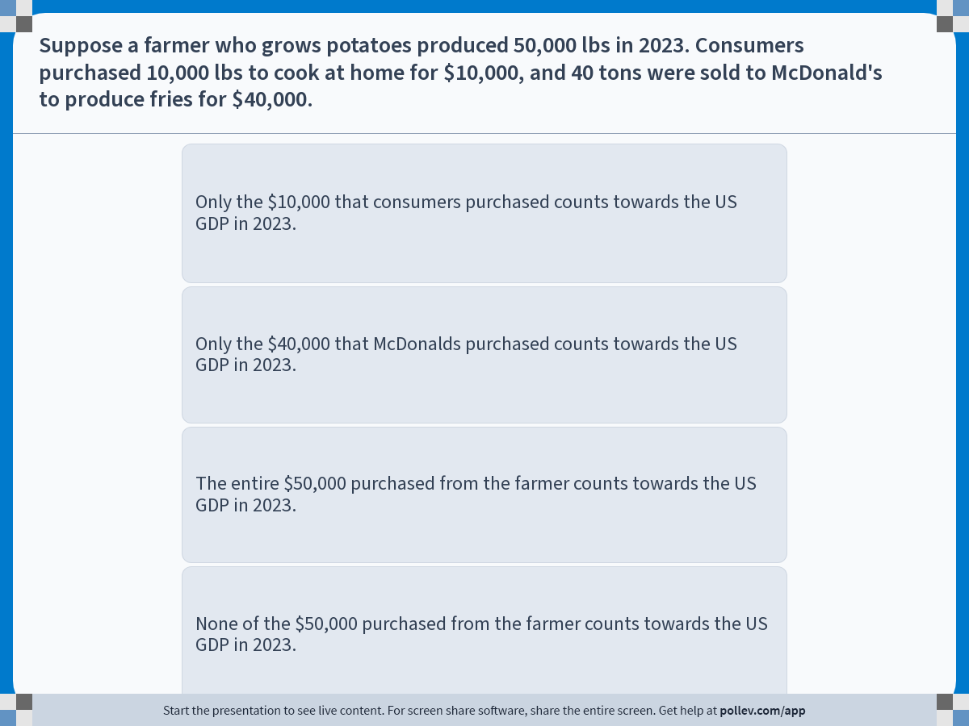
Notes:
Poll Title: Do not modify the notes in this section to avoid tampering with the Poll Everywhere activity.
More info at polleverywhere.com/support
Suppose a farmer who grows potatoes produced 50,000 lbs in 2023. Consumers purchased 10,000 lbs to cook at home for $10,000, and 40 tons were sold to McDonald's to produce fries for $40,000.
https://www.polleverywhere.com/multiple_choice_polls/RjjRKxhOw2oCOCylqbhfy?display_state=instructions&activity_state=opened&state=opened&flow=Engagement&onscreen=persist

Slide 17
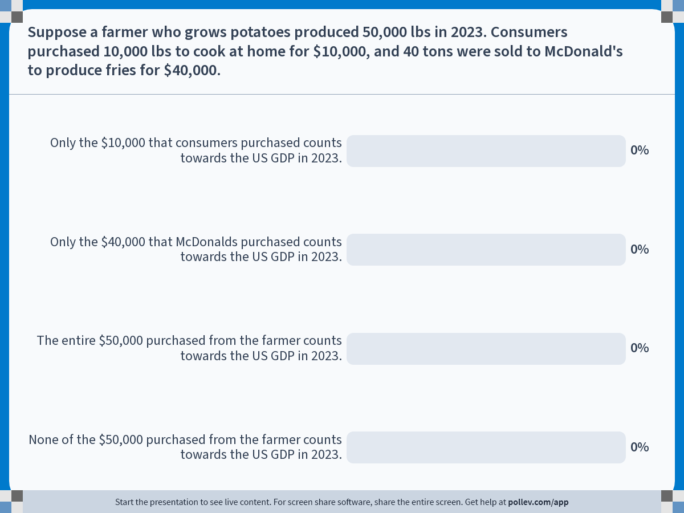
Notes:
Poll Title: Do not modify the notes in this section to avoid tampering with the Poll Everywhere activity.
More info at polleverywhere.com/support
Suppose a farmer who grows potatoes produced 50,000 lbs in 2023. Consumers purchased 10,000 lbs to cook at home for $10,000, and 40 tons were sold to McDonald's to produce fries for $40,000.
https://www.polleverywhere.com/multiple_choice_polls/RjjRKxhOw2oCOCylqbhfy?display_state=chart&activity_state=closed&state=closed&flow=Engagement&onscreen=persist

Slide 18
Solutions to In-Class Poll
The potatoes that were sold to the consumers directly were used to cook meals at home.
Therefore, it represents the sale of a final good, and should be counted towards GDP.
The potatoes sold to McDonalds were used to create fries, which were then in turn sold to consumers.
Therefore, it was used as an intermediate good, and should not be counted towards GDP.

Slide 19
Leaving Out Intermediate Goods
Why should the potatoes sold to McDonalds be left out?
Suppose that McDonalds turned $40,000 worth of potatoes into fries and sold it to consumers for $70,000.
If we count all transactions, the (incorrect) inflated value for GDP would be $120,000.
  Farmers to Consumers: $10,000
  Farmers to McDonalds: $40,000
  McDonalds to Consumers: $70,000
Avoiding double counting, the GDP is $80,000.

Slide 20
https://pollev.com/brianpark046

Slide 21
Alternate Approaches to GDP
Production – Value of Final Goods
  The market value of the final goods and services produced in the economy during a given period.
Production – Value Added
  The sum of value added in the economy during a given period.
Income – Payments to Factors of Production
  The sum of all incomes in the economy during a given period.
Not new “definitions,” but different methods of calculating the aggregate output of an economy.

Slide 22
Alternate Approaches to GDP
Suppose that firm A produces beef, firm B produces buns, and firm C uses the beef and buns to produce burgers.
Firm A
Sells $500 worth of beef to firm C.
Workers are paid $200, rent is $200, and $100 is kept as profit.
Firm C
Sells $1,000 worth of burgers to consumers. $700 was used to purchase ingredients. Workers are paid $150, rent is $100, and profit is $50.
Firm B
Sells $200 worth of buns to firm C.
Workers are paid $50, rent is $100, and $50 is kept as profit.

Slide 23
Alternate Approaches to GDP
Production – Value of Final Goods
  Only the final sale of burgers to the consumers would count towards GDP, so $1,000.
Production – Value Added
  Firm A generated $500 of value added.
  Firm B generated $200 value added.
  Firm C purchased $500 worth of beef and $200 worth of buns, and with it produced goods worth $1,000. So, its value added is $300.
  The sum of all value added is $500+$200+$300=$1,000
  Note that you cannot simply add the sum of all sales values, since it is $500+$200+$1,000=$1,700

Slide 24
Alternate Approaches to GDP
Income – Payments to Factors of Production
  Labor (Wage): Firm A pays $200, Firm B pays $50, and Firm C pays $150 for a total payment to labor of $400.
  Capital (Rent): Firm A pays $200, Firm B pays $100, and Firm C pays $100 for a total payment to capital of $400.
  Profit: Firm A generates a profit of $100, Firm B generates $50, and Firm C generates $50 for a total profit of $200.
Payment | Firm A | Firm B | Firm C | Subtotal
Wage | $200 | $50 | $150 | $400
Rent | $200 | $100 | $100 | $400
Profit | $100 | $50 | $50 | $200
Subtotal | $500 | $200 | $300 | $1,000

Slide 25
Limits of GDP
Already discussed that goods and services not traded in the market is excluded from GDP.
GDP does not consider depreciating physical capital.
GDP does not consider the production of “citizens abroad.”
GDP measures production, not the wellbeing of the society.
Simple measures of GDP can be misleading due to inflation.
Notes:
Capital Depreciation: Extracting Petroleum Depletes Natural Resources (not counted), Uber driver’s car losing value over time.
Wellbeing: Leisure, Income Inequality, Happiness?
Inflation: Real vs. Nominal GDP.

Slide 26
Alternatives to GDP?
Gross Output (https://www.grossoutput.com/)
Gross Domestic Income (GDI)
Gross National Product (GNP)
Value Added by Sector
…and more!

Slide 27
Real and Nominal GDP
The highest grossing movie of all time is Avatar (2009), but adjusted by inflation, it is Gone with the Wind (1939).
The original iPhone (2007) retailed for $499, and the base model iPhone 15 now sells for $799.
Nominal GDP is the total value of production determined using current market prices.
Real GDP is the total value of production determined using market prices from a specific base year.

Slide 28
Real and Nominal GDP
The nominal GDP of the US as measured in the third quarter of 2023 was $27 trillion.

Slide 29
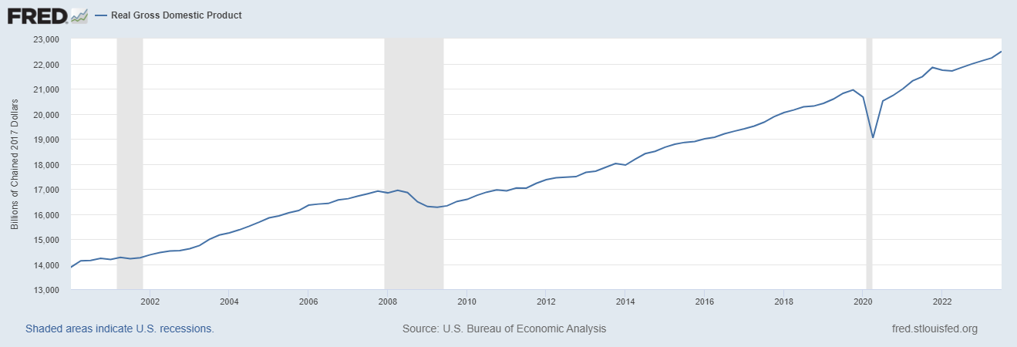
Real and Nominal GDP
The real GDP of the US as measured in the third quarter of 2023, based on 2017 prices was $22 trillion.

Slide 30

Real and Nominal GDP
Suppose that a country produces only Coffee and Donuts.
The nominal GDP of this country in 2023 will be…?
$$\$5×150+\$6×100=\$1,350$$
Year | Price (Coffee) | Price (Donuts) | Units (Coffee) | Units (Donuts)
2019 | $3 | $4 | 100 | 50
2020 | $3 | $4.5 | 150 | 100
2021 | $4 | $5 | 150 | 70
2022 | $5 | $6 | 200 | 100
2023 | $5 | $6 | 150 | 100

Slide 31
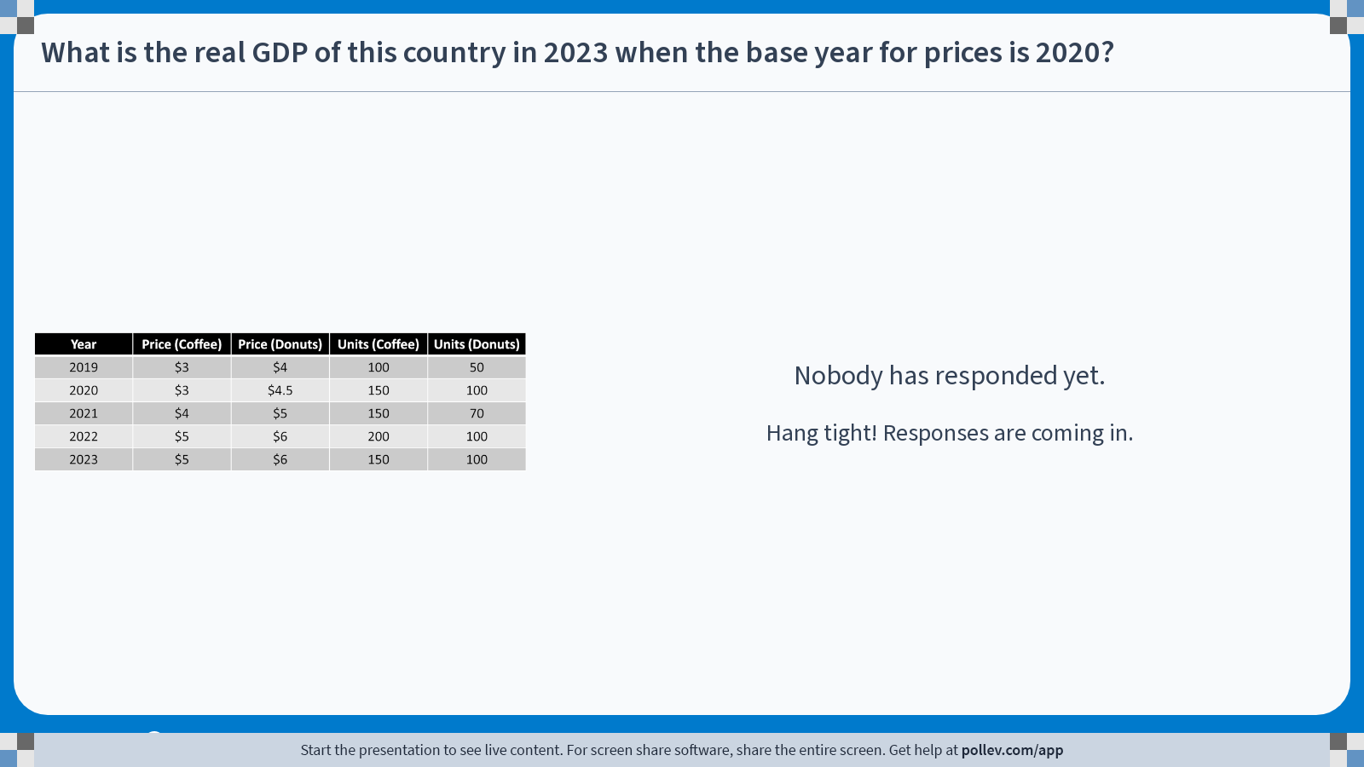
Poll Everywhere free text poll activity
Activity Title: What is the real GDP of this country in 2023 when the base year for prices is 2020?
Slide 31
Notes:
Do not modify the notes in this section to avoid tampering with the Poll Everywhere activity.
More info at polleverywhere.com/support
What is the real GDP of this country in 2023 when the base year for prices is 2020?
https://www.polleverywhere.com/free_text_polls/dUAPxglWax4R2qUjTPhZ1

Slide 32
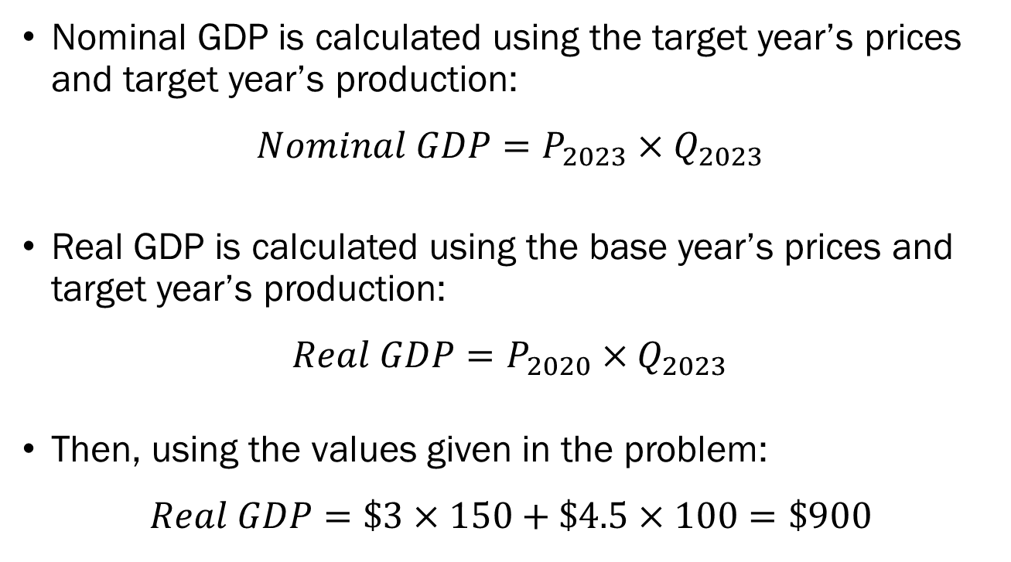
Solutions to In-Class Poll
Nominal GDP is calculated using the target year’s prices and target year’s production:
$$Nominal GDP=P_{2023}×Q_{2023}$$
Real GDP is calculated using the base year’s prices and target year’s production:
$$Real GDP=P_{2020}×Q_{2023}$$
Then, using the values given in the problem:
$$Real GDP=\$3×150+\$4.5×100=\$900$$

Slide 33
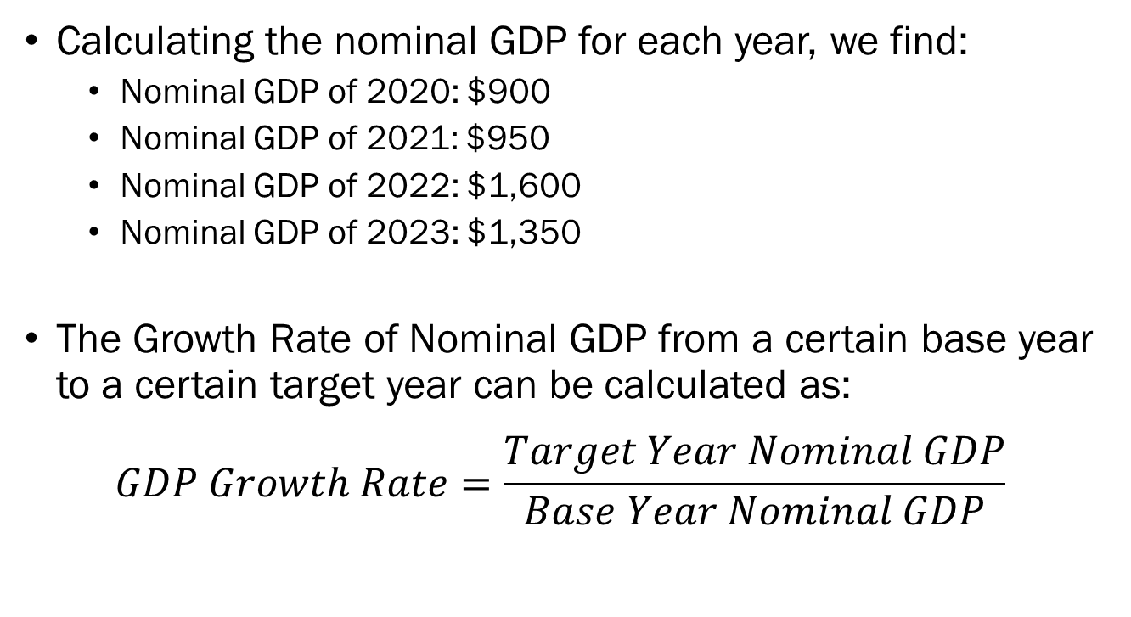
GDP Growth
Calculating the nominal GDP for each year, we find:
  Nominal GDP of 2020: $900
  Nominal GDP of 2021: $950
  Nominal GDP of 2022: $1,600
  Nominal GDP of 2023: $1,350
The Growth Rate of Nominal GDP from a certain base year to a certain target year can be calculated as:
$$GDP Growth Rate=\frac{Target Year Nominal GDP}{Base Year Nominal GDP}$$

Slide 34
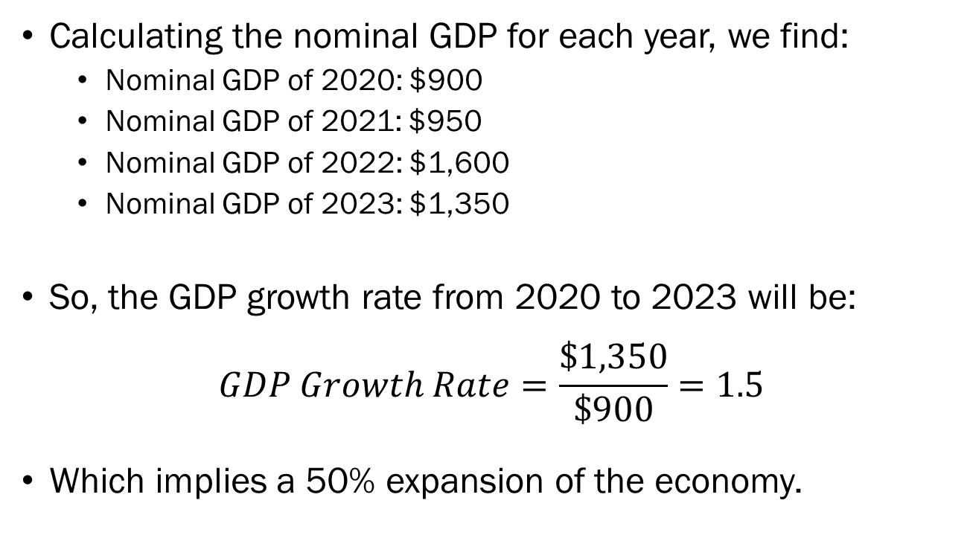
GDP Growth
Calculating the nominal GDP for each year, we find:
  Nominal GDP of 2020: $900
  Nominal GDP of 2021: $950
  Nominal GDP of 2022: $1,600
  Nominal GDP of 2023: $1,350
So, the GDP growth rate from 2020 to 2023 will be:
$$GDP Growth Rate=\frac{\$1,350}{\$900}=1.5$$
Which implies a 50% expansion of the economy.

Slide 35
Real and Nominal GDP
But… did the economy actually grow between 2020 and 2023 in our example?
The output of Coffee and Donuts remained constant.
But prices increased, so nominal GDP increased.
  Nominal GDP in 2020: $900
  Nominal GDP in 2023: $1,350
  Real GDP in 2023 (under 2020 prices): $900
Nominal GDP can be misleading, since it may increase regardless of the increase in output.

Slide 36
Inflation
Why is real and nominal GDP different?
Current prices are may be different from the base year’s market prices.
We may use this to measure changes in the overall price level of the economy.
“Inflation” refers to an increase in the overall price level.
“Deflation” refers to a decrease in the overall price level.

Slide 37
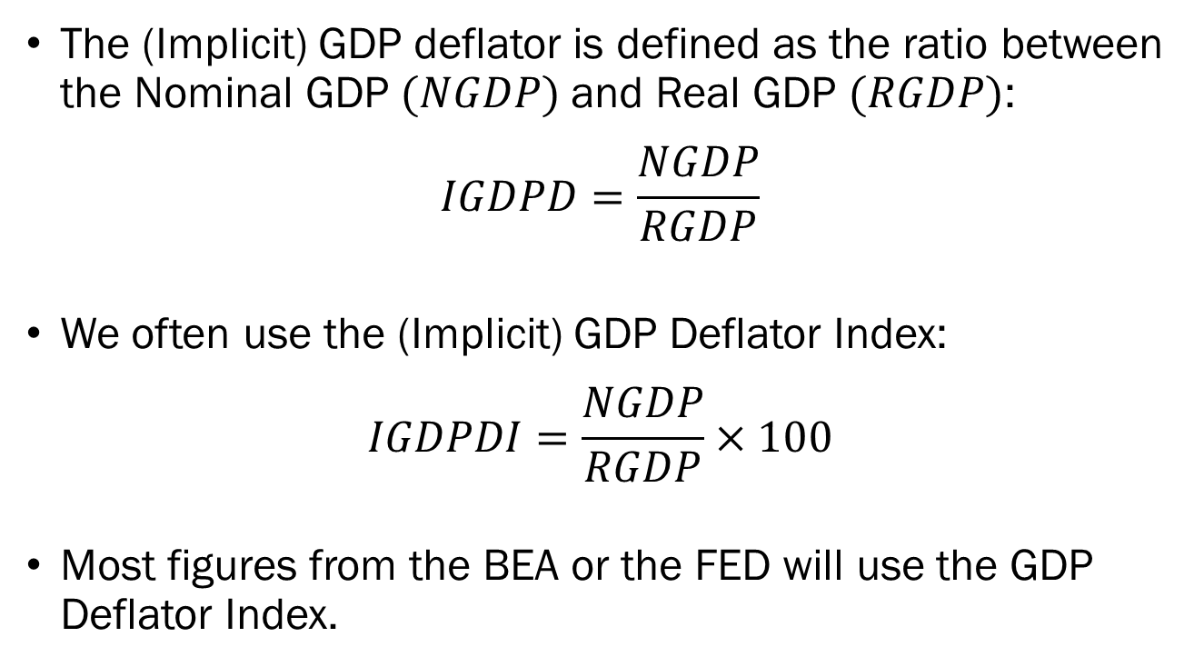
The Implicit GDP Deflator
The (Implicit) GDP deflator is defined as the ratio between the Nominal GDP $(NGDP)$and Real GDP $(RGDP)$:
$$IGDPD=\frac{NGDP}{RGDP}$$
We often use the (Implicit) GDP Deflator Index:
$$IGDPDI=\frac{NGDP}{RGDP}×100$$
Most figures from the BEA or the FED will use the GDP Deflator Index.

Slide 38
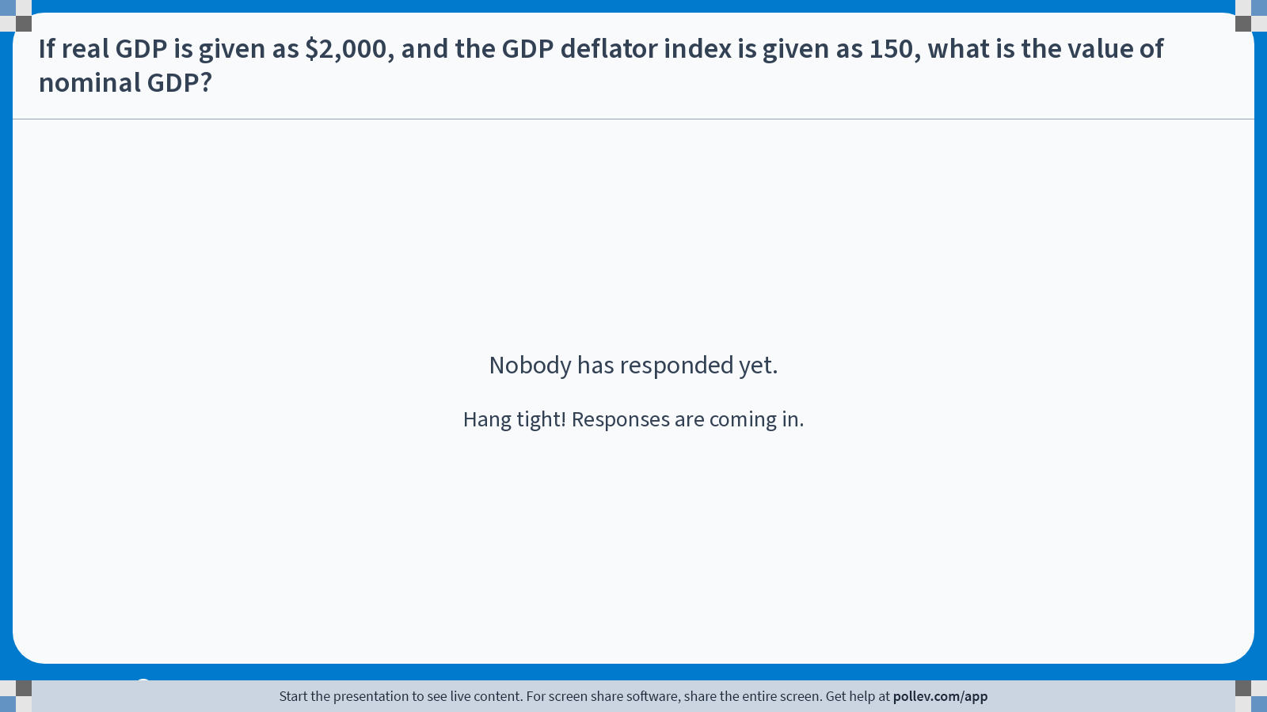
Poll Everywhere free text poll activity
Activity Title: If real GDP is given as $2,000, and the GDP deflator index is given as 150, what is the value of nominal GDP?
Slide 38
Notes:
Do not modify the notes in this section to avoid tampering with the Poll Everywhere activity.
More info at polleverywhere.com/support
If real GDP is given as $2,000, and the GDP deflator index is given as 150, what is the value of nominal GDP?
https://www.polleverywhere.com/free_text_polls/WGOhDhkqX4wkunOkl5hpW

Slide 39
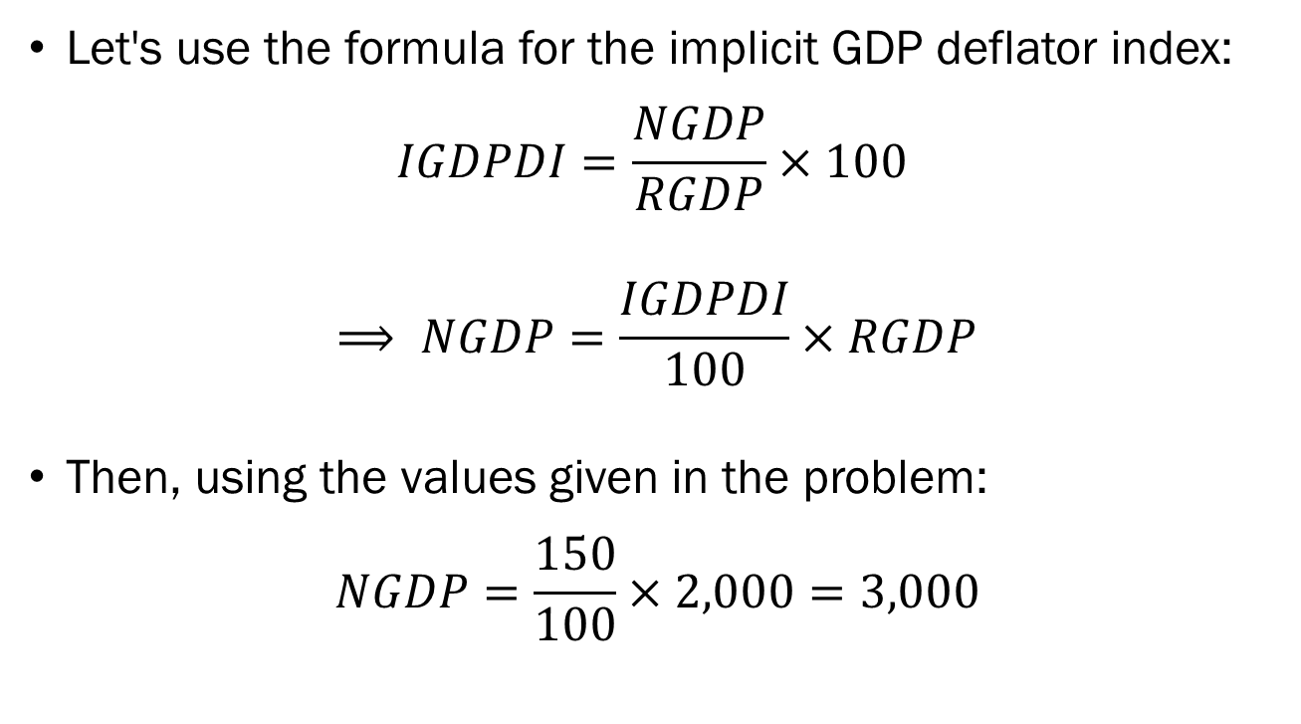
Solutions to In-Class Poll
Let's use the formula for the implicit GDP deflator index:
$$IGDPDI=\frac{NGDP}{RGDP}×100$$
$$⟹ NGDP=\frac{IGDPDI}{100}×RGDP$$
Then, using the values given in the problem:
$$NGDP=\frac{150}{100}×2,000=3,000$$

Slide 40
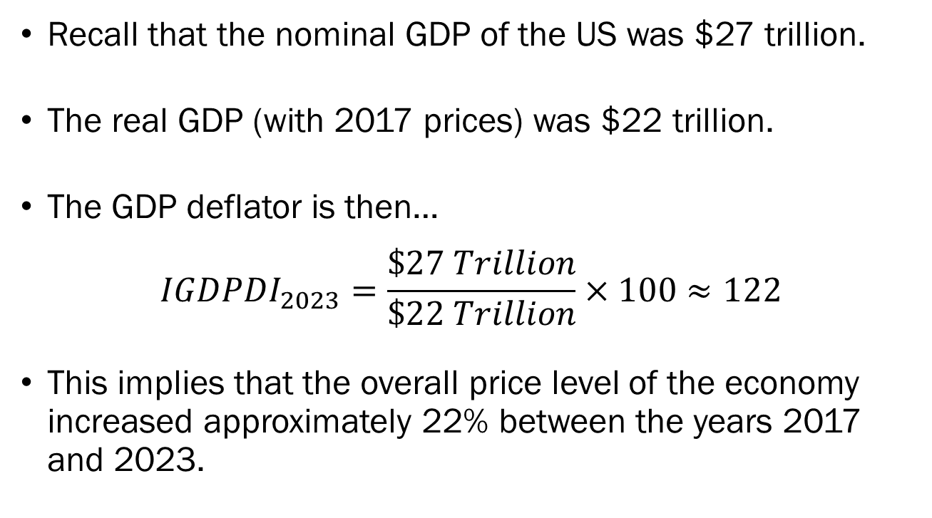
The Implicit GDP Deflator
Recall that the nominal GDP of the US was $27 trillion.
The real GDP (with 2017 prices) was $22 trillion.
The GDP deflator is then…
$$IGDPDI_{2023}=\frac{\$27 Trillion}{\$22 Trillion}×100≈122$$
This implies that the overall price level of the economy increased approximately 22% between the years 2017 and 2023.

Slide 41
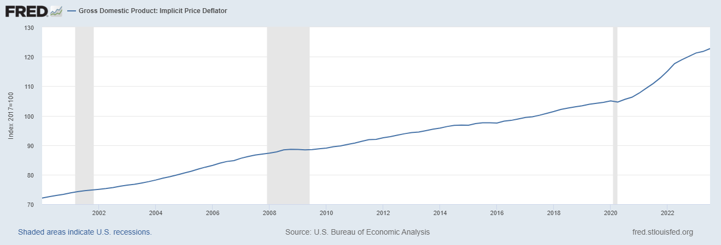
The Implicit GDP Deflator
This matches what we find in real world data, where the implicit GDP deflator index of the US as of 2023 with base year 2017 is 122.762

Slide 42
Limits of the GDP Deflator
The GDP deflator gives us a comprehensive view of the economy, but from a production standpoint.
However, consumers are influenced more directly by changes in the average price of consumption.
Some goods that are produced in the economy is sold exclusively to producers, foreigners, or governments.
Some goods that consumers purchase are produced overseas and are not included in GDP.

Slide 43
The Consumer Price Index (CPI)
The Consumer Price Index (CPI) is an index that tracks the prices of goods and services relevant to consumers.
The Bureau of Labor Statistics (BLS) conducts studies on consumer behavior to construct a “market basket.” (updated every 2 years)
The BLS tracks the prices of each items in the basket across the country every month to construct the CPI.

Slide 44
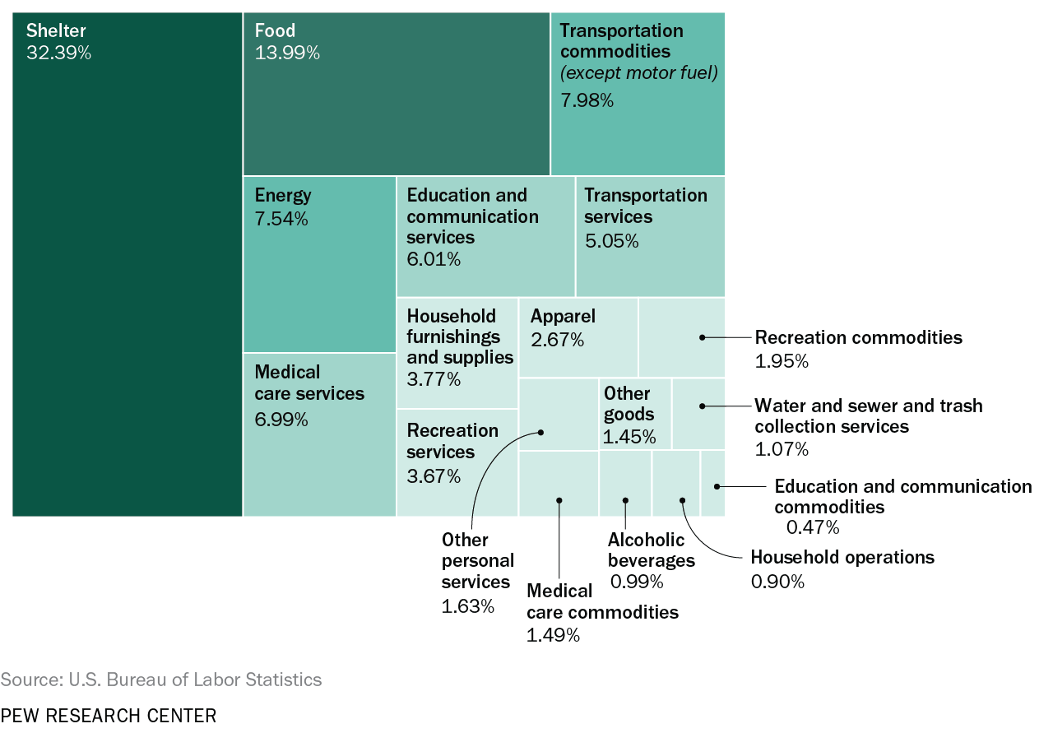
The Consumer Price Index (CPI)

Slide 45
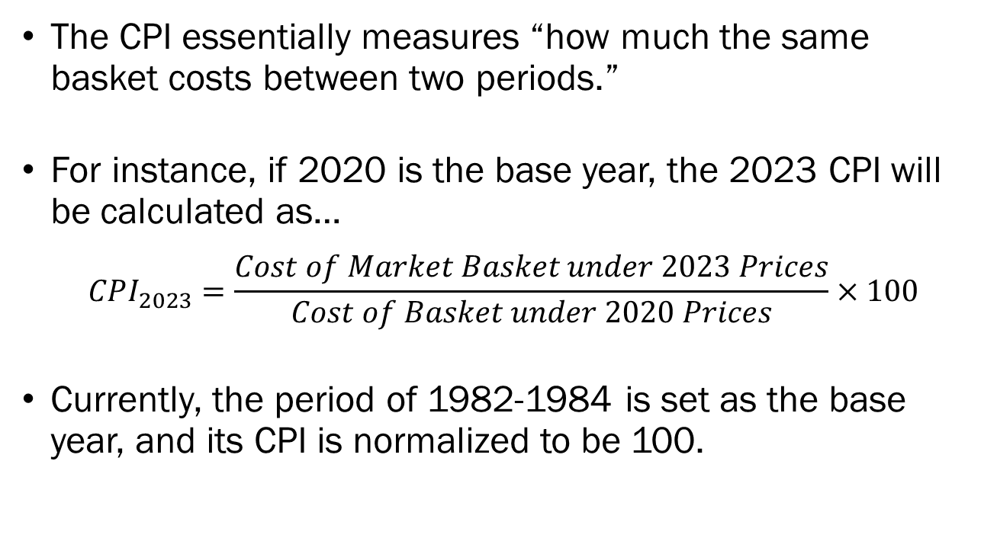
The Consumer Price Index (CPI)
The CPI essentially measures “how much the same basket costs between two periods.”
For instance, if 2020 is the base year, the 2023 CPI will be calculated as…
$$CPI_{2023}=\frac{Cost of Market Basket under 2023 Prices}{Cost of Basket under 2020 Prices}×100$$
Currently, the period of 1982-1984 is set as the base year, and its CPI is normalized to be 100.

Slide 46
The Consumer Price Index (CPI)
Suppose that we determined that a consumer’s basket should consist of 20 units of donuts, and 30 units of coffee.
Calculate the inflation rate between the year 2022 and 2023 using 2021 as the base year.
Year | Price (Coffee) | Price (Donuts) | Units (Coffee) | Units (Donuts)
2021 | $4 | $5 | 150 | 70
2022 | $5 | $6 | 200 | 100
2023 | $5.25 | $5.5 | 150 | 100

Slide 47
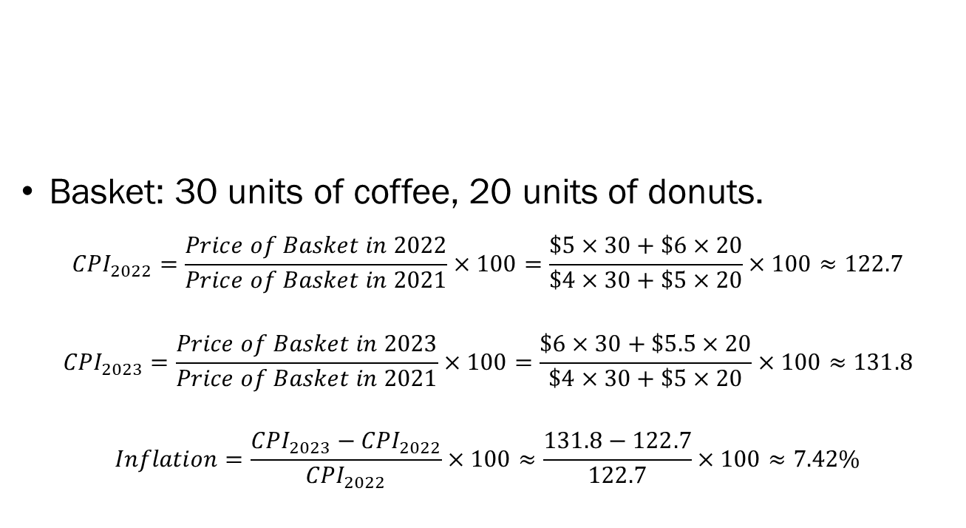
The Consumer Price Index (CPI)
Year | Price (Coffee) | Price (Donuts) | Units (Coffee) | Units (Donuts)
2021 | $4 | $5 | 150 | 70
2022 | $5 | $6 | 200 | 100
2023 | $6 | $5.5 | 150 | 100
Basket: 30 units of coffee, 20 units of donuts.
$$CPI_{2022}=\frac{Price of Basket in 2022}{Price of Basket in 2021}×100=\frac{\$5×30+\$6×20}{\$4×30+\$5×20}×100≈122.7$$
$$CPI_{2023}=\frac{Price of Basket in 2023}{Price of Basket in 2021}×100=\frac{\$6×30+\$5.5×20}{\$4×30+\$5×20}×100≈131.8$$
$$Inflation=\frac{CPI_{2023}−CPI_{2022}}{CPI_{2022}}×100≈\frac{131.8−122.7}{122.7}×100≈7.42\%$$

Slide 48
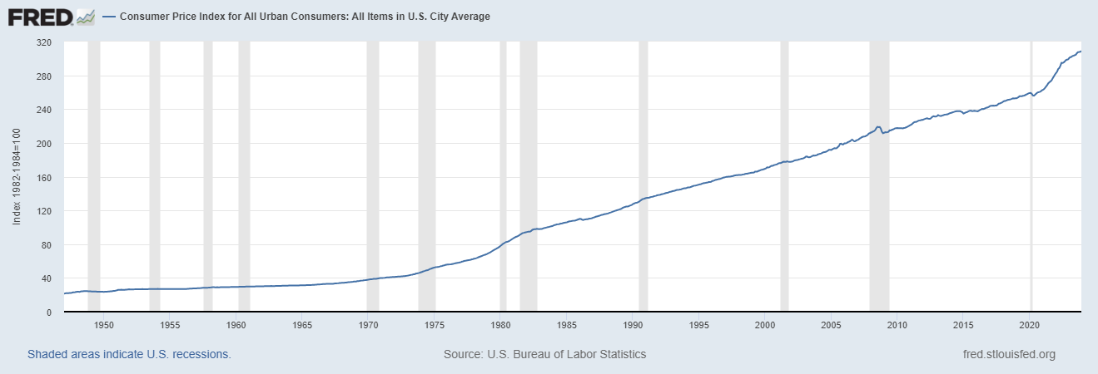
The Consumer Price Index (CPI)
Currently, the period of 1982-1984 is set as the base year, and its CPI is normalized to be 100.
https://www.bls.gov/data/inflation_calculator.htm

Slide 49
Why Inflation Matters
If all prices and wages increased by the same proportion (“Pure Inflation”), inflation would not matter at all.
Inflation has an uneven effect across the economy.
  Wages generally do not naturally outpace inflation, which leads to an erosion in the “real income” of households.
  Individuals relying on fixed value pensions will see their purchasing power decline significantly.
  The relative prices of goods will be affected, which leads to inefficiencies in the market.
  Disproportionally advantages debtors over creditors.
  Increased uncertainty and pessimism will affect investment choices of firms and consumers.

Slide 50
Why Deflation isn’t any Better
Most economists agree that a stable, and low inflation between 1% ~ 4% is optimal for the economy.
It is tempting to think that deflation, the overall price level of the economy trending downward should be good.
However, sustained deflation will limit the efficacy of certain monetary policy to affect output.
Prolonged deflation may also cause firms to decrease production in anticipation of decreased profits, which leads to increased unemployment.

Slide 51
https://pollev.com/brianpark046

Slide 52
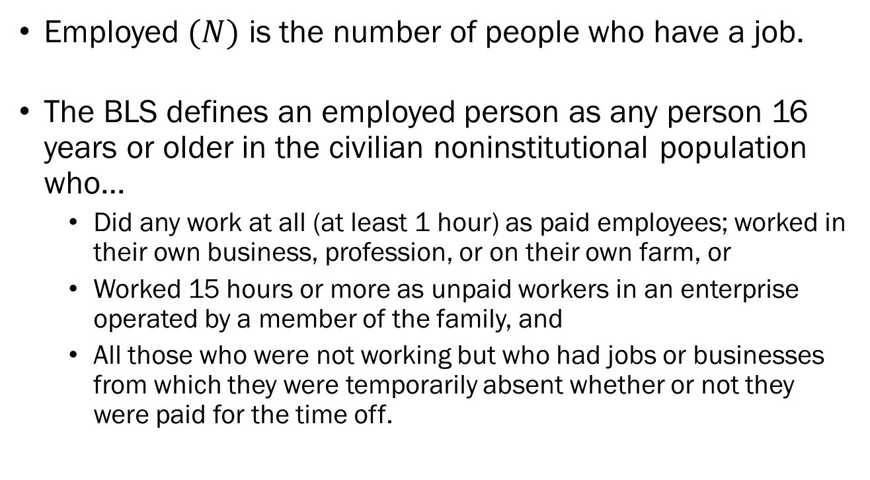
Unemployment
Employed $(N)$ is the number of people who have a job.
The BLS defines an employed person as any person 16 years or older in the civilian noninstitutional population who…
  Did any work at all (at least 1 hour) as paid employees; worked in their own business, profession, or on their own farm, or
  Worked 15 hours or more as unpaid workers in an enterprise operated by a member of the family, and
  All those who were not working but who had jobs or businesses from which they were temporarily absent whether or not they were paid for the time off.

Slide 53
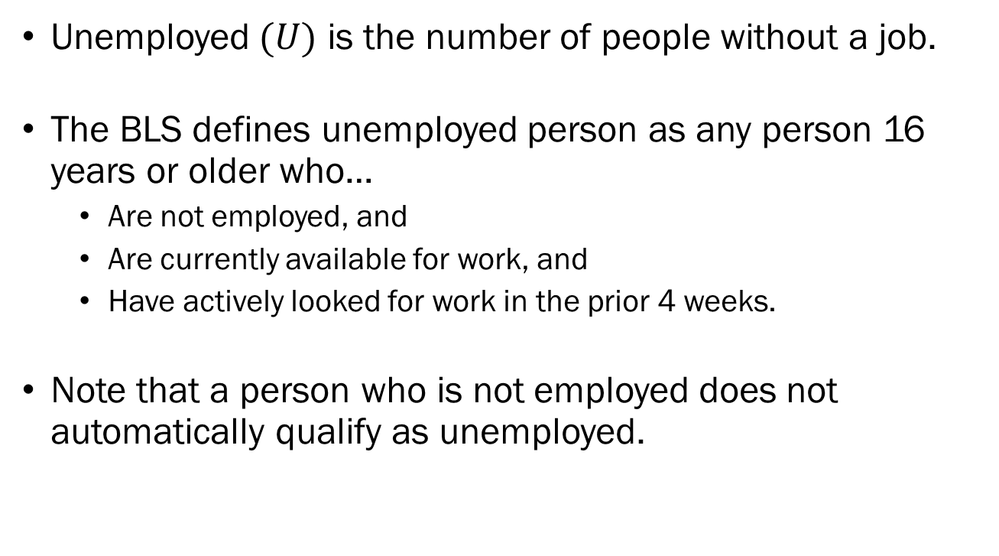
Unemployment
Unemployed $(U)$ is the number of people without a job.
The BLS defines unemployed person as any person 16 years or older who…
  Are not employed, and
  Are currently available for work, and
  Have actively looked for work in the prior 4 weeks.
Note that a person who is not employed does not automatically qualify as unemployed.

Slide 54
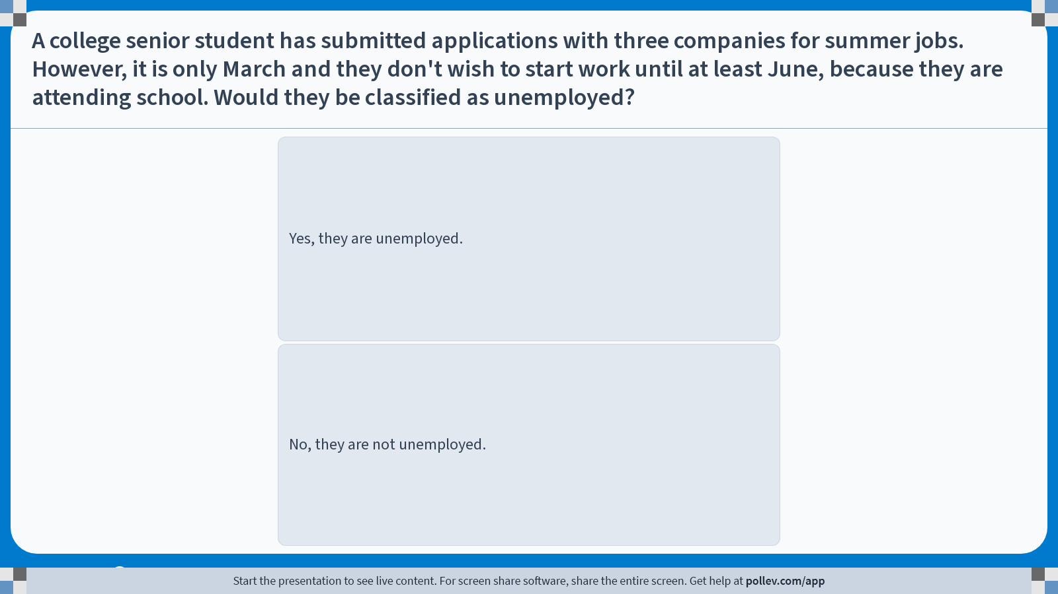
Poll Everywhere multiple choice poll instructions screen
Activity Title: A college senior student has submitted applications with three companies for summer jobs. However, it is only March and they don't wish to start work until at least June, because they are attending school. Would they be classified as unemployed?
Slide 53
Notes:
Do not modify the notes in this section to avoid tampering with the Poll Everywhere activity.
More info at polleverywhere.com/support
A college senior student has submitted applications with three companies for summer jobs. However, it is only March and they don't wish to start work until at least June, because they are attending school. Would they be classified as unemployed?
https://www.polleverywhere.com/multiple_choice_polls/z3iyM4Ho8WDV5i7xGqG4S?display_state=instructions&activity_state=opened&state=opened&flow=Engagement&onscreen=persist

Slide 55
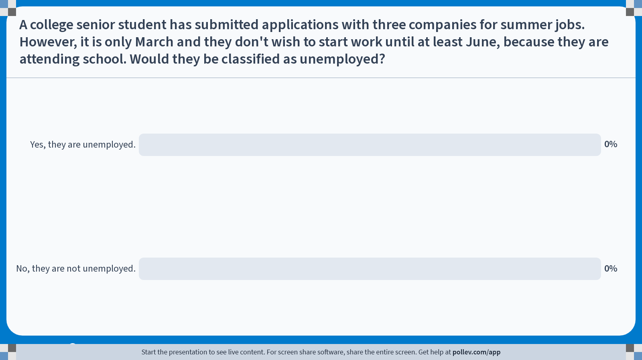
Poll Everywhere multiple choice poll chart screen
Activity Title: A college senior student has submitted applications with three companies for summer jobs. However, it is only March and they don't wish to start work until at least June, because they are attending school. Would they be classified as unemployed?
Slide 55
Notes:
Do not modify the notes in this section to avoid tampering with the Poll Everywhere activity.
More info at polleverywhere.com/support
A college senior student has submitted applications with three companies for summer jobs. However, it is only March and they don't wish to start work until at least June, because they are attending school. Would they be classified as unemployed?
https://www.polleverywhere.com/multiple_choice_polls/z3iyM4Ho8WDV5i7xGqG4S?display_state=chart&activity_state=closed&state=closed&flow=Engagement&onscreen=persist

Slide 56
Solutions to In-Class Poll
They were above 16 years old, and
They were not employed, and
They actively looked for work in the past 4 weeks,
However, they were not currently available to work, since they were still in school.
Therefore, they will not be counted as unemployed.

Slide 57
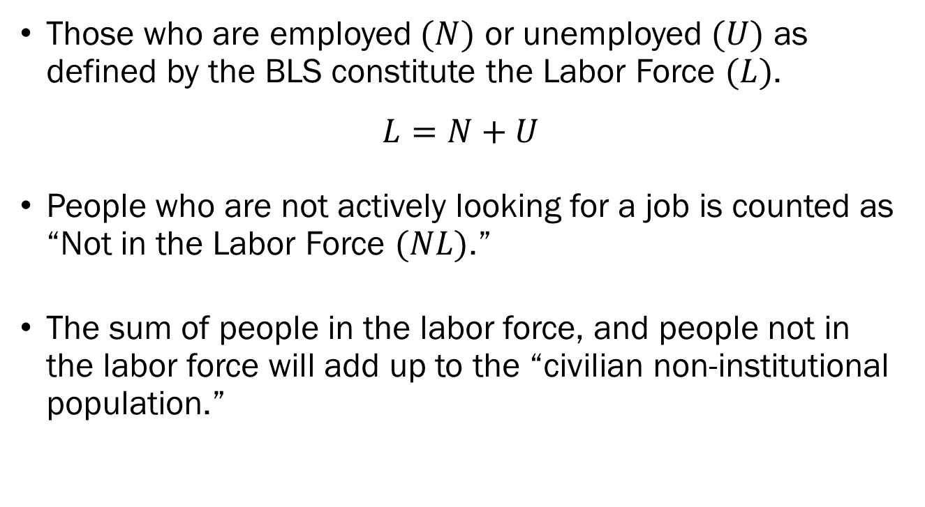
Unemployment
Those who are employed $(N)$ or unemployed $(U)$ as defined by the BLS constitute the Labor Force $(L)$.
$$L=N+U$$
People who are not actively looking for a job is counted as “Not in the Labor Force $(NL)$.”
The sum of people in the labor force, and people not in the labor force will add up to the “civilian non-institutional population.”

Slide 58
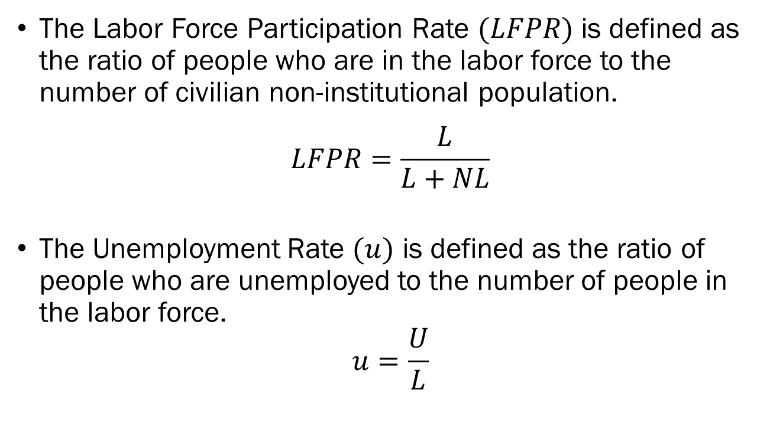
Unemployment
The Labor Force Participation Rate $(LFPR)$ is defined as the ratio of people who are in the labor force to the number of civilian non-institutional population.
$$LFPR=\frac{L}{L+NL}$$
The Unemployment Rate $(u)$ is defined as the ratio of people who are unemployed to the number of people in the labor force.
$$u=\frac{U}{L}$$

Slide 59
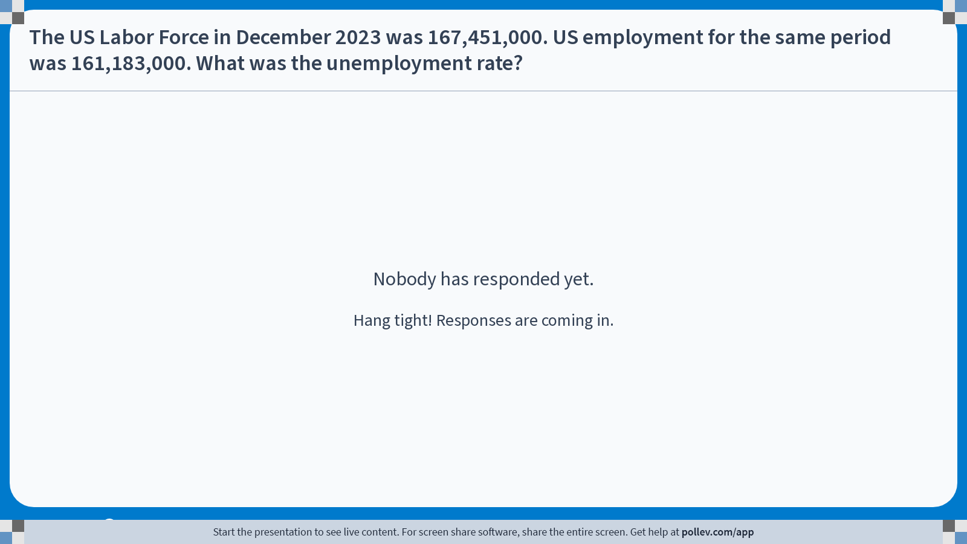
Notes:
Poll Title: Do not modify the notes in this section to avoid tampering with the Poll Everywhere activity.
More info at polleverywhere.com/support
The US Labor Force in December 2023 was 167,451,000. US employment for the same period was 161,183,000. What was the unemployment rate?
https://www.polleverywhere.com/free_text_polls/vC7p1EYtubDZgpJ9VTnC0

Slide 60
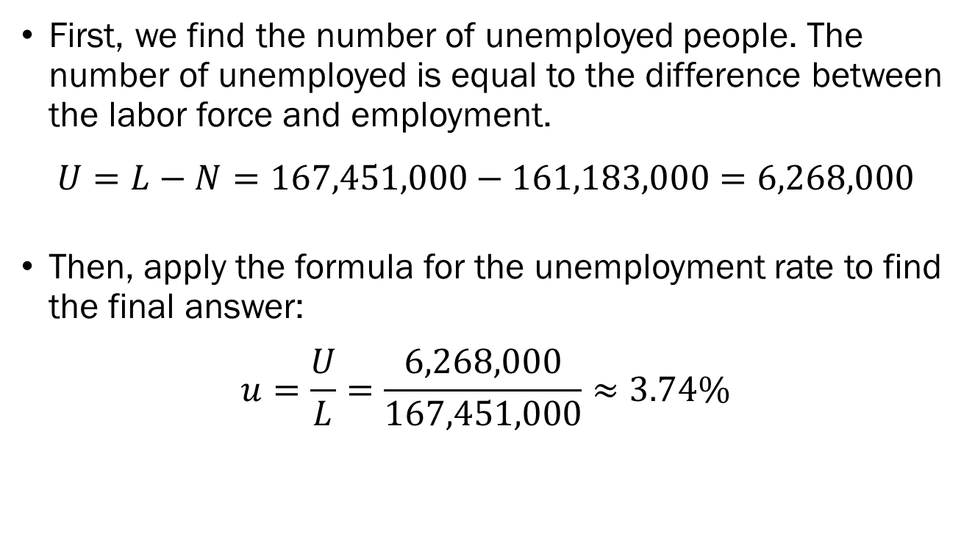
Solutions to In-Class Poll
First, we find the number of unemployed people. The number of unemployed is equal to the difference between the labor force and employment.
$$U=L−N=167,451,000−161,183,000=6,268,000$$
Then, apply the formula for the unemployment rate to find the final answer:
$$u=\frac{U}{L}=\frac{6,268,000}{167,451,000}≈3.74\%$$

Slide 61
Types of Unemployment
Frictional Unemployment
  Unemployment due to the nature of the labor market.
  Happens due to the time-consuming nature of job searches.
Structural Unemployment
  Unemployment due to labor supply overwhelming labor demand.
  Often accompanied by structural shifts at the industry-level.
Cyclical Unemployment
  Unemployment due to swings in the business cycle.

Slide 62
Limits of Unemployment Rates?
Suppose that the economy is deep in a recession so that employers cut back on hiring and lay off employees.
We may see a “discouraged worker effect” where people give up on looking for work, decreasing the size of the labor force.
Unemployment rates may be underestimated under prolonged recessions.
Economists sometime turn their attention to “employment rates” as a supplementary measure.

Slide 63
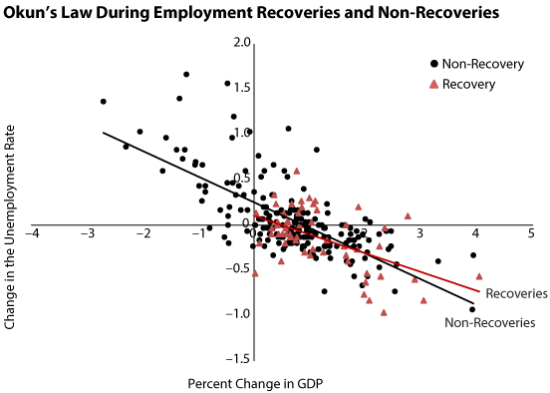
Output, Unemployment, and Inflation
Okun’s Law states that when output growth is high, unemployment will decrease.
St. Louis Fed

Slide 64
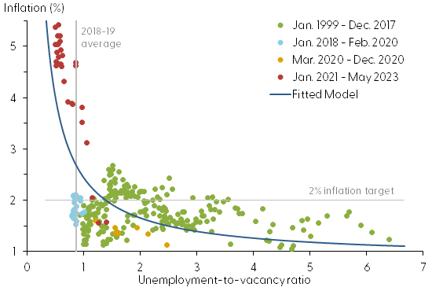
Output, Unemployment, and Inflation
The Phillips Curve shows that when unemployment is low, inflation will tend to be high.
San Francisco
Federal Reserve

Slide 65
The Short, Medium, and Long Run
We will be examining how the economy evolves over different horizons of time.
In the short run, output is largely determined by factors on the demand-side of the economy.
In the medium run, output seems to rely heavily on the supply-side factors.
In the long run, output is driven by R&D, innovations, education, and the strength of institutions.

