Slide 1
The Short Run:
Financial Markets
ECON 301

Slide 2

https://pollev.com/brianpark046

Slide 3
Defining Money
Money is a term that is well understood by most people.
It is tempting to equate “Money” to “Wealth.”
In the field of Economics, we define money by the role it plays in the market.
Money is an object that can serve three major roles:
  A medium of exchange, and
  A store of value, and
  A unit of account.

Slide 4
Money as a Medium of Exchange
A medium of exchange describes an asset that is accepted to facilitate the exchange of goods and services.
Anybody can use the USD to purchase goods and services almost anywhere in the US.
What would happen if we did not have a medium of exchange?
We would have return to a barter system, which requires a “double coincidence of wants.”

Slide 5
Money as a Store of Value
A store of value describes an asset that can preserve individuals’ purchasing power into the future.
If you have USD in hand, you can use it in the future to make a purchase.
Note that inflation may erode the purchasing power of USD over time.
That does not necessarily mean that USD does not serve as a store of value.

Slide 6
Money as a Unit of Account
A unit of account describes an asset that can be used to represent the value of different goods and services.
Typically, we can quote a dollar-amount to communicate how valuable a good or service is considered.
We often quote value by stating something like “This cup of coffee is worth $5.”
Much easier to communicate than “This cup of coffee is worth 0.6% of an iPhone 15.”

Slide 7
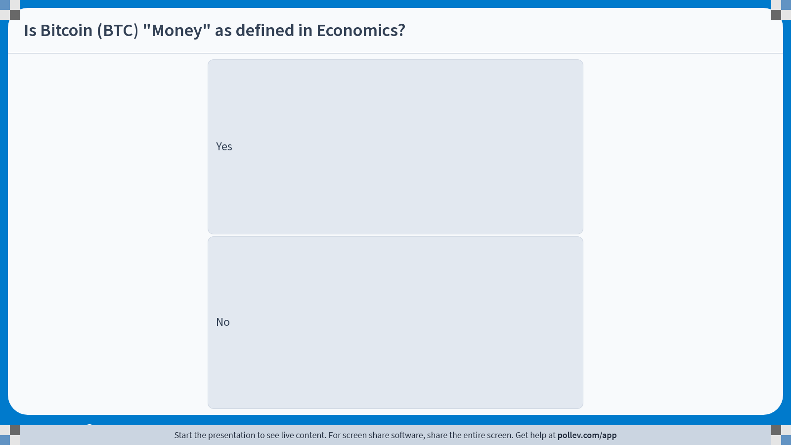
Notes:
Poll Title: Do not modify the notes in this section to avoid tampering with the Poll Everywhere activity.
More info at polleverywhere.com/support
Is Bitcoin (BTC) "Money" as defined in Economics?
https://www.polleverywhere.com/multiple_choice_polls/CFkm4E67pjh3k3Agpkw8G?display_state=instructions&activity_state=opened&state=opened&flow=Engagement&onscreen=persist

Slide 8
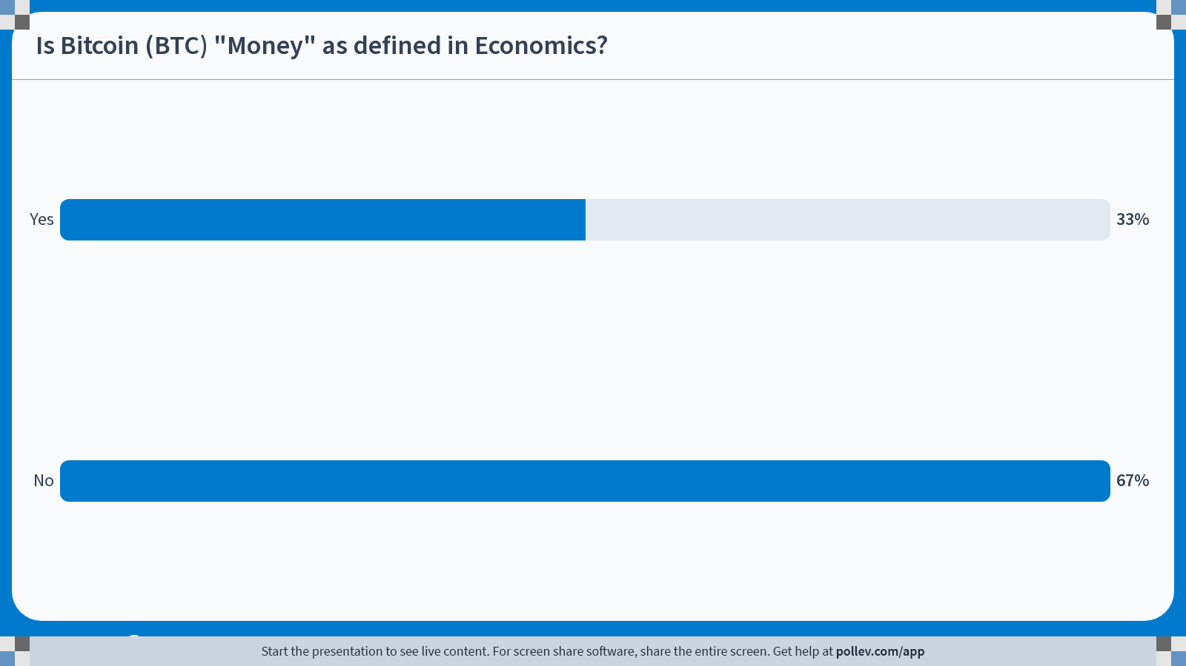
Notes:
Poll Title: Do not modify the notes in this section to avoid tampering with the Poll Everywhere activity.
More info at polleverywhere.com/support
Is Bitcoin (BTC) "Money" as defined in Economics?
https://www.polleverywhere.com/multiple_choice_polls/CFkm4E67pjh3k3Agpkw8G?display_state=chart&activity_state=closed&state=closed&flow=Engagement&onscreen=persist

Slide 9
Types of Money
Commodity Money
  Assets that are used as money that have an intrinsic value.
  Salt used as “Salary” for soldiers in the Roman empire.
  Precious metals such as gold, silver, etc.
Fiat Money
  Assets that are used as money that have no intrinsic value.
  Most modern currencies are classified as fiat money.
  Given value when designated as legal tender by governments.
  Top 5 Traded Currencies: USD, EUR, JPY, GBP, CNY

Slide 10
Measuring Money Supply: M1
M1 represents money that is immediately available for transactions.
M1 consists of the following:
  Currency
  Demand Deposits (Checking Account Balances)
  Traveler’s Checks
  Checkable Deposits
  Savings (was M2 pre-2020)
  Money Market Deposits (was M2 pre-2020)

Slide 11
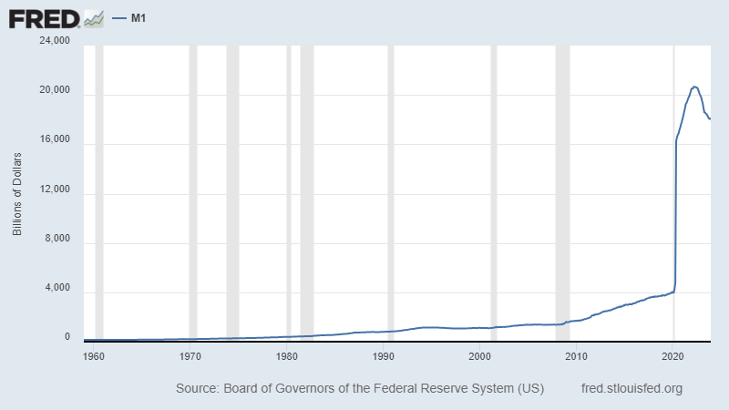
Measuring Money Supply: M1

Slide 12
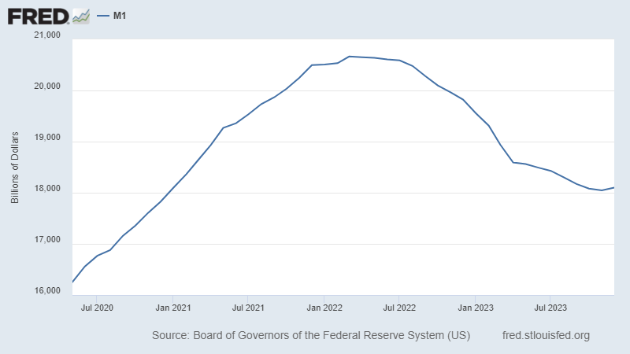
Measuring Money Supply: M1

Slide 13
Measuring Money Supply: M2
M2 refers to money that is immediately available for transactions, and its close substitutes.
M2 consists of the following:
  M1
  Small Time Deposits (CD)
  Money Market Funds
  Other “near money” assets
In most scenarios, “Money Supply” refers to the stock of M2 currency in the economy at a given point in time.

Slide 14
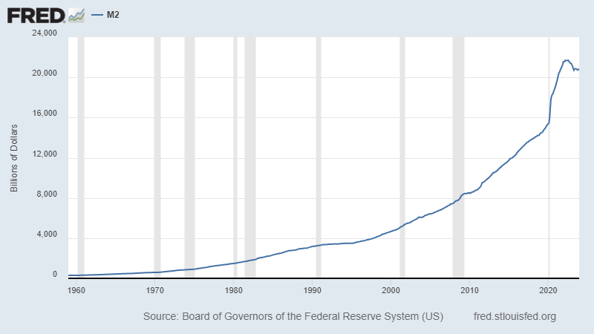
Measuring Money Supply: M2

Slide 15
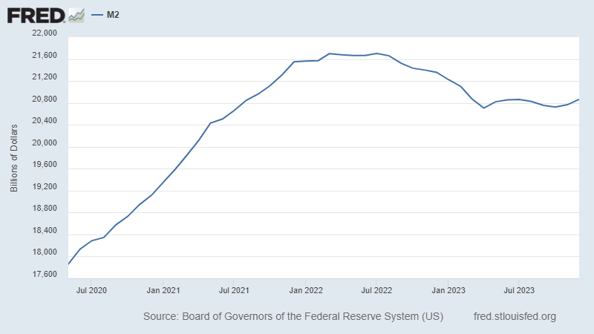
Measuring Money Supply: M2

Slide 16
Central Banks
Money supply is indirectly controlled by institutions called central banks of each country / entity.
  European Central Bank: EU and EUR
  Bank of England: UK and GBP
Central banks are government institutions that conducts monetary policy, which include:
  Monitoring financial institutions, and
  Controlling key interest rates, and
  (Indirectly) Controlling the money supply.
The Federal Reserve Bank is the central bank of the US.

Slide 17
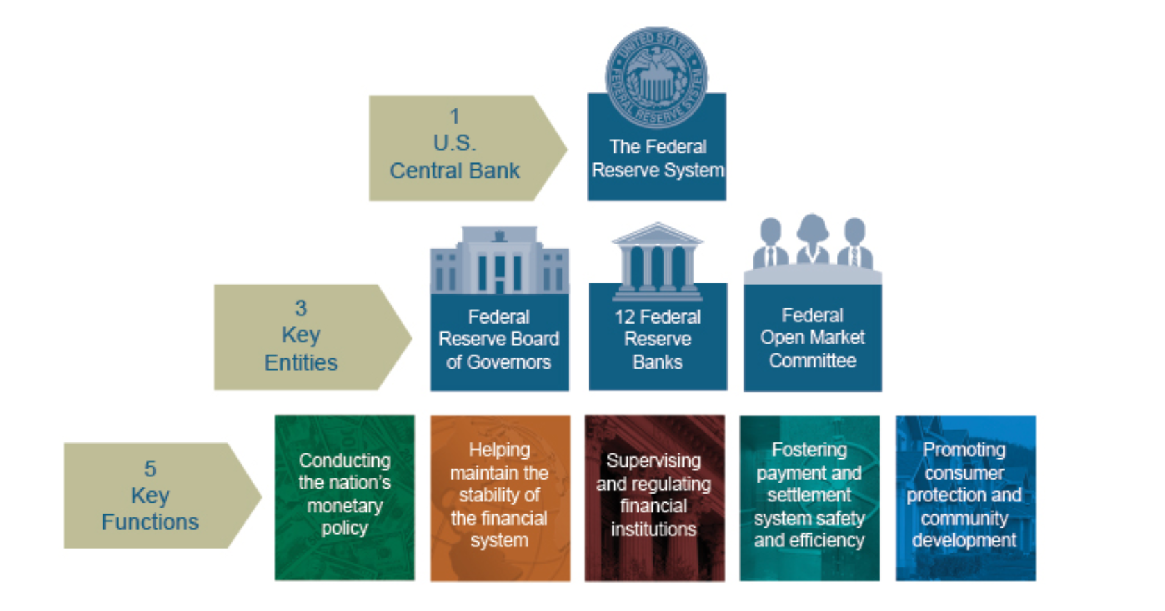
Federal Reserve System

Slide 18
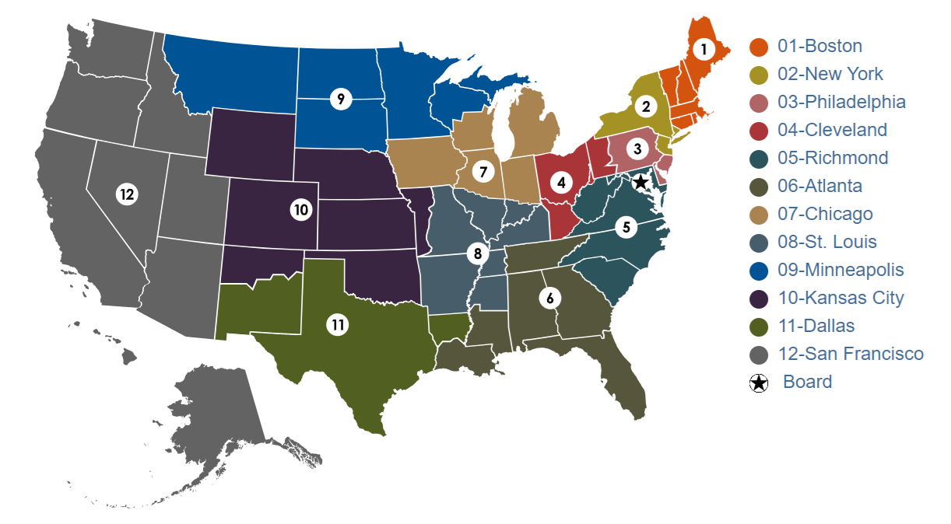
Federal Reserve System

Slide 19
Federal Reserve System
12 Regional Federal Reserve Banks
  Initially intended to work independently to accurately reflect local market conditions in 1913.
Board of Governors
  POTUS appoints 7 Governors for staggered 14-year terms.
  POTUS nominates the Chair of the Board for a 4-year term.
  Controls two out of the three tools of monetary policy; setting the discount rate, and the reserve requirements.
Federal Open Market Committee (FOMC)
  Conducts the third tool of monetary policy, open market operations.

Slide 20
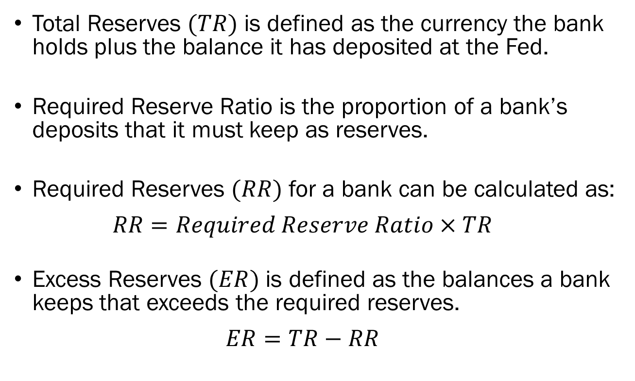
Reserve Requirements
Total Reserves $(TR)$ is defined as the currency the bank holds plus the balance it has deposited at the Fed.
Required Reserve Ratio is the proportion of a bank’s deposits that it must keep as reserves.
Required Reserves $(RR)$ for a bank can be calculated as:
  $$RR=Required Reserve Ratio×TR$$
Excess Reserves $(ER)$ is defined as the balances a bank keeps that exceeds the required reserves.
  $$ER=TR−RR$$

Slide 21
Reserve Requirements
Why does the ability to set reserve requirements matter?
Consider the following case:
  The required reserve ratio is set to be 10%
  Banks do not keep any excess reserves.
  There are infinite number of banks and consumers.
  Firm A deposits $100,000 to Bank A.
If all banks want to generate as much profit as possible, what would they be doing?
They would want to loan out as much funds as possible!

Slide 22
Reserve Requirements
Step 0:
  Money in the economy is $100,000, all held as assets (deposits) by Bank A.
Step 1:
  Bank A has $100,000 in deposits, and lends out the maximum allowed amount of $90,000 as loans to Consumer B.
  Bank A has $10,000 in reserves and $90,000 as loans for a total of $100,000 in assets.
  Consumer B deposits the entirety of $90,000 as savings with Bank B.
  Bank B has $90,000 as assets (deposits).
  Money in the economy now increased to $190,000.

Slide 23
Reserve Requirements
Step 2:
  Bank A has $10,000 in reserves and $90,000 as loans for a total of $100,000 in assets.
  Bank B has $90,000 in deposits, and lends out the maximum allowed amount of $81,000 as loans to Consumer C.
  Bank A has $9,000 in reserves and $81,000 as loans for a total of $90,000 in assets.
  Consumer C deposits the entirety of $81,000 as savings with Bank C.
  Bank C has $81,000 as assets (deposits).
  Money in the economy now increased to $271,000.

Slide 24
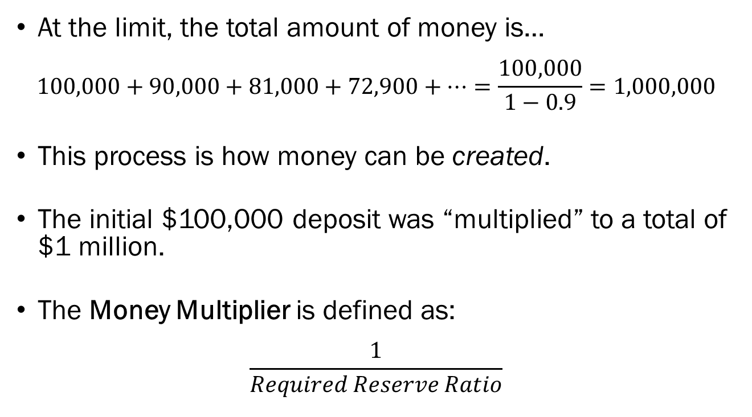
Reserve Requirements
At the limit, the total amount of money is…
$$100,000+90,000+81,000+72,900+⋯=\frac{100,000}{1−0.9}=1,000,000$$
This process is how money can be created.
The initial $100,000 deposit was “multiplied” to a total of $1 million.
The Money Multiplier is defined as:
$$\frac{1}{Required Reserve Ratio}$$

Slide 25
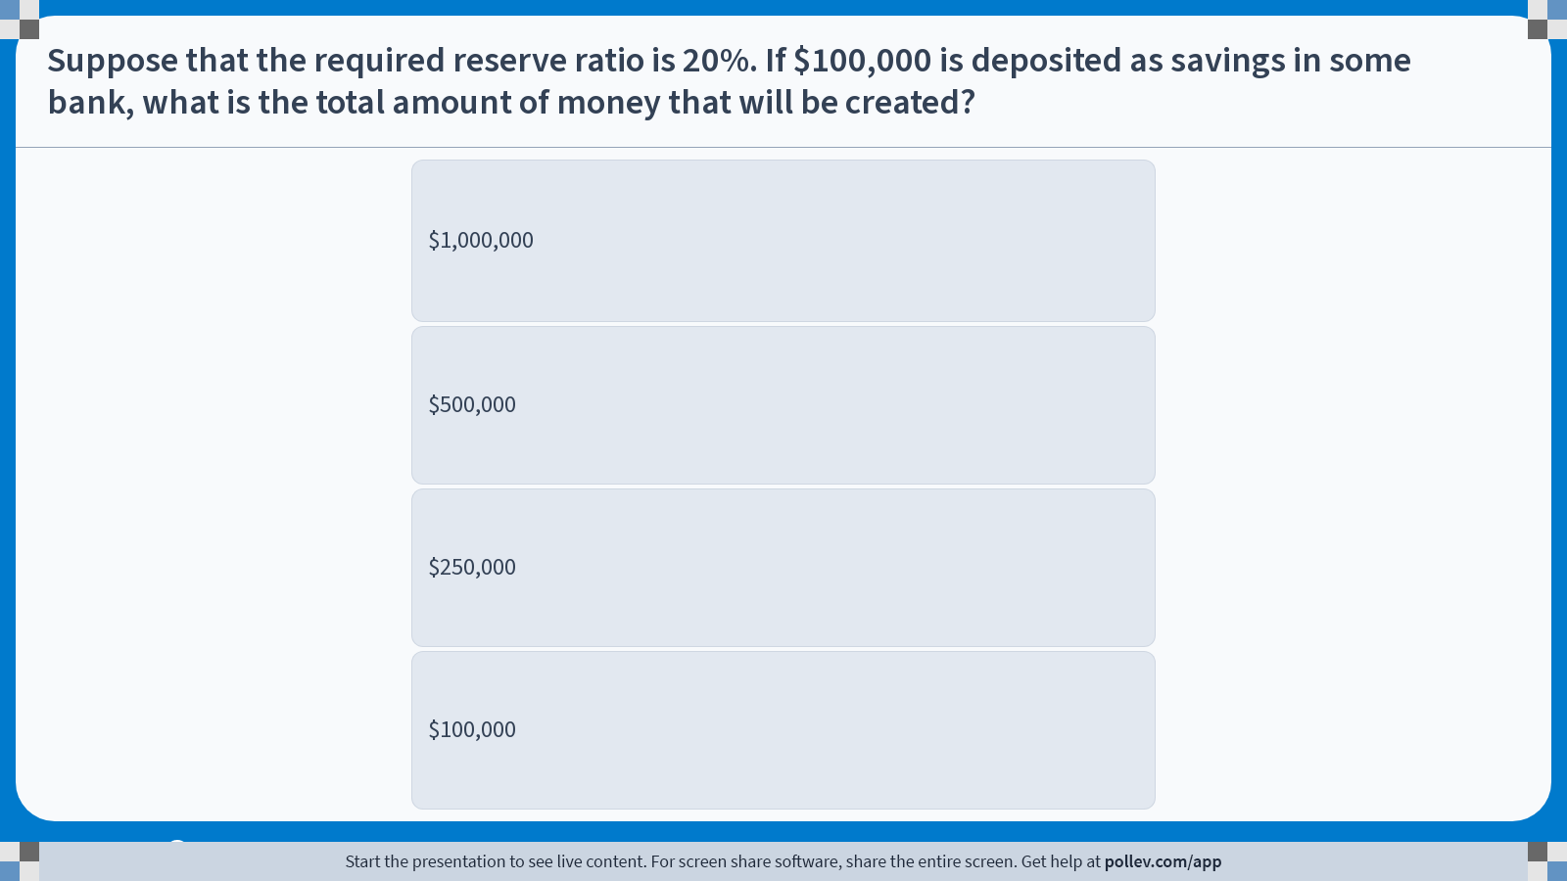
Notes:
Poll Title: Do not modify the notes in this section to avoid tampering with the Poll Everywhere activity.
More info at polleverywhere.com/support
Suppose that the required reserve ratio is 20%. If $100,000 is deposited as savings in some bank, what is the total amount of money that will be created?
https://www.polleverywhere.com/multiple_choice_polls/gndLgthmvl1J7CryvcbTd?display_state=instructions&activity_state=opened&state=opened&flow=Engagement&onscreen=persist

Slide 26
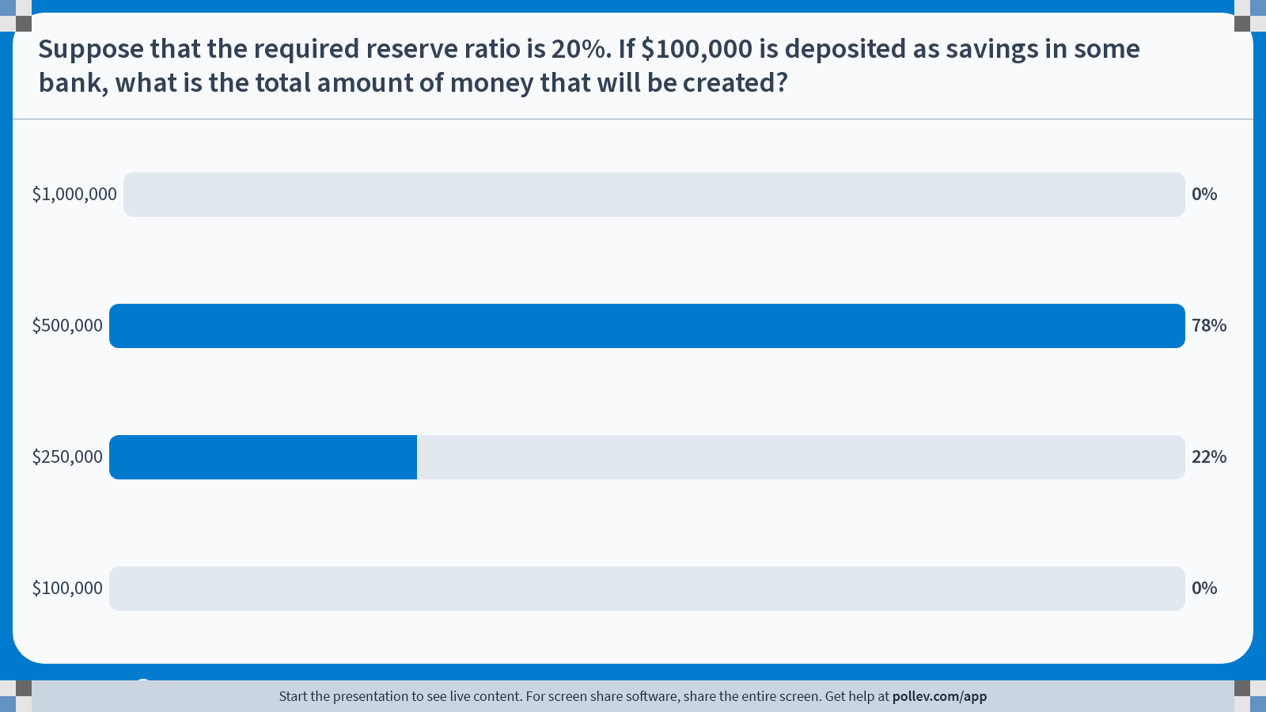
Notes:
Poll Title: Do not modify the notes in this section to avoid tampering with the Poll Everywhere activity.
More info at polleverywhere.com/support
Suppose that the required reserve ratio is 20%. If $100,000 is deposited as savings in some bank, what is the total amount of money that will be created?
https://www.polleverywhere.com/multiple_choice_polls/gndLgthmvl1J7CryvcbTd?display_state=chart&activity_state=closed&state=closed&flow=Engagement&onscreen=persist

Slide 27
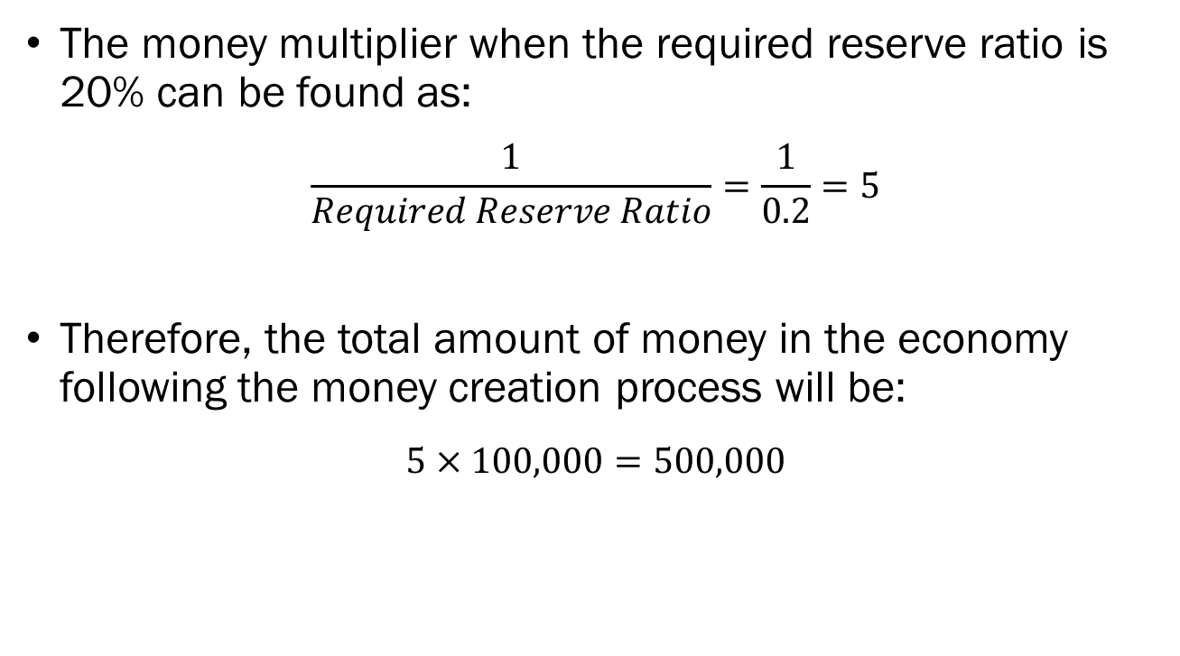
Solution to In-Class Poll
The money multiplier when the required reserve ratio is 20% can be found as:
$$\frac{1}{Required Reserve Ratio}=\frac{1}{0.2}=5$$
Therefore, the total amount of money in the economy following the money creation process will be:
$$5×100,000=500,000$$

Slide 28
Reserve Requirements
Note that by increasing the required reserve ratio, less money was created in the economy.
When the required reserve ratio is high, less money is created in the economy.
When the required reserve ratio is low, more money is created in the economy.
This is why the Federal Reserve considers the reserve requirements as a tool of monetary policy.

Slide 29
Reserve Requirements
The current required reserve ratio is…
  0%
  As of May 26th, 2020
  Response to the global pandemic and the resulting recession.
Prior to 2020,
  10% for large banks with more than $124.2 million in net transaction accounts.
  3% for mid-sized banks with more than $16.3 million to $124.2 million in net transaction accounts.
  0% for smaller banks with less than $16.3 million in net transaction accounts.

Slide 30
Reserve Requirements
If banks are profit-maximizing, they will lend out as much money as legally possible.
They will keep a small portion of their clients’ deposits, and loan out the remainder.
We call this a “fractional reserve banking” system, where banks are allowed to keep only fraction of deposits for withdrawal.

Slide 31
Reserve Requirements
But what happens when everyone wants their money at once?
When many customers request a withdrawal of their deposits over a short window of time, a bank run may occur.
The biggest bank run in history occurred on March 9th, 2023, when Silicon Valley Bank faced withdrawals of $42 billion in a single day.

Slide 32

Reserve Requirements

Slide 33
Controlling Interest Rates
Discount Rate
  The interest rate that is charged when private banks loan money from the Federal Reserve Bank.
  The channel is called the “discount window,” and it serves as private banks’ last resort under liquidity crises.
Federal Funds Rate
  The interest rate that private banks charge each other in the federal funds market.
  The federal funds market is an overnight (24 hour) market where banks lend and borrow from each other.
  It is called the federal funds market, since the funds traded are reserves held by the Federal Reserve Bank.

Slide 34
Controlling Interest Rates
The Fed sets a target for the federal funds rate by dictating the interest rate on reserves (or Open Market Operations).
As of Jan. 31st 2024, the target rate is 5.25% ~ 5.5%.
When interest rates are high, the cost of borrowing money is high, so borrowing will decrease, and money supply will fall.
When interest rates are low, cost of borrowing is low, so borrowing increases, and money supply increases.

Slide 35
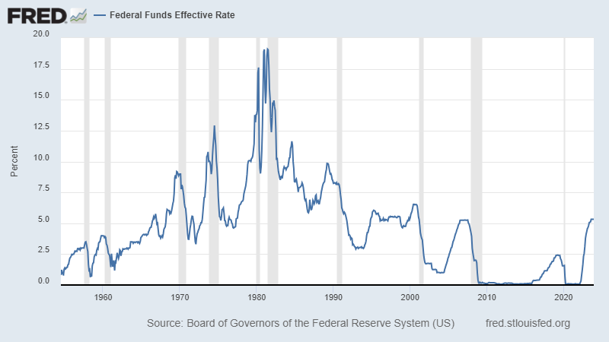
Controlling Interest Rates

Slide 36
Controlling Interest Rates
In the 1980s, Paul Volcker, then chair of the FRB raised the Federal Funds Rate to 20% to curb inflation and slow down the economy.
Influence on everyday consumers?
  New auto loan of $50,000 on a 60-month plan.
  Under a 5.5% interest, monthly payments is $955.06.
    Total sum of payments would have been $57,303.49.
  Under a 20% interest, monthly payments is $1,352.67.
    Total sum of payments would have been $81,160.08.
Called the “Volcker Shock,” but it did rein in inflation.

Slide 37
Open Market Operations
The Fed conducts open market operations, which simply means that they buy and sell securities, typically government bonds.
Open market purchases of securities by the Fed will lead to an increase of reserves in the banking system, which leads to an increase of money supply in the market.
Open market sales of securities by the Fed will lead to a decrease of reserves in the banking system, which leads to a decrease of money supply in the market.

Slide 38
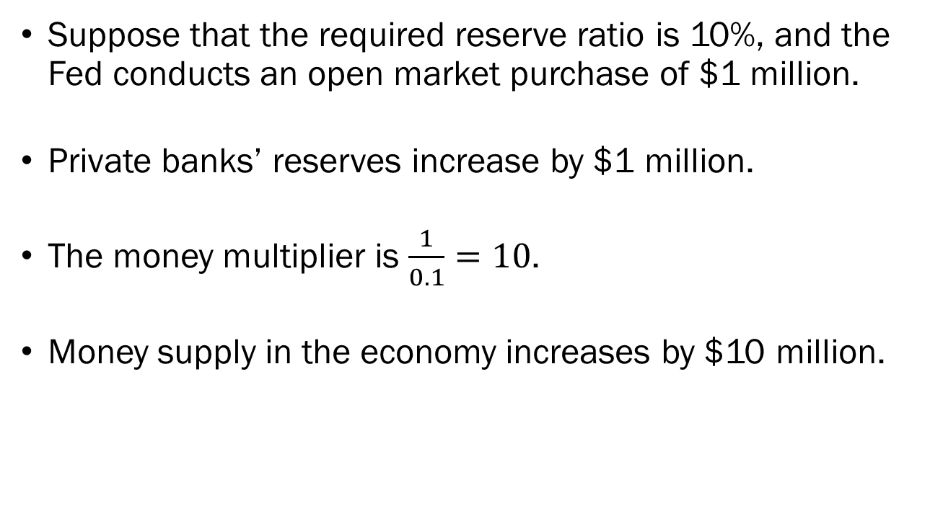
Open Market Operations: An Example
Suppose that the required reserve ratio is 10%, and the Fed conducts an open market purchase of $1 million.
Private banks’ reserves increase by $1 million.
The money multiplier is $\frac{1}{0.1}=10$.
Money supply in the economy increases by $10 million.

Slide 39
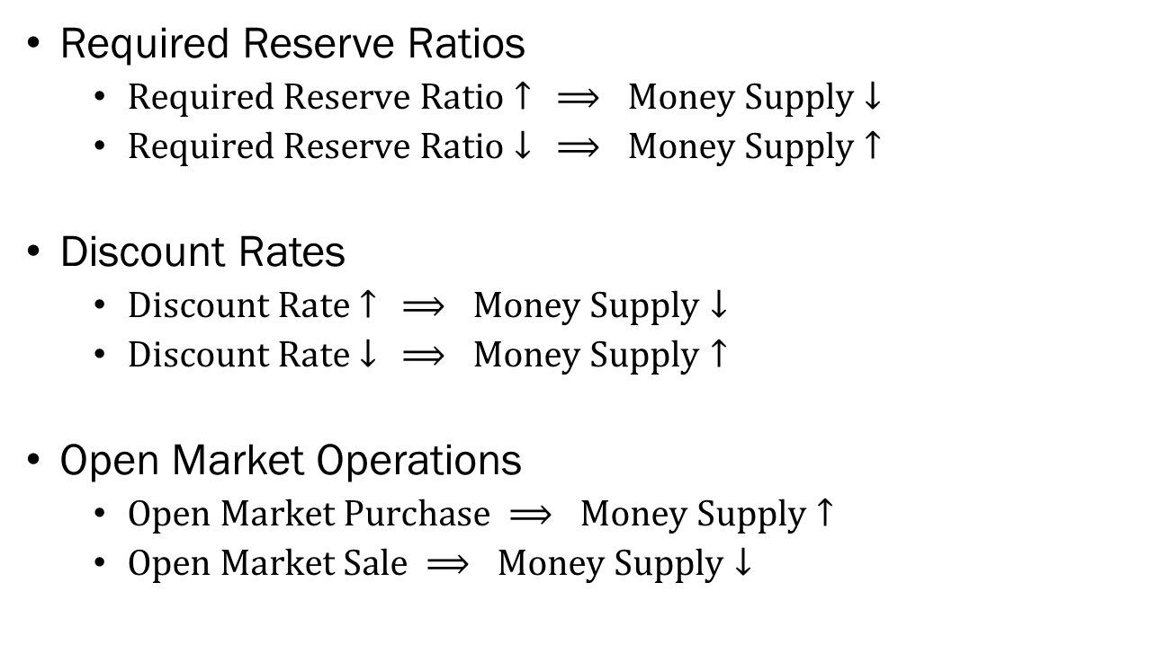
Federal Reserve’s Monetary Policy
Required Reserve Ratios
  $Required Reserve Ratio↑ ⟹ Money Supply↓$
  $Required Reserve Ratio↓ ⟹ Money Supply↑$
Discount Rates
  $Discount Rate↑ ⟹ Money Supply↓$
  $Discount Rate↓ ⟹ Money Supply↑$
Open Market Operations
  $Open Market Purchase ⟹ Money Supply↑$
  $Open Market Sale ⟹ Money Supply↓$

Slide 40

The Money Supply Curve
$$M^{S}$$
Money supply is under total control of the Fed.
Therefore, the money supply in our model will be a vertical line.
Money demand is more interesting, since it will be determined by households’ choices.
Interest
Money

Slide 41
The Demand for Money
In this simple model, we assume that there are two asset classes
  Money: May be used in transactions but bears no interest.
  Bonds: Cannot be used in transactions but bears interest.
All households in the economy must determine their optimal holdings of money and bonds.
  When households tend to spend a large portion of their income, they would want to hold more money than bonds.
  When the interest rate is high, households would favor holding more bonds than money.

Slide 42

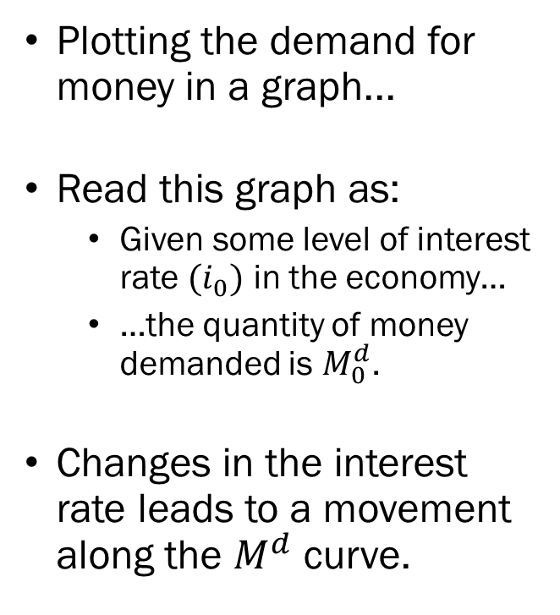


The Demand for Money
Plotting the demand for money in a graph...
Read this graph as:
  Given some level of interest rate $(i_{0})$ in the economy…
  …the quantity of money demanded is $M_{0}^{d}$.
Changes in the interest rate leads to a movement along the $M^{d}$ curve.
Interest Rate
$$i_{0}$$
$$M^{d}$$
$$M_{0}^{d}$$
Money

Slide 43

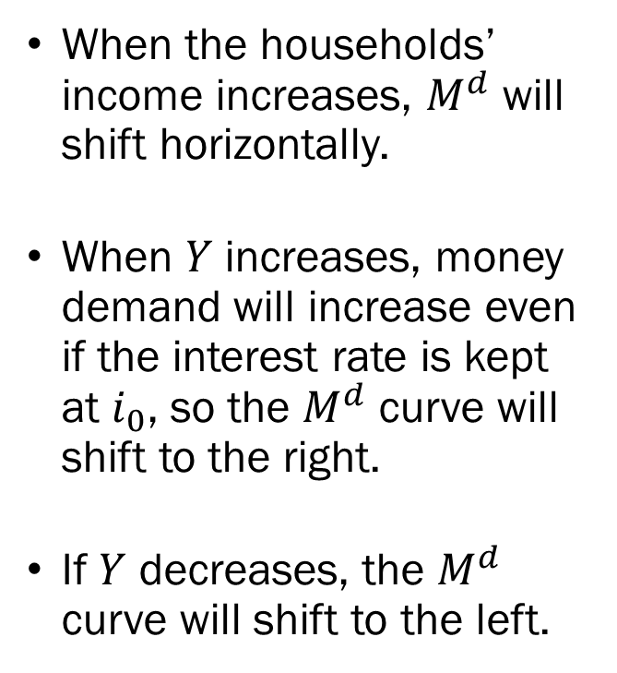

The Demand for Money
When the households’ income increases, $M^{d}$ will shift horizontally.
When $Y$ increases, money demand will increase even if the interest rate is kept at $i_{0}$, so the $M^{d}$ curve will shift to the right.
If $Y$ decreases, the $M^{d}$ curve will shift to the left.
Interest Rate
$$i_{0}$$
$$M^{d′}$$
$$M^{d}$$
$$M_{0}^{d}$$
$$M_{1}^{d}$$
Money

Slide 44
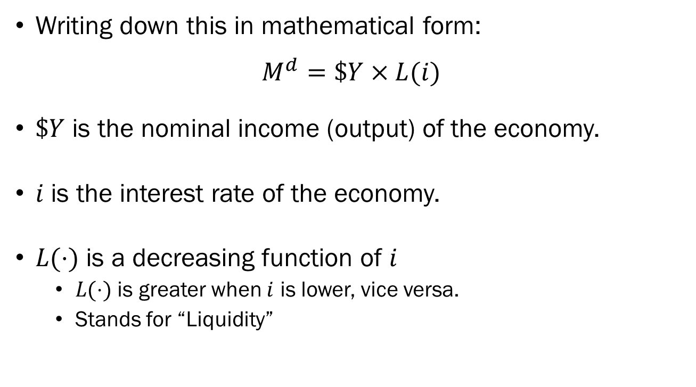
The Demand for Money
Writing down this in mathematical form:
$$M^{d}=\$Y×L(i)$$
$\$Y$ is the nominal income (output) of the economy.
$i$ is the interest rate of the economy.
$L(⋅)$ is a decreasing function of $i$
  $L(⋅)$ is greater when $i$ is lower, vice versa.
  Stands for “Liquidity”

Slide 45
Equilibrium in the Financial Market
We will combine money supply from the previous lectures, and money demand from this lecture to build a model that determines the equilibrium in the financial market.
Quick recap of money supply:
  Controlled by the Fed through its tools of monetary policies;
  Required Reserve Ratio.
  Key Interest Rates (Discount Rate, Federal Funds Rate).
  Open Market Operations.
  Expressed as a vertical line in graphs.

Slide 46

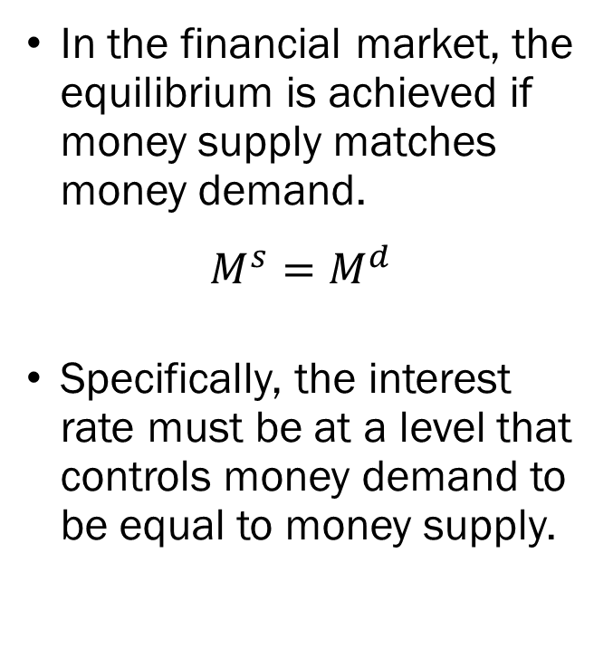



Equilibrium in the Financial Market
In the financial market, the equilibrium is achieved if money supply matches money demand.
$$M^{s}=M^{d}$$
Specifically, the interest rate must be at a level that controls money demand to be equal to money supply.
$$M^{s}$$
Interest Rate
$$i^{∗}$$
$$M^{d}$$
$$M^{s}=M^{d}=M^{∗}$$
Money

Slide 47
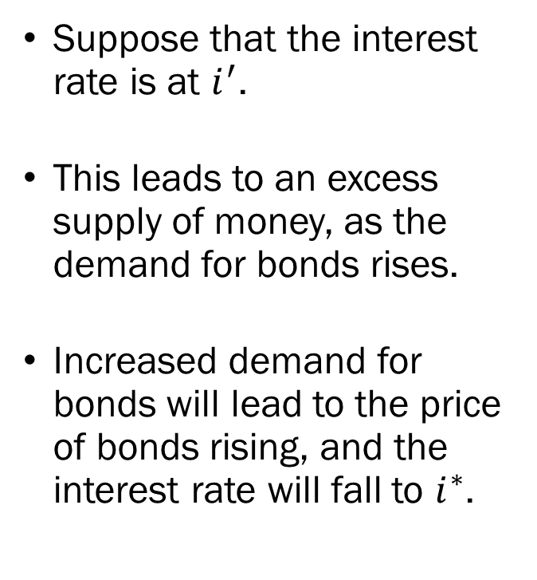

Equilibrium in the Financial Market
Suppose that the interest rate is at $i^{′}$.
This leads to an excess supply of money, as the demand for bonds rises.
Increased demand for bonds will lead to the price of bonds rising, and the interest rate will fall to $i^{∗}$.
$$M^{s}$$
Interest Rate
$$i^{′}$$
$$i^{∗}$$
$$M^{d}$$
Excess Money Supply
Money

Slide 48
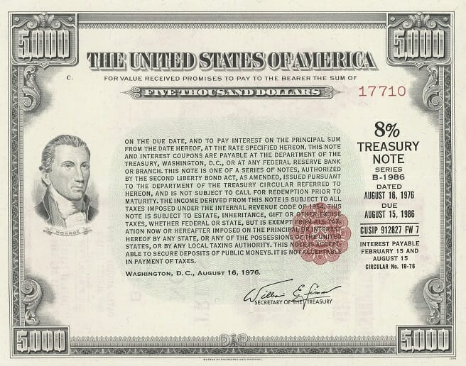
Detour: Bond Prices and Interest Rates
FACE VALUE
INTEREST
What does this mean?
  Face Value: $5,000
  Stated Interest Rate: 8%
  Maturity: 10 Years
“If you purchase this bond now, you will get 8% of the face value every 6 months, and at maturity (10 years from now) you will get the face value amount.”
MATURITY
INTEREST PAYMENTS

Slide 49
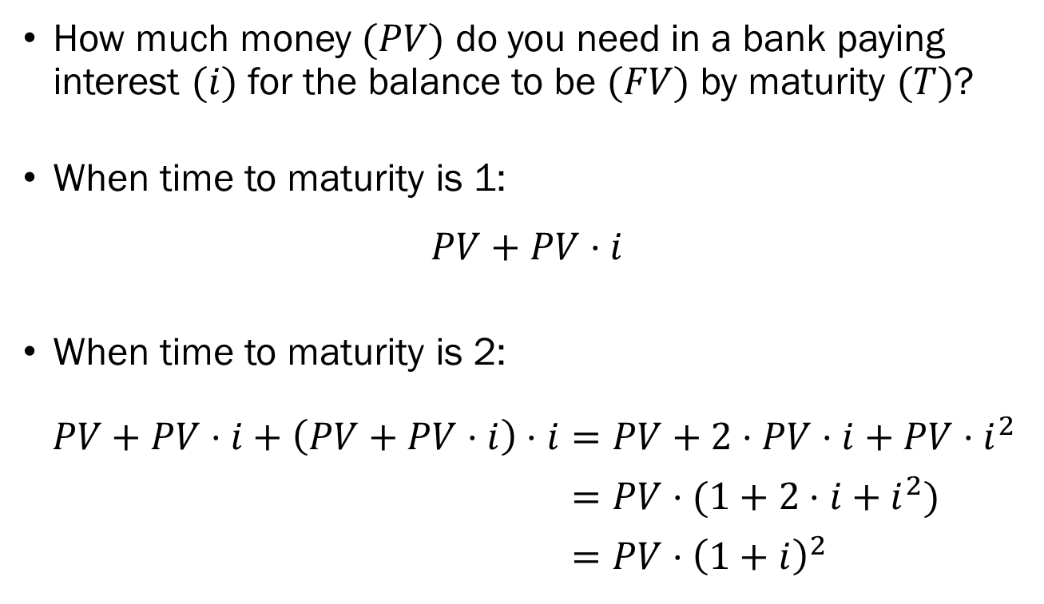
Detour: Bond Prices and Interest Rates
How much money $(PV)$ do you need in a bank paying interest $(i)$ for the balance to be $(FV)$ by maturity $(T)$?
When time to maturity is 1:
$$PV+PV⋅i$$
When time to maturity is 2:
$PV+PV⋅i+\left(PV+PV⋅i\right)⋅i=PV+2⋅PV⋅i+PV⋅i^{2}$
$=PV⋅(1+2⋅i+i^{2})$
$=PV⋅{\left(1+i\right)}^{2}$

Slide 50
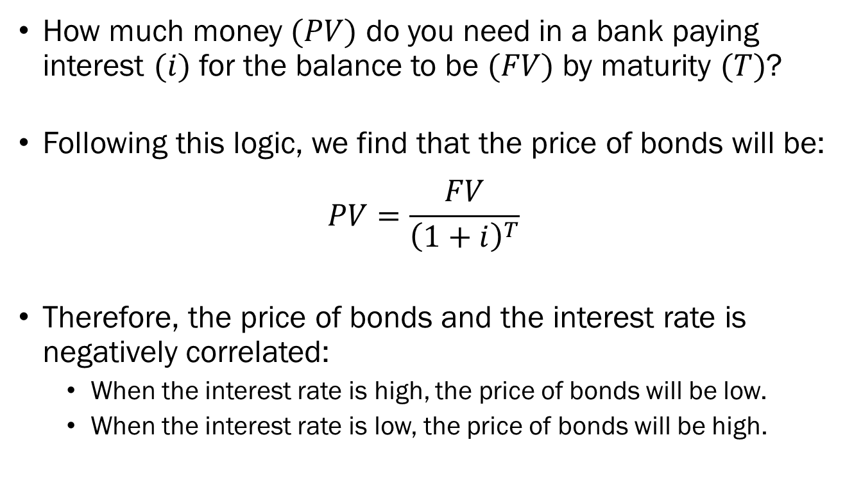
Detour: Bond Prices and Interest Rates
How much money $(PV)$ do you need in a bank paying interest $(i)$ for the balance to be $(FV)$ by maturity $(T)$?
Following this logic, we find that the price of bonds will be:
$$PV=\frac{FV}{{\left(1+i\right)}^{T}}$$
Therefore, the price of bonds and the interest rate is negatively correlated:
  When the interest rate is high, the price of bonds will be low.
  When the interest rate is low, the price of bonds will be high.

Slide 51
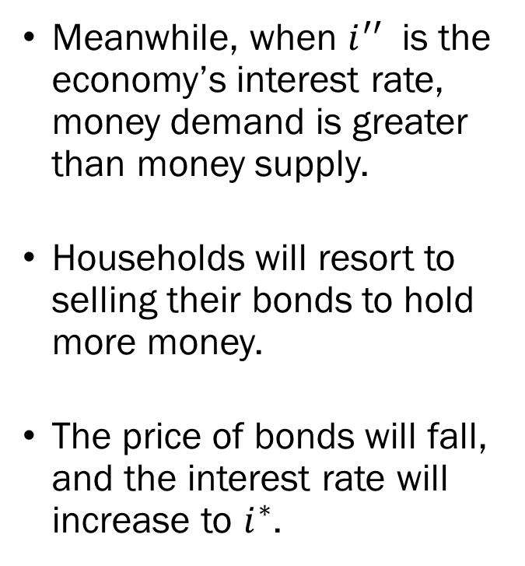

Equilibrium in the Financial Market
Meanwhile, when $i^{′′}$ is the economy’s interest rate, money demand is greater than money supply.
Households will resort to selling their bonds to hold more money.
The price of bonds will fall, and the interest rate will increase to $i^{∗}$.
$$M^{s}$$
Interest Rate
$$i^{∗}$$
$$i^{′′}$$
$$M^{d}$$
Excess Money Demand
Money

Slide 52

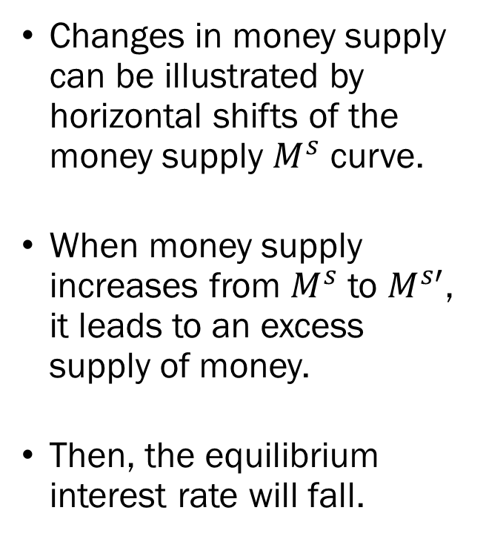

Changes in Money Supply
Changes in money supply can be illustrated by horizontal shifts of the money supply $M^{s}$ curve.
When money supply increases from $M^{s}$ to $M^{s′}$, it leads to an excess supply of money.
Then, the equilibrium interest rate will fall.
$$M^{s}$$
$$M^{s′}$$
Interest Rate
$$i^{∗}$$
$$i^{∗′}$$
$$M^{d}$$
Money

Slide 53

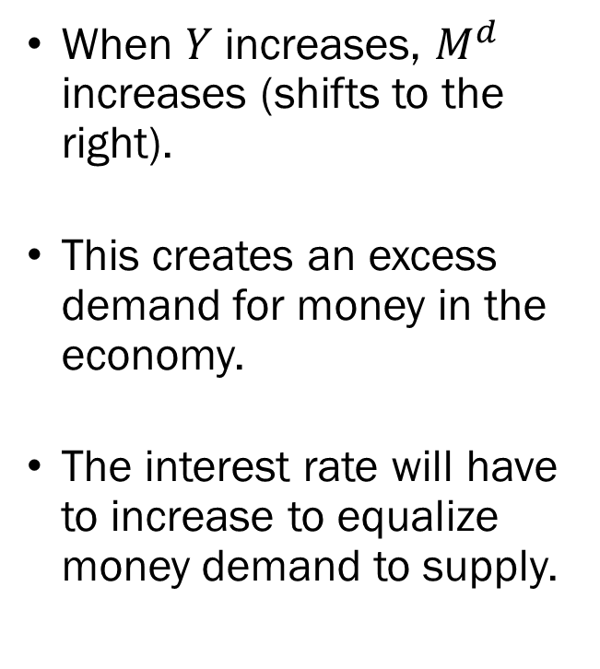


Changes in Nominal Income
When $Y$ increases, $M^{d}$ increases (shifts to the right).
This creates an excess demand for money in the economy.
The interest rate will have to increase to equalize money demand to supply.
$$M^{s}$$
Interest Rate
$$i^{∗′}$$
$$i^{∗}$$
$$M^{d′}$$
$$M^{d}$$
Money

Slide 54
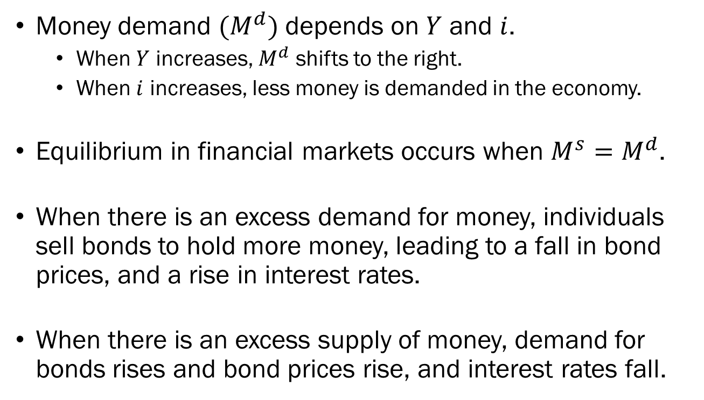
Recap
Money demand $(M^{d})$ depends on $Y$ and $i$.
  When $Y$ increases, $M^{d}$ shifts to the right.
  When $i$ increases, less money is demanded in the economy.
Equilibrium in financial markets occurs when $M^{s}=M^{d}$.
When there is an excess demand for money, individuals sell bonds to hold more money, leading to a fall in bond prices, and a rise in interest rates.
When there is an excess supply of money, demand for bonds rises and bond prices rise, and interest rates fall.

Slide 55
Combining the Goods Market and the Financial Market
The goods market is a place where economic agents trade goods and services, and its functions determine the equilibrium level of output in the economy.
This equilibrium level of output influences the financial market by shifting money demand.
The financial market is a place where financial assets are traded, and its functions determine the equilibrium level of interest rate in the economy.
The interest rate determined in the financial market will influence the goods market by shifting investment.

