Slide 1
Expectations:
Financial Markets
ECON 301

Slide 2
Expectations in the Economy
We already analyzed the role of expected inflation on the medium run and observed the consequences of the mis-management of expectations.
Expectations play a key role in the economy through other various channels as well.
We will start off by examining the role of expectations on the determination of asset prices, and its impact on the financial market.

Slide 3
POLLEVERYWHERE

Slide 4
Question!
How much should you pay to add a new machine in your production line?
This new machine will lead to higher productivity, which leads to an increase in output, generating more profit in the future.
While the benefits are reaped in the future, the cost must be incurred in the present.
How are we going to compare the value of the cost today, and the present value of expected profit in the future?

Slide 5
Expected Present Discounted Value
The concept of “expected present discounted value” will be useful in this type of situation.
Calculate the expected present discounted value of the stream of future profit.
Compare the value with the cost of purchasing the new machine.
If the cost is less than the expected present discounted value of increased profit, purchase the machine.

Slide 6
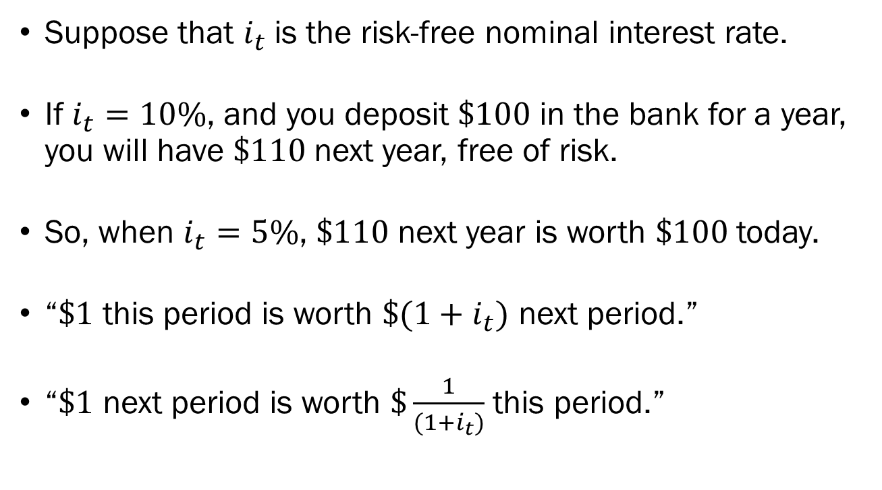
Expected Present Discounted Value
Suppose that $i_{t}$is the risk-free nominal interest rate.
If $i_{t}=10\%$, and you deposit $\$100$ in the bank for a year, you will have $\$110$ next year, free of risk.
So, when $i_{t}=5\%$, $\$110$ next year is worth $\$100$ today.
“$\$1$ this period is worth $\$(1+i_{t})$ next period.”
“$\$1$ next period is worth $\$\frac{1}{(1+i_{t})}$ this period.”

Slide 7
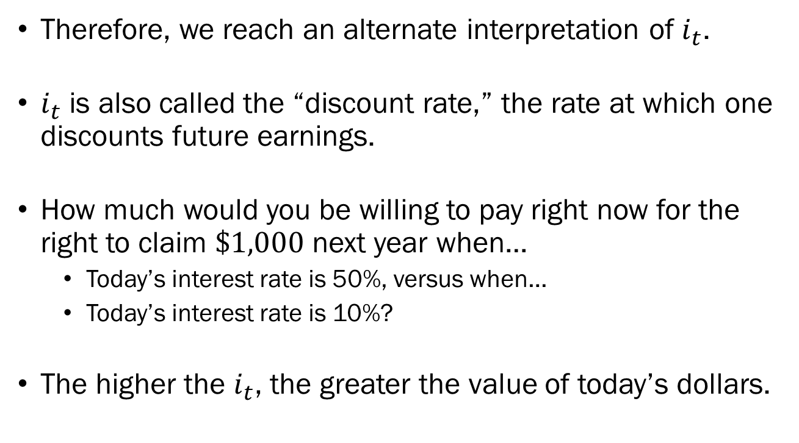
The Discount Rate
Therefore, we reach an alternate interpretation of $i_{t}$.
$i_{t}$ is also called the “discount rate,” the rate at which one discounts future earnings.
How much would you be willing to pay right now for the right to claim $\$1,000$ next year when…
  Today’s interest rate is 50%, versus when…
  Today’s interest rate is 10%?
The higher the $i_{t}$, the greater the value of today’s dollars.

Slide 8
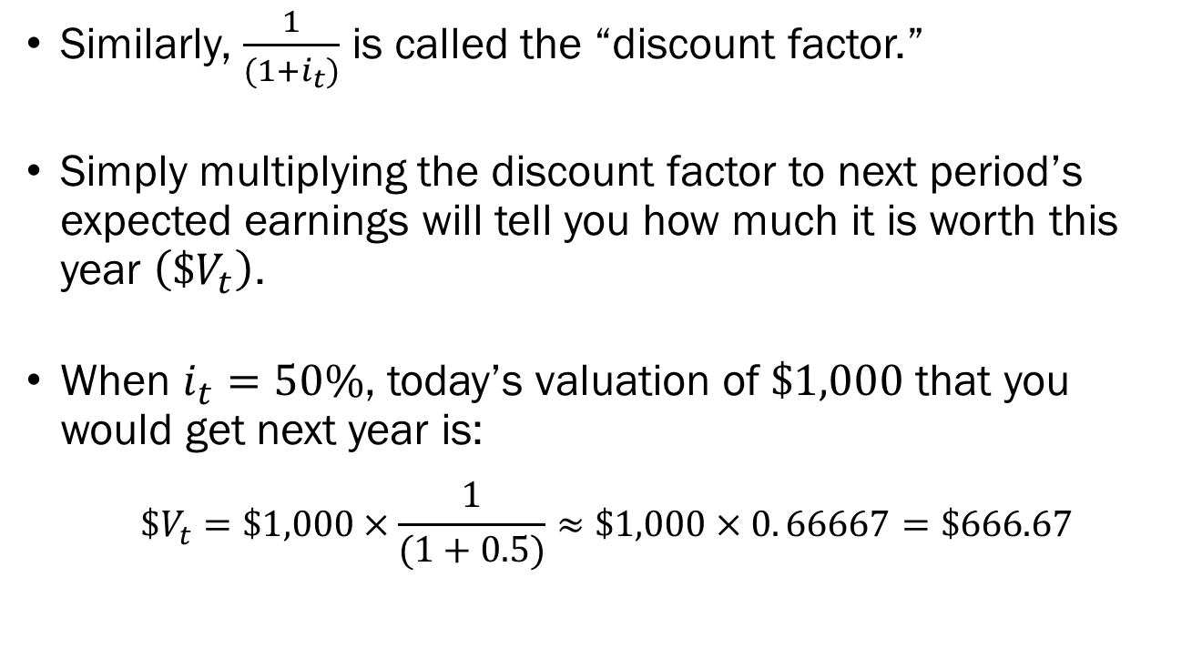
The Discount Factor
Similarly, $\frac{1}{(1+i_{t})}$ is called the “discount factor.”
Simply multiplying the discount factor to next period’s expected earnings will tell you how much it is worth this year $\left(\$V_{t}\right)$.
When $i_{t}=50\%$, today’s valuation of $\$1,000$ that you would get next year is:
$$\$V_{t}=\$1,000×\frac{1}{(1+0.5)}≈\$1,000×0. 66667=\$666.67$$

Slide 9
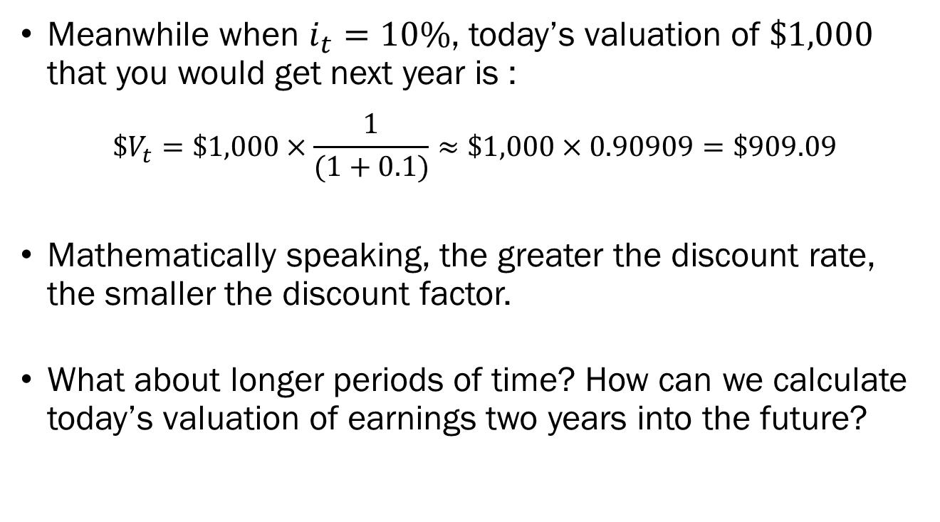
The Discount Factor
Meanwhile when $i_{t}=10\%$, today’s valuation of $\$1,000$ that you would get next year is :
$$\$V_{t}=\$1,000×\frac{1}{(1+0.1)}≈\$1,000×0.90909=\$909.09$$
Mathematically speaking, the greater the discount rate, the smaller the discount factor.
What about longer periods of time? How can we calculate today’s valuation of earnings two years into the future?

Slide 10
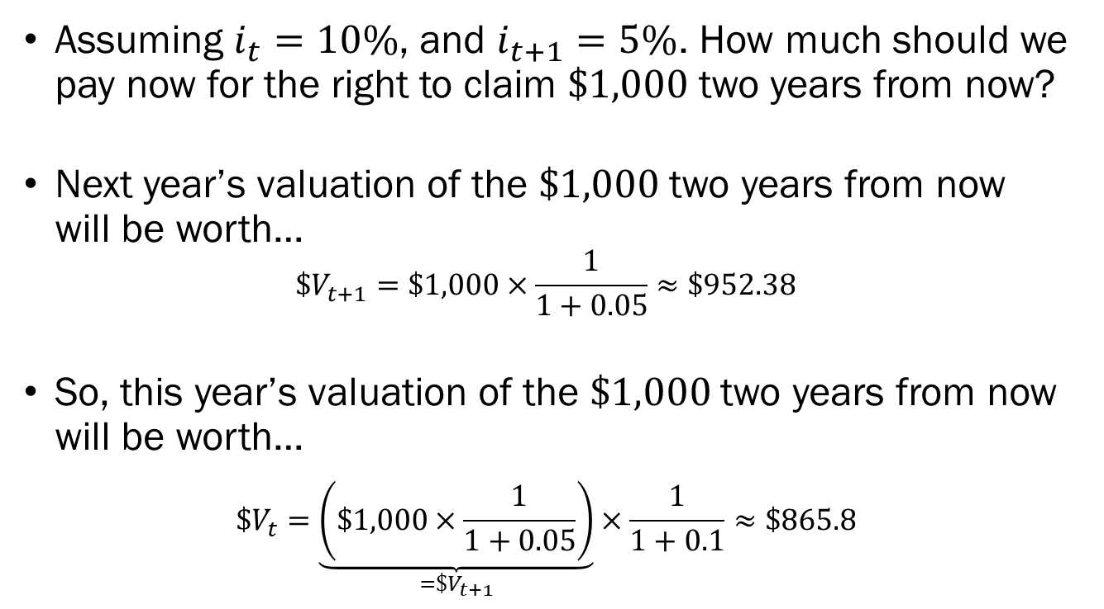
Two Periods of Time
Assuming $i_{t}=10\%$, and $i_{t+1}=5\%$. How much should we pay now for the right to claim $\$1,000$ two years from now?
Next year’s valuation of the $\$1,000$ two years from now will be worth…
$$\$V_{t+1}=\$1,000×\frac{1}{1+0.05}≈\$952.38$$
So, this year’s valuation of the $\$1,000$ two years from now will be worth…
$$\$V_{t}=\underset{=\$V_{t+1}}{\underbrace{\left(\$1,000×\frac{1}{1+0.05}\right)}}×\frac{1}{1+0.1}≈\$865.8$$

Slide 11

Two Periods of Time
If the risk-free rates in the future are given as $i_{t}, i_{t+1}$, then today’s valuation $\left(\$V_{t}\right)$ of $\$z$ available 2 years from now should be:
$$\$V_{t}=\$z×\frac{1}{\left(1+i_{t}\right)\left(1+i_{t+1}\right)}$$

Slide 12
Longer Periods of Time
For longer periods of time, finding the current valuation of future earnings follows a similar logic.
For simplicity’s sake, we will be considering the following scenarios.
Constant Interest Rates & Constant and Finite Payments
  “Interest is 5% every year, get paid $100 per year for 10 years.”
Constant Interest Rates & Constant and Infinite Payments
  “Interest is 5% every year, get paid $100 per year forever.”

Slide 13
Constant Interest Rates &
Constant and Finite Payments
Suppose that you are on the verge of purchasing a new machine that lasts 5 years, which would guarantee $100,000 extra profit at the end of each year.
Adding up the total additional profit we can get from the new machine would yield $500,000.
Assuming that the risk-free interest rate is 5%, how much should you be willing to pay for this new machine?
We will look at today’s valuation of each year’s extra profits one by one and add them up.

Slide 14
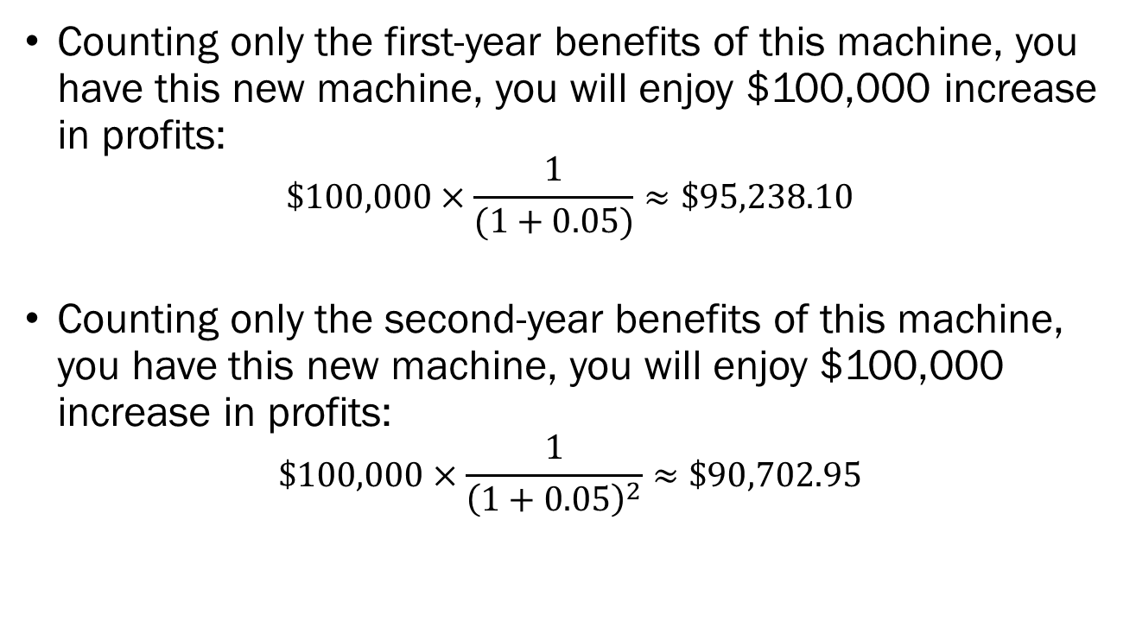
Constant Interest Rates &
Constant and Finite Payments
Counting only the first-year benefits of this machine, you have this new machine, you will enjoy $100,000 increase in profits:
$$\$100,000×\frac{1}{(1+0.05)}≈\$95,238.10$$
Counting only the second-year benefits of this machine, you have this new machine, you will enjoy $100,000 increase in profits:
$$\$100,000×\frac{1}{{\left(1+0.05\right)}^{2}}≈\$90,702.95$$

Slide 15
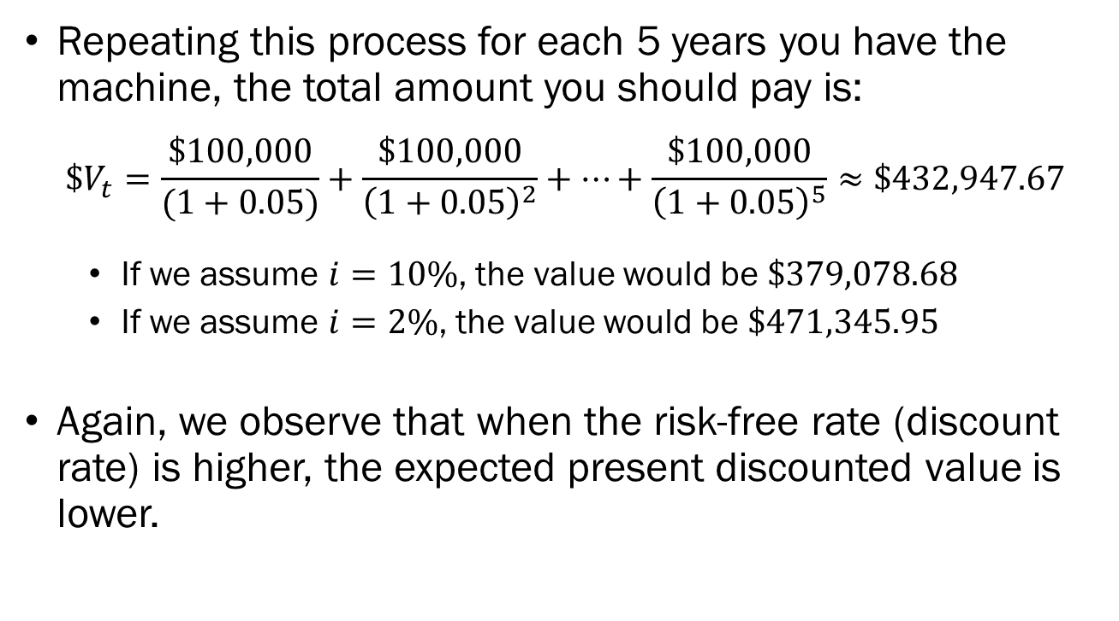
Constant Interest Rates &
Constant and Finite Payments
Repeating this process for each 5 years you have the machine, the total amount you should pay is:
$$\$V_{t}=\frac{\$100,000}{(1+0.05)}+\frac{\$100,000}{{\left(1+0.05\right)}^{2}}+⋯+\frac{\$100,000}{{\left(1+0.05\right)}^{5}}≈\$432,947.67$$
  If we assume $i=10\%$, the value would be $\$379,078.68$
  If we assume $i=2\%$, the value would be $\$471,345.95$
Again, we observe that when the risk-free rate (discount rate) is higher, the expected present discounted value is lower.

Slide 16
POLLEVERYWHERE

Slide 17
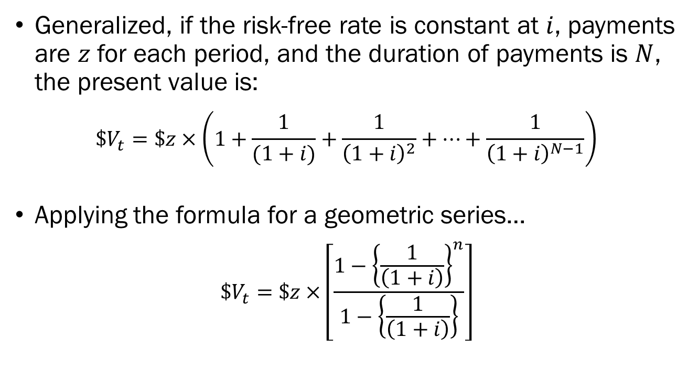
Constant Interest Rates &
Constant and Finite Payments
Generalized, if the risk-free rate is constant at $i$, payments are $z$ for each period, and the duration of payments is $N$, the present value is:
$$\$V_{t}=\$z×\left(1+\frac{1}{(1+i)}+\frac{1}{{\left(1+i\right)}^{2}}+⋯+\frac{1}{{\left(1+i\right)}^{N−1}}\right)$$
Applying the formula for a geometric series…
$$\$V_{t}=\$z×\left[\frac{1−{\left\{\frac{1}{\left(1+i\right)}\right\}}^{n}}{1−\left\{\frac{1}{\left(1+i\right)}\right\}}\right]$$

Slide 18
Constant Interest Rates &
Constant and Infinite Payments
Suppose that you are on the verge of purchasing a new machine that lasts forever, which would guarantee $100,000 extra profit at the end of each year.
Adding up the total additional profit we can get from the new machine would yield infinite profit?
Assuming that the risk-free interest rate is 5%, how much should you be willing to pay for this new machine?
The answer is $2,100,000… Let’s see how we got this…

Slide 19
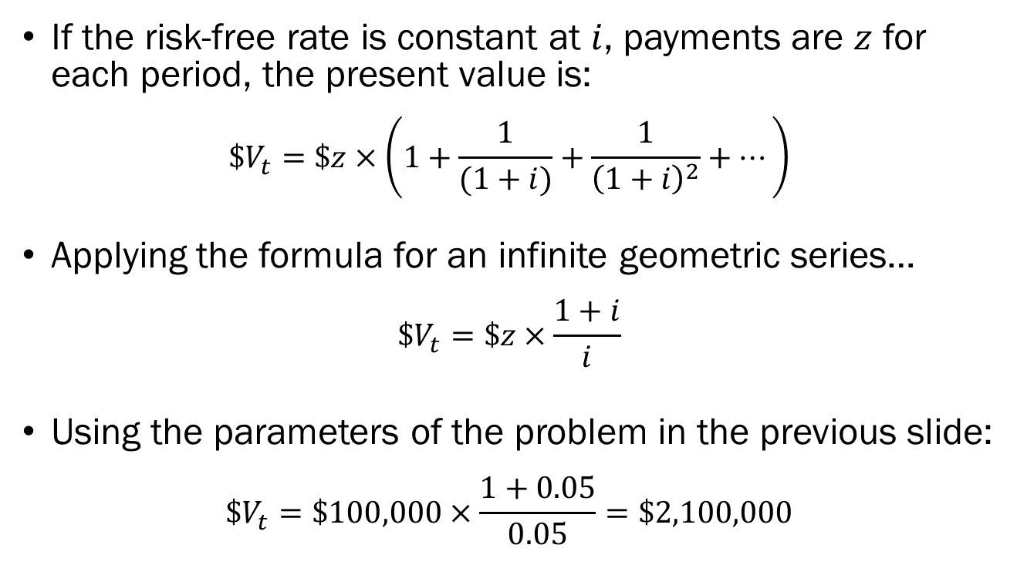
Constant Interest Rates &
Constant and Infinite Payments
If the risk-free rate is constant at $i$, payments are $z$ for each period, the present value is:
$$\$V_{t}=\$z×\left(1+\frac{1}{(1+i)}+\frac{1}{{\left(1+i\right)}^{2}}+⋯\right)$$
Applying the formula for an infinite geometric series…
$$\$V_{t}=\$z×\frac{1+i}{i}$$
Using the parameters of the problem in the previous slide:
$$\$V_{t}=\$100,000×\frac{1+0.05}{0.05}=\$2,100,000$$

Slide 20
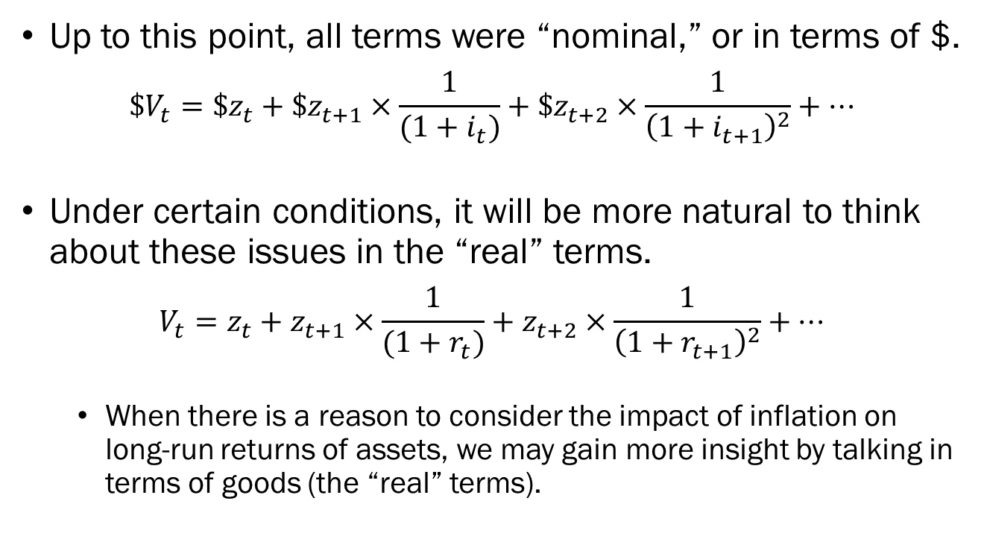
Nominal and Real Terms
Up to this point, all terms were “nominal,” or in terms of $.
$$\$V_{t}=\$z_{t}+\$z_{t+1}×\frac{1}{(1+i_{t})}+\$z_{t+2}×\frac{1}{{\left(1+i_{t+1}\right)}^{2}}+⋯$$
Under certain conditions, it will be more natural to think about these issues in the “real” terms.
$$V_{t}=z_{t}+z_{t+1}×\frac{1}{(1+r_{t})}+z_{t+2}×\frac{1}{{\left(1+r_{t+1}\right)}^{2}}+⋯$$
  When there is a reason to consider the impact of inflation on long-run returns of assets, we may gain more insight by talking in terms of goods (the “real” terms).

Slide 21
Bond Prices and Bond Yields
Bonds are financial assets that allow people to purchase government or corporate debt.
The two critical dimensions that define bonds are its maturity, and its risk.
Maturity is simply “the length of time over which the bond promises to make payments to the holder of the bond.”
The primary risk associated with a bond will be its default risk, which is the risk that the issuer of the bond will not be able to pay back the full amount of the issued bond.

Slide 22
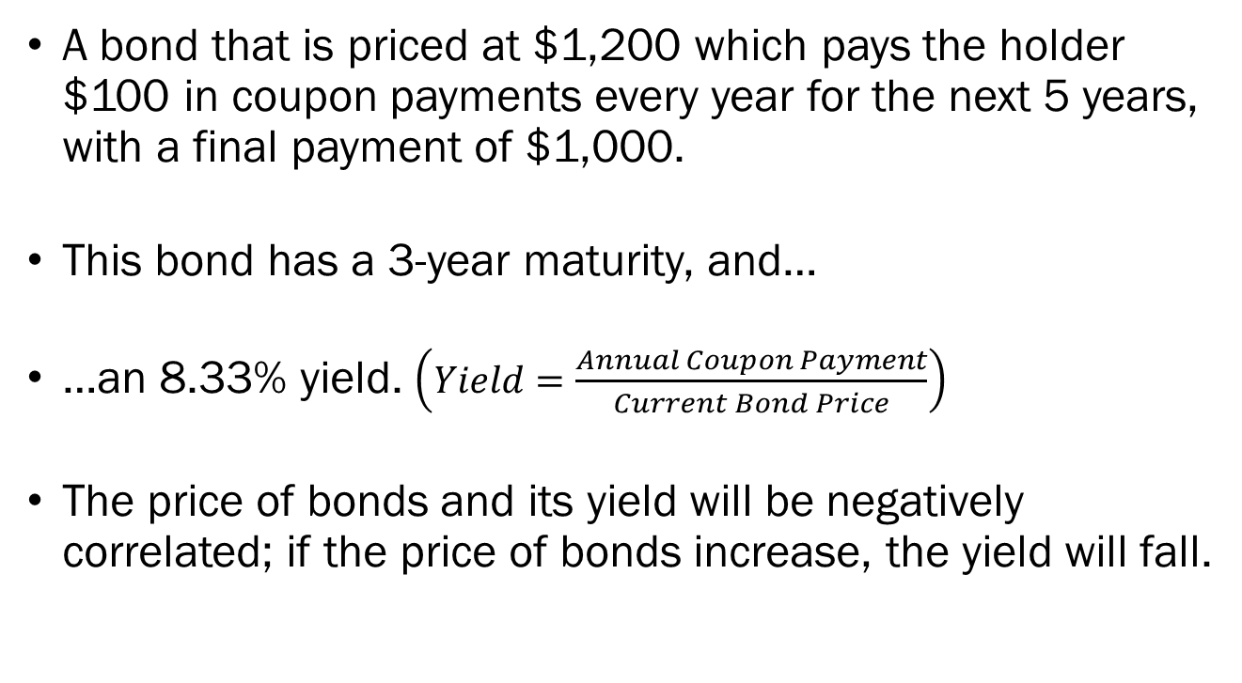
Bond Prices and Bond Yields
A bond that is priced at $1,200 which pays the holder $100 in coupon payments every year for the next 5 years, with a final payment of $1,000.
This bond has a 3-year maturity, and…
…an 8.33% yield. $\left(Yield=\frac{Annual Coupon Payment}{Current Bond Price}\right)$
The price of bonds and its yield will be negatively correlated; if the price of bonds increase, the yield will fall.

Slide 23
The Yield Curve
The yield of treasury bonds with a short maturity (less than 1 year) is called “short-term interest rates.”
The yield of treasury bonds with longer maturities are called “long-term interest rates.”
At any given time, we can plot the relationship between the maturity of each bond, and its yield.
The current values for the Yield Curve is:
Maturity | 3 month | 6 month | 1 year | 2 year | 5 year | 10 year | 30 year
Yield | 5.33% | 5.28% | 5.00% | 4.74% | 4.37% | 4.36% | 4.49%

Slide 24
The Yield Curve
A

