Slide 1
The Coase Theorem
ECON 380

Slide 2
Causes of Externalities
Usually, one of the following two reasons are behind most externalities.
Ambiguous Property Rights
  Who owns the right to clean water and air?
Prohibitive Transaction Costs
  It is almost impossible to get all stakeholders included in a discussion about clean air in Chicago.
To further discuss the role of property rights as a remedy for externalities, we must talk about Edgeworth Boxes.

Slide 3














Property Rights
$$Y^{A}$$
$$w_{x}^{B}$$
B
$$X^{B}$$
$$w_{∗}$$
$$IC_{∗}^{A}$$
$$w_{0}$$
$$w_{y}^{A}$$
$$w_{y}^{B}$$
$$IC_{∗}^{B}$$
$$IC_{0}^{A}$$
$$IC_{0}^{B}$$
$$X^{A}$$
A
$$w_{x}^{A}$$
$$Y^{B}$$

Slide 4
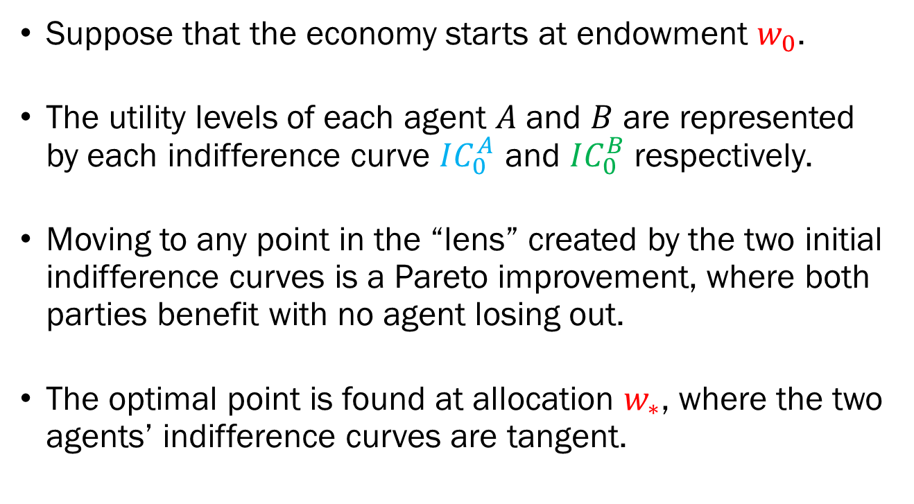
Property Rights
Suppose that the economy starts at endowment $w_{0}$.
The utility levels of each agent $A$ and $B$ are represented by each indifference curve $IC_{0}^{A}$ and $IC_{0}^{B}$ respectively.
Moving to any point in the “lens” created by the two initial indifference curves is a Pareto improvement, where both parties benefit with no agent losing out.
The optimal point is found at allocation $w_{∗}$, where the two agents’ indifference curves are tangent.

Slide 5
Property Rights
For the market to be efficient…
The endowment point (initial allocation) must be well defined and established.
The agents must be able to trade the goods to an alternate allocation representing a Pareto improvement.
The agents must be allowed to trade until they reach a Pareto optimal allocation.

Slide 6
Transaction Costs
Sometimes, even with clearly assigned property rights, the market may fail to achieve efficiency.
The transaction cost to negotiations may be prohibitively high to the degree it outweighs the benefits.
  Hundreds of non-smokers and smokers trying to reach an agreement on the smoking policy in a company.
  Constructing a new building that blocks the views from other existing buildings.
If the cost is too high, bargaining will not occur, and the economy will be stuck at the initial endowment point.

Slide 7
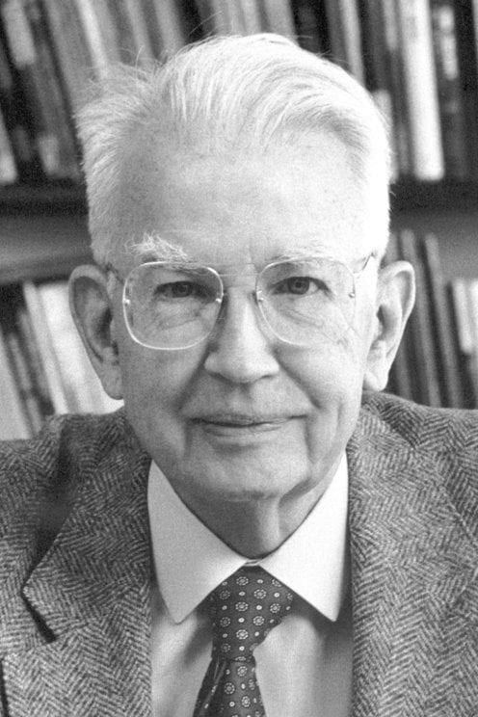
Are Government Interventions
Required to “Fix” Externalities?
We learned that externalities cause problems since it is not priced in the market.
For a long time, it was believed that governments must step in to remedy this externality.
Ronald H. Coase proposed in “The Problem of Social Cost,” that we may not need government interventions

Slide 8
Coase Theorem
The Coase Theorem states that even in the presence of externalities, the efficient outcome may be reached without government interventions given that…
  Property rights are clearly defined, and
  Transaction costs are very low, and
  There are no wealth (income) effects.
In fact, regardless of which agent owns the property rights, the economy will reach a socially optimal state.
This follows what is called “Coasean Bargaining.”

Slide 9

Sturges v Bridgman
(1879) LR 11 Ch D 852

Slide 10
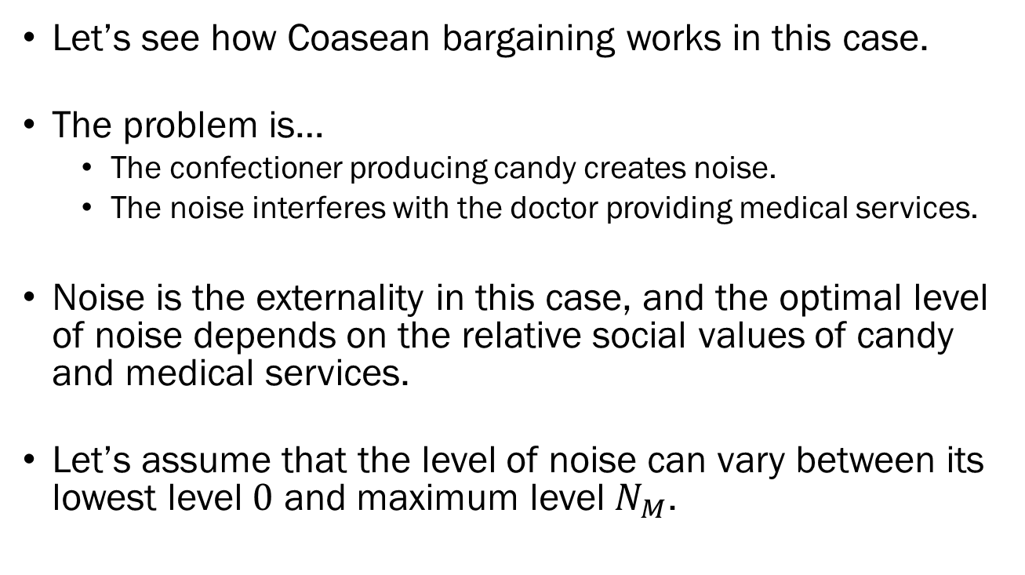
Coase Theorem
Let’s see how Coasean bargaining works in this case.
The problem is…
  The confectioner producing candy creates noise.
  The noise interferes with the doctor providing medical services.
Noise is the externality in this case, and the optimal level of noise depends on the relative social values of candy and medical services.
Let’s assume that the level of noise can vary between its lowest level $0$ and maximum level $N_{M}$.

Slide 11
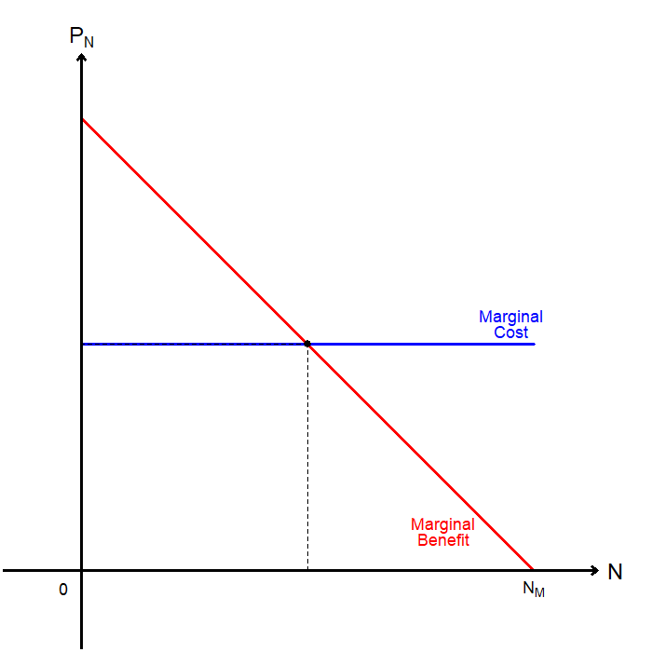
Coase Theorem
Marginal cost represents the cost imposed on the doctor by the confectioner’s production.
Marginal benefit represents the confectioner’s marginal profit from producing candy (and noise).
Suppose that the property rights goes to the doctor.

Slide 12
Coase Theorem
The initial noise will be set at 0, since the doctor dislikes noise.
The confectioner then may offer to pay the doctor some compensation for producing noise.
Is there any incentive for the doctor to consider this deal?

Slide 13
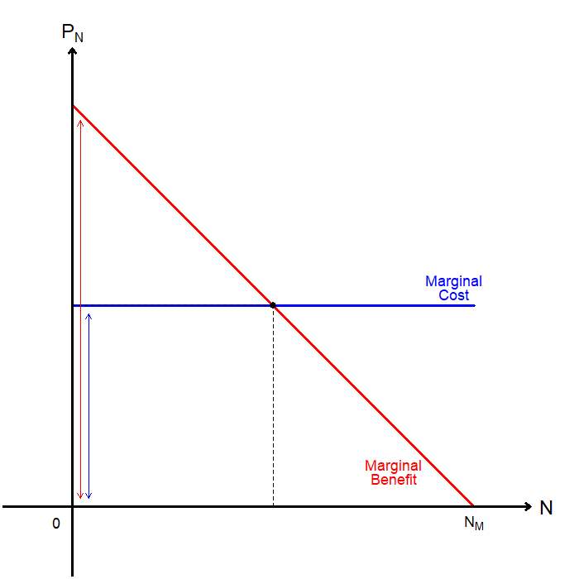
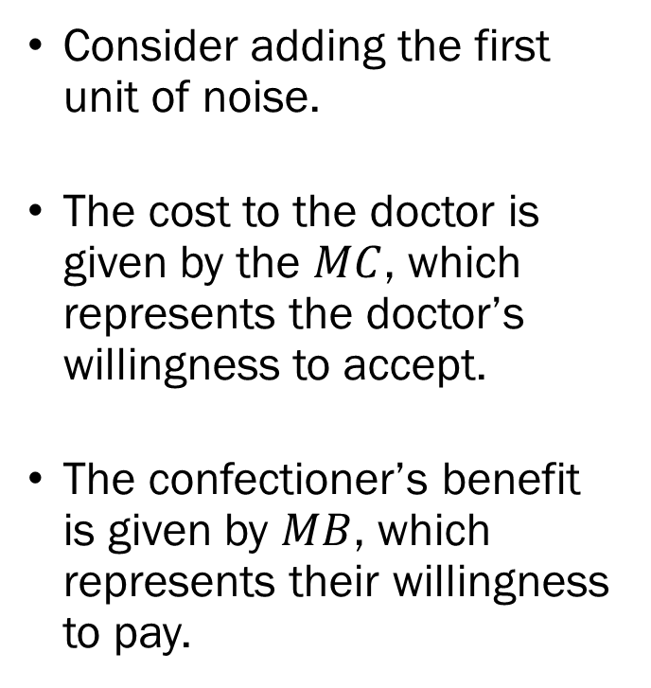
Coase Theorem
Consider adding the first unit of noise.
The cost to the doctor is given by the $MC$, which represents the doctor’s willingness to accept.
The confectioner’s benefit is given by $MB$, which represents their willingness to pay.

Slide 14
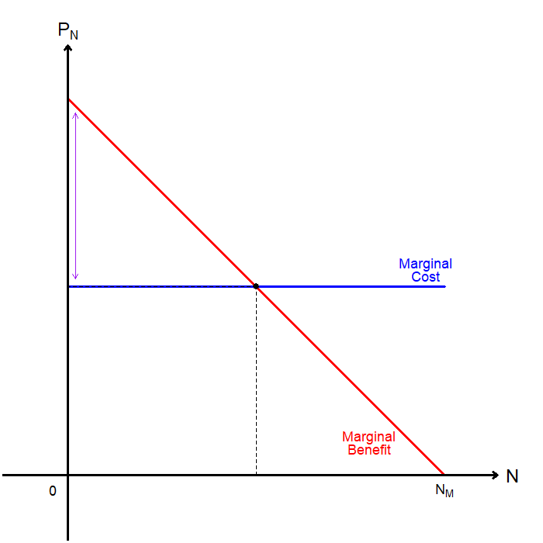
Coase Theorem
Since the confectioner is willing to pay more than the doctor’s asking price, the trade will be accepted.
Therefore, the noise level increases from 0 to some positive level.
Following the trade, the economy gains what is called “bargaining surplus.”

Slide 15
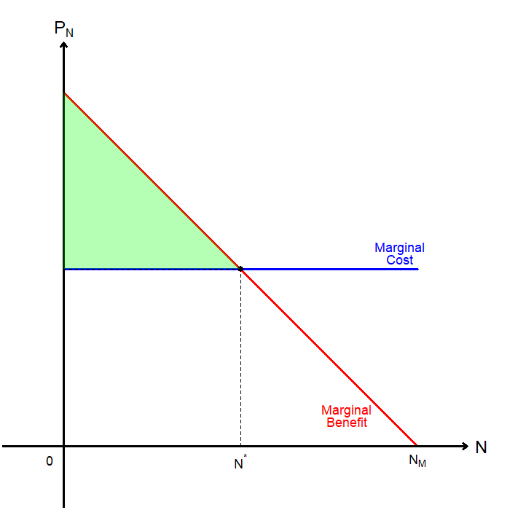
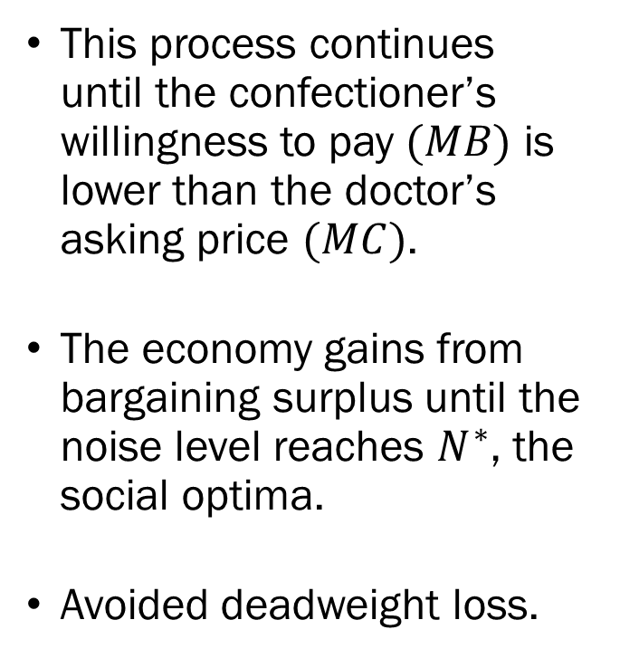
Coase Theorem
This process continues until the confectioner’s willingness to pay $(MB)$ is lower than the doctor’s asking price $(MC)$.
The economy gains from bargaining surplus until the noise level reaches $N^{∗}$, the social optima.
Avoided deadweight loss.

Slide 16
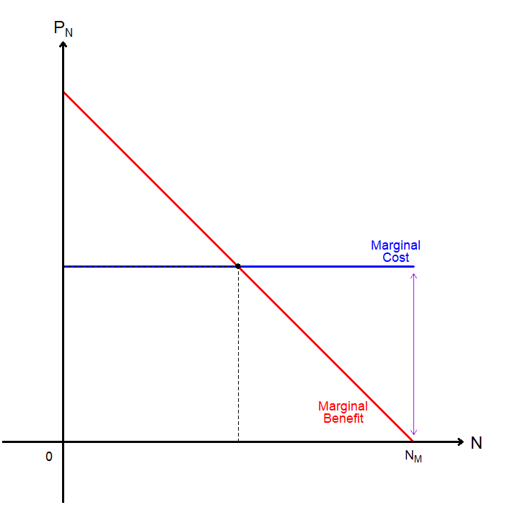
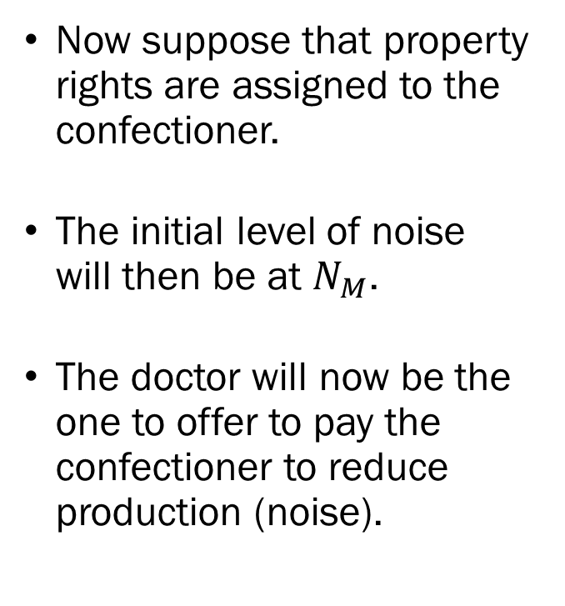
Coase Theorem
Now suppose that property rights are assigned to the confectioner.
The initial level of noise will then be at $N_{M}$.
The doctor will now be the one to offer to pay the confectioner to reduce production (noise).

Slide 17
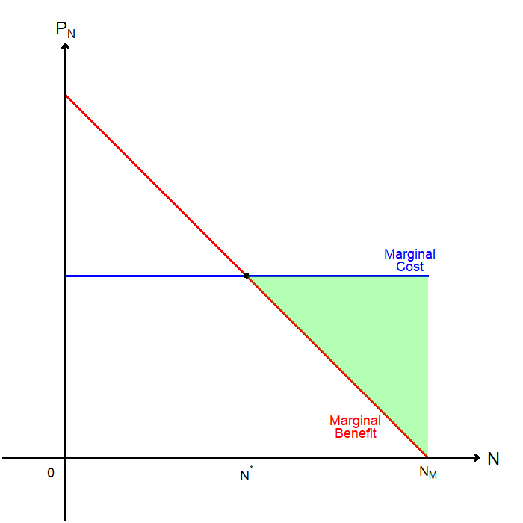
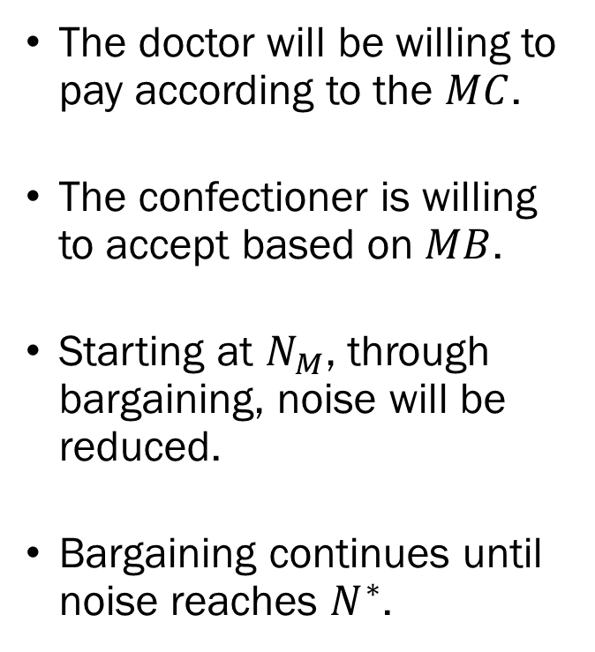
Coase Theorem
The doctor will be willing to pay according to the $MC$.
The confectioner is willing to accept based on $MB$.
Starting at $N_{M}$, through bargaining, noise will be reduced.
Bargaining continues until noise reaches $N^{∗}$.

Slide 18
Coase Theorem Takeaways
Regardless of which party is assigned the property rights, the level of noise reaches the social optima.
However, the initial allocation of property rights have implications on the distribution of the bargaining surplus.
  If the doctor holds the initial rights, the confectioner pays the doctor up to the entirety of the bargaining surplus.
  If the confectioner holds the initial rights, the doctor must pay up to the entirety of the bargaining surplus.
Property rights are valuable, as the agent holding the right will only accept changes when it benefits them.

Slide 19
Coase Theorem Caveats
Recall that the Coase Theorem hinges on 3 assumptions.
  Property rights are clearly defined, and
  Transaction costs are very low, and
  There are no wealth effects.
We examined how assigning property rights to agents and allowing them to bargain leads to an efficient equilibrium.
However, we still need very low transaction costs and no wealth effect for the Coase Theorem to hold.

Slide 20
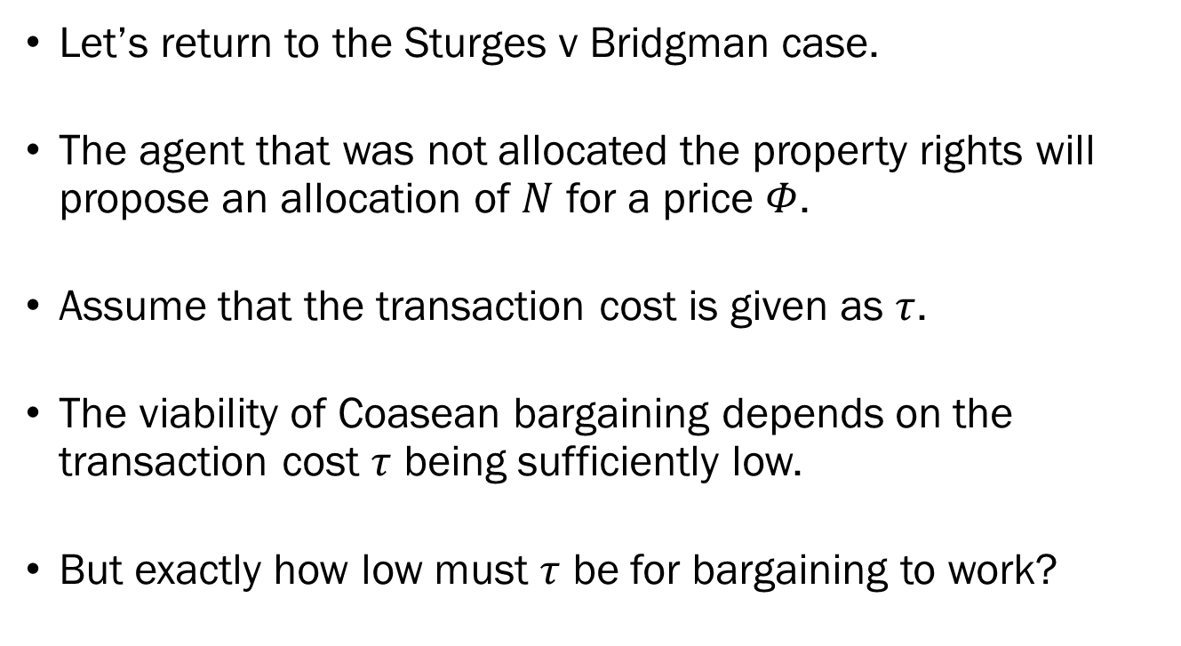
Transaction Costs and the Coase Theorem
Let’s return to the Sturges v Bridgman case.
The agent that was not allocated the property rights will propose an allocation of $N$ for a price $Φ$.
Assume that the transaction cost is given as $τ$.
The viability of Coasean bargaining depends on the transaction cost $τ$ being sufficiently low.
But exactly how low must $τ$ be for bargaining to work?

Slide 21
Transaction Costs and the Coase Theorem
The diagram depicts the case where the doctor is assigned property rights.
The total gain in social surplus must be greater than the transaction cost.
If transaction cost exceeds the bargaining surplus, bargaining will be a net loss for the economy.

Slide 22
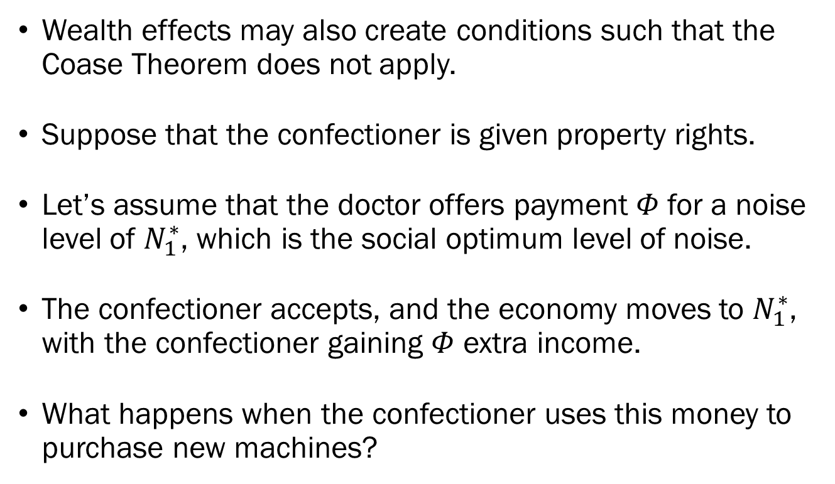
Wealth Effects and the Coase Theorem
Wealth effects may also create conditions such that the Coase Theorem does not apply.
Suppose that the confectioner is given property rights.
Let’s assume that the doctor offers payment $Φ$ for a noise level of $N_{1}^{∗}$, which is the social optimum level of noise.
The confectioner accepts, and the economy moves to $N_{1}^{∗}$, with the confectioner gaining $Φ$ extra income.
What happens when the confectioner uses this money to purchase new machines?

Slide 23
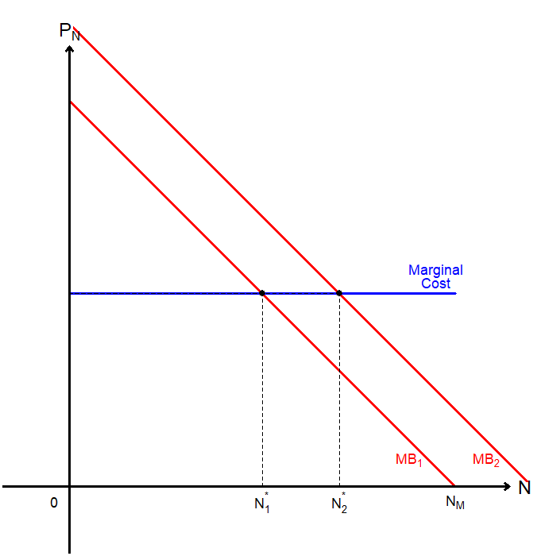
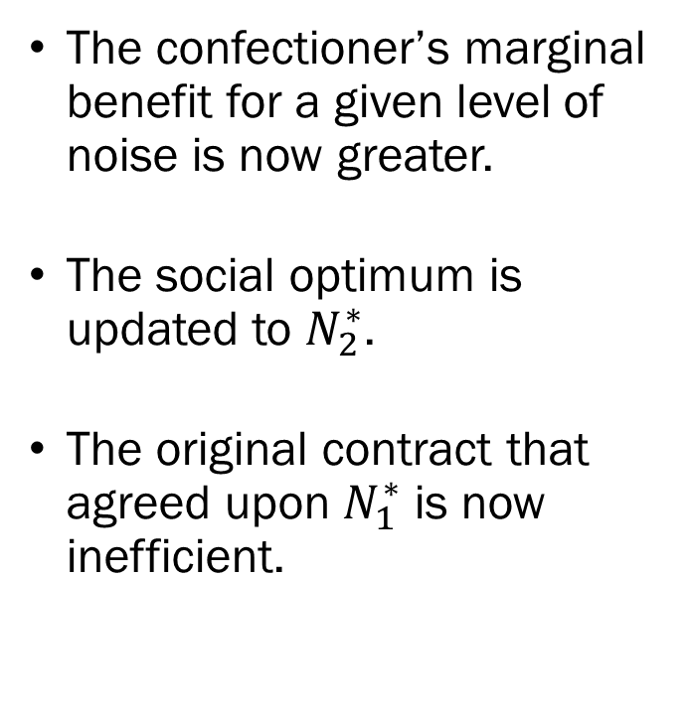
Wealth Effects and the Coase Theorem
The confectioner’s marginal benefit for a given level of noise is now greater.
The social optimum is updated to $N_{2}^{∗}$.
The original contract that agreed upon $N_{1}^{∗}$ is now inefficient.

Slide 24
Coase Theorem in the Real World?
One example of the Coase Theorem working in the real world can be found in “Cap-and-Trade” carbon pricing model.
Regulators allocate a certain quantity of pollution (“cap”) that the entire economy is allowed to generate in forms of permits.
Polluters can “trade” the permits among themselves if they need to pollute beyond their initial allocation of permits.
According to the Coase Theorem, should be efficient!

Slide 25

Coase Theorem in the Real World?

