Slide 1
Permits
ECON 380

Slide 2
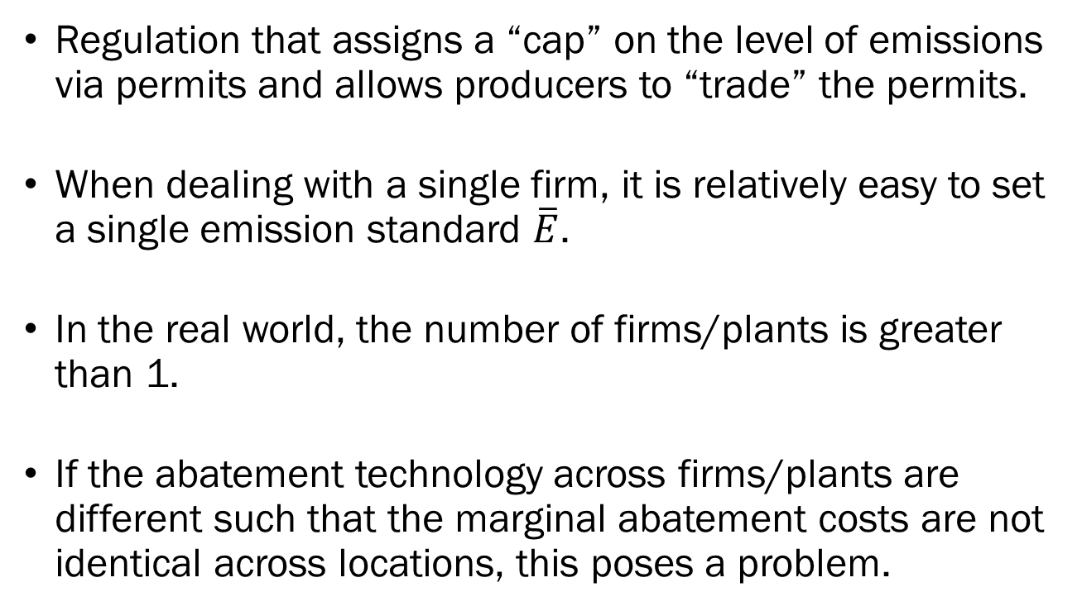
Tradable Permits
Regulation that assigns a “cap” on the level of emissions via permits and allows producers to “trade” the permits.
When dealing with a single firm, it is relatively easy to set a single emission standard $\overline{E}$.
In the real world, the number of firms/plants is greater than 1.
If the abatement technology across firms/plants are different such that the marginal abatement costs are not identical across locations, this poses a problem.

Slide 3
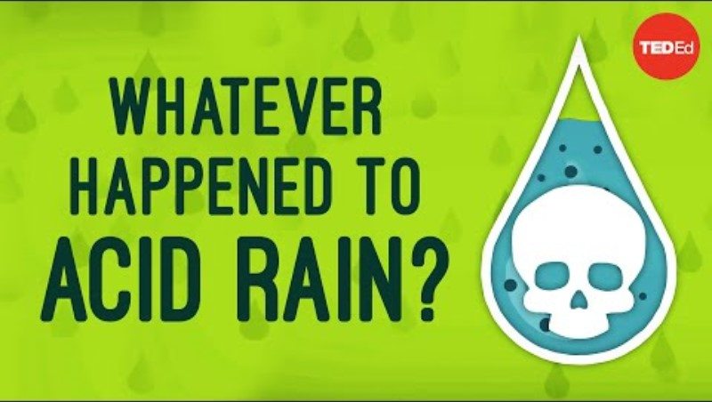
Acid Rain and Permits

Slide 4
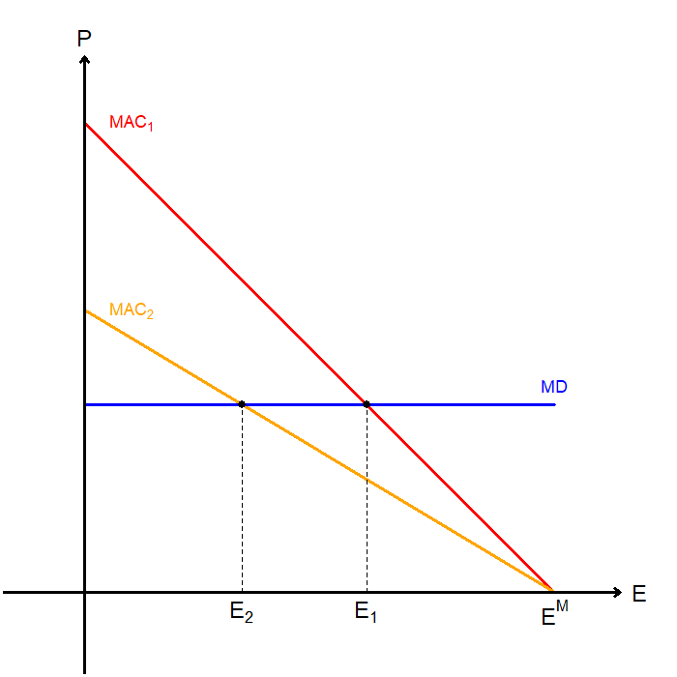
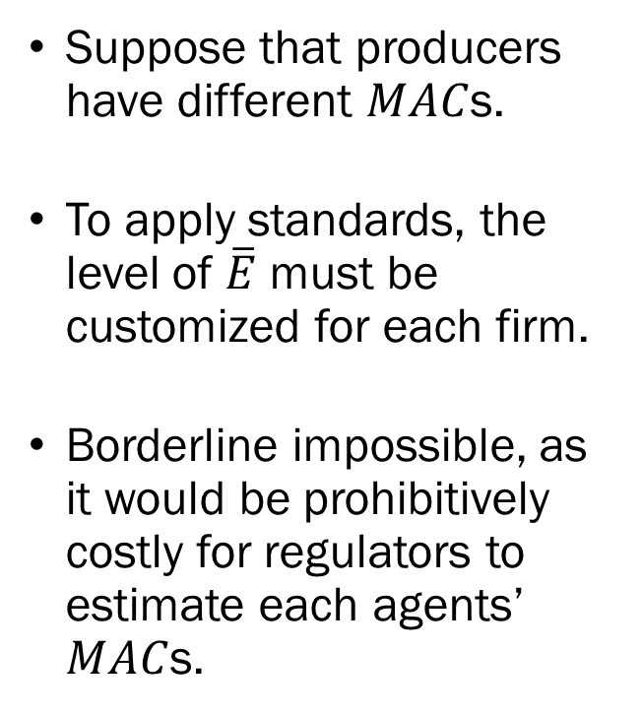
Standards vs. Permits
Suppose that producers have different $MAC$s.
To apply standards, the level of $\overline{E}$ must be customized for each firm.
Borderline impossible, as it would be prohibitively costly for regulators to estimate each agents’ $MAC$s.

Slide 5
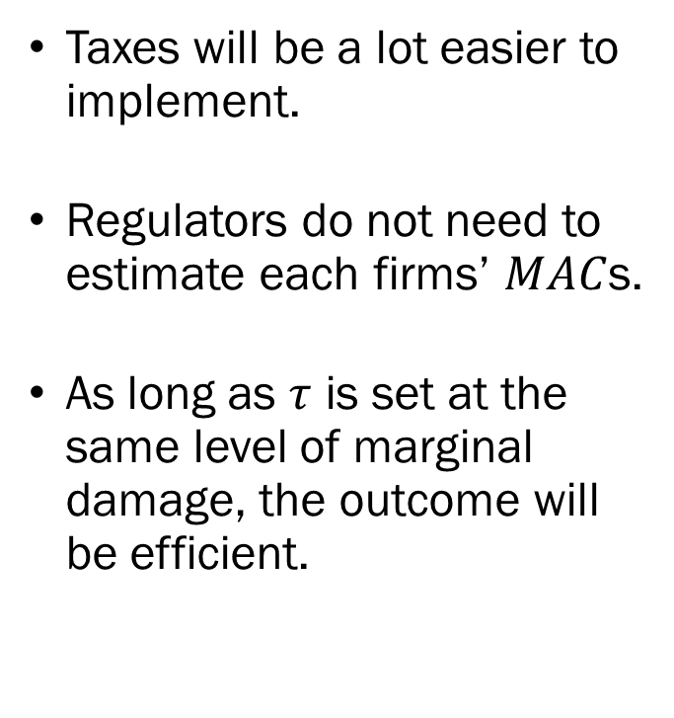
Taxation vs. Permits
Taxes will be a lot easier to implement.
Regulators do not need to estimate each firms’ $MAC$s.
As long as $τ$ is set at the same level of marginal damage, the outcome will be efficient.

Slide 6
Cap and Trade
Without discussing the mathematics, taxation will always be efficient at the lowest cost possible.
This is due to the fact that under taxation, all producers’ marginal cost of abatement will be identical, which satisfy the “equimarginal principle.”
The potential issue with levying a tax will be the pushback from firms, and political feasibility.
Cap and trade offers a more flexible approach compared to direct taxation.

Slide 7
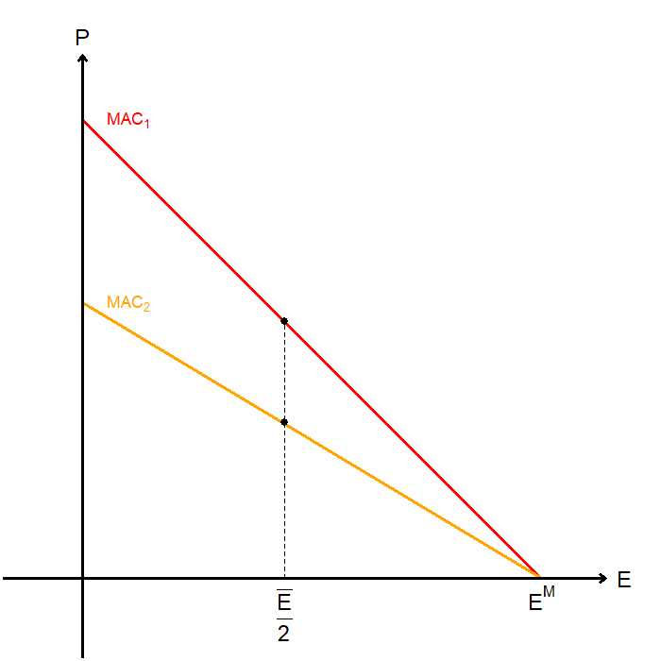
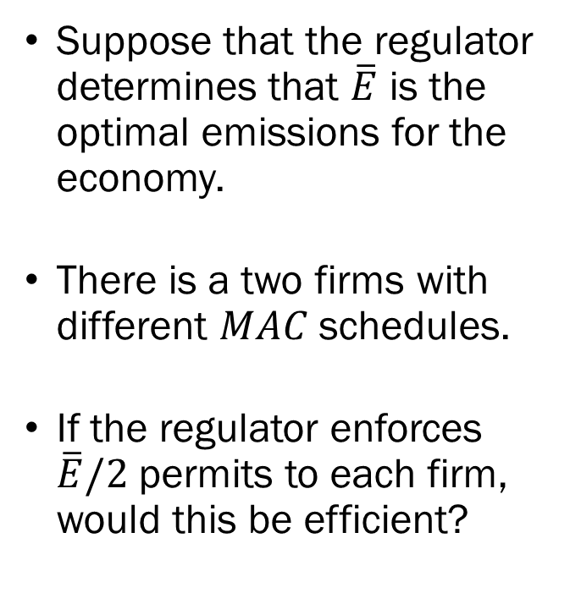
Cap and Trade
Suppose that the regulator determines that $\overline{E}$ is the optimal emissions for the economy.
There is a two firms with different $MAC$ schedules.
If the regulator enforces $\overline{E}/2$ permits to each firm, would this be efficient?

Slide 8
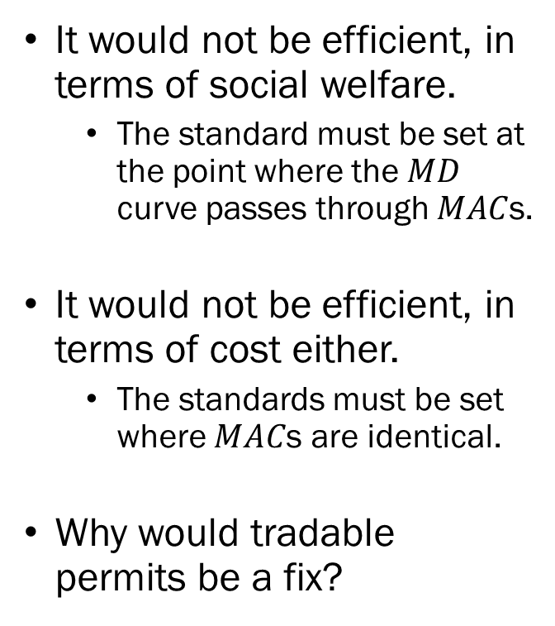
Cap and Trade
It would not be efficient, in terms of social welfare.
  The standard must be set at the point where the $MD$ curve passes through $MAC$s.
It would not be efficient, in terms of cost either.
  The standards must be set where $MAC$s are identical.
Why would tradable permits be a fix?

Slide 9

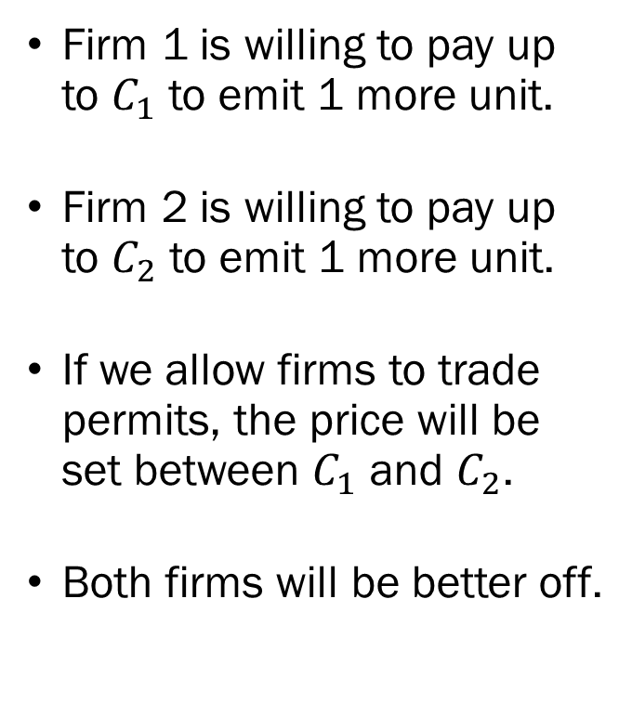
Cap and Trade
Firm 1 is willing to pay up to $C_{1}$ to emit 1 more unit.
Firm 2 is willing to pay up to $C_{2}$ to emit 1 more unit.
If we allow firms to trade permits, the price will be set between $C_{1}$ and $C_{2}$.
Both firms will be better off.

Slide 10
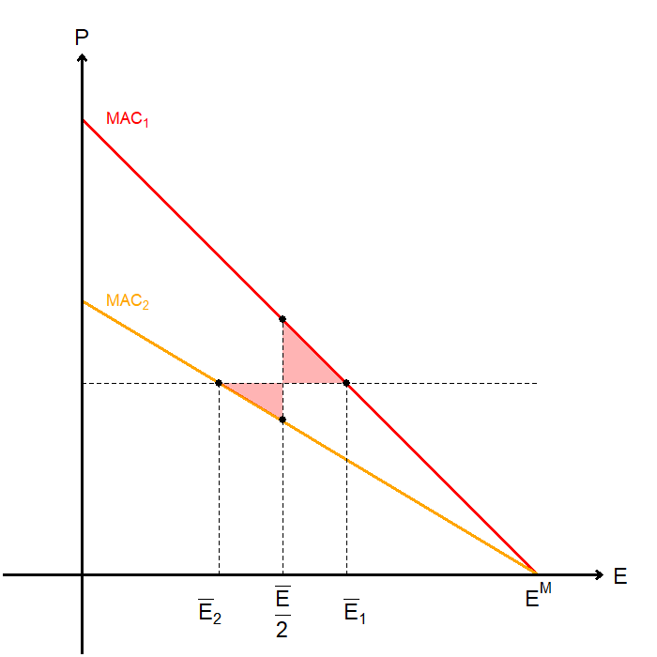
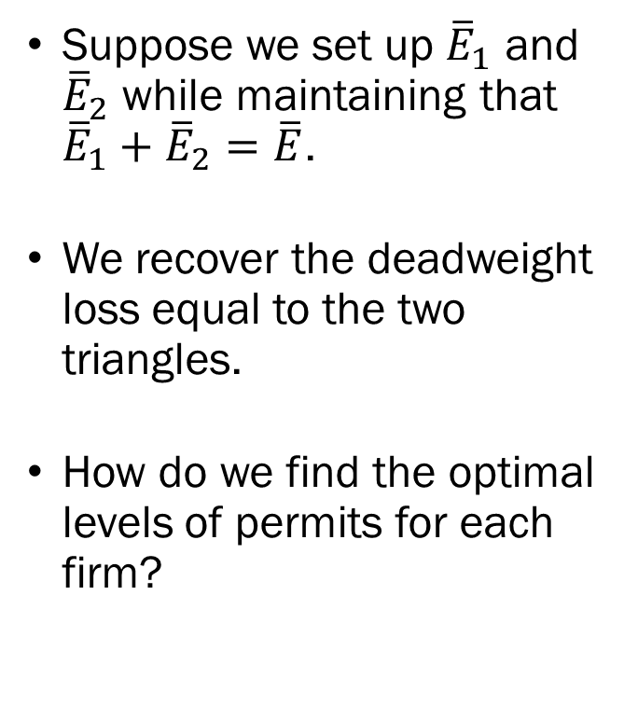
Cap and Trade
Suppose we set up ${\overline{E}}_{1}$ and ${\overline{E}}_{2}$ while maintaining that ${\overline{E}}_{1}+{\overline{E}}_{2}=\overline{E}$.
We recover the deadweight loss equal to the two triangles.
How do we find the optimal levels of permits for each firm?

Slide 11
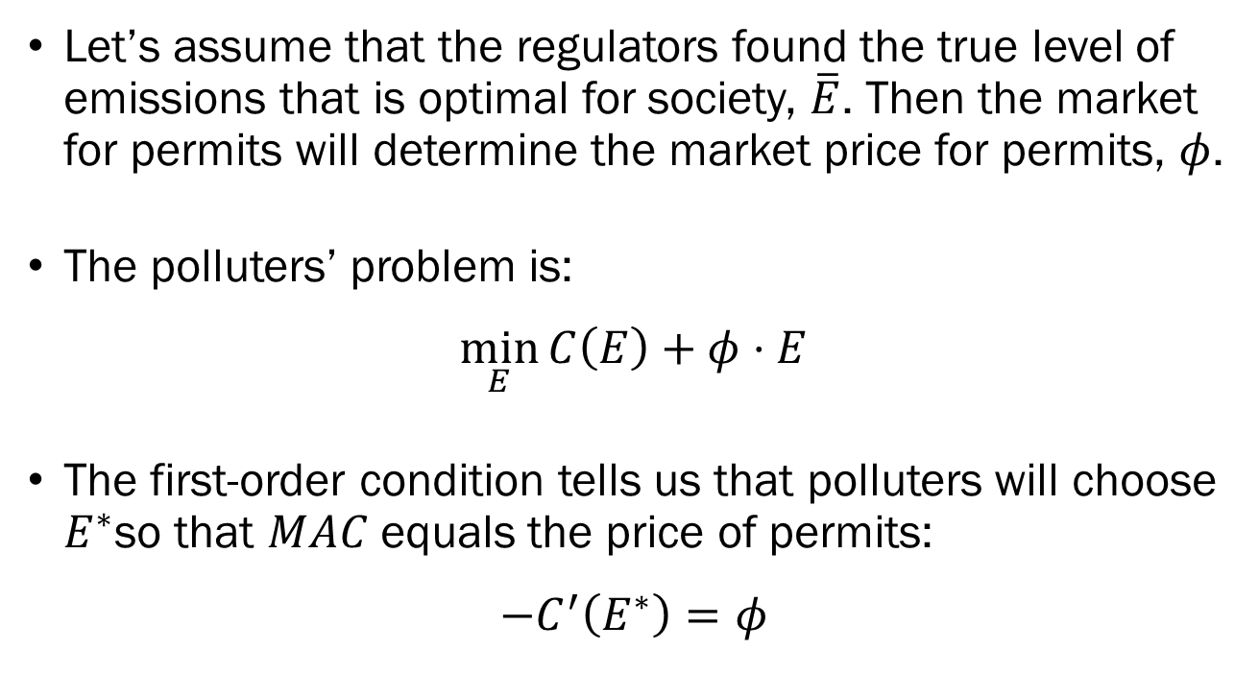
Cap and Trade
Let’s assume that the regulators found the true level of emissions that is optimal for society, $\overline{E}$. Then the market for permits will determine the market price for permits, $φ$.
The polluters’ problem is:
$$\min_{E}{C\left(E\right)+φ⋅E}$$
The first-order condition tells us that polluters will choose $E^{∗}$so that $MAC$ equals the price of permits:
$$−C^{′}\left(E^{∗}\right)=φ$$

Slide 12
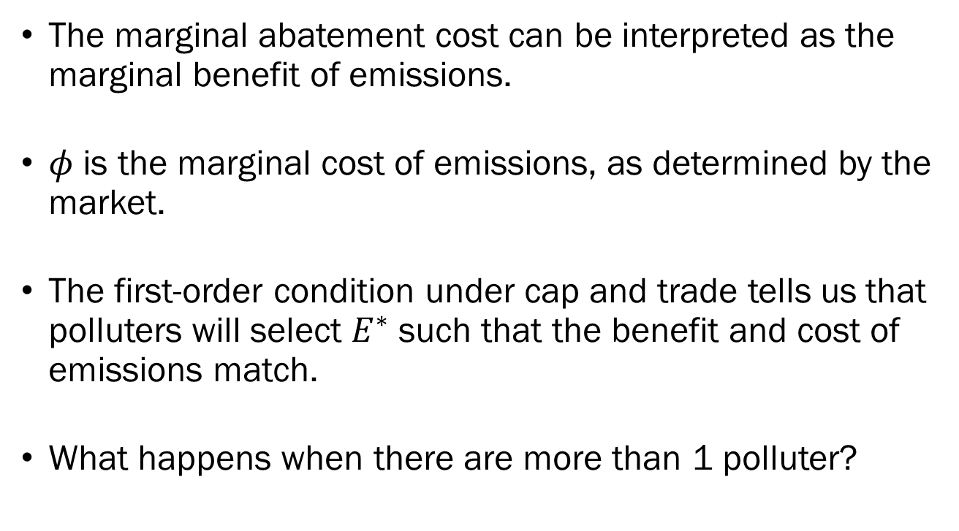
Cap and Trade
The marginal abatement cost can be interpreted as the marginal benefit of emissions.
$φ$ is the marginal cost of emissions, as determined by the market.
The first-order condition under cap and trade tells us that polluters will select $E^{∗}$ such that the benefit and cost of emissions match.
What happens when there are more than 1 polluter?

Slide 13
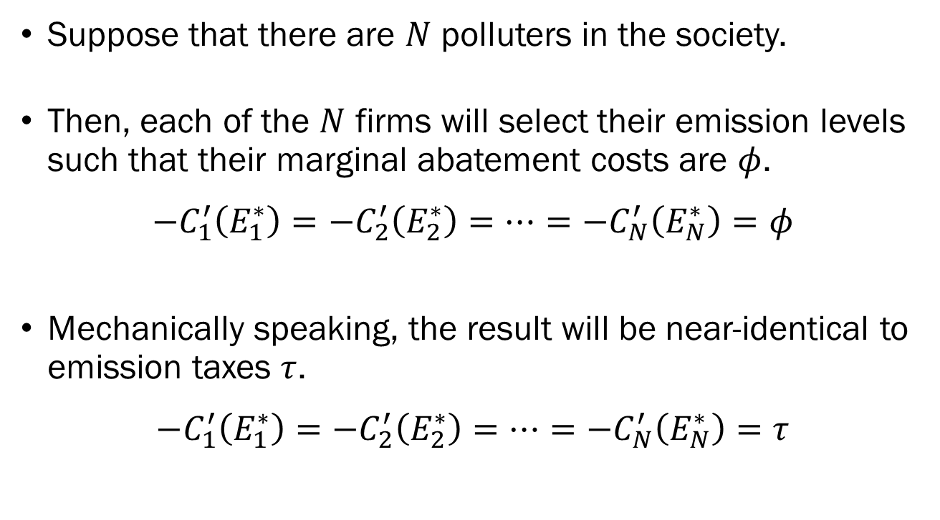
Cap and Trade
Suppose that there are $N$ polluters in the society.
Then, each of the $N$ firms will select their emission levels such that their marginal abatement costs are $φ$.
$$−C_{1}^{′}\left(E_{1}^{∗}\right)=−C_{2}^{′}\left(E_{2}^{∗}\right)=…=−C_{N}^{′}\left(E_{N}^{∗}\right)=φ$$
Mechanically speaking, the result will be near-identical to emission taxes $τ$.
$$−C_{1}^{′}\left(E_{1}^{∗}\right)=−C_{2}^{′}\left(E_{2}^{∗}\right)=…=−C_{N}^{′}\left(E_{N}^{∗}\right)=τ$$

Slide 14
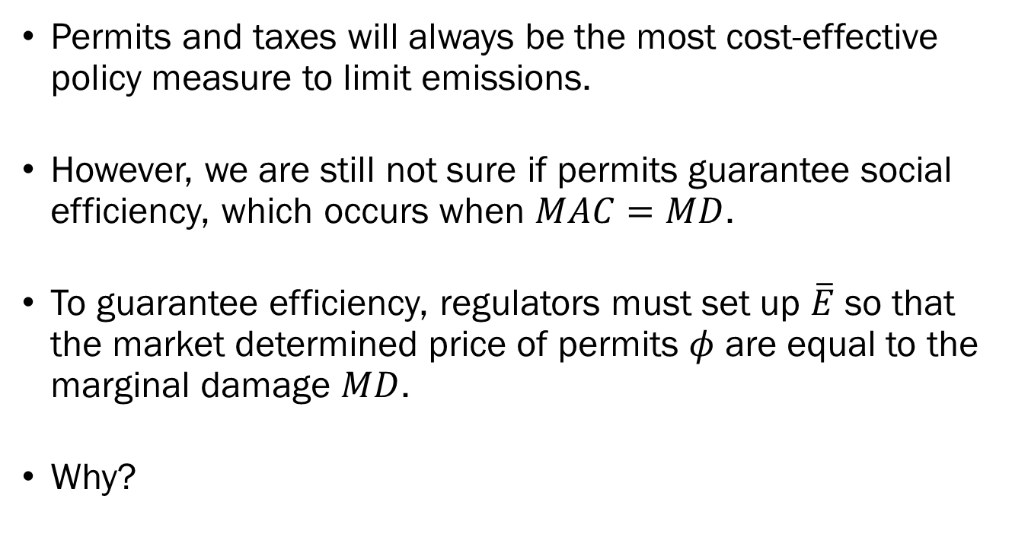
Cap and Trade
Permits and taxes will always be the most cost-effective policy measure to limit emissions.
However, we are still not sure if permits guarantee social efficiency, which occurs when $MAC=MD$.
To guarantee efficiency, regulators must set up $\overline{E}$ so that the market determined price of permits $φ$ are equal to the marginal damage $MD$.
Why?

Slide 15
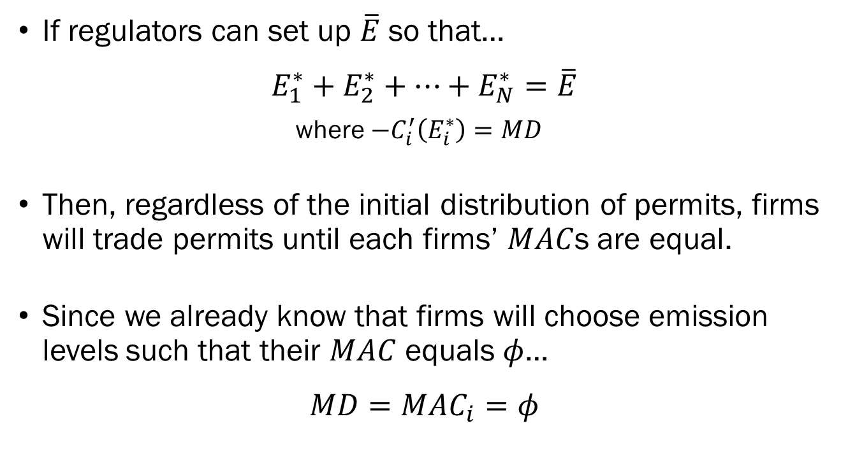
Cap and Trade
If regulators can set up $\overline{E}$ so that…
$$E_{1}^{∗}+E_{2}^{∗}+⋯+E_{N}^{∗}=\overline{E}$$
where $−C_{i}^{′}\left(E_{i}^{∗}\right)=MD$
Then, regardless of the initial distribution of permits, firms will trade permits until each firms’ $MAC$s are equal.
Since we already know that firms will choose emission levels such that their $MAC$ equals $φ$…
$$MD=MAC_{i}=φ$$

Slide 16
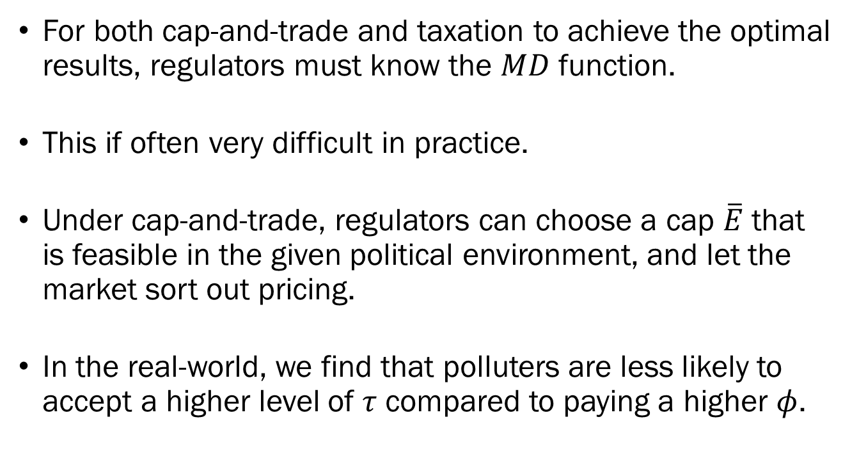
Cap and Trade:
The Real World
For both cap-and-trade and taxation to achieve the optimal results, regulators must know the $MD$ function.
This if often very difficult in practice.
Under cap-and-trade, regulators can choose a cap $\overline{E}$ that is feasible in the given political environment, and let the market sort out pricing.
In the real-world, we find that polluters are less likely to accept a higher level of $τ$ compared to paying a higher $φ$.

Slide 17
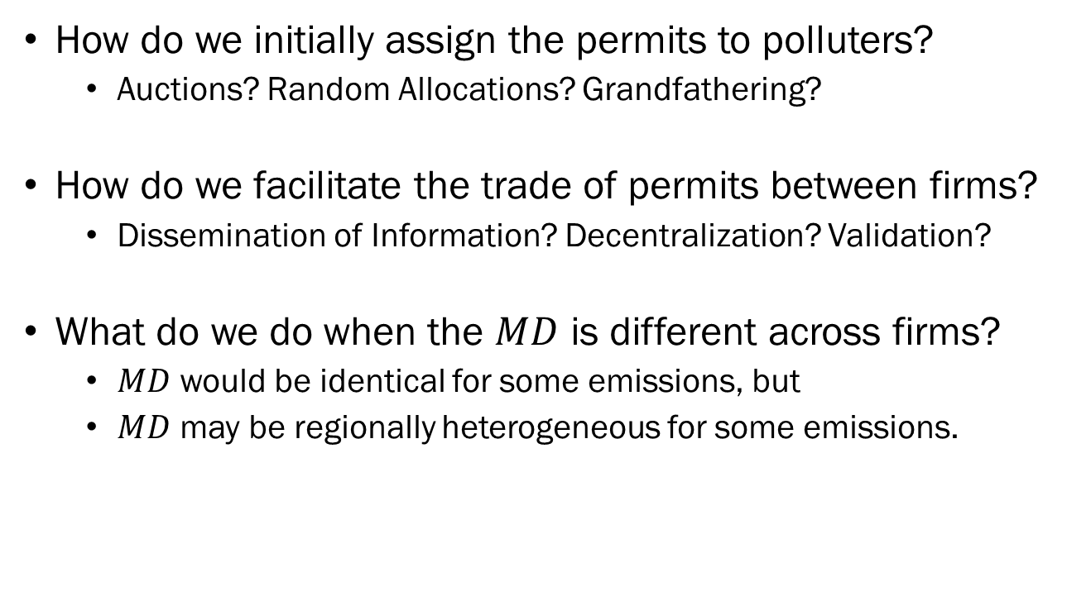
Cap and Trade:
Unanswered Questions
How do we initially assign the permits to polluters?
  Auctions? Random Allocations? Grandfathering?
How do we facilitate the trade of permits between firms?
  Dissemination of Information? Decentralization? Validation?
What do we do when the $MD$ is different across firms?
  $MD$ would be identical for some emissions, but
  $MD$ may be regionally heterogeneous for some emissions.

Slide 18
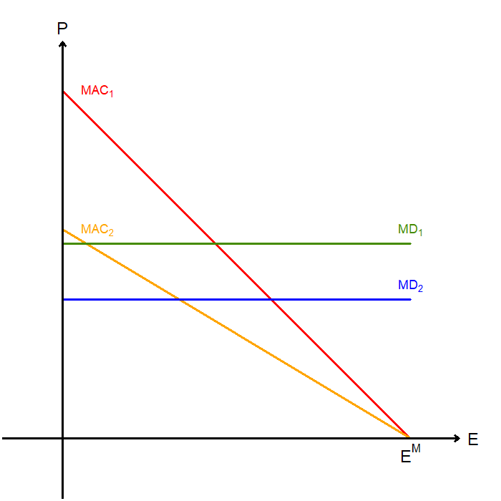
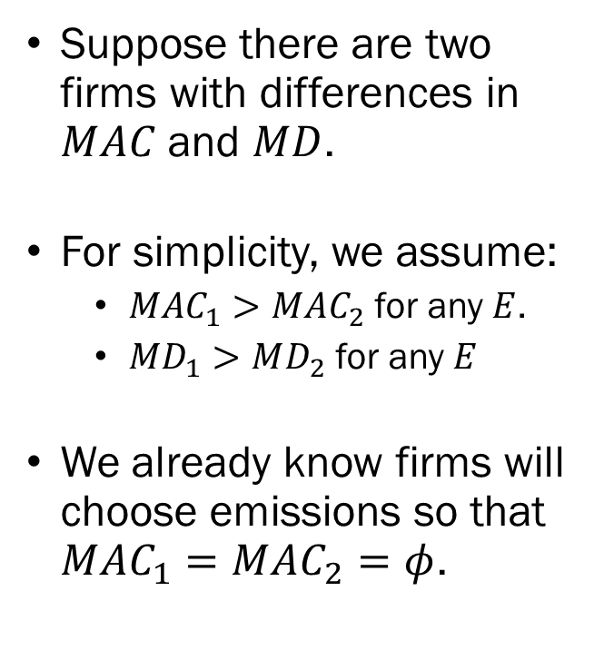
Cap and Trade:
Heterogeneous Marginal Damage
Suppose there are two firms with differences in $MAC$ and $MD$.
For simplicity, we assume:
  $MAC_{1}>MAC_{2}$ for any $E$.
  $MD_{1}>MD_{2}$ for any $E$
We already know firms will choose emissions so that $MAC_{1}=MAC_{2}=φ$.

Slide 19
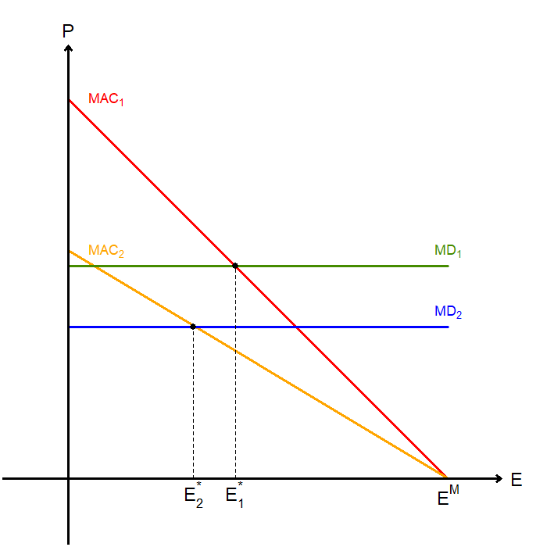
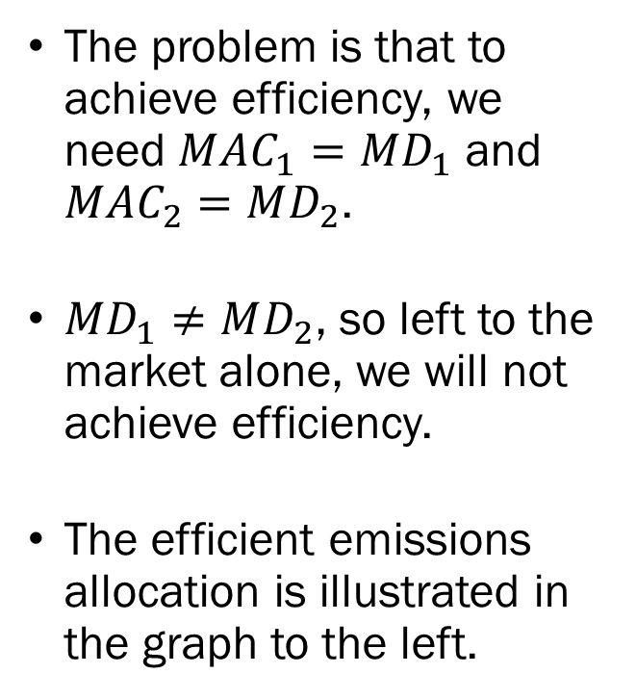
Cap and Trade:
Heterogeneous Marginal Damage
The problem is that to achieve efficiency, we need $MAC_{1}=MD_{1}$ and $MAC_{2}=MD_{2}$.
$MD_{1}≠MD_{2}$, so left to the market alone, we will not achieve efficiency.
The efficient emissions allocation is illustrated in the graph to the left.

Slide 20
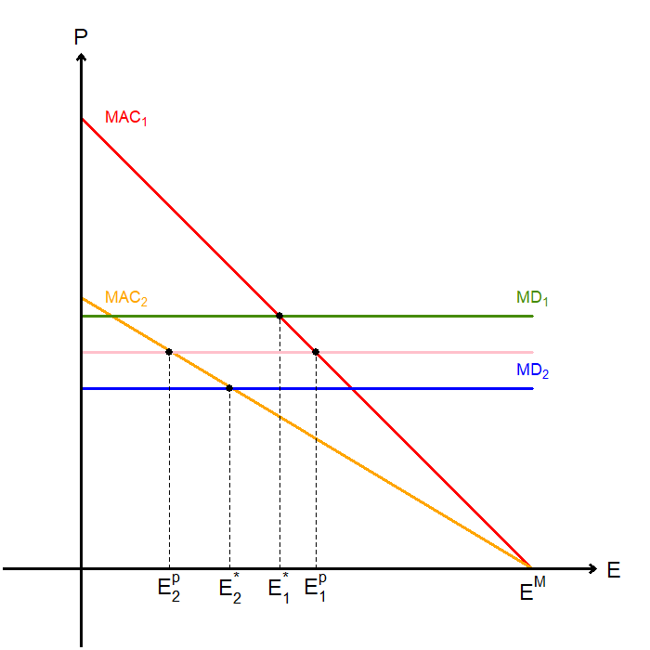
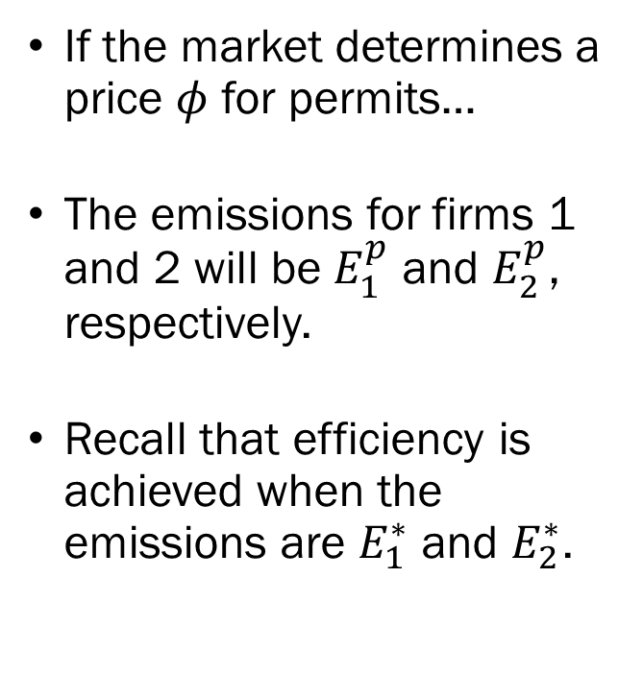
Cap and Trade:
Heterogeneous Marginal Damage
If the market determines a price $φ$ for permits…
The emissions for firms 1 and 2 will be $E_{1}^{p}$ and $E_{2}^{p}$, respectively.
Recall that efficiency is achieved when the emissions are $E_{1}^{∗}$ and $E_{2}^{∗}$.

Slide 21
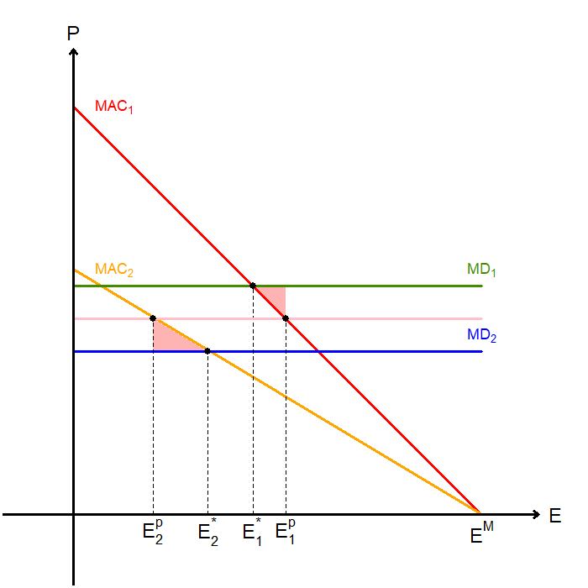
Cap and Trade:
Heterogeneous Marginal Damage
Compared to the optimal allocation, we face a loss in welfare equal to the two triangles.
However, this is still a Pareto improvement over the unregulated market.
Permits may also offer a Pareto improvement over a single standard.

Slide 22
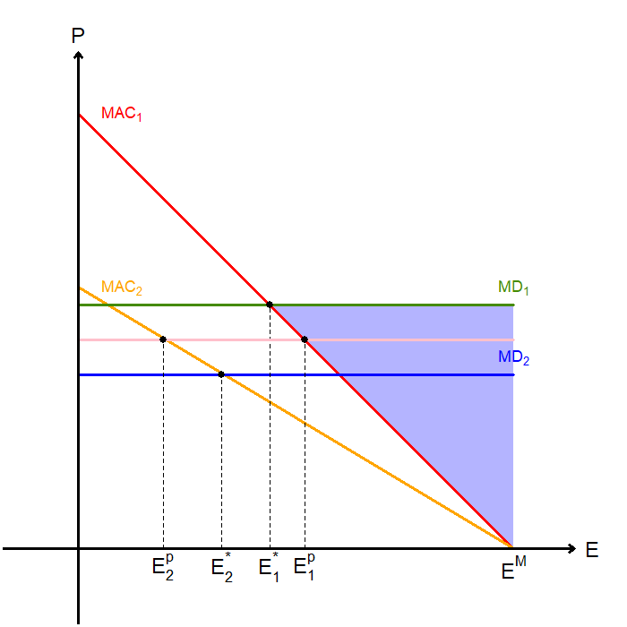
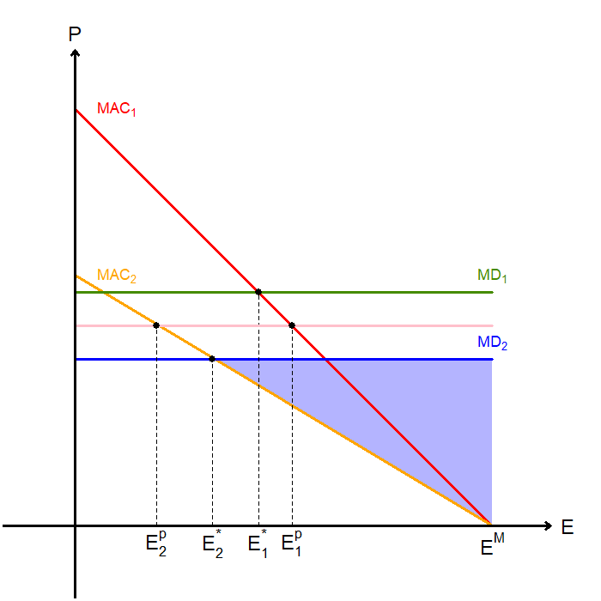
Cap and Trade:
Heterogeneous Marginal Damage
Unregulated Market’s
DWL from Firm 1
Unregulated Market’s
DWL from Firm 2

Slide 23
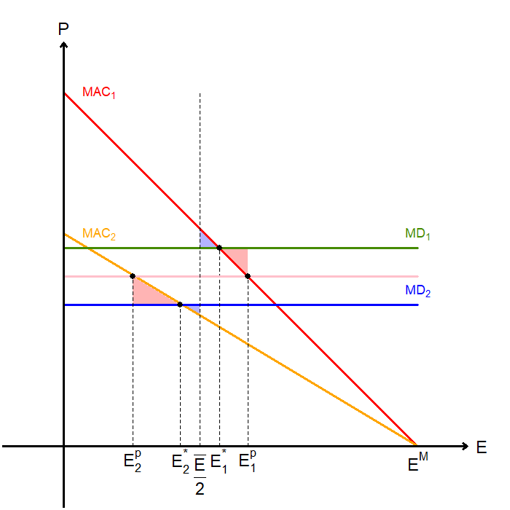
Cap and Trade:
Heterogeneous Marginal Damage
The two blue triangles represent the deadweight loss under a uniform standard.
The two red triangles represent the deadweight loss under cap-and-trade.
In this specific case, we see that the uniform standard may be better.

Slide 24
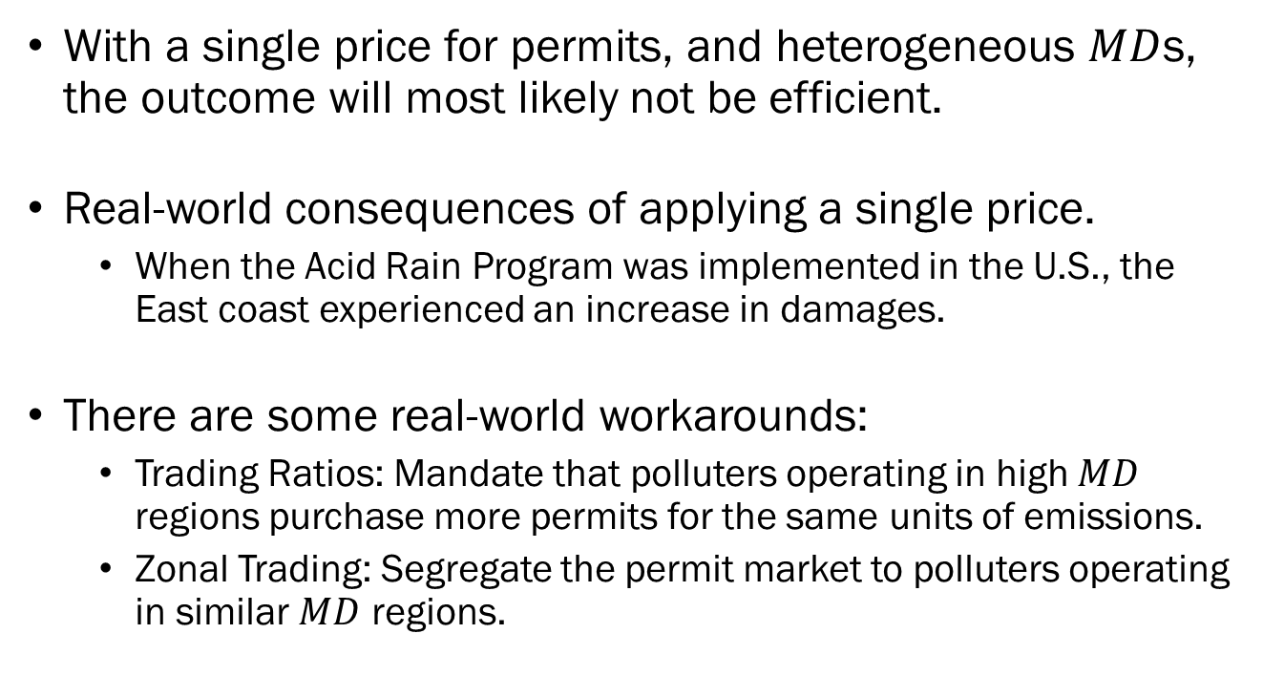
Cap and Trade:
Heterogeneous Marginal Damage
With a single price for permits, and heterogeneous $MD$s, the outcome will most likely not be efficient.
Real-world consequences of applying a single price.
  When the Acid Rain Program was implemented in the U.S., the East coast experienced an increase in damages.
There are some real-world workarounds:
  Trading Ratios: Mandate that polluters operating in high $MD$ regions purchase more permits for the same units of emissions.
  Zonal Trading: Segregate the permit market to polluters operating in similar $MD$ regions.

Slide 25
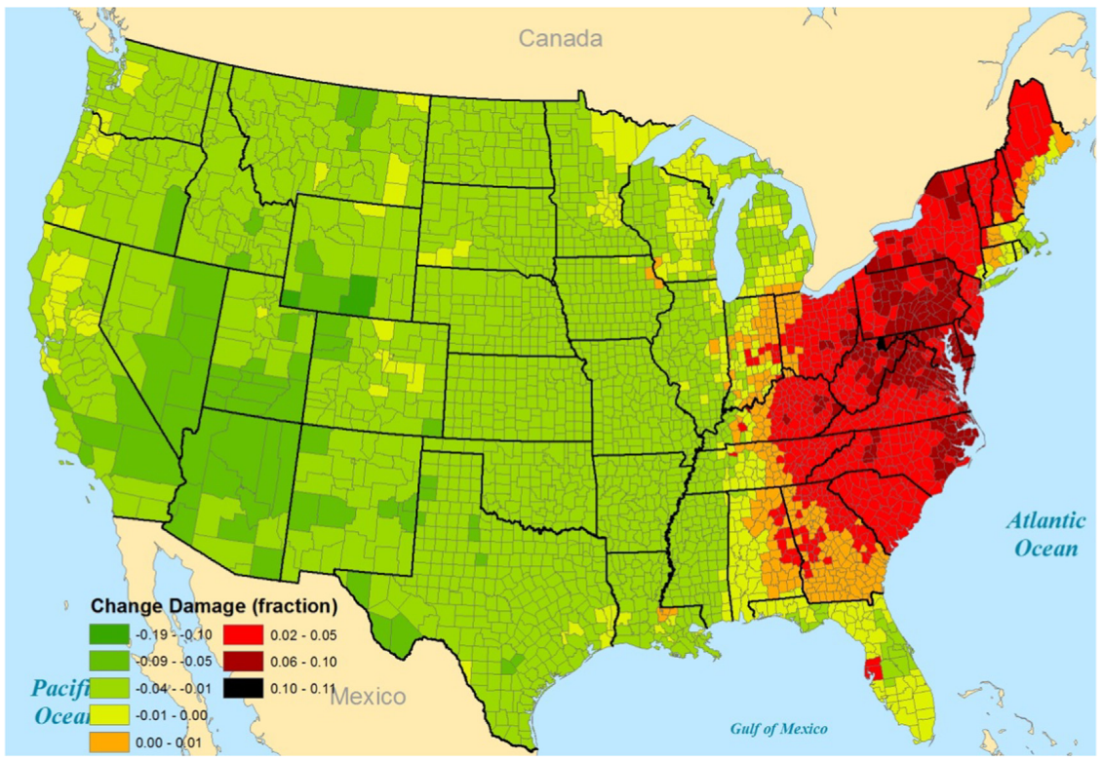
Chan et al. (2018)
Journal of Environmental Economics and Management

Slide 26
Standards, Taxes, and Permits
Under certain sets of assumptions, any of the three can achieve the socially optimal allocation.
The difference is that taxes and permits will always be cost effective and require less information for regulators.
But what about…
  Distributional Equity?
  Effects on Output?
  Administrative Costs?
  Incentive Structures?

Slide 27
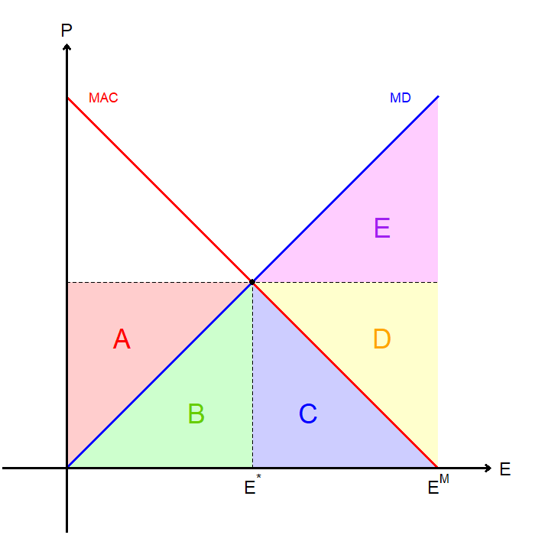
Standards, Taxes, and Permits:
Concerning Equity
Under taxation:
Firms lose A+B+C.
Households gain C+D+E.
The government gains A+B.
At the societal level, we gain D+E.

Slide 28
Standards, Taxes, and Permits:
Concerning Equity
Under subsidies:
Firms gain A+B-C.
Households gain C+D+E.
The government loses A+B.
At the societal level, we gain D+E.

Slide 29
Standards, Taxes, and Permits:
Concerning Equity
Under standards/permits:
Firms lose C.
Households gain C+D+E.
The government gains 0.
At the societal level, we gain D+E.

Slide 30
Standards, Taxes, and Permits :
Concerning Effects on Output
Under taxation…
  Firms pay taxes and abatement costs for each unit they produce,
  This effectively increases the marginal cost of production,
  Output falls as a response to rising costs,
  Pollution may decrease even more than the intended amount.
Under subsidies…
  Firms are given subsidies for reducing pollution,
  This effectively reduces the marginal cost of production,
  Output increases as a response to decreasing costs,
  Total emissions may increase in certain extreme scenarios.

Slide 31
Standards, Taxes, and Permits :
Concerning Effects on Output
Under standards/permits…
  Firms pay abatement costs for producing their output,
  This effectively increases the marginal cost of production,
  Output falls as a response to rising costs,
  Pollution may decrease more than the intended amount, but not as much as the scenario with taxes.

Slide 32
Standards, Taxes, and Permits :
Concerning Administrative Costs
The cost of enforcing each policy may differ widely.
Command-and-control style policies with the adoption of certain technologies is less costly to implement.
Standards, taxes, and subsidies require that regulators keep track of emissions, which incurs high costs.
Also, when it comes to non-point sources, measuring emission levels are near impossible.
  It is easy to measure emissions from a power plant, but can we do the same with a single vehicle?

Slide 33
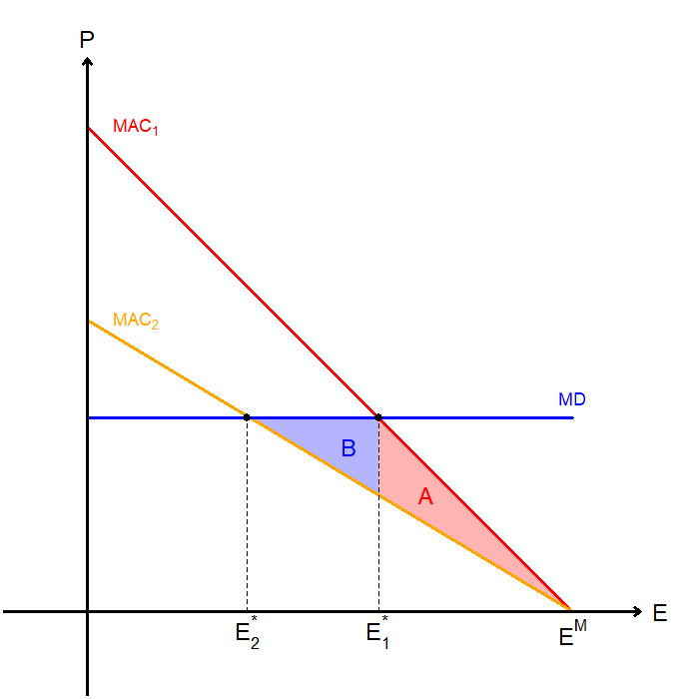
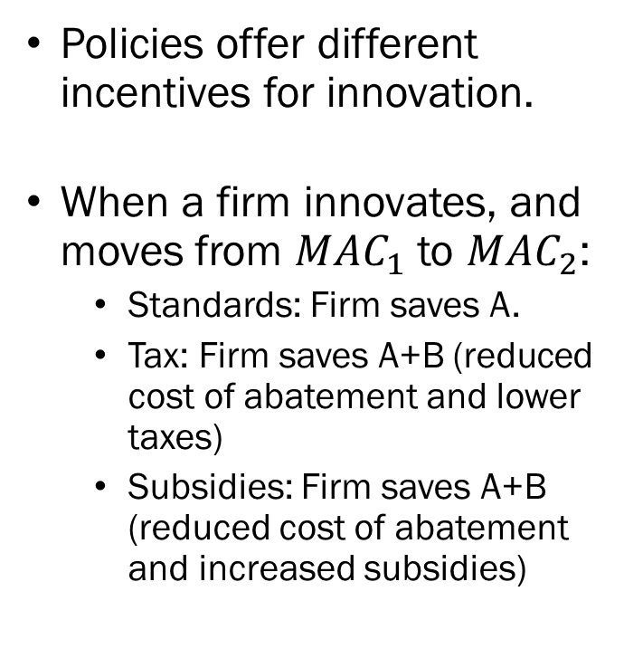
Standards, Taxes, and Permits:
Concerning Incentive Structures
Policies offer different incentives for innovation.
When a firm innovates, and moves from $MAC_{1}$ to $MAC_{2}$:
  Standards: Firm saves A.
  Tax: Firm saves A+B (reduced cost of abatement and lower taxes)
  Subsidies: Firm saves A+B (reduced cost of abatement and increased subsidies)

