Slide 1
BUSINESS STATISTICS
Chapter 5: Discrete Probability Distributions

Slide 2
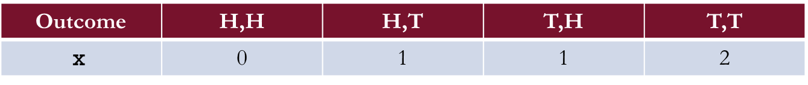
Random Variables
A random variable is a numerical description of the outcome of an experiment.
  A random variable assigns a numerical value to each possible outcome of an experiment.
  The value of the random variable depends on the outcome that occurs.
Example: The random experiment of tossing two fair coins in succession.
  Let x denote the number of tails observed.
  The possible outcomes and corresponding values of x are shown below.
The outcome is what happens, and the random variable is the numerical value assigned to that outcome.
Outcome | H,H | H,T | T,H | T,T
$$\text{x}$$ | 0 | 1 | 1 | 2

Slide 3
Continuous Random Variables
A continuous random variable is a random variable that can take any value within a range of values.
Some examples of continuous random variables:
  The time a student spends studying statistics.
  The amount of water used at the local café today.
  The weight of defective items in a shipment.
We return to discuss continuous random variables in Chapter 6.

Slide 4
Discrete Random Variables
A discrete random variable is a random variable that can take on a finite number of values or a countably infinite number of values.
  Discrete random variables arise from counting and can take only specific numerical values.
Some examples of discrete random variables:
  Number of students who receive an A in BUSN 320.
  Number of cups of coffee sold at the local café today.
  Number of defective items in a shipment.
Since discrete random variables can take only specific values, we can assign a probability to each possible value.

Slide 5
Discrete Probability Distributions

Slide 6
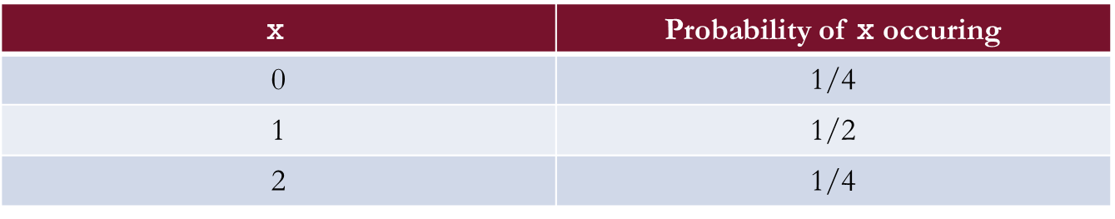
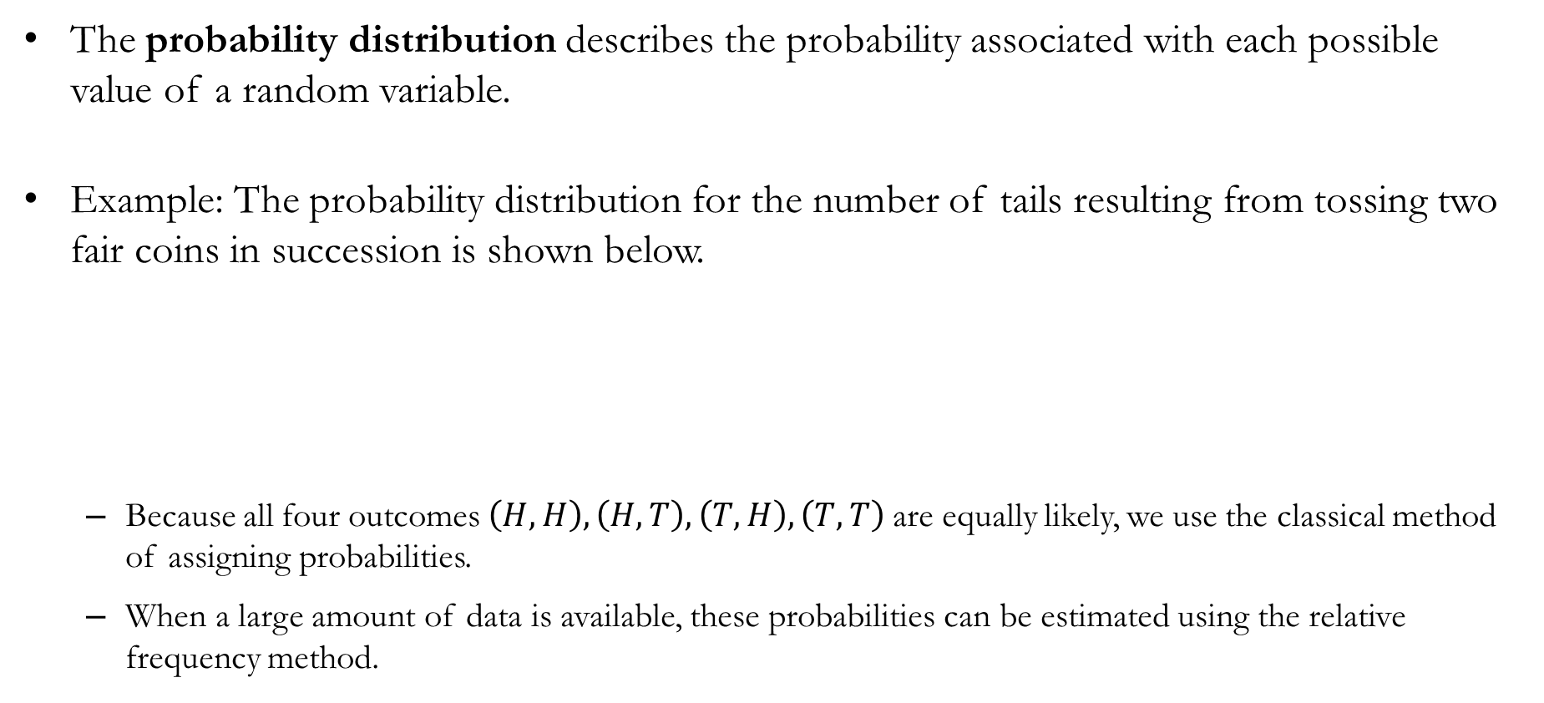
Discrete Probability Distributions
The probability distribution describes the probability associated with each possible value of a random variable.
Example: The probability distribution for the number of tails resulting from tossing two fair coins in succession is shown below.
  Because all four outcomes $\left(H,H\right), \left(H,T\right),\left(T,H\right),\left(T,T\right)$are equally likely, we use the classical method of assigning probabilities.
  When a large amount of data is available, these probabilities can be estimated using the relative frequency method.
$$\text{x}$$ | Probability of $\text{x}$ occuring
0 | 1/4
1 | 1/2
2 | 1/4

Slide 7
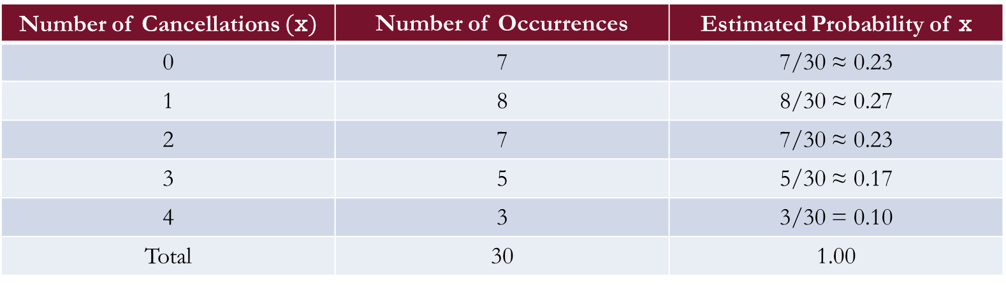
Empirical Probability Distributions
An empirical discrete distribution is obtained by estimating probabilities from observed data using the relative frequency method.
Example: Daily flight cancellations at Chicago O’Hare International Airport (ORD).
Number of Cancellations $(\text{x})$ | Number of Occurrences | Estimated Probability of x
0 | 7 | 7/30 ≈ 0.23
1 | 8 | 8/30 ≈ 0.27
2 | 7 | 7/30 ≈ 0.23
3 | 5 | 5/30 ≈ 0.17
4 | 3 | 3/30 = 0.10
Total | 30 | 1.00

Slide 8
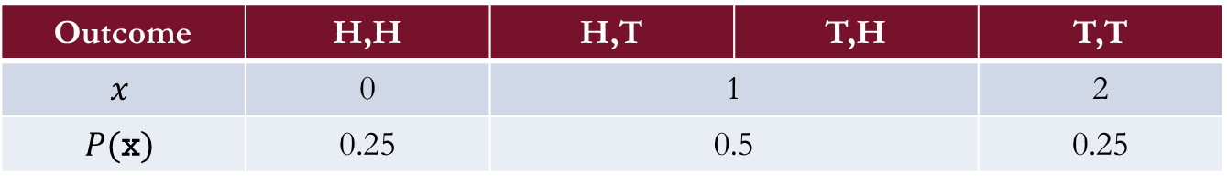
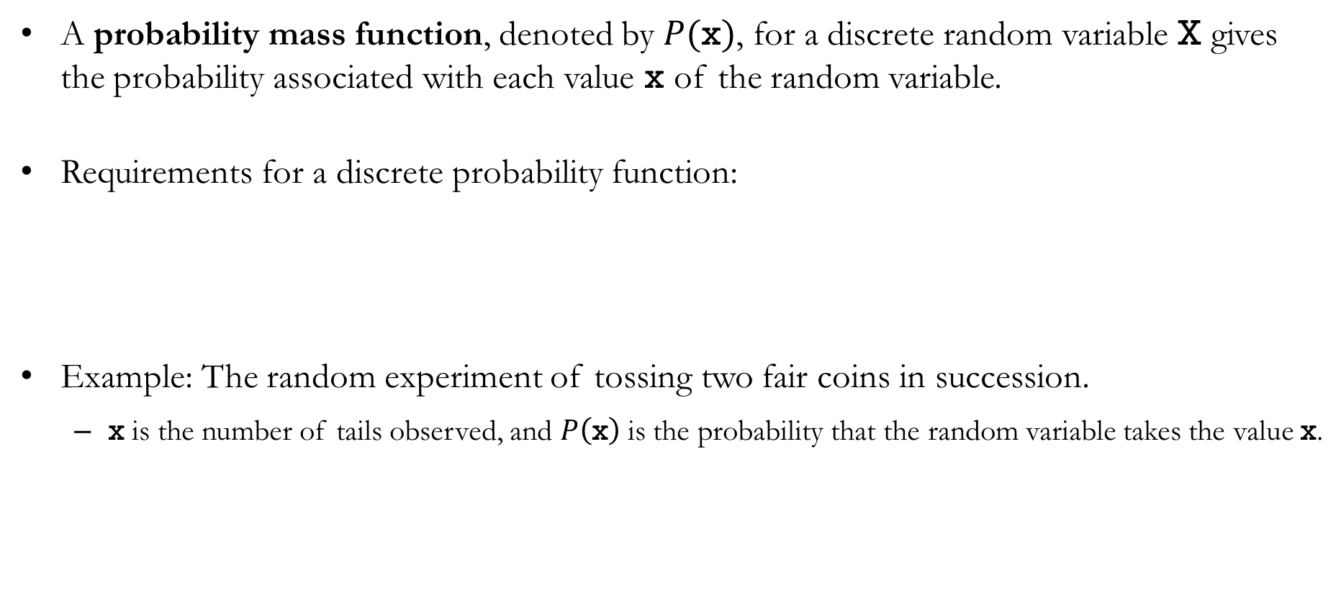
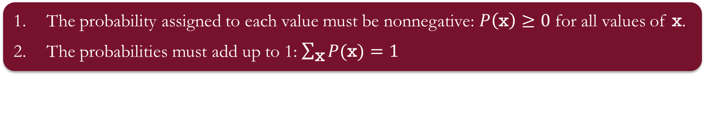
Discrete Probability Functions
A probability mass function, denoted by $P(\text{x})$, for a discrete random variable $\text{X}$ gives the probability associated with each value $\text{x}$ of the random variable.
Requirements for a discrete probability function:
Example: The random experiment of tossing two fair coins in succession.
  $\text{x}$ is the number of tails observed, and $P\left(\text{x}\right)$ is the probability that the random variable takes the value $\text{x}$.
The probability assigned to each value must be nonnegative: $P\left(\text{x}\right)≥0$ for all values of $\text{x}$.
The probabilities must add up to 1: $\sum_{\text{x}}{P(\text{x})}=1$
Outcome | H,H | H,T | T,H | T,T
$$x$$ | 0 | 1 |  | 2
$$P(\text{x})$$ | 0.25 | 0.5 |  | 0.25

Slide 9
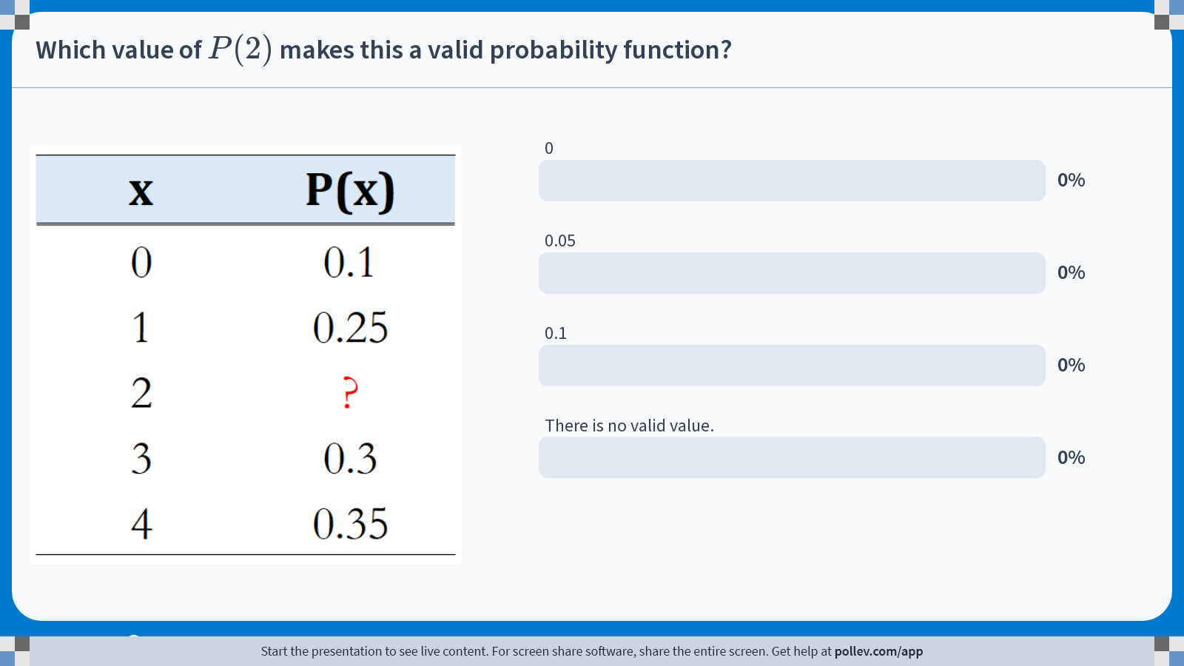
Poll Everywhere multiple choice poll activity
Activity Title: Which value of $$P(2)$$ makes this a valid probability function?
Slide 11
Notes:
Do not modify the notes in this section to avoid tampering with the Poll Everywhere activity.
More info at polleverywhere.com/support
Which value of $$P(2)$$ makes this a valid probability function?
https://www.polleverywhere.com/multiple_choice_polls/Or9lVhCzRKy2A1ygfhLHN?state=opened&flow=Default&onscreen=persist

Slide 10
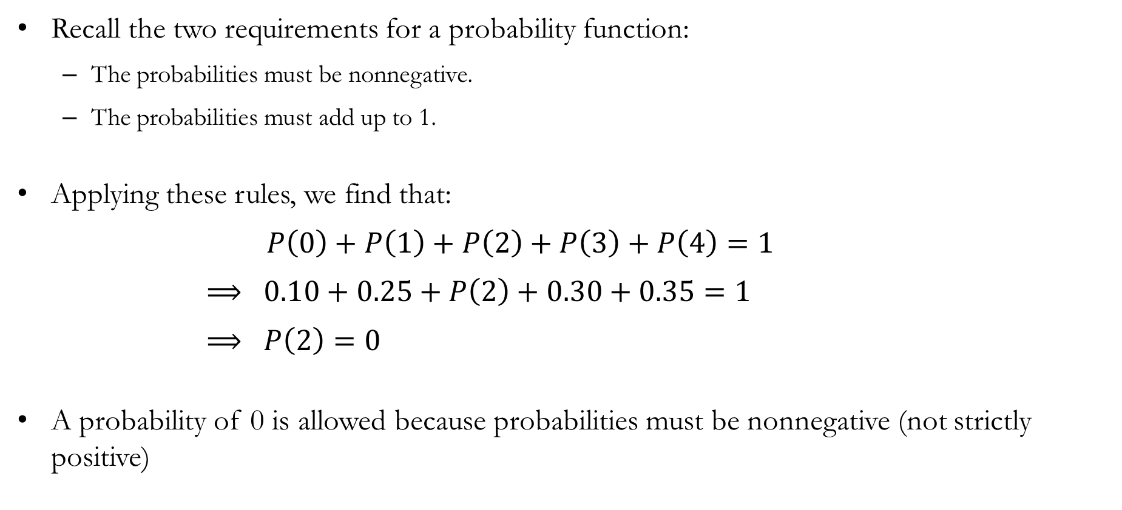
Solution to In-class Poll
Recall the two requirements for a probability function:
  The probabilities must be nonnegative.
  The probabilities must add up to 1.
Applying these rules, we find that:
$P\left(0\right)+P\left(1\right)+P\left(2\right)+P\left(3\right)+P\left(4\right)=1$
$⟹ 0.10+0.25+P\left(2\right)+0.30+0.35=1$
$⟹ P\left(2\right)=0$
A probability of 0 is allowed because probabilities must be nonnegative (not strictly positive)

Slide 11
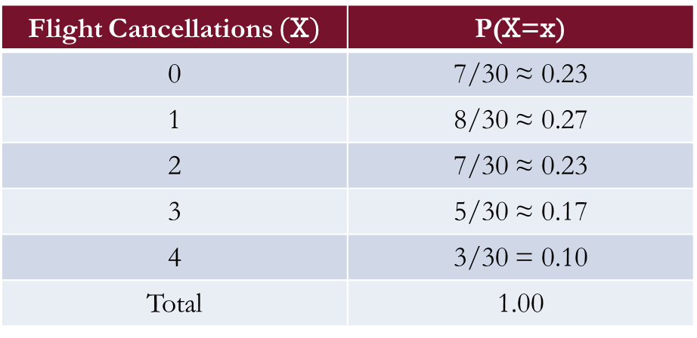
Graphical Representation
The standard way to graphically represent a discrete probability distribution is to:
  Plot the values of the random variable on the horizontal axis, and
  Plot the corresponding probabilities on the vertical axis.
Flight Cancellations $(\text{X})$ | P(X=x)
0 | 7/30 ≈ 0.23
1 | 8/30 ≈ 0.27
2 | 7/30 ≈ 0.23
3 | 5/30 ≈ 0.17
4 | 3/30 = 0.10
Total | 1.00

Slide 12
Expected Value and Variance

Slide 13
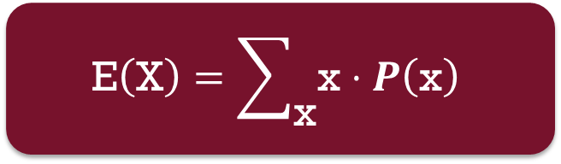
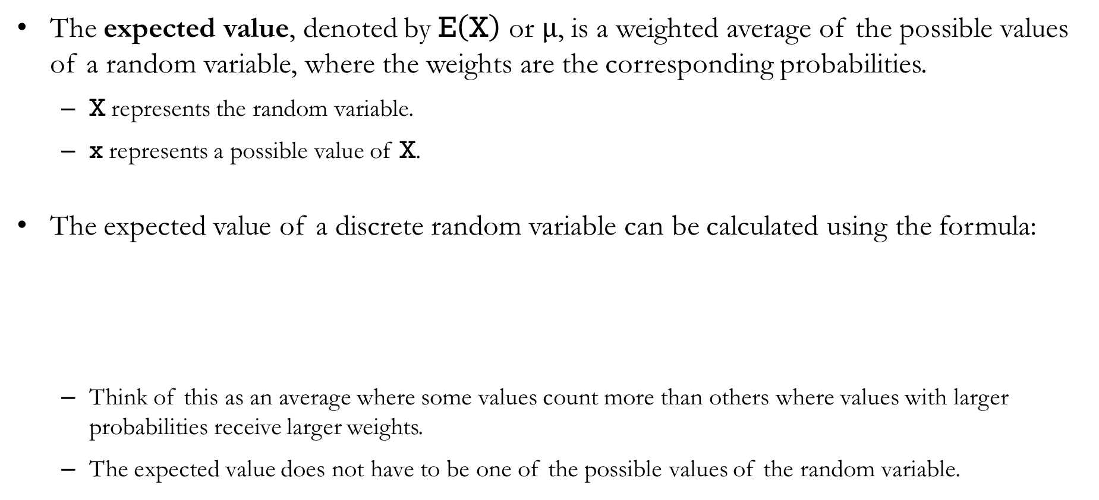
Expected Value
The expected value, denoted by $\text{E}\left(\text{X}\right)$ or $μ$, is a weighted average of the possible values of a random variable, where the weights are the corresponding probabilities.
  $\text{X}$ represents the random variable.
  $\text{x}$ represents a possible value of $\text{X}$.
The expected value of a discrete random variable can be calculated using the formula:
  Think of this as an average where some values count more than others where values with larger probabilities receive larger weights.
  The expected value does not have to be one of the possible values of the random variable.
$$\text{E}\left(\text{X}\right)=\sum_{\text{x}}{\text{x}⋅P\left(\text{x}\right)}$$

Slide 14
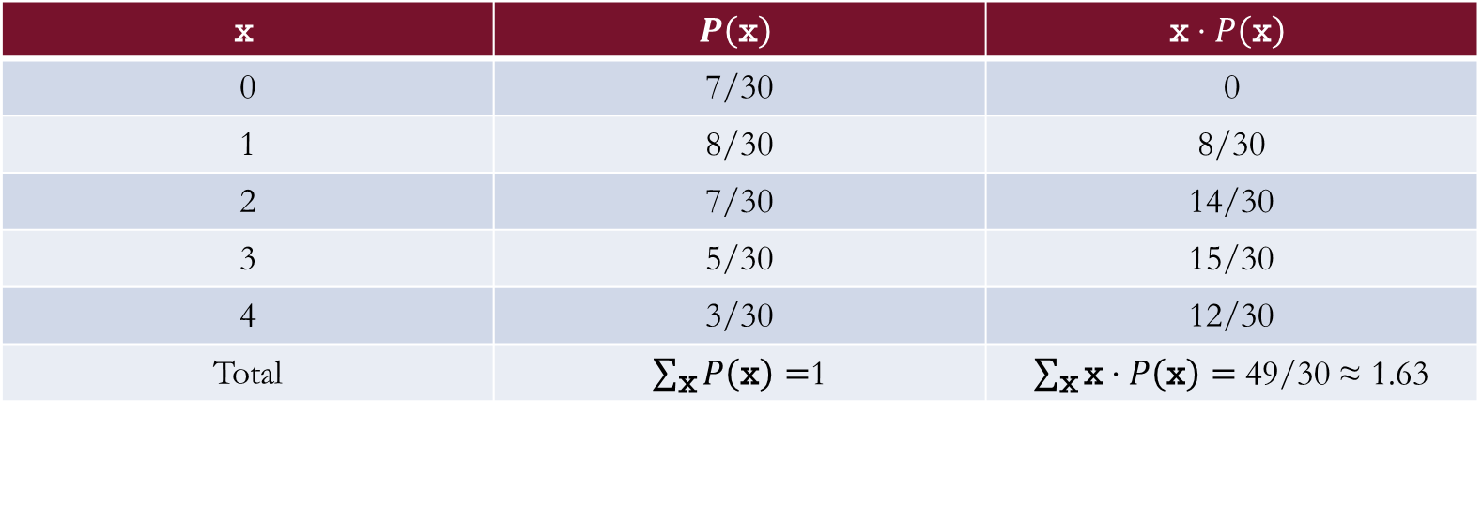
Exercise: Expected Value
Calculate the expected number of absences:
The expected number of absences is approximately 1.63 per class meeting.
$$\text{x}$$ | $$P\left(\text{x}\right)$$ | $$\text{x}⋅P\left(\text{x}\right)$$
0 | 7/30 | 0
1 | 8/30 | 8/30
2 | 7/30 | 14/30
3 | 5/30 | 15/30
4 | 3/30 | 12/30
Total | $\sum_{\text{x}}{P\left(\text{x}\right)}=$1 | $\sum_{\text{x}}{\text{x}⋅P\left(\text{x}\right)}=$ 49/30 ≈ 1.63

Slide 15
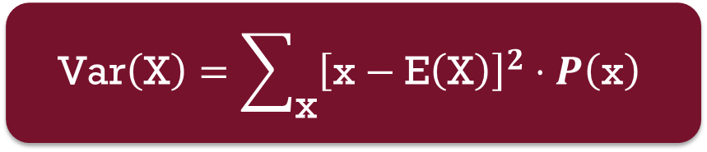
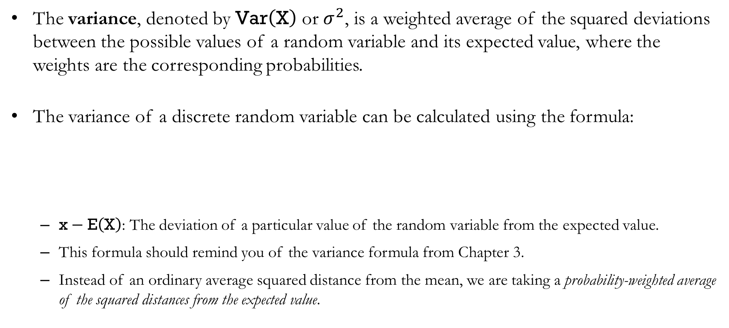
Variance
The variance, denoted by $\text{Var}\left(\text{X}\right)$ or $σ^{2}$, is a weighted average of the squared deviations between the possible values of a random variable and its expected value, where the weights are the corresponding probabilities.
The variance of a discrete random variable can be calculated using the formula:
  $\text{x}−\text{E}\left(\text{X}\right)$: The deviation of a particular value of the random variable from the expected value.
  This formula should remind you of the variance formula from Chapter 3.
  Instead of an ordinary average squared distance from the mean, we are taking a probability-weighted average of the squared distances from the expected value.
$$\text{Var}\left(\text{X}\right)=\sum_{\text{x}}{{\left[\text{x}−\text{E}\left(\text{X}\right)\right]}^{2}⋅P\left(\text{x}\right)}$$

Slide 16

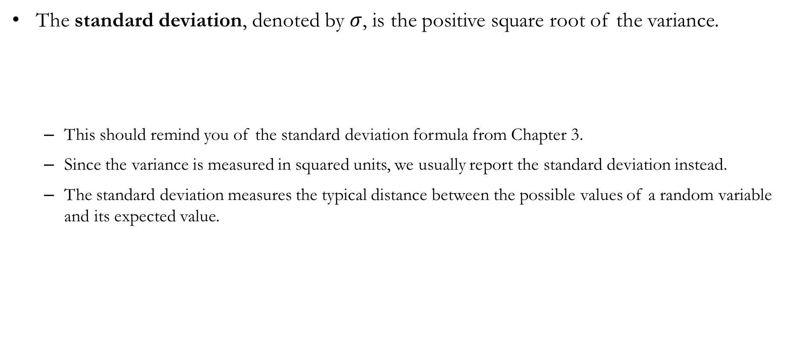
Standard Deviation
The standard deviation, denoted by $σ$, is the positive square root of the variance.
  This should remind you of the standard deviation formula from Chapter 3.
  Since the variance is measured in squared units, we usually report the standard deviation instead.
  The standard deviation measures the typical distance between the possible values of a random variable and its expected value.
$$σ=\sqrt{\text{Var}\left(\text{X}\right)}$$

Slide 17
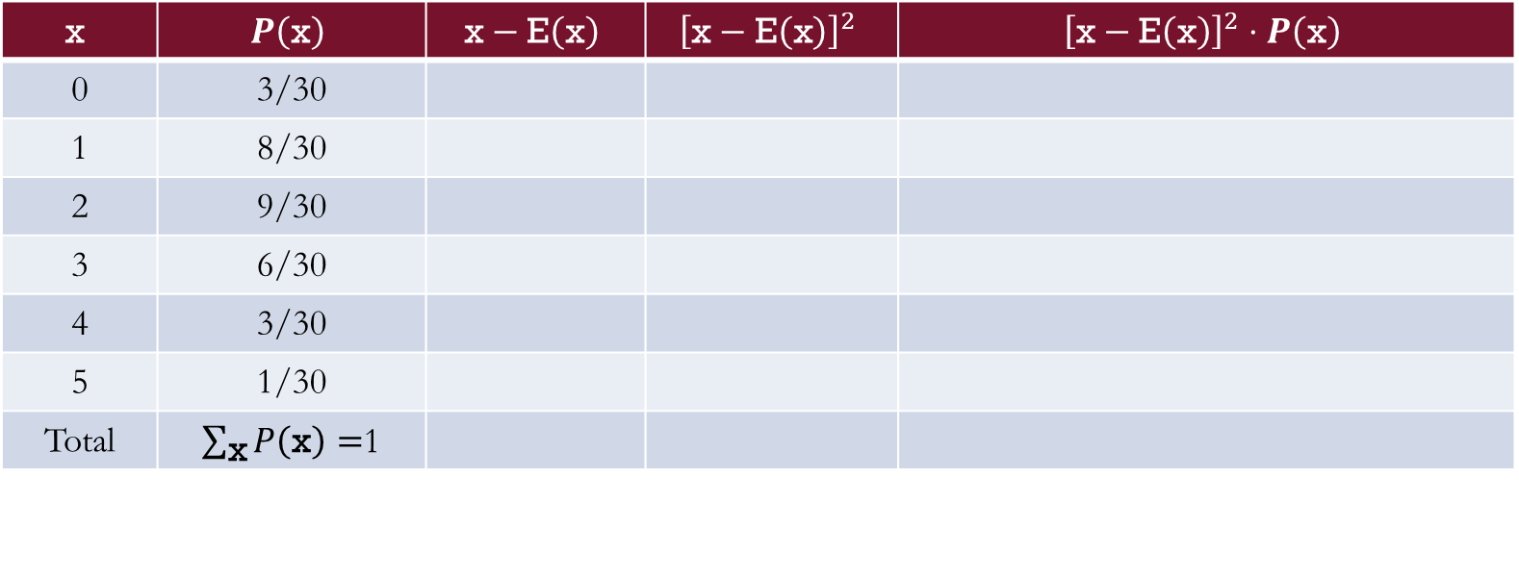

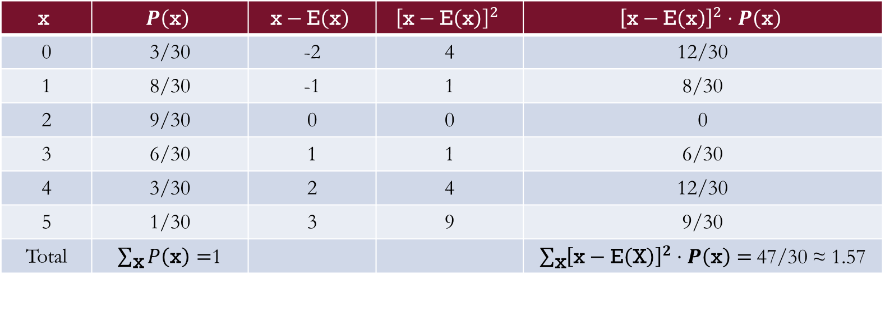
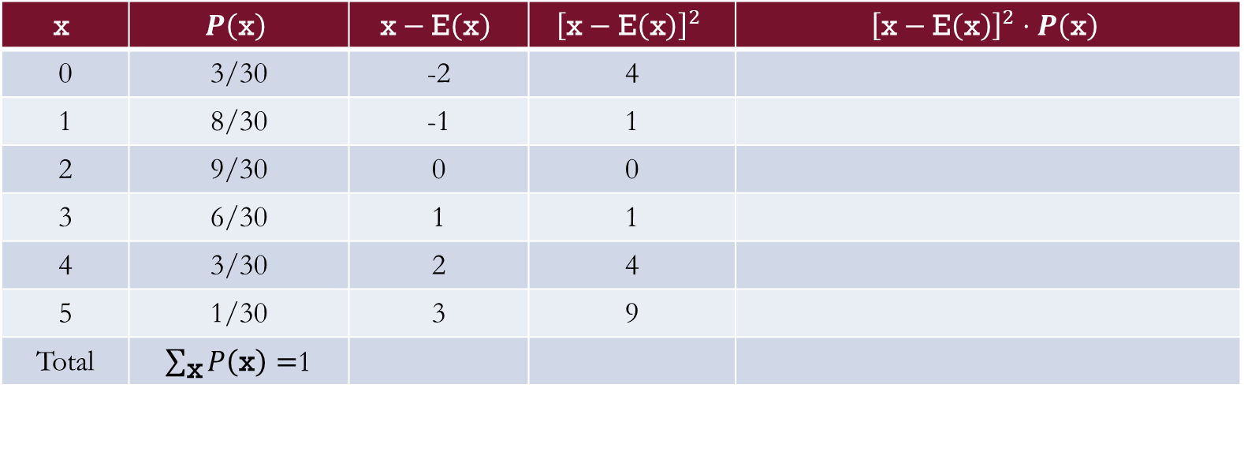
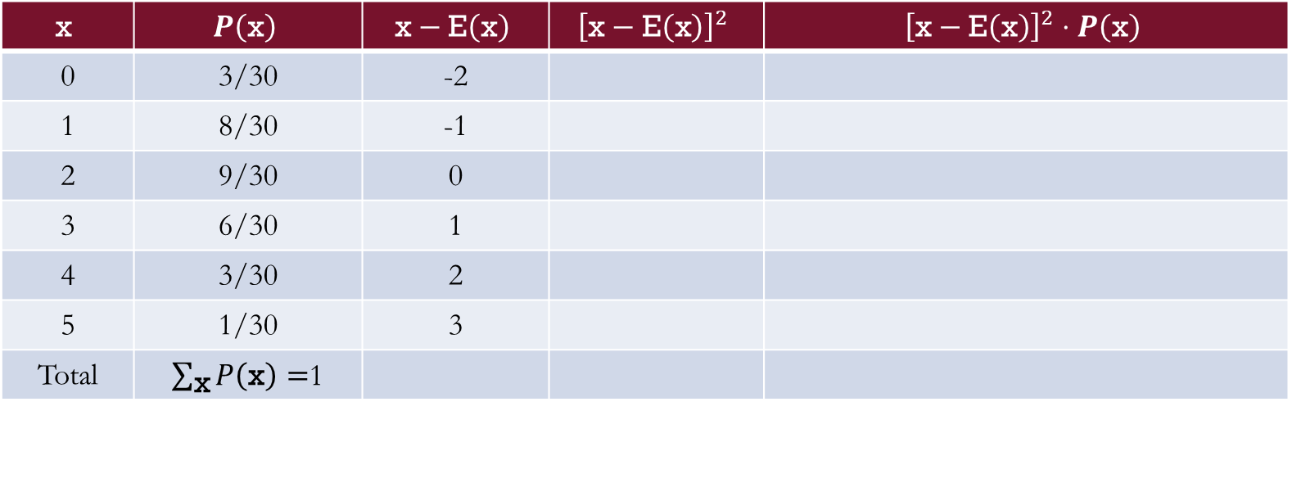
Exercise: Variance & Standard Deviation
For this exercise, use $\text{E}\left(\text{x}\right)=2$ as an approximation for simplicity.
So, the variance is measured as $\text{Var}\left(\text{X}\right)\text{≈}$ 1.57.
Then, the standard deviation is $σ=\sqrt{\text{Var}\left(\text{X}\right)} \text{≈} \sqrt{\text{1.57}}$ $\text{≈}$ 1.25
$$\text{x}$$ | $$P\left(\text{x}\right)$$ | $$\text{x}−\text{E}\left(\text{x}\right)$$ | $${\left[\text{x}−\text{E}\left(\text{x}\right)\right]}^{2}$$ | $${\left[\text{x}−\text{E}\left(\text{x}\right)\right]}^{2}⋅P\left(\text{x}\right)$$
0 | 3/30
1 | 8/30
2 | 9/30
3 | 6/30
4 | 3/30
5 | 1/30
Total | $\sum_{\text{x}}{P\left(\text{x}\right)}=$1
$$\text{x}$$ | $$P\left(\text{x}\right)$$ | $$\text{x}−\text{E}\left(\text{x}\right)$$ | $${\left[\text{x}−\text{E}\left(\text{x}\right)\right]}^{2}$$ | $${\left[\text{x}−\text{E}\left(\text{x}\right)\right]}^{2}⋅P\left(\text{x}\right)$$
0 | 3/30 | -2
1 | 8/30 | -1
2 | 9/30 | 0
3 | 6/30 | 1
4 | 3/30 | 2
5 | 1/30 | 3
Total | $\sum_{\text{x}}{P\left(\text{x}\right)}=$1
$$\text{x}$$ | $$P\left(\text{x}\right)$$ | $$\text{x}−\text{E}\left(\text{x}\right)$$ | $${\left[\text{x}−\text{E}\left(\text{x}\right)\right]}^{2}$$ | $${\left[\text{x}−\text{E}\left(\text{x}\right)\right]}^{2}⋅P\left(\text{x}\right)$$
0 | 3/30 | -2 | 4
1 | 8/30 | -1 | 1
2 | 9/30 | 0 | 0
3 | 6/30 | 1 | 1
4 | 3/30 | 2 | 4
5 | 1/30 | 3 | 9
Total | $\sum_{\text{x}}{P\left(\text{x}\right)}=$1
$$\text{x}$$ | $$P\left(\text{x}\right)$$ | $$\text{x}−\text{E}\left(\text{x}\right)$$ | $${\left[\text{x}−\text{E}\left(\text{x}\right)\right]}^{2}$$ | $${\left[\text{x}−\text{E}\left(\text{x}\right)\right]}^{2}⋅P\left(\text{x}\right)$$
0 | 3/30 | -2 | 4 | 12/30
1 | 8/30 | -1 | 1 | 8/30
2 | 9/30 | 0 | 0 | 0
3 | 6/30 | 1 | 1 | 6/30
4 | 3/30 | 2 | 4 | 12/30
5 | 1/30 | 3 | 9 | 9/30
Total | $\sum_{\text{x}}{P\left(\text{x}\right)}=$1 |  |  | $\sum_{\text{x}}{{\left[\text{x}−\text{E}\left(\text{X}\right)\right]}^{2}⋅P\left(\text{x}\right)}=$47/30 ≈ 1.57

Slide 18
Bivariate Distributions
and Covariance

Slide 19
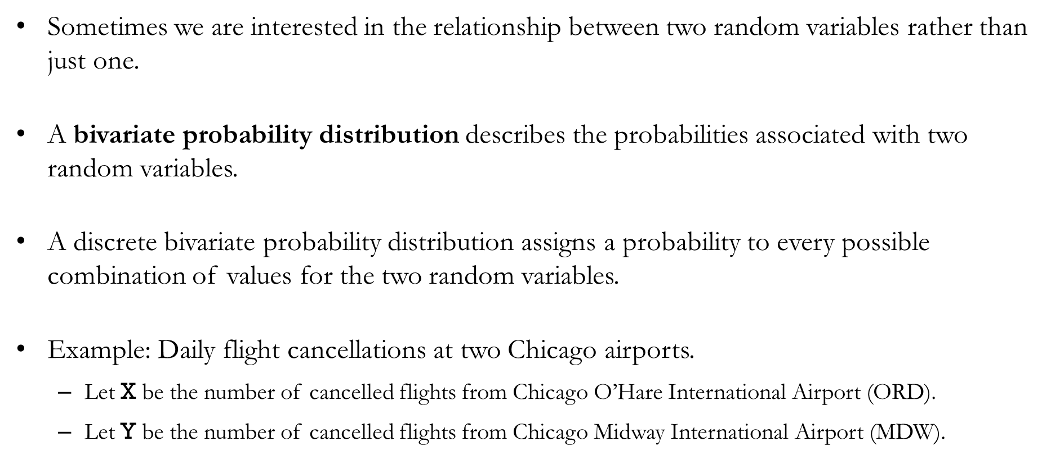
Bivariate Probability Distribution
Sometimes we are interested in the relationship between two random variables rather than just one.
A bivariate probability distribution describes the probabilities associated with two random variables.
A discrete bivariate probability distribution assigns a probability to every possible combination of values for the two random variables.
Example: Daily flight cancellations at two Chicago airports.
  Let $\text{X}$ be the number of cancelled flights from Chicago O’Hare International Airport (ORD).
  Let $\text{Y}$ be the number of cancelled flights from Chicago Midway International Airport (MDW).

Slide 20
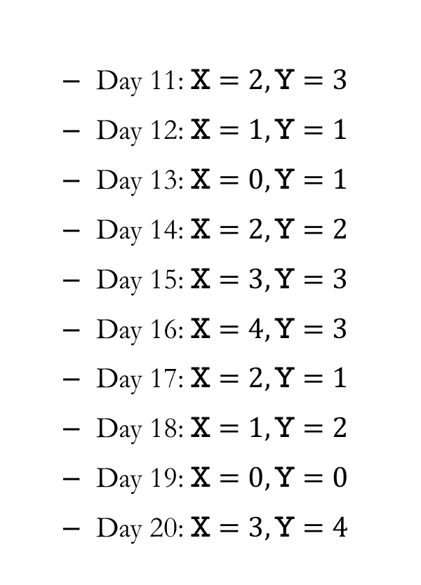
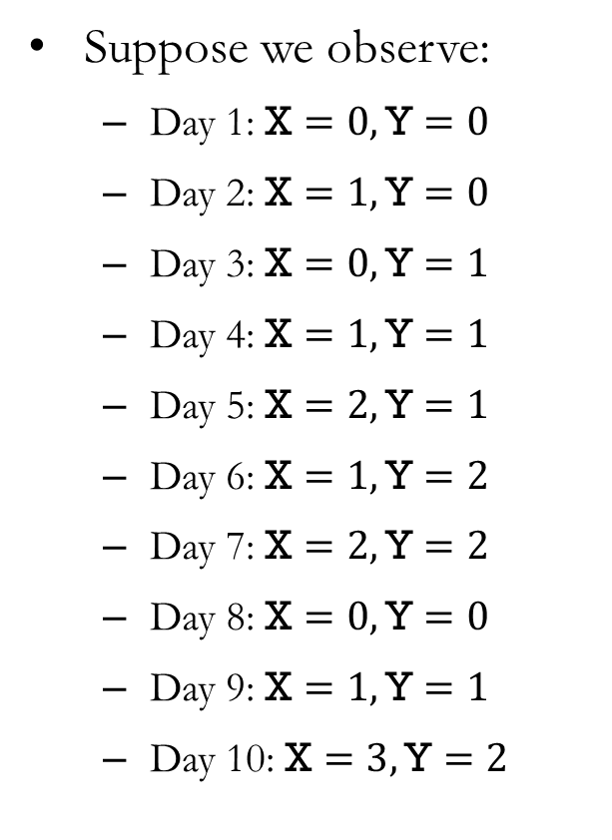
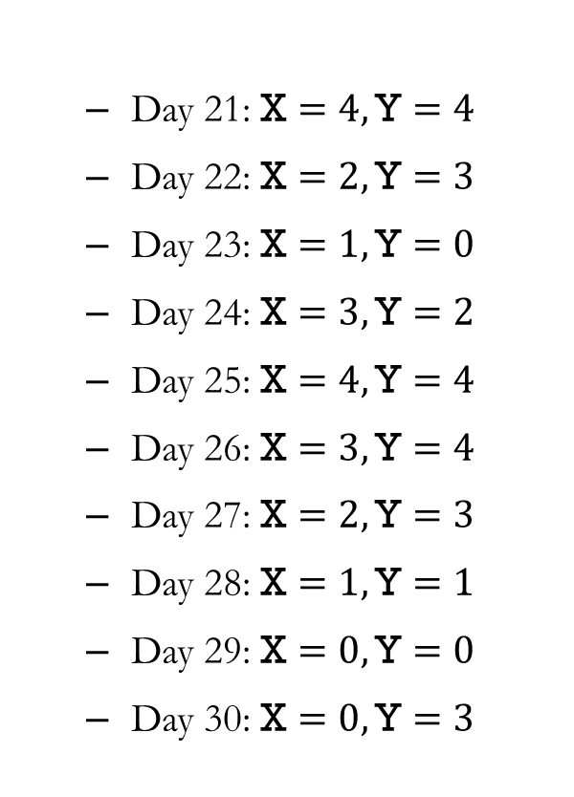
Example: Bivariate Probability Distribution
Suppose we observe:
  Day 1: $\text{X}=0,\text{Y}=0$
  Day 2: $\text{X}=1,\text{Y}=0$
  Day 3: $\text{X}=0,\text{Y}=1$
  Day 4: $\text{X}=1,\text{Y}=1$
  Day 5: $\text{X}=2,\text{Y}=1$
  Day 6: $\text{X}=1,\text{Y}=2$
  Day 7: $\text{X}=2,\text{Y}=2$
  Day 8: $\text{X}=0,\text{Y}=0$
  Day 9: $\text{X}=1,\text{Y}=1$
  Day 10: $\text{X}=3,\text{Y}=2$
  Day 11: $\text{X}=2,\text{Y}=3$
  Day 12: $\text{X}=1,\text{Y}=1$
  Day 13: $\text{X}=0,\text{Y}=1$
  Day 14: $\text{X}=2,\text{Y}=2$
  Day 15: $\text{X}=3,\text{Y}=3$
  Day 16: $\text{X}=4,\text{Y}=3$
  Day 17: $\text{X}=2,\text{Y}=1$
  Day 18: $\text{X}=1,\text{Y}=2$
  Day 19: $\text{X}=0,\text{Y}=0$
  Day 20: $\text{X}=3,\text{Y}=4$
  Day 21: $\text{X}=4,\text{Y}=4$
  Day 22: $\text{X}=2,\text{Y}=3$
  Day 23: $\text{X}=1,\text{Y}=0$
  Day 24: $\text{X}=3,\text{Y}=2$
  Day 25: $\text{X}=4,\text{Y}=4$
  Day 26: $\text{X}=3,\text{Y}=4$
  Day 27: $\text{X}=2,\text{Y}=3$
  Day 28: $\text{X}=1,\text{Y}=1$
  Day 29: $\text{X}=0,\text{Y}=0$
  Day 30: $\text{X}=0,\text{Y}=3$

Slide 21
Example: Bivariate Probability Distribution
We can summarize the observations in a joint frequency table. Each cell contains the number of observations for a particular combination of values of X and Y.
How many days were there no flights cancelled in both ORD and MDW?
  Four days: Days 1, 8, 19, and 29
 | Y
X | 0 | 1 | 2 | 3 | 4 | Total
0
1
2
3
4
Total
 | Y
X | 0 | 1 | 2 | 3 | 4 | Total
0 | 4
1
2
3
4
Total

Slide 22
Example: Bivariate Probability Distribution
Repeating this counting process for every combination of X and Y gives the completed joint frequency table.
  A row corresponds to a fixed value of X, and a column corresponds to a fixed value of Y.
  Each cell is a joint frequency, and the bottom-right corner is the total sample size.
 | Y
X | 0 | 1 | 2 | 3 | 4 | Total
0 | 4
1
2
3
4
Total
 | Y
X | 0 | 1 | 2 | 3 | 4 | Total
0 | 4 | 2 | 0 | 1 | 0 | 7
1
2
3
4
Total
 | Y
X | 0 | 1 | 2 | 3 | 4 | Total
0 | 4 | 2 | 0 | 1 | 0 | 7
1 | 2
2 | 0
3 | 0
4 | 0
Total | 6
 | Y
X | 0 | 1 | 2 | 3 | 4 | Total
0 | 4 | 2 | 0 | 1 | 0 | 7
1 | 2 | 4 | 2 | 0 | 0 | 8
2 | 0 | 2 | 2 | 3 | 0 | 7
3 | 0 | 0 | 2 | 1 | 2 | 5
4 | 0 | 0 | 0 | 1 | 2 | 3
Total | 6 | 8 | 6 | 6 | 4 | 30

Slide 23

Example: Bivariate Probability Distribution
We can convert the joint frequency table into a joint probability distribution by dividing every frequency by the total number of observations.
  Each cell now represents the probability of observing a particular combination of values of X and Y.
  For instance, $P\left(\text{X}=0,\text{Y}=0\right)=4/30≈0.13$
 | Y
X | 0 | 1 | 2 | 3 | 4 | Total
0 | 4/30 | 2/30 | 0 | 1/30 | 0 | 7/30
1 | 2/30 | 4/30 | 2/30 | 0 | 0 | 8/30
2 | 0 | 2/30 | 2/30 | 3/30 | 0 | 7/30
3 | 0 | 0 | 2/30 | 1/30 | 2/30 | 5/30
4 | 0 | 0 | 0 | 1/30 | 2/30 | 3/30
Total | 6/30 | 8/30 | 6/30 | 6/30 | 4/30 | 1

Slide 24

Example: Bivariate Probability Distribution
The totals along the margins are called marginal probabilities, and they give the probabilities of one random variable, regardless of the value of the other.
  The marginal probability $P\left(\text{X}=0\right)$ is obtained by adding the joint probabilities across the row.
  $P\left(\text{X}=0\right)=\frac{4}{30}+\frac{2}{30}+0+\frac{1}{30}+0=\frac{7}{30}$
 | Y
X | 0 | 1 | 2 | 3 | 4 | Total
0 | 4/30 | 2/30 | 0 | 1/30 | 0 | 7/30
1 | 2/30 | 4/30 | 2/30 | 0 | 0 | 8/30
2 | 0 | 2/30 | 2/30 | 3/30 | 0 | 7/30
3 | 0 | 0 | 2/30 | 1/30 | 2/30 | 5/30
4 | 0 | 0 | 0 | 1/30 | 2/30 | 3/30
Total | 6/30 | 8/30 | 6/30 | 6/30 | 4/30 | 1

Slide 25

Example: Bivariate Probability Distribution
The totals along the margins are called marginal probabilities, and they give the probabilities of one random variable, regardless of the value of the other.
  Similarly, the marginal probability $P\left(\text{Y}=2\right)$ is obtained by adding the probabilities down the column.
  $P\left(\text{Y}=2\right)=0+\frac{2}{30}+\frac{2}{30}+\frac{2}{30}+0=\frac{6}{30}$
 | Y
X | 0 | 1 | 2 | 3 | 4 | Total
0 | 4/30 | 2/30 | 0 | 1/30 | 0 | 7/30
1 | 2/30 | 4/30 | 2/30 | 0 | 0 | 8/30
2 | 0 | 2/30 | 2/30 | 3/30 | 0 | 7/30
3 | 0 | 0 | 2/30 | 1/30 | 2/30 | 5/30
4 | 0 | 0 | 0 | 1/30 | 2/30 | 3/30
Total | 6/30 | 8/30 | 6/30 | 6/30 | 4/30 | 1

Slide 26
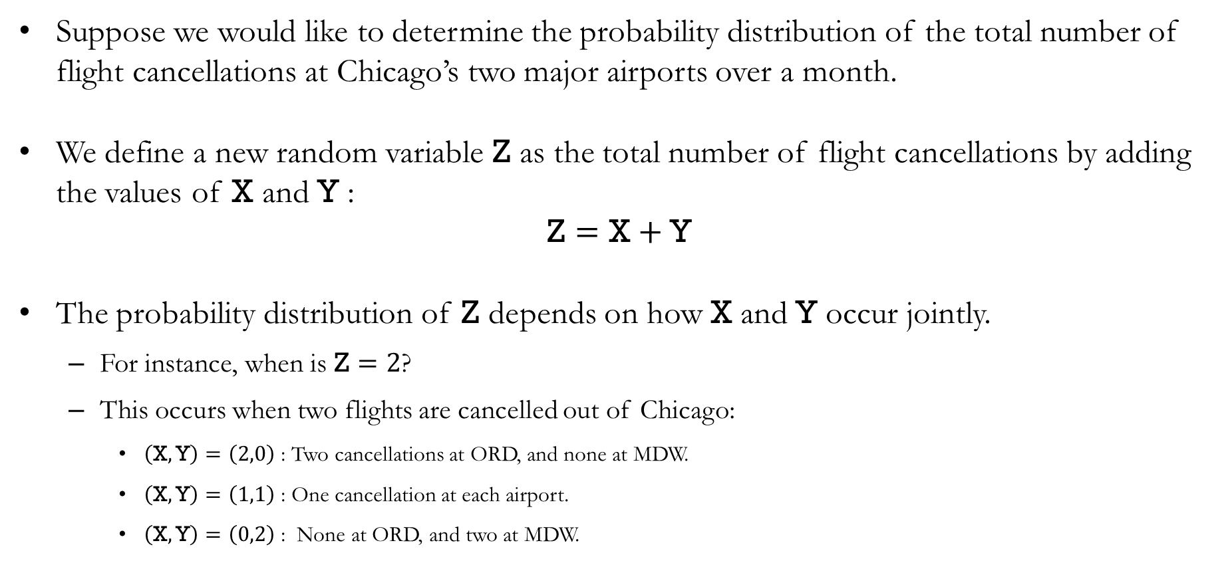
Bivariate Probability Distribution
Suppose we would like to determine the probability distribution of the total number of flight cancellations at Chicago’s two major airports over a month.
We define a new random variable Z as the total number of flight cancellations by adding the values of X and Y :
$$\text{Z}=\text{X}+\text{Y}$$
The probability distribution of Z depends on how X and Y occur jointly.
  For instance, when is $\text{Z}=2$?
  This occurs when two flights are cancelled out of Chicago:
    $\left(\text{X},\text{Y}\right)=\left(2,0\right)$ : Two cancellations at ORD, and none at MDW.
    $\left(\text{X},\text{Y}\right)=\left(1,1\right)$: One cancellation at each airport.
    $\left(\text{X},\text{Y}\right)=\left(0,2\right)$: None at ORD, and two at MDW.

Slide 27
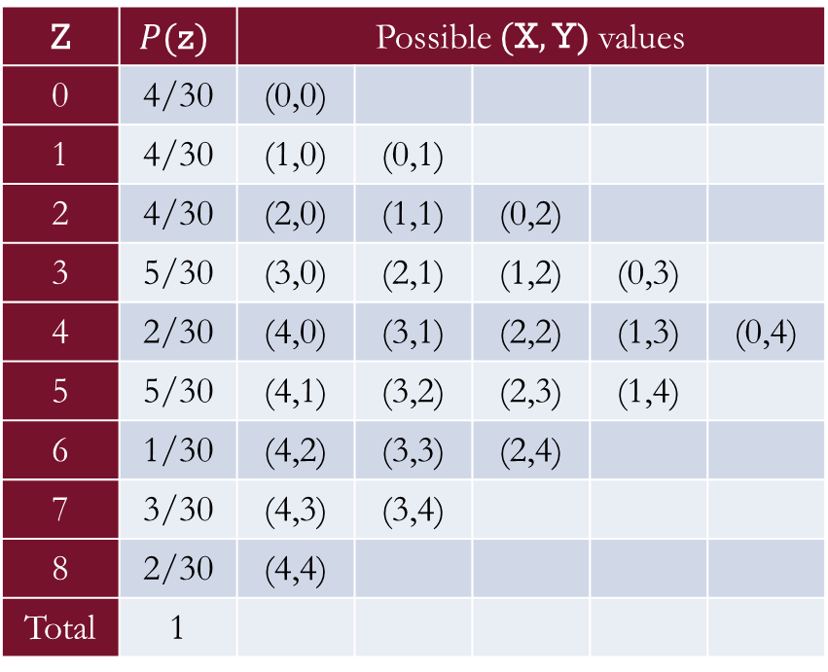
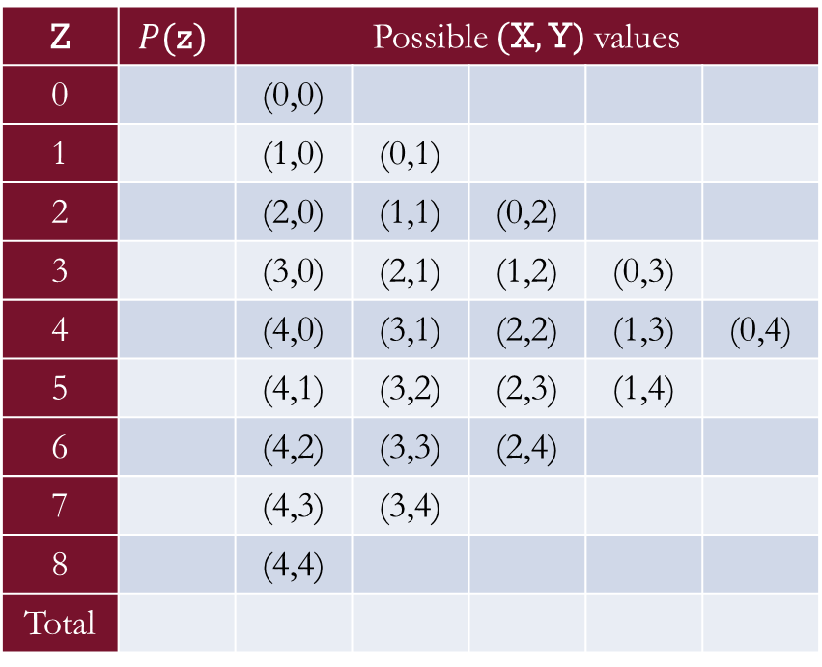
Bivariate Probability Distribution
Each probability in the distribution of Z is obtained by adding the appropriate cells from the joint probability table.
Z | $$P(\text{z})$$ | Possible $(\text{X},\text{Y)}$ values
0 | 4/30 | (0,0)
1 | 4/30 | (1,0) | (0,1)
2 | 4/30 | (2,0) | (1,1) | (0,2)
3 | 5/30 | (3,0) | (2,1) | (1,2) | (0,3)
4 | 2/30 | (4,0) | (3,1) | (2,2) | (1,3) | (0,4)
5 | 5/30 | (4,1) | (3,2) | (2,3) | (1,4)
6 | 1/30 | (4,2) | (3,3) | (2,4)
7 | 3/30 | (4,3) | (3,4)
8 | 2/30 | (4,4)
Total | 1
 | Y
X | 0 | 1 | 2 | 3 | 4 | Total
0 | 4/30 | 2/30 | 0 | 1/30 | 0 | 7/30
1 | 2/30 | 4/30 | 2/30 | 0 | 0 | 8/30
2 | 0 | 2/30 | 2/30 | 3/30 | 0 | 7/30
3 | 0 | 0 | 2/30 | 1/30 | 2/30 | 5/30
4 | 0 | 0 | 0 | 1/30 | 2/30 | 3/30
Total | 6/30 | 8/30 | 6/30 | 6/30 | 4/30 | 1
Z | $$P(\text{z})$$ | Possible $(\text{X},\text{Y)}$ values
0 |  | (0,0)
1 |  | (1,0) | (0,1)
2 |  | (2,0) | (1,1) | (0,2)
3 |  | (3,0) | (2,1) | (1,2) | (0,3)
4 |  | (4,0) | (3,1) | (2,2) | (1,3) | (0,4)
5 |  | (4,1) | (3,2) | (2,3) | (1,4)
6 |  | (4,2) | (3,3) | (2,4)
7 |  | (4,3) | (3,4)
8 |  | (4,4)
Total

Slide 28
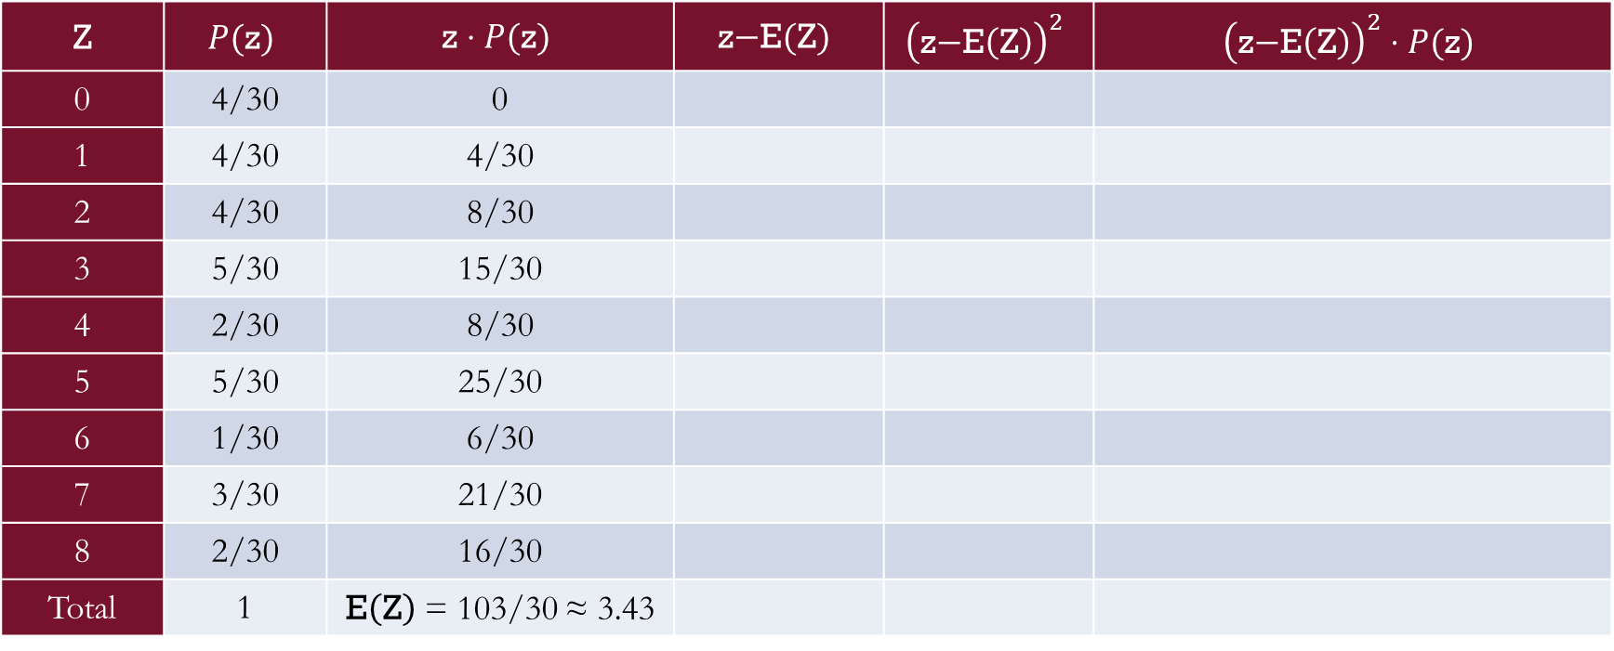
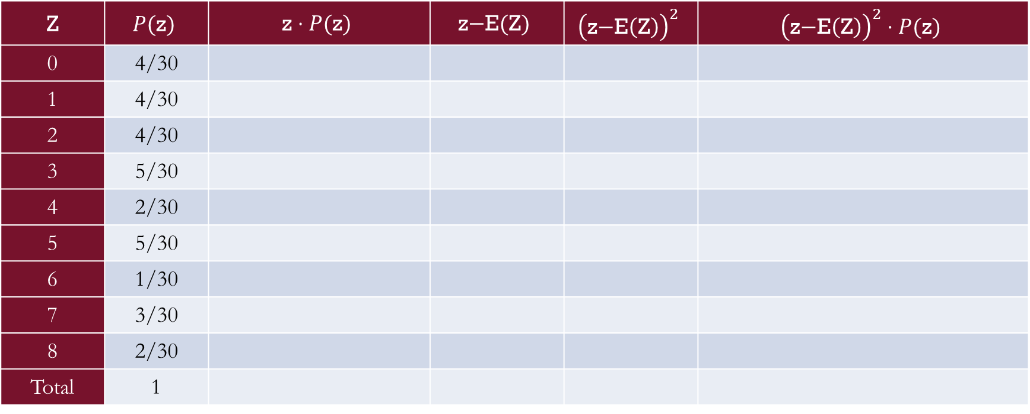
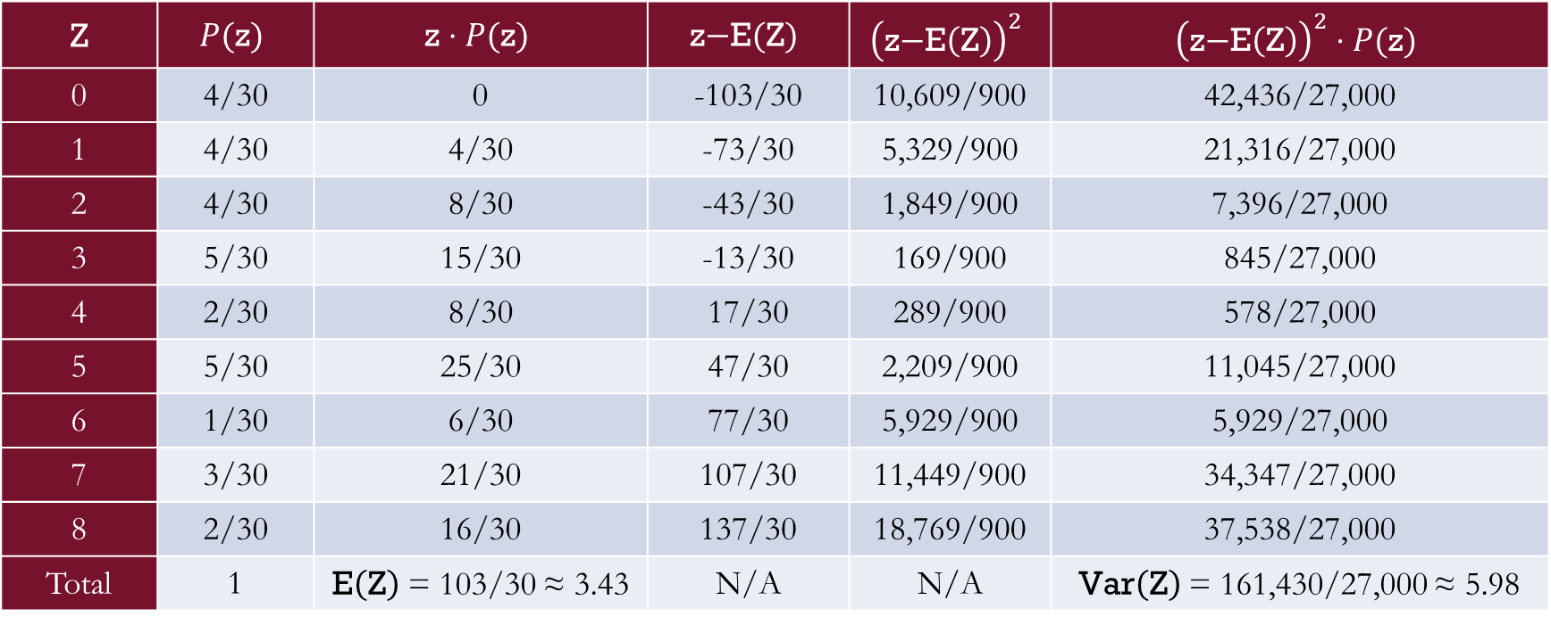
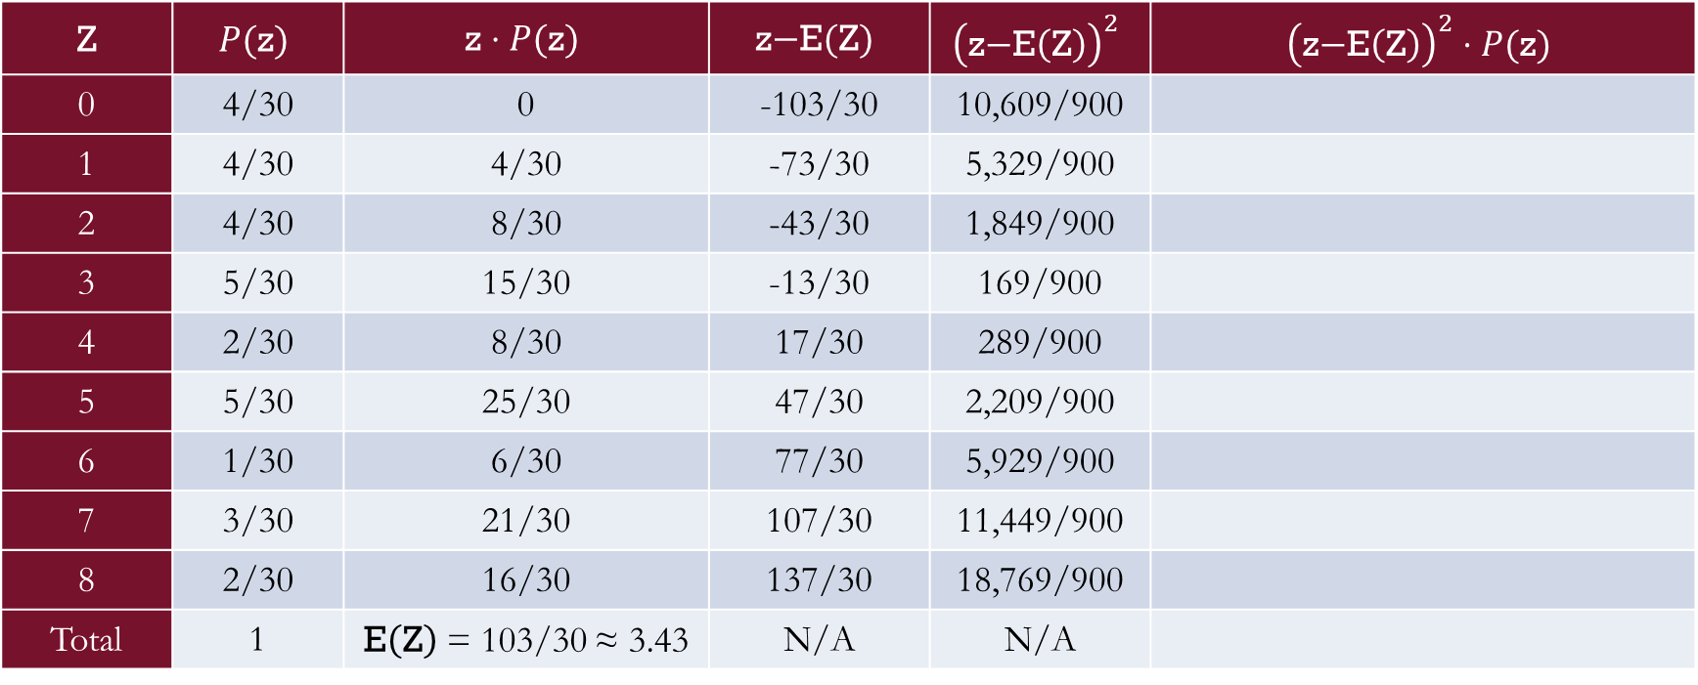
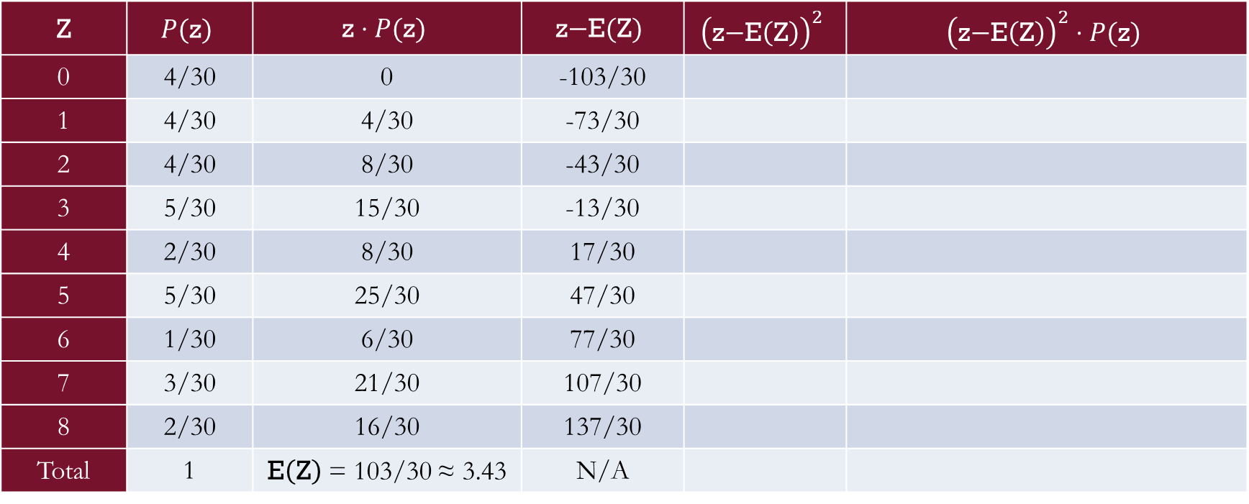
In-class Exercise
Fill out the following table, and find the expected value and variance of Z:
Z | $$P(\text{z})$$ | $$\text{z}⋅P(\text{z})$$ | $$\text{z−E}(\text{Z})$$ | $${\left(\text{z−E}\left(\text{Z}\right)\right)}^{2}$$ | $${\left(\text{z−E}\left(\text{Z}\right)\right)}^{2}⋅P(\text{z})$$
0 | 4/30
1 | 4/30
2 | 4/30
3 | 5/30
4 | 2/30
5 | 5/30
6 | 1/30
7 | 3/30
8 | 2/30
Total | 1
Z | $$P(\text{z})$$ | $$\text{z}⋅P(\text{z})$$ | $$\text{z−E}(\text{Z})$$ | $${\left(\text{z−E}\left(\text{Z}\right)\right)}^{2}$$ | $${\left(\text{z−E}\left(\text{Z}\right)\right)}^{2}⋅P(\text{z})$$
0 | 4/30 | 0
1 | 4/30 | 4/30
2 | 4/30 | 8/30
3 | 5/30 | 15/30
4 | 2/30 | 8/30
5 | 5/30 | 25/30
6 | 1/30 | 6/30
7 | 3/30 | 21/30
8 | 2/30 | 16/30
Total | 1 | $\text{E}\left(\text{Z}\right)$ = 103/30 ≈ 3.43
Z | $$P(\text{z})$$ | $$\text{z}⋅P(\text{z})$$ | $$\text{z−E}(\text{Z})$$ | $${\left(\text{z−E}\left(\text{Z}\right)\right)}^{2}$$ | $${\left(\text{z−E}\left(\text{Z}\right)\right)}^{2}⋅P(\text{z})$$
0 | 4/30 | 0 | -103/30
1 | 4/30 | 4/30 | -73/30
2 | 4/30 | 8/30 | -43/30
3 | 5/30 | 15/30 | -13/30
4 | 2/30 | 8/30 | 17/30
5 | 5/30 | 25/30 | 47/30
6 | 1/30 | 6/30 | 77/30
7 | 3/30 | 21/30 | 107/30
8 | 2/30 | 16/30 | 137/30
Total | 1 | $\text{E}\left(\text{Z}\right)$ = 103/30 ≈ 3.43 | N/A
Z | $$P(\text{z})$$ | $$\text{z}⋅P(\text{z})$$ | $$\text{z−E}(\text{Z})$$ | $${\left(\text{z−E}\left(\text{Z}\right)\right)}^{2}$$ | $${\left(\text{z−E}\left(\text{Z}\right)\right)}^{2}⋅P(\text{z})$$
0 | 4/30 | 0 | -103/30 | 10,609/900
1 | 4/30 | 4/30 | -73/30 | 5,329/900
2 | 4/30 | 8/30 | -43/30 | 1,849/900
3 | 5/30 | 15/30 | -13/30 | 169/900
4 | 2/30 | 8/30 | 17/30 | 289/900
5 | 5/30 | 25/30 | 47/30 | 2,209/900
6 | 1/30 | 6/30 | 77/30 | 5,929/900
7 | 3/30 | 21/30 | 107/30 | 11,449/900
8 | 2/30 | 16/30 | 137/30 | 18,769/900
Total | 1 | $\text{E}\left(\text{Z}\right)$ = 103/30 ≈ 3.43 | N/A | N/A
Z | $$P(\text{z})$$ | $$\text{z}⋅P(\text{z})$$ | $$\text{z−E}(\text{Z})$$ | $${\left(\text{z−E}\left(\text{Z}\right)\right)}^{2}$$ | $${\left(\text{z−E}\left(\text{Z}\right)\right)}^{2}⋅P(\text{z})$$
0 | 4/30 | 0 | -103/30 | 10,609/900 | 42,436/27,000
1 | 4/30 | 4/30 | -73/30 | 5,329/900 | 21,316/27,000
2 | 4/30 | 8/30 | -43/30 | 1,849/900 | 7,396/27,000
3 | 5/30 | 15/30 | -13/30 | 169/900 | 845/27,000
4 | 2/30 | 8/30 | 17/30 | 289/900 | 578/27,000
5 | 5/30 | 25/30 | 47/30 | 2,209/900 | 11,045/27,000
6 | 1/30 | 6/30 | 77/30 | 5,929/900 | 5,929/27,000
7 | 3/30 | 21/30 | 107/30 | 11,449/900 | 34,347/27,000
8 | 2/30 | 16/30 | 137/30 | 18,769/900 | 37,538/27,000
Total | 1 | $\text{E}\left(\text{Z}\right)$ = 103/30 ≈ 3.43 | N/A | N/A | $\text{Var}\left(\text{Z}\right)$ = 161,430/27,000 ≈ 5.98

Slide 29
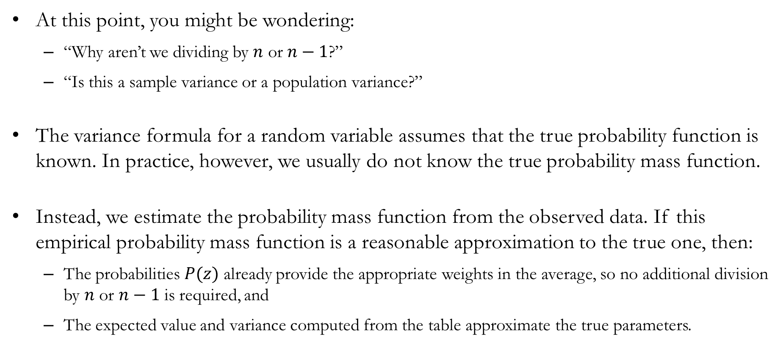
Caveats: The True Probabilities
At this point, you might be wondering:
  “Why aren’t we dividing by $n$ or $n−1$?”
  “Is this a sample variance or a population variance?”
The variance formula for a random variable assumes that the true probability function is known. In practice, however, we usually do not know the true probability mass function.
Instead, we estimate the probability mass function from the observed data. If this empirical probability mass function is a reasonable approximation to the true one, then:
  The probabilities $P(z)$ already provide the appropriate weights in the average, so no additional division by $n$ or $n−1$ is required, and
  The expected value and variance computed from the table approximate the true parameters.

Slide 30
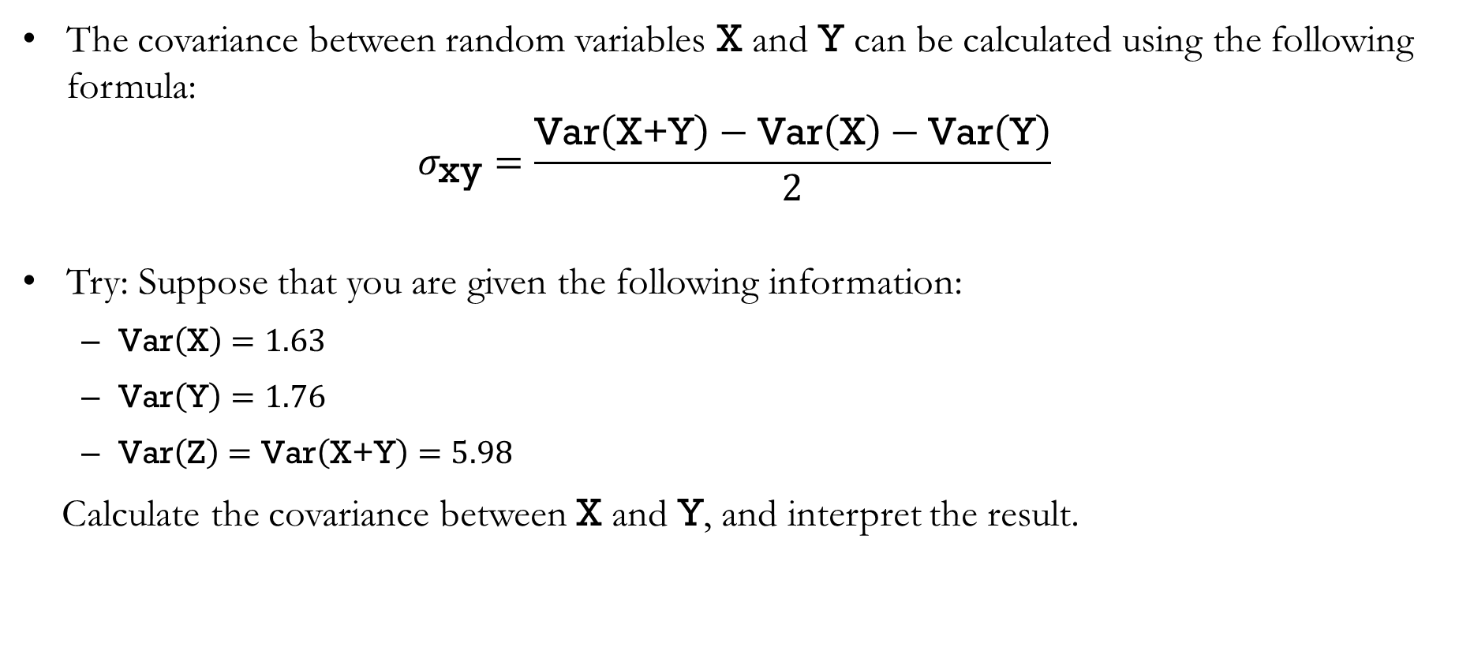
Covariance
The covariance between random variables X and Y can be calculated using the following formula:
$$σ_{\text{xy}}=\frac{\text{Var}\left(\text{X+Y}\right)−\text{Var}\left(\text{X}\right)−\text{Var}\left(\text{Y}\right)}{2}$$
Try: Suppose that you are given the following information:
  $\text{Var}\left(\text{X}\right)=1.63$
  $\text{Var}\left(\text{Y}\right)=1.76$
  $\text{Var}\left(\text{Z}\right)=\text{Var}\left(\text{X+Y}\right)=5.98$
Calculate the covariance between X and Y, and interpret the result.

Slide 31
Examples of Some
Discrete Probability Distributions

Slide 32
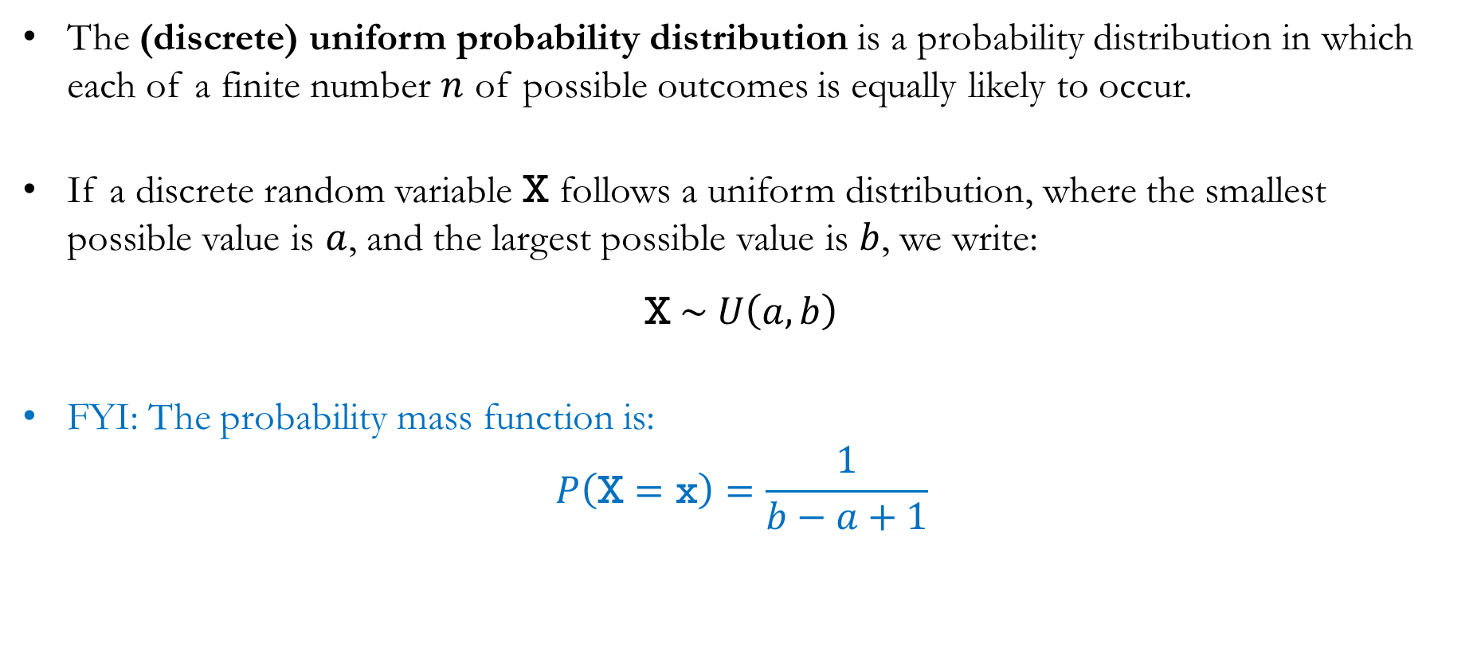
Uniform Distribution
The (discrete) uniform probability distribution is a probability distribution in which each of a finite number $n$ of possible outcomes is equally likely to occur.
If a discrete random variable $\text{X}$ follows a uniform distribution, where the smallest possible value is $a$, and the largest possible value is $b$, we write:
$$\text{X} \sim U\left(a,b\right)$$
FYI: The probability mass function is:
$$P\left(\text{X}=\text{x}\right)=\frac{1}{b−a+1}$$

Slide 33
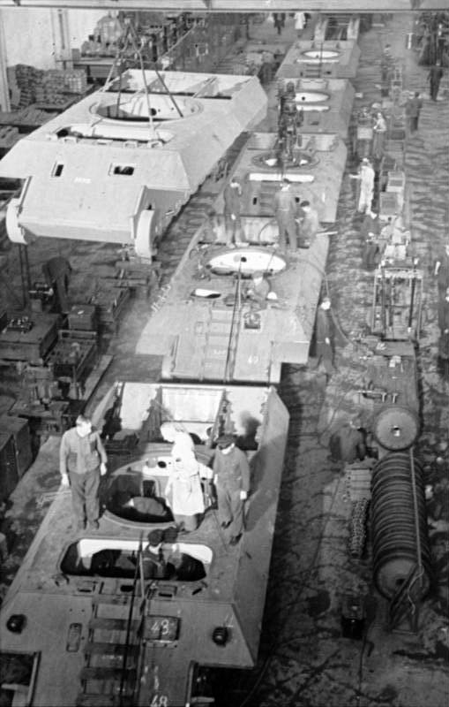
Detour: The German Tank Problem
During World War II, the Allied forces wanted to estimate how many tanks Germany was producing.
Conventional military intelligence estimated that 1,550 tanks would have been produced in August 1942.
Instead, statisticians examined the serial numbers on a small sample of captured German tanks and estimated that only 327 tanks would have been produced in August 1942.
Post-war German production records showed that 342 tanks were actually produced in August 1942.

Slide 34
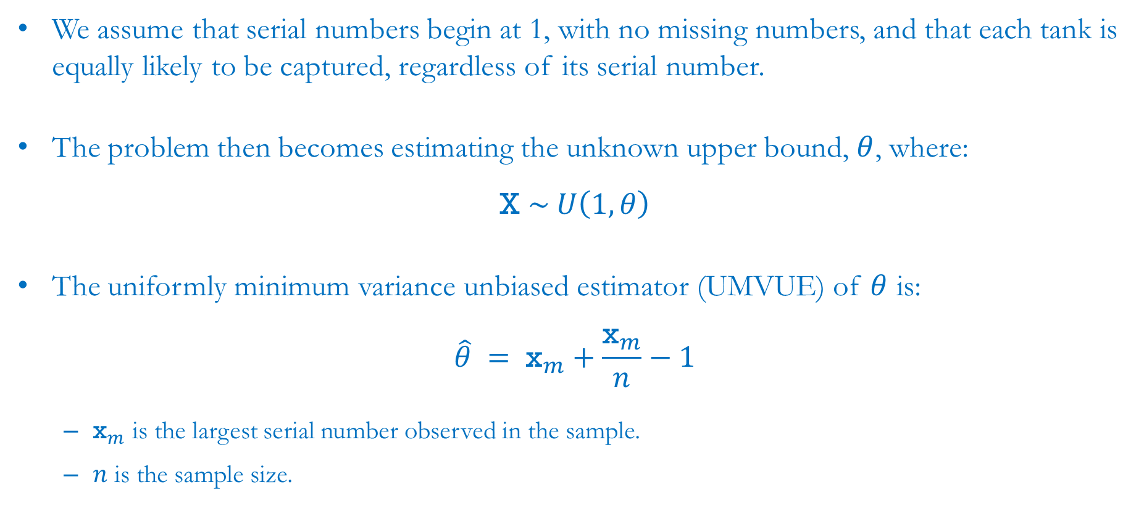
Detour: The German Tank Problem (with Math)
We assume that serial numbers begin at 1, with no missing numbers, and that each tank is equally likely to be captured, regardless of its serial number.
The problem then becomes estimating the unknown upper bound, $θ$, where:
$$\text{X} \sim U\left(1,θ\right)$$
The uniformly minimum variance unbiased estimator (UMVUE) of $θ$ is:
$$\hat{θ} = {\text{x}}_{m}+\frac{{\text{x}}_{m}}{n}−1$$
  ${\text{x}}_{m}$ is the largest serial number observed in the sample.
  $n$ is the sample size.

Slide 35
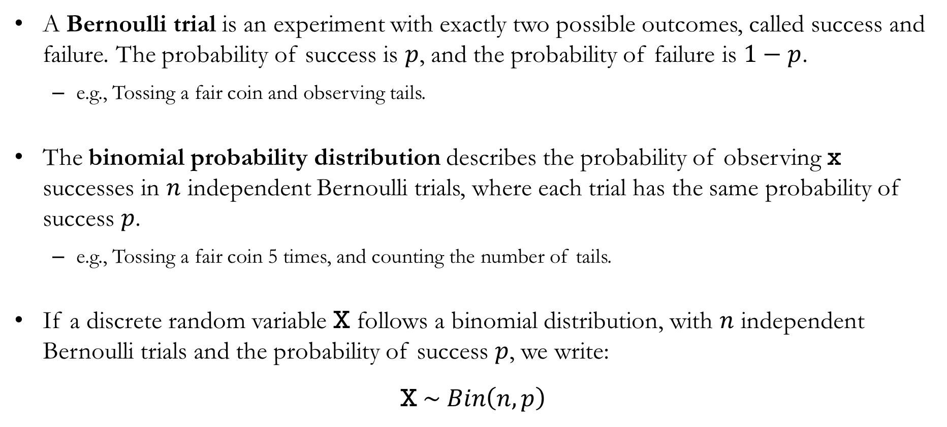
Bernoulli Trials and the Binomial Distribution
A Bernoulli trial is an experiment with exactly two possible outcomes, called success and failure. The probability of success is $p$, and the probability of failure is $1−p$.
  e.g., Tossing a fair coin and observing tails.
The binomial probability distribution describes the probability of observing $\text{x}$ successes in $n$ independent Bernoulli trials, where each trial has the same probability of success $p$.
  e.g., Tossing a fair coin 5 times, and counting the number of tails.
If a discrete random variable $\text{X}$ follows a binomial distribution, with $n$ independent Bernoulli trials and the probability of success $p$, we write:
$$\text{X} \sim Bin\left(n,p\right)$$

Slide 36

Detour: Bernoulli’s Insurance Problem
During the 1700s, merchants faced an important question:
  Should they purchase insurance before sending cargo overseas?
  Most voyages were successful, but some resulted in complete losses.
Each voyage can be viewed as a Bernoulli trial:
  Success: The ship returns safely from its trade mission.
  Failure: The ship and cargo is lost.
If each voyage is independent and has the same probability of loss, the binomial distribution can be used to predict how many ships are lost over many voyages.

Slide 37
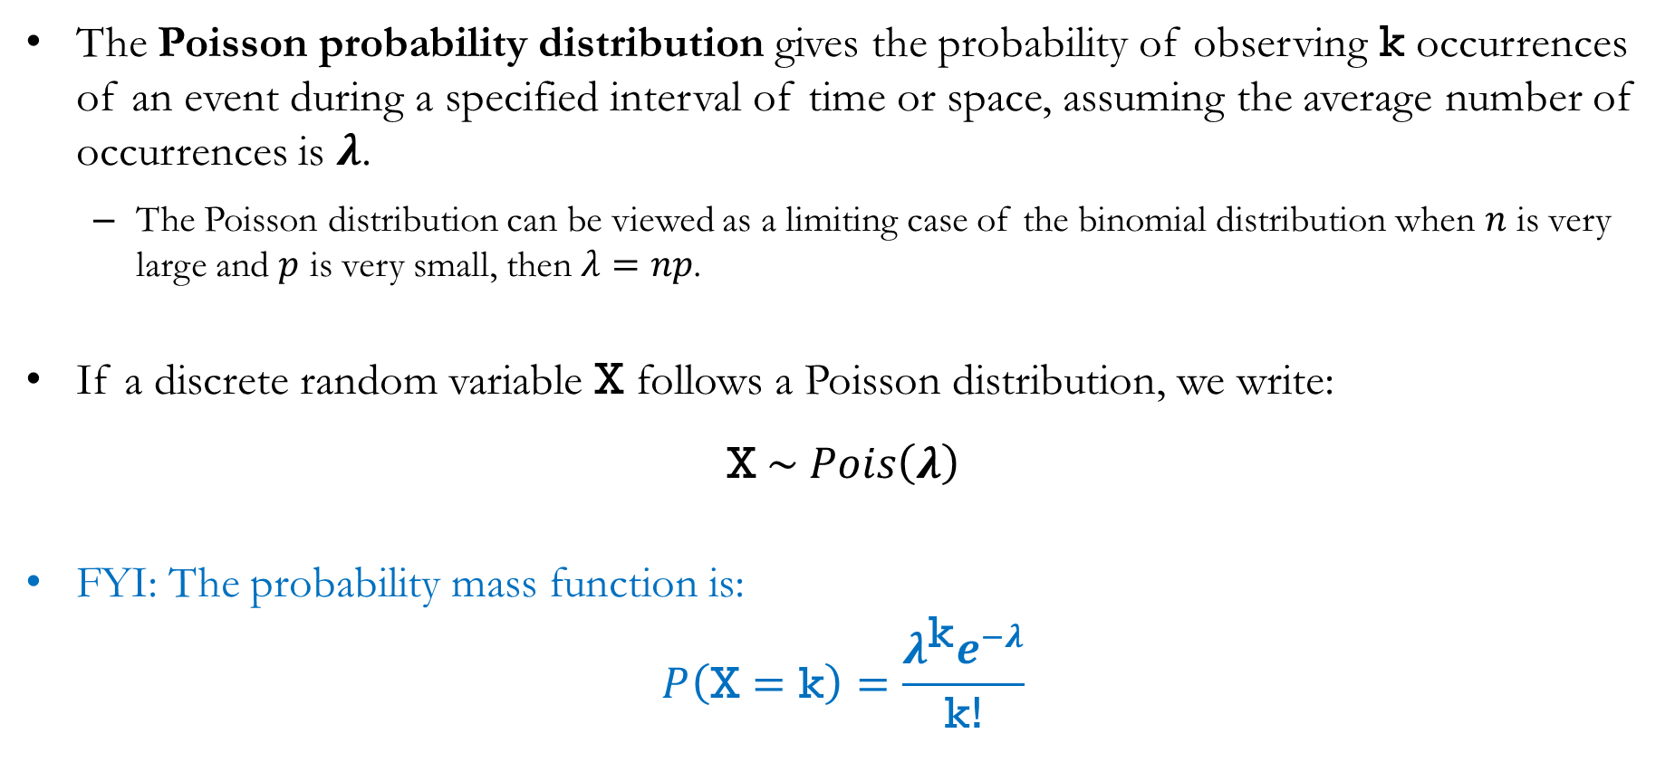
Poisson Distribution
The Poisson probability distribution gives the probability of observing $\text{k}$ occurrences of an event during a specified interval of time or space, assuming the average number of occurrences is $λ$.
  The Poisson distribution can be viewed as a limiting case of the binomial distribution when $n$ is very large and $p$ is very small, then $λ=np$.
If a discrete random variable $\text{X}$ follows a Poisson distribution, we write:
$$\text{X} \sim Pois\left(λ\right)$$
FYI: The probability mass function is:
$$P\left(\text{X}=\text{k}\right)=\frac{λ^{\text{k}}e^{−λ}}{\text{k}\text{!}}$$

Slide 38
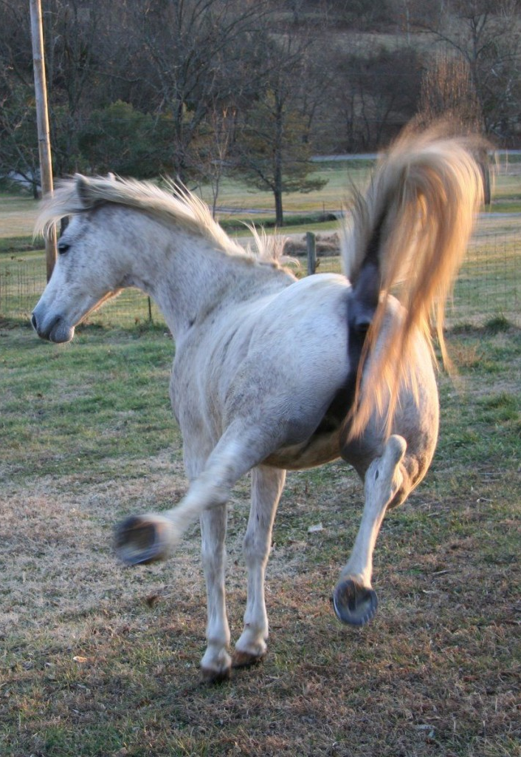
Detour: Death by Horse Kick
The Poisson distribution was long viewed primarily as a limited mathematical curiosity project.
In the late 1890s, Russian economist and statistician Ladislaus Bortkiewicz analyzed records of soldiers in the Prussian army who were accidentally killed by horse kicks.
He found that the annual number of horse-kick deaths closely followed a Poisson distribution.
This study became one of the most famous demonstrations that probability distributions can accurately model real-world events.

Slide 39
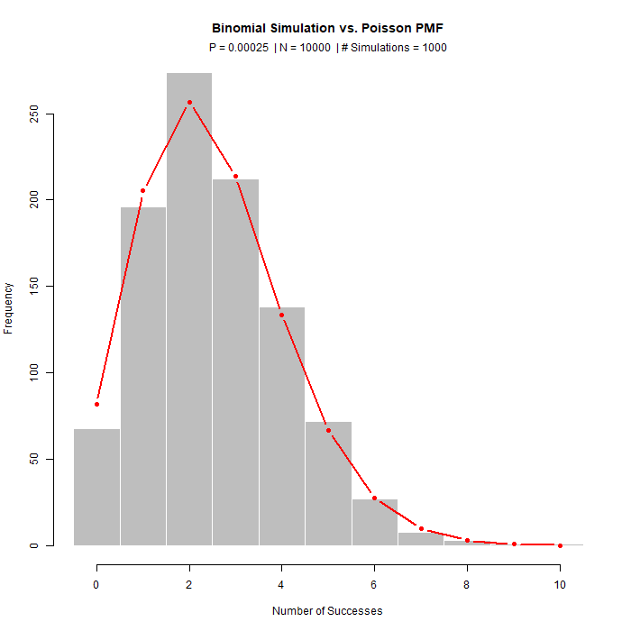
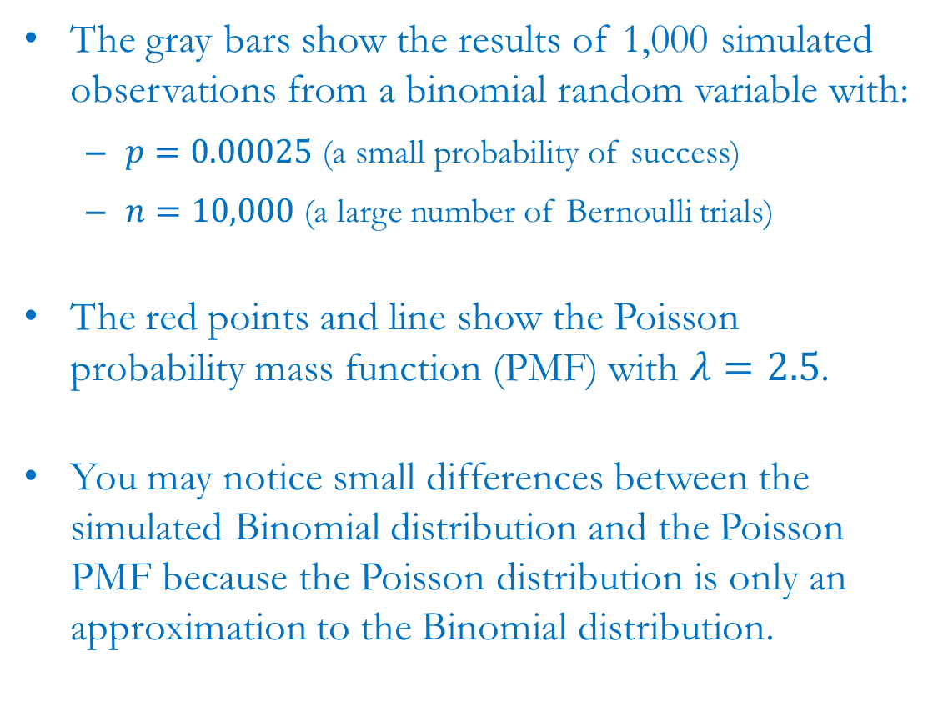
Detour: Binomial and Poisson
The gray bars show the results of 1,000 simulated observations from a binomial random variable with:
  $p=0.00025$ (a small probability of success)
  $n=10,000$ (a large number of Bernoulli trials)
The red points and line show the Poisson probability mass function (PMF) with $λ=2.5$.
You may notice small differences between the simulated Binomial distribution and the Poisson PMF because the Poisson distribution is only an approximation to the Binomial distribution.

Slide 40
Recap & Preview

Slide 41
Recap: Chapter 5
Today we introduced discrete probability distributions and learned how they describe random variables.
We covered:
  Random variables and probability mass functions (PMFs).
  Expected values, variances, and standard deviations.
  Joint probability distributions and covariance.
  Three important discrete probability distributions: Uniform, Binomial, and Poisson.
Probability distributions allow us to model uncertainty mathematically and summarize the behavior of random variables.

Slide 42
Preview: Chapter 6
In the next chapter, we will extend our discussion of probability distributions to continuous random variables.
Topics include:
  Continuous random variables.
  Probability density functions.
  The normal probability distribution.
  The standard normal distribution.
  Calculating probabilities for continuous random variables.

