Slide 1
BUSINESS STATISTICS
Chapter 7: Sampling and Sampling Distributions

Slide 2
Recap: The Sample and the Population
Recall:
  An element is the entity on which data are collected.
  The population is the collection of all elements of interest.
  A sample is a subset of the population.
  A parameter is a numerical measure that describes a characteristic of the population.
  A (sample) statistic is a numerical measure that describes a characteristic of a sample.
Parameters are generally unknown and fixed, while statistics can be calculated from the sample and may vary from one sample to another.
In this chapter, we begin to examine how information from a sample can be used to draw conclusions about the population.

Slide 3
Selecting a Sample

Slide 4
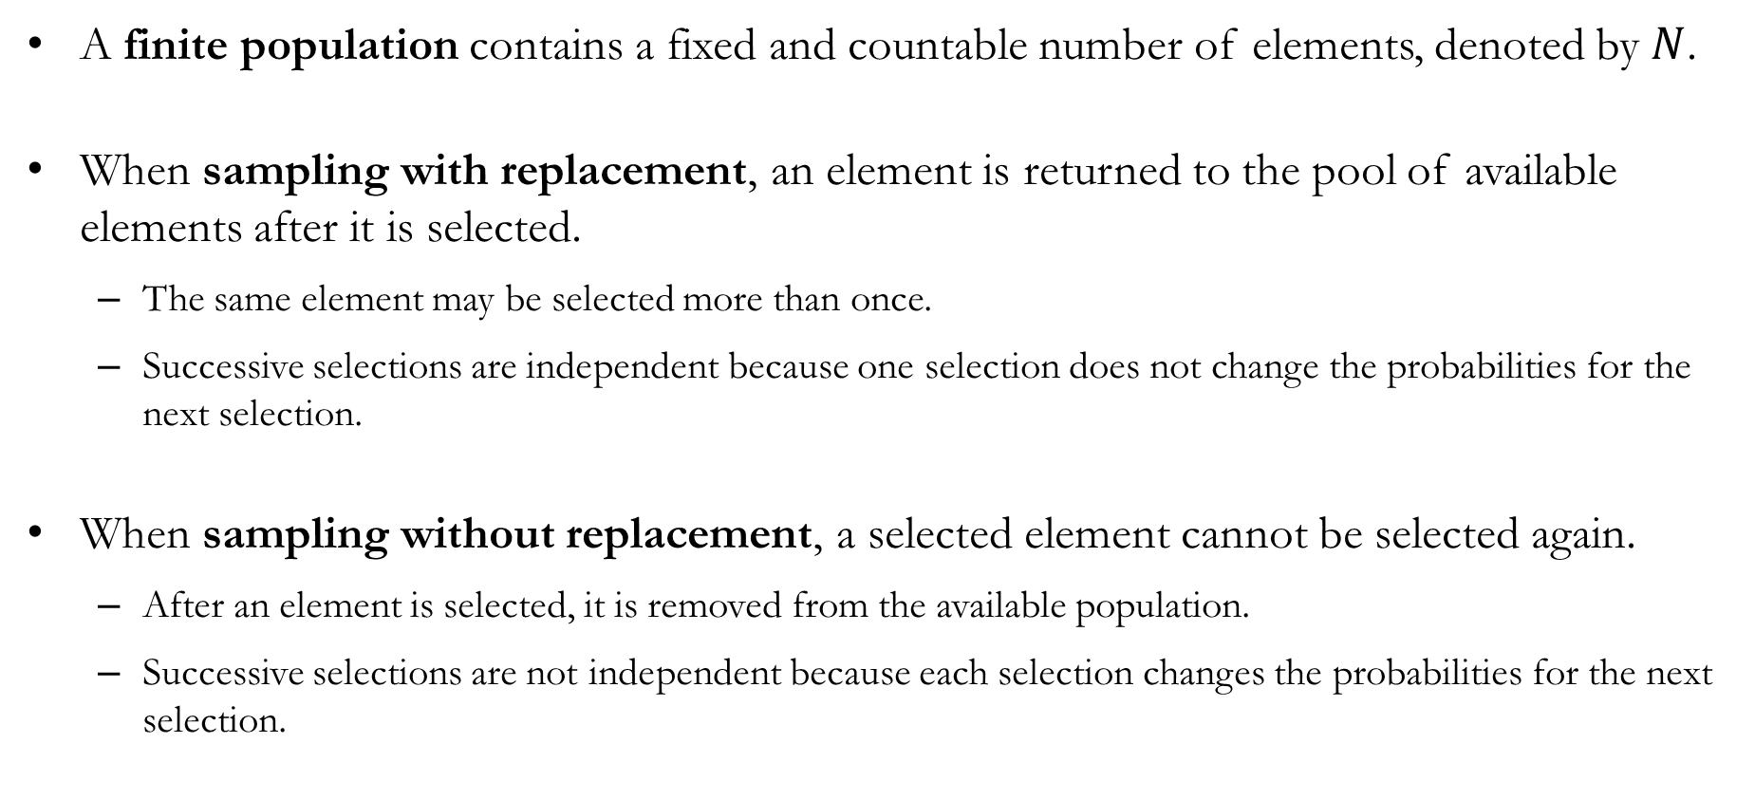
Finite Populations
A finite population contains a fixed and countable number of elements, denoted by $N$.
When sampling with replacement, an element is returned to the pool of available elements after it is selected.
  The same element may be selected more than once.
  Successive selections are independent because one selection does not change the probabilities for the next selection.
When sampling without replacement, a selected element cannot be selected again.
  After an element is selected, it is removed from the available population.
  Successive selections are not independent because each selection changes the probabilities for the next selection.

Slide 5
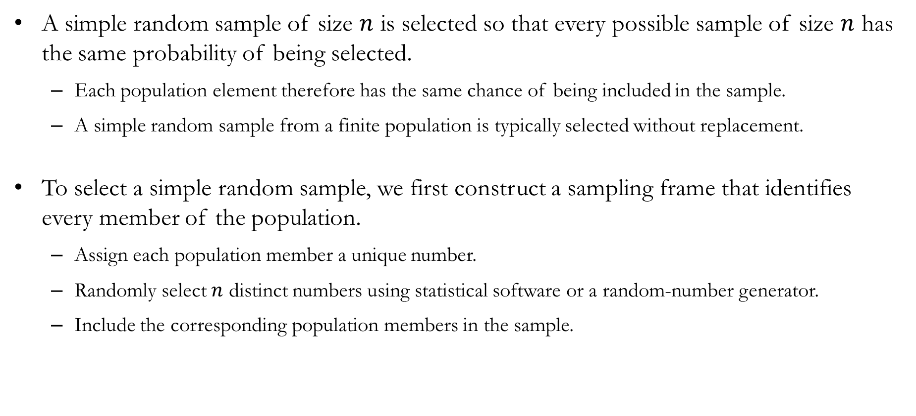
Sampling from Finite Populations
A simple random sample of size $n$ is selected so that every possible sample of size $n$ has the same probability of being selected.
  Each population element therefore has the same chance of being included in the sample.
  A simple random sample from a finite population is typically selected without replacement.
To select a simple random sample, we first construct a sampling frame that identifies every member of the population.
  Assign each population member a unique number.
  Randomly select $n$ distinct numbers using statistical software or a random-number generator.
  Include the corresponding population members in the sample.

Slide 6
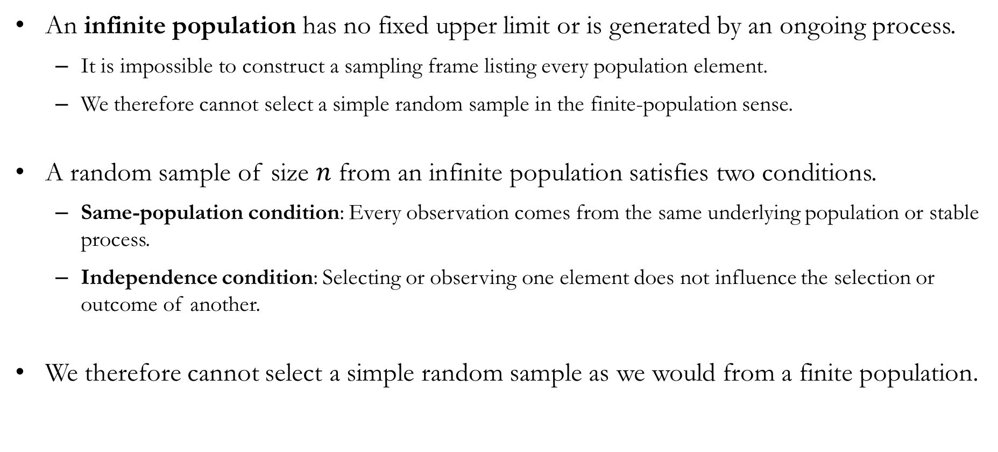
Infinite Populations
An infinite population has no fixed upper limit or is generated by an ongoing process.
  It is impossible to construct a sampling frame listing every population element.
  We therefore cannot select a simple random sample in the finite-population sense.
A random sample of size $n$ from an infinite population satisfies two conditions.
  Same-population condition: Every observation comes from the same underlying population or stable process.
  Independence condition: Selecting or observing one element does not influence the selection or outcome of another.
We therefore cannot select a simple random sample as we would from a finite population.

Slide 7
Sampling from Infinite Populations
Suppose we want to estimate the mean airtime of future flights from Fargo to Chicago.
  The population consists of all such flights that the ongoing airline process could generate.
  Because future flights cannot be listed in advance, no complete sampling frame exists.
To obtain a valid random sample:
  Same-population condition: All selected observations should represent the same route and reasonably stable operating conditions.
  Independence condition: The airtime of one selected flight should not influence the airtime of another.
These conditions require careful judgment.
  Changes in routes, aircraft, or operating procedures may alter the underlying population.
  Shared weather systems or air-traffic disruptions may make flight times dependent.

Slide 8
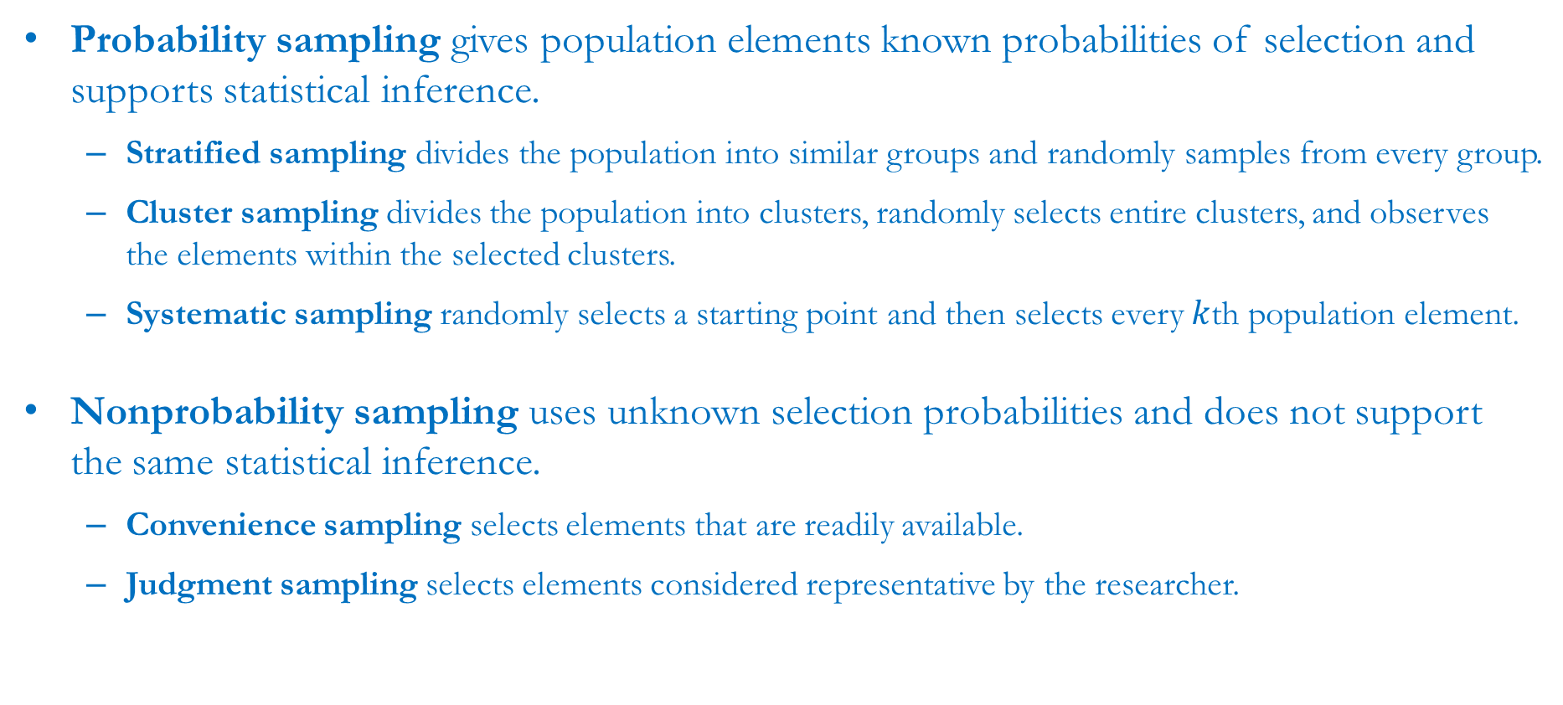
FYI: Various Sampling Methods
Probability sampling gives population elements known probabilities of selection and supports statistical inference.
  Stratified sampling divides the population into similar groups and randomly samples from every group.
  Cluster sampling divides the population into clusters, randomly selects entire clusters, and observes the elements within the selected clusters.
  Systematic sampling randomly selects a starting point and then selects every $k$th population element.
Nonprobability sampling uses unknown selection probabilities and does not support the same statistical inference.
  Convenience sampling selects elements that are readily available.
  Judgment sampling selects elements considered representative by the researcher.

Slide 9
Point Estimation

Slide 10
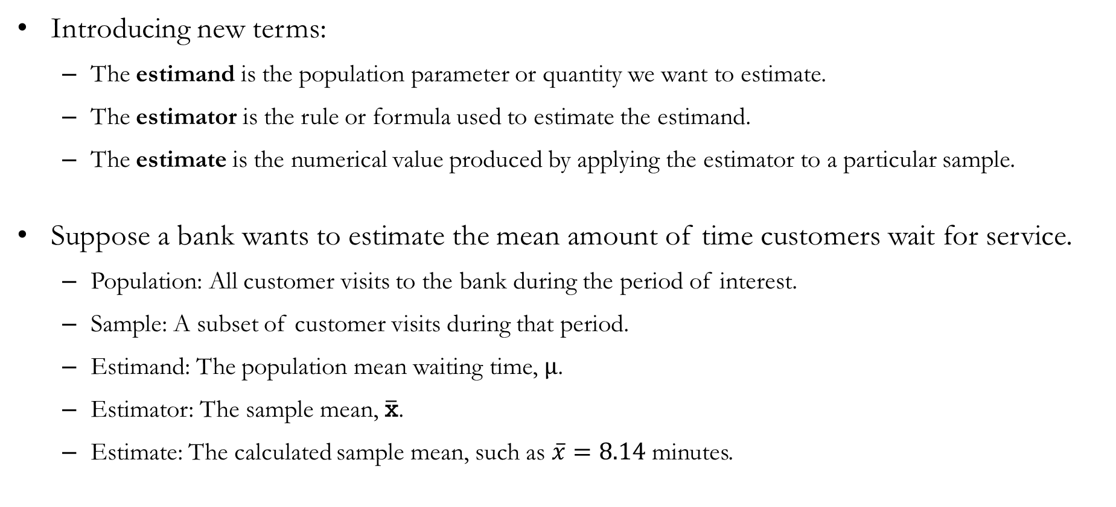
The Estimand, Estimator, and Estimate
Introducing new terms:
  The estimand is the population parameter or quantity we want to estimate.
  The estimator is the rule or formula used to estimate the estimand.
  The estimate is the numerical value produced by applying the estimator to a particular sample.
Suppose a bank wants to estimate the mean amount of time customers wait for service.
  Population: All customer visits to the bank during the period of interest.
  Sample: A subset of customer visits during that period.
  Estimand: The population mean waiting time, $μ$.
  Estimator: The sample mean, $\overline{\text{x}}$.
  Estimate: The calculated sample mean, such as $\overline{x}=8.14$ minutes.

Slide 11
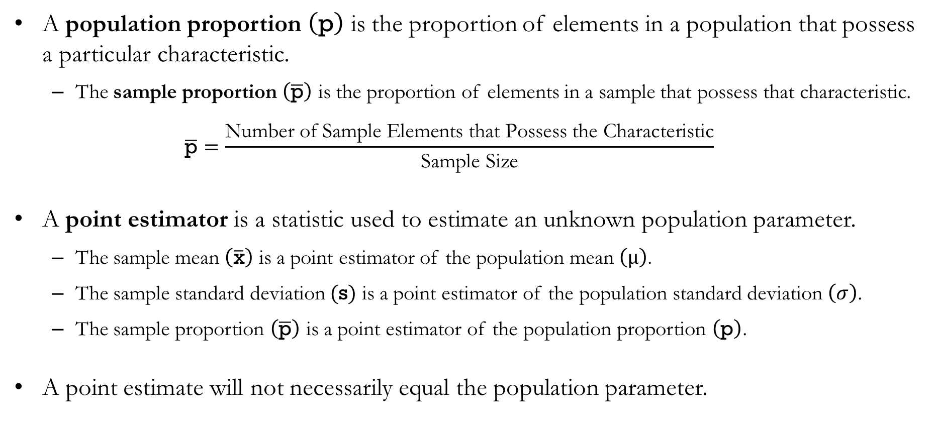
Point Estimation
A population proportion $\left(\text{p}\right)$ is the proportion of elements in a population that possess a particular characteristic.
  The sample proportion $\left(\overline{\text{p}}\right)$ is the proportion of elements in a sample that possess that characteristic.
  $$\overline{\text{p}}=\frac{\text{Number of Sample Elements that Possess the Characteristic}}{\text{Sample Size}}$$
A point estimator is a statistic used to estimate an unknown population parameter.
  The sample mean $\left(\overline{\text{x}}\right)$ is a point estimator of the population mean $\left(μ\right)$.
  The sample standard deviation $(\text{s})$ is a point estimator of the population standard deviation $\left(σ\right)$.
  The sample proportion $\left(\overline{\text{p}}\right)$ is a point estimator of the population proportion $\left(\text{p}\right)$.
A point estimate will not necessarily equal the population parameter.

Slide 12
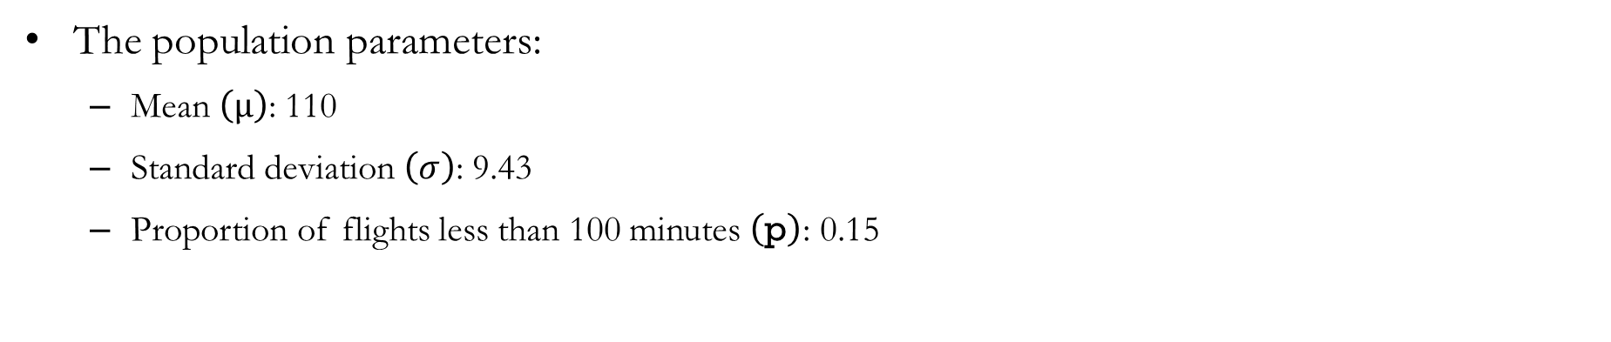
Example: Point Estimation
We consider a simplified case of 20 flight records between FAR and ORD (in minutes):
  104
  112
  97
  121
  108
  115
  101
  126
  110
  106
  99
  118
  103
  124
  107
  113
  95
  129
  105
  107
The population parameters:
  Mean $\left(μ\right)$: 110
  Standard deviation $\left(σ\right)$: 9.43
  Proportion of flights less than 100 minutes $\left(\text{p}\right)$: 0.15

Slide 13
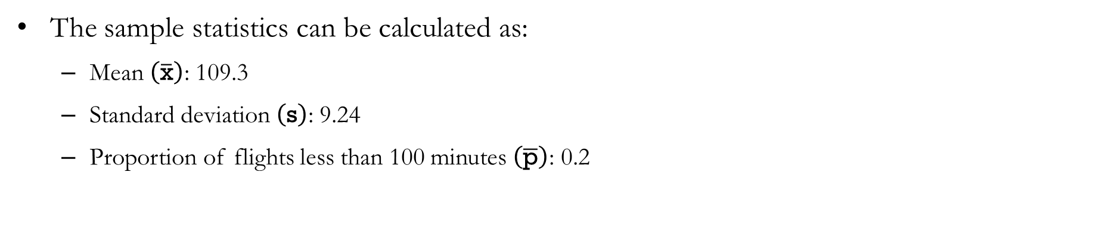
Example: Point Estimation
Let us choose a random sample of 10 flights:
  104
  112
  97
  121
  108
  115
  101
  126
  110
  106
  99
  118
  103
  124
  107
  113
  95
  129
  105
  107
The sample statistics can be calculated as:
  Mean $\left(\overline{\text{x}}\right)$: 109.3
  Standard deviation $\left(\text{s}\right)$: 9.24
  Proportion of flights less than 100 minutes $\left(\overline{\text{p}}\right)$: 0.2

Slide 14
Sampling Distribution

Slide 15
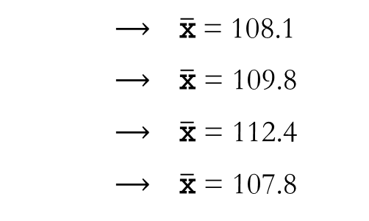
Example: Small-Scale Inquiry
Consider a small population of 20 FAR–ORD flight times, measured in minutes:
  104
  112
  97
  121
  108
  115
  101
  126
  110
  106
  99
  118
  103
  124
  107
  113
  95
  129
  105
  107
Exercise: Calculate the sample mean for each of the following random samples.
  Sample A: (104, 112, 97, 108, 126, 110, 99, 113, 105, 107)
  Sample B: (121, 108, 115, 101, 106, 118, 103, 124, 95, 107)
  Sample C: (104, 97, 115, 126, 110, 118, 107, 113, 129, 105)
  Sample D: (112, 121, 101, 110, 106, 99, 103, 124, 107, 95)
    $⟶ \overline{\text{x}}$= 108.1
    $⟶ \overline{\text{x}}$ = 109.8
    $⟶ \overline{\text{x}}$ = 112.4
    $⟶ \overline{\text{x}}$ = 107.8

Slide 16
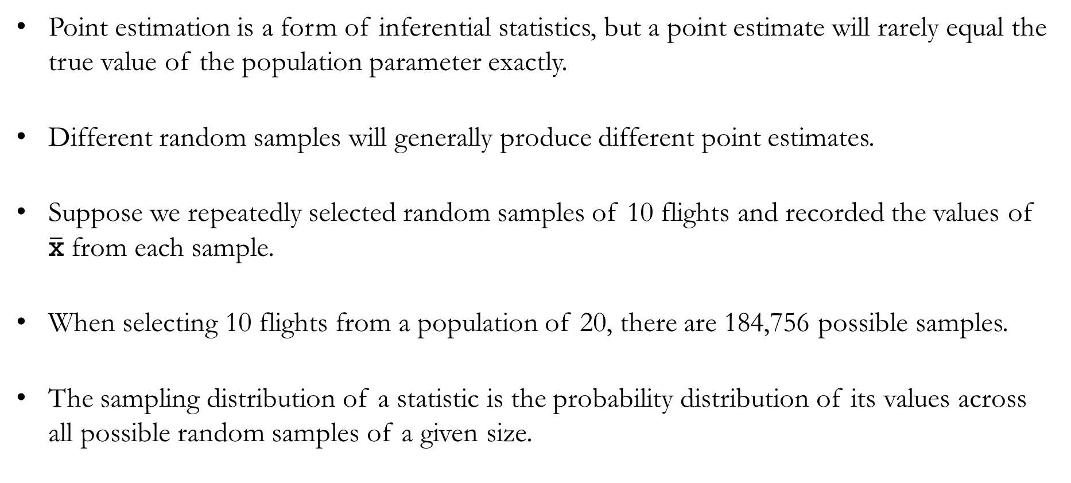
Introduction to Sampling Distributions
Point estimation is a form of inferential statistics, but a point estimate will rarely equal the true value of the population parameter exactly.
Different random samples will generally produce different point estimates.
Suppose we repeatedly selected random samples of 10 flights and recorded the values of $\overline{\text{x}}$ from each sample.
When selecting 10 flights from a population of 20, there are 184,756 possible samples.
The sampling distribution of a statistic is the probability distribution of its values across all possible random samples of a given size.

Slide 17
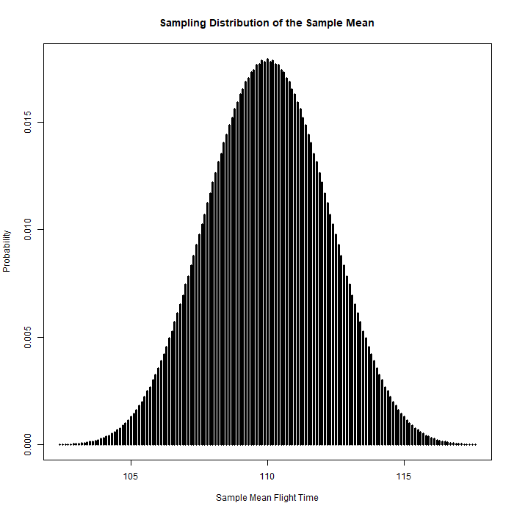
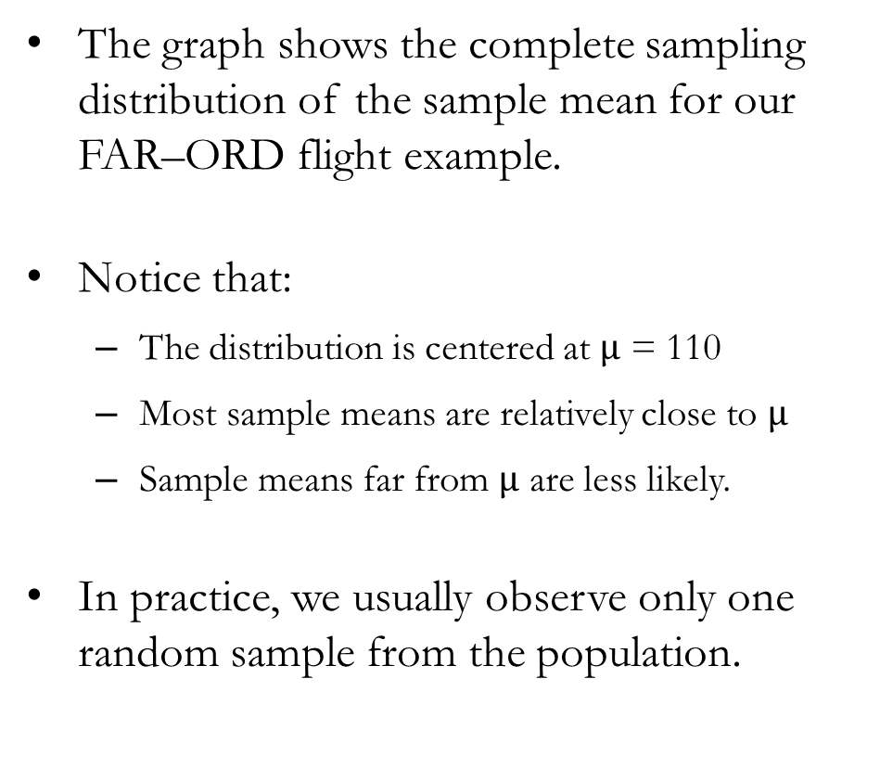
Example: Sampling Distribution
The graph shows the complete sampling distribution of the sample mean for our FAR–ORD flight example.
Notice that:
  The distribution is centered at $μ$ = 110
  Most sample means are relatively close to $μ$
  Sample means far from $μ$ are less likely.
In practice, we usually observe only one random sample from the population.

Slide 18
Sampling Distribution of $\overline{\text{x}}$

Slide 19
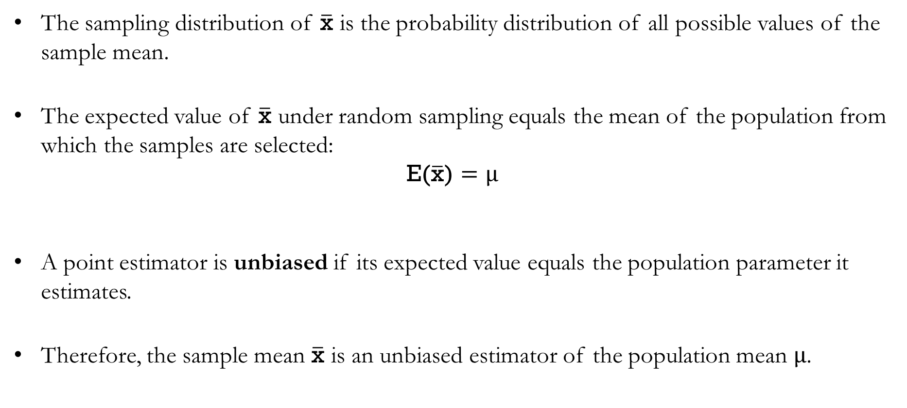
The Expected Value of $\overline{\text{x}}$
The sampling distribution of $\overline{\text{x}}$ is the probability distribution of all possible values of the sample mean.
The expected value of $\overline{\text{x}}$ under random sampling equals the mean of the population from which the samples are selected:
$$\text{E(}\overline{\text{x}}\text{)}=μ$$
A point estimator is unbiased if its expected value equals the population parameter it estimates.
Therefore, the sample mean $\overline{\text{x}}$ is an unbiased estimator of the population mean $μ$.

Slide 20
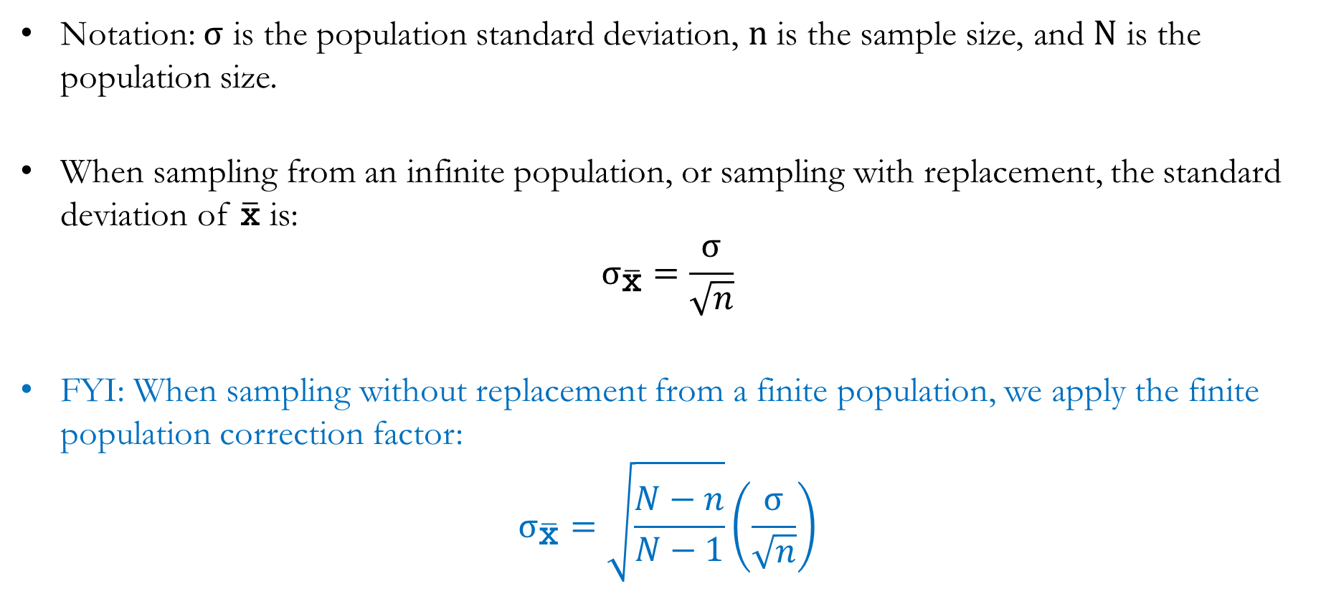
The Standard Deviation of $\overline{\text{x}}$
Notation: $σ$ is the population standard deviation, $n$ is the sample size, and $N$ is the population size.
When sampling from an infinite population, or sampling with replacement, the standard deviation of $\overline{\text{x}}$ is:
$$σ_{\overline{\text{x}}}=\frac{σ}{\sqrt{n}}$$
FYI: When sampling without replacement from a finite population, we apply the finite population correction factor:
$$σ_{\overline{\text{x}}}=\sqrt{\frac{N−n}{N−1}}\left(\frac{σ}{\sqrt{n}}\right)$$

Slide 21
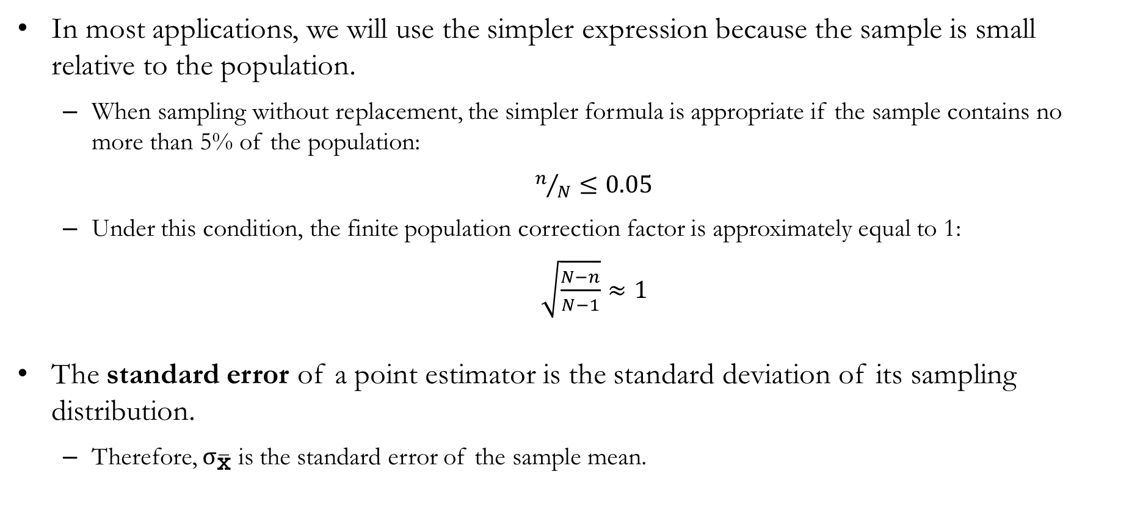
The Standard Deviation of $\overline{\text{x}}$
In most applications, we will use the simpler expression because the sample is small relative to the population.
  When sampling without replacement, the simpler formula is appropriate if the sample contains no more than 5% of the population:
  $n/N≤0.05$
  Under this condition, the finite population correction factor is approximately equal to 1:
  $\sqrt{\frac{N−n}{N−1}}≈1$
The standard error of a point estimator is the standard deviation of its sampling distribution.
  Therefore, $σ_{\overline{\text{x}}}$ is the standard error of the sample mean.

Slide 22
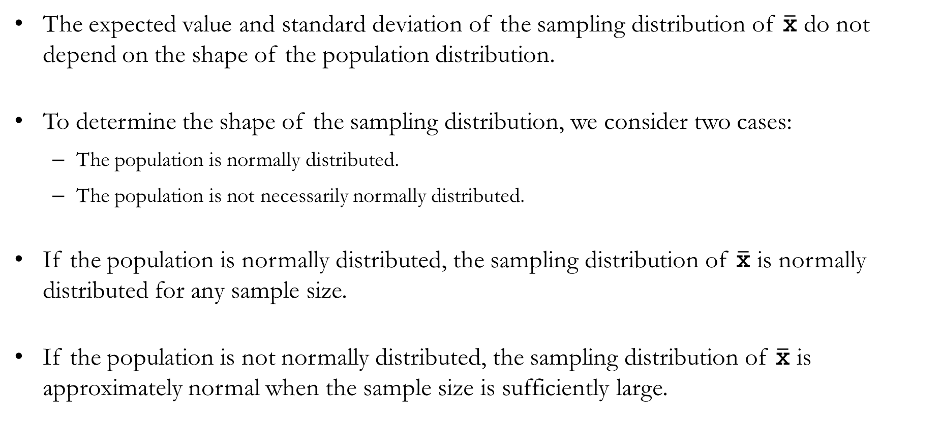
The Form of the Sampling Distribution of $\overline{\text{x}}$
The expected value and standard deviation of the sampling distribution of $\overline{\text{x}}$ do not depend on the shape of the population distribution.
To determine the shape of the sampling distribution, we consider two cases:
  The population is normally distributed.
  The population is not necessarily normally distributed.
If the population is normally distributed, the sampling distribution of $\overline{\text{x}}$ is normally distributed for any sample size.
If the population is not normally distributed, the sampling distribution of $\overline{\text{x}}$ is approximately normal when the sample size is sufficiently large.

Slide 23
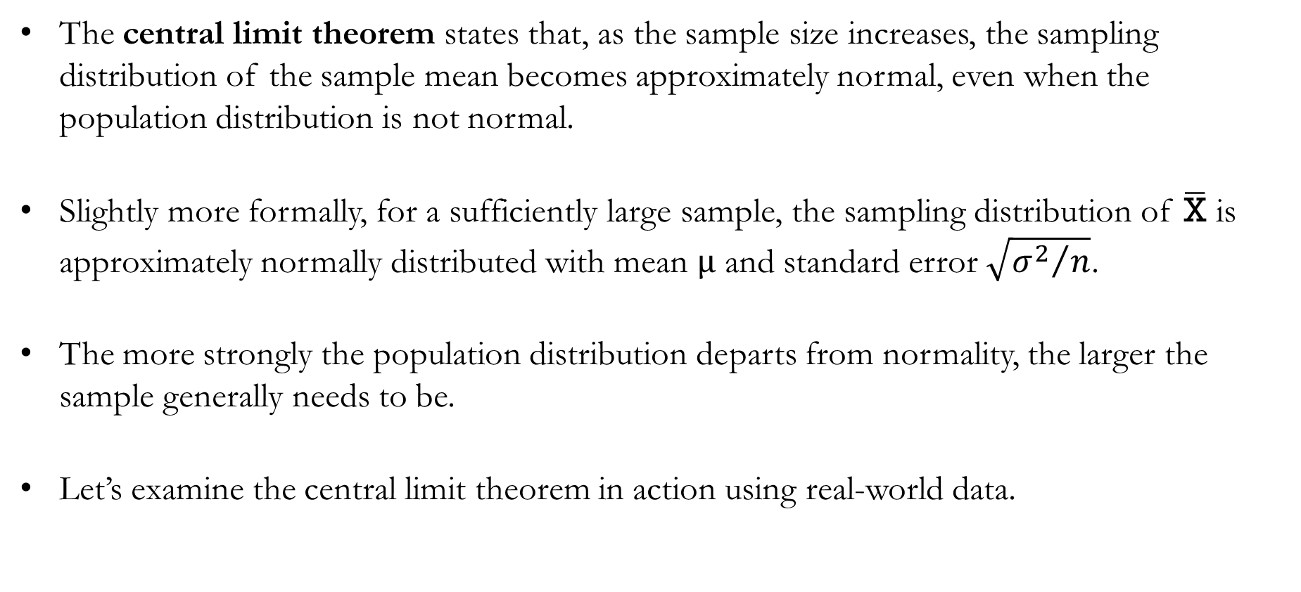
The Central Limit Theorem
The central limit theorem states that, as the sample size increases, the sampling distribution of the sample mean becomes approximately normal, even when the population distribution is not normal.
Slightly more formally, for a sufficiently large sample, the sampling distribution of $\overline{\text{X}}$ is approximately normally distributed with mean $μ$ and standard error $\sqrt{{σ^{2}}/n}$.
The more strongly the population distribution departs from normality, the larger the sample generally needs to be.
Let’s examine the central limit theorem in action using real-world data.

Slide 24

Sampling Distribution of $\overline{\text{x}}$:
Examining Real-World Data

Slide 25
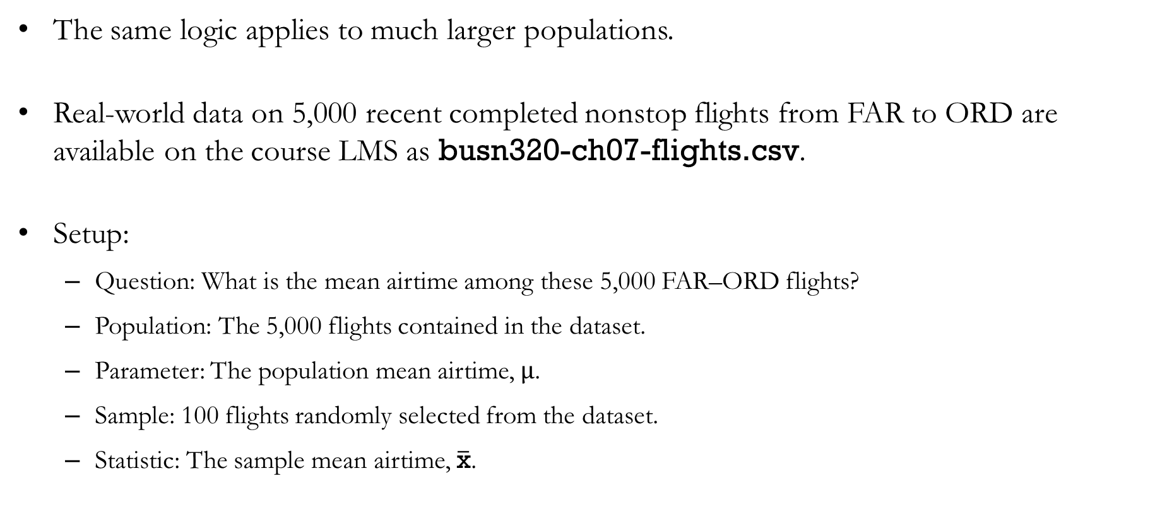
Example: Real-World Flight Data from FAR to ORD
The same logic applies to much larger populations.
Real-world data on 5,000 recent completed nonstop flights from FAR to ORD are available on the course LMS as busn320-ch07-flights.csv.
Setup:
  Question: What is the mean airtime among these 5,000 FAR–ORD flights?
  Population: The 5,000 flights contained in the dataset.
  Parameter: The population mean airtime, $μ$.
  Sample: 100 flights randomly selected from the dataset.
  Statistic: The sample mean airtime, $\overline{\text{x}}$.

Slide 26
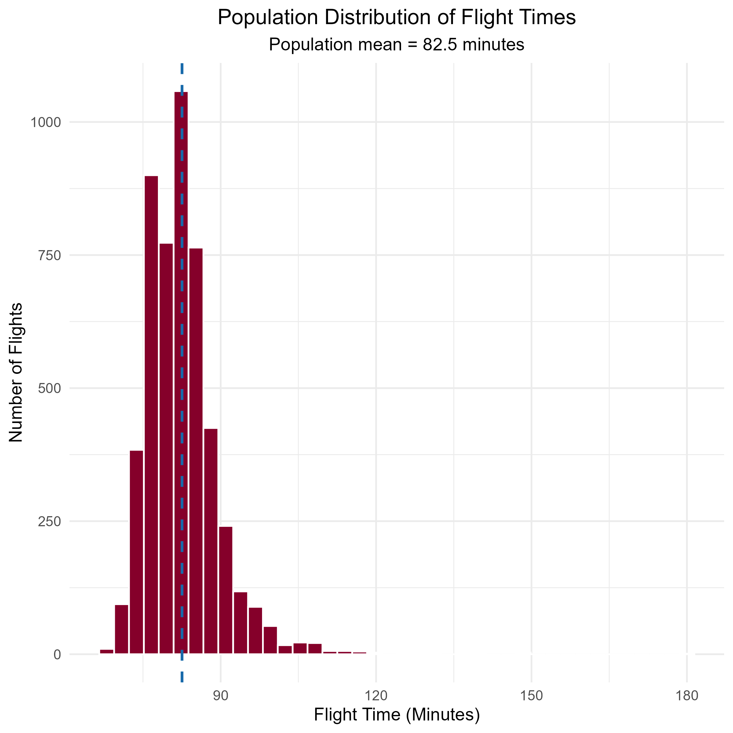
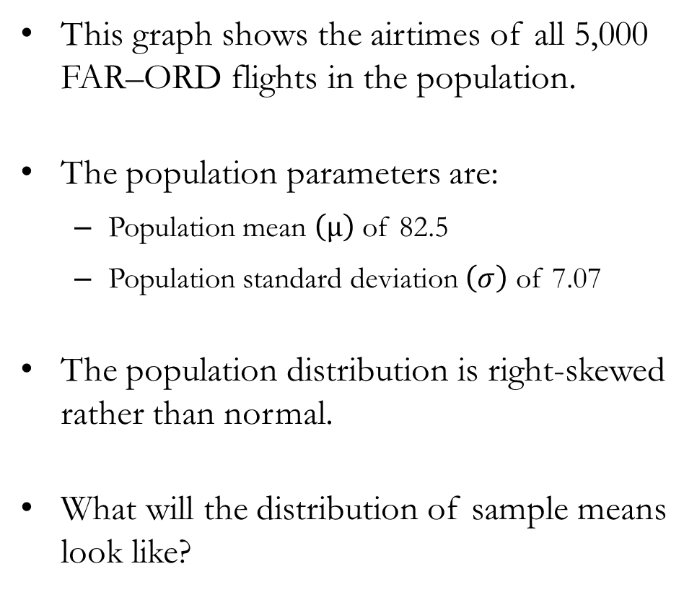
Example: Real-World Flight Data from FAR to ORD
This graph shows the airtimes of all 5,000 FAR–ORD flights in the population.
The population parameters are:
  Population mean $\left(μ\right)$ of 82.5
  Population standard deviation $\left(σ\right)$ of 7.07
The population distribution is right-skewed rather than normal.
What will the distribution of sample means look like?

Slide 27
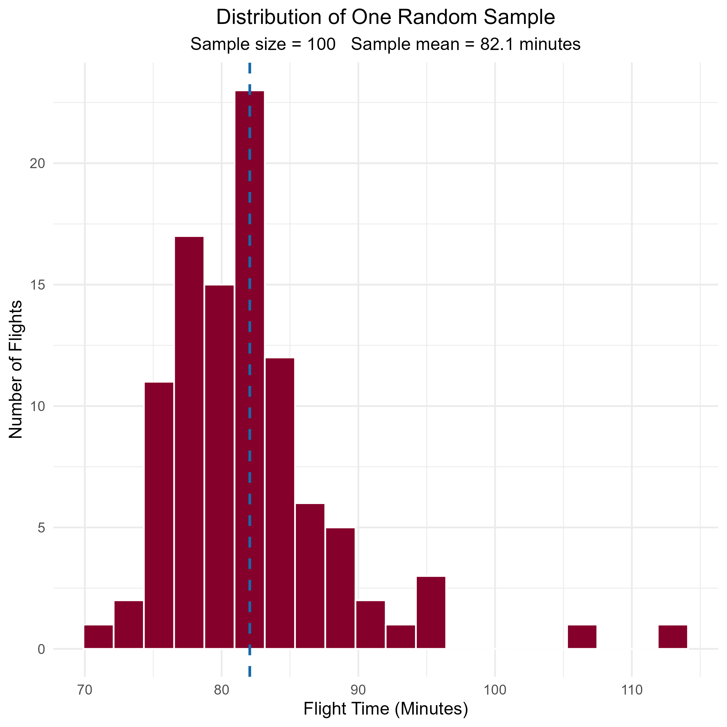
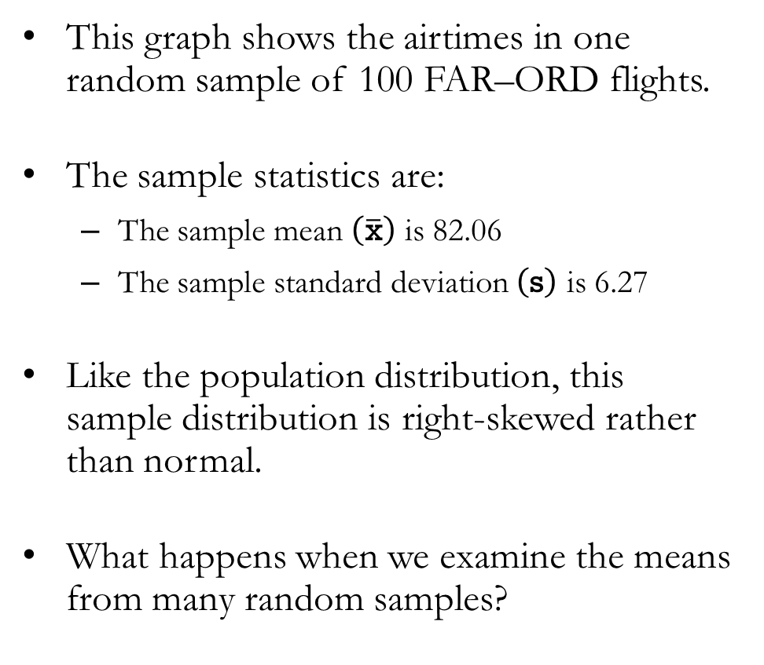
Example: Real-World Flight Data from FAR to ORD
This graph shows the airtimes in one random sample of 100 FAR–ORD flights.
The sample statistics are:
  The sample mean $\left(\overline{\text{x}}\right)$ is 82.06
  The sample standard deviation $\left(\text{s}\right)$ is 6.27
Like the population distribution, this sample distribution is right-skewed rather than normal.
What happens when we examine the means from many random samples?

Slide 28
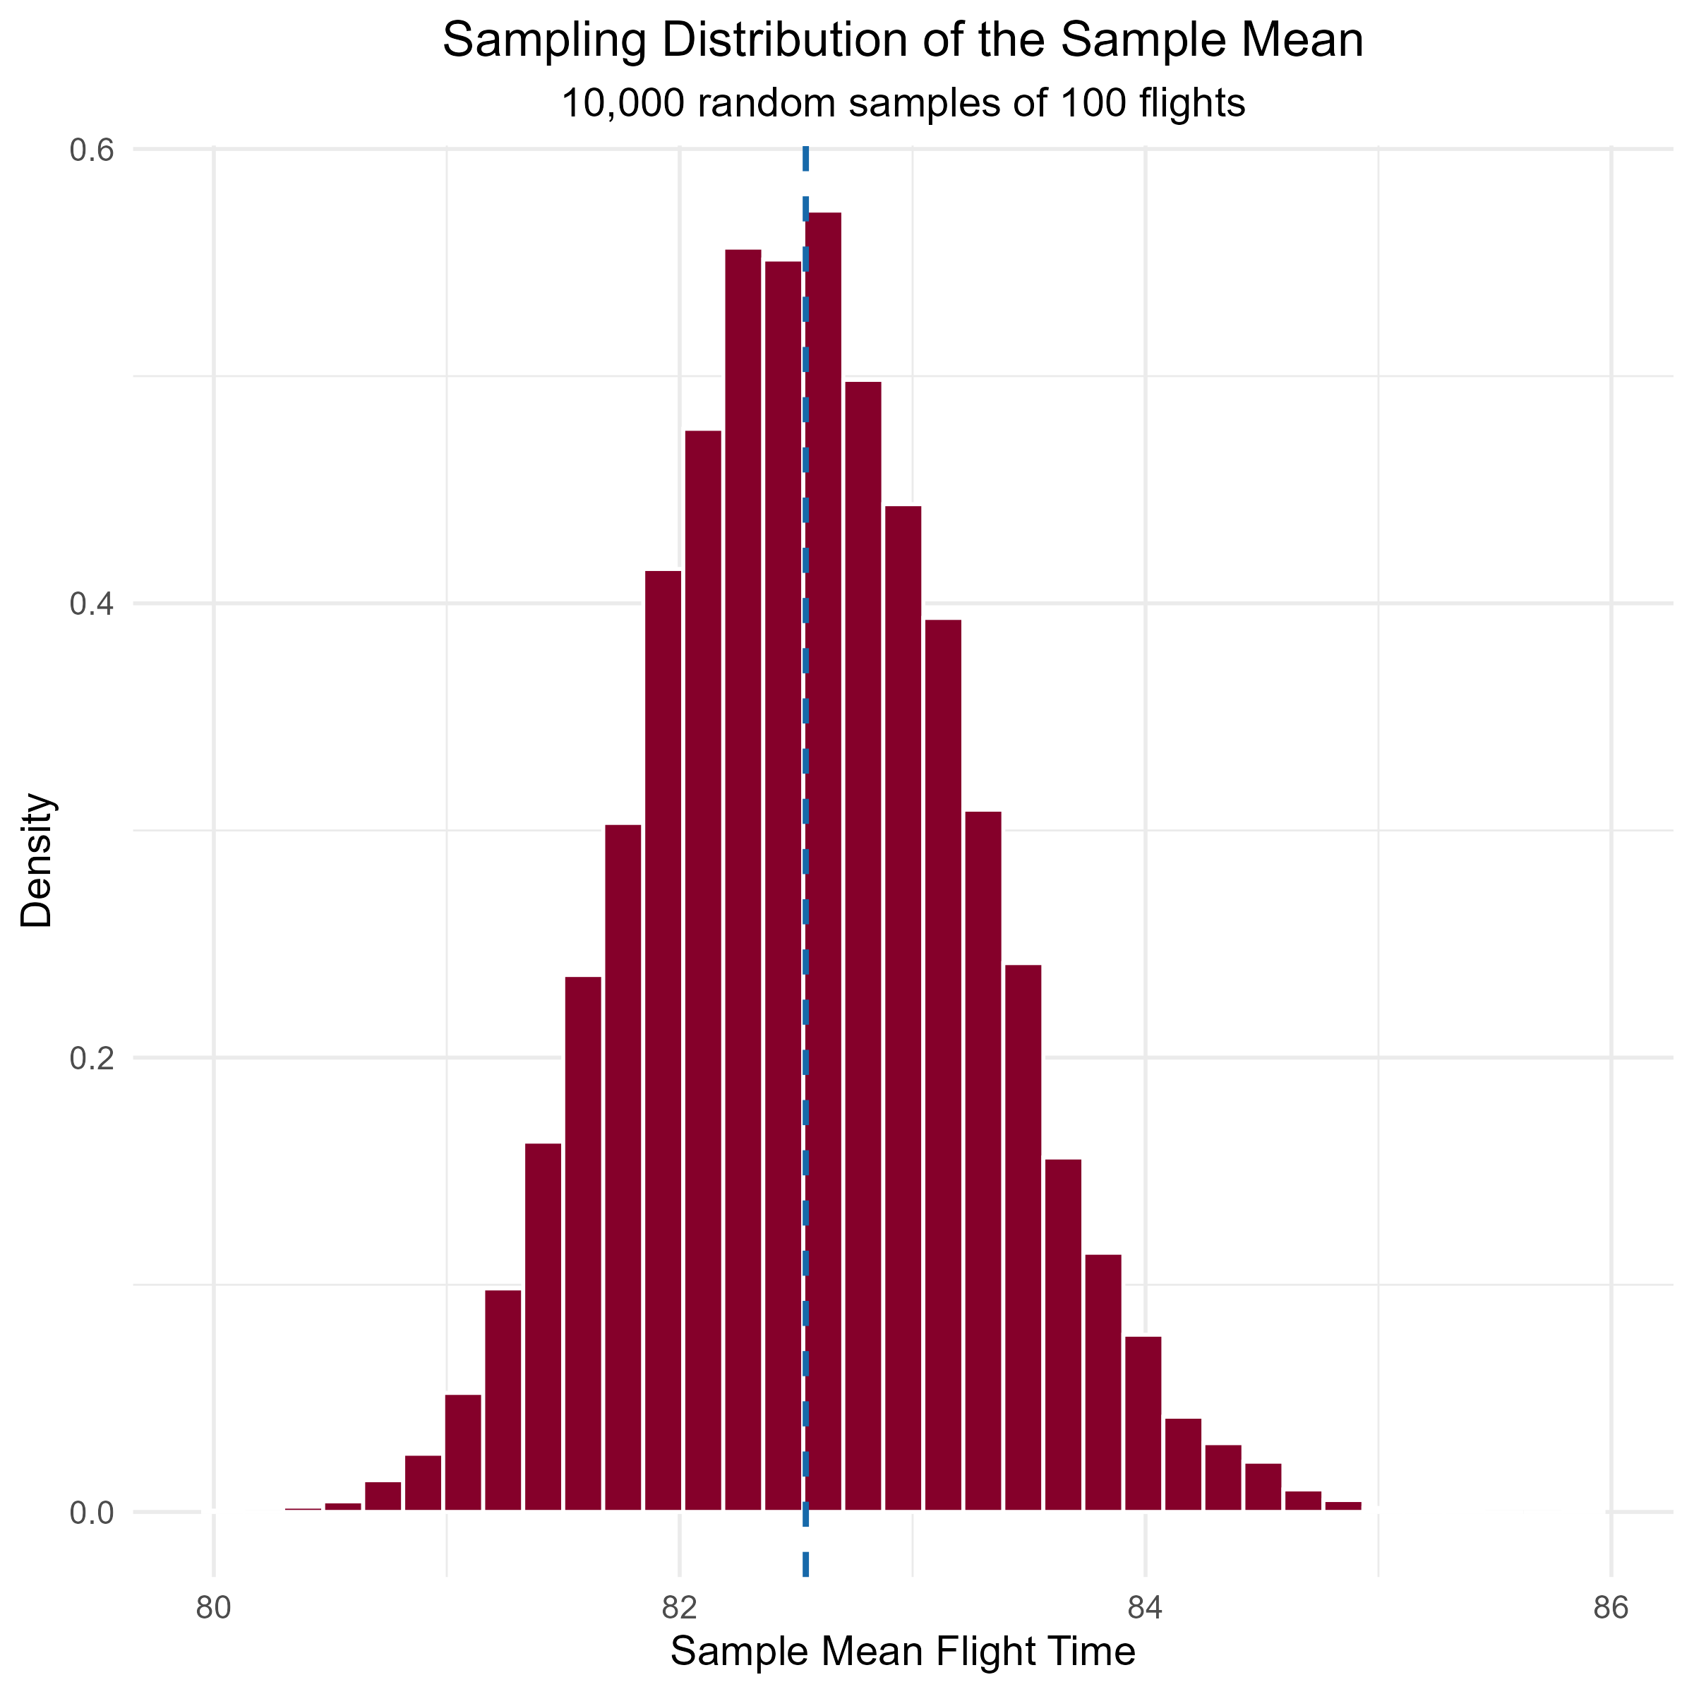
Example: Real-World Flight Data from FAR to ORD
This graph shows the sampling distribution of the sample mean airtime.
  Each observation represents the mean airtime from one random sample of 100 flights.
  The graph contains 10,000 such sample means.
The mean of these 10,000 sample means is approximately 82.5 minutes, matching the population mean.
Notice that the sampling distribution is approximately normal, even though the population distribution is right-skewed.

Slide 29
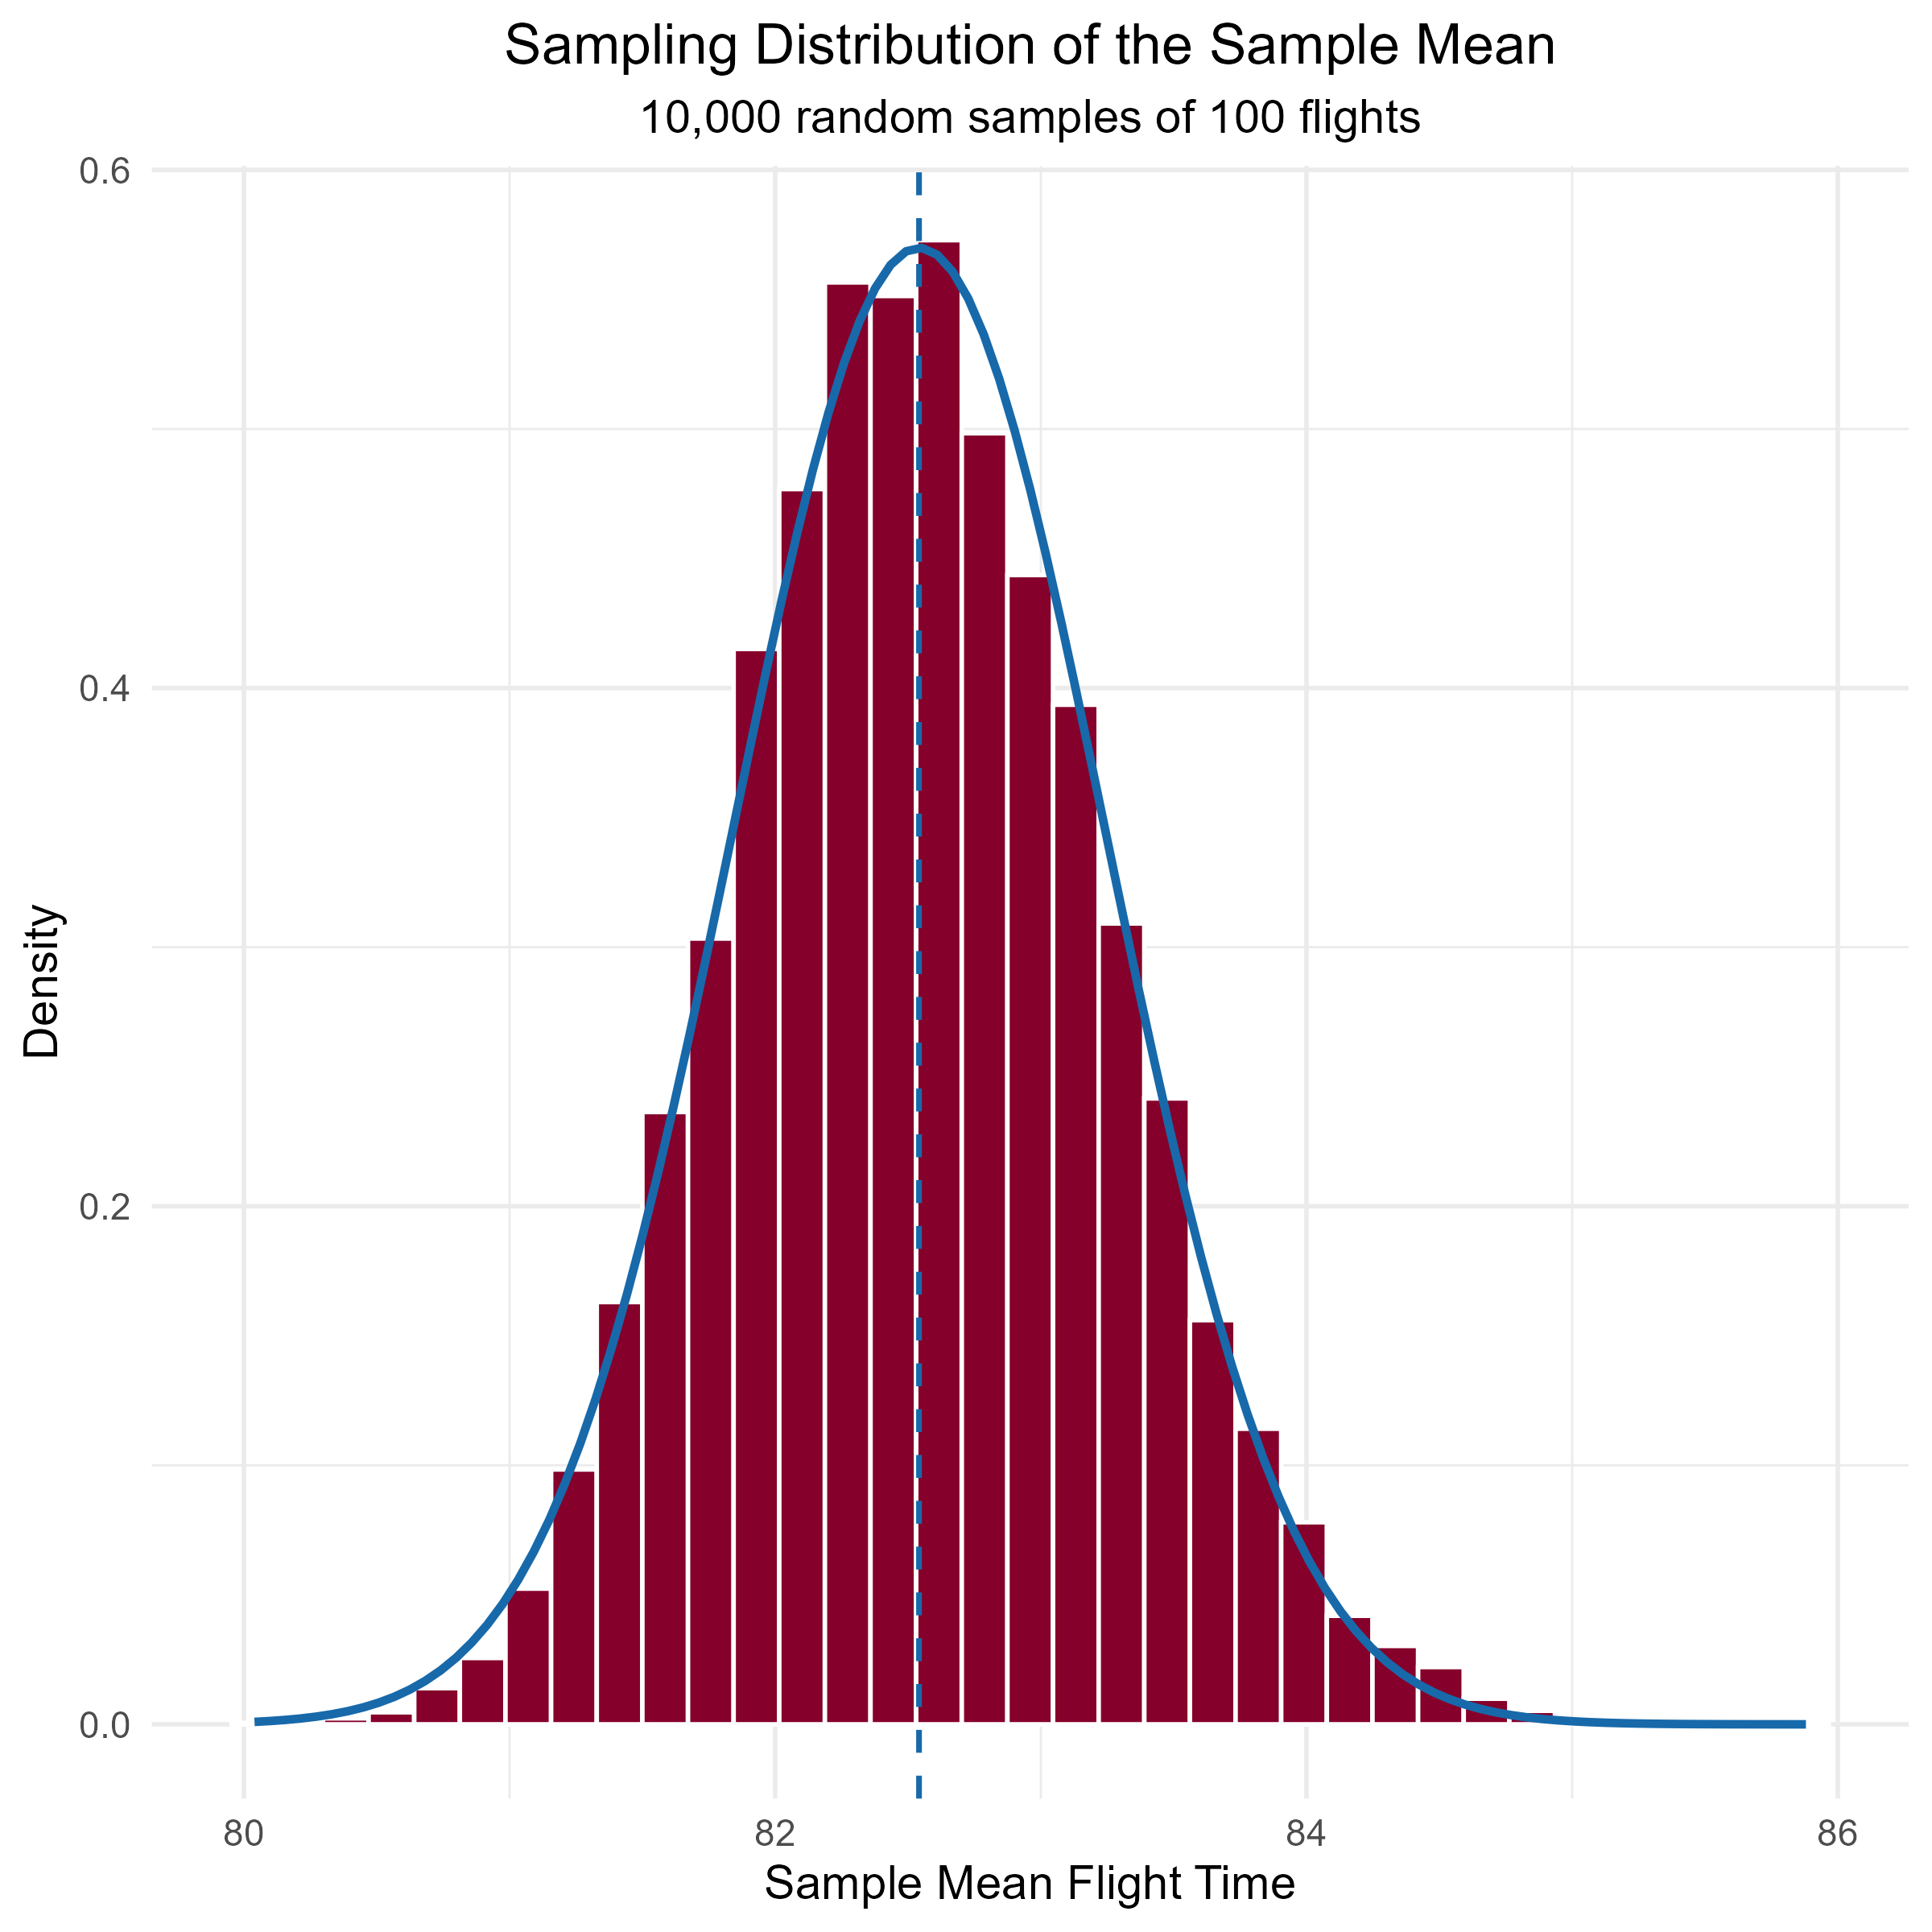
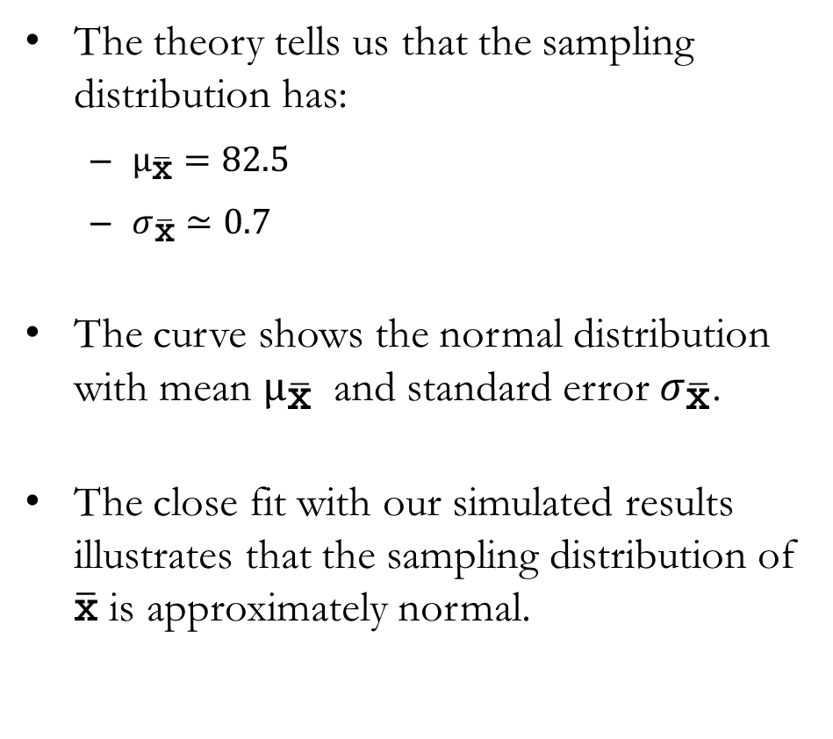
Example: Real-World Flight Data from FAR to ORD
The theory tells us that the sampling distribution has:
  $μ_{\overline{\text{x}}}=82.5$
  $σ_{\overline{\text{x}}}≃0.7$
The curve shows the normal distribution with mean $μ_{\overline{\text{x}}}$ and standard error $σ_{\overline{\text{x}}}$.
The close fit with our simulated results illustrates that the sampling distribution of $\overline{\text{x}}$ is approximately normal.

Slide 30
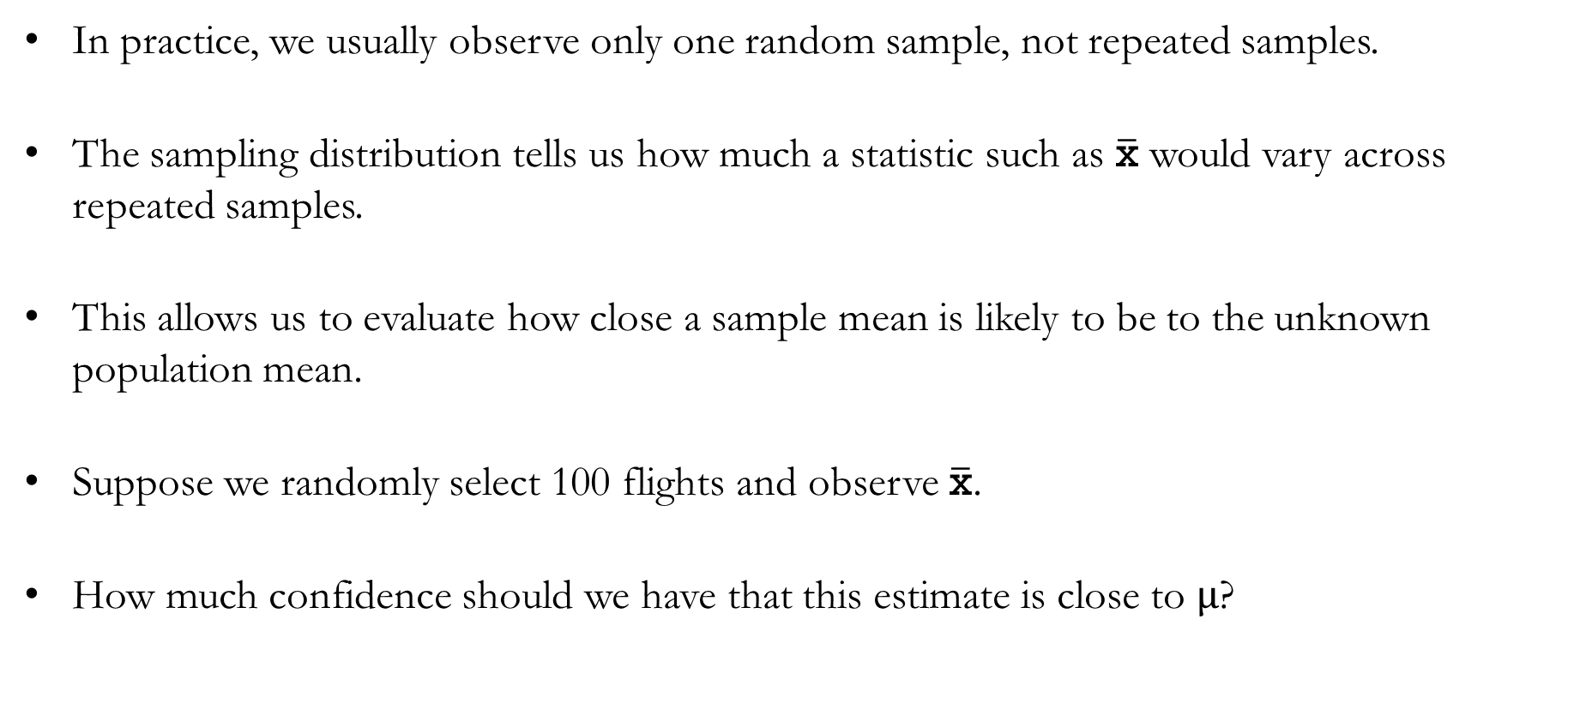
Practical Value of the Sampling Distribution of $\overline{\text{x}}$
In practice, we usually observe only one random sample, not repeated samples.
The sampling distribution tells us how much a statistic such as $\overline{\text{x}}$ would vary across repeated samples.
This allows us to evaluate how close a sample mean is likely to be to the unknown population mean.
Suppose we randomly select 100 flights and observe $\overline{\text{x}}$.
How much confidence should we have that this estimate is close to $μ$?

Slide 31
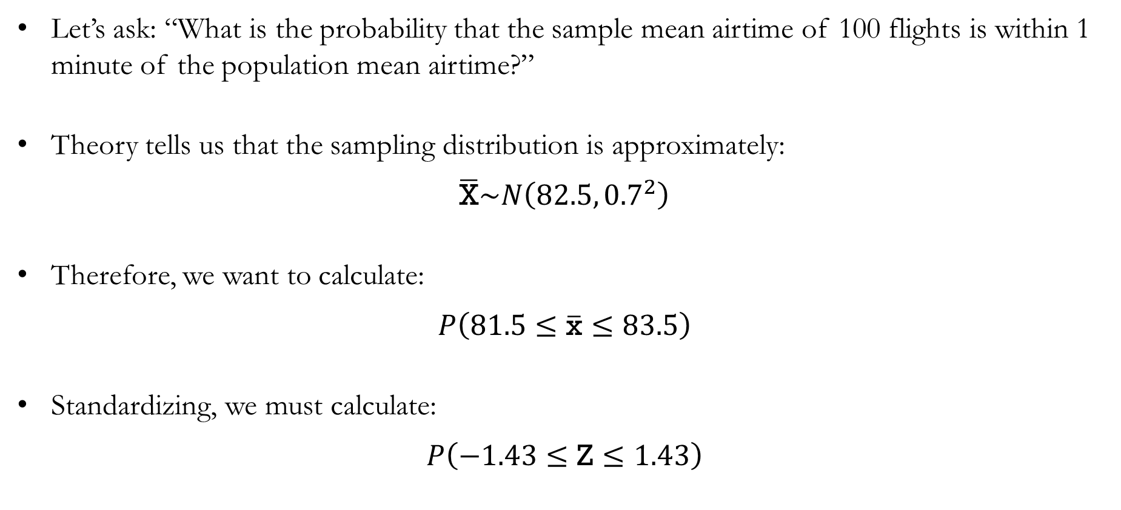
Example: Real-World Flight Data from FAR to ORD
Let’s ask: “What is the probability that the sample mean airtime of 100 flights is within 1 minute of the population mean airtime?”
Theory tells us that the sampling distribution is approximately:
$$\overline{\text{X}}\sim N\left({82.5, 0.7}^{2}\right)$$
Therefore, we want to calculate:
$$P\left(81.5≤\overline{\text{x}}≤83.5\right)$$
Standardizing, we must calculate:
$$P\left(−1.43≤\text{Z}≤1.43\right)$$

Slide 32
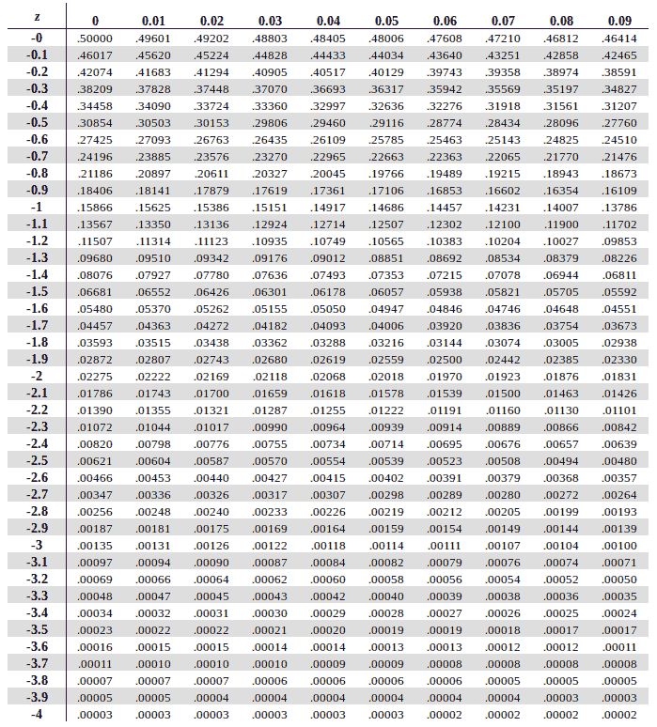
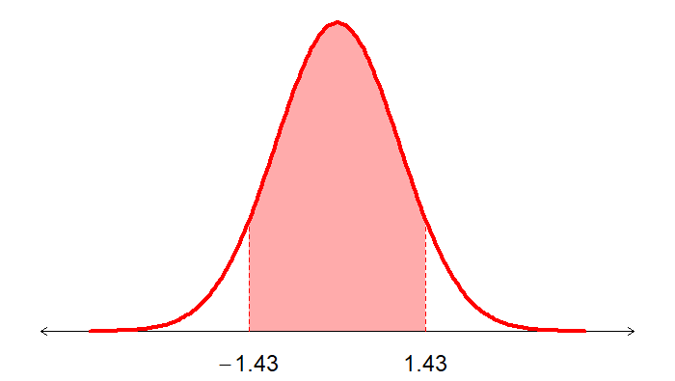

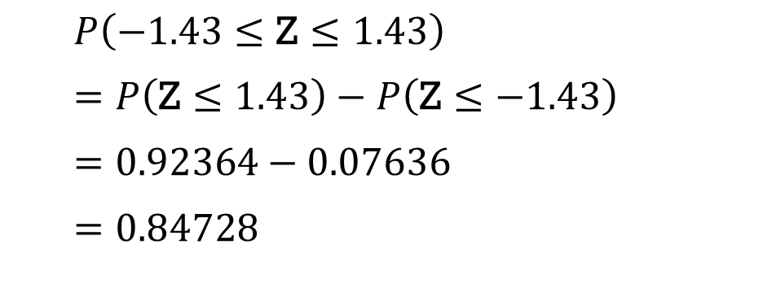
Example: Real-World Flight Data from FAR to ORD
$$P\left(\text{Z}≤−1.43\right)$$
$P\left(\text{−}\text{1.43}≤\text{Z}≤\text{1}\text{.}\text{4}3\right)$
$=P\left(\text{Z}≤\text{1}\text{.}\text{43}\right)−P\left(\text{Z}≤\text{−1.43}\right)$
$=0.92364−0.07636$
$=0.84728$

Slide 33
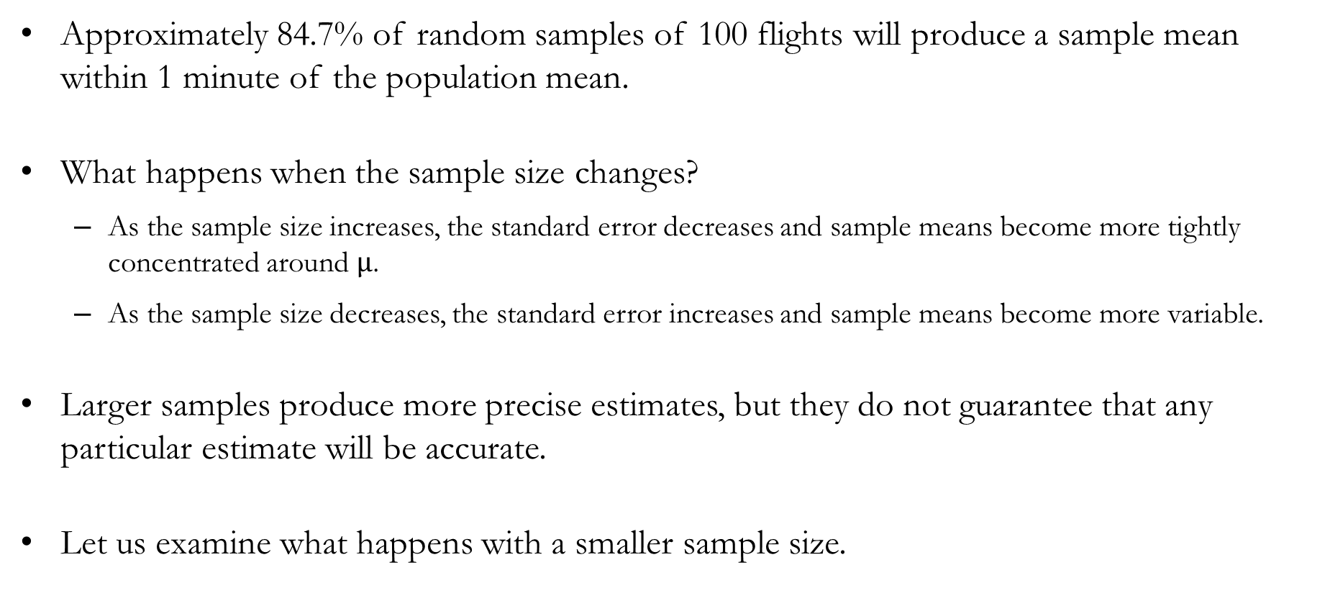
Example: Real-World Flight Data from FAR to ORD
Approximately 84.7% of random samples of 100 flights will produce a sample mean within 1 minute of the population mean.
What happens when the sample size changes?
  As the sample size increases, the standard error decreases and sample means become more tightly concentrated around $μ$.
  As the sample size decreases, the standard error increases and sample means become more variable.
Larger samples produce more precise estimates, but they do not guarantee that any particular estimate will be accurate.
Let us examine what happens with a smaller sample size.

Slide 34
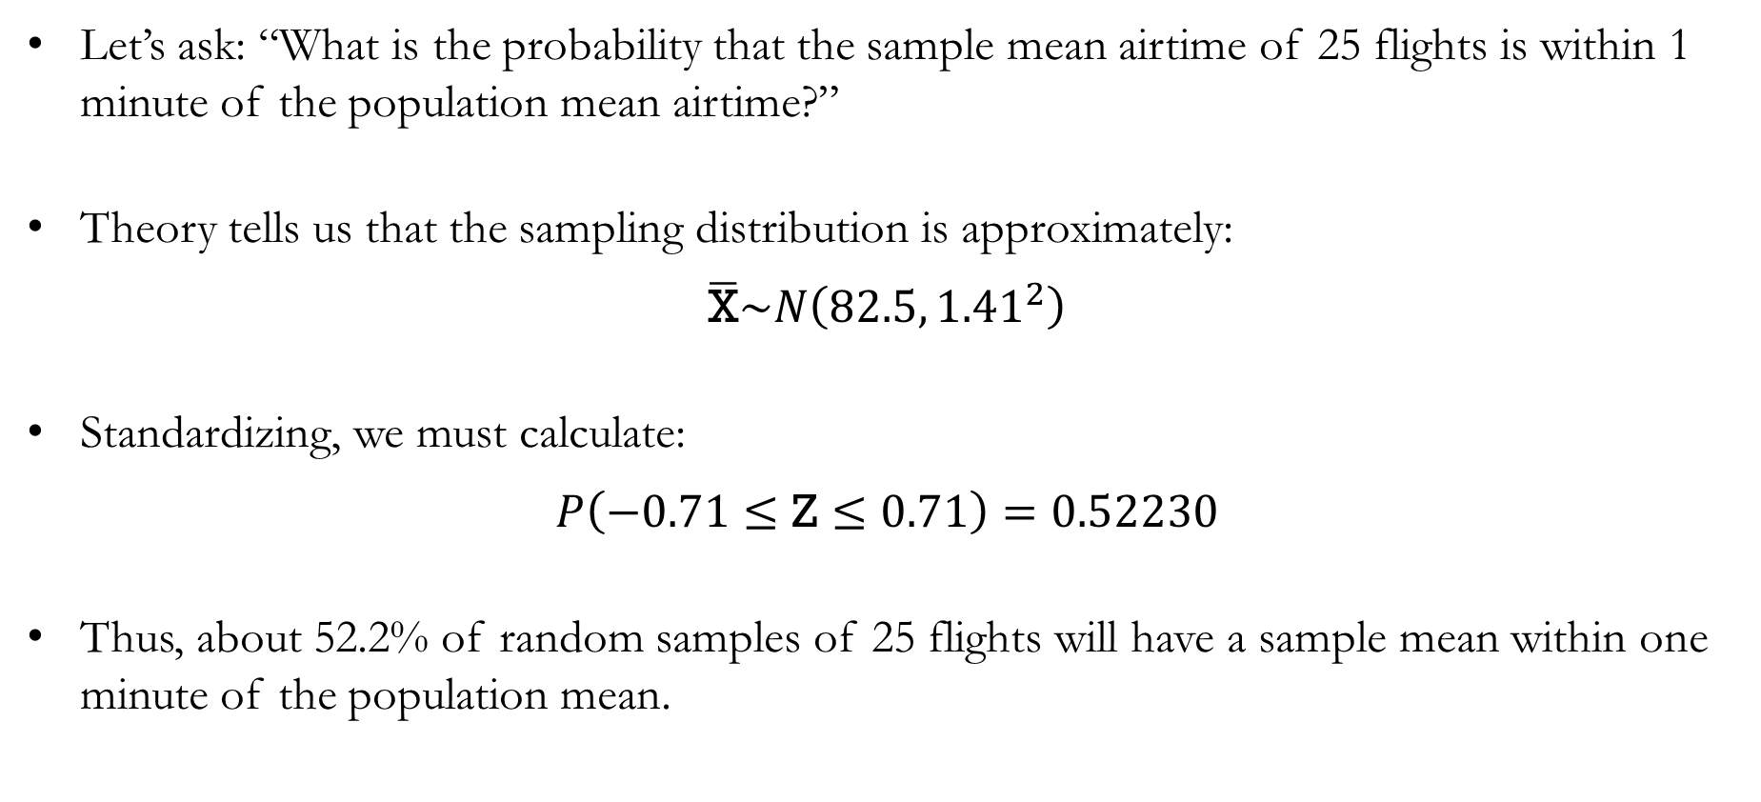
Example: Real-World Flight Data from FAR to ORD
Let’s ask: “What is the probability that the sample mean airtime of 25 flights is within 1 minute of the population mean airtime?”
Theory tells us that the sampling distribution is approximately:
$$\overline{\text{X}}\sim N\left({82.5, 1.41}^{2}\right)$$
Standardizing, we must calculate:
$$P\left(−0.71≤\text{Z}≤0.71\right)=0.52230$$
Thus, about 52.2% of random samples of 25 flights will have a sample mean within one minute of the population mean.

Slide 35
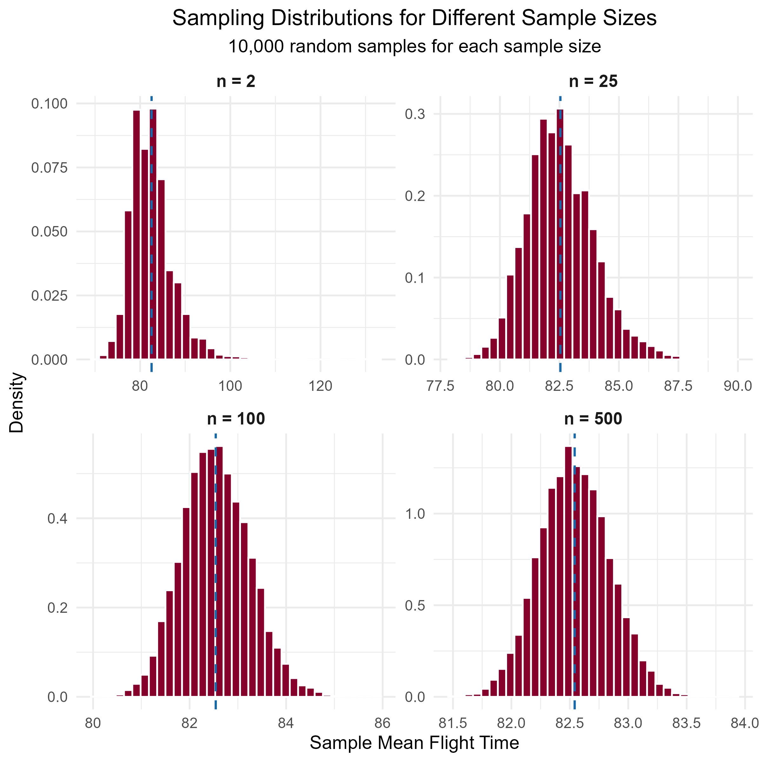
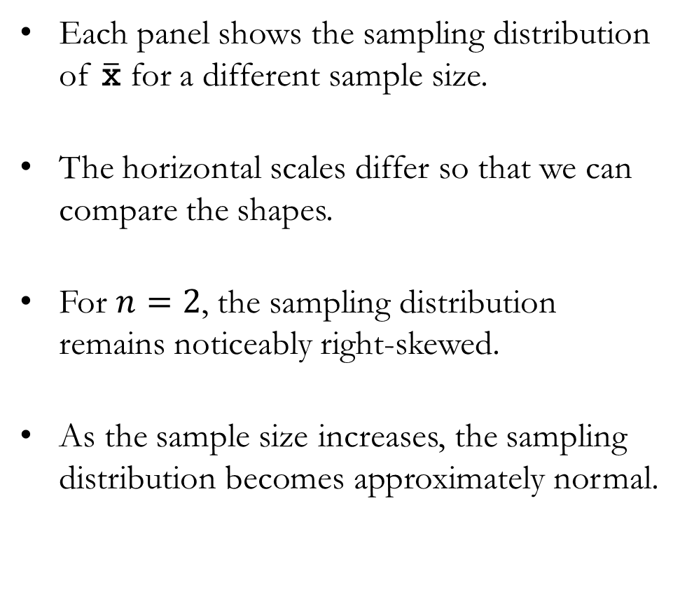
Example: Real-World Flight Data from FAR to ORD
Each panel shows the sampling distribution of $\overline{\text{x}}$ for a different sample size.
The horizontal scales differ so that we can compare the shapes.
For $n=2$, the sampling distribution remains noticeably right-skewed.
As the sample size increases, the sampling distribution becomes approximately normal.

Slide 36
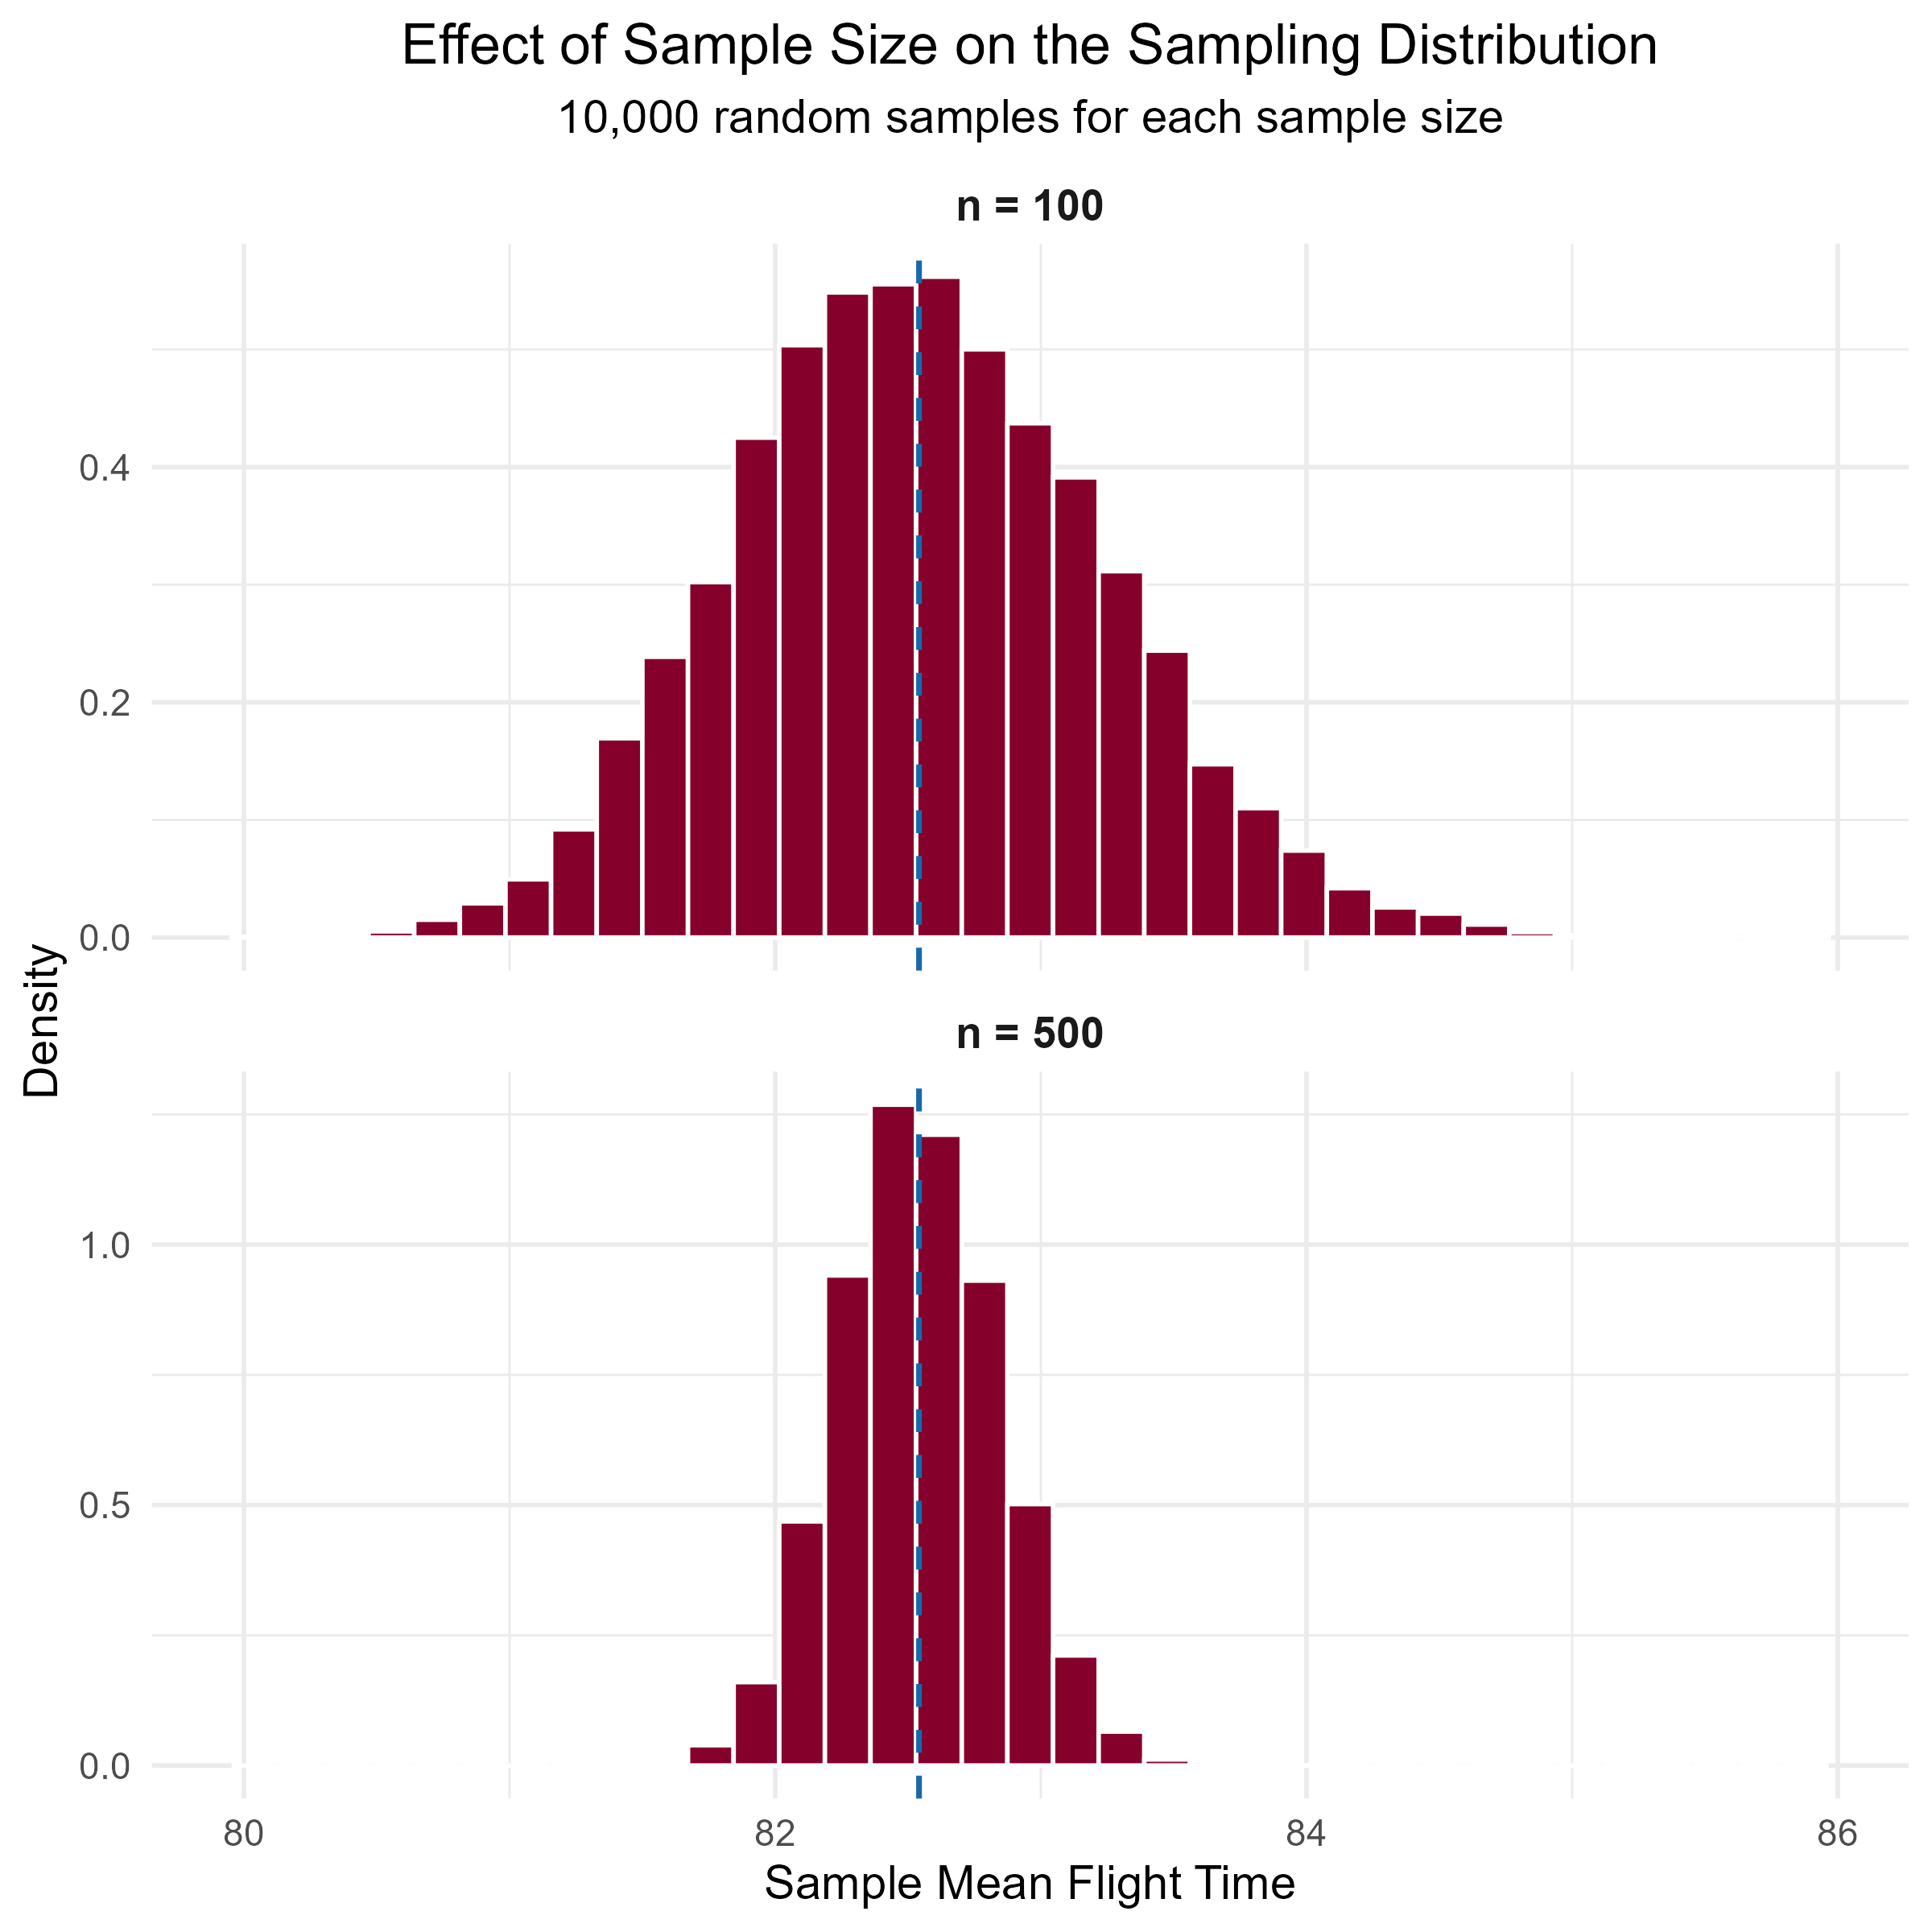
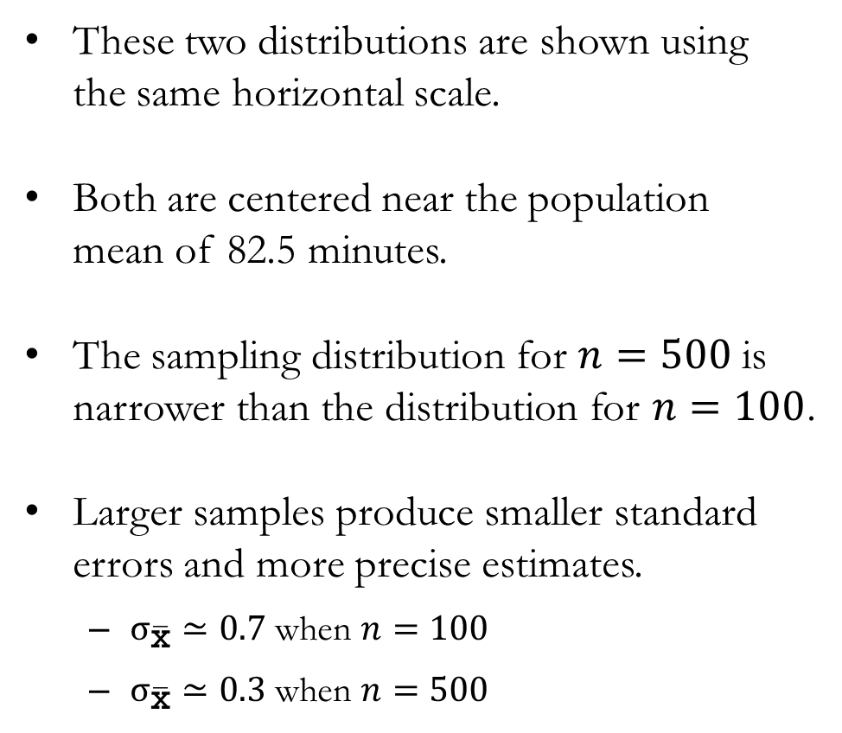
Example: Real-World Flight Data from FAR to ORD
These two distributions are shown using the same horizontal scale.
Both are centered near the population mean of 82.5 minutes.
The sampling distribution for $n=500$ is narrower than the distribution for $n=100$.
Larger samples produce smaller standard errors and more precise estimates.
  $σ_{\overline{\text{x}}}≃0.7$ when $n=100$
  $σ_{\overline{\text{x}}}≃0.3$ when $n=500$

Slide 37
Sampling Distribution of $\overline{\text{p}}$

Slide 38
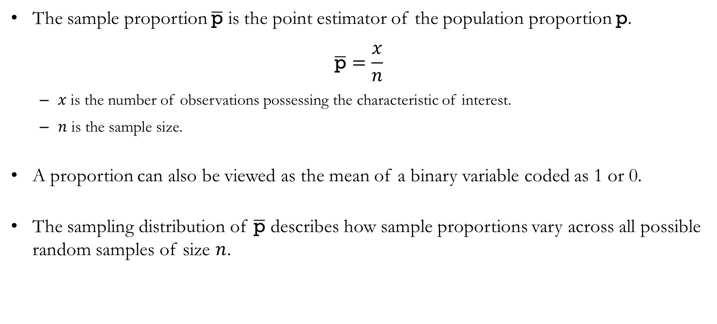
The Sample Proportion $\overline{\text{p}}$
The sample proportion $\overline{\text{p}}$ is the point estimator of the population proportion $\text{p}$.
$$\overline{\text{p}}=\frac{x}{n}$$
  $x$ is the number of observations possessing the characteristic of interest.
  $n$ is the sample size.
A proportion can also be viewed as the mean of a binary variable coded as 1 or 0.
The sampling distribution of $\overline{\text{p}}$ describes how sample proportions vary across all possible random samples of size $n$.

Slide 39
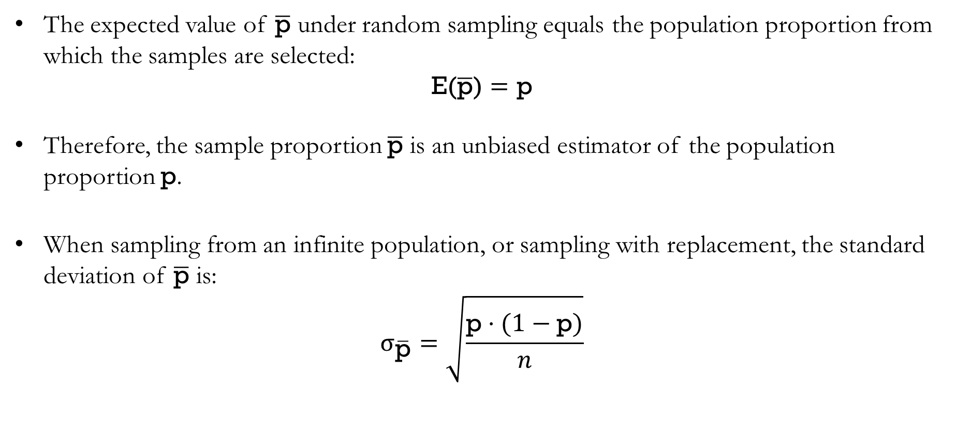
The Expected Value and Standard Deviation of $\overline{\text{p}}$
The expected value of $\overline{\text{p}}$ under random sampling equals the population proportion from which the samples are selected:
$$\text{E(}\overline{\text{p}}\text{)}=\text{p}$$
Therefore, the sample proportion $\overline{\text{p}}$ is an unbiased estimator of the population proportion $\text{p}$.
When sampling from an infinite population, or sampling with replacement, the standard deviation of $\overline{\text{p}}$ is:
$$σ_{\overline{\text{p}}}=\sqrt{\frac{\text{p}⋅(1−\text{p})}{n}}$$

Slide 40
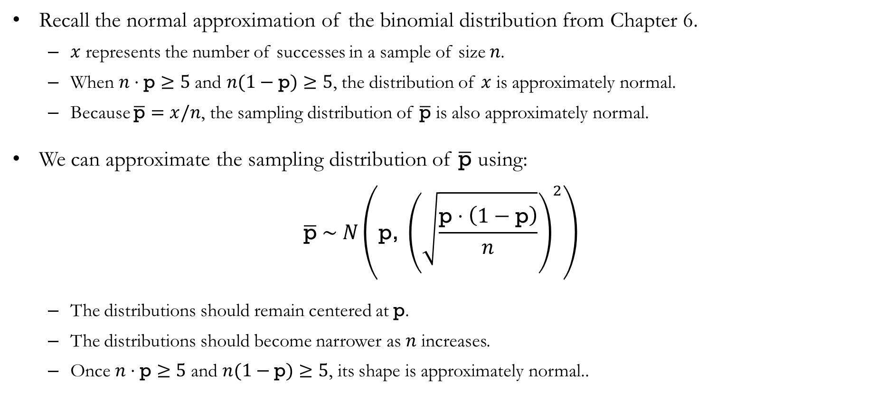
The Form of the Sampling Distribution of $\overline{\text{p}}$
Recall the normal approximation of the binomial distribution from Chapter 6.
  $x$ represents the number of successes in a sample of size $n$.
  When $n⋅\text{p}≥5$ and $n(1−\text{p})≥5$, the distribution of $x$ is approximately normal.
  Because $\overline{\text{p}}=x/n$, the sampling distribution of $\overline{\text{p}}$ is also approximately normal.
We can approximate the sampling distribution of $\overline{\text{p}}$ using:
$$\overline{\text{p}} \sim N\left(\text{p}\text{, }{\left(\sqrt{\frac{\text{p}⋅\left(1−\text{p}\right)}{n}}\right)}^{2}\right)$$
  The distributions should remain centered at $\text{p}$.
  The distributions should become narrower as $n$ increases.
  Once $n⋅\text{p}≥5$ and $n(1−\text{p})≥5$, its shape is approximately normal..

Slide 41
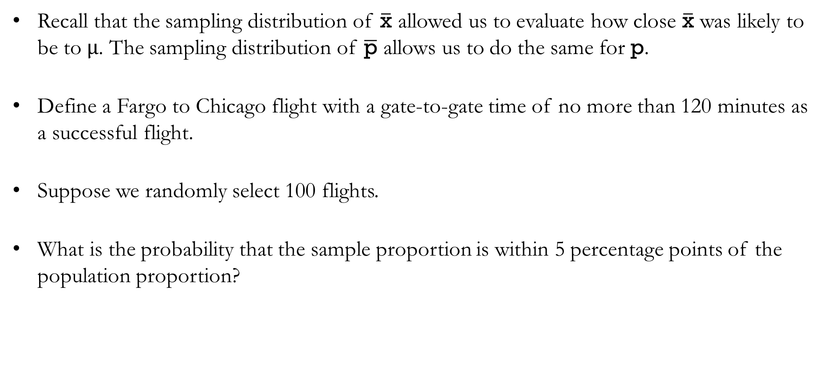
Practical Value of the Sampling Distribution of $\overline{\text{p}}$
Recall that the sampling distribution of $\overline{\text{x}}$ allowed us to evaluate how close $\overline{\text{x}}$ was likely to be to $μ$. The sampling distribution of $\overline{\text{p}}$ allows us to do the same for $\text{p}$.
Define a Fargo to Chicago flight with a gate-to-gate time of no more than 120 minutes as a successful flight.
Suppose we randomly select 100 flights.
What is the probability that the sample proportion is within 5 percentage points of the population proportion?

Slide 42
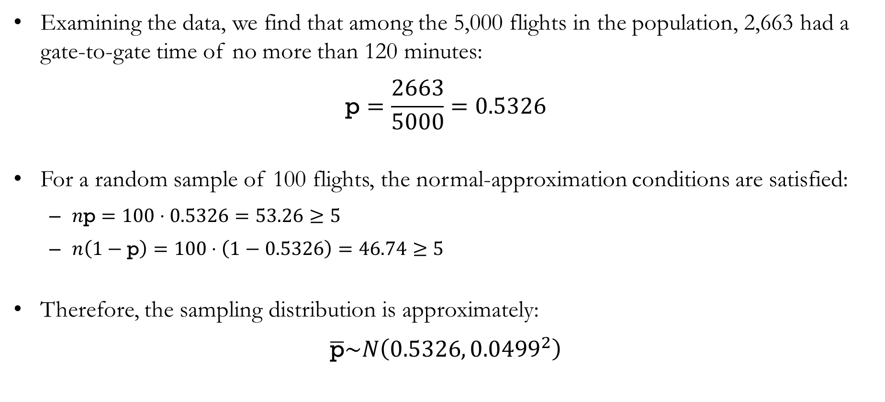
Example: Real-World Flight Data from FAR to ORD
Examining the data, we find that among the 5,000 flights in the population, 2,663 had a gate-to-gate time of no more than 120 minutes:
$$\text{p}=\frac{2663}{5000}=0.5326$$
For a random sample of 100 flights, the normal-approximation conditions are satisfied:
  $n\text{p}=100⋅0.5326=53.26≥5$
  $n\left(1−\text{p}\right)=100⋅\left(1−0.5326\right)=46.74≥5$
Therefore, the sampling distribution is approximately:
$$\overline{\text{p}}\sim N\left({0.5326, 0.0499}^{2}\right)$$

Slide 43
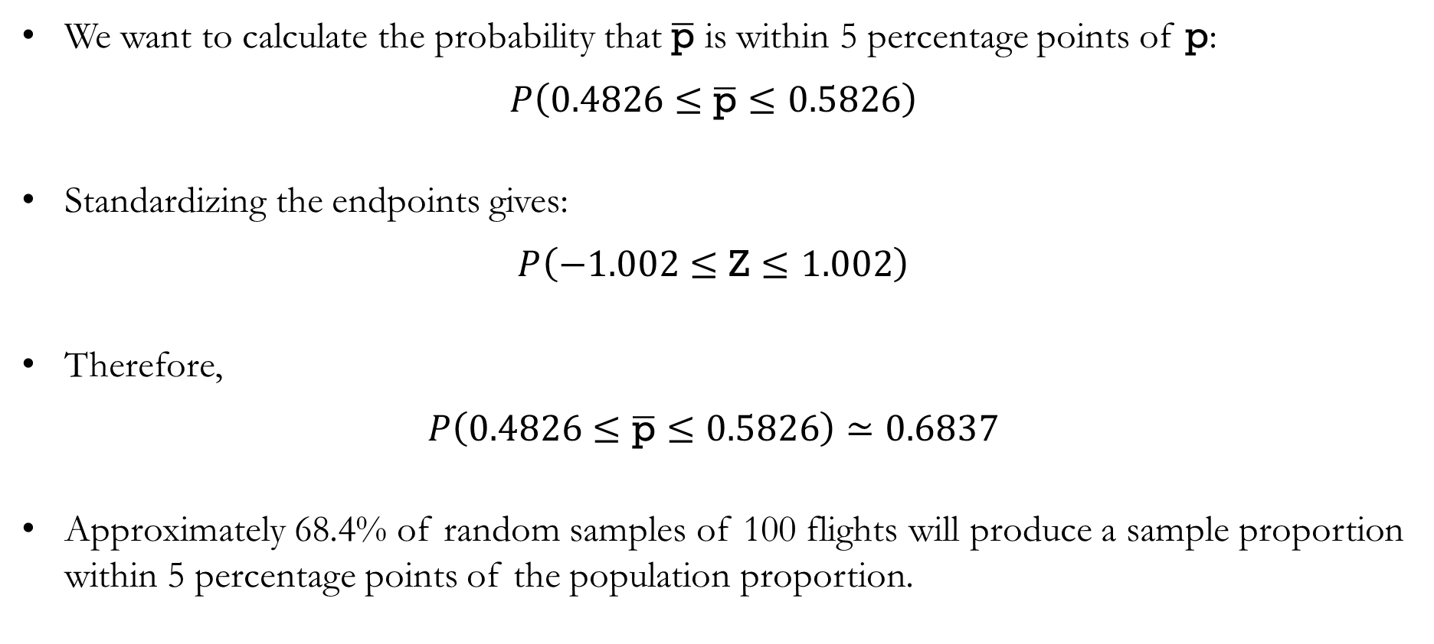
Example: Real-World Flight Data from FAR to ORD
We want to calculate the probability that $\overline{\text{p}}$ is within 5 percentage points of $\text{p}$:
$$P\left(0.4826≤\overline{\text{p}}≤0.5826\right)$$
Standardizing the endpoints gives:
$$P\left(−1.002≤\text{Z}≤1.002\right)$$
Therefore,
$$P\left(0.4826≤\overline{\text{p}}≤0.5826\right)≃0.6837$$
Approximately 68.4% of random samples of 100 flights will produce a sample proportion within 5 percentage points of the population proportion.

Slide 44
Properties of Point Estimators

Slide 45
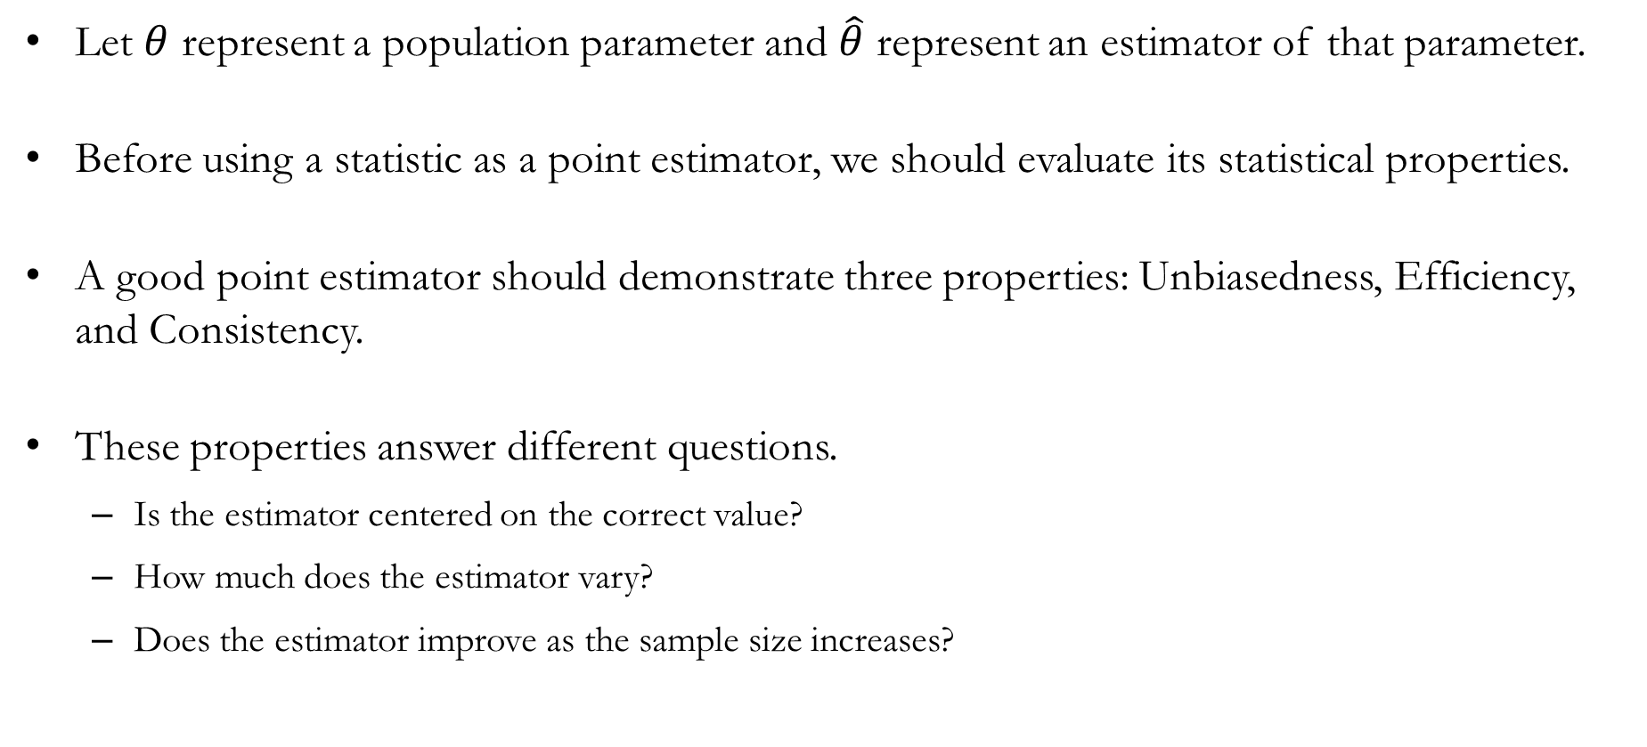
Desired Properties of Point Estimators
Let $θ$ represent a population parameter and $\hat{θ}$ represent an estimator of that parameter.
Before using a statistic as a point estimator, we should evaluate its statistical properties.
A good point estimator should demonstrate three properties: Unbiasedness, Efficiency, and Consistency.
These properties answer different questions.
  Is the estimator centered on the correct value?
  How much does the estimator vary?
  Does the estimator improve as the sample size increases?

Slide 46
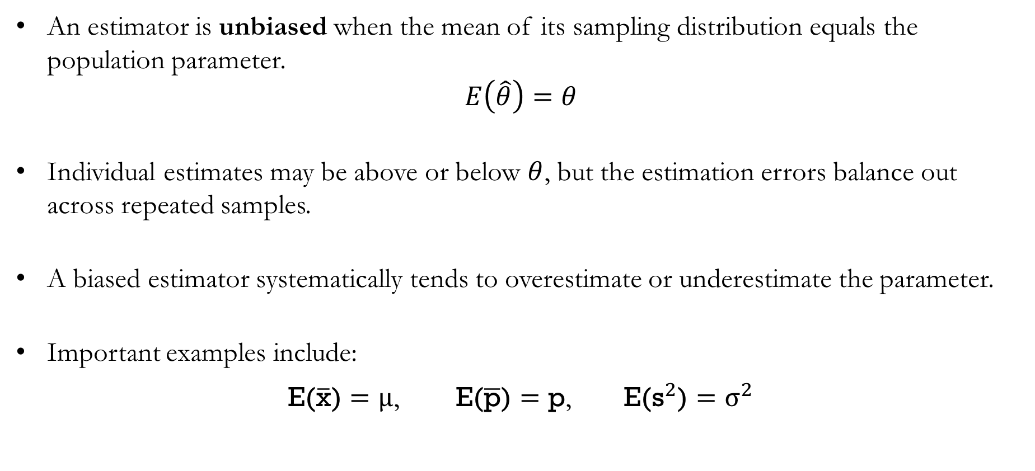
Unbiasedness
An estimator is unbiased when the mean of its sampling distribution equals the population parameter.
$$E\left(\hat{θ}\right)=θ$$
Individual estimates may be above or below $θ$, but the estimation errors balance out across repeated samples.
A biased estimator systematically tends to overestimate or underestimate the parameter.
Important examples include:
$\text{E(}\overline{\text{x}}\text{)}=μ$, $\text{E(}\overline{\text{p}}\text{)}=\text{p}$, $\text{E(}{\text{s}}^{2}\text{)}=σ^{2}$

Slide 47
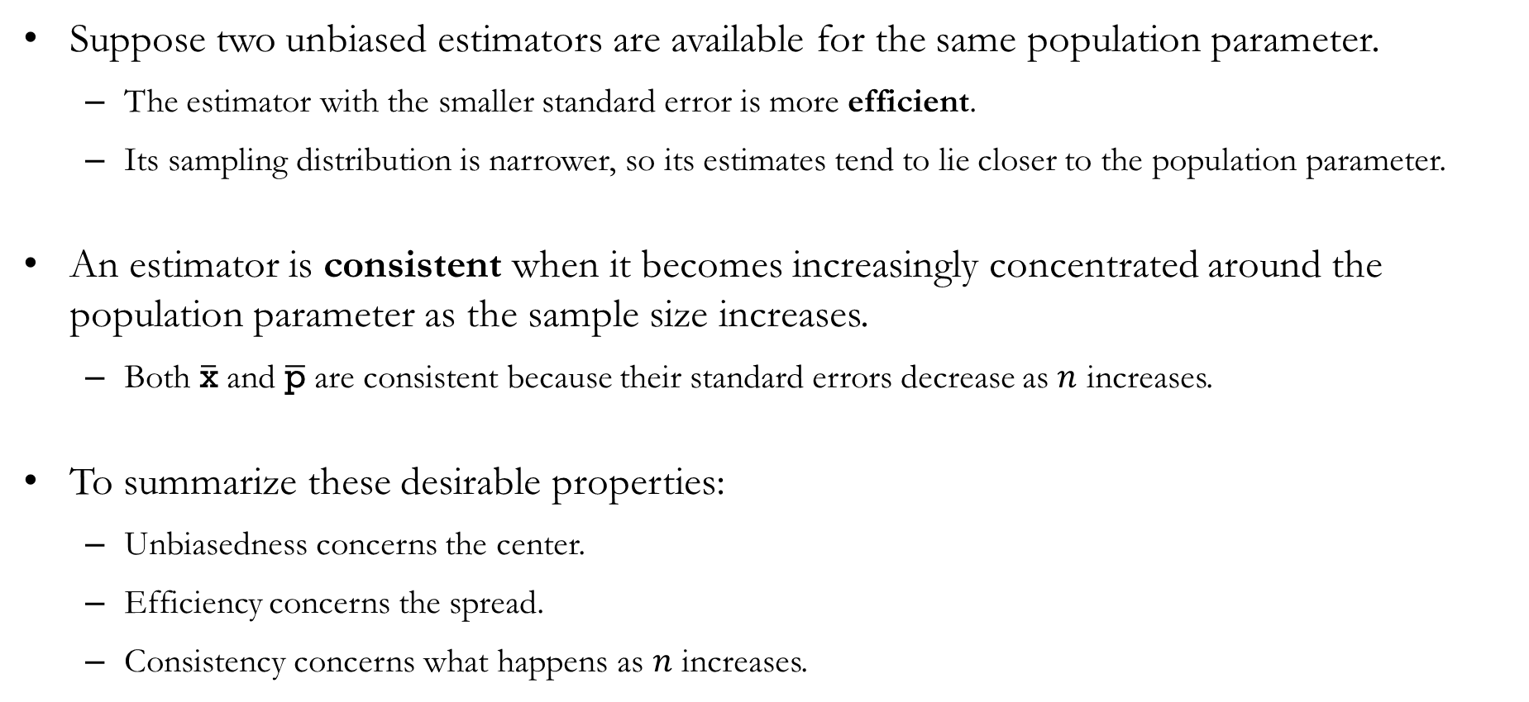
Efficiency and Consistency
Suppose two unbiased estimators are available for the same population parameter.
  The estimator with the smaller standard error is more efficient.
  Its sampling distribution is narrower, so its estimates tend to lie closer to the population parameter.
An estimator is consistent when it becomes increasingly concentrated around the population parameter as the sample size increases.
  Both $\overline{\text{x}}$ and $\overline{\text{p}}$ are consistent because their standard errors decrease as $n$ increases.
To summarize these desirable properties:
  Unbiasedness concerns the center.
  Efficiency concerns the spread.
  Consistency concerns what happens as $n$ increases.

Slide 48
Big Data and Standard Errors
of Sampling Distributions

Slide 49
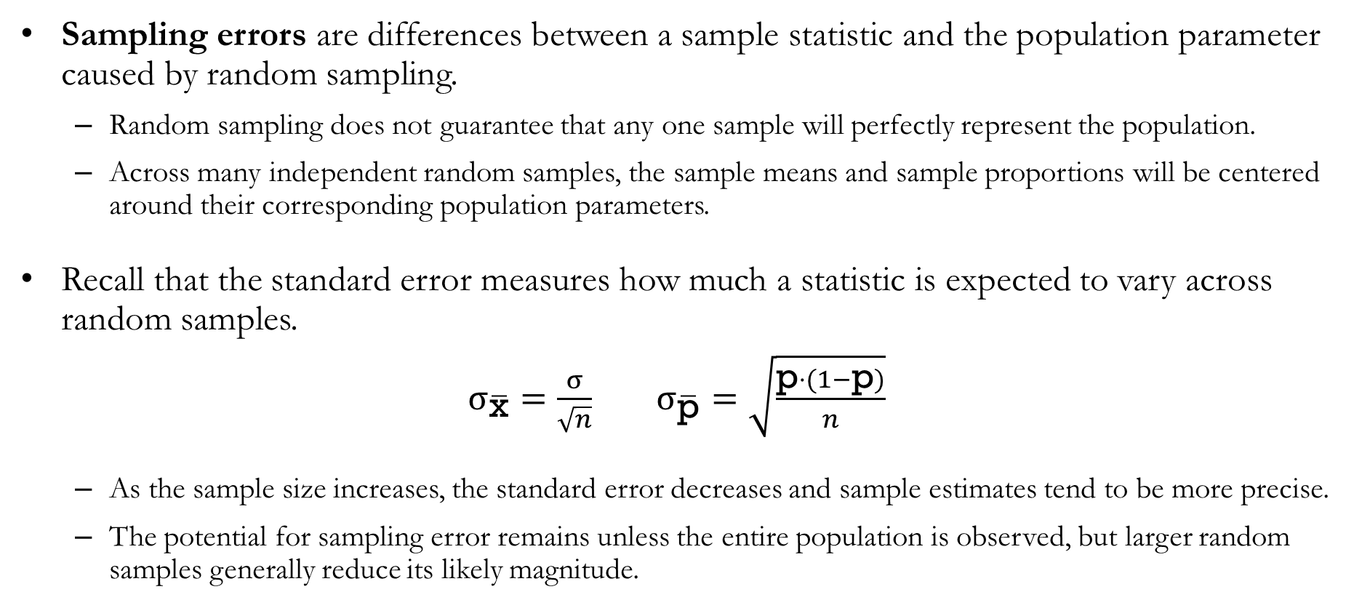
Sampling Error
Sampling errors are differences between a sample statistic and the population parameter caused by random sampling.
  Random sampling does not guarantee that any one sample will perfectly represent the population.
  Across many independent random samples, the sample means and sample proportions will be centered around their corresponding population parameters.
Recall that the standard error measures how much a statistic is expected to vary across random samples.
$σ_{\overline{\text{x}}}=\frac{σ}{\sqrt{n}}$ $σ_{\overline{\text{p}}}=\sqrt{\frac{\text{p}⋅(1−\text{p})}{n}}$
  As the sample size increases, the standard error decreases and sample estimates tend to be more precise.
  The potential for sampling error remains unless the entire population is observed, but larger random samples generally reduce its likely magnitude.

Slide 50
Nonsampling Error
Nonsampling errors can occur in either samples or censuses when the collected data fail to represent the target population for reasons other than random sampling.
  Coverage error occurs when the population being sampled does not align with the target population.
  Nonresponse error occurs when some groups are systematically less likely to participate.
  Measurement error occurs when questions or measurements do not accurately capture the characteristic of interest.
  Interviewer and processing errors can occur while collecting, recording, or preparing the data.
Increasing the sample size reduces sampling error, but it does not eliminate nonsampling error.
  Nonsampling error can be reduced by clearly defining the target population, using an appropriate sampling method, pretesting the data-collection process, and carefully training data collectors.

Slide 51
Big Data
Big data refers to data that are exceptionally large, complex, diverse, or rapidly generated.
Big data are often described using the four Vs.
  Volume refers to the amount of data.
  Variety refers to the different types and structures of data.
  Velocity refers to how rapidly data are generated.
  Veracity refers to the reliability of the data.
Big data may be tall, with many observations, wide, with many variables, or both.

Slide 52
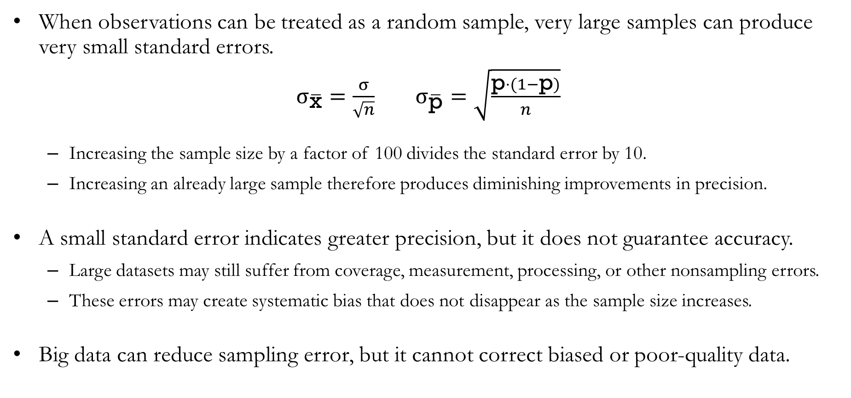
Big Data and Sampling Error
When observations can be treated as a random sample, very large samples can produce very small standard errors.
$σ_{\overline{\text{x}}}=\frac{σ}{\sqrt{n}}$ $σ_{\overline{\text{p}}}=\sqrt{\frac{\text{p}⋅(1−\text{p})}{n}}$
  Increasing the sample size by a factor of 100 divides the standard error by 10.
  Increasing an already large sample therefore produces diminishing improvements in precision.
A small standard error indicates greater precision, but it does not guarantee accuracy.
  Large datasets may still suffer from coverage, measurement, processing, or other nonsampling errors.
  These errors may create systematic bias that does not disappear as the sample size increases.
Big data can reduce sampling error, but it cannot correct biased or poor-quality data.

Slide 53
Recap & Preview

Slide 54
Recap: Chapter 7
In this chapter, we learned how to.
  Distinguish between finite and infinite populations and select an appropriate random sample.
  Use sample statistics as point estimators of population parameters.
  Describe the sampling distributions of the sample mean and sample proportion.
  Calculate and interpret the expected value and standard error of a sampling distribution.
  Apply the central limit theorem and determine when a normal approximation is appropriate.
  Use sampling distributions to evaluate how close a sample statistic is likely to be to its population parameter.
  Explain how sample size affects sampling error and precision.
  Distinguish between sampling error and nonsampling error.
Takeaway: Sampling distributions allow us to evaluate the reliability of sample statistics as estimates of population parameters.

Slide 55
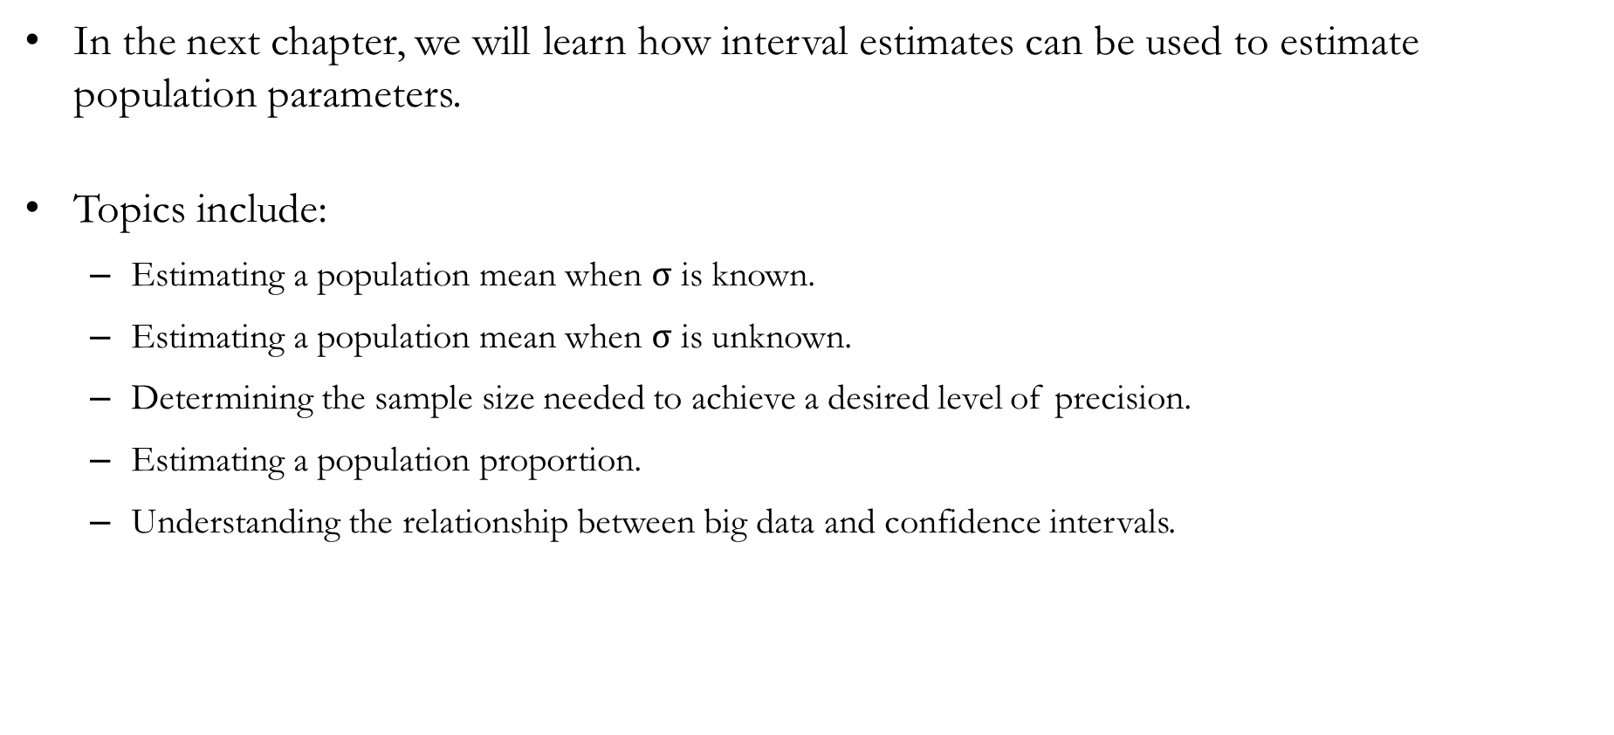
Preview: Chapter 8
In the next chapter, we will learn how interval estimates can be used to estimate population parameters.
Topics include:
  Estimating a population mean when $σ$ is known.
  Estimating a population mean when $σ$ is unknown.
  Determining the sample size needed to achieve a desired level of precision.
  Estimating a population proportion.
  Understanding the relationship between big data and confidence intervals.

