Slide 1
INTERMEDIATE MICROECONOMIC THEORY
Chapter 23: Firm Supply

Slide 2
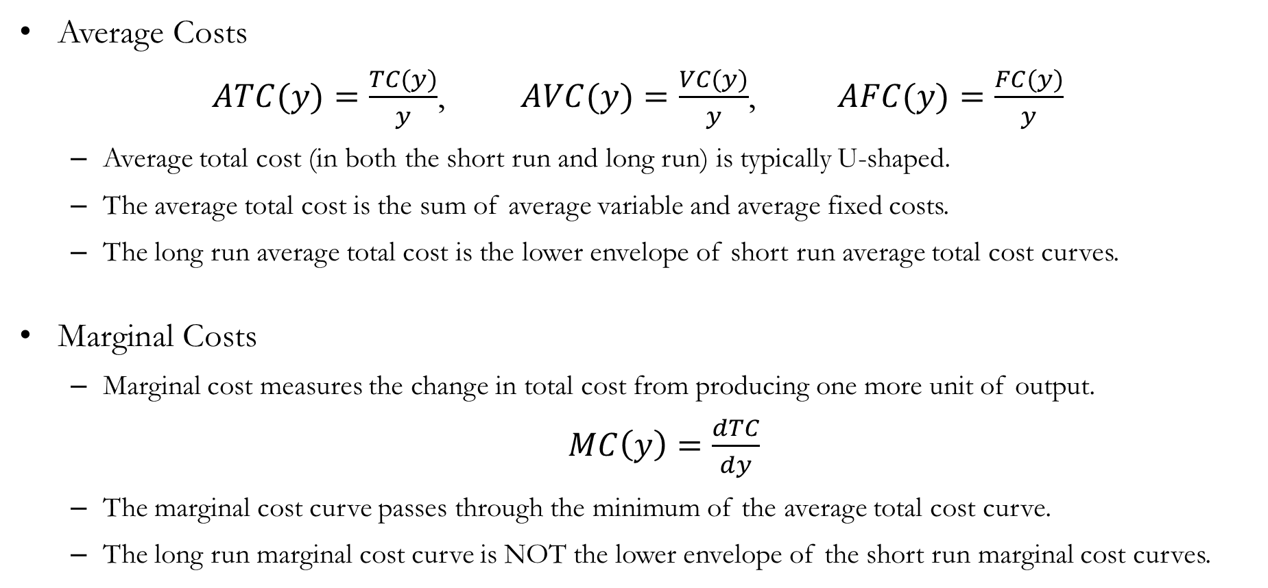
Recap: Cost Curves
Average Costs
$ATC(y)=\frac{TC(y)}{y}$, $AVC(y)=\frac{VC(y)}{y}$, $AFC(y)=\frac{FC(y)}{y}$
Average total cost (in both the short run and long run) is typically U-shaped.
The average total cost is the sum of average variable and average fixed costs.
The long run average total cost is the lower envelope of short run average total cost curves.
Marginal Costs
Marginal cost measures the change in total cost from producing one more unit of output.
$MC\left(y\right)=\frac{dTC}{dy}$
The marginal cost curve passes through the minimum of the average total cost curve.
The long run marginal cost curve is NOT the lower envelope of the short run marginal cost curves.

Slide 3
Individual Firm’s Supply

Slide 4
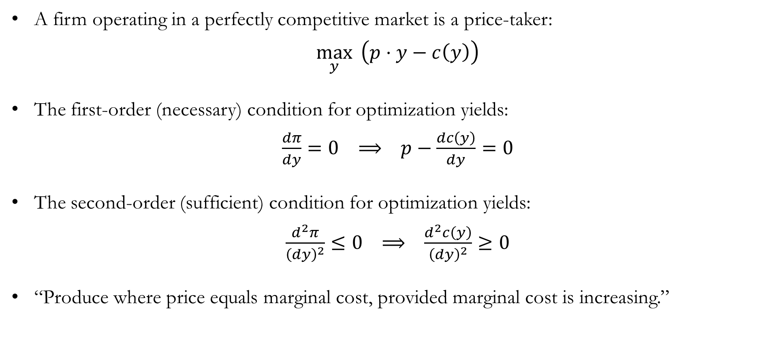
Supply Decisions of Competitive Firms
A firm operating in a perfectly competitive market is a price-taker:
$\max_{y}{ \left(p⋅y−c\left(y\right)\right)}$
The first-order (necessary) condition for optimization yields:
$\frac{dπ}{dy}=0 ⟹ p−\frac{dc\left(y\right)}{dy}=0$
The second-order (sufficient) condition for optimization yields:
$\frac{d^{2}π}{{\left(dy\right)}^{2}}≤0 ⟹ \frac{d^{2}c\left(y\right)}{{\left(dy\right)}^{2}}≥0$
“Produce where price equals marginal cost, provided marginal cost is increasing.”

Slide 5
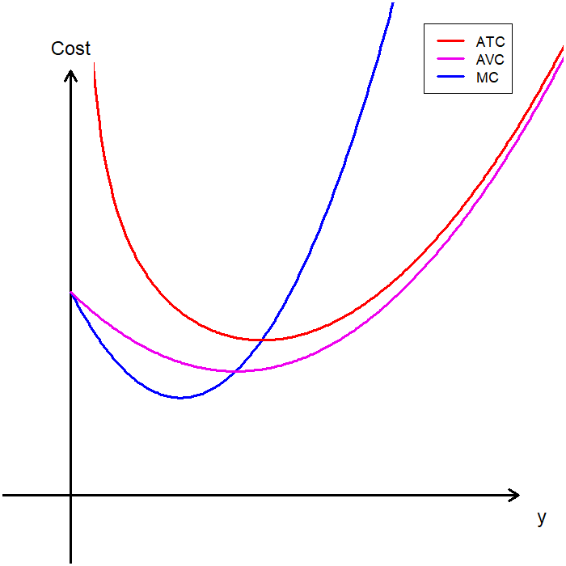
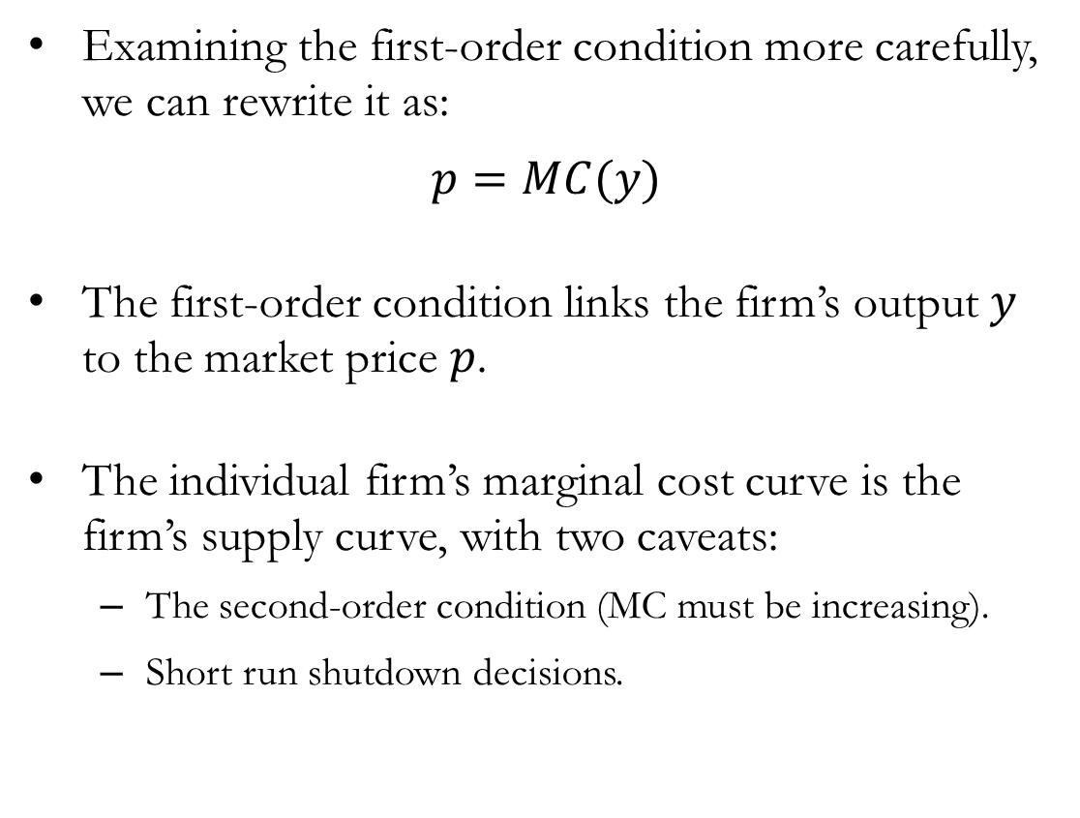
The Marginal Cost Curve as the Supply Curve
Examining the first-order condition more carefully, we can rewrite it as:
$$p=MC(y)$$
The first-order condition links the firm’s output $y$ to the market price $p$.
The individual firm’s marginal cost curve is the firm’s supply curve, with two caveats:
The second-order condition (MC must be increasing).
Short run shutdown decisions.

Slide 6
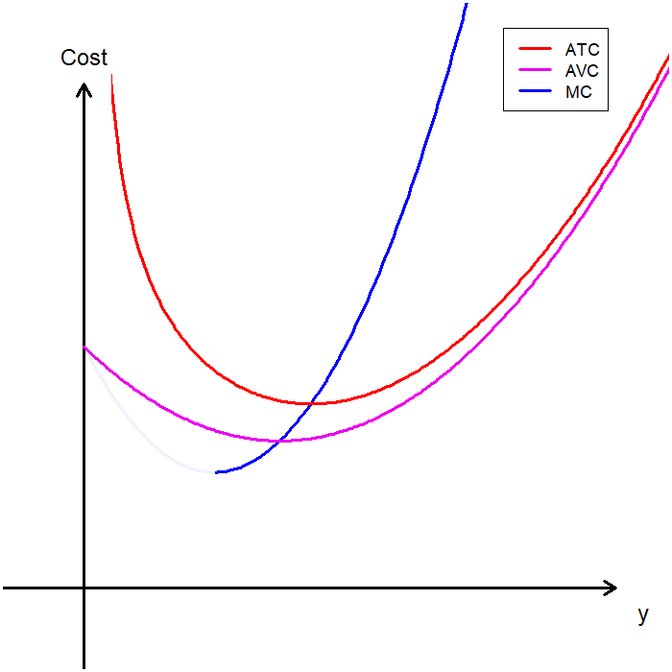
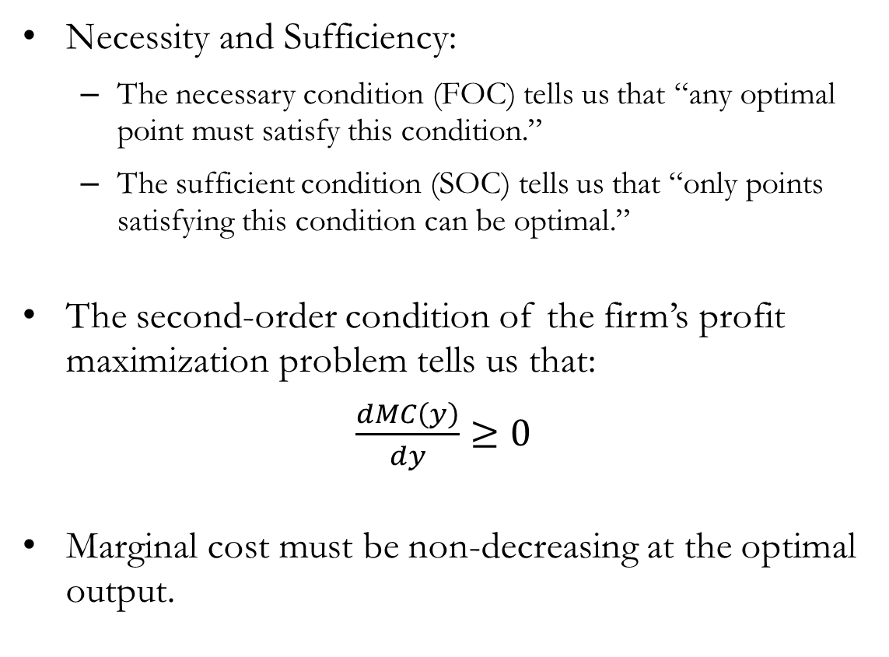
Caveat #1: The Second-Order Condition
Necessity and Sufficiency:
The necessary condition (FOC) tells us that “any optimal point must satisfy this condition.”
The sufficient condition (SOC) tells us that “only points satisfying this condition can be optimal.”
The second-order condition of the firm’s profit maximization problem tells us that:
$\frac{dMC\left(y\right)}{dy}≥0$
Marginal cost must be non-decreasing at the optimal output.

Slide 7
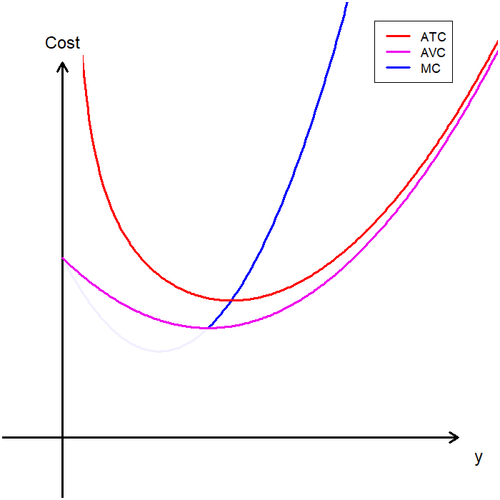
Caveat #2: Short Run Shutdown Conditions
Firms cease production when it is no longer in their best interest to operate.
In the short run, firms shut down when the price of their output is lower than their average variable cost (AVC).
Why not average total cost?
In the short run, firms incur fixed costs.
Even if the firm shuts down, it must still pay fixed costs (which are sunk in the short run).
If operating allows the firm to cover variable costs and reduce its losses, it should continue production.

Slide 8
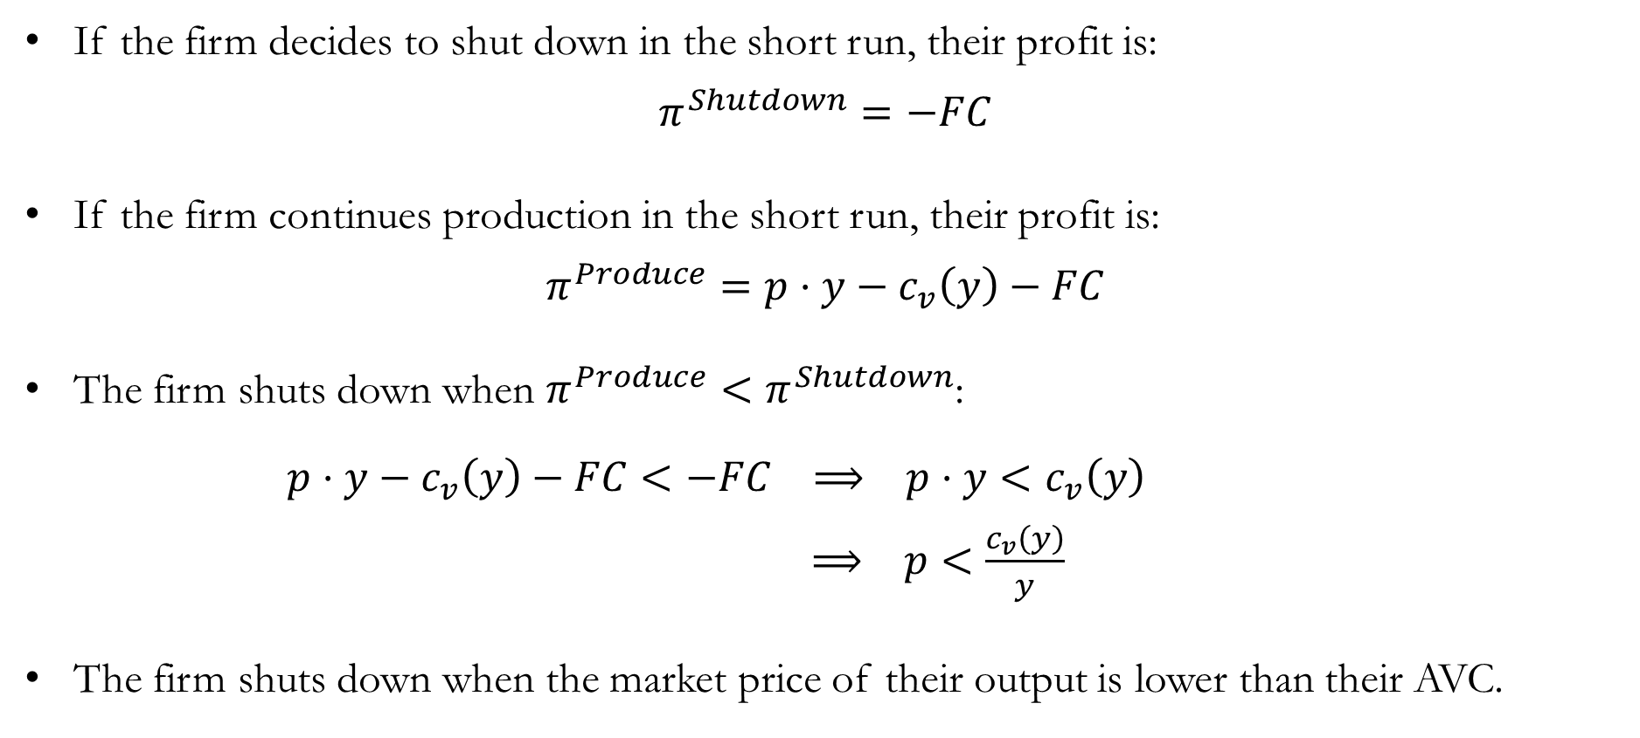
Detour: Shutdown Decisions in the Short Run
If the firm decides to shut down in the short run, their profit is:
$$π^{Shutdown}=−FC$$
If the firm continues production in the short run, their profit is:
$$π^{Produce}=p⋅y−c_{v}\left(y\right)−FC$$
The firm shuts down when $π^{Produce}<π^{Shutdown}$:
$p⋅y−c_{v}\left(y\right)−FC<−FC ⟹ p⋅y<c_{v}\left(y\right)$
$⟹ p<\frac{c_{v}\left(y\right)}{y}$
The firm shuts down when the market price of their output is lower than their AVC.

Slide 9
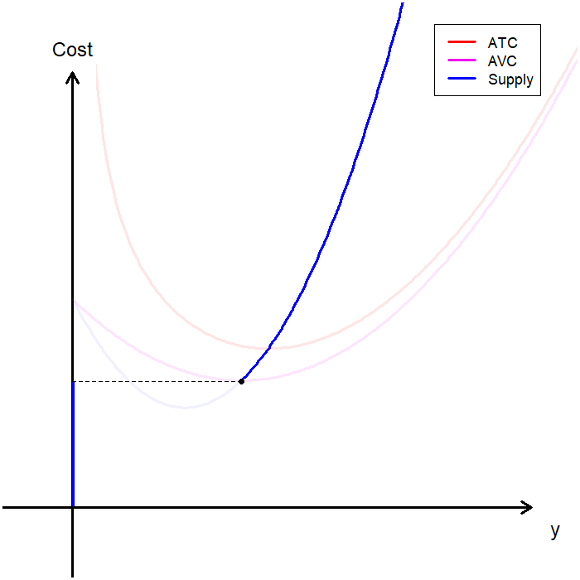
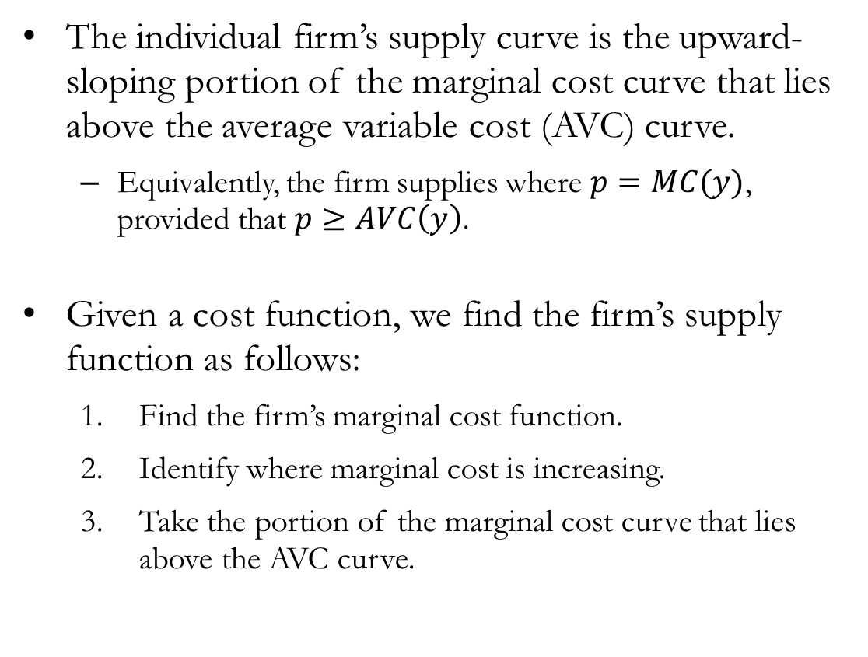
The Firm’s Supply
The individual firm’s supply curve is the upward-sloping portion of the marginal cost curve that lies above the average variable cost (AVC) curve.
Equivalently, the firm supplies where $p=MC(y)$, provided that $p≥AVC\left(y\right)$.
Given a cost function, we find the firm’s supply function as follows:
Find the firm’s marginal cost function.
Identify where marginal cost is increasing.
Take the portion of the marginal cost curve that lies above the AVC curve.

Slide 10
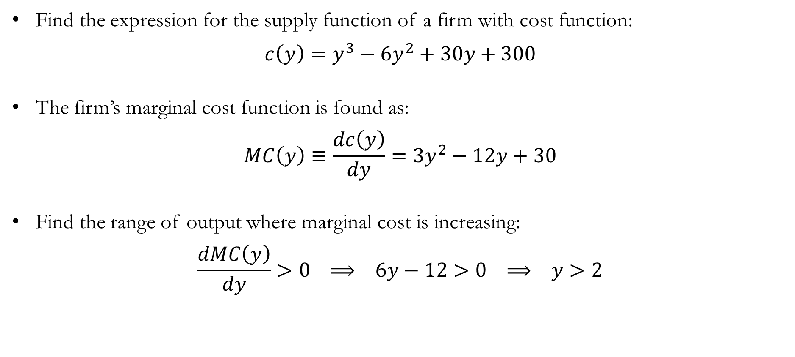
Numerical Example: Finding the Supply Function
Find the expression for the supply function of a firm with cost function:
$$c\left(y\right)=y^{3}−6y^{2}+30y+300$$
The firm’s marginal cost function is found as:
$$MC\left(y\right)≡\frac{dc\left(y\right)}{dy}=3y^{2}−12y+30$$
Find the range of output where marginal cost is increasing:
$$\frac{dMC\left(y\right)}{dy}>0 ⟹ 6y−12>0 ⟹ y>2$$

Slide 11
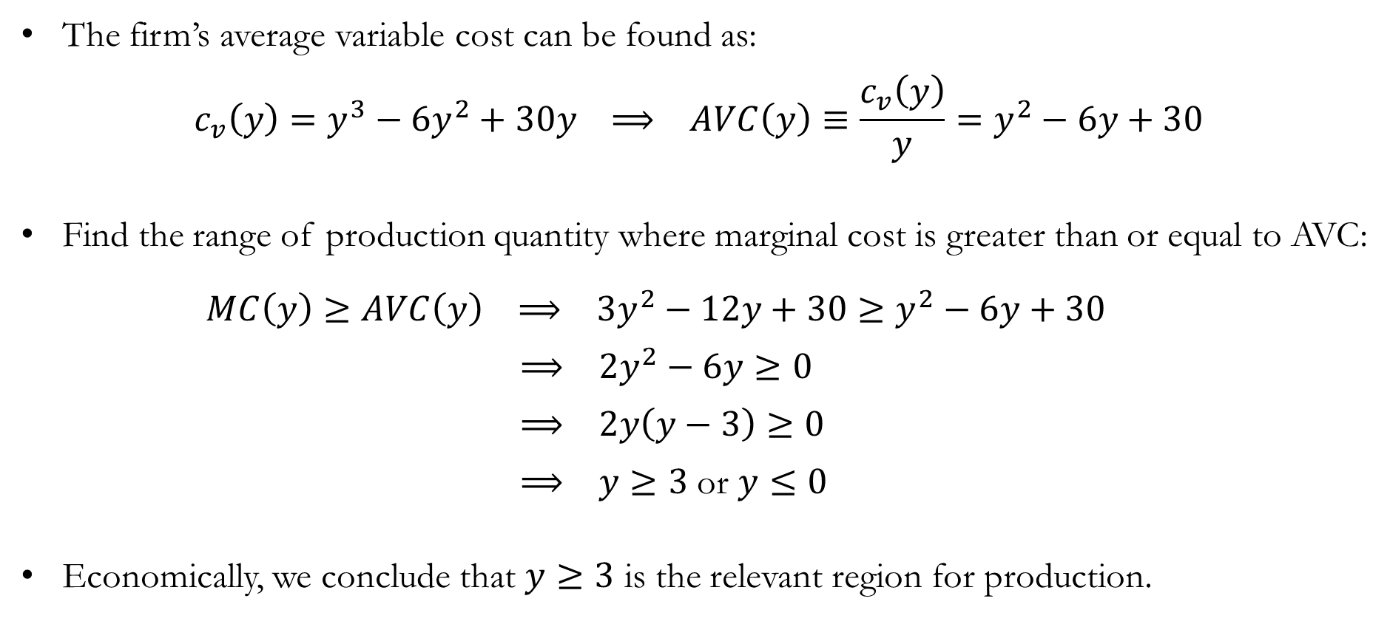
Numerical Example: Finding the Supply Function
The firm’s average variable cost can be found as:
$$c_{v}\left(y\right)=y^{3}−6y^{2}+30y ⟹ AVC\left(y\right)≡\frac{c_{v}\left(y\right)}{y}=y^{2}−6y+30$$
Find the range of production quantity where marginal cost is greater than or equal to AVC:
$MC\left(y\right)≥AVC\left(y\right) ⟹ 3y^{2}−12y+30≥y^{2}−6y+30$
$⟹ 2y^{2}−6y≥0$
$⟹ 2y\left(y−3\right)≥0$
$⟹ y≥3$ or $y≤0$
Economically, we conclude that $y≥3$ is the relevant region for production.

Slide 12
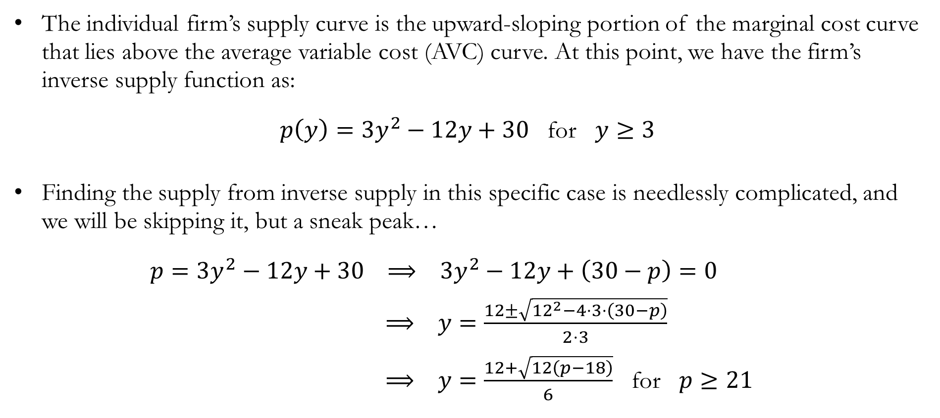
Numerical Example: Finding the Supply Function
The individual firm’s supply curve is the upward-sloping portion of the marginal cost curve that lies above the average variable cost (AVC) curve. At this point, we have the firm’s inverse supply function as:
$p\left(y\right)=3y^{2}−12y+30$ for $y≥3$
Finding the supply from inverse supply in this specific case is needlessly complicated, and we will be skipping it, but a sneak peak…
$p=3y^{2}−12y+30 ⟹ 3y^{2}−12y+\left(30−p\right)=0$
$⟹ y=\frac{12±\sqrt{{12}^{2}−4⋅3⋅\left(30−p\right)}}{2⋅3}$
$⟹ y=\frac{12+\sqrt{12\left(p−18\right)}}{6}$ for $p≥21$

Slide 13
Producer’s Surplus

Slide 14
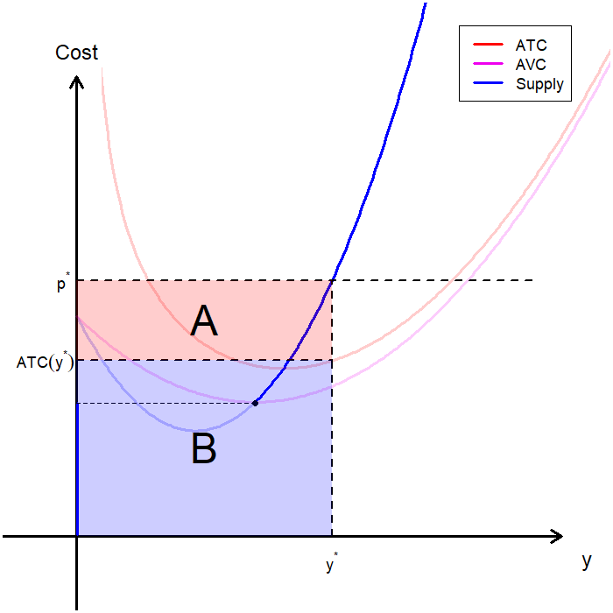
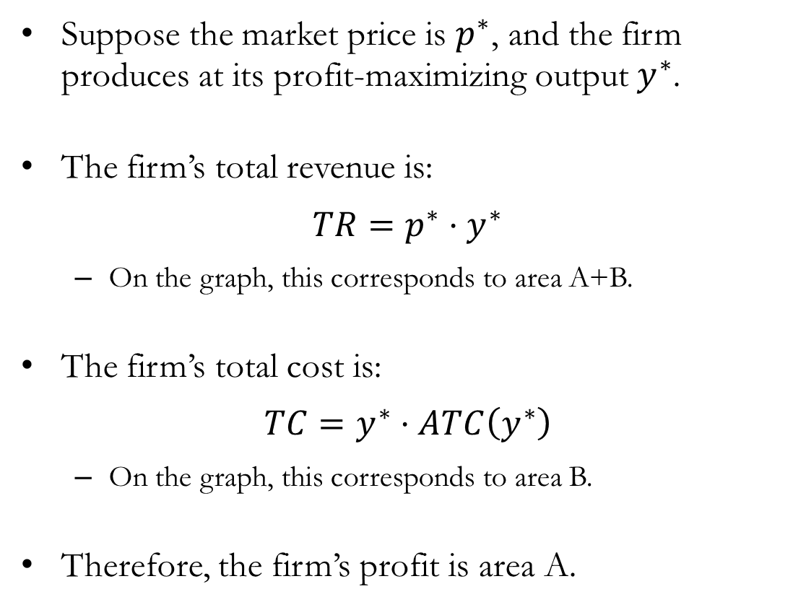
The Producer’s Profit
Suppose the market price is $p^{∗}$, and the firm produces at its profit-maximizing output $y^{∗}$.
The firm’s total revenue is:
$$TR=p^{∗}⋅y^{∗}$$
On the graph, this corresponds to area A+B.
The firm’s total cost is:
$$TC=y^{∗}⋅ATC\left(y^{∗}\right)$$
On the graph, this corresponds to area B.
Therefore, the firm’s profit is area A.

Slide 15
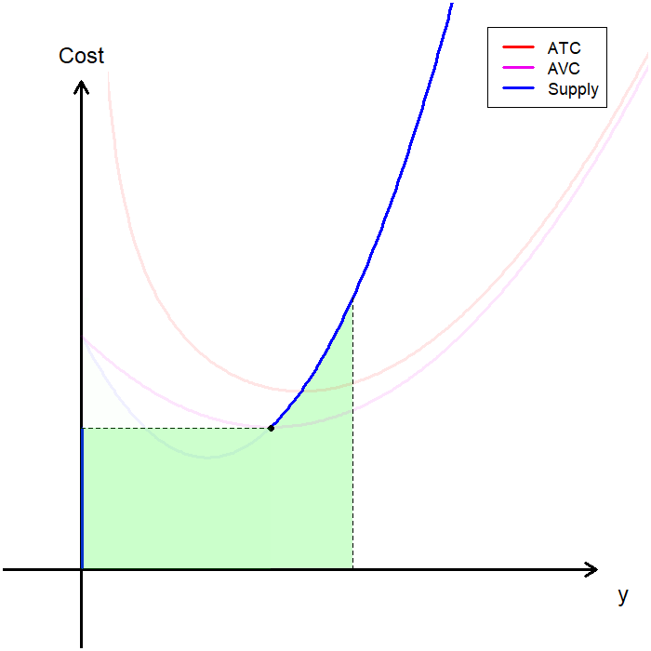
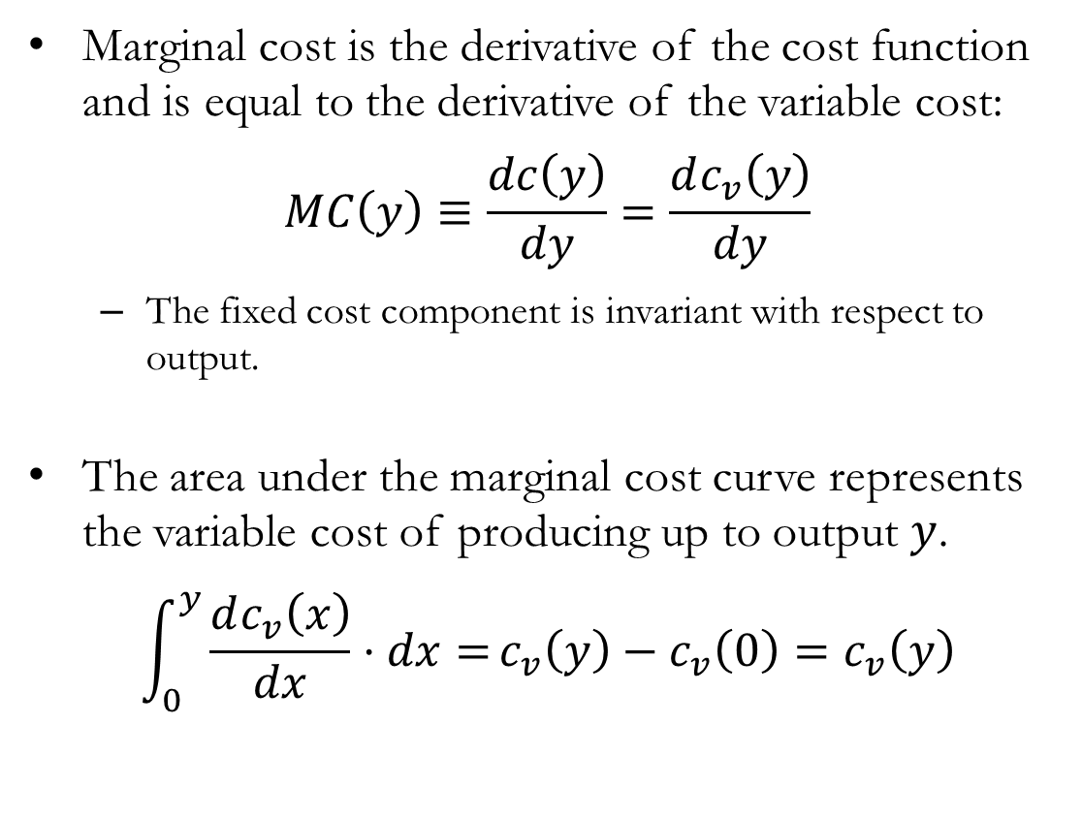
Marginal Cost and Variable Cost
Marginal cost is the derivative of the cost function and is equal to the derivative of the variable cost:
$$MC\left(y\right)≡\frac{dc\left(y\right)}{dy}=\frac{dc_{v}\left(y\right)}{dy}$$
The fixed cost component is invariant with respect to output.
The area under the marginal cost curve represents the variable cost of producing up to output $y$.
$$\int_{0}^{y}{\frac{dc_{v}\left(x\right)}{dx}⋅dx=}c_{v}\left(y\right)−c_{v}\left(0\right)=c_{v}\left(y\right)$$

Slide 16
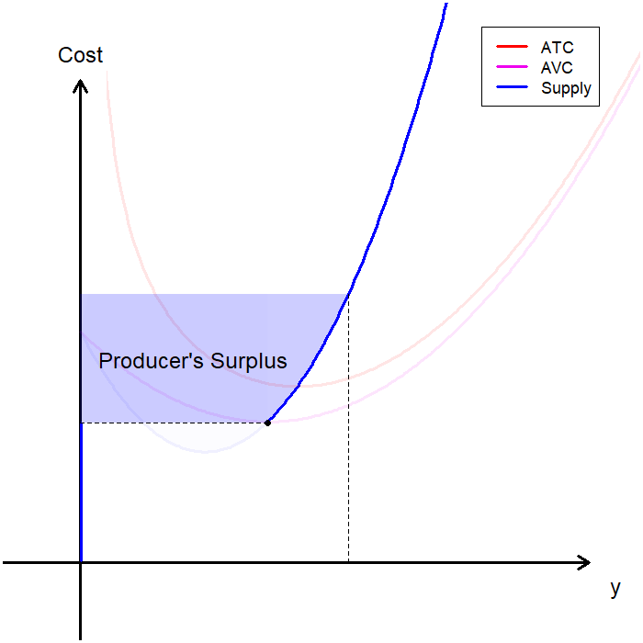
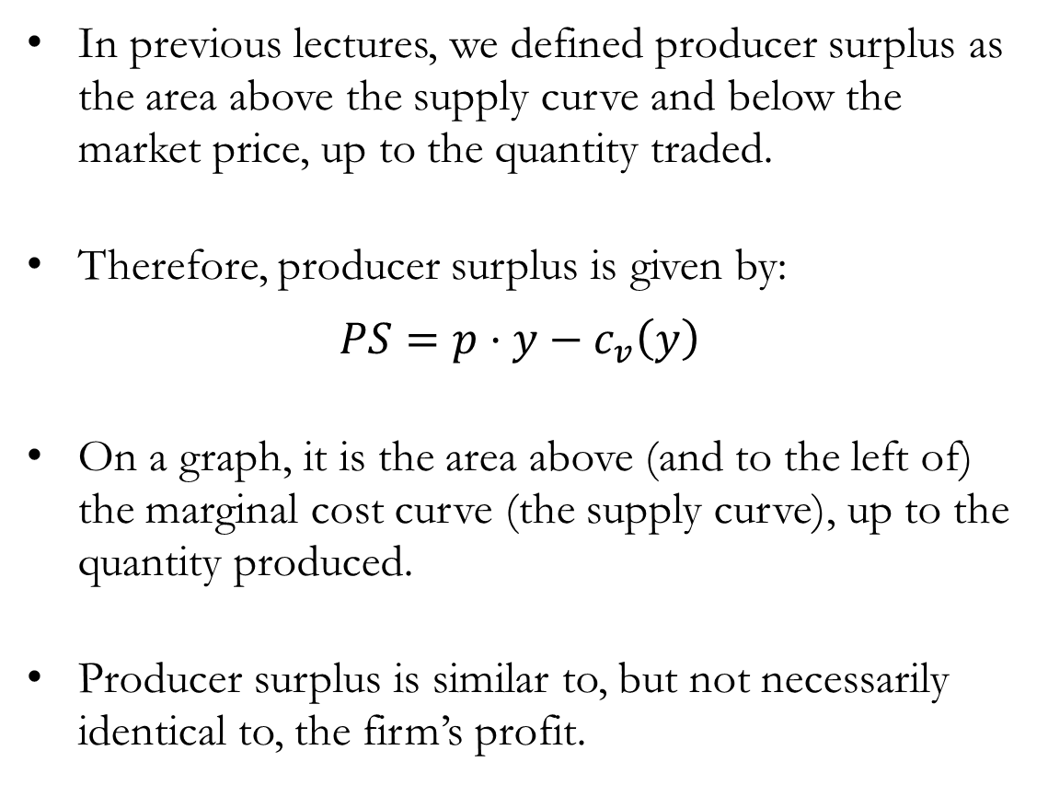
Producer’s Surplus
In previous lectures, we defined producer surplus as the area above the supply curve and below the market price, up to the quantity traded.
Therefore, producer surplus is given by:
$$PS=p⋅y−c_{v}\left(y\right)$$
On a graph, it is the area above (and to the left of) the marginal cost curve (the supply curve), up to the quantity produced.
Producer surplus is similar to, but not necessarily identical to, the firm’s profit.

Slide 17
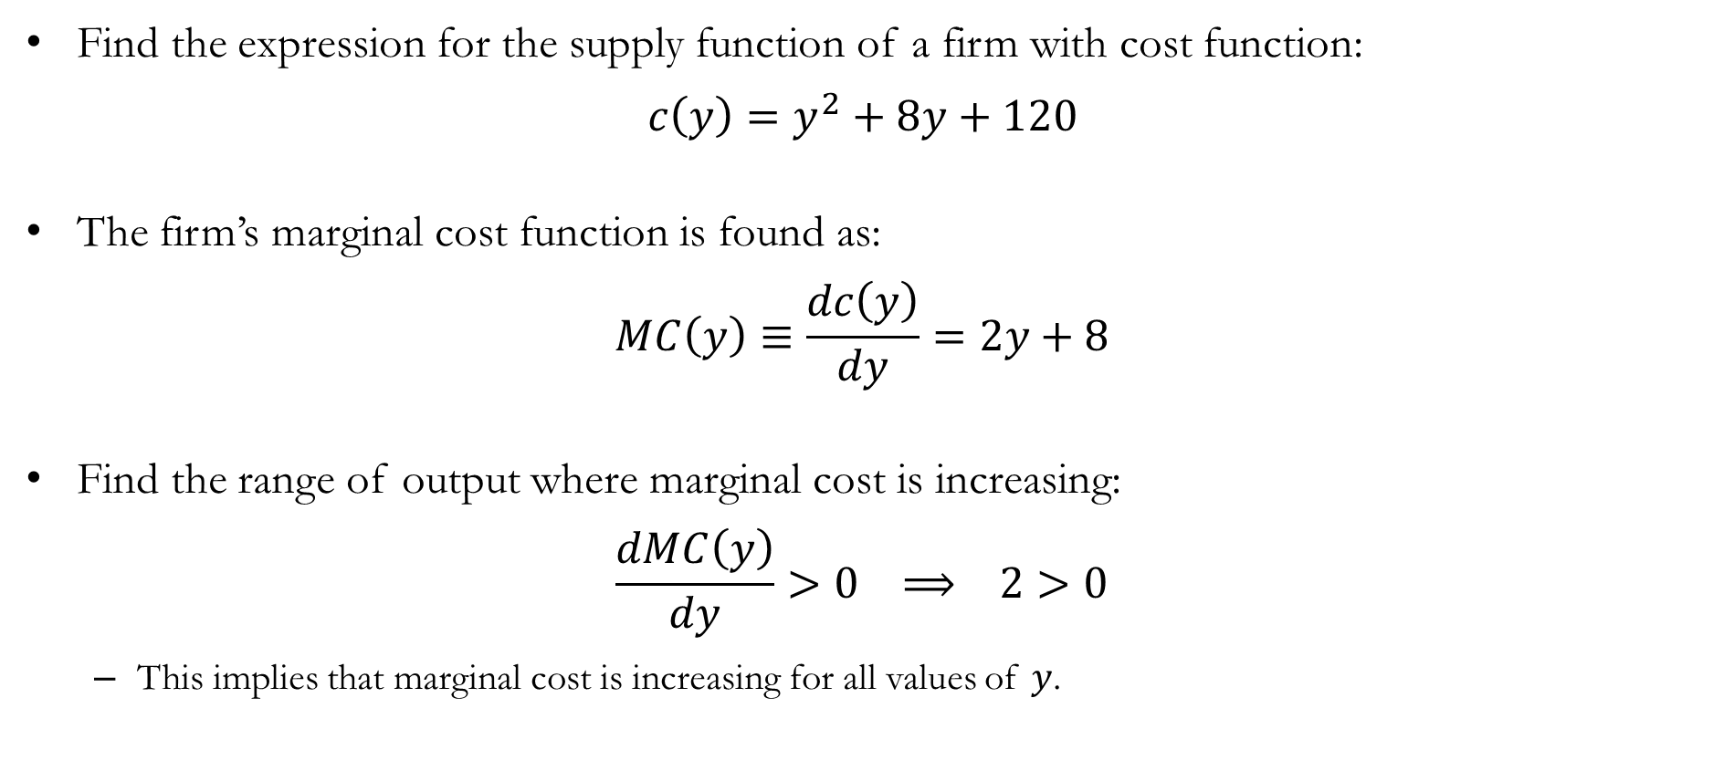
Numerical Example: Supply and Producer’s Surplus
Find the expression for the supply function of a firm with cost function:
$$c\left(y\right)=y^{2}+8y+120$$
The firm’s marginal cost function is found as:
$$MC\left(y\right)≡\frac{dc\left(y\right)}{dy}=2y+8$$
Find the range of output where marginal cost is increasing:
$$\frac{dMC\left(y\right)}{dy}>0 ⟹ 2>0$$
This implies that marginal cost is increasing for all values of $y$.

Slide 18
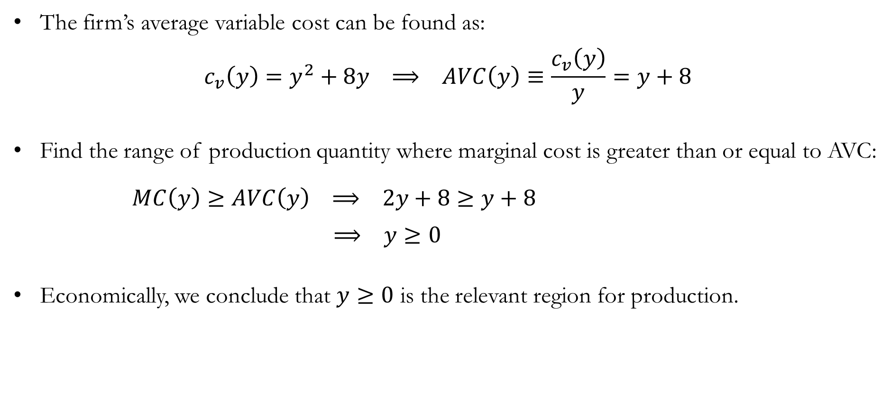
Numerical Example: Supply and Producer’s Surplus
The firm’s average variable cost can be found as:
$$c_{v}\left(y\right)=y^{2}+8y ⟹ AVC\left(y\right)≡\frac{c_{v}\left(y\right)}{y}=y+8$$
Find the range of production quantity where marginal cost is greater than or equal to AVC:
$MC\left(y\right)≥AVC\left(y\right) ⟹ 2y+8≥y+8$
$⟹ y≥0$
Economically, we conclude that $y≥0$ is the relevant region for production.

Slide 19
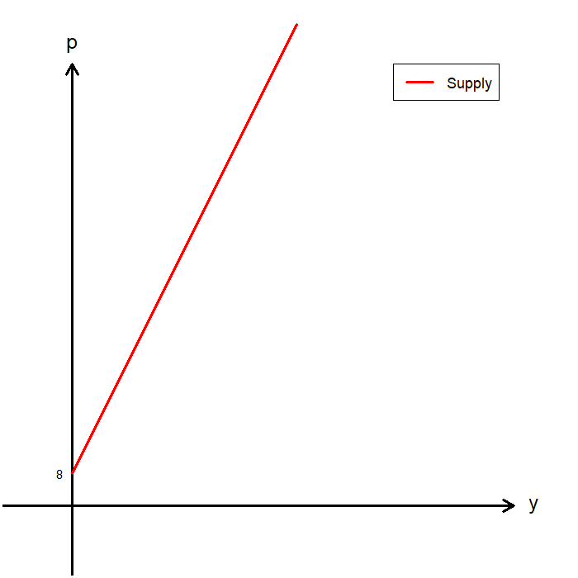
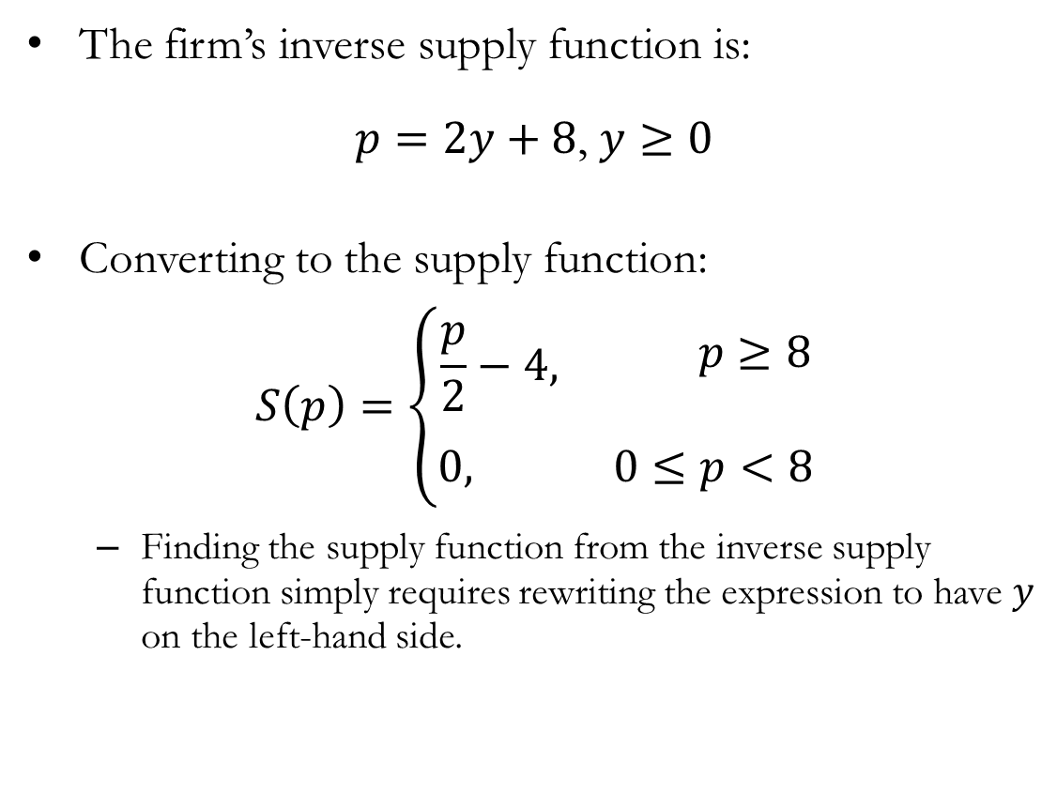
Numerical Example: Supply and Producer’s Surplus
The firm’s inverse supply function is:
$p=2y+8$, $y≥0$
Converting to the supply function:
$$S\left(p\right)=\left\{\begin{aligned}\begin{matrix}\begin{aligned}\frac{p}{2}−4, \\ \end{aligned} & \begin{aligned} p≥8 \\ \end{aligned}\end{matrix} \\ \begin{matrix}0, & 0≤p<8\end{matrix}\end{aligned}\right.$$
Finding the supply function from the inverse supply function simply requires rewriting the expression to have $y$ on the left-hand side.

Slide 20
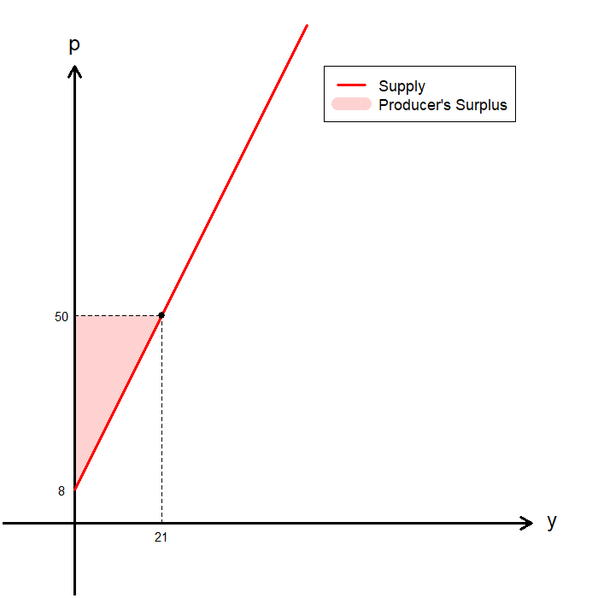
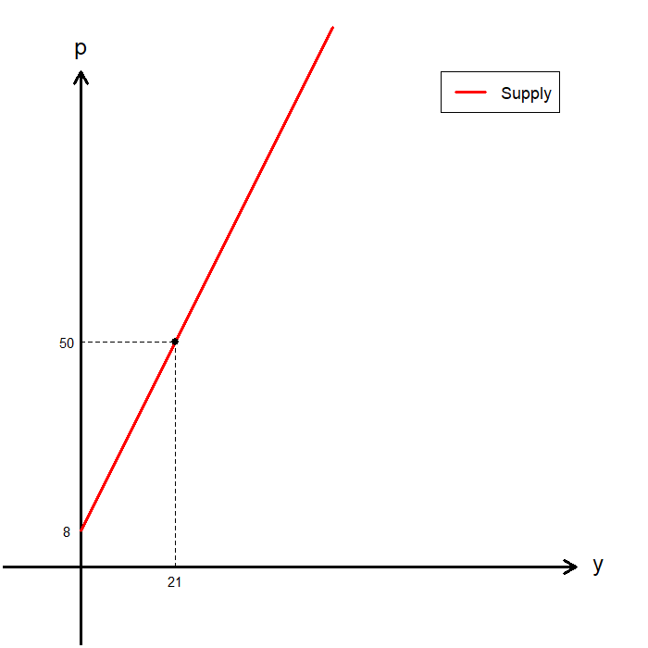
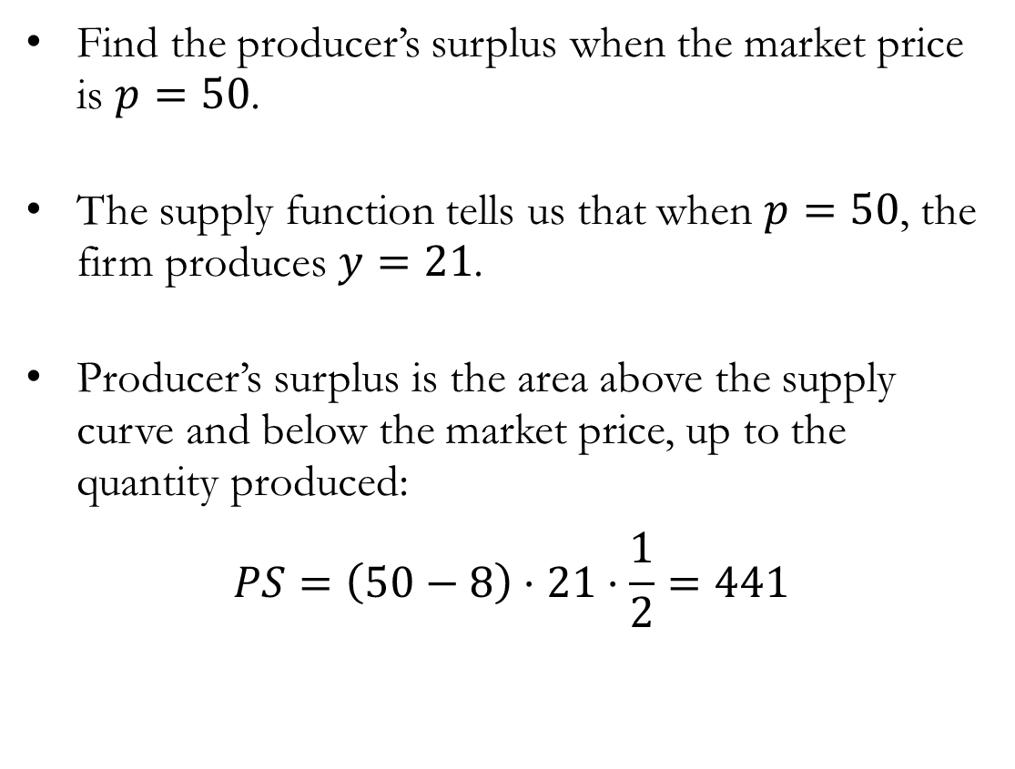
Numerical Example: Supply and Producer’s Surplus
Find the producer’s surplus when the market price is $p=50$.
The supply function tells us that when $p=50$, the firm produces $y=21$.
Producer’s surplus is the area above the supply curve and below the market price, up to the quantity produced:
$$PS=\left(50−8\right)⋅21⋅\frac{1}{2}=441$$

Slide 21
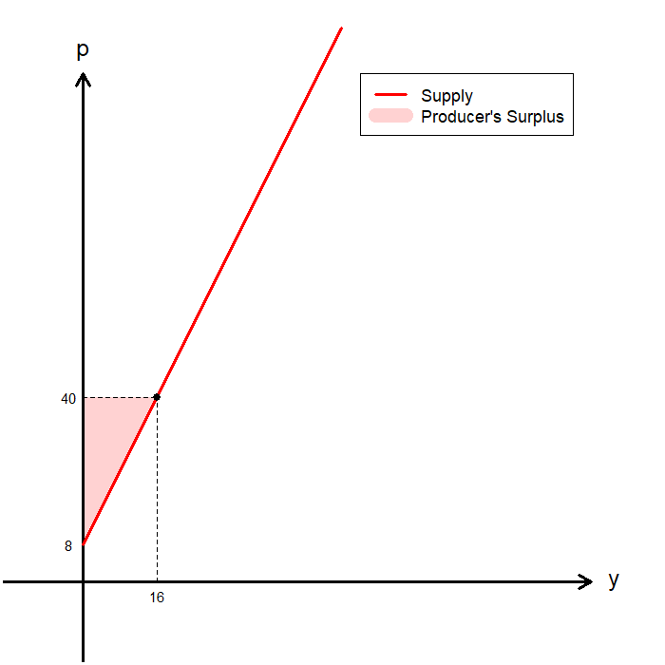
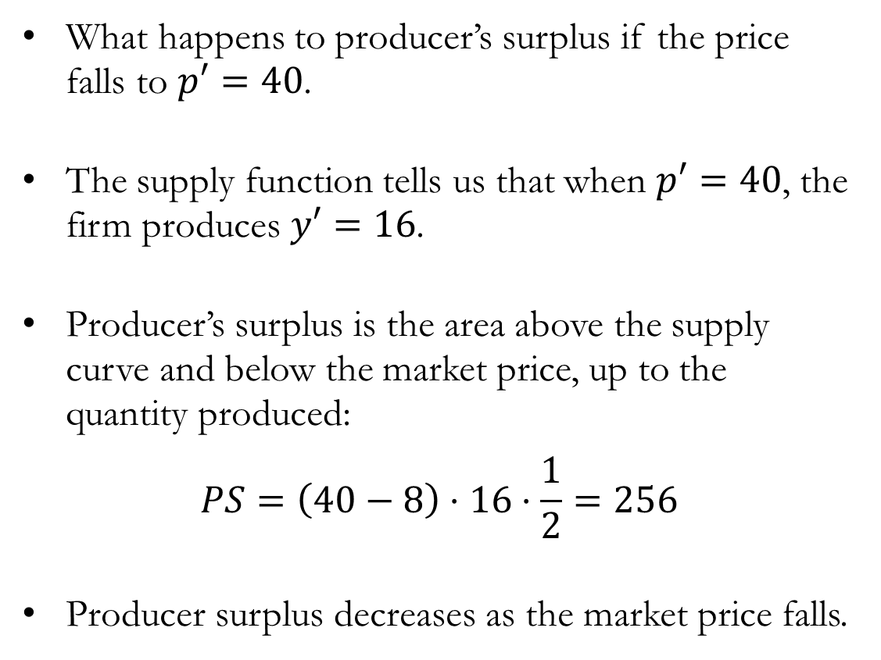
Numerical Example: Supply and Producer’s Surplus
What happens to producer’s surplus if the price falls to $p′=40$.
The supply function tells us that when $p′=40$, the firm produces $y′=16$.
Producer’s surplus is the area above the supply curve and below the market price, up to the quantity produced:
$$PS=\left(40−8\right)⋅16⋅\frac{1}{2}=256$$
Producer surplus decreases as the market price falls.

Slide 22
The Long Run

Slide 23
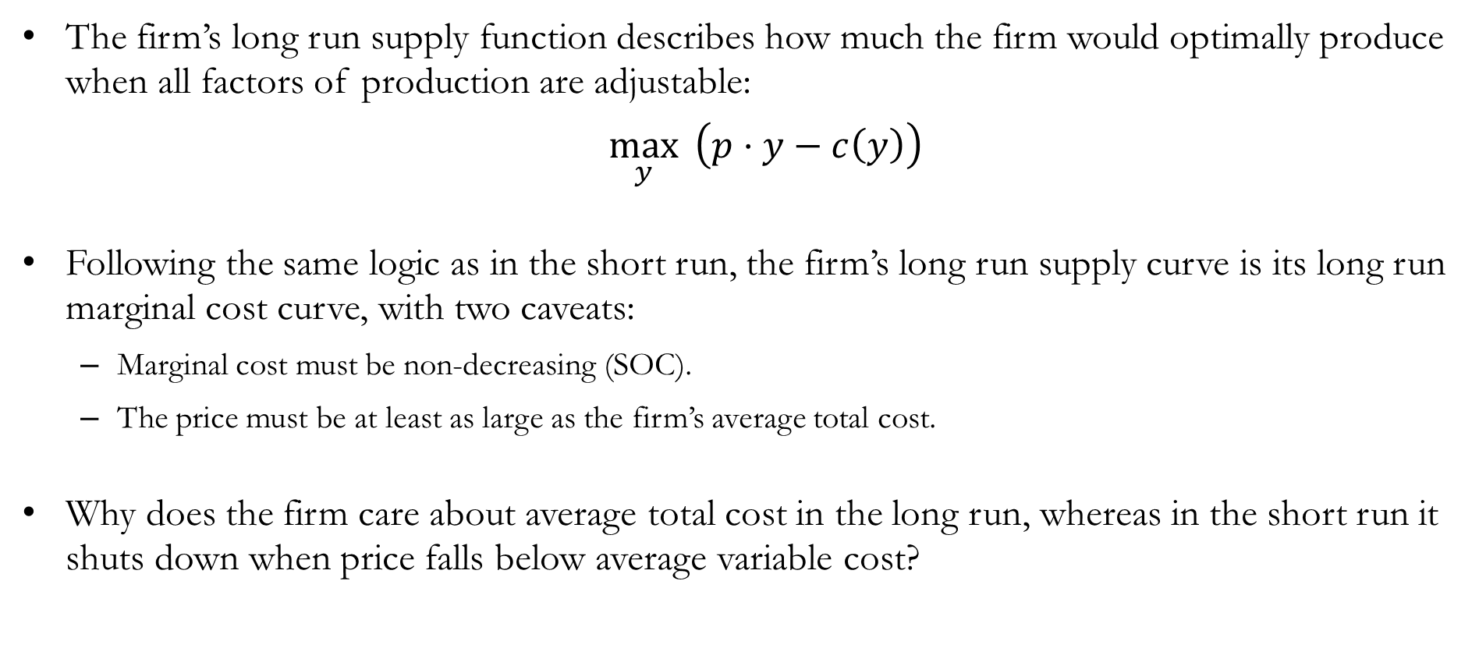
The Firm’s Long Run Setup
The firm’s long run supply function describes how much the firm would optimally produce when all factors of production are adjustable:
$\max_{y}{ \left(p⋅y−c\left(y\right)\right)}$
Following the same logic as in the short run, the firm’s long run supply curve is its long run marginal cost curve, with two caveats:
Marginal cost must be non-decreasing (SOC).
The price must be at least as large as the firm’s average total cost.
Why does the firm care about average total cost in the long run, whereas in the short run it shuts down when price falls below average variable cost?

Slide 24

Exiting the Market in the Long Run
In the long run, the firm does not incur sunk costs, and it will exit the market if:
$π<0 ⟹ p⋅y−c\left(y\right)<0$
$⟹ p−\frac{c\left(y\right)}{y}<0$
$⟹ p<\frac{c\left(y\right)}{y}=ATC(y)$
Therefore:
In the short run, the firm shuts down production if $p<\frac{c_{v}\left(y\right)}{y}=AVC\left(y\right)$.
In the long run, the firm exits the market if $p<\frac{c\left(y\right)}{y}=ATC\left(y\right)$.

Slide 25
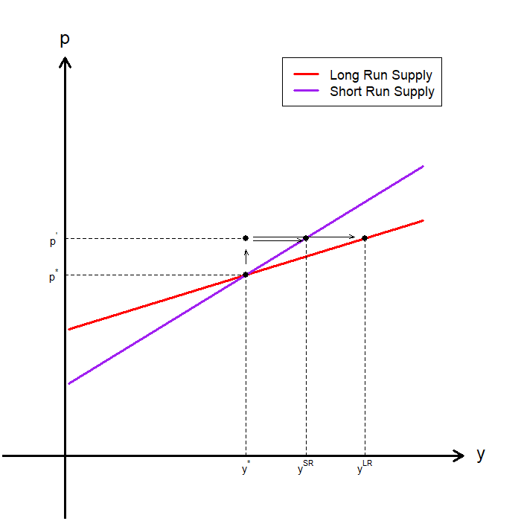
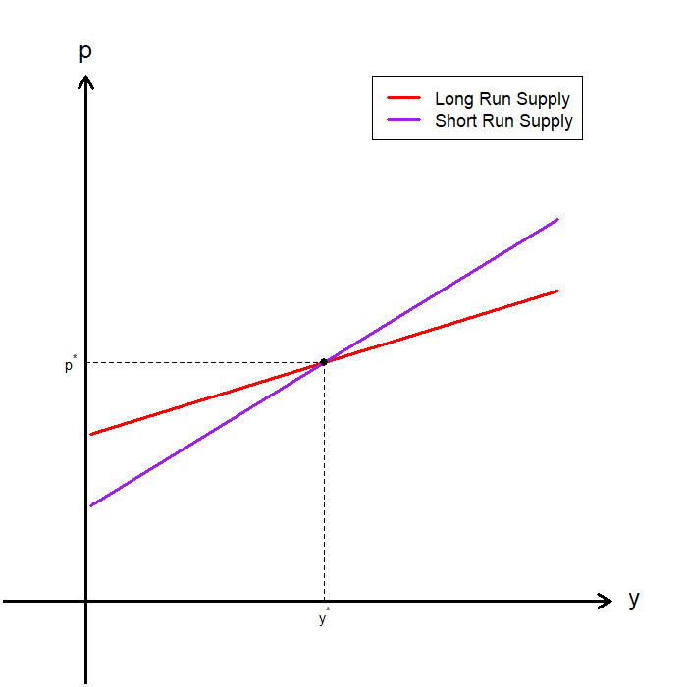
The Short Run and Long Run Supply
The firm’s long run supply curve is “flatter” than its short run supply curve.
This makes economic sense as well:
In the short run, some inputs are fixed, so the firm cannot fully adjust production.
In the long run, all inputs are adjustable.
If price rises, short run output is lower than the long run optimum.
Therefore, firms adjust output more in response to price changes in the long run.
Hence, the long run supply curve is “flatter.”

Slide 26
Recap & Preview

Slide 27
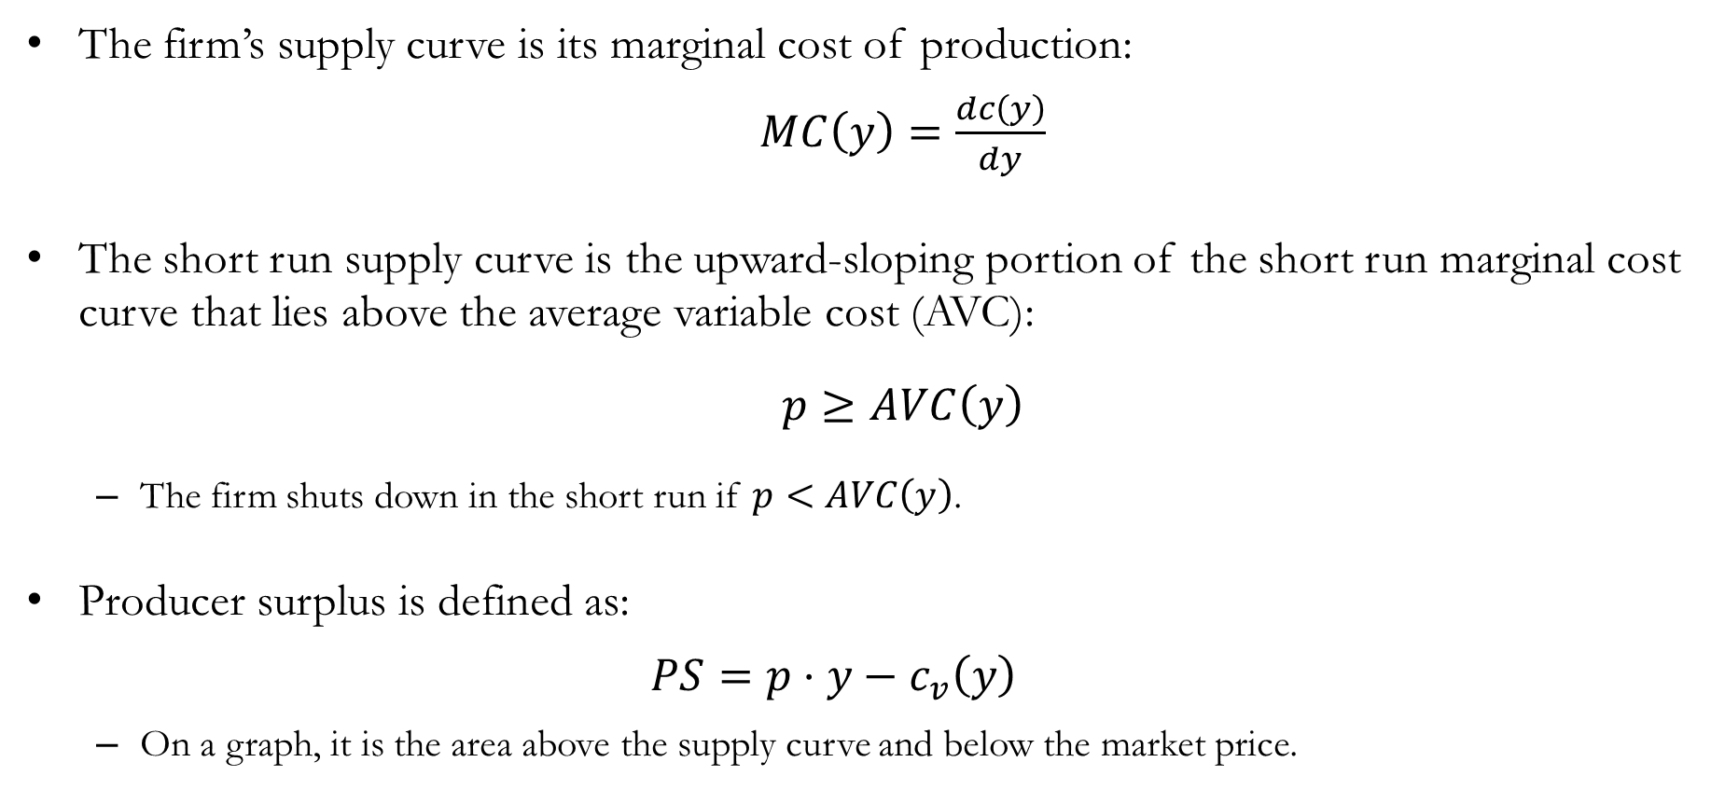
Recap: Firm Supply
The firm’s supply curve is its marginal cost of production:
$MC\left(y\right)=\frac{dc\left(y\right)}{dy}$
The short run supply curve is the upward-sloping portion of the short run marginal cost curve that lies above the average variable cost (AVC):
$p≥AVC\left(y\right)$
The firm shuts down in the short run if $p<AVC\left(y\right)$.
Producer surplus is defined as:
$$PS=p⋅y−c_{v}\left(y\right)$$
On a graph, it is the area above the supply curve and below the market price.

Slide 28

Recap: Firm Supply
The long run supply curve is the upward-sloping portion of the long run marginal cost curve that lies above the average total cost (ATC):
$p≥ATC\left(y\right)$
The firm exits the market in the long run if $p<ATC\left(y\right)$.
Compared to the short run:
Firms adjust output more in the long run.
Hence, the long run supply curve is “flatter.”

Slide 29
Preview: Industry Supply
So far, we have analyzed the supply behavior of a single firm.
How do we move from individual firm supply to market (industry) supply?
In the short run:
The industry supply curve is the horizontal sum of individual firm supply curves.
Fixed factors and entry/exit are not allowed
In the long run:
Firms can enter and exit the market
Input usage can be fully adjusted
Industry supply depends on how costs change as the industry expands

