Slide 1
MANAGEMENT INFORMATION SYSTEMS
Chapter 7: Telecommunications, the Internet, and Wireless Technology

Slide 2
Recap of Chapter 6
Describe traditional file environment data management problems.
﻿Describe DBMS and relational DBMS capabilities.
﻿Discuss relational database design principles.
﻿Describe non-relational, cloud, and blockchain database capabilities.
﻿Describe tools used to analyze data in databases.
﻿Discuss data governance, data quality assurance, and data management.

Slide 3
7.1: Telecommunications Networks

Slide 4
Digital Networks in Business
All modern organizations rely on digital networks for communication, collaboration, and data sharing.
A digital network is a collection of connected devices that can communicate and exchange data.
Voice, video, and data now travel through the same Internet-based infrastructure.
Network literacy helps managers evaluate trade-offs in cost, reliability, security, and strategic capability.
Learning Goals
Identify the components of a business network.
Explain how the Internet connects global organizations.
Describe the main Internet services businesses use.
Understand how the web supports marketing and e-commerce.

Slide 5
Why Networks Matter for Managers
Networks connect employees, suppliers, partners, and customers, enabling faster coordination and decision making.
Technological convergence has merged telephone, television, and computer networks into a single digital platform.
Network improvements lower costs and expand reach. Typical consumer speeds have increased from about 56 Kbps dial-up in 2000 to 100 Mbps or more with modern broadband.
Wireless broadband enables work from almost anywhere. Over 90% of U.S. Internet users access the web through mobile devices.
Network quality directly affects productivity, customer experience, and innovation.

Slide 6
Anatomy of a Simple Network
Clients:
Devices that request network resources or services.
Clients initiate communication with servers on the network.
e.g., Laptops, desktops, tablets, or smartphones.
Servers:
Computers that provide services or resources to other devices on the network.
Servers may store data, run applications, manage databases, or host websites.
A single server may support many client devices at the same time
Network Interface Controllers (NICs):
Hardware components that allow a device to connect to a network.
NICs enable communication through wired connections or wireless signals.
Every networked device must have a NIC to send and receive data

Slide 7
Anatomy of a Simple Network
Switches and Routers:
Switches: Devices that connect multiple devices within a local network.
Routers: Devices that connect different networks together.
Switches move data within a local network, while routers connect different networks together.
Transmission Media:
The channels through which data travels across a network.
Common media include copper cables, fiber optic cables, and wireless radio signals.
The choice of transmission media affects network speed, reliability, and cost
Network Operating System:
Software that manages communication and shared resources on a network.
The NOS controls user access, security permissions, and network services.

Slide 8
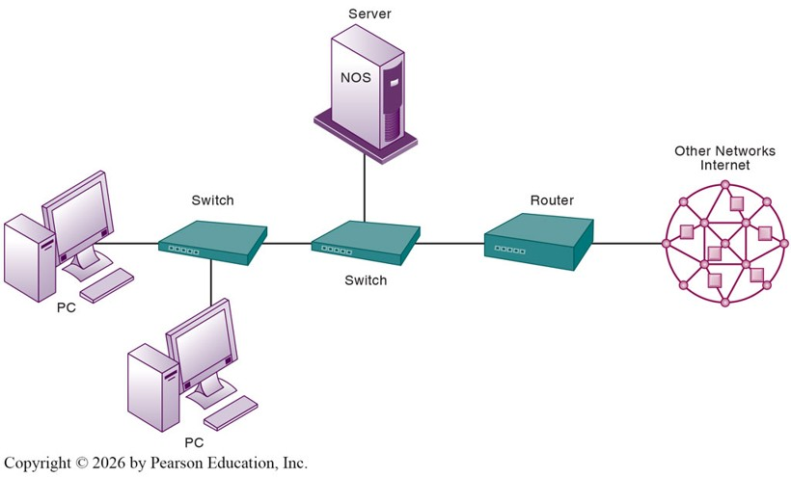
Anatomy of a Simple Network

Slide 9
From Local to Corporate Networks
A small office might use one Local Area Network (LAN).
As firms grow, several LANs connect into a corporate network linking offices across multiple locations.
These networks support company websites, intranets for internal use, and extranets that provide limited access to partners.
Many companies now use Internet telephony (Voice over Internet Protocol, VoIP) instead of traditional phone systems.
Key Challenge: Integrating voice, data, wireless, and cloud systems into one reliable network infrastructure.

Slide 10
7.4: The Internet

Slide 11

BBC Click (2019, Oct 30). How Does The Internet Work? - BBC Click [Video]. YouTube. https://youtu.be/eHp1l73ztB8?si=gmE8uruxJQqc_oWH

Slide 12
The Internet as a Global Network
The Internet connects millions of private and public networks around the world.
Communication on the Internet relies on the TCP/IP protocol suite.
TCP/IP stands for Transmission Control Protocol / Internet Protocol
These protocols define how data is packaged, addressed, transmitted, and received.
IP address: A unique numeric identifier assigned to each device on the network.
IPv4: 32-bit addresses, about four billion possible addresses, now largely exhausted.
IPv6: 128-bit addresses, providing a vastly larger address space.
Domain Name System (DNS)
Functions as the Internet’s directory service.
Translates human-readable domain names (such as Amazon.com) into IP addresses.

Slide 13
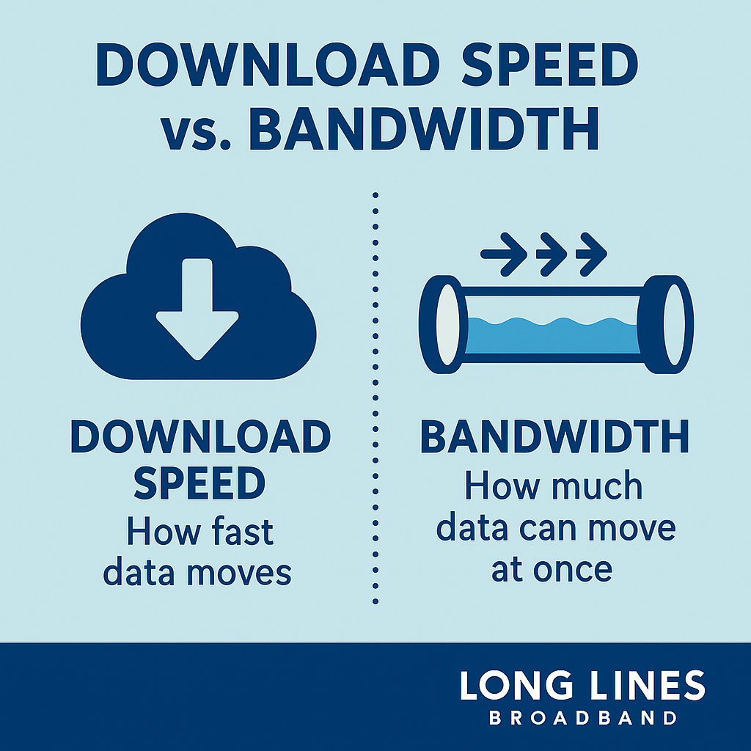
Internet Access for Businesses
Businesses connect to the Internet through broadband, leased fiber, or satellite links.
Bandwidth: The maximum capacity of a connection to transmit data.
Common options:
Cable or fiber connections for most offices.
Digital Subscriber Line (DSL) for smaller or legacy sites.
Cellular broadband for mobile employees and remote locations.
Managers should evaluate speed, reliability, cost, and service guarantees before selecting an Internet provider.

Slide 14
What the Internet Enables
Lower Costs
A single digital infrastructure supports data, voice, and video communication.
Organizations no longer need separate systems for telephone, video, and data networks
Faster Communication
The Internet enables near-instant communication across geographic distances.
Greater Reach
Businesses can connect directly with customers, suppliers, and partners around the world.
Real-time Data
Cloud services allow employees to access information and applications from anywhere.
Dependence
Modern organizations rely heavily on Internet connectivity for daily operations.
Network outages or disruptions can halt communication, transactions, and access to systems

Slide 15
7.5: Internet Services for Business

Slide 16
Core Internet Services: Email and Instant Messaging
Email
Sends and receives messages globally at almost no cost.
Instant Messaging
Tools such as Microsoft Teams and Slack enable real-time chat and file sharing.
Often integrated with calendars, document collaboration, and video meetings.
Benefits
Fast communication and easy accessibility across devices.
Creates a written record of interactions
Risks
Message overload or security risks such as phishing or data leaks
Organizations should establish clear policies for usage, data retention, and privacy.

Slide 17
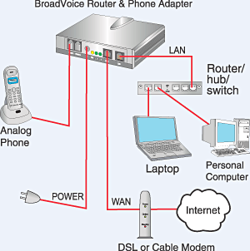
Core Internet Services: Voice over IP (VoIP)
VoIP
Converts voice signals into digital data packets that travel across IP networks.
Allows voice calls to use the same infrastructure as Internet data.
Can operate on computers, smartphones, or dedicated IP phones.
Cost Advantages
Reduces or eliminates local and long-distance telephone charges.
Uses existing Internet connections instead of separate phone networks.
Business Capabilities
Cloud platforms such as RingCentral or Nextiva provide call routing, call analytics, and integration with CRM systems

Slide 18
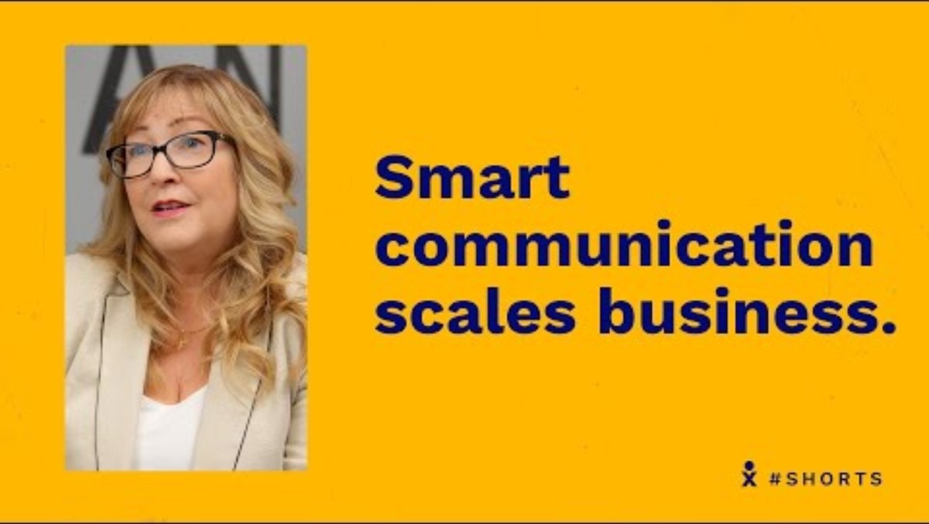
Nextiva (2022, April 4). Scaling Communication: Titan Solar Power + Nextiva [Video]. YouTube. https://youtu.be/lKsm0bfO4bM?si=YDrzoHD8I-hiH-XG

Slide 19
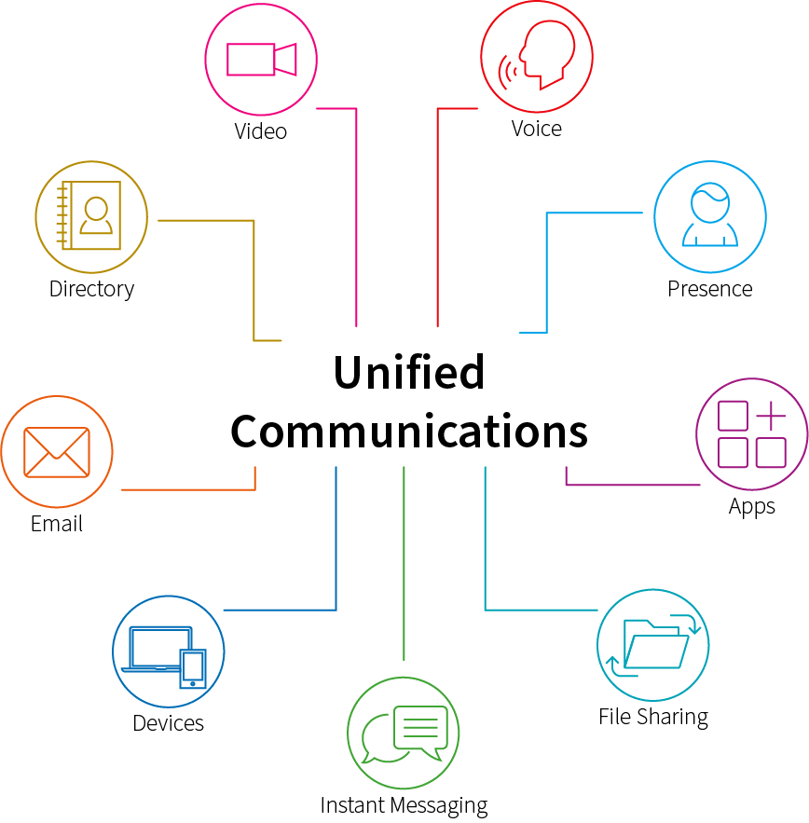
Core Internet Services: Unified Communications
Integrates voice, video, messaging, and email into a single communication platform.
Unified Communications as a Service (UCaaS): Cloud-based version that reduces hardware needs.
Presence indicators show if a person is available to receive messages.
AI tools add transcription, translation, and meeting summaries.
Value: Improves responsiveness and coordination across distributed or hybrid teams.

Slide 20
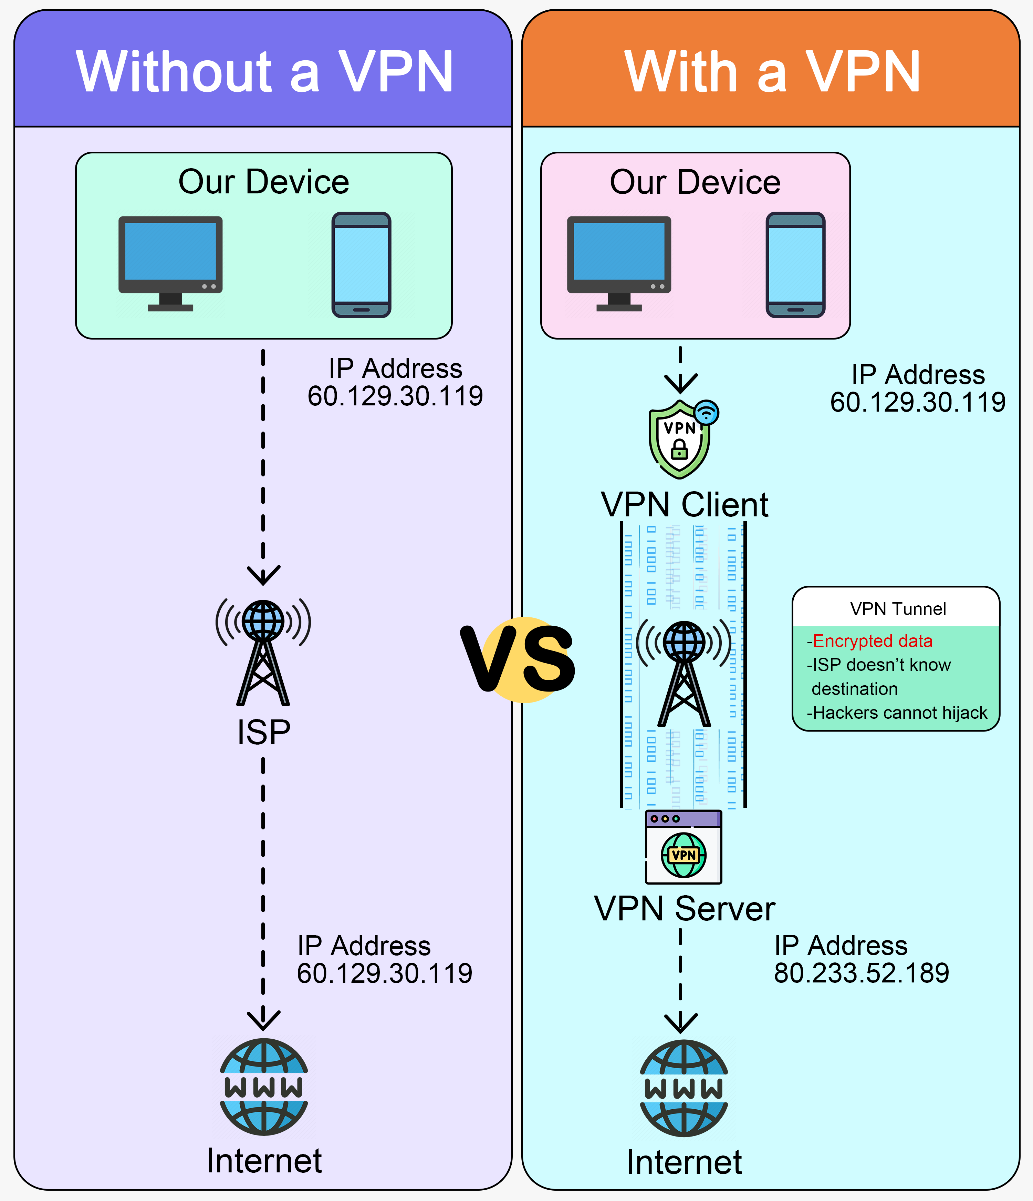
Core Internet Services: Virtual Private Networks
A Virtual Private Network (VPN) creates an encrypted tunnel across the Internet to protect data transmission.
Allows remote employees to safely access internal corporate systems.
Provides encryption, authentication, and privacy for network traffic.
Essential for remote work environments and for protecting sensitive organizational information.

Slide 21
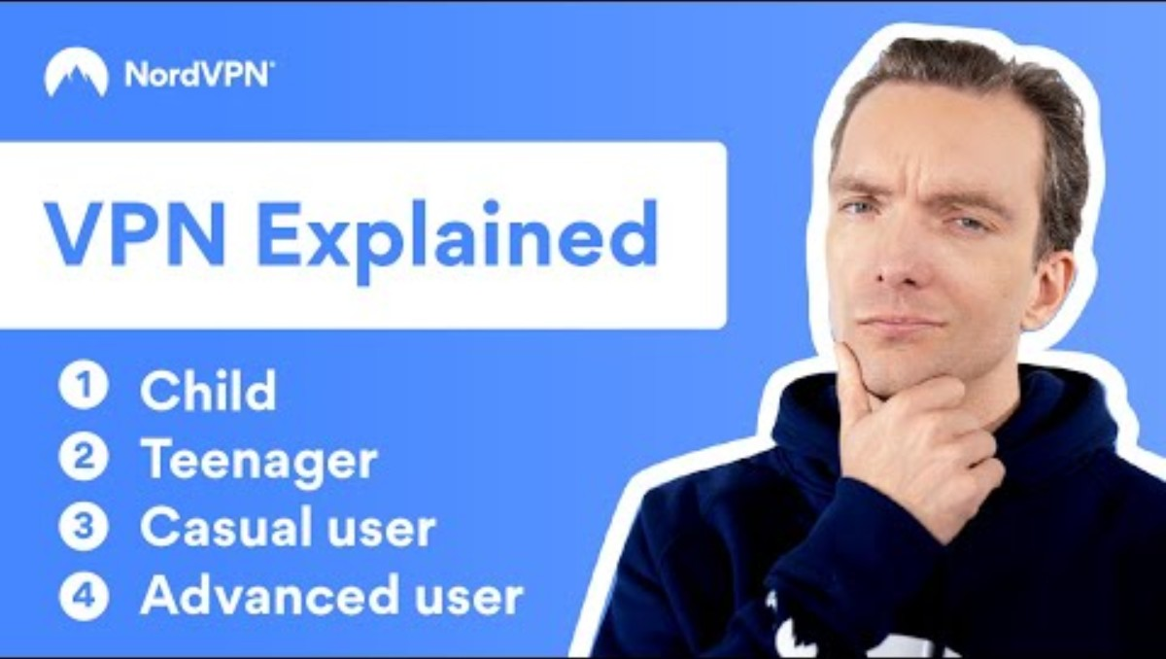
NordVPN (2022, June 29). What is a VPN? Explained in 4 levels of difficulty | NordVPN [Video]. YouTube. https://youtu.be/bjD-wGVrFCg?si=ZjKEzj956p80kpRa

Slide 22
7.6: The Web and Business Use

Slide 23

The Web as a Business Platform
The World Wide Web uses HTTP or HTTPS to transfer linked documents between servers and browsers.
HTTP(S): Hypertext Transfer Protocol (Secure)
HTTPS encrypts data and is required for secure transactions.
Web pages written in HTML (HyperText Markup Language) can include text, images, video, and hyperlinks.
A website is a company’s public face and often its main customer portal.

Slide 24
Uniform Resource Locator (URL)
https://www.megacorp.com/content/features/082610.html
https: Secure protocol used to transfer web data.
www.megacorp.com: Domain name identifying the host.
/content/features: Directory path.
082610.html: Specific page name and format.
URLs provide precise addresses so browsers can locate information quickly.

Slide 25
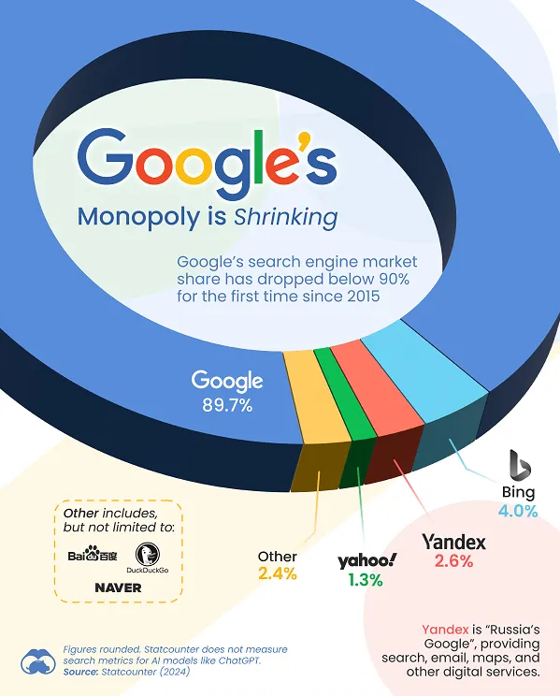
Search Engines
Search engines index billions of pages with automated programs called crawlers.
Web crawlers automatically scan the web, follow hyperlinks, and add new pages to the search index.
Google controls almost 90% of global search activity.
Ranking depends on relevance, reliability, and the number of inbound links.
Semantic search uses AI to interpret user intent and meaning rather than individual keywords.
Mobile optimization improves ranking and accessibility.

Slide 26
Search Engine Marketing and Optimization
Search Engine Marketing (SEM): Paid ads that appear when users search chosen keywords.
Search Engine Optimization (SEO): Improving site structure and content for organic visibility.
Both depend on relevance, credibility, and technical performance.
Digital advertising through search accounts for more than 40% of global digital marketing spending.
Managers track impressions, clicks, and conversions to measure ROI.

Slide 27

WebFX (2022, January 24). SEO vs. SEM: What's the difference? Do you need both? [Video]. YouTube. https://youtu.be/6jOdC8vCA_g?si=H87Uh5tZfDNA3jwY

Slide 28
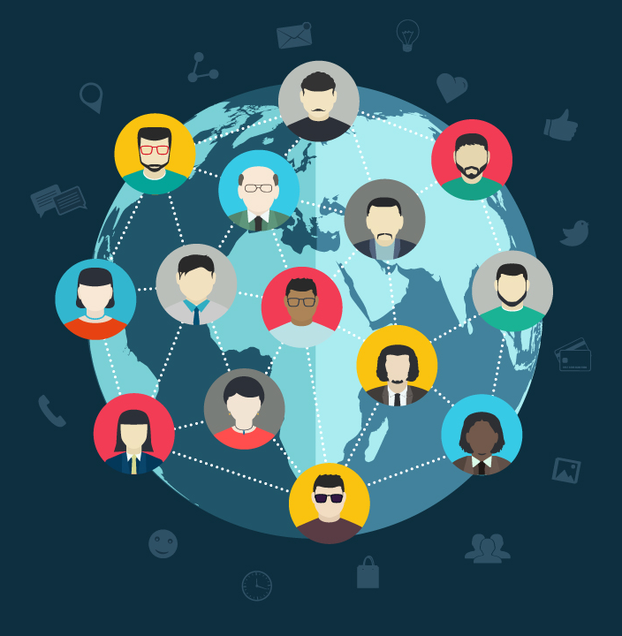
Sharing and Collaboration Online
Blogs: Regular posts for ideas, updates, and engagement.
RSS Feeds: Automatically deliver new content to subscribers.
Wikis: Editable pages that support collaborative knowledge creation and management.
Social Networks: LinkedIn, Facebook, and TikTok allow direct interaction with customers.
Managers use these tools for branding, reputation management, and feedback collection.

Slide 29
The Future Internet and Web
Internet2: High-capacity research network testing new technologies.
Metaverse and Web3: Immersive and decentralized digital environments.
Internet of Things (IoT): Billions of connected sensors collecting data.
Cloud and SaaS models: Shift computing power from local servers to remote platforms.
Generative AI: Automates content creation but raises concerns about accuracy, reliability, and authenticity.
Managers must balance innovation, privacy, and security.

Slide 30

PBS NewsHour (2024, January 3). A Brief But Spectacular take on the future of the internet [Video]. YouTube. https://youtu.be/F45bQrV1ix0?si=e2z9EDNtRmm-G94o

Slide 31
Recap of Chapter 7

Slide 32
Recap of Chapter 7
Describe key components of telecommunications networks.
Identify major Internet services that support business communication.
Discuss how the web operates and how firms use it for marketing and collaboration.
Examine how emerging Internet and web technologies influence business strategy.

