Slide 1
Game Theory:
Static Games
ECON 300

Slide 2
Game Theory
Game
  Situation in which participating agents make strategic decisions based on each other’s actions and responses.
  e.g. Cournot competition, Poker matches, Auctions, etc
Payoff
  The outcomes of a game that generate rewards.
  e.g. Profits, Surplus, Monetary Benefits, etc
Strategy
  A complete action plan for playing the game.

Slide 3
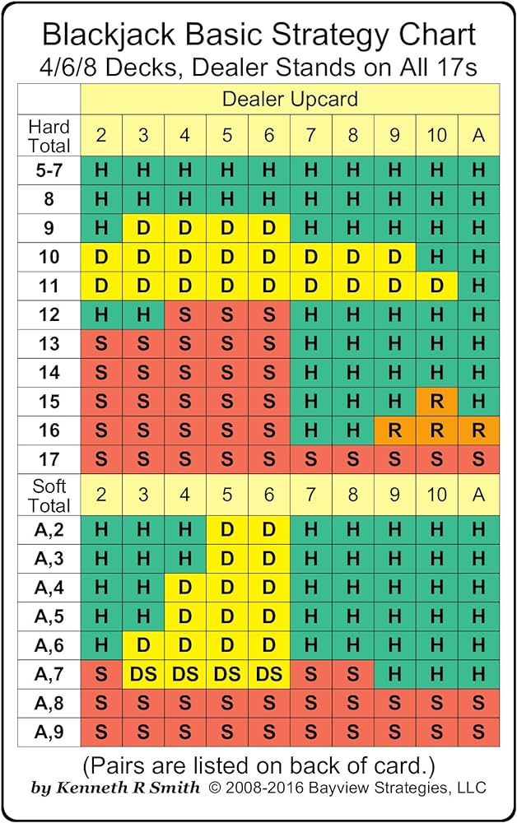
Not Quite a “Game” but…
“Game”: Blackjack
  Get the sum of your cards as close to 21 as possible, without going over 21.
Payoff:
  Win: Twice the bet.
  Lose: Lose the bet.
  Blackjack: 2.5 times the bet.
  Other minor rules…
Strategy: See Image

Slide 4
Classification of Games
Timing of the Decisions
  Static Games: Players move simultaneously.
  Dynamic Games: Players move sequentially.
Available Information
  Complete Information: Each players know each other’s payoffs.
  Incomplete Information: Players do not know other’s payoffs.
Frequency of the Game
  One-Shot Games: The game is played once.
  Repeated Games (Finite): Game is played a set number of times.
  Repeated Games (Infinite): Game is repeated indefinitely.

Slide 5
A Gentle Introduction to Game Theory
In this introductory session, we will be leaving out many aspects of game theory, and will be concentrating on two types of games:
Static Games of Complete Information.
Dynamic Games of Complete Information.
Topics Not Covered:
  Existence of Nash Equilibria, Mixed Strategies, Incomplete Information Games, etc.

Slide 6
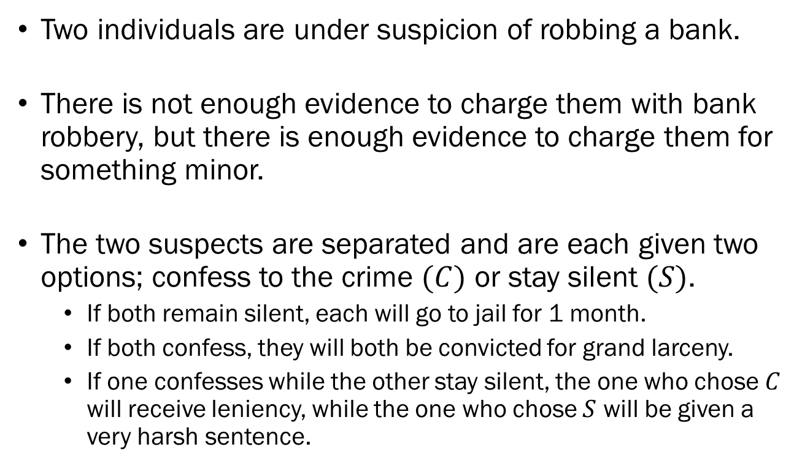
Example #1:
Static Games of Complete Information
Two individuals are under suspicion of robbing a bank.
There is not enough evidence to charge them with bank robbery, but there is enough evidence to charge them for something minor.
The two suspects are separated and are each given two options; confess to the crime $(C)$ or stay silent $(S)$.
  If both remain silent, each will go to jail for 1 month.
  If both confess, they will both be convicted for grand larceny.
  If one confesses while the other stay silent, the one who chose $C$ will receive leniency, while the one who chose $S$ will be given a very harsh sentence.

Slide 7
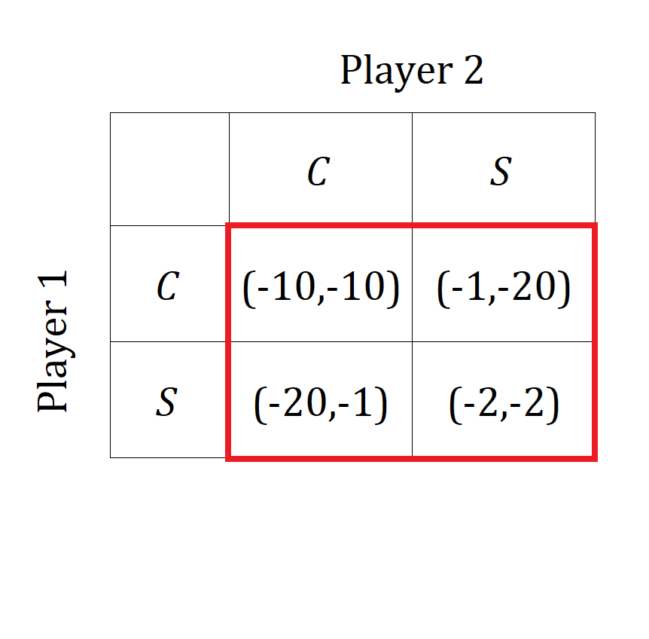
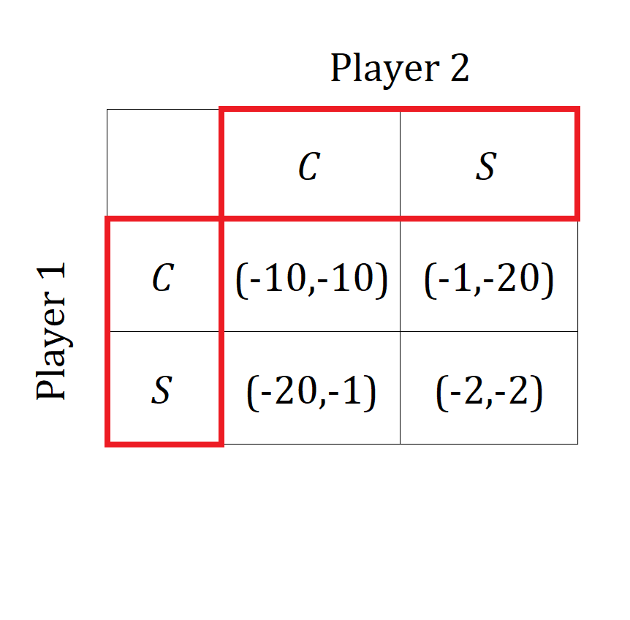
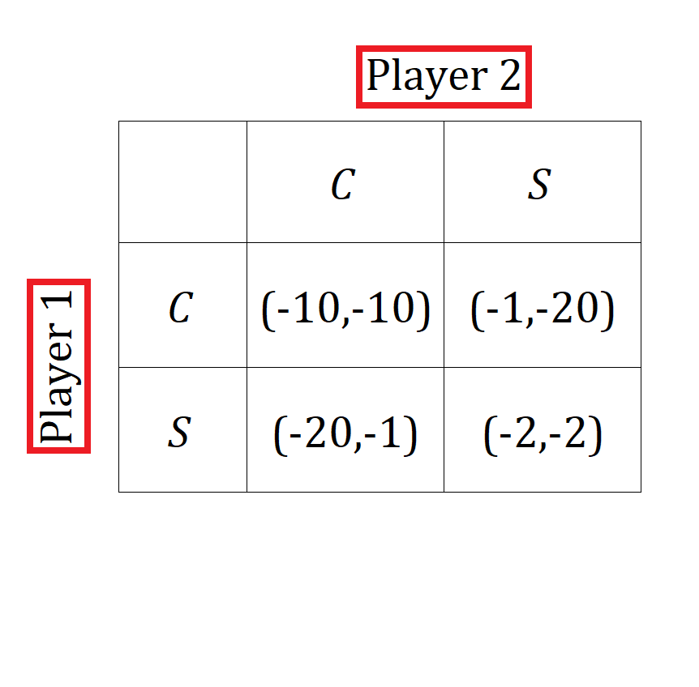
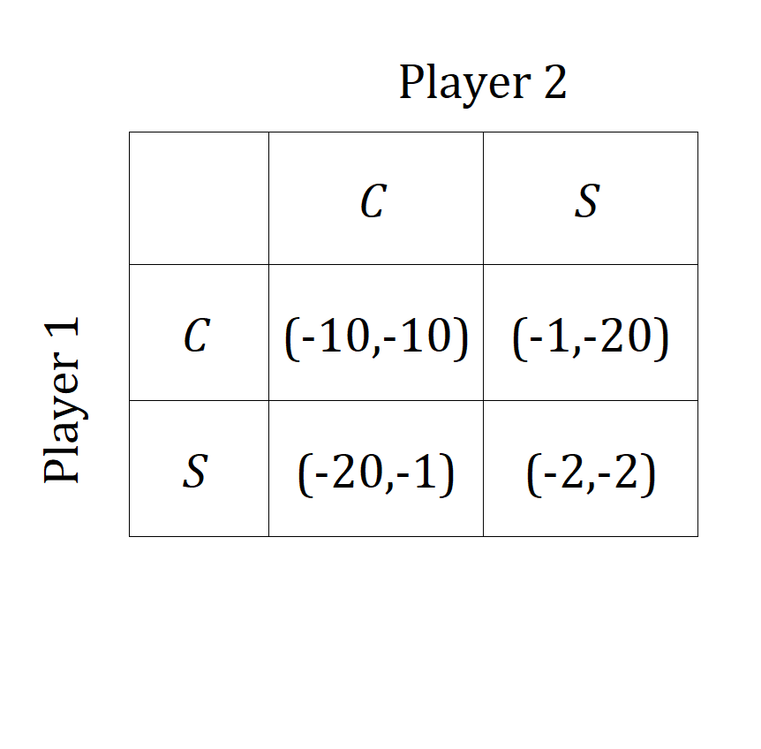
Example #1:
Static Games of Complete Information
We can represent the game in a table, which we call the normal form representation of the game.
The normal form will give us the following information:
  The players, and
  Their available actions, and
  The payoffs for each player in all possible scenarios.

Slide 8
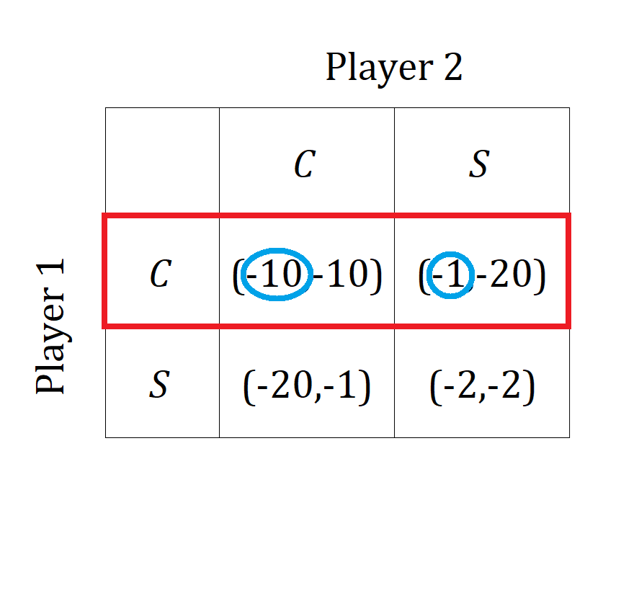
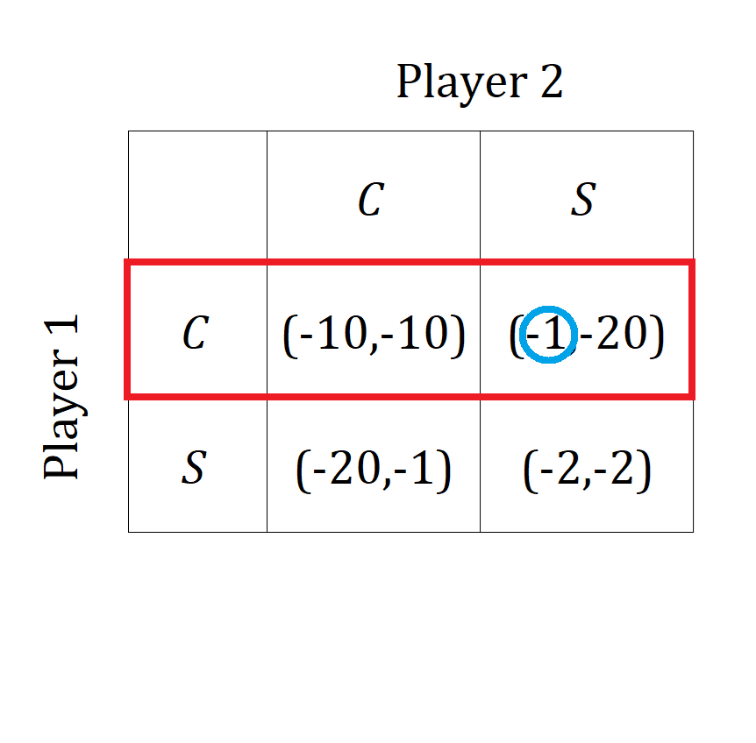
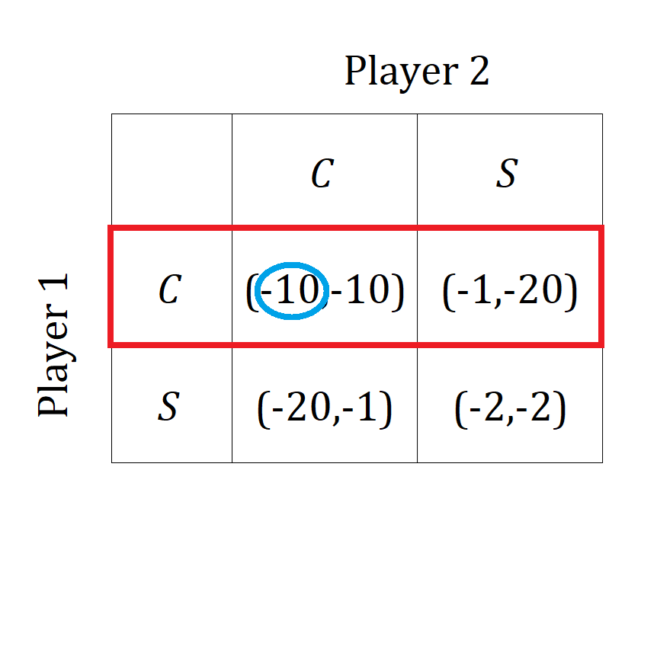
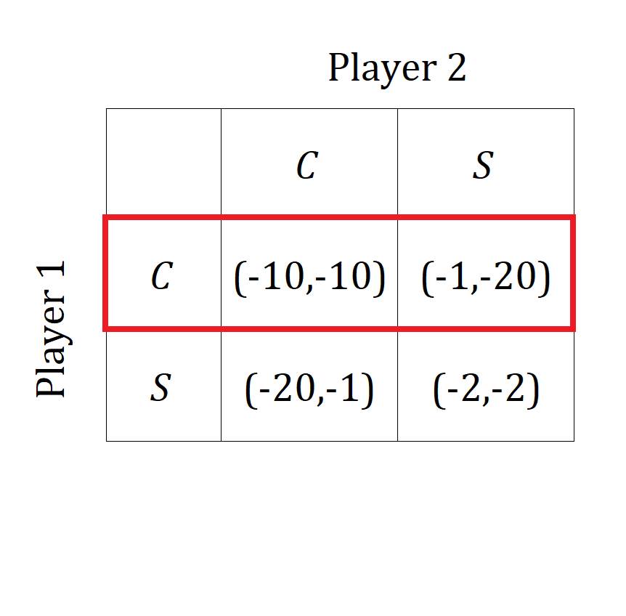
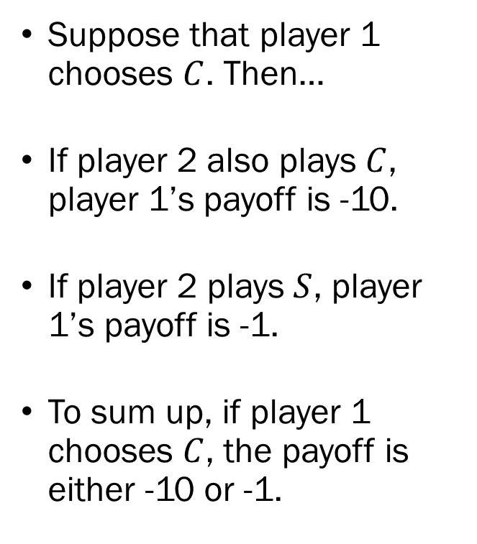
Example #1:
Static Games of Complete Information
Suppose that player 1 chooses $C$. Then…
If player 2 also plays $C$, player 1’s payoff is -10.
If player 2 plays $S$, player 1’s payoff is -1.
To sum up, if player 1 chooses $C$, the payoff is either -10 or -1.

Slide 9
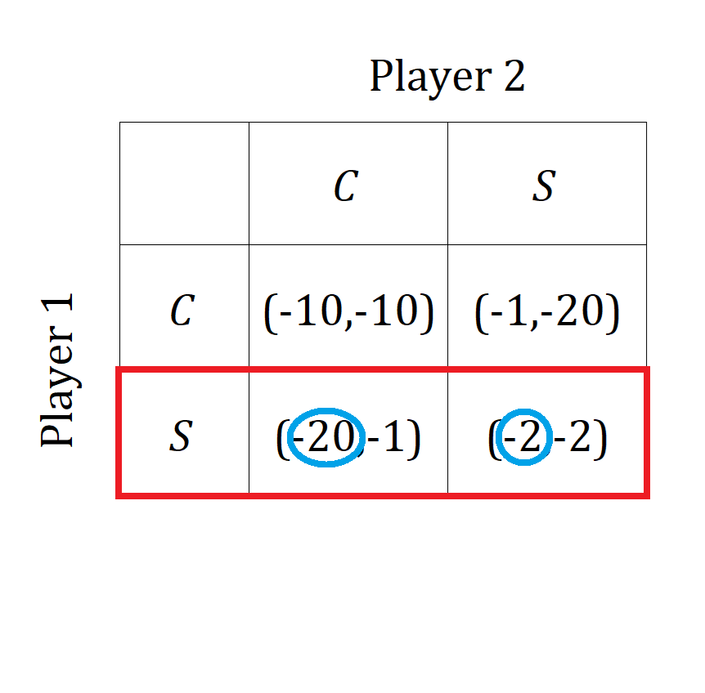
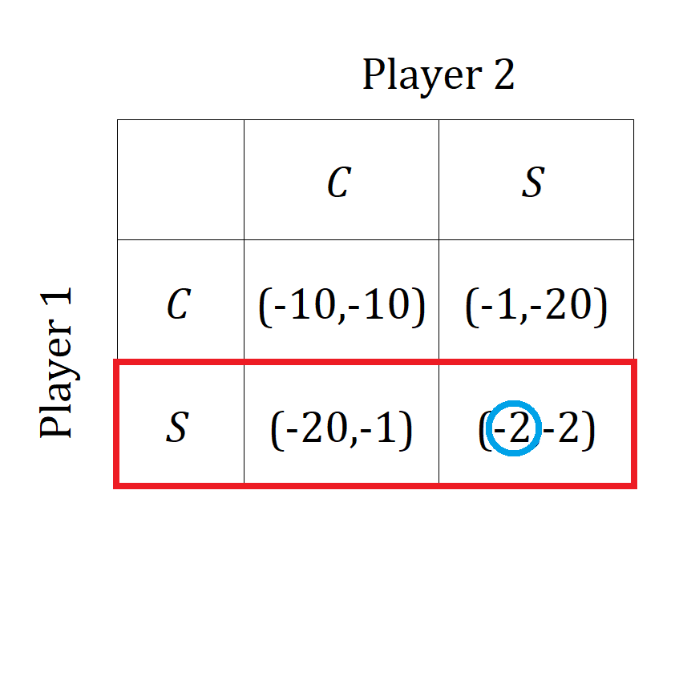
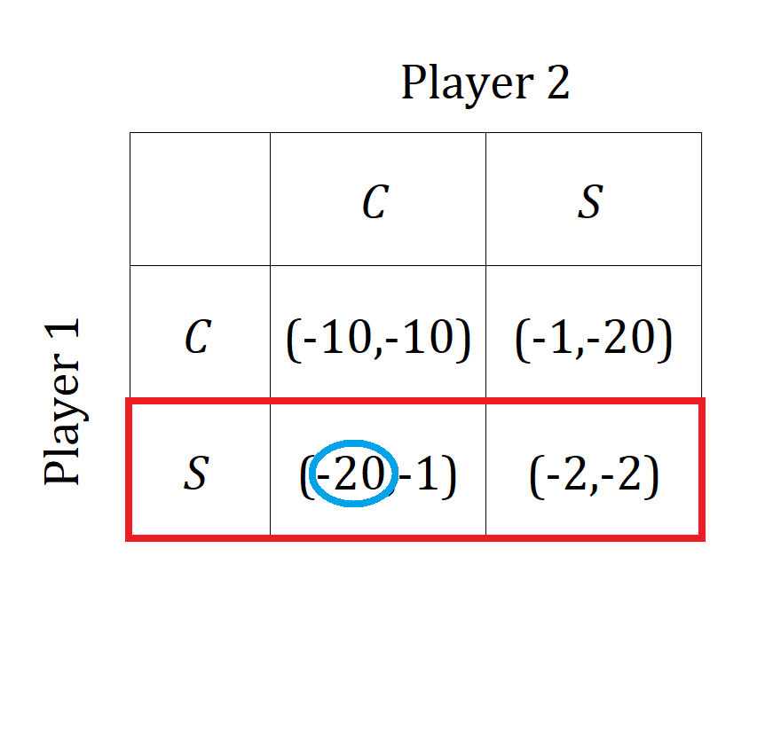
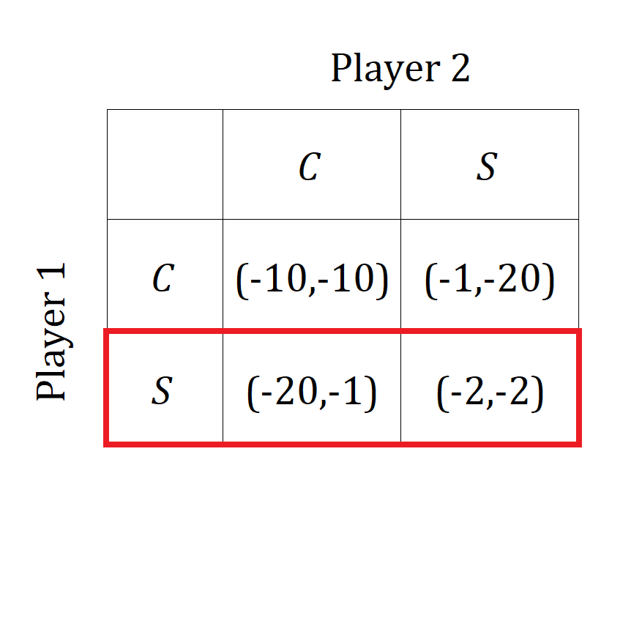
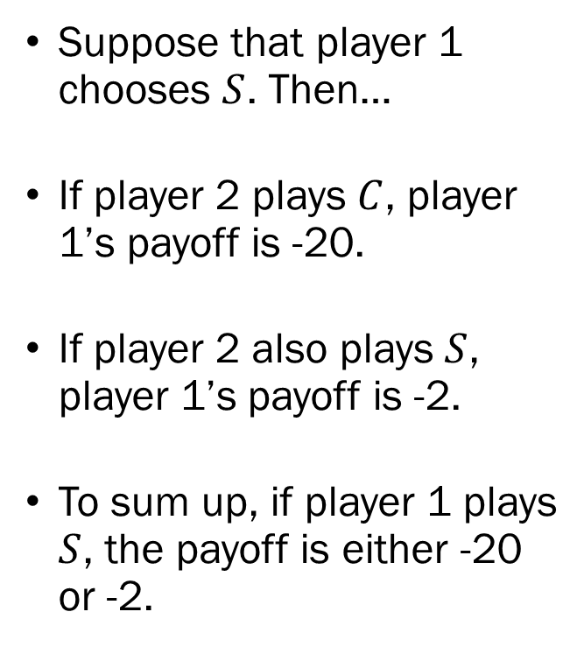
Example #1:
Static Games of Complete Information
Suppose that player 1 chooses $S$. Then…
If player 2 plays $C$, player 1’s payoff is -20.
If player 2 also plays $S$, player 1’s payoff is -2.
To sum up, if player 1 plays $S$, the payoff is either -20 or -2.

Slide 10
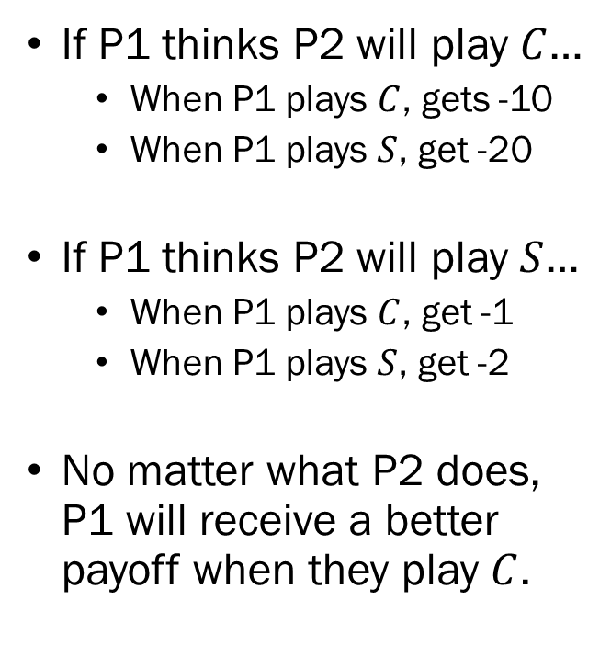
Example #1:
Static Games of Complete Information
If P1 thinks P2 will play $C$…
  When P1 plays $C$, gets -10
  When P1 plays $S$, get -20
If P1 thinks P2 will play $S$…
  When P1 plays $C$, get -1
  When P1 plays $S$, get -2
No matter what P2 does, P1 will receive a better payoff when they play $C$.

Slide 11
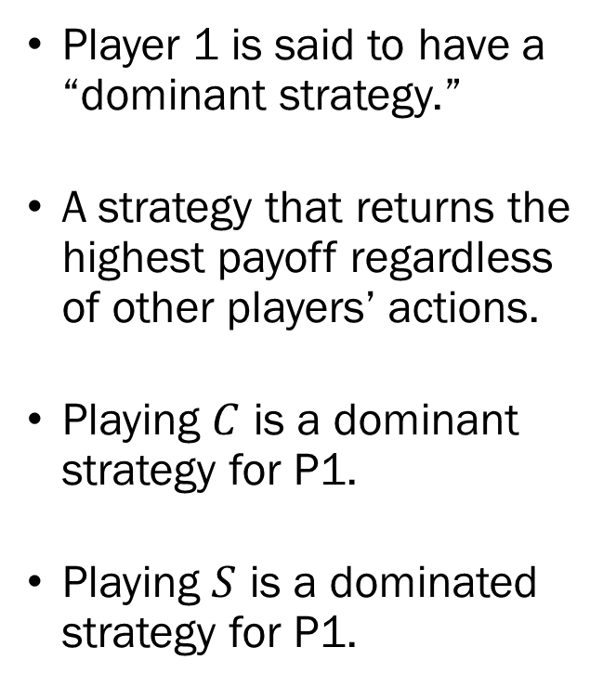
Example #1:
Static Games of Complete Information
Player 1 is said to have a “dominant strategy.”
A strategy that returns the highest payoff regardless of other players’ actions.
Playing $C$ is a dominant strategy for P1.
Playing $S$ is a dominated strategy for P1.

Slide 12
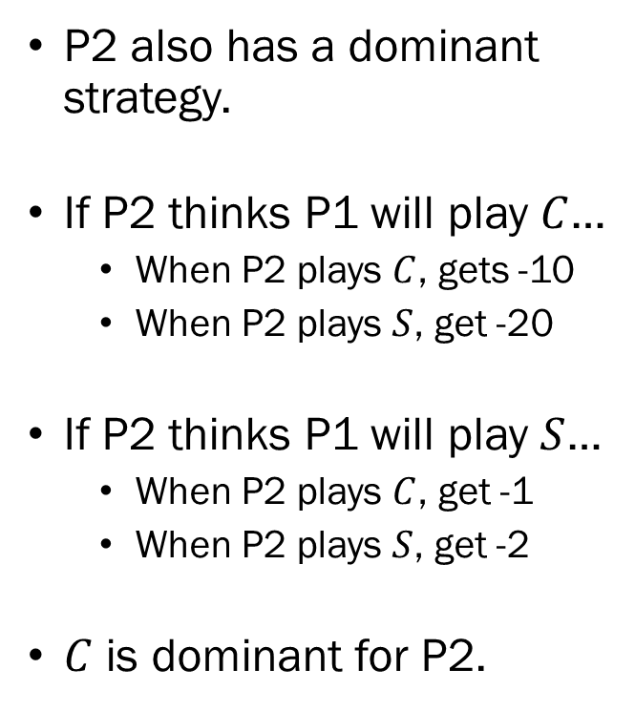
Example #1:
Static Games of Complete Information
P2 also has a dominant strategy.
If P2 thinks P1 will play $C$…
  When P2 plays $C$, gets -10
  When P2 plays $S$, get -20
If P2 thinks P1 will play $S$…
  When P2 plays $C$, get -1
  When P2 plays $S$, get -2
$C$ is dominant for P2.

Slide 13
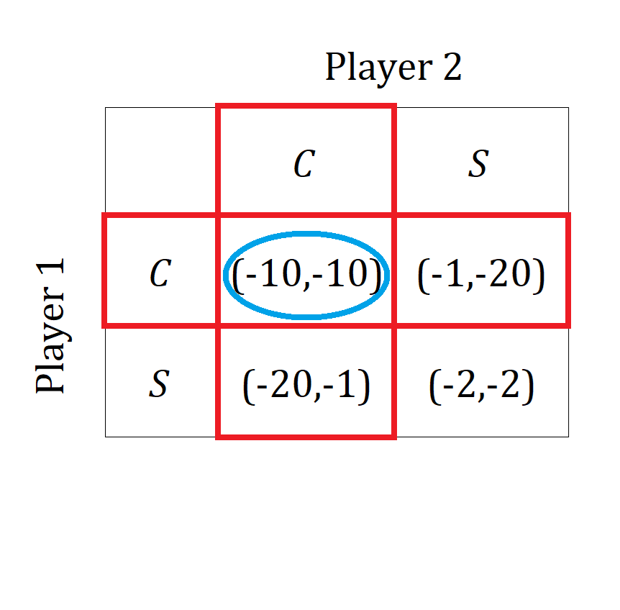
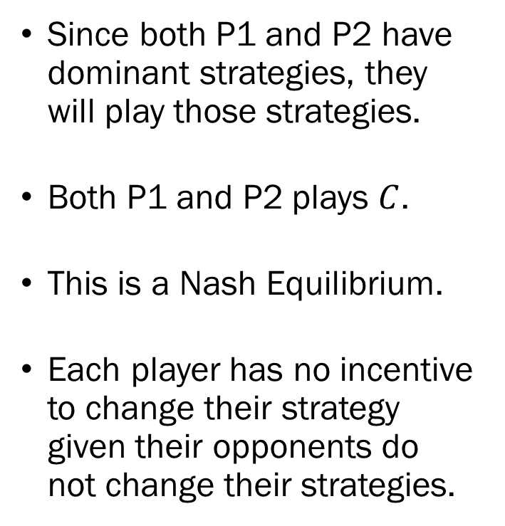
Example #1:
Static Games of Complete Information
Since both P1 and P2 have dominant strategies, they will play those strategies.
Both P1 and P2 plays $C$.
This is a Nash Equilibrium.
Each player has no incentive to change their strategy given their opponents do not change their strategies.

Slide 14
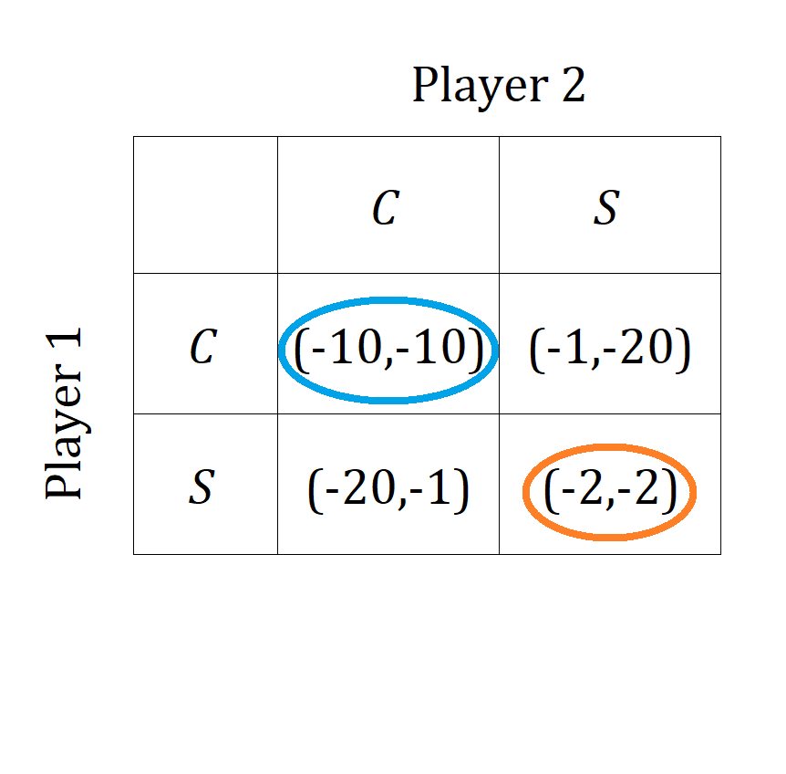
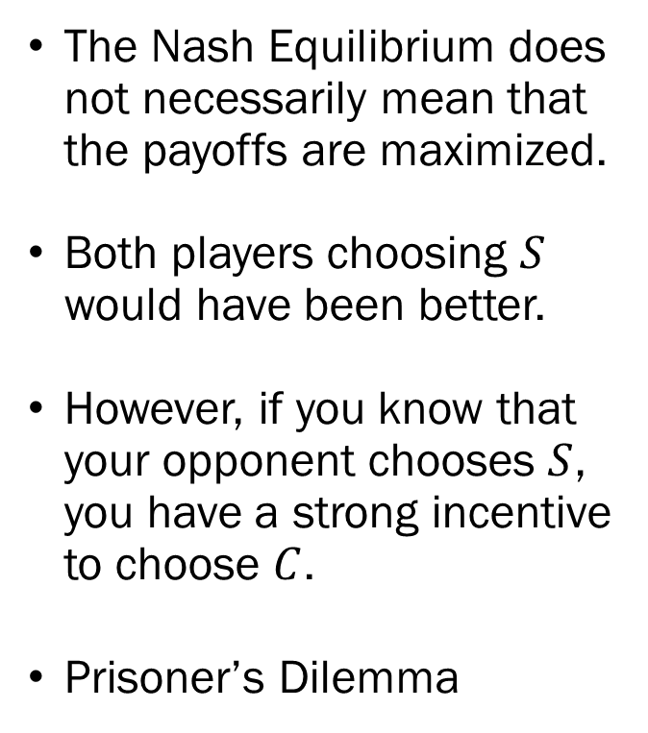
Example #1:
Static Games of Complete Information
The Nash Equilibrium does not necessarily mean that the payoffs are maximized.
Both players choosing $S$ would have been better.
However, if you know that your opponent chooses $S$, you have a strong incentive to choose $C$.
Prisoner’s Dilemma

Slide 15
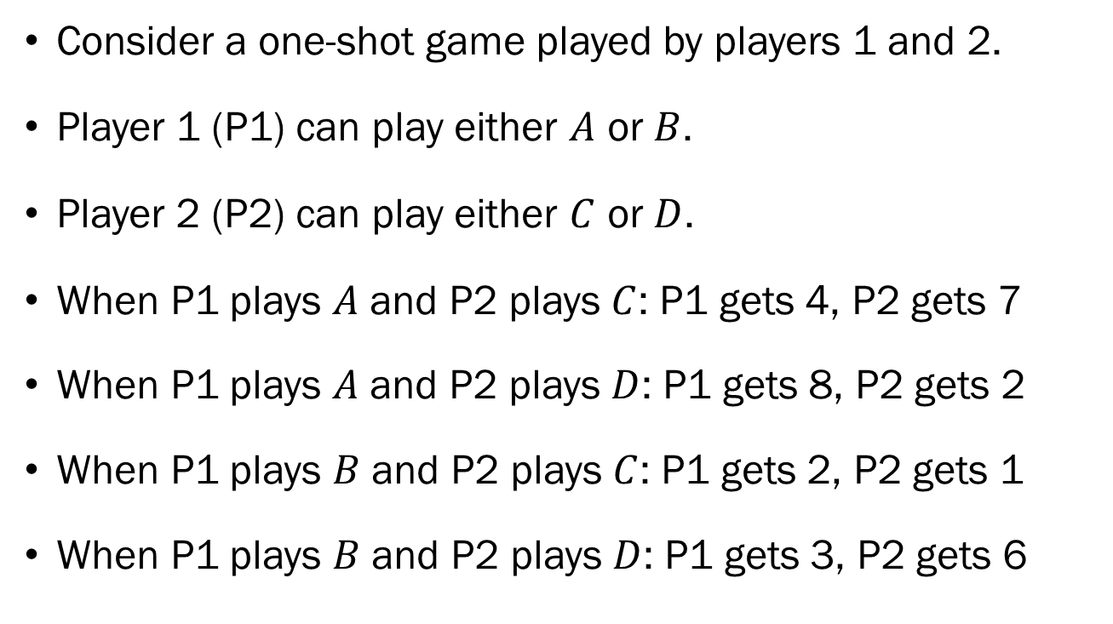
Example #2:
Static Games of Complete Information
Consider a one-shot game played by players 1 and 2.
Player 1 (P1) can play either $A$ or $B$.
Player 2 (P2) can play either $C$ or $D$.
When P1 plays $A$ and P2 plays $C$: P1 gets 4, P2 gets 7
When P1 plays $A$ and P2 plays $D$: P1 gets 8, P2 gets 2
When P1 plays $B$ and P2 plays $C$: P1 gets 2, P2 gets 1
When P1 plays $B$ and P2 plays $D$: P1 gets 3, P2 gets 6

Slide 16
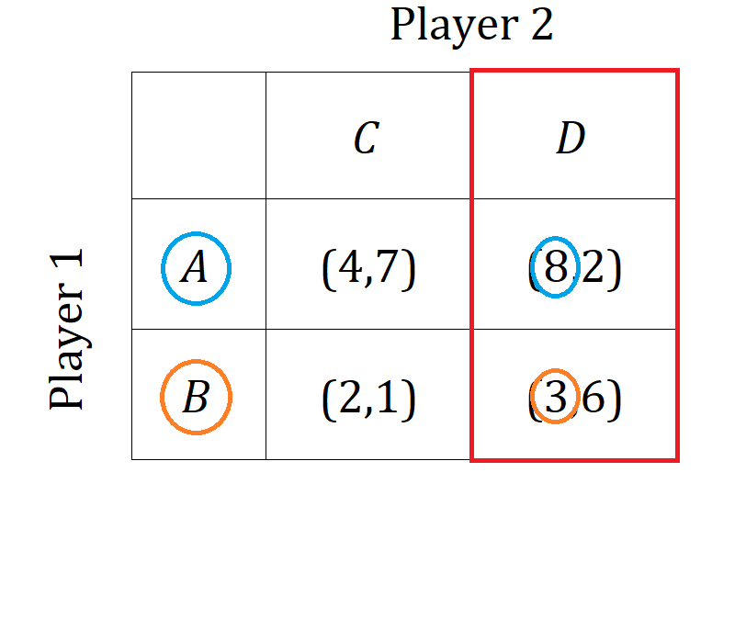
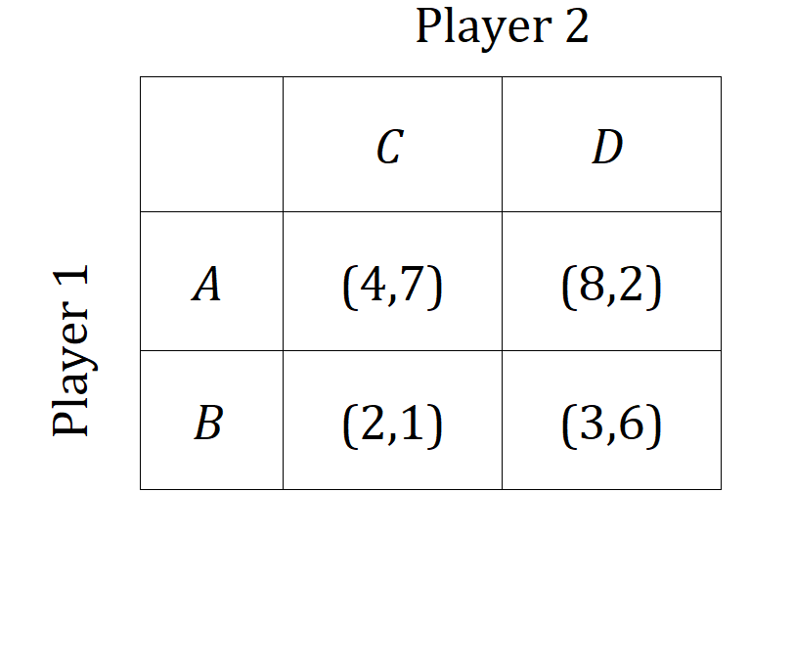
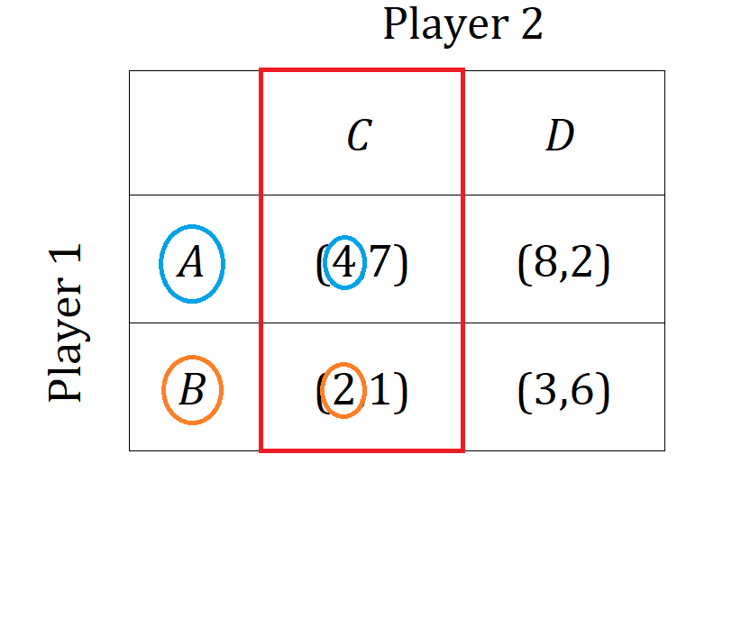
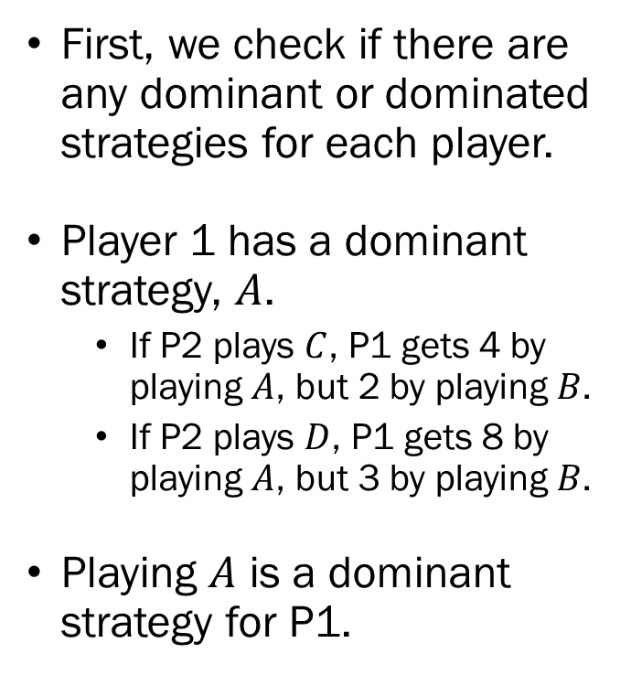
Example #2:
Static Games of Complete Information
First, we check if there are any dominant or dominated strategies for each player.
Player 1 has a dominant strategy, $A$.
  If P2 plays $C$, P1 gets 4 by playing $A$, but 2 by playing $B$.
  If P2 plays $D$, P1 gets 8 by playing $A$, but 3 by playing $B$.
Playing $A$ is a dominant strategy for P1.

Slide 17
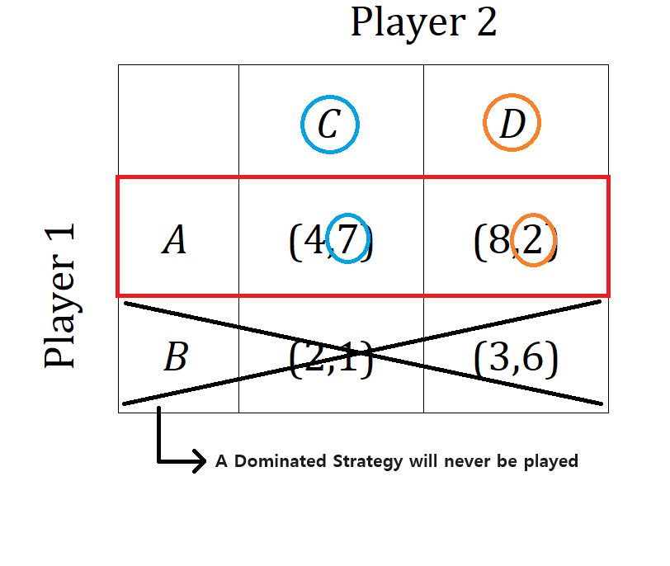
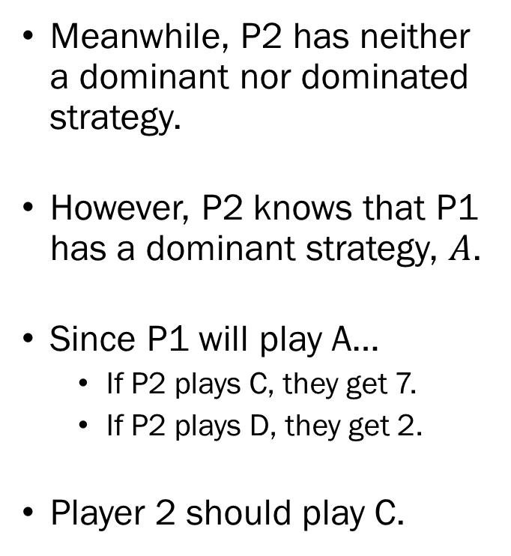
Example #2:
Static Games of Complete Information
Meanwhile, P2 has neither a dominant nor dominated strategy.
However, P2 knows that P1 has a dominant strategy, $A$.
Since P1 will play A…
  If P2 plays C, they get 7.
  If P2 plays D, they get 2.
Player 2 should play C.

Slide 18
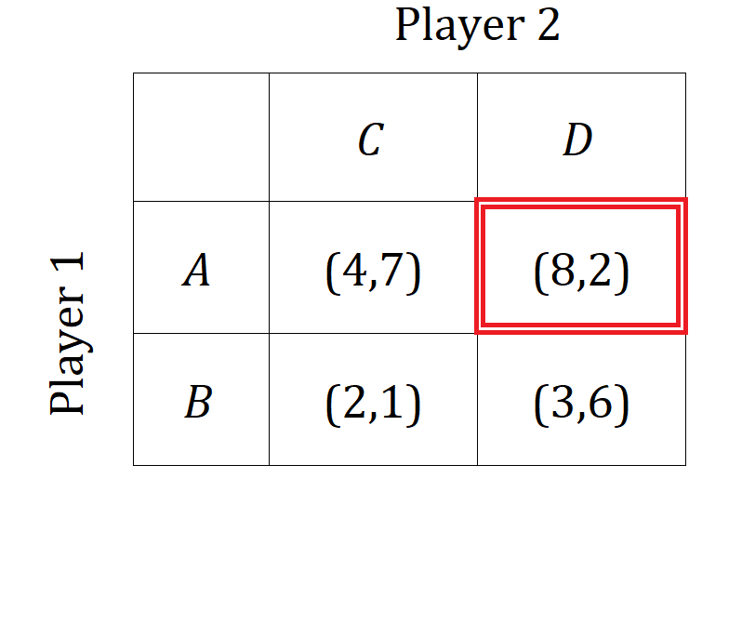
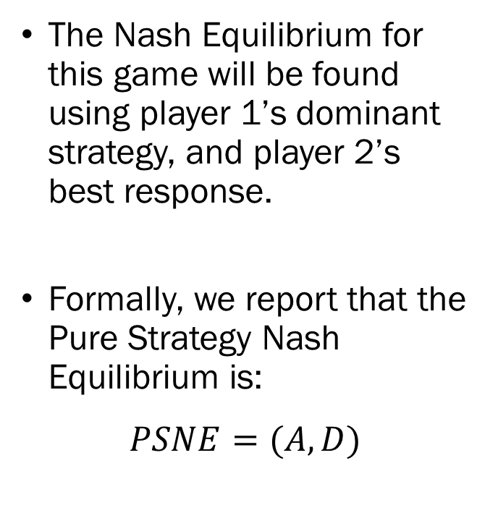
Example #2:
Static Games of Complete Information
The Nash Equilibrium for this game will be found using player 1’s dominant strategy, and player 2’s best response.
Formally, we report that the Pure Strategy Nash Equilibrium is:
$$PSNE=(A,D)$$

Slide 19
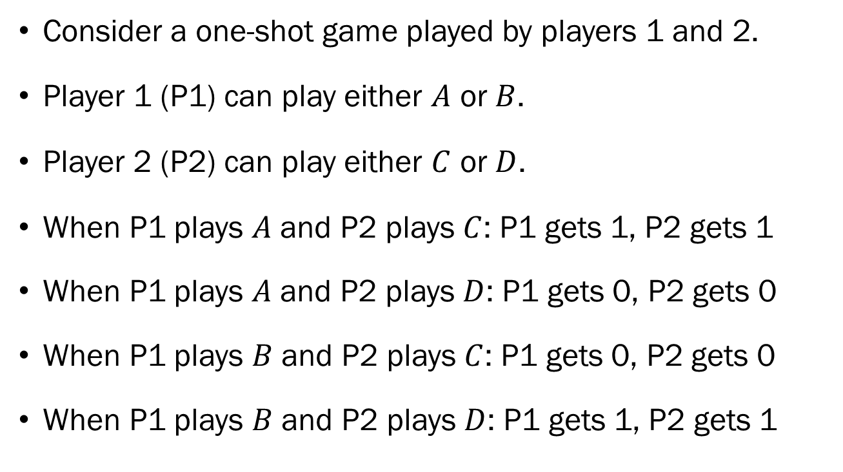
Example #3:
Static Games of Complete Information
Consider a one-shot game played by players 1 and 2.
Player 1 (P1) can play either $A$ or $B$.
Player 2 (P2) can play either $C$ or $D$.
When P1 plays $A$ and P2 plays $C$: P1 gets 1, P2 gets 1
When P1 plays $A$ and P2 plays $D$: P1 gets 0, P2 gets 0
When P1 plays $B$ and P2 plays $C$: P1 gets 0, P2 gets 0
When P1 plays $B$ and P2 plays $D$: P1 gets 1, P2 gets 1

Slide 20
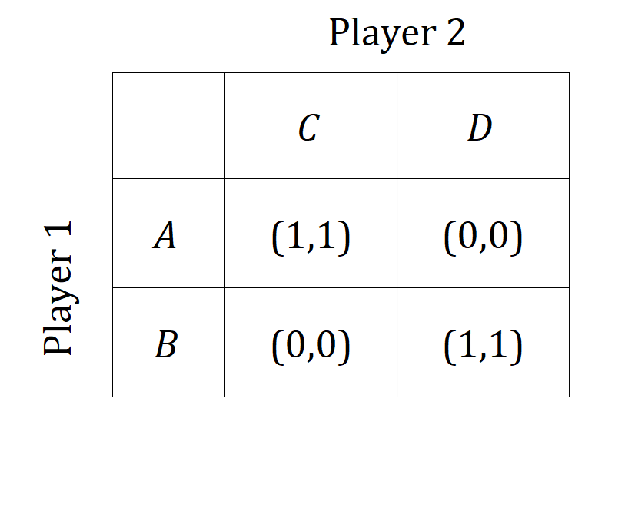
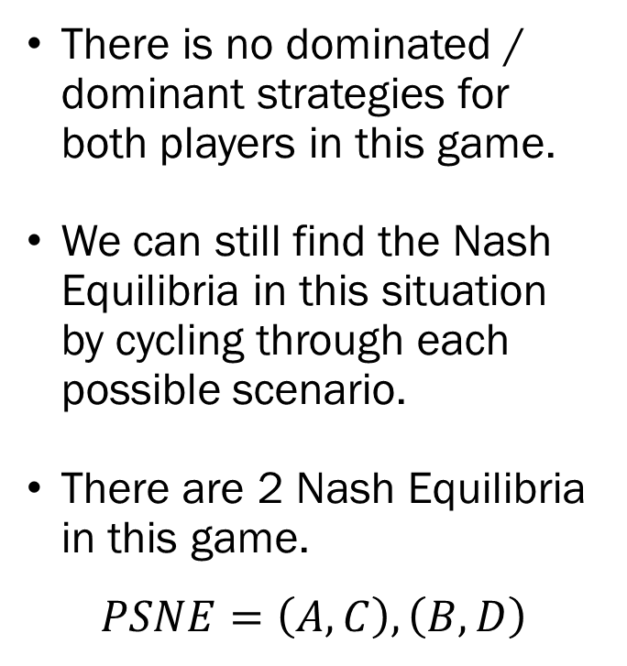
Example #3:
Static Games of Complete Information
There is no dominated / dominant strategies for both players in this game.
We can still find the Nash Equilibria in this situation by cycling through each possible scenario.
There are 2 Nash Equilibria in this game.
$$PSNE=\left(A,C\right), \left(B,D\right)$$

Slide 21
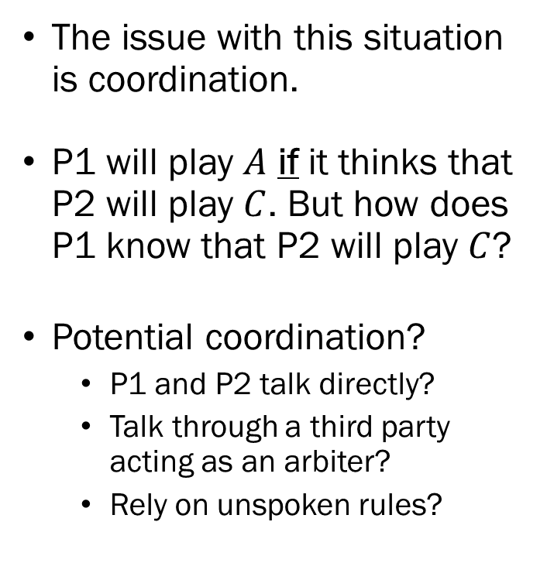
Example #3:
Static Games of Complete Information
The issue with this situation is coordination.
P1 will play $A$ if it thinks that P2 will play $C$. But how does P1 know that P2 will play $C$?
Potential coordination?
  P1 and P2 talk directly?
  Talk through a third party acting as an arbiter?
  Rely on unspoken rules?

Slide 22
Example #4:
Static Games of Complete Information
Some games can’t be represented in the normal form.
Suppose there are two political candidates, one from the Democratic party and one from the Republican party running for the Governorship in a swing state.
Equal number of voters identifying as conservative / liberal.
Voters will cast their votes based on “how conservative / liberal a candidate appears to be.”
If you are the campaign manager of one of the candidates, what is your advice to your candidate?

Slide 23
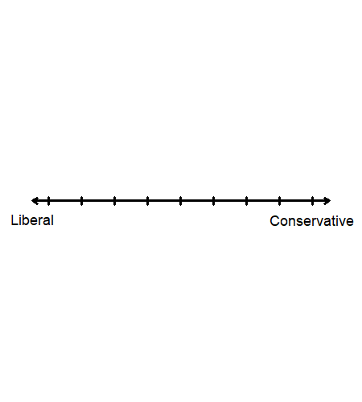
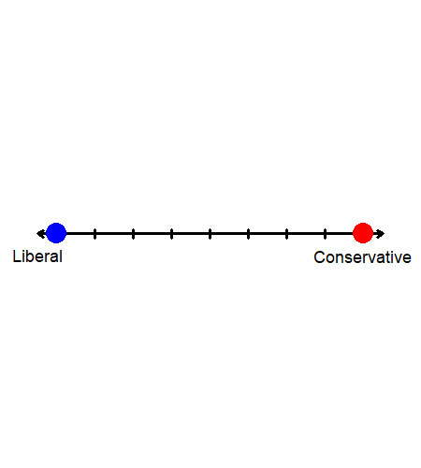
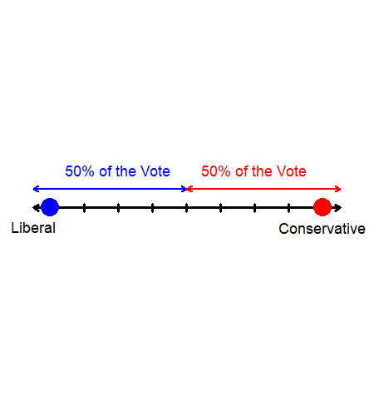
Example #4:
Static Games of Complete Information
Suppose we start off with both candidates taking extreme stances.
Each candidate will get exactly 50% of the votes.
Is there a way for candidates to increase the number of votes they get?
Yes! Let’s assume that you are the Blue candidate…

Slide 24
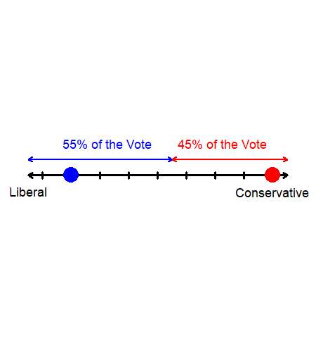
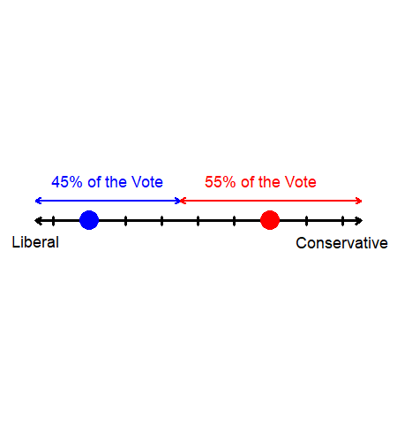
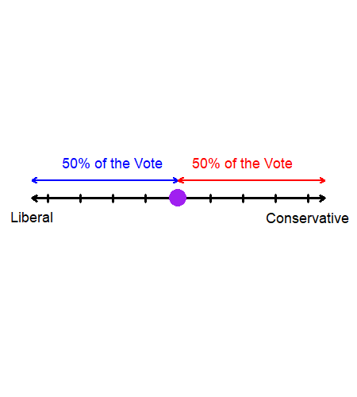
Example #4:
Static Games of Complete Information
By sending messages that are more moderate, the liberal candidate can win over some votes.
Then, the best response of the conservative candidate will move even further to the moderate end.
This process will repeat until both candidates reach the median point.

Slide 25
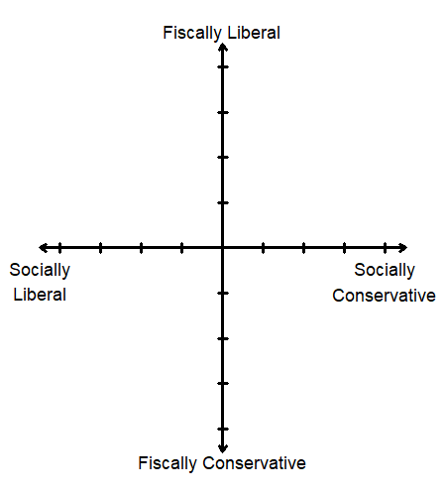
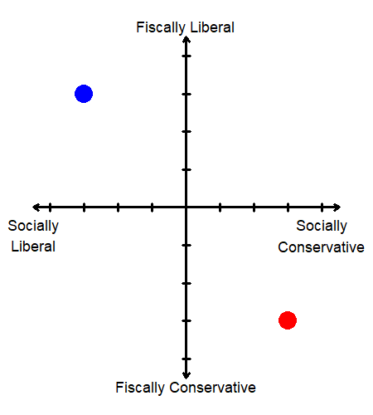
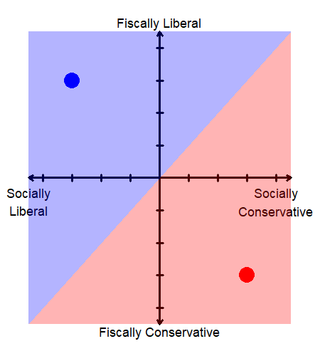
Example #4:
Static Games of Complete Information
The Median Voter Theorem, or Hotelling’s Law
Why political candidates change their stance to align with the median voter.
But voters often do not cast votes on a single issue. A voter may be socially liberal, but fiscally conservative.
Adjust the model…

Slide 26
Example #5:
Static Games of Complete Information
Suppose that two firms are producing an identical product. They can set either a low price, or a high price. If both firms set high prices, each firm will make 10 as profit. If both firms set low prices, each firm will make 5 as profit. When one firm sets a high price while the other sets a low price, the firm that set a high price will earn 1, while the other earns 20.
Represent this game in its normal form and find all Nash Equilibria.

Slide 27
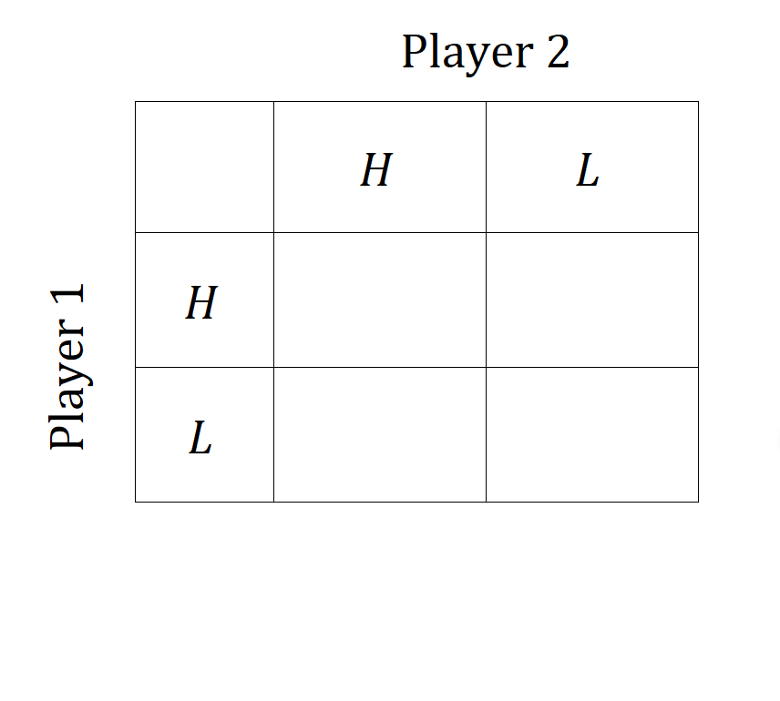
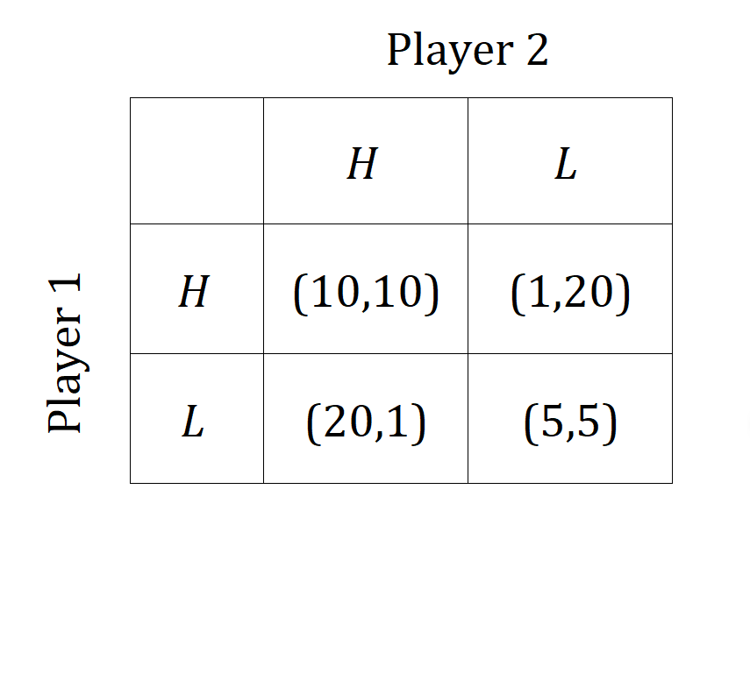
Example #5:
Static Games of Complete Information
First, we should start off by creating an empty table with players and actions.
Then, fill out the payoffs for each possible outcome of the game.
Check whether there is a dominant strategy.

Slide 28
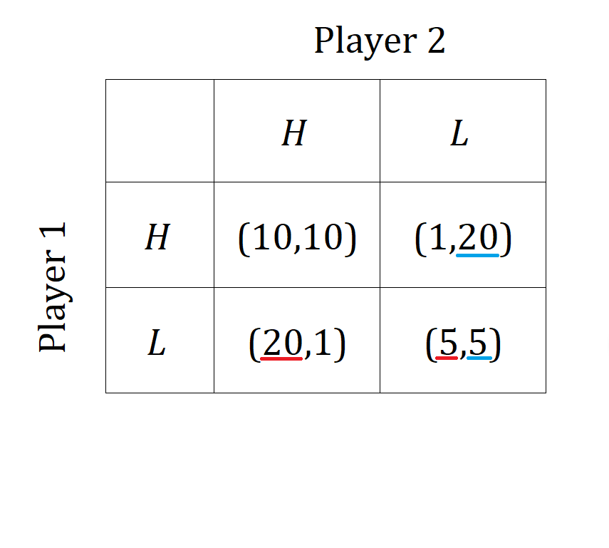
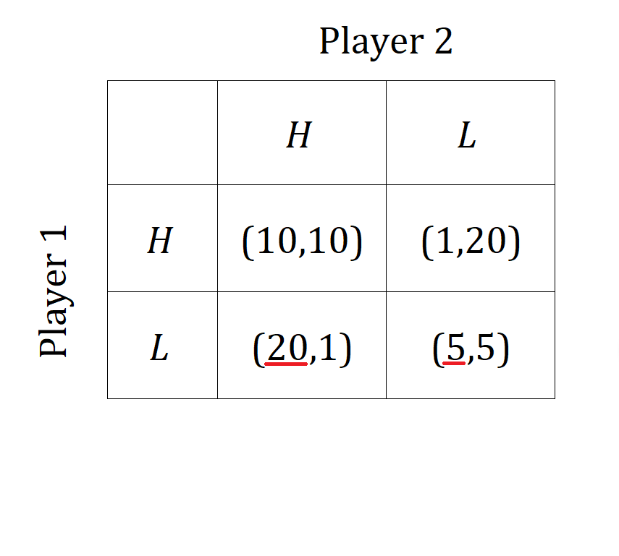
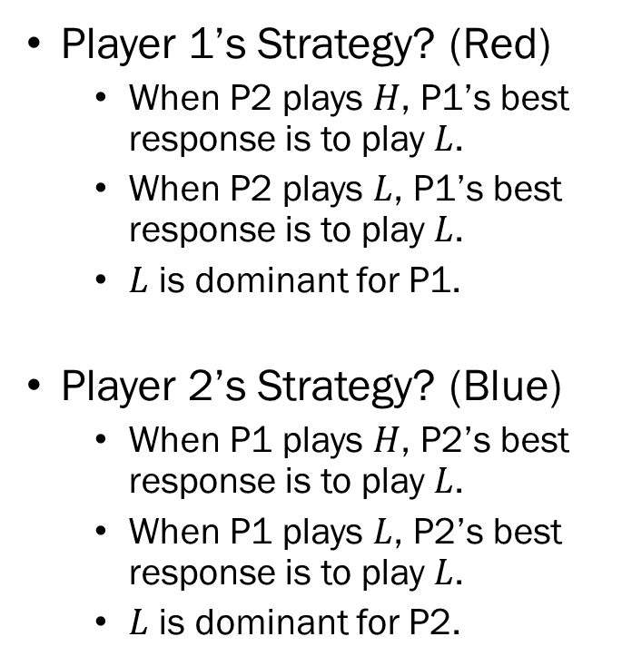
Example #5:
Static Games of Complete Information
Player 1’s Strategy? (Red)
  When P2 plays $H$, P1’s best response is to play $L$.
  When P2 plays $L$, P1’s best response is to play $L$.
  $L$ is dominant for P1.
Player 2’s Strategy? (Blue)
  When P1 plays $H$, P2’s best response is to play $L$.
  When P1 plays $L$, P2’s best response is to play $L$.
  $L$ is dominant for P2.

Slide 29

Example #5:
Static Games of Complete Information
Any payoff that has two “underlines,” and the strategy that leads to said payoffs consist the Pure Strategy Nash Equilibrium (PSNE).
The PSNE for this game is:
$$PSNE=(L,L)$$

