Slide 1
The Open Economy:
The Goods Market
ECON 301

Slide 2

https://pollev.com/brianpark046

Slide 3
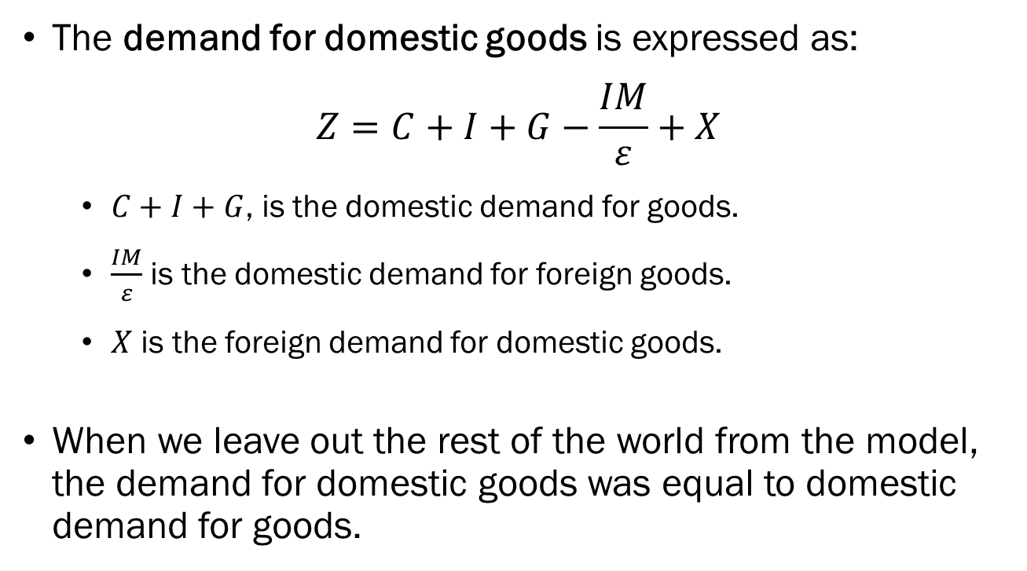
The Goods Market & IS Relation in an Open Economy
The demand for domestic goods is expressed as:
$$Z=C+I+G−\frac{IM}{ε}+X$$
  $C+I+G$, is the domestic demand for goods.
  $\frac{IM}{ε}$ is the domestic demand for foreign goods.
  $X$ is the foreign demand for domestic goods.
When we leave out the rest of the world from the model, the demand for domestic goods was equal to domestic demand for goods.

Slide 4
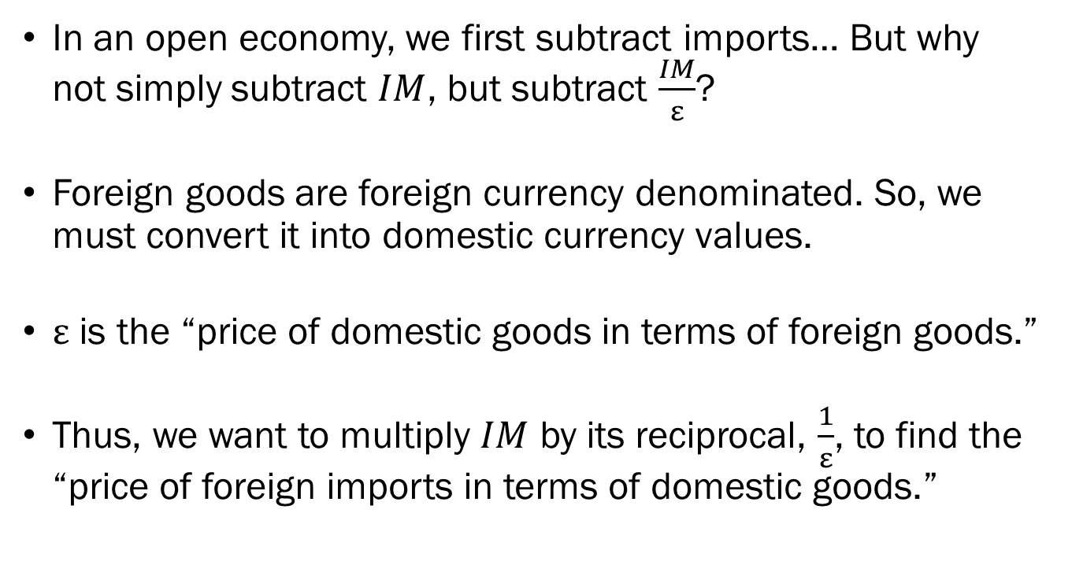
Accounting for Imports
In an open economy, we first subtract imports… But why not simply subtract $IM$, but subtract $\frac{IM}{ε}$?
Foreign goods are foreign currency denominated. So, we must convert it into domestic currency values.
$ε$ is the “price of domestic goods in terms of foreign goods.”
Thus, we want to multiply $IM$ by its reciprocal, $\frac{1}{ε}$, to find the “price of foreign imports in terms of domestic goods.”

Slide 5
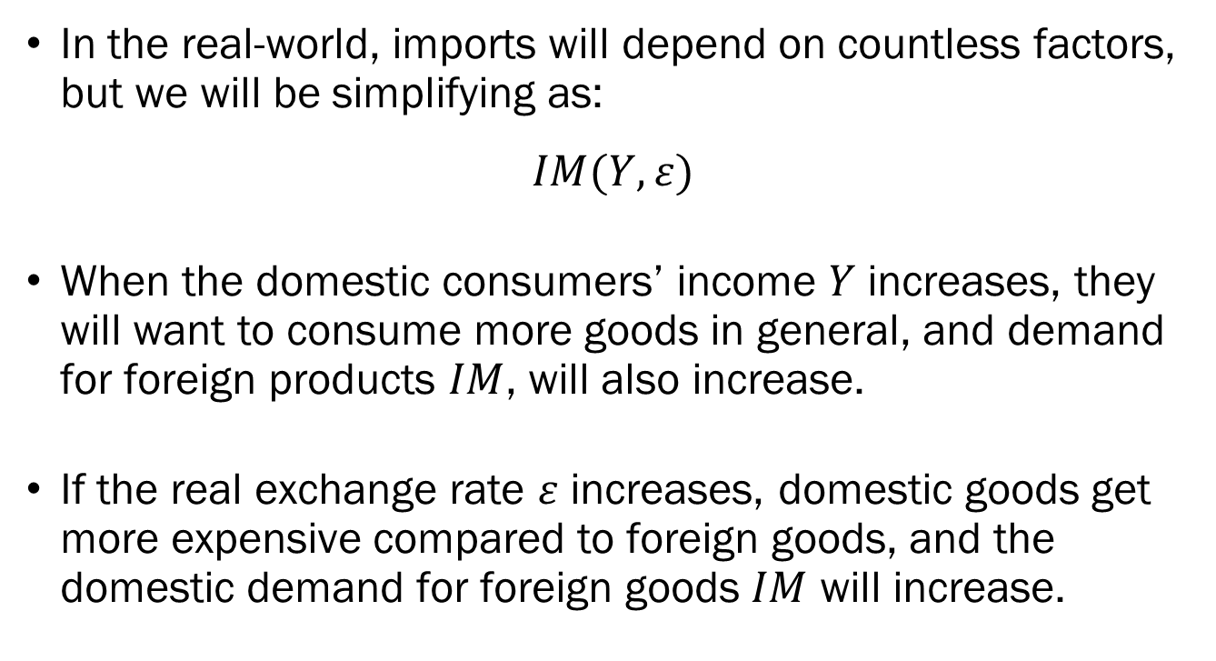
Accounting for Imports
In the real-world, imports will depend on countless factors, but we will be simplifying as:
$$IM(Y,ε)$$
When the domestic consumers’ income $Y$ increases, they will want to consume more goods in general, and demand for foreign products $IM$, will also increase.
If the real exchange rate $ε$ increases, domestic goods get more expensive compared to foreign goods, and the domestic demand for foreign goods $IM$ will increase.

Slide 6
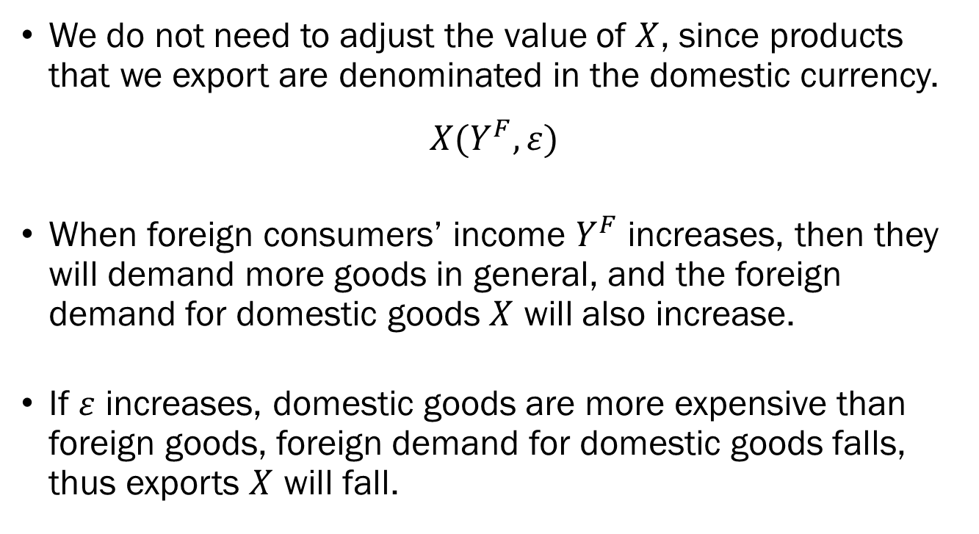
Accounting for Exports
We do not need to adjust the value of $X$, since products that we export are denominated in the domestic currency.
$$X(Y^{F},ε)$$
When foreign consumers’ income $Y^{F}$ increases, then they will demand more goods in general, and the foreign demand for domestic goods $X$ will also increase.
If $ε$ increases, domestic goods are more expensive than foreign goods, foreign demand for domestic goods falls, thus exports $X$ will fall.

Slide 7
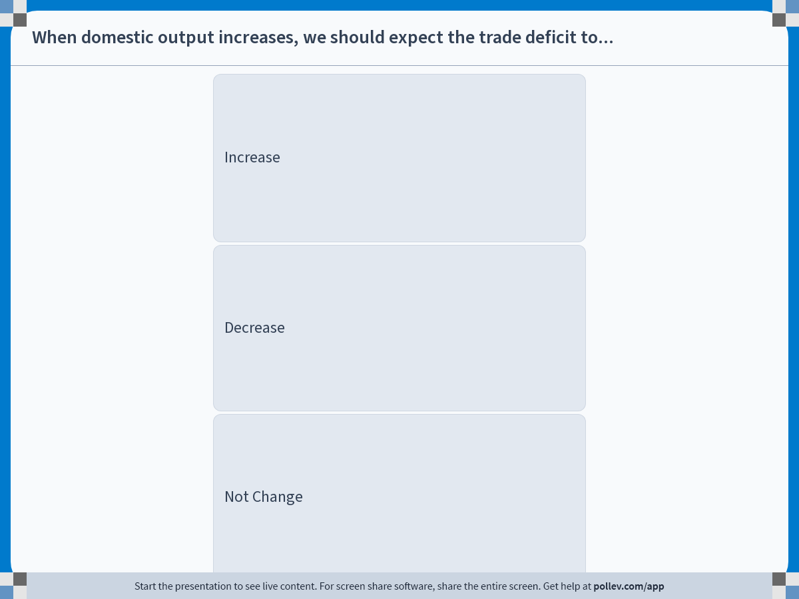
Notes:
Poll Title: Do not modify the notes in this section to avoid tampering with the Poll Everywhere activity.
More info at polleverywhere.com/support
When domestic output increases, we should expect the trade deficit to...
https://www.polleverywhere.com/multiple_choice_polls/0D7GRekkE19ejrbsdmyOm?display_state=instructions&activity_state=opened&state=opened&flow=Engagement&onscreen=persist

Slide 8
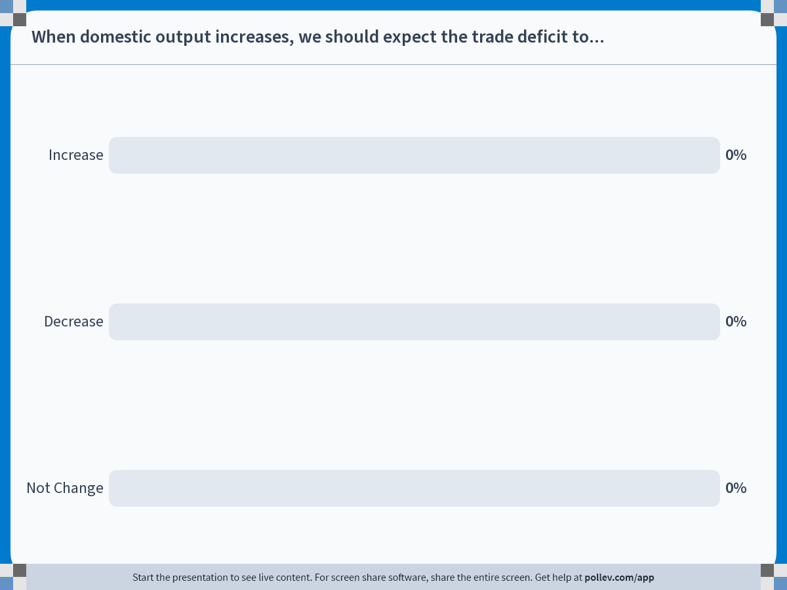
Notes:
Poll Title: Do not modify the notes in this section to avoid tampering with the Poll Everywhere activity.
More info at polleverywhere.com/support
When domestic output increases, we should expect the trade deficit to...
https://www.polleverywhere.com/multiple_choice_polls/0D7GRekkE19ejrbsdmyOm?display_state=chart&activity_state=closed&state=closed&flow=Engagement&onscreen=persist

Slide 9

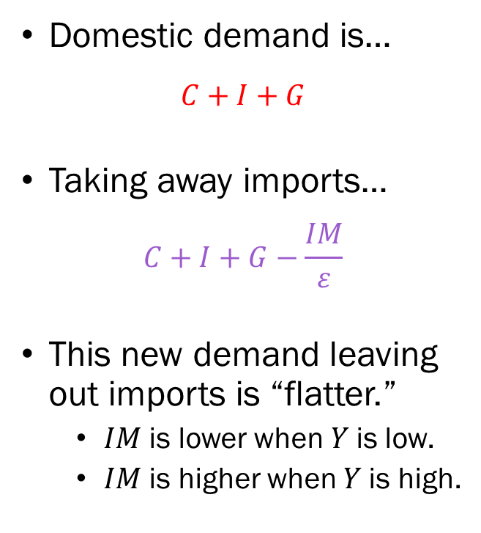

Visualizing the Open Goods Market
Domestic demand is…
$$C+I+G$$
Taking away imports…
$$C+I+G−\frac{IM}{ε}$$
This new demand leaving out imports is “flatter.”
  $IM$ is lower when $Y$ is low.
  $IM$ is higher when $Y$ is high.
Demand
$$C+I+G$$
$$C+I+G−\frac{IM}{ε}$$
Output

Slide 10

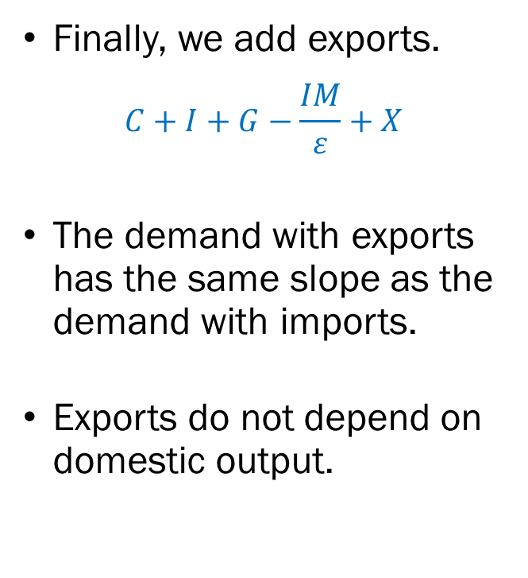

Observations
Finally, we add exports.
$$C+I+G−\frac{IM}{ε}+X$$
The demand with exports has the same slope as the demand with imports.
Exports do not depend on domestic output.
Demand
$$C+I+G$$
$$Z=C+I+G−\frac{IM}{ε}+X$$
$$C+I+G−\frac{IM}{ε}$$
Output

Slide 11


Visualizing the Open Goods Market
Demand
$$C+I+G$$
Net Exports
$$Z=C+I+G−\frac{IM}{ε}+X$$
Output
$$C+I+G−\frac{IM}{ε}$$
$$NX$$
Output

Slide 12
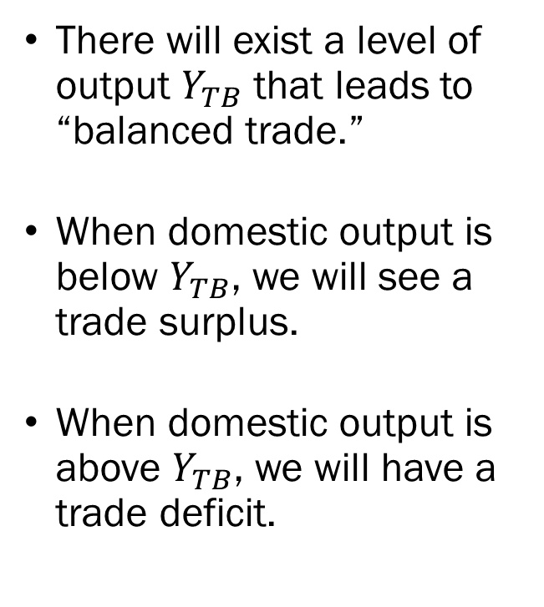


Visualizing the Open Goods Market
There will exist a level of output $Y_{TB}$ that leads to “balanced trade.”
When domestic output is below $Y_{TB}$, we will see a trade surplus.
When domestic output is above $Y_{TB}$, we will have a trade deficit.
Net Exports $(NX)$
Output
$$Y_{TB}$$
$$NX$$

Slide 13
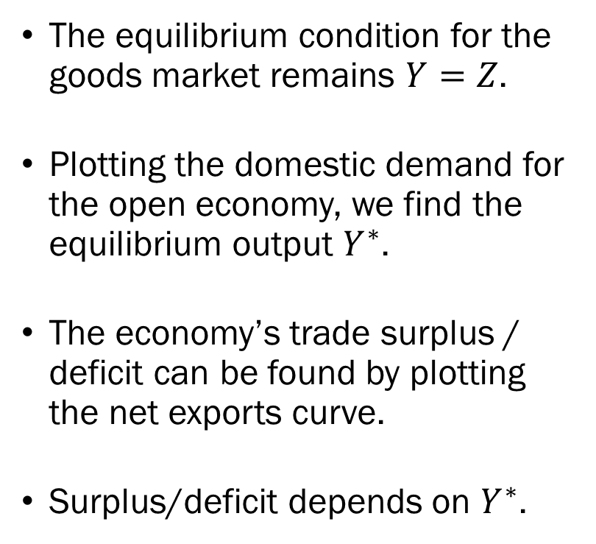




Visualizing the Open Goods Market
The equilibrium condition for the goods market remains $Y=Z$.
Plotting the domestic demand for the open economy, we find the equilibrium output $Y^{∗}$.
The economy’s trade surplus / deficit can be found by plotting the net exports curve.
Surplus/deficit depends on $Y^{∗}$.
Demand
$$Z$$
Output
$$Y^{∗}$$
$$NX$$
$$Y_{TB}$$
Output
Trade Deficit
$$NX$$

Slide 14



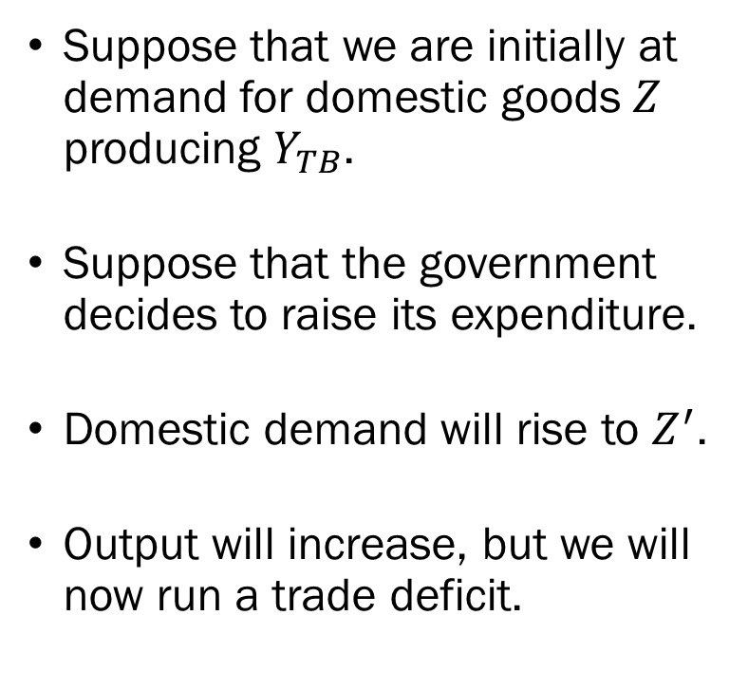
Changes to Demand:
Government Expenditure
Suppose that we are initially at demand for domestic goods $Z$ producing $Y_{TB}$.
Suppose that the government decides to raise its expenditure.
Domestic demand will rise to $Z^{′}$.
Output will increase, but we will now run a trade deficit.
Demand
$$Z^{′}$$
$$Z$$
Output
$$Y^{∗}$$
$$Y^{∗′}$$
$$NX$$
$$Y_{TB}$$
Output
$$NX$$

Slide 15
Changes to Demand:
Government Expenditure
In the closed economy, the increase in households’ income (demand) would be directed entirely towards domestic goods.
In the open economy, the increased demand will be shared by domestic and foreign goods.
This leads to two noticeable effects in our model.
  The trade deficit will increase, and
  The government expenditure multiplier will be smaller.
Then what when foreign demand increases?

Slide 16



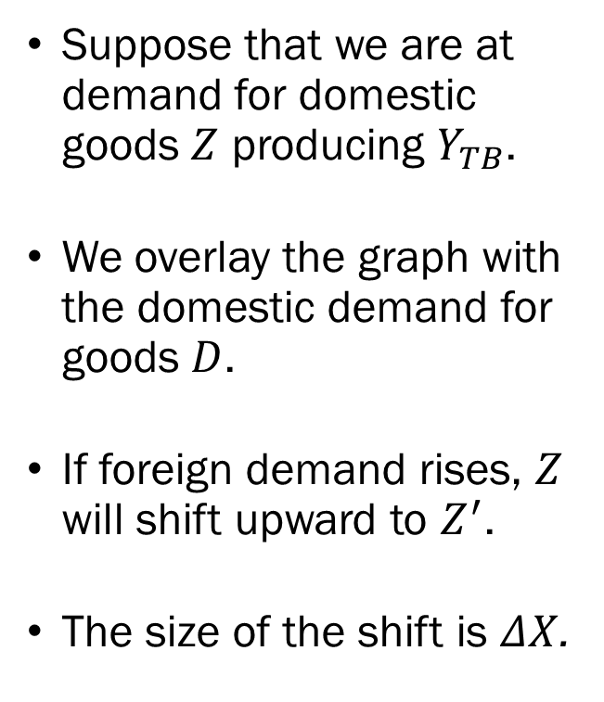






Changes to Demand:
Foreign Demand
Suppose that we are at demand for domestic goods $Z$ producing $Y_{TB}$.
We overlay the graph with the domestic demand for goods $D$.
If foreign demand rises, $Z$ will shift upward to $Z^{′}$.
The size of the shift is $ΔX$.
Demand
$$D$$
$$A^{′}$$
$$Z^{′}$$
$$C$$
$$ΔX$$
$$A$$
$$Z$$
$$Y_{TB}$$
$$Y^{∗′}$$
Output

Slide 17
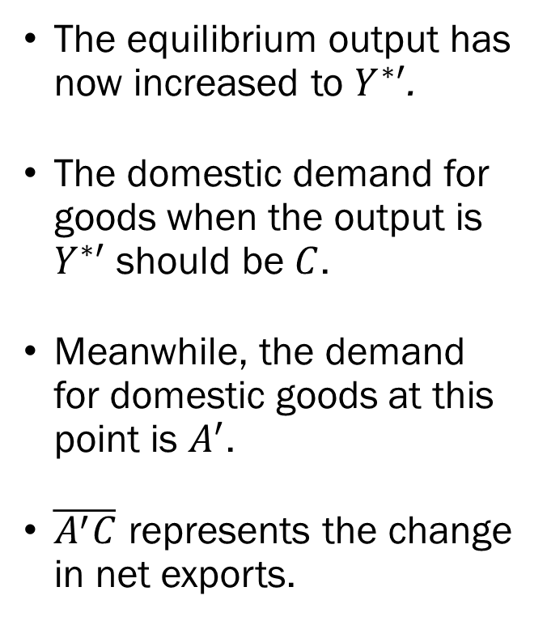
Changes to Demand:
Foreign Demand
The equilibrium output has now increased to $Y^{∗′}$.
The domestic demand for goods when the output is $Y^{∗′}$ should be $C$.
Meanwhile, the demand for domestic goods at this point is $A^{′}$.
$\overline{A^{′}C}$ represents the change in net exports.
Demand
$$D$$
$$A^{′}$$
$$Z^{′}$$
$$C$$
$$ΔX$$
$$A$$
$$Z$$
$$Y_{TB}$$
$$Y^{∗′}$$
Output

Slide 18





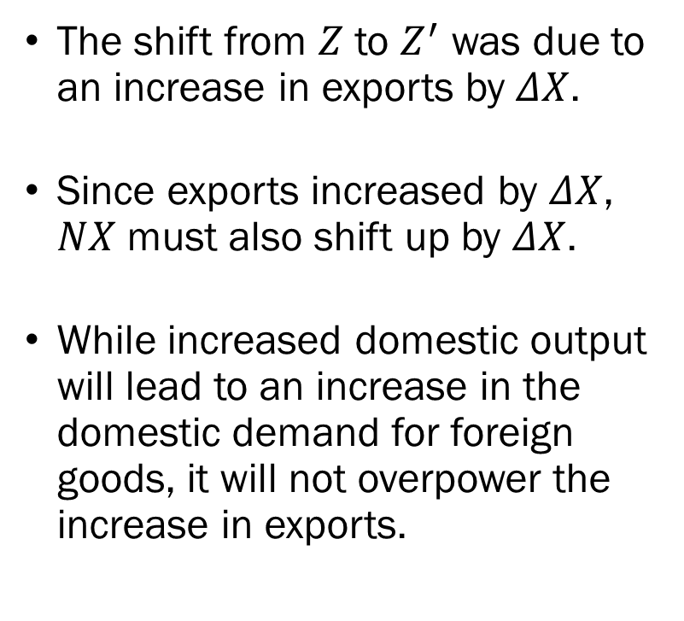

Changes to Demand:
Foreign Demand
The shift from $Z$ to $Z^{′}$ was due to an increase in exports by $ΔX$.
Since exports increased by $ΔX$, $NX$ must also shift up by $ΔX$.
While increased domestic output will lead to an increase in the domestic demand for foreign goods, it will not overpower the increase in exports.
Demand
$$D$$
$$A^{′}$$
$$Z^{′}$$
$$C$$
$$Z$$
$$A$$
Output
$$Y_{TB}$$
$$Y^{∗′}$$
$$NX$$
Output
$$Y_{TB}$$
$$NX^{′}$$
$$NX$$

Slide 19
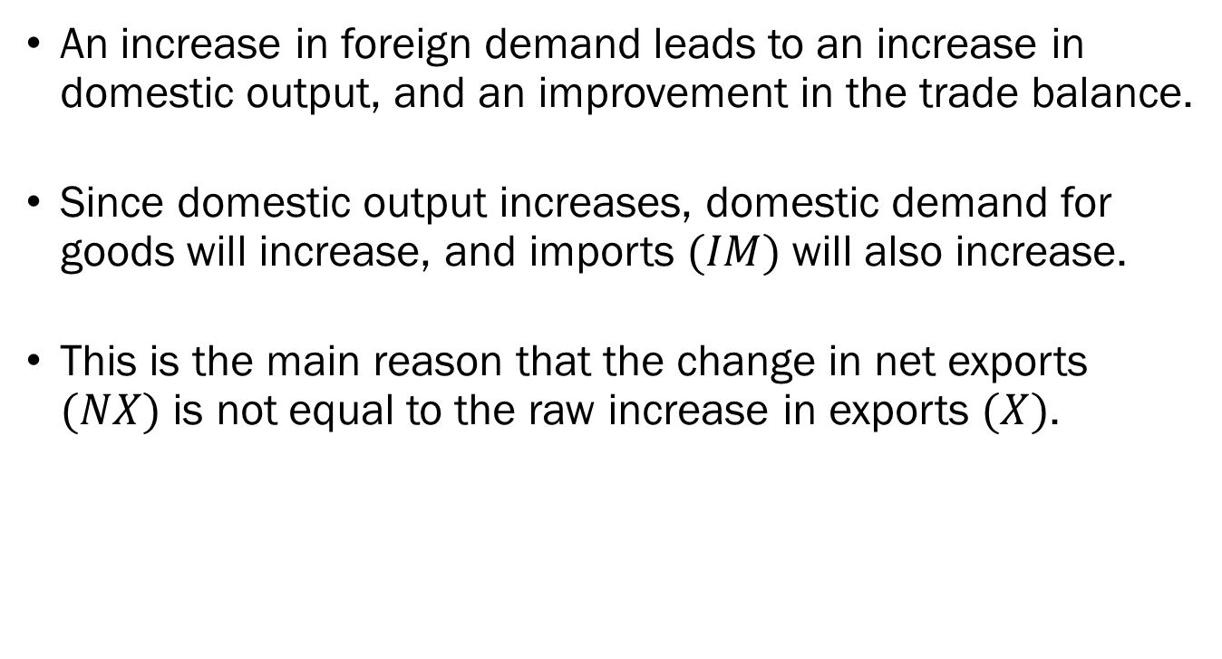
Changes to Demand:
Foreign Demand
An increase in foreign demand leads to an increase in domestic output, and an improvement in the trade balance.
Since domestic output increases, domestic demand for goods will increase, and imports $(IM)$ will also increase.
This is the main reason that the change in net exports $(NX)$ is not equal to the raw increase in exports $(X)$.

Slide 20
Consequences of Openness
We just examined two scenarios where…
  Increasing domestic demand leads to a worsening trade balance.
  Increasing foreign demand leads to an increase in domestic output and an improvement in the trade balance.
This implies that shocks to the demand in other countries will affect the economy of other countries.
This complicates the tasks of policymakers, especially for those in charge of fiscal policy.

Slide 21
Consequences of Openness
Suppose that multiple countries are closely tied in trade relations managing balanced trade are simultaneously hit with recession, which calls for expansionary fiscal policy.
The problem arises due to the close trade relations; if one country increases domestic output through stimuli, they will inevitably run a trade deficit.
The governments of the other countries can simply wait out until the first mover increases their imports, which will boost domestic output without any effort on their end.

Slide 22
Consequences of Openness
There is a simple solution: “If every country can coordinate their increase in government expenditure…”
The issue is that the implementation of this solution isn’t as simple as it sounds.
Countries will have an incentive to “promise” to implement expansionary policies, just to not deliver.
In the real world, each countries will have different politics, varying levels of trade deficits, national debts, which will further complicate coordination.

Slide 23
Real-World Attempts at Coordination
Policy coordination was attempted as a response to the Great Recession of 2008, where G20 countries committed to a 2% (of GDP) benchmark of fiscal expansion.
The G20 countries roughly met this goal, where the average level of fiscal expansion reached 2.3% of combined GDP.
Some countries such as the US which had more fiscal room was able to commit more, while others with less fiscal room such as Italy were not able to meet the 2% benchmark.
Did they succeed? Difficult to tell…

Slide 24
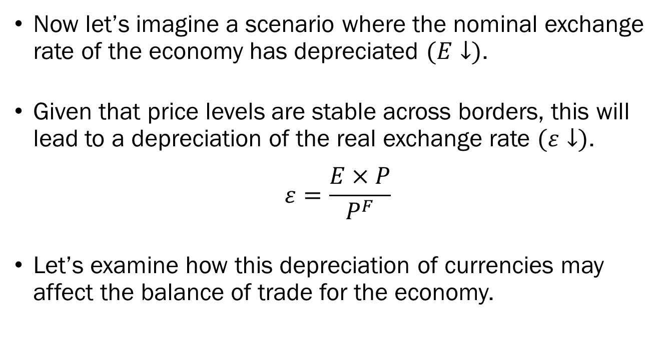
Changes to Exchange Rates:
Nominal & Real Depreciation
Now let’s imagine a scenario where the nominal exchange rate of the economy has depreciated $(E↓)$.
Given that price levels are stable across borders, this will lead to a depreciation of the real exchange rate $(ε↓)$.
$$ε=\frac{E×P}{P^{F}}$$
Let’s examine how this depreciation of currencies may affect the balance of trade for the economy.

Slide 25
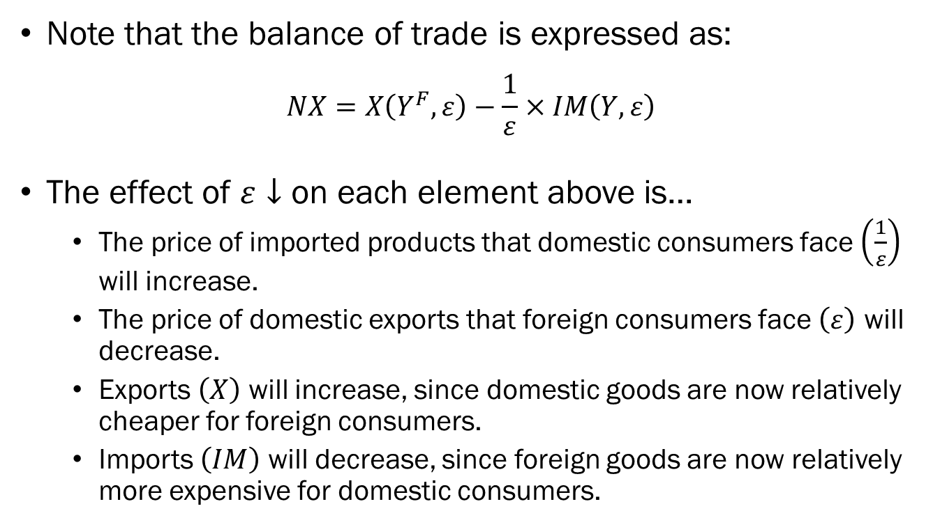
Changes to Exchange Rates:
Real Depreciation
Note that the balance of trade is expressed as:
$$NX=X\left(Y^{F},ε\right)−\frac{1}{ε}×IM\left(Y,ε\right)$$
The effect of $ε↓$ on each element above is…
  The price of imported products that domestic consumers face $\left(\frac{1}{ε}\right)$ will increase.
  The price of domestic exports that foreign consumers face $\left(ε\right)$ will decrease.
  Exports $\left(X\right)$ will increase, since domestic goods are now relatively cheaper for foreign consumers.
  Imports $\left(IM\right)$ will decrease, since foreign goods are now relatively more expensive for domestic consumers.

Slide 26
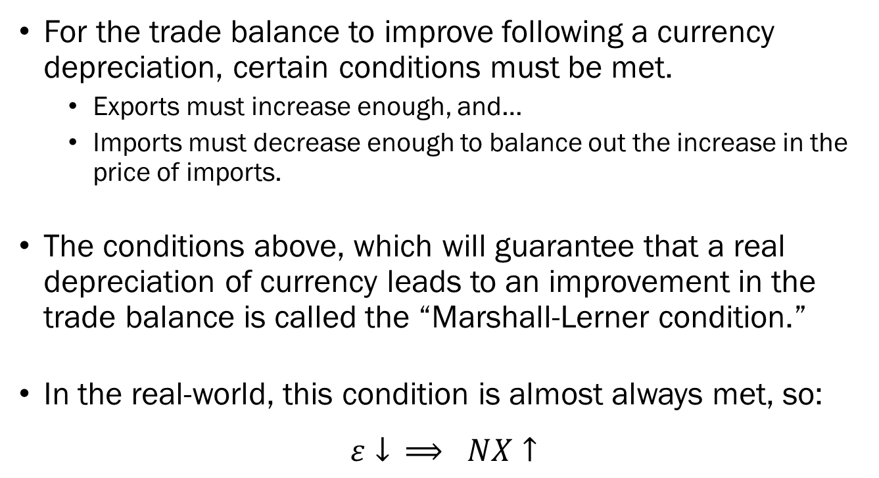
Changes to Exchange Rates:
The Marshall-Lerner Condition
For the trade balance to improve following a currency depreciation, certain conditions must be met.
  Exports must increase enough, and…
  Imports must decrease enough to balance out the increase in the price of imports.
The conditions above, which will guarantee that a real depreciation of currency leads to an improvement in the trade balance is called the “Marshall-Lerner condition.”
In the real-world, this condition is almost always met, so:
$$ε↓ ⟹ NX↑$$

Slide 27
Changes to Exchange Rates:
Real Depreciation
The depreciation of but it also affects domestic output.
Domestically produced goods are now relatively cheaper in the eyes of the foreign consumers.
Since domestic goods are more affordable in general, both domestic and foreign demand will shift in favor of domestic goods.
Illustrated on a graph, it will look identical to an increase in foreign demand.

Slide 28
Fiscal Policy and Exchange Rates
Introducing openness in the economy introduces a new array of tools for policymakers.
Suppose that an economy is in its medium-run equilibrium, but meanwhile is running a large trade deficit.
The government want to steer the economy so that total output remains at potential output, while decreasing the trade deficit.
Is this possible?

Slide 29
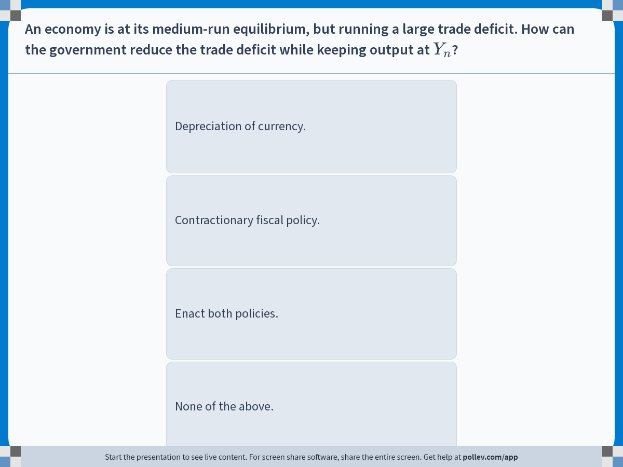
Notes:
Poll Title: Do not modify the notes in this section to avoid tampering with the Poll Everywhere activity.
More info at polleverywhere.com/support
An economy is at its medium-run equilibrium, but running a large trade deficit. How can the government reduce the trade deficit while keeping output at $$Y_n$$?
https://www.polleverywhere.com/multiple_choice_polls/5VJZC85jct271OoworQur?display_state=instructions&activity_state=opened&state=opened&flow=Engagement&onscreen=persist

Slide 30
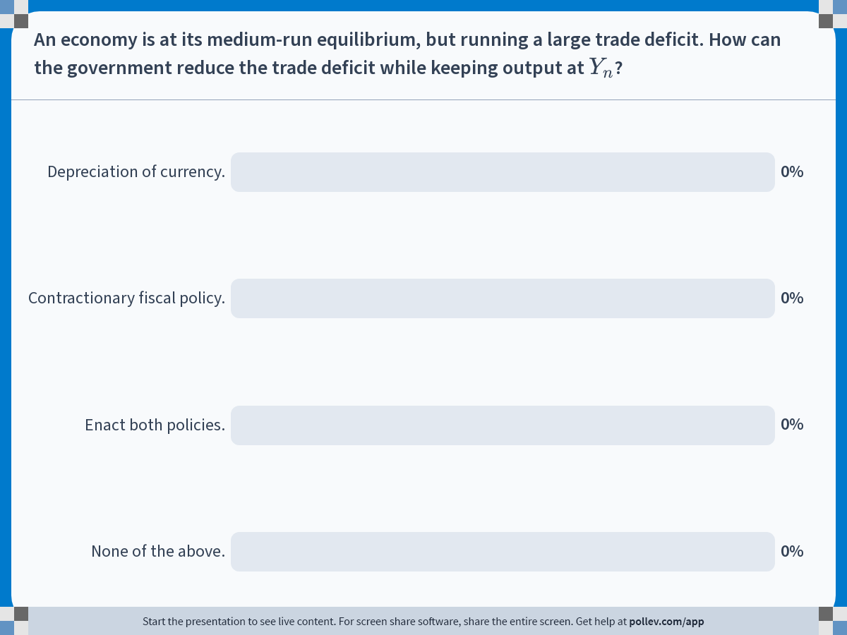
Notes:
Poll Title: Do not modify the notes in this section to avoid tampering with the Poll Everywhere activity.
More info at polleverywhere.com/support
An economy is at its medium-run equilibrium, but running a large trade deficit. How can the government reduce the trade deficit while keeping output at $$Y_n$$?
https://www.polleverywhere.com/multiple_choice_polls/5VJZC85jct271OoworQur?display_state=chart&activity_state=closed&state=closed&flow=Engagement&onscreen=persist

Slide 31
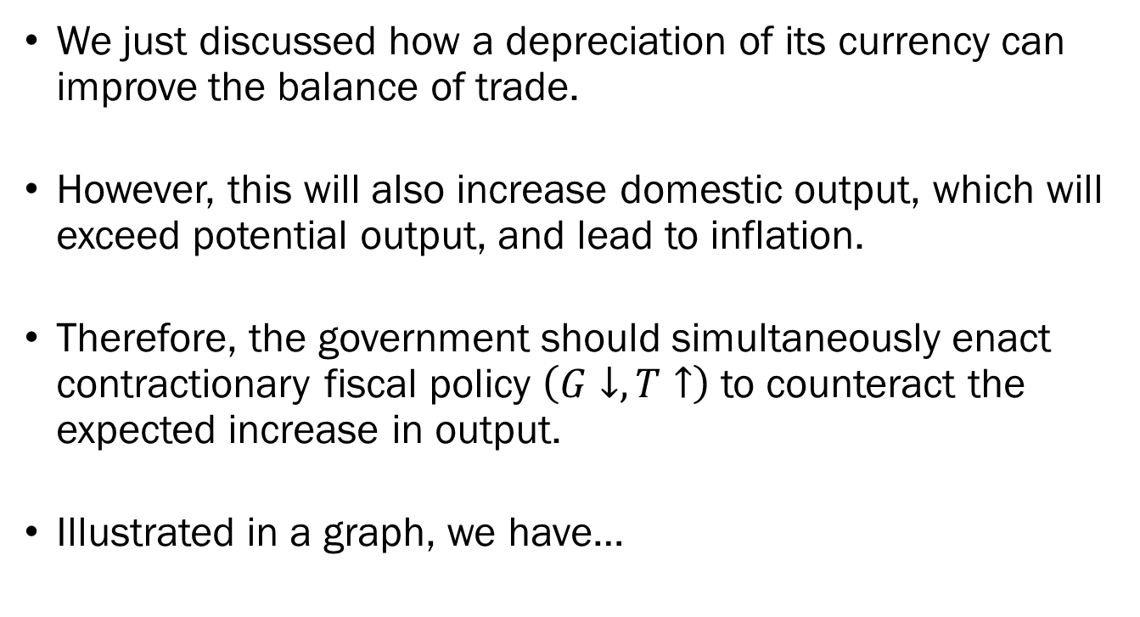
Fiscal Policy and Exchange Rates
We just discussed how a depreciation of its currency can improve the balance of trade.
However, this will also increase domestic output, which will exceed potential output, and lead to inflation.
Therefore, the government should simultaneously enact contractionary fiscal policy $\left(G↓, T↑\right)$ to counteract the expected increase in output.
Illustrated in a graph, we have…

Slide 32

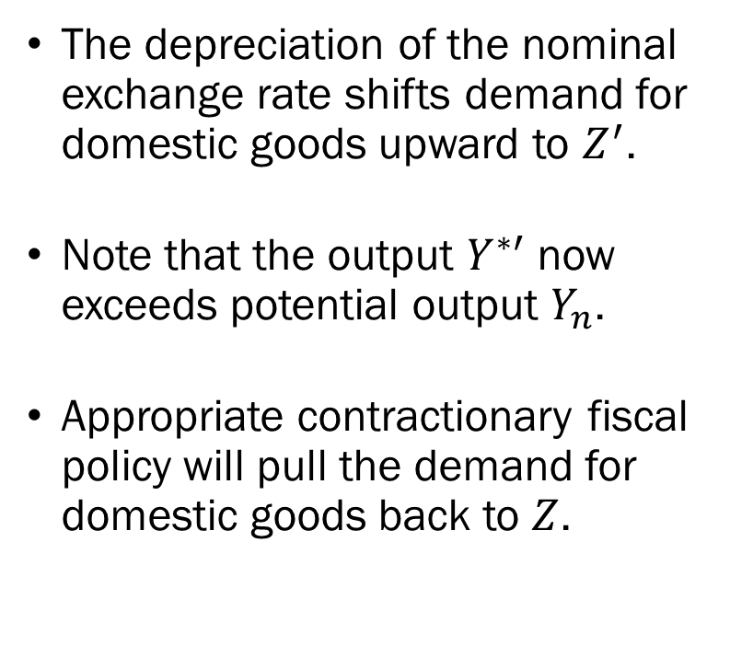


Fiscal Policy and Exchange Rates
The depreciation of the nominal exchange rate shifts demand for domestic goods upward to $Z^{′}$.
Note that the output $Y^{∗′}$ now exceeds potential output $Y_{n}$.
Appropriate contractionary fiscal policy will pull the demand for domestic goods back to $Z$.
Demand
$$A^{′}$$
$$Z^{′}$$
$$ΔG$$
$$Z$$
$$A$$
$$ΔNX$$
Output
$$Y_{n}$$
$$Y^{∗′}$$
$$NX$$
Output
$$NX^{′}$$
$$NX$$

Slide 33
Fiscal Policy and Exchange Rates
To target two goals – balance of trade, and output – we must rely on a combination of at lest least two policies.
Suppose now we had low output alongside a trade deficit.
  The depreciation of real exchange rates will lead to an increase in output and an improvement of the trade balance.
  However, there is no guarantee that both goals will be met exactly based on a single policy change, so we may have to fine-tune our approach with fiscal policy.
Suppose now we had high output and a trade surplus…

Slide 34
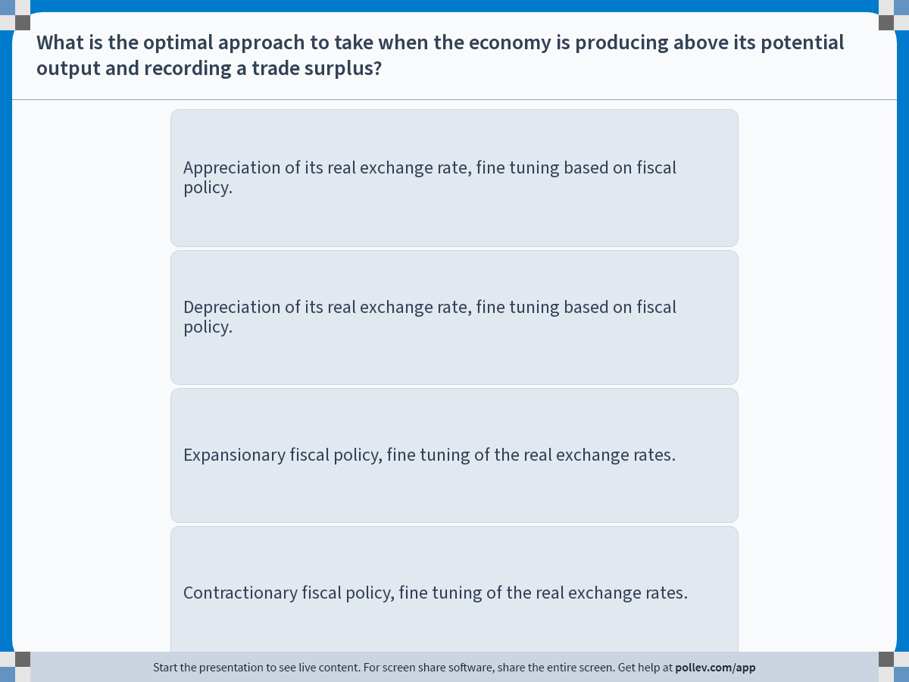
Notes:
Poll Title: Do not modify the notes in this section to avoid tampering with the Poll Everywhere activity.
More info at polleverywhere.com/support
What is the optimal approach to take when the economy is producing above its potential output and recording a trade surplus?
https://www.polleverywhere.com/multiple_choice_polls/slWDCZG94MAb7r3hLdkck?display_state=instructions&activity_state=opened&state=opened&flow=Engagement&onscreen=persist

Slide 35
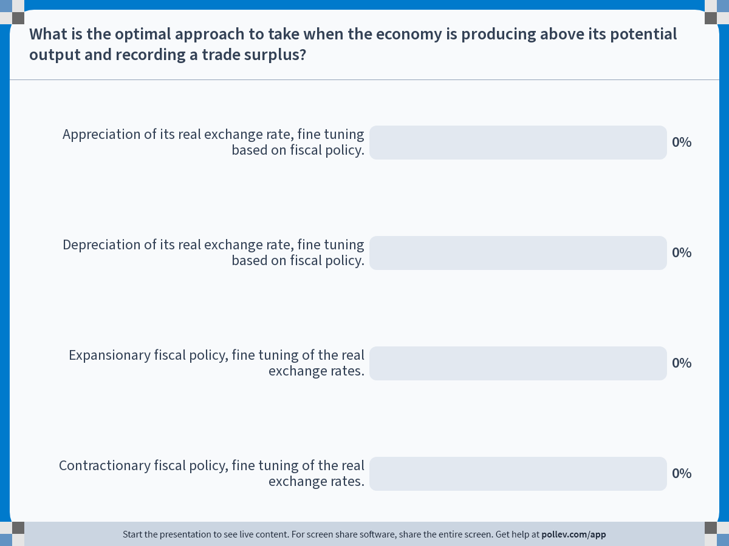
Notes:
Poll Title: Do not modify the notes in this section to avoid tampering with the Poll Everywhere activity.
More info at polleverywhere.com/support
What is the optimal approach to take when the economy is producing above its potential output and recording a trade surplus?
https://www.polleverywhere.com/multiple_choice_polls/slWDCZG94MAb7r3hLdkck?display_state=chart&activity_state=closed&state=closed&flow=Engagement&onscreen=persist

Slide 36
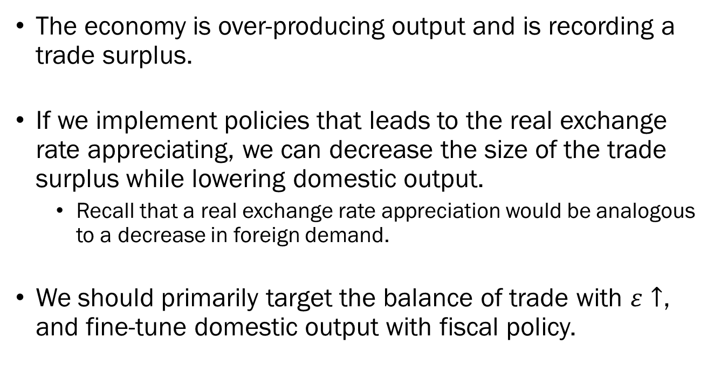
Solution to In-Class Poll
The economy is over-producing output and is recording a trade surplus.
If we implement policies that leads to the real exchange rate appreciating, we can decrease the size of the trade surplus while lowering domestic output.
  Recall that a real exchange rate appreciation would be analogous to a decrease in foreign demand.
We should primarily target the balance of trade with $ε↑$, and fine-tune domestic output with fiscal policy.

Slide 37
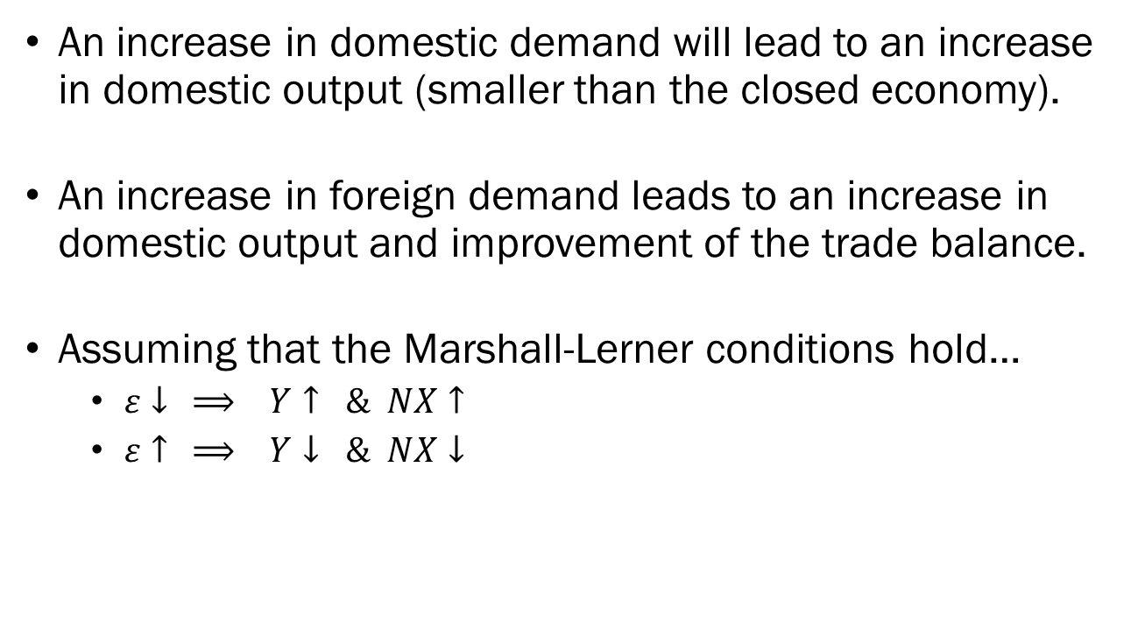
When the Economy is Open…
An increase in domestic demand will lead to an increase in domestic output (smaller than the closed economy).
An increase in foreign demand leads to an increase in domestic output and improvement of the trade balance.
Assuming that the Marshall-Lerner conditions hold…
  $ε↓ ⟹ Y↑ \& NX↑$
  $ε↑ ⟹ Y↓ \& NX↓$

