Slide 1
Introduction
ECON 301
Intermediate Macroeconomics

Slide 2
What is Intermediate Macroeconomics?
Directly from the Monmouth College course catalog...
“A detailed examination of the elements that determine the level of national income. Includes analysis of government fiscal and monetary policies.”
Prerequisites:
  ECON 200 Principles of Economics
  BUSI 201 Business Data Analysis
  BUSI 205 Business Math and Statistics

Slide 3
What is Intermediate Macroeconomics?
JEL Classification under “Macroeconomics”
  Consumption, Saving, Production, Investment, Labor Markets, and Informal Economy
  Prices, Business Fluctuations, and Cycles
  Money and Interest Rates
  Monetary Policy, Central Banking, and the Supply of Money and Credit
  Macroeconomic Policy, Macroeconomic Aspects of Public Finance, and General Outlook
  Macro-Based Behavioral Economics
Study of the Economy as a whole.

Slide 4
What is Intermediate Macroeconomics?
National level of output (income).
National level of unemployment.
National level of prices.
Role of Fiscal / Monetary Policy.
How economies grow.

Slide 5

Textbook / Reading Material
Macroeconomics, 8th ed.
Olivier Blanchard
Pearson
MUST purchase with MyLab Access.
Slides will be distributed via LMS.

Slide 6
Pearson MyLab
https://mlm.pearson.com/
Course ID: park04791
Homework and online quizzes will be administered on this platform.
When purchasing the textbook, make sure you purchase access to Pearson MyLab as well!
A trial of 14 days is allowed until you acquire a textbook.

Slide 7
About Me
Ph.D. Cornell University
B.A. Korea University
Research Interests
  Environmental: Climate Change, Air Pollution
  Demographic: Migration, Fertility
  Labor: Employment Stability
1st Year at Monmouth College

Slide 8
Contact Information
Email: BPARK@monmouthcollege.edu
  Please include “ECON301” in the subject line.
  Target response within 1 business day.
Office: CSB 248
Regular Office Hours: Tue/Thu 11:00 AM ~ 2:00 PM
Individual (or Group) Appointments via Calendly.
  https://calendly.com/brianhwpark
  Book on-demand office hours in 30-minute increments
  Calendar opens 15 days in advance
Send me an email if you need anything else

Slide 9
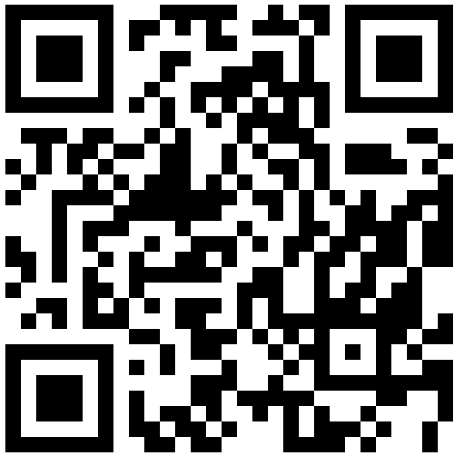
Office Hours

Slide 10
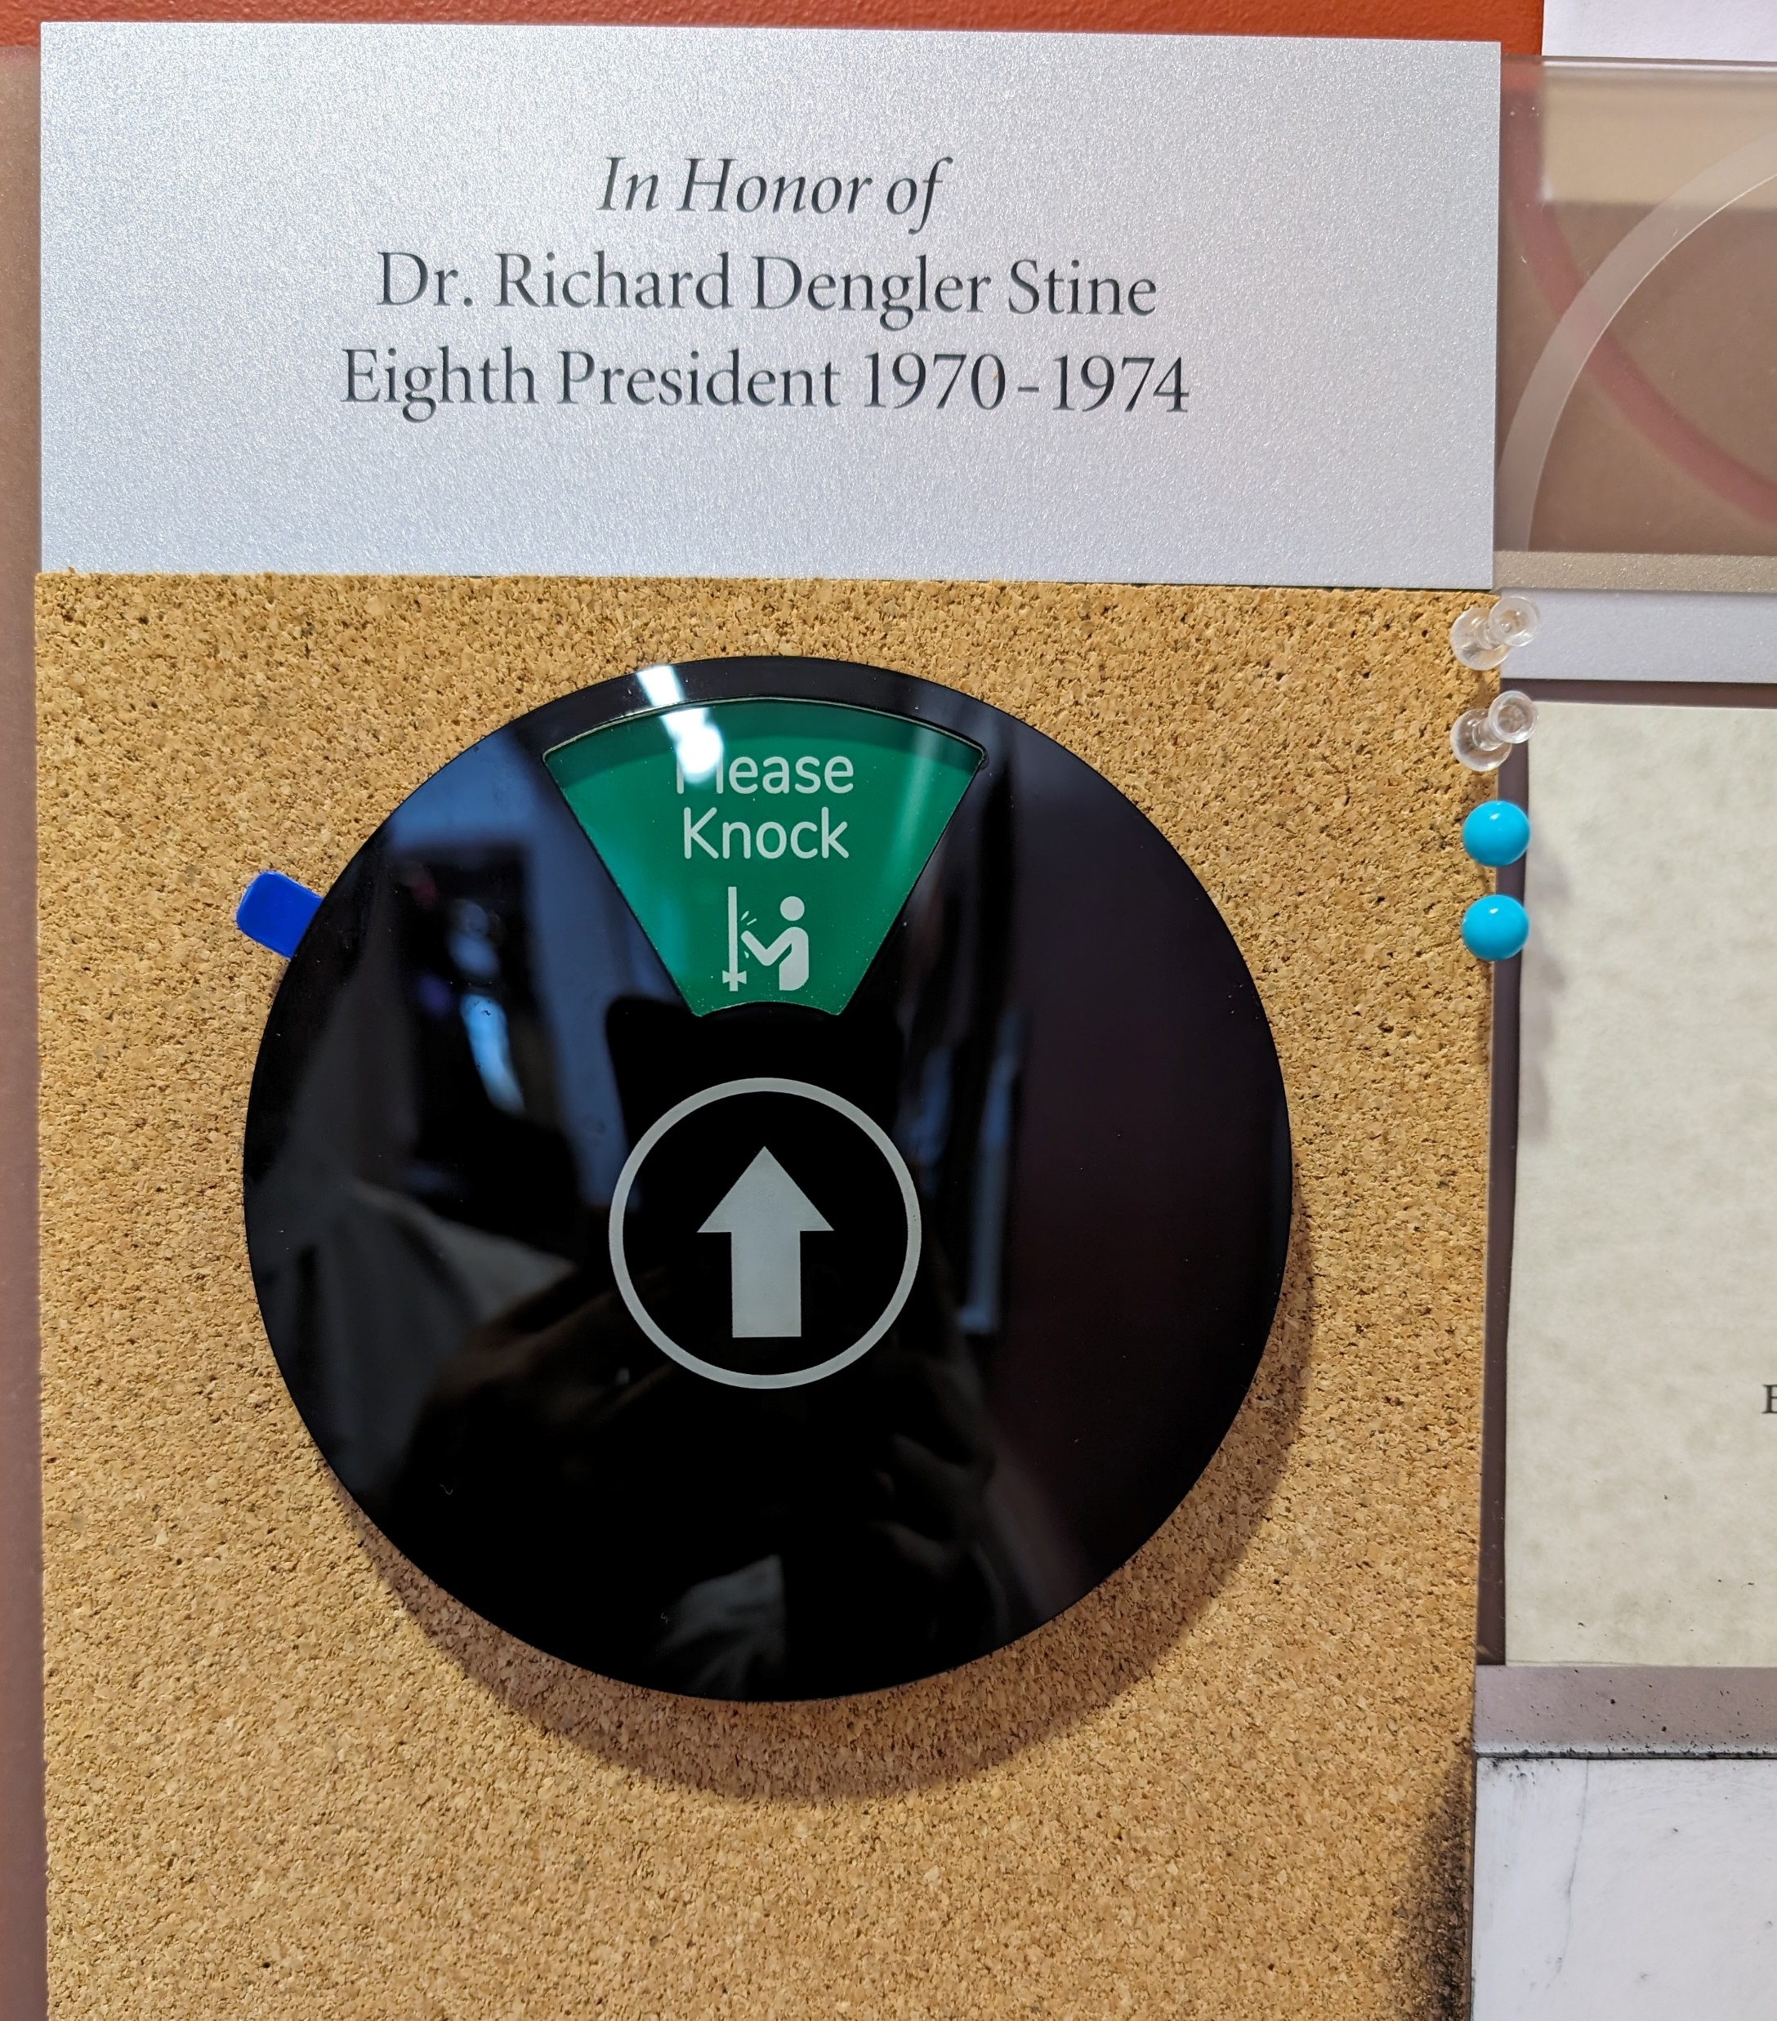
Office Hours
The wheel is set at Please Knock, then feel free to knock and enter.
The wheel is set at Back Soon, then the instructor will be back in 30 minutes.
When the wheel is set to any other status, the instructor will not be available.

Slide 11
Grades
The semester “Grand Total” will be based on four factors:
  Attendance: 10%
  Homework: 15%
  Quizzes: 45%
  Final Exam: 30%
No predetermined “cutoff” points for letter grades.
  Last semester for ECON 300 “A” was “Above 90,” and “A-” was “Between 87 and 90.”
The cutoffs will be determined later in the semester.

Slide 12
Attendance
Attendance may be called every time we meet.
One “no-points-deducted” absence for each month.
Extra “no-points-deducted” absences may be granted on a case-by-case basis.
Attendance scores will be calculated as:
$$Attendance= \frac{\# Attendance Checks−\# Absences+\# Excused Absences}{\# Attendance Checks}×10$$

Slide 13
Homework
Homework will be assigned through the Pearson MyLab platform.
Homework will be announced in class when assigned, and students will have one week to finish each homework assignment.
Students get a total of 5 attempts, and the max score out of all five attempts will be used when determining the grand total score.

Slide 14
Quizzes
6 in-person quizzes are planned throughout the semester and will act as a low-stakes status check.
Students may recover extra credit by attending recovery office hours and “correcting” any mistakes made.
The lowest quiz will be dropped at the end of the semester when calculating the grand total score.
Quizzes may be substituted to homework assignments at the instructor’s discretion.

Slide 15
Final Exam
The final exam will be a comprehensive exam on all materials covered over the semester.
No “recovery sessions” for partial credit for exams.
Students may submit a request for regrading within the first 3 days the scores are made available.
If you miss the final exam due to valid cause, the option would be either a written make-up exam, or an oral exam.

Slide 16

PollEverywhere
https://pollev.com/brianpark046

Slide 17
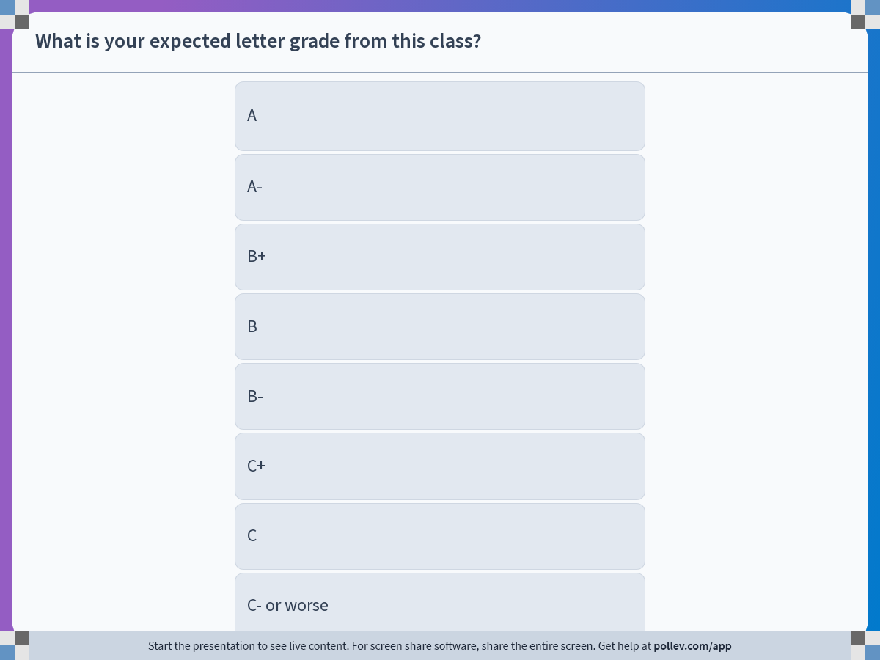
Notes:
Poll Title: Do not modify the notes in this section to avoid tampering with the Poll Everywhere activity.
More info at polleverywhere.com/support
What is your expected letter grade from this class?
https://www.polleverywhere.com/multiple_choice_polls/CbK3EUF22j8SSEKUVH8Xx?display_state=instructions&activity_state=opened&state=opened&flow=Engagement&onscreen=persist

Slide 18
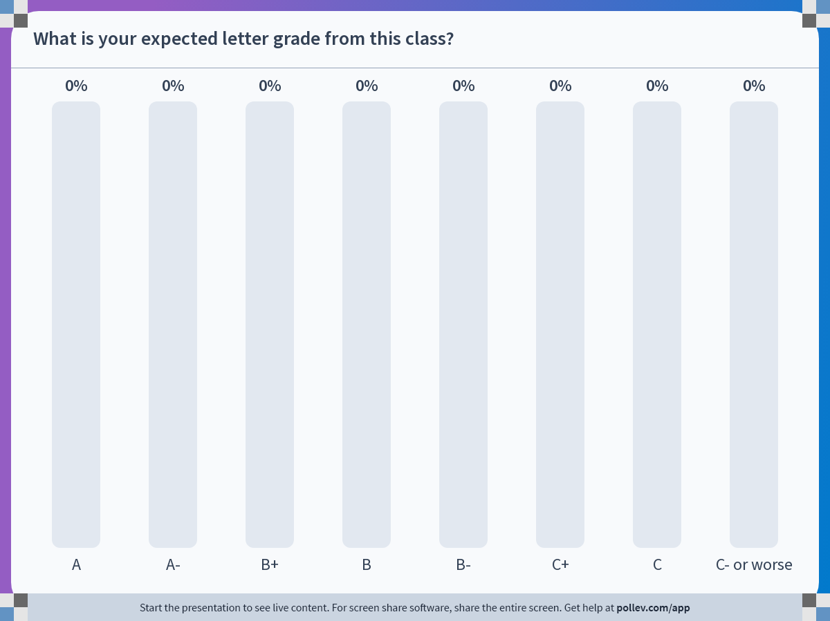
Notes:
Poll Title: Do not modify the notes in this section to avoid tampering with the Poll Everywhere activity.
More info at polleverywhere.com/support
What is your expected letter grade from this class?
https://www.polleverywhere.com/multiple_choice_polls/CbK3EUF22j8SSEKUVH8Xx?display_state=chart&activity_state=closed&state=closed&flow=Engagement&onscreen=persist

