Slide 1
The Open Economy:
The IS-LM Framework
ECON 301

Slide 2

https://pollev.com/brianpark046

Slide 3
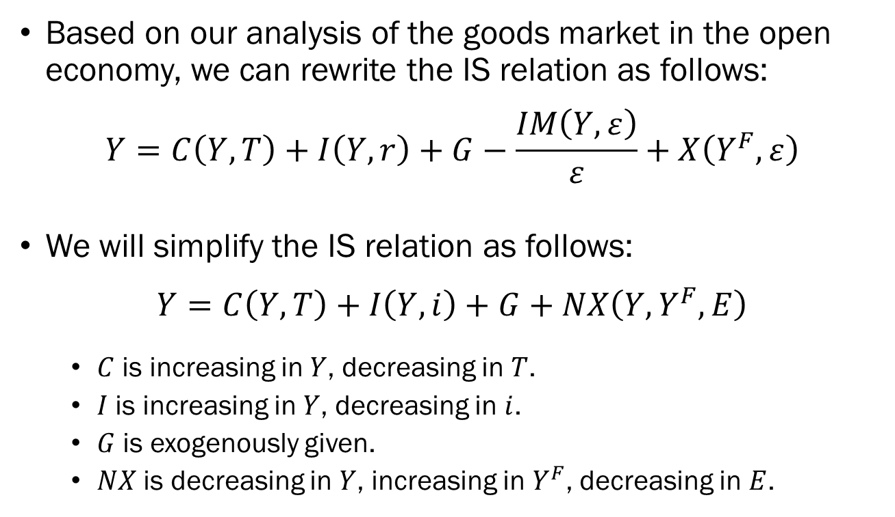
The Equilibrium in the Open Economy:
The Goods Market
Based on our analysis of the goods market in the open economy, we can rewrite the IS relation as follows:
$$Y=C\left(Y,T\right)+I\left(Y,r\right)+G−\frac{IM\left(Y,ε\right)}{ε}+X\left(Y^{F},ε\right)$$
We will simplify the IS relation as follows:
$$Y=C\left(Y,T\right)+I\left(Y,i\right)+G+NX\left(Y,Y^{F},E\right)$$
  $C$ is increasing in $Y$, decreasing in $T$.
  $I$ is increasing in $Y$, decreasing in $i$.
  $G$ is exogenously given.
  $NX$ is decreasing in $Y$, increasing in $Y^{F}$, decreasing in $E$.

Slide 4
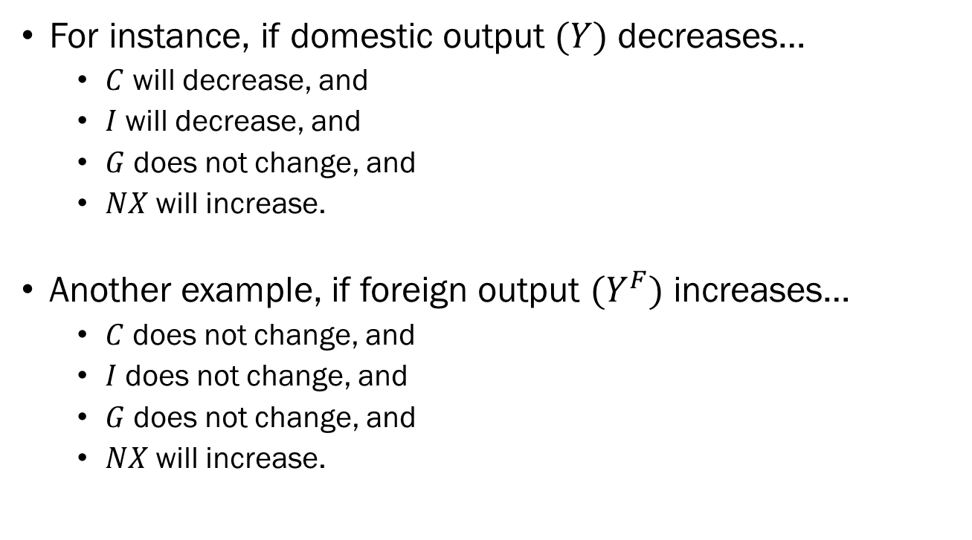
The Equilibrium in the Open Economy:
The Goods Market
For instance, if domestic output $(Y)$ decreases…
  $C$ will decrease, and
  $I$ will decrease, and
  $G$ does not change, and
  $NX$ will increase.
Another example, if foreign output $(Y^{F})$ increases…
  $C$ does not change, and
  $I$ does not change, and
  $G$ does not change, and
  $NX$ will increase.

Slide 5
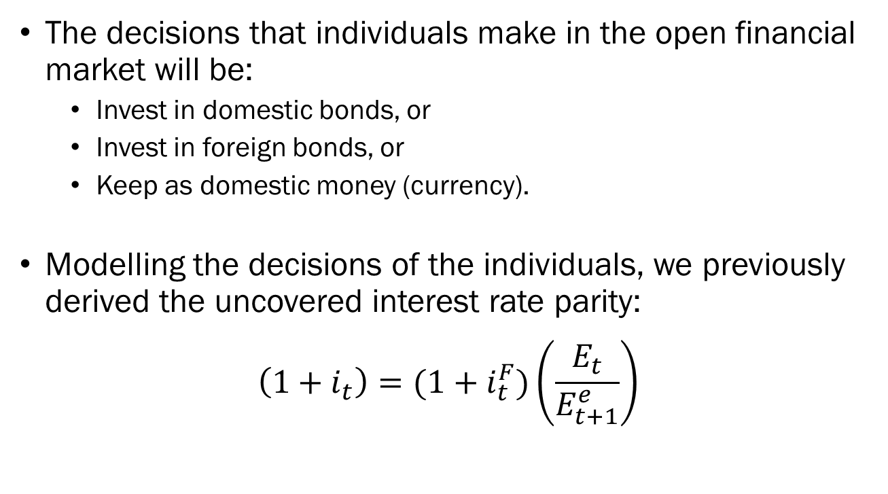
The Equilibrium in the Open Economy:
The Financial Market
The decisions that individuals make in the open financial market will be:
  Invest in domestic bonds, or
  Invest in foreign bonds, or
  Keep as domestic money (currency).
Modelling the decisions of the individuals, we previously derived the uncovered interest rate parity:
$$\left(1+i_{t}\right)=(1+i_{t}^{F})\left(\frac{E_{t}}{E_{t+1}^{e}}\right)$$

Slide 6
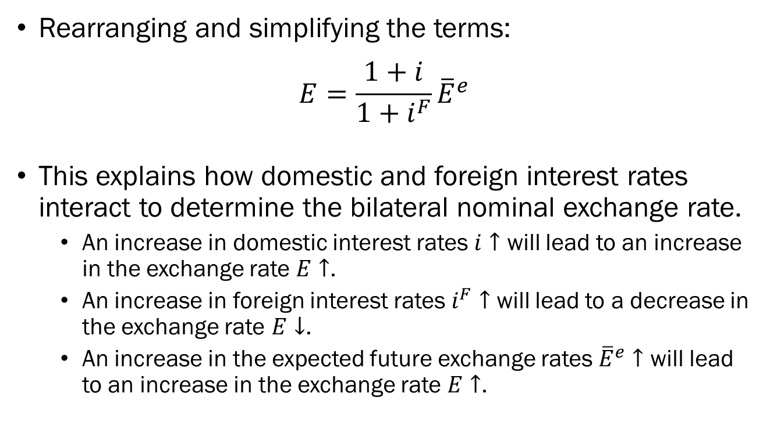
The Equilibrium in the Open Economy:
Interest Rate Parity
Rearranging and simplifying the terms:
$$E=\frac{1+i}{1+i^{F}}{\overline{E}}^{e}$$
This explains how domestic and foreign interest rates interact to determine the bilateral nominal exchange rate.
  An increase in domestic interest rates $i↑$ will lead to an increase in the exchange rate $E↑$.
  An increase in foreign interest rates $i^{F}↑$ will lead to a decrease in the exchange rate $E↓$.
  An increase in the expected future exchange rates ${\overline{E}}^{e}↑$ will lead to an increase in the exchange rate $E↑$.

Slide 7
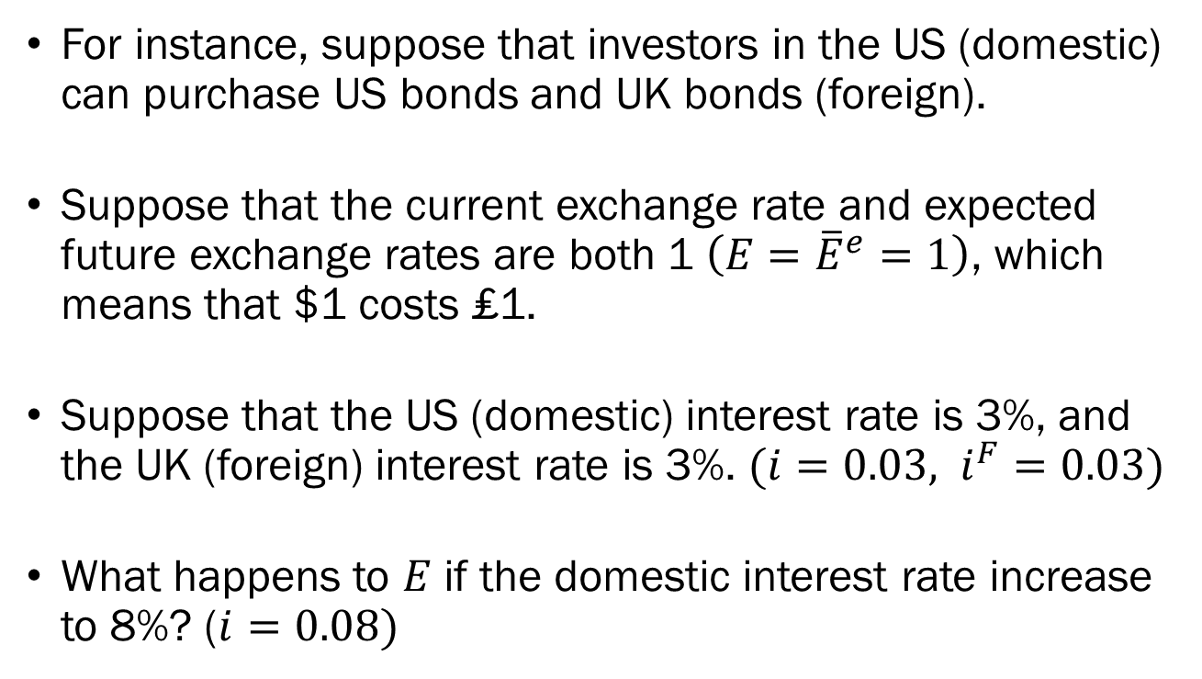
Interest Rate Parity:
Example #1
For instance, suppose that investors in the US (domestic) can purchase US bonds and UK bonds (foreign).
Suppose that the current exchange rate and expected future exchange rates are both 1 $\left(E={\overline{E}}^{e}=1\right)$, which means that $1 costs ₤1.
Suppose that the US (domestic) interest rate is 3%, and the UK (foreign) interest rate is 3%. $(i=0.03, i^{F}=0.03)$
What happens to $E$ if the domestic interest rate increase to 8%? ($i=0.08)$

Slide 8
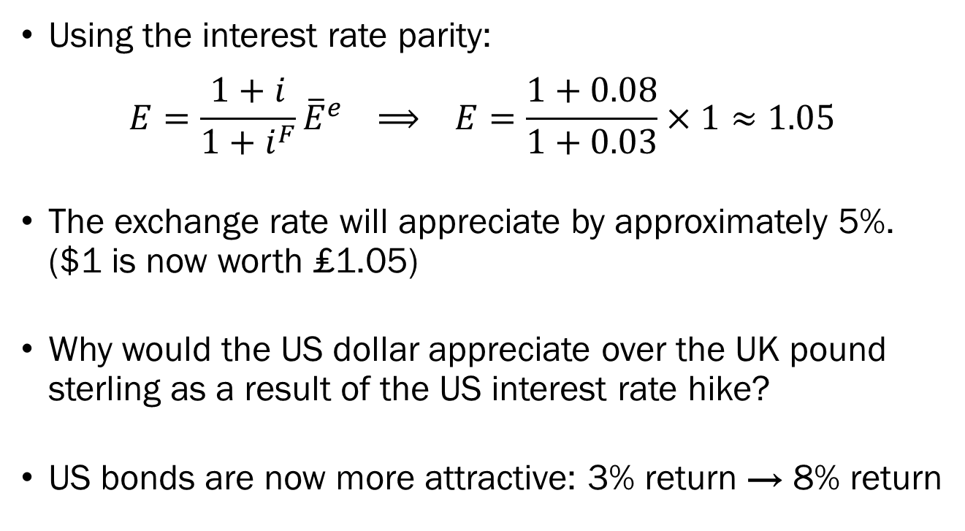
Interest Rate Parity:
Example #1
Using the interest rate parity:
$$E=\frac{1+i}{1+i^{F}}{\overline{E}}^{e} ⟹ E=\frac{1+0.08}{1+0.03}×1≈1.05$$
The exchange rate will appreciate by approximately 5%. ($1 is now worth ₤1.05)
Why would the US dollar appreciate over the UK pound sterling as a result of the US interest rate hike?
US bonds are now more attractive: 3% return → 8% return

Slide 9
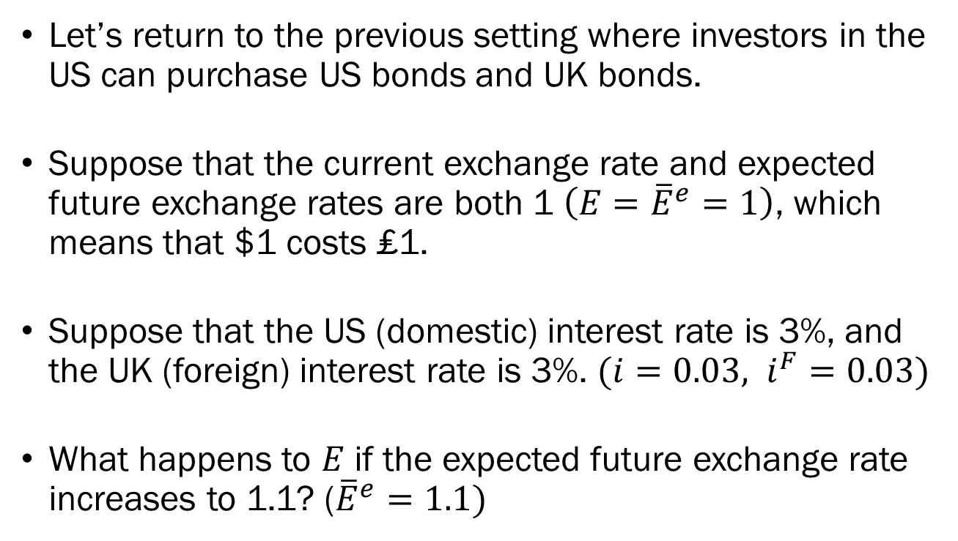
Interest Rate Parity:
Example #2
Let’s return to the previous setting where investors in the US can purchase US bonds and UK bonds.
Suppose that the current exchange rate and expected future exchange rates are both 1 $\left(E={\overline{E}}^{e}=1\right)$, which means that $1 costs ₤1.
Suppose that the US (domestic) interest rate is 3%, and the UK (foreign) interest rate is 3%. $(i=0.03, i^{F}=0.03)$
What happens to $E$ if the expected future exchange rate increases to 1.1? (${\overline{E}}^{e}=1.1)$

Slide 10
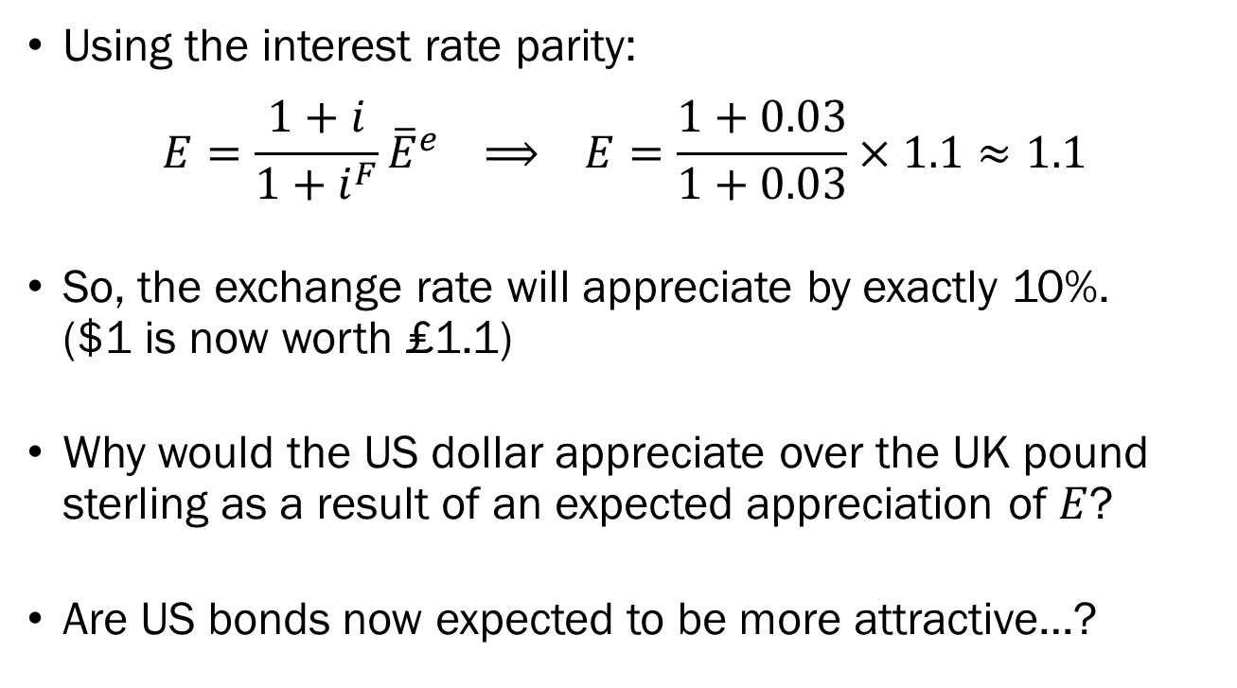
Interest Rate Parity:
Example #2
Using the interest rate parity:
$$E=\frac{1+i}{1+i^{F}}{\overline{E}}^{e} ⟹ E=\frac{1+0.03}{1+0.03}×1.1≈1.1$$
So, the exchange rate will appreciate by exactly 10%. ($1 is now worth ₤1.1)
Why would the US dollar appreciate over the UK pound sterling as a result of an expected appreciation of $E$?
Are US bonds now expected to be more attractive…?

Slide 11
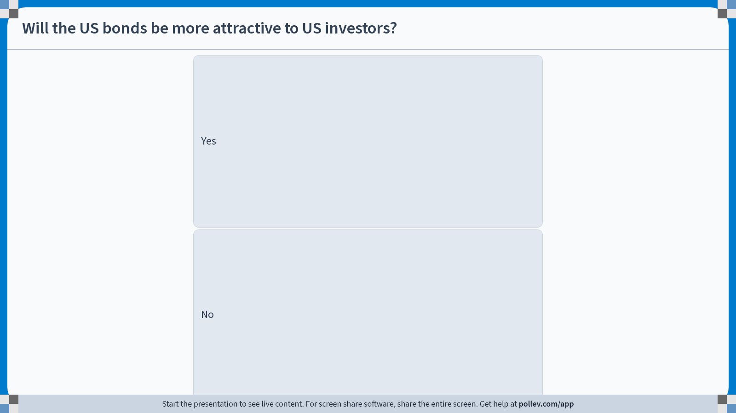
Notes:
Poll Title: Do not modify the notes in this section to avoid tampering with the Poll Everywhere activity.
More info at polleverywhere.com/support
Will the US bonds be more attractive to US investors?
https://www.polleverywhere.com/multiple_choice_polls/FTgaKECKhuPGfDlSQGdmf?display_state=instructions&activity_state=opened&state=opened&flow=Engagement&onscreen=persist

Slide 12
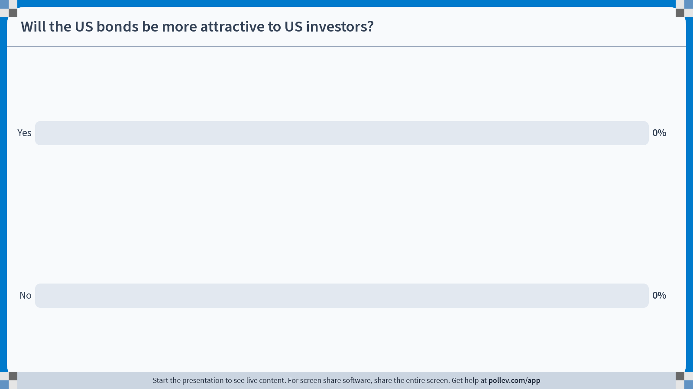
Notes:
Poll Title: Do not modify the notes in this section to avoid tampering with the Poll Everywhere activity.
More info at polleverywhere.com/support
Will the US bonds be more attractive to US investors?
https://www.polleverywhere.com/multiple_choice_polls/FTgaKECKhuPGfDlSQGdmf?display_state=chart&activity_state=closed&state=closed&flow=Engagement&onscreen=persist

Slide 13






Interest Rate Parity:
Example #2
Investing in US bonds directly, the US investor gets:
Investing in UK bonds, the US investor gets:
$$\$100$$
Bond Pays Interest
$$\$103$$
$$\$100$$
$$\$\frac{103}{1.1}≈\$93.64$$
Convert
Convert
USD to GBP
GBP to USD
$$\text{£}100$$
Bond Pays Interest
$$\text{£}103$$

Slide 14

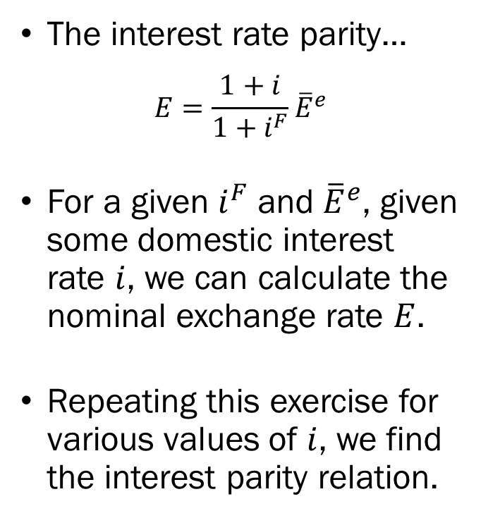


The Equilibrium in the Open Economy:
Interest Rate Parity Visualized
The interest rate parity…
$$E=\frac{1+i}{1+i^{F}}{\overline{E}}^{e}$$
For a given $i^{F}$ and ${\overline{E}}^{e}$, given some domestic interest rate $i$, we can calculate the nominal exchange rate $E$.
Repeating this exercise for various values of $i$, we find the interest parity relation.
Domestic Interest Rate $i$
$$i$$
$$E$$
Exchange Rate, $E$

Slide 15
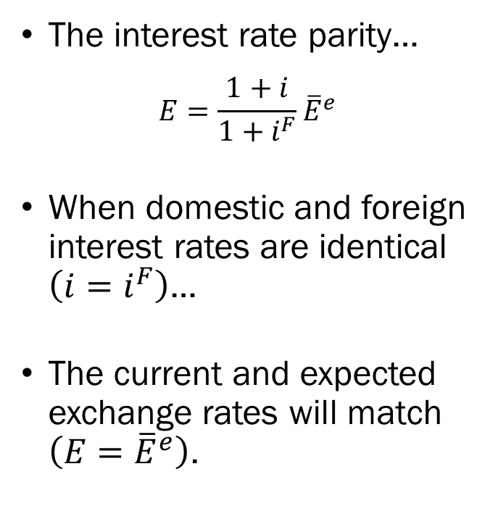


The Equilibrium in the Open Economy:
Interest Rate Parity Visualized
The interest rate parity…
$$E=\frac{1+i}{1+i^{F}}{\overline{E}}^{e}$$
When domestic and foreign interest rates are identical $\left(i=i^{F}\right)$…
The current and expected exchange rates will match $\left(E={\overline{E}}^{e}\right)$.
Domestic Interest Rate $i$
$$i=i^{F}$$
$$E={\overline{E}}^{e}$$
Exchange Rate, $E$

Slide 16
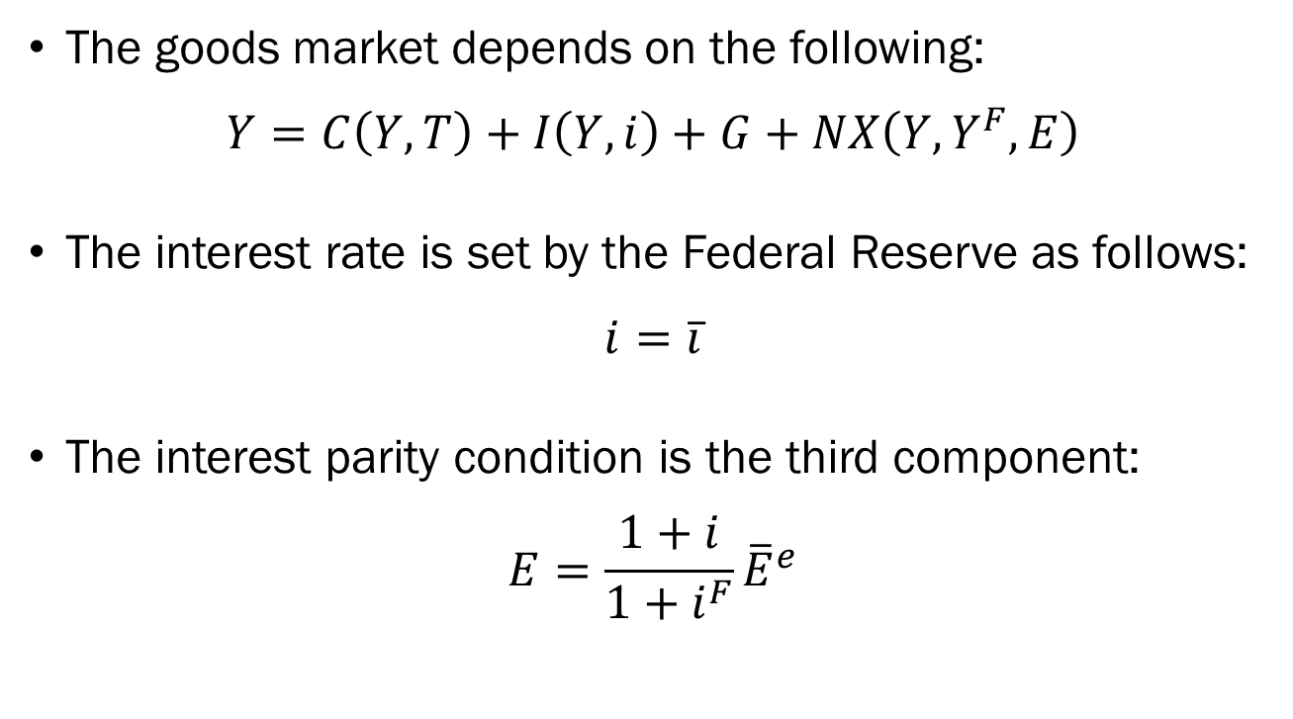
The Equilibrium in the Open Economy:
The Goods and Financial Markets
The goods market depends on the following:
$$Y=C\left(Y,T\right)+I\left(Y,i\right)+G+NX\left(Y,Y^{F},E\right)$$
The interest rate is set by the Federal Reserve as follows:
$$i=\overline{i}$$
The interest parity condition is the third component:
$$E=\frac{1+i}{1+i^{F}}{\overline{E}}^{e}$$

Slide 17
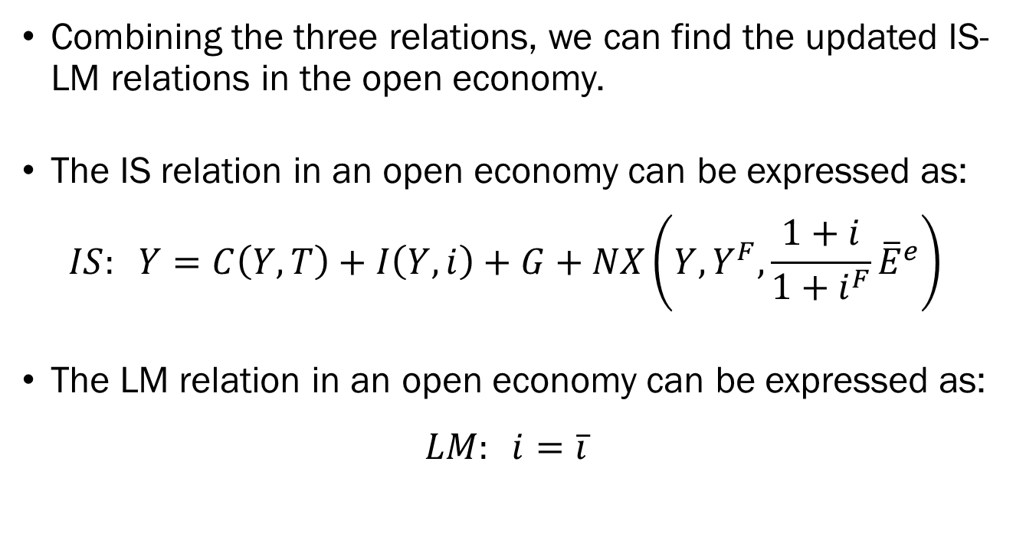
The Equilibrium in the Open Economy:
The Goods and Financial Markets
Combining the three relations, we can find the updated IS-LM relations in the open economy.
The IS relation in an open economy can be expressed as:
$$IS: Y=C\left(Y,T\right)+I\left(Y,i\right)+G+NX\left(Y,Y^{F},\frac{1+i}{1+i^{F}}{\overline{E}}^{e}\right)$$
The LM relation in an open economy can be expressed as:
$$LM: i=\overline{i}$$

Slide 18








The Equilibrium in the Open Economy:
The Goods and Financial Markets
$$Interest$$
$$Parity$$
Domestic Interest Rate $i$
Domestic Interest Rate $i$
$$\overline{i}$$
$$LM$$
$$\overline{i}$$
$$IS$$
$$Y$$
Output, $Y$
$$E$$
Exchange Rate, $E$

Slide 19
The Equilibrium in the Open Economy:
Monetary Policy
Recall that in the closed economy, monetary policy works through the effect of the interest rate on investment.
Monetary policy works through two channels in an open economy.
  The effect of the interest rate on investment, and
  The effect of the interest rate on the exchange rate, and the effect of the exchange rate on exports and imports.
In case of a contractionary monetary policy…

Slide 20






The Equilibrium in the Open Economy:
Contractionary Monetary Policy
$$Interest$$
$$Parity$$
Domestic Interest Rate $i$
Domestic Interest Rate $i$
$${\overline{i}}^{′}$$
$$LM^{′}$$
$${\overline{i}}^{′}$$
$$\overline{i}$$
$$LM$$
$$\overline{i}$$
$$IS$$
$$Y^{′}$$
$$Y$$
Output, $Y$
$$E$$
$$E^{′}$$
Exchange Rate, $E$

Slide 21
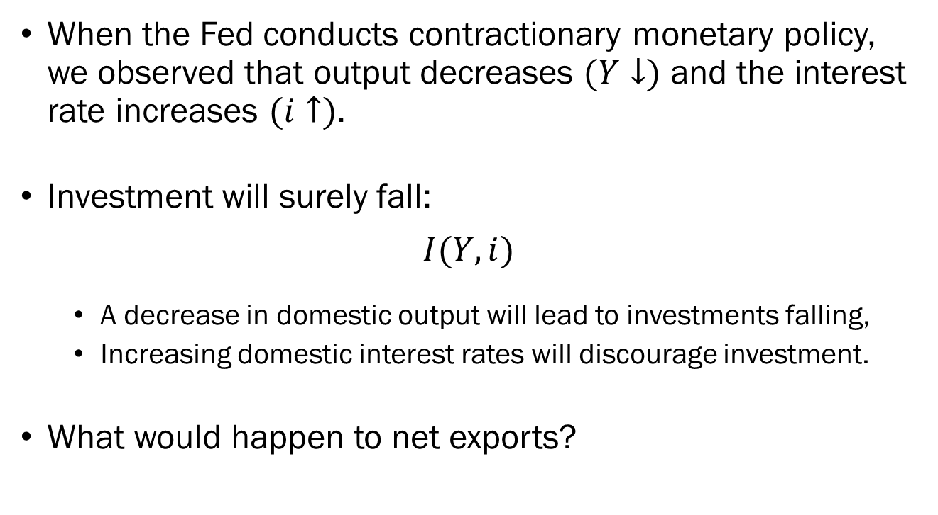
The Equilibrium in the Open Economy:
Contractionary Monetary Policy
When the Fed conducts contractionary monetary policy, we observed that output decreases $(Y↓)$ and the interest rate increases $(i↑)$.
Investment will surely fall:
$$I(Y,i)$$
  A decrease in domestic output will lead to investments falling,
  Increasing domestic interest rates will discourage investment.
What would happen to net exports?

Slide 22
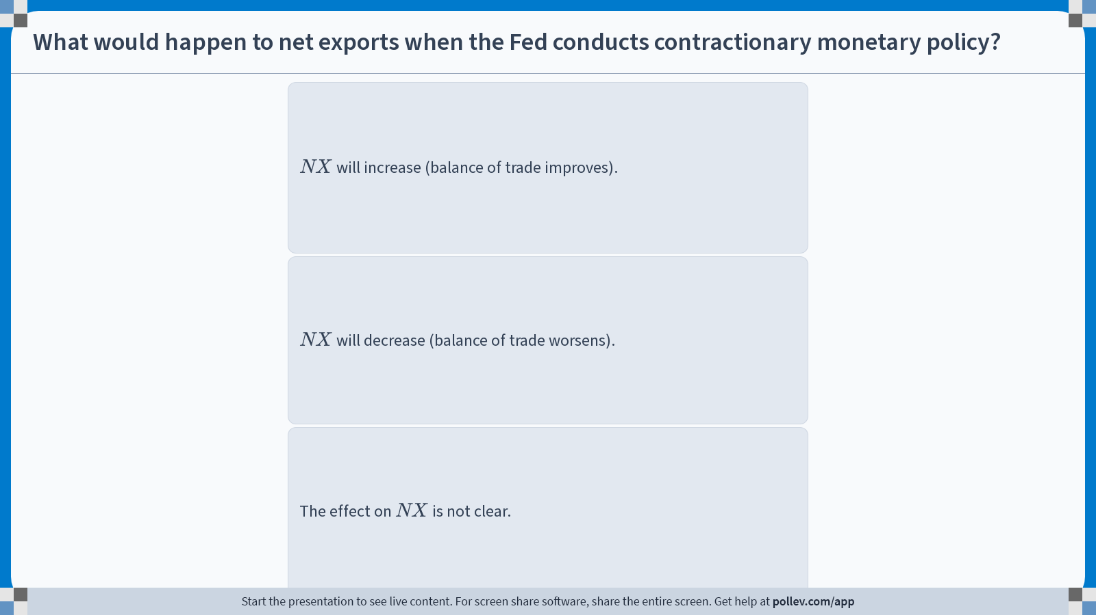
Notes:
Poll Title: Do not modify the notes in this section to avoid tampering with the Poll Everywhere activity.
More info at polleverywhere.com/support
What would happen to net exports when the Fed conducts contractionary monetary policy?
https://www.polleverywhere.com/multiple_choice_polls/mTaICMNauSYra7x6du5jb?display_state=instructions&activity_state=opened&state=opened&flow=Engagement&onscreen=persist

Slide 23
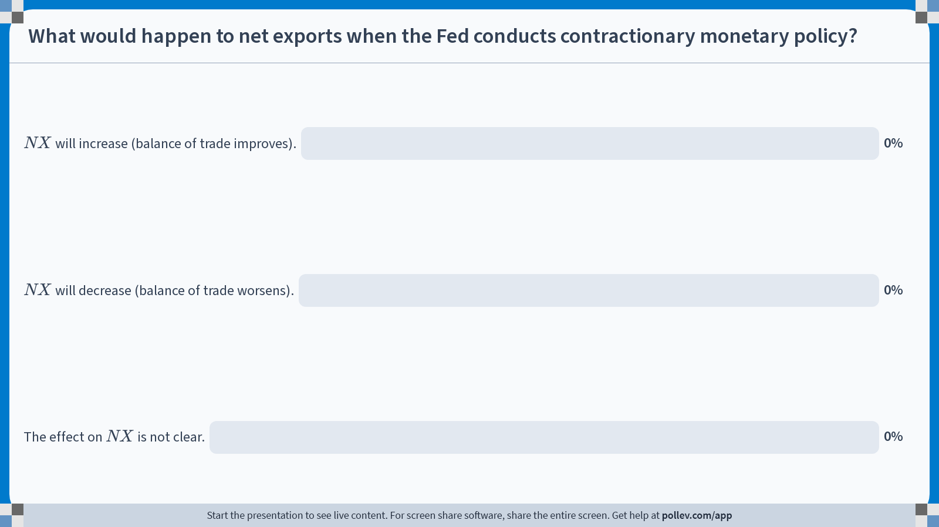
Notes:
Poll Title: Do not modify the notes in this section to avoid tampering with the Poll Everywhere activity.
More info at polleverywhere.com/support
What would happen to net exports when the Fed conducts contractionary monetary policy?
https://www.polleverywhere.com/multiple_choice_polls/mTaICMNauSYra7x6du5jb?display_state=chart&activity_state=closed&state=closed&flow=Engagement&onscreen=persist

Slide 24
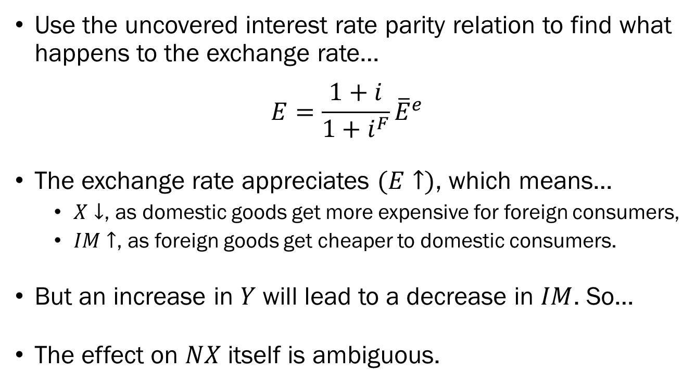
Solutions to In-Class Poll
Use the uncovered interest rate parity relation to find what happens to the exchange rate…
$$E=\frac{1+i}{1+i^{F}}{\overline{E}}^{e}$$
The exchange rate appreciates $(E↑)$, which means…
  $X↓$, as domestic goods get more expensive for foreign consumers,
  $IM↑$, as foreign goods get cheaper to domestic consumers.
But an increase in $Y$ will lead to a decrease in $IM$. So…
The effect on $NX$ itself is ambiguous.

Slide 25





The Equilibrium in the Open Economy:
Expansionary Monetary Policy
$$Interest$$
$$Parity$$
Domestic Interest Rate $i$
Domestic Interest Rate $i$
$$\overline{i}$$
$$LM$$
$$\overline{i}$$
$${\overline{i}}^{′}$$
$$LM^{′}$$
$$\overline{i^{′}}$$
$$IS$$
$$Y$$
$$Y^{′}$$
Output, $Y$
$$E^{′}$$
$$E$$
Exchange Rate, $E$

Slide 26
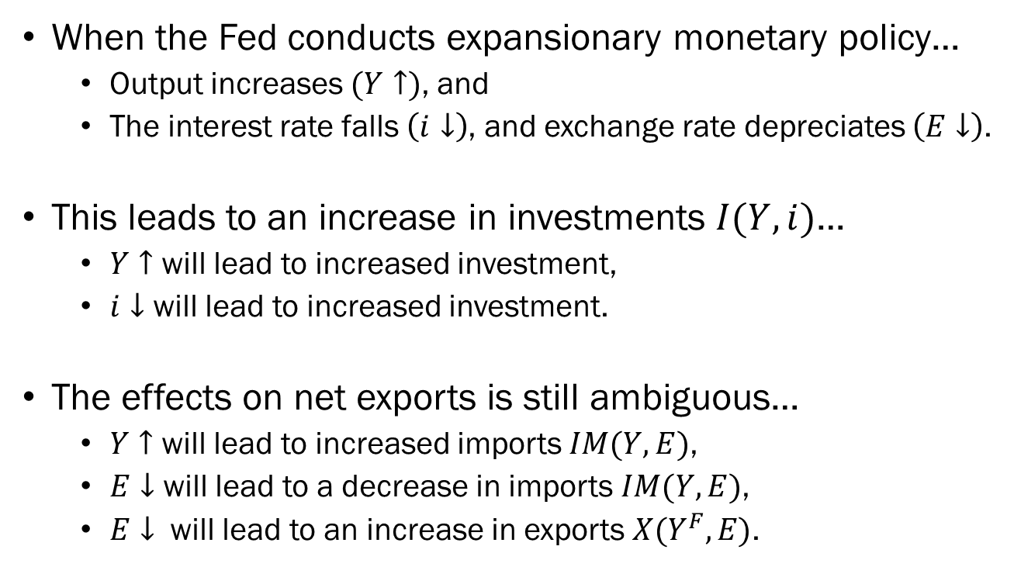
The Equilibrium in the Open Economy:
Expansionary Monetary Policy
When the Fed conducts expansionary monetary policy…
  Output increases $(Y↑)$, and
  The interest rate falls $\left(i↓\right)$, and exchange rate depreciates $\left(E↓\right)$.
This leads to an increase in investments $I(Y,i)$…
  $Y↑$ will lead to increased investment,
  $i↓$ will lead to increased investment.
The effects on net exports is still ambiguous…
  $Y↑$ will lead to increased imports $IM(Y,E)$,
  $E↓$ will lead to a decrease in imports $IM(Y,E)$,
  $E↓$ will lead to an increase in exports $X(Y^{F},E)$.

Slide 27

The Equilibrium in the Open Economy:
Expansionary Fiscal Policy
$$Interest$$
$$Parity$$
Domestic Interest Rate $i$
Domestic Interest Rate $i$
$$\overline{i}$$
$$LM$$
$$\overline{i}$$
$$IS^{′}$$
$$IS$$
$$Y$$
$$Y^{′}$$
Output, $Y$
$$E$$
Exchange Rate, $E$

Slide 28
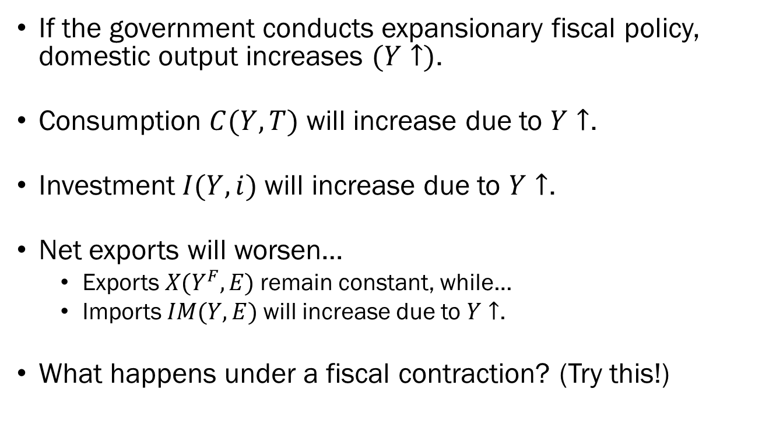
The Equilibrium in the Open Economy:
Expansionary Fiscal Policy
If the government conducts expansionary fiscal policy, domestic output increases $(Y↑)$.
Consumption $C(Y,T)$ will increase due to $Y↑$.
Investment $I(Y,i)$will increase due to $Y↑$.
Net exports will worsen…
  Exports $X(Y^{F},E)$remain constant, while…
  Imports $IM(Y,E)$will increase due to $Y↑$.
What happens under a fiscal contraction? (Try this!)

Slide 29
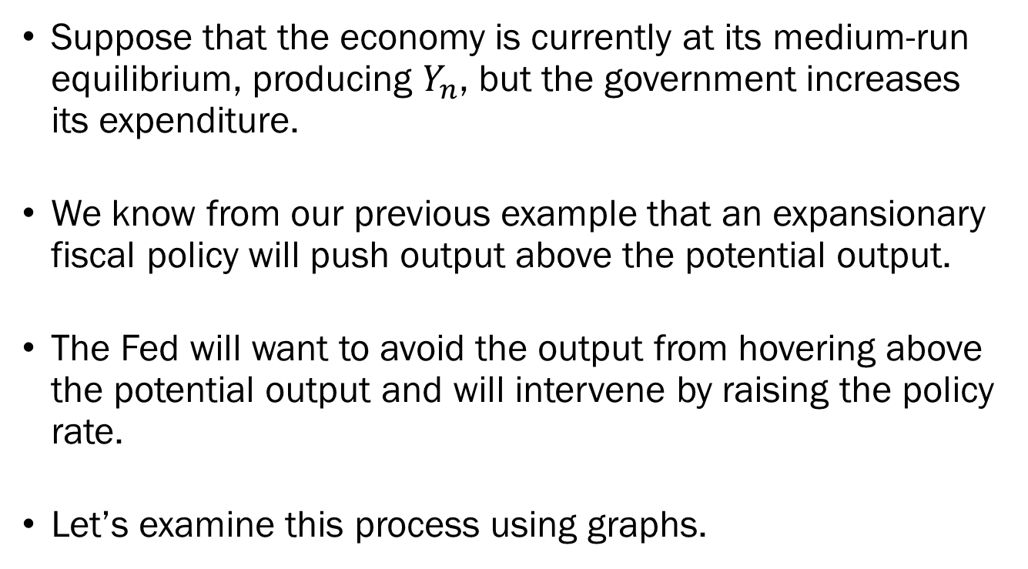
The Equilibrium in the Open Economy:
Fiscal & Monetary Policy
Suppose that the economy is currently at its medium-run equilibrium, producing $Y_{n}$, but the government increases its expenditure.
We know from our previous example that an expansionary fiscal policy will push output above the potential output.
The Fed will want to avoid the output from hovering above the potential output and will intervene by raising the policy rate.
Let’s examine this process using graphs.

Slide 30











The Equilibrium in the Open Economy:
Fiscal & Monetary Policy
$$i$$
$$i$$
$$Interest$$
$$Parity$$
$$A^{′′}$$
$$A^{′′}$$
$${\overline{i}}^{′}$$
$$LM^{′}$$
$${\overline{i}}^{′}$$
$$A$$
$$A^{′}$$
$$A$$
$$\overline{i}$$
$$LM$$
$$\overline{i}$$
$$IS^{′}$$
$$IS$$
$$Y_{n}$$
$$Y^{′′}$$
$$Y^{′}$$
$$Y$$
$$E$$
$$E^{′′}$$
$$E$$

Slide 31
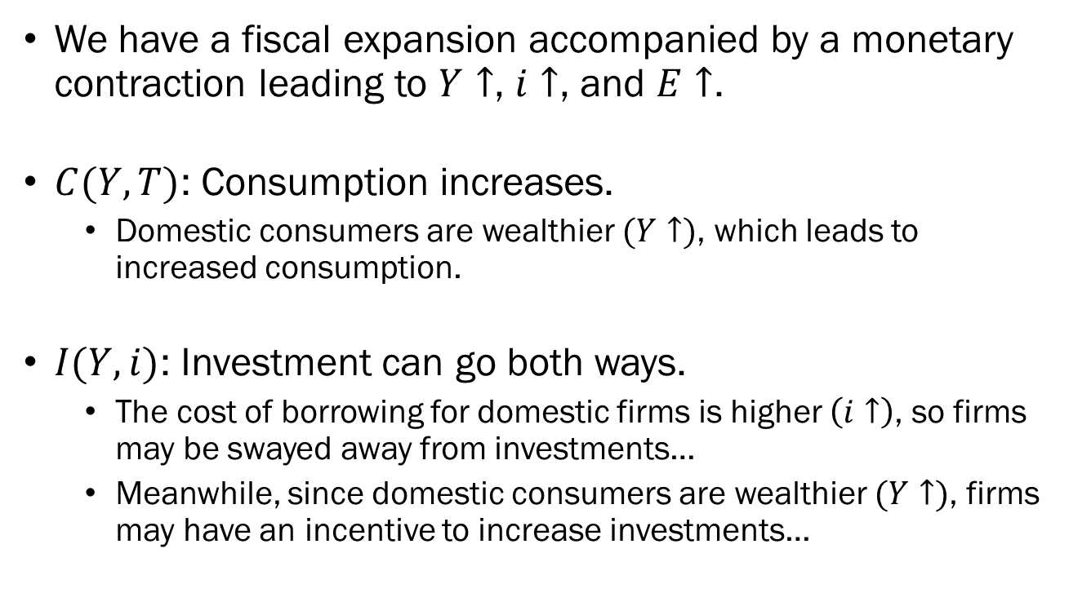
The Equilibrium in the Open Economy:
Fiscal & Monetary Policy
We have a fiscal expansion accompanied by a monetary contraction leading to $Y↑$, $i↑$, and $E↑$.
$C(Y,T)$: Consumption increases.
  Domestic consumers are wealthier $(Y↑)$, which leads to increased consumption.
$I(Y,i)$: Investment can go both ways.
  The cost of borrowing for domestic firms is higher $\left(i↑\right)$, so firms may be swayed away from investments…
  Meanwhile, since domestic consumers are wealthier $(Y↑)$, firms may have an incentive to increase investments…

Slide 32
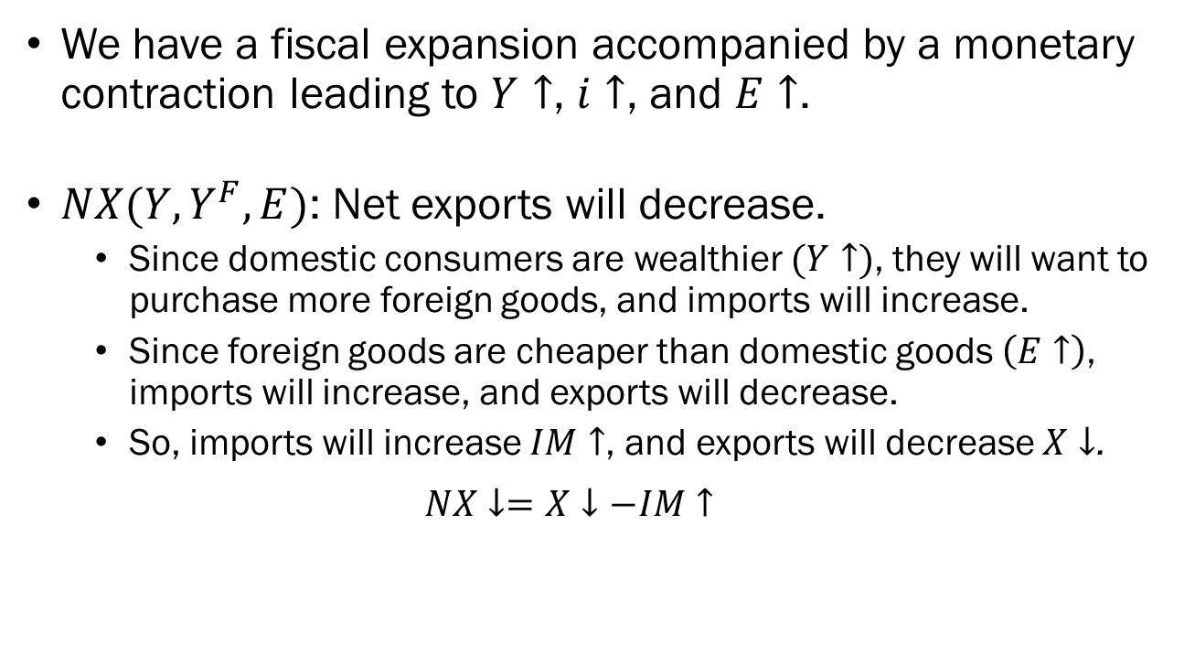
The Equilibrium in the Open Economy:
Fiscal & Monetary Policy
We have a fiscal expansion accompanied by a monetary contraction leading to $Y↑$, $i↑$, and $E↑$.
$NX(Y,Y^{F},E)$: Net exports will decrease.
  Since domestic consumers are wealthier $(Y↑)$, they will want to purchase more foreign goods, and imports will increase.
  Since foreign goods are cheaper than domestic goods $\left(E↑\right)$, imports will increase, and exports will decrease.
  So, imports will increase $IM↑$, and exports will decrease $X↓$.
  $$NX↓=X↓−IM↑$$

Slide 33
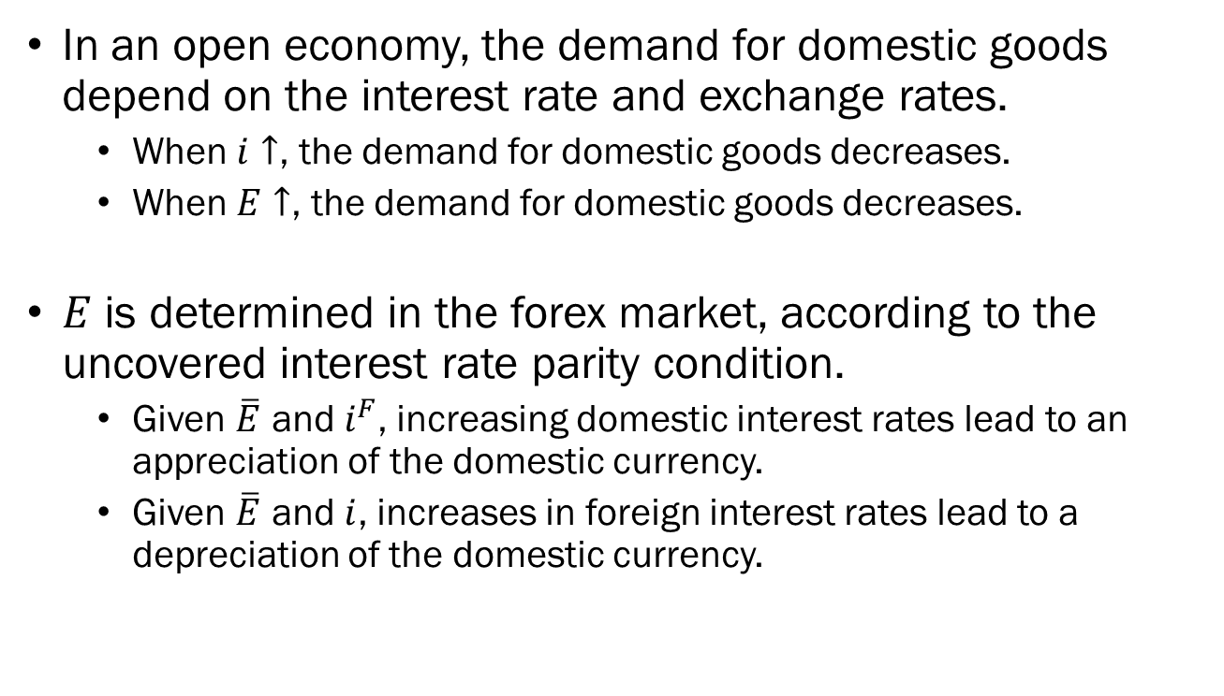
Wrapping Up
In an open economy, the demand for domestic goods depend on the interest rate and exchange rates.
  When $i↑$, the demand for domestic goods decreases.
  When $E↑$, the demand for domestic goods decreases.
$E$ is determined in the forex market, according to the uncovered interest rate parity condition.
  Given $\overline{E}$ and $i^{F}$, increasing domestic interest rates lead to an appreciation of the domestic currency.
  Given $\overline{E}$ and $i$, increases in foreign interest rates lead to a depreciation of the domestic currency.

Slide 34
Wrapping Up
Expansionary fiscal policies in an open economy will lead to an increase in output.
  …but may be offset by contractionary monetary policies enacted by the Central Banks fearing the economy “heating up” too much.
  This increases the interest rates and leads to an appreciation of the domestic currency.
Expansionary monetary policies will lead to an increase in output, a decrease of domestic interest rates, and a depreciation of the domestic currency.

