Slide 1
Consumer Theory:
The Utility Maximization Problem
ECON 300

Slide 2

PollEv.com/brianpark046

Slide 3
Review of Previous Lecture
The Law of Diminishing Marginal Utility.
Marginal Rate of Substitution.
Cobb-Douglas Utility Functions.
Linear Utility Functions.
Leontief Utility Functions.

Slide 4
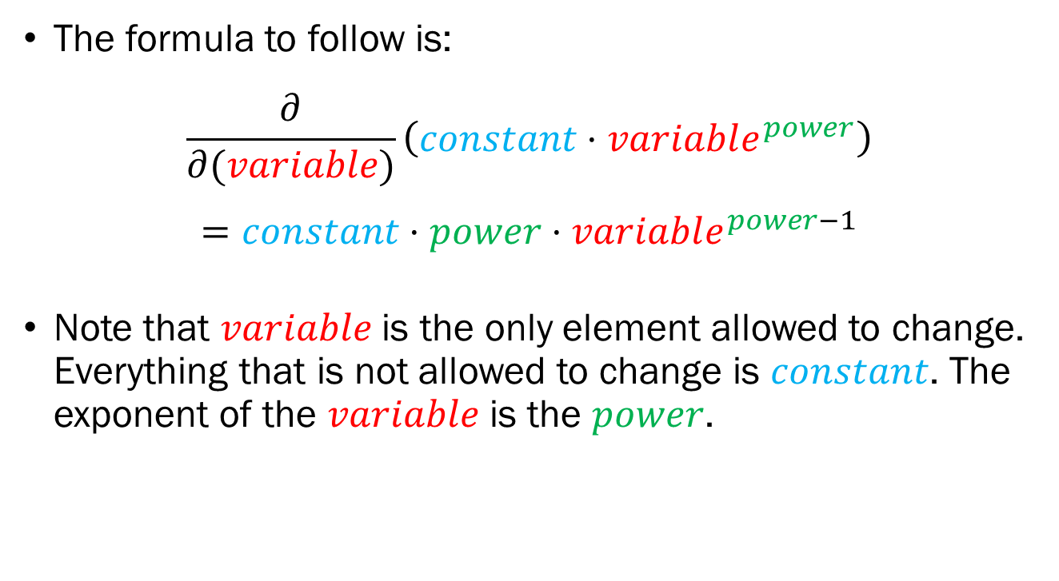
Recap: Partial Derivatives
The formula to follow is:
$$\frac{∂}{∂(variable)}\left(constant⋅variable^{power}\right)$$
$$=constant⋅power⋅variable^{power−1}$$
Note that $variable$is the only element allowed to change. Everything that is not allowed to change is $constant$. The exponent of the $variable$ is the $power$.

Slide 5

Recap: Partial Derivatives
$$\frac{∂}{∂(variable)}\left(constant⋅variable^{power}\right)$$
$$=constant⋅power⋅variable^{power−1}$$
Try out the following:
  $\frac{∂}{∂x}10x^{2}y$
  $\frac{∂}{∂y}10x^{2}y$

Slide 6
The Utility Maximization Problem
The consumer has preferences when it comes to consumption, represented by the utility function, which is visualized as the indifference curves.
The consumer also has a limiting factor, the budget constraint, which sets a cap on the consumer’s wants based on the consumer’s income and price of goods.
The consumer wants to find the commodity bundle that maximizes their utility, while not violating the budget constraint.

Slide 7
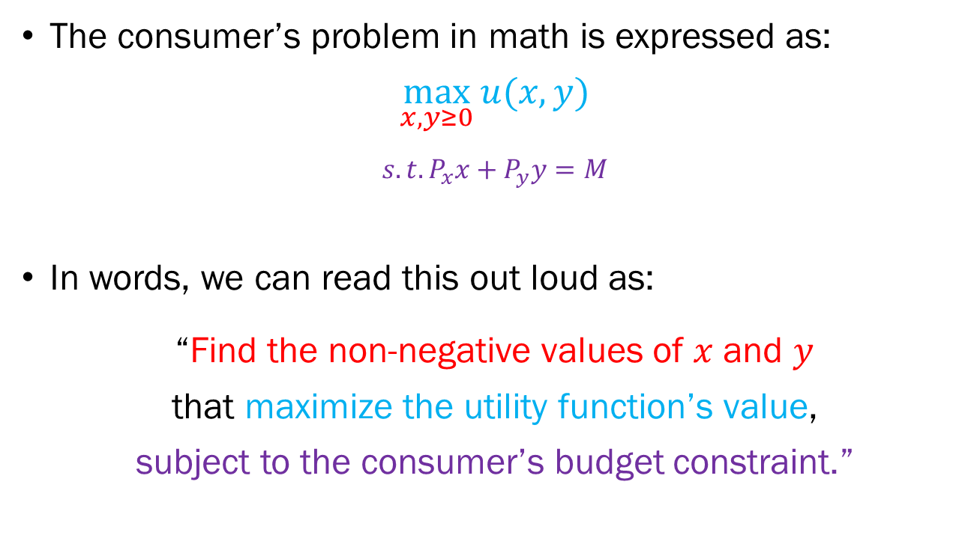
The Utility Maximization Problem
The consumer’s problem in math is expressed as:
$$\max_{x,y≥0}{u(x,y)}$$
$$s.t. P_{x}x+P_{y}y=M$$
In words, we can read this out loud as:
“Find the non-negative values of $x$ and $y$
that maximize the utility function’s value,
subject to the consumer’s budget constraint.”

Slide 8
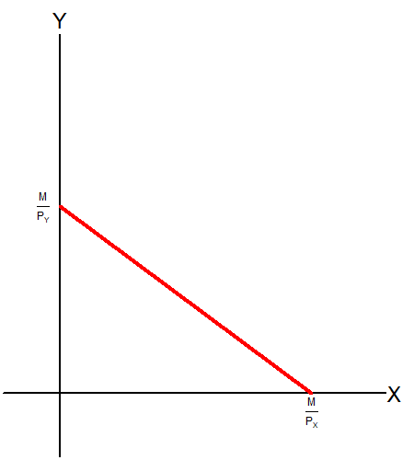
Recap: Budget Constraint
Recall what the budget constraint looks like when it is plotted in the commodity space.
The budget line “splits” the commodity space into two sections:

Slide 9
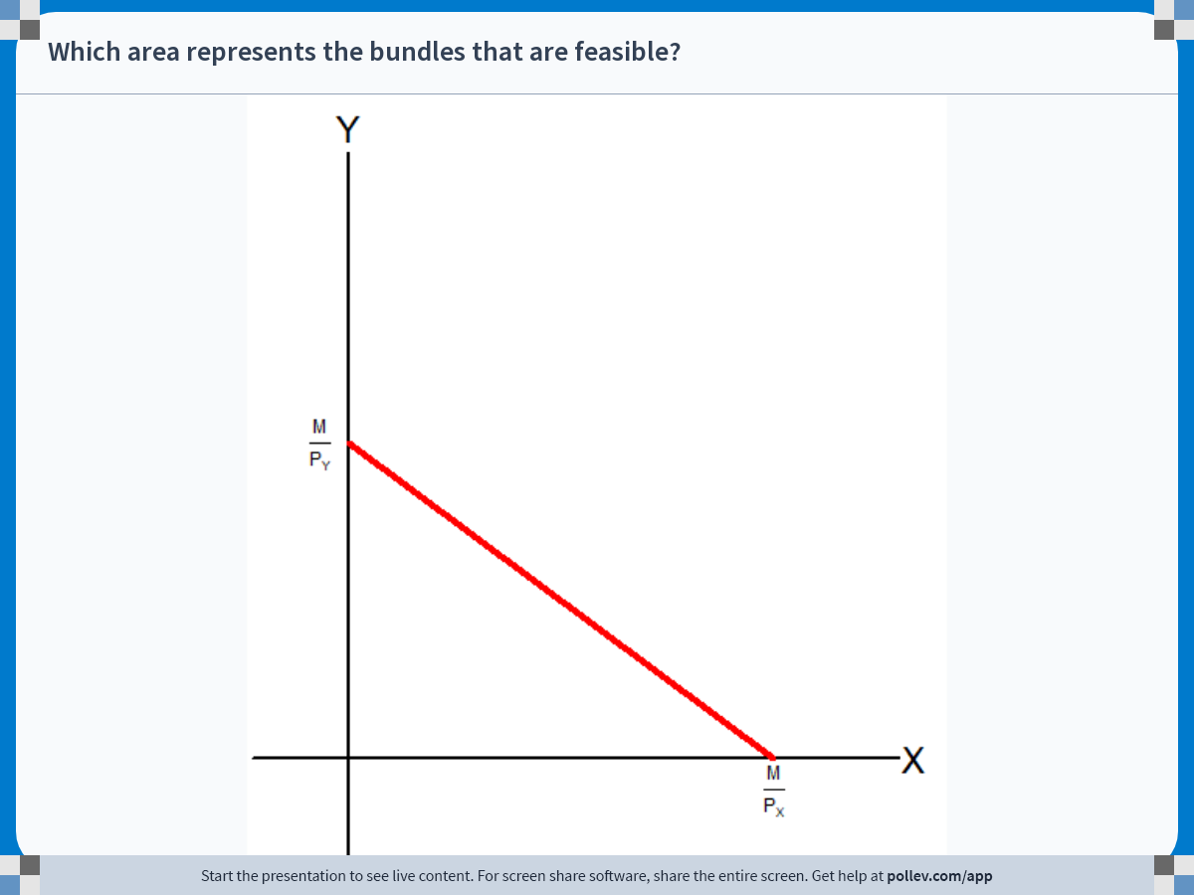
Notes:
Poll Title: Do not modify the notes in this section to avoid tampering with the Poll Everywhere activity.
More info at polleverywhere.com/support
Which area represents the bundles that are feasible?
https://www.polleverywhere.com/clickable_images/mwxt7ErnvcXWXIKtQJbCi

Slide 10
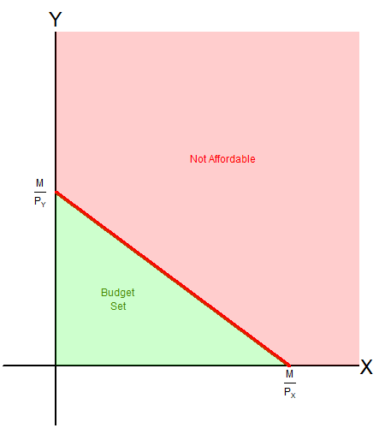
Recap: Budget Constraint
Recall what the budget constraint looks like when it is plotted in the commodity space.
The budget line “splits” the commodity space into two sections:
  The affordable budget set
  The non affordable zone.

Slide 11
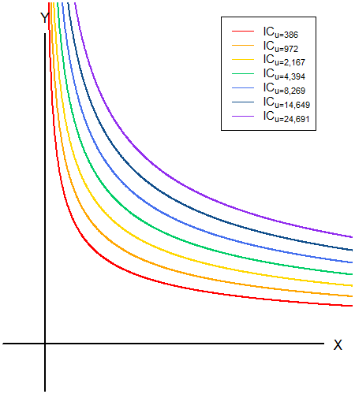
Recap: Indifference Curve
Recall that the indifference curves are analogous to contour lines on a map.
The “lower” indifference curves are the bundles that provide “lower” utility to the consumer.
The “higher” indifference curves are the bundles that provide a “higher” utility to the consumer.

Slide 12
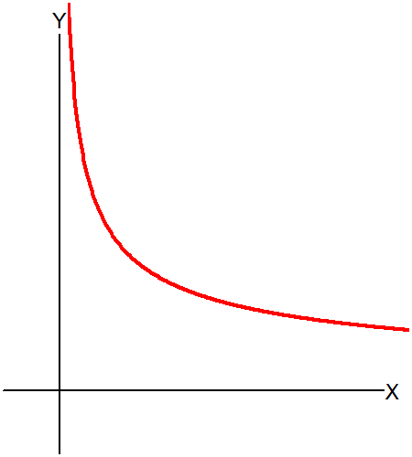
Recap: Indifference Curve
The indifference curve also “splits” the commodity space into two sections:

Slide 13
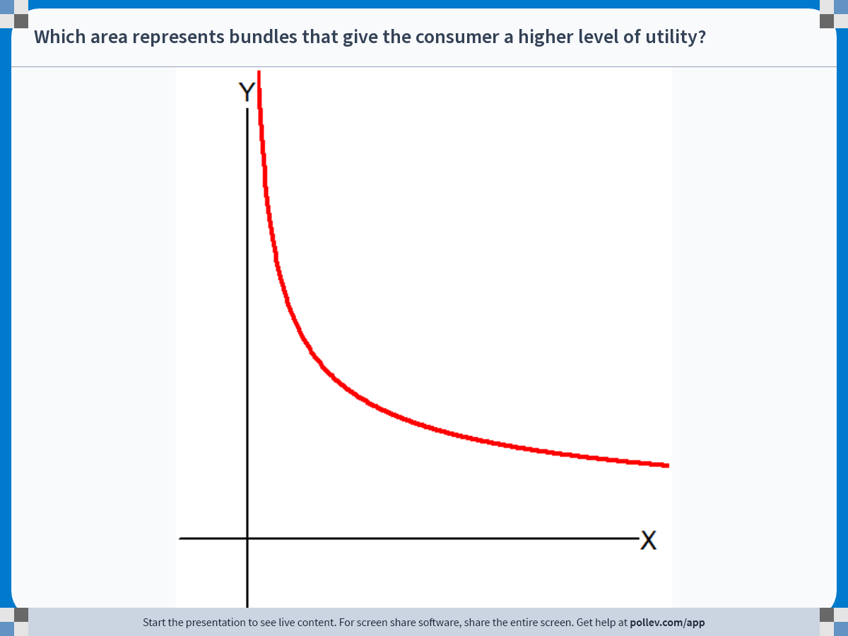
Notes:
Poll Title: Do not modify the notes in this section to avoid tampering with the Poll Everywhere activity.
More info at polleverywhere.com/support
Which area represents bundles that give the consumer a higher level of utility?
https://www.polleverywhere.com/clickable_images/f9suSuyrsx1yQF53QpuuM

Slide 14
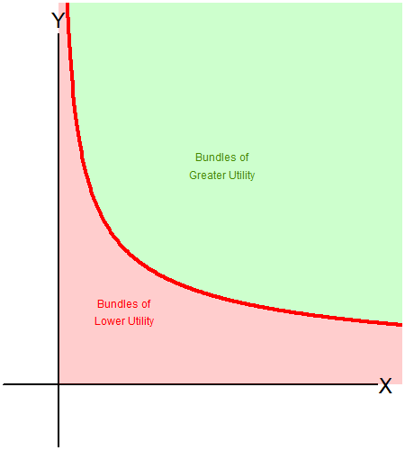
Recap: Indifference Curve
The indifference curve also “splits” the commodity space into two sections:
  The “better off” bundles
  The “worse off” bundles

Slide 15
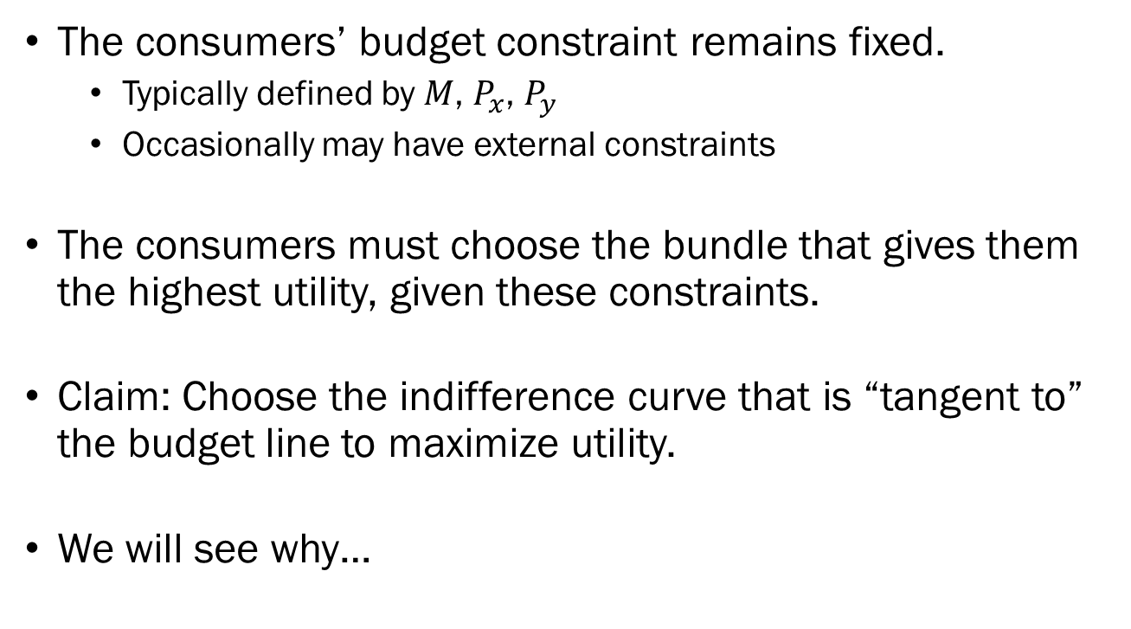
The Utility Maximization Problem
The consumers’ budget constraint remains fixed.
  Typically defined by $M$, $P_{x}$, $P_{y}$
  Occasionally may have external constraints
The consumers must choose the bundle that gives them the highest utility, given these constraints.
Claim: Choose the indifference curve that is “tangent to” the budget line to maximize utility.
We will see why…

Slide 16
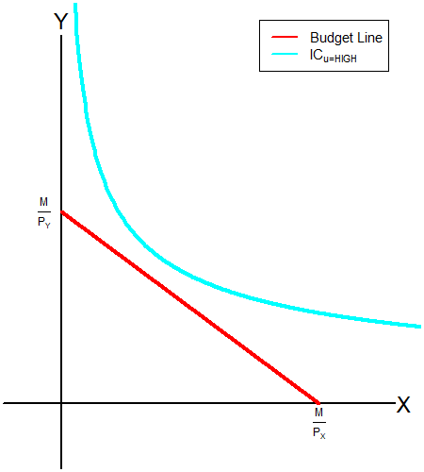
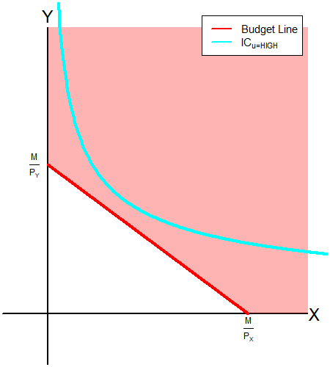
The Utility Maximization Problem
Suppose that the consumer chooses the cyan indifference curve.
None of the bundles on this indifference curve are feasible for the consumer.
The consumer cannot reach this level of utility, so they must adjust.

Slide 17
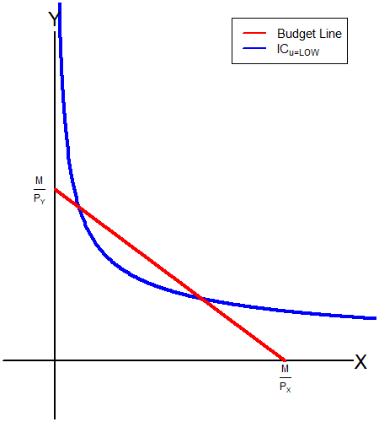
The Utility Maximization Problem
Suppose that the consumer chooses the blue indifference curve.
There is ample room for improvement.

Slide 18
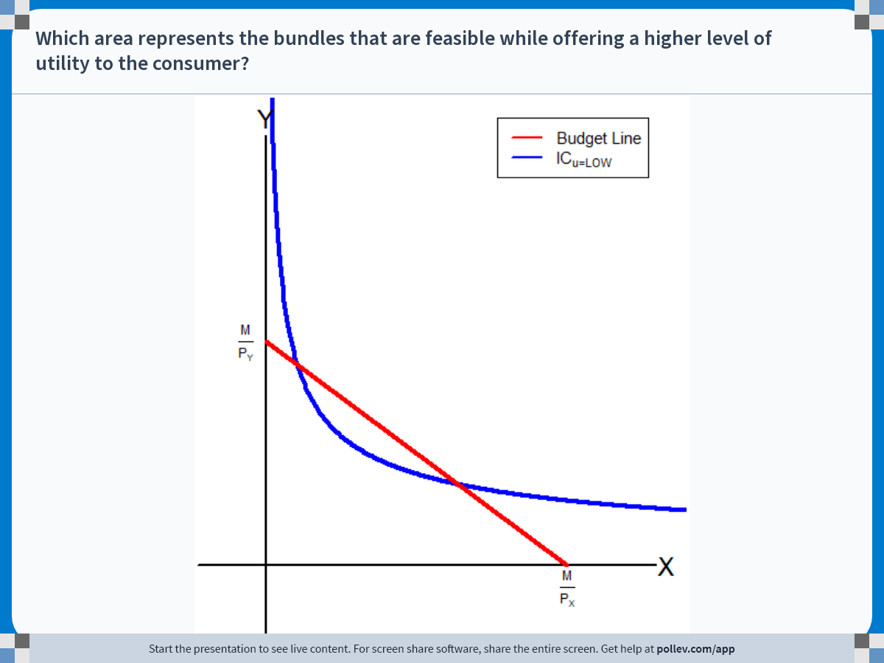
Notes:
Poll Title: Do not modify the notes in this section to avoid tampering with the Poll Everywhere activity.
More info at polleverywhere.com/support
Which area represents the bundles that are feasible while offering a higher level of utility to the consumer?
https://www.polleverywhere.com/clickable_images/SaAe2oOTbWvfLoRkyF3v4

Slide 19
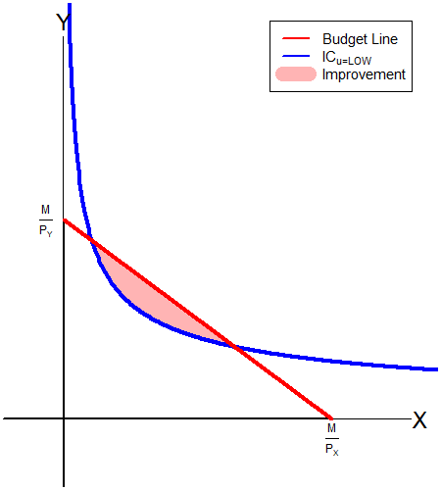
The Utility Maximization Problem
Suppose that the consumer chooses the blue indifference curve.
There is ample room for improvement.
Any bundle in the shaded area provides the consumer with greater utility, while meeting the constraints.

Slide 20
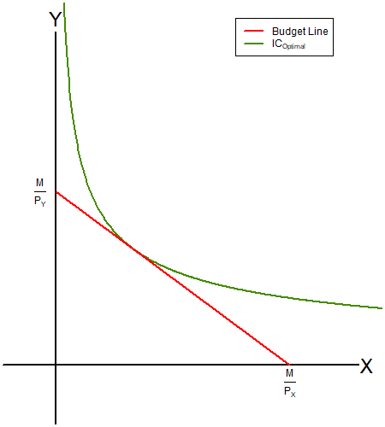
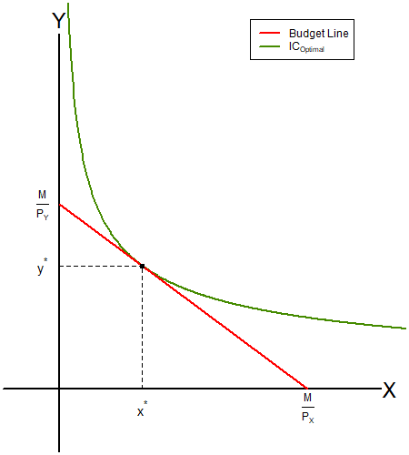
The Utility Maximization Problem
The natural conclusion we reach is that the consumer may maximize their utility when their indifference curve is “tangent to” the budget line.
The “tangent point” is the bundle that guarantees the highest feasible utility to the consumer.

Slide 21
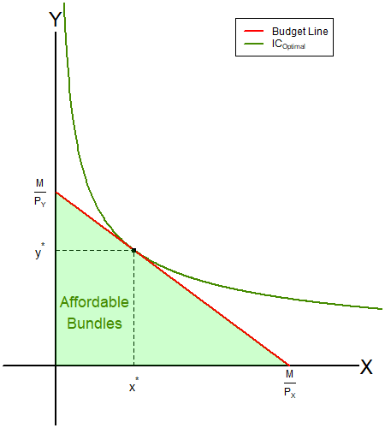
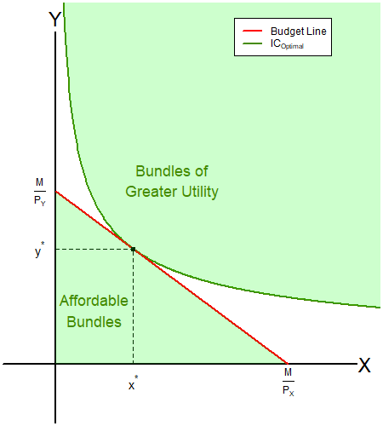
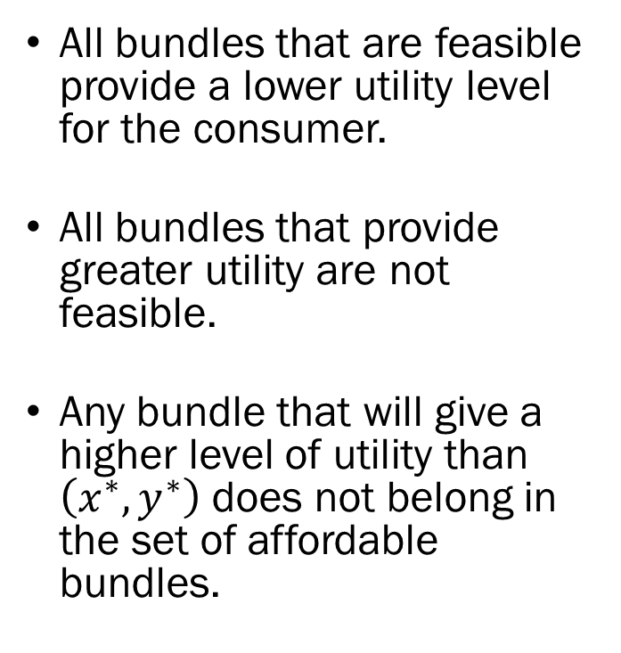
The Utility Maximization Problem
All bundles that are feasible provide a lower utility level for the consumer.
All bundles that provide greater utility are not feasible.
Any bundle that will give a higher level of utility than $\left(x^{∗},y^{∗}\right)$ does not belong in the set of affordable bundles.

Slide 22
The Utility Maximization Problem
Graphically speaking, the UMP boils down to finding the indifference curve that is tangent to the budget line, and then finding the unique bundle along that indifference curve that maximizes the consumer’s utility.
How does all this link back to the slopes?
  Budget Line: Relative Prices
  Indifference Curve: Marginal Rate of Substitution
The optimal bundle happens to coincide with the point where those slopes match.

Slide 23
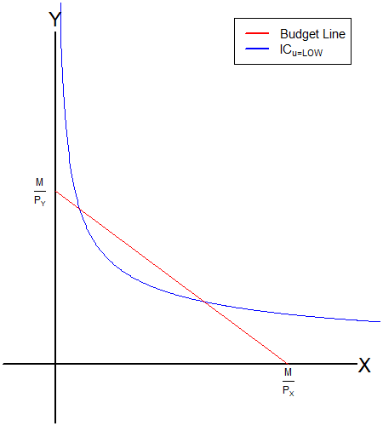
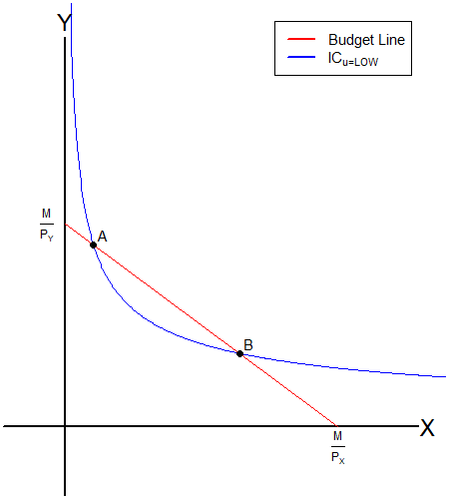
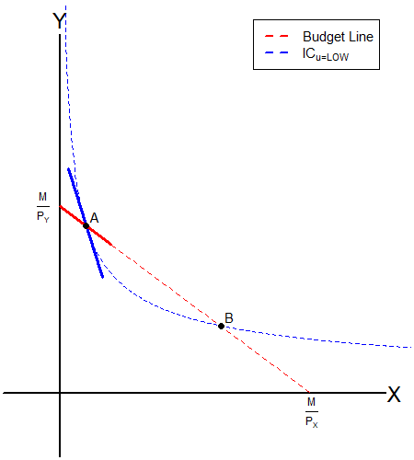
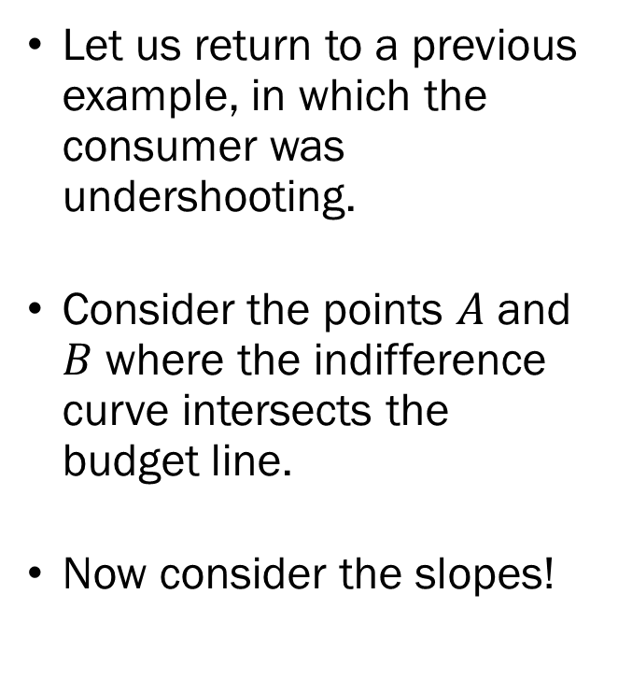
UMP: The Slopes
Let us return to a previous example, in which the consumer was undershooting.
Consider the points $A$ and $B$ where the indifference curve intersects the budget line.
Now consider the slopes!

Slide 24
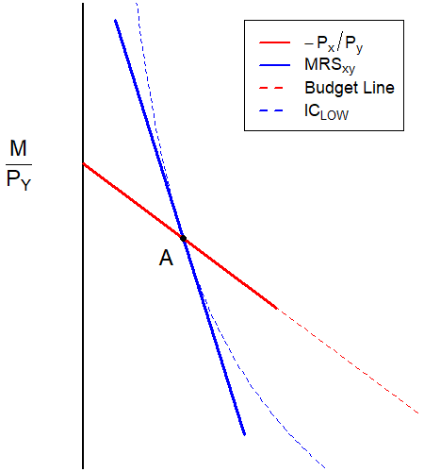
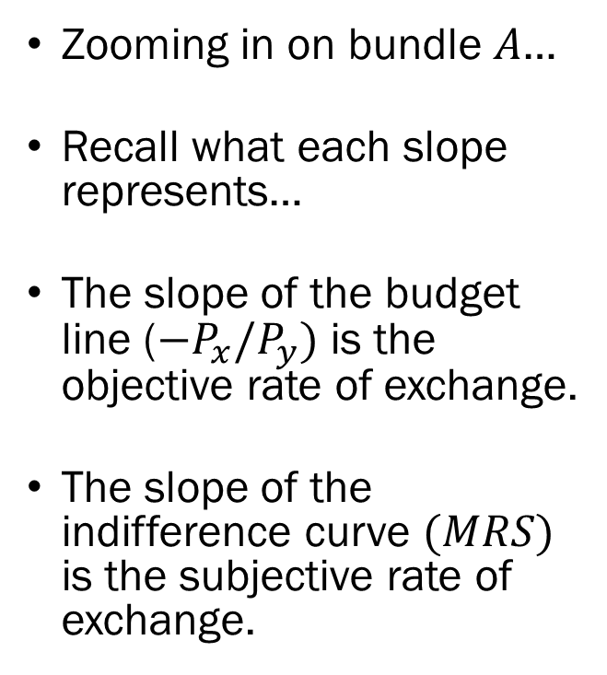
UMP: The Slopes
Zooming in on bundle $A$…
Recall what each slope represents…
The slope of the budget line ($−P_{x}/P_{y})$ is the objective rate of exchange.
The slope of the indifference curve $(MRS)$ is the subjective rate of exchange.

Slide 25

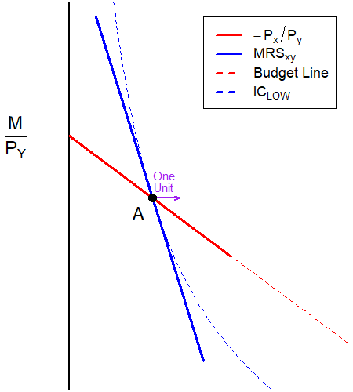
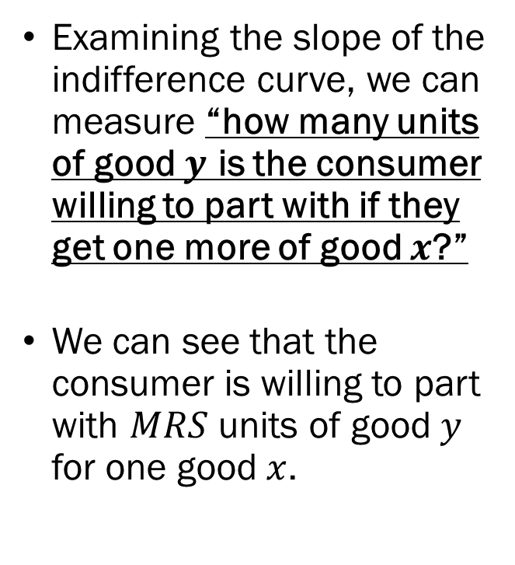
The Marginal Rate of Substitution
Examining the slope of the indifference curve, we can measure “how many units of good $y$ is the consumer willing to part with if they get one more of good $x$?”
We can see that the consumer is willing to part with $MRS$ units of good $y$ for one good $x$.

Slide 26

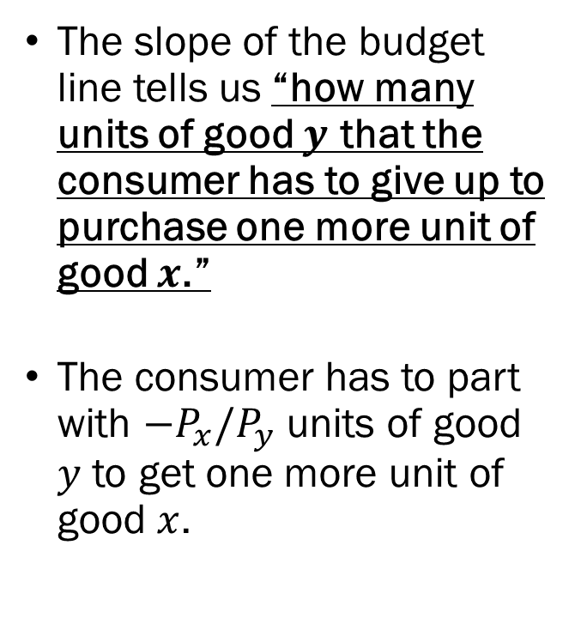
The Relative Price
The slope of the budget line tells us “how many units of good $y$ that the consumer has to give up to purchase one more unit of good $x$.”
The consumer has to part with $−P_{x}/P_{y}$ units of good $y$ to get one more unit of good $x$.

Slide 27

UMP when $MRS_{xy}>P_{x}/P_{y}$
Marginal Rate of Substitution
Relative Prices

Slide 28
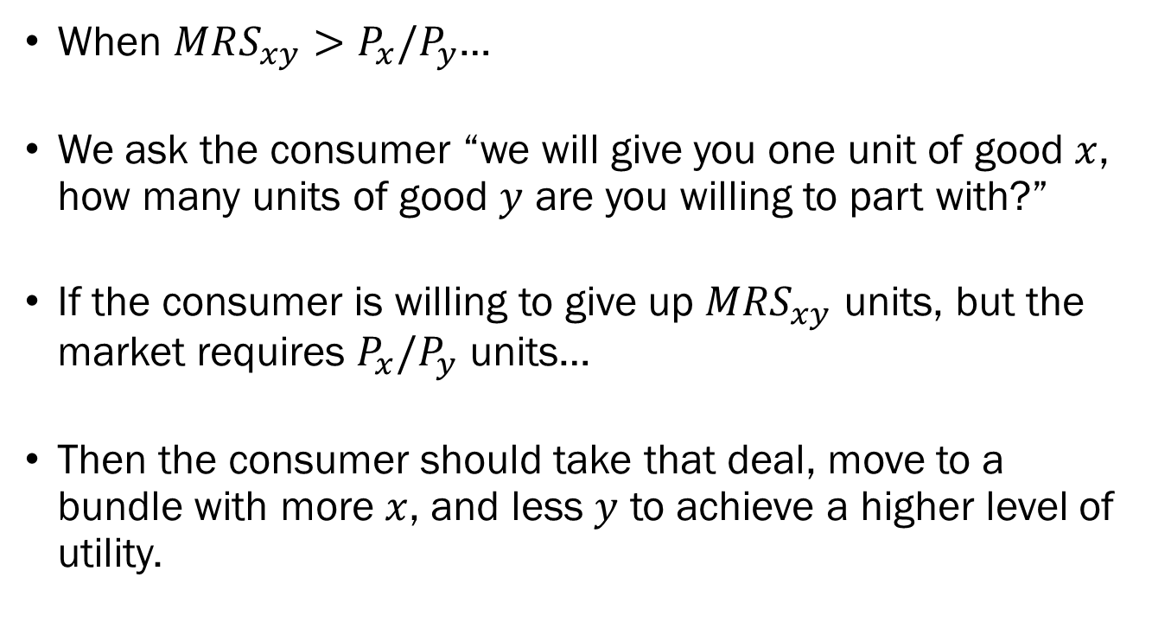

UMP when $MRS_{xy}>P_{x}/P_{y}$
When $MRS_{xy}>P_{x}/P_{y}$…
We ask the consumer “we will give you one unit of good $x$, how many units of good $y$ are you willing to part with?”
If the consumer is willing to give up $MRS_{xy}$ units, but the market requires $P_{x}/P_{y}$ units…
Then the consumer should take that deal, move to a bundle with more $x$, and less $y$ to achieve a higher level of utility.

Slide 29
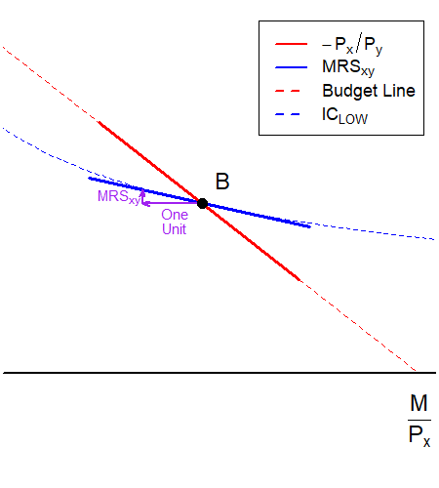
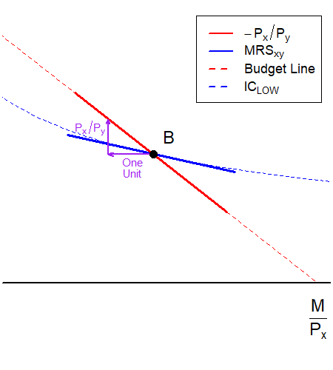

When $MRS_{xy}<P_{x}/P_{y}$
Marginal Rate of Substitution
Relative Prices

Slide 30
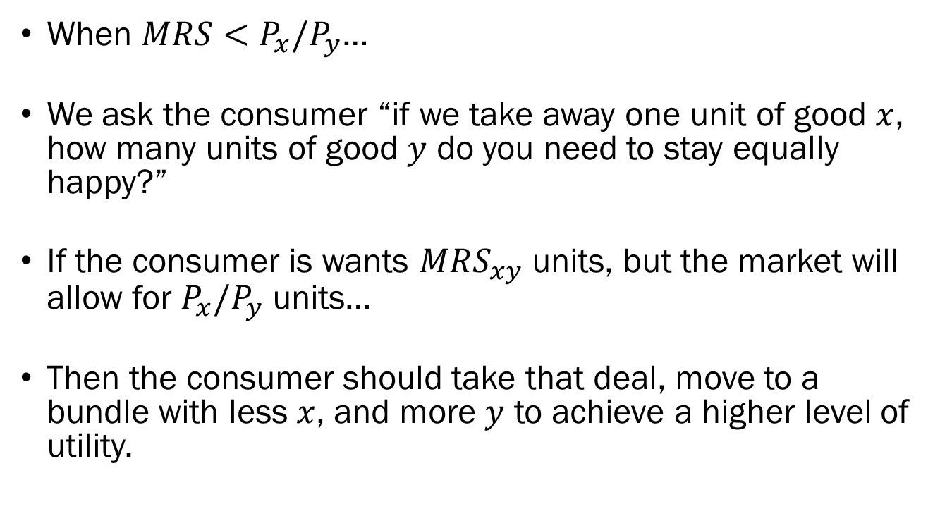

UMP when $MRS_{xy}<P_{x}/P_{y}$
When $MRS<P_{x}/P_{y}$…
We ask the consumer “if we take away one unit of good $x$, how many units of good $y$ do you need to stay equally happy?”
If the consumer is wants $MRS_{xy}$ units, but the market will allow for $P_{x}/P_{y}$ units…
Then the consumer should take that deal, move to a bundle with less $x$, and more $y$ to achieve a higher level of utility.

Slide 31
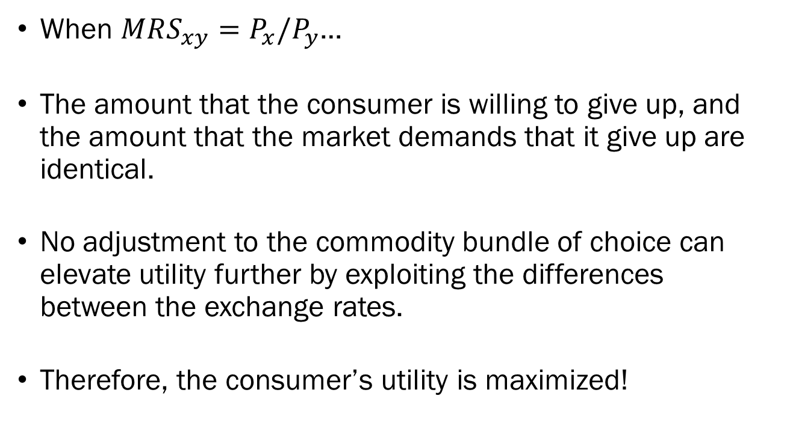
The Utility Maximization Problem
When $MRS_{xy}=P_{x}/P_{y}$…
The amount that the consumer is willing to give up, and the amount that the market demands that it give up are identical.
No adjustment to the commodity bundle of choice can elevate utility further by exploiting the differences between the exchange rates.
Therefore, the consumer’s utility is maximized!

Slide 32
Preview of Next Lecture
Optimization in Math
Optimization when the Utility Functions are “Special”
  The Linear Utility Function
  The Leontief Utility Function
Comparative Statics of Consumer Choice
  Changes in the consumer’s income
  Changes in the market prices

