Slide 1
Consumer Theory:
UMP with some Calculus
ECON 300

Slide 2
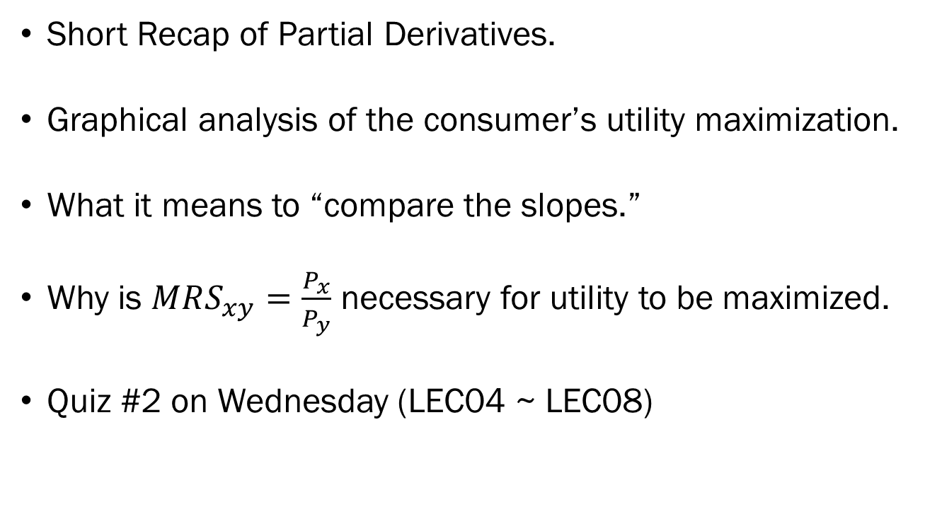
Review of Previous Lecture
Short Recap of Partial Derivatives.
Graphical analysis of the consumer’s utility maximization.
What it means to “compare the slopes.”
Why is $MRS_{xy}=\frac{P_{x}}{P_{y}}$ necessary for utility to be maximized.
Quiz #2 on Wednesday (LEC04 ~ LEC08)

Slide 3

Recap: Partial Derivatives
$$\frac{∂}{∂(variable)}\left(constant⋅variable^{power}\right)$$
$$=constant⋅power⋅variable^{power−1}$$
Try out the following:
  $\frac{∂}{∂x}4x^{2}y^{3}$
  $\frac{∂}{∂y}4x^{2}y^{3}$

Slide 4
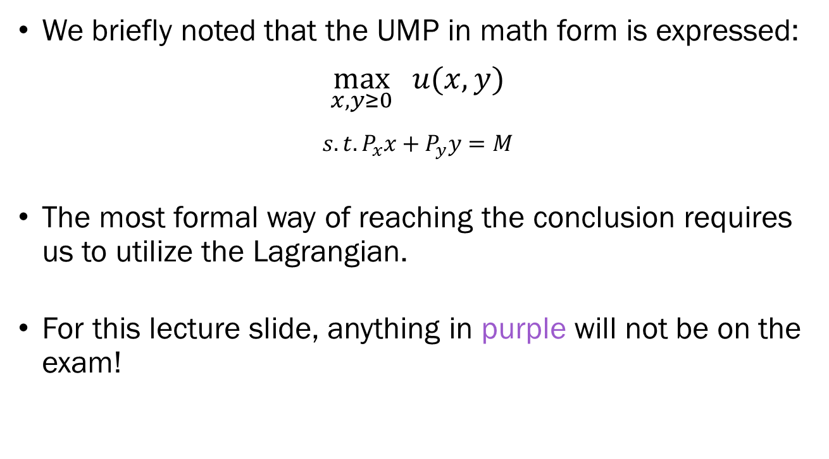
The UMP in Math
We briefly noted that the UMP in math form is expressed:
$$\max_{x,y≥0}{ u(x,y)}$$
$$s.t. P_{x}x+P_{y}y=M$$
The most formal way of reaching the conclusion requires us to utilize the Lagrangian.
For this lecture slide, anything in purple will not be on the exam!

Slide 5
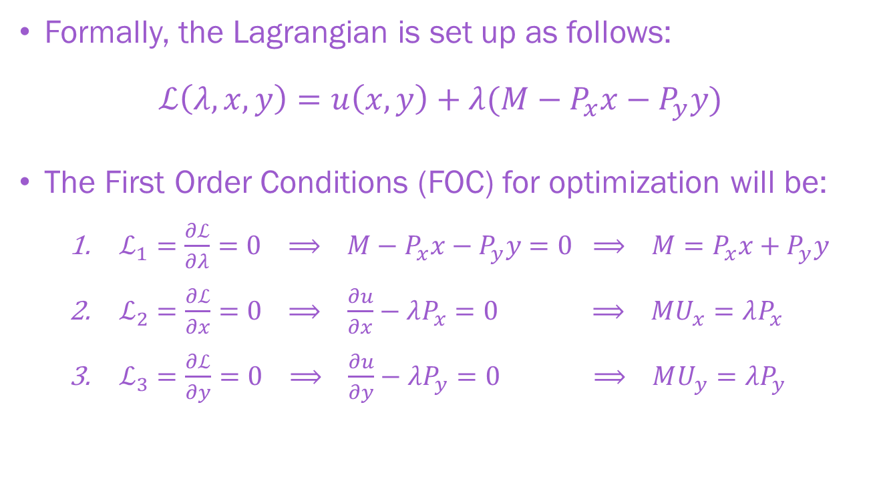
The UMP in Math
Formally, the Lagrangian is set up as follows:
$$ℒ\left(λ,x,y\right)=u\left(x,y\right)+λ(M−P_{x}x−P_{y}y)$$
The First Order Conditions (FOC) for optimization will be:
  $ℒ_{1}=\frac{∂ℒ}{∂λ}=0 ⟹ M−P_{x}x−P_{y}y=0 ⟹ M=P_{x}x+P_{y}y$
  $ℒ_{2}=\frac{∂ℒ}{∂x}=0 ⟹ \frac{∂u}{∂x}−λP_{x}=0 ⟹ MU_{x}=λP_{x}$
  $ℒ_{3}=\frac{∂ℒ}{∂y}=0 ⟹ \frac{∂u}{∂y}−λP_{y}=0 ⟹ MU_{y}=λP_{y}$

Slide 6
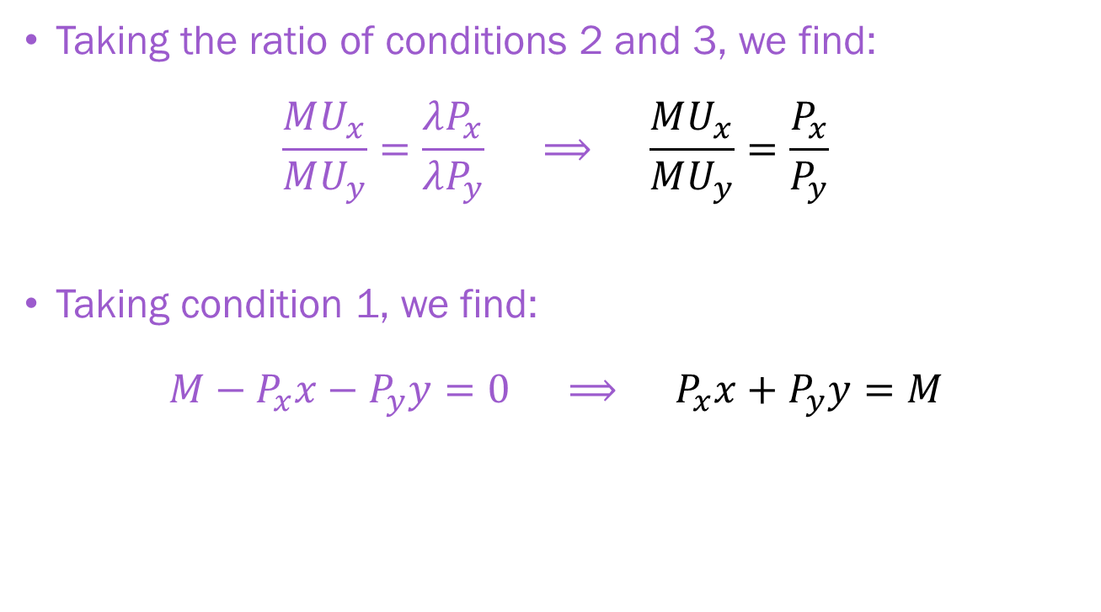
The UMP in Math
Taking the ratio of conditions 2 and 3, we find:
$$\frac{MU_{x}}{MU_{y}}=\frac{λP_{x}}{λP_{y}} ⟹ \frac{MU_{x}}{MU_{y}}=\frac{P_{x}}{P_{y}}$$
Taking condition 1, we find:
$$M−P_{x}x−P_{y}y=0 ⟹ P_{x}x+P_{y}y=M$$

Slide 7
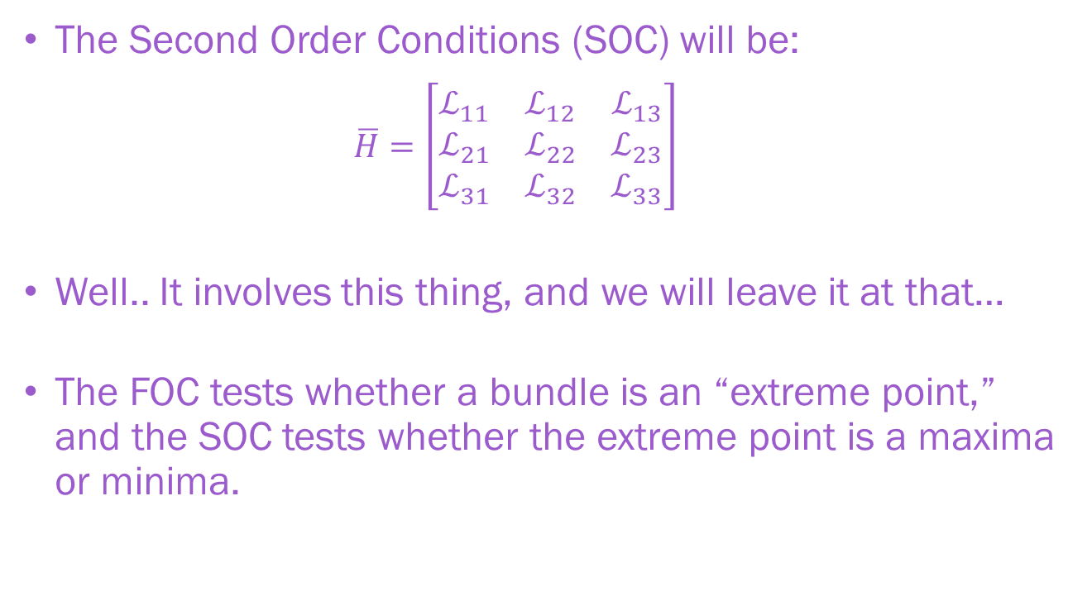
The UMP in Math
The Second Order Conditions (SOC) will be:
  $$\overline{H}=\left[\begin{matrix}ℒ_{11} & ℒ_{12} & ℒ_{13} \\ ℒ_{21} & ℒ_{22} & ℒ_{23} \\ ℒ_{31} & ℒ_{32} & ℒ_{33}\end{matrix}\right]$$
Well.. It involves this thing, and we will leave it at that…
The FOC tests whether a bundle is an “extreme point,” and the SOC tests whether the extreme point is a maxima or minima.

Slide 8
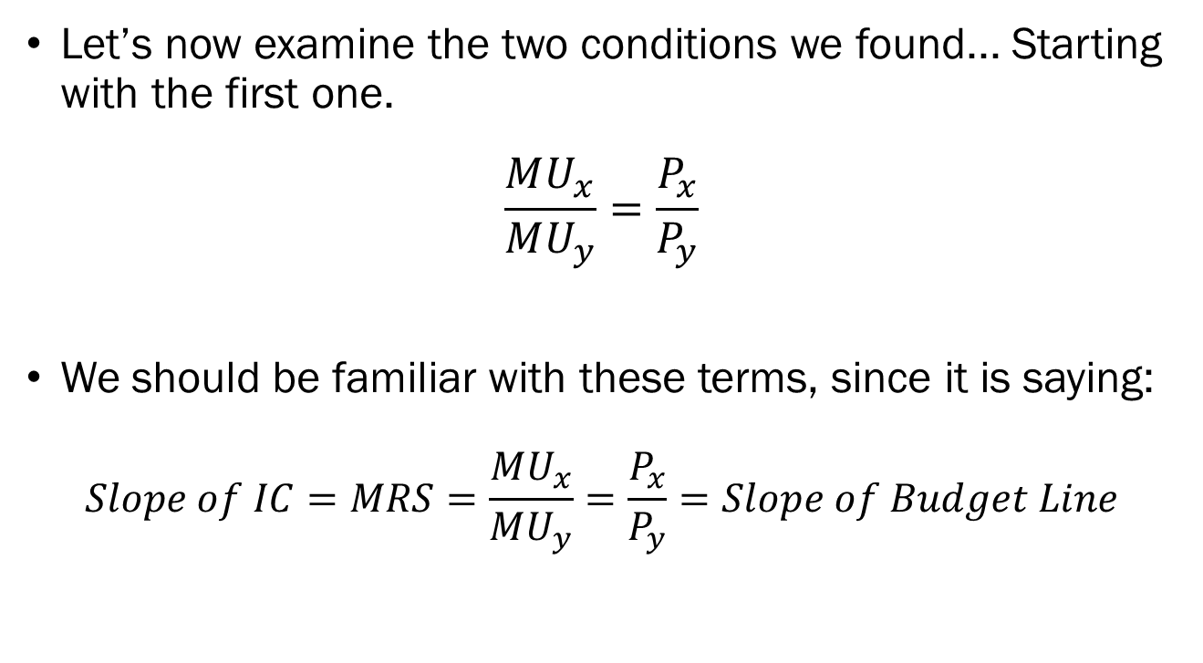
Equalize the Slopes
Let’s now examine the two conditions we found... Starting with the first one.
$$\frac{MU_{x}}{MU_{y}}=\frac{P_{x}}{P_{y}}$$
We should be familiar with these terms, since it is saying:
$$Slope of IC=MRS=\frac{MU_{x}}{MU_{y}}=\frac{P_{x}}{P_{y}}=Slope of Budget Line$$

Slide 9



$$MRS_{xy}>P_{x}/P_{y}$$
Marginal Rate of Substitution
Relative Prices

Slide 10
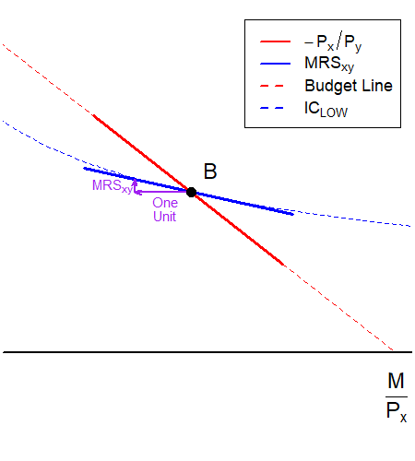
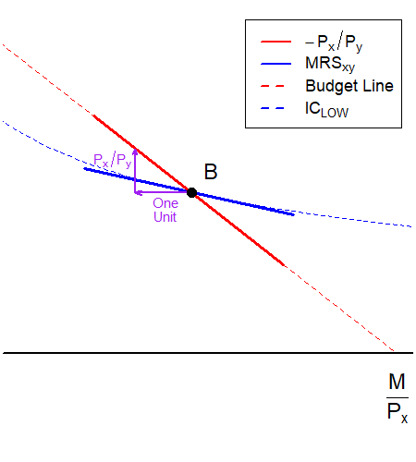

$$MRS_{xy}<P_{x}/P_{y}$$
Marginal Rate of Substitution
Relative Prices

Slide 11
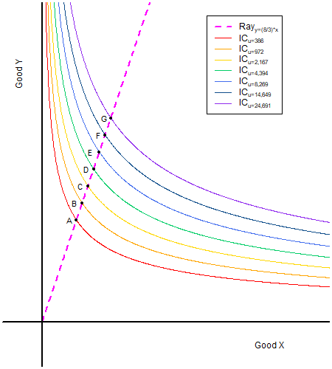
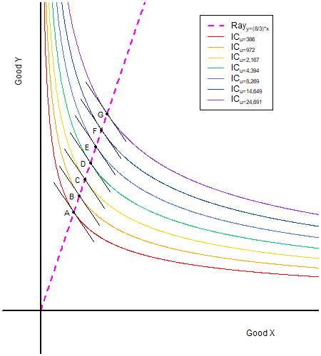

$$MRS_{xy}=P_{x}/P_{y}$$
One problem is that the indifference curve is not “unique.”
For every possible utility level, there is an indifference curve.
For each indifference curve, there can be a point where the slope matches the relative price.

Slide 12
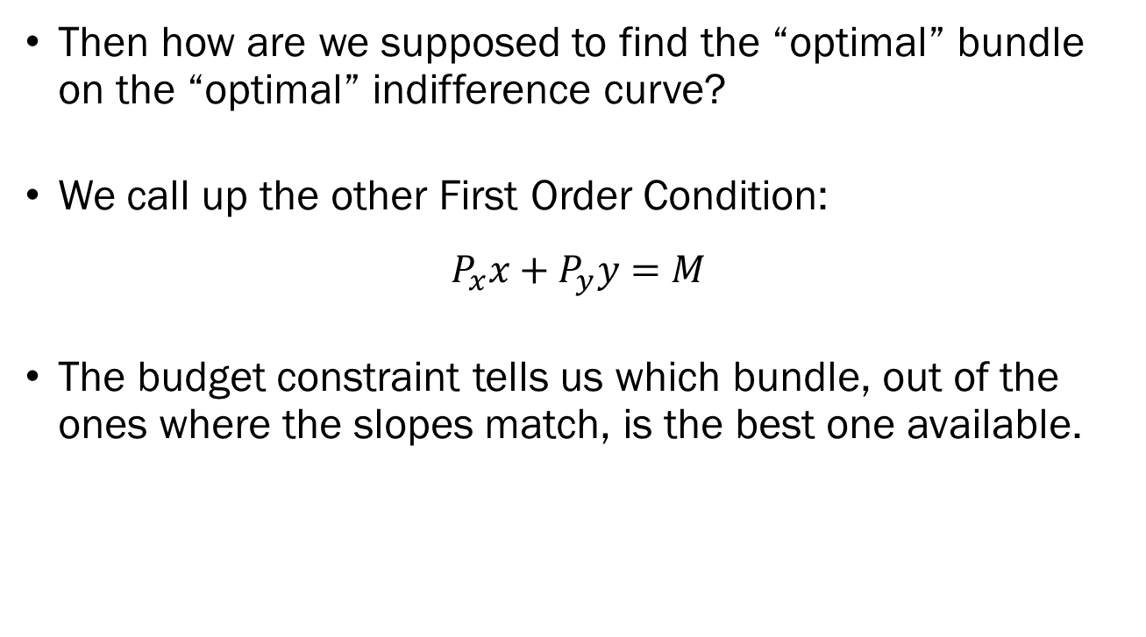
Finding the Correct One
Then how are we supposed to find the “optimal” bundle on the “optimal” indifference curve?
We call up the other First Order Condition:
$$P_{x}x+P_{y}y=M$$
The budget constraint tells us which bundle, out of the ones where the slopes match, is the best one available.

Slide 13
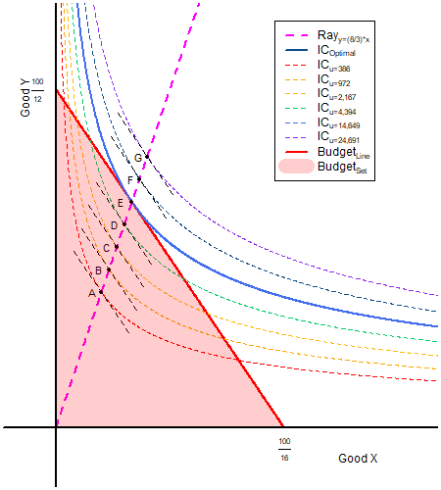

$MRS_{xy}=P_{x}/P_{y}$ and…

Slide 14
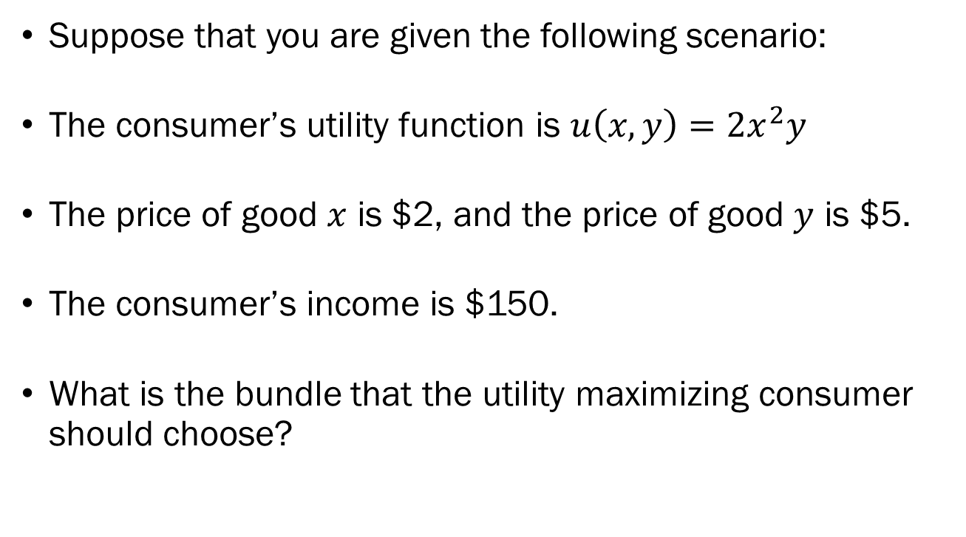
Example: The Setup
Suppose that you are given the following scenario:
The consumer’s utility function is $u\left(x,y\right)=2x^{2}y$
The price of good $x$ is $2, and the price of good $y$ is $5.
The consumer’s income is $150.
What is the bundle that the utility maximizing consumer should choose?

Slide 15

Example: To Do List
Marginal Utility of $x$
Marginal Utility of $y$
Price of $x$
Price of $y$
Income $M$

Slide 16
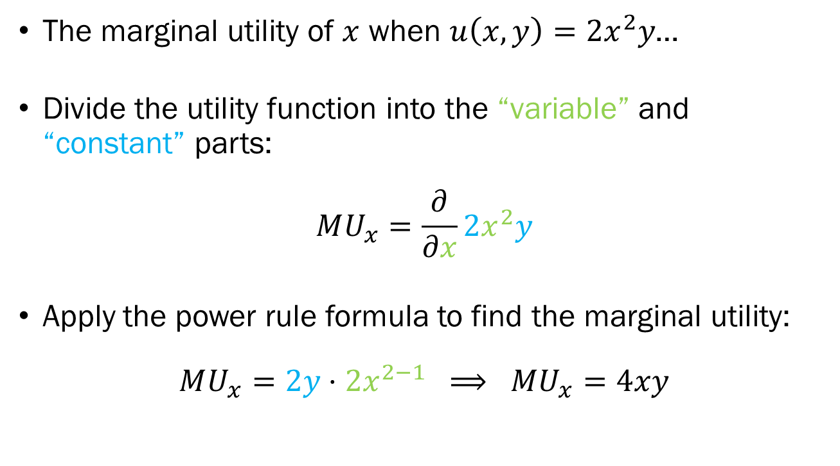
Example: To Do List Item 1
The marginal utility of $x$ when $u\left(x,y\right)=2x^{2}y$…
Divide the utility function into the “variable” and “constant” parts:
$$MU_{x}=\frac{∂}{∂x}2x^{2}y$$
Apply the power rule formula to find the marginal utility:
$$MU_{x}=2y⋅2x^{2−1} ⟹ MU_{x}=4xy$$

Slide 17
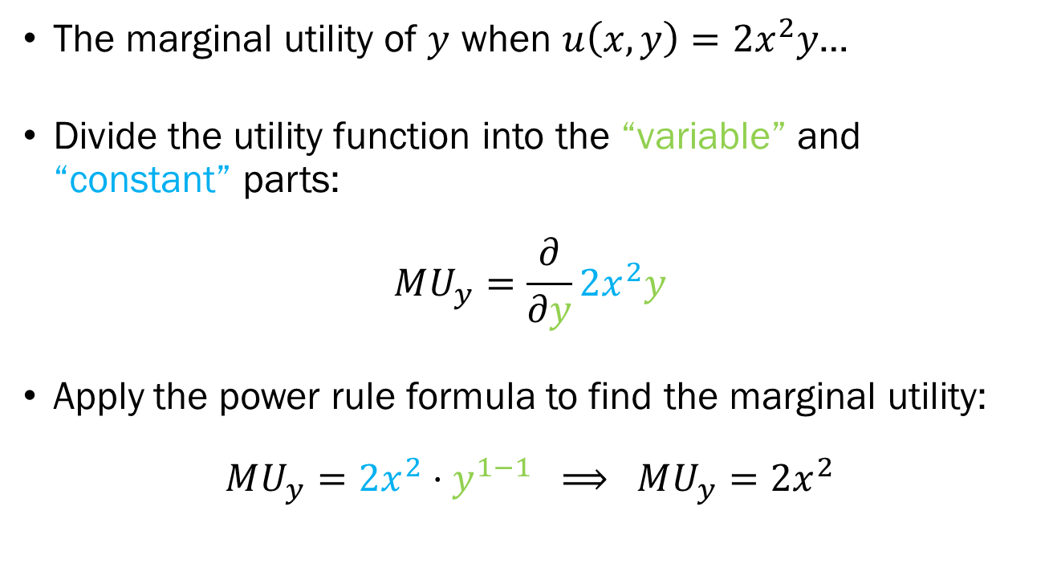
Example: To Do List Item 2
The marginal utility of $y$ when $u\left(x,y\right)=2x^{2}y$…
Divide the utility function into the “variable” and “constant” parts:
$$MU_{y}=\frac{∂}{∂y}2x^{2}y$$
Apply the power rule formula to find the marginal utility:
$$MU_{y}=2x^{2}⋅y^{1−1} ⟹ MU_{y}=2x^{2}$$

Slide 18

Example: To Do List Item 3~5
Items 3 ~ 5 are simply given in the setup:
$$P_{x}=2$$
$$P_{y}=5$$
$$M=150$$
The budget constraint for this problem is now:
$$2x+5y=M$$

Slide 19
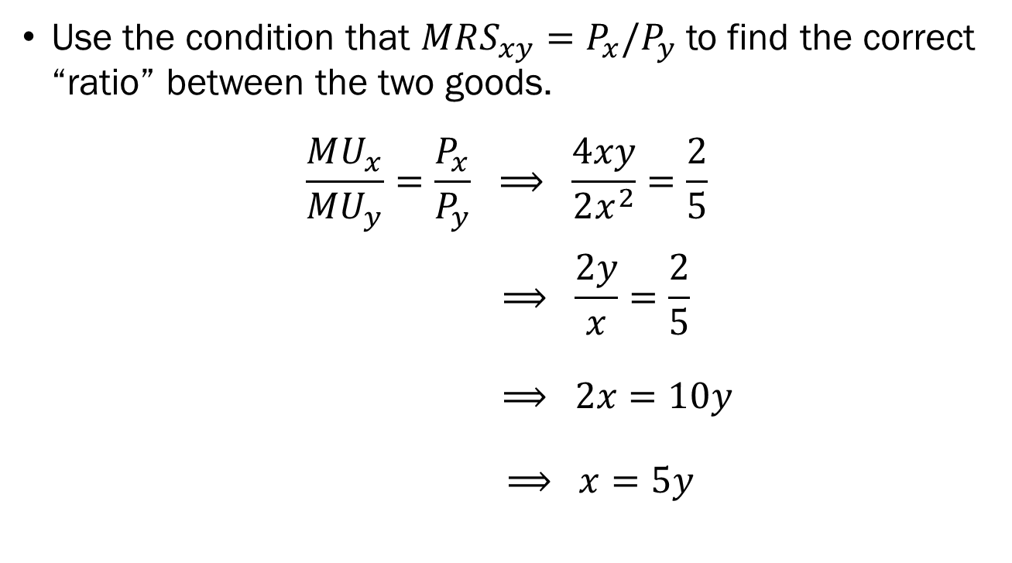
Example: Equalizing the Slopes
Use the condition that $MRS_{xy}=P_{x}/P_{y}$ to find the correct “ratio” between the two goods.
$$\frac{MU_{x}}{MU_{y}}=\frac{P_{x}}{P_{y}} ⟹ \frac{4xy}{2x^{2}}=\frac{2}{5}$$
$$⟹ \frac{2y}{x}=\frac{2}{5}$$
$$⟹ 2x=10y$$
$$⟹ x=5y$$

Slide 20
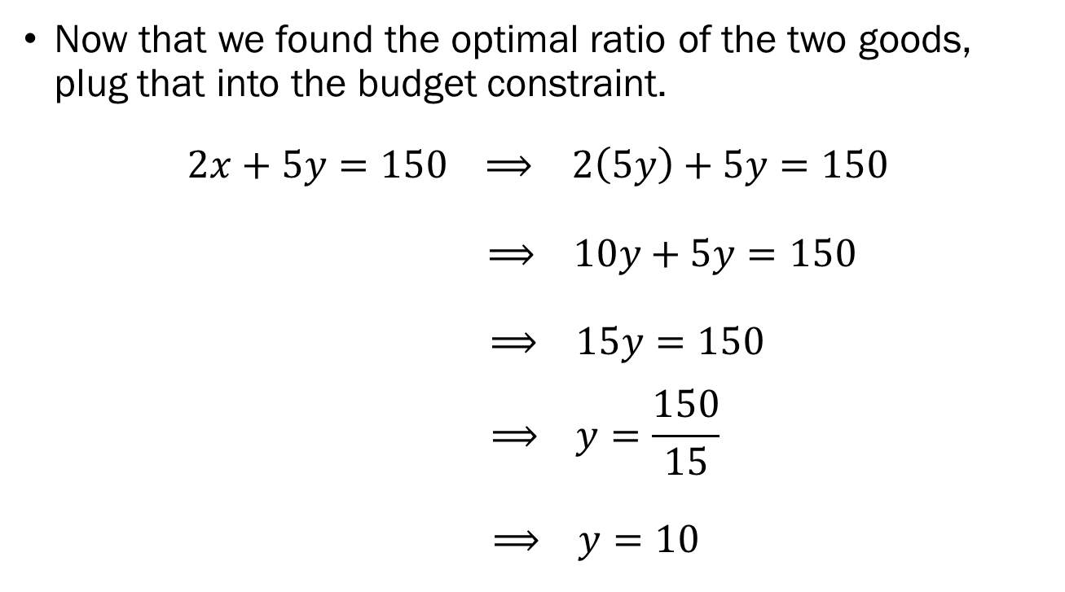
Example: The Budget Constraint
Now that we found the optimal ratio of the two goods, plug that into the budget constraint.
$$2x+5y=150 ⟹ 2\left(5y\right)+5y=150$$
$$⟹ 10y+5y=150$$
$$⟹ 15y=150$$
$$⟹ y=\frac{150}{15}$$
$$⟹ y=10$$

Slide 21
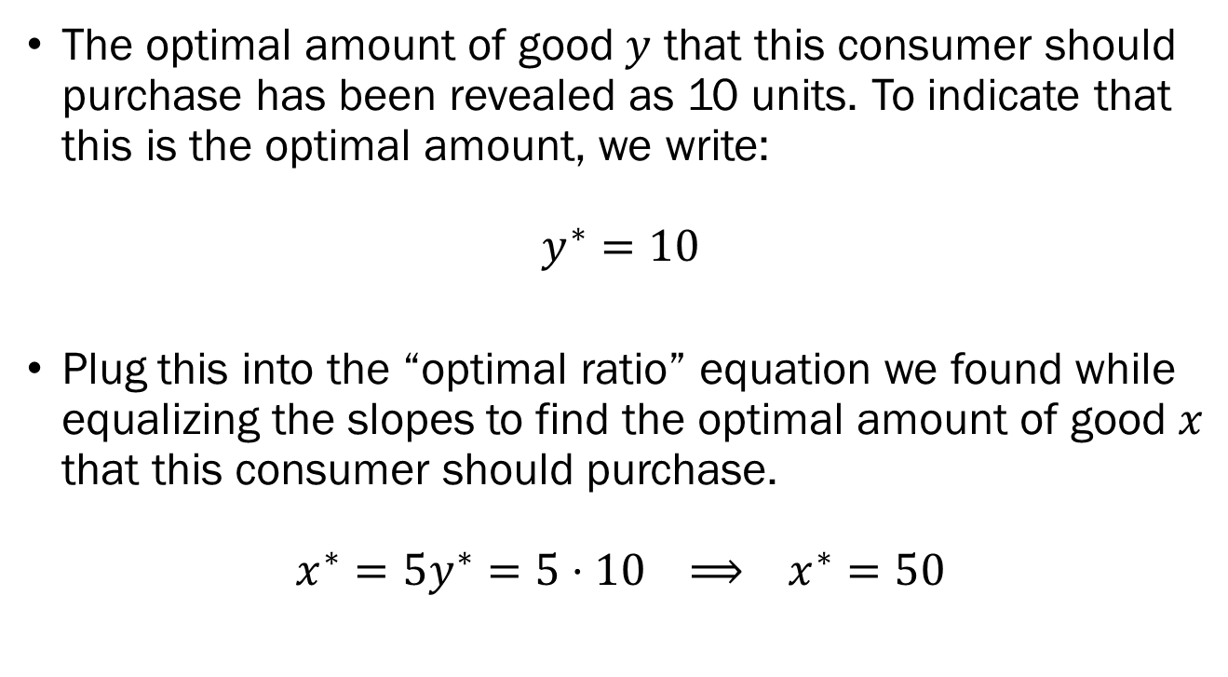
Example: The Solution
The optimal amount of good $y$ that this consumer should purchase has been revealed as 10 units. To indicate that this is the optimal amount, we write:
$$y^{∗}=10$$
Plug this into the “optimal ratio” equation we found while equalizing the slopes to find the optimal amount of good $x$ that this consumer should purchase.
$$x^{∗}=5y^{∗}=5⋅10 ⟹ x^{∗}=50$$

Slide 22
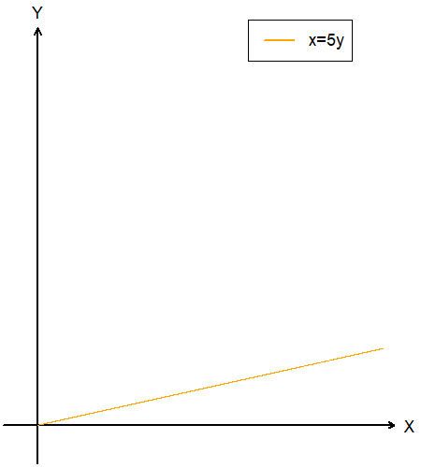
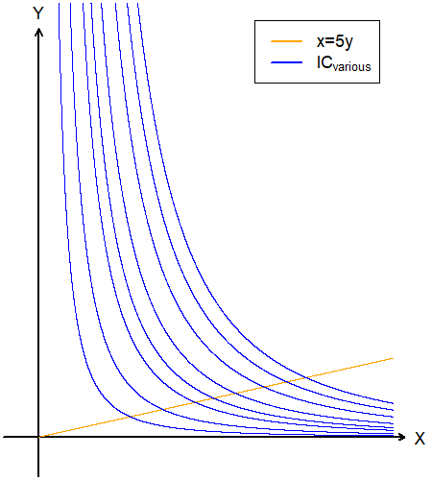
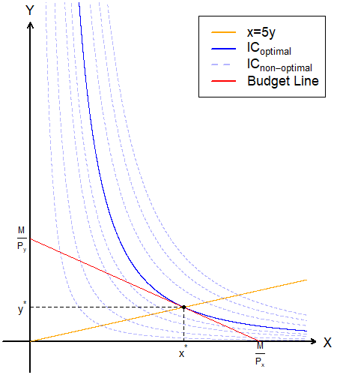
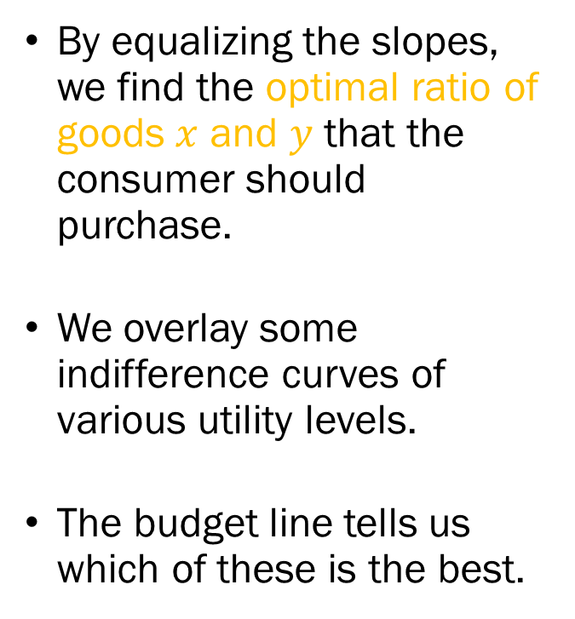
Example: Graphs
By equalizing the slopes, we find the optimal ratio of goods $x$ and $y$ that the consumer should purchase.
We overlay some indifference curves of various utility levels.
The budget line tells us which of these is the best.

Slide 23
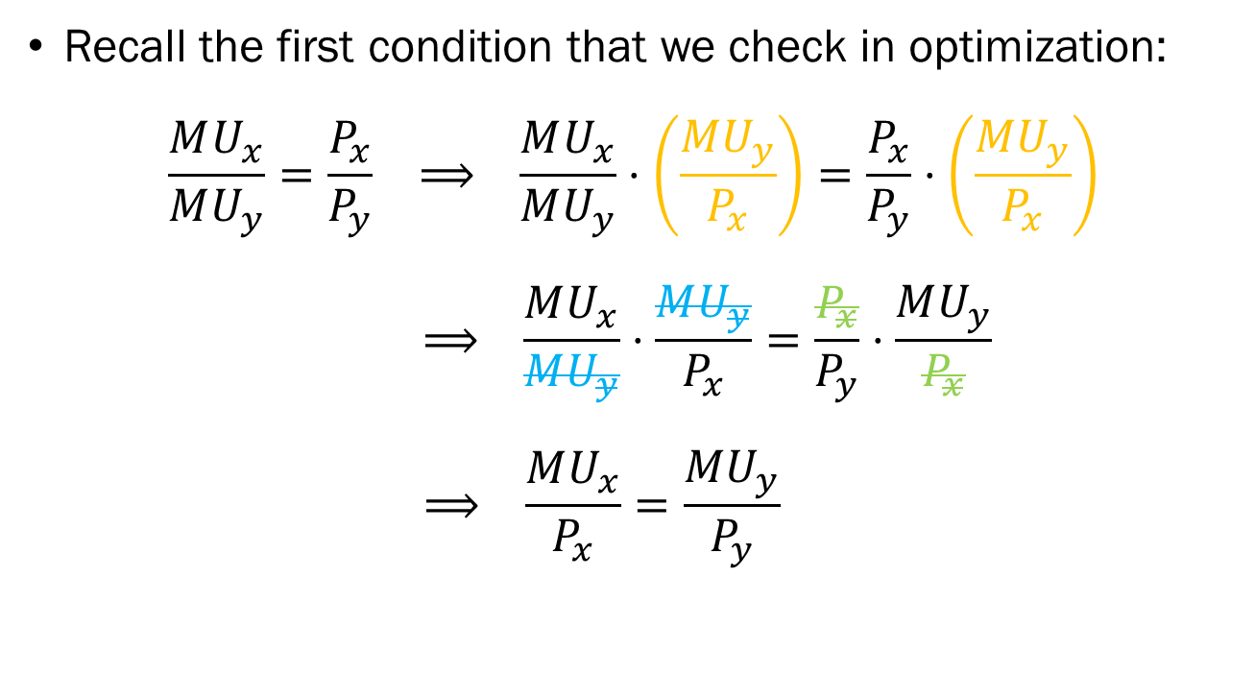
Equalizing Slopes?
Recall the first condition that we check in optimization:
$$\frac{MU_{x}}{MU_{y}}=\frac{P_{x}}{P_{y}} ⟹ \frac{MU_{x}}{MU_{y}}⋅\left(\frac{MU_{y}}{P_{x}}\right)=\frac{P_{x}}{P_{y}}⋅\left(\frac{MU_{y}}{P_{x}}\right)$$
$$⟹ \frac{MU_{x}}{MU_{y}}⋅\frac{MU_{y}}{P_{x}}=\frac{P_{x}}{P_{y}}⋅\frac{MU_{y}}{P_{x}}$$
$$⟹ \frac{MU_{x}}{P_{x}}=\frac{MU_{y}}{P_{y}}$$

Slide 24
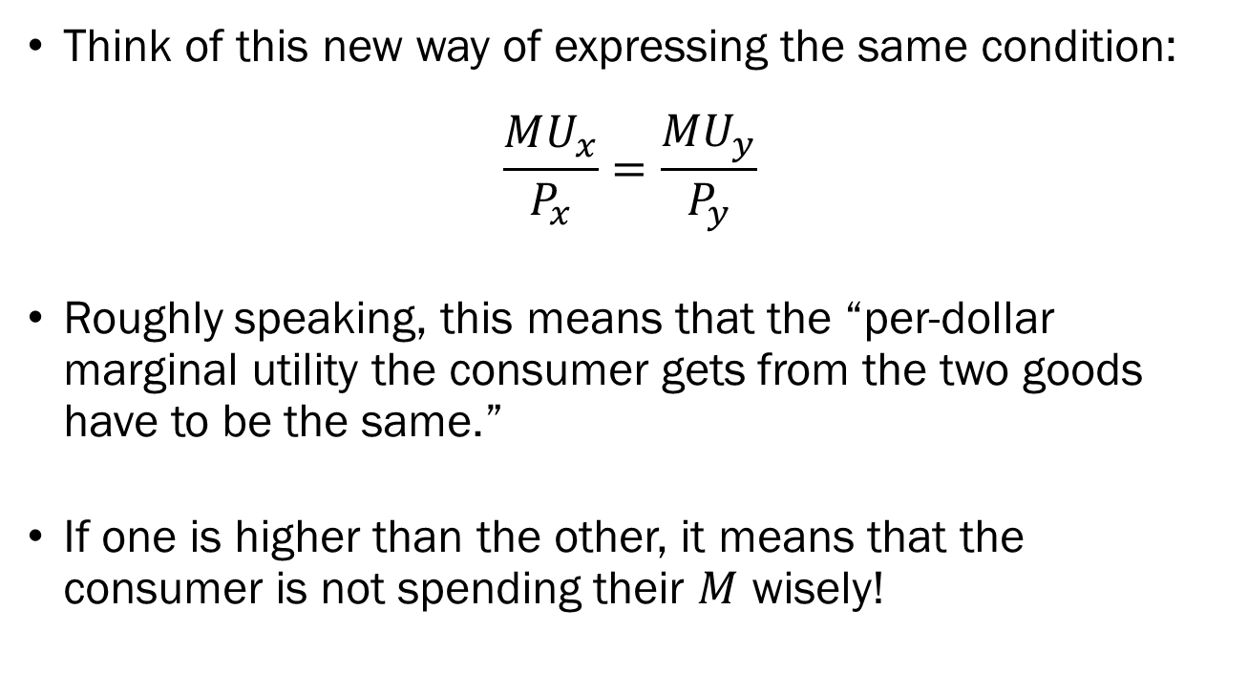
The Per Dollar Marginal Utility
Think of this new way of expressing the same condition:
$$\frac{MU_{x}}{P_{x}}=\frac{MU_{y}}{P_{y}}$$
Roughly speaking, this means that the “per-dollar marginal utility the consumer gets from the two goods have to be the same.”
If one is higher than the other, it means that the consumer is not spending their $M$ wisely!

Slide 25
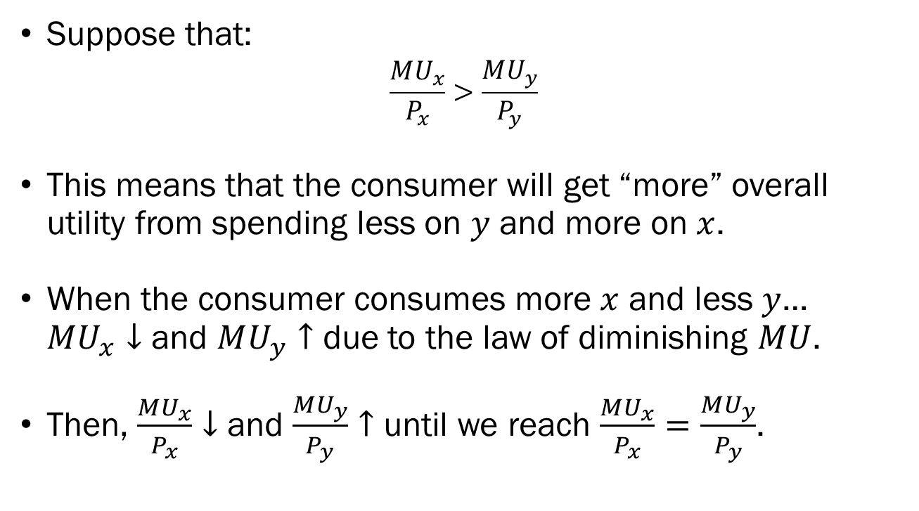
Imbalance Scenario #1
Suppose that:
$$\frac{MU_{x}}{P_{x}}>\frac{MU_{y}}{P_{y}}$$
This means that the consumer will get “more” overall utility from spending less on $y$ and more on $x$.
When the consumer consumes more $x$ and less $y$… $MU_{x}↓$ and $MU_{y}↑$ due to the law of diminishing $MU$.
Then, $\frac{MU_{x}}{P_{x}}↓$ and $\frac{MU_{y}}{P_{y}}↑$ until we reach $\frac{MU_{x}}{P_{x}}=\frac{MU_{y}}{P_{y}}$.

Slide 26
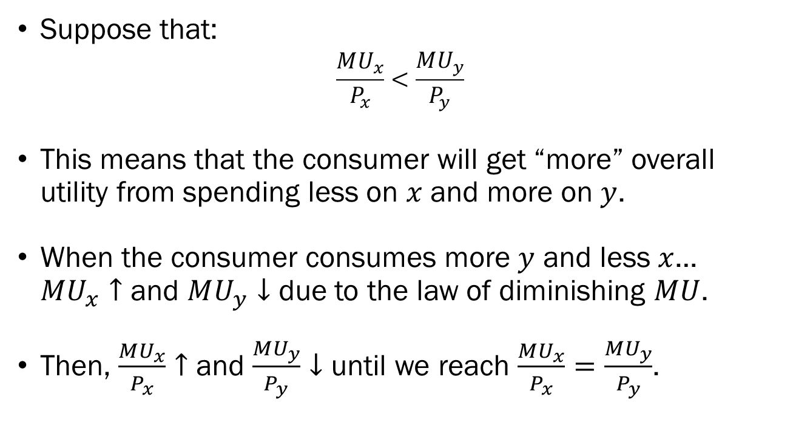
Imbalance Scenario #2
Suppose that:
$$\frac{MU_{x}}{P_{x}}<\frac{MU_{y}}{P_{y}}$$
This means that the consumer will get “more” overall utility from spending less on $x$ and more on $y$.
When the consumer consumes more $y$ and less $x$… $MU_{x}↑$ and $MU_{y}↓$ due to the law of diminishing $MU$.
Then, $\frac{MU_{x}}{P_{x}}↑$ and $\frac{MU_{y}}{P_{y}}↓$ until we reach $\frac{MU_{x}}{P_{x}}=\frac{MU_{y}}{P_{y}}$.

Slide 27
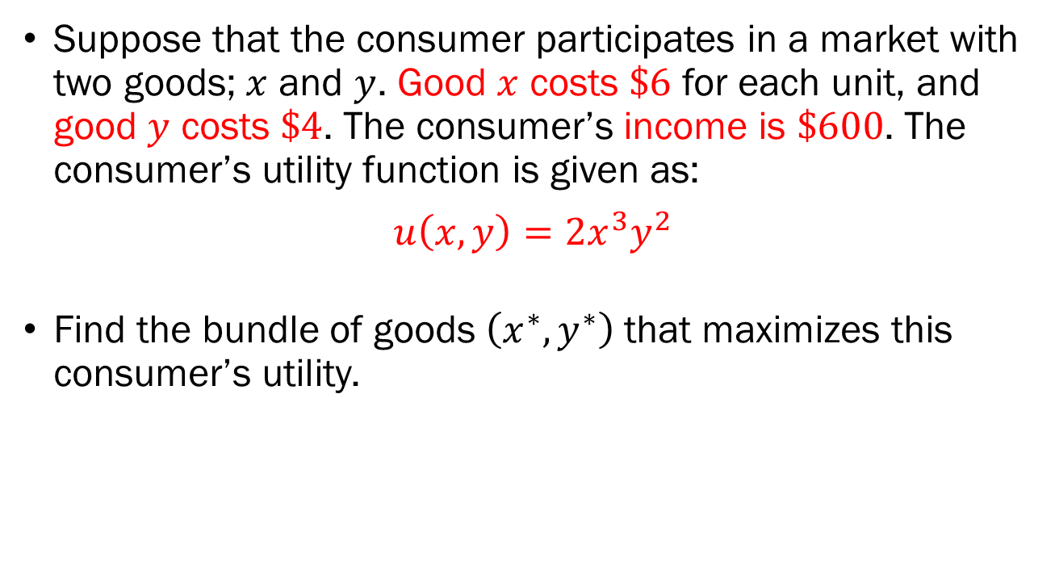
In-Class Exercise
Suppose that the consumer participates in a market with two goods; $x$ and $y$. Good $x$ costs $\$6$ for each unit, and good $y$ costs $\$4$. The consumer’s income is $\$600$. The consumer’s utility function is given as:
$$u\left(x,y\right)=2x^{3}y^{2}$$
Find the bundle of goods $\left(x^{∗},y^{∗}\right)$ that maximizes this consumer’s utility.

Slide 28
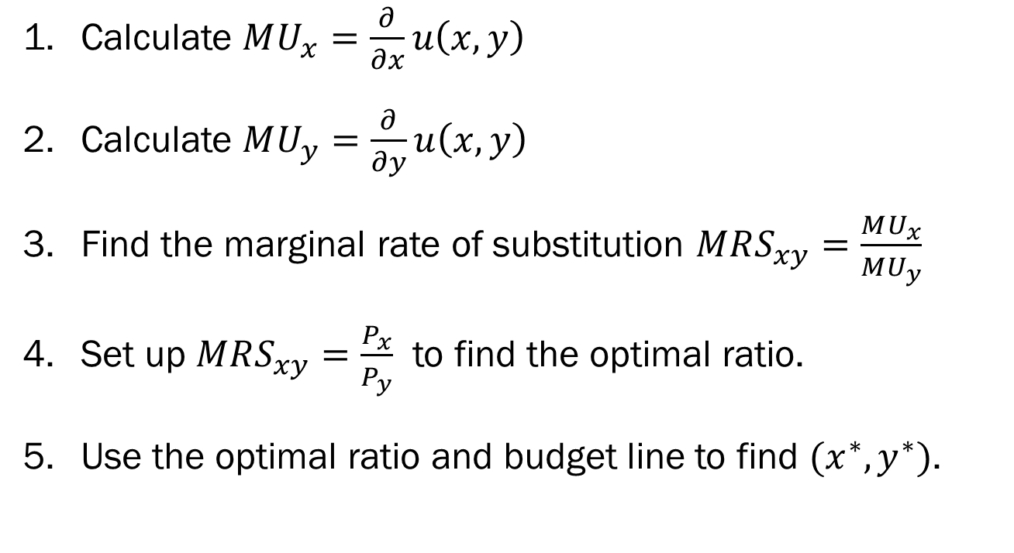
Recap of Standard UMP
Calculate $MU_{x}=\frac{∂}{∂x}u\left(x,y\right)$
Calculate $MU_{y}=\frac{∂}{∂y}u\left(x,y\right)$
Find the marginal rate of substitution $MRS_{xy}=\frac{MU_{x}}{MU_{y}}$
Set up $MRS_{xy}=\frac{P_{x}}{P_{y}}$ to find the optimal ratio.
Use the optimal ratio and budget line to find $(x^{∗},y^{∗})$.

Slide 29
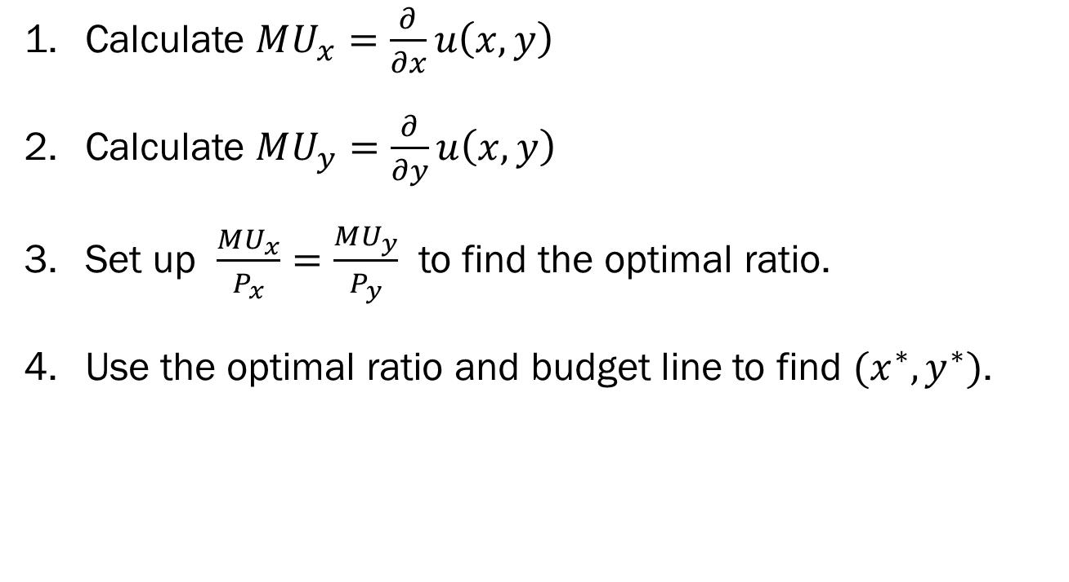
Alternative Recap of Standard UMP
Calculate $MU_{x}=\frac{∂}{∂x}u\left(x,y\right)$
Calculate $MU_{y}=\frac{∂}{∂y}u\left(x,y\right)$
Set up $\frac{MU_{x}}{P_{x}}=\frac{MU_{y}}{P_{y}}$ to find the optimal ratio.
Use the optimal ratio and budget line to find $(x^{∗},y^{∗})$.

