Slide 1
Consumer Theory:
Review Slides
ECON 300

Slide 2
Topics in Consumer Theory
The Budget Constraint
Preferences, Utility Functions, and Indifference Curves
Utility Maximization Problem
Comparative Statics of the Utility Maximization Problem

Slide 3
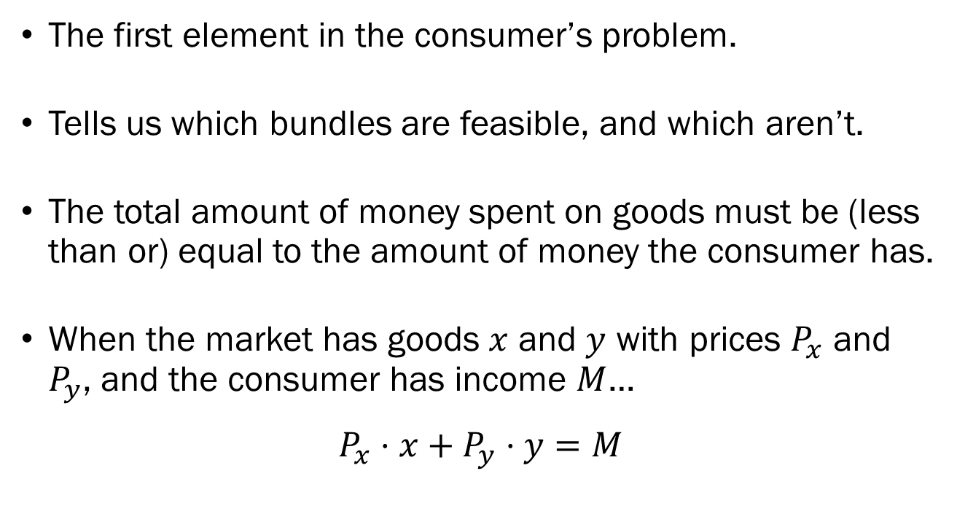
Budget Constraints
The first element in the consumer’s problem.
Tells us which bundles are feasible, and which aren’t.
The total amount of money spent on goods must be (less than or) equal to the amount of money the consumer has.
When the market has goods $x$ and $y$ with prices $P_{x}$ and $P_{y}$, and the consumer has income $M$…
$$P_{x}⋅x+P_{y}⋅y=M$$

Slide 4
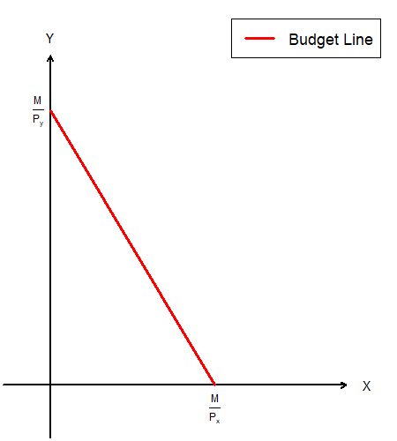
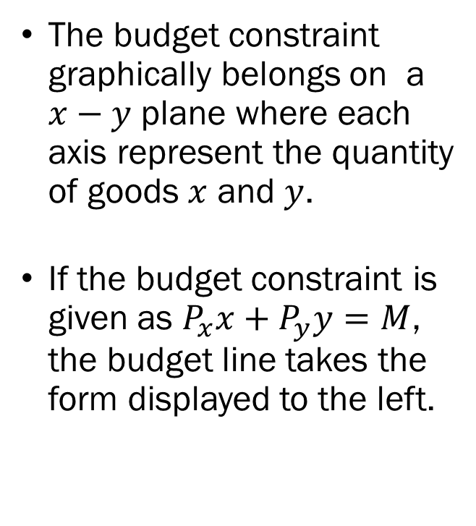
Budget Constraints
The budget constraint graphically belongs on a $x−y$ plane where each axis represent the quantity of goods $x$ and $y$.
If the budget constraint is given as $P_{x}x+P_{y}y=M$, the budget line takes the form displayed to the left.

Slide 5
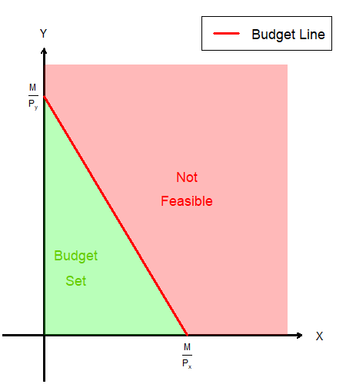
Budget Constraints
The area below the budget line represent bundles that are feasible.
The area above the budget line represent bundles that are not feasible.
Any bundle on the budget line will exhaust the consumer’s income.

Slide 6
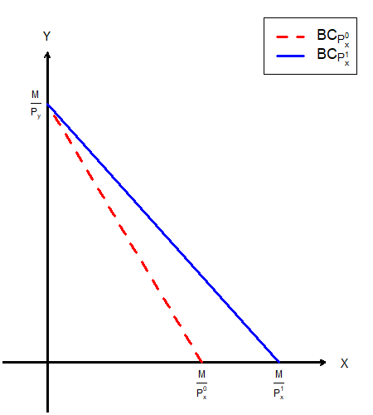
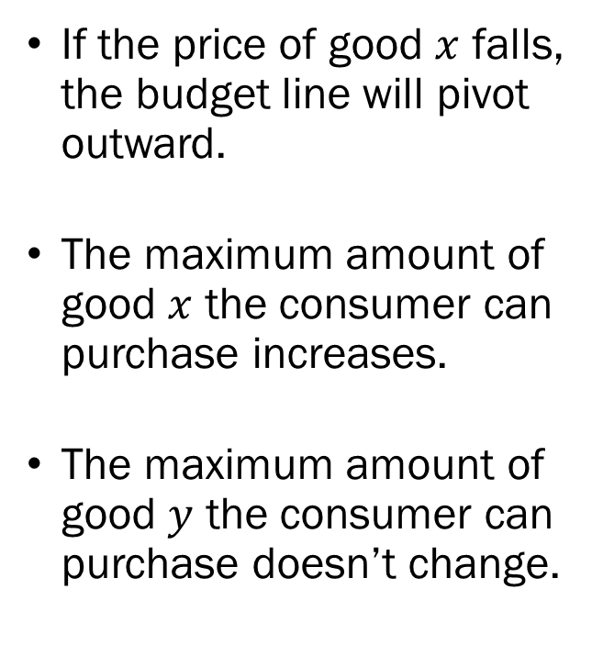
Budget Constraints
If the price of good $x$ falls, the budget line will pivot outward.
The maximum amount of good $x$ the consumer can purchase increases.
The maximum amount of good $y$ the consumer can purchase doesn’t change.

Slide 7
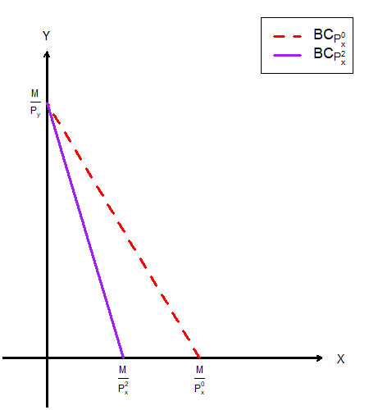
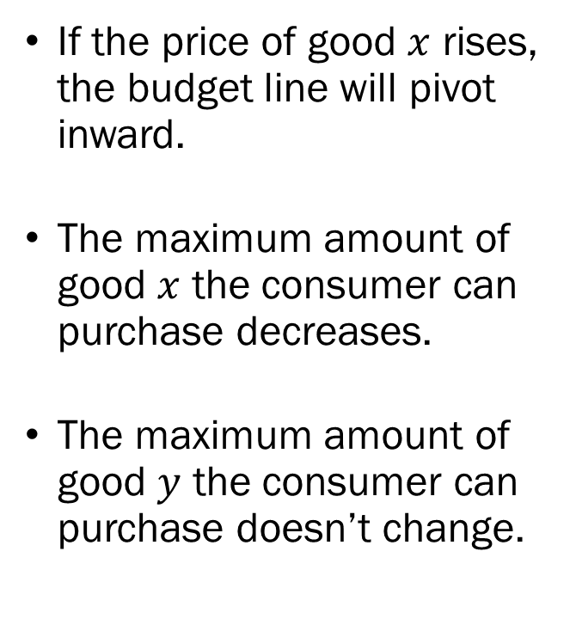
Budget Constraints
If the price of good $x$ rises, the budget line will pivot inward.
The maximum amount of good $x$ the consumer can purchase decreases.
The maximum amount of good $y$ the consumer can purchase doesn’t change.

Slide 8
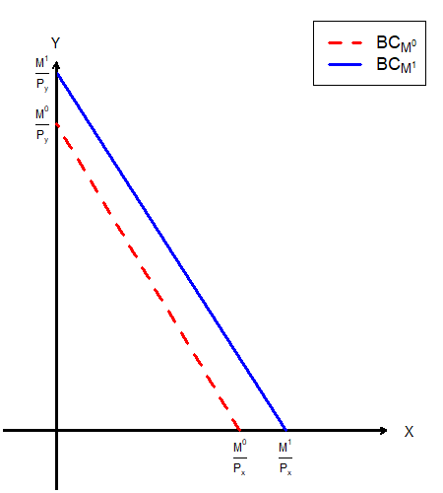
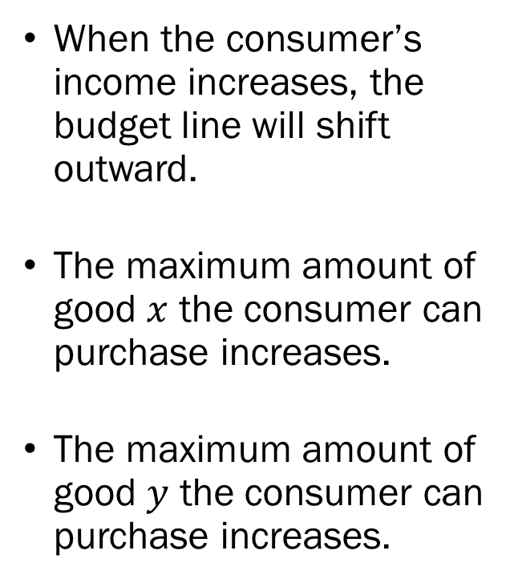
Budget Constraints
When the consumer’s income increases, the budget line will shift outward.
The maximum amount of good $x$ the consumer can purchase increases.
The maximum amount of good $y$ the consumer can purchase increases.

Slide 9
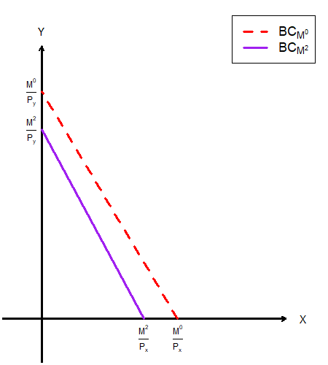
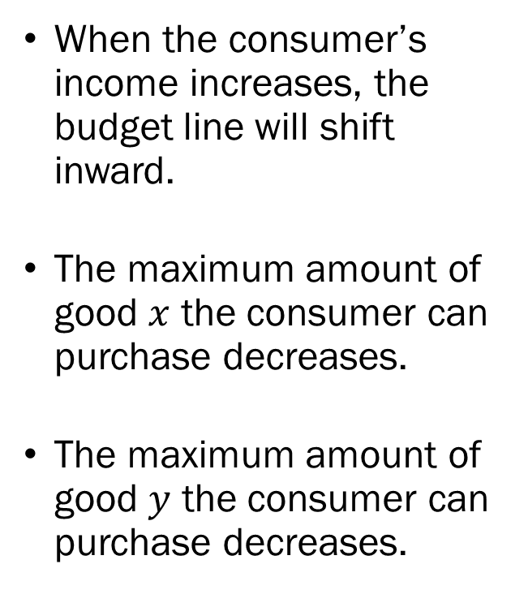
Budget Constraints
When the consumer’s income increases, the budget line will shift inward.
The maximum amount of good $x$ the consumer can purchase decreases.
The maximum amount of good $y$ the consumer can purchase decreases.

Slide 10
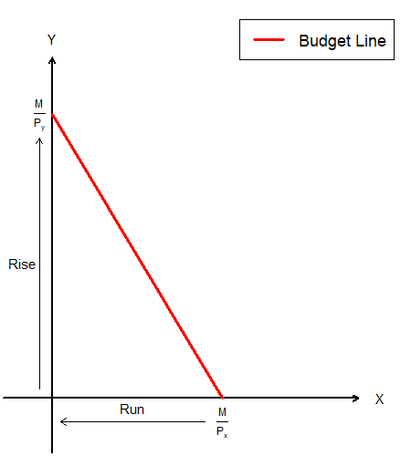
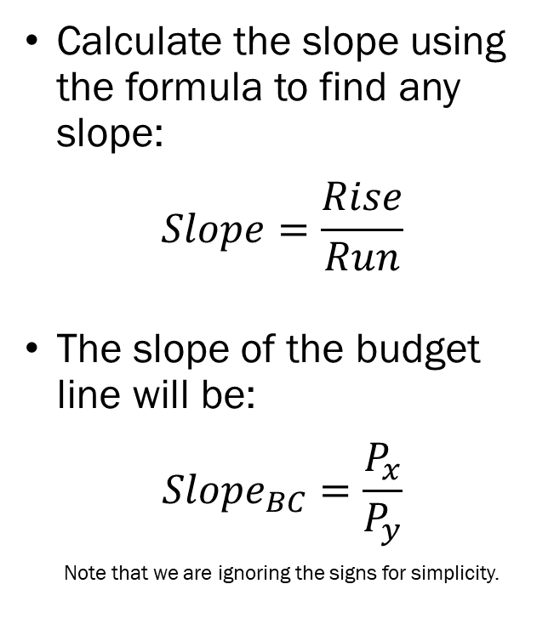
Budget Constraints
Calculate the slope using the formula to find any slope:
$$Slope=\frac{Rise}{Run}$$
The slope of the budget line will be:
$$Slope_{BC}=\frac{P_{x}}{P_{y}}$$
Note that we are ignoring the signs for simplicity.

Slide 11
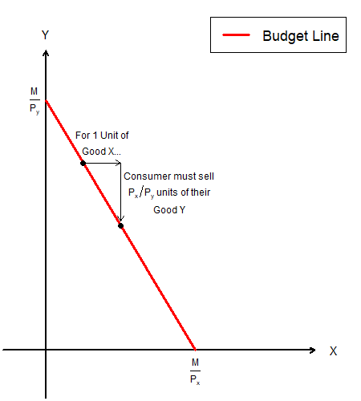
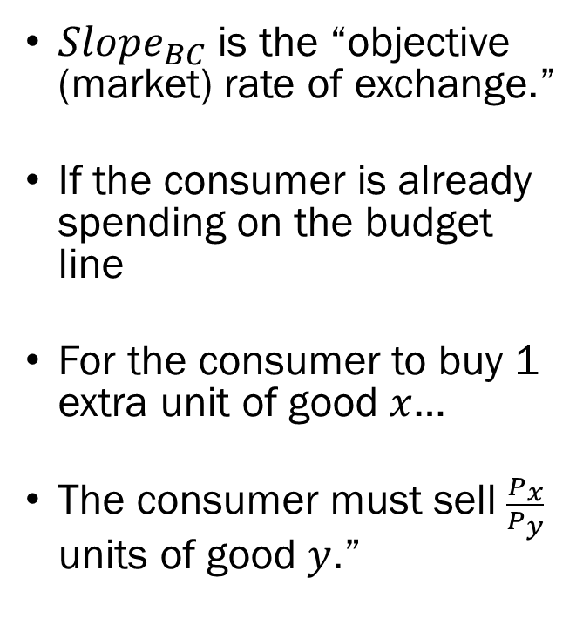
Budget Constraints
$Slope_{BC}$ is the “objective (market) rate of exchange.”
If the consumer is already spending on the budget line
For the consumer to buy 1 extra unit of good $x$…
The consumer must sell $\frac{P_{x}}{P_{y}}$ units of good $y$.”

Slide 12
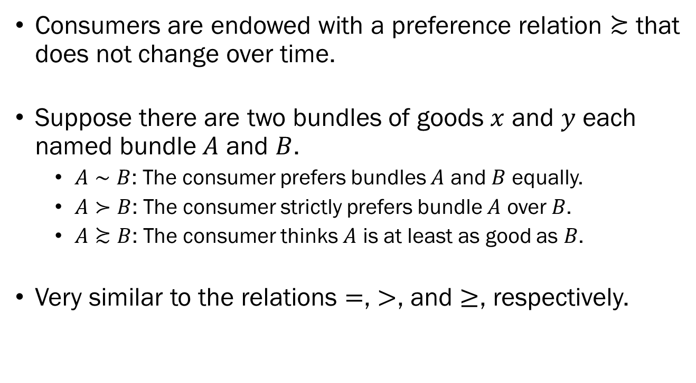
Preferences
Consumers are endowed with a preference relation $≿$ that does not change over time.
Suppose there are two bundles of goods $x$ and $y$ each named bundle $A$ and $B$.
  $A∼B$: The consumer prefers bundles $A$ and $B$ equally.
  $A≻B$: The consumer strictly prefers bundle $A$ over $B$.
  $A≿B$: The consumer thinks $A$ is at least as good as $B$.
Very similar to the relations $=$, $>$, and $≥$, respectively.

Slide 13
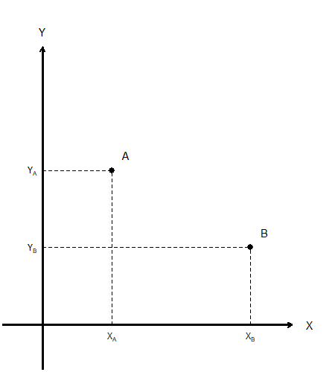
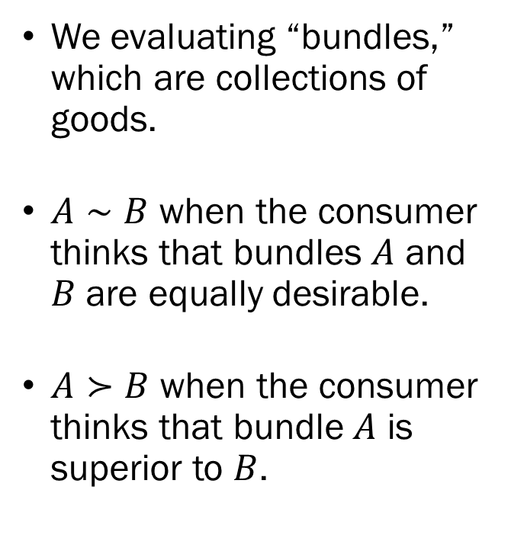
Preferences
We evaluating “bundles,” which are collections of goods.
$A∼B$ when the consumer thinks that bundles $A$ and $B$ are equally desirable.
$A≻B$ when the consumer thinks that bundle $A$ is superior to $B$.

Slide 14
Preferences
Baseline assumptions about the consumers’ preference.
We deal with preferences that are said to be:
  Complete: Any bundle can be evaluated.
  Transitive: No circular preferences allowed.
  Reflexive: Anything is as good as itself.
  Continuous: No sudden jumps in preferences.
  Monotone: The more the better.
  Convex: Consumers prefer diverse bundles.
Complete and Transitive preferences are “Rational.”

Slide 15
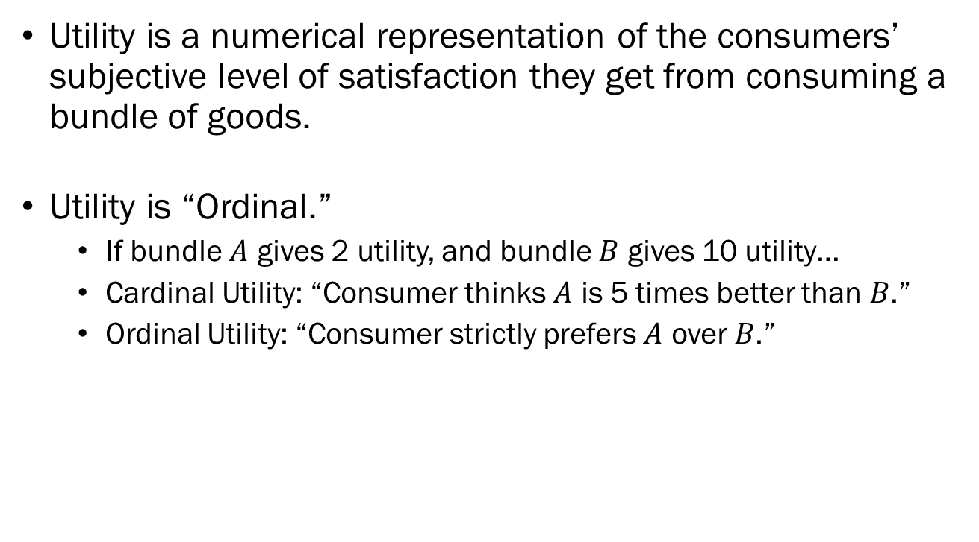
Utility and Utility Functions
Utility is a numerical representation of the consumers’ subjective level of satisfaction they get from consuming a bundle of goods.
Utility is “Ordinal.”
  If bundle $A$ gives 2 utility, and bundle $B$ gives 10 utility…
  Cardinal Utility: “Consumer thinks $A$ is 5 times better than $B$.”
  Ordinal Utility: “Consumer strictly prefers $A$ over $B$.”
 | Rank | Magnitude
Ordinal | Matters | Does not Matter
Cardinal | Matters | Matters

Slide 16
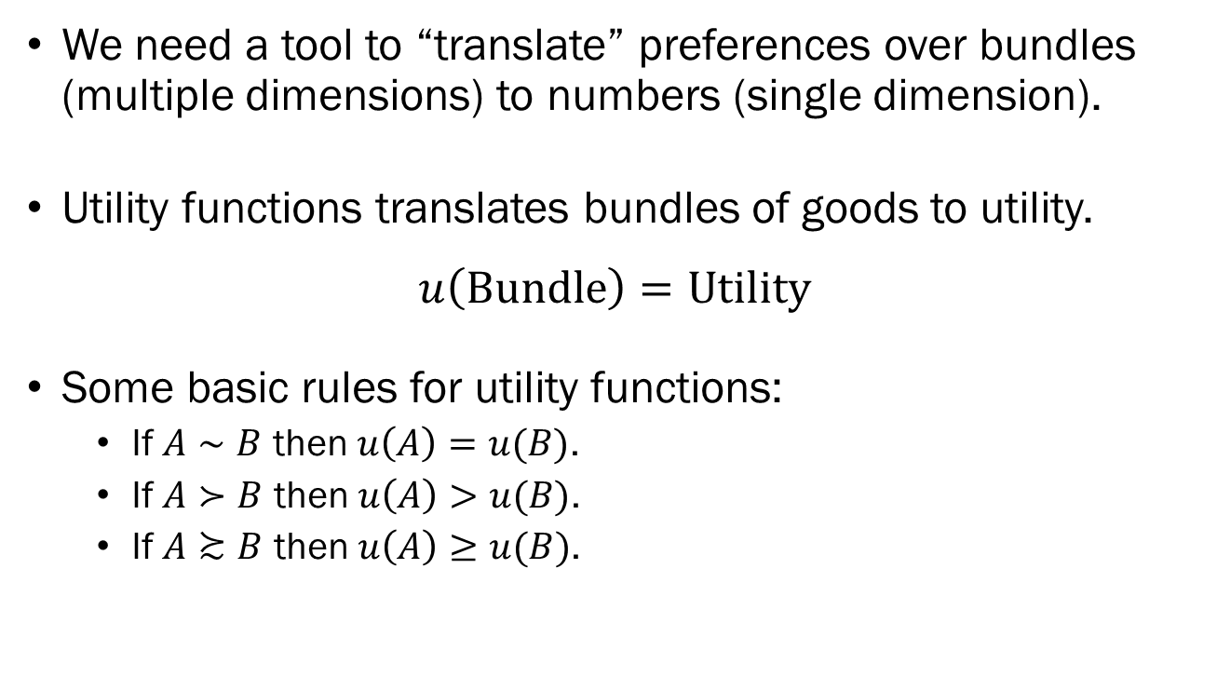
Utility and Utility Functions
We need a tool to “translate” preferences over bundles (multiple dimensions) to numbers (single dimension).
Utility functions translates bundles of goods to utility.
$$u\left(\text{Bundle}\right)=\text{Utility}$$
Some basic rules for utility functions:
  If $A∼B$ then $u\left(A\right)=u(B)$.
  If $A≻B$ then $u\left(A\right)>u(B)$.
  If $A≿B$ then $u\left(A\right)≥u(B)$.

Slide 17
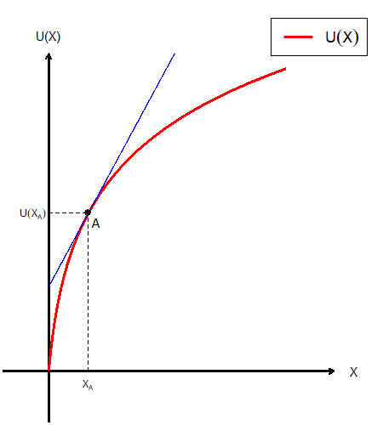
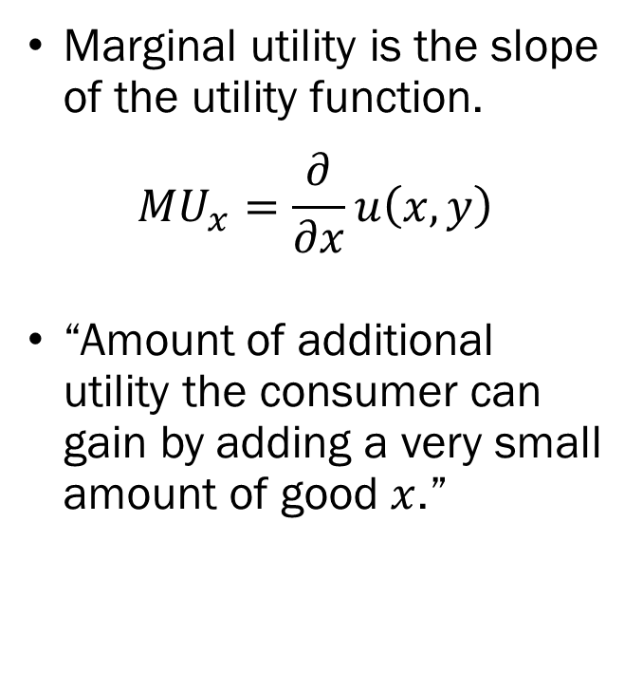
Utility and Utility Functions
Marginal utility is the slope of the utility function.
$$MU_{x}=\frac{∂}{∂x}u\left(x,y\right)$$
“Amount of additional utility the consumer can gain by adding a very small amount of good $x$.”

Slide 18
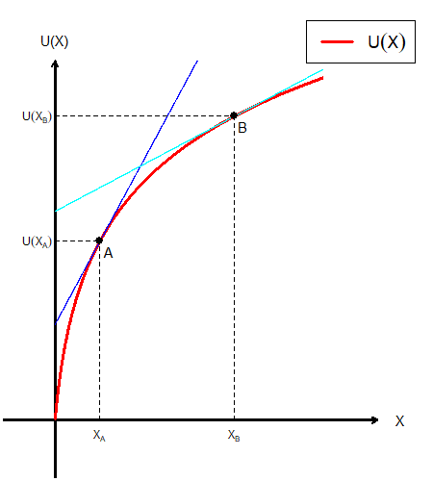
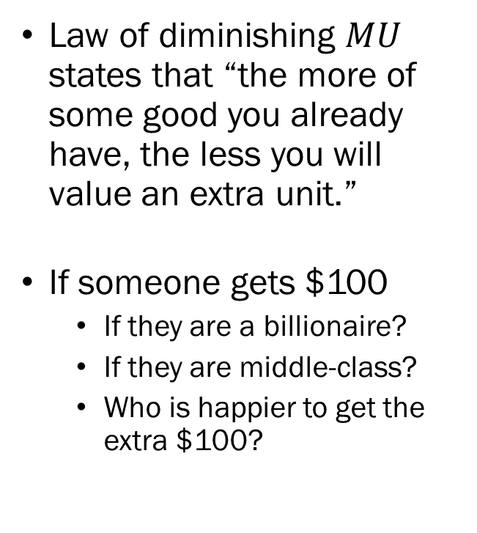
Utility and Utility Functions
Law of diminishing $MU$ states that “the more of some good you already have, the less you will value an extra unit.”
If someone gets $100
  If they are a billionaire?
  If they are middle-class?
  Who is happier to get the extra $100?

Slide 19
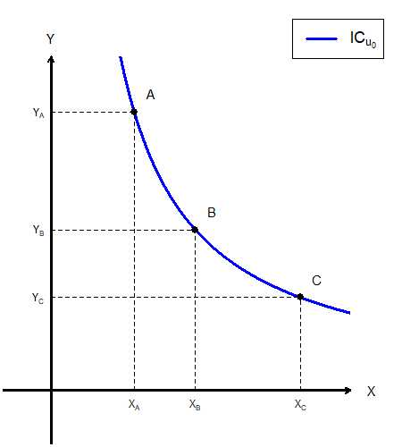
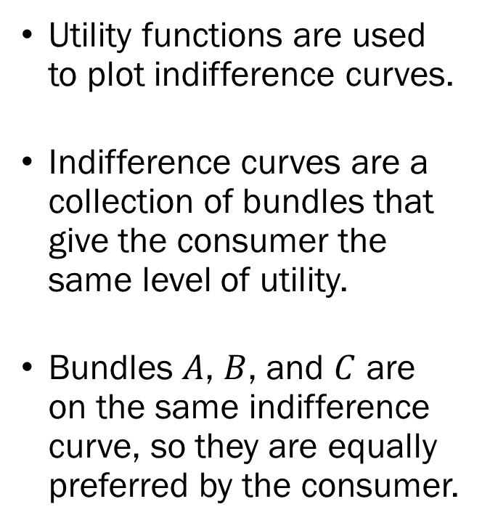
Indifference Curves
Utility functions are used to plot indifference curves.
Indifference curves are a collection of bundles that give the consumer the same level of utility.
Bundles $A$, $B$, and $C$ are on the same indifference curve, so they are equally preferred by the consumer.

Slide 20
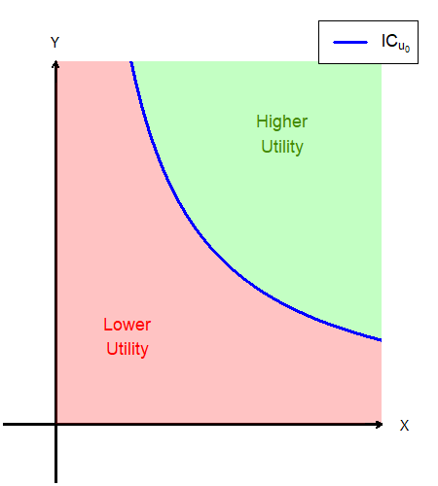
Indifference Curves
The area below the indifference curve consist of bundles that give the consumer lower utility than any bundle on the indifference curve.
The area above the indifference curve consist of bundles that give the consumer greater utility than any bundle on the indifference curve.

Slide 21
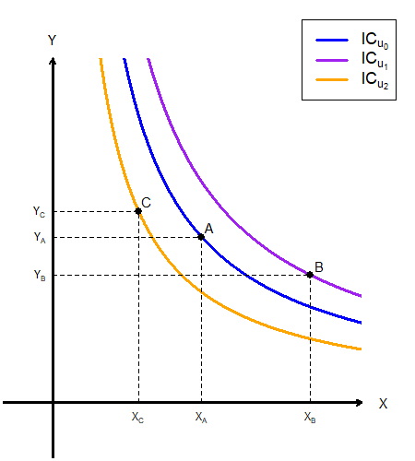
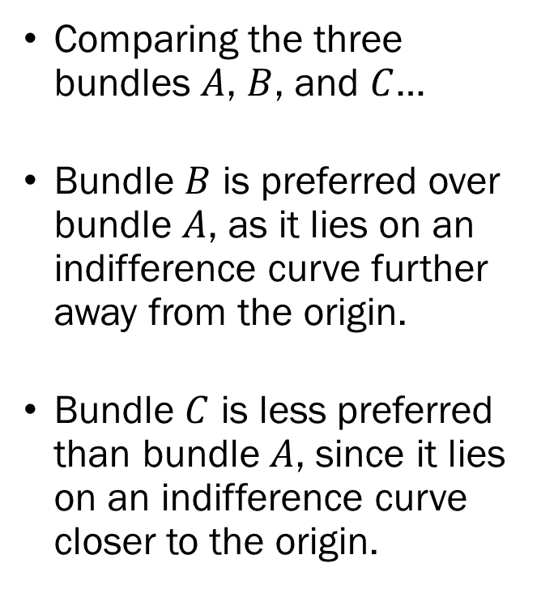
Indifference Curves
Comparing the three bundles $A$, $B$, and $C$…
Bundle $B$ is preferred over bundle $A$, as it lies on an indifference curve further away from the origin.
Bundle $C$ is less preferred than bundle $A$, since it lies on an indifference curve closer to the origin.

Slide 22
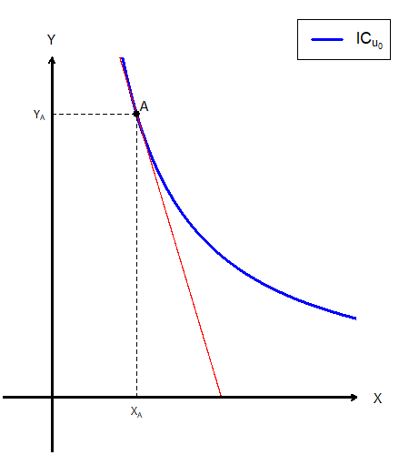
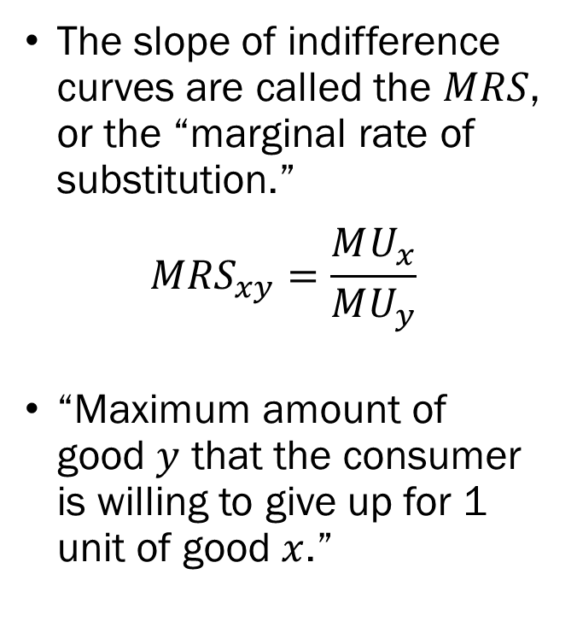
Indifference Curves
The slope of indifference curves are called the $MRS$, or the “marginal rate of substitution.”
$$MRS_{xy}=\frac{MU_{x}}{MU_{y}}$$
“Maximum amount of good $y$ that the consumer is willing to give up for 1 unit of good $x$.”

Slide 23
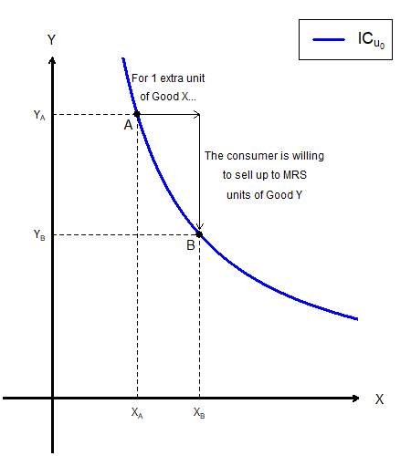
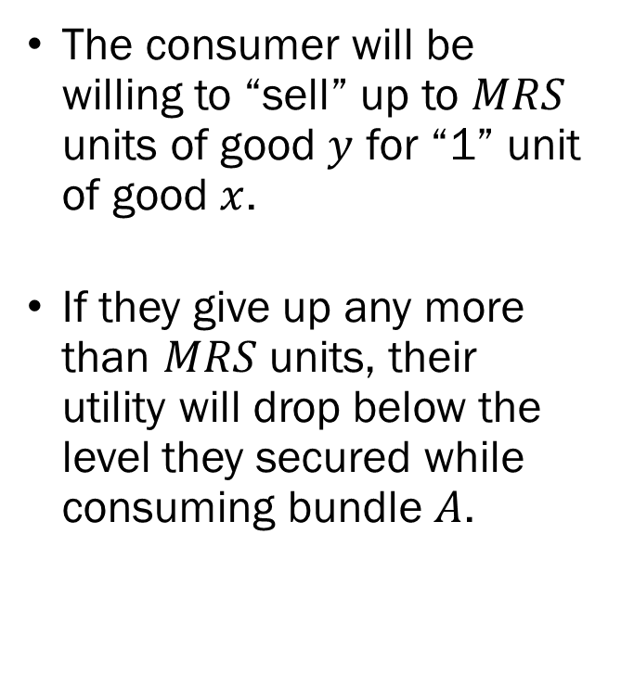
Indifference Curves
The consumer will be willing to “sell” up to $MRS$ units of good $y$ for “1” unit of good $x$.
If they give up any more than $MRS$ units, their utility will drop below the level they secured while consuming bundle $A$.

Slide 24
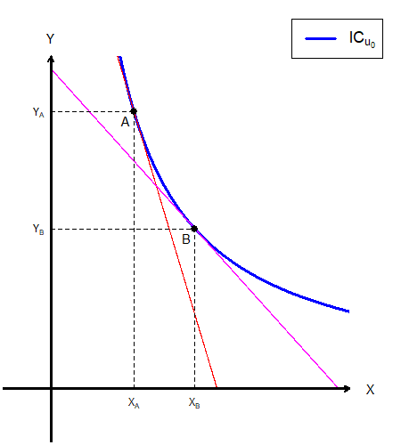
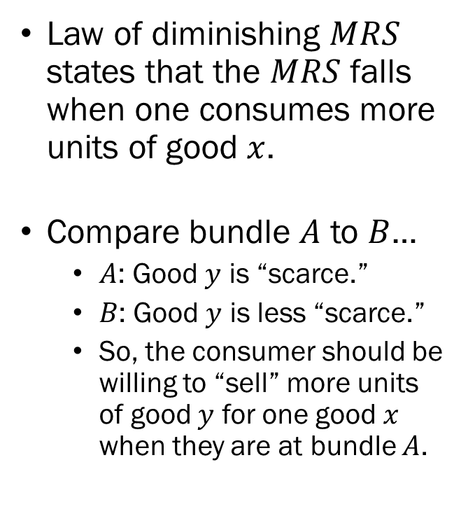
Indifference Curves
Law of diminishing $MRS$ states that the $MRS$ falls when one consumes more units of good $x$.
Compare bundle $A$ to $B$…
  $A$: Good $y$ is “scarce.”
  $B$: Good $y$ is less “scarce.”
  So, the consumer should be willing to “sell” more units of good $y$ for one good $x$ when they are at bundle $A$.

Slide 25
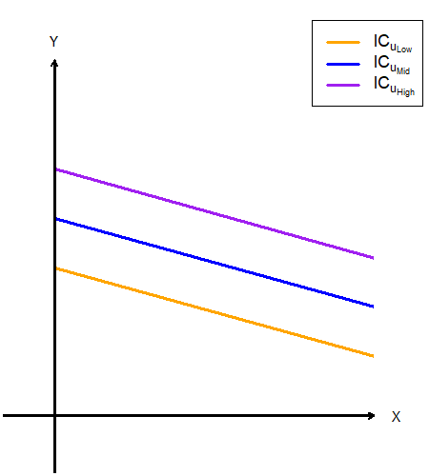
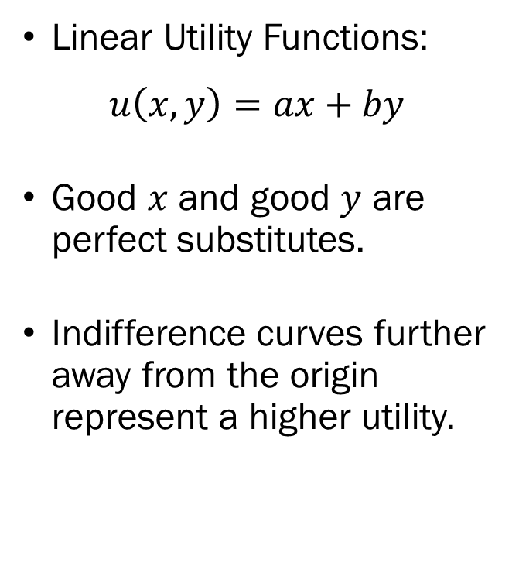
Types of Utility Functions
Linear Utility Functions:
$$u\left(x,y\right)=ax+by$$
Good $x$ and good $y$ are perfect substitutes.
Indifference curves further away from the origin represent a higher utility.

Slide 26
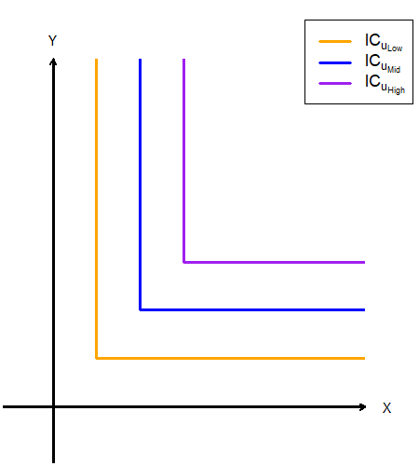
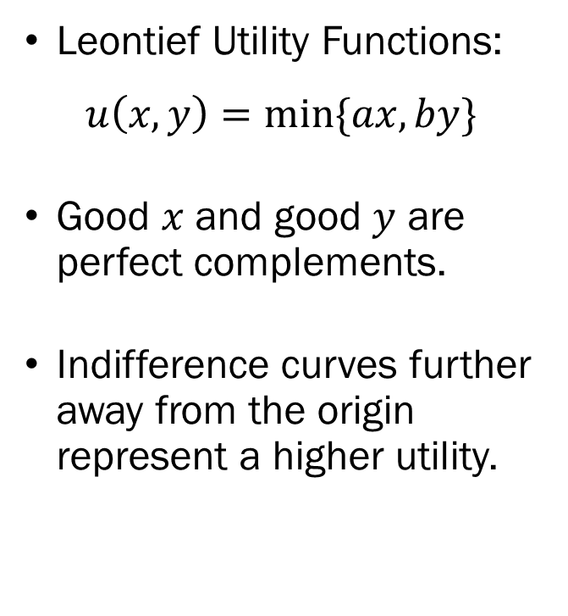
Types of Utility Functions
Leontief Utility Functions:
$$u\left(x,y\right)=min⁡\{ax,by\}$$
Good $x$ and good $y$ are perfect complements.
Indifference curves further away from the origin represent a higher utility.

Slide 27
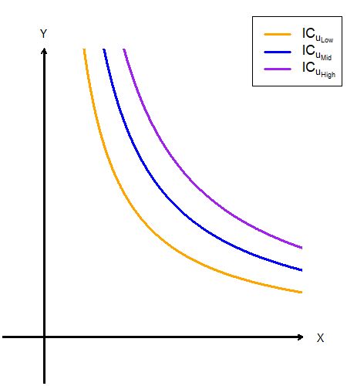
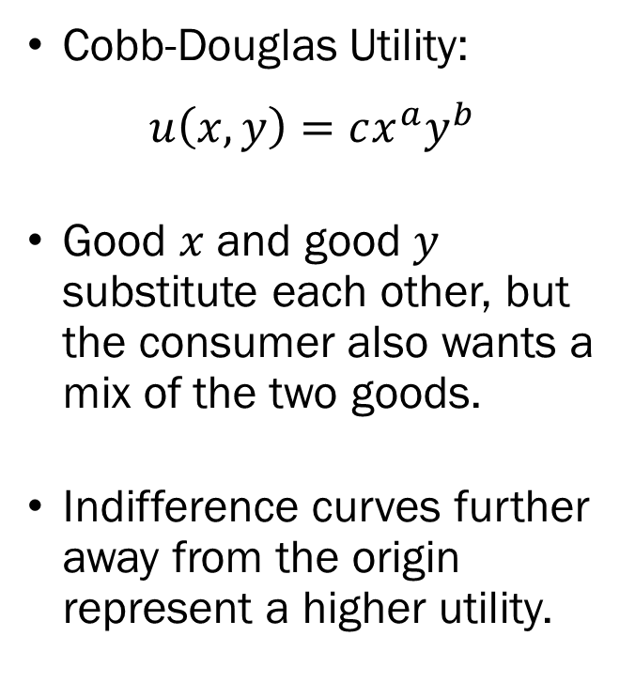
Types of Utility Functions
Cobb-Douglas Utility:
$$u\left(x,y\right)=cx^{a}y^{b}$$
Good $x$ and good $y$ substitute each other, but the consumer also wants a mix of the two goods.
Indifference curves further away from the origin represent a higher utility.

Slide 28
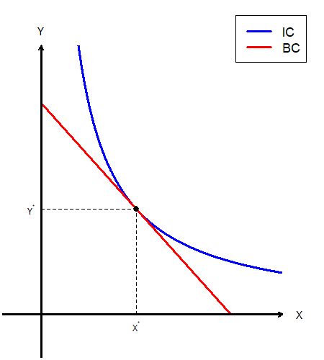
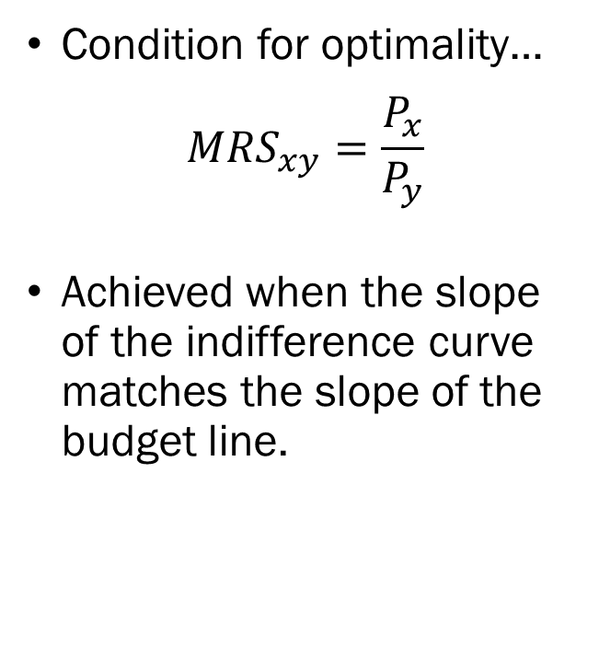
Utility Maximization Problem
Condition for optimality…
$$MRS_{xy}=\frac{P_{x}}{P_{y}}$$
Achieved when the slope of the indifference curve matches the slope of the budget line.

Slide 29
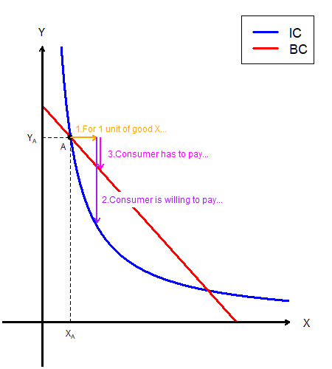
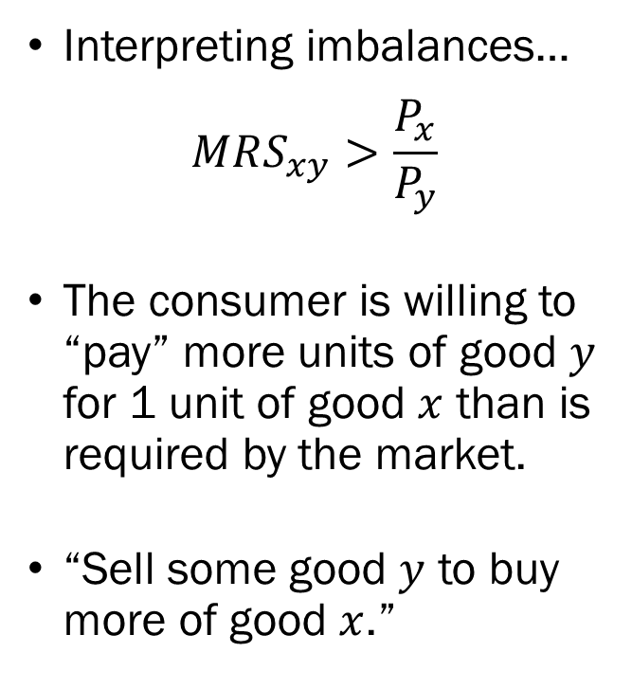
Utility Maximization Problem
Interpreting imbalances…
$$MRS_{xy}>\frac{P_{x}}{P_{y}}$$
The consumer is willing to “pay” more units of good $y$ for 1 unit of good $x$ than is required by the market.
“Sell some good $y$ to buy more of good $x$.”

Slide 30
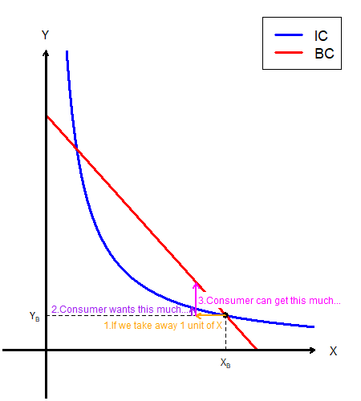
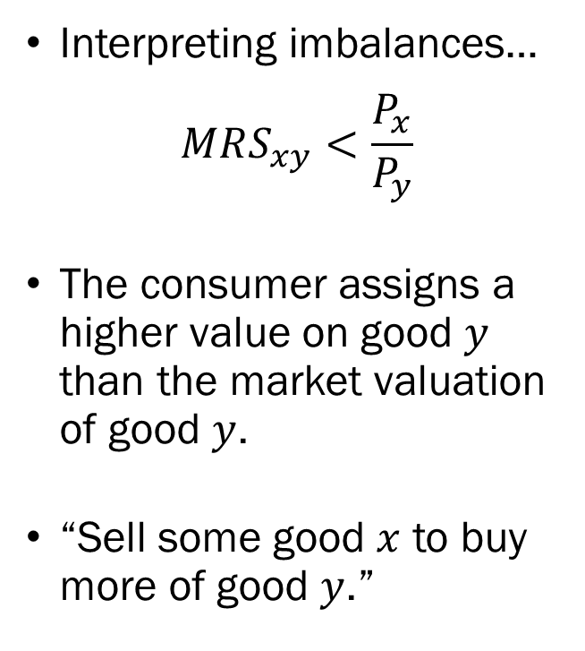
Utility Maximization Problem
Interpreting imbalances…
$$MRS_{xy}<\frac{P_{x}}{P_{y}}$$
The consumer assigns a higher value on good $y$ than the market valuation of good $y$.
“Sell some good $x$ to buy more of good $y$.”

Slide 31
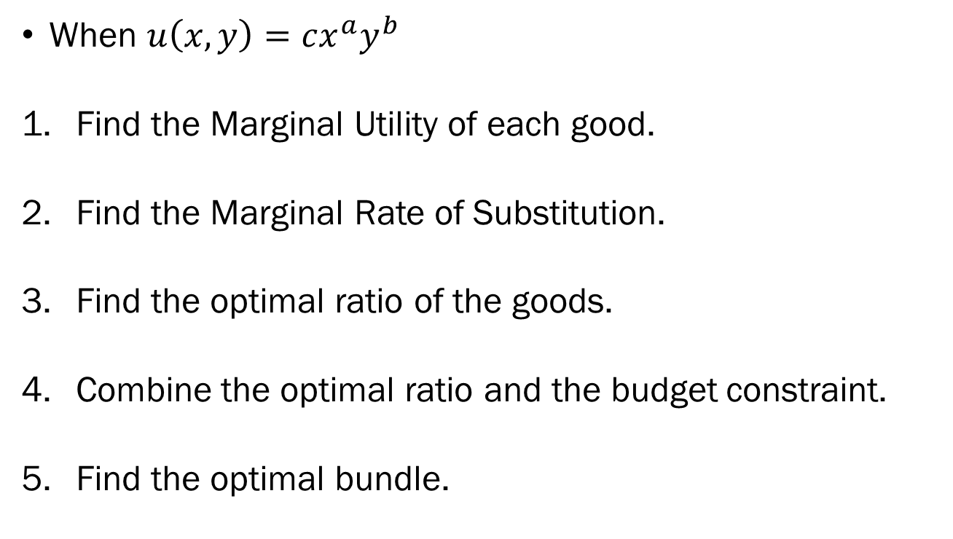
UMP: Cobb-Douglas Utility Functions
When $u\left(x,y\right)=cx^{a}y^{b}$
Find the Marginal Utility of each good.
Find the Marginal Rate of Substitution.
Find the optimal ratio of the goods.
Combine the optimal ratio and the budget constraint.
Find the optimal bundle.

Slide 32
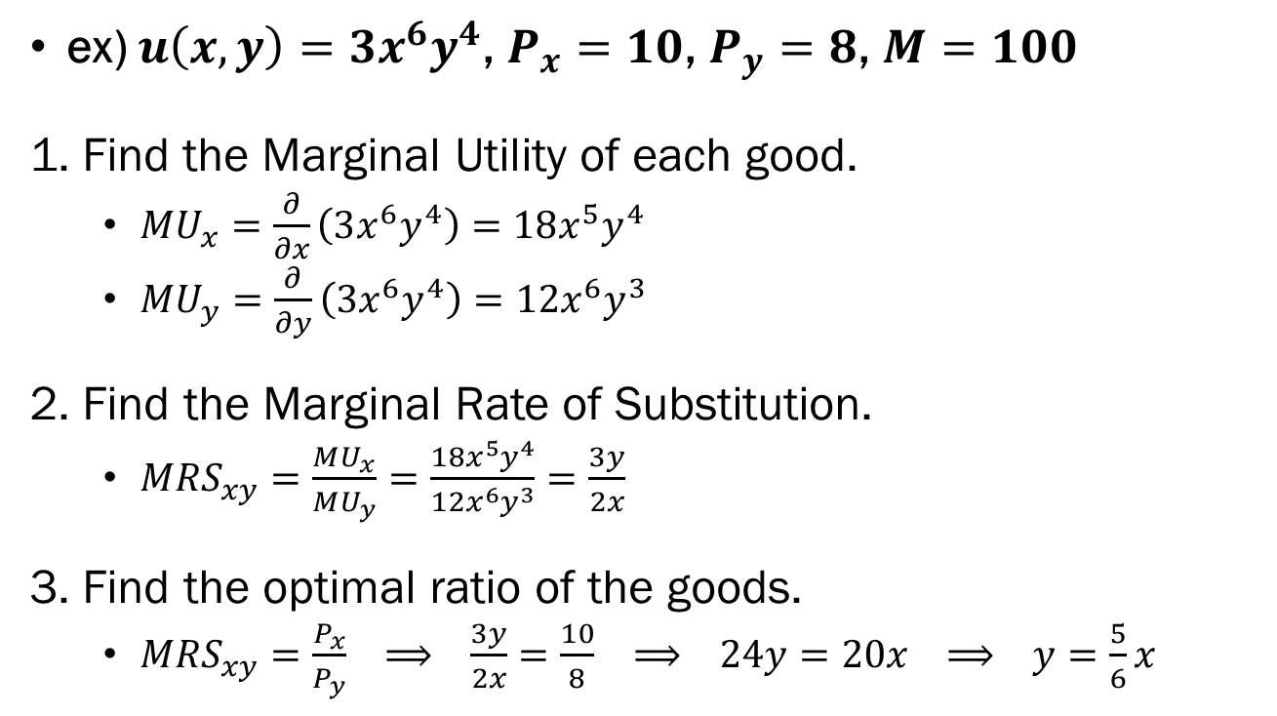
UMP: Cobb-Douglas Utility Functions
ex) $u\left(x,y\right)=3x^{6}y^{4}$, $P_{x}=10$, $P_{y}=8$, $M=100$
1. Find the Marginal Utility of each good.
  $MU_{x}=\frac{∂}{∂x}\left(3x^{6}y^{4}\right)=18x^{5}y^{4}$
  $MU_{y}=\frac{∂}{∂y}\left(3x^{6}y^{4}\right)=12x^{6}y^{3}$
2. Find the Marginal Rate of Substitution.
  $MRS_{xy}=\frac{MU_{x}}{MU_{y}}=\frac{18x^{5}y^{4}}{12x^{6}y^{3}}=\frac{3y}{2x}$
3. Find the optimal ratio of the goods.
  $MRS_{xy}=\frac{P_{x}}{P_{y}} ⟹ \frac{3y}{2x}=\frac{10}{8} ⟹ 24y=20x ⟹ y=\frac{5}{6}x$

Slide 33

UMP: Cobb-Douglas Utility Functions
ex) $u\left(x,y\right)=3x^{6}y^{4}$, $P_{x}=10$, $P_{y}=8$, $M=100$
4. Combine the optimal ratio and the budget constraint.
  $10x+8y=100 ⟹ 10x+8\left(\frac{5}{6}x\right)=100 ⟹ \frac{50}{3}x=100$
5. Find the optimal bundle.
  $x^{∗}=6 ⟹ y^{∗}=\frac{5}{6}x^{∗} ⟹ y^{∗}=5$

Slide 34

UMP: Linear Utility Functions
When $u\left(x,y\right)=ax+by$
Find the Marginal Utility of each good.
Find the “Rule” to follow.
  $MRS_{xy}=\frac{P_{x}}{P_{y}}$ or $\frac{{MU}_{x}}{P_{x}}=\frac{{MU}_{y}}{P_{y}}$
Find the optimal bundle.

Slide 35

UMP: Linear Utility Functions
ex) $u\left(x,y\right)=7x+5y$, $P_{x}=10$, $P_{y}=8$, $M=100$
1. Find the Marginal Utility of each good.
  $MU_{x}=\frac{∂}{∂x}\left(7x+5y\right)=7$
  $MU_{y}=\frac{∂}{∂y}\left(7x+5y\right)=5$
2. Find the “Rule” to follow.
  $\frac{MU_{x}}{P_{x}}=\frac{7}{10}>\frac{5}{8}=\frac{MU_{y}}{P_{y}}$, so exclusively consume good $x$.
3. Find the optimal bundle.
  $x^{∗}=10$, $y^{∗}=0$

Slide 36

UMP: Leontief Utility Functions
When $u\left(x,y\right)=\min\left\{ax,by\right\}$
Find the “Rule” to follow.
  $ax=by$
Combine the “Rule” and the budget constraint.
Find the optimal bundle.

Slide 37

UMP: Leontief Utility Functions
ex) $u\left(x,y\right)=min\{5x,4y\}$, $P_{x}=10$, $P_{y}=8$, $M=100$
1. Find the “Rule” to follow.
  $5x=4y ⟹ y=\frac{5}{4}x$
2. Combine the “Rule” and the budget constraint.
  $10x+8y=100 ⟹ 10x+8\left(\frac{5}{4}x \right)=100 ⟹ 20x=100$
3. Find the optimal bundle.
  $x^{∗}=5 ⟹ y^{∗}=\frac{5}{4}x^{∗} ⟹ y^{∗}=\frac{25}{4}$

Slide 38

Comparative Statics of the UMP
Changes in the Consumers’ Income.
Normal Goods: Income Elasticity is Positive.
  $x↑$ when $M↑$
  $x↓$ when $M↓$
Inferior Goods: Income Elasticity is Negative.
  $x↓$ when $M↑$
  $x↑$ when $M↓$
The Income Consumption Curve and the Engel Curve.

Slide 39


Comparative Statics of the UMP
Income Consumption Curve
Engel Curve

Slide 40

Comparative Statics of the UMP
Changes in the Market Price of a Good.
Ordinary Goods: Price Elasticity is Negative.
  $x↑$ when $P_{x}↓$
  $x↓$ when $P_{x}↑$
Giffen Goods: Price Elasticity is Positive.
  $x↓$ when $P_{x}↓$
  $x↑$ when $P_{x}↑$
The Price Consumption Curve and the Demand Curve.
Price, Substitution, and Income Effects.

Slide 41


Comparative Statics of the UMP
Price Consumption Curve
Demand Curve

Slide 42
Comparative Statics of the UMP
When the market price of a good changes…
  One good gets “relatively more expensive,” and
  The other good gets “relatively cheaper,”, and
  The consumer’s perceived purchasing power will change.
The Price Effect, Substitution Effect, and Income Effect
  Price Effect: Aggregate Effect of Changes in Price
  Substitution Effect: Isolated Effect of Changes in Relative Prices
  Income Effect: Isolated Effect of Changes in Purchasing Power
The Slutsky Equation
  Price Effect = Substitution Effect + Income Effect

Slide 43


Comparative Statics of the UMP
Diagram when good $x$ is an ordinary good, and market price increased.
“New Prices, Old Utility.”
The Breakdown
  Substitution Effect: $x_{0}→x_{H}$
  Income Effect: $x_{H}→x_{1}$
  Price Effect: $x_{0}→x_{1}$

Slide 44

Own Price Elasticity
The measure of “how sensitive is the quantity demanded of $x$ to changes in $P_{x}$.”
The (own) price elasticity is defined as:
$$ε_{xp}=\frac{\% Change of x}{\% Change of P_{x}}=\frac{∂x}{∂p_{x}}⋅\frac{P_{x}}{x}$$
  When $ε_{xp}<0$, good $x$ is an Ordinary Good.
  When $ε_{xp}>0$, good $x$ is a Giffen Good.
  When $ε_{xp}<−1$, good $x$ is said to be “Elastic.”
  When$ε_{xp}=−1$, good $x$ is said to be “Unit Elastic.”
  When $−1<ε_{xp}<0$, good $x$ is said to be “Inelastic.”

Slide 45

Income Elasticity
The measure of “how sensitive is the quantity demanded of $x$ to changes in $M$.”
The income elasticity is defined as:
$$ε_{xM}=\frac{\% Change of x}{\% Change of M}=\frac{∂x}{∂M}⋅\frac{M}{x}$$
  When $ε_{xM}>0$, Good $x$ is a Normal Good.
  When $ε_{xM}<0$, Good $x$ is an Inferior Good.
  When $ε_{xM}>1$, Good $x$ is a Luxury Good.
  When $0<ε_{xM}<1$, Good $x$ is a Necessary Good.

Slide 46

Cross-Price Elasticity
The measure of “how sensitive is the quantity demanded of $x$ to changes in $P_{y}$.”
The cross-price elasticity is defined as:
$$ε_{xy}=\frac{\% Change of x}{\% Change of P_{y}}=\frac{∂x}{∂P_{y}}⋅\frac{P_{y}}{x}$$
  When $ε_{xy}>0$, Good $y$ is a Substitute to Good $x$.
  When $ε_{xy}=0$, Good $y$ and Good $x$ are Independent.
  When $ε_{xy}<0$, Good $y$ is a Complement to Good $x$.

Slide 47

Total Revenue
Total Revenue is the amount of money that the seller receives from consumers by selling their products.
Total Revenue is defined as:
$$TR\left(x\right)=P_{x}⋅x$$
Marginal Revenue is the extra amount of revenue the producer gets when they increase production by a small amount:
$$MR\left(x\right)=\frac{d}{dx}TR\left(x\right)$$

Slide 48

Total Revenue
ex) When the (inverse) demand function is: $P_{x}=a−bx$
Total Revenue:
$$TR\left(x\right)=P_{x}⋅x=\left(a−bx\right)⋅x=ax−bx^{2}$$
Marginal Revenue:
$$MR\left(x\right)=\frac{d}{dx}TR\left(x\right)=\frac{d}{dx}\left(ax−bx^{2}\right)=a−2bx$$

Slide 49

Total Revenue and Price Elasticity
Marginal Revenue is:
$$MR\left(x\right)=P_{x}⋅\left(1+\frac{1}{ε_{xp}}\right)$$
  When demand is elastic $\left(ε_{xp}<−1\right)$, marginal revenue is positive, and firms should increase production to increase total revenue.
  When demand is inelastic $\left(−1<ε_{xp}<0\right)$, marginal revenue is negative, and firms should decrease production to increase total revenue.

Slide 50



Total Revenue and Price Elasticity
Plot the demand and marginal revenue curves.
  $P_{x}=a−bx$
  $MR(x)=a−2bx$
From the previous slide:
  When $ε_{xp}<−1$, decrease production to increase revenue.
  When $−1<ε_{xp}<0$, increase production to increase revenue

