Slide 1
Producer Theory:
Cost of Production and
The Cost Minimization Problem
ECON 300

Slide 2

PollEv.com/brianpark046

Slide 3
Opportunity Cost
When Economists consider the concept of cost, we are referring to the “Opportunity Cost.”
“The cost associated with all opportunities that are forgone by not putting the firm’s resources to their best alternative use.”
  If you already own the machines in a factory, is the cost 0?
  If you are working in the factory yourself, is the cost 0?
  Had you rented out the machines, you would have gained rent.
  Had you worked for another firm, you would have earned wages.

Slide 4
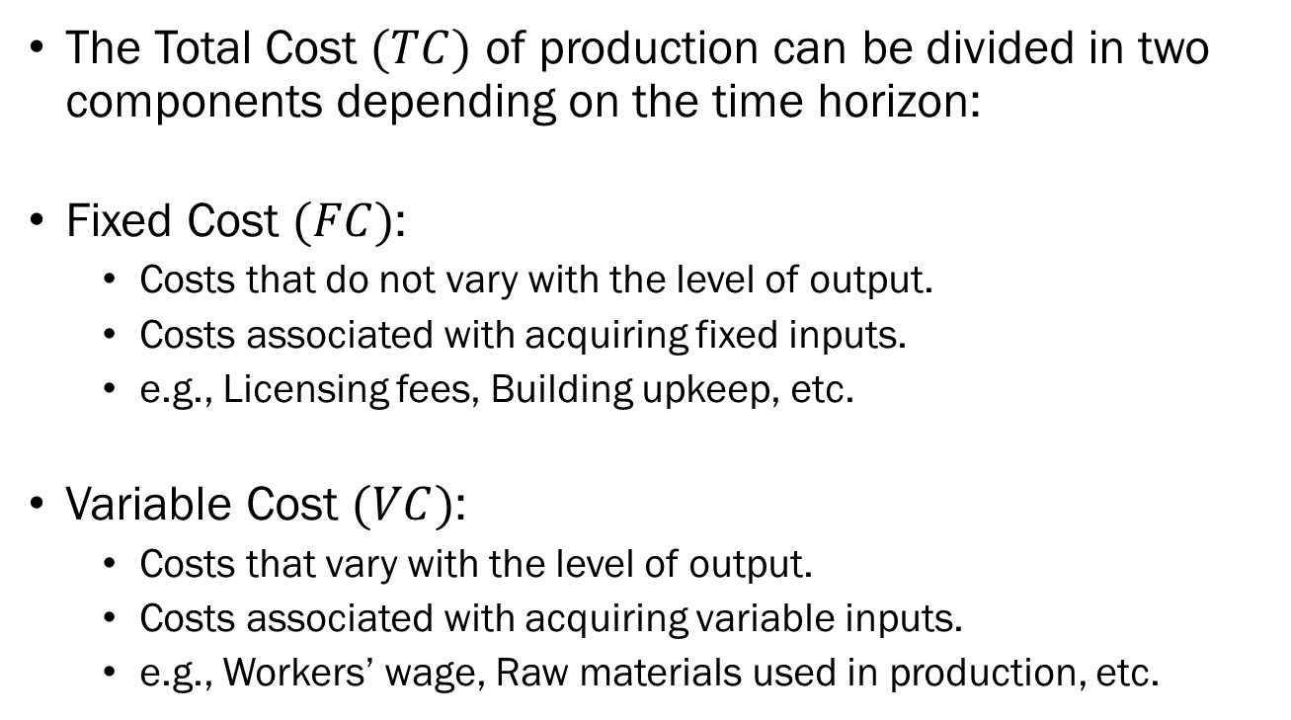
Fixed vs. Variable Cost
The Total Cost $(TC)$ of production can be divided in two components depending on the time horizon:
Fixed Cost $(FC)$:
  Costs that do not vary with the level of output.
  Costs associated with acquiring fixed inputs.
  e.g., Licensing fees, Building upkeep, etc.
Variable Cost $(VC)$:
  Costs that vary with the level of output.
  Costs associated with acquiring variable inputs.
  e.g., Workers’ wage, Raw materials used in production, etc.

Slide 5
Total, Average, and Marginal Costs
Suppose that we are creating Monmouth College branded ceramic coffee mugs.
For simplicity’s sake, we will ignore labor input for now.
The cost of acquiring a machine that prints the Monmouth College logo onto a ceramic mug is $5,000.
The cost of purchasing one blank ceramic mug is between $4~$10 depending on the total quantity ordered.
Assuming we live in a “discrete” world, we can find…

Slide 6
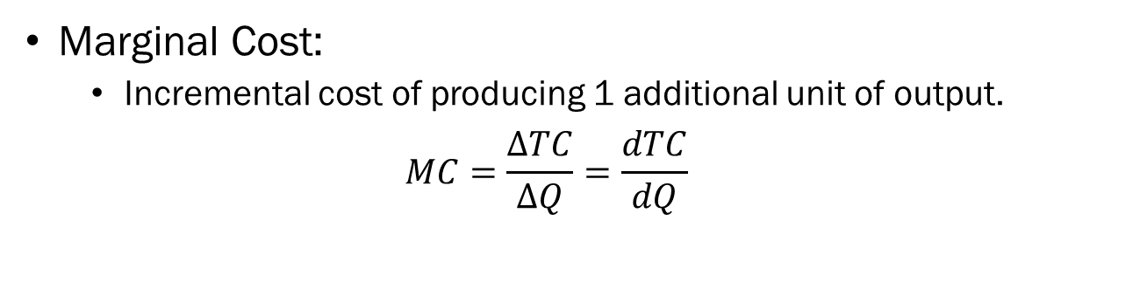
Total, Average, and Marginal Costs
Q | FC | VC | TC | MC | AFC | AVC | ATC
0 | 5,000 | 0 | 5,000 | - | - | - | -
1 | 5,000 | 10 | 5,010 | 10 | 5,000 | 10 | 5,010
2 | 5,000 | 19 | 5,019 | 9 | 2,500 | 9.5 | 2,509.5
3 | 5,000 | 27 | 5,027 | 8 | 1,250 | 9 | 1,675.7
4 | 5,000 | 34 | 5,034 | 7 | 625 | 8.5 | 1,258.5
Marginal Cost:
  Incremental cost of producing 1 additional unit of output.
  $$MC=\frac{∆TC}{∆Q}=\frac{dTC}{dQ}$$

Slide 7
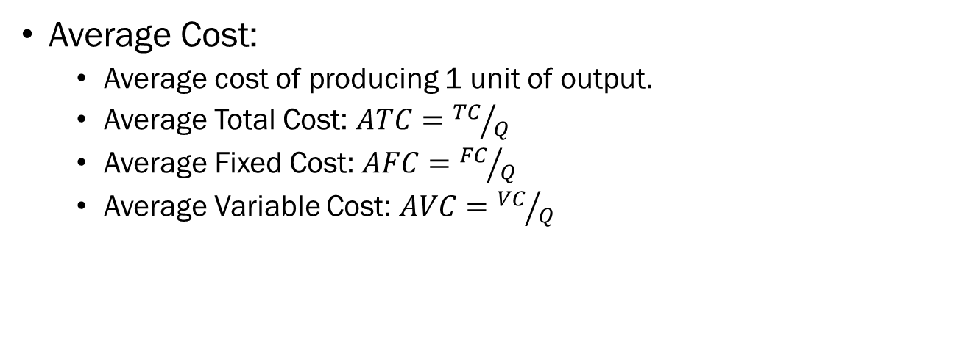
Total, Average, and Marginal Costs
Q | FC | VC | TC | MC | AFC | AVC | ATC
0 | 5,000 | 0 | 5,000 | - | - | - | -
1 | 5,000 | 10 | 5,010 | 10 | 5,000 | 10 | 5,010
2 | 5,000 | 19 | 5,019 | 9 | 2,500 | 9.5 | 2,509.5
3 | 5,000 | 27 | 5,027 | 8 | 1,250 | 9 | 1,675.7
4 | 5,000 | 34 | 5,034 | 7 | 625 | 8.5 | 1,258.5
Average Cost:
  Average cost of producing 1 unit of output.
  Average Total Cost: $ATC={TC}/Q$
  Average Fixed Cost: $AFC={FC}/Q$
  Average Variable Cost: $AVC={VC}/Q$

Slide 8
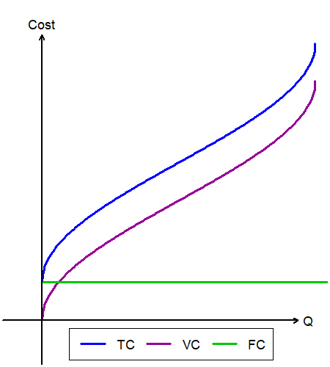
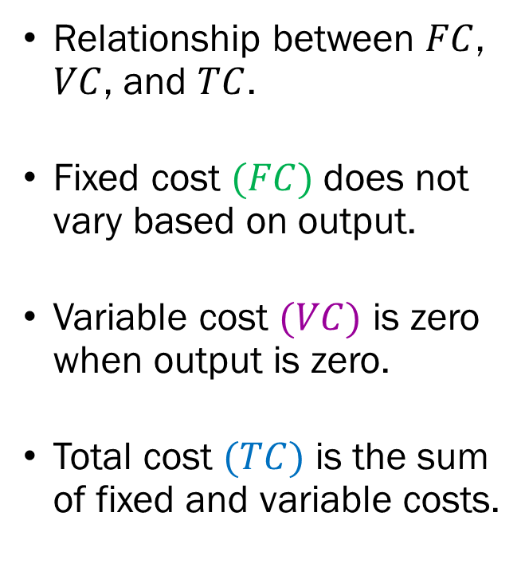
Total, Average, and Marginal Costs
Relationship between $FC$, $VC$, and $TC$.
Fixed cost $(FC)$ does not vary based on output.
Variable cost $(VC)$ is zero when output is zero.
Total cost $(TC)$ is the sum of fixed and variable costs.

Slide 9
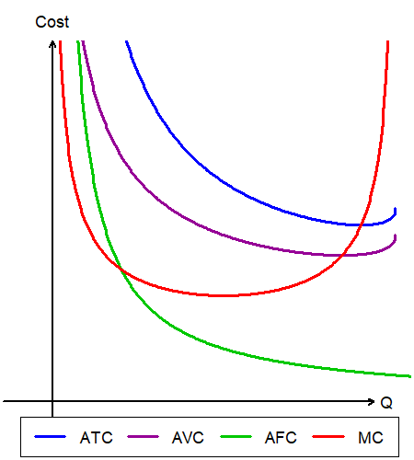
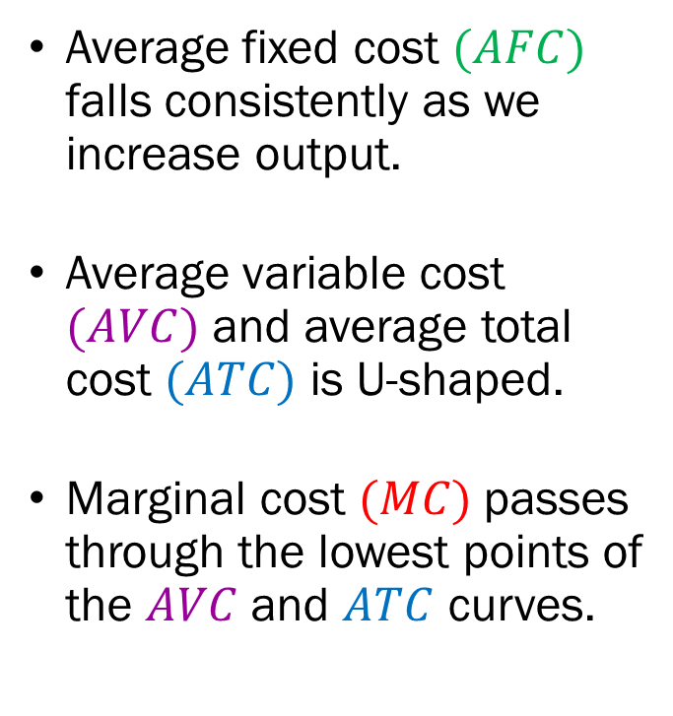
Total, Average, and Marginal Costs
Average fixed cost $(AFC)$ falls consistently as we increase output.
Average variable cost $(AVC)$ and average total cost $(ATC)$ is U-shaped.
Marginal cost $(MC)$passes through the lowest points of the $AVC$ and $ATC$ curves.

Slide 10
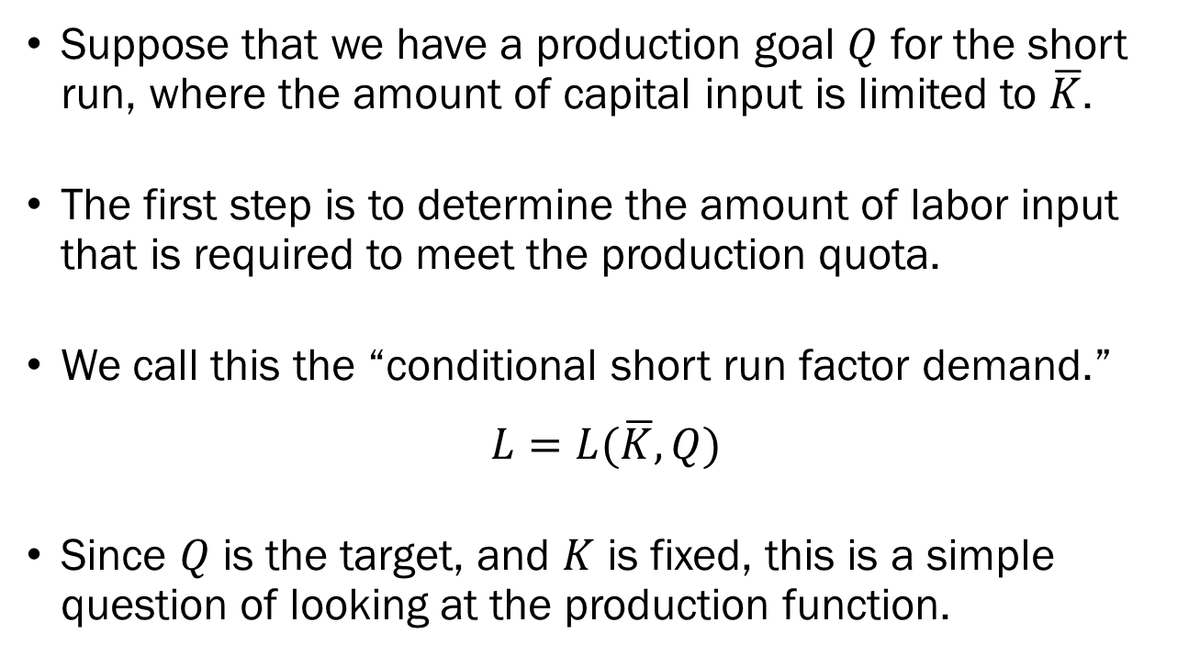
Short Run Cost
Suppose that we have a production goal $Q$ for the short run, where the amount of capital input is limited to $\overline{K}$.
The first step is to determine the amount of labor input that is required to meet the production quota.
We call this the “conditional short run factor demand.”
$$L=L(\overline{K},Q)$$
Since $Q$ is the target, and $K$ is fixed, this is a simple question of looking at the production function.

Slide 11
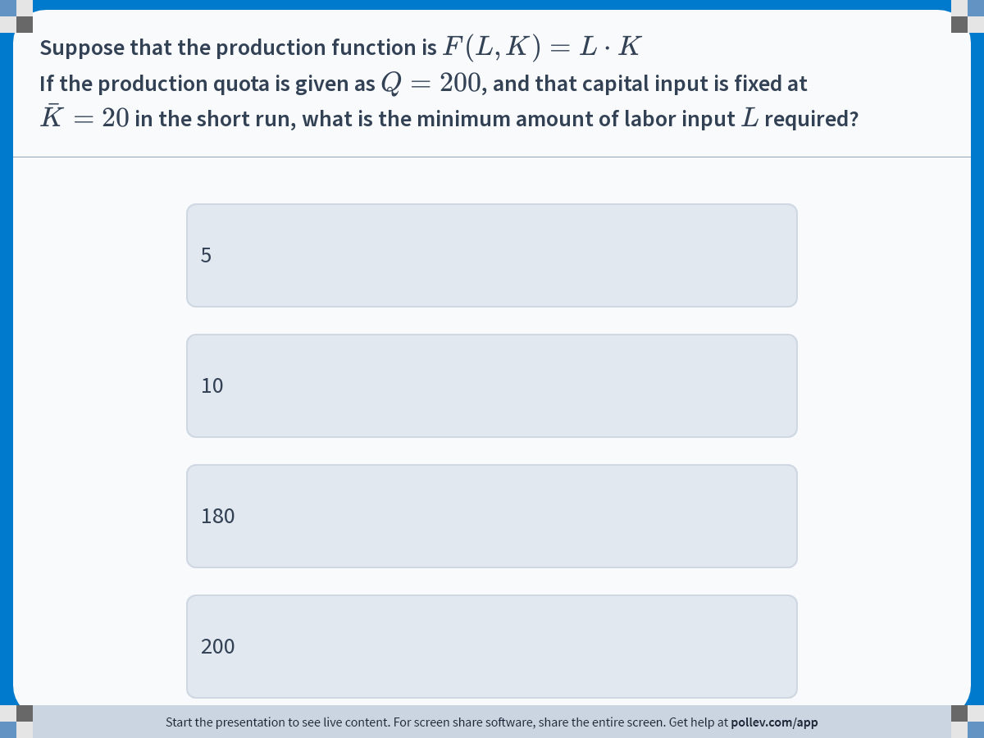
Notes:
Poll Title: Do not modify the notes in this section to avoid tampering with the Poll Everywhere activity.
More info at polleverywhere.com/support
If the production quota is given as $$Q=200$$, and that capital input is fixed at $$\\bar{K}=20$$ in the short run, what is the minimum amount of labor input $$L$$ required?
https://www.polleverywhere.com/multiple_choice_polls/2p38Uf7wMTBXfalRqnpXs?display_state=instructions&activity_state=opened&state=opened&flow=Engagement&onscreen=persist

Slide 12
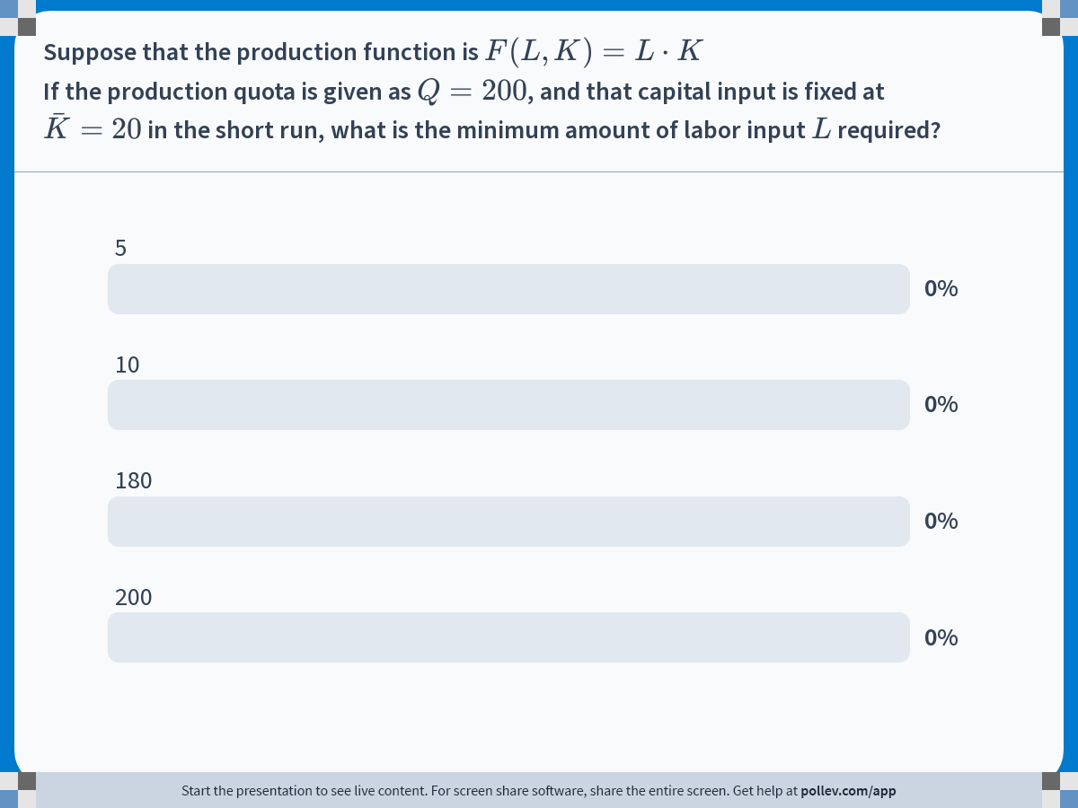
Notes:
Poll Title: Do not modify the notes in this section to avoid tampering with the Poll Everywhere activity.
More info at polleverywhere.com/support
If the production quota is given as $$Q=200$$, and that capital input is fixed at $$\\bar{K}=20$$ in the short run, what is the minimum amount of labor input $$L$$ required?
https://www.polleverywhere.com/multiple_choice_polls/2p38Uf7wMTBXfalRqnpXs?display_state=chart&activity_state=closed&state=closed&flow=Engagement&onscreen=persist

Slide 13
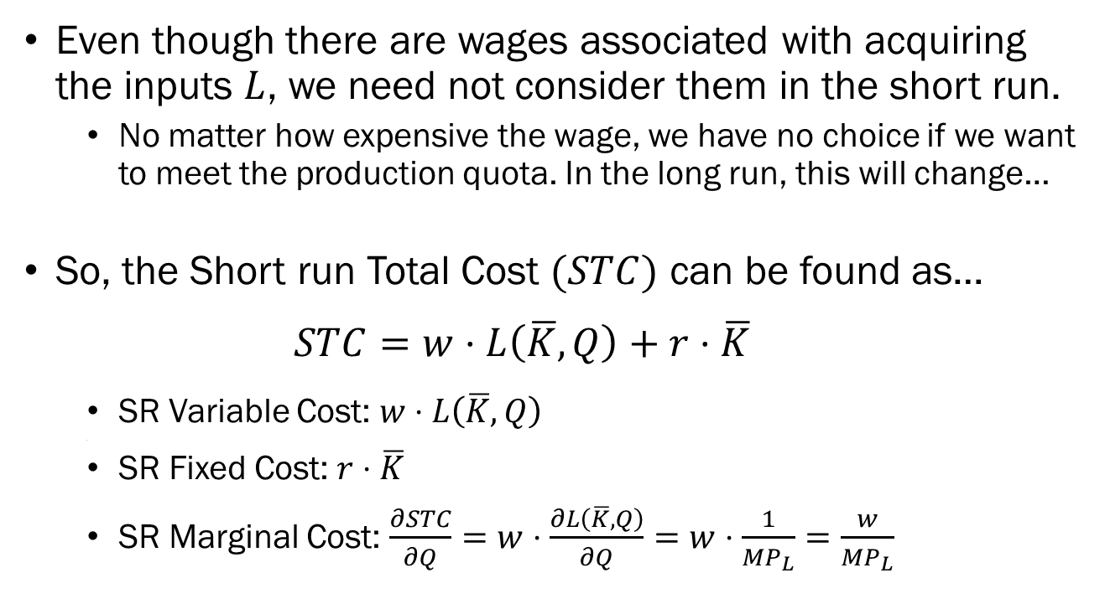
Short Run Cost
Even though there are wages associated with acquiring the inputs $L$, we need not consider them in the short run.
  No matter how expensive the wage, we have no choice if we want to meet the production quota. In the long run, this will change…
So, the Short run Total Cost $(STC)$ can be found as…
  $$STC=w⋅L\left(\overline{K},Q\right)+r⋅\overline{K}$$
  SR Variable Cost: $w⋅L\left(\overline{K},Q\right)$
  .
  SR Fixed Cost: $r⋅\overline{K}$
  SR Marginal Cost: $\frac{∂STC}{∂Q}=w⋅\frac{∂L\left(\overline{K},Q\right)}{∂Q}=w⋅\frac{1}{MP_{L}}=\frac{w}{MP_{L}}$

Slide 14
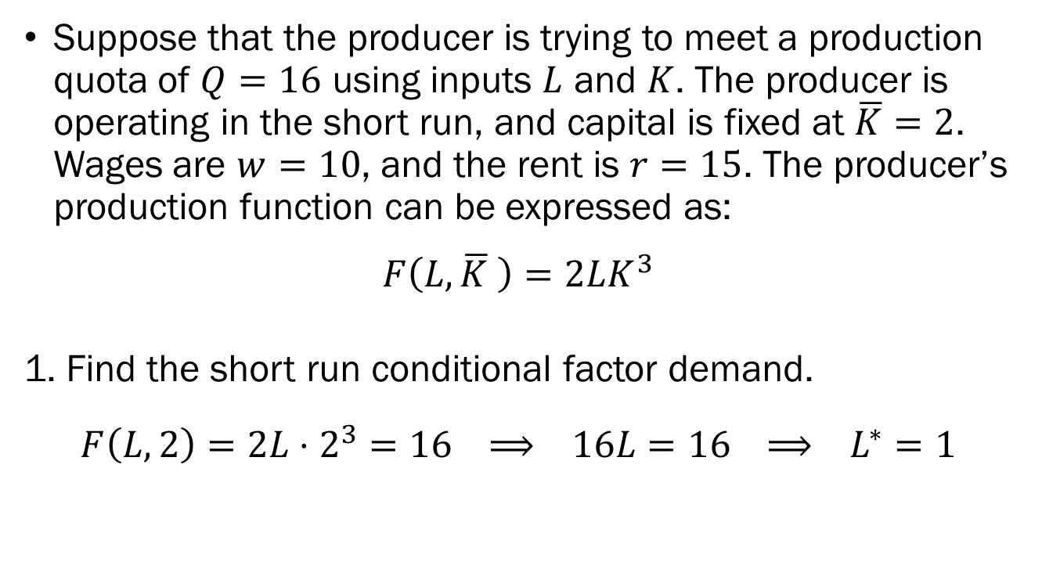
Short Run Cost Minimization
An Example
Suppose that the producer is trying to meet a production quota of $Q=16$ using inputs $L$ and $K$. The producer is operating in the short run, and capital is fixed at $\overline{K}=2$. Wages are $w=10$, and the rent is $r=15$. The producer’s production function can be expressed as:
$$F\left(L,\overline{K} \right)=2LK^{3}$$
1. Find the short run conditional factor demand.
$$F\left(L,2\right)=2L⋅2^{3}=16 ⟹ 16L=16 ⟹ L^{∗}=1$$

Slide 15
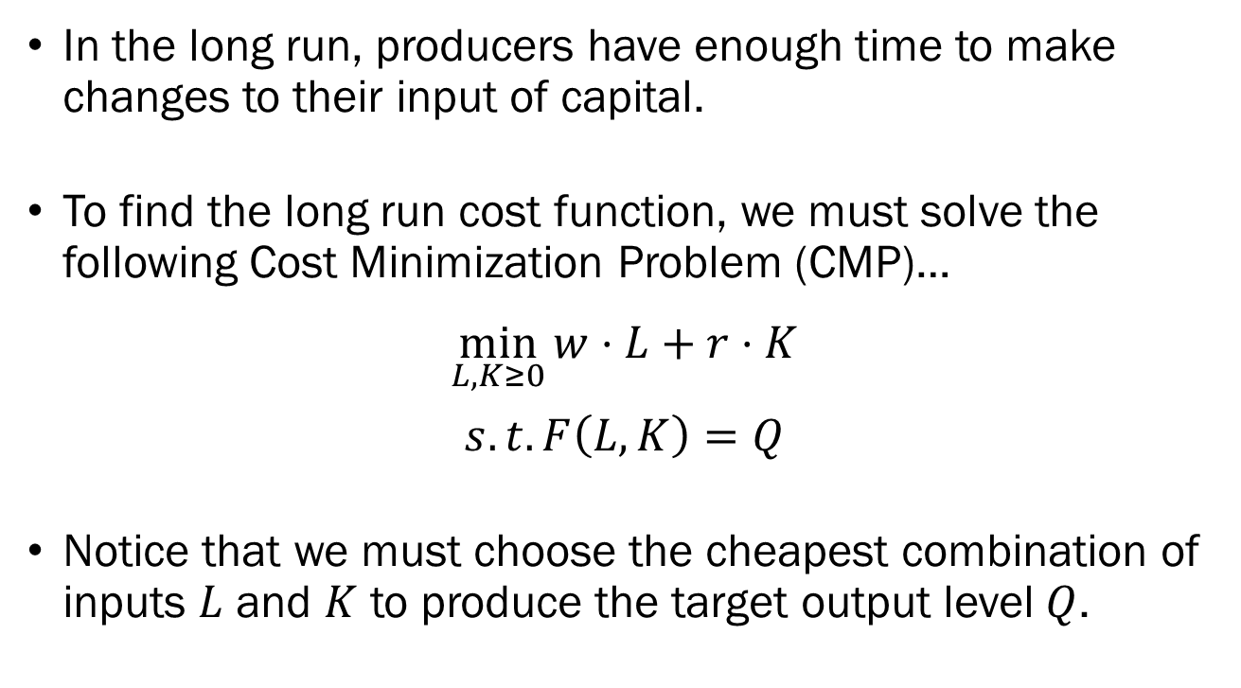
Long Run Cost
In the long run, producers have enough time to make changes to their input of capital.
To find the long run cost function, we must solve the following Cost Minimization Problem (CMP)…
$$\min_{L,K≥0}{w⋅L+r⋅K}$$
$$s.t. F\left(L,K\right)=Q$$
Notice that we must choose the cheapest combination of inputs $L$ and $K$ to produce the target output level $Q$.

Slide 16
Long Run Cost
When finding the conditional short run factor demand, we did not have to consider the price of each input, since there was only one way to meet some production quota.
In the long run, we must consider the price of acquiring each unit of input and choose the cheapest mix that is able to meet the production quota.
We will now see how the producer may determine their conditional factor demand by solving the CMP.

Slide 17
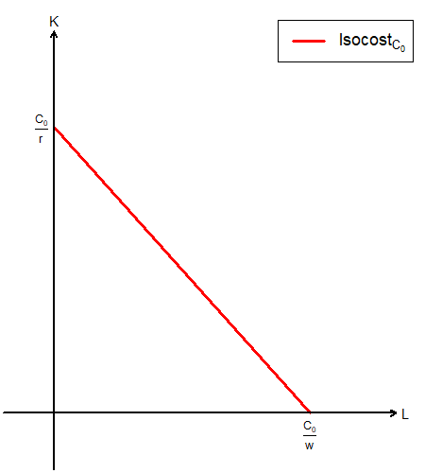
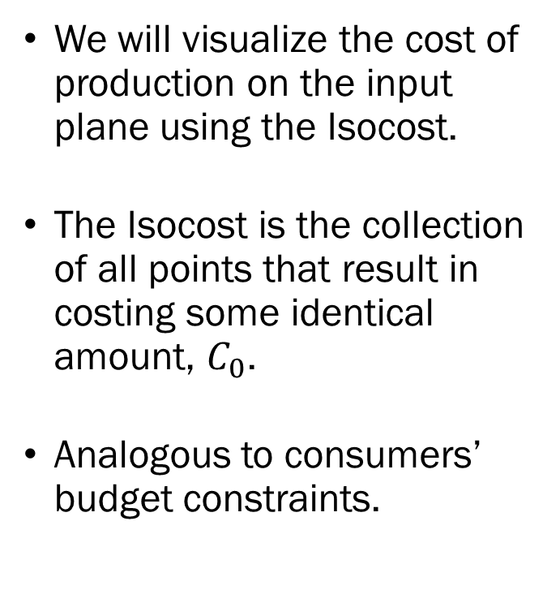
The Isocost
We will visualize the cost of production on the input plane using the Isocost.
The Isocost is the collection of all points that result in costing some identical amount, $C_{0}$.
Analogous to consumers’ budget constraints.

Slide 18
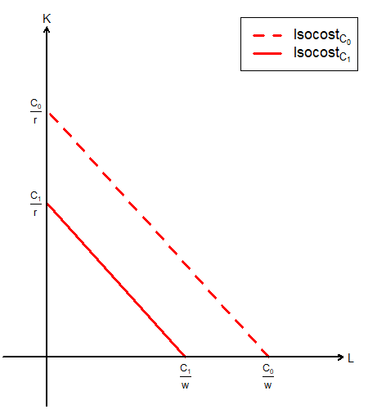
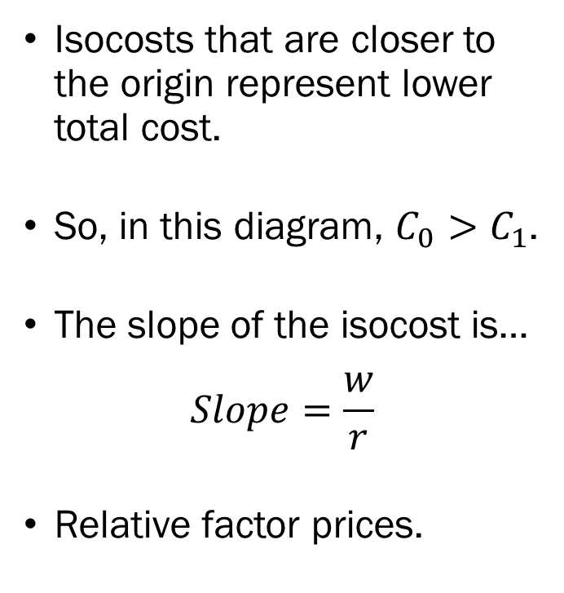
The Isocost
Isocosts that are closer to the origin represent lower total cost.
So, in this diagram, $C_{0}>C_{1}$.
The slope of the isocost is…
$$Slope=\frac{w}{r}$$
Relative factor prices.

Slide 19
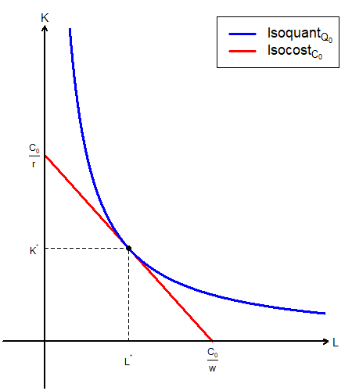
The Cost Minimization Problem
The isoquant represents the production quota, and the production technology.
The isocost represents the total cost of production.
The CMP may be solved on a graph by finding the isocost that is tangent to the isoquant that represent the production quota.

Slide 20
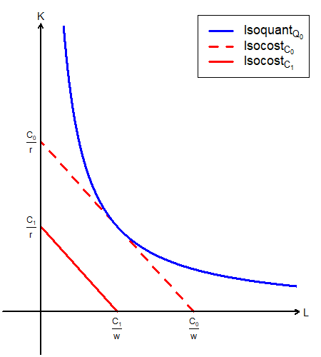
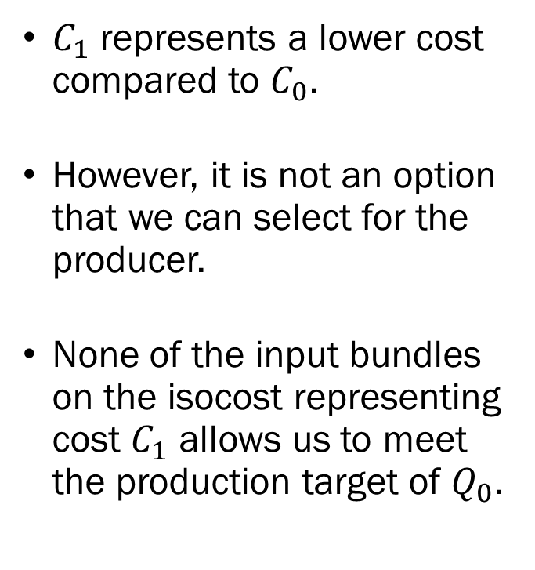
The Cost Minimization Problem
$C_{1}$ represents a lower cost compared to $C_{0}$.
However, it is not an option that we can select for the producer.
None of the input bundles on the isocost representing cost $C_{1}$ allows us to meet the production target of $Q_{0}$.

Slide 21
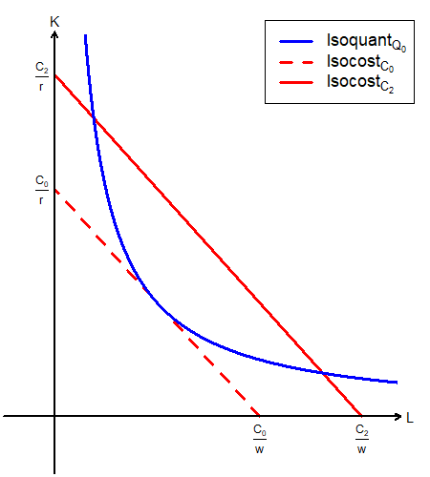
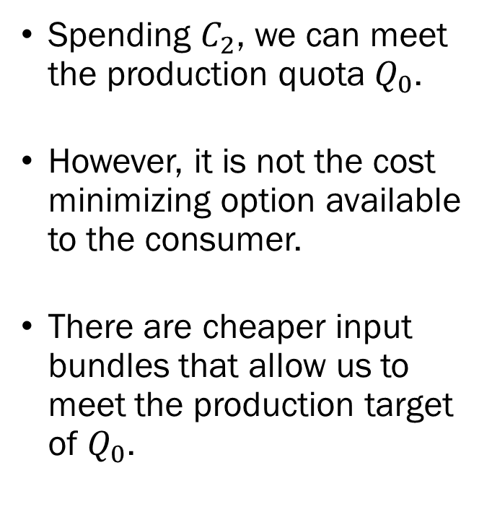
The Cost Minimization Problem
Spending $C_{2}$, we can meet the production quota $Q_{0}$.
However, it is not the cost minimizing option available to the consumer.
There are cheaper input bundles that allow us to meet the production target of $Q_{0}$.

Slide 22

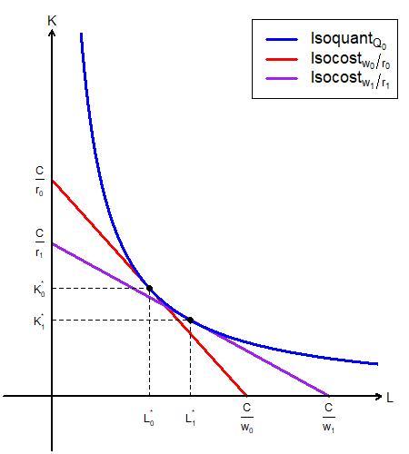
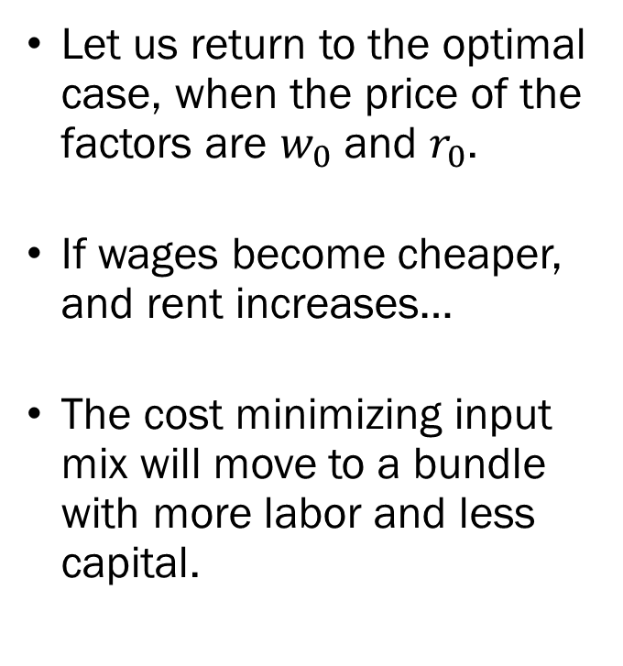
The Cost Minimization Problem
Let us return to the optimal case, when the price of the factors are $w_{0}$ and $r_{0}$.
If wages become cheaper, and rent increases…
The cost minimizing input mix will move to a bundle with more labor and less capital.

Slide 23
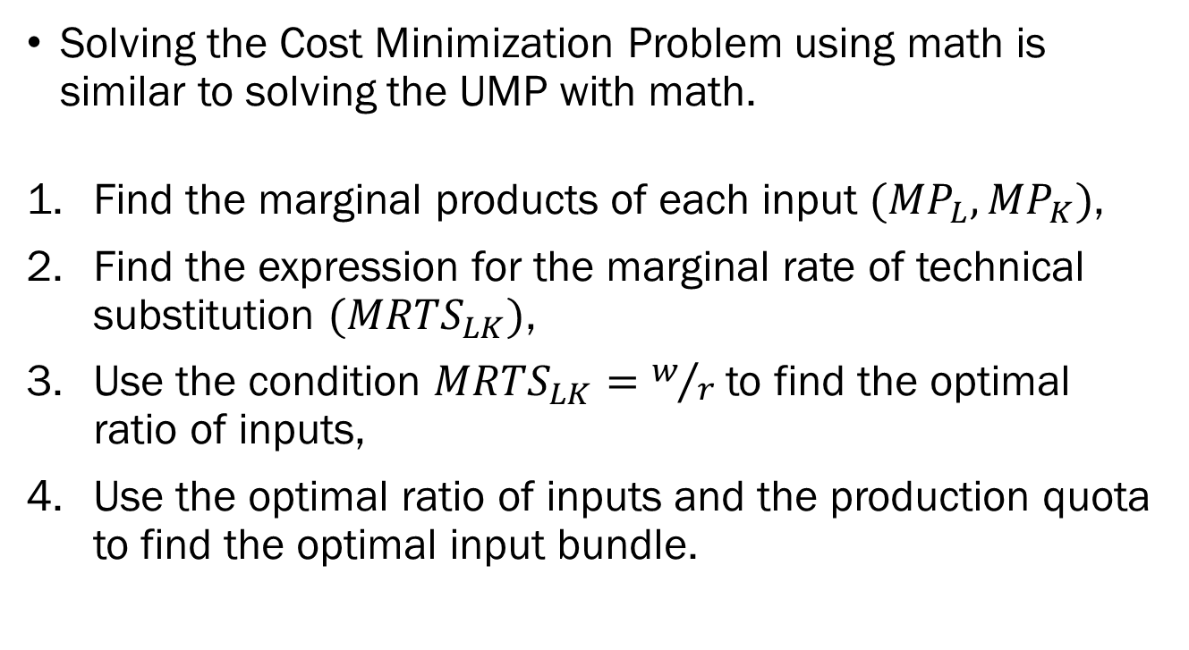
The Cost Minimization Problem
Solving the Cost Minimization Problem using math is similar to solving the UMP with math.
Find the marginal products of each input $(MP_{L}, MP_{K})$,
Find the expression for the marginal rate of technical substitution $(MRTS_{LK})$,
Use the condition $MRTS_{LK}=w/r$ to find the optimal ratio of inputs,
Use the optimal ratio of inputs and the production quota to find the optimal input bundle.

Slide 24
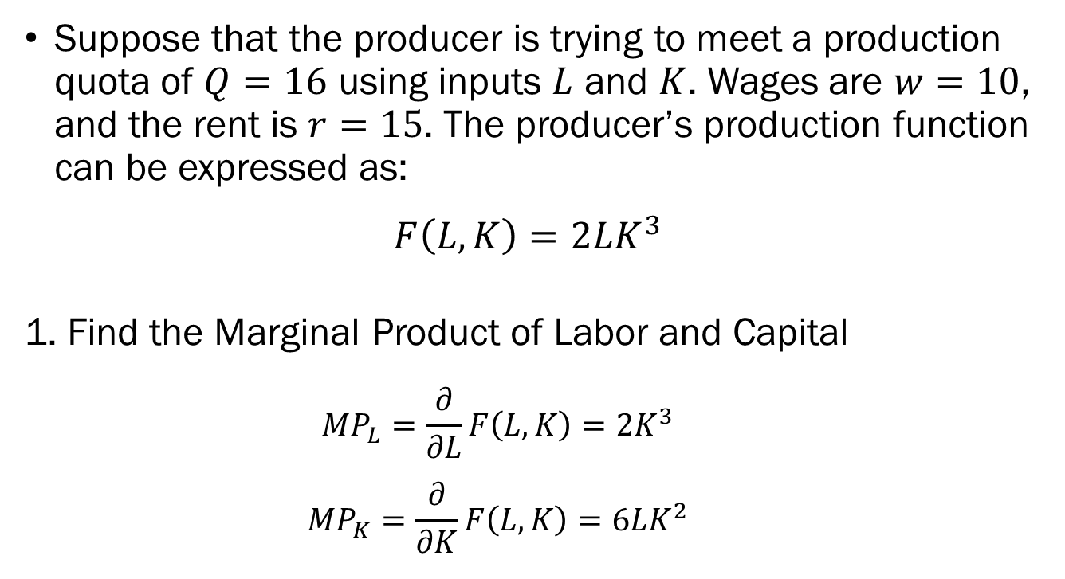
Long Run Cost Minimization
An Example
Suppose that the producer is trying to meet a production quota of $Q=16$ using inputs $L$ and $K$. Wages are $w=10$, and the rent is $r=15$. The producer’s production function can be expressed as:
$$F\left(L,K\right)=2LK^{3}$$
1. Find the Marginal Product of Labor and Capital
  $$MP_{L}=\frac{∂}{∂L}F\left(L,K\right)=2K^{3}$$
  $$MP_{K}=\frac{∂}{∂K}F\left(L,K\right)=6LK^{2}$$

Slide 25
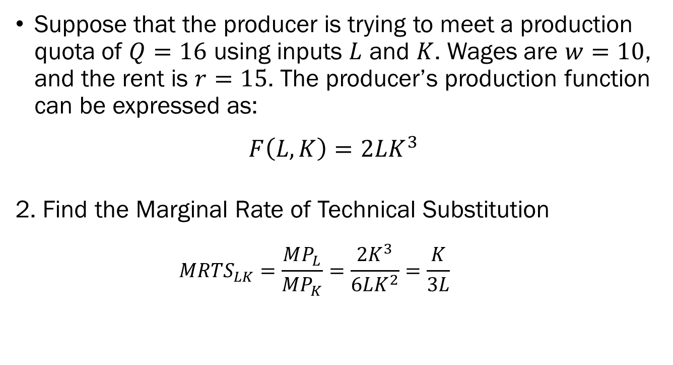
Long Run Cost Minimization
An Example
Suppose that the producer is trying to meet a production quota of $Q=16$ using inputs $L$ and $K$. Wages are $w=10$, and the rent is $r=15$. The producer’s production function can be expressed as:
$$F\left(L,K\right)=2LK^{3}$$
2. Find the Marginal Rate of Technical Substitution
  $$MRTS_{LK}=\frac{MP_{L}}{MP_{K}}=\frac{2K^{3}}{6LK^{2}}=\frac{K}{3L}$$

Slide 26
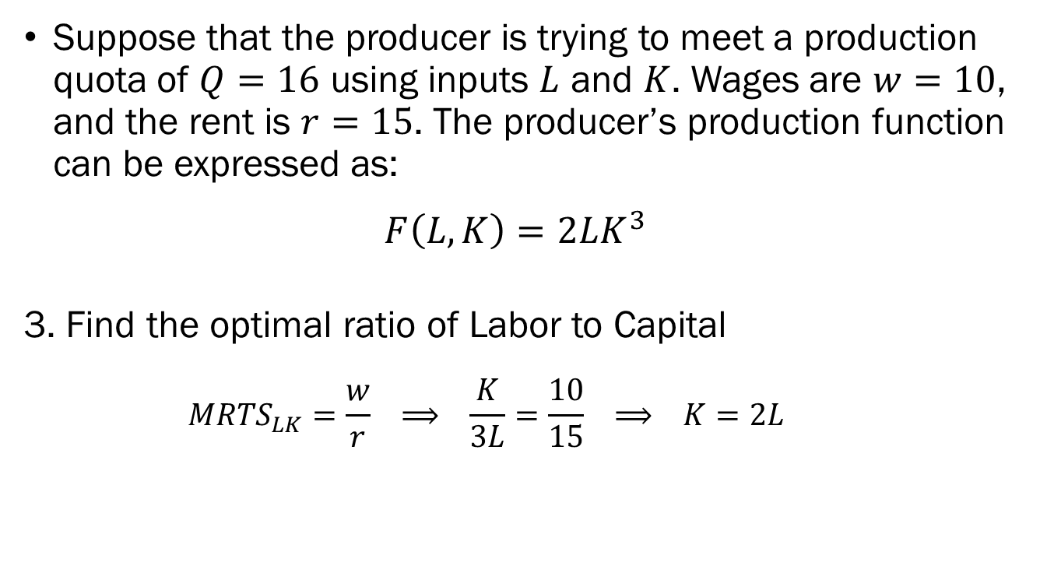
Long Run Cost Minimization
An Example
Suppose that the producer is trying to meet a production quota of $Q=16$ using inputs $L$ and $K$. Wages are $w=10$, and the rent is $r=15$. The producer’s production function can be expressed as:
$$F\left(L,K\right)=2LK^{3}$$
3. Find the optimal ratio of Labor to Capital
  $$MRTS_{LK}=\frac{w}{r} ⟹ \frac{K}{3L}=\frac{10}{15} ⟹ K=2L$$

Slide 27
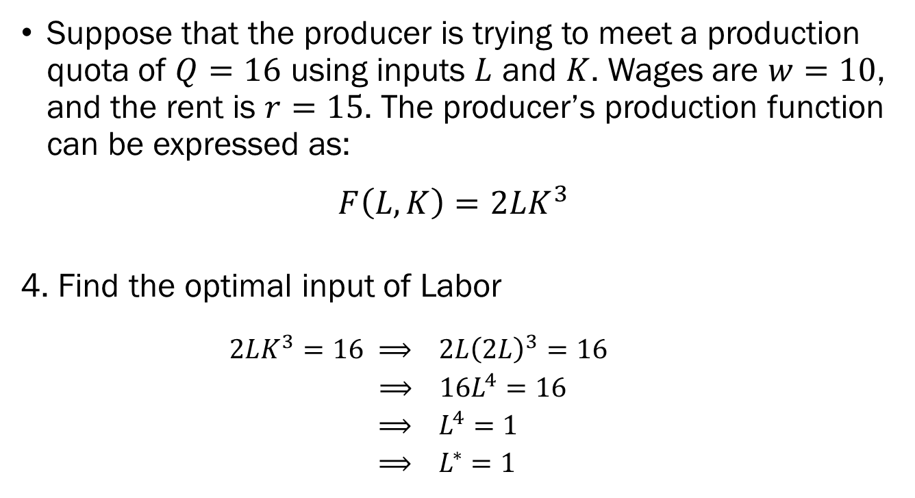
Long Run Cost Minimization
An Example
Suppose that the producer is trying to meet a production quota of $Q=16$ using inputs $L$ and $K$. Wages are $w=10$, and the rent is $r=15$. The producer’s production function can be expressed as:
$$F\left(L,K\right)=2LK^{3}$$
4. Find the optimal input of Labor
  $$2LK^{3}=16 ⟹ 2L{\left(2L\right)}^{3}=16$$
  $⟹ 16L^{4}=16$
  $⟹ L^{4}=1$
  $⟹ L^{∗}=1$

Slide 28
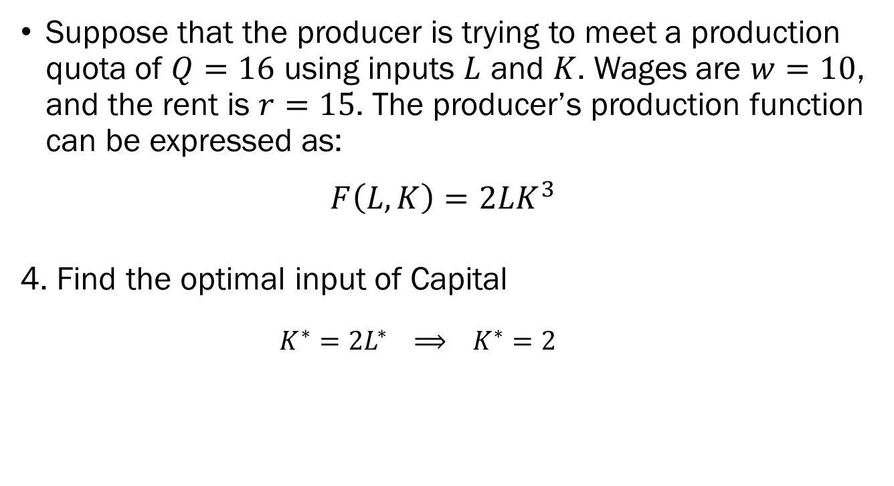
Long Run Cost Minimization
An Example
Suppose that the producer is trying to meet a production quota of $Q=16$ using inputs $L$ and $K$. Wages are $w=10$, and the rent is $r=15$. The producer’s production function can be expressed as:
$$F\left(L,K\right)=2LK^{3}$$
4. Find the optimal input of Capital
  $$K^{∗}=2L^{∗} ⟹ K^{∗}=2$$

Slide 29
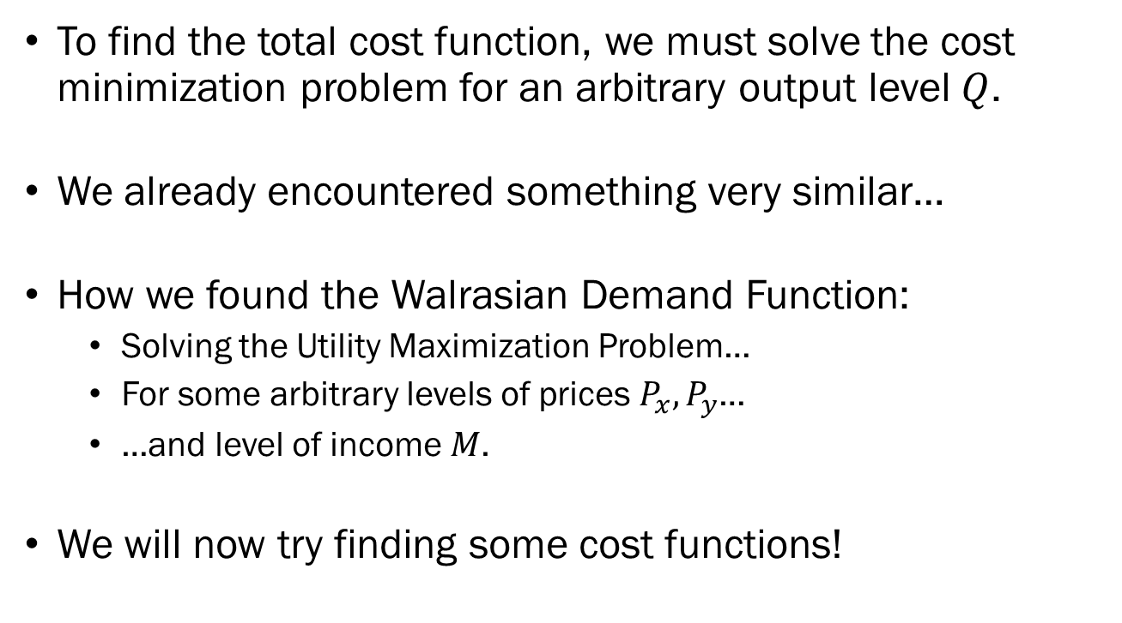
The Cost Function
To find the total cost function, we must solve the cost minimization problem for an arbitrary output level $Q$.
We already encountered something very similar…
How we found the Walrasian Demand Function:
  Solving the Utility Maximization Problem…
  For some arbitrary levels of prices $P_{x}, P_{y}$…
  …and level of income $M$.
We will now try finding some cost functions!

Slide 30
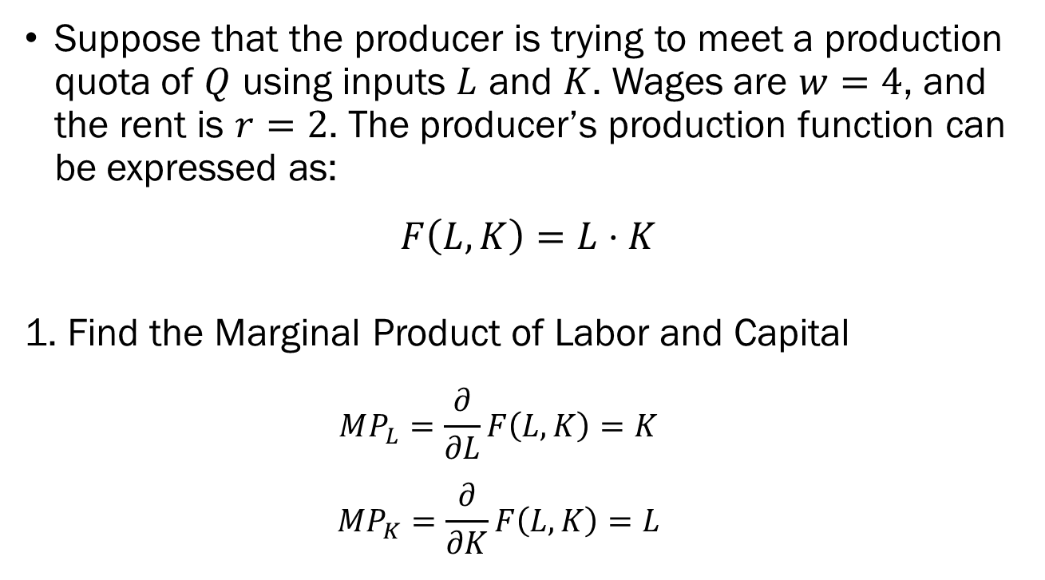
Long Run Cost Minimization
An Example
Suppose that the producer is trying to meet a production quota of $Q$ using inputs $L$ and $K$. Wages are $w=4$, and the rent is $r=2$. The producer’s production function can be expressed as:
$$F\left(L,K\right)=L⋅K$$
1. Find the Marginal Product of Labor and Capital
  $$MP_{L}=\frac{∂}{∂L}F\left(L,K\right)=K$$
  $$MP_{K}=\frac{∂}{∂K}F\left(L,K\right)=L$$

Slide 31
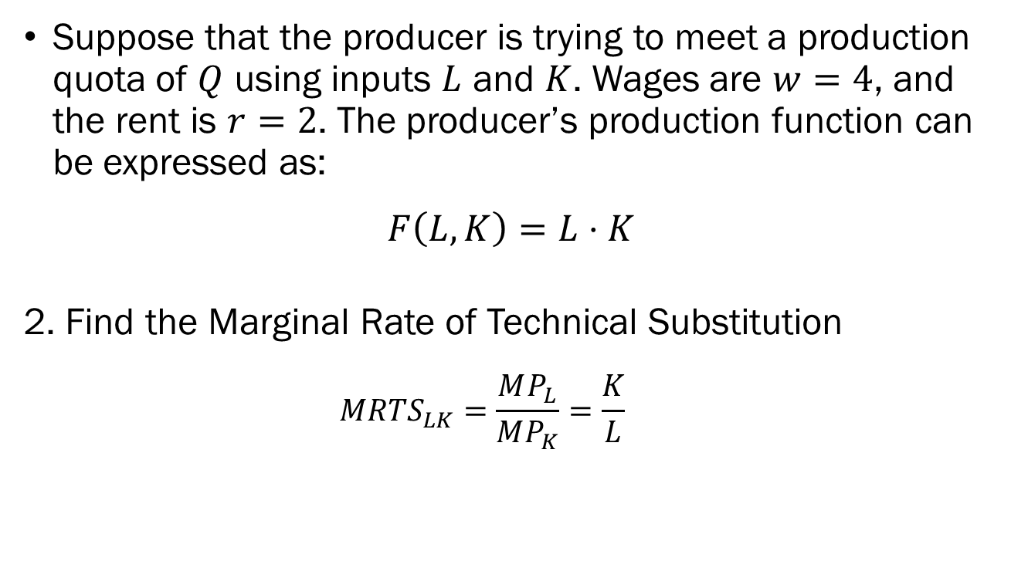
Long Run Cost Minimization
An Example
Suppose that the producer is trying to meet a production quota of $Q$ using inputs $L$ and $K$. Wages are $w=4$, and the rent is $r=2$. The producer’s production function can be expressed as:
$$F\left(L,K\right)=L⋅K$$
2. Find the Marginal Rate of Technical Substitution
  $$MRTS_{LK}=\frac{MP_{L}}{MP_{K}}=\frac{K}{L}$$

Slide 32
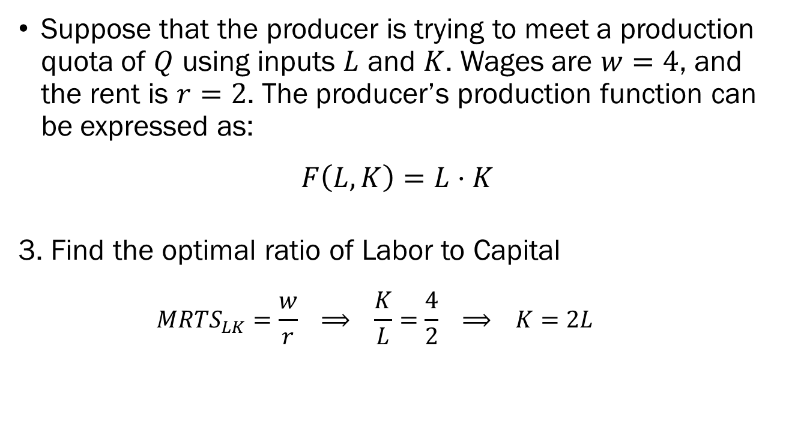
Long Run Cost Minimization
An Example
Suppose that the producer is trying to meet a production quota of $Q$ using inputs $L$ and $K$. Wages are $w=4$, and the rent is $r=2$. The producer’s production function can be expressed as:
$$F\left(L,K\right)=L⋅K$$
3. Find the optimal ratio of Labor to Capital
  $$MRTS_{LK}=\frac{w}{r} ⟹ \frac{K}{L}=\frac{4}{2} ⟹ K=2L$$

Slide 33
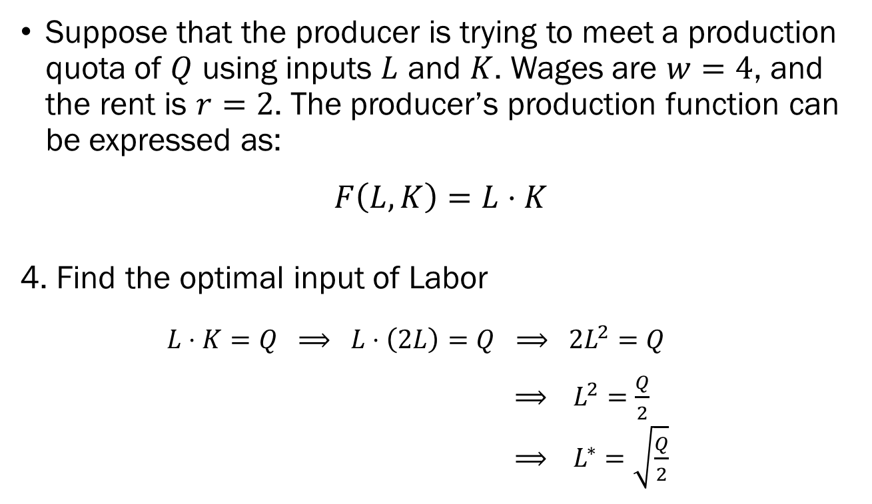
Long Run Cost Minimization
An Example
Suppose that the producer is trying to meet a production quota of $Q$ using inputs $L$ and $K$. Wages are $w=4$, and the rent is $r=2$. The producer’s production function can be expressed as:
$$F\left(L,K\right)=L⋅K$$
4. Find the optimal input of Labor
  $$L⋅K=Q ⟹ L⋅\left(2L\right)=Q ⟹ 2L^{2}=Q$$
  $⟹ L^{2}=\frac{Q}{2}$
  $⟹ L^{∗}=\sqrt{\frac{Q}{2}}$

Slide 34
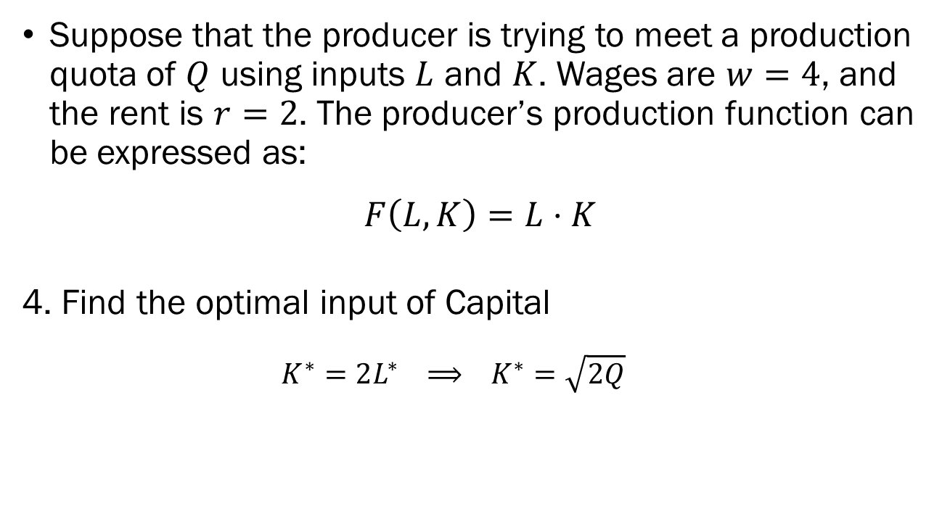
Long Run Cost Minimization
An Example
Suppose that the producer is trying to meet a production quota of $Q$ using inputs $L$ and $K$. Wages are $w=4$, and the rent is $r=2$. The producer’s production function can be expressed as:
$$F\left(L,K\right)=L⋅K$$
4. Find the optimal input of Capital
  $$K^{∗}=2L^{∗} ⟹ K^{∗}=\sqrt{2Q}$$

Slide 35
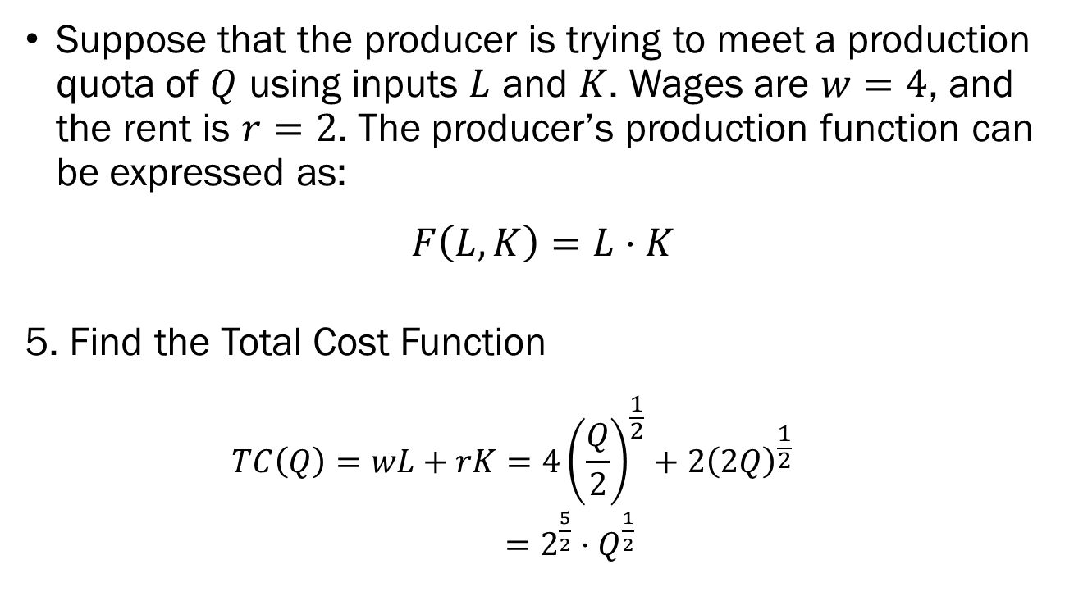
Long Run Cost Minimization
An Example
Suppose that the producer is trying to meet a production quota of $Q$ using inputs $L$ and $K$. Wages are $w=4$, and the rent is $r=2$. The producer’s production function can be expressed as:
$$F\left(L,K\right)=L⋅K$$
5. Find the Total Cost Function
  $$TC\left(Q\right)=wL+rK=4{\left(\frac{Q}{2}\right)}^{\frac{1}{2}}+2{\left(2Q\right)}^{\frac{1}{2}}$$
  $=2^{\frac{5}{2}}⋅Q^{\frac{1}{2}}$

Slide 36
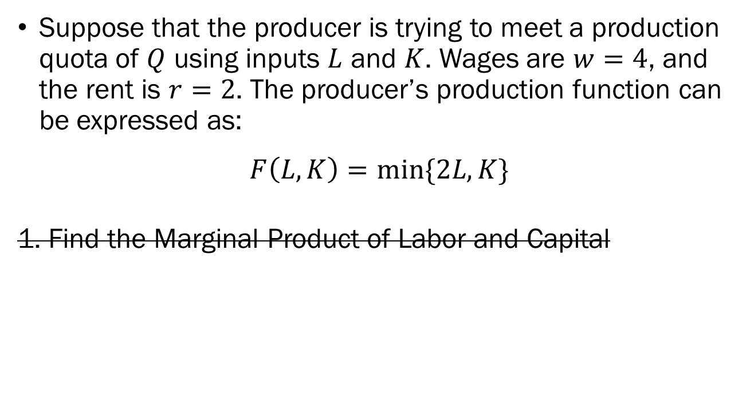
Long Run Cost Minimization
An Example
Suppose that the producer is trying to meet a production quota of $Q$ using inputs $L$ and $K$. Wages are $w=4$, and the rent is $r=2$. The producer’s production function can be expressed as:
$$F\left(L,K\right)=min⁡\{2L,K\}$$
1. Find the Marginal Product of Labor and Capital

Slide 37
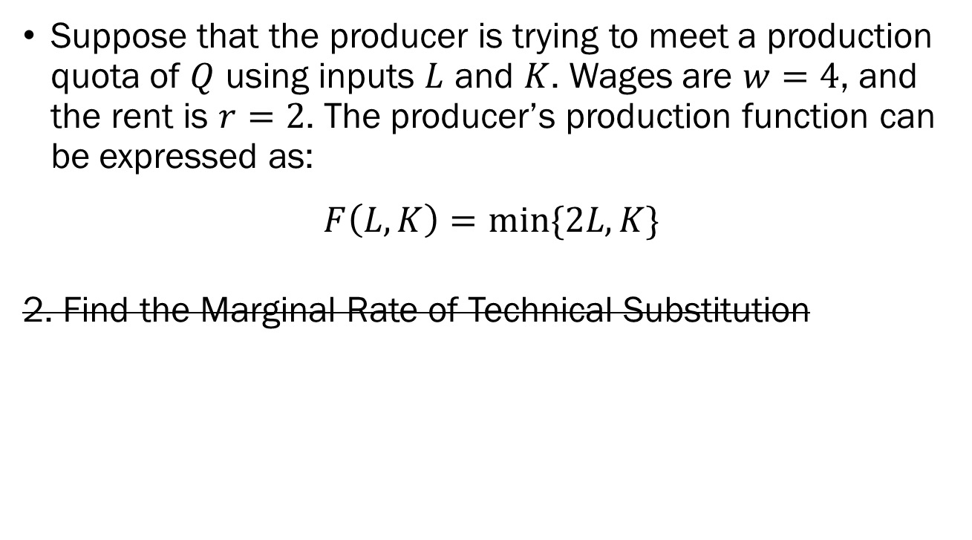
Long Run Cost Minimization
An Example
Suppose that the producer is trying to meet a production quota of $Q$ using inputs $L$ and $K$. Wages are $w=4$, and the rent is $r=2$. The producer’s production function can be expressed as:
$$F\left(L,K\right)=min⁡\{2L,K\}$$
2. Find the Marginal Rate of Technical Substitution

Slide 38
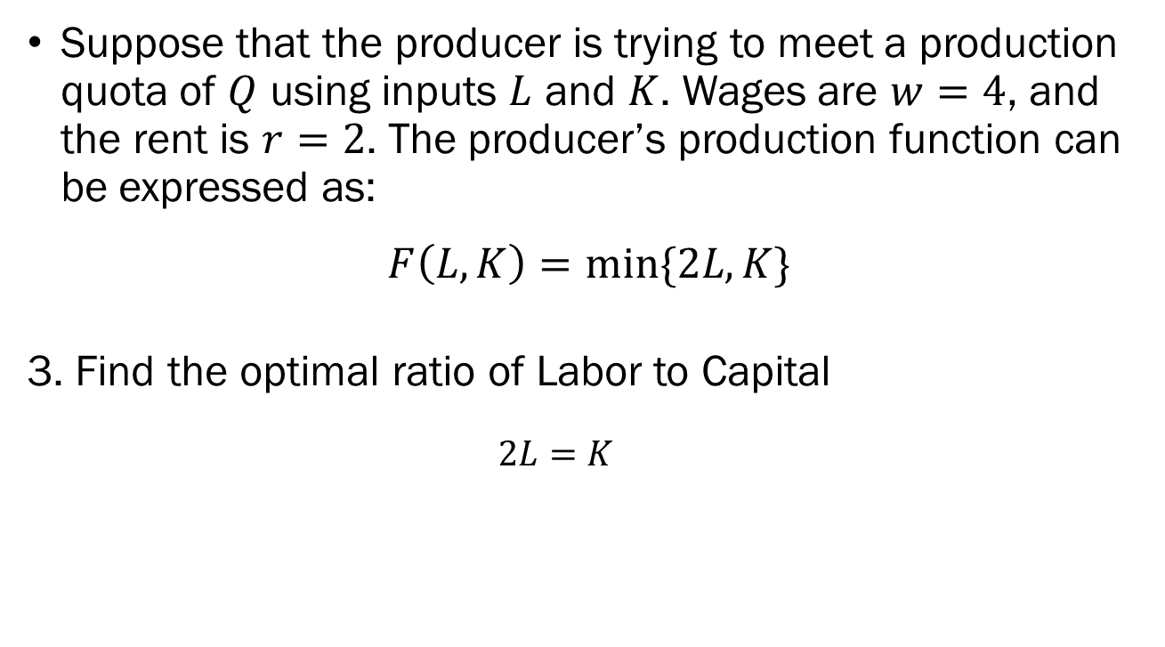
Long Run Cost Minimization
An Example
Suppose that the producer is trying to meet a production quota of $Q$ using inputs $L$ and $K$. Wages are $w=4$, and the rent is $r=2$. The producer’s production function can be expressed as:
$$F\left(L,K\right)=min⁡\{2L,K\}$$
3. Find the optimal ratio of Labor to Capital
  $$2L=K$$

Slide 39
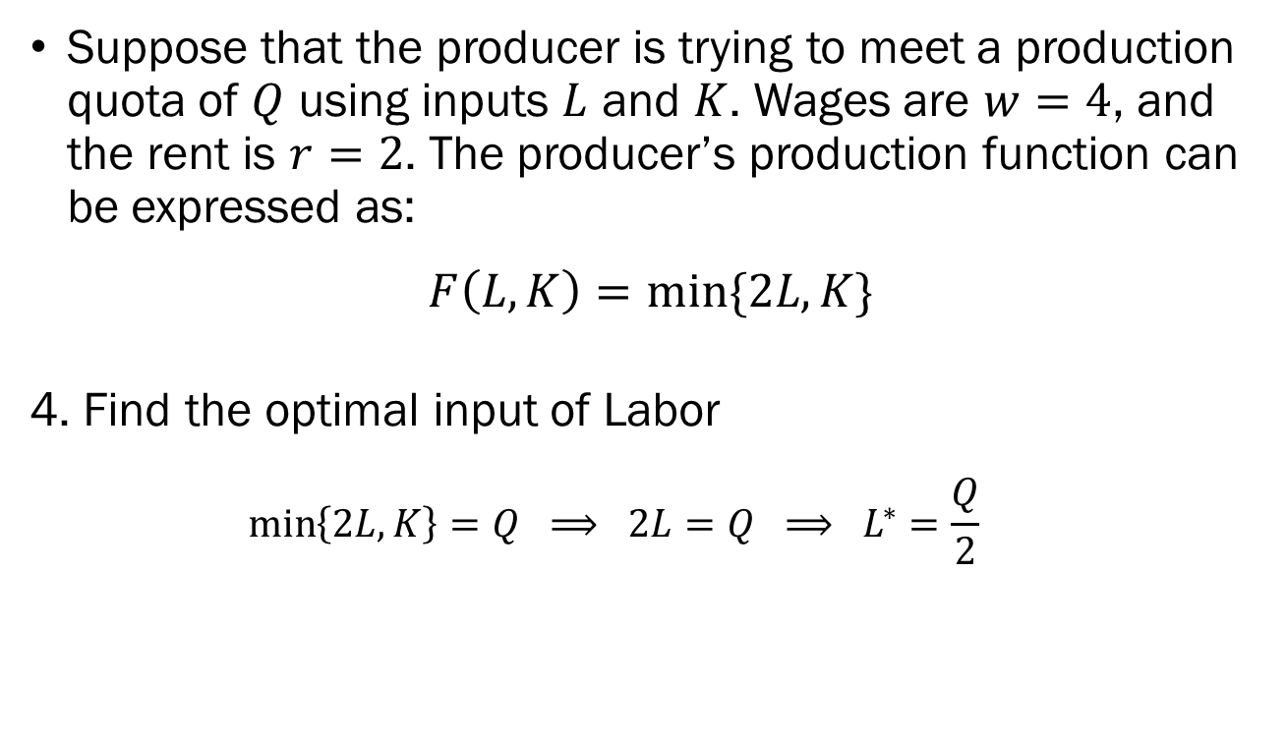
Long Run Cost Minimization
An Example
Suppose that the producer is trying to meet a production quota of $Q$ using inputs $L$ and $K$. Wages are $w=4$, and the rent is $r=2$. The producer’s production function can be expressed as:
$$F\left(L,K\right)=min⁡\{2L,K\}$$
4. Find the optimal input of Labor
  $$\min\left\{2L,K\right\}=Q ⟹ 2L=Q ⟹ L^{∗}=\frac{Q}{2}$$

Slide 40
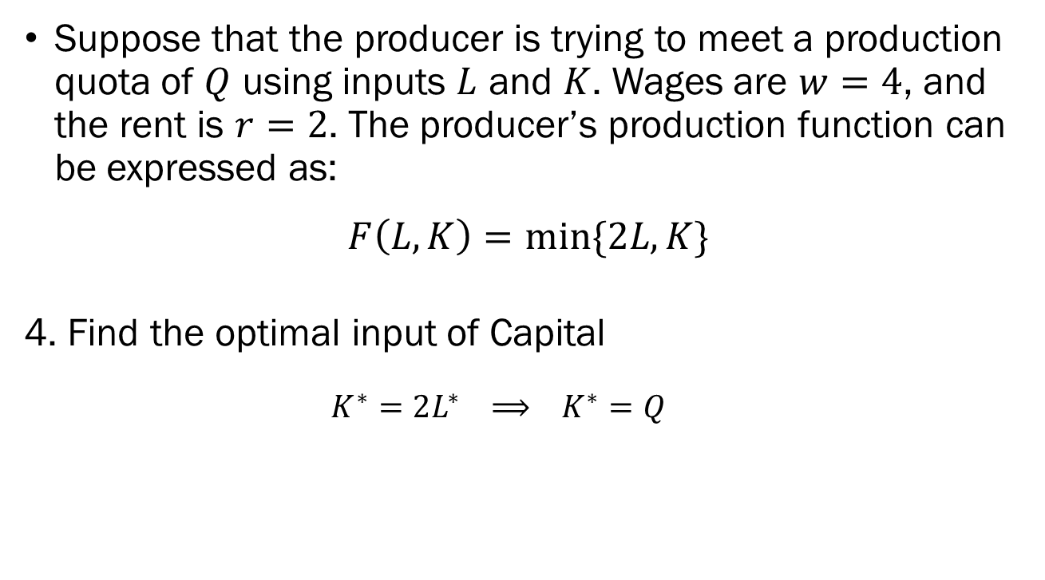
Long Run Cost Minimization
An Example
Suppose that the producer is trying to meet a production quota of $Q$ using inputs $L$ and $K$. Wages are $w=4$, and the rent is $r=2$. The producer’s production function can be expressed as:
$$F\left(L,K\right)=min⁡\{2L,K\}$$
4. Find the optimal input of Capital
  $$K^{∗}=2L^{∗} ⟹ K^{∗}=Q$$

Slide 41
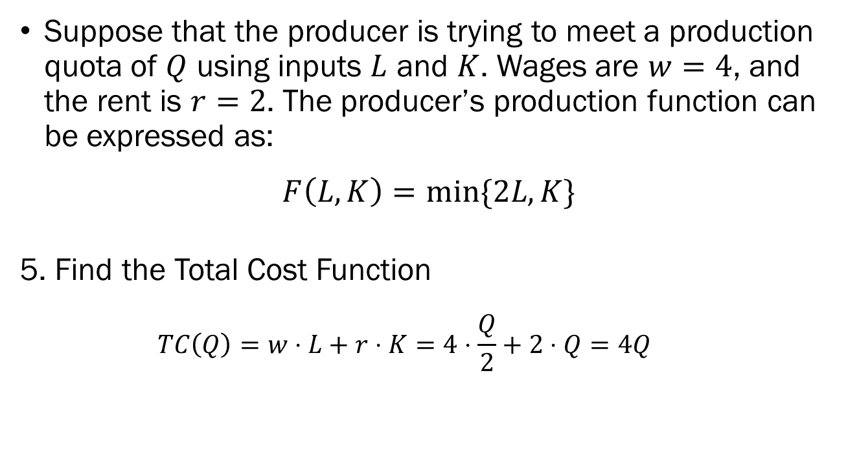
Long Run Cost Minimization
An Example
Suppose that the producer is trying to meet a production quota of $Q$ using inputs $L$ and $K$. Wages are $w=4$, and the rent is $r=2$. The producer’s production function can be expressed as:
$$F\left(L,K\right)=min⁡\{2L,K\}$$
5. Find the Total Cost Function
  $$TC\left(Q\right)=w⋅L+r⋅K=4⋅\frac{Q}{2}+2⋅Q=4Q$$

