Slide 1
Market Analysis:
Monopolies and Monopsonies
ECON 300

Slide 2
Breaking the Rules of Perfect Competition
Up to this point, we have been analyzing the output market under perfect competition.
  Infinite number of producers and consumers, and
  Homogeneous products, and
  Perfect information, and
  Free entry and exit, and
  Zero transaction costs.
Today, we will be examining the profit maximization process for monopolists.
  Breaking Rule #1: One Producer, Infinite Consumers.

Slide 3
Sources of Monopoly Power
Monopolies exist in the real world, and can have “natural” causes including, but not limited to…
  Economies of Scale, or
  Economies of Scope.
Some artificial or institutional factors may lead to the rise of a monopoly in the economy such as…
  Patents and Copyrights, or
  Resource Constraints.

Slide 4
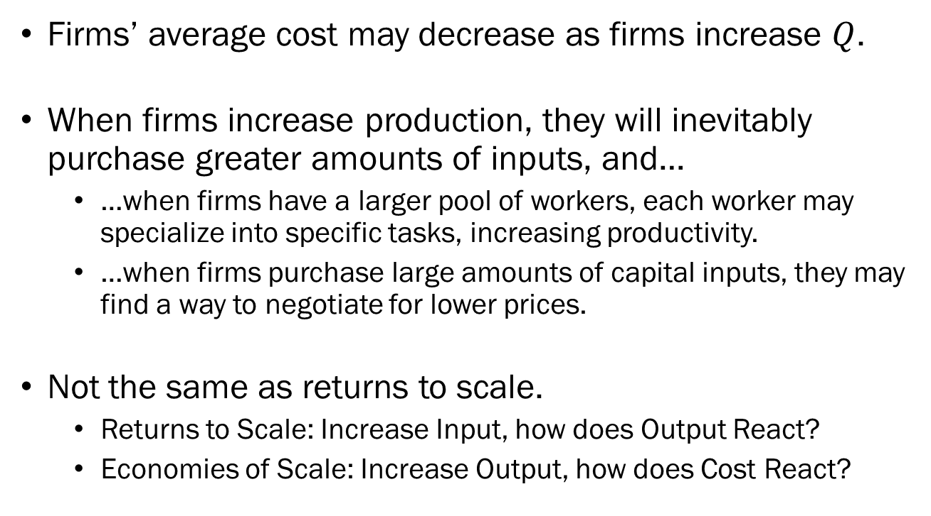
Economies of Scale
Firms’ average cost may decrease as firms increase $Q$.
When firms increase production, they will inevitably purchase greater amounts of inputs, and…
  …when firms have a larger pool of workers, each worker may specialize into specific tasks, increasing productivity.
  …when firms purchase large amounts of capital inputs, they may find a way to negotiate for lower prices.
Not the same as returns to scale.
  Returns to Scale: Increase Input, how does Output React?
  Economies of Scale: Increase Output, how does Cost React?

Slide 5
Economies of Scope
Firms may be more efficient in production when they produce two or more related products.
Cost of producing separately is greater than the cost of producing jointly.
For instance, firms that offer internet services often offer cable TV, landline, or broadband services, because these services share a common cost.
Economies of scale is the efficiency arising from “volume.”
Economies of scope is the efficiency arising from “variety.”

Slide 6
Patents and Resource Constraints
Patents on new technology, or copyright on creative work can serve as a barrier to entry.
  The technology behind Post-it notes was protected until 1997.
  Now, firms other than 3M (the original patent holder) can produce sticky notes based on this technology.
  However, the name “Post-it” is still protected under trademarks.
Sometimes, inputs required in production may be limited.
  Rare-earth elements are crucial in the production of electric vehicles, phones, stealth fighter jets, etc.
  As of 2020, 98% of all rare-earth materials used in the EU was imported from China.

Slide 7
Monopoly vs. Perfect Competition
The single most impactful difference between a monopoly and perfect competition is that the producer has market power.
Recall that in a perfectly competitive output market with infinite producers, a single firm did not have the power to set prices.
In a monopoly, where there is a single producer of a good, that firm alone can dictate the price and quantity supplied.

Slide 8
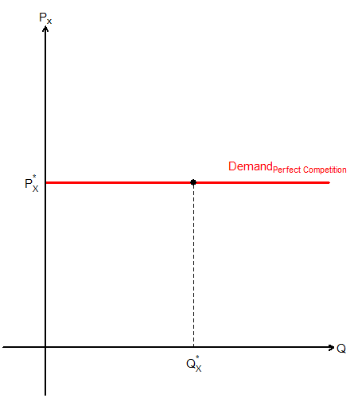
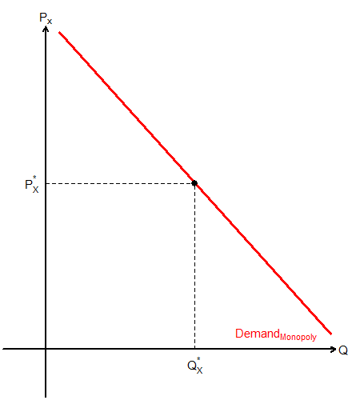
Monopoly vs. Perfect Competition
Individual Firms’ Demand under Perfect Competition
The Monopoly Producer’s Demand Curve

Slide 9
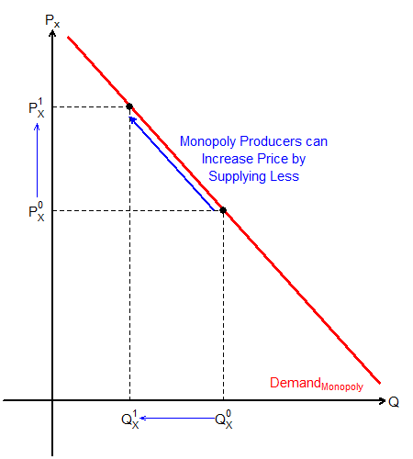
Monopoly Producer’s
Individual Demand Curve
Monopoly producers face the entire market’s demand as their individual firm’s demand.
They can exert market power by controlling the amount of output they produce.

Slide 10
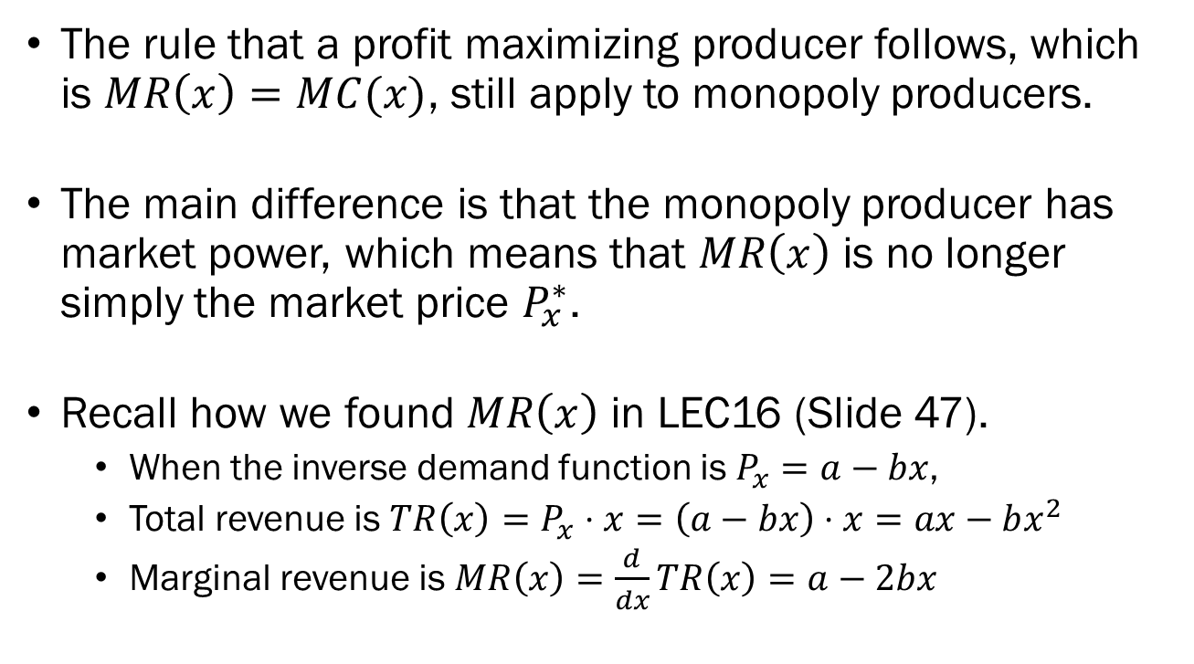
Profit Maximization of
Monopoly Producers
The rule that a profit maximizing producer follows, which is $MR\left(x\right)=MC(x)$, still apply to monopoly producers.
The main difference is that the monopoly producer has market power, which means that $MR\left(x\right)$ is no longer simply the market price $P_{x}^{∗}$.
Recall how we found $MR\left(x\right)$ in LEC16 (Slide 47).
  When the inverse demand function is $P_{x}=a−bx$,
  Total revenue is $TR\left(x\right)=P_{x}⋅x=\left(a−bx\right)⋅x=ax−bx^{2}$
  Marginal revenue is $MR\left(x\right)=\frac{d}{dx}TR\left(x\right)=a−2bx$

Slide 11
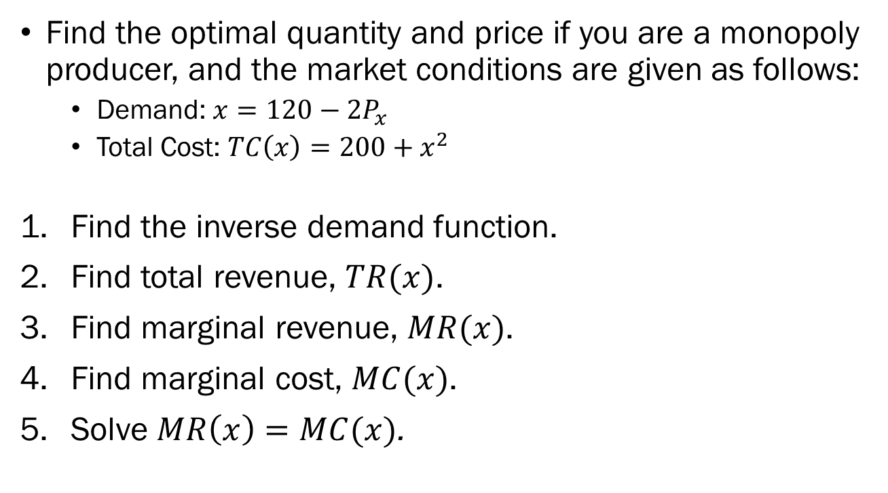
Example:
Profit Maximization of Monopolies
Find the optimal quantity and price if you are a monopoly producer, and the market conditions are given as follows:
  Demand: $x=120−2P_{x}$
  Total Cost: $TC\left(x\right)=200+x^{2}$
Find the inverse demand function.
Find total revenue, $TR(x)$.
Find marginal revenue, $MR(x)$.
Find marginal cost, $MC(x)$.
Solve $MR\left(x\right)=MC(x)$.

Slide 12
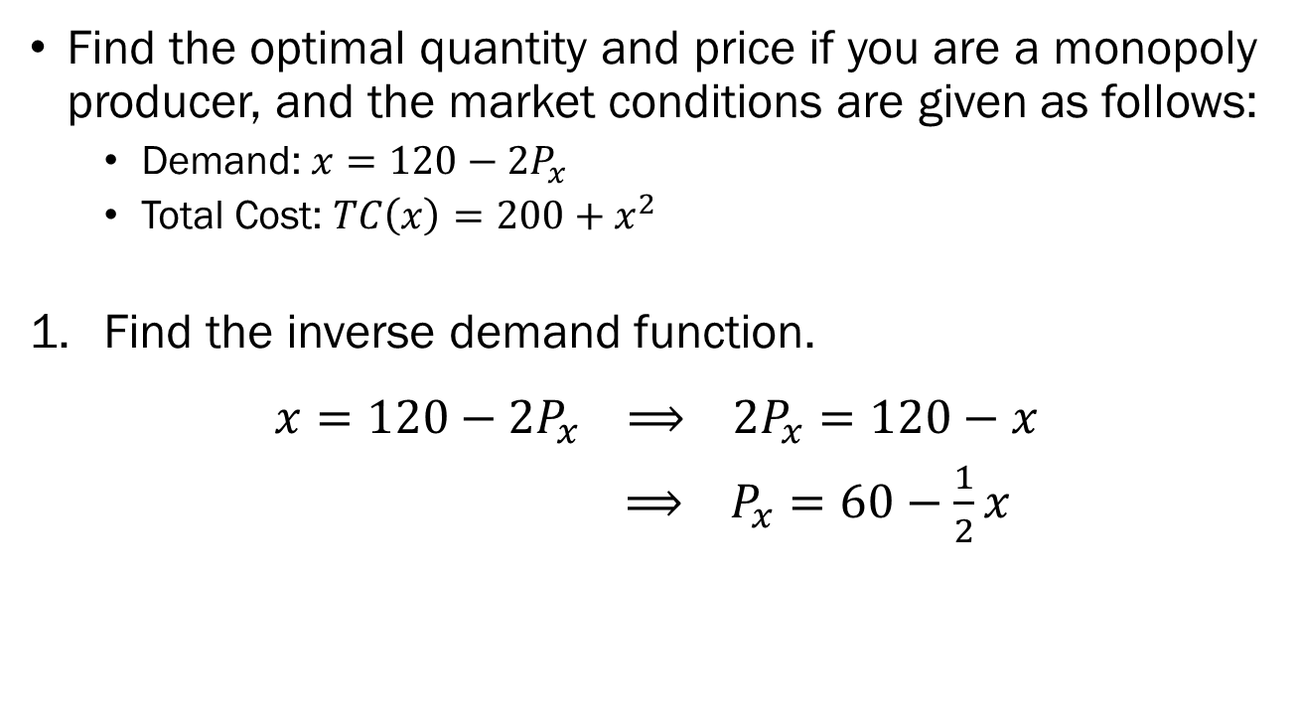
Example:
Profit Maximization of Monopolies
Find the optimal quantity and price if you are a monopoly producer, and the market conditions are given as follows:
  Demand: $x=120−2P_{x}$
  Total Cost: $TC\left(x\right)=200+x^{2}$
Find the inverse demand function.
$$x=120−2P_{x} ⟹ 2P_{x}=120−x$$
$⟹ P_{x}=60−\frac{1}{2}x$

Slide 13
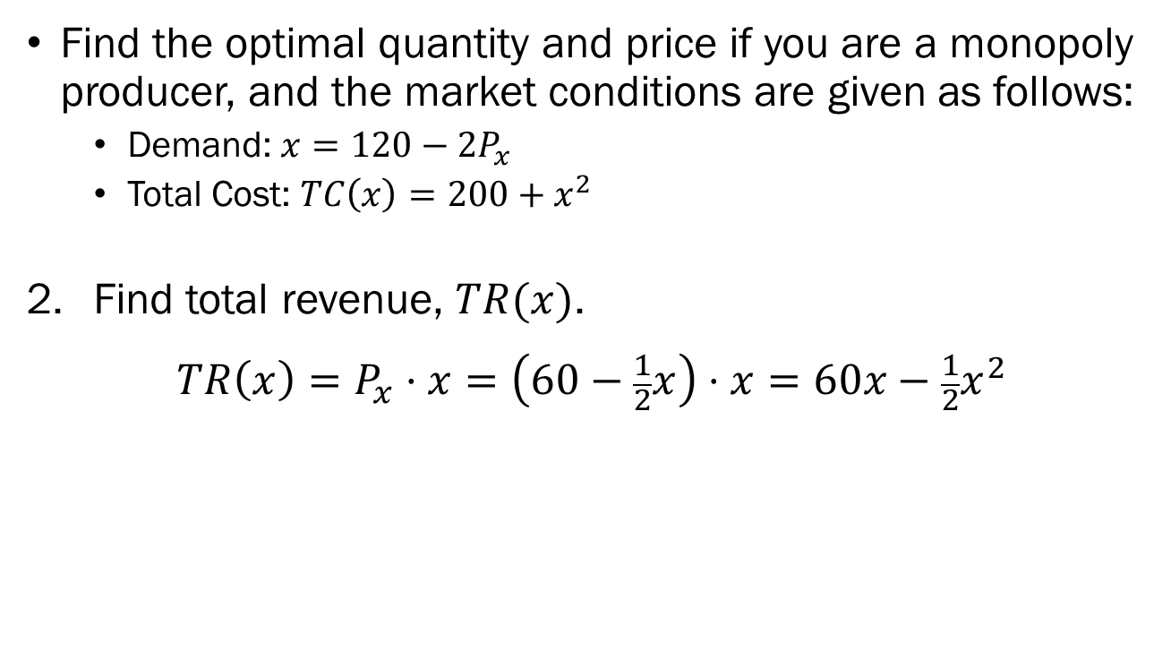
Example:
Profit Maximization of Monopolies
Find the optimal quantity and price if you are a monopoly producer, and the market conditions are given as follows:
  Demand: $x=120−2P_{x}$
  Total Cost: $TC\left(x\right)=200+x^{2}$
Find total revenue, $TR(x)$.
$$TR\left(x\right)=P_{x}⋅x=\left(60−\frac{1}{2}x\right)⋅x=60x−\frac{1}{2}x^{2}$$

Slide 14
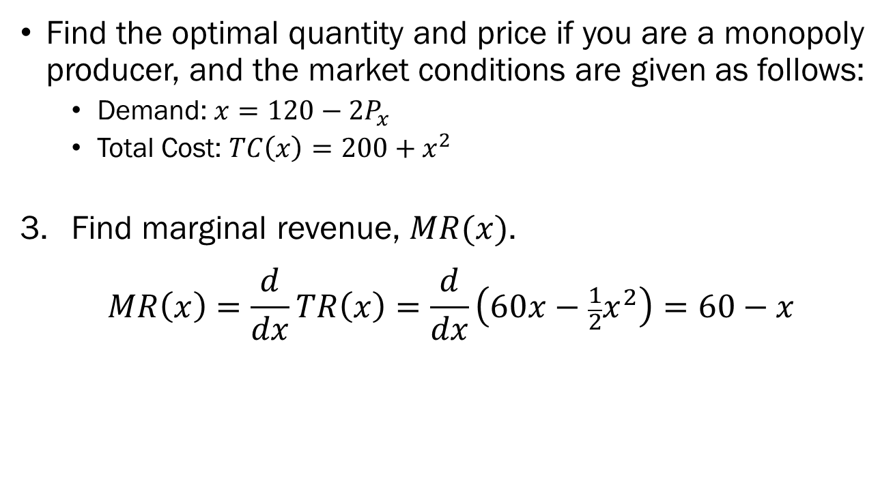
Example:
Profit Maximization of Monopolies
Find the optimal quantity and price if you are a monopoly producer, and the market conditions are given as follows:
  Demand: $x=120−2P_{x}$
  Total Cost: $TC\left(x\right)=200+x^{2}$
Find marginal revenue, $MR(x)$.
$$MR\left(x\right)=\frac{d}{dx}TR\left(x\right)=\frac{d}{dx}\left(60x−\frac{1}{2}x^{2}\right)=60−x$$

Slide 15
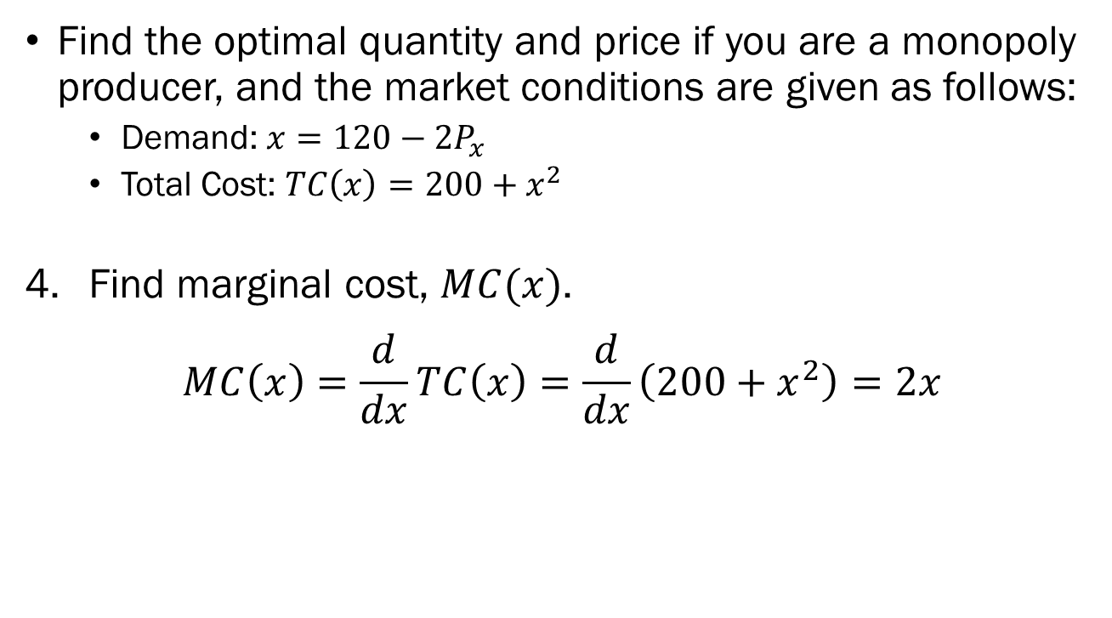
Example:
Profit Maximization of Monopolies
Find the optimal quantity and price if you are a monopoly producer, and the market conditions are given as follows:
  Demand: $x=120−2P_{x}$
  Total Cost: $TC\left(x\right)=200+x^{2}$
Find marginal cost, $MC(x)$.
$$MC\left(x\right)=\frac{d}{dx}TC\left(x\right)=\frac{d}{dx}\left(200+x^{2}\right)=2x$$

Slide 16
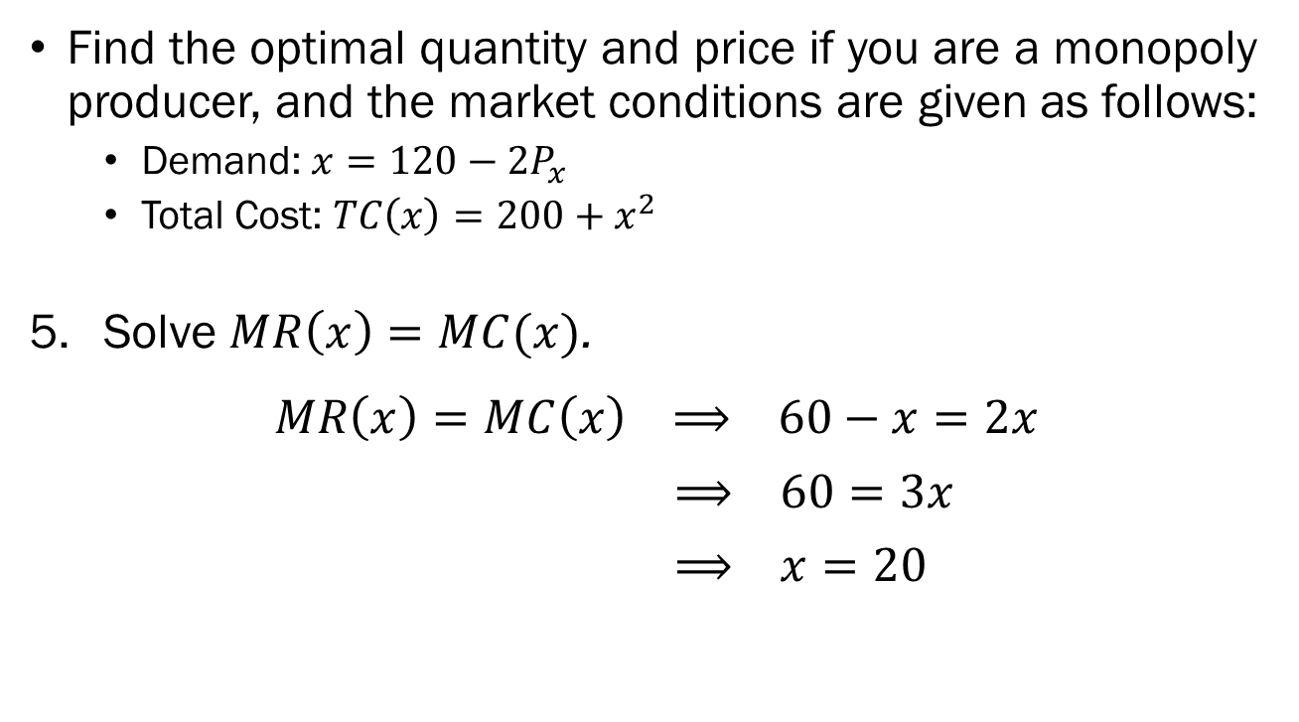
Example:
Profit Maximization of Monopolies
Find the optimal quantity and price if you are a monopoly producer, and the market conditions are given as follows:
  Demand: $x=120−2P_{x}$
  Total Cost: $TC\left(x\right)=200+x^{2}$
Solve $MR\left(x\right)=MC(x)$.
$$MR\left(x\right)=MC\left(x\right) ⟹ 60−x=2x$$
$⟹ 60=3x$
$⟹ x=20$

Slide 17
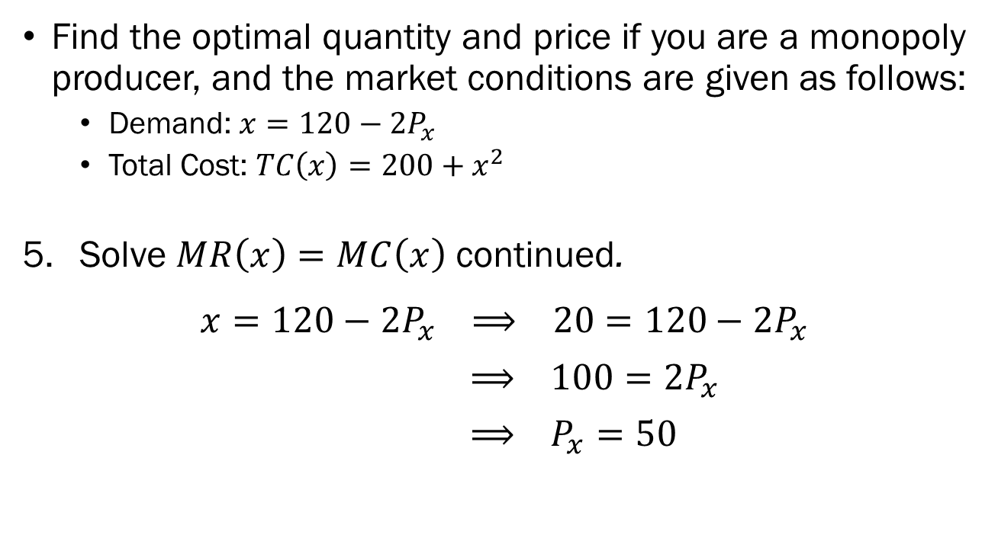
Example:
Profit Maximization of Monopolies
Find the optimal quantity and price if you are a monopoly producer, and the market conditions are given as follows:
  Demand: $x=120−2P_{x}$
  Total Cost: $TC\left(x\right)=200+x^{2}$
Solve $MR\left(x\right)=MC\left(x\right)$ continued.
$$x=120−2P_{x} ⟹ 20=120−2P_{x}$$
$⟹ 100=2P_{x}$
$⟹ P_{x}=50$

Slide 18
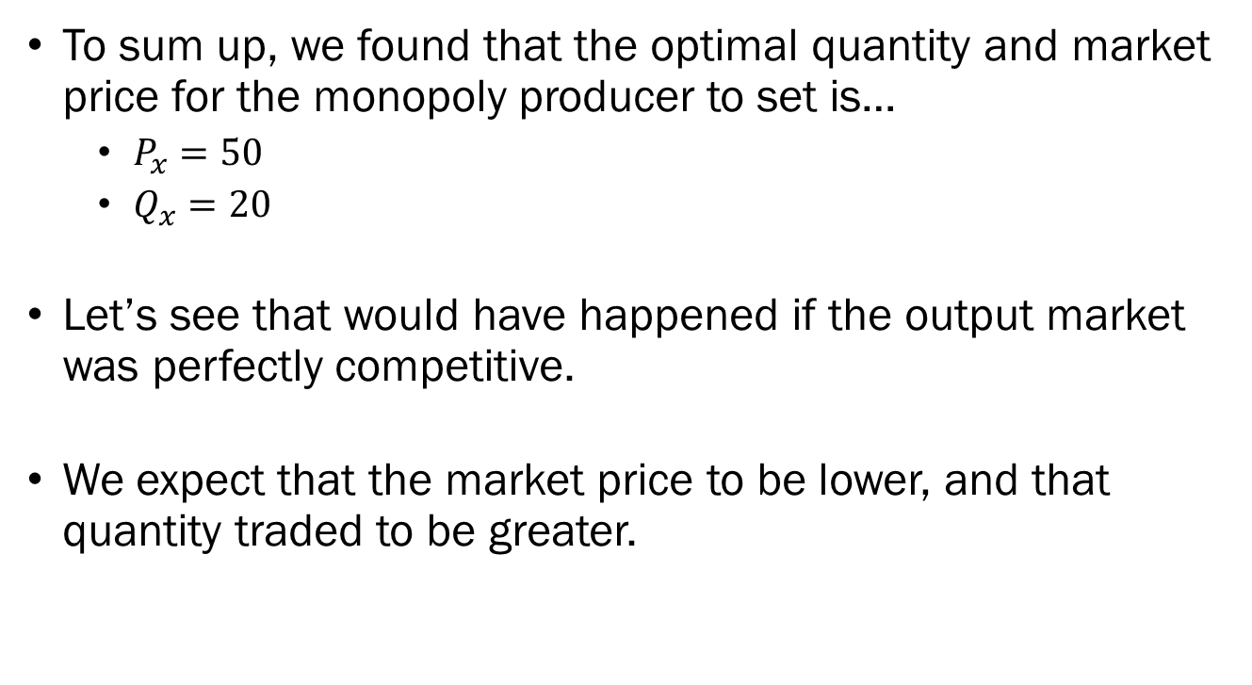
Example:
Profit Maximization of Monopolies
To sum up, we found that the optimal quantity and market price for the monopoly producer to set is…
  $P_{x}=50$
  $Q_{x}=20$
Let’s see that would have happened if the output market was perfectly competitive.
We expect that the market price to be lower, and that quantity traded to be greater.

Slide 19
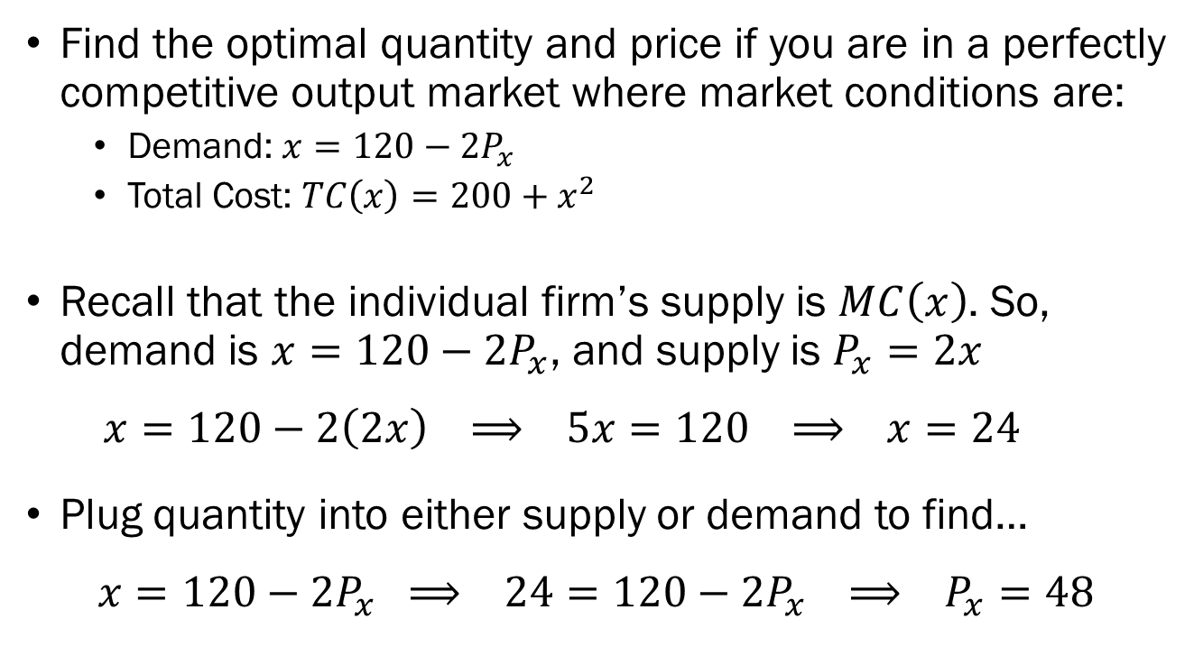
Example:
Monopolies vs. Perfect Competition
Find the optimal quantity and price if you are in a perfectly competitive output market where market conditions are:
  Demand: $x=120−2P_{x}$
  Total Cost: $TC\left(x\right)=200+x^{2}$
Recall that the individual firm’s supply is $MC\left(x\right)$. So, demand is $x=120−2P_{x}$, and supply is $P_{x}=2x$
  $$x=120−2\left(2x\right) ⟹ 5x=120 ⟹ x=24$$
Plug quantity into either supply or demand to find…
$$x=120−2P_{x} ⟹ 24=120−2P_{x} ⟹ P_{x}=48$$

Slide 20
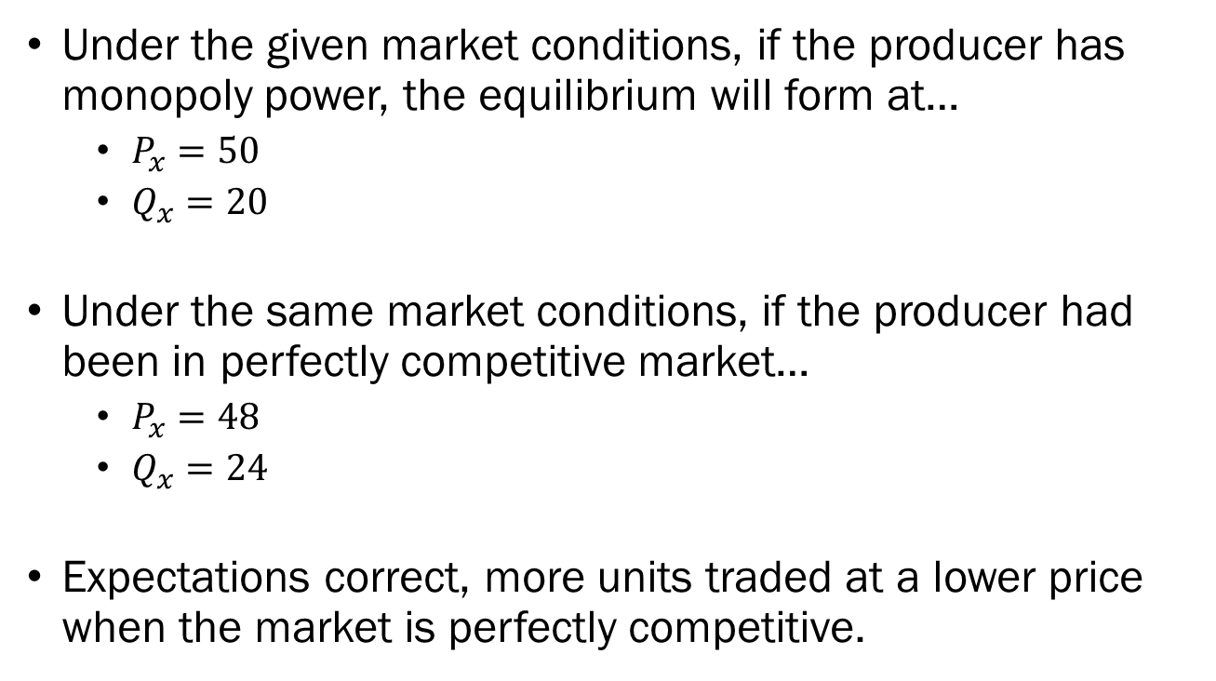
Example:
Monopolies vs. Perfect Competition
Under the given market conditions, if the producer has monopoly power, the equilibrium will form at…
  $P_{x}=50$
  $Q_{x}=20$
Under the same market conditions, if the producer had been in perfectly competitive market…
  $P_{x}=48$
  $Q_{x}=24$
Expectations correct, more units traded at a lower price when the market is perfectly competitive.

Slide 21
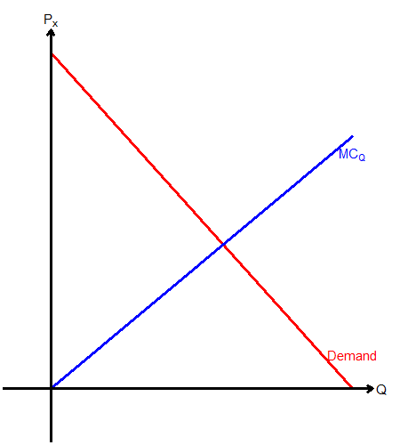
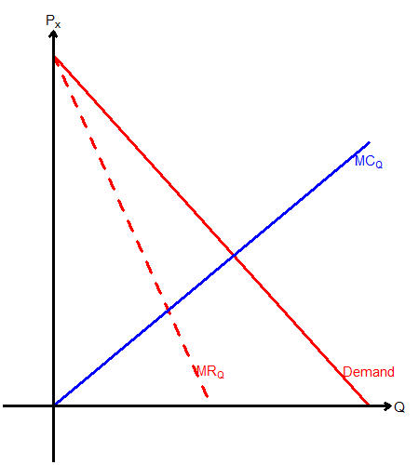
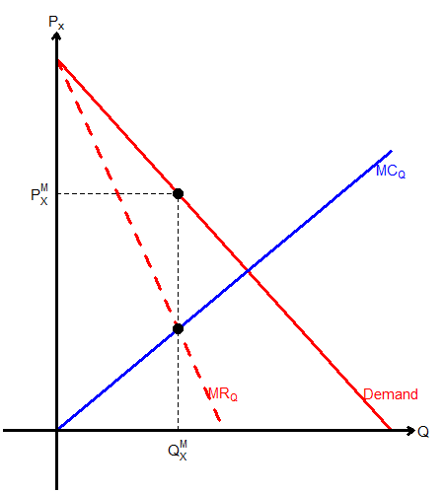
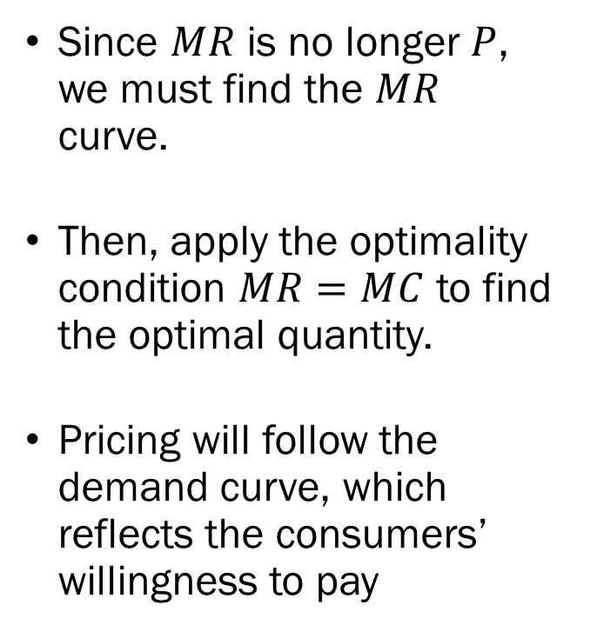
Profit Maximization of
Monopoly Producers
Since $MR$ is no longer $P$, we must find the $MR$ curve.
Then, apply the optimality condition $MR=MC$ to find the optimal quantity.
Pricing will follow the demand curve, which reflects the consumers’ willingness to pay

Slide 22
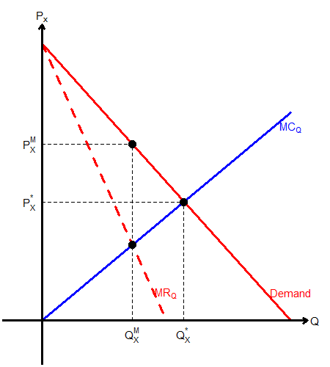
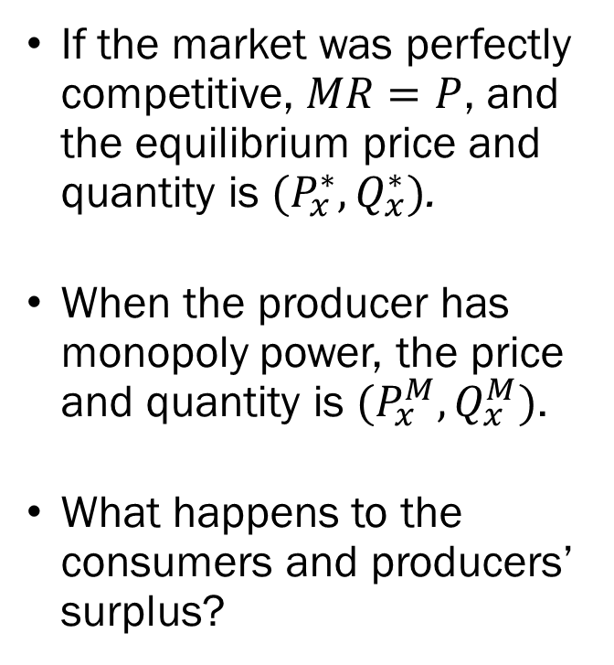
Monopolies vs. Perfect Competition
If the market was perfectly competitive, $MR=P$, and the equilibrium price and quantity is ${(P}_{x}^{∗},Q_{x}^{∗})$.
When the producer has monopoly power, the price and quantity is ${(P}_{x}^{M},Q_{x}^{M})$.
What happens to the consumers and producers’ surplus?

Slide 23
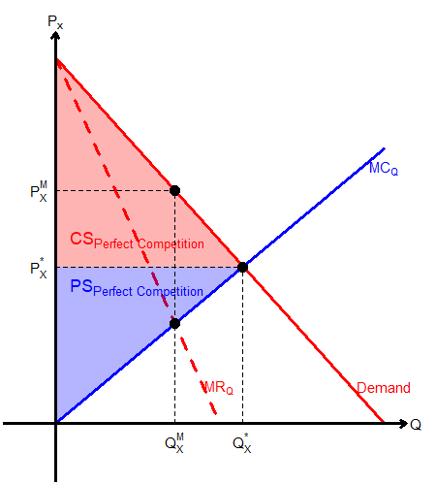
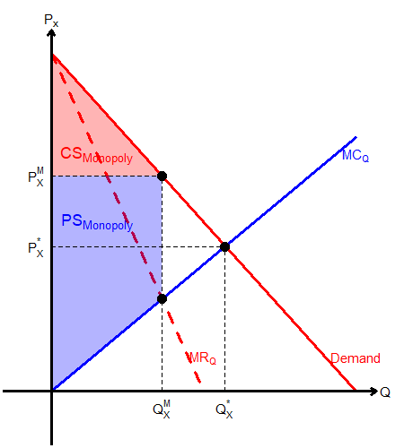
Changes in Societal Surplus
Perfect Competition
Monopoly

Slide 24
Breaking the Rules of Perfect Competition… Again
Let us now consider a flipped case. We will be looking into a market where there is a single consumer with infinitely many producers.
  Breaking Rule #1: Infinite Producers, One Consumer.
We call this situation a Monopsony.
May arise in the labor market, when there is a single large employer in some commuting zone.
The firm will be the only entity that demands labor, setting up a monopsony.

Slide 25
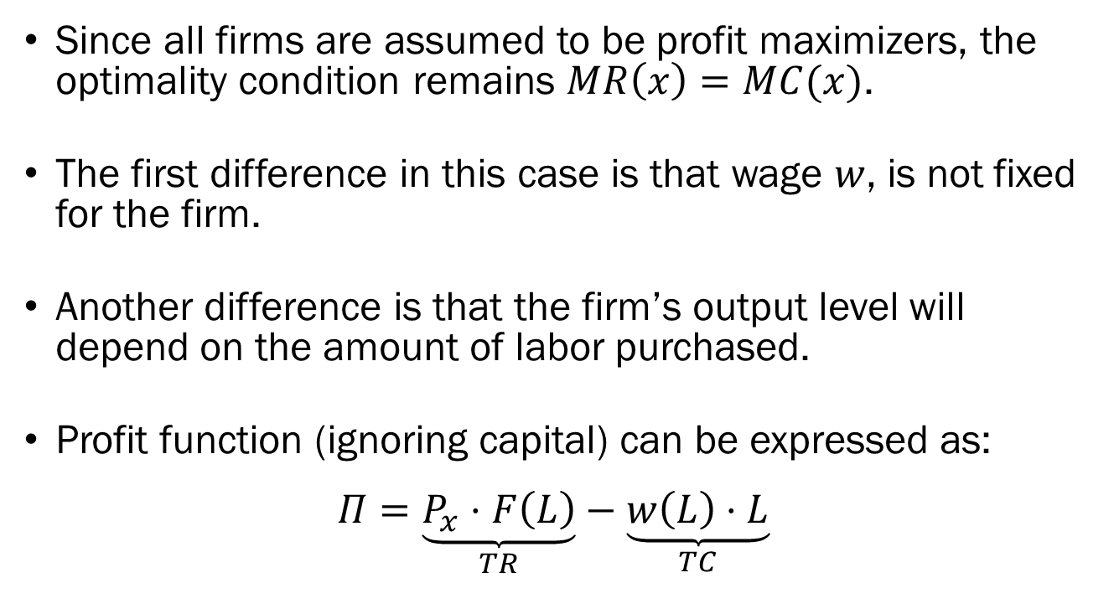
Profit Maximization of
Monopsony Producers
Since all firms are assumed to be profit maximizers, the optimality condition remains $MR\left(x\right)=MC(x)$.
The first difference in this case is that wage $w$, is not fixed for the firm.
Another difference is that the firm’s output level will depend on the amount of labor purchased.
Profit function (ignoring capital) can be expressed as:
$$Π=\underset{TR}{\underbrace{P_{x}⋅F\left(L\right)}}−\underset{TC}{\underbrace{w\left(L\right)⋅L}}$$

Slide 26
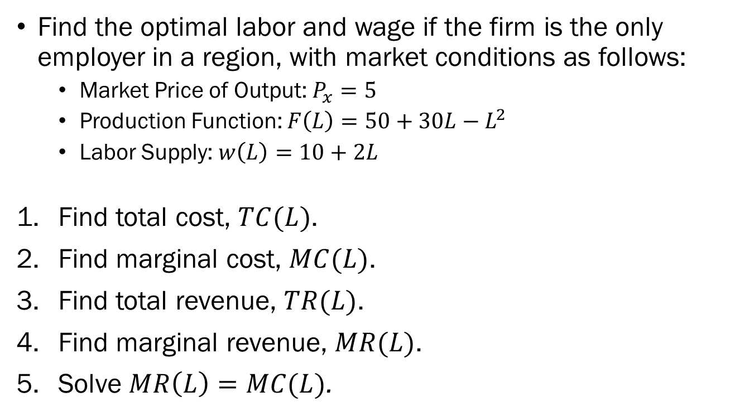
Example: Profit Maximization of
Monopsony Producers
Find the optimal labor and wage if the firm is the only employer in a region, with market conditions as follows:
  Market Price of Output: $P_{x}=5$
  Production Function: $F\left(L\right)=50+30L−L^{2}$
  Labor Supply: $w\left(L\right)=10+2L$
Find total cost, $TC(L)$.
Find marginal cost, $MC(L)$.
Find total revenue, $TR(L)$.
Find marginal revenue, $MR(L)$.
Solve $MR\left(L\right)=MC(L)$.

Slide 27
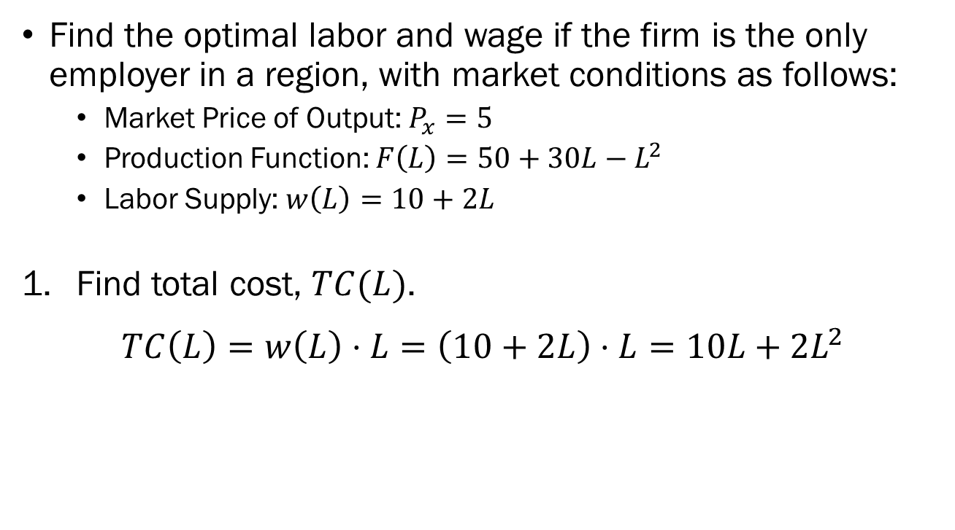
Example: Profit Maximization of
Monopsony Producers
Find the optimal labor and wage if the firm is the only employer in a region, with market conditions as follows:
  Market Price of Output: $P_{x}=5$
  Production Function: $F\left(L\right)=50+30L−L^{2}$
  Labor Supply: $w\left(L\right)=10+2L$
Find total cost, $TC(L)$.
$$TC\left(L\right)=w\left(L\right)⋅L=\left(10+2L\right)⋅L=10L+2L^{2}$$

Slide 28
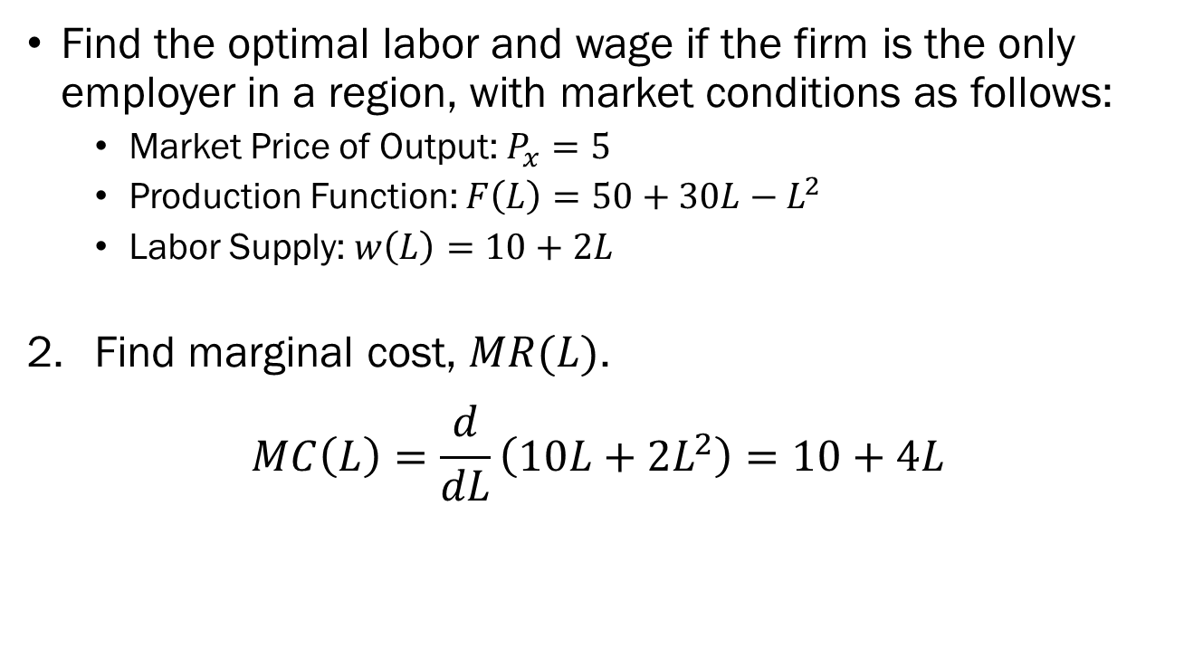
Example: Profit Maximization of
Monopsony Producers
Find the optimal labor and wage if the firm is the only employer in a region, with market conditions as follows:
  Market Price of Output: $P_{x}=5$
  Production Function: $F\left(L\right)=50+30L−L^{2}$
  Labor Supply: $w\left(L\right)=10+2L$
Find marginal cost, $MR(L)$.
$$MC\left(L\right)=\frac{d}{dL}\left(10L+2L^{2}\right)=10+4L$$

Slide 29
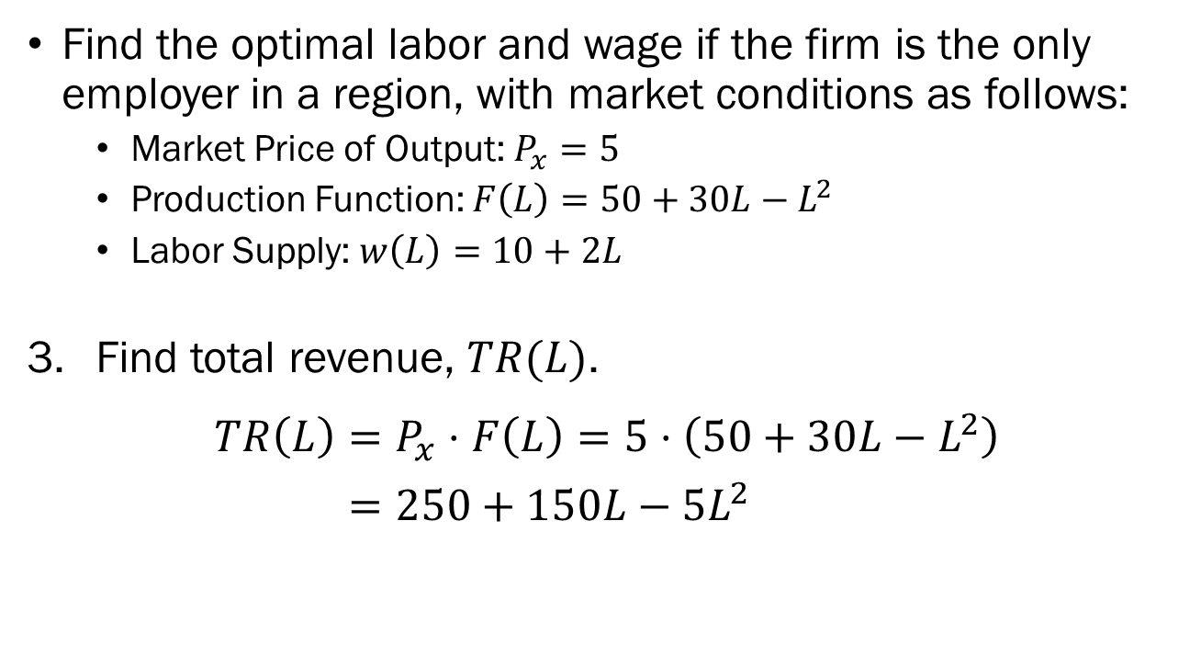
Example: Profit Maximization of
Monopsony Producers
Find the optimal labor and wage if the firm is the only employer in a region, with market conditions as follows:
  Market Price of Output: $P_{x}=5$
  Production Function: $F\left(L\right)=50+30L−L^{2}$
  Labor Supply: $w\left(L\right)=10+2L$
Find total revenue, $TR(L)$.
$$TR\left(L\right)=P_{x}⋅F\left(L\right)=5⋅\left(50+30L−L^{2}\right)$$
$=250+150L−5L^{2}$

Slide 30
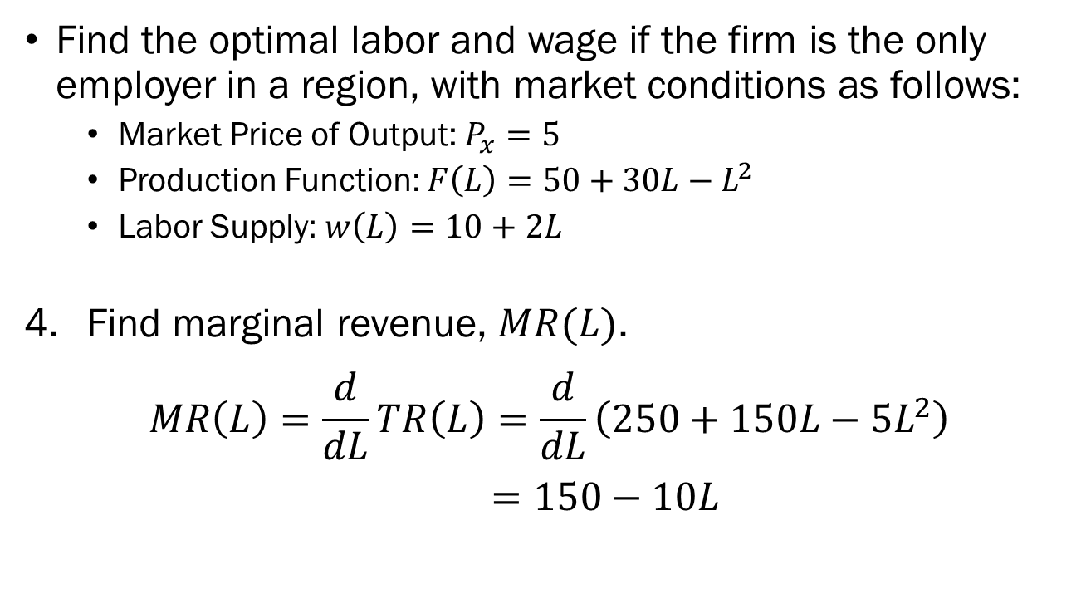
Example: Profit Maximization of
Monopsony Producers
Find the optimal labor and wage if the firm is the only employer in a region, with market conditions as follows:
  Market Price of Output: $P_{x}=5$
  Production Function: $F\left(L\right)=50+30L−L^{2}$
  Labor Supply: $w\left(L\right)=10+2L$
Find marginal revenue, $MR(L)$.
$$MR\left(L\right)=\frac{d}{dL}TR\left(L\right)=\frac{d}{dL}\left(250+150L−5L^{2}\right)$$
$=150−10L$

Slide 31
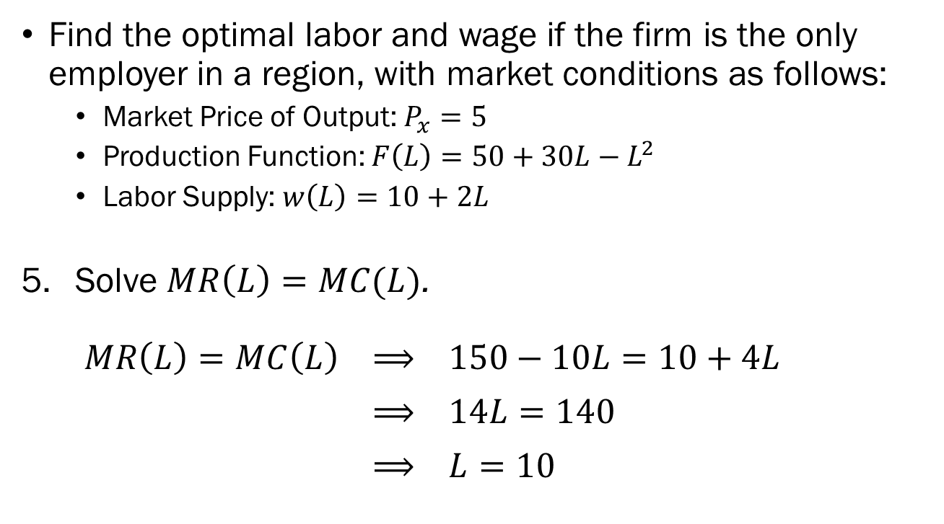
Example: Profit Maximization of
Monopsony Producers
Find the optimal labor and wage if the firm is the only employer in a region, with market conditions as follows:
  Market Price of Output: $P_{x}=5$
  Production Function: $F\left(L\right)=50+30L−L^{2}$
  Labor Supply: $w\left(L\right)=10+2L$
Solve $MR\left(L\right)=MC(L)$.
$MR\left(L\right)=MC\left(L\right) ⟹ 150−10L=10+4L$
$⟹ 14L=140$
$⟹ L=10$

Slide 32
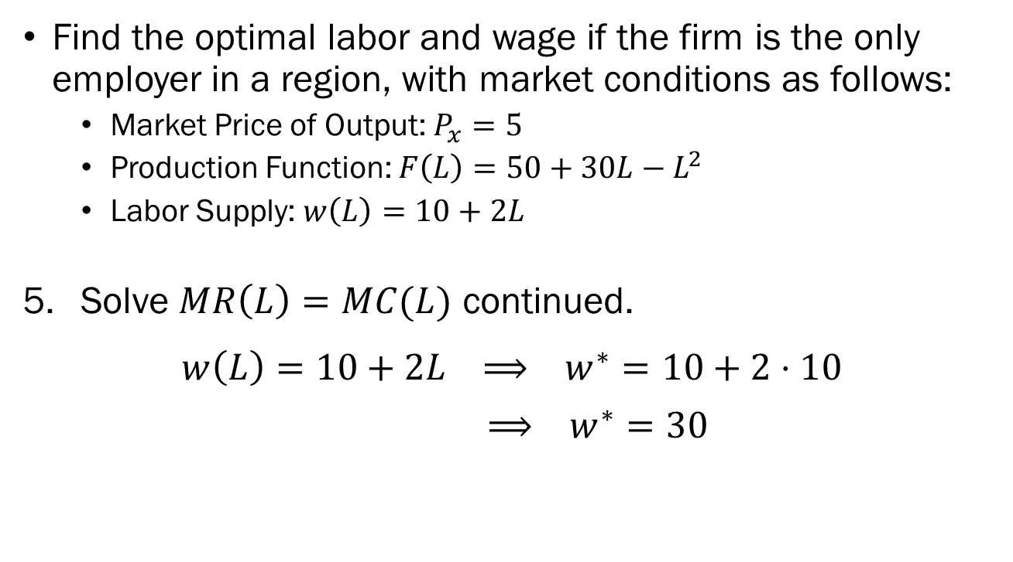
Example: Profit Maximization of
Monopsony Producers
Find the optimal labor and wage if the firm is the only employer in a region, with market conditions as follows:
  Market Price of Output: $P_{x}=5$
  Production Function: $F\left(L\right)=50+30L−L^{2}$
  Labor Supply: $w\left(L\right)=10+2L$
Solve $MR\left(L\right)=MC(L)$ continued.
$$w\left(L\right)=10+2L ⟹ w^{∗}=10+2⋅10$$
$⟹ w^{∗}=30$

Slide 33
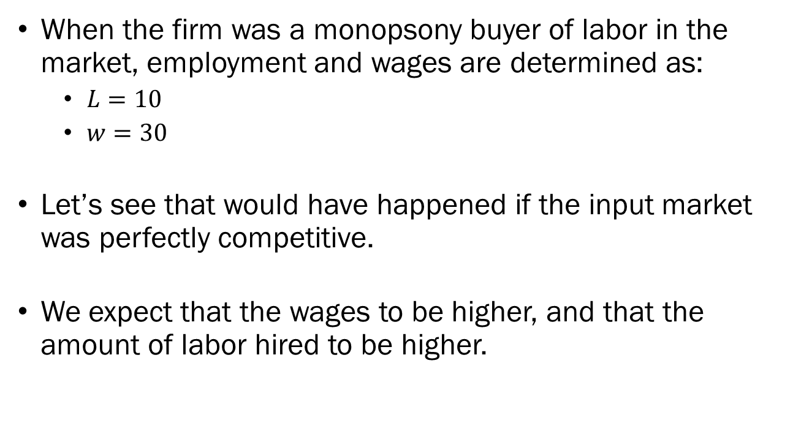
Example: Profit Maximization of
Monopsony Producers
When the firm was a monopsony buyer of labor in the market, employment and wages are determined as:
  $L=10$
  $w=30$
Let’s see that would have happened if the input market was perfectly competitive.
We expect that the wages to be higher, and that the amount of labor hired to be higher.

Slide 34
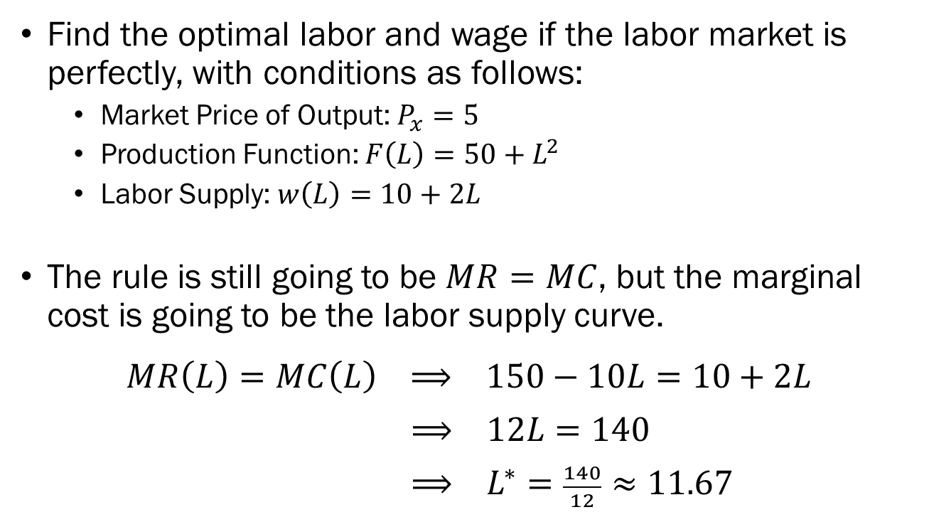
Example:
Monopsony vs. Perfect Competition
Find the optimal labor and wage if the labor market is perfectly, with conditions as follows:
  Market Price of Output: $P_{x}=5$
  Production Function: $F\left(L\right)=50+L^{2}$
  Labor Supply: $w\left(L\right)=10+2L$
The rule is still going to be $MR=MC$, but the marginal cost is going to be the labor supply curve.
$$MR\left(L\right)=MC\left(L\right) ⟹ 150−10L=10+2L$$
$⟹ 12L=140$
$⟹ L^{∗}=\frac{140}{12}≈11.67$

Slide 35
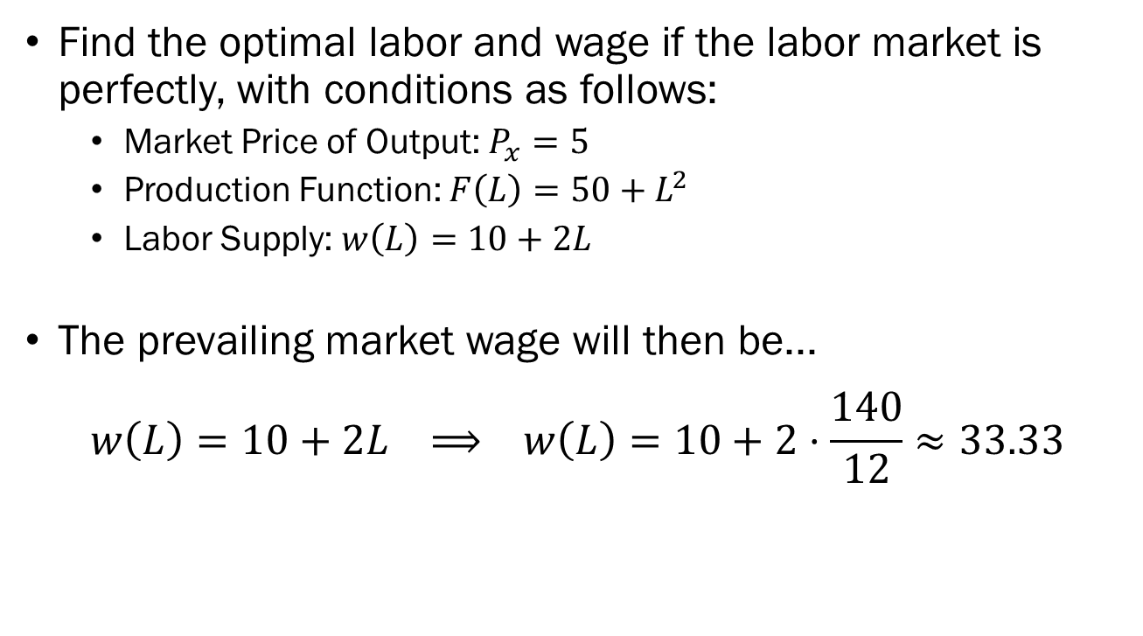
Example:
Monopsony vs. Perfect Competition
Find the optimal labor and wage if the labor market is perfectly, with conditions as follows:
  Market Price of Output: $P_{x}=5$
  Production Function: $F\left(L\right)=50+L^{2}$
  Labor Supply: $w\left(L\right)=10+2L$
The prevailing market wage will then be...
$$w\left(L\right)=10+2L ⟹ w\left(L\right)=10+2⋅\frac{140}{12}≈33.33$$

Slide 36
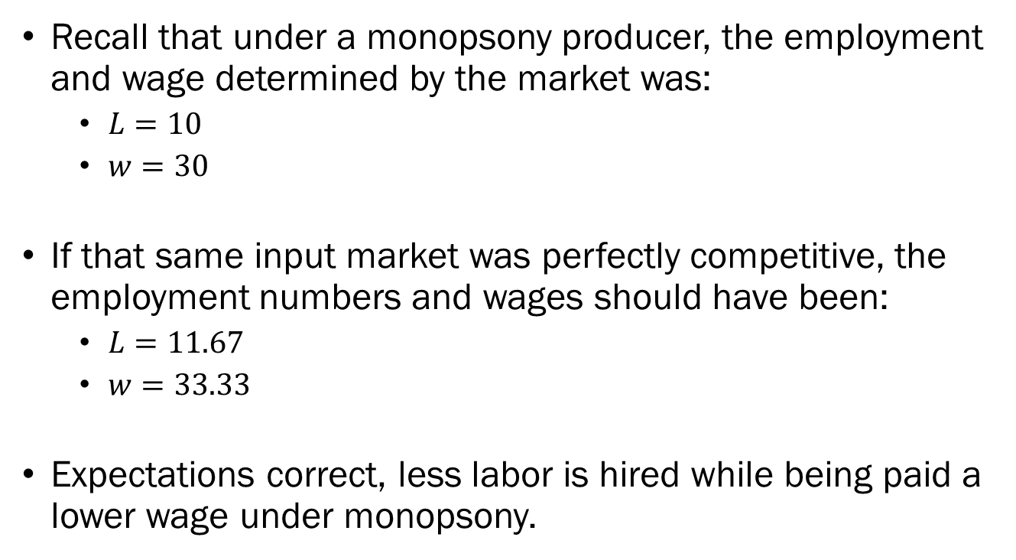
Example: Profit Maximization of
Monopsony Producers
Recall that under a monopsony producer, the employment and wage determined by the market was:
  $L=10$
  $w=30$
If that same input market was perfectly competitive, the employment numbers and wages should have been:
  $L=11.67$
  $w=33.33$
Expectations correct, less labor is hired while being paid a lower wage under monopsony.

Slide 37
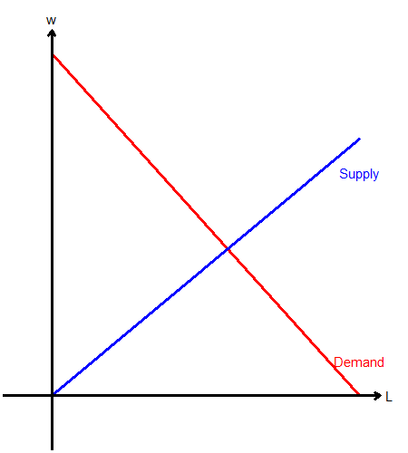
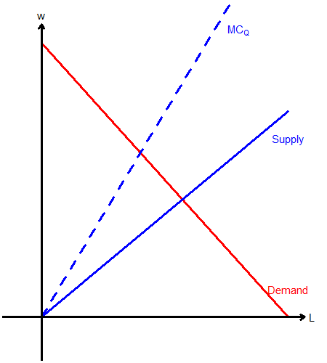
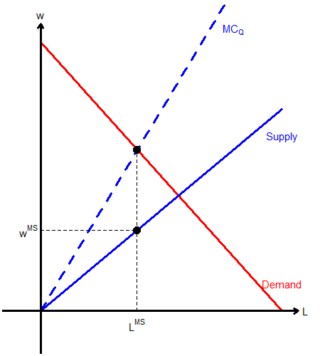
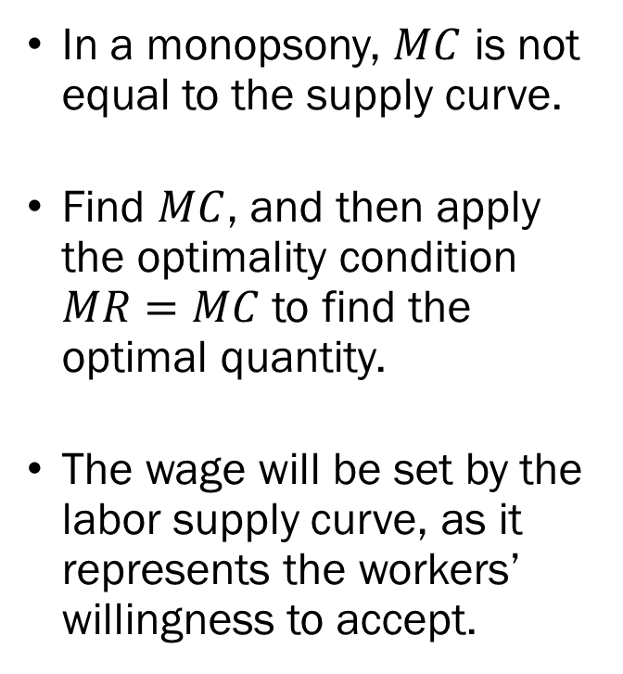
Monopsony vs. Perfect Competition
In a monopsony, $MC$ is not equal to the supply curve.
Find $MC$, and then apply the optimality condition $MR=MC$ to find the optimal quantity.
The wage will be set by the labor supply curve, as it represents the workers’ willingness to accept.

Slide 38
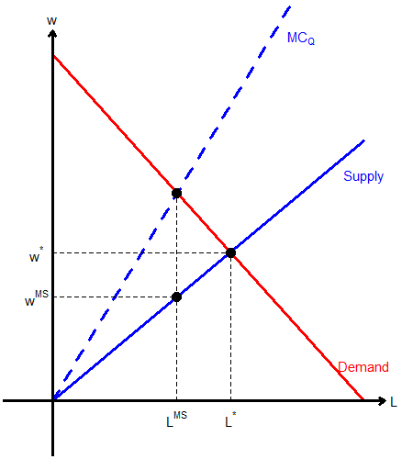
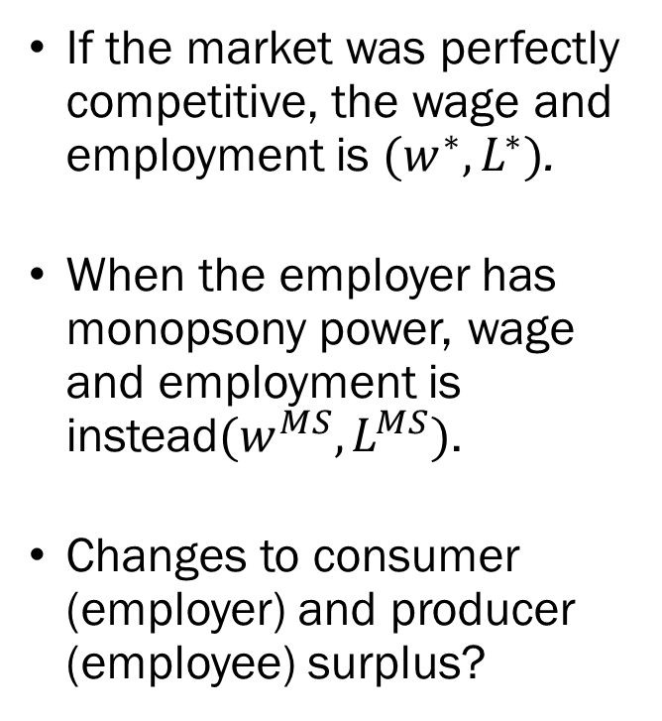
Monopsony vs. Perfect Competition
If the market was perfectly competitive, the wage and employment is $(w^{∗},L^{∗})$.
When the employer has monopsony power, wage and employment is instead$(w^{MS},L^{MS})$.
Changes to consumer (employer) and producer (employee) surplus?

Slide 39
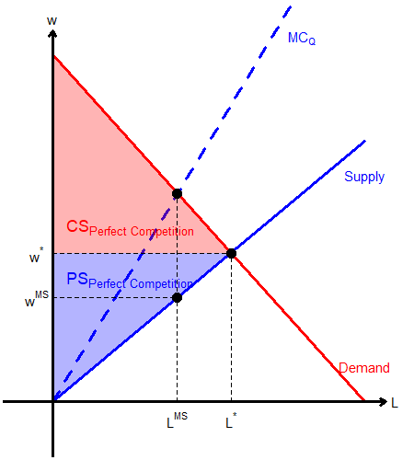
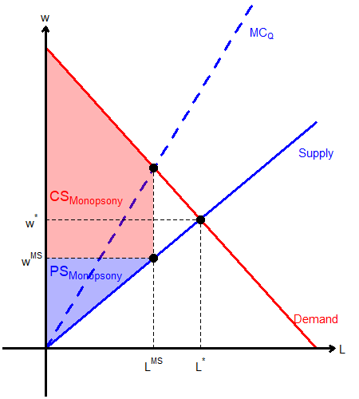
Changes in Societal Surplus
Perfect Competition
Monopsony

