Slide 1
Consumer Theory:
Indifference Curves Part 2
ECON 300

Slide 2
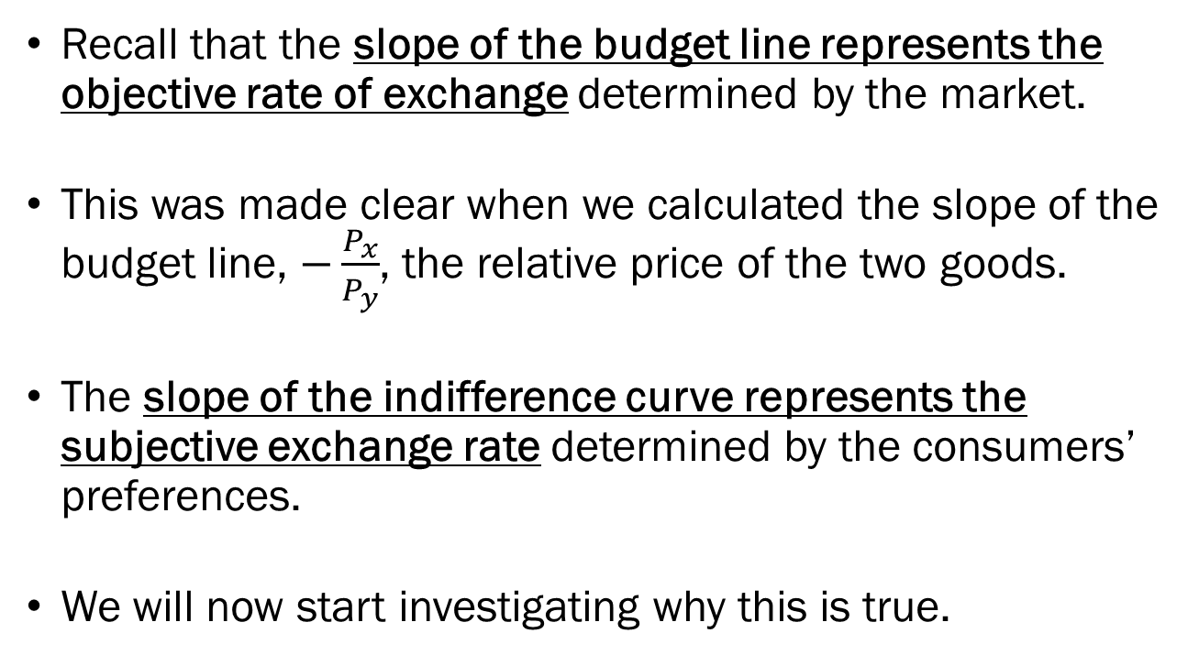
Slopes and their Meanings
Recall that the slope of the budget line represents the objective rate of exchange determined by the market.
This was made clear when we calculated the slope of the budget line, $−\frac{P_{x}}{P_{y}}$, the relative price of the two goods.
The slope of the indifference curve represents the subjective exchange rate determined by the consumers’ preferences.
We will now start investigating why this is true.

Slide 3
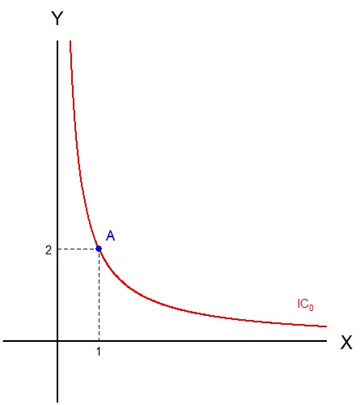
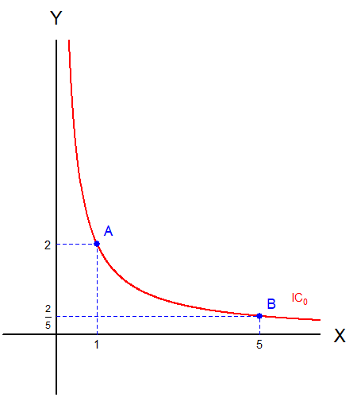
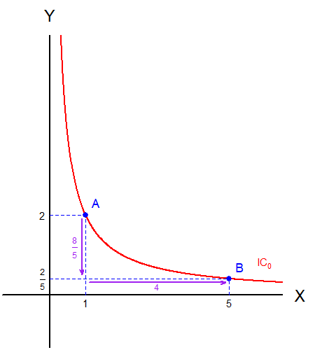
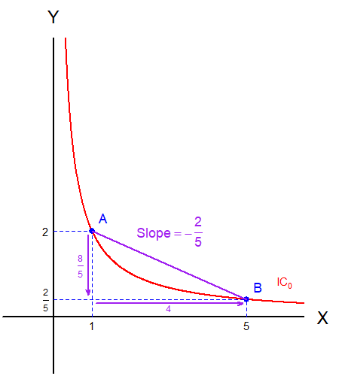
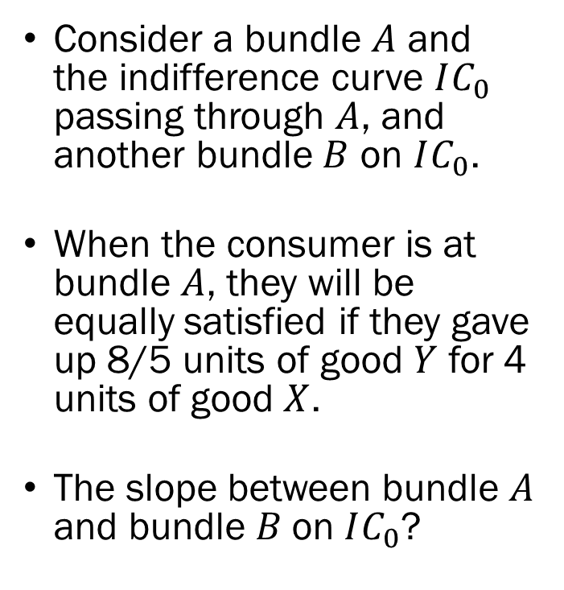
The Slope Along the Indifference Curve
Consider a bundle $A$ and the indifference curve $IC_{0}$ passing through $A$, and another bundle $B$ on $IC_{0}$.
When the consumer is at bundle $A$, they will be equally satisfied if they gave up 8/5 units of good $Y$ for 4 units of good $X$.
The slope between bundle $A$ and bundle $B$on $IC_{0}$?

Slide 4
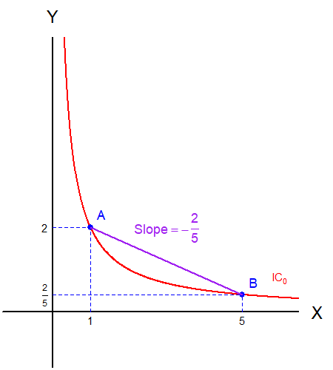
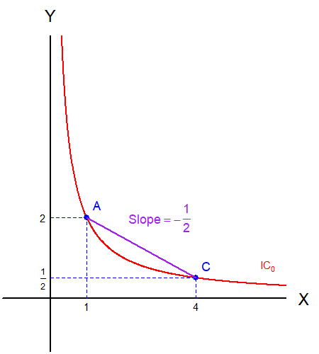
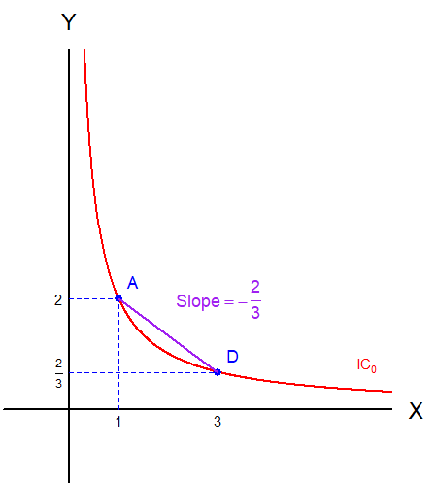
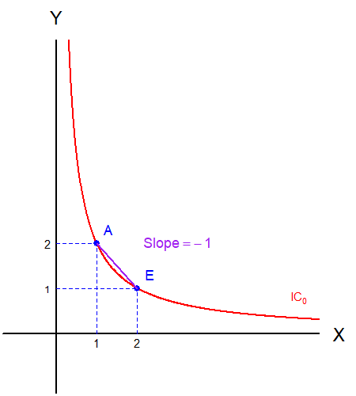
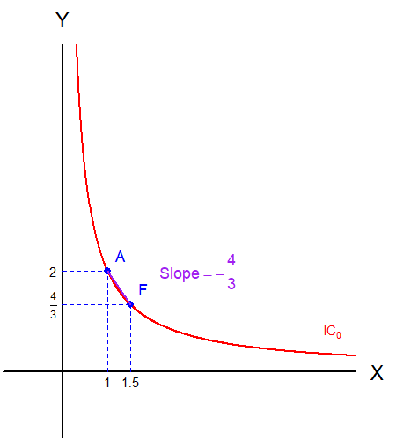
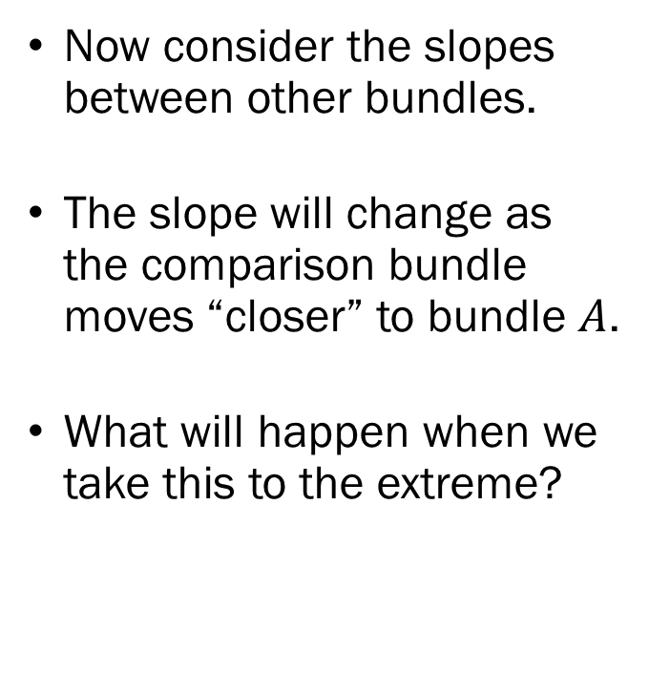
The Slope Along the Indifference Curve
Now consider the slopes between other bundles.
The slope will change as the comparison bundle moves “closer” to bundle $A$.
What will happen when we take this to the extreme?

Slide 5
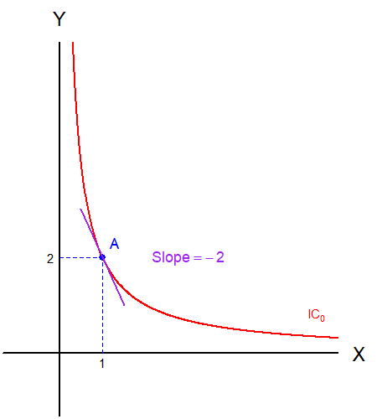
The Slope “On” the Indifference Curve
We arrive at the slope “at the point.”
This slope still represents the subjective rate of exchange of the consumer who is currently consuming bundle A.
But how do we calculate this “instantaneous” slope?

Slide 6
Detour: Marginal Utility
Marginal Utility, in discrete terms, is the utility the consumer obtains from “at the margin.”
Let us see with a simplified example:
Units of X | U(X) | U’(X)
1 | 100 | 100
2 | 180 | 80
3 | 244 | 64
4 | 295 | 51
5 | 336 | 41
6 | 369 | 33

Slide 7
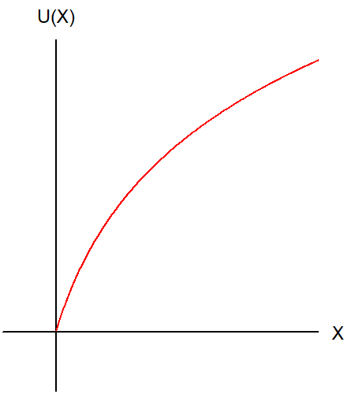
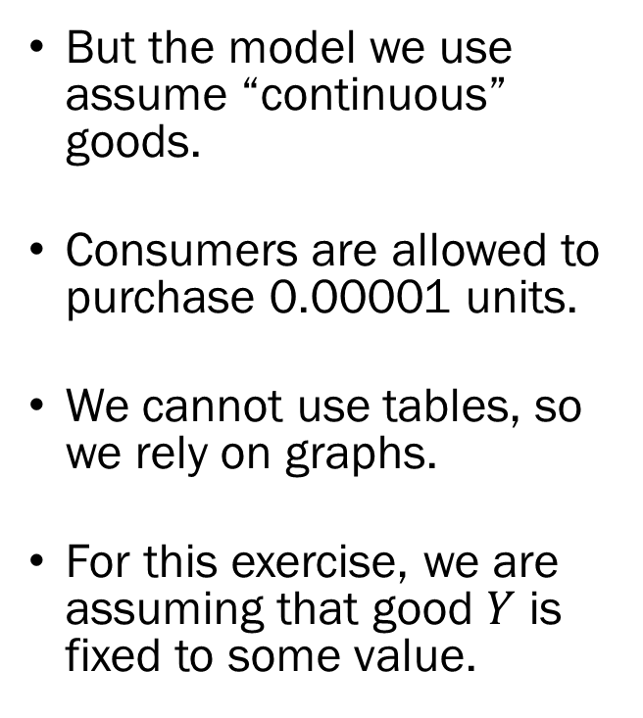
Detour: Marginal Utility
But the model we use assume “continuous” goods.
Consumers are allowed to purchase 0.00001 units.
We cannot use tables, so we rely on graphs.
For this exercise, we are assuming that good $Y$ is fixed to some value.

Slide 8
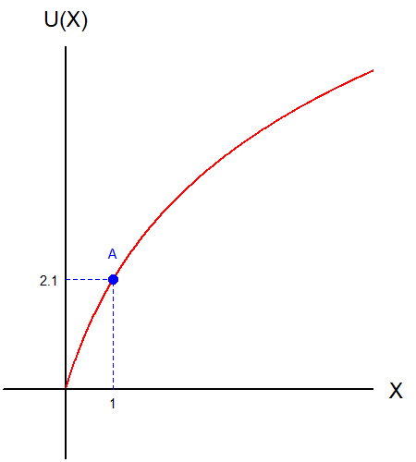
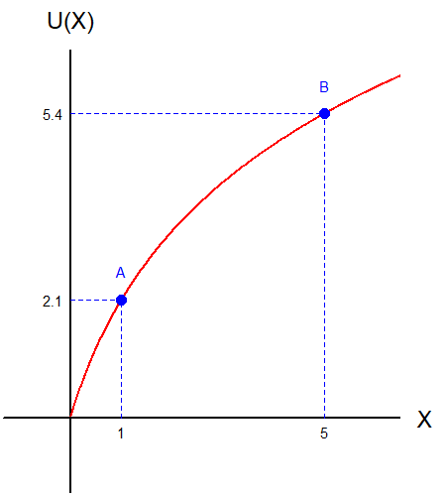
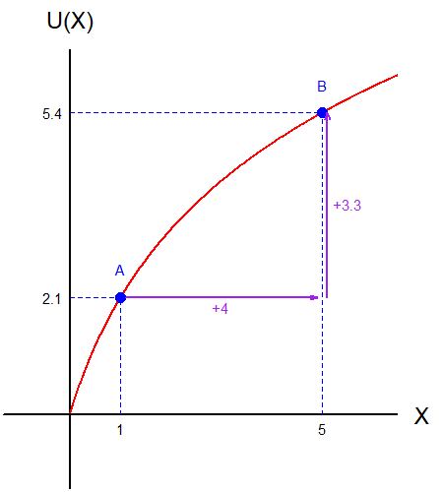
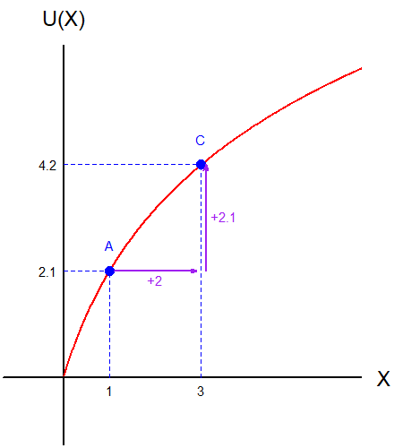
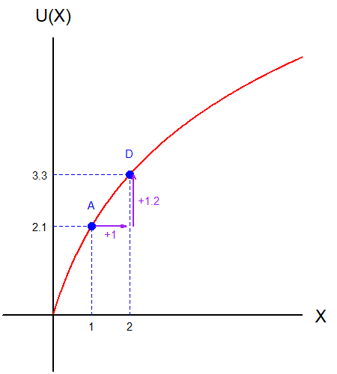
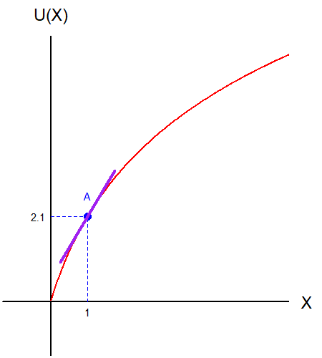
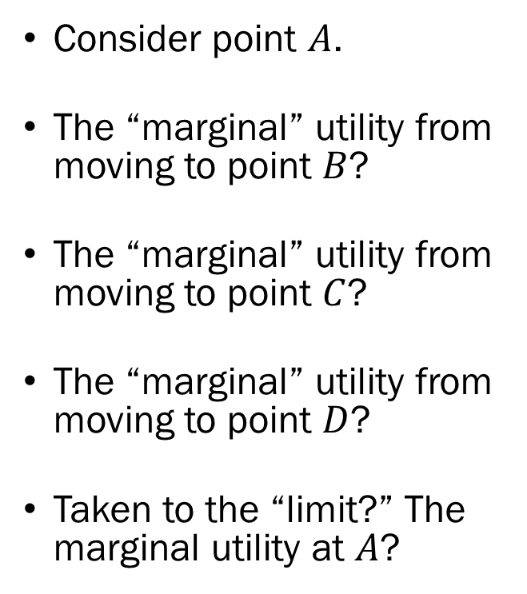
Detour: Marginal Utility
Consider point $A$.
The “marginal” utility from moving to point $B$?
The “marginal” utility from moving to point $C$?
The “marginal” utility from moving to point $D$?
Taken to the “limit?” The marginal utility at $A$?

Slide 9
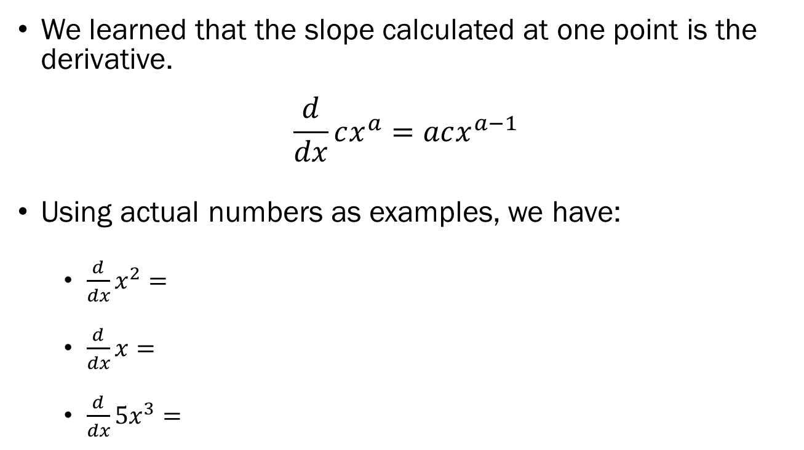
Detour: Derivatives
We learned that the slope calculated at one point is the derivative.
$$\frac{d}{dx}cx^{a}=acx^{a−1}$$
Using actual numbers as examples, we have:
  $\frac{d}{dx}x^{2}=2x$
  $\frac{d}{dx}x=1$
  $\frac{d}{dx}5x^{3}=5⋅\left(3x^{2}\right)=15x^{2}$

Slide 10
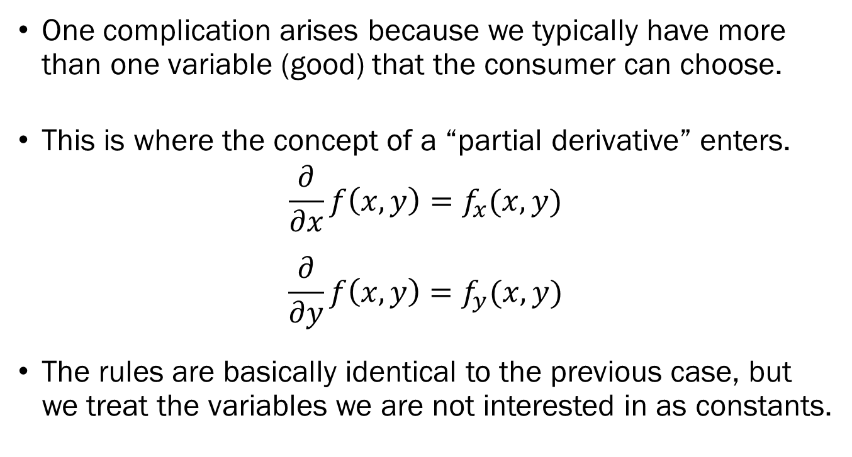
Detour: Partial Derivatives
One complication arises because we typically have more than one variable (good) that the consumer can choose.
This is where the concept of a “partial derivative” enters.
$$\frac{∂}{∂x}f\left(x,y\right)=f_{x}(x,y)$$
$$\frac{∂}{∂y}f\left(x,y\right)=f_{y}(x,y)$$
The rules are basically identical to the previous case, but we treat the variables we are not interested in as constants.

Slide 11
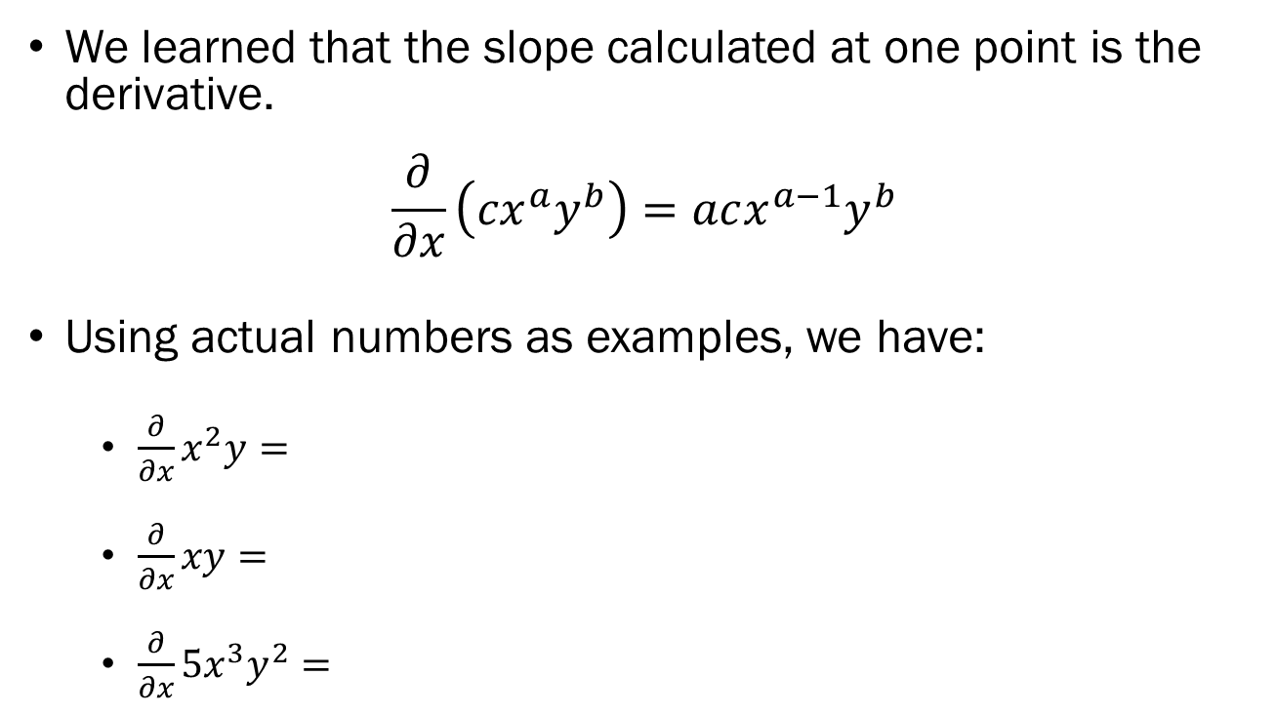
Detour: Partial Derivatives
We learned that the slope calculated at one point is the derivative.
$$\frac{∂}{∂x}\left({cx}^{a}y^{b}\right)=acx^{a−1}y^{b}$$
Using actual numbers as examples, we have:
  $\frac{∂}{∂x}x^{2}y=2xy$
  $\frac{∂}{∂x}xy=y$
  $\frac{∂}{∂x}5x^{3}y^{2}=15x^{2}y^{2}$

