Slide 1
Consumer Theory:
Review Session
ECON 300

Slide 2
Topics
The Budget Constraint
Preferences and Utility
Utility Functions and the Indifference Curve
The Utility Maximization Problem

Slide 3
The Budget Constraint

Slide 4
The Budget Constraint Basics
The budget constraint’s role is to classify bundles of goods as either “feasible,” or “not feasible.”
Bundles whose cost does not exceed the consumer’s income is considered “feasible,” and make up the “budget set.”
Bundles whose cost exceed the consumer’s income is considered “not feasible.”
The bundles whose cost is exactly the consumer’s income consist the “budget line.”

Slide 5
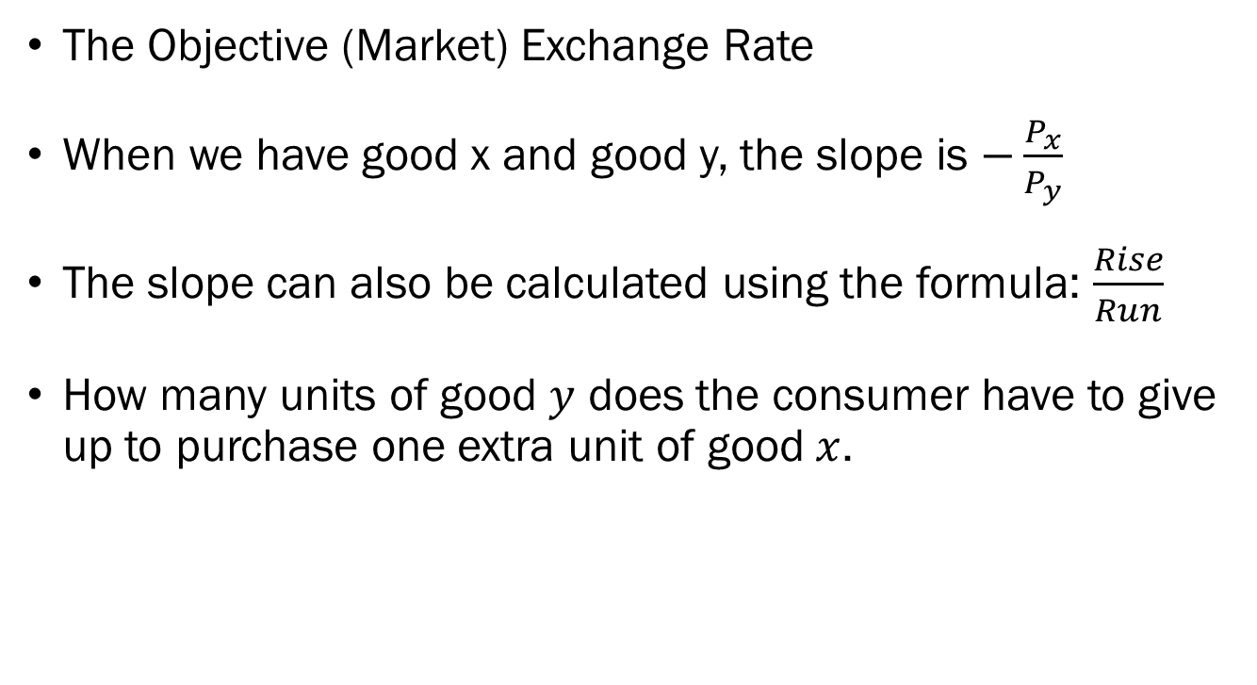
The Slope of the Budget Line
The Objective (Market) Exchange Rate
When we have good x and good y, the slope is $−\frac{P_{x}}{P_{y}}$
The slope can also be calculated using the formula: $\frac{Rise}{Run}$
How many units of good $y$ does the consumer have to give up to purchase one extra unit of good $x$.

Slide 6
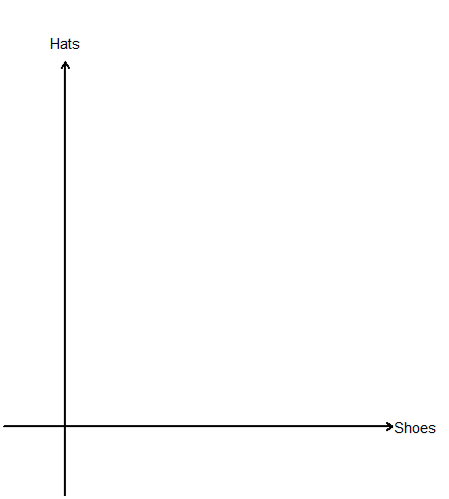
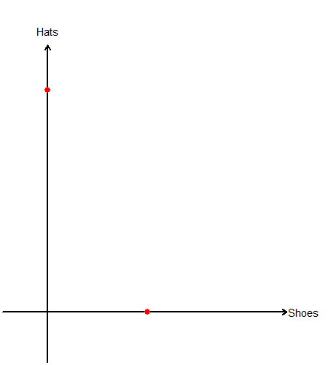
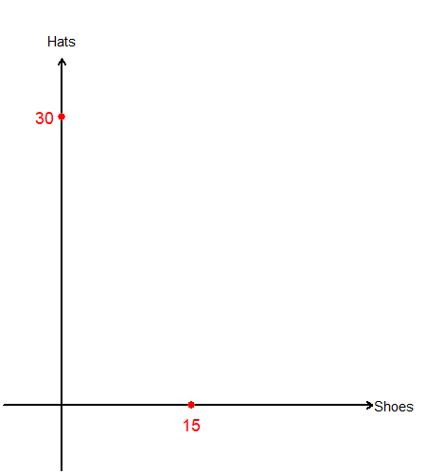
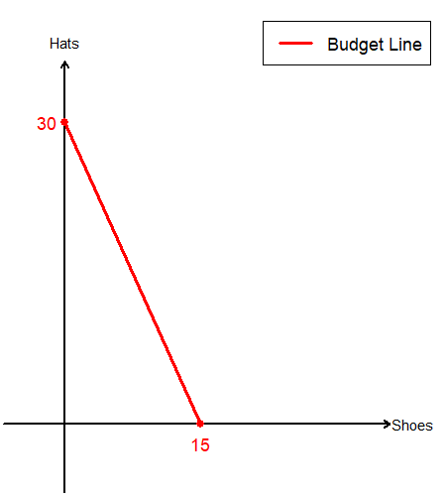
The Budget Constraint: An Example
Suppose that there is a market for shoes and hats.
Each pair of shoes cost $40, and a hat costs $20.
The consumer has $600 they can spend as income.

Slide 7
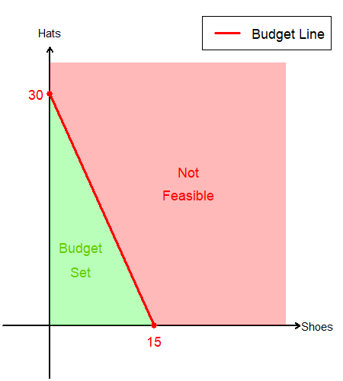
The Budget Constraint: An Example
The “Budget Line” splits the commodity space into two distinct parts.
Any bundle in the “Budget Set” (below the budget line) costs less than or up to $600.
Any bundle in the “Not Feasible” zone (above the budget line) costs more than $600.

Slide 8
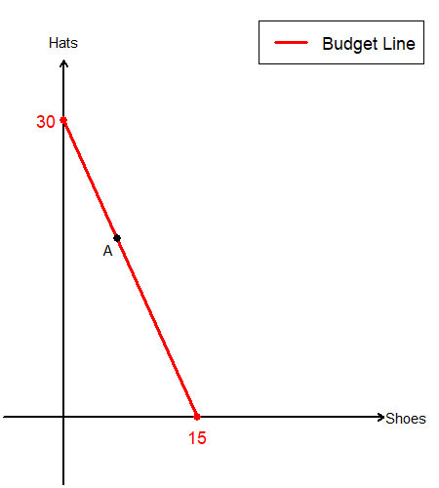
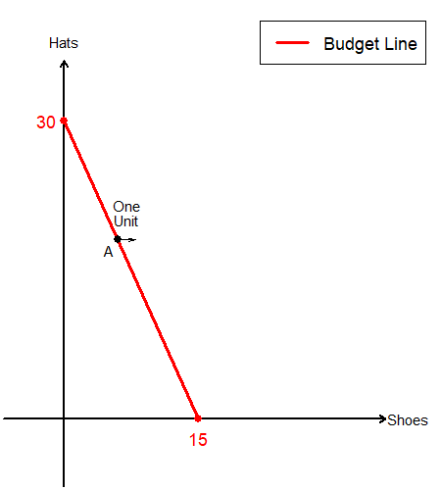

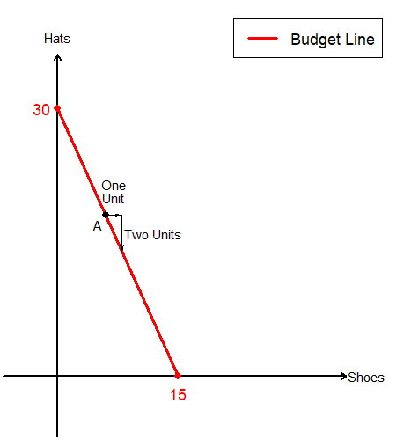
The Budget Constraint: An Example
Suppose the consumer is consuming bundle A.
If they wanted to purchase an extra pair of shoes…
How many units of hats do they need to sell?
They need to sell 2 units of hats to be able to afford 1 pair of shoes.

Slide 9
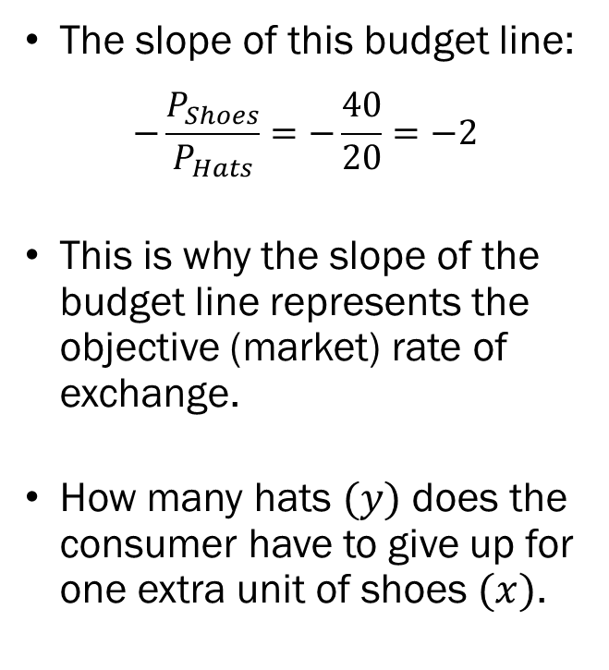
The Budget Constraint: An Example
The slope of this budget line:
$$−\frac{P_{Shoes}}{P_{Hats}}=−\frac{40}{20}=−2$$
This is why the slope of the budget line represents the objective (market) rate of exchange.
How many hats $(y)$ does the consumer have to give up for one extra unit of shoes $(x)$.

Slide 10
Preferences, Utility, and Utility Functions

Slide 11
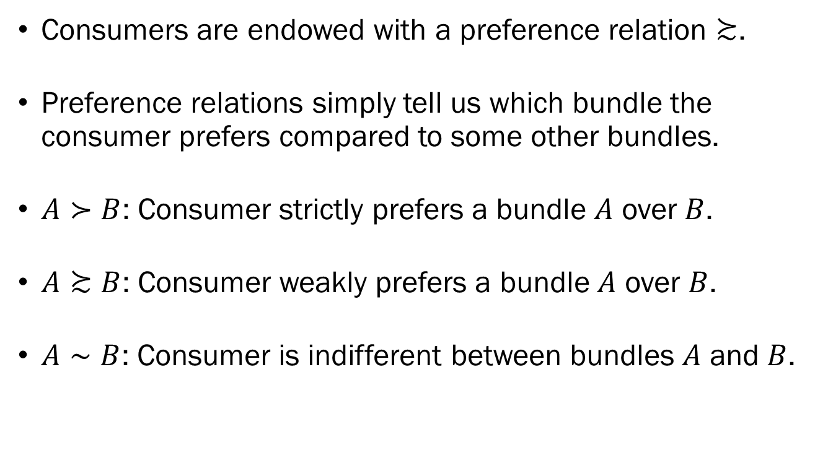
Preference Relations Basics
Consumers are endowed with a preference relation $≿$.
Preference relations simply tell us which bundle the consumer prefers compared to some other bundles.
$A≻B$: Consumer strictly prefers a bundle $A$ over $B$.
$A≿B$: Consumer weakly prefers a bundle $A$ over $B$.
$A∼B$: Consumer is indifferent between bundles $A$ and $B$.

Slide 12
Axioms of Preference Relations
Completeness: “Any bundle can be evaluated.”
Transitivity: “No circular preferences.”
Reflexivity: “Anything is as good as itself.”
Continuity: “No sudden jumps in preference.”
Strong Monotonicity: “The more the better.”
Convexity: “Consumers like diverse bundles.”

Slide 13
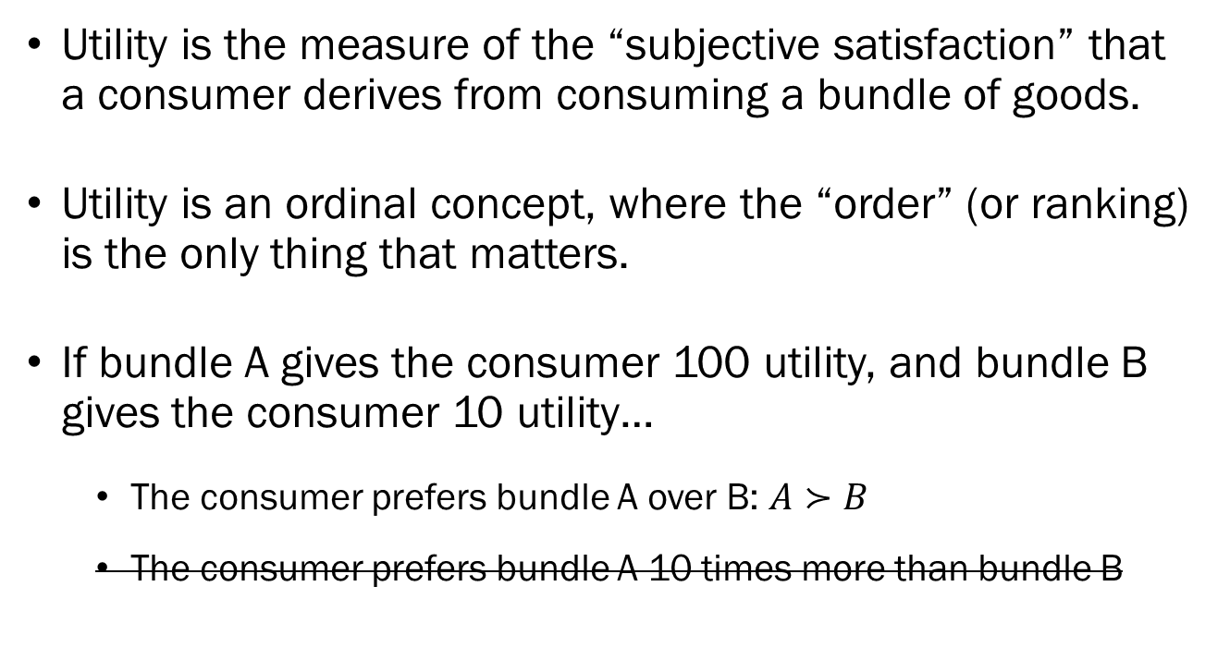
Utility Basics
Utility is the measure of the “subjective satisfaction” that a consumer derives from consuming a bundle of goods.
Utility is an ordinal concept, where the “order” (or ranking) is the only thing that matters.
If bundle A gives the consumer 100 utility, and bundle B gives the consumer 10 utility…
  The consumer prefers bundle A over B: $A≻B$
  The consumer prefers bundle A 10 times more than bundle B

Slide 14
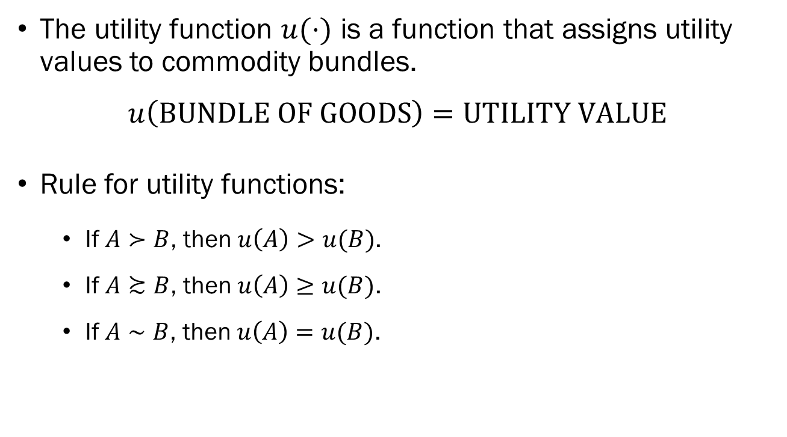
Utility Function Basics
The utility function $u(⋅)$ is a function that assigns utility values to commodity bundles.
$$u\left(\text{BUNDLE} \text{OF} \text{GOODS}\right)=UTILITY VALUE$$
Rule for utility functions:
  If $A≻B$, then $u\left(A\right)>u(B)$.
  If $A≿B$, then $u\left(A\right)≥u(B)$.
  If $A∼B$, then $u\left(A\right)=u(B)$.

Slide 15
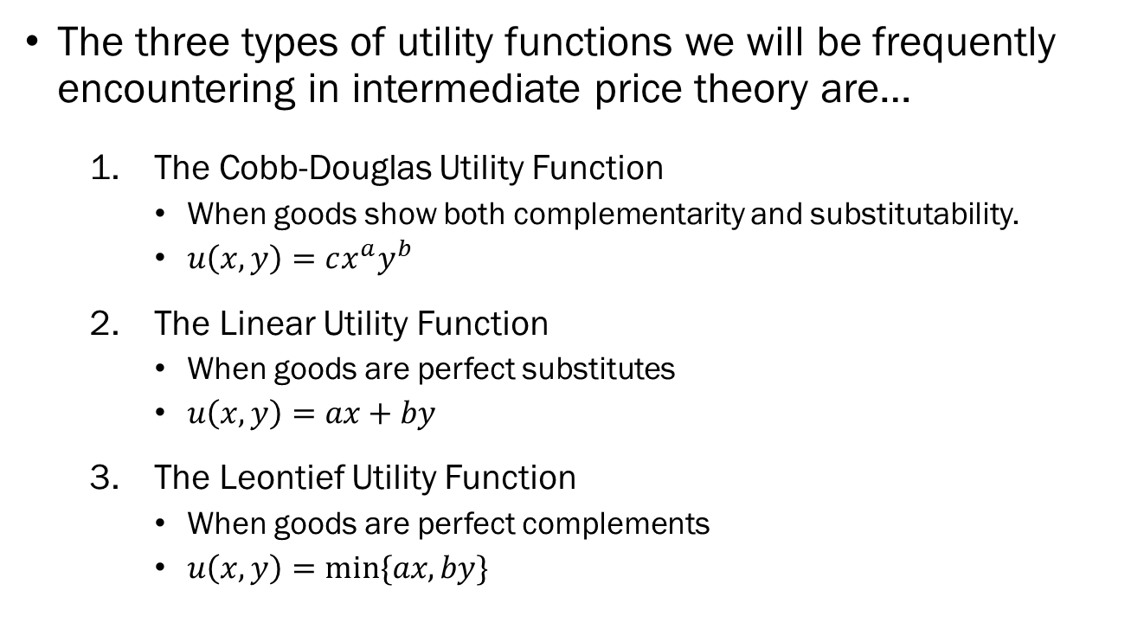
Families of Utility Functions
The three types of utility functions we will be frequently encountering in intermediate price theory are…
  The Cobb-Douglas Utility Function
    When goods show both complementarity and substitutability.
    $u\left(x,y\right)=cx^{a}y^{b}$
  The Linear Utility Function
    When goods are perfect substitutes
    $u\left(x,y\right)=ax+by$
  The Leontief Utility Function
    When goods are perfect complements
    $u\left(x,y\right)=min⁡\{ax,by\}$

Slide 16
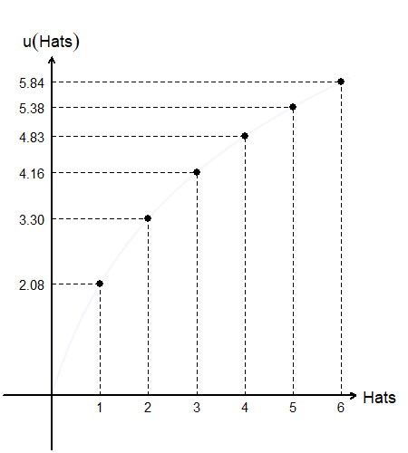
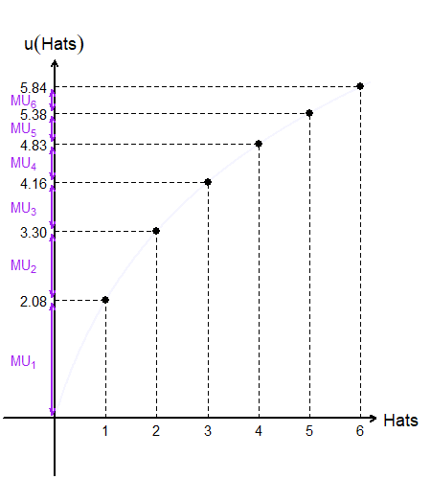
Marginal Utility in a Discrete World
Marginal utility is the extra utility generated by consuming the last unit.
The marginal utility from consuming the…
  1st hat is 2.08
  2nd hat is 1.22
  3rd hat is 0.86
  4th hat is 0.67
  5th hat is 0.55
  6th hat is 0.46

Slide 17
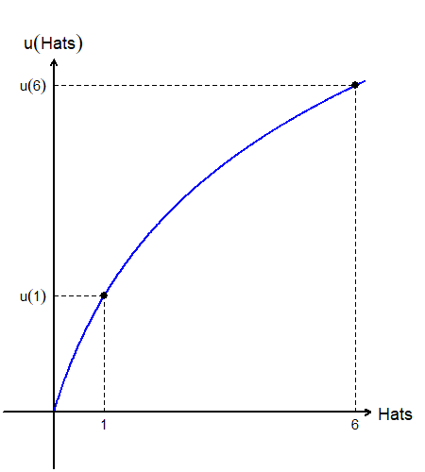
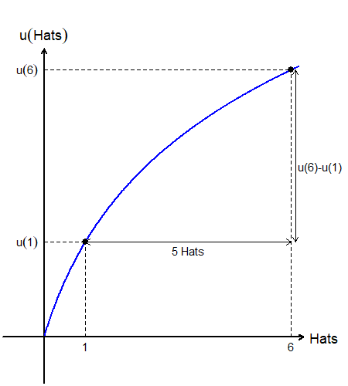
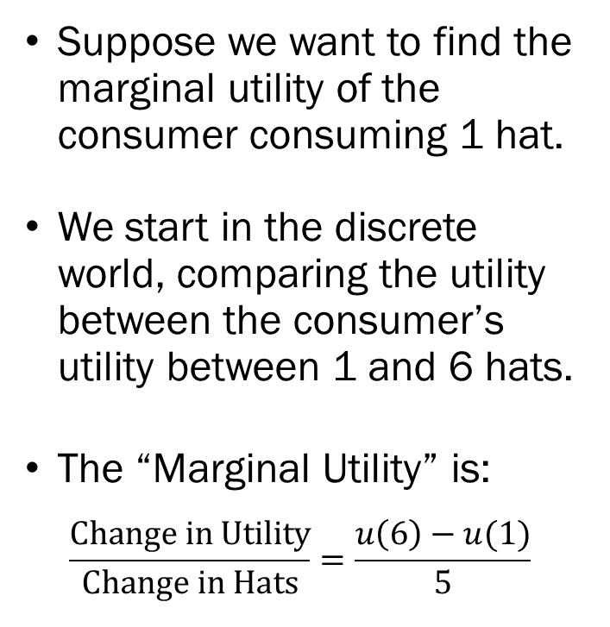
Marginal Utility in a Continuous World
Suppose we want to find the marginal utility of the consumer consuming 1 hat.
We start in the discrete world, comparing the utility between the consumer’s utility between 1 and 6 hats.
The “Marginal Utility” is:
$$\frac{Change in Utility}{Change in Hats}=\frac{u\left(6\right)−u(1)}{5}$$

Slide 18
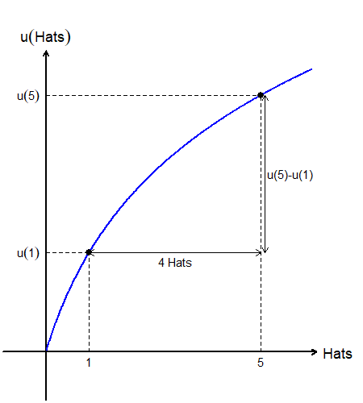
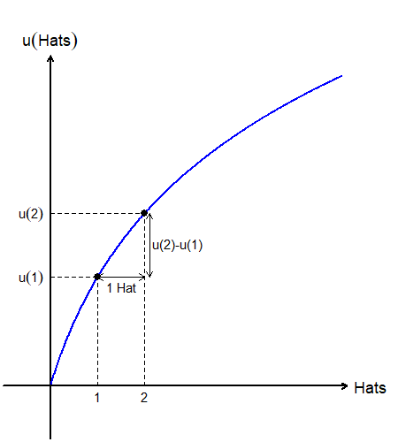
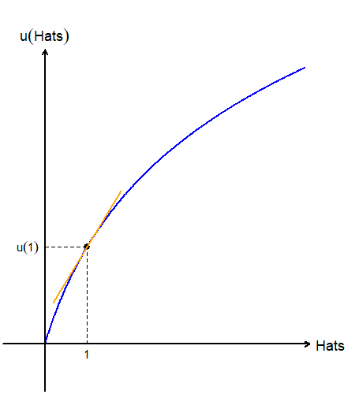
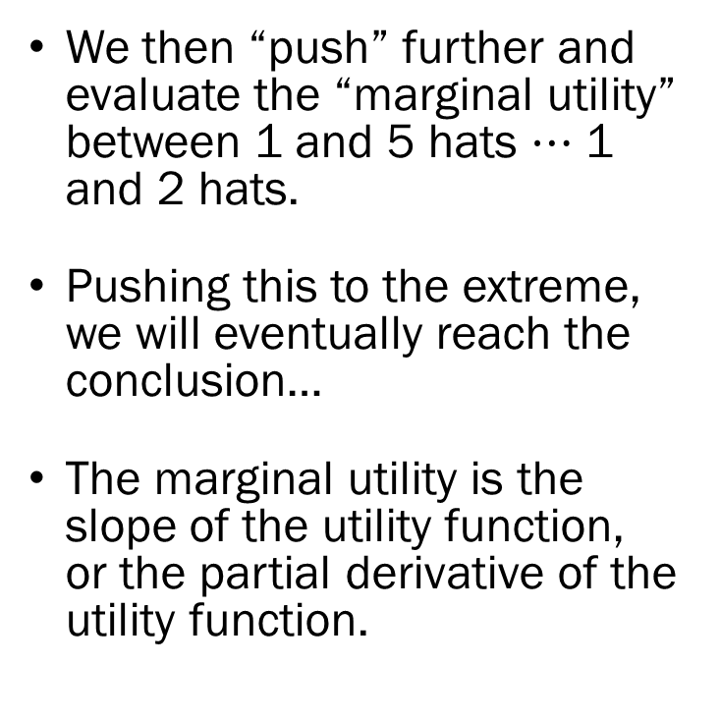
Marginal Utility in a Continuous World
We then “push” further and evaluate the “marginal utility” between 1 and 5 hats $⋯$ 1 and 2 hats.
Pushing this to the extreme, we will eventually reach the conclusion…
The marginal utility is the slope of the utility function, or the partial derivative of the utility function.

Slide 19
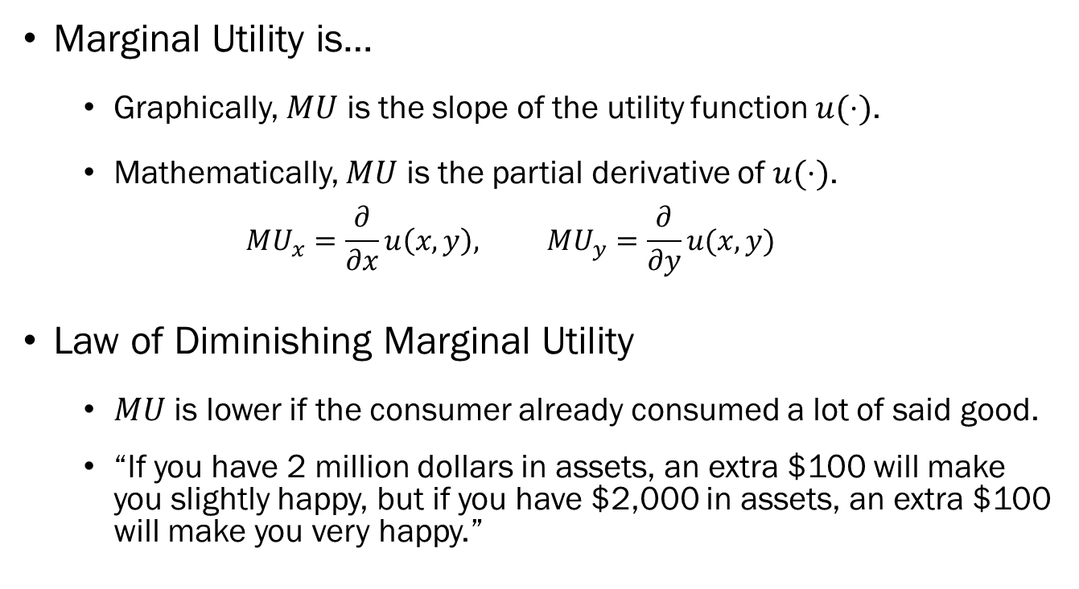

Marginal Utility $(MU)$
Marginal Utility is…
  Graphically, $MU$ is the slope of the utility function $u(⋅)$.
  Mathematically, $MU$ is the partial derivative of $u(⋅)$.
  $$MU_{x}=\frac{∂}{∂x}u\left(x,y\right), MU_{y}=\frac{∂}{∂y}u(x,y)$$
Law of Diminishing Marginal Utility
  $MU$ is lower if the consumer already consumed a lot of said good.
  “If you have 2 million dollars in assets, an extra $100 will make you slightly happy, but if you have $2,000 in assets, an extra $100 will make you very happy.”

Slide 20
Indifference Curves

Slide 21
Indifference Curve Basics
Given some utility function, we can draw the consumer’s indifference curves.
Indifference curves are the collection of all goods that the consumer prefers equally.
The shape of the indifference curves depend on the assumptions we place on preferences, and the nature of the goods involved.

Slide 22
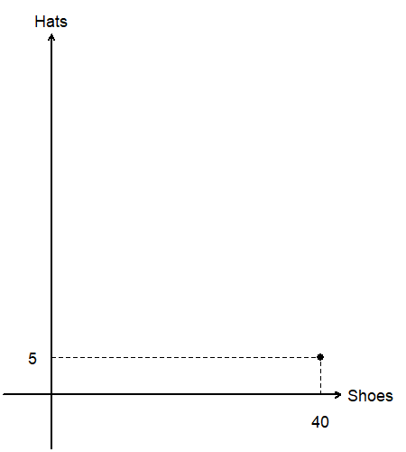
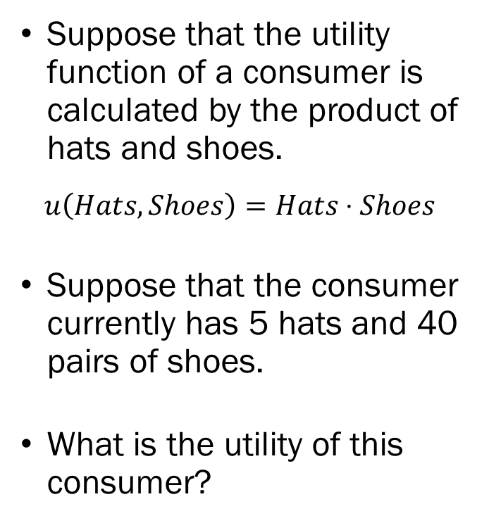
The Indifference Curve: An Example
Suppose that the utility function of a consumer is calculated by the product of hats and shoes.
$$u\left(Hats,Shoes\right)=Hats⋅Shoes$$
Suppose that the consumer currently has 5 hats and 40 pairs of shoes.
What is the utility of this consumer?

Slide 23
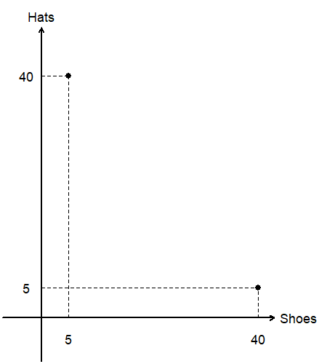
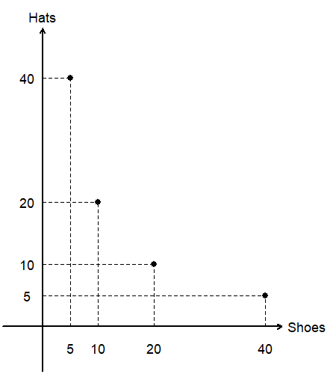
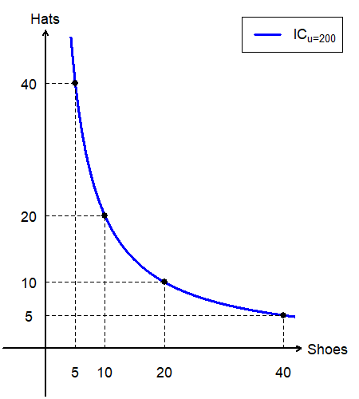
The Indifference Curve: An Example
Find another bundle that gives the consumer exactly 200 utility.
  40 hats and 5 pairs of shoes
  10 hats and 20 pairs of shoes
  20 hats and 10 pairs of shoes
“Linking” all these bundles that give the consumer exactly 200 utility gives us an indifference curve for utility level 200.

Slide 24
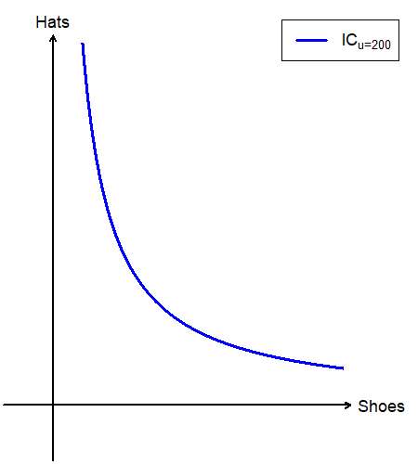
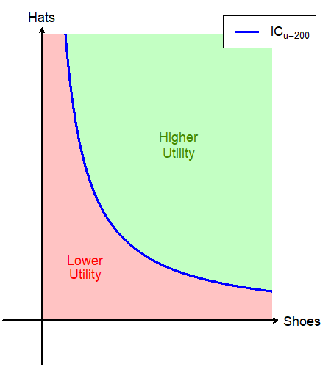
The Indifference Curve: An Example
The indifference curve splits the commodity space into two distinct parts.
Any bundle above this specific indifference curve produces more than 200 utility for the consumer.
Any bundle below this specific indifference curve produces less than 200 utility for the consumer.

Slide 25
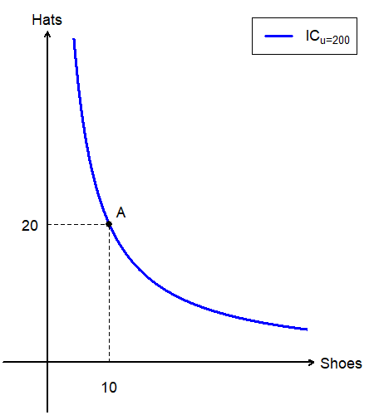
The Indifference Curve: An Example
Suppose the consumer is consuming bundle A.
If they wanted to purchase more shoes…
How many units of hats would they be willing to give up, while ending up on the same level of utility?

Slide 26
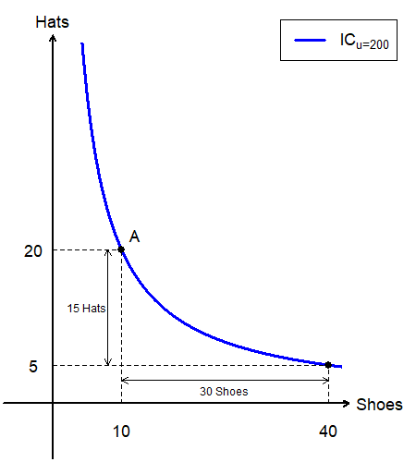
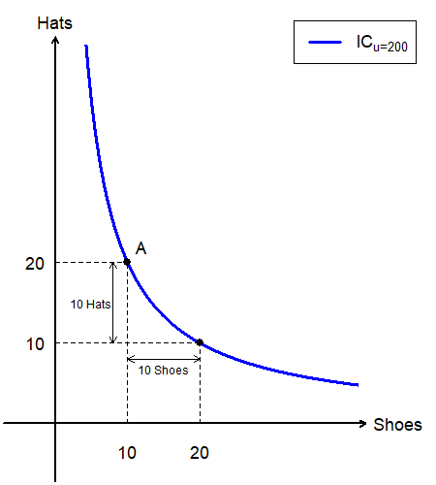
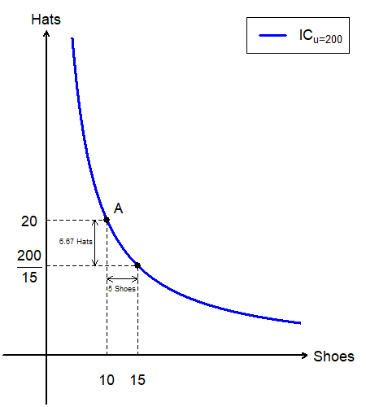
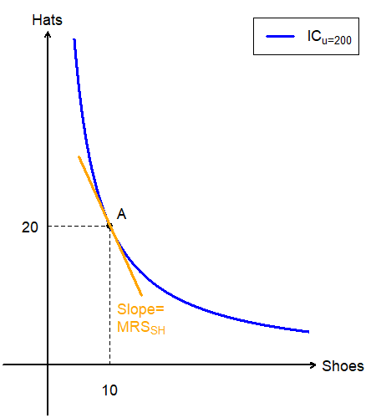
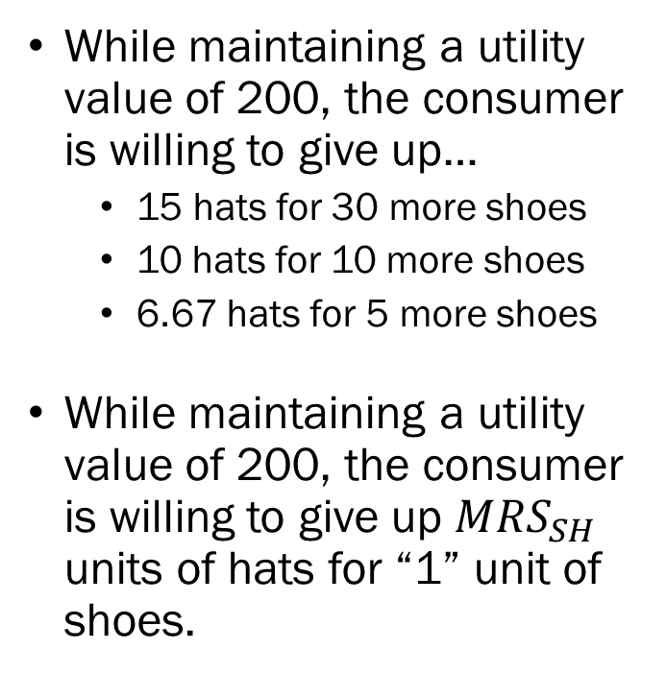
The Indifference Curve: An Example
While maintaining a utility value of 200, the consumer is willing to give up…
  15 hats for 30 more shoes
  10 hats for 10 more shoes
  6.67 hats for 5 more shoes
While maintaining a utility value of 200, the consumer is willing to give up $MRS_{SH}$ units of hats for “1” unit of shoes.

Slide 27
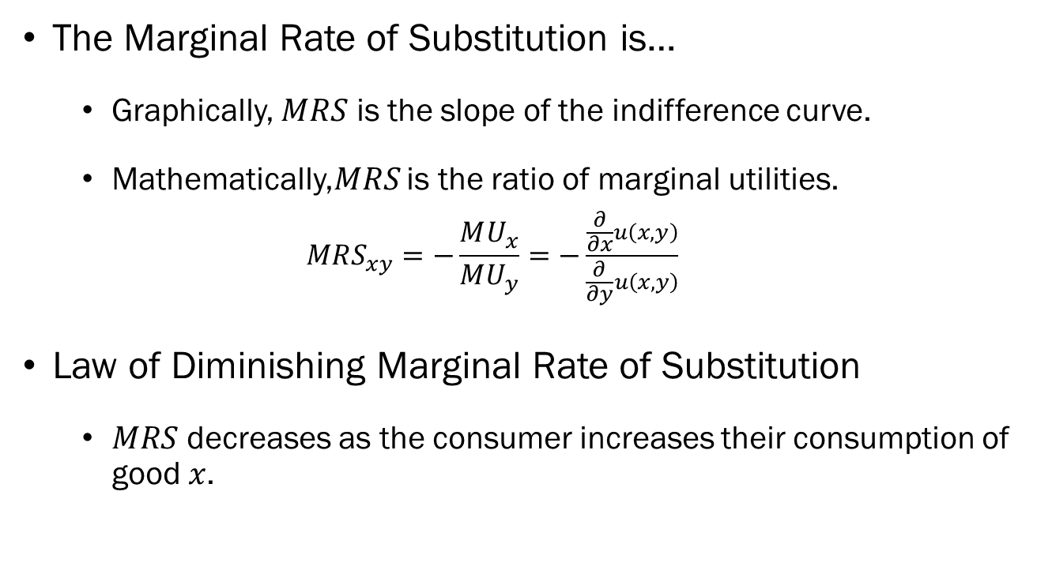

Marginal Rate of Substitution $(MRS)$
The Marginal Rate of Substitution is…
  Graphically, $MRS$ is the slope of the indifference curve.
  Mathematically,$MRS$ is the ratio of marginal utilities.
  $$MRS_{xy}=−\frac{MU_{x}}{MU_{y}}=−\frac{\frac{∂}{∂x}u\left(x,y\right)}{\frac{∂}{∂y}u\left(x,y\right)}$$
Law of Diminishing Marginal Rate of Substitution
  $MRS$ decreases as the consumer increases their consumption of good $x$.

Slide 28
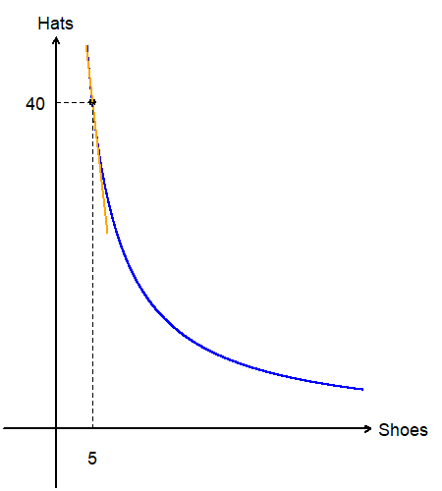
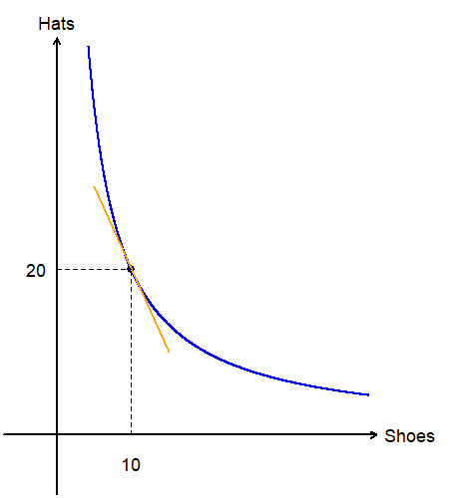
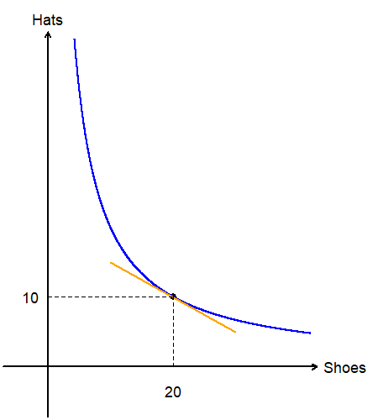
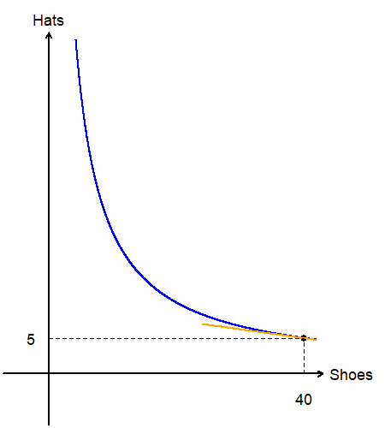
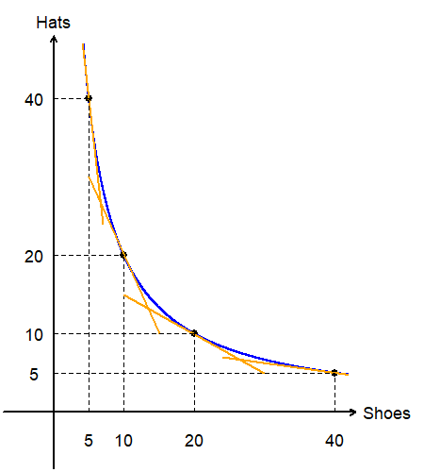
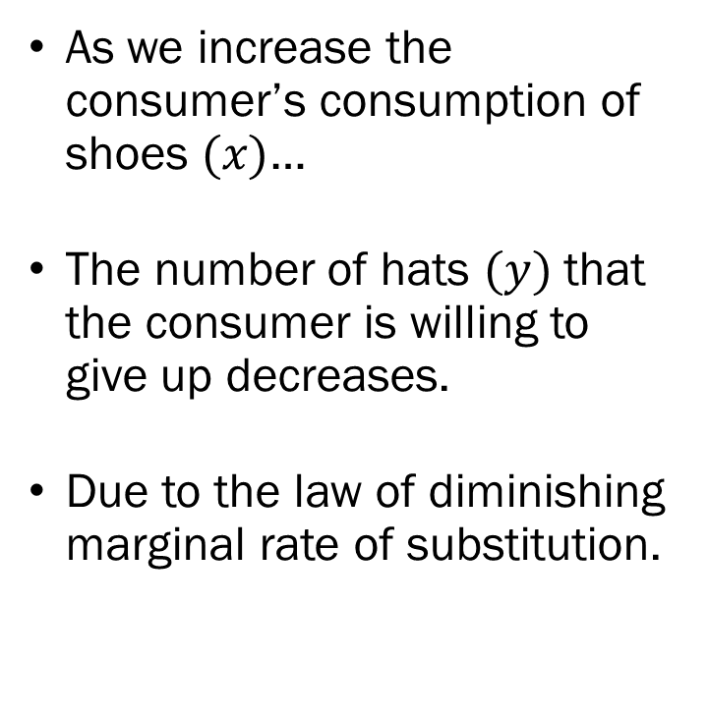
The Law of Diminishing MRS
As we increase the consumer’s consumption of shoes $(x)$…
The number of hats $(y)$ that the consumer is willing to give up decreases.
Due to the law of diminishing marginal rate of substitution.

Slide 29
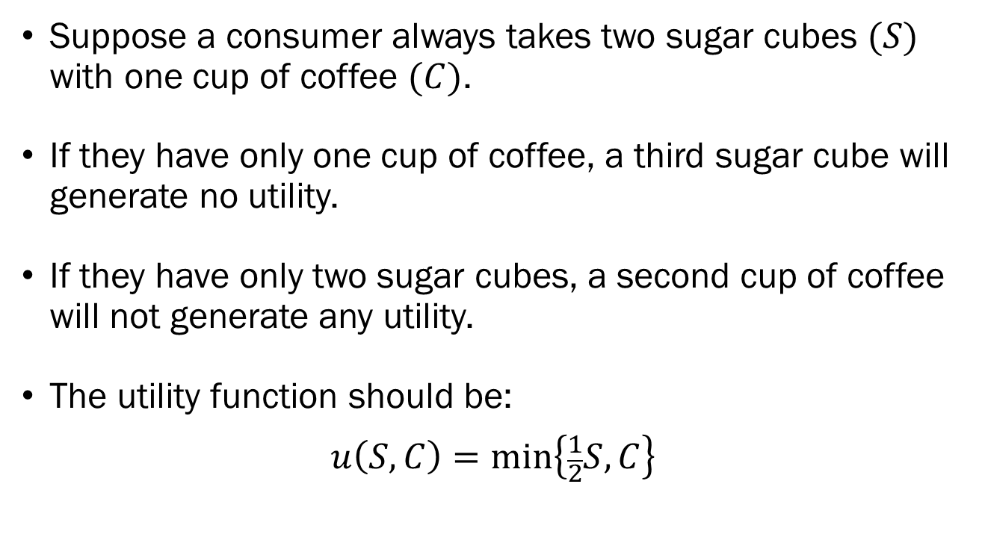
Leontief Utility Functions
Suppose a consumer always takes two sugar cubes $(S)$ with one cup of coffee $(C)$.
If they have only one cup of coffee, a third sugar cube will generate no utility.
If they have only two sugar cubes, a second cup of coffee will not generate any utility.
The utility function should be:
$$u\left(S,C\right)=min⁡\left\{\frac{1}{2}S, C\right\}$$

Slide 30
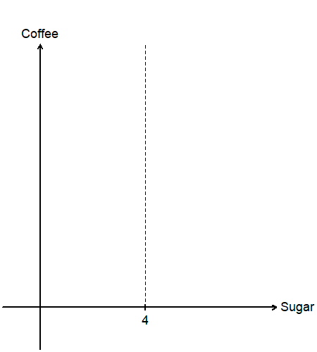
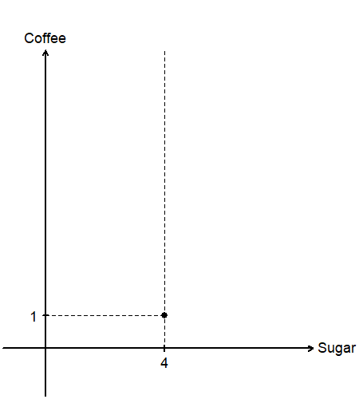
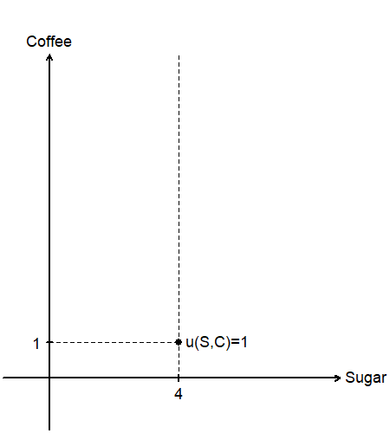
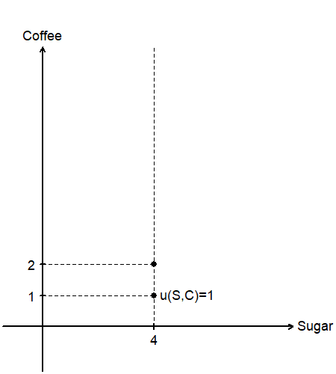
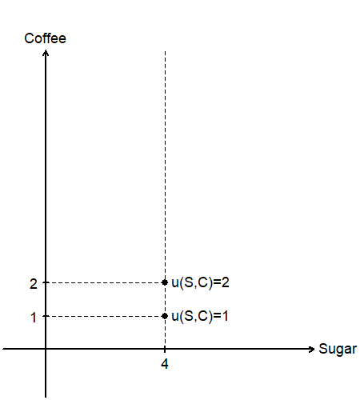




The Leontief Utility Function
Suppose this consumer has four sugar cubes.
What would the utility be when they are given…
  One cup of coffee?
  Two cups of coffee?
  Three cups of coffee?
  Even more?
“Link” all bundles that give us 2 utility.

Slide 31






The Leontief Utility Function
Now consider the same consumer has two cups of coffee, and nothing else.
What would the utility be when they are given…
  Two sugar cubes?
  Four sugar cubes?
  Six sugar cubes?
  Even more?
“Link” all bundles that give us 2 utility.

Slide 32

The Leontief Utility Function
What about the indifference curve representing utility level 1?
Similarly, find all bundles that will result in one perfect cup of coffee.
The indifference curve representing a lower level of utility lies “below” our original curve.

Slide 33
The Utility Maximization Problem

Slide 34




UMP Basics
One of the most important conditions in the UMP will be “equalizing the slopes.”
Examine why we want the slopes to be equalized.
Consider the point $A$ and where the indifference curve intersects the budget line.

Slide 35




UMP: The Marginal Rate of Substitution
Examining the slope of the indifference curve, we can measure “how many units of good $y$ is the consumer willing to part with if they get one more of good $x$?”
We can see that the consumer is willing to part with $MRS$ units of good $y$ for one good $x$.

Slide 36


UMP: Relative Prices
The slope of the budget line tells us “how many units of good $y$ that the consumer has to give up to purchase one more unit of good $x$.”
The consumer has to part with $−P_{x}/P_{y}$ units of good $y$ to get one more unit of good $x$.

Slide 37

UMP: When $MRS_{xy}>P_{x}/P_{y}$
Marginal Rate of Substitution
Relative Prices

Slide 38


UMP: When $MRS_{xy}>P_{x}/P_{y}$
When $MRS_{xy}>P_{x}/P_{y}$…
We ask the consumer “we will give you one unit of good $x$, how many units of good $y$ are you willing to part with?”
If the consumer is willing to give up $MRS_{xy}$ units, but the market requires $P_{x}/P_{y}$ units…
Then the consumer should take that deal, move to a bundle with more $x$, and less $y$ to achieve a higher level of utility.

Slide 39

Utility Maximization Problem (UMP) with Standard Utility Functions
When the utility function is given as $u\left(x,y\right)=cx^{a}y^{b}$
Find the marginal utility of good $x$ and good $y$:
  $MU_{x}=\frac{∂}{∂x}u(x,y)$ and $MU_{y}=\frac{∂}{∂y}u(x,y)$
Find the optimal $x,y$ ratio:
  $\frac{MU_{x}}{P_{x}}=\frac{MU_{y}}{P_{y}}$ or $\frac{MU_{x}}{{MU}_{y}}=\frac{P_{x}}{P_{y}}$
Plug the optimal mix into the budget line to find the optimal bundle:
  $P_{x}x+P_{y}y=M$

Slide 40

Utility Maximization Problem (UMP) with Linear Utility Functions
When the utility function is given as $u\left(x,y\right)=ax+by$
Find the marginal utility of good $x$ and good $y$:
  $MU_{x}=\frac{∂}{∂x}u\left(x,y\right)=a$ and $MU_{y}=\frac{∂}{∂y}u\left(x,y\right)=b$
Compare the per-dollar marginal utilities:
  $\frac{MU_{x}}{P_{x}}>\frac{MU_{y}}{P_{y}}$: Spend entire budget on good $x$.
  $\frac{MU_{x}}{P_{x}}<\frac{MU_{y}}{P_{y}}$: Spend entire budget on good $y$.
  $\frac{MU_{x}}{P_{x}}=\frac{MU_{y}}{P_{y}}$: Spend entire budget on any mix of $x$ and $y$.

Slide 41

Utility Maximization Problem (UMP) with Leontief Utility Functions
When the utility function is given as $u\left(x,y\right)=min⁡\{ax,by\}$
Find the optimal mix of $x$ and $y$:
  $ax=by ⇒ y=\frac{a}{b}x$
Plug the optimal mix into the budget line to find the optimal bundle:
  $P_{x}x+P_{y}y=M$

