Slide 1
Producer Theory:
Profit Maximization
ECON 300

Slide 2
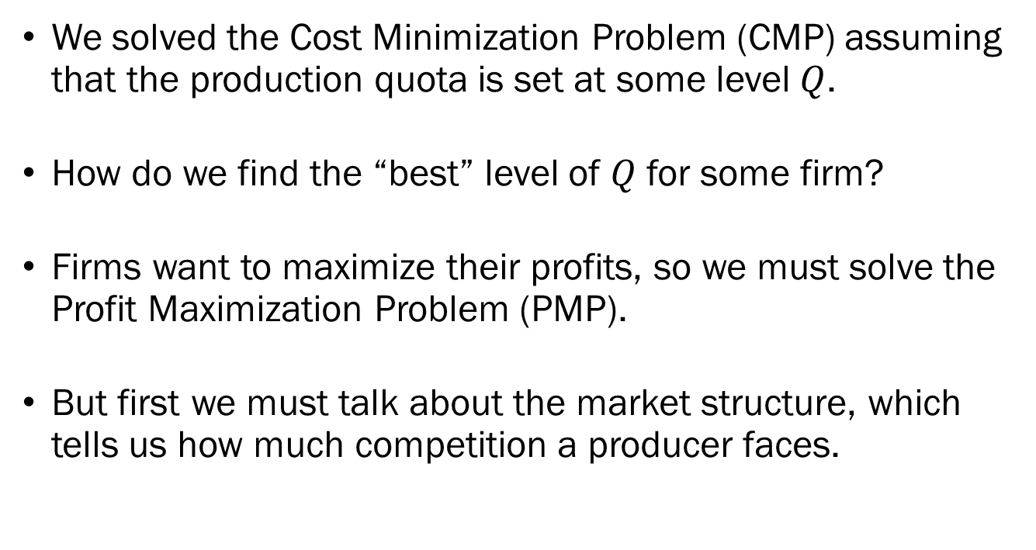
From Cost Minimization to Profit Maximization
We solved the Cost Minimization Problem (CMP) assuming that the production quota is set at some level $Q$.
How do we find the “best” level of $Q$ for some firm?
Firms want to maximize their profits, so we must solve the Profit Maximization Problem (PMP).
But first we must talk about the market structure, which tells us how much competition a producer faces.

Slide 3
Market Structure
Competition in the output market ranges from…
  Perfect Competition
  Monopolistic Competition
  Oligopoly
  Monopoly
In this section, we will be primarily interested in perfect competition.
We will return to the other types of competition later in the semester.

Slide 4
Perfect Competition
Five assumptions characterize the market under perfect competition:
  Infinite number of producers and consumers, and
  Homogeneous products, and
  Perfect information, and
  Free entry and exit, and
  Zero transaction costs.
The implications of perfect competition:
  No producer has market power, and
  Firms work under zero profit in the long run.

Slide 5
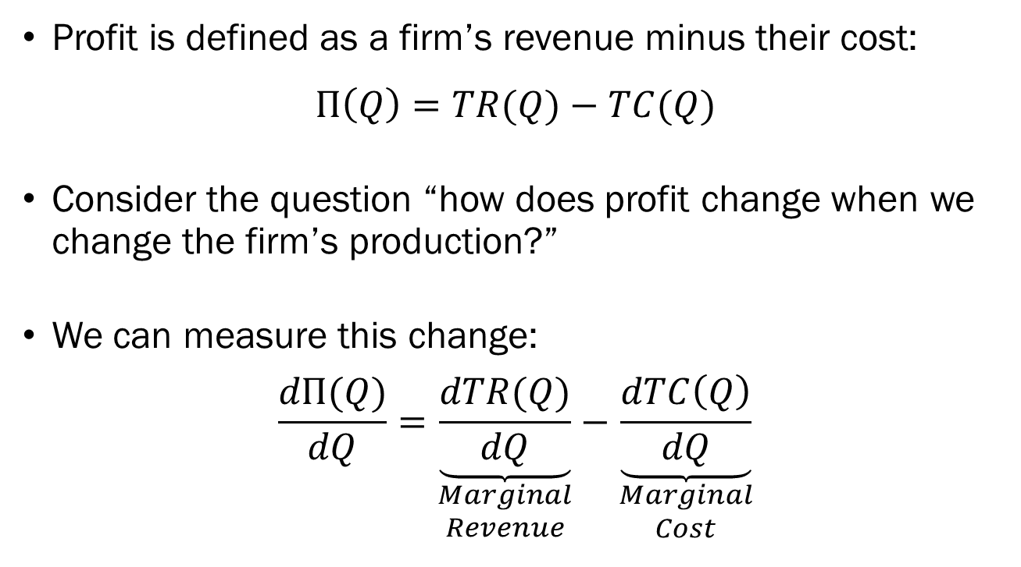
Profit Maximization under
Perfect Competition
Profit is defined as a firm’s revenue minus their cost:
$$Π\left(Q\right)=TR(Q)−TC(Q)$$
Consider the question “how does profit change when we change the firm’s production?”
We can measure this change:
$$\frac{dΠ(Q)}{dQ}=\underset{\begin{aligned}Marginal \\ Revenue\end{aligned}}{\underbrace{\frac{dTR(Q)}{dQ}}}−\underset{\begin{aligned}Marginal \\ Cost\end{aligned}}{\underbrace{\frac{dTC\left(Q\right)}{dQ}}}$$

Slide 6
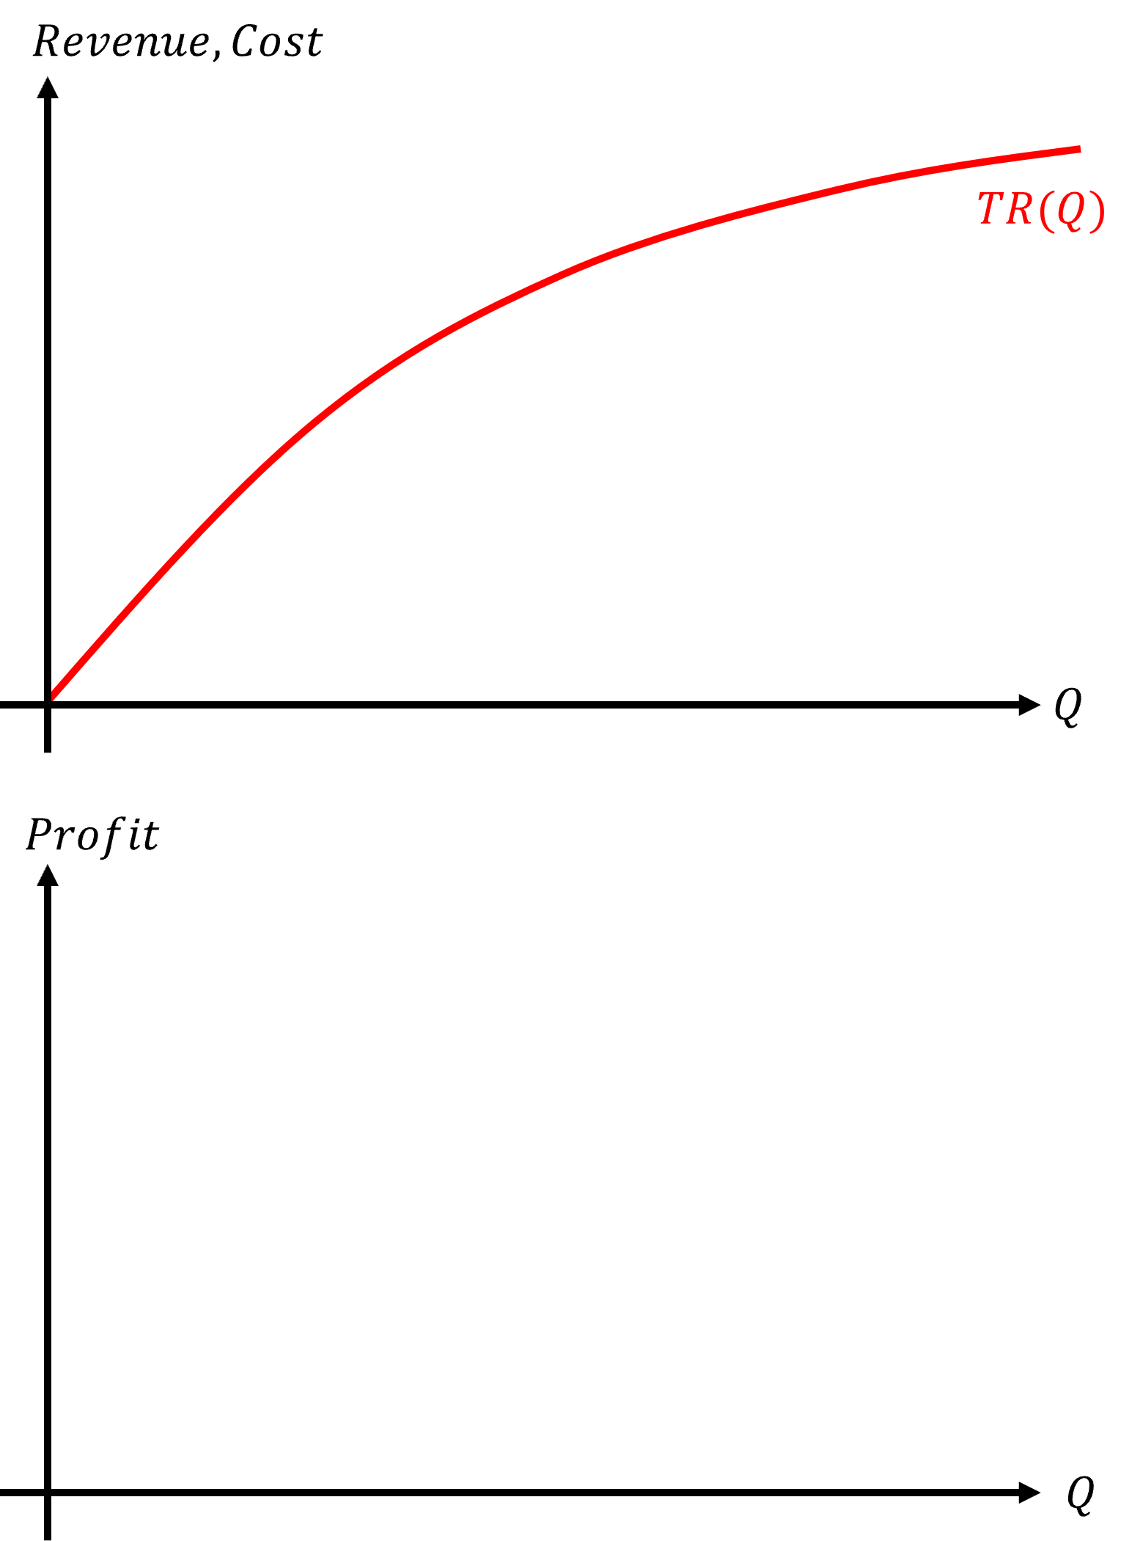
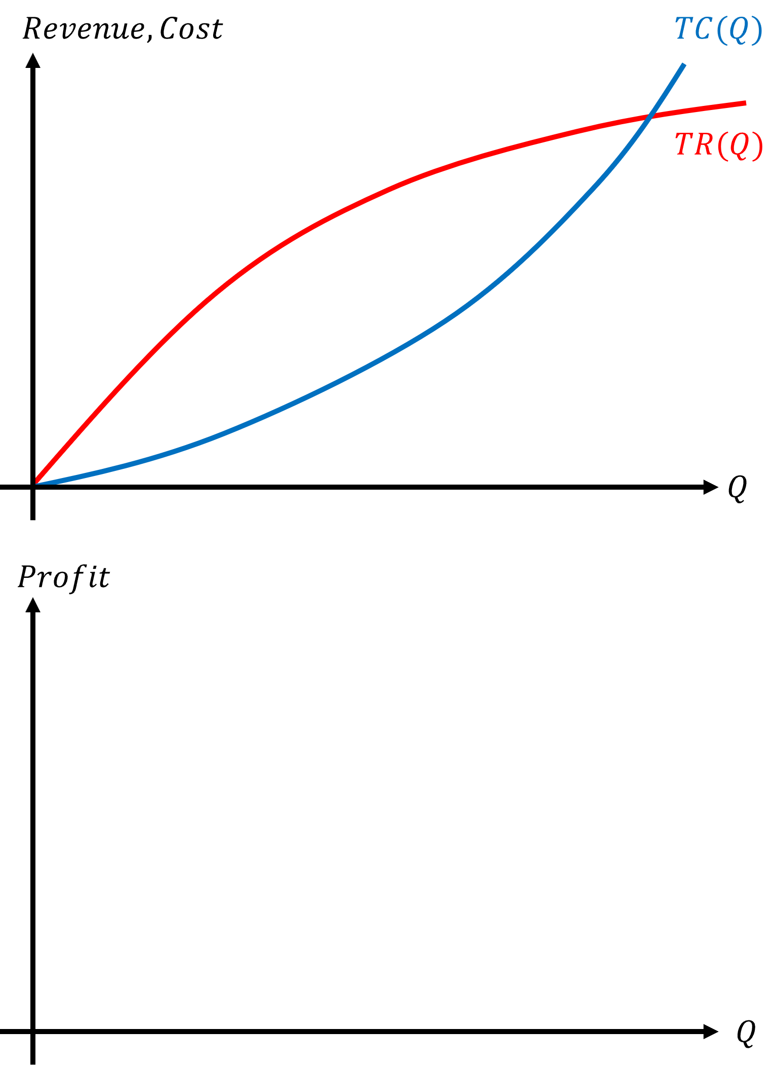
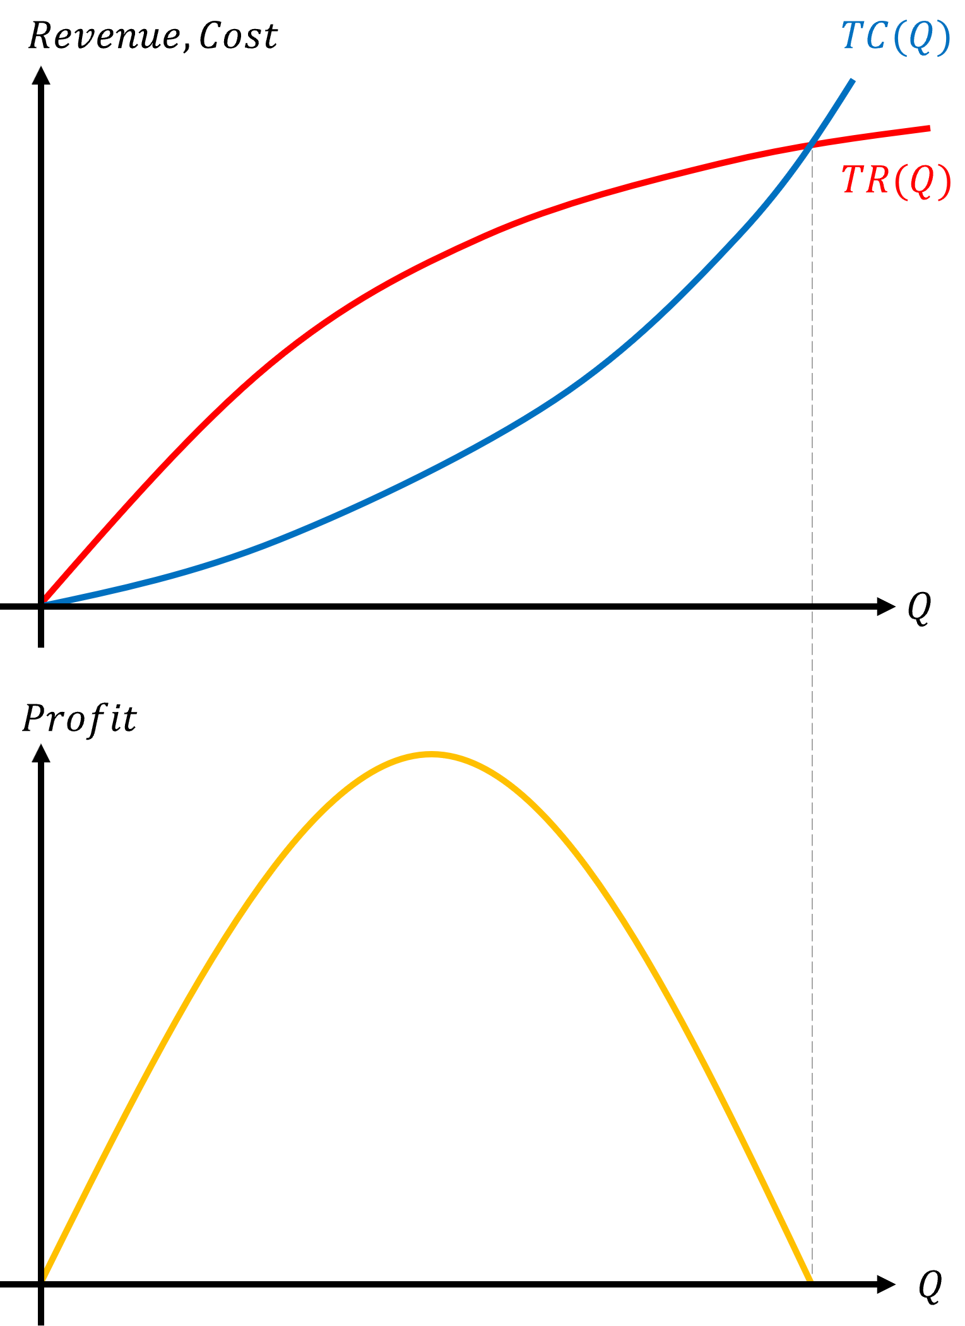
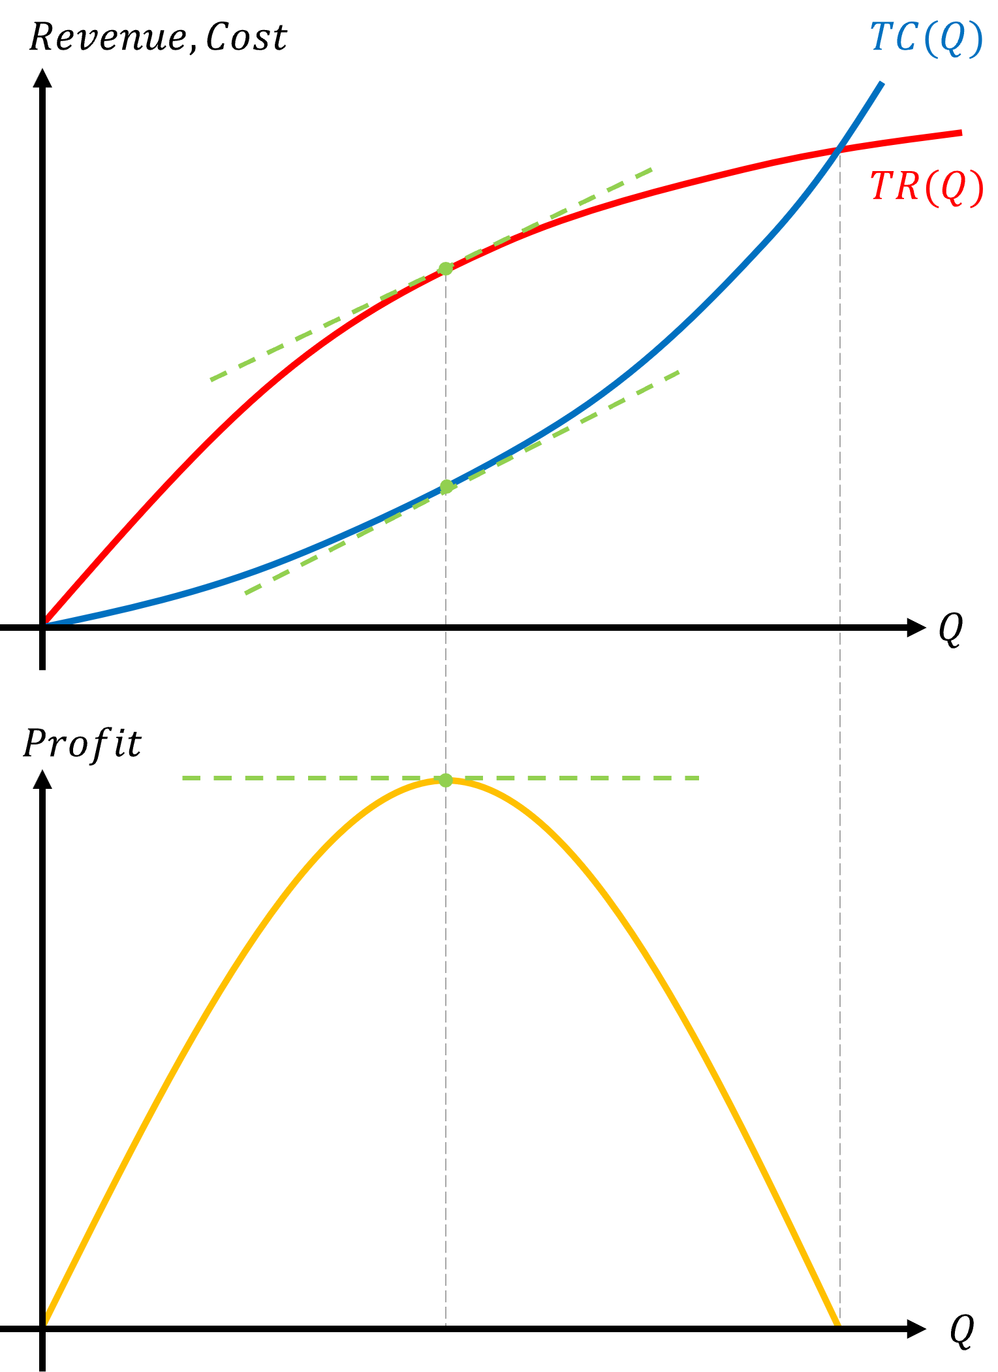
Profit Maximization under
Perfect Competition
Plot the total revenue function on the top.
Plot the total cost function on the top.
The difference of the two is the profit function.
Profit is maximized when the change in profit is zero.

Slide 7
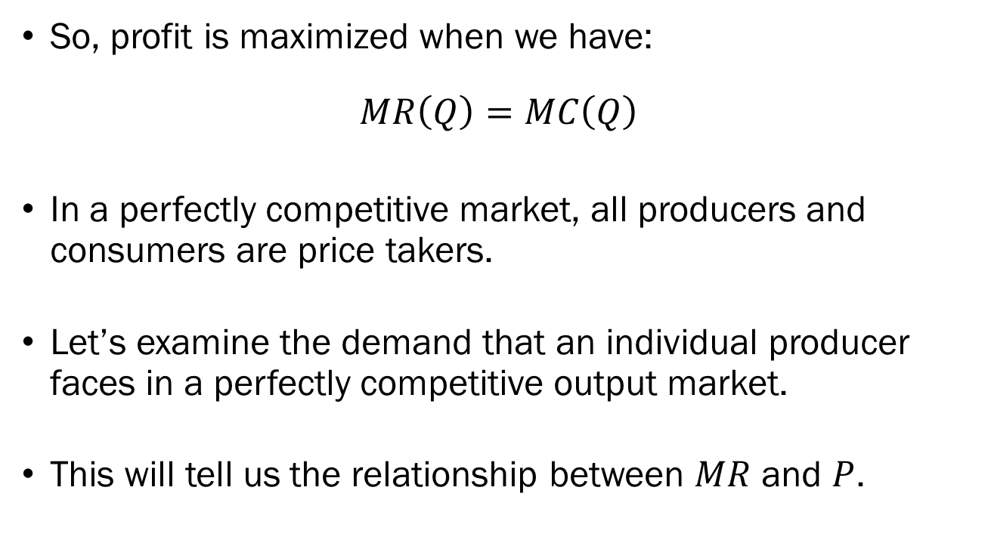
Profit Maximization under
Perfect Competition
So, profit is maximized when we have:
$$MR\left(Q\right)=MC\left(Q\right)$$
In a perfectly competitive market, all producers and consumers are price takers.
Let’s examine the demand that an individual producer faces in a perfectly competitive output market.
This will tell us the relationship between $MR$ and $P$.

Slide 8
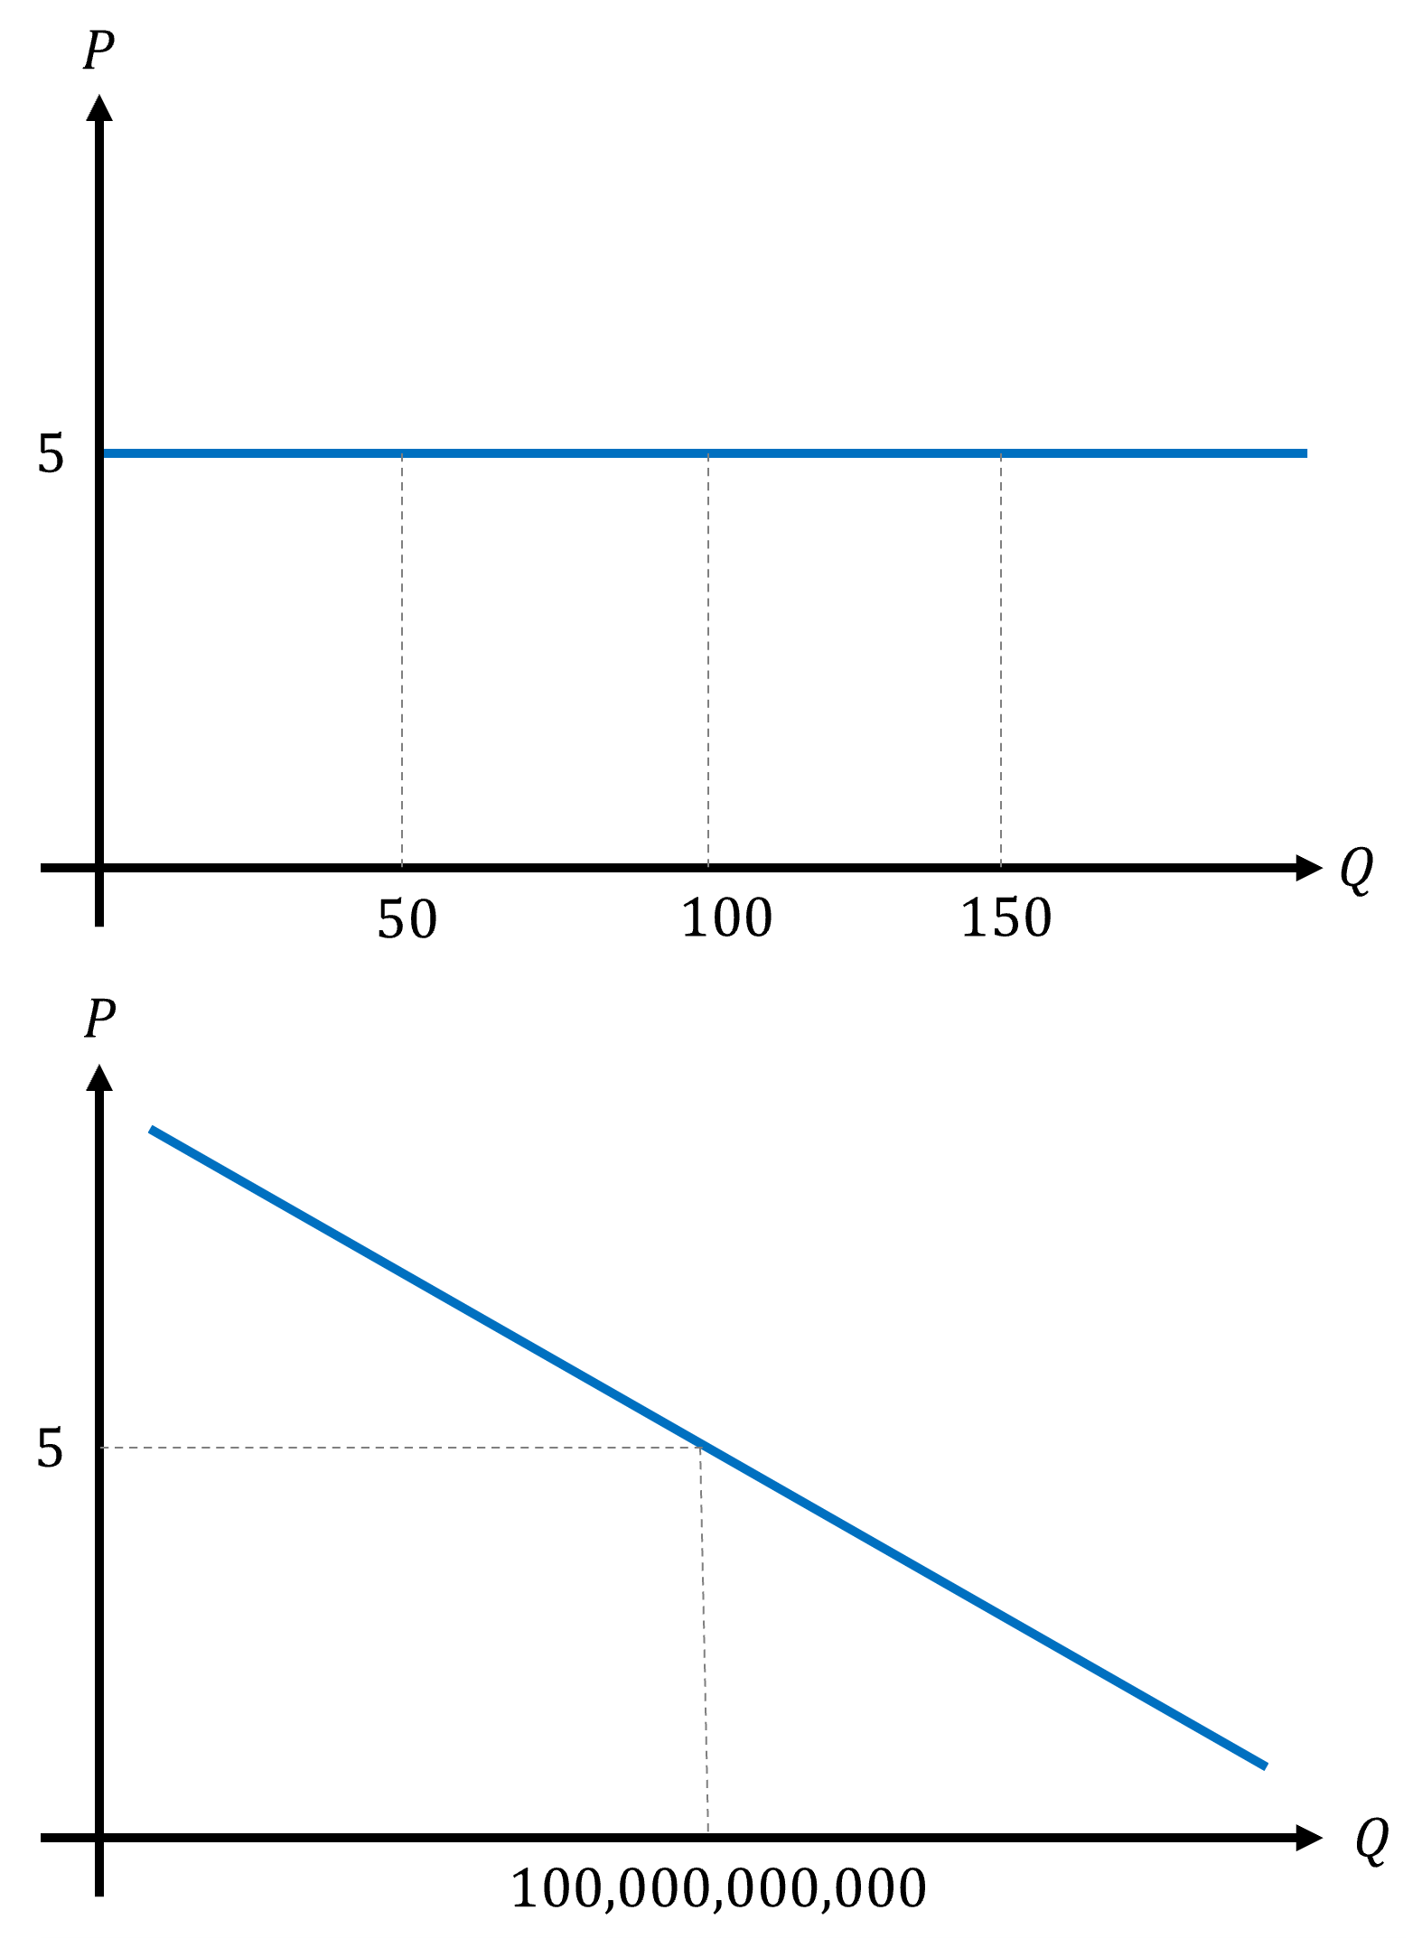
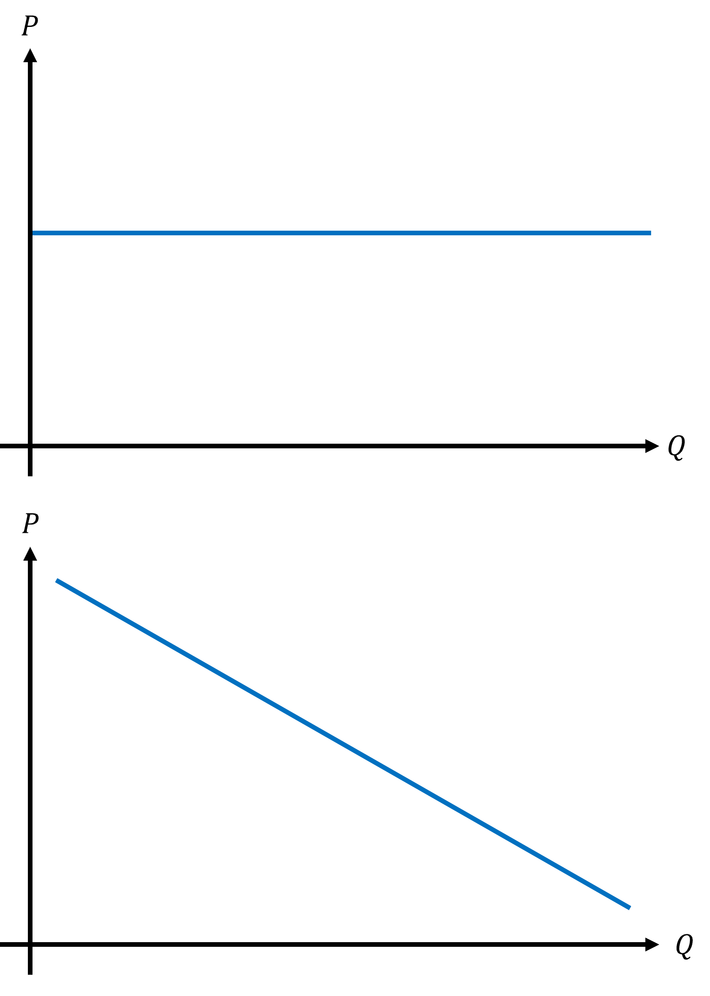
Profit Maximization under
Perfect Competition
The demand function an individual firm faces is horizontal.
The demand function for the entire market is downward sloping.
In a perfectly competitive output market, the producer’s marginal revenue is the market price.

Slide 9
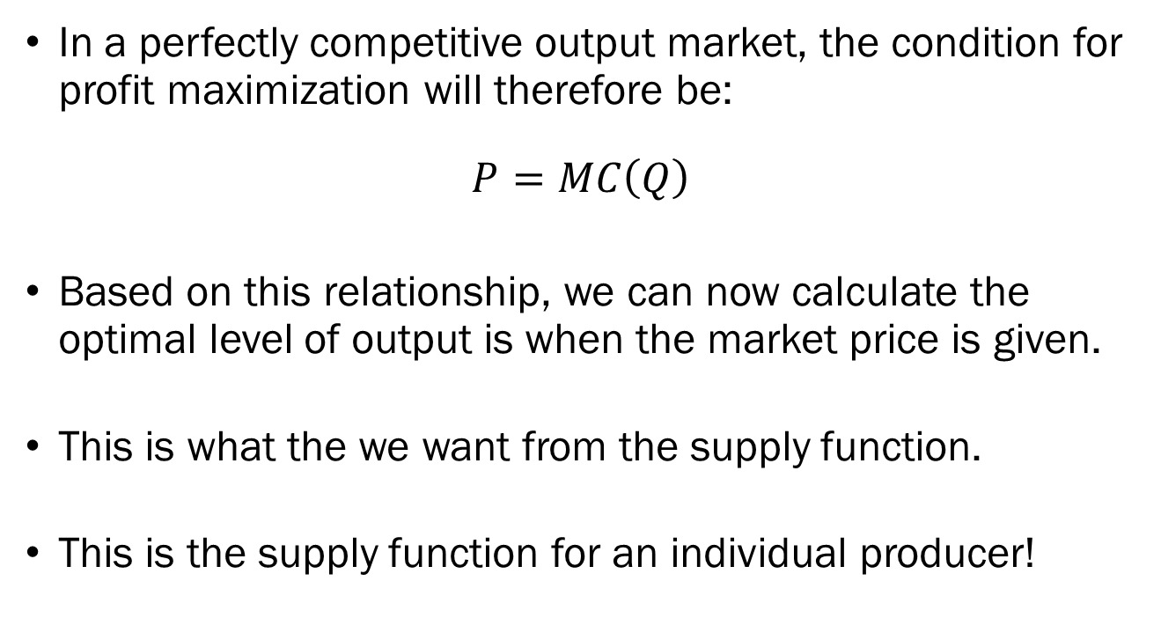
Profit Maximization under
Perfect Competition
In a perfectly competitive output market, the condition for profit maximization will therefore be:
$$P=MC\left(Q\right)$$
Based on this relationship, we can now calculate the optimal level of output is when the market price is given.
This is what the we want from the supply function.
This is the supply function for an individual producer!

Slide 10
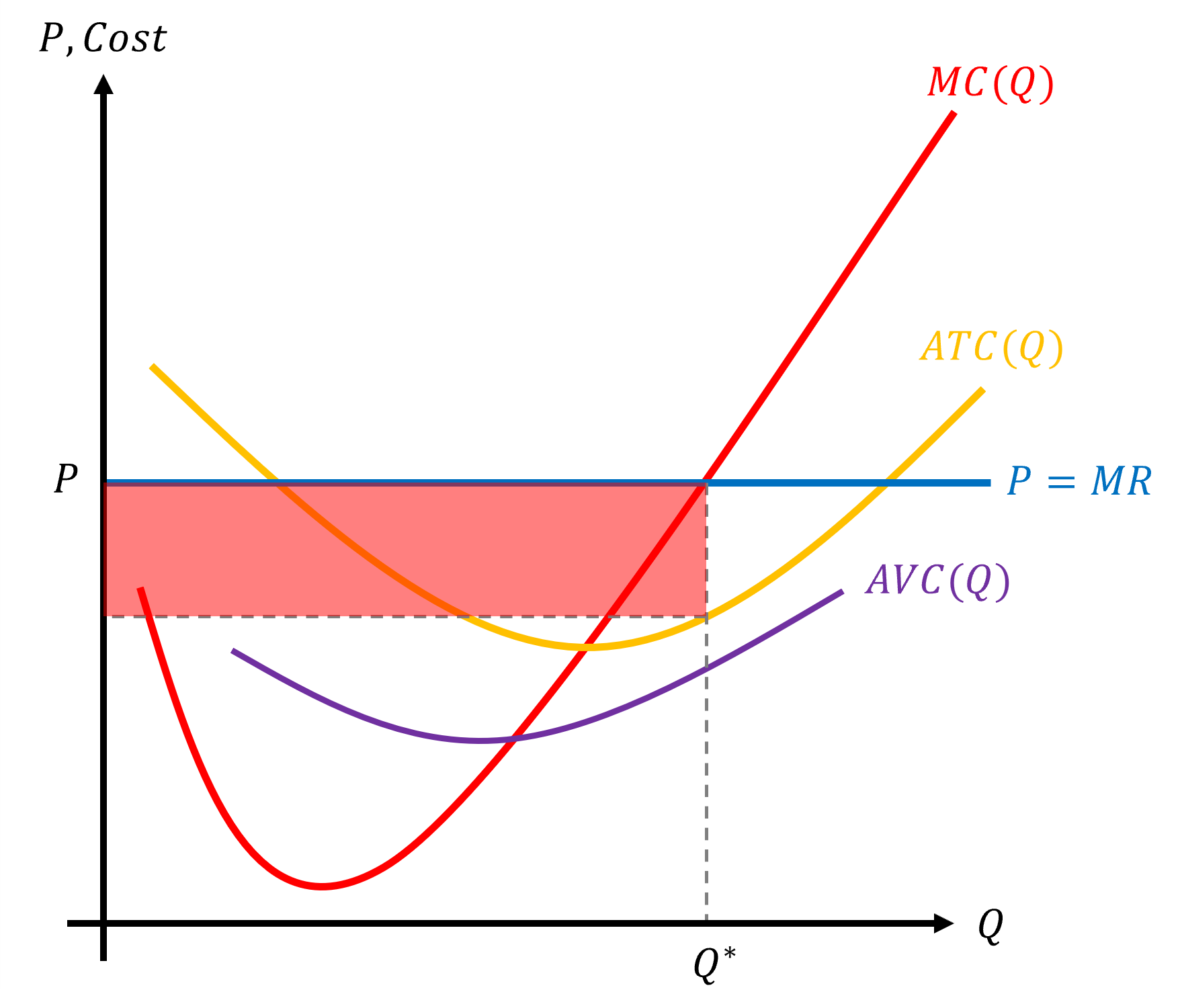
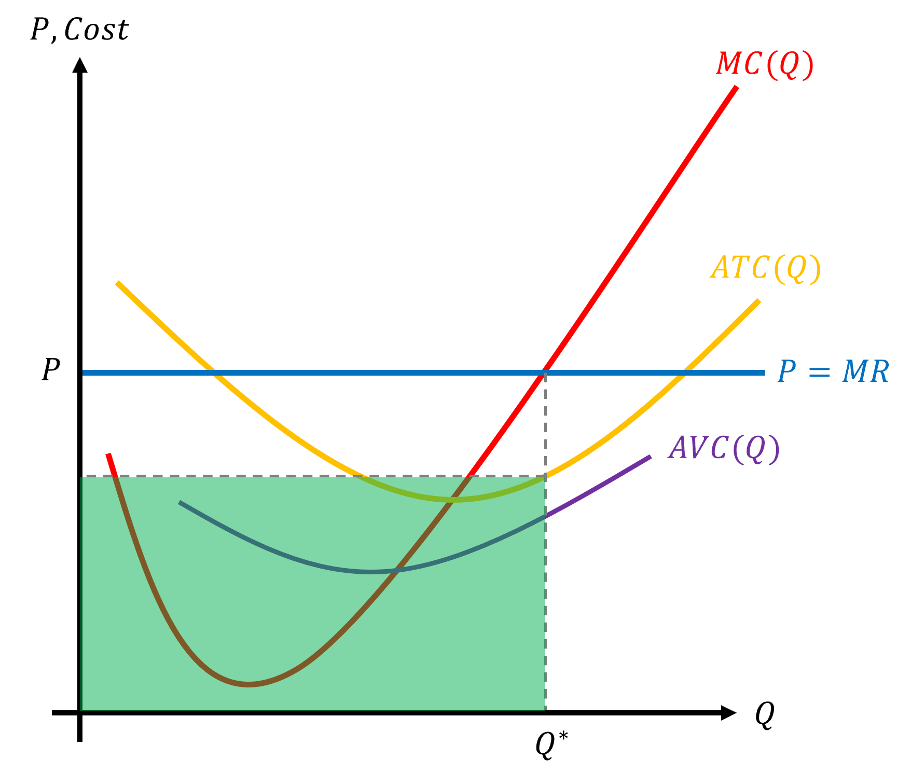
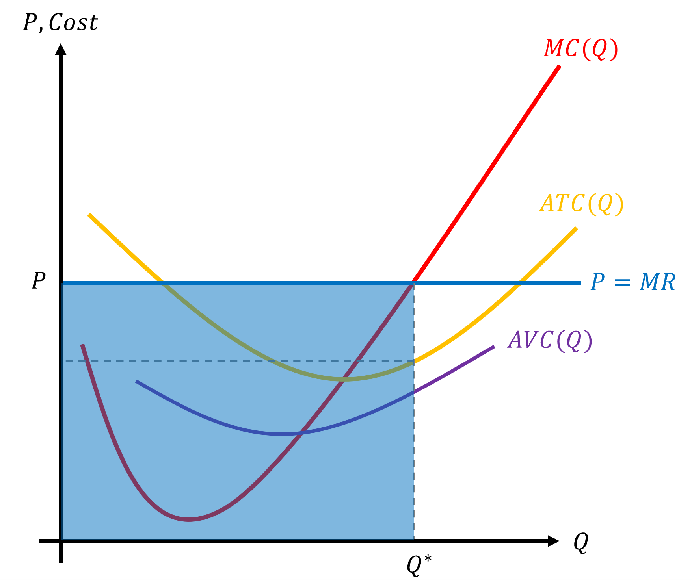
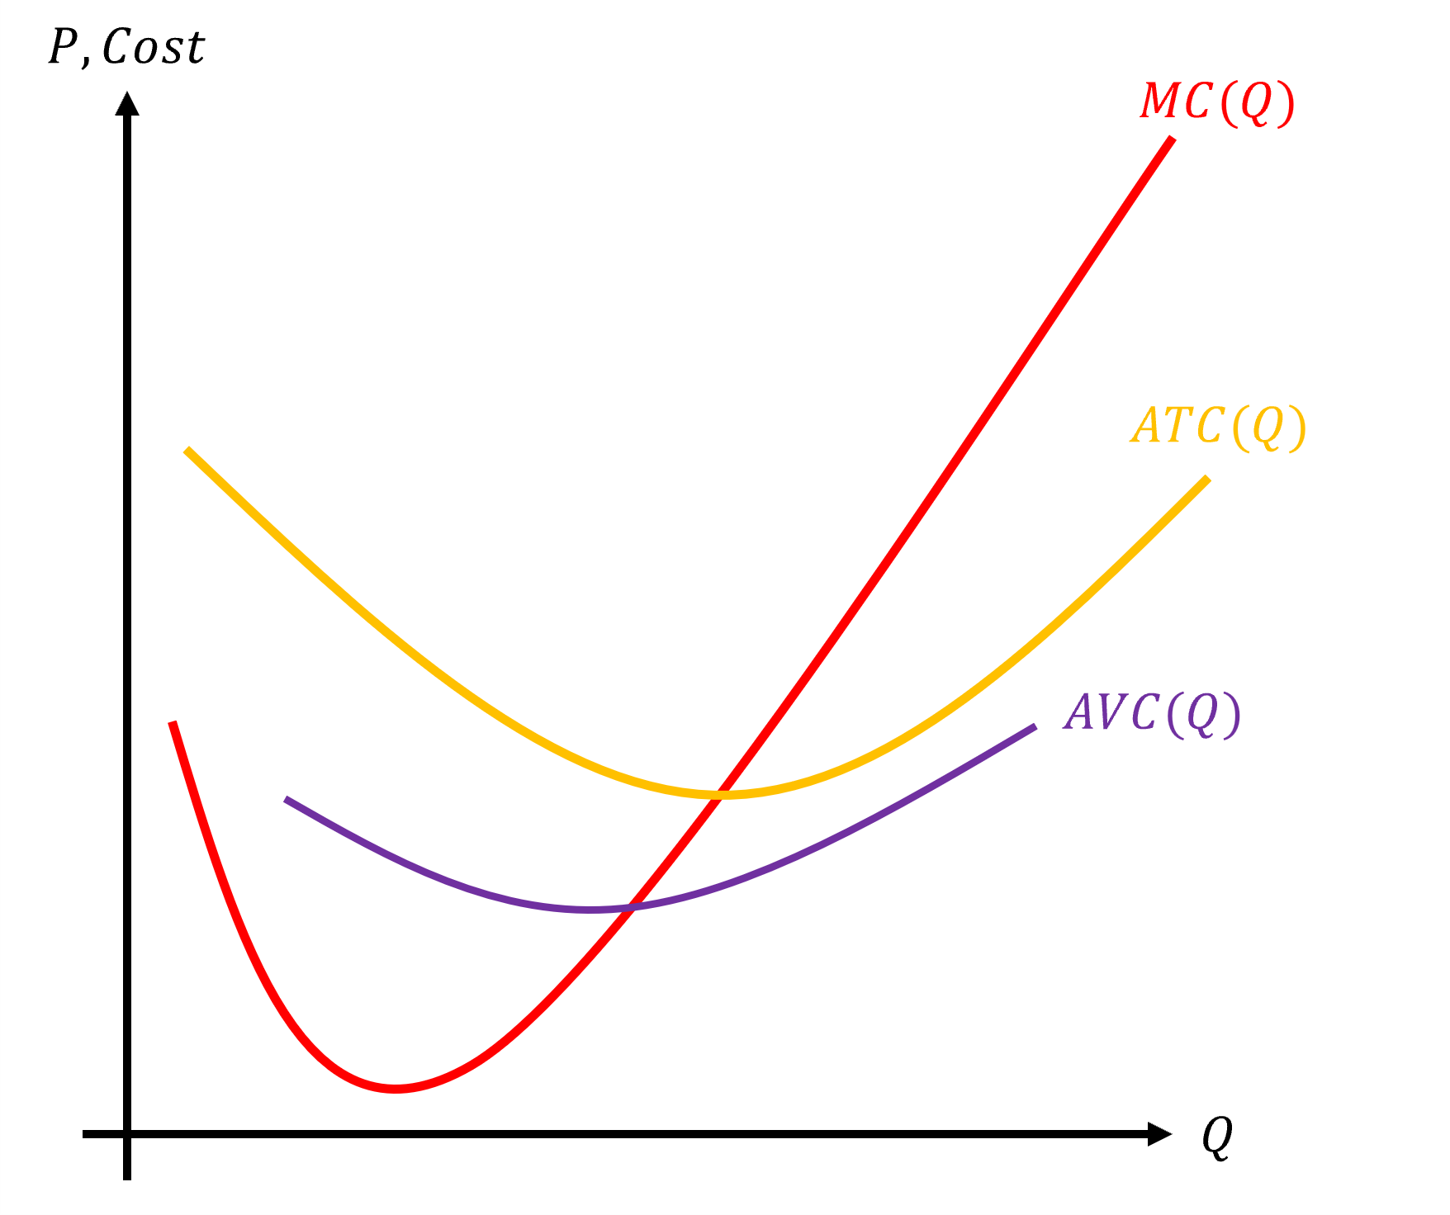
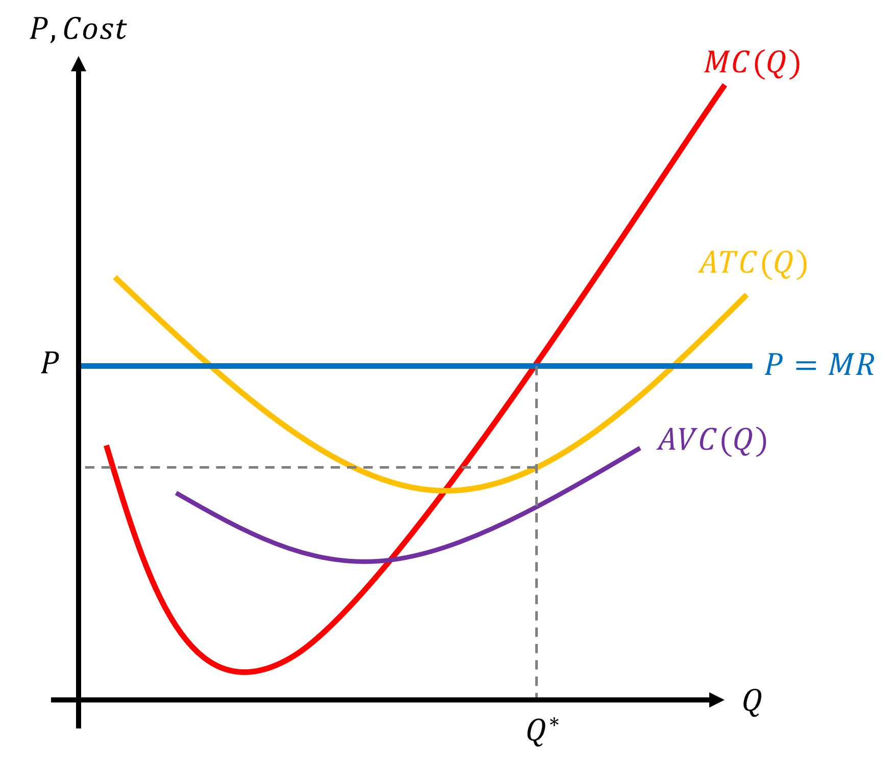
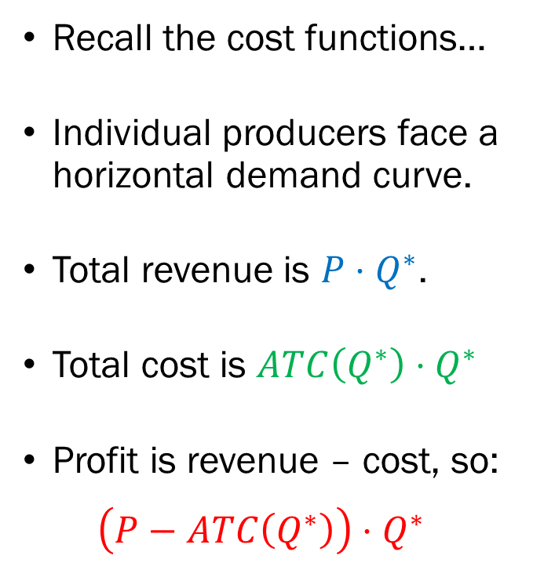
Profit Maximization under
Perfect Competition
Recall the cost functions…
Individual producers face a horizontal demand curve.
Total revenue is $P⋅Q^{∗}$.
Total cost is $ATC\left(Q^{∗}\right)⋅Q^{∗}$
Profit is revenue – cost, so:
$$\left(P−ATC\left(Q^{∗}\right)\right)⋅Q^{∗}$$

Slide 11
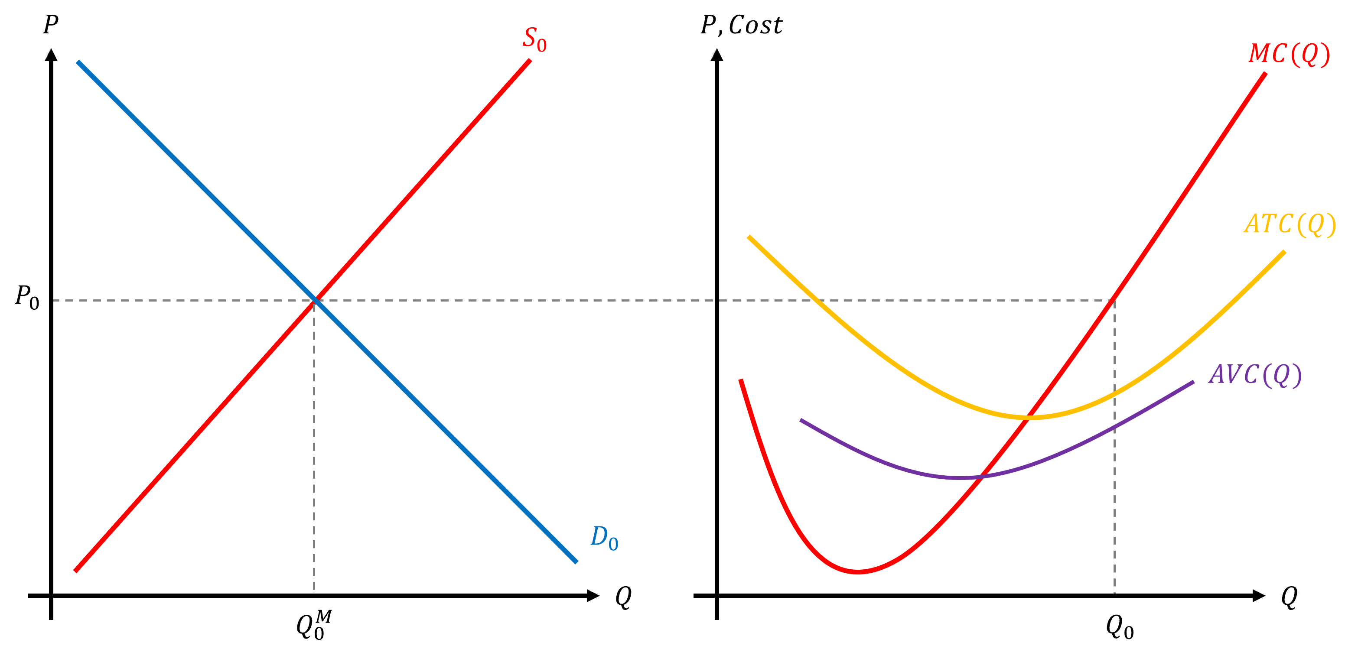
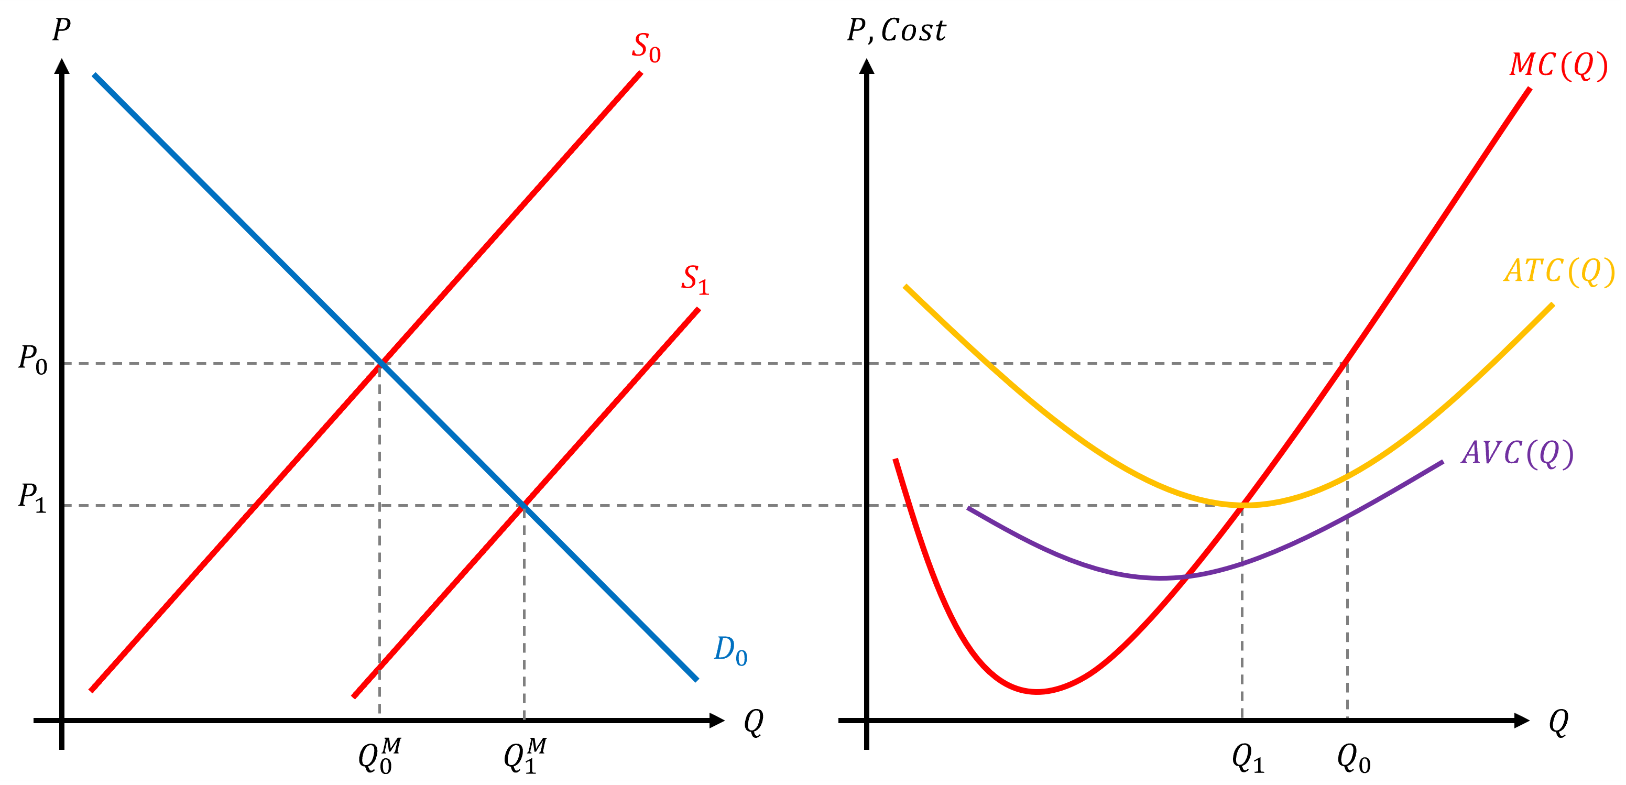
Profit Maximization under
Perfect Competition
Since there is no barrier to entry and exit, the positive profit will entice producers to join the market, driving profits to zero in the long run.

Slide 12
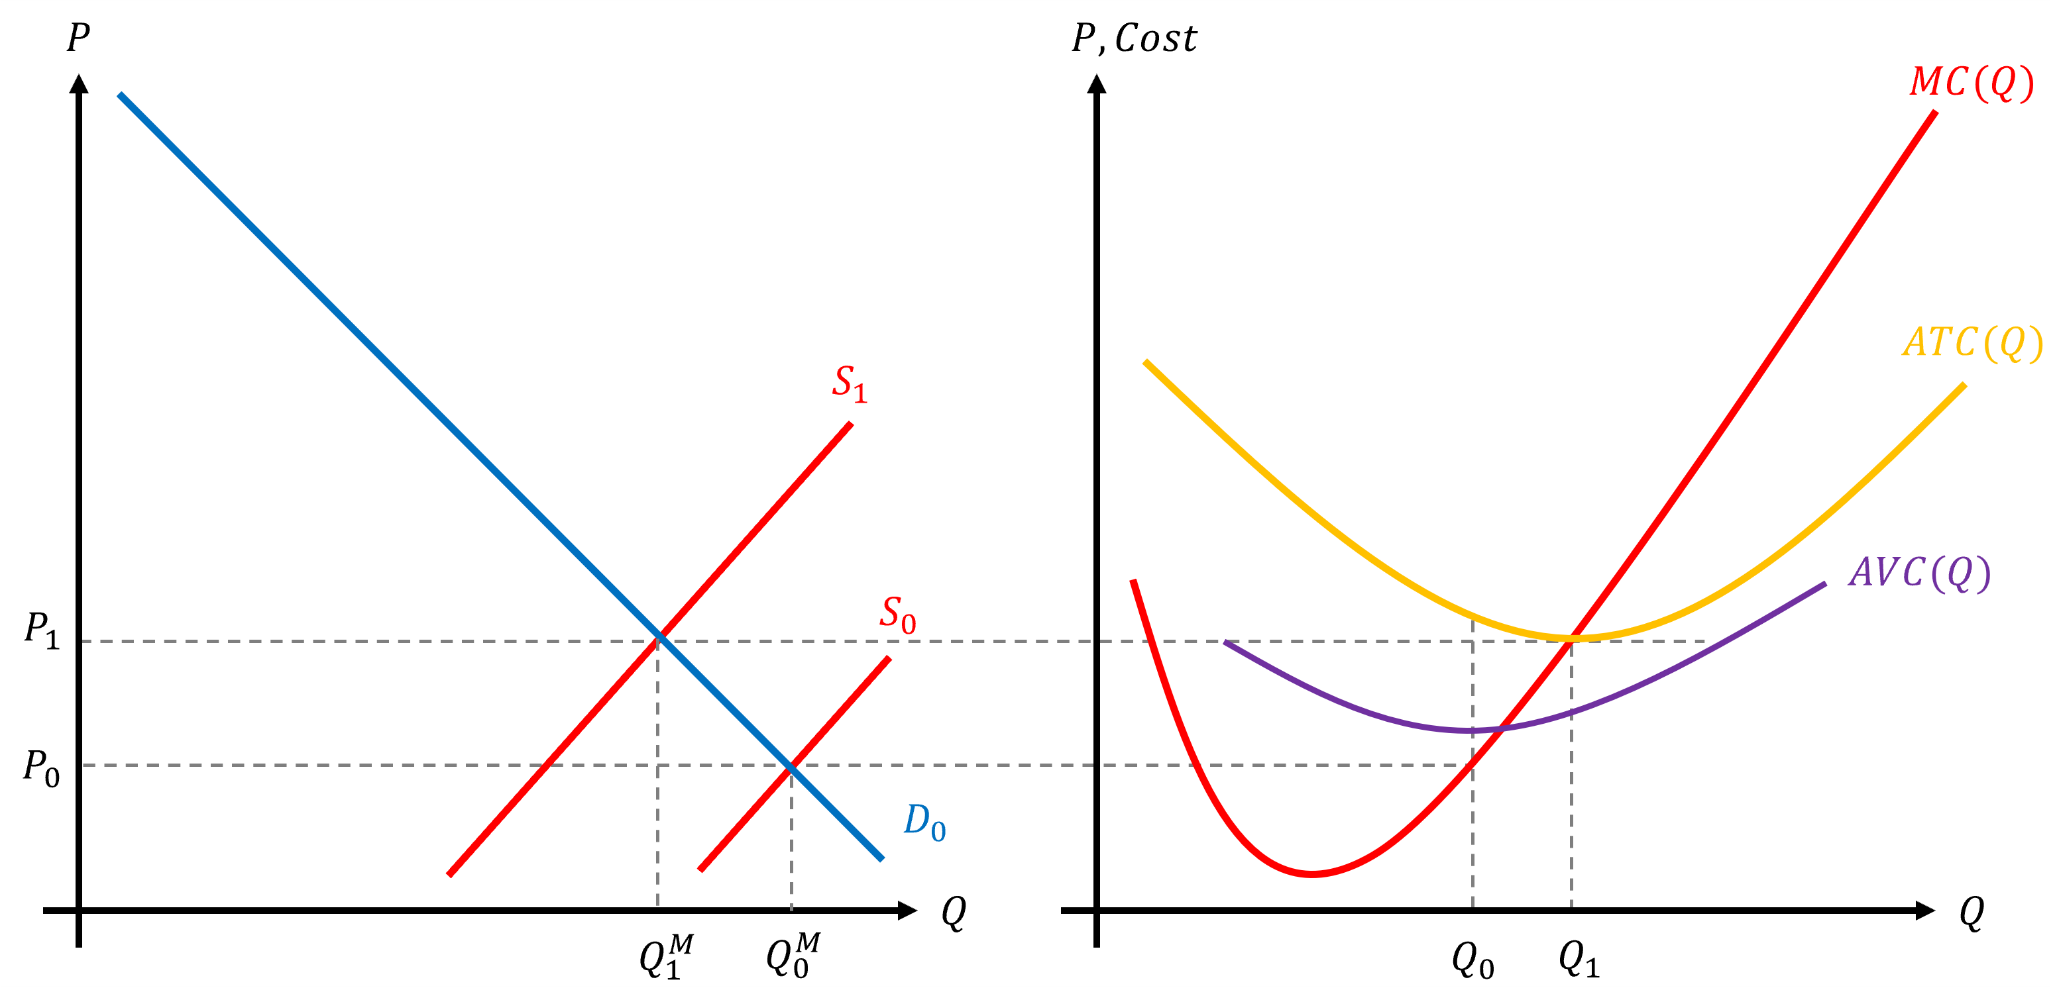

Profit Maximization under
Perfect Competition
If firms in the market are losing money, $(P<AVC)$, then firms will exit the market, market supply shifts to the left, and the market price increases until profits reach 0.

Slide 13
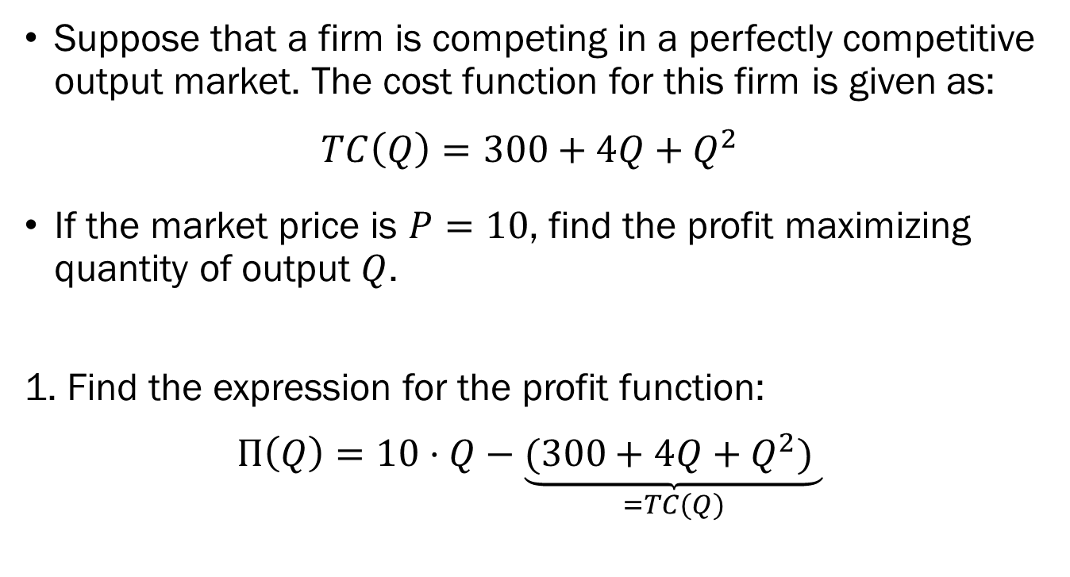
Example of Profit Maximization under Perfect Competition
Suppose that a firm is competing in a perfectly competitive output market. The cost function for this firm is given as:
$$TC\left(Q\right)=300+4Q+Q^{2}$$
If the market price is $P=10$, find the profit maximizing quantity of output $Q$.
1. Find the expression for the profit function:
$$Π\left(Q\right)=10⋅Q−\underset{=TC(Q)}{\underbrace{(300+4Q+Q^{2}) }}$$

Slide 14
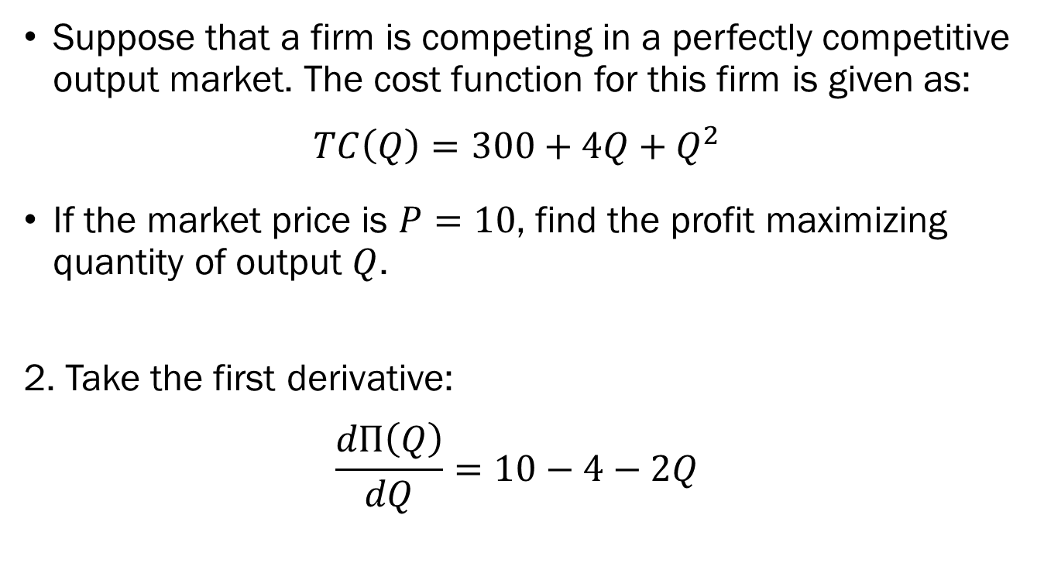
Example of Profit Maximization under Perfect Competition
Suppose that a firm is competing in a perfectly competitive output market. The cost function for this firm is given as:
$$TC\left(Q\right)=300+4Q+Q^{2}$$
If the market price is $P=10$, find the profit maximizing quantity of output $Q$.
2. Take the first derivative:
$$\frac{dΠ\left(Q\right)}{dQ}=10−4−2Q$$

Slide 15
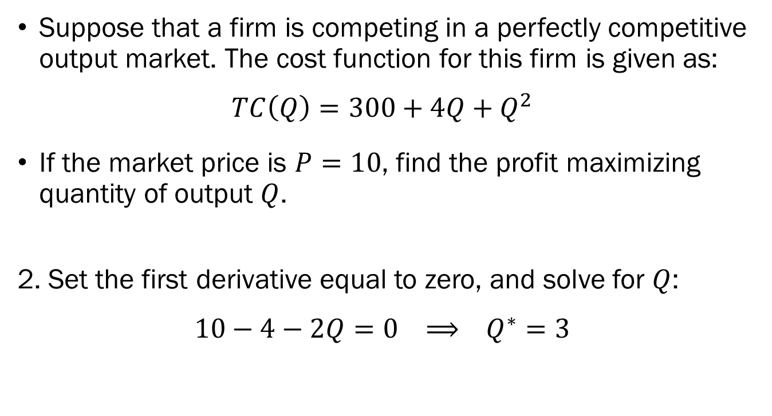
Example of Profit Maximization under Perfect Competition
Suppose that a firm is competing in a perfectly competitive output market. The cost function for this firm is given as:
$$TC\left(Q\right)=300+4Q+Q^{2}$$
If the market price is $P=10$, find the profit maximizing quantity of output $Q$.
2. Set the first derivative equal to zero, and solve for $Q$:
$$10−4−2Q=0 ⟹ Q^{∗}=3$$

