Slide 1
INTERMEDIATE MICROECONOMIC THEORY
Chapter 34: Welfare

Slide 2
Preview: Welfare
So far, we have characterized efficient allocations in various settings.
However, efficiency alone does not determine which allocation is better for society:
An allocation can be efficient, yet not socially optimal.
Recall that the “corners” of Edgeworth boxes are Pareto optimal.
How do we compare different Pareto optimal allocations?
We will introduce:
Social welfare functions
Equity vs. efficiency trade-offs
The role of policy and redistribution

Slide 3
Aggregation of Preferences

Slide 4
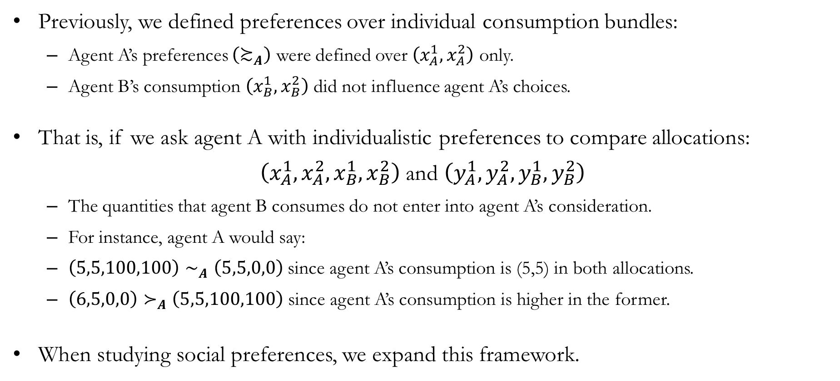
Expanding Individuals’ Preferences
Previously, we defined preferences over individual consumption bundles:
Agent A’s preferences $\left(≿_{A}\right)$ were defined over $\left(x_{A}^{1},x_{A}^{2}\right)$ only.
Agent B’s consumption $\left(x_{B}^{1},x_{B}^{2}\right)$ did not influence agent A’s choices.
That is, if we ask agent A with individualistic preferences to compare allocations:
$\left(x_{A}^{1},x_{A}^{2},x_{B}^{1},x_{B}^{2}\right)$ and $\left(y_{A}^{1},y_{A}^{2},y_{B}^{1},y_{B}^{2}\right)$
The quantities that agent B consumes do not enter into agent A’s consideration.
For instance, agent A would say:
$\left(5,5,100,100\right)∼_{A}\left(5,5,0,0\right)$ since agent A’s consumption is (5,5) in both allocations.
$\left(6,5,0,0\right)≻_{A}\left(5,5,100,100\right)$ since agent A’s consumption is higher in the former.
When studying social preferences, we expand this framework.

Slide 5
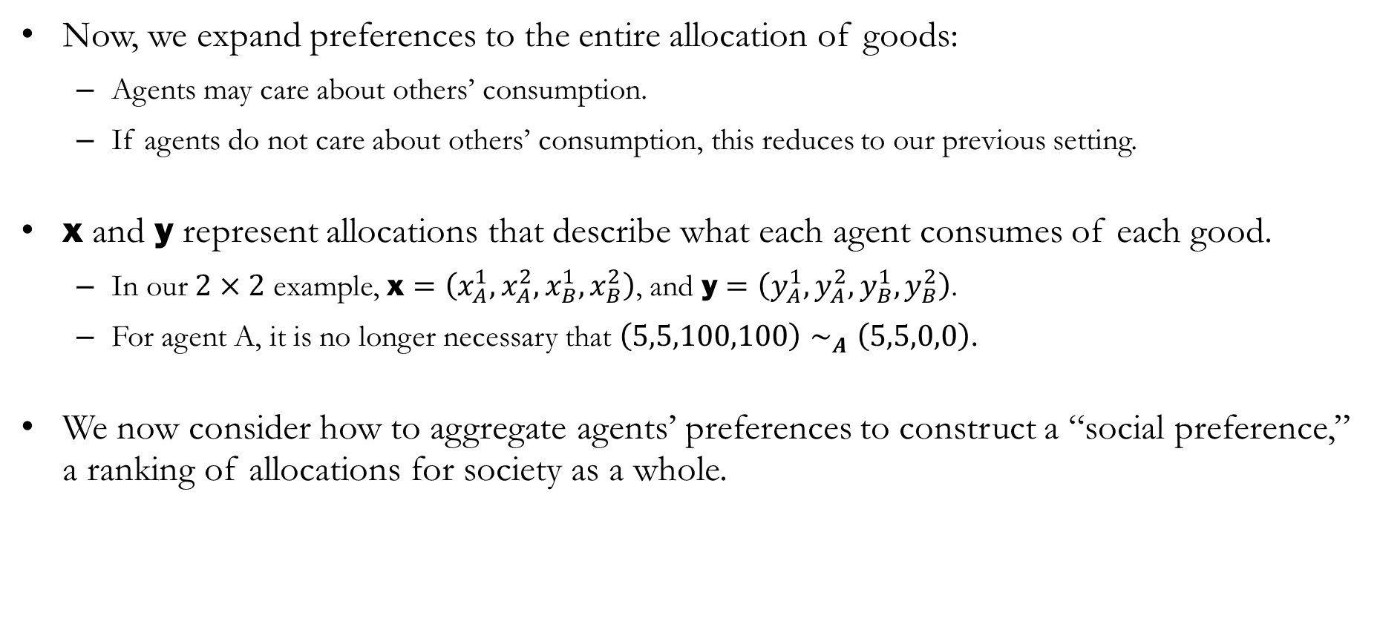
Preferences over Allocations
Now, we expand preferences to the entire allocation of goods:
Agents may care about others’ consumption.
If agents do not care about others’ consumption, this reduces to our previous setting.
$\text{x}$ and $\text{y}$ represent allocations that describe what each agent consumes of each good.
In our $2×2$ example, $\text{x}=\left(x_{A}^{1},x_{A}^{2},x_{B}^{1},x_{B}^{2}\right)$, and $\text{y}=\left(y_{A}^{1},y_{A}^{2},y_{B}^{1},y_{B}^{2}\right)$.
For agent A, it is no longer necessary that $\left(5,5,100,100\right)∼_{A}\left(5,5,0,0\right)$.
We now consider how to aggregate agents’ preferences to construct a “social preference,” a ranking of allocations for society as a whole.

Slide 6
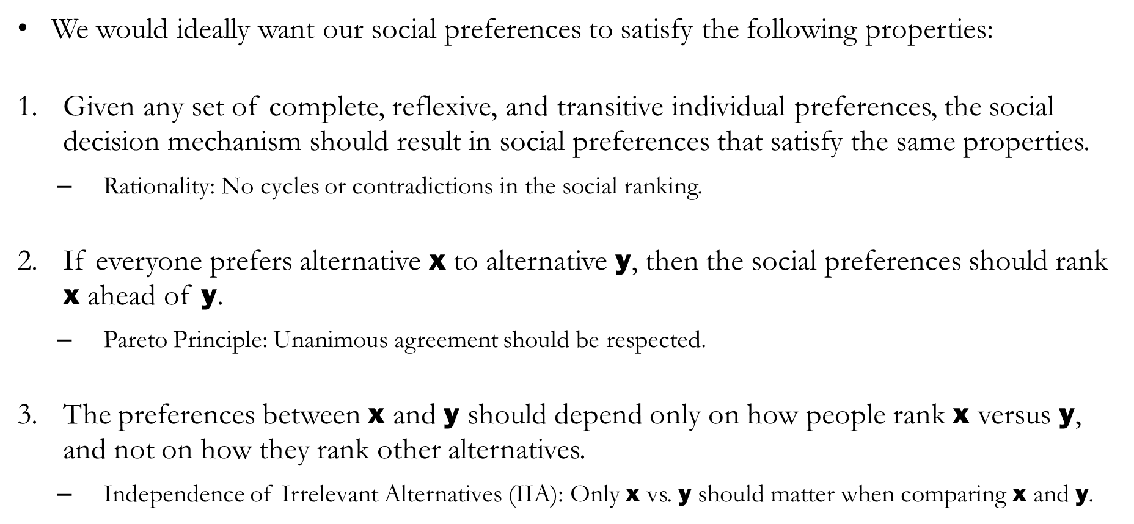
Social Preferences: Desirable Properties
We would ideally want our social preferences to satisfy the following properties:
Given any set of complete, reflexive, and transitive individual preferences, the social decision mechanism should result in social preferences that satisfy the same properties.
Rationality: No cycles or contradictions in the social ranking.
If everyone prefers alternative $\text{x}$ to alternative $\text{y}$, then the social preferences should rank $\text{x}$ ahead of $\text{y}$.
Pareto Principle: Unanimous agreement should be respected.
The preferences between $\text{x}$ and $\text{y}$ should depend only on how people rank $\text{x}$ versus $\text{y}$, and not on how they rank other alternatives.
Independence of Irrelevant Alternatives (IIA): Only $\text{x}$ vs. $\text{y}$ should matter when comparing $\text{x}$ and $\text{y}$.

Slide 7
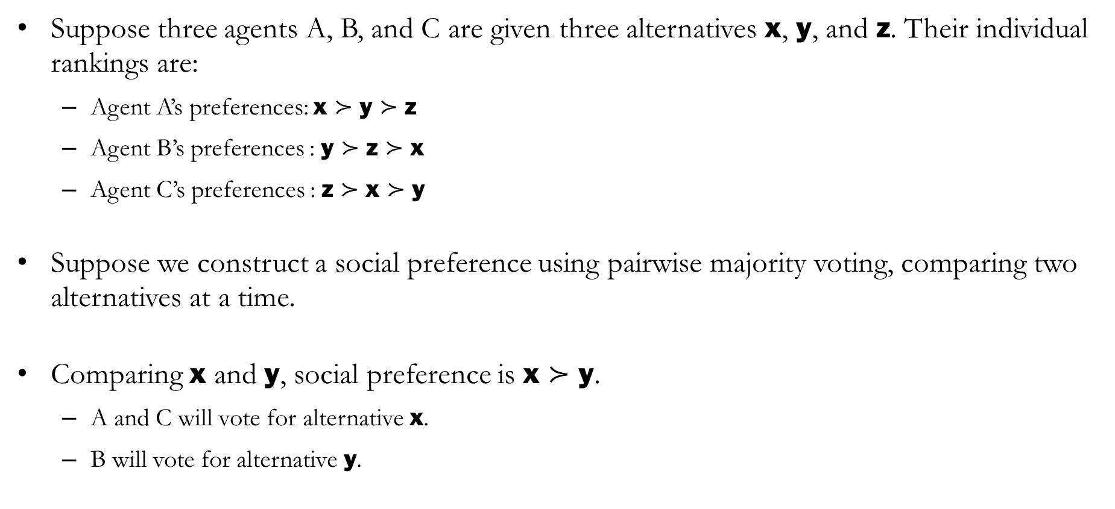
Example: Violating Rationality
Suppose three agents A, B, and C are given three alternatives $\text{x}$, $\text{y}$, and $\text{z}$. Their individual rankings are:
Agent A’s preferences: $\text{x}≻\text{y}≻\text{z}$
Agent B’s preferences : $\text{y}≻\text{z}≻\text{x}$
Agent C’s preferences : $\text{z}≻\text{x}≻\text{y}$
Suppose we construct a social preference using pairwise majority voting, comparing two alternatives at a time.
Comparing $\text{x}$ and $\text{y}$, social preference is $\text{x}≻\text{y}$.
A and C will vote for alternative $\text{x}$.
B will vote for alternative $\text{y}$.

Slide 8
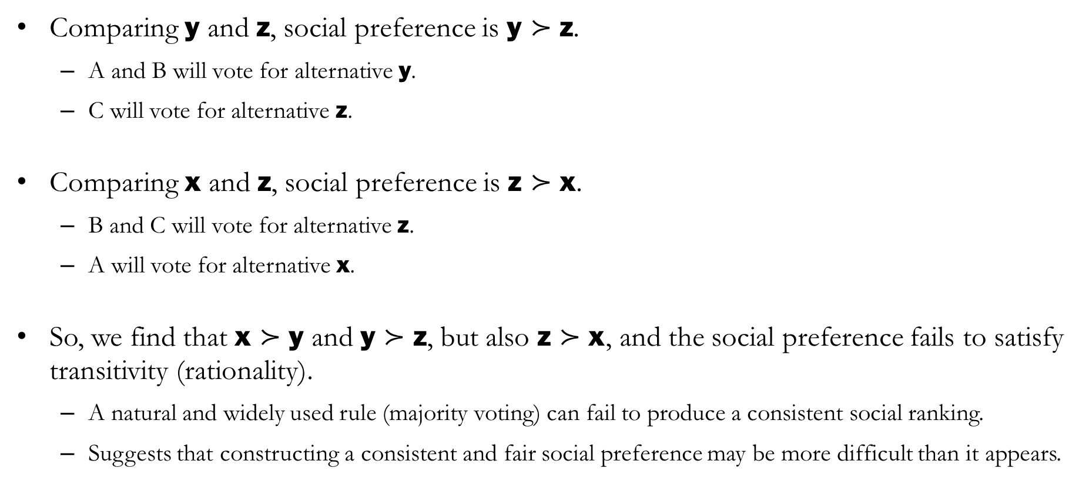
Example: Violating Rationality (Transitivity)
Comparing $\text{y}$ and $\text{z}$, social preference is $\text{y}≻\text{z}$.
A and B will vote for alternative $\text{y}$.
C will vote for alternative $\text{z}$.
Comparing $\text{x}$ and $\text{z}$, social preference is $\text{z}≻\text{x}$.
B and C will vote for alternative $\text{z}$.
A will vote for alternative $\text{x}$.
So, we find that $\text{x}≻\text{y}$ and $\text{y}≻\text{z}$, but also $\text{z}≻\text{x}$, and the social preference fails to satisfy transitivity (rationality).
A natural and widely used rule (majority voting) can fail to produce a consistent social ranking.
Suggests that constructing a consistent and fair social preference may be more difficult than it appears.

Slide 9
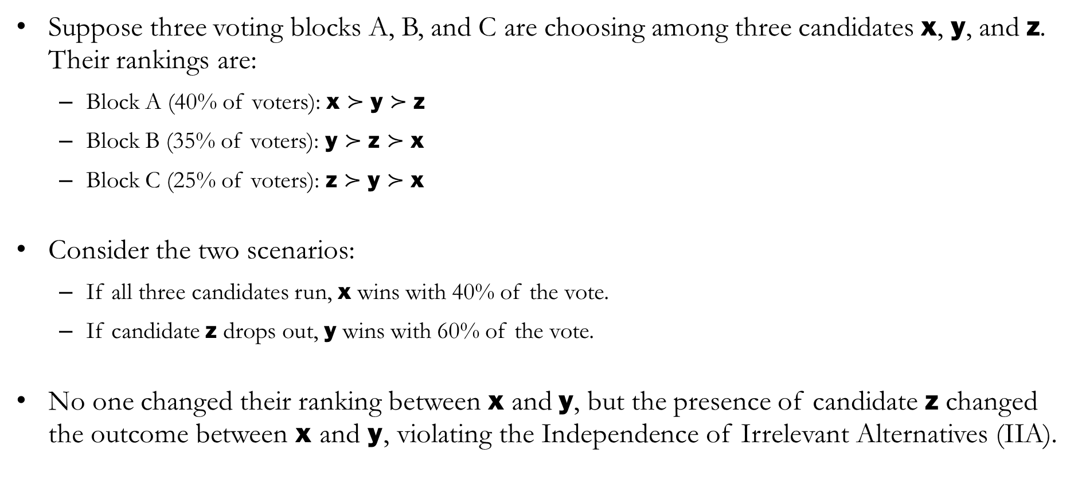
Example: Independence of Irrelevant Alternatives
Suppose three voting blocks A, B, and C are choosing among three candidates $\text{x}$, $\text{y}$, and $\text{z}$. Their rankings are:
Block A (40% of voters): $\text{x}≻\text{y}≻\text{z}$
Block B (35% of voters): $\text{y}≻\text{z}≻\text{x}$
Block C (25% of voters): $\text{z}≻\text{y}≻\text{x}$
Consider the two scenarios:
If all three candidates run, $\text{x}$ wins with 40% of the vote.
If candidate $\text{z}$ drops out, $\text{y}$ wins with 60% of the vote.
No one changed their ranking between $\text{x}$ and $\text{y}$, but the presence of candidate $\text{z}$ changed the outcome between $\text{x}$ and $\text{y}$, violating the Independence of Irrelevant Alternatives (IIA).

Slide 10
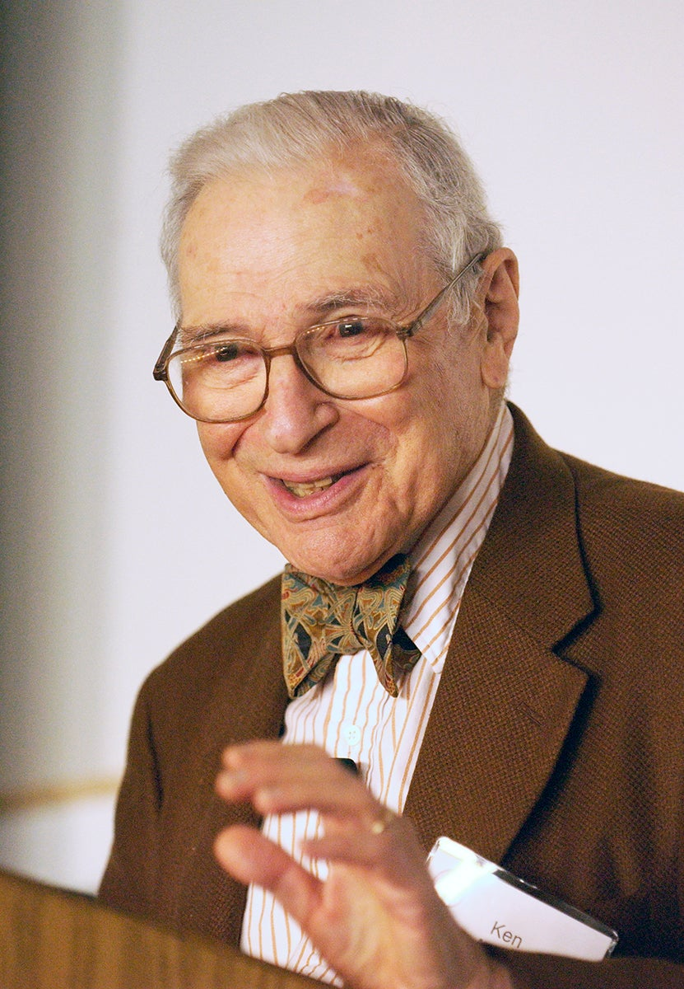
Kenneth Arrow’s Insight
It turns out that there is a fundamental limitation in constructing social preferences.
Even when we impose a handful of reasonable properties:
Rationality
Pareto Principle
Independence of Irrelevant Alternatives
Trying to satisfy all three properties simultaneously imposes very strong restrictions on any decision rule.
This is the key idea behind Arrow’s Impossibility Theorem.

Slide 11
Arrow’s Impossibility Theorem
The only way to satisfy all three properties simultaneously is through a dictatorship.
This does not mean that we should seek to implement a benevolent dictator, but rather there is no perfect way to aggregate individual preferences into a social ranking.
The real-world implication is that in practice, we may have to give up at least one desirable property in designing democratic decision rules.
Caveat: Arrow’s results prove that it is not possible to have a democratic method of social decision making that will always satisfy all three properties simultaneously.
If a social decision mechanism satisfies Rationality, the Pareto Principle, and
Independence of Irrelevant Alternatives, then the resulting social preferences
must coincide with the preferences of a single individual.

Slide 12
Social Welfare

Slide 13
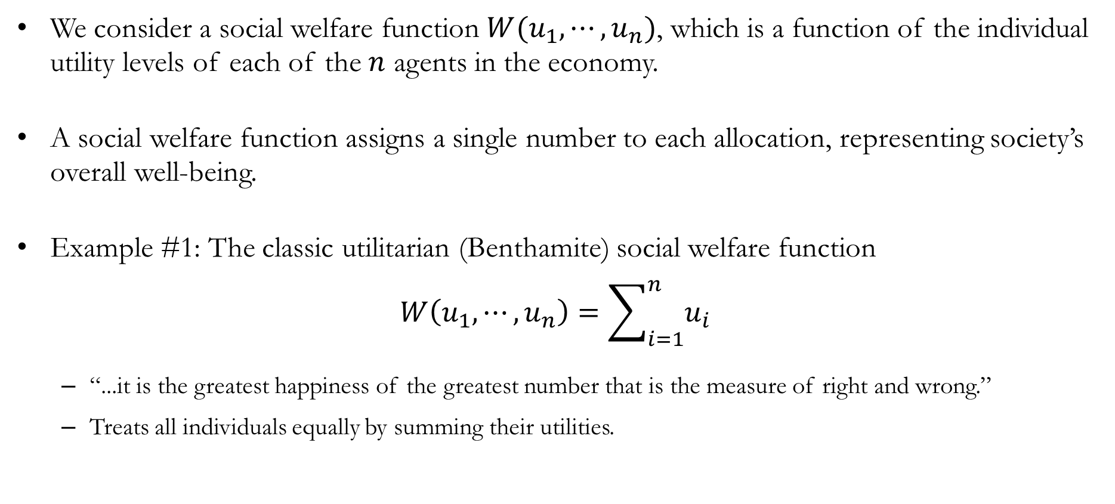
Social Welfare Functions
We consider a social welfare function $W(u_{1},⋯,u_{n})$, which is a function of the individual utility levels of each of the $n$ agents in the economy.
A social welfare function assigns a single number to each allocation, representing society’s overall well-being.
Example #1: The classic utilitarian (Benthamite) social welfare function
$$W\left(u_{1},⋯,u_{n}\right)=\sum_{i=1}^{n}{u_{i}}$$
“...it is the greatest happiness of the greatest number that is the measure of right and wrong.”
Treats all individuals equally by summing their utilities.

Slide 14
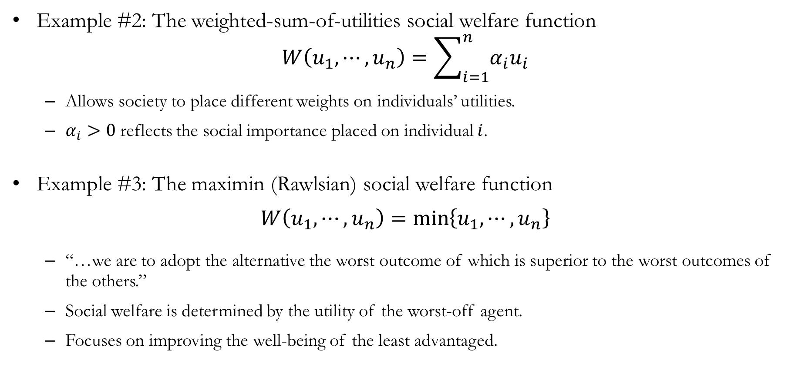
Social Welfare Functions
Example #2: The weighted-sum-of-utilities social welfare function
$$W\left(u_{1},⋯,u_{n}\right)=\sum_{i=1}^{n}{α_{i}u_{i}}$$
Allows society to place different weights on individuals’ utilities.
$α_{i}>0$ reflects the social importance placed on individual $i$.
Example #3: The maximin (Rawlsian) social welfare function
$$W\left(u_{1},⋯,u_{n}\right)=\min\left\{u_{1},⋯,u_{n}\right\}$$
“…we are to adopt the alternative the worst outcome of which is superior to the worst outcomes of the others.”
Social welfare is determined by the utility of the worst-off agent.
Focuses on improving the well-being of the least advantaged.

Slide 15
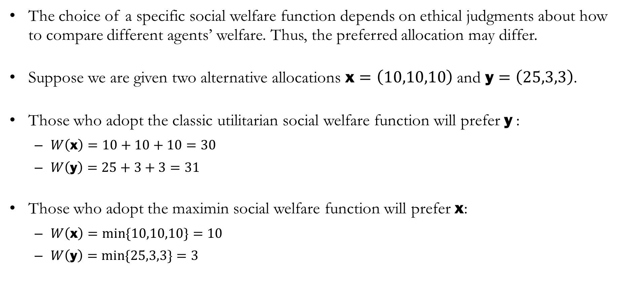
Evaluating Social Welfare Functions
The choice of a specific social welfare function depends on ethical judgments about how to compare different agents’ welfare. Thus, the preferred allocation may differ.
Suppose we are given two alternative allocations $\text{x}=\left(10,10,10\right)$ and $\text{y}=\left(25,3,3\right)$.
Those who adopt the classic utilitarian social welfare function will prefer $\text{y}$:
$W\left(\text{x}\right)=10+10+10=30$
$W\left(\text{y}\right)=25+3+3=31$
Those who adopt the maximin social welfare function will prefer $\text{x}$:
$W\left(\text{x}\right)=min⁡\{10,10,10\}=10$
$W\left(\text{y}\right)=min⁡\{25,3,3\}=3$

Slide 16
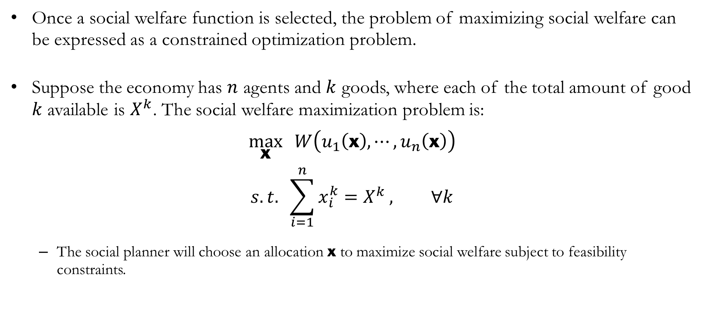
The Social Planner’s Problem
Once a social welfare function is selected, the problem of maximizing social welfare can be expressed as a constrained optimization problem.
Suppose the economy has $n$ agents and $k$ goods, where each of the total amount of good $k$ available is $X^{k}$. The social welfare maximization problem is:
$$\max_{\text{x}}{ W\left(u_{1}\left(\text{x}\right),⋯,u_{n}\left(\text{x}\right)\right)}$$
$$s.t. \sum_{i=1}^{n}{x_{i}^{k}=X^{k}}, ∀k$$
The social planner will choose an allocation $\text{x}$ to maximize social welfare subject to feasibility constraints.

Slide 17
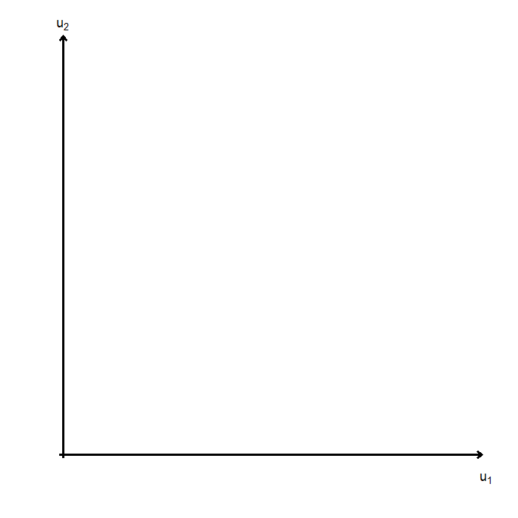
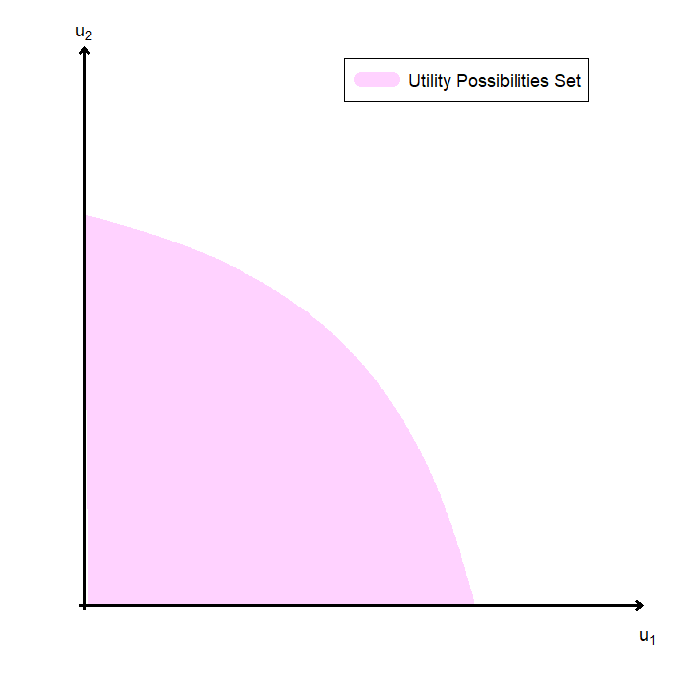
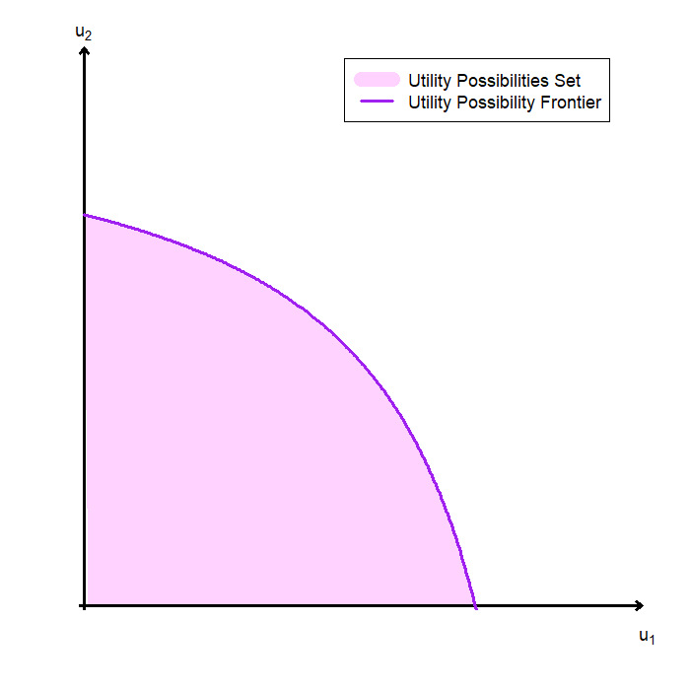
Visualizing the Social Planner’s Problem
To visualize the social planner’s problem, we begin with a simple economy with two agents.
Given the economy’s resources and technology, we can construct the utility possibilities set:
The utility possibilities set includes all attainable combinations of utility levels for the two agents.
The boundary of this set is called the utility possibilities frontier (UPF):
Points on the frontier are Pareto efficient.
Points inside the set are feasible but inefficient.

Slide 18
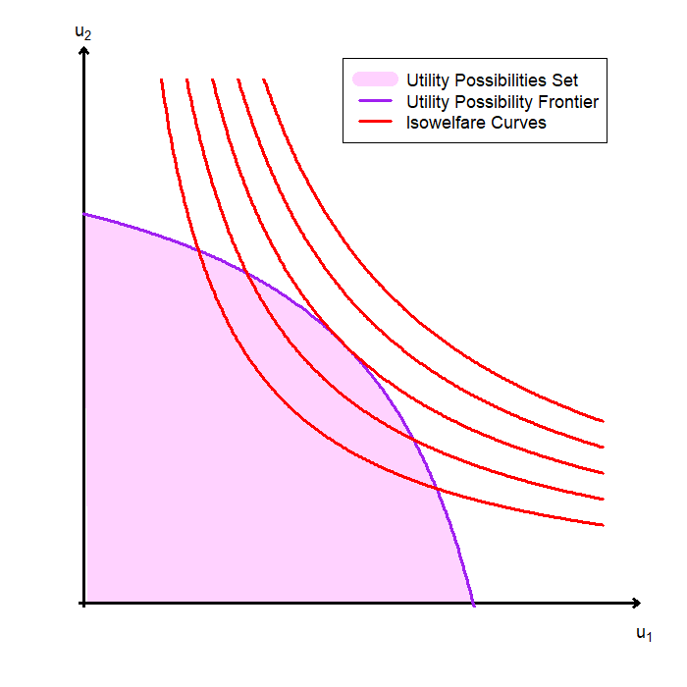
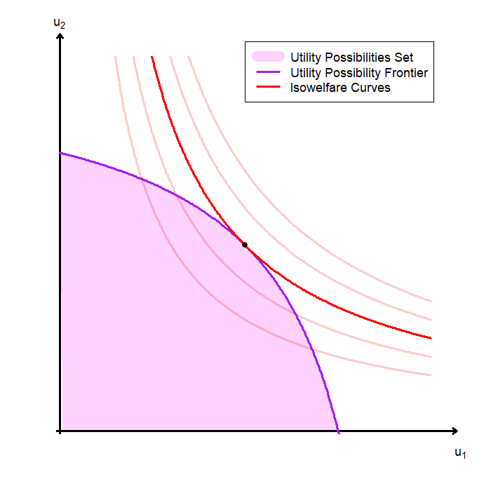
Visualizing the Social Planner’s Problem
We now combine feasibility with the planner’s notion of desirability.
Given a social welfare function, we can draw isowelfare curves:
Isowelfare curves represent combinations of utility levels that yield the same level of social welfare.
They are the social planner’s indifference curves over utility allocations.
The social planner’s optimal allocation occurs at the tangency between the utility possibilities frontier (UPF) and the highest attainable isowelfare curve.

Slide 19
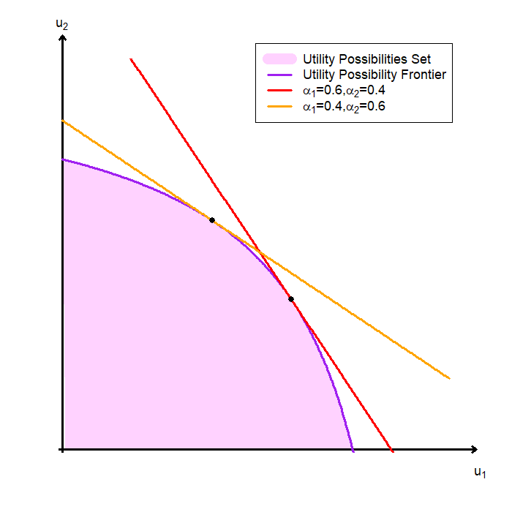
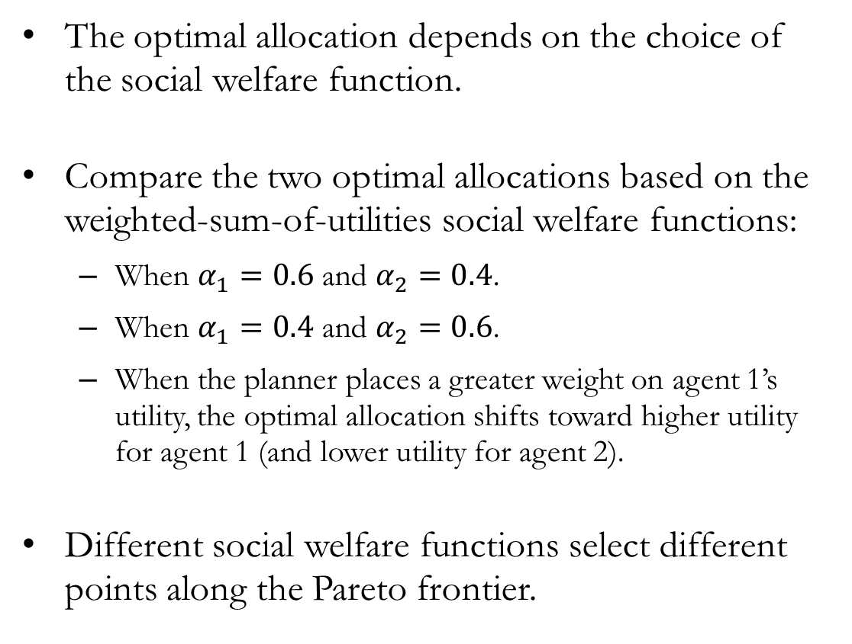
Visualizing the Social Planner’s Problem
The optimal allocation depends on the choice of the social welfare function.
Compare the two optimal allocations based on the weighted-sum-of-utilities social welfare functions:
When $α_{1}=0.6$ and $α_{2}=0.4$.
When $α_{1}=0.4$ and $α_{2}=0.6$.
When the planner places a greater weight on agent 1’s utility, the optimal allocation shifts toward higher utility for agent 1 (and lower utility for agent 2).
Different social welfare functions select different points along the Pareto frontier.

Slide 20
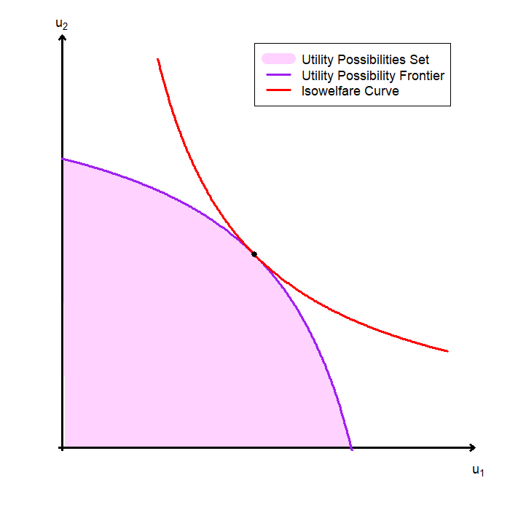
Properties of the Social Optima #1
The social planner’s optimal allocation is Pareto optimal.
Graph-based explanation:
The utility possibilities frontier is the collection of all Pareto optimal allocations.
Isowelfare curves farther from the origin represent higher levels of social welfare.
The planner chooses the highest attainable isowelfare curve.
Therefore, the optimum lies on the frontier, where no further Pareto improvements are possible.
Any point inside the feasible set cannot be optimal, since we could increase both agents’ utilities and achieve higher social welfare.

Slide 21
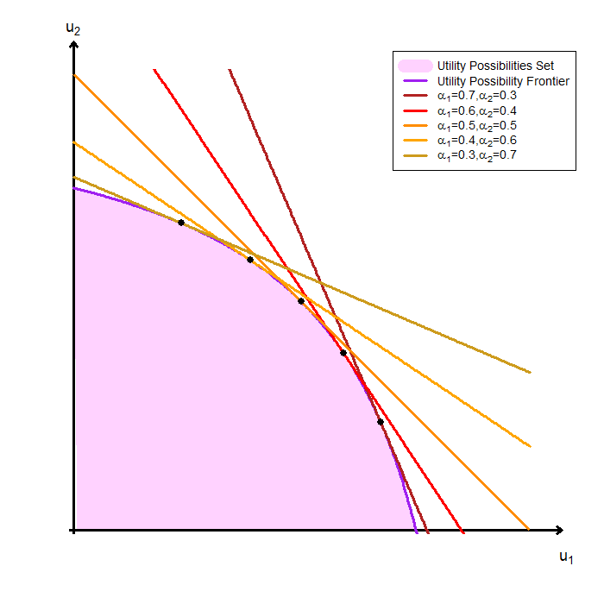
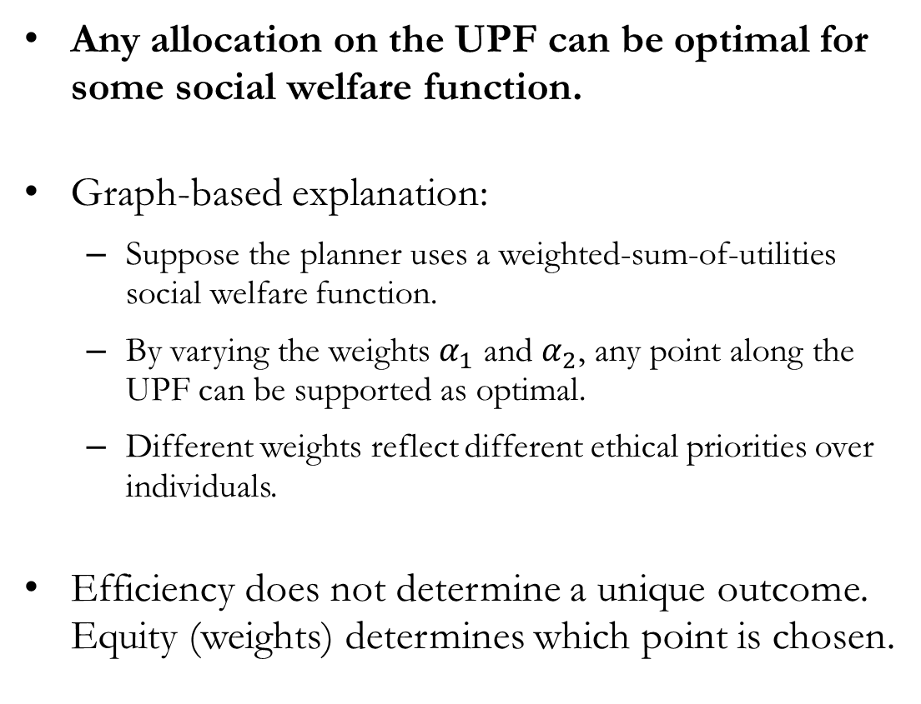
Properties of the Social Optima #2
Any allocation on the UPF can be optimal for some social welfare function.
Graph-based explanation:
Suppose the planner uses a weighted-sum-of-utilities social welfare function.
By varying the weights $α_{1}$ and $α_{2}$, any point along the UPF can be supported as optimal.
Different weights reflect different ethical priorities over individuals.
Efficiency does not determine a unique outcome. Equity (weights) determines which point is chosen.

Slide 22
Envy and Equity

Slide 23
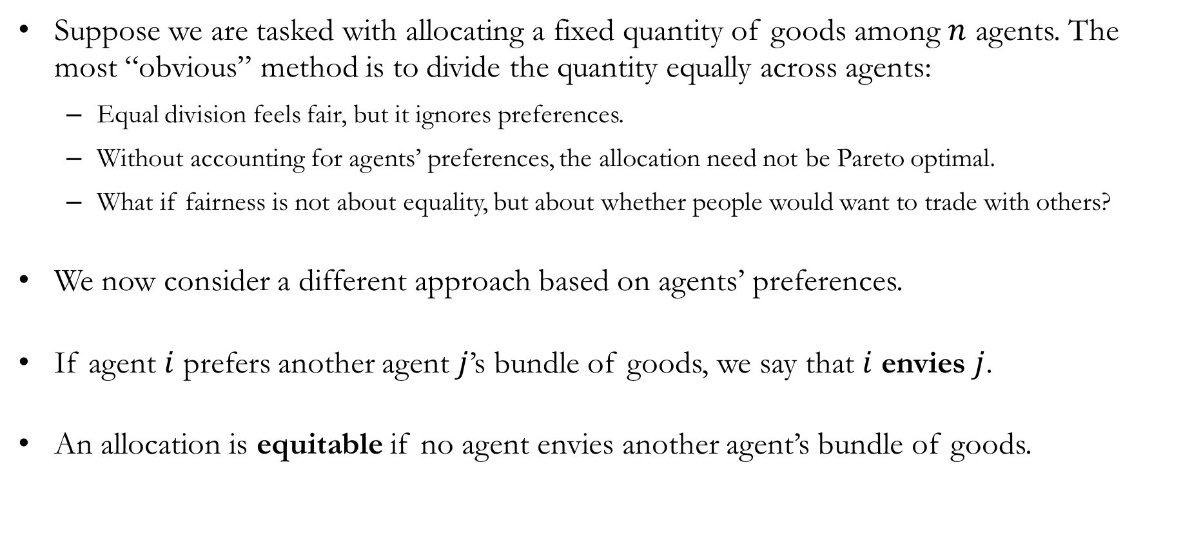
Envy and Equity
Suppose we are tasked with allocating a fixed quantity of goods among $n$ agents. The most “obvious” method is to divide the quantity equally across agents:
Equal division feels fair, but it ignores preferences.
Without accounting for agents’ preferences, the allocation need not be Pareto optimal.
What if fairness is not about equality, but about whether people would want to trade with others?
We now consider a different approach based on agents’ preferences.
If agent $i$ prefers another agent $j$’s bundle of goods, we say that $i$ envies $j$.
An allocation is equitable if no agent envies another agent’s bundle of goods.

Slide 24
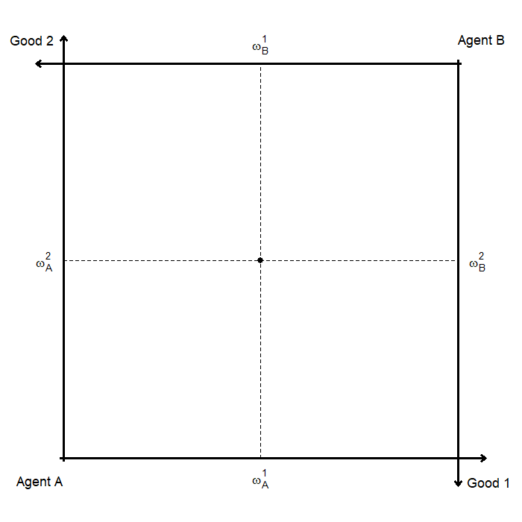
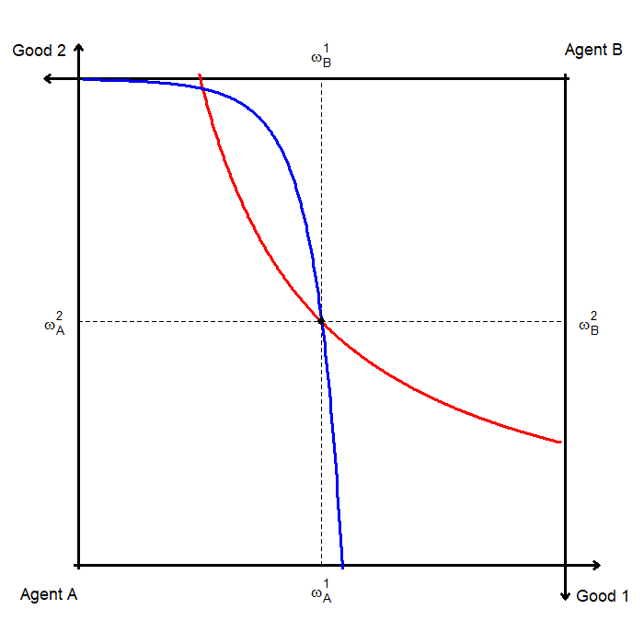
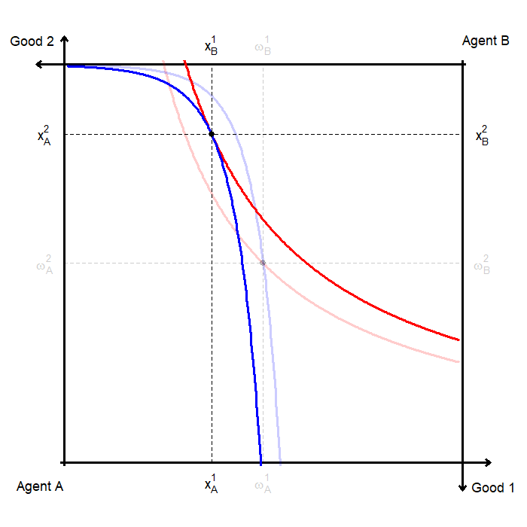
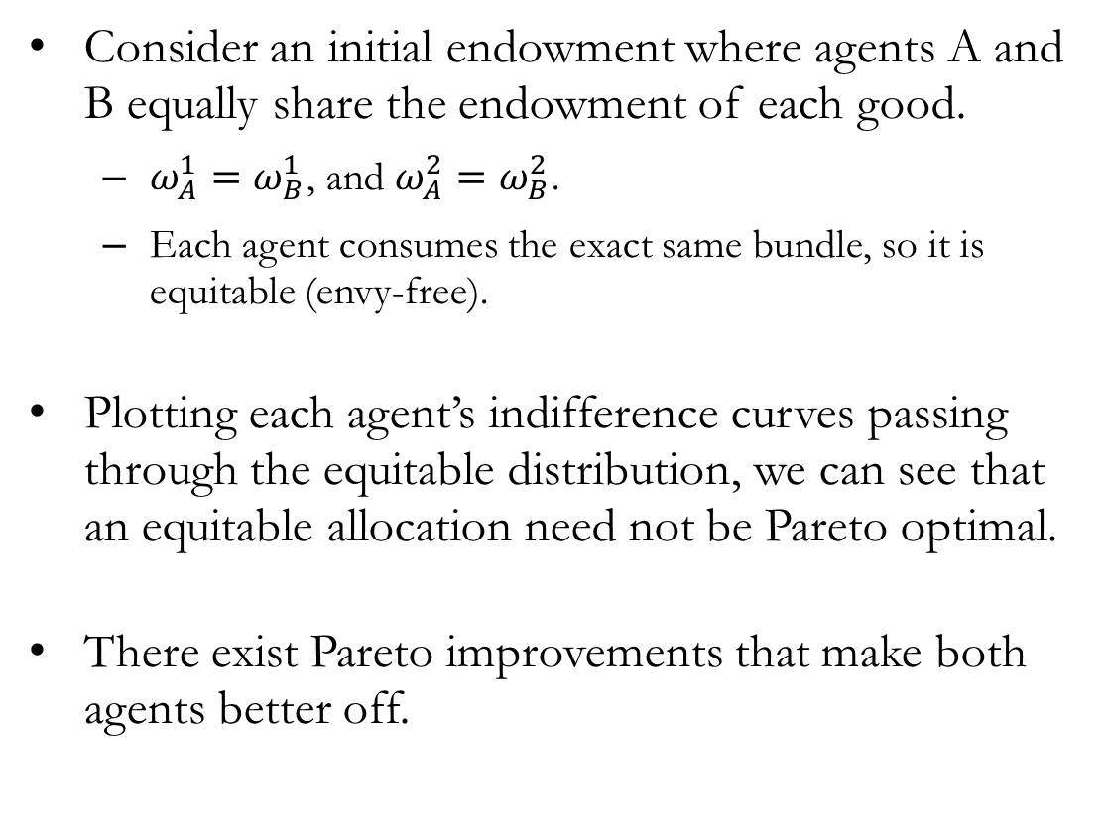
Equitable, but not Pareto Optimal
Consider an initial endowment where agents A and B equally share the endowment of each good.
$ω_{A}^{1}=ω_{B}^{1}$, and $ω_{A}^{2}=ω_{B}^{2}$.
Each agent consumes the exact same bundle, so it is equitable (envy-free).
Plotting each agent’s indifference curves passing through the equitable distribution, we can see that an equitable allocation need not be Pareto optimal.
There exist Pareto improvements that make both agents better off.

Slide 25
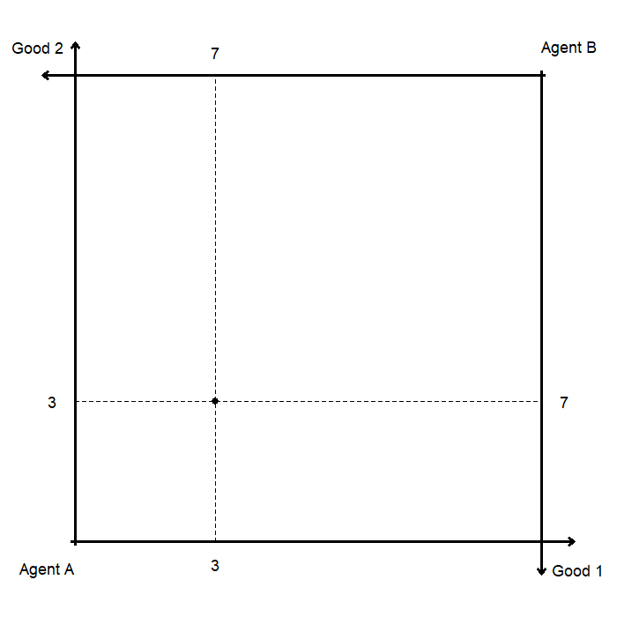
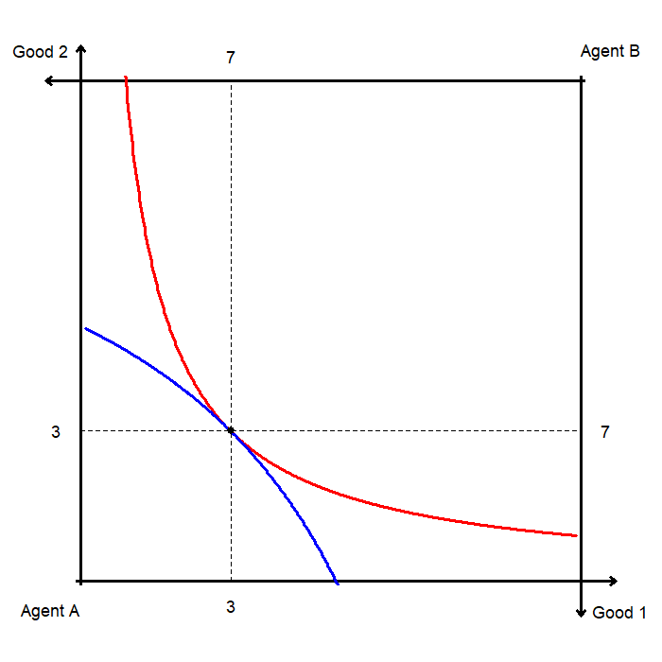
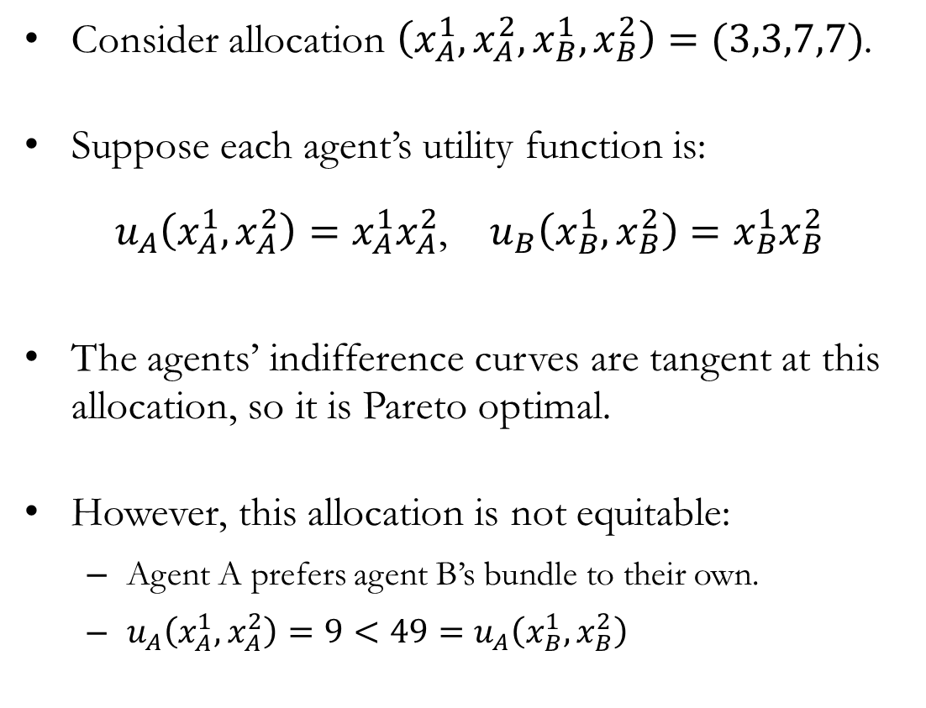
Pareto Optimal, but not Equitable
Consider allocation $\left(x_{A}^{1},x_{A}^{2},x_{B}^{1},x_{B}^{2}\right)=(3,3,7,7)$.
Suppose each agent’s utility function is:
$u_{A}\left(x_{A}^{1},x_{A}^{2}\right)=x_{A}^{1}x_{A}^{2}$, $u_{B}\left(x_{B}^{1},x_{B}^{2}\right)=x_{B}^{1}x_{B}^{2}$
The agents’ indifference curves are tangent at this allocation, so it is Pareto optimal.
However, this allocation is not equitable:
Agent A prefers agent B’s bundle to their own.
$u_{A}\left(x_{A}^{1},x_{A}^{2}\right)=9<49=u_{A}\left(x_{B}^{1},x_{B}^{2}\right)$

Slide 26
Fair Allocations
A fair allocation is defined as an allocation that is both Pareto optimal and equitable.
Generally, competitive markets under standard assumptions do not lead to a fair allocation:
A competitive equilibrium is Pareto optimal (the First Welfare Theorem), but
A competitive equilibrium need not be equitable.
If the initial endowment is an equal split, then under standard assumptions the competitive equilibrium leads to a fair allocation.
The Second Welfare Theorem states that, under standard assumptions, any Pareto optimal allocation can be achieved as a competitive equilibrium after an appropriate redistribution of endowments.
Efficiency can be achieved by markets, and fairness can be addressed through redistribution.

Slide 27
Recap & Preview

Slide 28
Recap: Welfare
We extended preferences from individual bundles to allocations across agents.
Aggregating preferences is difficult, and Arrow’s theorem shows that no perfect rule exists.
Social welfare functions rank allocations, and the choice of the “correct” function depends on normative judgments about welfare.
Given a social welfare function, the social planner chooses:
The highest attainable isowelfare curve
Subject to feasibility constraints
Optimal allocations are Pareto optimal, and any Pareto efficient point can be supported by some welfare function

