Slide 1
BUSINESS STATISTICS
Introduction & Syllabus

Slide 2
About Me: Brian Park
Education & Research:
Ph.D. in Applied Economics and Management, Cornell University
B.A. in Economics, Korea University
Research interests in Environmental Economics and Public Policy
Teaching Experience:
4th year of full-time teaching
2nd year at Concordia College
First time teaching Business Statistics
Outside of Work:
Travel
Aviation
Credit card points
Miscellaneous:
Originally from South Korea
Completed most of my formal education in Korea
Completed military service in Korea
My educational background may mean that some of my expectations or classroom norms are different from what you are used to.
If something I ask seems unusual, let me know!

Slide 3
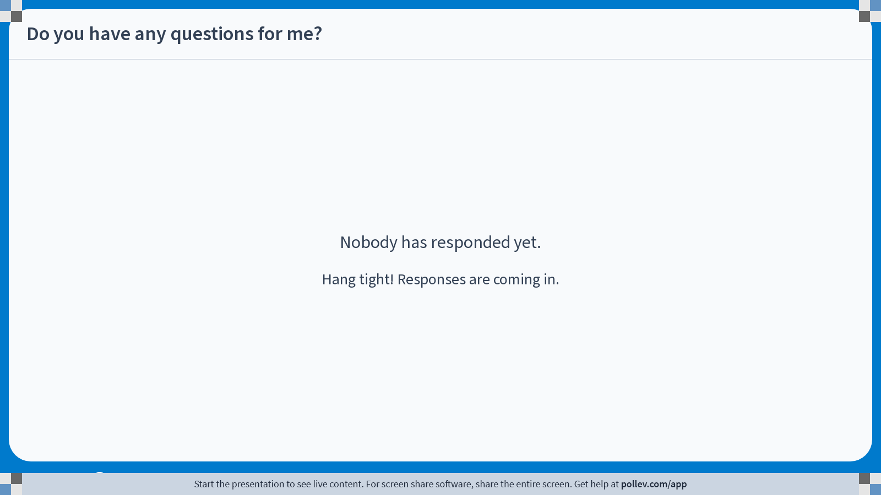
Poll Everywhere free text poll activity Activity Title: Do you have any questions for me? Slide 3
Notes:
Do not modify the notes in this section to avoid tampering with the Poll Everywhere activity. More info at polleverywhere.com/support Do you have any questions for me? https://www.polleverywhere.com/free_text_polls/3yI8BMhCjy5QgyRGhmpkX

Slide 4
Announcements: Contact
Email: HPARK3@cord.edu
Please include BUSN 320 in the subject line. My target response time is within 1 business day.
Office: Grant Center 101
Regular Office Hours
Mondays & Wednesdays, 10:30 AM to 12:00 PM
Tuesdays, 10:00 AM to 11:30 AM
By appointment via Calendly
Calendly: calendly.com/brianhwpark
Book on-demand office hours in 15-minute increments
Calendar opens 10 days in advance, with a minimum of 90 minutes notice
For longer sessions, you may book 2-3 sessions in a row

Slide 5
Policies: Grading
Score #1: Balanced
20% for Check-ins, 40% for Quizzes, 10% for Homework, and 30% for the Final Exam
Score #2: Rewarding Consistency
20% for Check-ins, 60% for Quizzes, 10% for Homework, and 10% for the Final Exam
Score #3: The “Hail Mary” option
10% for Check-ins, 20% for Quizzes, 5% for Homework, and 65% for the Final Exam
At the end of the term, I will calculate all three scores. The highest of the three will be your Grand Total score, which will be used to determine your letter grade.

Slide 6
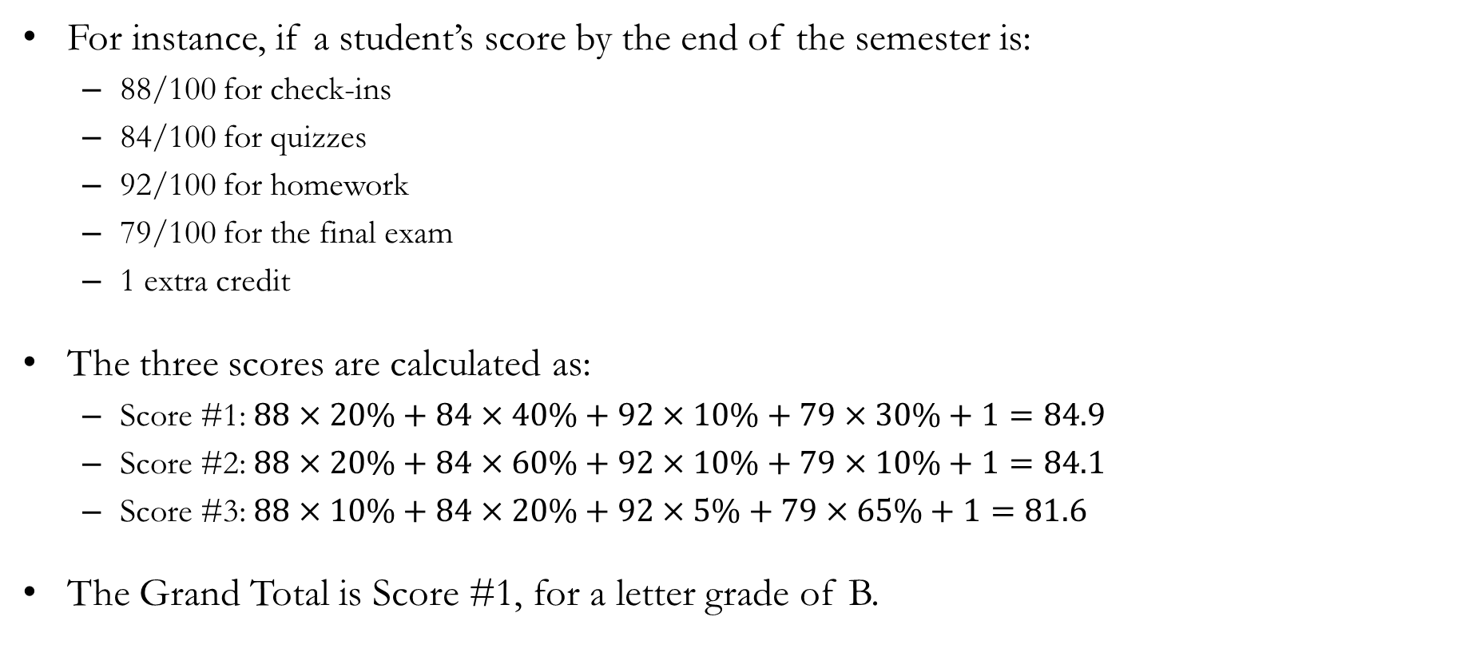
Policies: Grading
For instance, if a student’s score by the end of the semester is:
88/100 for check-ins
84/100 for quizzes
92/100 for homework
79/100 for the final exam
1 extra credit
The three scores are calculated as:
Score #1: $88×20\%+84×40\%+92×10\%+79×30\%+1=84.9$
Score #2: $88×20\%+84×60\%+92×10\%+79×10\%+1=84.1$
Score #3: $88×10\%+84×20\%+92×5\%+79×65\%+1=81.6$
The Grand Total is Score #1, for a letter grade of B.

Slide 7
Policies: Attendance
Attendance may be checked at the beginning of each class session.
Each student is permitted one unexcused absence per calendar month without penalty.
Attendance does not directly factor into a student’s Grand Total score; however, it will be used to determine recovery rates following each quiz.
Five or more unexcused absences (excluding the monthly no-penalty absences) over the duration of the term may result in a failing grade.
Whether an absence is considered excused or unexcused will follow Concordia College policy, with final discretion resting with the instructor.

Slide 8
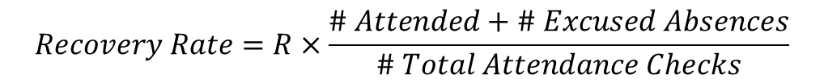
Policies: Quizzes
Up to 4 closed-book, in-class quizzes will be administered throughout the term.
Because quizzes are designed to be low-stakes assessments, students will have opportunities to recover deducted points.
To participate in grade recovery, students must review their graded material, demonstrate a clear understanding of their errors, and present the correct answers to the instructor in person during office hours.
The proportion of points that a student can recover is directly tied to their attendance rate. Assuming a maximum recovery rate of R%, the student’s recovery rate is calculated as:
$$Recovery Rate=R×\frac{\# Attended+\# Excused Absences}{\# Total Attendance Checks}$$

Slide 9
Policies: Quizzes
Regardless of the recovery rate, the maximum number of points a student may recover shall not exceed 20% of the total points available on each quiz.
Grade recovery deadlines will be 5 class days after the distribution of graded material unless otherwise specified by the instructor.
It is the student’s responsibility to complete grade recovery within the stated deadline.
A missed quiz without an approved reason will result in a grade of zero.
Make-up quizzes must be approved by the instructor and are granted only for documented or unavoidable conflicts.
Examples of commonly approved reasons include illness, medical appointments that cannot be rescheduled, family emergencies, and College-sponsored activities.
Personal scheduling conflicts or non-emergency commitments are generally not considered valid reasons for a make-up quiz.

Slide 10
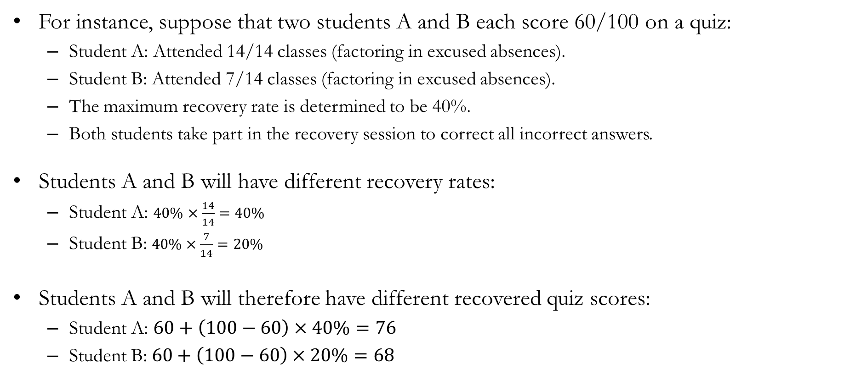
Policies: Quizzes
For instance, suppose that two students A and B each score 60/100 on a quiz:
Student A: Attended 14/14 classes (factoring in excused absences).
Student B: Attended 7/14 classes (factoring in excused absences).
The maximum recovery rate is determined to be 40%.
Both students take part in the recovery session to correct all incorrect answers.
Students A and B will have different recovery rates:
Student A: $40\%×\frac{14}{14}=40\%$
Student B: $40\%×\frac{7}{14}=20\%$
Students A and B will therefore have different recovered quiz scores:
Student A: $60+\left(100−60\right)×40\%=76$
Student B: $60+\left(100−60\right)×20\%=68$

Slide 11
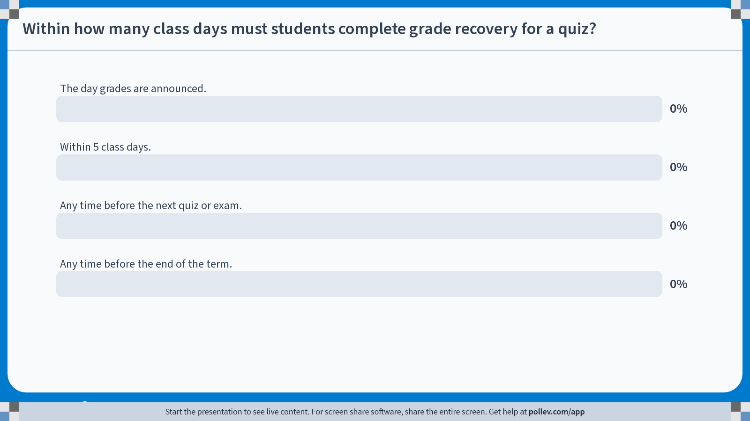
Poll Everywhere multiple choice poll activity Activity Title: Within how many class days must students complete grade recovery for a quiz? Slide 11
Notes:
Do not modify the notes in this section to avoid tampering with the Poll Everywhere activity. More info at polleverywhere.com/support Within how many class days must students complete grade recovery for a quiz? https://www.polleverywhere.com/multiple_choice_polls/VsH9t4VcL0PyesGuGvcZO?state=opened&flow=Default&onscreen=persist

Slide 12
Policies: Check-ins
Short (<10-minute) in-class check-ins will be administered on a roughly weekly basis.
Check-ins are designed to assess understanding of recently covered material, and include a mix of conceptual, calculation, and interpretation-based problems.
The lowest 3 check-in scores will be dropped when calculating the check-in component of the Grand Total score.
The drop policy is designed to accommodate occasional absences, so there will be no make-up opportunities for missed check-ins.
Students who arrive late or leave early may not be given additional time to complete check-ins.
There will be no opportunity to recover deducted points. Students may request that their entire check-in be regraded to check for grading errors.

Slide 13
Policies: Homework
A small number of data-based homework assignments will be assigned throughout the semester.
Students will use basic spreadsheet tools (e.g., Microsoft Excel) to organize data, perform calculations, and interpret the results.
Emphasis will be placed on interpreting outputs, explaining results clearly, and connecting statistical findings to the underlying concepts.
All data homework assignments must be completed individually unless explicitly stated otherwise.
Assignments must be submitted in the required format (e.g., Excel file and/or PDF) with clear organization and labeling of all work.

Slide 14
Policies: Final Exam
A comprehensive, closed-book final exam will be administered on the date determined by the Registrar’s Office.
The final exam will follow the quiz format, with length and complexity adjusted for the extended test period.
There will be no opportunity to recover deducted points. Students may request that their entire final exam be regraded to check for grading errors.
A missed final exam without an approved reason will result in a grade of zero.
Make-up final exams must be approved by the instructor and are granted exclusively for documented or unavoidable conflicts.

Slide 15
Policies: Miscellaneous
Extra credit opportunities may be offered on rare occasions at the instructor’s discretion.
The maximum number of extra credit points that may be applied to a student’s Grand Total score will not exceed 3 points.
Students are responsible for checking their Concordia email and the course learning platform regularly for announcements.

Slide 16
Policies: AI
AI is a powerful tool that, when used carefully, can support the learning process.
Students may use generative AI tools to support their learning in this course, including:
Creating practice problems
Preparing answers for recovery sessions
Writing Excel formulas and creating data visualizations
Most assessments in this course are completed in person without access to electronic devices.
Overreliance on AI is therefore likely to result in lower assessment scores.

