Slide 1
BUSINESS STATISTICS
Chapter 4: Introduction to Probability

Slide 2
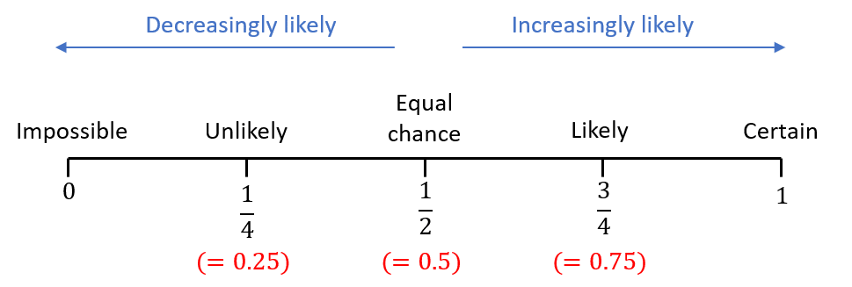
Probability
Probability is a numerical measure of how likely an event is to occur.
Probability values range from 0 to 1.
A probability close to 0 means the event is very unlikely.
A probability close to 1 means the event is very likely.
A probability of 0.5 means the event is equally likely to occur or not occur.

Slide 3
Random Experiments, Counting
Rules, and Assigning Probabilities

Slide 4
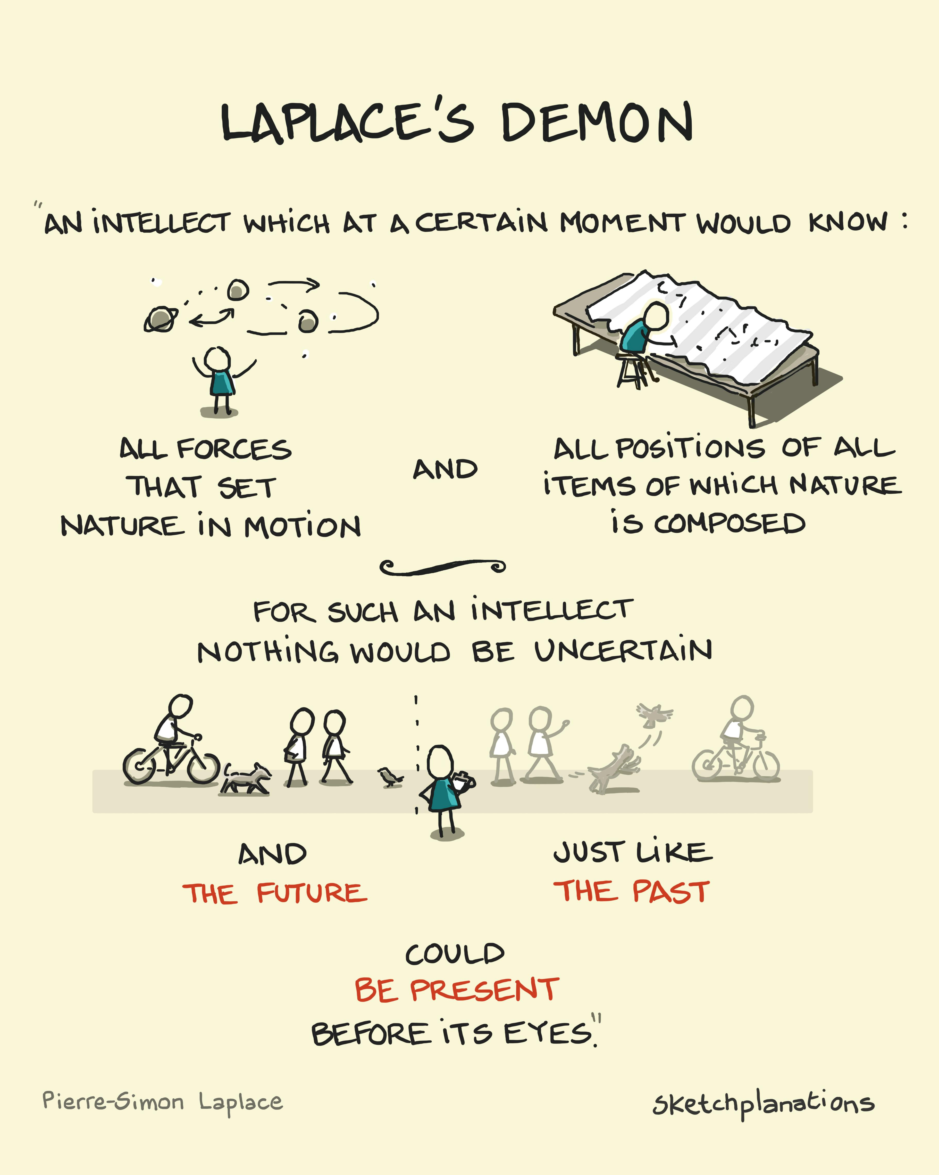
Random Experiments
A random experiment is a process that:
Has a clearly defined set of possible outcomes.
Produces exactly one outcome each time it is performed.
Has an outcome that cannot be predicted with certainty.
We know the possible outcomes before the experiment, but we do not know which outcome will occur.
Example: A single, fair coin toss
(1&2) The only possible outcomes: Heads (H) or Tails (T).
(3) If the coin is fair, we cannot predict whether the result will be H or T with certainty.

Slide 5
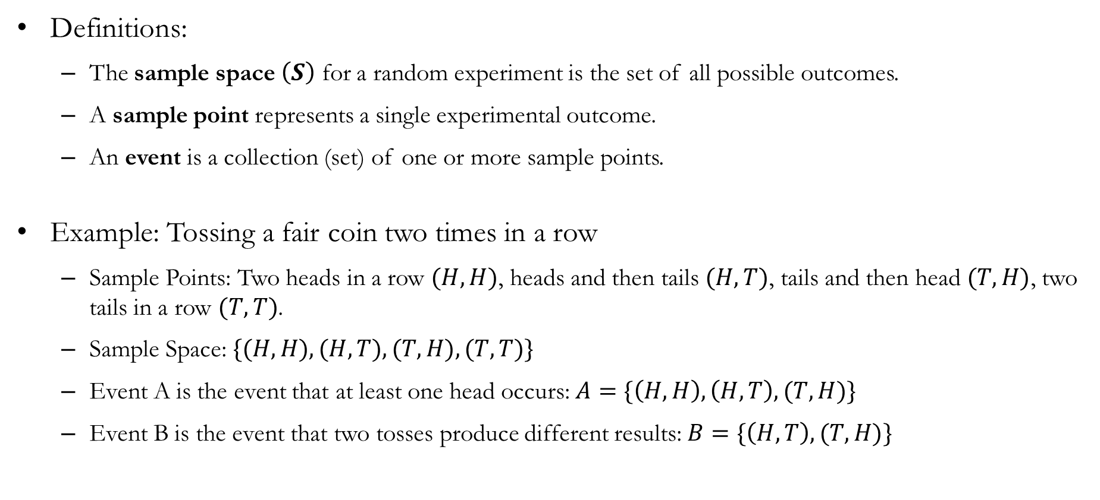
The Sample Space, Sample Point, and Events
Definitions:
The sample space $\left(S\right)$ for a random experiment is the set of all possible outcomes.
A sample point represents a single experimental outcome.
An event is a collection (set) of one or more sample points.
Example: Tossing a fair coin two times in a row
Sample Points: Two heads in a row $(H,H)$, heads and then tails $(H,T)$, tails and then head $(T,H)$, two tails in a row $(T,T)$.
Sample Space: $\{(H,H), (H,T), (T,H), (T,T)\}$
Event A is the event that at least one head occurs: $A=\{\left(H,H\right), \left(H,T\right), (T,H)\}$
Event B is the event that two tosses produce different results: $B=\{\left(H,T\right), (T,H)\}$

Slide 6
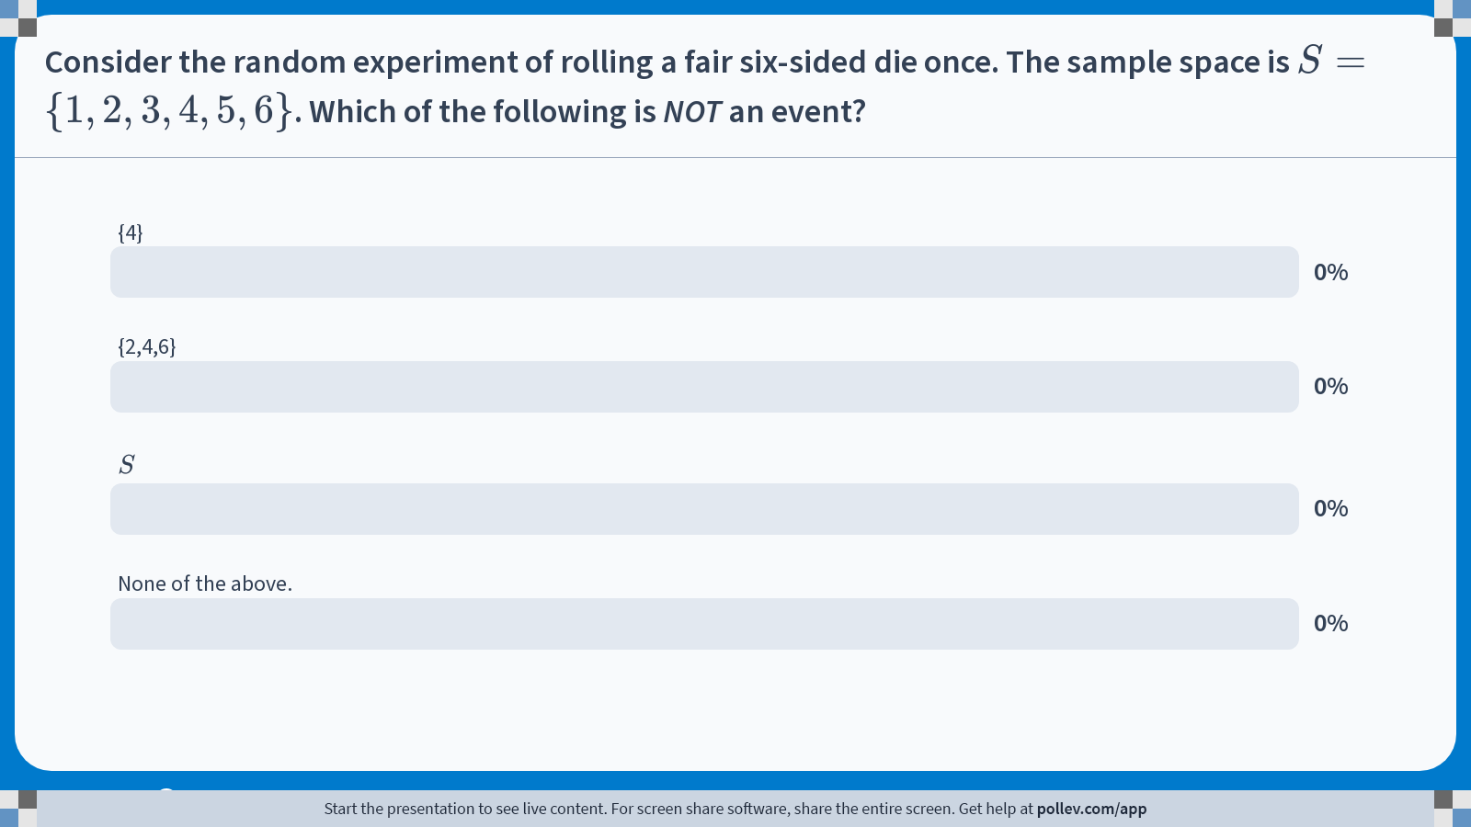
Poll Everywhere multiple choice poll activity Activity Title: Consider the random experiment of rolling a fair six-sided die once. The sample space is $$S=\\{1,2,3,4,5,6\\}$$. Which of the following is NOT an event? Slide 6
Notes:
Do not modify the notes in this section to avoid tampering with the Poll Everywhere activity. More info at polleverywhere.com/support Consider the random experiment of rolling a fair six-sided die once. The sample space is $$S=\\{1,2,3,4,5,6\\}$$. Which of the following is NOT an event? https://www.polleverywhere.com/multiple_choice_polls/hg4VQYxrKSJA0bNOZr9An?state=opened&flow=Default&onscreen=persist

Slide 7
Solution to In-class Poll
Option A: The event that the outcome is exactly 4.
Option B: The event that the outcome is an even number.
Option C: The event that the outcome is any valid die roll.
Therefore, the correct answer is D: None of the above.
Takeaway: An event can contain one outcome (A), several outcomes (B), or even all outcomes in the sample space (C).

Slide 8
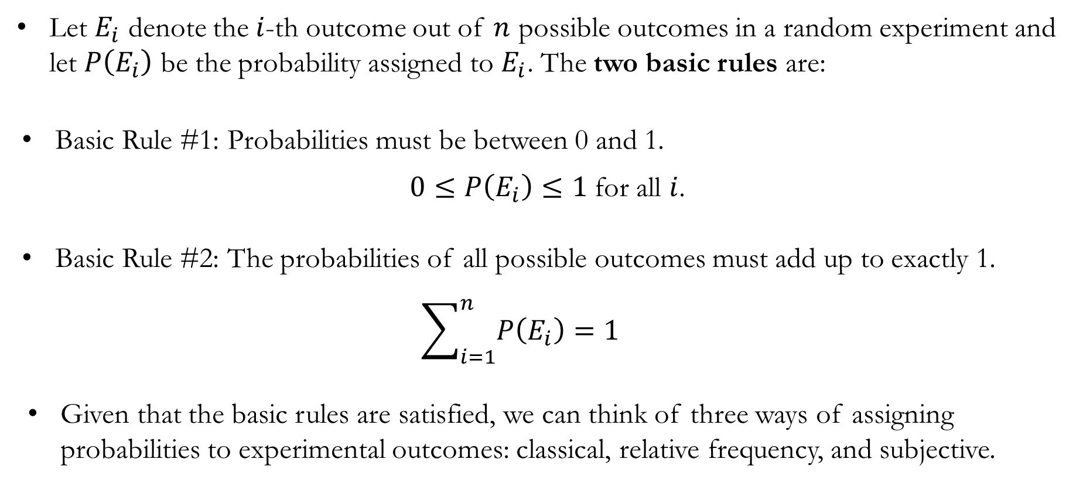
Basic Rules of Assigning Probabilities
Let $E_{i}$ denote the $i$-th outcome out of $n$ possible outcomes in a random experiment and let $P\left(E_{i}\right)$ be the probability assigned to $E_{i}$. The two basic rules are:
Basic Rule #1: Probabilities must be between 0 and 1.
$0≤P\left(E_{i}\right)≤1$ for all $i$.
Basic Rule #2: The probabilities of all possible outcomes must add up to exactly 1.
$$\sum_{i=1}^{n}{P\left(E_{i}\right)}=1$$
Given that the basic rules are satisfied, we can think of three ways of assigning probabilities to experimental outcomes: classical, relative frequency, and subjective.

Slide 9
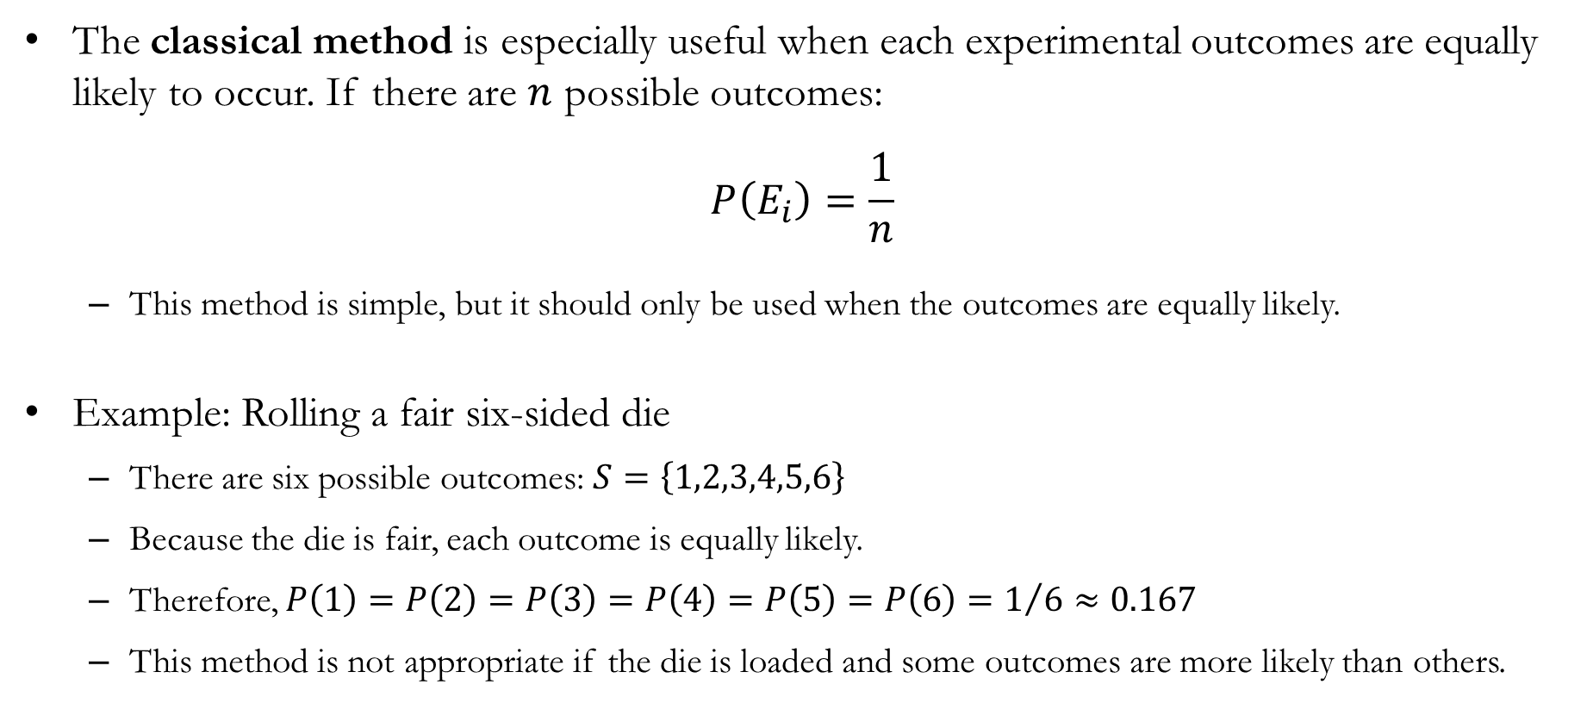
The Classical Method
The classical method is especially useful when each experimental outcomes are equally likely to occur. If there are $n$ possible outcomes:
$$P\left(E_{i}\right)=\frac{1}{n}$$
This method is simple, but it should only be used when the outcomes are equally likely.
Example: Rolling a fair six-sided die
There are six possible outcomes: $S=\left\{1,2,3,4,5,6\right\}$
Because the die is fair, each outcome is equally likely.
Therefore, $P\left(1\right)=P\left(2\right)=P\left(3\right)=P\left(4\right)=P\left(5\right)=P\left(6\right)=1/6≈0.167$
This method is not appropriate if the die is loaded and some outcomes are more likely than others.

Slide 10
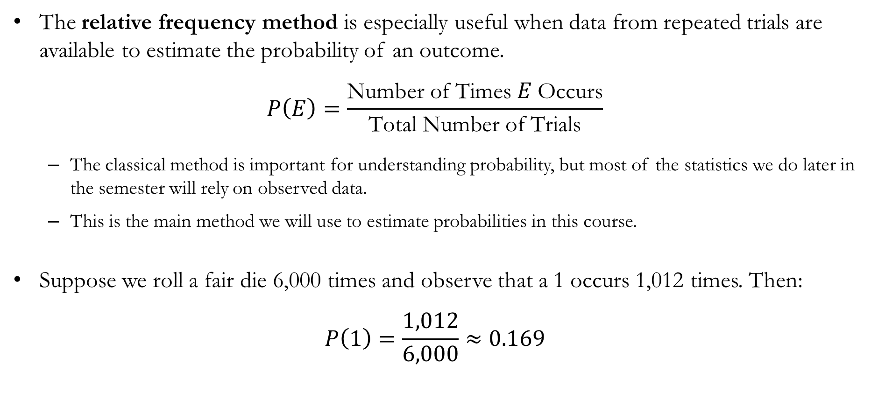
The Relative Frequency Method
The relative frequency method is especially useful when data from repeated trials are available to estimate the probability of an outcome.
$$P\left(E\right)=\frac{\text{Number of Times }E \text{Occurs}}{\text{Total Number of Trials}}$$
The classical method is important for understanding probability, but most of the statistics we do later in the semester will rely on observed data.
This is the main method we will use to estimate probabilities in this course.
Suppose we roll a fair die 6,000 times and observe that a 1 occurs 1,012 times. Then:
$$P\left(1\right)=\frac{1,012}{6,000}≈0.169$$

Slide 11
In-Class Exercise: Relative Frequency Method
Example: 6,000 repeated rolls of a six-sided die
Outcome | # | Estimated Probability
1 | 1,012 | 1,012/6,000 = 0.169
2 | 985
3 | 1,003
4 | 997
5 | 1,010
6 | 993
Outcome | # | Estimated Probability
1 | 1,012 | 1,012/6,000 = 0.169
2 | 985 | 0.164
3 | 1,003 | 0.167
4 | 997 | 0.166
5 | 1,010 | 0.168
6 | 993 | 0.166

Slide 12
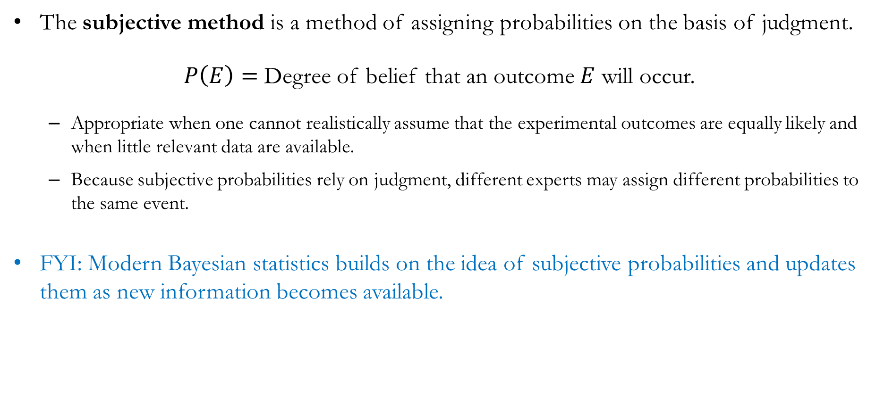
The Subjective Method
The subjective method is a method of assigning probabilities on the basis of judgment.
$P\left(E\right)=$ Degree of belief that an outcome $E$ will occur.
Appropriate when one cannot realistically assume that the experimental outcomes are equally likely and when little relevant data are available.
Because subjective probabilities rely on judgment, different experts may assign different probabilities to the same event.
FYI: Modern Bayesian statistics builds on the idea of subjective probabilities and updates them as new information becomes available.

Slide 13
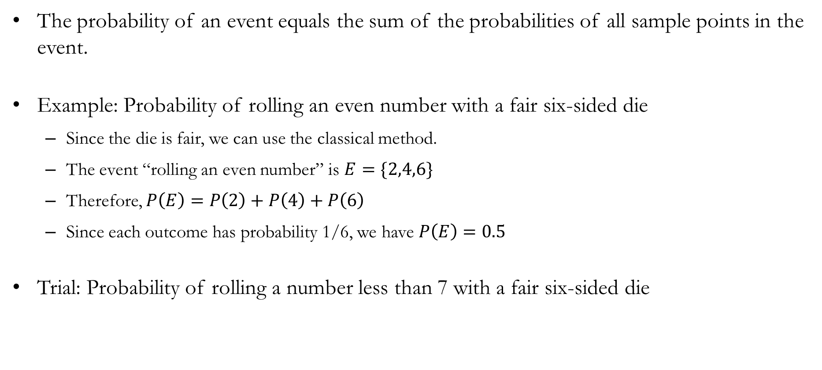
Probability of Events
The probability of an event equals the sum of the probabilities of all sample points in the event.
Example: Probability of rolling an even number with a fair six-sided die
Since the die is fair, we can use the classical method.
The event “rolling an even number” is $E=\{2,4,6\}$
Therefore, $P\left(E\right)=P\left(2\right)+P\left(4\right)+P\left(6\right)$
Since each outcome has probability 1/6, we have $P\left(E\right)=0.5$
Trial: Probability of rolling a number less than 7 with a fair six-sided die

Slide 14
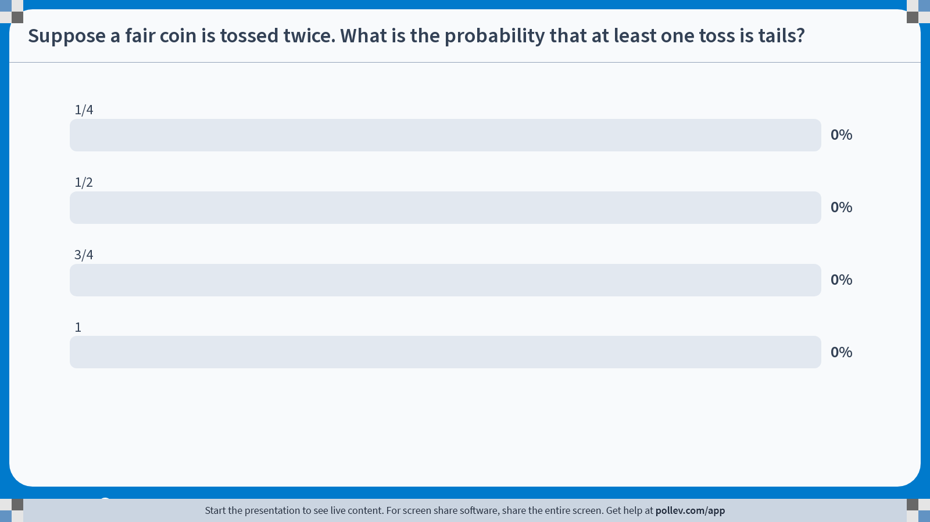
Poll Everywhere multiple choice poll activity Activity Title: Suppose a fair coin is tossed twice. What is the probability that at least one toss is tails? Slide 14
Notes:
Do not modify the notes in this section to avoid tampering with the Poll Everywhere activity. More info at polleverywhere.com/support Suppose a fair coin is tossed twice. What is the probability that at least one toss is tails? https://www.polleverywhere.com/multiple_choice_polls/I8HmOwFwu1wThzowZyyJf?state=opened&flow=Default&onscreen=persist

Slide 15

Solution to In-class Poll
The sample space is:
$$S=\left\{\left(H,H\right), \left(H,T\right),\left(T,H\right),\left(T,T\right)\right\}$$
The event “at least one toss is tails” is:
$$E=\left\{\left(H,T\right),\left(T,H\right),\left(T,T\right)\right\}$$
All four outcomes in the sample space are equally likely, so:
$$P\left(E\right)=\frac{3}{4}$$

Slide 16
Basic Probability Rules

Slide 17
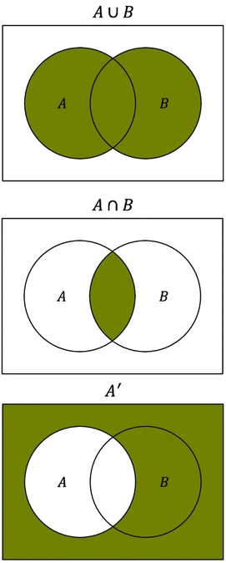
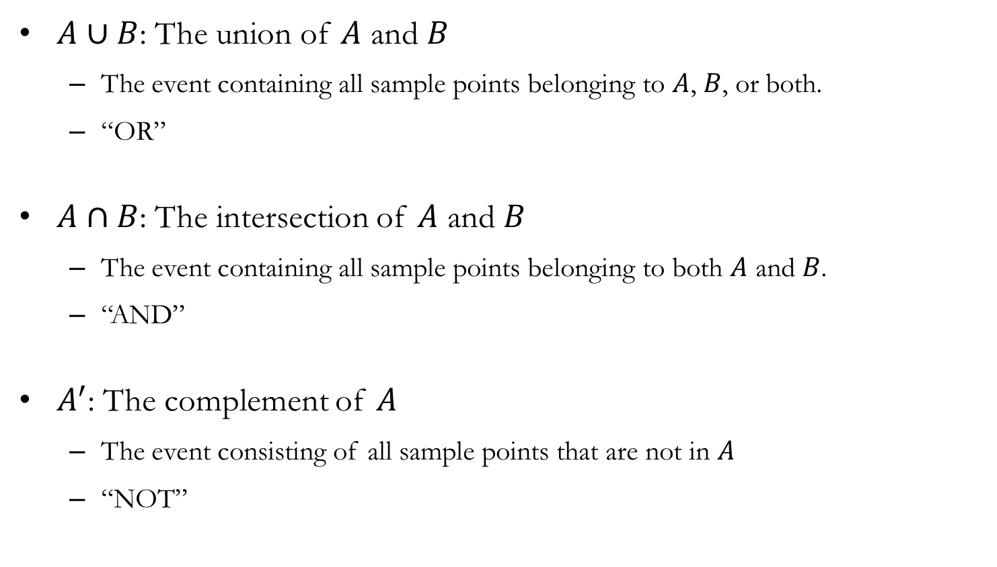
Set Operations
$A∪B$: The union of 𝐴 and 𝐵
The event containing all sample points belonging to $A$, $B$, or both.
“OR”
$A∩B$: The intersection of $A$ and $B$
The event containing all sample points belonging to both $A$ and $B$.
“AND”
$A^{′}$: The complement of $A$
The event consisting of all sample points that are not in $A$
“NOT”

Slide 18

Exercise: Set Operations
Consider the random experiment of tossing two fair coins in succession:
$A$: The first coin toss results in tails.
$B$: Exactly one of the coin tosses results in tails.
The sample space:
$$S=\left\{\left(H,H\right), \left(H,T\right),\left(T,H\right),\left(T,T\right)\right\}$$
Event $A$:
$$A=\left\{\left(T,H\right),\left(T,T\right)\right\}$$
Event $B$:
$$B=\left\{\left(H,T\right),\left(T,H\right) \right\}$$

Slide 19

Exercise: Set Operations
$A∪B$
The outcomes that show up in either event A OR event B.
$$A∪B=\left\{\left(H,T\right),\left(T,H\right),\left(T,T\right)\right\}$$
$A∩B$
The outcomes that show up in both events A AND event B.
$$A∩B=\left\{\left(T,H\right)\right\}$$
$A^{′}$
The outcomes that do NOT show up in event A.
$$A^{′}=\left\{\left(H,H\right), \left(H,T\right)\right\}$$

Slide 20
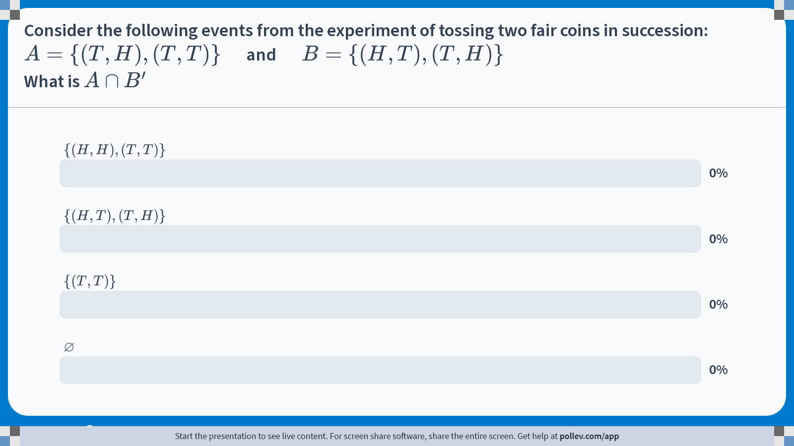
Poll Everywhere multiple choice poll activity Activity Title: Consider the following events from the experiment of tossing two fair coins in succession:$$A=\\{(T,H),(T,T)\\}\\quad $$ and $$\\quad B=\\{(H,T),(T,H)\\}$$What is $$A\\cap B^{\\prime}$$ Slide 20
Notes:
Do not modify the notes in this section to avoid tampering with the Poll Everywhere activity. More info at polleverywhere.com/support Consider the following events from the experiment of tossing two fair coins in succession:$$A=\\{(T,H),(T,T)\\}\\quad $$ and $$\\quad B=\\{(H,T),(T,H)\\}$$What is $$A\\cap B^{\\prime}$$ https://www.polleverywhere.com/multiple_choice_polls/MHppLrgkpjNcKzHGcu67v?state=opened&flow=Default&onscreen=persist

Slide 21
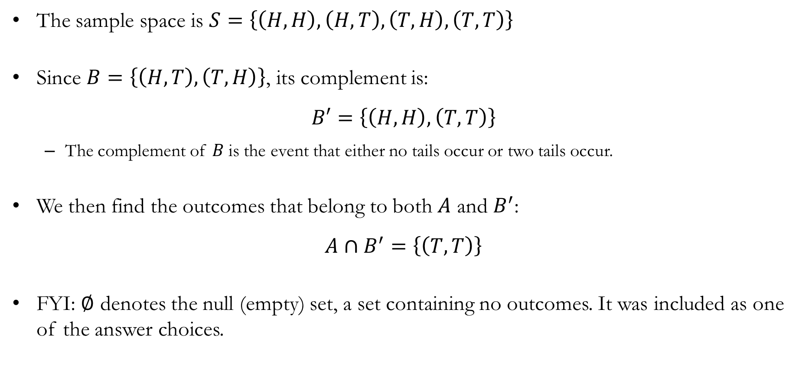
Solution to In-class Poll
The sample space is $S=\left\{\left(H,H\right), \left(H,T\right),\left(T,H\right),\left(T,T\right)\right\}$
Since $B=\left\{\left(H,T\right),\left(T,H\right)\right\}$, its complement is:
$$B′=\left\{\left(H,H\right), \left(T,T\right)\right\}$$
The complement of $B$ is the event that either no tails occur or two tails occur.
We then find the outcomes that belong to both $A$ and $B^{′}$:
$$A∩B^{′}=\left\{\left(T,T\right)\right\}$$
FYI: $∅$ denotes the null (empty) set, a set containing no outcomes. It was included as one of the answer choices.

Slide 22
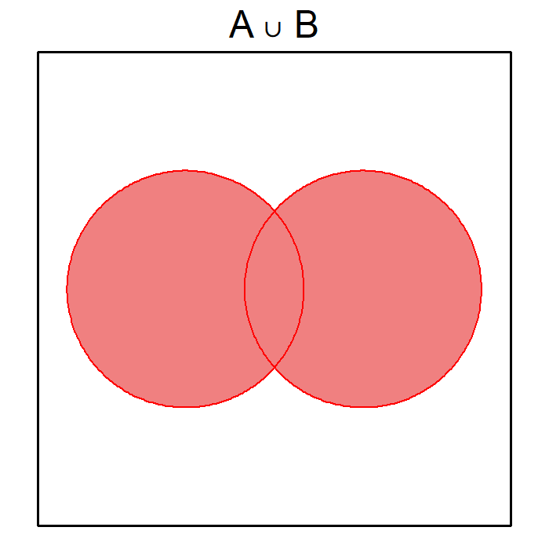
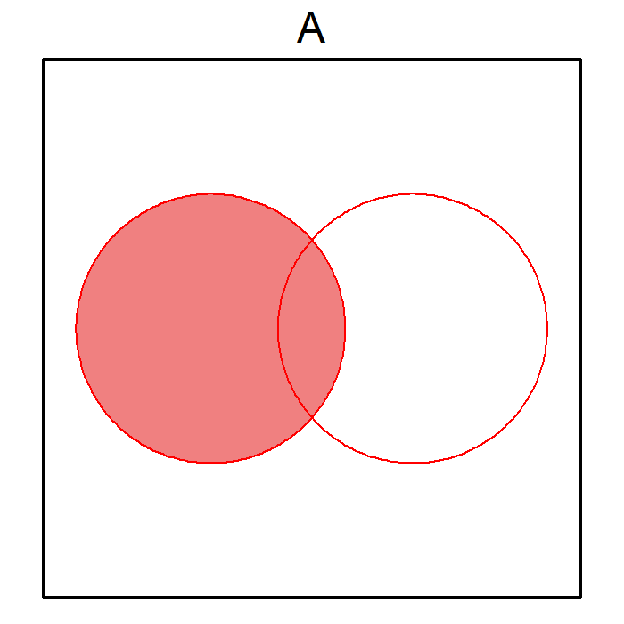
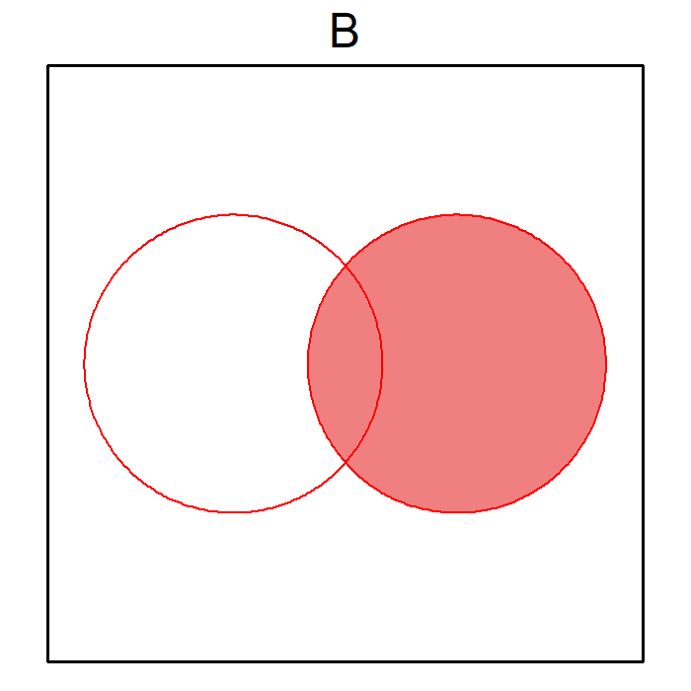
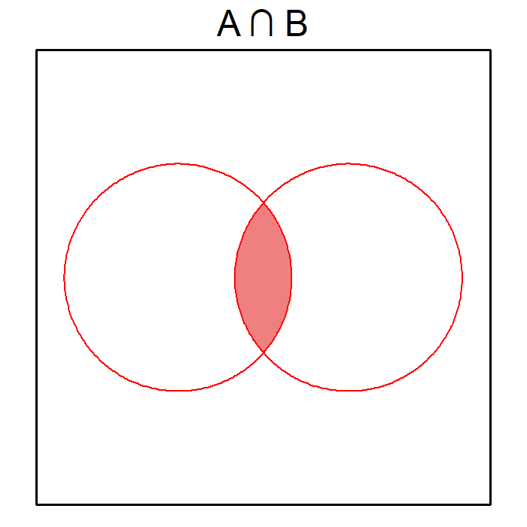

Addition Rule
The addition rule is used to calculate the probability that either event $A$ or $B$, occurs. For any two events $A$ and $B$:
$$P\left(A∪B\right)=P\left(A\right)+P\left(B\right)−P\left(A∩B\right)$$
The overlap $(A∩B)$ is counted twice when we add $P(A)$ and $P(B)$, so we subtract it once.

Slide 23
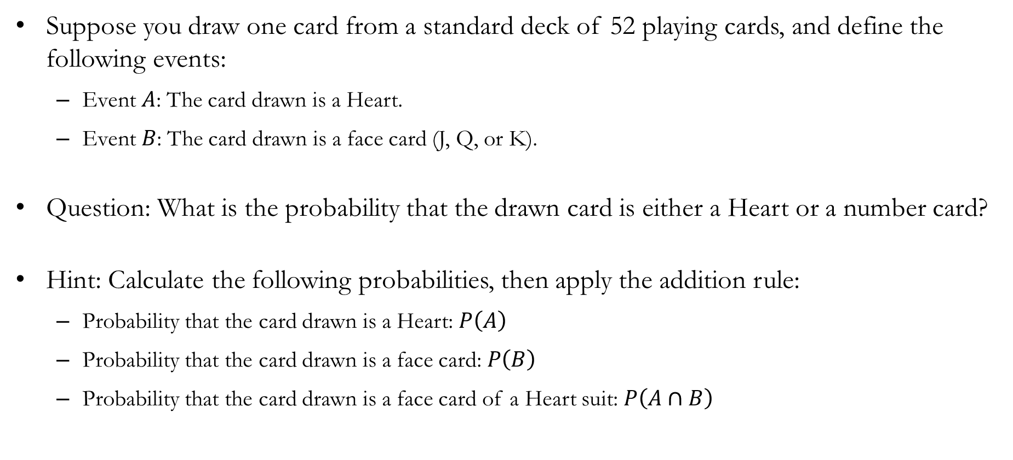
In-class Exercise
Suppose you draw one card from a standard deck of 52 playing cards, and define the following events:
Event $A$: The card drawn is a Heart.
Event $B$: The card drawn is a face card (J, Q, or K).
Question: What is the probability that the drawn card is either a Heart or a number card?
Hint: Calculate the following probabilities, then apply the addition rule:
Probability that the card drawn is a Heart: $P\left(A\right)$
Probability that the card drawn is a face card: $P\left(B\right)$
Probability that the card drawn is a face card of a Heart suit: $P\left(A∩B\right)$

Slide 24

Solution to In-class Exercise
There are 13 Hearts, so $P\left(A\right)=\frac{13}{52}$
There are 12 face cards, so $P\left(B\right)=\frac{12}{52}$
There are 3 face cards that are Hearts, so $P\left(A∩B\right)=\frac{3}{52}$
Using the addition rule:
$$P\left(A∪B\right)=P\left(A\right)+P\left(B\right)−P\left(A∩B\right)=\frac{13}{52}+\frac{12}{52}−\frac{3}{52}=\frac{22}{52}≈42.31\%$$

Slide 25
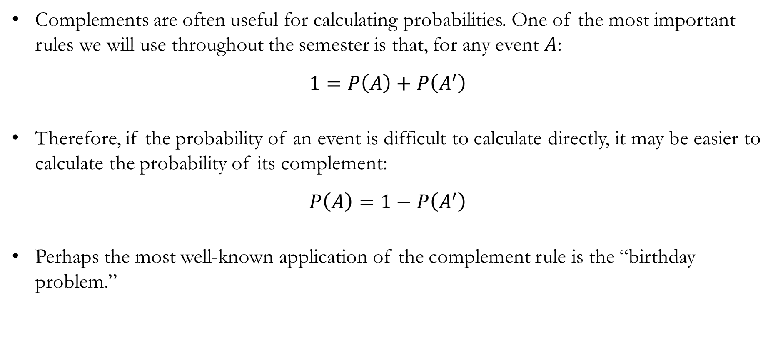
Complements
Complements are often useful for calculating probabilities. One of the most important rules we will use throughout the semester is that, for any event $A$:
$$1=P\left(A\right)+P\left(A^{′}\right)$$
Therefore, if the probability of an event is difficult to calculate directly, it may be easier to calculate the probability of its complement:
$$P\left(A\right)=1−P\left(A^{′}\right)$$
Perhaps the most well-known application of the complement rule is the “birthday problem.”

Slide 26
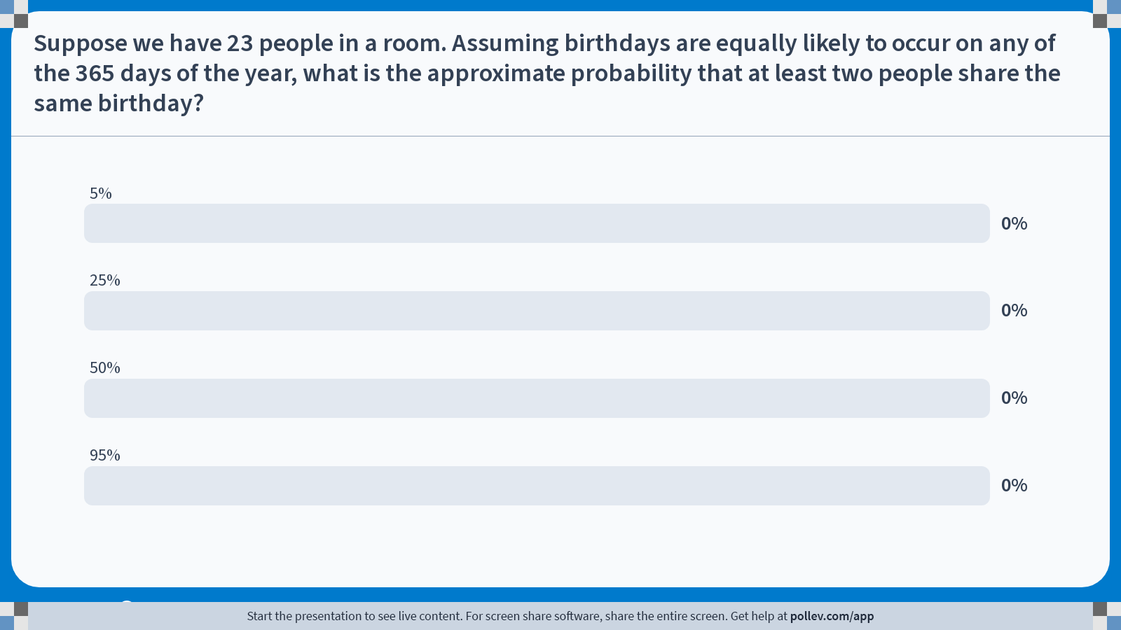
Poll Everywhere multiple choice poll activity Activity Title: Suppose we have 23 people in a room. Assuming birthdays are equally likely to occur on any of the 365 days of the year, what is the approximate probability that at least two people share the same birthday? Slide 24
Notes:
Do not modify the notes in this section to avoid tampering with the Poll Everywhere activity. More info at polleverywhere.com/support Suppose we have 23 people in a room. Assuming birthdays are equally likely to occur on any of the 365 days of the year, what is the approximate probability that at least two people share the same birthday? https://www.polleverywhere.com/multiple_choice_polls/T6B3zrEZcC7AwVahnC4EZ?state=opened&flow=Default&onscreen=persist

Slide 27
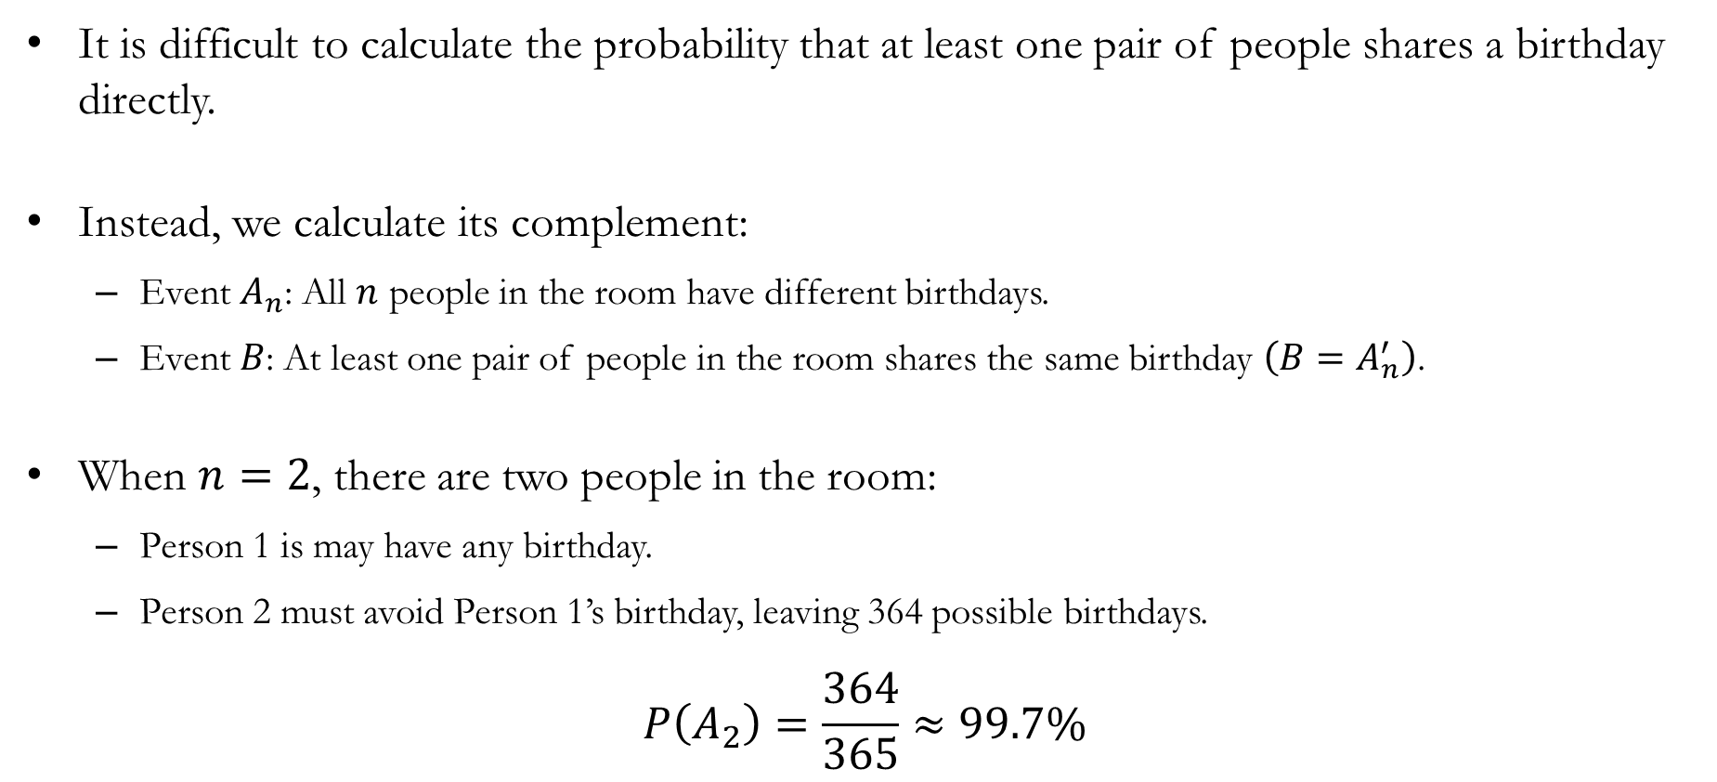
Detour: Solution to the “Birthday Problem”
It is difficult to calculate the probability that at least one pair of people shares a birthday directly.
Instead, we calculate its complement:
Event $A_{n}$: All $n$ people in the room have different birthdays.
Event $B$: At least one pair of people in the room shares the same birthday $\left(B=A_{n}^{′}\right)$.
When $n=2$, there are two people in the room:
Person 1 is may have any birthday.
Person 2 must avoid Person 1’s birthday, leaving 364 possible birthdays.
$$P\left(A_{2}\right)=\frac{364}{365}≈99.7\%$$

Slide 28
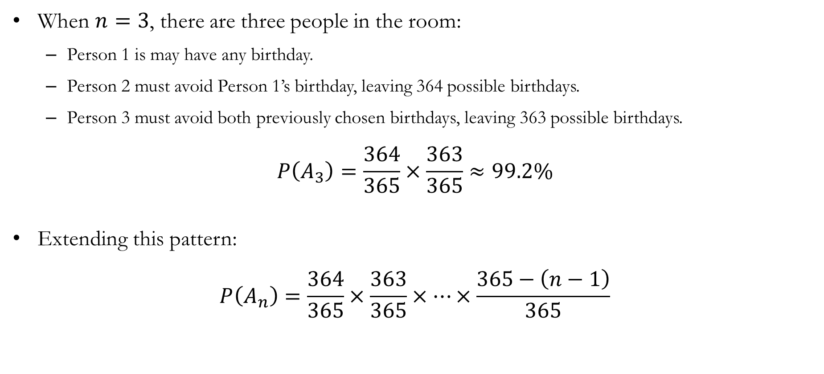
Detour: Solution to the “Birthday Problem”
When $n=3$, there are three people in the room:
Person 1 is may have any birthday.
Person 2 must avoid Person 1’s birthday, leaving 364 possible birthdays.
Person 3 must avoid both previously chosen birthdays, leaving 363 possible birthdays.
$$P\left(A_{3}\right)=\frac{364}{365}×\frac{363}{365}≈99.2\%$$
Extending this pattern:
$$P\left(A_{n}\right)=\frac{364}{365}×\frac{363}{365}×⋯×\frac{365−\left(n−1\right)}{365}$$

Slide 29

Detour: Solution to the “Birthday Problem”
When $n=23$, we find that:
$$P\left(A_{23}\right)=\frac{364}{365}×\frac{363}{365}×⋯×\frac{365−\left(23−1\right)}{365}≈49.27\%$$
Therefore, the probability that at least one pair of people shares the same birthday in a room of 23 people is:
$$P\left(B\right)=1−P\left(A_{23}\right)≈50.73\%$$

Slide 30
Conditional Probability

Slide 31
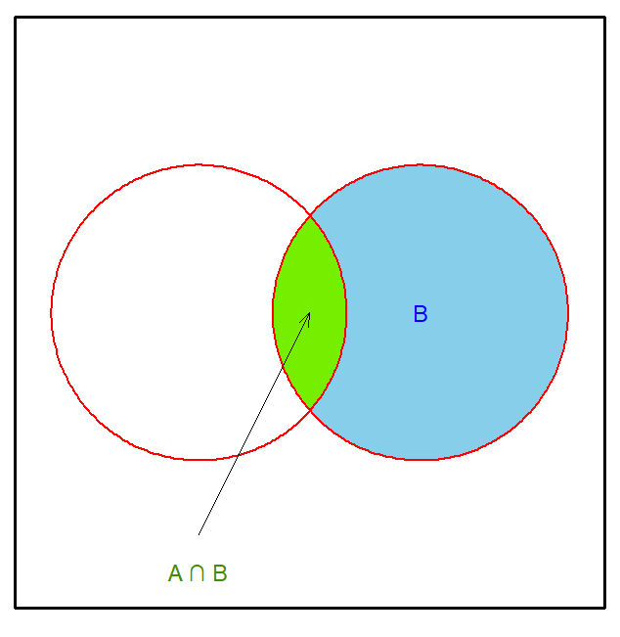
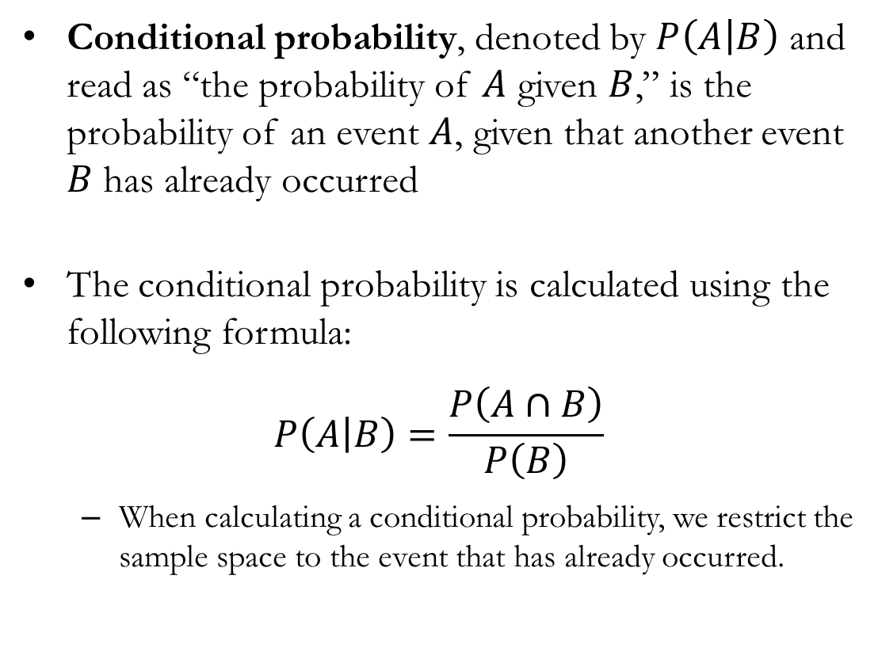
Conditional Probability
Conditional probability, denoted by $P\left(A | B\right)$ and read as “the probability of $A$ given $B$,” is the probability of an event $A$, given that another event $B$ has already occurred
The conditional probability is calculated using the following formula:
$$P\left(A | B\right)=\frac{P\left(A∩B\right)}{P\left(B\right)}$$
When calculating a conditional probability, we restrict the sample space to the event that has already occurred.

Slide 32
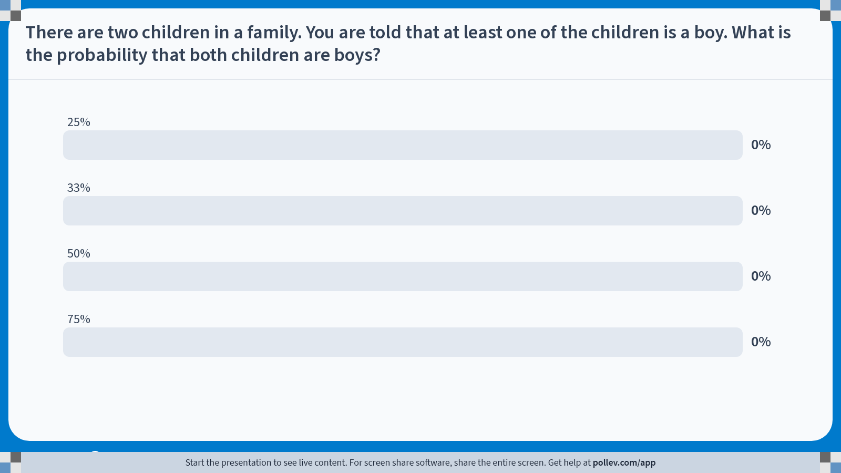
Poll Everywhere multiple choice poll activity Activity Title: There are two children in a family. You are told that at least one of the children is a boy. What is the probability that both children are boys? Slide 30
Notes:
Do not modify the notes in this section to avoid tampering with the Poll Everywhere activity. More info at polleverywhere.com/support There are two children in a family. You are told that at least one of the children is a boy. What is the probability that both children are boys? https://www.polleverywhere.com/multiple_choice_polls/TB9s9cdCkpADLJ2fy6wWz?state=opened&flow=Default&onscreen=persist

Slide 33
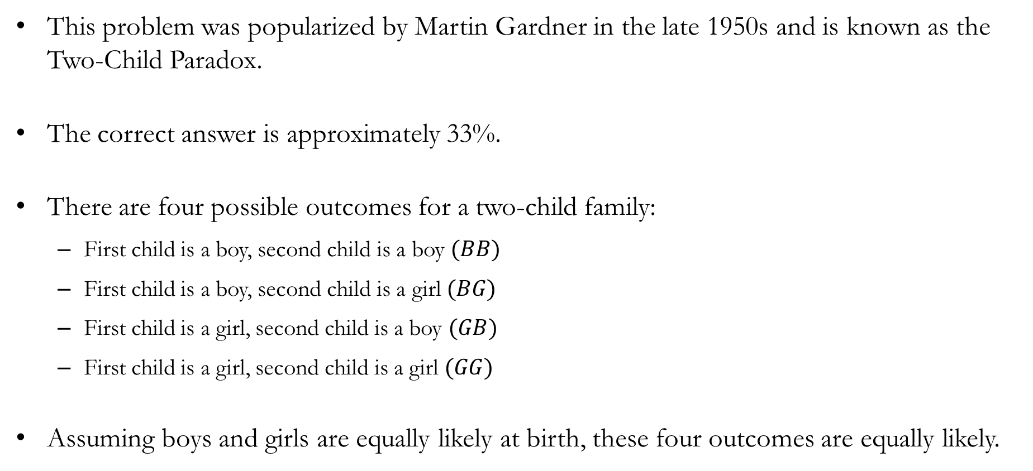
Solution to In-class Poll
This problem was popularized by Martin Gardner in the late 1950s and is known as the Two-Child Paradox.
The correct answer is approximately 33%.
There are four possible outcomes for a two-child family:
First child is a boy, second child is a boy $(BB)$
First child is a boy, second child is a girl $(BG)$
First child is a girl, second child is a boy $(GB)$
First child is a girl, second child is a girl $(GG)$
Assuming boys and girls are equally likely at birth, these four outcomes are equally likely.

Slide 34

Solution to In-class Poll
So, the sample space without any information on the sex of the children is:
$$S=\left\{BB,BG,GB,GG\right\}$$
Knowing that at least one child is a boy rules out one possible outcome, $GG$. Thus, the sample space becomes:
$$S=\left\{BB,BG,GB\right\}$$
Therefore:
$$P\left(BB | \text{at least one child is a boy}\right)=\frac{1}{3}$$

Slide 35
Detour: Extensions to the Two-Child Paradox
Information provided can change the sample space in non-obvious ways.
Question #1: There are two children in a family. You are told that the older child is a boy. What is the probability that both children are boys?
Question #2: There are two children in a family. You are told that at least one child is a boy born in the spring. What is the probability that both children are boys?
Answer to Question #1: 50%
Answer to Question #2: Approximately 48.4%

Slide 36
Recap & Preview

Slide 37
Recap: Chapter 4
In this chapter, we learned the basics of probability.
Probability measures how likely an event is to occur.
We learned the fundamental rules for combining probabilities.
We saw how additional information can change probabilities.
We distinguished between independent and dependent events.
We used probability to reason about uncertainty and make informed decisions.
Takeaway: We covered the basic tools of probability for describing and reasoning about uncertainty.

Slide 38
Preview: Chapter 5
In the next chapter, we'll move beyond individual events and learn how to describe all possible outcomes of a random process.
We will learn how to:
Define random variables.
Distinguish between discrete and continuous random variables.
Build a probability distribution.
Interpret a probability mass function (PMF).
Summarize a distribution using its expected value and standard deviation.

