Slide 1
BUSINESS STATISTICS
Chapter 1: Data and Statistics

Slide 2
Preview
Suppose we want to find the average height of visitors to Disneyland in 2025.
The Ideal: Measure every visitor and compute the average.
In 2025 alone, Disneyland admitted approximately 17.4 million visitors.
The ideal is possible in theory, but impractical in reality: too costly and time-consuming.
Instead, we look at a smaller group of visitors (e.g., all visitors in a 3-hour window) and use that to estimate the average.

Slide 3
Preview
Statistics allows us to use a smaller sample to learn about a larger population.
e.g., Visitors in one given day in 2025 is a sample.
e.g., All visitors in 2025 is the population.
From Data to Answers:
We collect data from a sample
We summarize the data (averages, graphs, patterns)
We use the sample to learn about the population
We acknowledge uncertainty in our conclusions
Statistics is not just collecting data. It is about learning from limited information.

Slide 4
Preview
Descriptive Statistics: Summarizing and organizing data.
e.g., Measuring and calculating the average height of today’s visitors to Disneyland.
Inferential Statistics: Using a sample to make statements about a population.
e.g., Estimating the average height of all visitors to Disneyland.
Questions we will be asking?
How do we collect a good sample?
What are some commonly used measures?
Why can we rely on truths about samples to infer information on the population?
How do we know our estimate is a good measure of the population?

Slide 5
Data

Slide 6
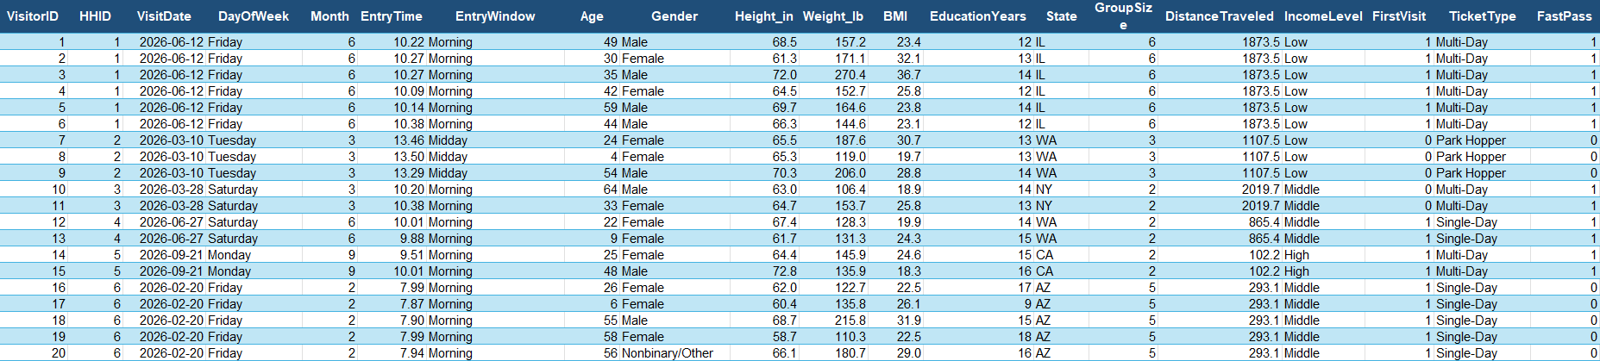
Data
A researcher collects data on 5,000 randomly selected individuals entering Disneyland:
Each row here represents one visitor and their recorded characteristics.
Each column represents a different characteristic, such as age, entry time, or total spending.
The information collected is called data, and the collection of all data for a specific study is called a data set.

Slide 7
Data: Elements, Variables, Observations
To analyze data correctly, we need to define what we are observing and what we are measuring.
Element: Entities on which data are collected.
In this Disneyland study, the elements are individual visitors, who are uniquely identified by VisitorID.
Variable: A characteristic measured for each element.
In this Disneyland study, examples of variables include Age, EntryTime, and TotalSpending.
Observation: All measurements collected for a single element.
In this Disneyland study, an observation corresponds to an entire row.

Slide 8
Data: Scales of Measurement
Not all variables are measured the same way:
Nominal: Categories with no inherent order (arbitrary ordering, such as alphabetical, doesn’t count).
Ordinal: Ordered categories, but differences are not measurable.
Interval: Numeric scale with equal spacing, but no meaningful zero (differences are meaningful).
Ratio: Numeric scale with equal spacing and a true zero (ratios are meaningful).
Consider the following variables in the Disneyland dataset:
State: Nominal, since it is non-numerical with no inherent ordering.
IncomeLevel: Ordinal, since it is non-numerical, and has a natural ordering (low<middle<high).
EntryTime: Interval, since it is numeric, but 0 does not represent “no time.”
TotalSpending: Ratio, since it is numeric, and 0 does mean “no spending.”

Slide 9
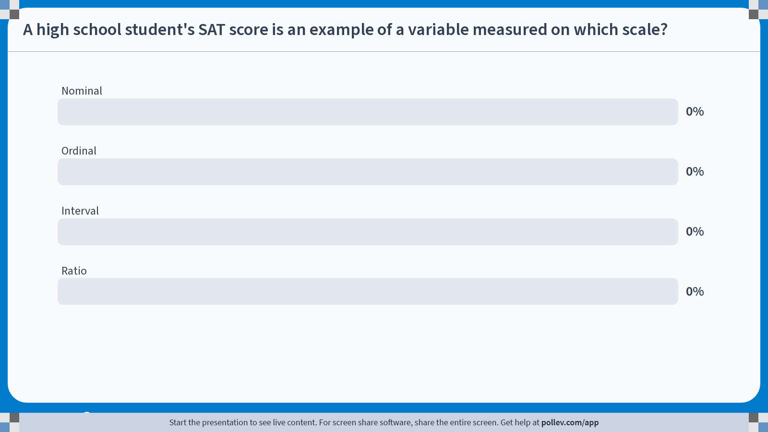
Poll Everywhere multiple choice poll activity Activity Title: A high school student's SAT score is an example of a variable measured on which scale? Slide 9
Notes:
Do not modify the notes in this section to avoid tampering with the Poll Everywhere activity. More info at polleverywhere.com/support A high school student's SAT score is an example of a variable measured on which scale? https://www.polleverywhere.com/multiple_choice_polls/DZlIIYYwoglg8T4pE6B1z?state=opened&flow=Default&onscreen=persist

Slide 10
Solution to In-class Poll
A student’s SAT score is best categorized as a variable measured on the interval scale.
Because the variable is numerical, it is neither nominal nor ordinal.
The variable has equal spacing, meaning:
The difference between scores of 1200 and 1300 is intended to be the same as the difference between 1300 and 1400.
Therefore, the differences in scores are meaningful.
However, an SAT score of 0 does not mean “no ability” or “no knowledge.”
We cannot say that a student with a score of 1400 knows twice as much as a student with a score of 700.
Therefore, ratios are not meaningful, and the variable is not measured on a ratio scale.

Slide 11
Data: Categorical and Quantitative
Data can also be classified as categorical or quantitative.
Categorical: Data that describe categories or groups.
Categorical data uses either the nominal or ordinal scale of measurement.
A variable with categorical data is called a categorical variable.
In the Disneyland study, DayOfWeek is an example of a categorical variable.
Quantitative: Data that are numeric and support meaningful arithmetic.
Quantitative data uses either the interval or ratio scale of measurement.
A variable with quantitative data is called a quantitative variable.
In the Disneyland study, Height_in is an example of a quantitative variable, because differences and averages are meaningful.

Slide 12
Data: Categorical and Quantitative
Caveat: Just because a variable is expressed using numbers does not mean it is truly quantitative.
Suppose we create a new variable called DayOfWeek_num.
Monday is coded as the number 1,
Tuesday is coded as the number 2,
and so on…
Question:
Is DayOfWeek_num a quantitative variable?
Does it make sense to take the average of DayOfWeek_num?
No. Numbers don’t make something quantitative. Meaningful arithmetic does.

Slide 13
Data: Cross-sectional and Time Series
Some data provide a snapshot of many individuals at a given point in time, while other data track how variables evolve over time.
Cross-Sectional: Data that provides a snapshot of many individuals at a given point in time.
Time-Series: Data that tracks how variables change over time.
Longitudinal (Panel): Data that combines both dimensions by tracking the same individuals over time.
For instance:
Data from questionnaires given to all Disneyland visitors in a given day is cross-sectional.
Data tracking total daily visitors to Disneyland throughout a given year is time-series.
Data tracking the same Disneyland visitor over multiple visits is longitudinal.

Slide 14
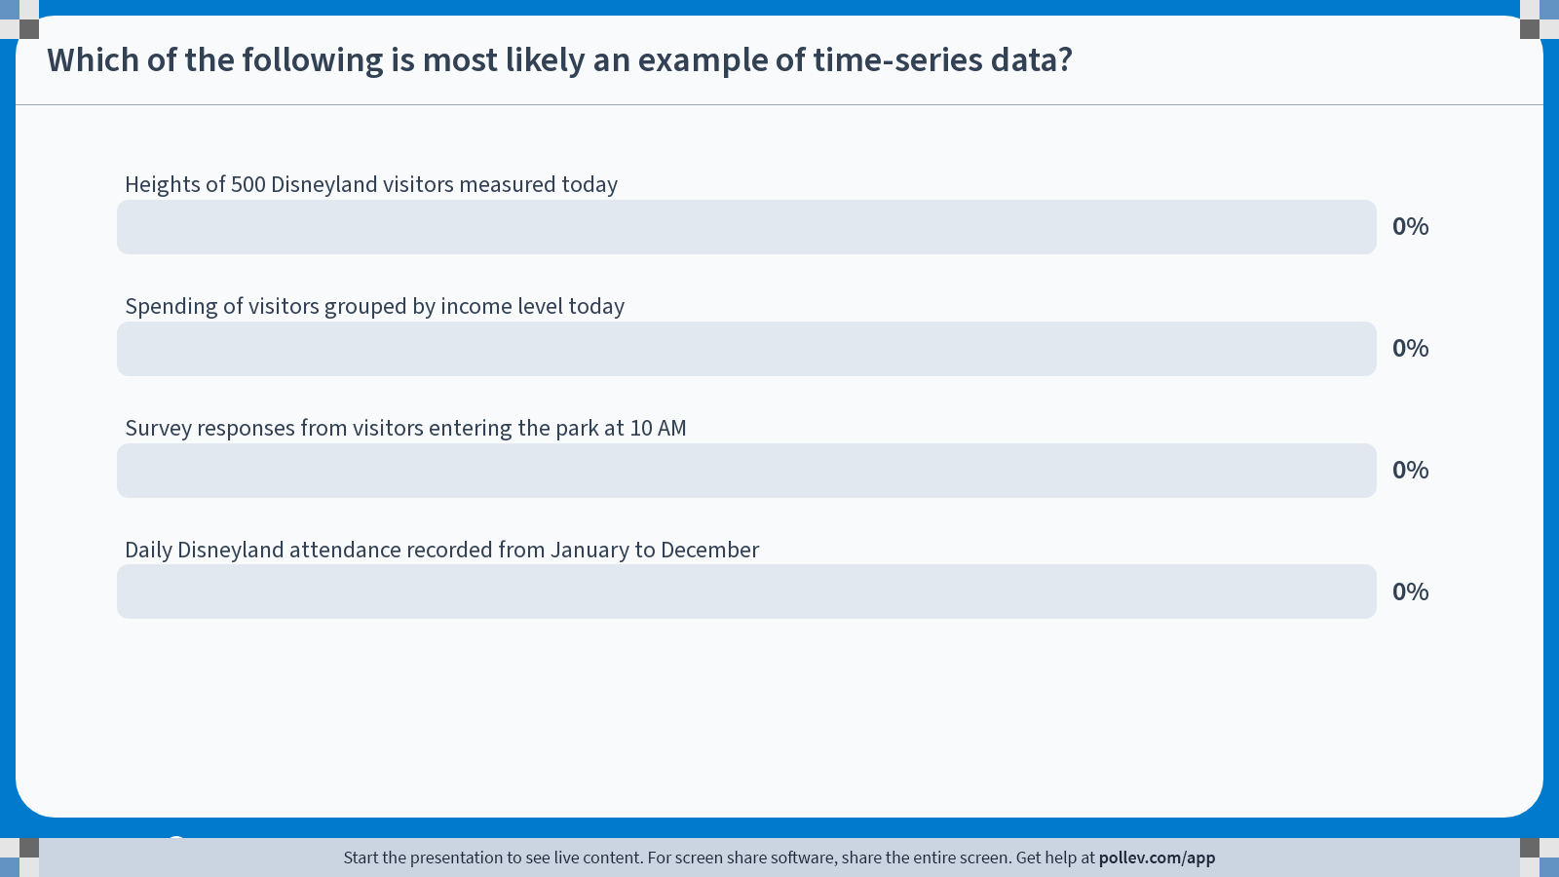
Poll Everywhere multiple choice poll activity Activity Title: Which of the following is most likely an example of time-series data? Slide 14
Notes:
Do not modify the notes in this section to avoid tampering with the Poll Everywhere activity. More info at polleverywhere.com/support Which of the following is most likely an example of time-series data? https://www.polleverywhere.com/multiple_choice_polls/QCmyBOtu335wpPuEJdf4f?state=opened&flow=Default&onscreen=persist

Slide 15
Solution to In-class Poll
The correct answer is: Daily Disneyland attendance recorded from January to December.
This is an example of time-series data because:
The same variable (daily attendance) is measured repeatedly over time.
The goal is to observe how the variable changes across days, weeks, or months.
The other options are examples of cross-sectional data because:
They provide a snapshot of many individuals at a single point in time.
Even though they involve many observations, they are not tracking changes over time.
Cross-sectional data compares many individuals at one point in time, while time-series data tracks a variable across multiple time periods.

Slide 16
Visualization and
Interpretation

Slide 17
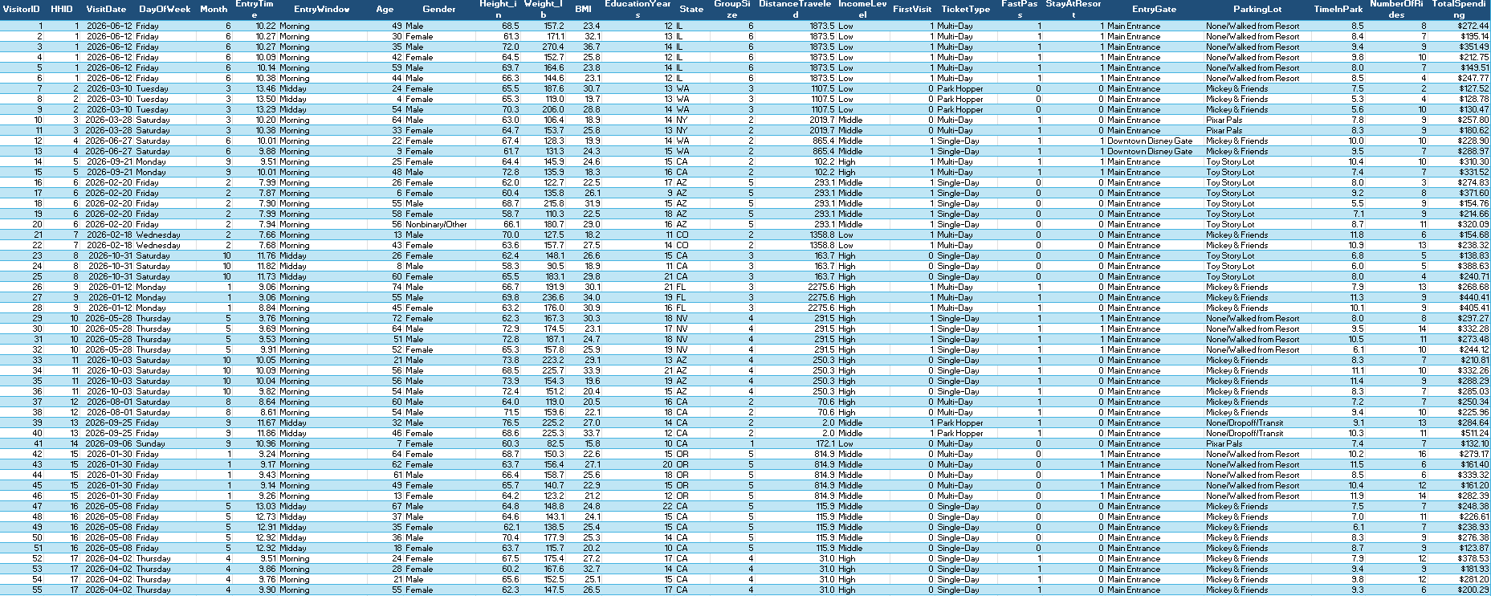
From Raw Data to Insight

Slide 18
Descriptive Statistics
The previous slide displays approximately 1.1% of the entire data set.
Could you identify the average visitor spending by income level just by looking at this table?
Humans cannot meaningfully interpret raw datasets directly.
Data can be summarized and presented using descriptive statistics, which are methods used to organize and summarize data, helping us better understand the information.
Common ways data is summarized:
Numerical: Use summary statistics such as the mean, median, standard deviation, or percentiles to describe the data using numbers.
Tabular: Organize data into tables to summarize frequencies, categories, or grouped values.
Graphical: Use visualizations to display patterns, distributions, or relationships in the data.

Slide 19
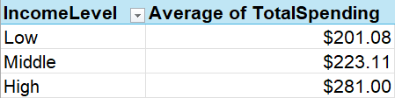
Descriptive Statistics: Examples
The same information can be summarized in multiple ways:
Numerical:
Average spending (low): $201.08
Average spending (middle): $223.11
Average spending (high): $281.00
Tabular
Graphical:

Slide 20
Statistical Inference
Population: The set of all elements of interest in a particular study.
Gathering information on the entire population would provide the highest possible accuracy in answering our questions.
A census is the process of collecting data from the entire population.
Sample: A subset of the population.
Due to real-world constraints such as time and cost, we often only have access to a smaller subset of elements.
A sample survey is the process of collecting data from a sample.
Statistical inference refers to the process of learning about the population using the information available in the sample.

Slide 21
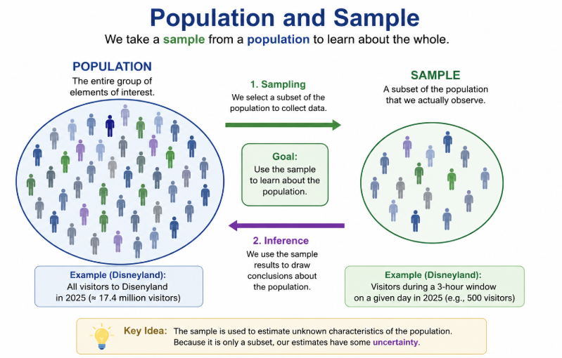
Statistical Inference

Slide 22
Analytics
A pile of bricks does not make a house. Likewise, raw data alone does not automatically produce useful insights.
We must organize, analyze, and interpret data before it can support better decision-making.
The broad process of transforming raw data into useful insights is called analytics:
Descriptive: Techniques that describe what happened in the past - “What happened?”
Predictive: Techniques that use models to predict future outcomes - “What is likely to happen?”
Prescriptive: Techniques that identify a recommended course of action - “What should we do?”
Most of the techniques used in analytics has been derived from the study of probability and statistics.

Slide 23
Recap & Preview

Slide 24
Recap
Statistics is the process of learning about large populations using limited information.
We collect data from a sample
The sample represents a larger population
Data can take different forms:
Nominal vs. Ordinal vs. Interval vs. Ratio
Categorical vs. Quantitative
Cross-sectional vs. Time-series
Descriptive statistics help us organize and summarize data
Statistical inference uses sample information to learn about populations and support decision-making
Analytics transforms raw data into useful insights for decision-making

Slide 25
Preview
In the next lecture, we will learn how to organize and visualize data using tables and graphs.
We will focus on questions such as:
How can we summarize large datasets visually?
What types of graphs work best for different kinds of data?
How can visualizations help us identify patterns and trends?
How can misleading graphs distort interpretation?
Key Idea: Good visualizations transform raw data into understandable information.

