Slide 1
BUSINESS STATISTICS
Chapter 2: Descriptive Statistics – Tabular and Graphical Displays

Slide 2
Summarizing
Categorical Variables

Slide 3
Frequency Distribution
A frequency distribution is a tabular summary of data showing the number (frequency) of observations within each of several nonoverlapping categories or classes.
For instance, suppose we are interested in the number of visitors who entered Disneyland through each of the entrances:
Main Entrance
Downtown Disney Gate
Hotel Guest Entrance
This is equivalent to asking for a frequency distribution.
Frequency: “How many guests entered through each entrance?”
Categories: “Main Entrance,” “Downtown Disney Gate,” etc.

Slide 4
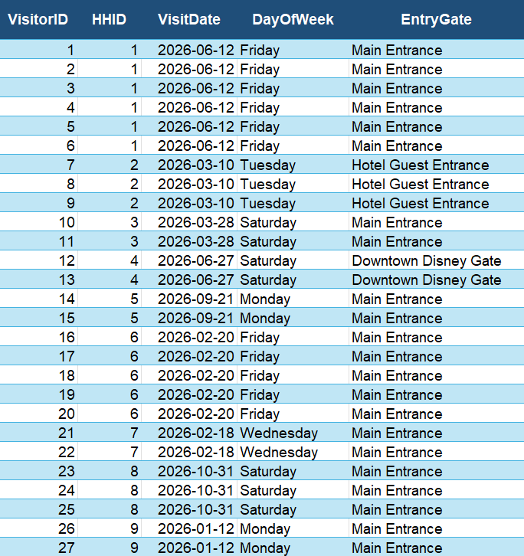
Frequency Distribution: A Brief Example
Let’s see what this looks like using a small portion of the Disneyland data set.
We can count how many guests entered through each gate by counting how many times each gate appears in the EntryGate variable.
The count reveals:
Main Entrance: 21 guests
Downtown Disney Gate: 2 guests
Hotel Guest Entrance: 3 guests

Slide 5
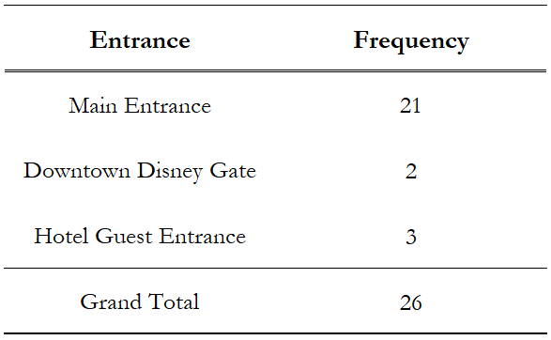
Frequency Distribution: Tabular View
A frequency distribution can be summarized using a table.
A tabular representation makes it easy to see the exact frequencies.
Most guests entered through the Main Entrance, while the remaining entrances had relatively similar frequencies.

Slide 6
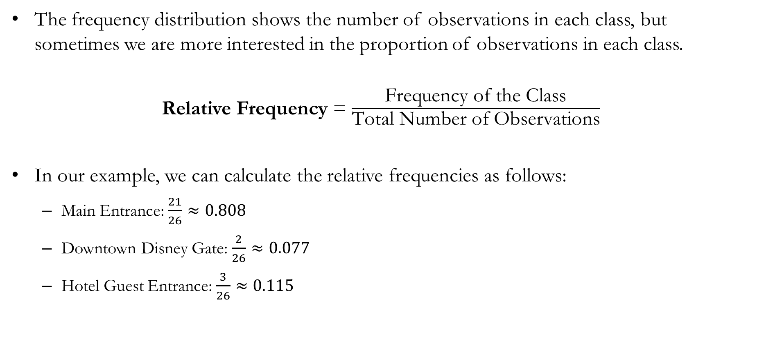
Frequency and Relative Frequency
The frequency distribution shows the number of observations in each class, but sometimes we are more interested in the proportion of observations in each class.
Relative Frequency = $\frac{\text{Frequency} \text{of} \text{the} \text{Class}}{\text{Total} \text{Number} \text{of} \text{Observations}}$
In our example, we can calculate the relative frequencies as follows:
Main Entrance: $\frac{21}{26}≈0.808$
Downtown Disney Gate: $\frac{2}{26}≈0.077$
Hotel Guest Entrance: $\frac{3}{26}≈0.115$
Approximately 81% of guests used the main entrance.
Approximately 7% of guests used the downtown Disney gate.
Approximately 12% of guests used the hotel guest entrance.

Slide 7
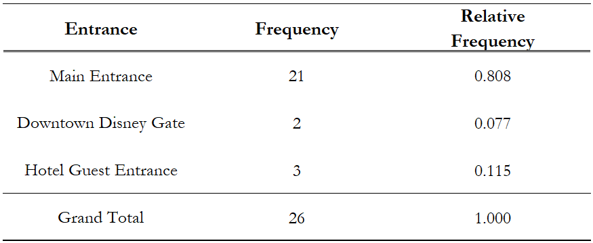
Frequency Distribution: Tabular View Expanded
A frequency distribution can be expanded to include relative frequencies.
Relative frequencies show the proportion of observations in each class.
The relative frequencies sum to 1.
Multiplying the relative frequencies by 100 gives the percent frequencies.

Slide 8
Frequency Distribution: Bar Charts
A bar chart is a graphical display used to depict categorical data summarized in a frequency, relative frequency, or percent frequency distribution.
Conventionally, we place the class along the horizontal axis, while the vertical axis represents the frequency, relative frequency, or percent frequency.
Using bars of fixed widths, we extend the height of each bar to represent the frequency, relative frequency, or percent frequency of the class.

Slide 9
Frequency Distribution: Pie Charts
A pie chart is a graphical display used to depict categorical data summarized in a relative frequency or percent frequency distribution.
We first draw a circle to represent all the data.
Then we use the relative frequencies to divide the circle into sectors corresponding to the relative frequency of each class.

Slide 10
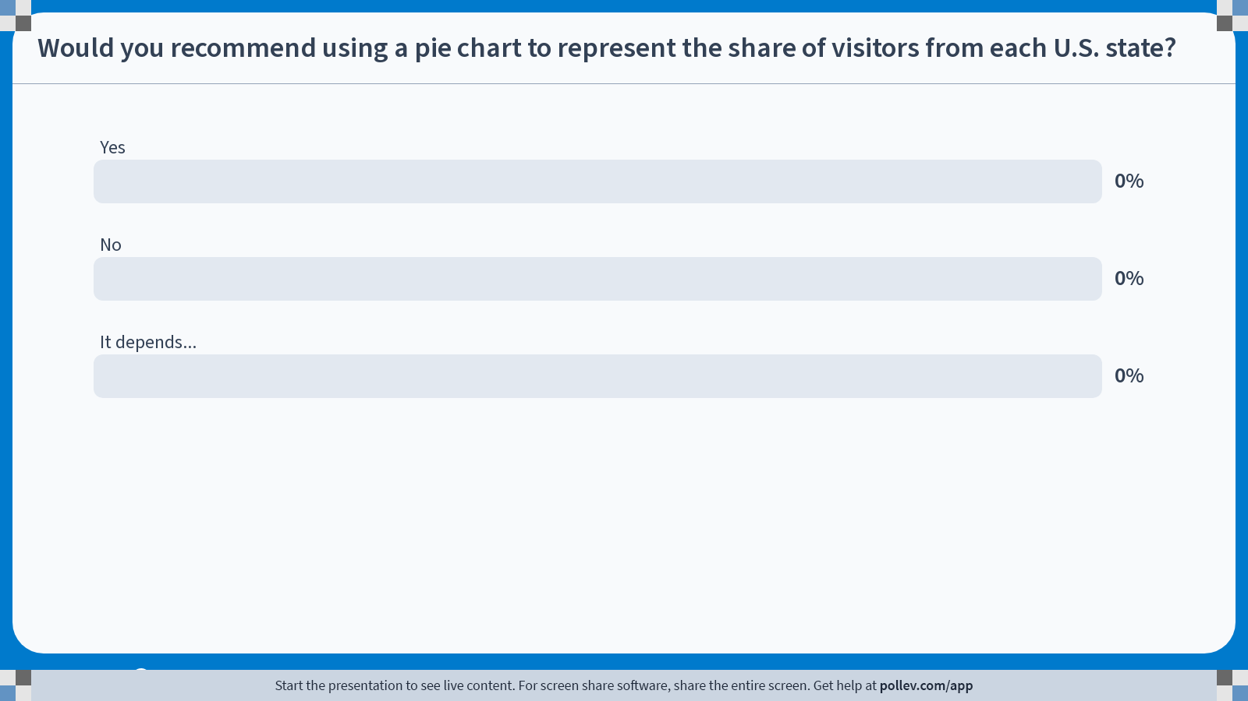
Poll Everywhere multiple choice poll activity Activity Title: Would you recommend using a pie chart to represent the share of visitors from each U.S. state? Slide 11
Notes:
Do not modify the notes in this section to avoid tampering with the Poll Everywhere activity. More info at polleverywhere.com/support Would you recommend using a pie chart to represent the share of visitors from each U.S. state? https://www.polleverywhere.com/multiple_choice_polls/XdGdWnh3PEPF1NN4p50rt?state=opened&flow=Default&onscreen=persist

Slide 11
Summarizing
Quantitative Variables

Slide 12
Number of Classes
A frequency distribution for a quantitative variable is still a tabular summary of data showing the number of observations in nonoverlapping classes.
However, quantitative data introduce a few additional decisions:
How many classes should we use?
What class width should we use?
What should the class limits be?
For categorical variables, these decisions were largely determined by how the data were organized and collected.
Consider visualizing the quantitative variable: Age

Slide 13
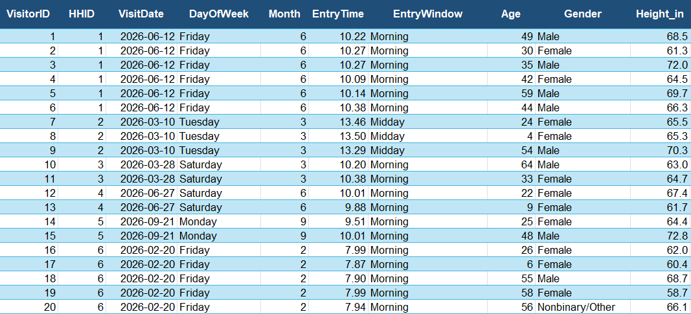
Frequency Distribution: Another Brief Example

Slide 14
Decisions: Number of Classes & Widths of Classes
Number of Classes:
The number of classes depends on the range of the quantitative data and the amount of detail we want to display.
As a general guideline, using more than 20 classes is usually not effective.
Width of the Classes:
A larger number of classes means narrower class widths.
A smaller number of classes means wider class widths.
Therefore, the number of classes and class widths are usually determined simultaneously.
As a general guideline, all classes should have the same width.
Approximate Class Width = $\frac{\text{Largest} \text{Data} \text{Value}\text{ − }\text{Smallest} \text{Data} \text{Value}}{\text{Number} \text{of} \text{Clasess}}$

Slide 15
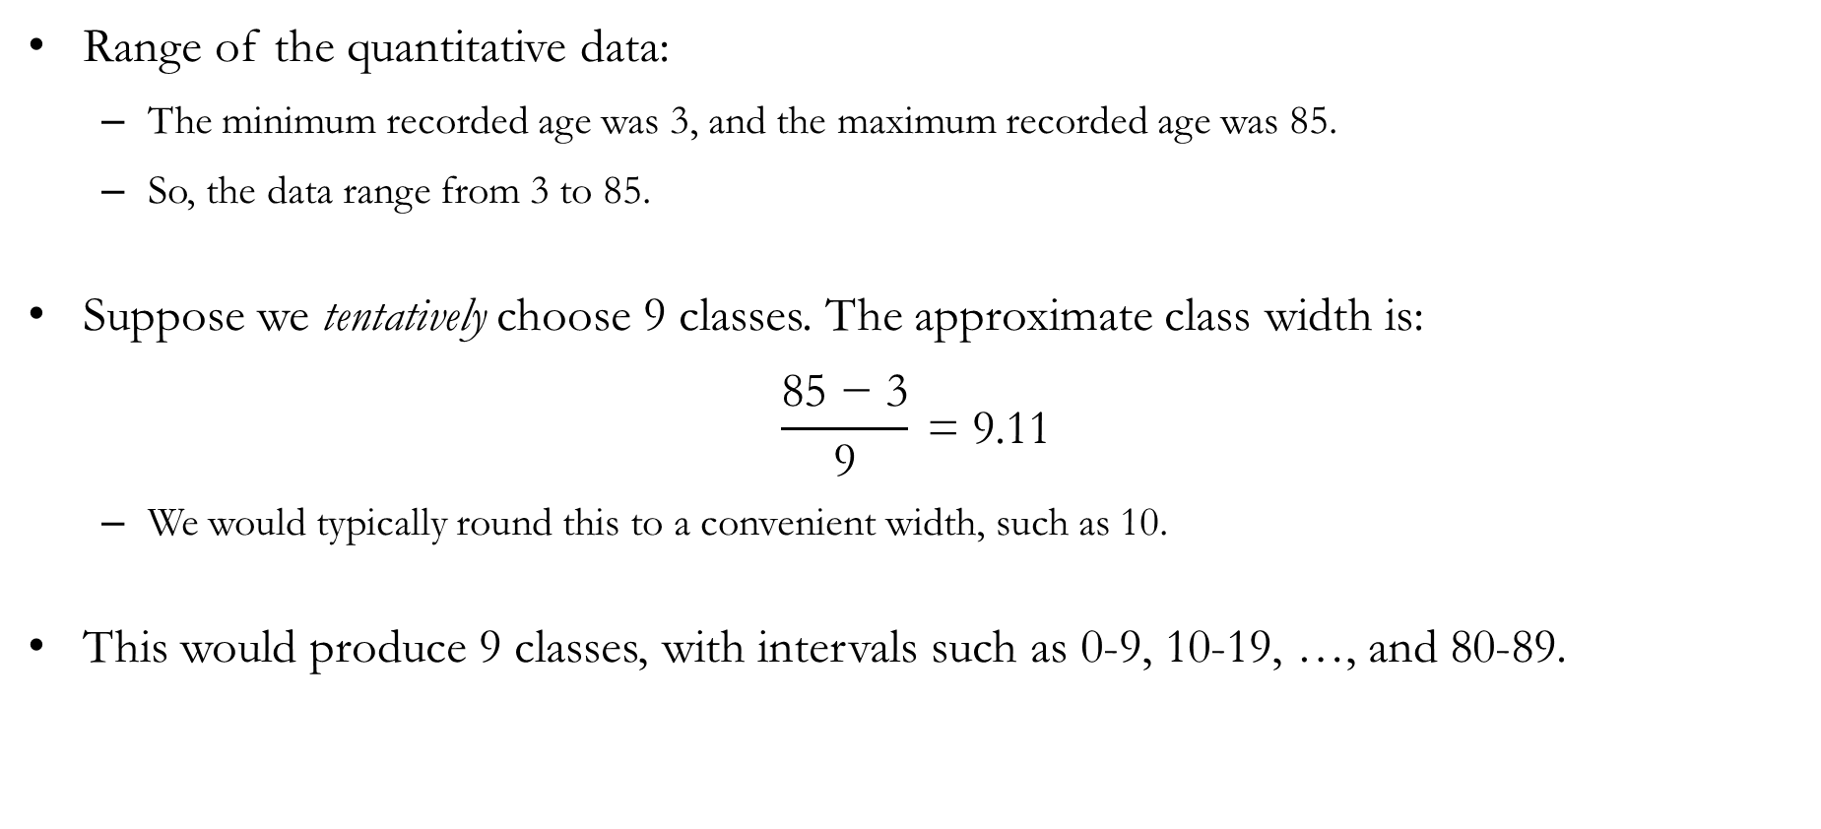
Example: Number of Classes & Widths of Classes
Range of the quantitative data:
The minimum recorded age was 3, and the maximum recorded age was 85.
So, the data range from 3 to 85.
Suppose we tentatively choose 9 classes. The approximate class width is:
$$\frac{\text{85}\text{ − }\text{3}}{\text{9}} \text{= }\text{9.11}$$
We would typically round this to a convenient width, such as 10.
This would produce 9 classes, with intervals such as 0-9, 10-19, …, and 80-89.

Slide 16
Caveat: Number of Classes & Widths of Classes
In the real-world, practitioners would rarely commit to a rigid number of classes first.
In practice, analysts typically use the following iterative approach:
Examine the data range.
Choose a tentative number of classes.
Compute the implied class width.
Round the width to a convenient value.
Check whether the resulting number of classes is reasonable.
Adjust as needed.
There is no single best frequency distribution for a given data set.

Slide 17
Decisions: Class Limits
Class Limits:
The lower class limit is the smallest value that can belong to a class.
The upper class limit identifies the largest possible data value assigned to the class.
Class limits are simply the starting and ending values of each class interval.
Example: Age of guests to Disneyland
We already determined that the range of data was 3 to 85.
We also determined we want class widths of 10, and a total of 9 classes.
In the class 0-9, the lower class limit is 0 and the upper class limit is 9.
In the class 10-19, the lower class limit is 10 and the upper class limit is 19.
Continuing this pattern gives the classes: 0-9, 10-19, …, and 80-89.

Slide 18
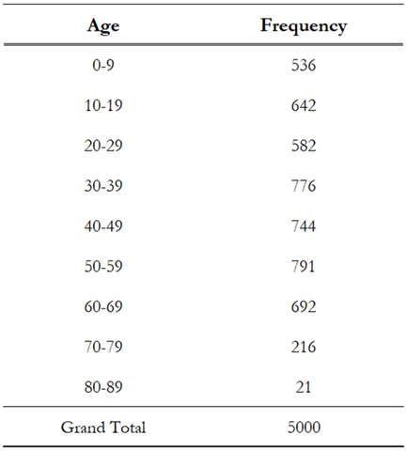
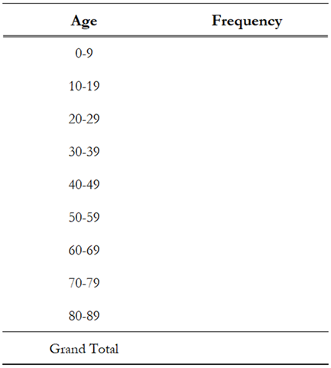
Frequency Distribution: Tabular View
We have now determined the number of classes, class widths, and class limits.
The frequency distribution is obtained by counting how many observations fall within each class.
We can gather some insight:
The 50-59 age group has the highest frequency, with 791 guests, making it the most common age group in the sample.
Only 21 guests were between 80 and 89 years old, making this the least common age group.

Slide 19
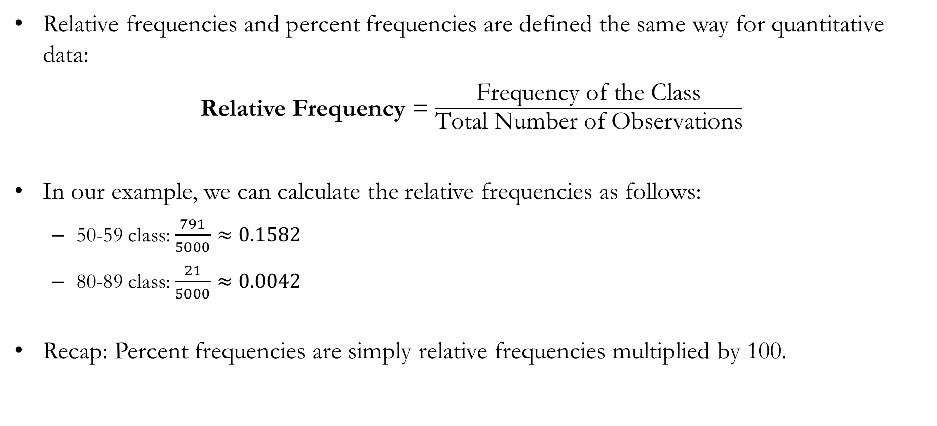
Frequency, Relative Frequency, & Percent Frequency
Relative frequencies and percent frequencies are defined the same way for quantitative data:
Relative Frequency = $\frac{\text{Frequency} \text{of} \text{the} \text{Class}}{\text{Total} \text{Number} \text{of} \text{Observations}}$
In our example, we can calculate the relative frequencies as follows:
50-59 class: $\frac{791}{5000}≈0.1582$
80-89 class: $\frac{21}{5000}≈0.0042$
Recap: Percent frequencies are simply relative frequencies multiplied by 100.
Approximately 15.8% of guests were in their 50s.
Approximately 0.4% of guests were in their 80s.

Slide 20
Frequency Distribution: Dot Plot
A dot plot is one of the simplest (but not widely used) graphical summaries of data:
Conventionally, we place the range of the data along the horizontal axis.
Each data value is represented by a dot placed above the axis.
Example: Suppose that the data is given as 1, 2, 2, 2, 3, 4, 4, 6, 6, 6, 6, 6.
First, we mark the possible values along the horizontal axis.
Then, we place one dot for each observation.
0
1
2
3
4
5
6
7

Slide 21
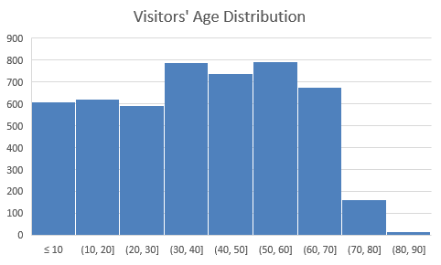
Frequency Distribution: Histogram
A histogram is one of the most common graphical summaries of data:
Conventionally, we place the range of the data along the horizontal axis.
The vertical axis shows the frequency, relative frequency, or percent frequency.
Each rectangle spans the class limits on the horizontal axis, and its height represents the corresponding frequency, relative frequency, or percent frequency.
The vertical axis shows the frequency.
The height of each rectangle represents the number of observations in that class.
The horizontal axis shows the class intervals.

Slide 22
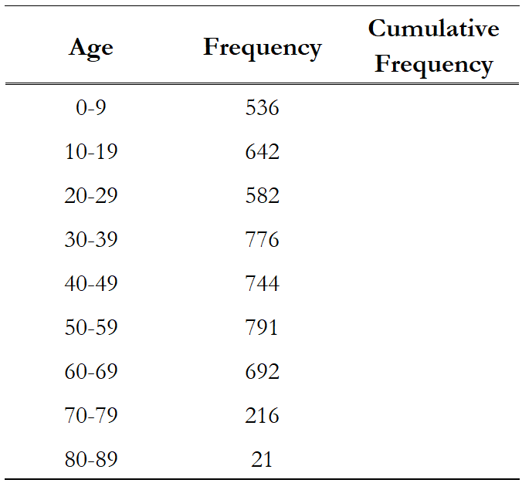
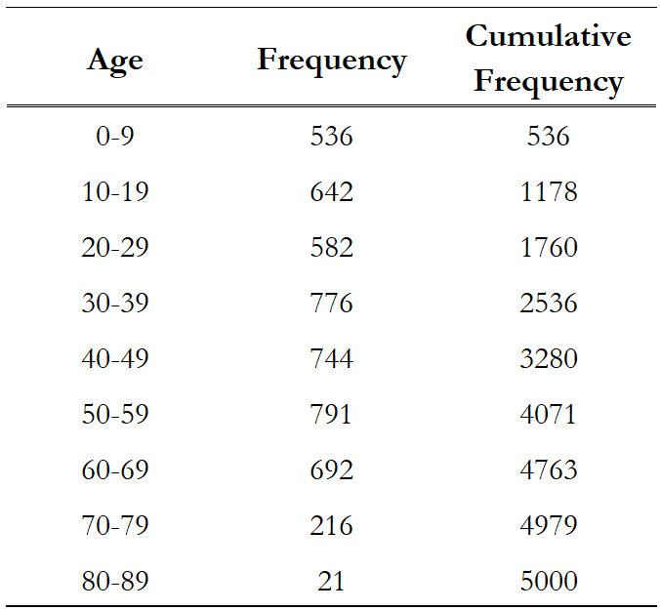
Cumulative Distributions
The cumulative frequency distribution is a variation of the frequency distribution that shows the number of observations with values less than or equal to the upper class limit of each class.
Example:
The first entry answers the question, “How many visitors were age 9 or younger?”
The second entry answers the question, “How many visitors were age 19 or younger?”
This process continues until the final cumulative frequency equals the total number of observations.

Slide 23
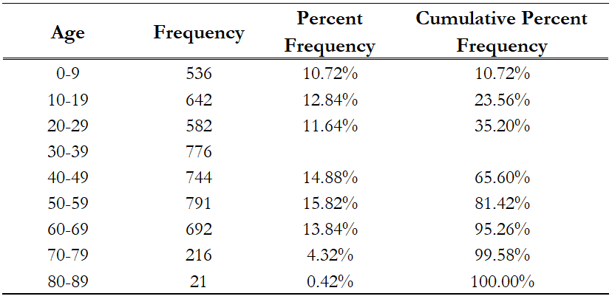
In-class Exercise: Cumulative Percent Frequency
?
?

Slide 24
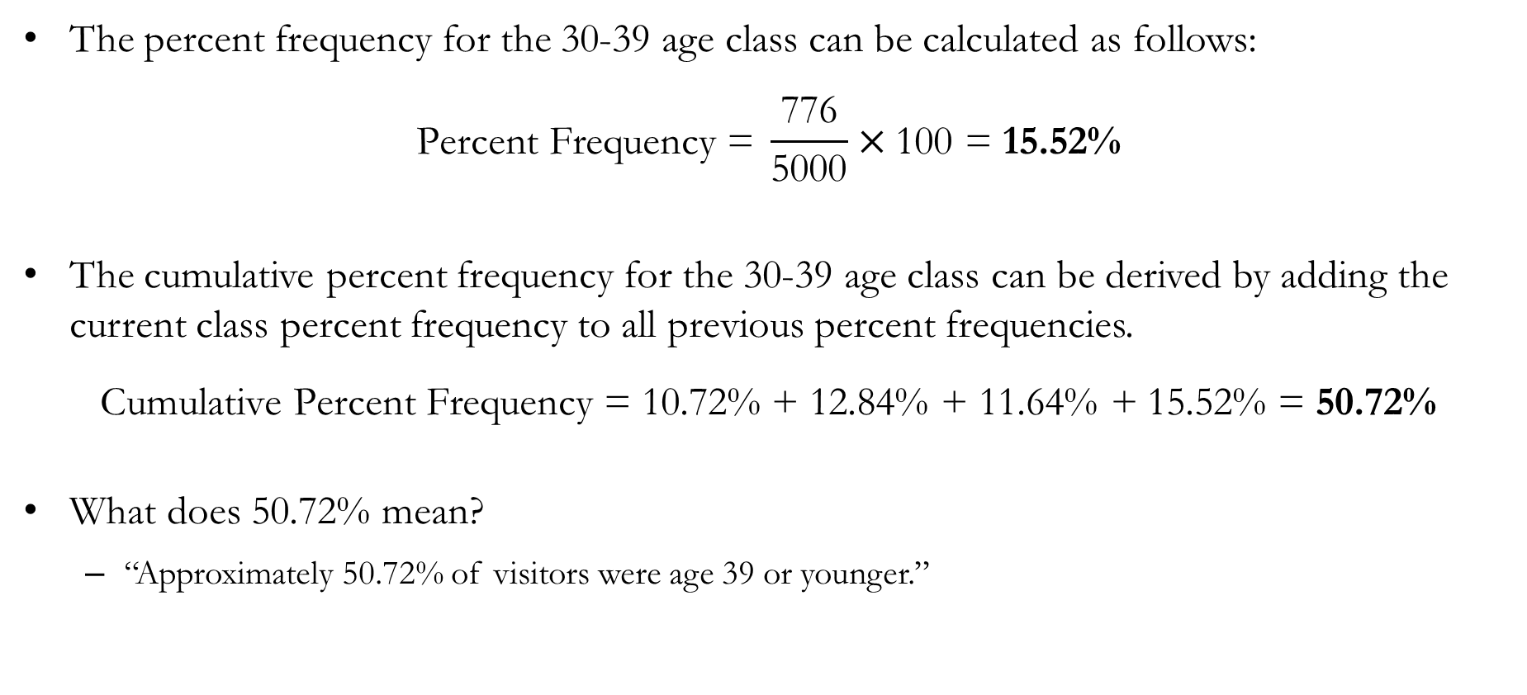
Solutions to In-class Exercise
The percent frequency for the 30-39 age class can be calculated as follows:
$$\text{Percent} \text{Frequency} \text{= }\frac{\text{776}}{\text{5000}}×\text{100 }\text{= 15.52\%}$$
The cumulative percent frequency for the 30-39 age class can be derived by adding the current class percent frequency to all previous percent frequencies.
$$\text{Cumulative} \text{Percent} \text{Frequency}\text{ = 10.72\% + 12.84\% + 11.64\% + 15.52\% = 50.72\%}$$
What does 50.72% mean?
“Approximately 50.72% of visitors were age 39 or younger.”

Slide 25
Summarizing Data for
Two Variables Using Tables

Slide 26
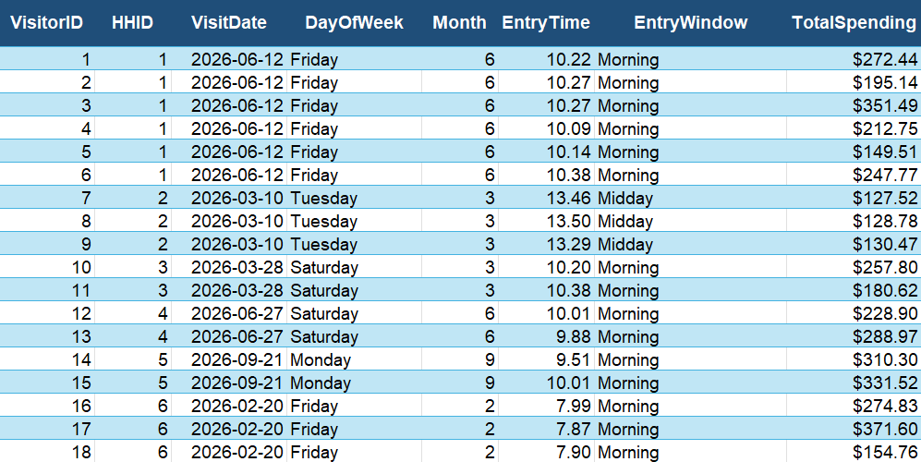
Time of Entry and Total Spending

Slide 27
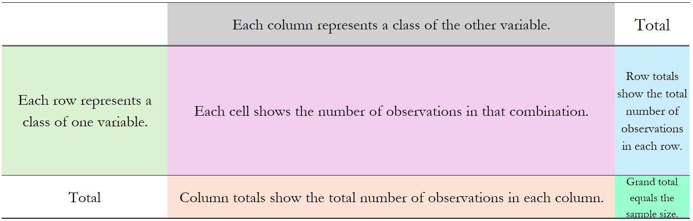
Summarizing Two Variables
Suppose we want to examine the relationship between guests’ time of entry into Disneyland (EntryWindow) and how much they spent during their visit (TotalSpending).
EntryWindow is a categorical variable with three classes: Morning, Midday, and Late Afternoon/Evening.
TotalSpending is a quantitative variable ranging from $51.84 to $650.
We can imagine a table that summarizes the relationship between these two variables.

Slide 28
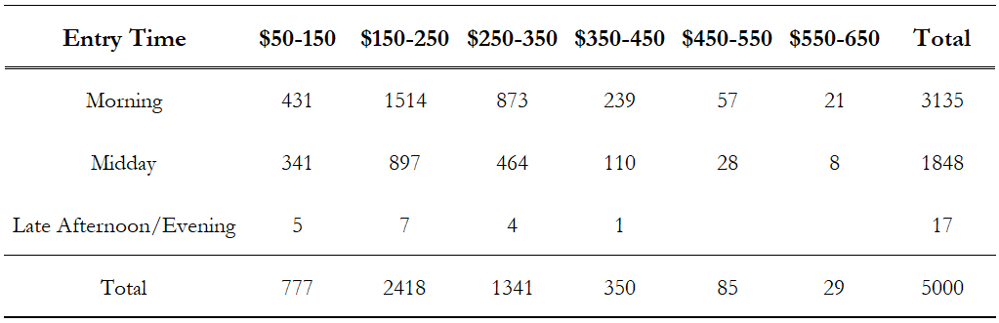
Crosstabulation
A crosstabulation is a tabular summary of data for two variables:
The rows each represent the three classes in the variable EntryWindow.
The columns represent grouped entries of TotalSpending.
Each cell shows the number of visitors that fall into that particular combination of categories.

Slide 29
Crosstabulation
A crosstabulation is a tabular summary of data for two variables:
For example, consider the cell containing 464 (the rectangle).
This means that 464 visitors entered Disneyland during midday and spent between $250 and $350 during their visit.

Slide 30
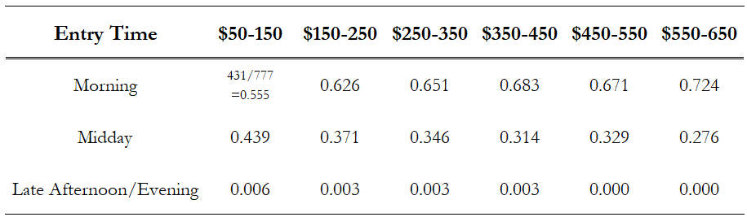
Crosstabulation and Relative Frequencies
Dividing each cell value by the column totals in the bottom row of the crosstabulation provides the relative frequency distribution of Entry Time for each TotalSpending class:
For example, the highlighted cell indicates that approximately 34.6% of visitors who spent between $250 and $350 entered Disneyland during midday.
So, dividing by the column totals provides the relative frequency distribution of EntryWindow for each TotalSpending class.

Slide 31
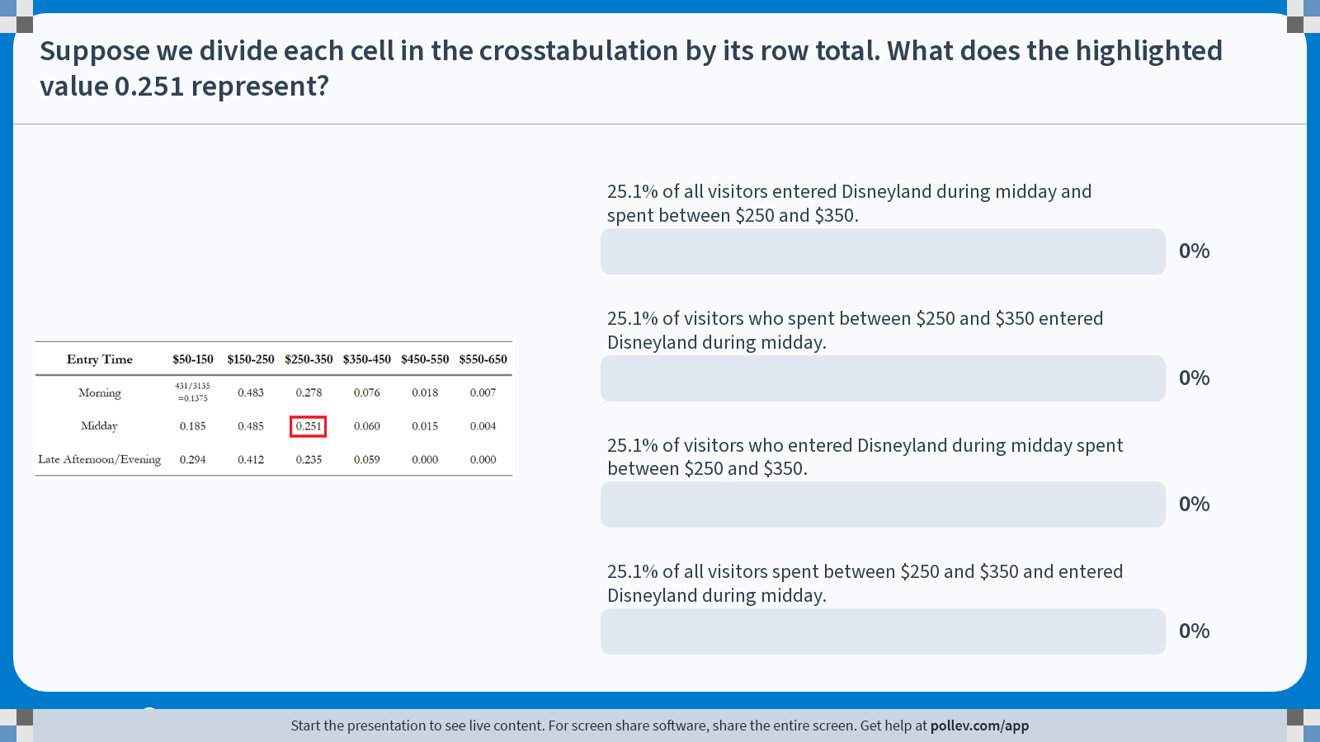
Poll Everywhere multiple choice poll activity Activity Title: Suppose we divide each cell in the crosstabulation by its row total. What does the highlighted value 0.251 represent? Slide 33
Notes:
Do not modify the notes in this section to avoid tampering with the Poll Everywhere activity. More info at polleverywhere.com/support Suppose we divide each cell in the crosstabulation by its row total. What does the highlighted value 0.251 represent? https://www.polleverywhere.com/multiple_choice_polls/K5aQGxZ6q4AHLQSmZLTGX?state=opened&flow=Default&onscreen=persist

Slide 32
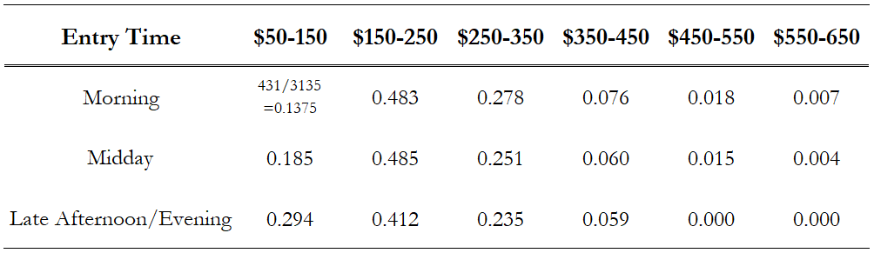
Solution to In-class Poll
Dividing each cell by its row total (in the rightmost column of the original crosstabulation) provides the relative frequency distribution of TotalSpending for each entry time:
The highlighted cell indicates that approximately 25.1% of visitors who entered Disneyland during midday spent between $250 and $350 during their visit.
The correct answer is option C.

Slide 33
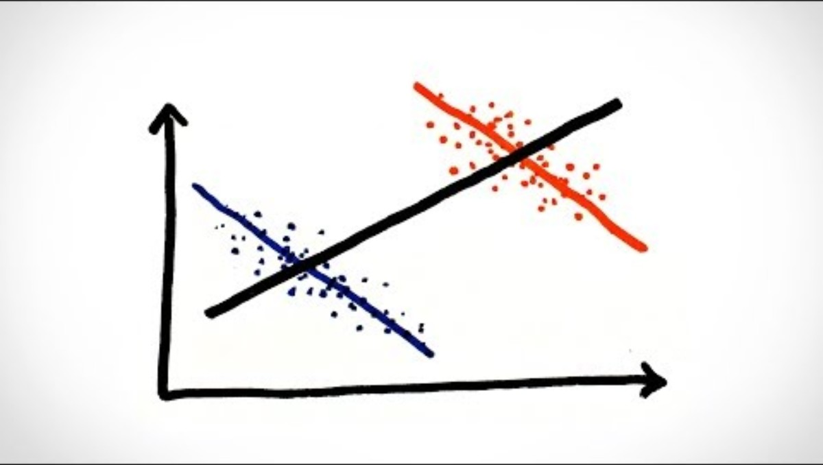
minutephysics. (2017, October 24). Simpson’s Paradox [Video]. YouTube. https://youtu.be/ebEkn-BiW5k?si=vkw_5blX2MUvxvhO

Slide 34
Simpson’s Paradox
Simpson’s Paradox occurs when a relationship that appears in several separate groups reverses or disappears when the groups are combined.
It often arises because of a third hidden variable that influences both variables being studied and changes the overall pattern.
In our example, something like this could happen:
Truth: Morning visitors spend more than midday visitors within each age group.
Hidden Variable: Midday visitors may be older, on average, and older visitors may spend more overall.
Paradox: When all visitors are combined, it may appear that midday visitors spend more, even though the opposite is true within each age group.
Always consider whether hidden groups or confounding variables may be affecting the data.

Slide 35
Summarizing Data for
Two Variables Using Graphs

Slide 36
Scatter Diagrams
Suppose we are still interested in the relationship between visitors’ time of entry and their total spending during their visit.
A scatter diagram (or scatter plot) is a graphical display of the relationship between two quantitative variables.
The vertical axis represents the total spending of each visitor.
The horizontal axis represents the visitors’ time of entry.
Each dot represents one visitor, where:
The horizontal position indicates the visitor’s time of entry, and
The vertical position indicates the visitor’s total spending.

Slide 37
Scatter Diagrams and Trendlines
A useful tool that can be used alongside scatter diagrams is a trendline, which is a line that approximates the relationship between two variables.
The slightly downward-sloping trendline suggests that visitors who enter later in the day tend to spend slightly less than visitors who enter earlier in the day.

Slide 38
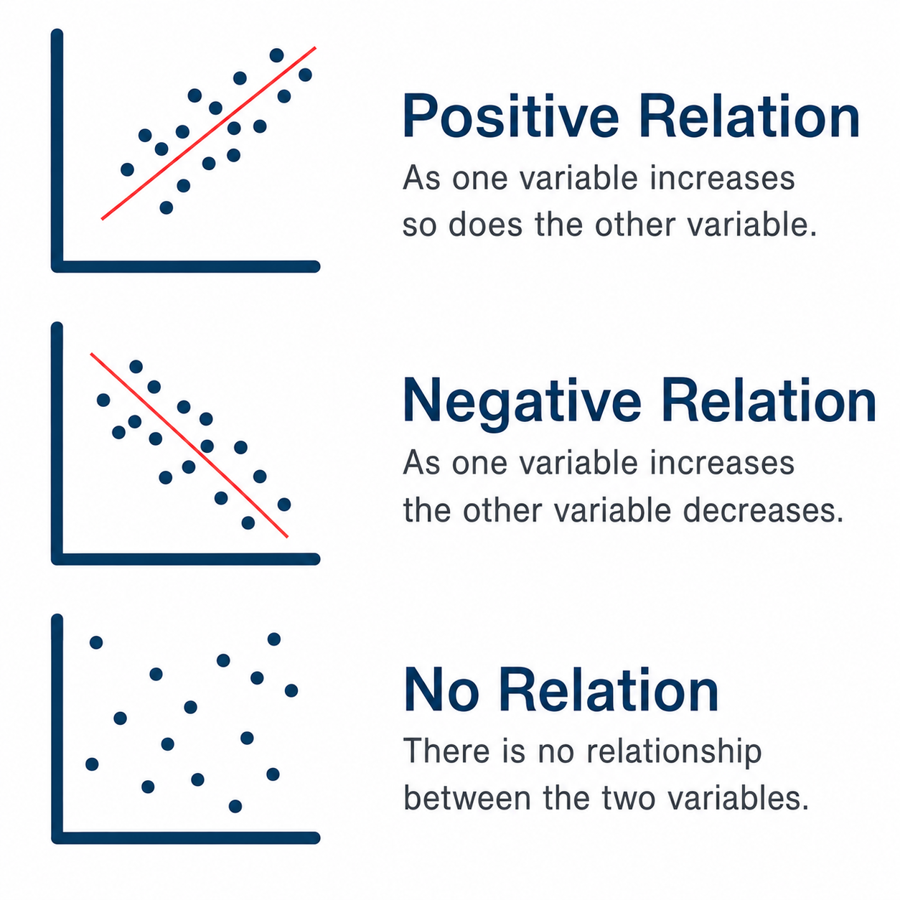
Trendlines and Relations Between Variables
Trendlines illustrate three common types of relationships between two variables:
Positive relation: As one variable increases, the other tends to increase. (e.g., advertising spending and sales)
Negative relation: As one variable increases, the other tends to decrease. (e.g., price and quantity demanded)
No relation: There is no clear pattern between the two variables. (e.g., student ID and GPA)
Trendlines help us summarize the general direction of a relationship.

Slide 39
Side-by-side Bar Charts
A side-by-side bar chart is a graphical display that shows multiple bar charts on the same set of axes.
The figure below is a graphical representation of the crosstabulation between the two variables EntryWindow and TotalSpending.
The horizontal axis represents the classes of EntryWindow.
The color of each bar represents a spending class for TotalSpending.
The height of each bar represents the number of observations.
The Late Afternoon/Evening class has so few observations that its bars are barely visible.

Slide 40
Stacked Bar Charts
A stacked bar chart is a bar chart in which each bar is divided into rectangular segments of different colors that show the frequency of each class.
The figure below is another graphical representation of the crosstabulation between EntryWindow and TotalSpending.
The horizontal axis represents the classes of EntryWindow.
The color of each segment within a bar represents a spending class for TotalSpending.
The height of each segment represents the number of observations (frequency) in that spending class.
The total height of each bar represents the total number of observations for that entry window.

Slide 41
100% Stacked Bar Charts
A 100% stacked bar chart is a bar chart in which each bar is divided into rectangular segments of different colors that show the relative frequency of each class.
The figure below is yet another graphical representation of the crosstabulation between EntryWindow and TotalSpending.
The horizontal axis represents the classes of EntryWindow.
The color of each segment within a bar represents a spending class for TotalSpending.
The height of each segment represents the relative frequency of observations in that spending class.
Each bar has the same total height because the segment heights sum to 100%.

Slide 42
Choosing the Right Visualization
While there is no single “best” way to visualize data, the following table provides general guidelines for choosing among common graphical displays.
Visualization | Best For… | Strength | Weakness
Crosstabulation | Showing exact numerical values | Most precise | Hard to identify patterns quickly
Side-by-side Bar Chart | Comparing counts across classes | Easy to compare individual bars | Can become cluttered when there are many classes
Stacked Bar Chart | Comparing totals and composition | Shows both totals and breakdowns | Hard to compare interior segments
100% Stacked Bar Chart | Comparing relative frequencies | Highlights differences in proportions | Hides differences in sample sizes
Scatter Diagram | Examining relationships between two quantitative variables | Reveals trends and patterns | Not appropriate when one or both variables are categorical

Slide 43
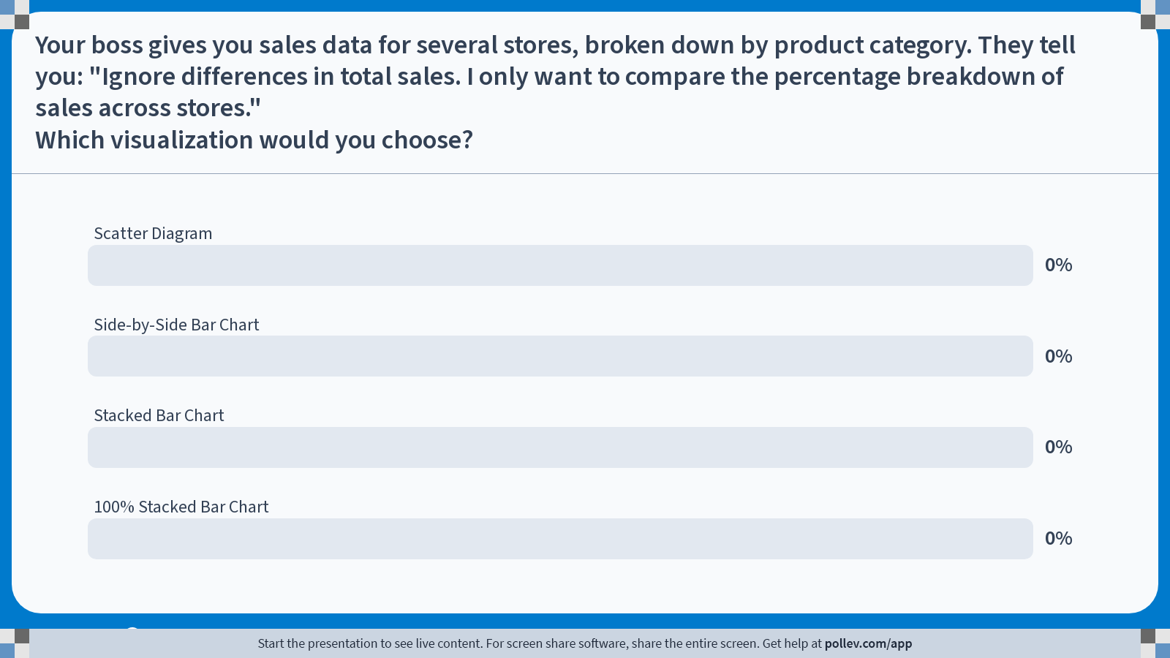
Poll Everywhere multiple choice poll activity Activity Title: Your boss gives you sales data for several stores, broken down by product category. They tell you: "Ignore differences in total sales. I only want to compare the percentage breakdown of sales across stores."Which visualization would you choose? Slide 45
Notes:
Do not modify the notes in this section to avoid tampering with the Poll Everywhere activity. More info at polleverywhere.com/support Your boss gives you sales data for several stores, broken down by product category. They tell you: "Ignore differences in total sales. I only want to compare the percentage breakdown of sales across stores."Which visualization would you choose? https://www.polleverywhere.com/multiple_choice_polls/zMtN8apREWxdmlYvMI8Li?state=opened&flow=Default&onscreen=persist

Slide 44
Recap & Preview

Slide 45
Recap: Chapter 2
In this chapter, we learned how to organize and visualize data to uncover meaningful patterns.
Frequency, relative frequency, and percent frequency distributions summarize how data are distributed.
Bar charts and pie charts visualize categorical data, and histograms visualize quantitative data.
Crosstabulations summarize relationships between two variables.
Scatter diagrams and trendlines help reveal relationships between two variables.
Side-by-side, stacked, and 100% stacked bar charts provide alternative ways to visualize crosstabulations.
The purpose of descriptive statistics is to organize data so that patterns become easier to see and interpret.

Slide 46
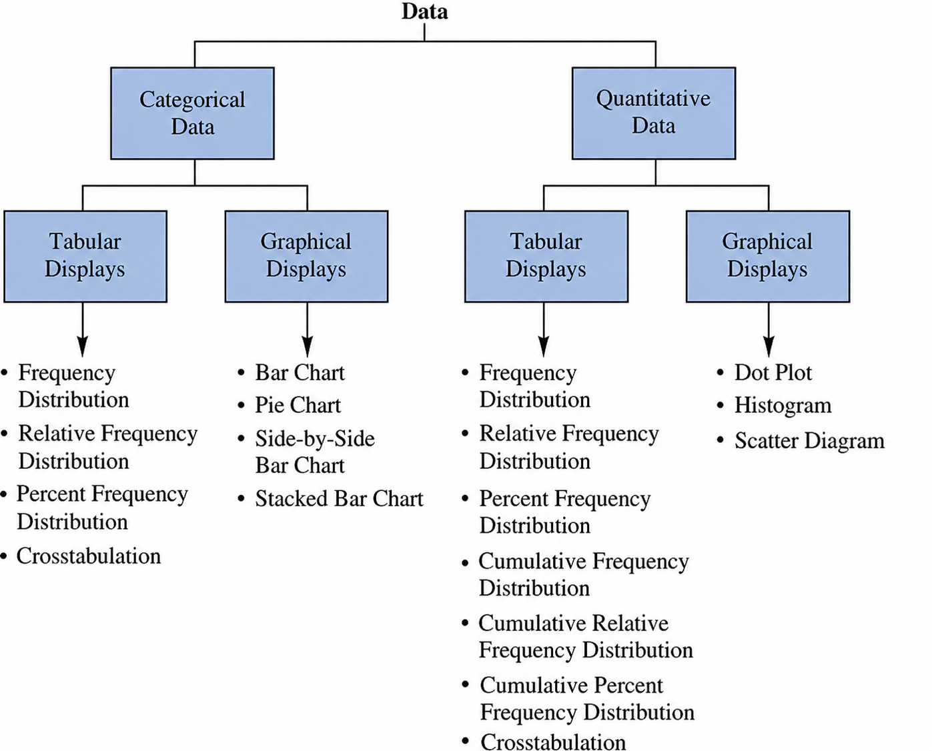
Recap: Chapter 2
Key Questions to Ask When Visualizing Data:
Is the variable categorical or quantitative?
Am I analyzing one variable or two variables?
Do I want exact numerical values or a visual summary?
Which graph best communicates the pattern?

Slide 47
Preview: Chapter 3
In the next chapter, we will summarize data using numerical measures.
Topics include:
Measures of the typical or average value.
Measures of how spread out the data are.
Percentiles and quartiles, which show where a value stands relative to the rest of the data.
Standardized scores (z-scores), which tell us how unusual a value is.
Rules of thumb for understanding the distribution of data.
Methods for identifying unusually large or small values (outliers).
The five-number summary and boxplots.
Measures of how two quantitative variables move together.

