Slide 1
BUSINESS STATISTICS
Chapter 3: Descriptive Statistics – Numerical Measures

Slide 2
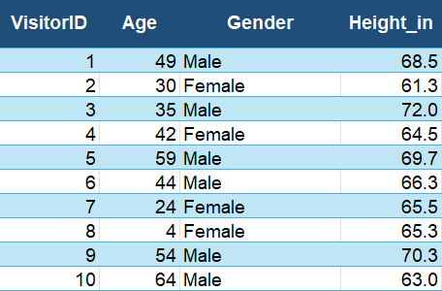
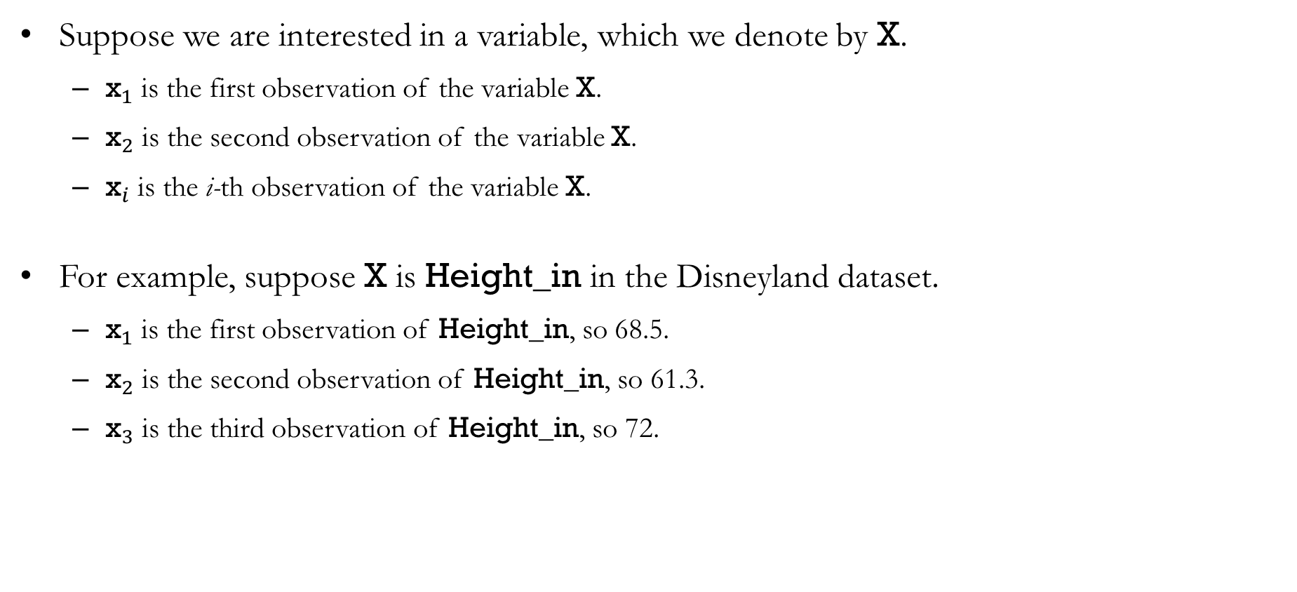
Notations
Suppose we are interested in a variable, which we denote by X.
${\text{x}}_{1}$ is the first observation of the variable X.
${\text{x}}_{2}$ is the second observation of the variable X.
${\text{x}}_{i}$ is the i-th observation of the variable X.
For example, suppose X is Height_in in the Disneyland dataset.
${\text{x}}_{1}$ is the first observation of Height_in, so 68.5.
${\text{x}}_{2}$ is the second observation of Height_in, so 61.3.
${\text{x}}_{3}$ is the third observation of Height_in, so 72.

Slide 3
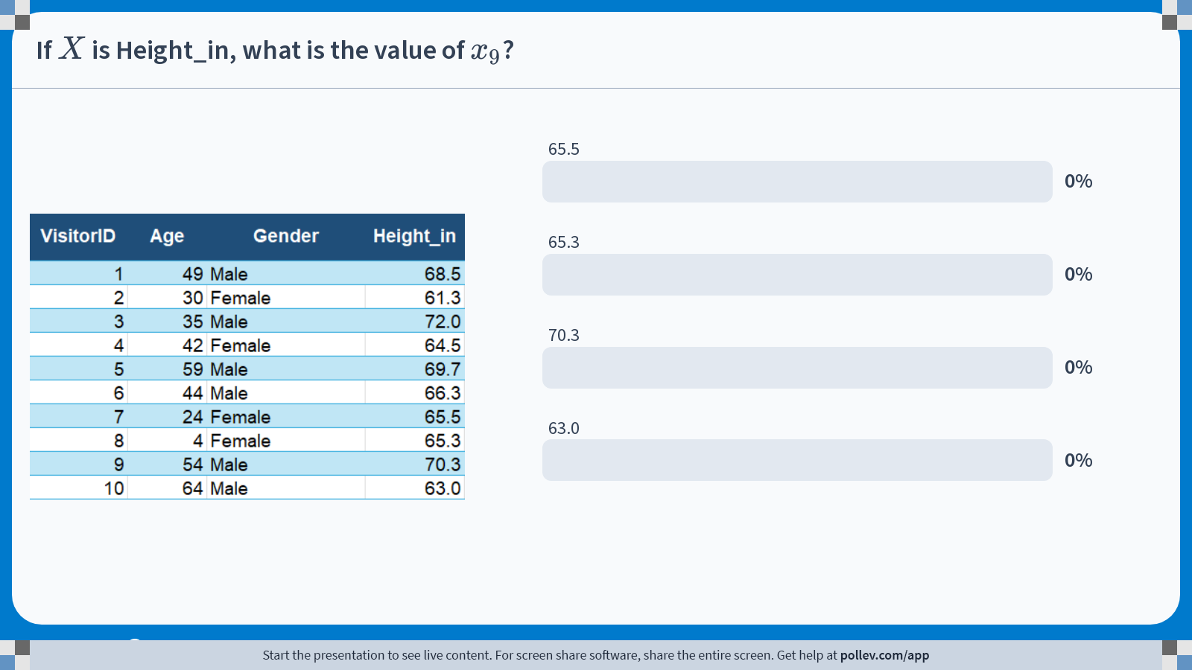
Poll Everywhere multiple choice poll activity Activity Title: If $$X$$ is Height_in, what is the value of $$x_9$$? Slide 3
Notes:
Do not modify the notes in this section to avoid tampering with the Poll Everywhere activity. More info at polleverywhere.com/support If $$X$$ is Height_in, what is the value of $$x_9$$? https://www.polleverywhere.com/multiple_choice_polls/IMVPIrEwEd2KUdGQrOodA?state=opened&flow=Default&onscreen=persist

Slide 4
Notations
Population vs. Sample:
The population is the set of all elements of interest in a particular study. The size of the population is typically denoted by the uppercase letter N.
The sample is the subset of the population that we actually observe. The size of the sample is typically denoted by the lowercase letter n.
Parameter vs. Statistic:
A parameter is a numerical characteristic of the population. Parameters are often unknown because we rarely observe the entire population.
A statistic is a numerical characteristic of the sample. Statistics can be computed from the observed data and are used to estimate population parameters.
We use statistics computed from a sample to estimate parameters of a population.

Slide 5
Measures of Location

Slide 6
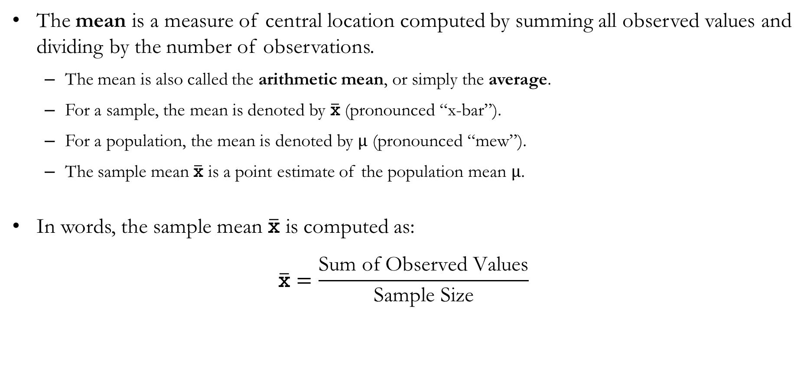
Mean
The mean is a measure of central location computed by summing all observed values and dividing by the number of observations.
The mean is also called the arithmetic mean, or simply the average.
For a sample, the mean is denoted by $\overline{\text{x}}$ (pronounced “x-bar”).
For a population, the mean is denoted by $μ$ (pronounced “mew”).
The sample mean $\overline{\text{x}}$ is a point estimate of the population mean $μ$.
In words, the sample mean $\overline{\text{x}}$ is computed as:
$$\overline{\text{x}}=\frac{\text{Sum} \text{of} \text{Observed} \text{Values}}{\text{Sample} \text{Size}}$$

Slide 7
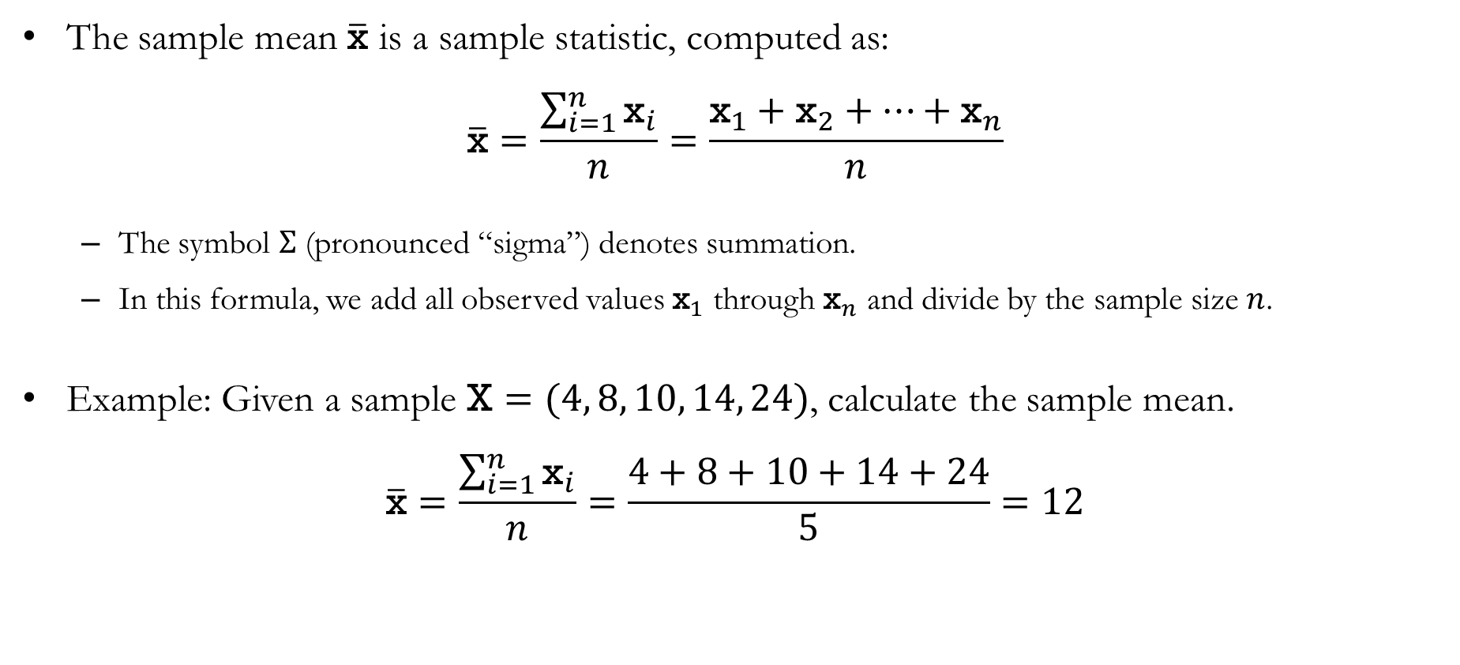
Mean
The sample mean $\overline{\text{x}}$ is a sample statistic, computed as:
$$\overline{\text{x}}=\frac{\sum_{i=1}^{n}{{\text{x}}_{i}}}{n}=\frac{{\text{x}}_{1}+{\text{x}}_{2}+⋯+{\text{x}}_{n}}{n}$$
The symbol $Σ$ (pronounced “sigma”) denotes summation.
In this formula, we add all observed values ${\text{x}}_{1}$ through ${\text{x}}_{n}$ and divide by the sample size $n$.
Example: Given a sample $\text{X}=(4, 8, 10, 14, 24)$, calculate the sample mean.
$$\overline{\text{x}}=\frac{\sum_{i=1}^{n}{{\text{x}}_{i}}}{n}=\frac{4+8+10+14+24}{5}=12$$

Slide 8
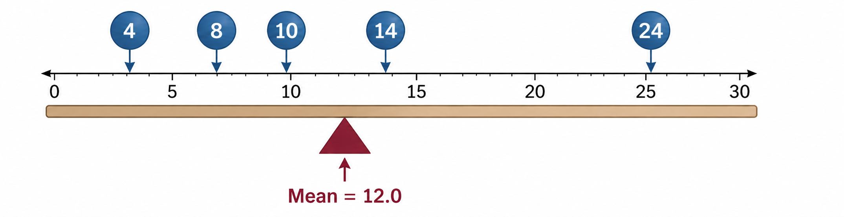

The Mean as a Measure of Central Location
The mean provides a measure of central location for the data:
Think of each observation as an equal weight placed on a number line.
The sample mean is the point where the system balances.
Example: For the sample $\text{X}=(4, 8, 10, 14, 24)$, the sample mean is 12.

Slide 9
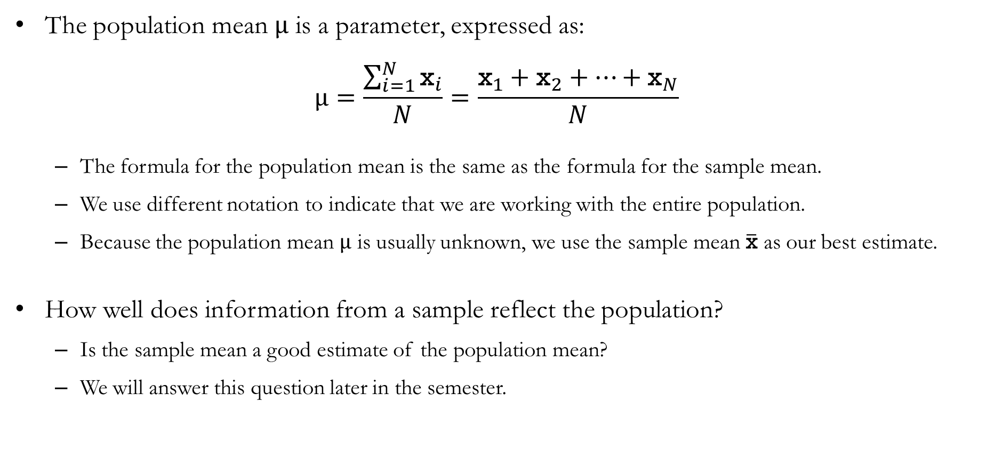
The Sample Mean and Population Mean
The population mean $μ$ is a parameter, expressed as:
$$μ=\frac{\sum_{i=1}^{N}{{\text{x}}_{i}}}{N}=\frac{{\text{x}}_{1}+{\text{x}}_{2}+⋯+{\text{x}}_{N}}{N}$$
The formula for the population mean is the same as the formula for the sample mean.
We use different notation to indicate that we are working with the entire population.
Because the population mean $μ$ is usually unknown, we use the sample mean $\overline{\text{x}}$ as our best estimate.
How well does information from a sample reflect the population?
Is the sample mean a good estimate of the population mean?
We will answer this question later in the semester.

Slide 10
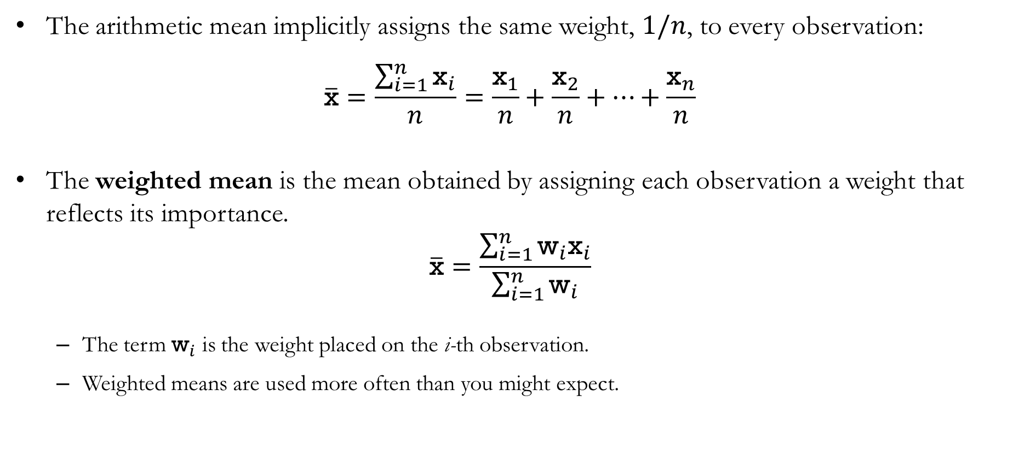
Weighted Mean
The arithmetic mean implicitly assigns the same weight, $1/n$, to every observation:
$$\overline{\text{x}}=\frac{\sum_{i=1}^{n}{{\text{x}}_{i}}}{n}=\frac{{\text{x}}_{1}}{n}+\frac{{\text{x}}_{2}}{n}+⋯+\frac{{\text{x}}_{n}}{n}$$
The weighted mean is the mean obtained by assigning each observation a weight that reflects its importance.
$$\overline{\text{x}}=\frac{\sum_{i=1}^{n}{{\text{w}}_{i}{\text{x}}_{i}}}{\sum_{i=1}^{n}{{\text{w}}_{i}}}$$
The term ${\text{w}}_{i}$ is the weight placed on the i-th observation.
Weighted means are used more often than you might expect.

Slide 11
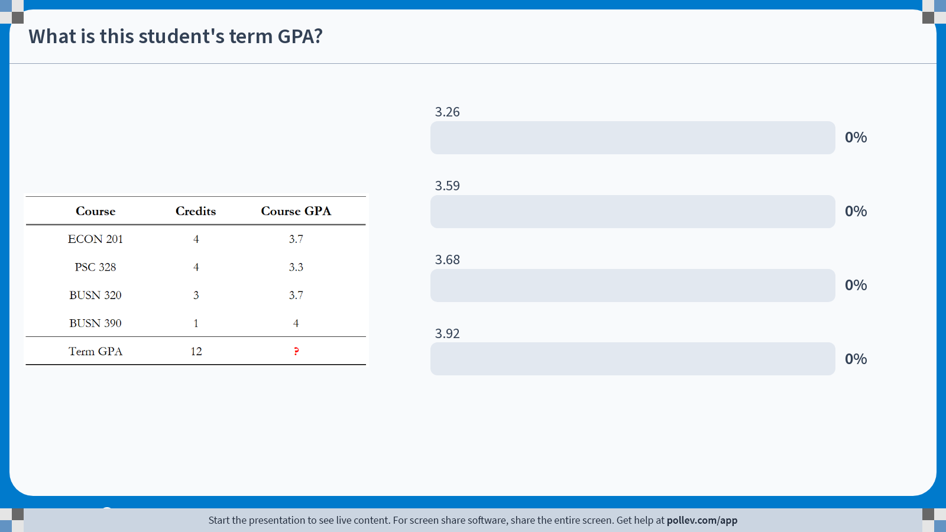
Poll Everywhere multiple choice poll activity Activity Title: What is this student's term GPA? Slide 11
Notes:
Do not modify the notes in this section to avoid tampering with the Poll Everywhere activity. More info at polleverywhere.com/support What is this student's term GPA? https://www.polleverywhere.com/multiple_choice_polls/Gl0eNpNuv1sW4mmBZOKHm?state=opened&flow=Default&onscreen=persist

Slide 12
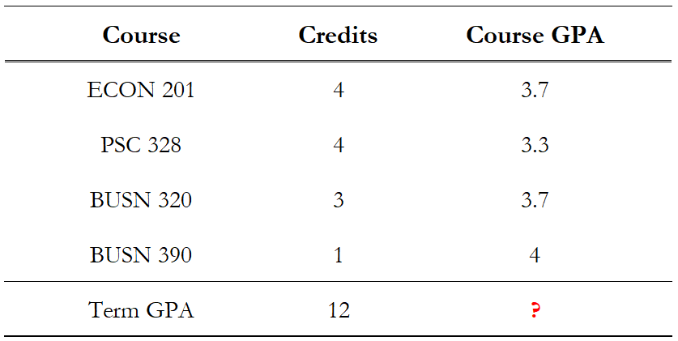
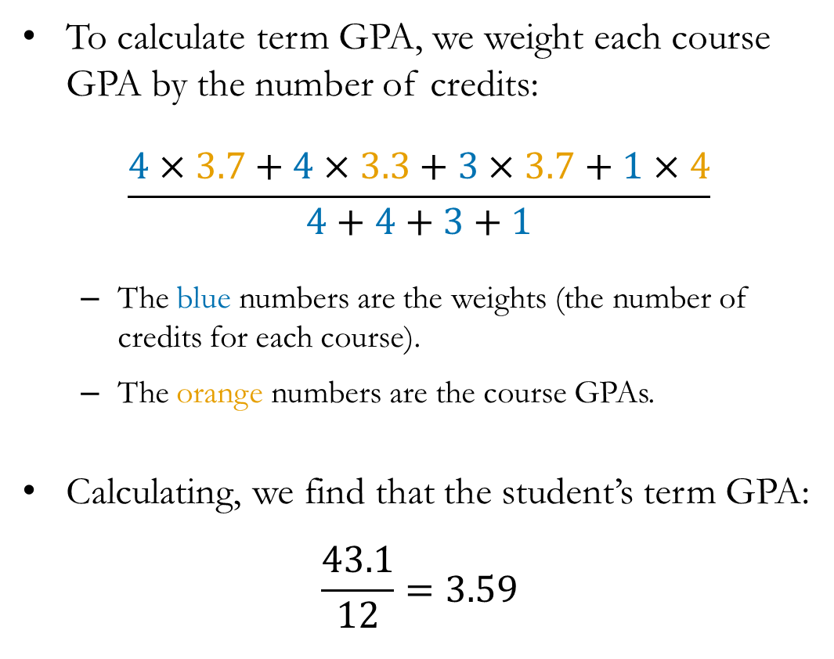
Solution to In-class Poll
To calculate term GPA, we weight each course GPA by the number of credits:
$$\frac{4×3.7+4×3.3+3×3.7+1×4}{4+4+3+1}$$
The blue numbers are the weights (the number of credits for each course).
The orange numbers are the course GPAs.
Calculating, we find that the student’s term GPA:
$$\frac{43.1}{12}=3.59$$

Slide 13
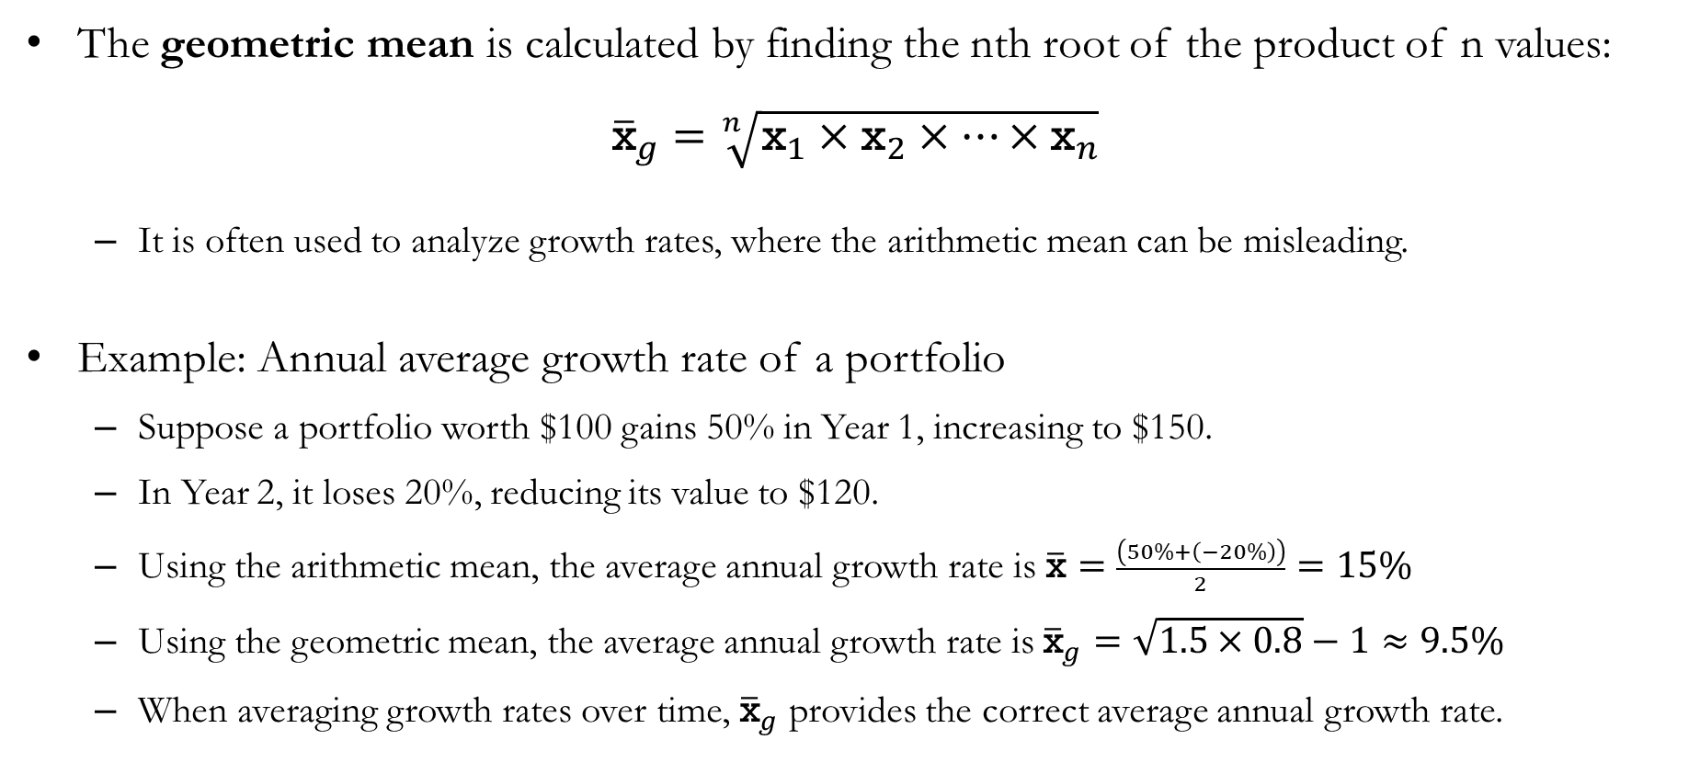
Geometric Mean
The geometric mean is calculated by finding the nth root of the product of n values:
$${\overline{\text{x}}}_{g}=\sqrt[n]{{\text{x}}_{1}×{\text{x}}_{2}×⋯×{\text{x}}_{n}}$$
It is often used to analyze growth rates, where the arithmetic mean can be misleading.
Example: Annual average growth rate of a portfolio
Suppose a portfolio worth $100 gains 50% in Year 1, increasing to $150.
In Year 2, it loses 20%, reducing its value to $120.
Using the arithmetic mean, the average annual growth rate is $\overline{\text{x}}=\frac{\left(50\%+\left(−20\%\right)\right)}{2}=15\%$
Using the geometric mean, the average annual growth rate is${\overline{\text{x}}}_{g}=\sqrt{1.5×0.8}−1≈9.5\%$
When averaging growth rates over time, ${\overline{\text{x}}}_{g}$ provides the correct average annual growth rate.

Slide 14
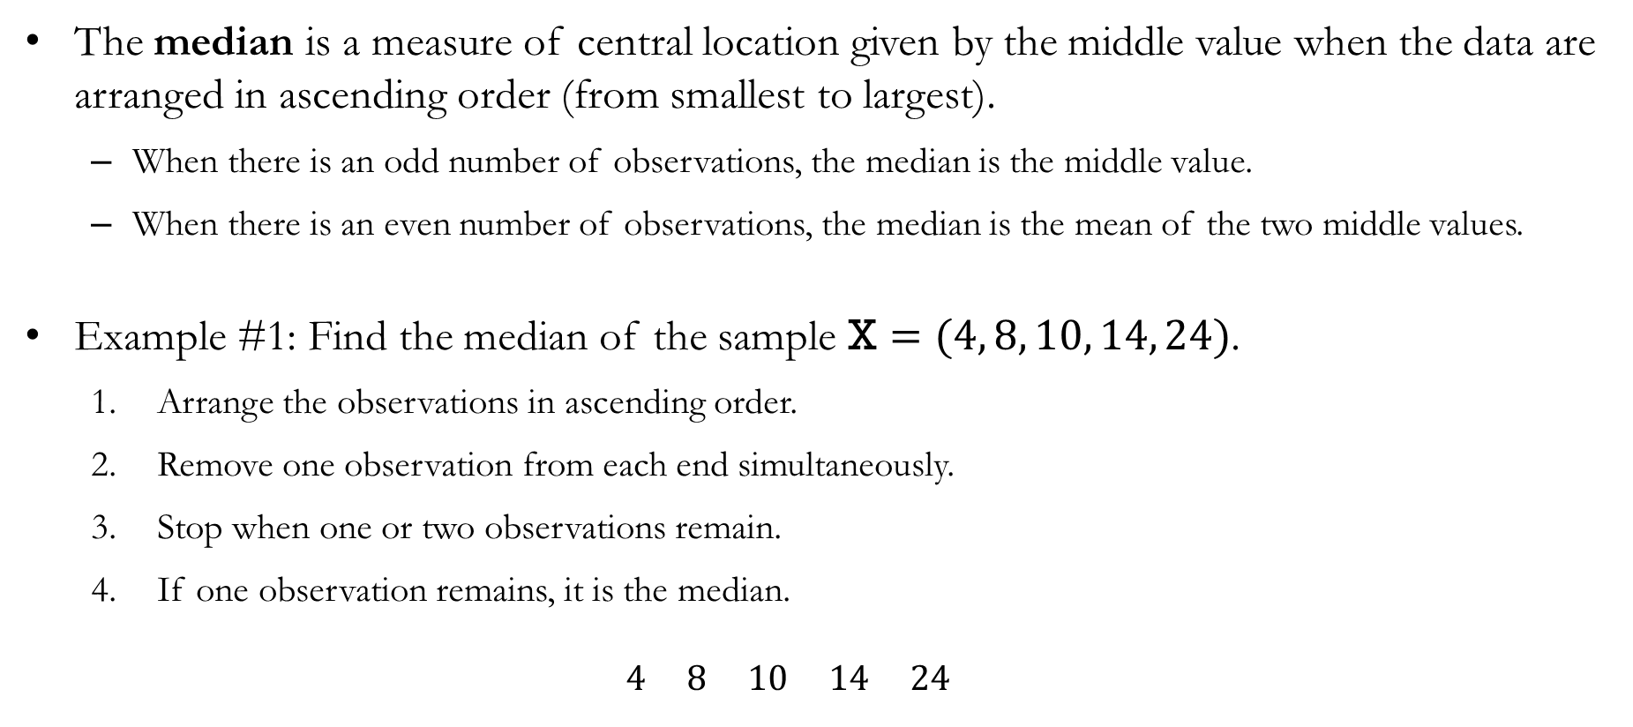
Median
The median is a measure of central location given by the middle value when the data are arranged in ascending order (from smallest to largest).
When there is an odd number of observations, the median is the middle value.
When there is an even number of observations, the median is the mean of the two middle values.
Example #1: Find the median of the sample $\text{X}=(4, 8, 10, 14, 24)$.
Arrange the observations in ascending order.
Remove one observation from each end simultaneously.
Stop when one or two observations remain.
If one observation remains, it is the median.
$$4 8 10 14 24$$

Slide 15
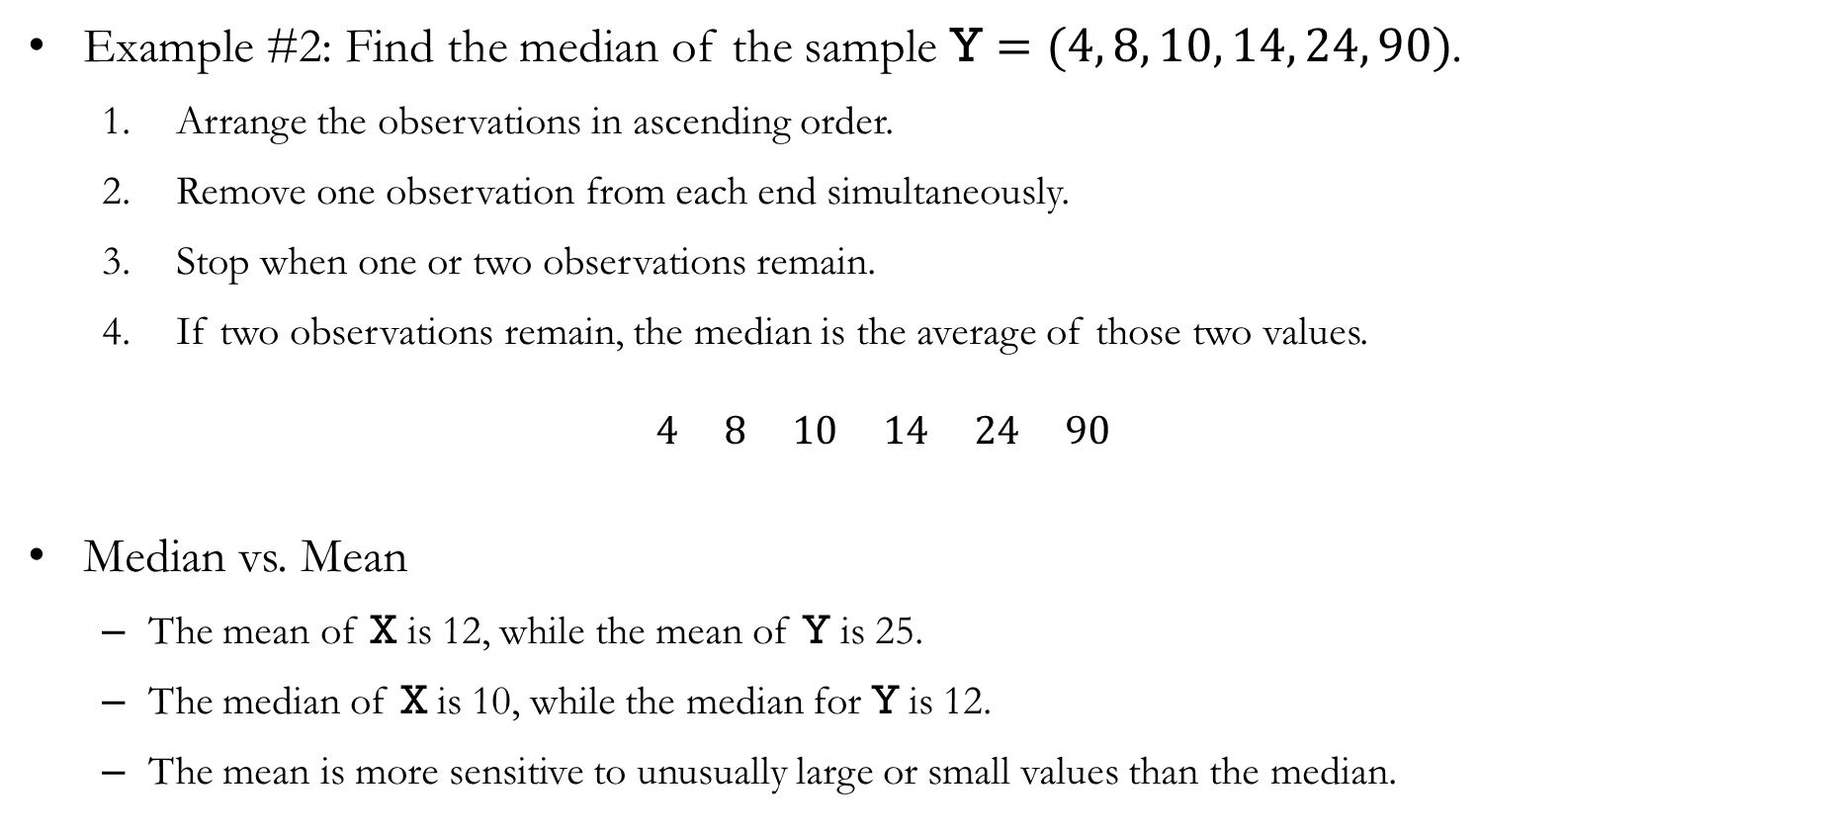
Median
Example #2: Find the median of the sample $\text{Y}=(4, 8, 10, 14, 24, 90)$.
Arrange the observations in ascending order.
Remove one observation from each end simultaneously.
Stop when one or two observations remain.
If two observations remain, the median is the average of those two values.
$$4 8 10 14 24 90$$
Median vs. Mean
The mean of $\text{X}$ is 12, while the mean of $\text{Y}$ is 25.
The median of $\text{X}$ is 10, while the median for $\text{Y}$ is 12.
The mean is more sensitive to unusually large or small values than the median.

Slide 16
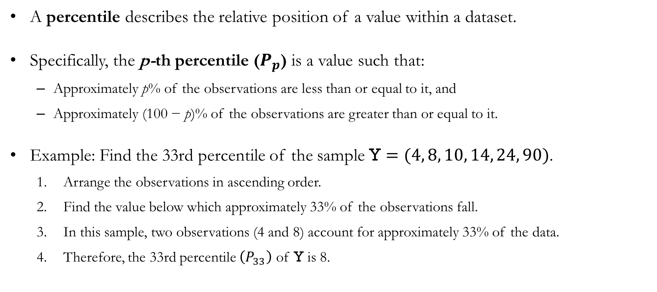
Percentiles
A percentile describes the relative position of a value within a dataset.
Specifically, the p-th percentile ($P_{p}$) is a value such that:
Approximately p% of the observations are less than or equal to it, and
Approximately (100 − p)% of the observations are greater than or equal to it.
Example: Find the 33rd percentile of the sample $\text{Y}=(4, 8, 10, 14, 24, 90)$.
Arrange the observations in ascending order.
Find the value below which approximately 33% of the observations fall.
In this sample, two observations (4 and 8) account for approximately 33% of the data.
Therefore, the 33rd percentile $\left(P_{33}\right)$ of $\text{Y}$ is 8.

Slide 17
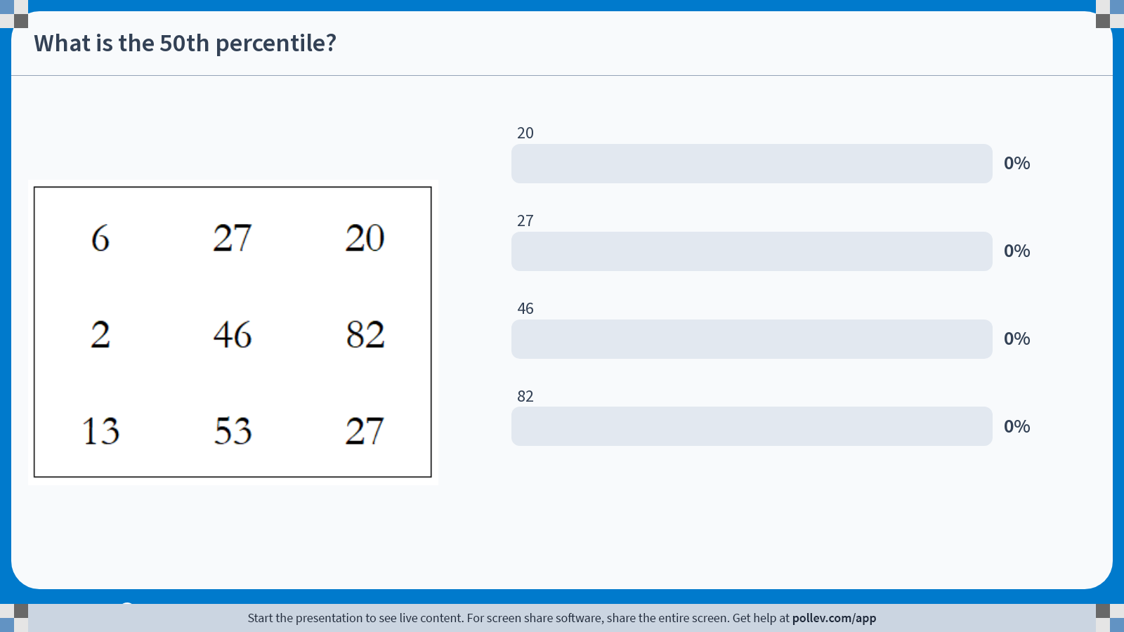
Poll Everywhere multiple choice poll activity Activity Title: What is the 50th percentile? Slide 16
Notes:
Do not modify the notes in this section to avoid tampering with the Poll Everywhere activity. More info at polleverywhere.com/support What is the 50th percentile? https://www.polleverywhere.com/multiple_choice_polls/S8ADp38cOcsU7eKm1bj1i?state=opened&flow=Default&onscreen=persist

Slide 18
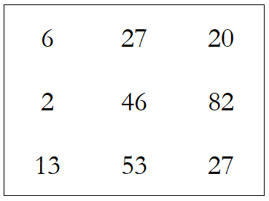
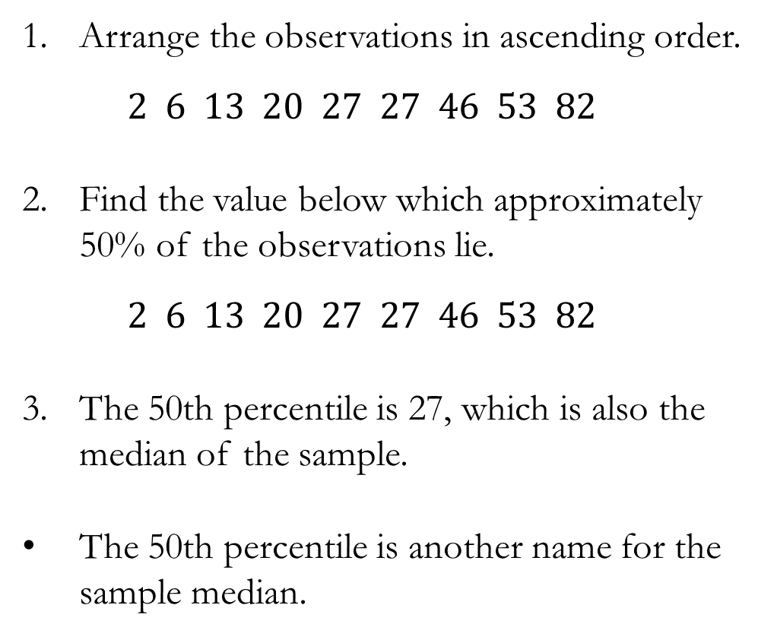
Solution to In-class Poll
Arrange the observations in ascending order.
$$2 6 13 20 27 27 46 53 82$$
Find the value below which approximately 50% of the observations lie.
$$2 6 13 20 27 27 46 53 82$$
The 50th percentile is 27, which is also the median of the sample.
The 50th percentile is another name for the sample median.

Slide 19
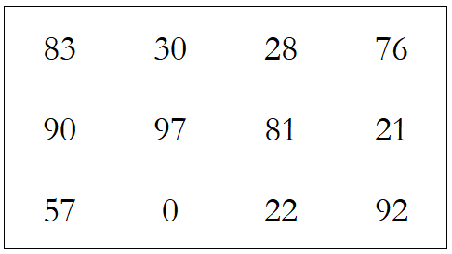

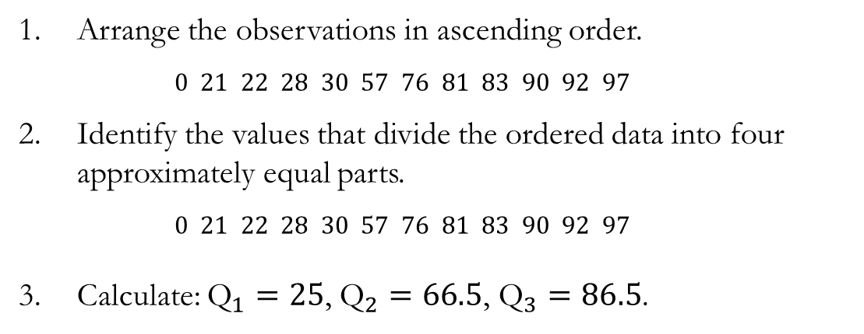
Quartiles
Quartiles are specific percentiles that divide the data into four approximately equal parts:
${\text{Q}}_{1}$: The first quartile, or the 25th percentile.
${\text{Q}}_{2}$: The second quartile, or the 50th percentile (also the median).
${\text{Q}}_{3}$: The third quartile, or the 75th percentile.
Example: Find ${\text{Q}}_{1}$, ${\text{Q}}_{2}$, and ${\text{Q}}_{3}$.
Arrange the observations in ascending order.
$$0 21 22 28 30 57 76 81 83 90 92 97$$
Identify the values that divide the ordered data into four approximately equal parts.
$$0 21 22 28 30 57 76 81 83 90 92 97$$
Calculate: ${\text{Q}}_{1}=25$, ${\text{Q}}_{2}=66.5$, ${\text{Q}}_{3}=86.5$.

Slide 20
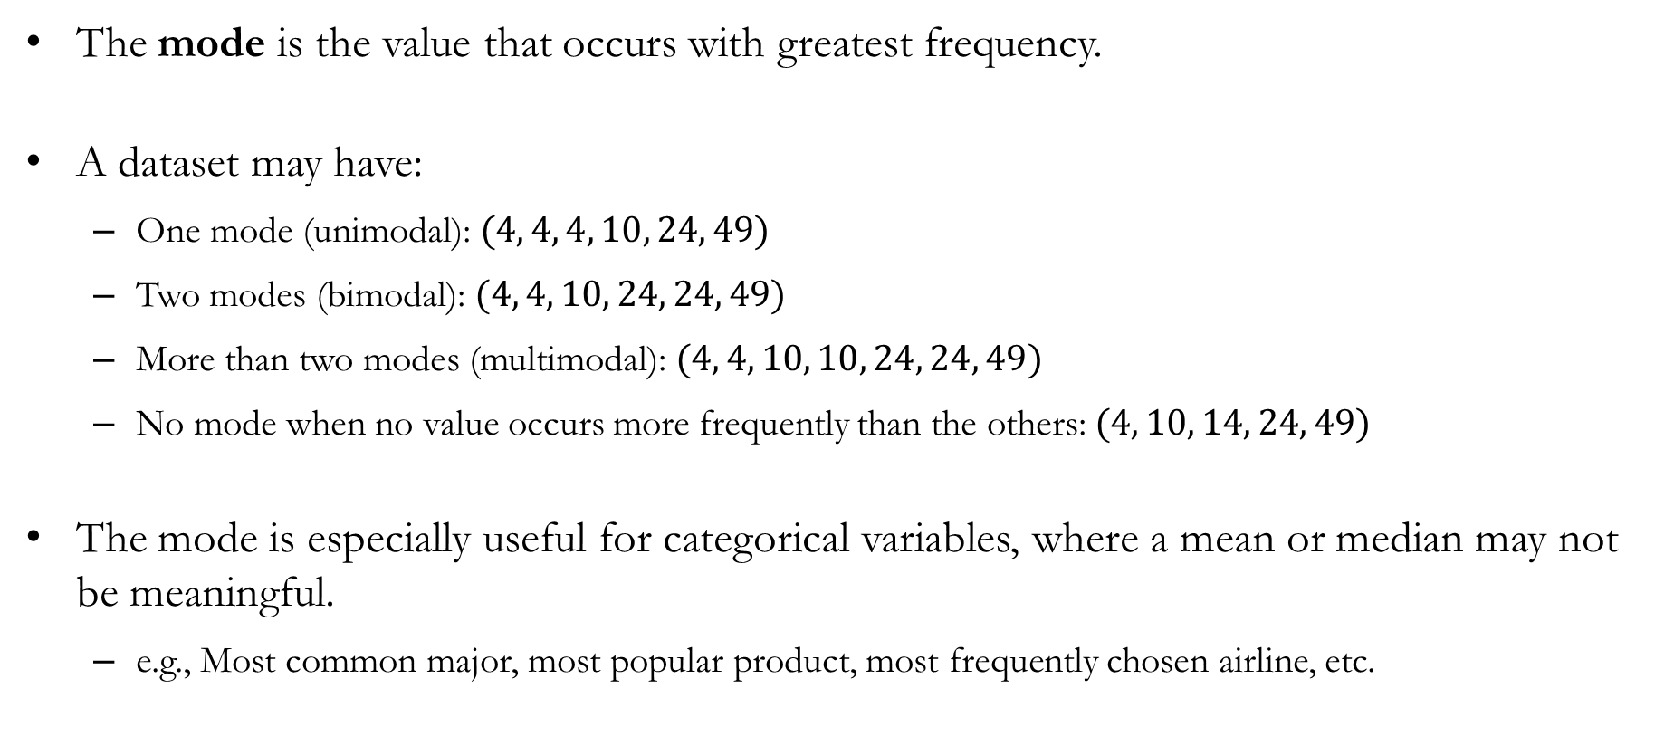
Mode
The mode is the value that occurs with greatest frequency.
A dataset may have:
One mode (unimodal): $(4, 4, 4, 10, 24, 49)$
Two modes (bimodal): $(4, 4, 10, 24, 24, 49)$
More than two modes (multimodal): $(4, 4, 10, 10, 24, 24, 49)$
No mode when no value occurs more frequently than the others:$(4, 10, 14, 24, 49)$
The mode is especially useful for categorical variables, where a mean or median may not be meaningful.
e.g., Most common major, most popular product, most frequently chosen airline, etc.

Slide 21
Measures of Location: Not Full Definitions
Measures calculated using formulas
Mean: The average of all observations.
Weighted Mean: An average that assigns different weights to observations.
Geometric Mean: The average growth rate over time.
Measures found by sorting the data
Median: The middle value in the ordered data.
Percentiles: Values that indicate relative position within the data.
Quartiles: Special percentiles corresponding to the 25th, 50th, and 75th percentiles.
Measures found by counting frequencies
Mode: The value(s) that occur most frequently.

Slide 22
Measures of Variability

Slide 23
Measures of Variability
Measures of location tell us what is typical or average.
Measures of variability tell us how much observations differ from one another.
Suppose your company is deciding between two marketing campaigns:
Campaign A: Average sales increase of 10%, but results vary greatly across stores.
Campaign B: Average sales increase of 10%, and results are much more consistent across stores.
Which campaign would you choose?
Even when two campaigns have the same average effect, differences in variability can matter.

Slide 24
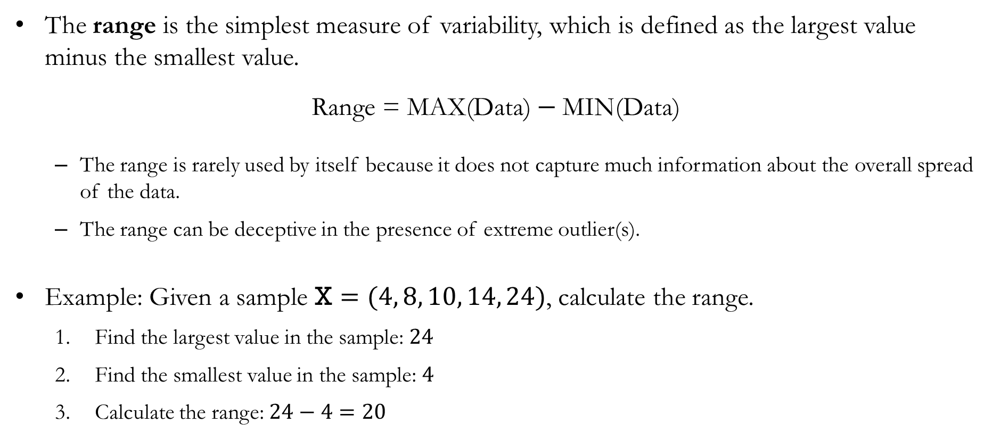
Range
The range is the simplest measure of variability, which is defined as the largest value minus the smallest value.
$$\text{Range}\text{ = }\text{MAX}\text{(}\text{Data}\text{)}−\text{MIN}\text{(}\text{Data}\text{)}$$
The range is rarely used by itself because it does not capture much information about the overall spread of the data.
The range can be deceptive in the presence of extreme outlier(s).
Example: Given a sample $\text{X}=(4, 8, 10, 14, 24)$, calculate the range.
Find the largest value in the sample: $24$
Find the smallest value in the sample: $4$
Calculate the range: $24−4=20$

Slide 25
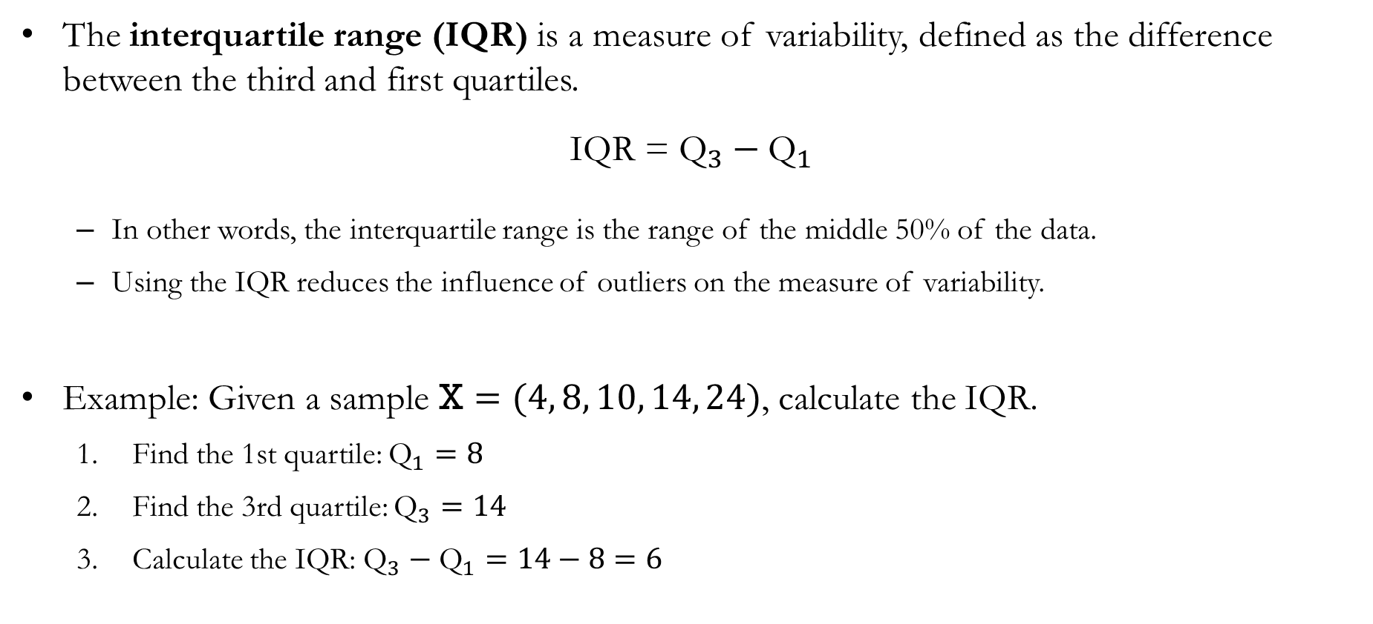
Interquartile Range (IQR)
The interquartile range (IQR) is a measure of variability, defined as the difference between the third and first quartiles.
$$\text{IQR}\text{ = }{\text{Q}}_{3}−{\text{Q}}_{1}$$
In other words, the interquartile range is the range of the middle 50% of the data.
Using the IQR reduces the influence of outliers on the measure of variability.
Example: Given a sample $\text{X}=(4, 8, 10, 14, 24)$, calculate the IQR.
Find the 1st quartile: ${\text{Q}}_{1}=8$
Find the 3rd quartile: ${\text{Q}}_{3}=14$
Calculate the IQR: ${\text{Q}}_{3}−{\text{Q}}_{1}=14−8=6$

Slide 26
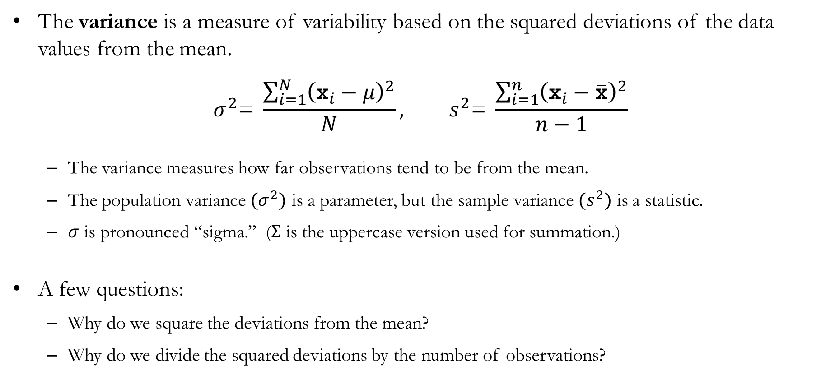
Variance
The variance is a measure of variability based on the squared deviations of the data values from the mean.
$$σ^{2}\text{= }\frac{\sum_{i=1}^{N}{{\left({\text{x}}_{i}−μ\right)}^{2}}}{N}, s^{2}\text{= }\frac{\sum_{i=1}^{n}{{\left({\text{x}}_{i}−\overline{\text{x}}\right)}^{2}}}{n−1}$$
The variance measures how far observations tend to be from the mean.
The population variance $(σ^{2})$ is a parameter, but the sample variance $(s^{2})$ is a statistic.
$σ$ is pronounced “sigma.” ($Σ$ is the uppercase version used for summation.)
A few questions:
Why do we square the deviations from the mean?
Why do we divide the squared deviations by the number of observations?

Slide 27
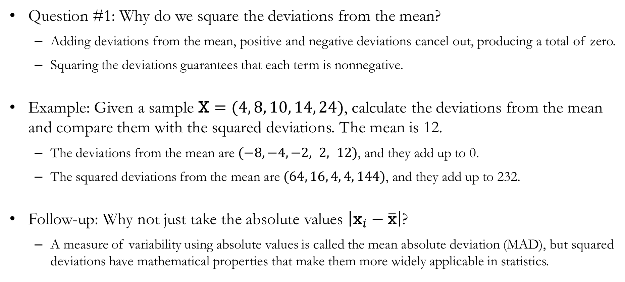
Variance: Question #1
Question #1: Why do we square the deviations from the mean?
Adding deviations from the mean, positive and negative deviations cancel out, producing a total of zero.
Squaring the deviations guarantees that each term is nonnegative.
Example: Given a sample $\text{X}=(4, 8, 10, 14, 24)$, calculate the deviations from the mean and compare them with the squared deviations. The mean is 12.
The deviations from the mean are $(−8, −4,−2, 2, 12)$, and they add up to 0.
The squared deviations from the mean are $(64, 16, 4, 4, 144)$, and they add up to 232.
Follow-up: Why not just take the absolute values $\left|{\text{x}}_{i}−\overline{\text{x}}\right|$?
A measure of variability using absolute values is called the mean absolute deviation (MAD), but squared deviations have mathematical properties that make them more widely applicable in statistics.

Slide 28
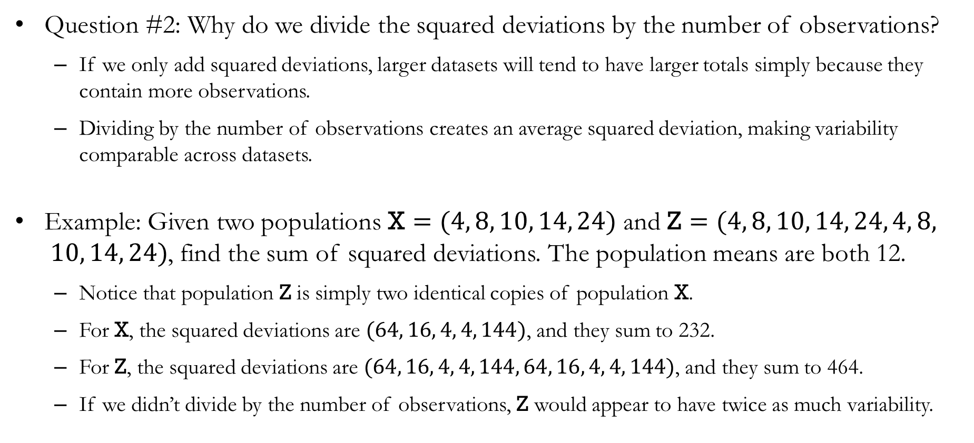
Variance: Question #2
Question #2: Why do we divide the squared deviations by the number of observations?
If we only add squared deviations, larger datasets will tend to have larger totals simply because they contain more observations.
Dividing by the number of observations creates an average squared deviation, making variability comparable across datasets.
Example: Given two populations $\text{X}=(4, 8, 10, 14, 24)$ and $\text{Z}=(4, 8, 10, 14, 24, 4, 8, 10, 14, 24)$, find the sum of squared deviations. The population means are both 12.
Notice that population $\text{Z}$ is simply two identical copies of population $\text{X}$.
For $\text{X}$, the squared deviations are $(64, 16, 4, 4, 144)$, and they sum to 232.
For $\text{Z}$, the squared deviations are $(64, 16, 4, 4, 144, 64, 16, 4, 4, 144)$, and they sum to 464.
If we didn’t divide by the number of observations, $\text{Z}$ would appear to have twice as much variability.

Slide 29
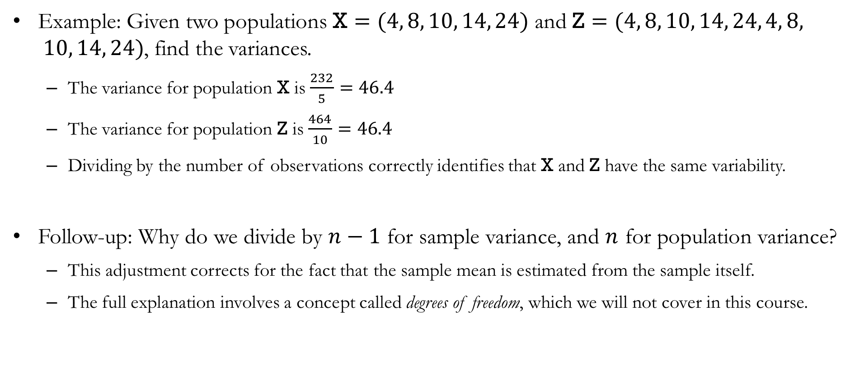
Variance: Question #2
Example: Given two populations $\text{X}=(4, 8, 10, 14, 24)$ and $\text{Z}=(4, 8, 10, 14, 24, 4, 8, 10, 14, 24)$, find the variances.
The variance for population $\text{X}$ is $\frac{232}{5}=46.4$
The variance for population $\text{Z}$ is $\frac{464}{10}=46.4$
Dividing by the number of observations correctly identifies that $\text{X}$ and $\text{Z}$ have the same variability.
Follow-up: Why do we divide by $n−1$ for sample variance, and $n$ for population variance?
This adjustment corrects for the fact that the sample mean is estimated from the sample itself.
The full explanation involves a concept called degrees of freedom, which we will not cover in this course.

Slide 30
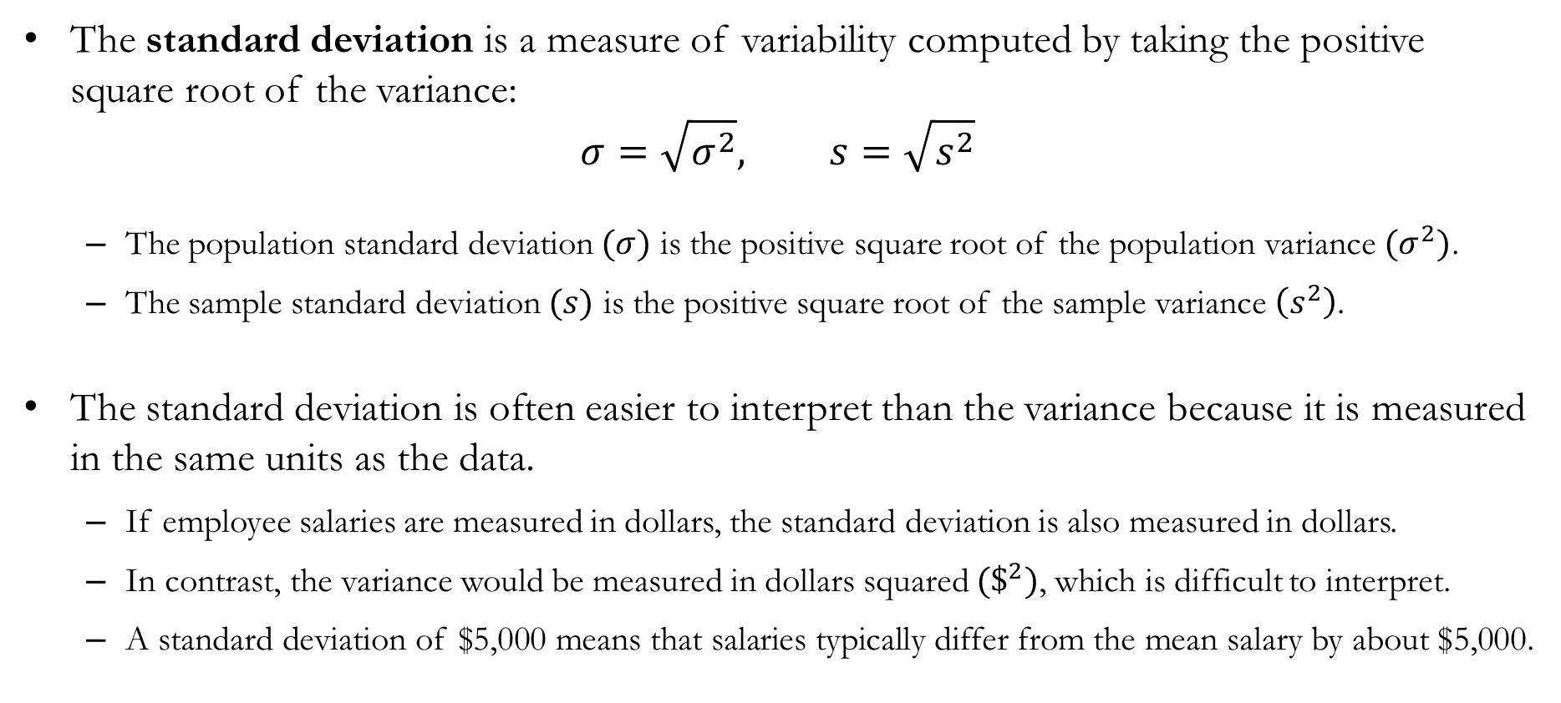
Standard Deviation
The standard deviation is a measure of variability computed by taking the positive square root of the variance:
$$σ=\sqrt{σ^{2}}, s=\sqrt{s^{2}}$$
The population standard deviation $(σ)$ is the positive square root of the population variance $(σ^{2})$.
The sample standard deviation $(s)$ is the positive square root of the sample variance $\left(s^{2}\right)$.
The standard deviation is often easier to interpret than the variance because it is measured in the same units as the data.
If employee salaries are measured in dollars, the standard deviation is also measured in dollars.
In contrast, the variance would be measured in dollars squared $(\$^{2})$, which is difficult to interpret.
A standard deviation of $5,000 means that salaries typically differ from the mean salary by about $5,000.

Slide 31
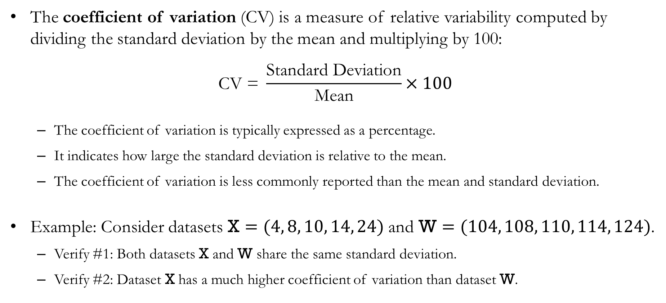
Coefficient of Variation
The coefficient of variation (CV) is a measure of relative variability computed by dividing the standard deviation by the mean and multiplying by 100:
$$\text{CV}\text{ = }\frac{\text{S}\text{tandard} \text{D}\text{eviation}}{\text{Mean}}×100$$
The coefficient of variation is typically expressed as a percentage.
It indicates how large the standard deviation is relative to the mean.
The coefficient of variation is less commonly reported than the mean and standard deviation.
Example: Consider datasets $\text{X}=(4, 8, 10, 14, 24)$ and $\text{W}=(104, 108, 110, 114, 124)$.
Verify #1: Both datasets $\text{X}$ and $\text{W}$ share the same standard deviation.
Verify #2: Dataset $\text{X}$ has a much higher coefficient of variation than dataset $\text{W}$.

Slide 32
Measures of Distribution Shape,
Relative Location, and Detecting Outliers

Slide 33
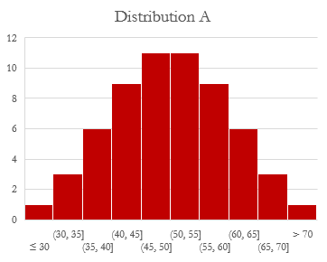
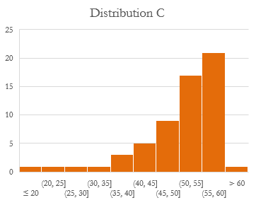
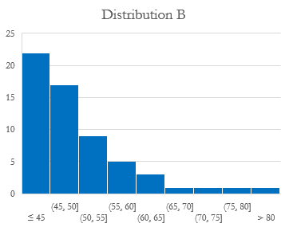
Distribution Shape
Knowing the mean and the standard deviation of a dataset can provide useful insight.
But datasets with the same mean and standard deviations may be surprisingly different:
All three distributions share the same mean (50) and standard deviation (10).
Distribution shape provides additional information beyond center and spread.

Slide 34
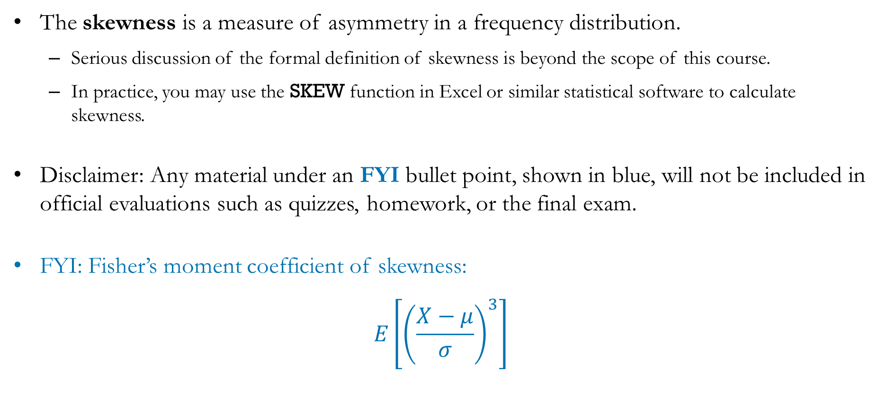
Skewness
The skewness is a measure of asymmetry in a frequency distribution.
Serious discussion of the formal definition of skewness is beyond the scope of this course.
In practice, you may use the SKEW function in Excel or similar statistical software to calculate skewness.
Disclaimer: Any material under an FYI bullet point, shown in blue, will not be included in official evaluations such as quizzes, homework, or the final exam.
FYI: Fisher’s moment coefficient of skewness:
$$E\left[{\left(\frac{X−μ}{σ}\right)}^{3}\right]$$

Slide 35



Skewness
“Symmetric”
Skewness = 0
“Skewed to the right”
Positive skewness
“Skewed to the left”
Negative skewness
It is often thought that a right-skew means the data are concentrated on the right. That is not what it means. A right-skew means the distribution has a longer tail on the right.

Slide 36
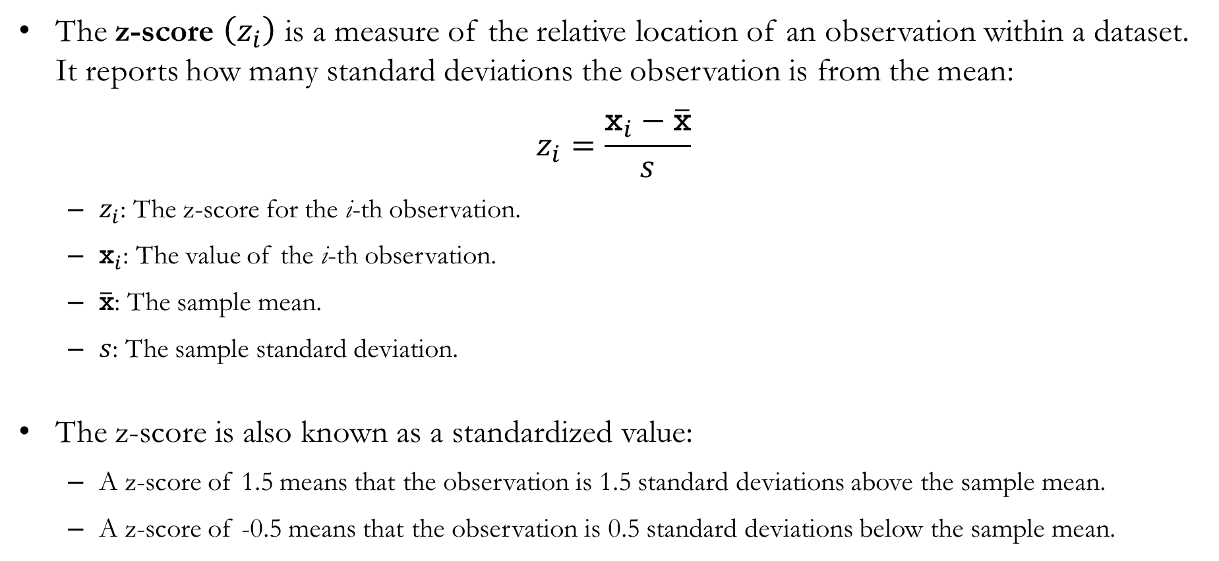
Z-Scores
The z-score $\left(z_{i}\right)$ is a measure of the relative location of an observation within a dataset. It reports how many standard deviations the observation is from the mean:
$$z_{i}=\frac{{\text{x}}_{i}−\overline{\text{x}}}{s}$$
$z_{i}$: The z-score for the i-th observation.
${\text{x}}_{i}$: The value of the i-th observation.
$\overline{\text{x}}$: The sample mean.
$s$: The sample standard deviation.
The z-score is also known as a standardized value:
A z-score of 1.5 means that the observation is 1.5 standard deviations above the sample mean.
A z-score of -0.5 means that the observation is 0.5 standard deviations below the sample mean.

Slide 37
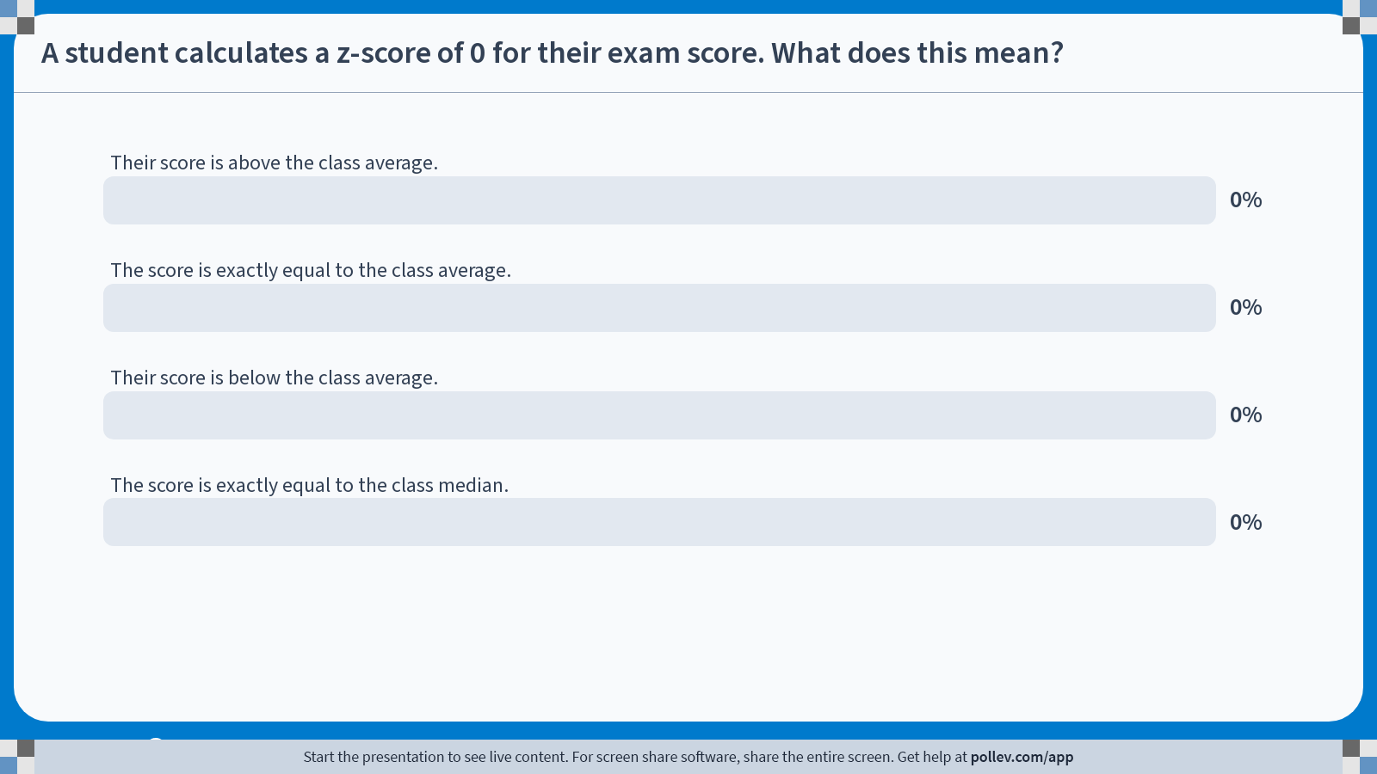
Poll Everywhere multiple choice poll activity Activity Title: A student calculates a z-score of 0 for their exam score. What does this mean? Slide 37
Notes:
Do not modify the notes in this section to avoid tampering with the Poll Everywhere activity. More info at polleverywhere.com/support A student calculates a z-score of 0 for their exam score. What does this mean? https://www.polleverywhere.com/multiple_choice_polls/EJuyyvqOQ285Yu3981ByM?state=opened&flow=Default&onscreen=persist

Slide 38

Solution to In-class Poll
Recall that the z-score is calculated as:
$$z_{i}=\frac{{\text{x}}_{i}−\overline{\text{x}}}{s}$$
If $z_{i}=0$, then the numerator must be zero.
Therefore, ${\text{x}}_{i}−\overline{\text{x}}=0$.
Which implies that ${\text{x}}_{i}=\overline{\text{x}}$.
Therefore, the student’s score is equal to the class average.
Challenge: Suppose you calculate the z-score for every observation in a dataset. What is the sum of the z-scores?

Slide 39
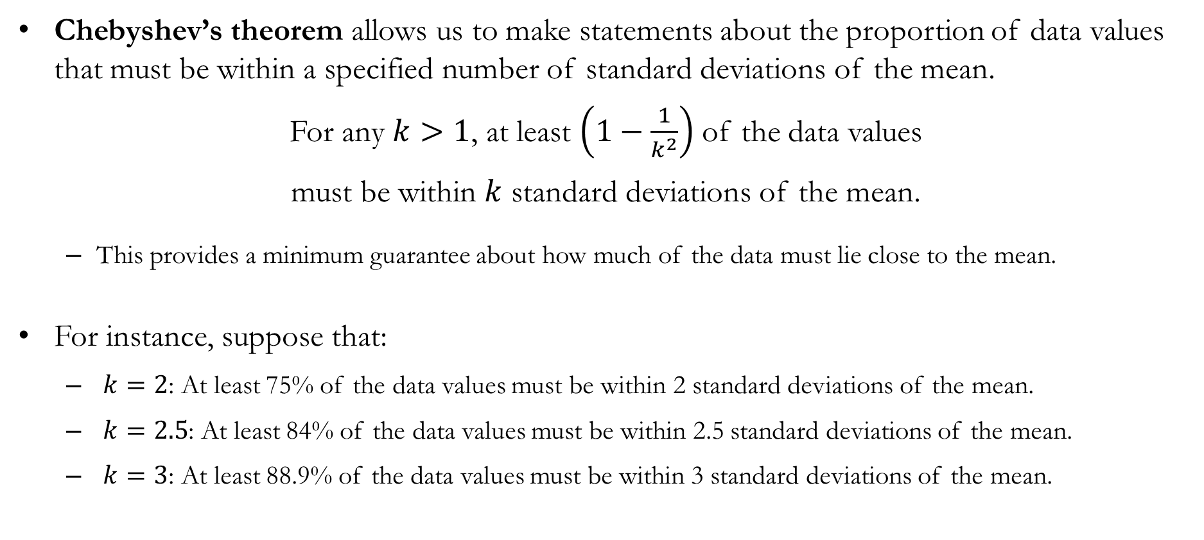
Detour: Chebyshev’s Theorem
Chebyshev’s theorem allows us to make statements about the proportion of data values that must be within a specified number of standard deviations of the mean.
For any $k>1$, at least $\left(1−\frac{1}{k^{2}}\right)$ of the data values
must be within $k$ standard deviations of the mean.
This provides a minimum guarantee about how much of the data must lie close to the mean.
For instance, suppose that:
$k=2$: At least 75% of the data values must be within 2 standard deviations of the mean.
$k=2.5$: At least 84% of the data values must be within 2.5 standard deviations of the mean.
$k=3$: At least 88.9% of the data values must be within 3 standard deviations of the mean.

Slide 40
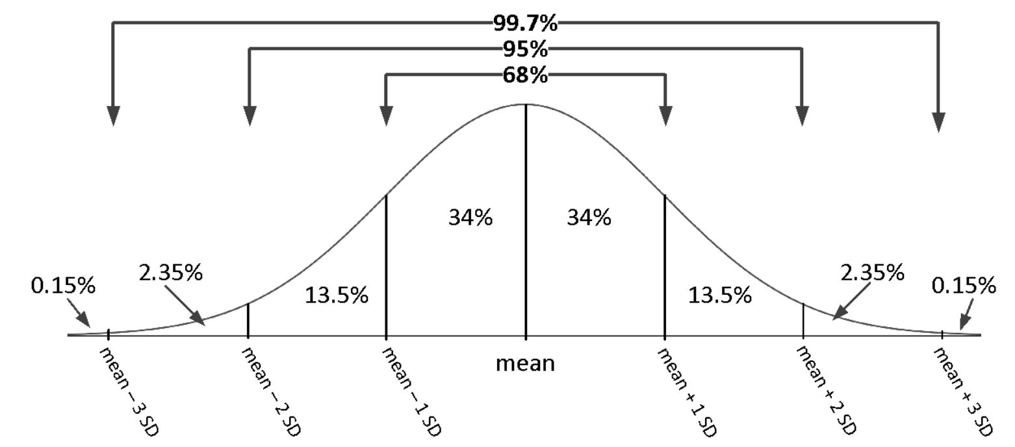

Empirical Rule
The empirical rule (or 68-95-99.7 rule) is a more restrictive version of Chebyshev’s theorem that applies to symmetric, bell-shaped distributions:
Approximately 68% of the data will be within one standard deviation of the mean.
Approximately 95% of the data will be within two standard deviations of the mean.
Approximately 99.7% of the data values will be within three standard deviations of the mean.
Business applications: Six Sigma $\left(6σ\right)$
Developed by engineers at Motorola in the 1980s as a quality-control method.
Under the Six Sigma standard, there are approximately 3.4 defects per million opportunities (DPMO).

Slide 41
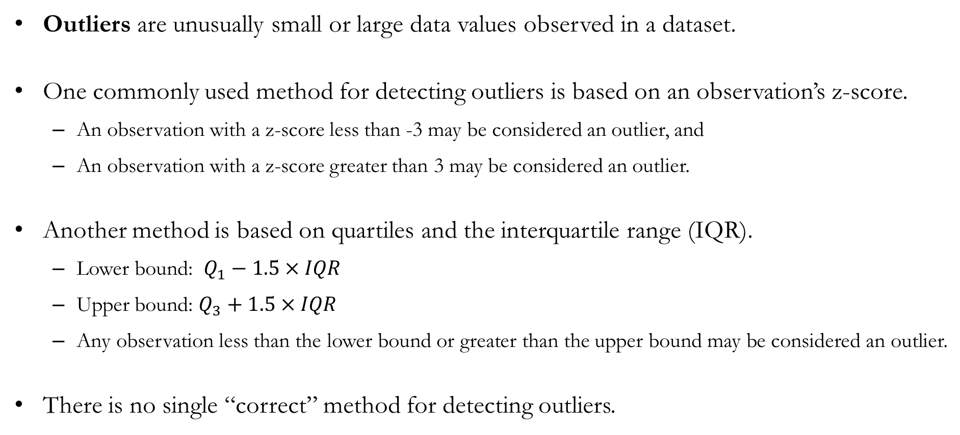
Detecting Outliers
Outliers are unusually small or large data values observed in a dataset.
One commonly used method for detecting outliers is based on an observation’s z-score.
An observation with a z-score less than -3 may be considered an outlier, and
An observation with a z-score greater than 3 may be considered an outlier.
Another method is based on quartiles and the interquartile range (IQR).
Lower bound: $Q_{1}−1.5×IQR$
Upper bound: $Q_{3}+1.5×IQR$
Any observation less than the lower bound or greater than the upper bound may be considered an outlier.
There is no single “correct” method for detecting outliers.

Slide 42
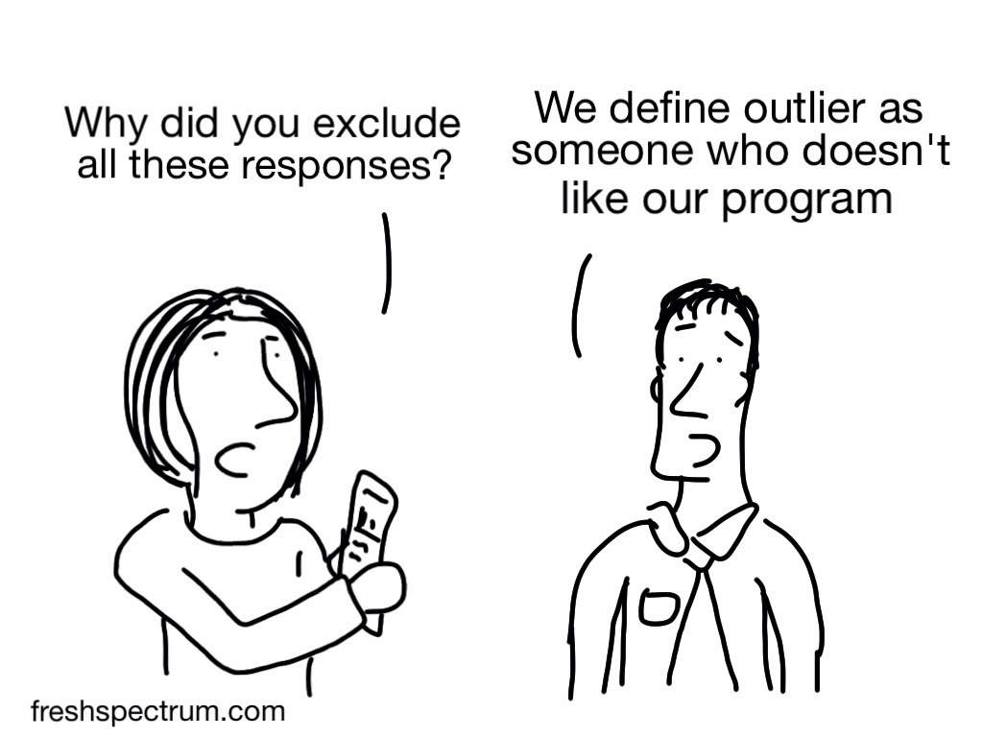
Handling Outliers
Outliers may appear in a dataset for different reasons. An outlier may be:
A data value that was recorded incorrectly, or an observation that was incorrectly included the dataset.
An unusual data value that was recorded correctly and legitimately belongs in the dataset.
How we handle outliers depends on our judgment regarding their cause.
The decision should be guided by the context of the problem.

Slide 43
Five-Number Summaries
and Boxplots

Slide 44
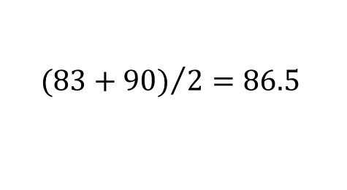

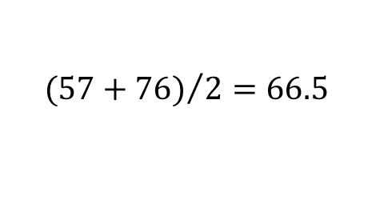

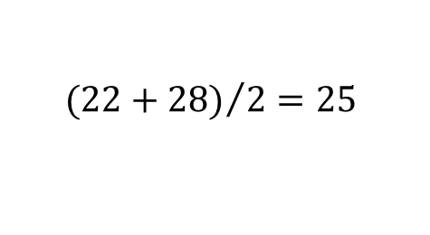


Five-Number Summary
A five-number summary is a technique that uses five numbers to summarize the data:
Smallest value
First quartile $\left(Q_{1}\right)$
Median $\left(Q_{2}\right)$
Example: Find the five-number summary for the following dataset.
Third quartile $\left(Q_{3}\right)$
Largest value
Smallest value:
First quartile:
Median:
Third quartile:
Largest value:
$$0$$
$${(22+28)}/2=25$$
$${(57+76)}/2=66.5$$
$${(83+90)}/2=86.5$$
$$97$$

Slide 45
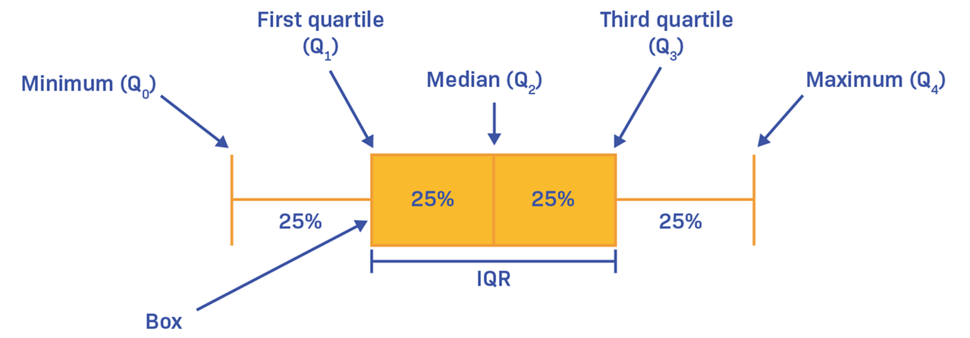

Boxplot: Simple
A boxplot is a graphical summary of data based on a five-number summary:
The box extends from $Q_{1}$ to $Q_{3}$, so the length of the box is the interquartile range (IQR).
The vertical line inside the box represents the median $\left(Q_{2}\right)$.
The whiskers extend to the minimum and maximum values in the dataset.

Slide 46


Boxplot: Tukey
Most statistical software (Excel, R, Python, Tableau, etc.) uses a Tukey boxplot by default.
The box still extends from $Q_{1}$ to $Q_{3}$, and the line inside the box is the median.
However, the whiskers do not necessarily extend to the minimum and maximum values.
Instead, observations beyond $Q_{1}−1.5×IQR$ or $Q_{3}+1.5×IQR$ are displayed as outliers.

Slide 47
Measures of Association
Between Two Variables

Slide 48





Covariance
The covariance is a measure of linear association between two variables $\text{X}$ and $\text{Y}$.
$${\text{s}}_{\text{xy}}=\frac{\sum_{i=1}^{n}{\left({\text{x}}_{i}−\overline{\text{x}}\right)\left({\text{y}}_{i}−\overline{\text{y}}\right)}}{n−1}$$
A linear association means that the relationship can be approximated by a straight line.
So, covariance measures how closely the data follow a straight-line pattern.
Example: Calculate the sample covariance between $\text{X}$ and $\text{Y}$.
$\overline{\text{x}}=12$
$\overline{\text{y}}=33$
$\sum_{i=1}^{5}{\left({\text{x}}_{i}−\overline{\text{x}}\right)\left({\text{y}}_{i}−\overline{\text{y}}\right)}=−708$
$\text{cov}\left(\text{X},\text{Y}\right)=\frac{−708}{5−1}=−177$

Slide 49


Interpreting Covariance
The sign of covariance tells us the direction of the linear association between the variables:
Covariance is positive if large values of $\text{X}$ tend to occur with large values of $\text{Y}$.
Covariance is negative if large values of $\text{X}$ tend to occur with small values of $\text{Y}$.
Covariance is close to zero if there is little or no linear association between $\text{X}$ and $\text{Y}$.
Covariance indicates the direction of a relationship, but its magnitude is difficult to interpret because it depends on the units of measurement.

Slide 50

Correlation Coefficient
The correlation coefficient is a standardized measure of linear association between two variables.
$${\text{r}}_{\text{x}\text{y}}=\frac{{\text{s}}_{\text{x}\text{y}}}{{\text{s}}_{\text{x}}{\text{s}}_{\text{y}}}$$
${\text{s}}_{\text{x}}$ and ${\text{s}}_{\text{y}}$ are the standard deviations of $\text{X}$ and $\text{Y}$, respectively.
Dividing by the standard deviations removes the effect of the variables’ units of measurement. Therefore, correlation is unit-free and easier to interpret than covariance.
The correlation coefficient always lies between −1 and +1.
Unlike covariance, whose magnitude is difficult to interpret, the magnitude and sign of the correlation coefficient convey information about the association between the two variables.

Slide 51


Interpreting Correlation
Correlation coefficients can tell us both the direction and strength of the linear association:
If ${\text{r}}_{\text{xy}}=1$, there is a perfect positive linear relationship.
${\text{r}}_{\text{xy}}=0.8$ indicates a strong positive linear relationship.
${\text{r}}_{\text{xy}}=0.4$ indicates a weak positive linear relationship.
If ${\text{r}}_{\text{xy}}=0$, there is no linear relationship.
${\text{r}}_{\text{xy}}=−0.4$ indicates a weak negative linear relationship.
${\text{r}}_{\text{xy}}=−0.8$ indicates a strong negative linear relationship.
If ${\text{r}}_{\text{xy}}=−1$, there is a perfect negative linear relationship.
Caveat: There is no universally accepted cutoff for “weak” or “strong” correlations.

Slide 52

Population Covariance and Correlation
The formula for computing the population covariance for a population of size N is:
$$σ_{\text{xy}}=\frac{\sum_{i=1}^{N}{\left({\text{x}}_{i}−μ_{\text{x}}\right)\left({\text{y}}_{i}−μ_{\text{y}}\right)}}{N}$$
$σ$ is pronounced “sigma.”
$μ_{\text{x}}$ and $μ_{\text{y}}$ represent the population means of X and Y, respectively.
The formula for computing the population correlation coefficient is:
$$ρ_{\text{xy}}=\frac{σ_{\text{xy}}}{σ_{\text{x}}σ_{\text{y}}}$$
$ρ$ is pronounced “rho.”
$σ_{\text{x}}$ and $σ_{\text{y}}$ represent the population standard deviations of X and Y, respectively.

Slide 53


Interpreting Correlation
We must be very careful when interpreting associations between variables:
See the following plots of two series of data presented as a line chart and a scatterplot.
The correlation coefficient between the variables is 0.917, which is very high.
If the correlation is 0.917, should we conclude that one variable causes the other?

Slide 54

Interpreting Correlation
Source: https://www.tylervigen.com/spurious-correlations

Slide 55

Correlation and Causation
Correlation tells us that two variables move together, but it does not tell us why they move together.
The relationship may be spurious, or
The relationship may reflect a real causal link.
Correlation does not imply causation.

Slide 56
Recap & Preview

Slide 57
Recap: Chapter 3
In this chapter, we learned how to summarize and compare data using numerical measures.
Measures of center (mean, median, mode) describe a typical value.
Measures of variability (range, variance, standard deviation) describe how spread out the data are.
Percentiles, quartiles, and z-scores describe where an observation falls within a distribution.
The five-number summary and boxplots help identify the shape of a distribution and potential outliers.
Covariance and the correlation coefficient summarize the relationship between two quantitative variables.
Key takeaway: Numerical measures complement graphs by providing objective summaries of a dataset.

Slide 58
Preview: Chapter 4
In the next chapter, we will learn how to measure uncertainty using probability.
Topics include:
Random experiments, sample spaces, and events.
Three methods of assigning probabilities.
Basic probability rules and set operations.
The addition rule and complement rule.
Conditional probability.

