Slide 1
BUSINESS STATISTICS
Chapter 6: Continuous Probability Distributions

Slide 2
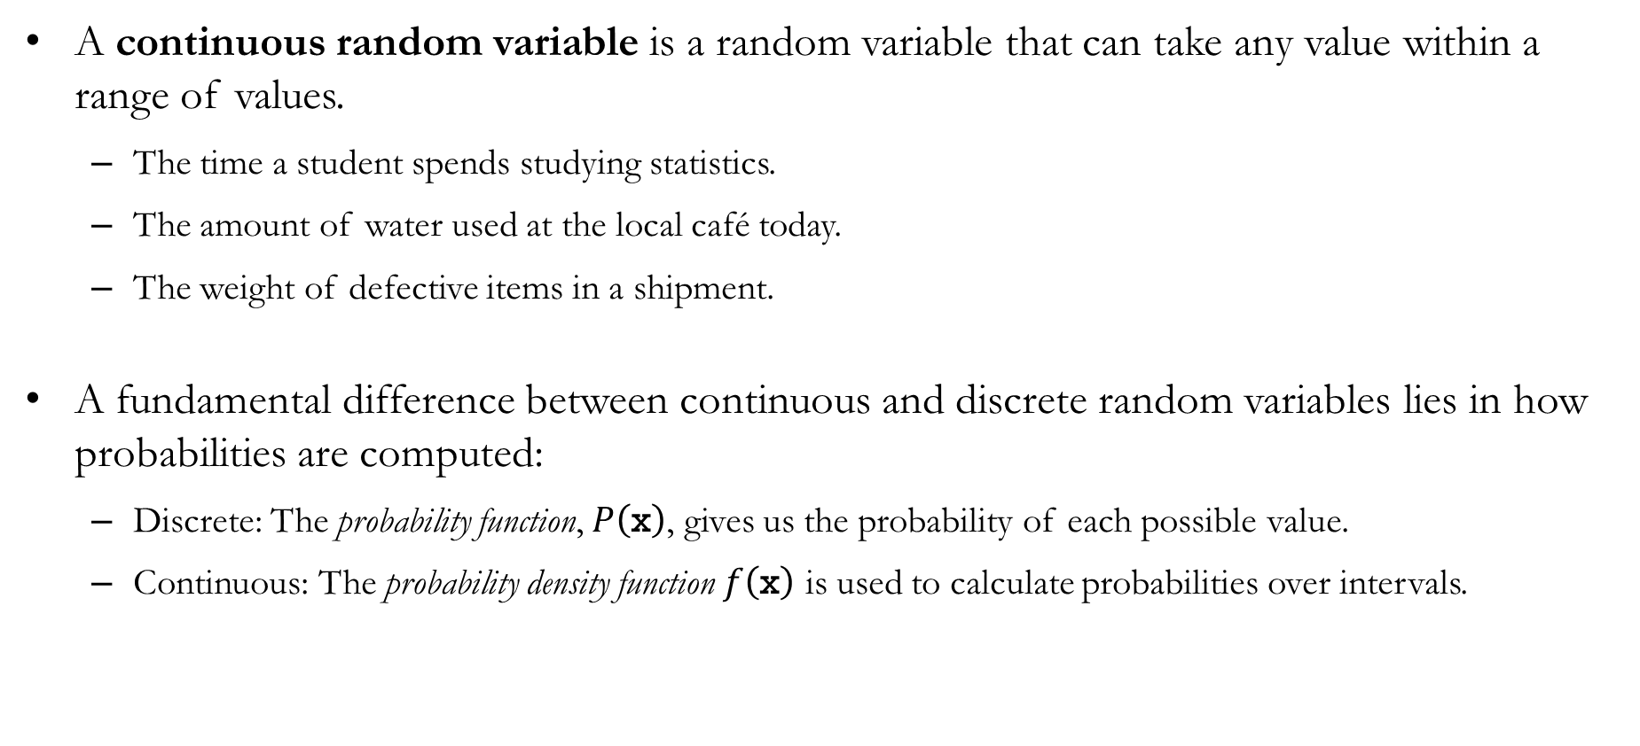
Recap: Continuous Random Variables
A continuous random variable is a random variable that can take any value within a range of values.
The time a student spends studying statistics.
The amount of water used at the local café today.
The weight of defective items in a shipment.
A fundamental difference between continuous and discrete random variables lies in how probabilities are computed:
Discrete: The probability function, $P\left(\text{x}\right)$, gives us the probability of each possible value.
Continuous: The probability density function $f\left(\text{x}\right)$ is used to calculate probabilities over intervals.

Slide 3
The Probability Density Function
A probability density function (PDF) is a function used to compute probabilities for a continuous random variable.
The probability density function does not directly give probabilities.
Instead, the area under the graph of the probability density function over an interval represents the probability that the random variable falls within that interval.
Recap: A probability mass function (PMF) is a function that assigns probabilities to the possible values of a discrete random variable.
The probability mass function directly gives probabilities.
This is possible because a discrete random variable has a countable set of possible outcomes.

Slide 4
Uniform Distribution

Slide 5
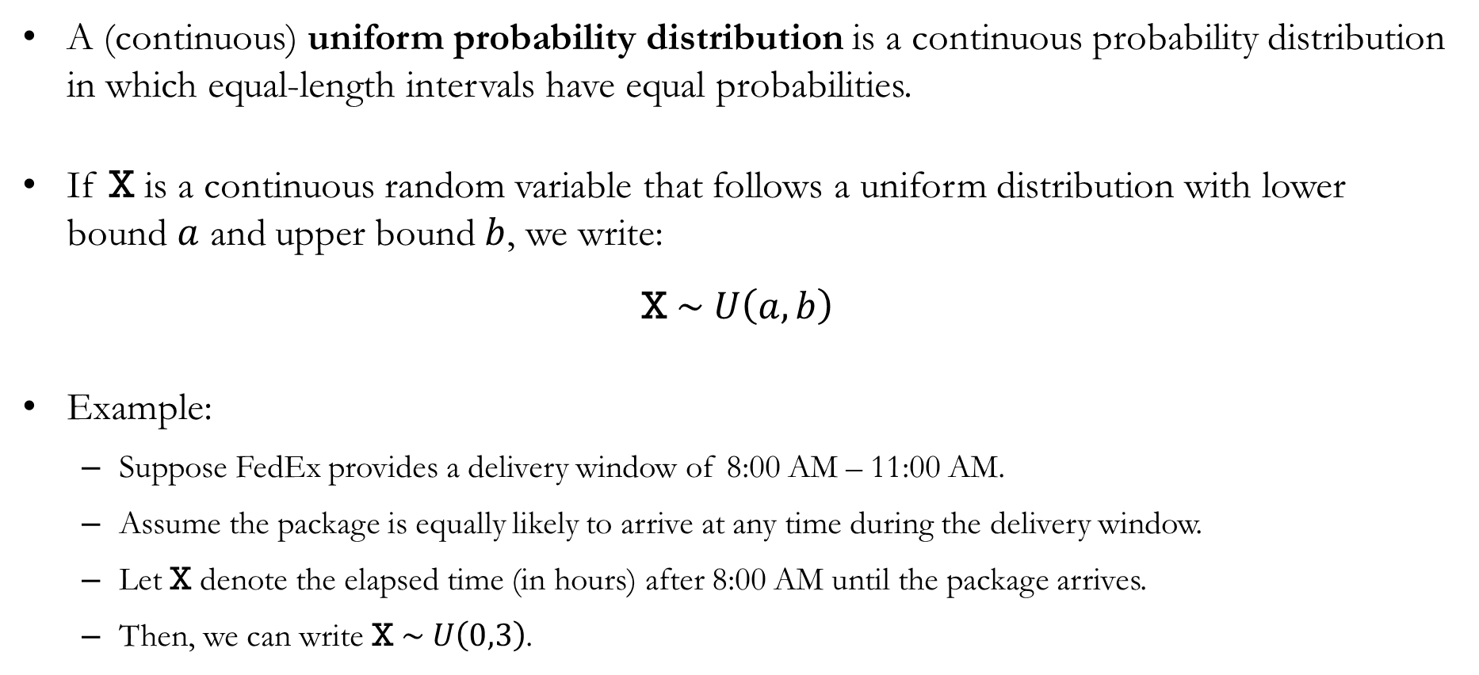
Uniform Probability Distribution
A (continuous) uniform probability distribution is a continuous probability distribution in which equal-length intervals have equal probabilities.
If X is a continuous random variable that follows a uniform distribution with lower bound $a$ and upper bound $b$, we write:
$$\text{X} \sim U\left(a,b\right)$$
Example:
Suppose FedEx provides a delivery window of 8:00 AM – 11:00 AM.
Assume the package is equally likely to arrive at any time during the delivery window.
Let X denote the elapsed time (in hours) after 8:00 AM until the package arrives.
Then, we can write $\text{X} \sim U\left(0,3\right)$.

Slide 6
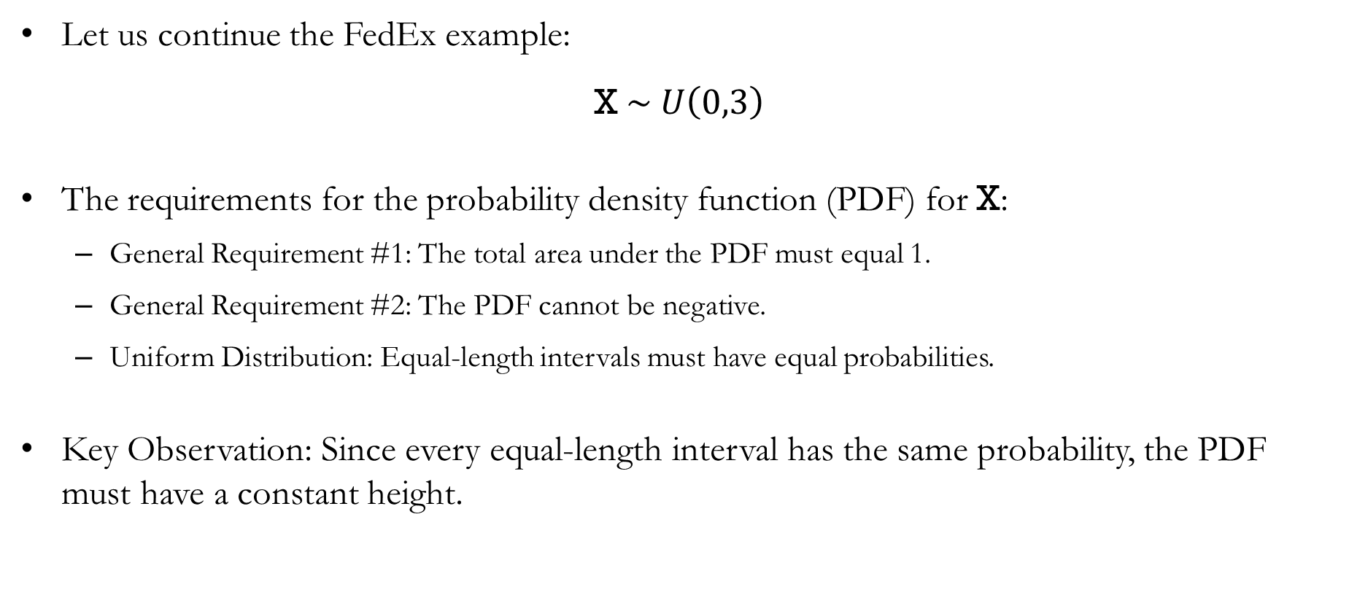
Uniform Probability Distribution: FedEx
Let us continue the FedEx example:
$$\text{X} \sim U\left(0,3\right)$$
The requirements for the probability density function (PDF) for X:
General Requirement #1: The total area under the PDF must equal 1.
General Requirement #2: The PDF cannot be negative.
Uniform Distribution: Equal-length intervals must have equal probabilities.
Key Observation: Since every equal-length interval has the same probability, the PDF must have a constant height.

Slide 7
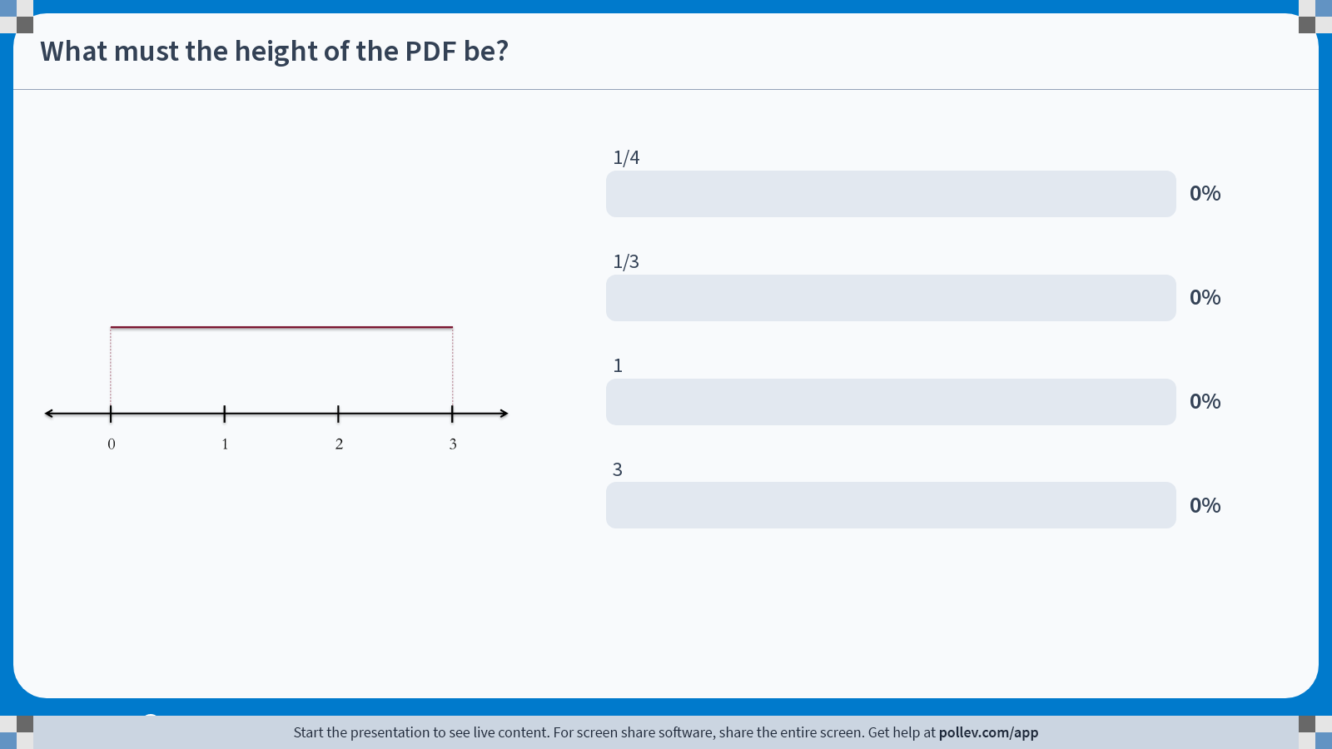
Poll Everywhere multiple choice poll activity Activity Title: What must the height of the PDF be? Slide 7
Notes:
Do not modify the notes in this section to avoid tampering with the Poll Everywhere activity. More info at polleverywhere.com/support What must the height of the PDF be? https://www.polleverywhere.com/multiple_choice_polls/ToqZQyMciz7Tjsv03nIXz?state=opened&flow=Default&onscreen=persist

Slide 8

Solution to In-class Poll
We have one equation with one unknown:
The width of the rectangle is 3, and the height of the rectangle is unknown.
The area of the rectangle must equal 1.
Solving for the height $h$:
$$h×3=1 ⟹ h=\frac{1}{3}$$
So, the PDF for the random variable X in our FedEx example is:
$$f\left(\text{x}\right)=\left\{\begin{aligned}\begin{matrix}1/3 & \text{for} \text{0}≤\text{x}≤3\end{matrix} \\ \begin{matrix}0 & \text{elsewhere} \end{matrix}\end{aligned}\right.$$

Slide 9

Uniform Probability Distribution: FedEx
Let us continue the FedEx example, where $\text{X} \sim U\left(0,3\right)$.
What is the probability that the package will arrive between 8:00 AM – 9:30 AM?
This corresponds to the interval $0≤\text{X}≤1.5$.
The width of the shaded rectangle is 1.5, and the height is 1/3.
Therefore, we can calculate the probability as:
$$P\left(0≤\text{X}≤1.5\right)=1.5×\frac{1}{3}=\frac{1}{2}$$
0
1
1.5
2
3

Slide 10
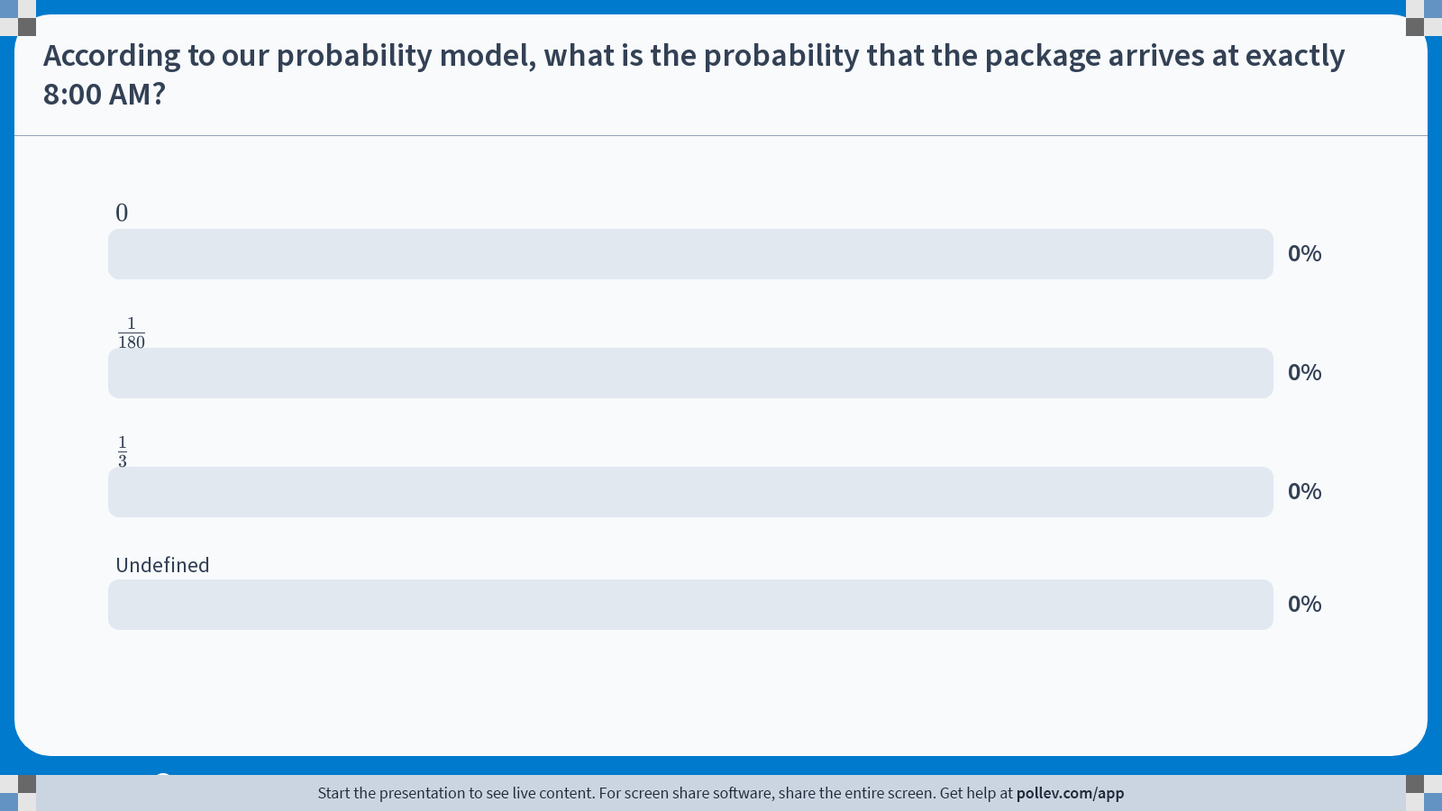
Poll Everywhere multiple choice poll activity Activity Title: According to our probability model, what is the probability that the package arrives at exactly 8:00 AM? Slide 10
Notes:
Do not modify the notes in this section to avoid tampering with the Poll Everywhere activity. More info at polleverywhere.com/support According to our probability model, what is the probability that the package arrives at exactly 8:00 AM? https://www.polleverywhere.com/multiple_choice_polls/UO2xsyt6Kss7MrTnrxWgR?state=opened&flow=Default&onscreen=persist

Slide 11
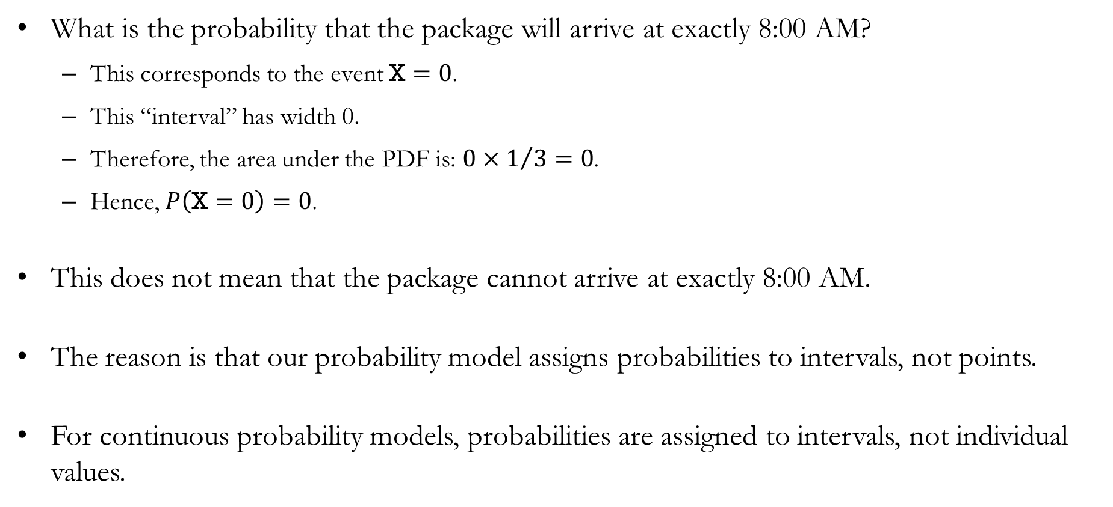
Solution to In-class Poll
What is the probability that the package will arrive at exactly 8:00 AM?
This corresponds to the event $\text{X}=0$.
This “interval” has width 0.
Therefore, the area under the PDF is: $0×1/3=0$.
Hence, $P\left(\text{X}=0\right)=0$.
This does not mean that the package cannot arrive at exactly 8:00 AM.
The reason is that our probability model assigns probabilities to intervals, not points.
For continuous probability models, probabilities are assigned to intervals, not individual values.

Slide 12

Uniform Probability Distribution
Generalizing, if a continuous random variable follows
$$\text{X} \sim U\left(a,b\right)$$
Then its probability density function is
$$f\left(\text{x}\right)=\left\{\begin{aligned}\begin{matrix}1/{\left(b−a\right)} & \text{for} a≤\text{x}≤b\end{matrix} \\ \begin{matrix} 0 & \text{elsewhere }\end{matrix}\end{aligned}\right.$$

Slide 13
Normal Probability Distribution

Slide 14
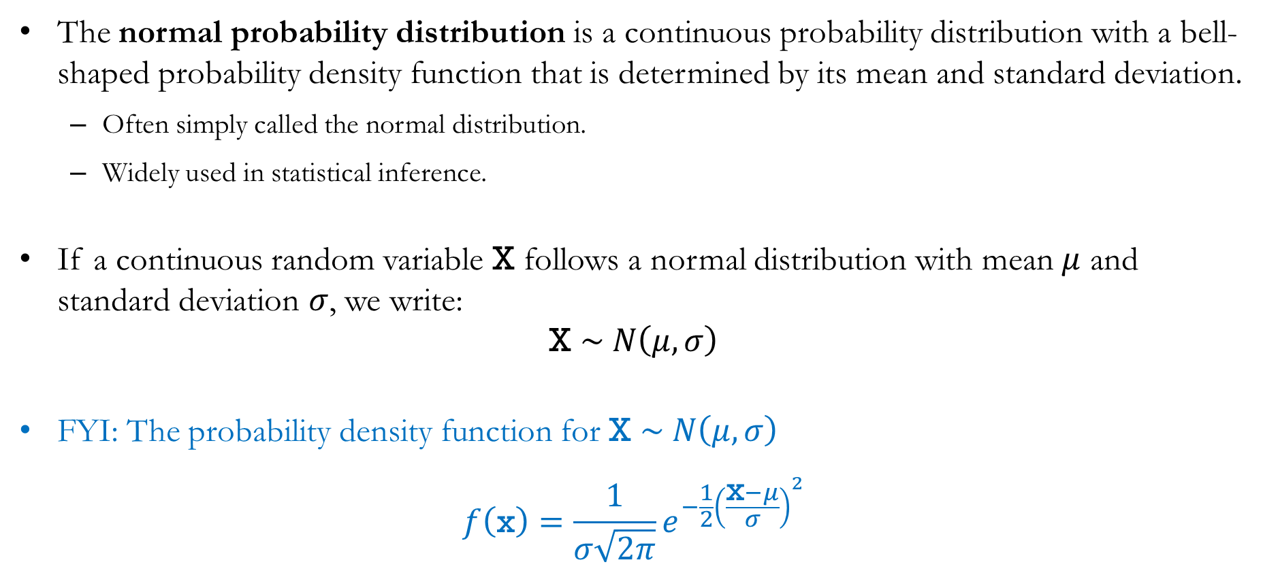
Normal Probability Distribution
The normal probability distribution is a continuous probability distribution with a bell-shaped probability density function that is determined by its mean and standard deviation.
Often simply called the normal distribution.
Widely used in statistical inference.
If a continuous random variable X follows a normal distribution with mean $μ$ and standard deviation $σ$, we write:
$$\text{X} \sim N\left(μ,σ\right)$$
FYI: The probability density function for $\text{X }\sim N\left(μ,σ\right)$
$$f\left(\text{x}\right)=\frac{1}{σ\sqrt{2π}}e^{−\frac{1}{2}{\left(\frac{\text{x}−μ}{σ}\right)}^{2}}$$

Slide 15
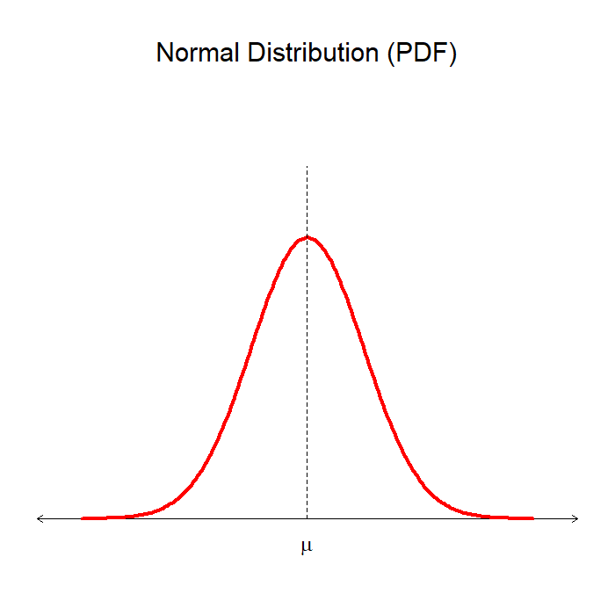
Characteristics of the Normal Distribution
Normal distributions are characterized entirely by two parameters:
The mean 𝜇, and
the standard deviation 𝜎.
The highest point of the normal PDF occurs at the mean,
which is also the median, and
which is also the mode.
The normal distribution is symmetric about its mean, and the tails of the normal curve extend infinitely in both directions.

Slide 16
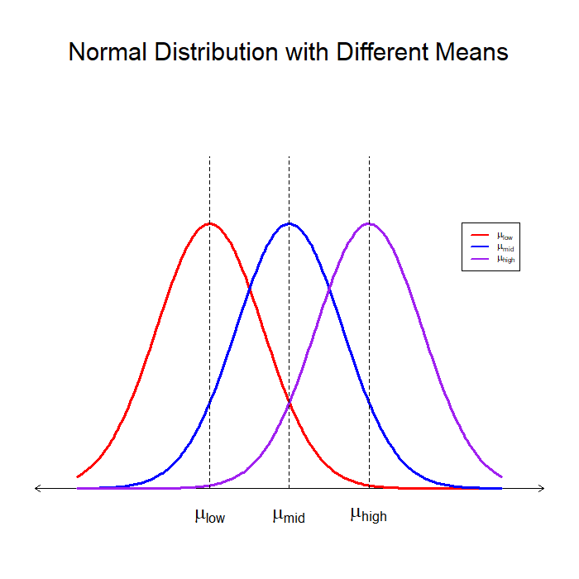
Characteristics of the Normal Distribution
The mean 𝜇 determines the center (location) of the distribution.
Increasing 𝜇 shifts the distribution to the right.
Decreasing 𝜇 shifts the distribution to the left.
Changing 𝜇 alone does not change the shape of the distribution.
Note: All three distributions have the same standard deviation.

Slide 17
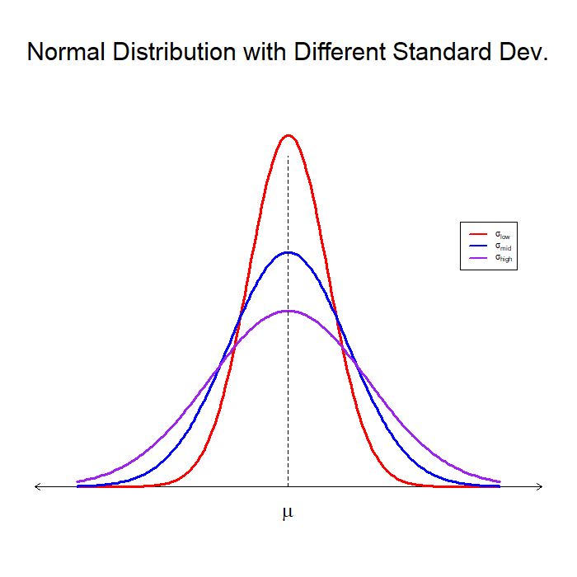
Characteristics of the Normal Distribution
The standard deviation 𝜎 determines the spread of the distribution.
A larger 𝜎 leads to a wider and flatter distribution.
A smaller 𝜎 leads to a narrower and taller distribution.
Changing 𝜎 alone does not change the center of the distribution.
Note: All three distributions have the same mean

Slide 18
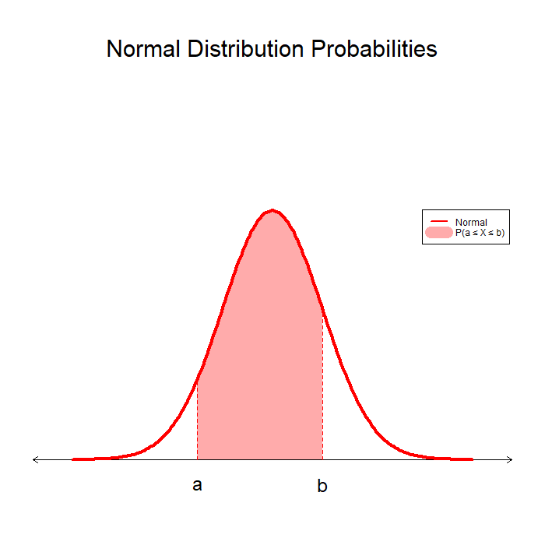
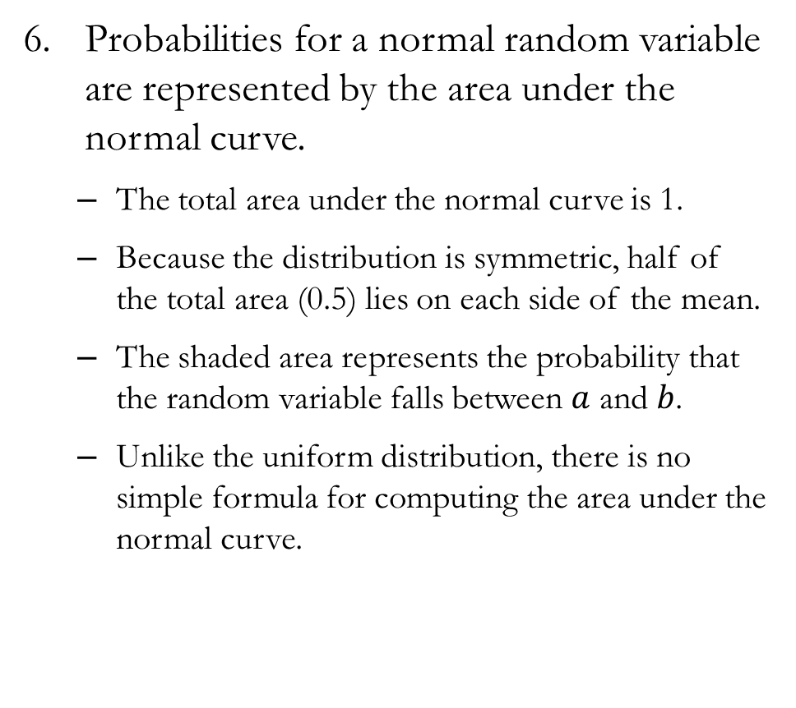
Characteristics of the Normal Distribution
Probabilities for a normal random variable are represented by the area under the normal curve.
The total area under the normal curve is 1.
Because the distribution is symmetric, half of the total area (0.5) lies on each side of the mean.
The shaded area represents the probability that the random variable falls between $a$ and $b$.
Unlike the uniform distribution, there is no simple formula for computing the area under the normal curve.

Slide 19
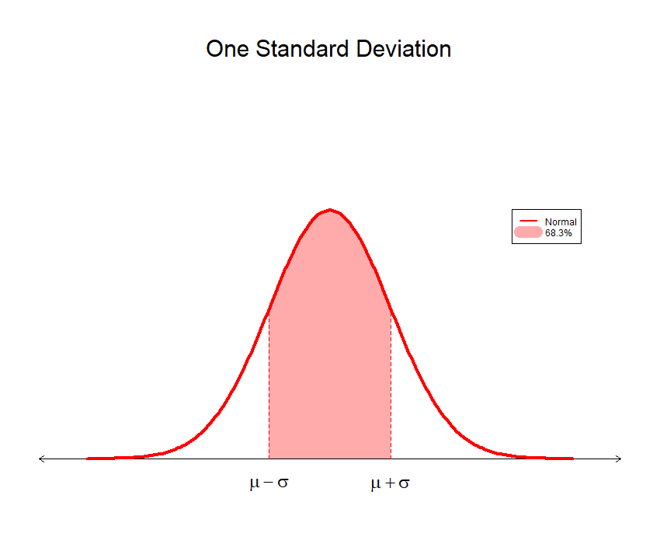
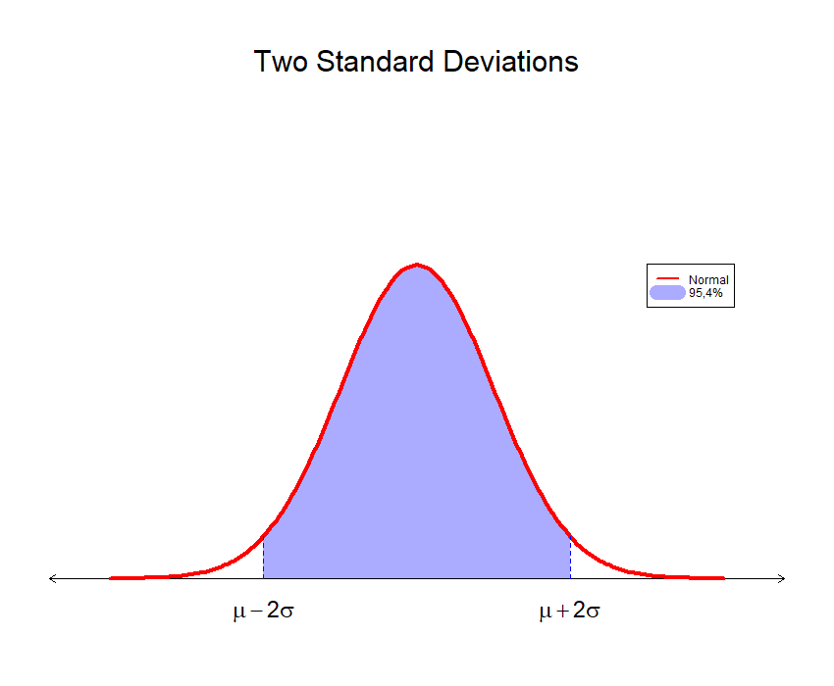
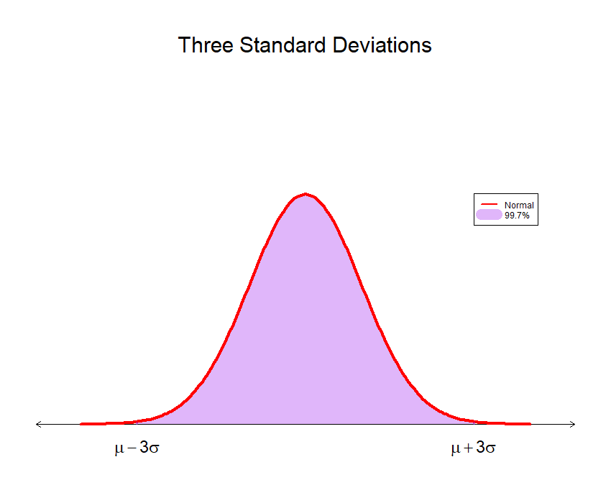
Characteristics of the Normal Distribution
For a normally distributed random variable, the following approximate percentages apply:
68.3% of values are within plus or minus one standard deviation of its mean.
95.4% of values are within plus or minus two standard deviations of its mean.
99.7% of values are within plus or minus three standard deviations of its mean.

Slide 20
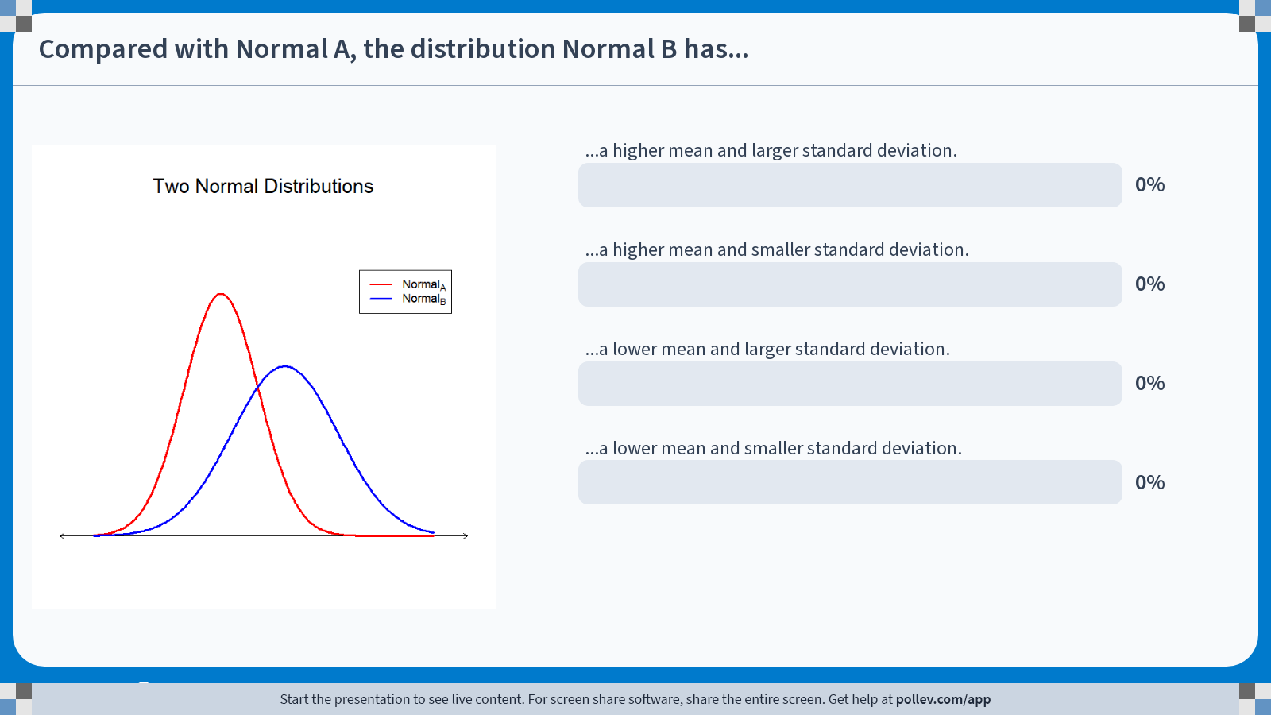
Poll Everywhere multiple choice poll activity Activity Title: Compared with Normal A, the distribution Normal B has... Slide 20
Notes:
Do not modify the notes in this section to avoid tampering with the Poll Everywhere activity. More info at polleverywhere.com/support Compared with Normal A, the distribution Normal B has... https://www.polleverywhere.com/multiple_choice_polls/5xSRrsYm7S7aCM6mwrmyX?state=opened&flow=Default&onscreen=persist

Slide 21
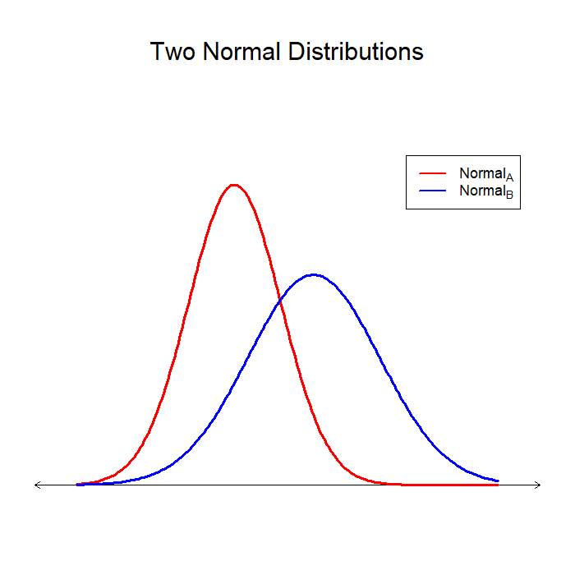
Solution to In-class Poll
Comparing the centers:
Normal A’s peak is to the left of Normal B’s peak.
Therefore, Normal B has a higher mean than Normal A.
Comparing the spread:
Normal A is narrower and taller than Normal B.
Therefore, Normal B has a larger standard deviation than Normal A.
Normal B has a higher mean and larger standard deviation.

Slide 22
Standard Normal Distribution

Slide 23
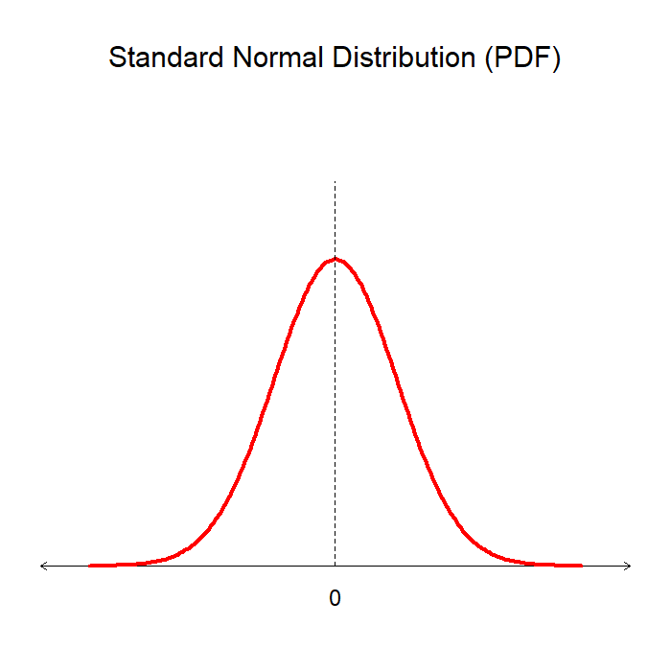
Standard Normal Probability Distribution
The standard normal probability distribution is a normal distribution with a mean of 0 and a standard deviation of 1.
Often simply called the standard normal distribution.
Random variables that follow a standard normal distribution are commonly denoted by Z.
The standard normal distribution has all the same properties as any other normal distribution because it is simply a special case of the normal distribution.

Slide 24
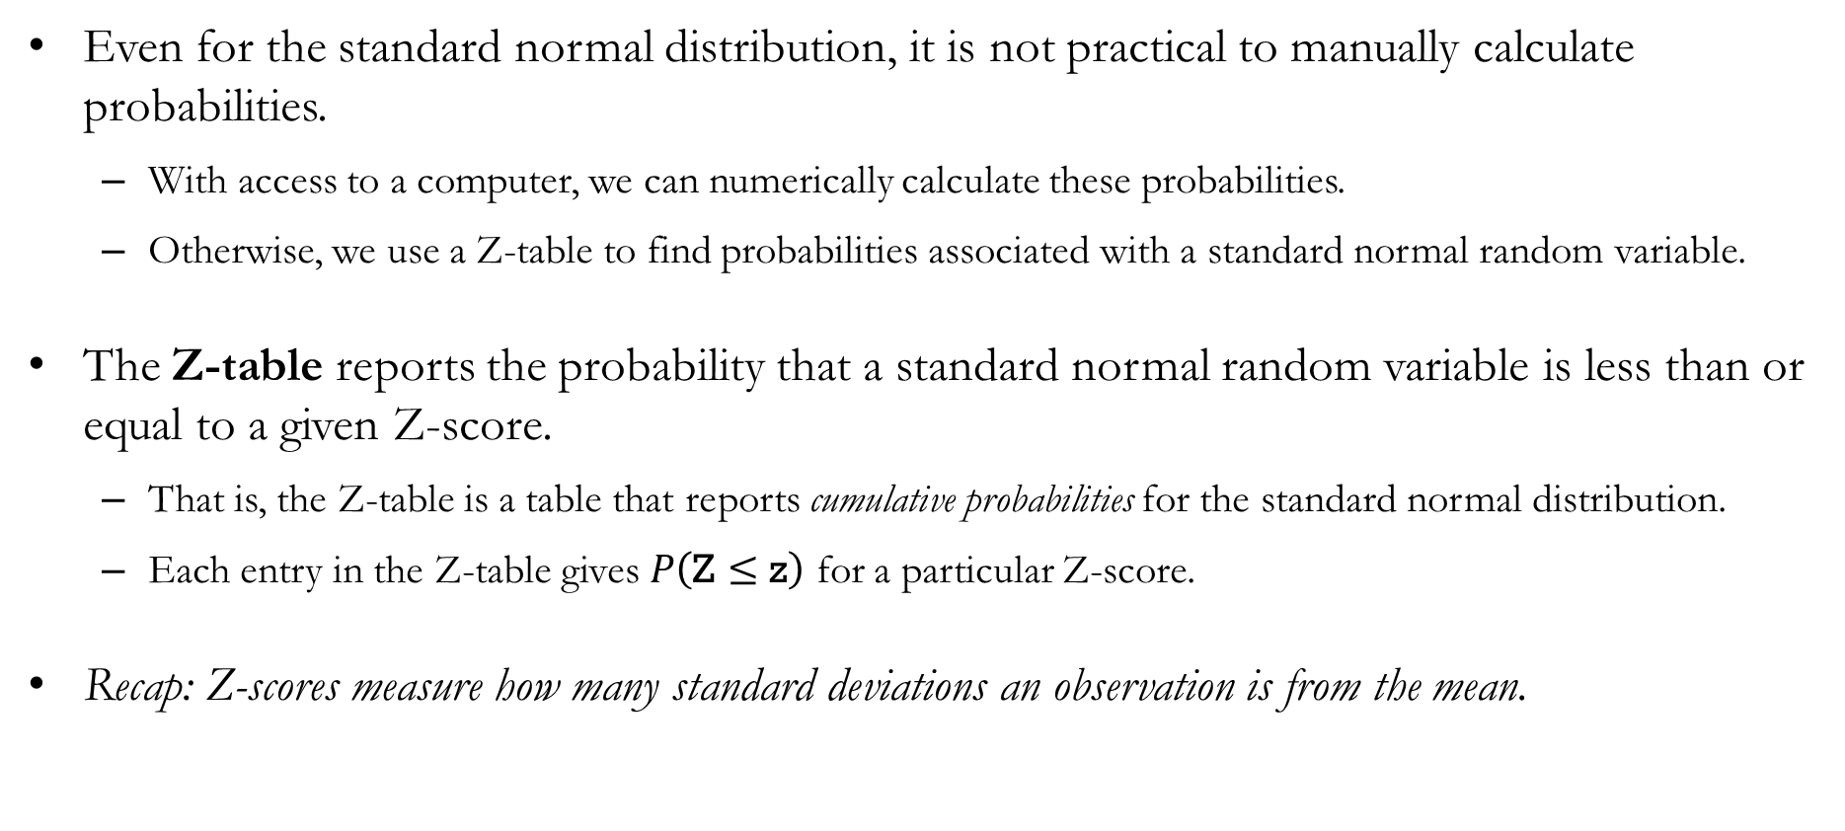
Why Standard Normal?
Even for the standard normal distribution, it is not practical to manually calculate probabilities.
With access to a computer, we can numerically calculate these probabilities.
Otherwise, we use a Z-table to find probabilities associated with a standard normal random variable.
The Z-table reports the probability that a standard normal random variable is less than or equal to a given Z-score.
That is, the Z-table is a table that reports cumulative probabilities for the standard normal distribution.
Each entry in the Z-table gives $P\left(\text{Z}≤\text{z}\right)$ for a particular Z-score.
Recap: Z-scores measure how many standard deviations an observation is from the mean.

Slide 25
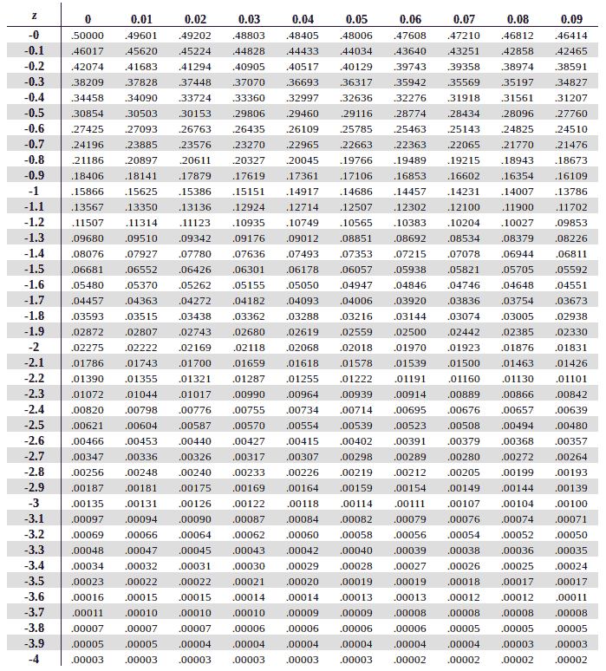
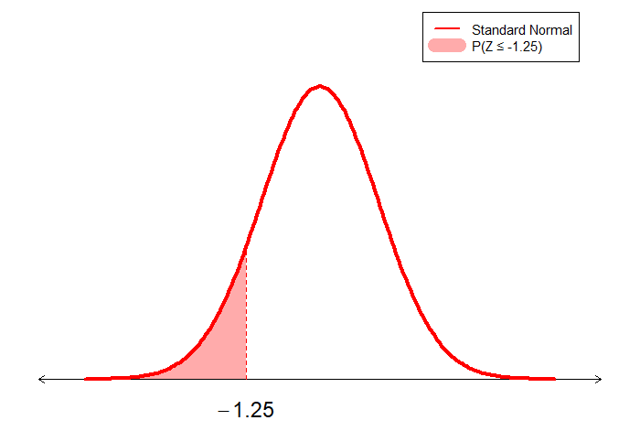
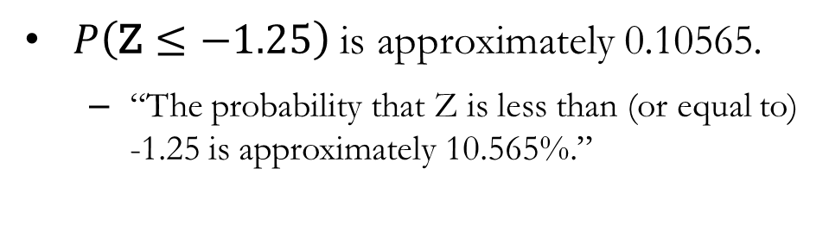
Probability that Z is less than or equal to a given value
2. Select column 0.05
1. Select row -1.2
3. Read the probability at the intersection
$P\left(\text{Z}≤−1.25\right)$ is approximately 0.10565.
“The probability that Z is less than (or equal to) -1.25 is approximately 10.565%.”

Slide 26
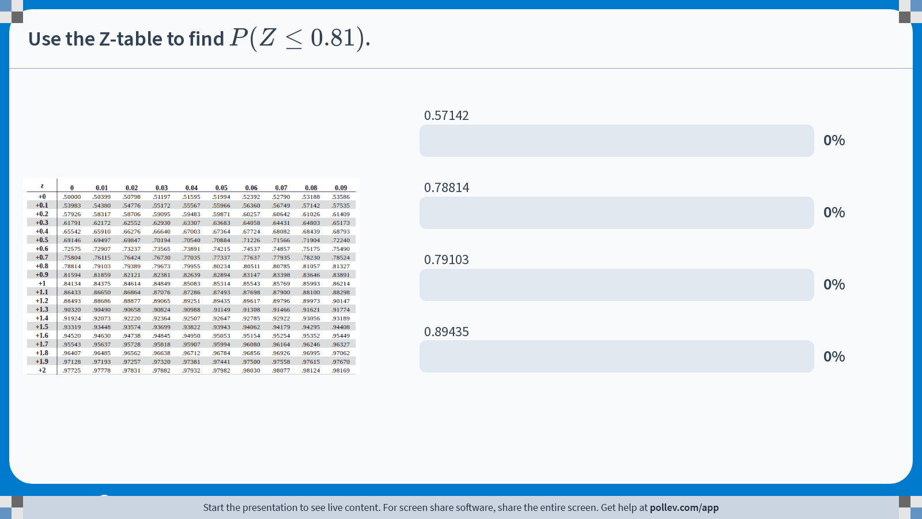
Poll Everywhere multiple choice poll activity Activity Title: Use the Z-table to find $$P(Z\\leq 0.81)$$. Slide 26
Notes:
Do not modify the notes in this section to avoid tampering with the Poll Everywhere activity. More info at polleverywhere.com/support Use the Z-table to find $$P(Z\\leq 0.81)$$. https://www.polleverywhere.com/multiple_choice_polls/ocM4heCCsacDg6B0NQ26u?state=opened&flow=Default&onscreen=persist

Slide 27
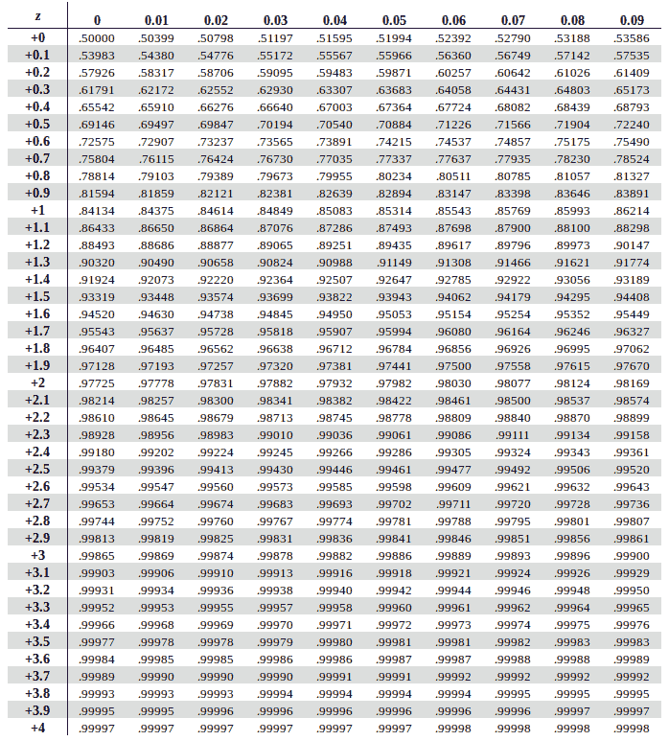
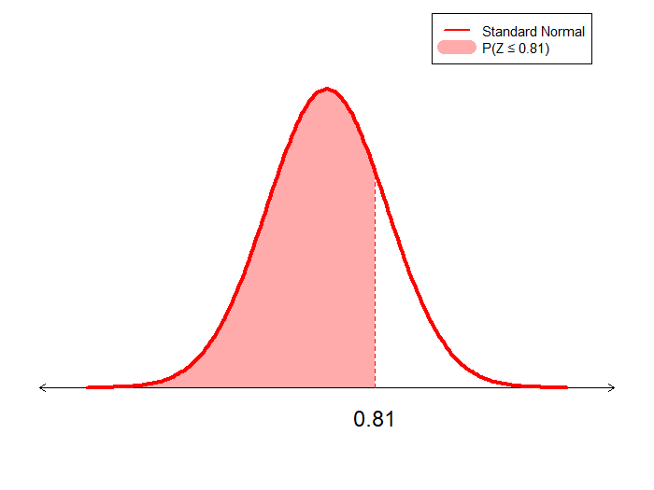
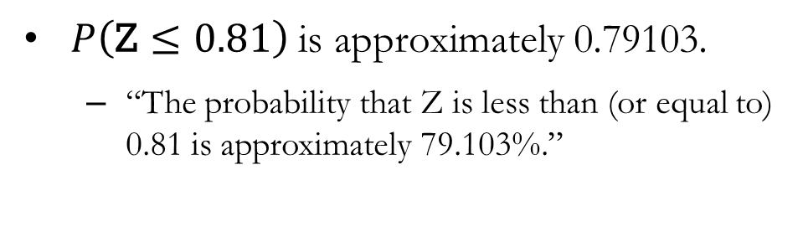
Solution to In-class Poll
$P\left(\text{Z}≤0.81\right)$ is approximately 0.79103.
“The probability that Z is less than (or equal to) 0.81 is approximately 79.103%.”

Slide 28
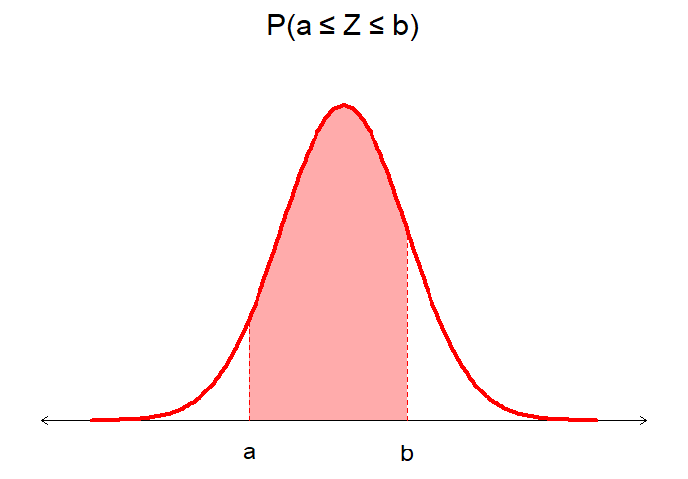
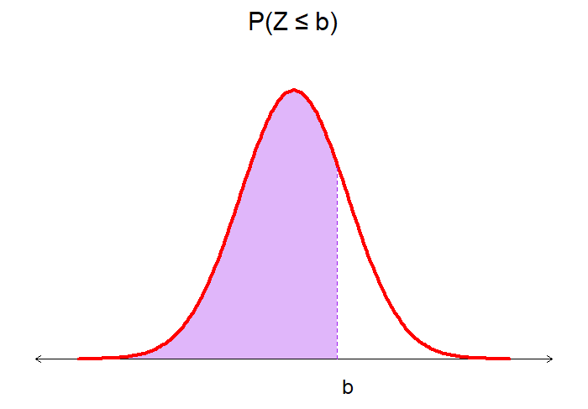
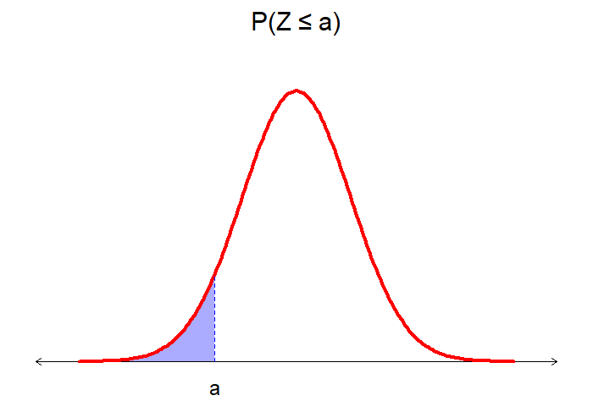

Probability that Z lies between two given values
The probability $P\left(a≤\text{Z}≤b\right)$ can also be calculated using the Z-table:
$$P\left(a≤\text{Z}≤b\right)=P\left(\text{Z}≤b\right)−P\left(\text{Z}≤a\right)$$
The desired probability, $P\left(a≤\text{Z}≤b\right)$, is shown in red.
The purple area represents $P\left(\text{Z}≤b\right)$, the blue area represents $P\left(\text{Z}≤a\right)$.
Subtract the blue area from the purple area to obtain the desired probability.

Slide 29
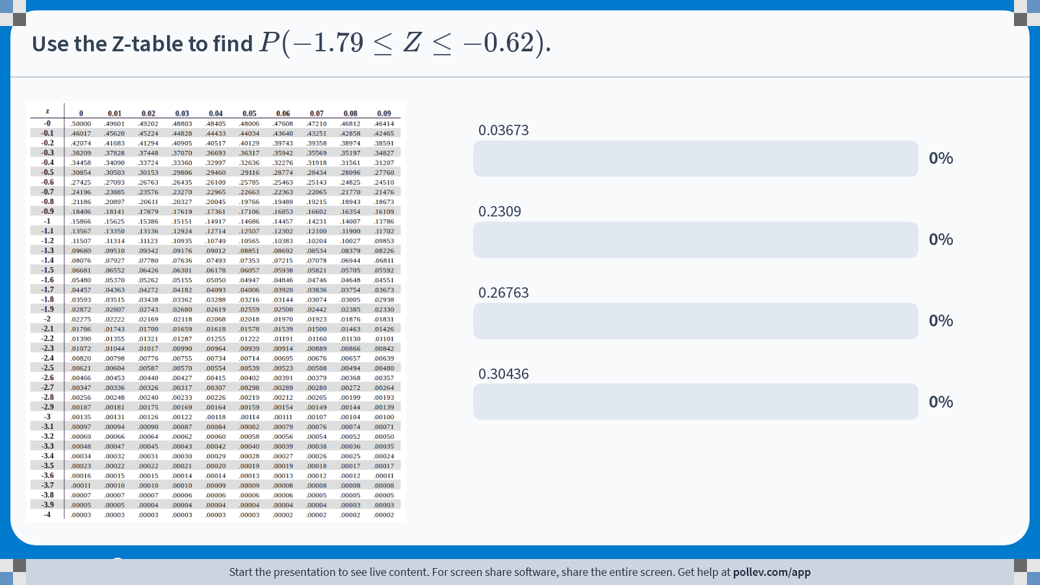
Poll Everywhere multiple choice poll activity Activity Title: Use the Z-table to find $$P(-1.79 \\leq Z\\leq -0.62)$$. Slide 30
Notes:
Do not modify the notes in this section to avoid tampering with the Poll Everywhere activity. More info at polleverywhere.com/support Use the Z-table to find $$P(-1.79 \\leq Z\\leq -0.62)$$. https://www.polleverywhere.com/multiple_choice_polls/Odt3swjuhOyA1ZPd3c1Yi?state=opened&flow=Default&onscreen=persist

Slide 30
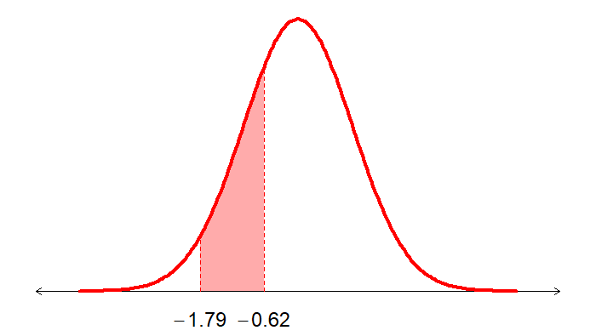


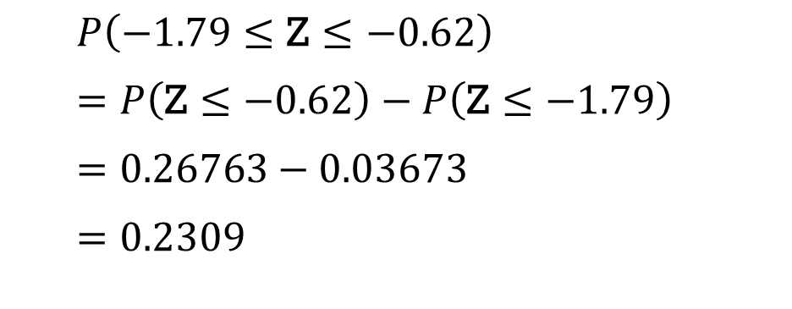
Solution to In-class Poll
$$P\left(\text{Z}≤−0.62\right)$$
$$P\left(\text{Z}≤−1.79\right)$$
$P\left(\text{−}\text{1.79}≤\text{Z}≤\text{−}\text{0}\text{.}\text{62}\right)$
$=P\left(\text{Z}≤\text{−0.62}\right)−P\left(\text{Z}≤\text{−}\text{1}\text{.}\text{79}\right)$
$=0.26763−0.03673$
$=0.2309$

Slide 31
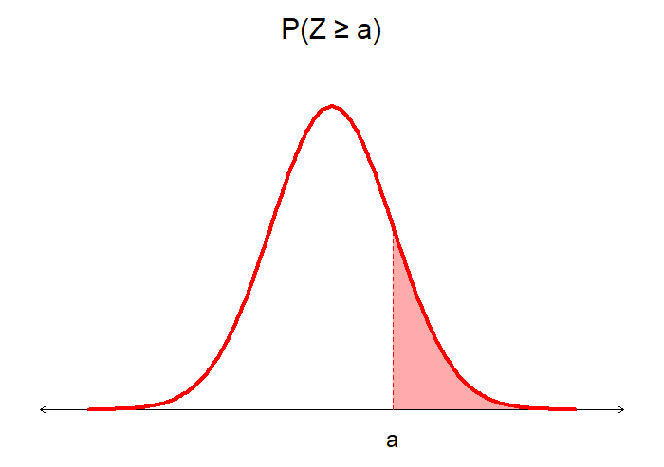
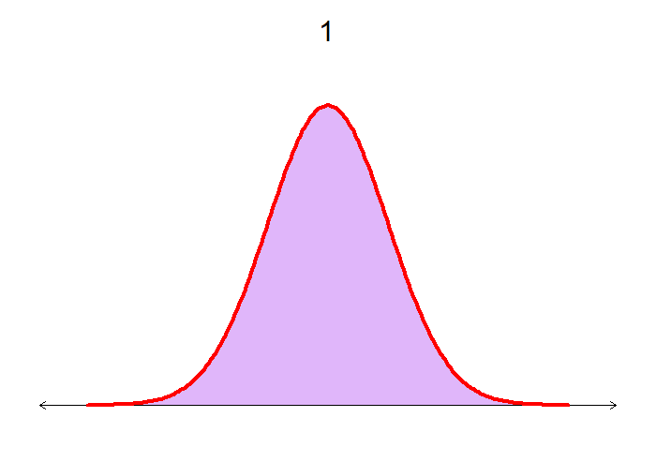
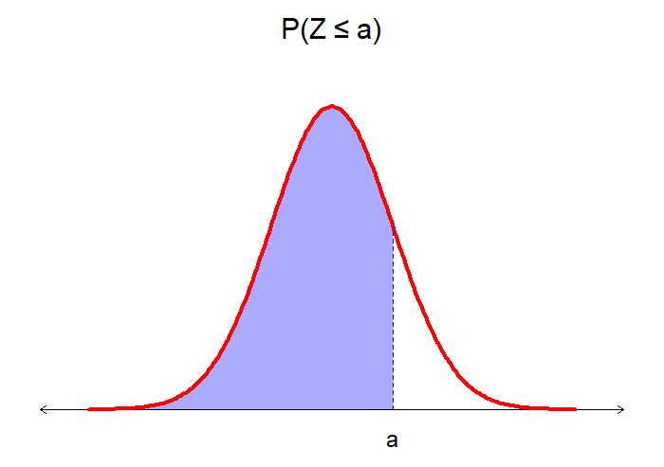

Probability that Z is greater than or equal to a given value
The probability $P\left(\text{Z}≥a\right)$ can also be calculated using the Z-table:
$$P\left(\text{Z}≥a\right)=1−P\left(\text{Z}≤a\right)$$
The desired probability, $P\left(\text{Z}≥a\right)$, is shown in red.
The purple area represents the total probability which is 1, and the blue area represents $P\left(\text{Z}≤a\right)$.
Subtract the blue area from the purple area to obtain the desired probability.

Slide 32
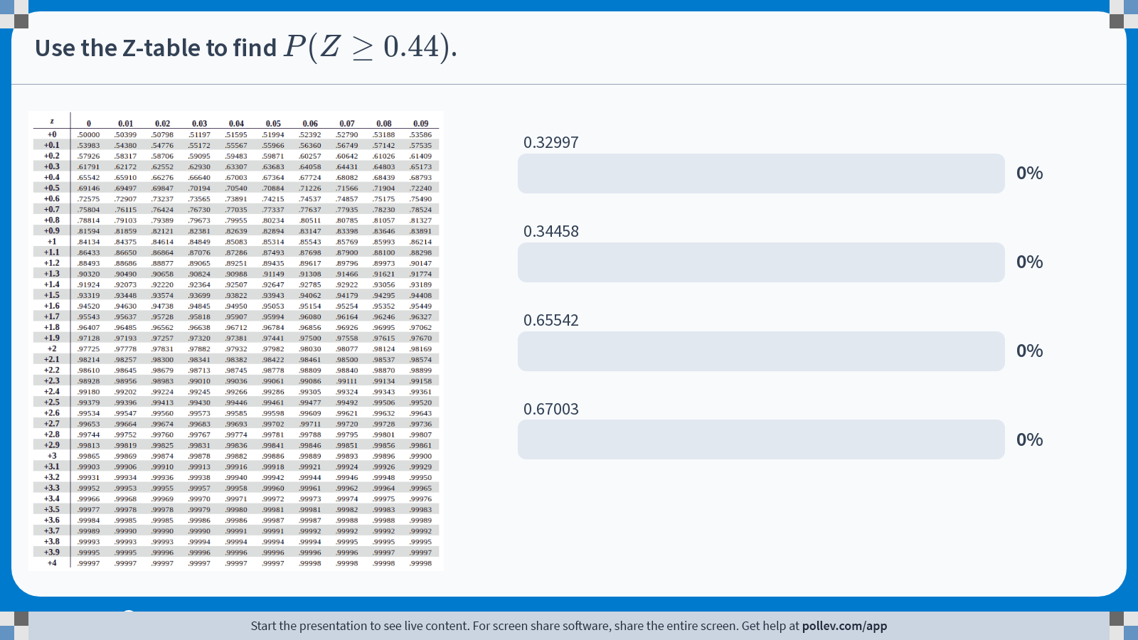
Poll Everywhere multiple choice poll activity Activity Title: Use the Z-table to find $$P(Z\\geq 0.44)$$. Slide 33
Notes:
Do not modify the notes in this section to avoid tampering with the Poll Everywhere activity. More info at polleverywhere.com/support Use the Z-table to find $$P(Z\\geq 0.44)$$. https://www.polleverywhere.com/multiple_choice_polls/OxtUs6ZIOpsmAAC1JVnzY?state=opened&flow=Default&onscreen=persist

Slide 33
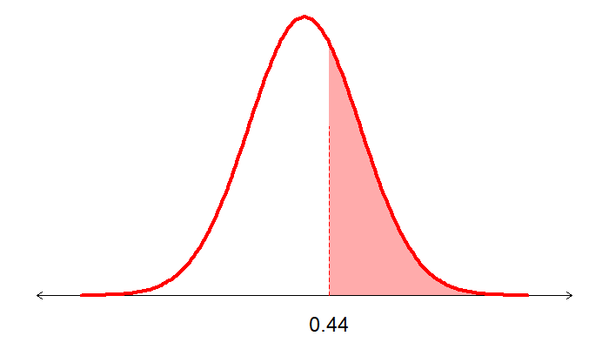

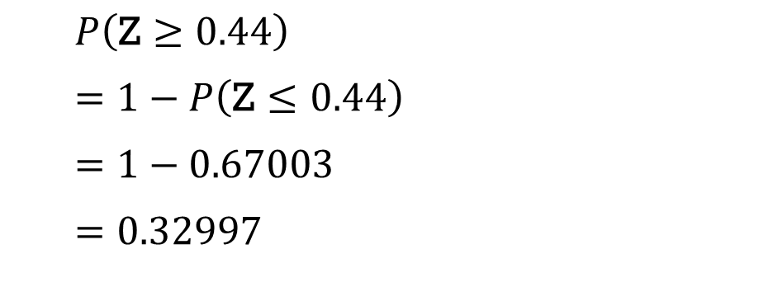
Solution to In-class Poll
$$P\left(\text{Z}≤0.44\right)$$
$P\left(\text{Z}≥\text{0}\text{.}\text{44}\right)$
$=1−P\left(\text{Z}≤\text{0}\text{.44}\right)$
$=1−0.67003$
$=0.32997$

Slide 34
Probabilities for Normal Distributions

Slide 35
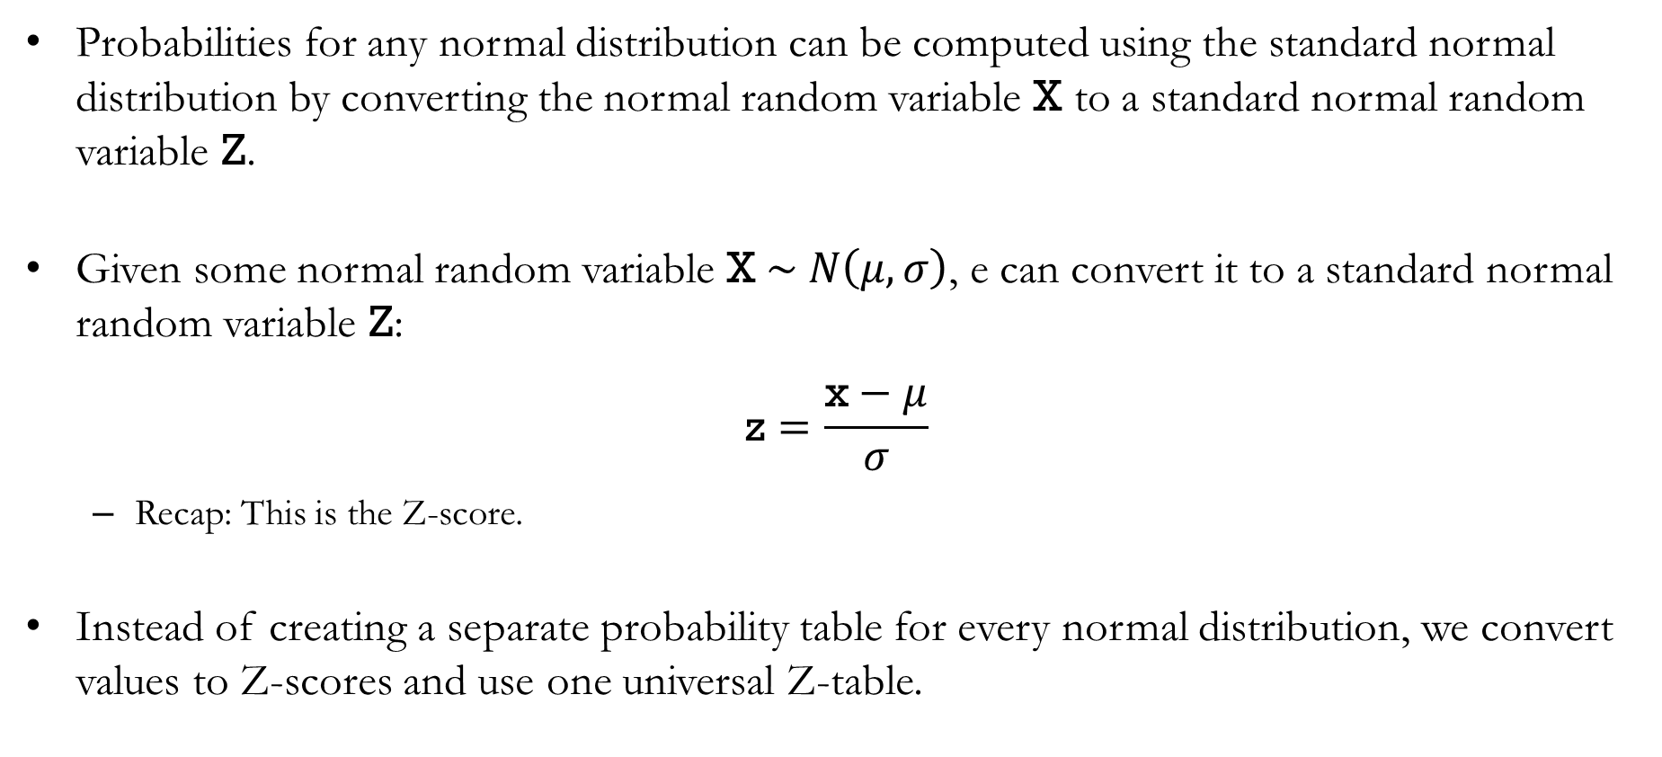
Standardization
Probabilities for any normal distribution can be computed using the standard normal distribution by converting the normal random variable X to a standard normal random variable Z.
Given some normal random variable $\text{X} \sim N\left(μ,σ\right)$, e can convert it to a standard normal random variable Z:
$$\text{z}=\frac{\text{x}−μ}{σ}$$
Recap: This is the Z-score.
Instead of creating a separate probability table for every normal distribution, we convert values to Z-scores and use one universal Z-table.

Slide 36
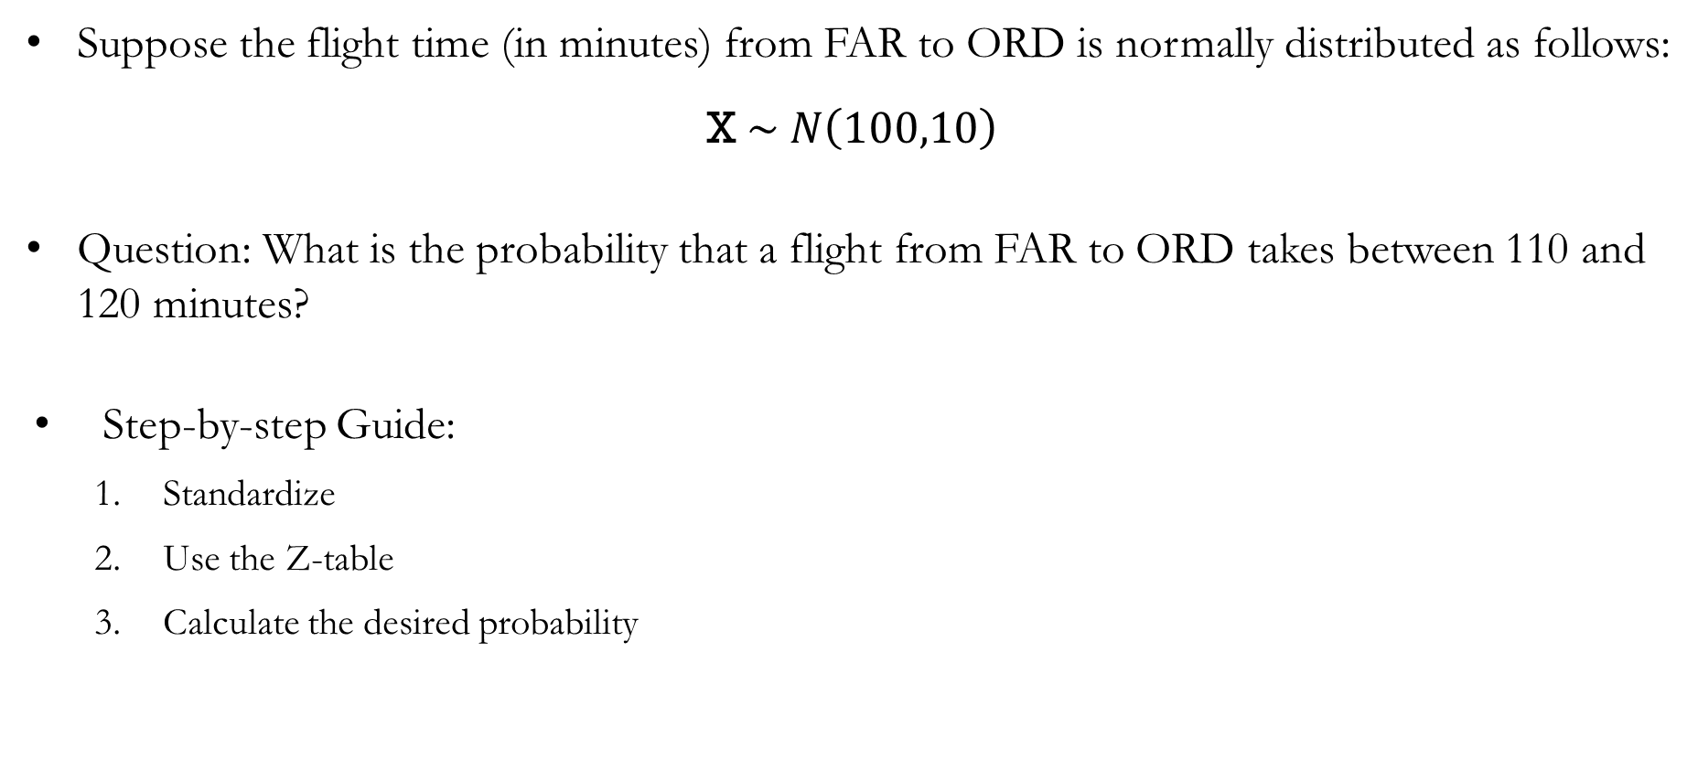
In-class Exercise
Suppose the flight time (in minutes) from FAR to ORD is normally distributed as follows:
$$\text{X} \sim N\left(100,10\right)$$
Question: What is the probability that a flight from FAR to ORD takes between 110 and 120 minutes?
Step-by-step Guide:
Standardize
Use the Z-table
Calculate the desired probability

Slide 37
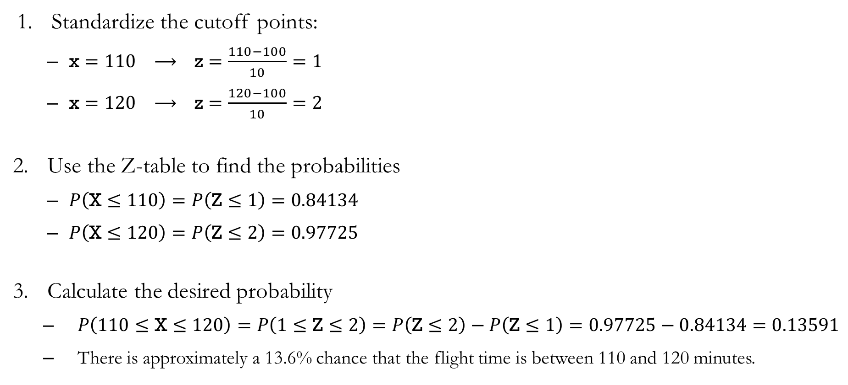
Solution to In-class Exercise
Standardize the cutoff points:
$\text{x}=110 ⟶ \text{z}=\frac{110−100}{10}=1$
$\text{x}=120 ⟶ \text{z}=\frac{120−100}{10}=2$
Use the Z-table to find the probabilities
$P\left(\text{X}≤110\right)=P\left(\text{Z}≤1\right)=0.84134$
$P\left(\text{X}≤120\right)=P\left(\text{Z}≤2\right)=0.97725$
Calculate the desired probability
$P\left(110≤\text{X}≤120\right)=P\left(1≤\text{Z}≤2\right)=P\left(\text{Z}≤2\right)−P\left(\text{Z}≤1\right)=0.97725−0.84134=0.13591$
There is approximately a 13.6% chance that the flight time is between 110 and 120 minutes.

Slide 38
Examples of Some
Continuous Probability Distributions

Slide 39
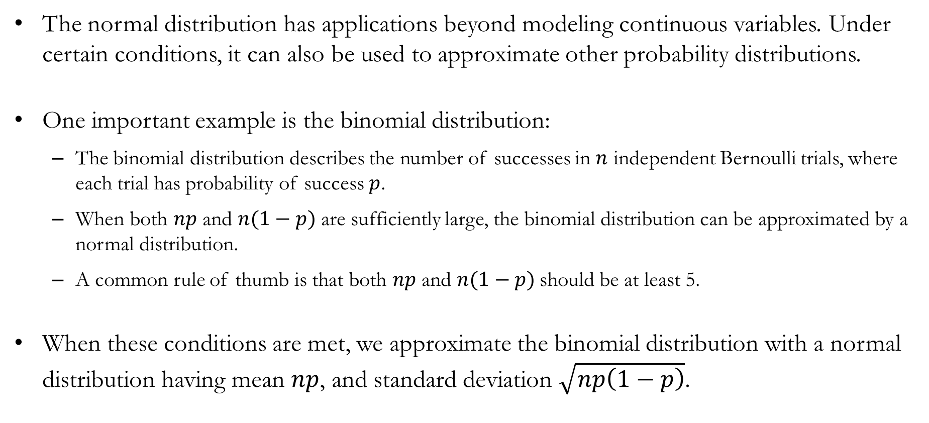
Normal Approximation of Binomial Distributions
The normal distribution has applications beyond modeling continuous variables. Under certain conditions, it can also be used to approximate other probability distributions.
One important example is the binomial distribution:
The binomial distribution describes the number of successes in $n$ independent Bernoulli trials, where each trial has probability of success $p$.
When both $np$ and $n(1−p)$ are sufficiently large, the binomial distribution can be approximated by a normal distribution.
A common rule of thumb is that both $np$ and $n(1−p)$should be at least 5.
When these conditions are met, we approximate the binomial distribution with a normal distribution having mean $np$, and standard deviation $\sqrt{np\left(1−p\right)}$.

Slide 40
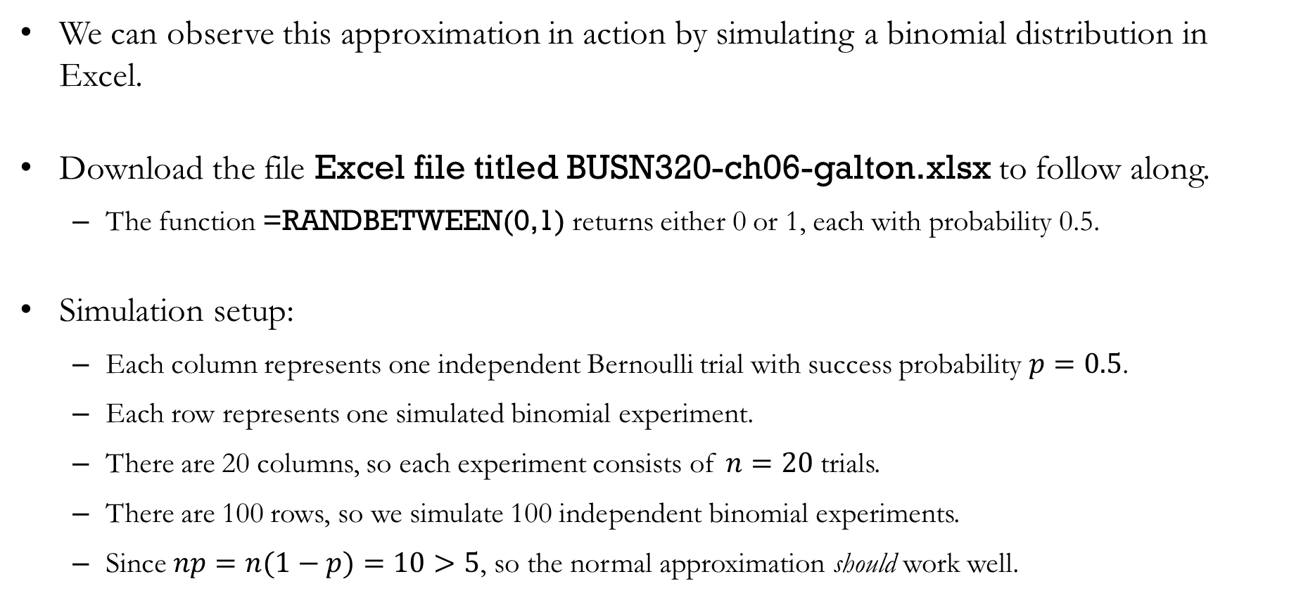
Binomial Simulation: Excel
We can observe this approximation in action by simulating a binomial distribution in Excel.
Download the file Excel file titled BUSN320-ch06-galton.xlsx to follow along.
The function =RANDBETWEEN(0,1) returns either 0 or 1, each with probability 0.5.
Simulation setup:
Each column represents one independent Bernoulli trial with success probability $p=0.5$.
Each row represents one simulated binomial experiment.
There are 20 columns, so each experiment consists of $n=20$ trials.
There are 100 rows, so we simulate 100 independent binomial experiments.
Since $np=n(1−p)=10>5$, so the normal approximation should work well.

Slide 41
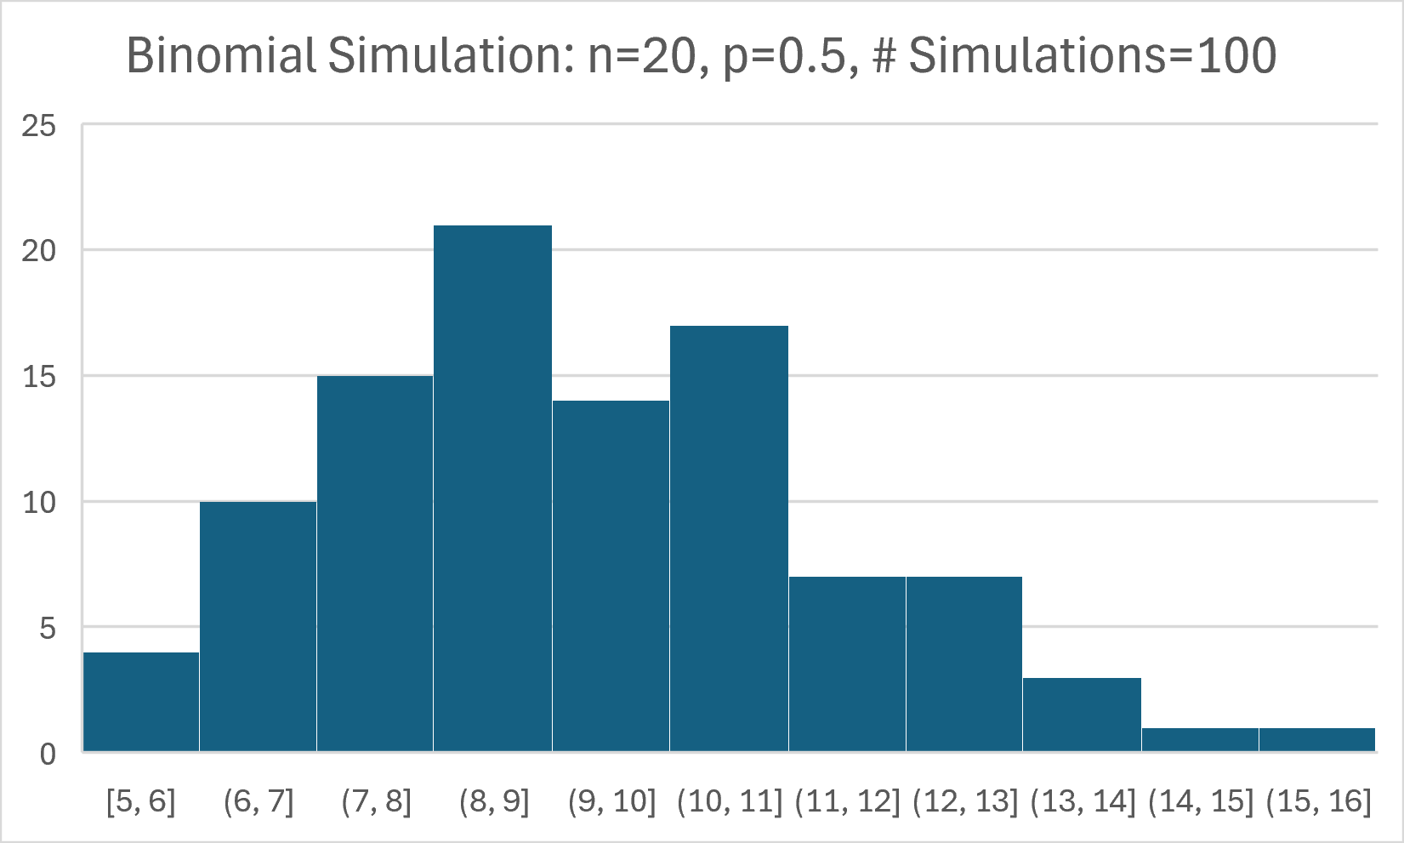
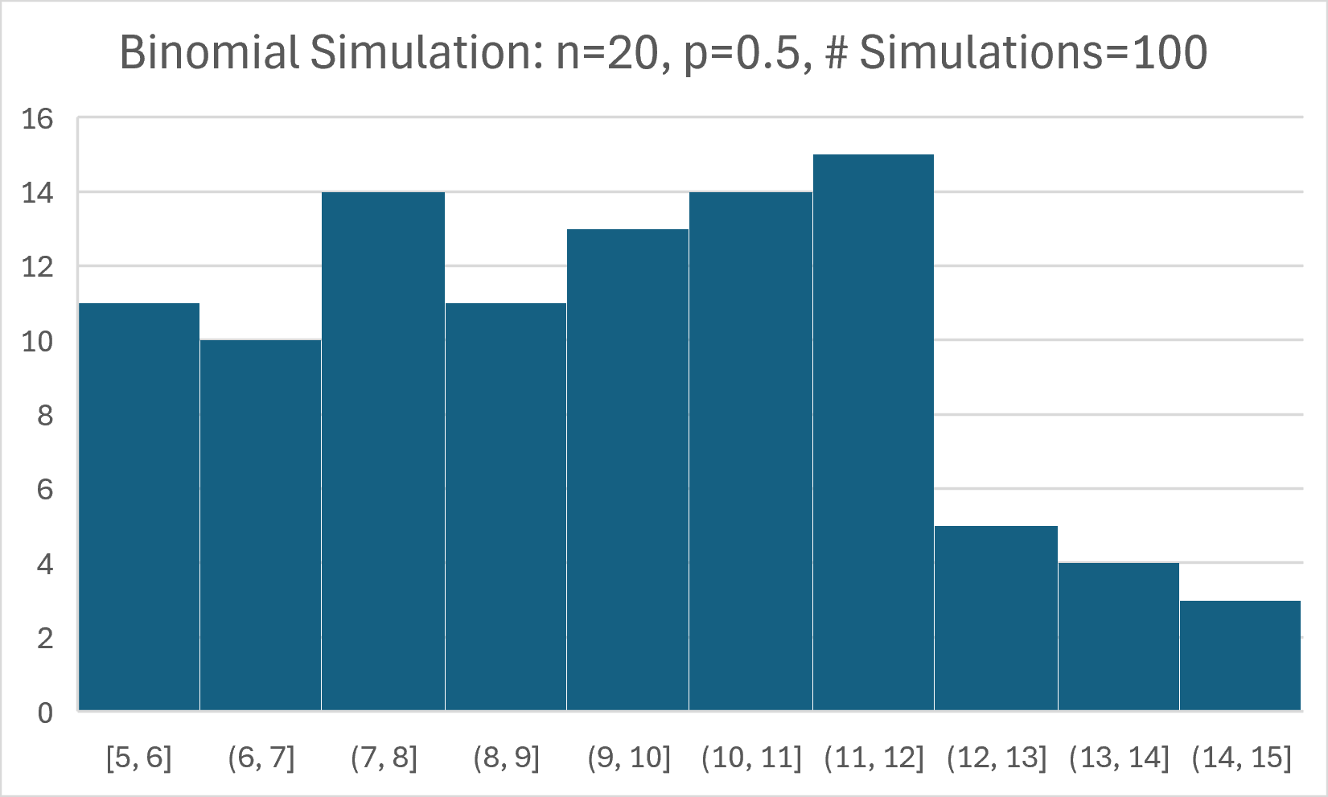
Binomial Simulation: Excel Results
The two figures on the left show two possible outcomes from simulating the same binomial distribution.
Since each simulation is generated randomly, some histograms may appear more bell-shaped than others.
The main reason is that we are only simulating 100 independent binomial experiments.
Using a more powerful tool such as R, we can easily run 10,000 or more simulations, making the bell-shaped pattern much clearer.

Slide 42


Detour: Binomial Simulation Using R
The code above simulates 10,000 independent binomial experiments, each consisting of 50 Bernoulli trials.
The histogram shows the simulated binomial distribution.
The red curve is the normal distribution with the same mean and standard deviation, illustrating how closely the normal distribution approximates the binomial distribution.

Slide 43

In-class Exercise
Suppose that a traveler takes 100 flights between FAR and ORD. Assume that each flight runs on schedule with probability $p=0.9$.
Question: What is the probability that this traveler experiences fewer than 84 on-time flights?
Step-by-step Guide:
Determine the appropriate binomial parameters.
Standardize the cutoff values.
Use the Z-table.
Calculate the desired probability.

Slide 44

Solution to In-class Exercise
Determine the appropriate binomial parameters:
The traveler takes 100 flights which are each assumed to be Bernoulli trials: $n=100$
The probability that any flight runs on schedule is given as: $p=0.9$
The normal approximation is appropriate, since $np=90>5$and $n\left(1−p\right)=10>5$
The approximating normal distribution has mean $np=90$
The approximating normal distribution has standard deviation $\sqrt{np\left(1−p\right)}=3$
Standardize the cutoff values:
$\text{x}=84 ⟶ \text{z}=\frac{84−90}{3}=−2$
$\text{x}$ represents the normal approximation where $\text{X \sim } N\left(90,3\right)$.

Slide 45

Solution to In-class Exercise
Use the Z-table:
$P\left(\text{X}≤84\right)=P\left(\text{Z}≤−2\right)=0.02275$
Calculate the desired probability
$P\left(\text{X}≤84\right)=P\left(\text{Z}≤−2\right)=0.02275$
There is approximately a 2.28% chance that the traveler experiences fewer than 84 on-time flights.
In other words, there is approximately a 2.28% chance that the traveler experiences more than 16 flight disruptions.

Slide 46

Solution to In-class Exercise
Visually, this is what we are doing:
The gray bars are simulations of 10,000 binomial experiments, where each experiment consists of 100 flights between FAR and ORD.
The solid red curve is the normal distribution used to approximate the binomial distribution.
The dashed blue line marks the cutoff of 84 on-time flights.

Slide 47
Recap & Preview

Slide 48
Recap: Chapter 6
In this chapter, we learned how to.
Distinguish between discrete and continuous probability distributions.
Compute probabilities for uniform and normal distributions.
Use Z-scores and the Z-table to calculate probabilities.
Approximate a binomial distribution using a normal distribution when appropriate.
Takeaway: Continuous probability distributions provide a powerful framework for modeling uncertainty and computing probabilities.

Slide 49
Preview: Chapter 7
In the next chapter, we will learn how samples can be used to understand populations.
Topics include:
Sampling and sampling distributions.
The Central Limit Theorem.
The sampling distribution of the sample mean.
The sampling distribution of the sample proportion.
Standard errors.

