Slide 1
Introduction to
Environmental Economics
ECON 380

Slide 2
What is Environmental Economics
Economics is the study of choices under scarcity, and the societal outcome resulting from said choices.
  Choices between alternatives and constraints.
  What happens to the larger society when agents make these choices.
Environmental Economics is the application of Economics to the study of Environmental issues.
  How agents react to energy efficiency labelling.
  The efficacy of EV tax credits.
  The optimal amount of tax to manage pollution.

Slide 3

LEED Certification

Slide 4
How do Agents Respond?
Is it better for the businesses?
Is it better for the occupants?
Is it better for the environment?

Slide 5
Answers from Environmental Econ.
Is it better for the businesses?
  LEED-certified buildings have consistently achieved higher rents than non-LEED counterparts, averaging $4.13 or 11.1% higher rent than non-LEED certified buildings.
  LEED-certified assets outperform during recession-recovery periods, having lower vacancies than their non-LEED counterparts in the wake of COVID-19.
  Since 2018, LEED-certified assets have held a 21.4% higher average market sales price per square foot over non-LEED buildings.

Slide 6
Answers from Environmental Econ.
Is it better for the occupants?
  Employers in LEED-certified spaces report higher recruitment and retention rates and increased employee productivity.
  LEED creates healthier spaces with cleaner air and access to daylight and is free from harmful chemicals in paints and finishings.
  Improving indoor air quality can reduce absenteeism and work hours affected by asthma, respiratory allergies, depression and stress, leading to self-reported productivity improvements.

Slide 7
Answers from Environmental Econ.
Is it better for the environment?
  By building to LEED standards, buildings contributed 50% fewer GHGs than conventionally constructed buildings due to water consumption, 48% fewer GHGs due to solid waste and 5% fewer GHGs due to transportation.
  By 2030, LEED projects will have diverted more than 540 million tons of waste from landfills.
  25% less energy on average used by LEED buildings compared to commercial buildings.

Slide 8
Recap of Microeconomic Theory
Market: Any structure that allows buyers and sellers to exchange any type of goods and services.
  The allocation and price of goods and services are determined in a decentralized manner.
Demand Curve: Graph depicting the quantity of a good or service that consumers are willing to buy at each price.
  May infer the marginal willingness to pay, or marginal benefit.
Supply Curve: Graph depicting the quantity of a good or service that producers are willing to sell at each price.
  May infer the marginal willingness to accept, or marginal cost.

Slide 9
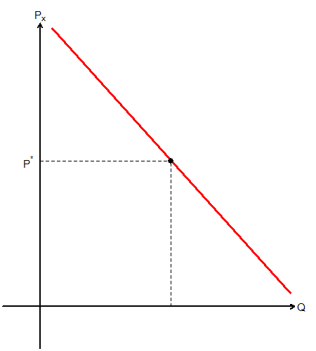
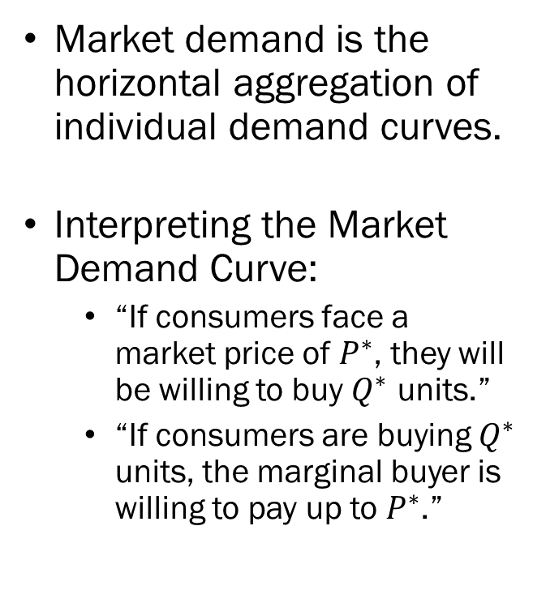
Demand and Consumer Surplus
Market demand is the horizontal aggregation of individual demand curves.
Interpreting the Market Demand Curve:
  “If consumers face a market price of $P^{∗}$, they will be willing to buy $Q^{∗}$ units.”
  “If consumers are buying $Q^{∗}$ units, the marginal buyer is willing to pay up to $P^{∗}$.”

Slide 10
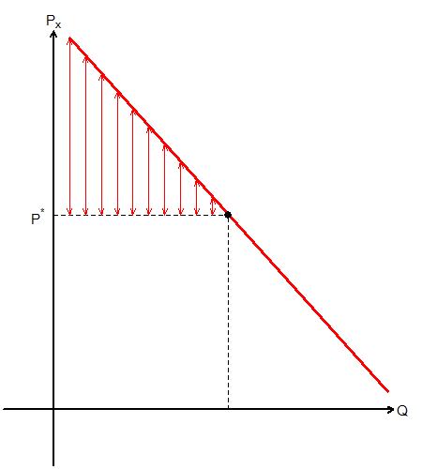
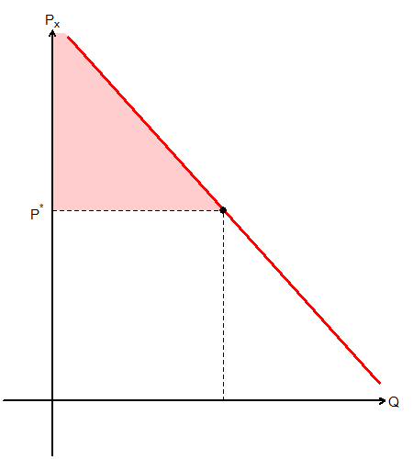
Demand and Consumer Surplus
Consumer Surplus (CS) is the difference between the consumers’ maximum willingness to pay and the amount actually paid.
In a graph, this difference is the distance between the price and the demand curve.
CS: Red Triangle

Slide 11
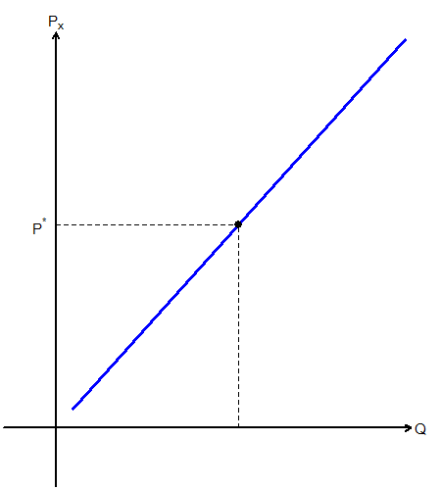
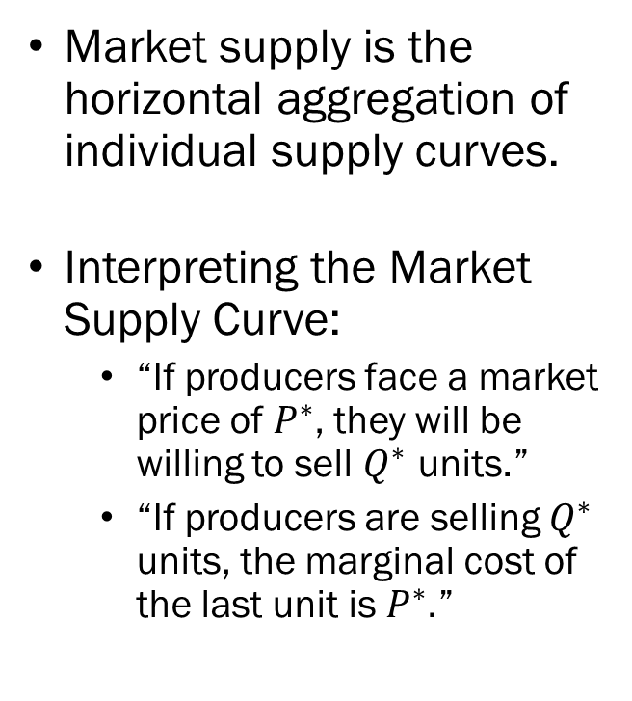
Supply and Producer Surplus
Market supply is the horizontal aggregation of individual supply curves.
Interpreting the Market Supply Curve:
  “If producers face a market price of $P^{∗}$, they will be willing to sell $Q^{∗}$ units.”
  “If producers are selling $Q^{∗}$ units, the marginal cost of the last unit is $P^{∗}$.”

Slide 12
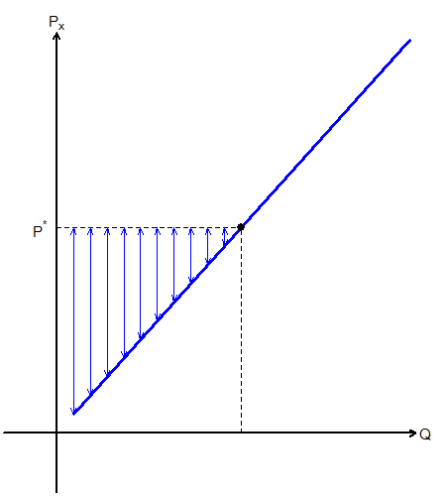
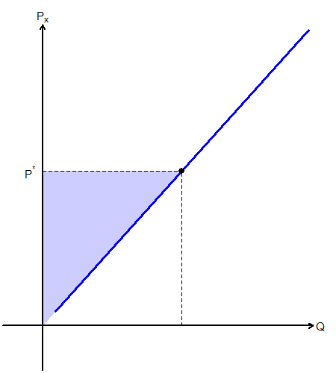
Supply and Producer Surplus
Producer Surplus (PS) is the difference between the amount the producer receives and the minimum willingness to sell.
In a graph, this difference is the distance between the price and the supply curve.
PS: Blue Triangle

Slide 13
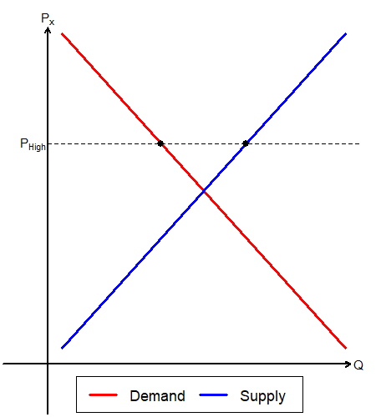
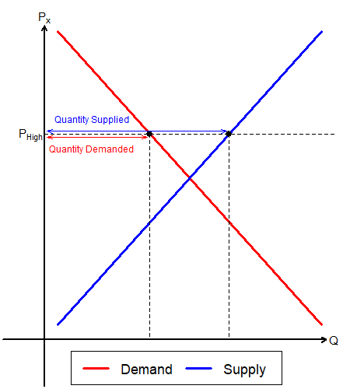
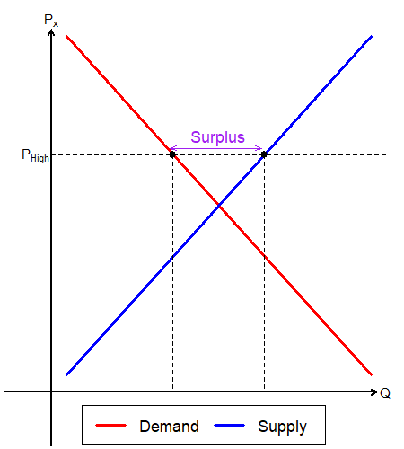
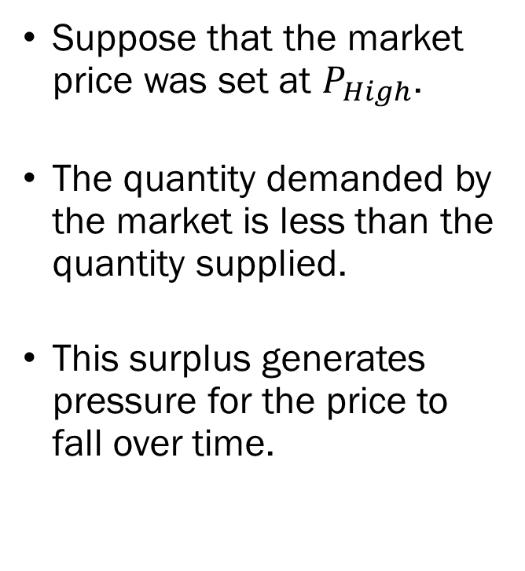
Reaching the Market Equilibrium
Suppose that the market price was set at $P_{High}$.
The quantity demanded by the market is less than the quantity supplied.
This surplus generates pressure for the price to fall over time.

Slide 14
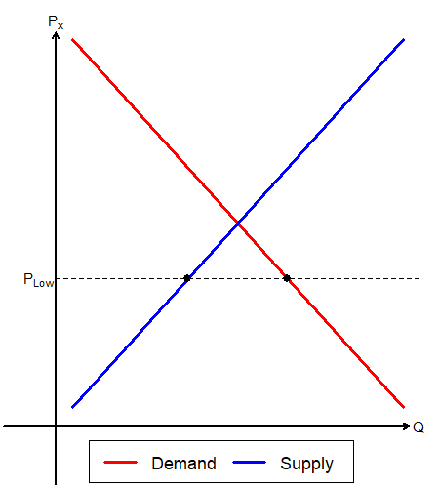
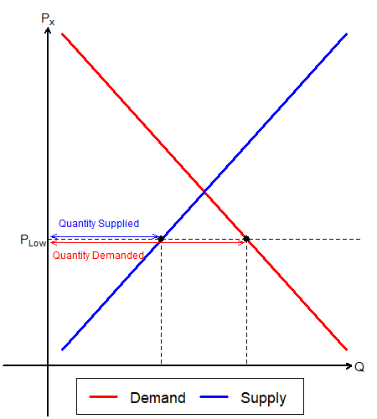
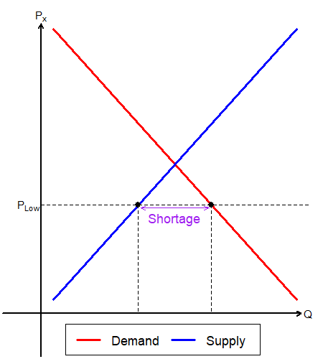
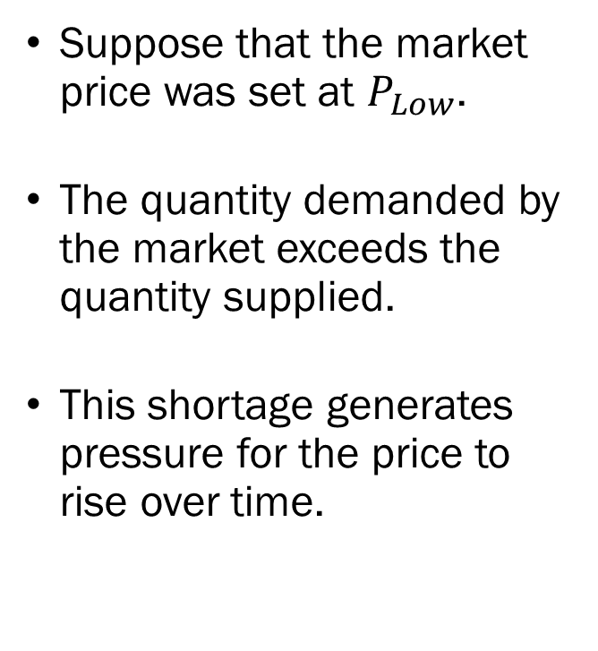
Reaching the Market Equilibrium
Suppose that the market price was set at $P_{Low}$.
The quantity demanded by the market exceeds the quantity supplied.
This shortage generates pressure for the price to rise over time.

Slide 15
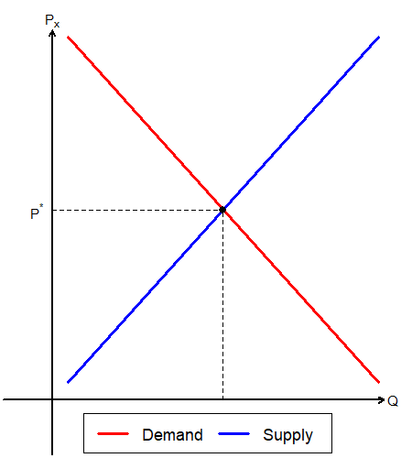
Reaching the Market Equilibrium
Eventually, the market price will reach a point where there is no surplus and no shortage.
This price is the equilibrium market price. Also called the market clearing price.
The quantity traded in the market at this price is the equilibrium quantity.

Slide 16
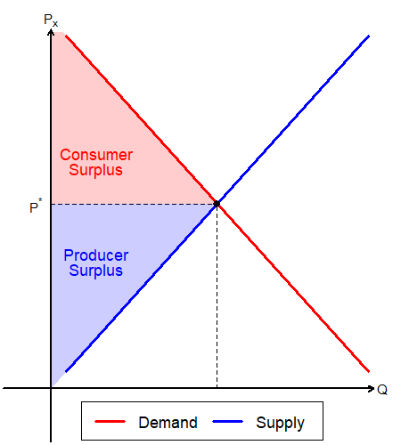
Defining Efficiency
Total Surplus is defined as the sum of Consumer and Producer Surplus.

Slide 17
Defining Efficiency
A Socially Optimal Quantity is the quantity of goods or services that maximize Total Surplus for the economy.
An allocation is said to be Pareto Efficient if there is no way to change the distribution so that it benefits at least one agent, without making anyone worse off.
A change in the allocation that strictly benefits at least one agent, without making any other agent strictly worse off is called a Pareto Improvement.

Slide 18
Are Markets Efficient?
The Fundamental Theorems of Welfare Economics:
The First Welfare Theorem says that in economic equilibrium, a set of complete markets, with complete information, and in perfect competition, will be Pareto Efficient.
The Second Welfare Theorem says that any Pareto optimum can be supported as a competitive equilibrium for some initial set of endowments.
Takeaway: Markets are efficient, given that…

Slide 19
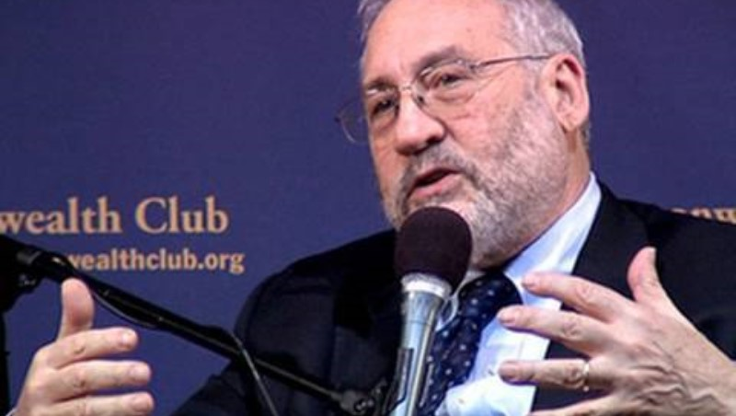
Markets and Efficiency

Slide 20
When Are Markets Efficient?
Perfect Competition
  Homogeneous products, Infinite sellers and buyers, complete information, Free entry and exit, Zero transaction costs.
Complete Markets
  All goods and services must be traded in the market, and have a price determined by said market.
No Externalities
  Externalities arise when a market transaction imposes a cost or benefit on a third party.
  In the presence of externalities, private and social marginal costs / benefits no longer align.

Slide 21
Departures in Environmental Econ.
We deal with externalities, rivalry in goods, non-excludable goods, and imbalances in information.
Non-rival goods are goods that can be consumed by multiple people at the same time without reducing the availability of the good.
  Food (Rival) vs. YouTube Videos (Non-rival)
Non-excludable goods are products that people can't be prevented from using, even if they don't pay for them.
  Food (Excludable) vs. Air (Non-excludable)

Slide 22
Efficiency vs. Equity?
Even if all assumptions that are required for the first welfare theorem to hold, and we have a Pareto efficient allocation, is it “desirable?”
If one person holds the entirety of the world’s wealth, it is still Pareto efficient.
If producers are able to enact perfect price discrimination, there will be zero consumer surplus, maximum producer surplus, and is still Pareto efficient.

